Slide 1
The African Monsoon Recent Evolution and Current Status Include Week-1 and Week-2 Outlooks
Update prepared
20 February 2024
For more information, visit:
http://www.cpc.ncep.noaa.gov/products/Global_Monsoons/African_Monsoons/precip_monitoring.shtml

Slide 2
Outline
Highlights
Recent Evolution and Current Conditions
NCEP GEFS Forecasts
Summary

Slide 3
Highlights: Last 7 Days
During the past 7 days, in East Africa, rainfall was above-average in southwestern and west-central Ethiopia, northern and southeastern Uganda, parts in southern South Sudan, western and southern Tanzania. Rainfall was below average in southern Kenya and northeastern Tanzania. In central Africa, rainfall was above-average in many areas in DRC and southwestern Congo. Rainfall was below-average in western and southern Cameroon, Equatorial Guinea, most parts in Gabon, northern Congo, southwestern CAR, and southern DRC. In West Africa, rainfall was below-average in Cote d’Ivoire, central Ghana, and southern Nigeria. In southern Africa, rainfall was above-average over northwestern Angola, northern Zambia, pocket areas in eastern Namibia and southwestern Botswana, northern Malawi, areas in northern Mozambique, and much of Madagascar. Rainfall was below-average over eastern and southern Angola, northern Namibia, western and southern Zambia, northern Botswana, Zimbabwe, southern Malawi, central and eastern South Africa, western and southern Mozambique.
The Week-1 outlook calls for above-average rainfall in part of southern Nigeria, the western portion of Central Africa and northwestern Angola. In contrast, there is an increased chance for below-average rainfall over parts of Liberia and Guinea-Conakry and most places in the central and southern sector in southern Africa. The Week-2 outlook calls for above-average rainfall in pocket areas in southern Togo, southern Nigeria, western and central Cameroon, western CAR, Gabon, southwestern Congo, western and central DRC, western Angola, and southern Tanzania. In contrast, there is an increased chance for below-average rainfall in southeastern Guinea-Conakry, western Liberia, the central and eastern region in southern Africa, and southern Madagascar.

Slide 4
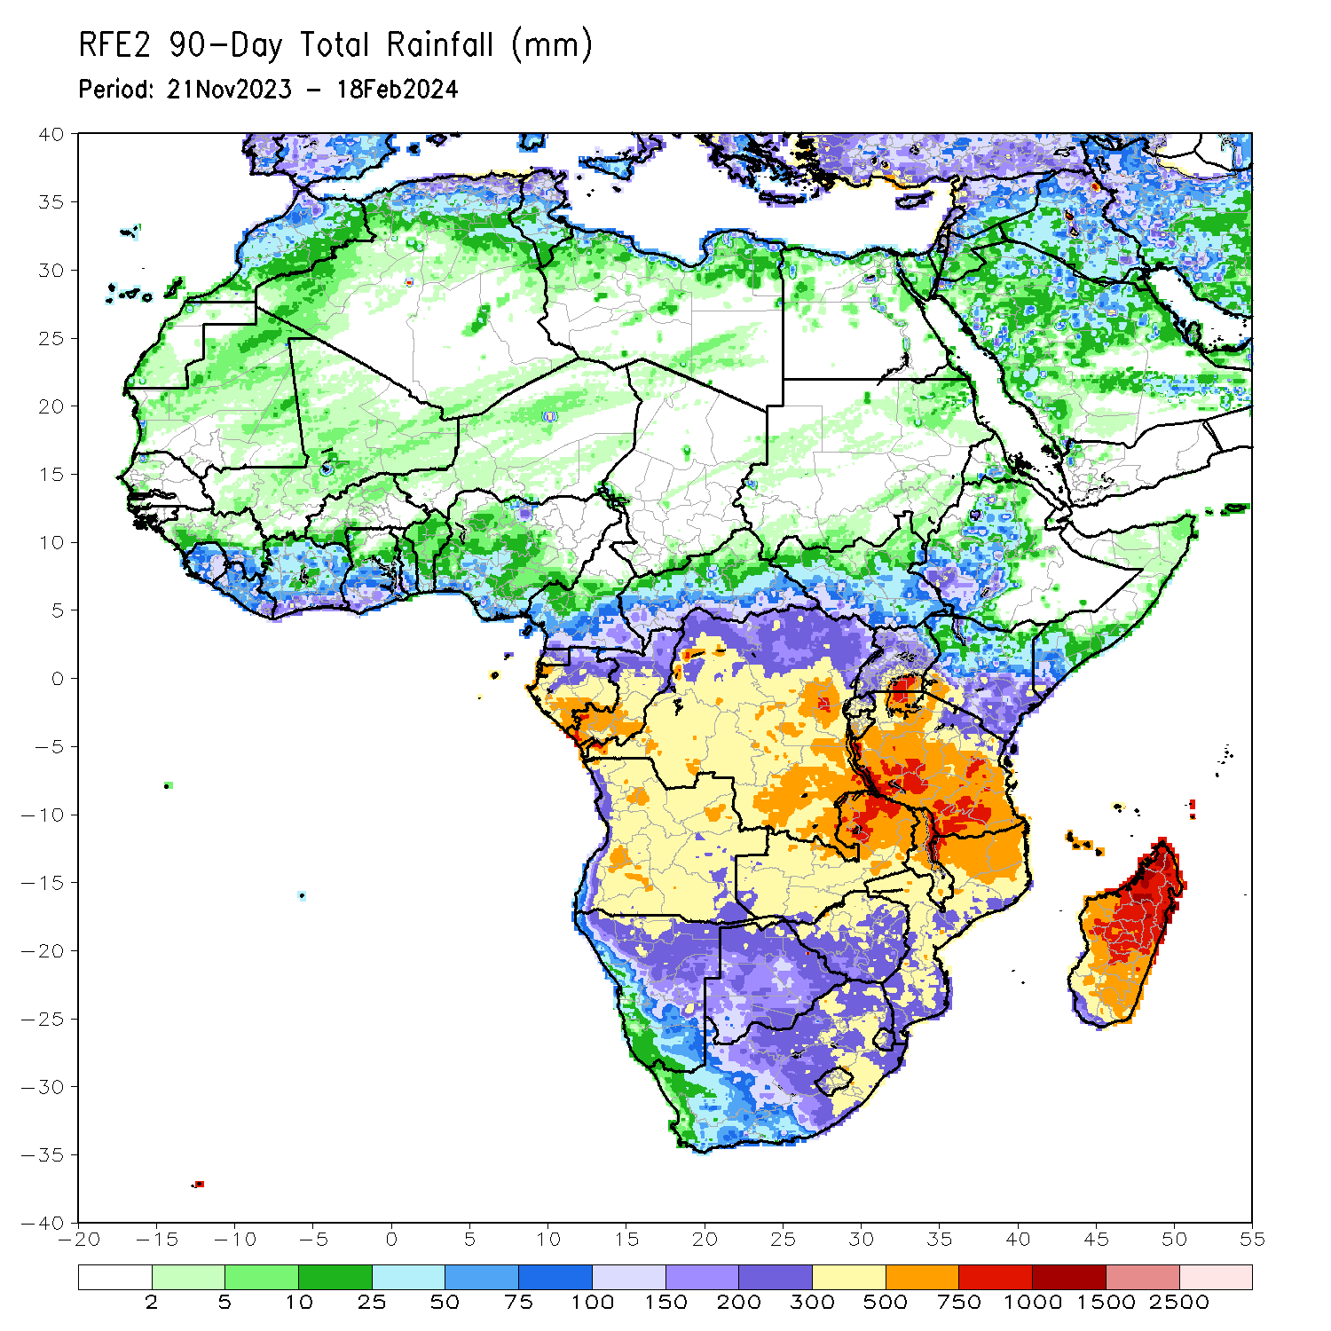
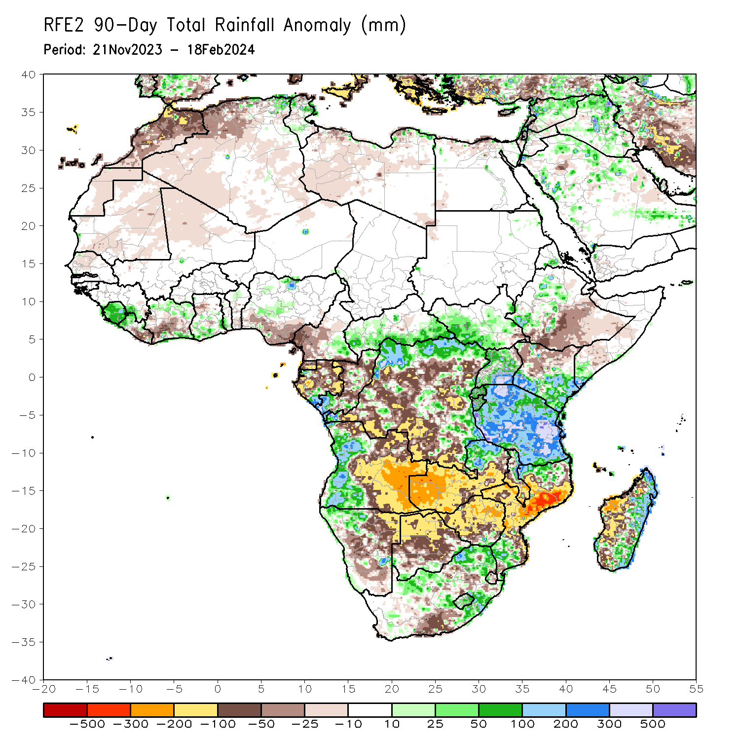
Rainfall Patterns: Last 90 Days
Over the past 90 days, in East Africa, rainfall was above-average in most parts in South Sudan, parts in western and central Ethiopia, Uganda, southern and eastern Kenya, southern Somalia, Rwanda, Burundi, and Tanzania. Rainfall was below-average in southeastern South Sudan, southern Ethiopia, northwestern Kenya, and northeastern Uganda. In Central Africa, rainfall was above-average in southern CAR, parts in northern, eastern, and central DRC, southern and parts of central Congo, southern Gabon, and southeastern Cameroon. Rainfall was below-average over western Cameroon, Equatorial Guinea, many parts in Gabon, parts of Congo, and parts of western, central, and southwestern DRC. In West Africa, rainfall was above-average over Sierra Leone, western Liberia, parts in northern and southern Cote d’Ivoire, southern Ghana, southwestern Togo, north-central Benin, and many parts of central Nigeria. Rainfall was below-average in eastern Liberia, south-central Cote d’Ivoire, northwestern Ghana, and southern Nigeria. In southern Africa, rainfall was above-average over western Angola, northwestern Namibia, northern Zambia, southeastern Zimbabwe, northeastern Malawi, northern and southern Mozambique, parts of eastern, central, and northeastern South Africa, western Eswatini, Lesotho, northern and eastern Madagascar. Rainfall was below-average over central and eastern Angola, northeastern Namibia, western and southern Zambia, northern Botswana, Zimbabwe, parts of southern and east-central South Africa, western, central, and southeastern Mozambique, southern Malawi, western and southwestern Madagascar.
Notes:
4

Slide 5
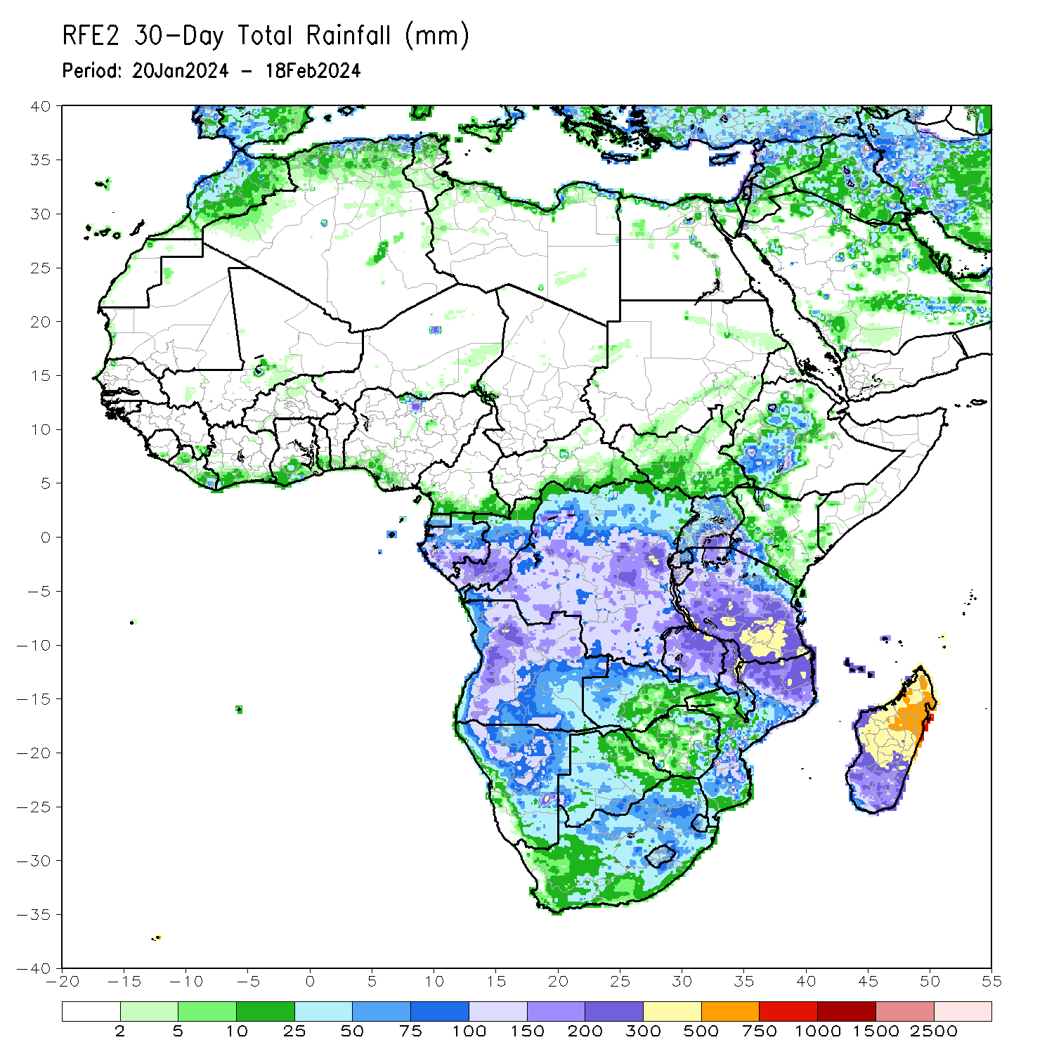
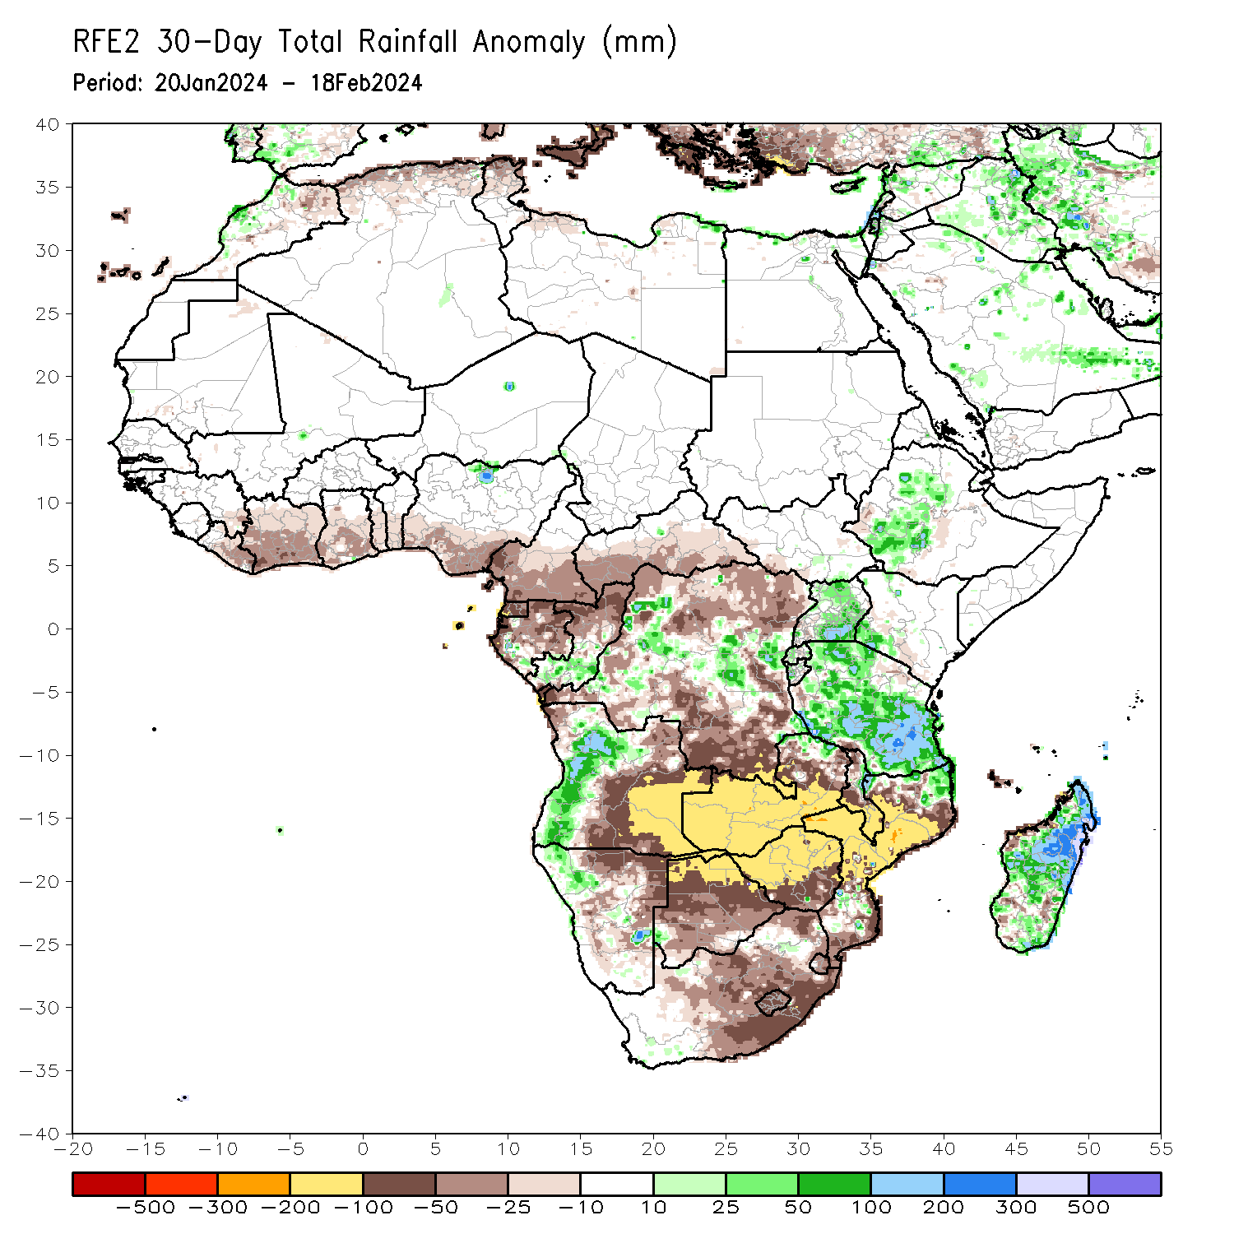
Rainfall Patterns: Last 30 Days
Over the past 30 days, in East Africa, rainfall was above-average in west-central Ethiopia, Uganda, southwestern Kenya, Rwanda, Burundi, and much of Tanzania. In Central Africa, rainfall was above-average over parts of central and eastern DRC, part in western Gabon, and south-central Congo. Rainfall was below-average across southern Cameroon, Equatorial Guinea, northern Gabon, northern Congo, northern and southern DRC, and southern CAR. In West Africa, rainfall was below-average along the Gulf of Guinea from eastern Liberia to southern Nigeria. In southern Africa, rainfall was above-average in western Angola, northwestern and parts in central Namibia, northeastern and parts in south-central Mozambique, central and eastern Madagascar. Rainfall was below-average in northwestern and eastern Angola, western Zambia, northeastern Namibia, western Botswana, Zimbabwe, central, eastern, and northeastern South Africa, western and central Mozambique, Lesotho, Eswatini, coastal western and parts in southern Madagascar.
Notes:
5

Slide 6
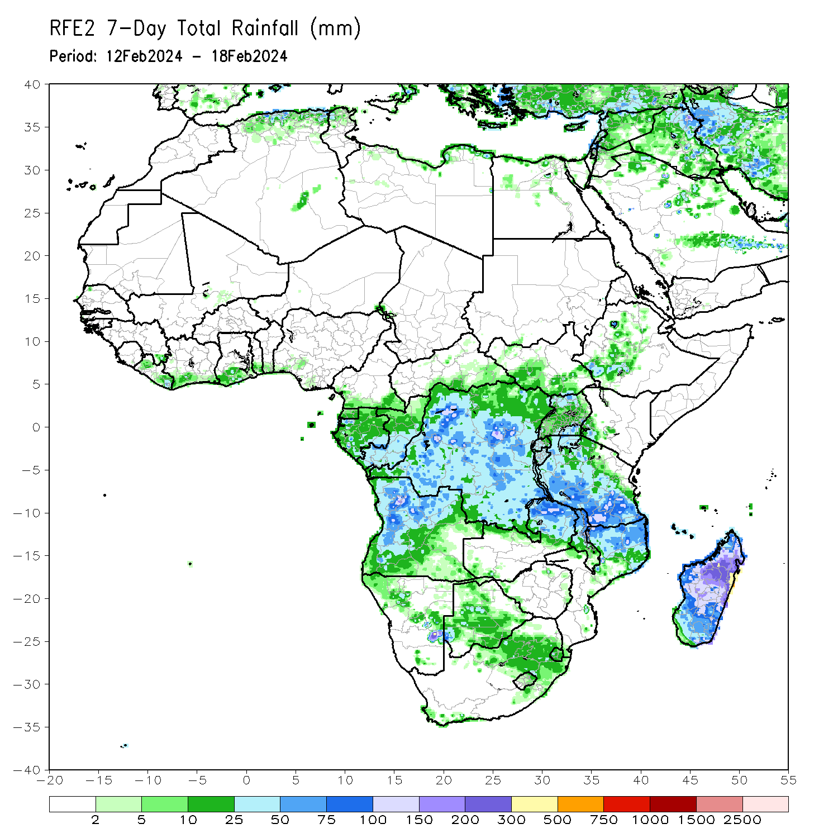
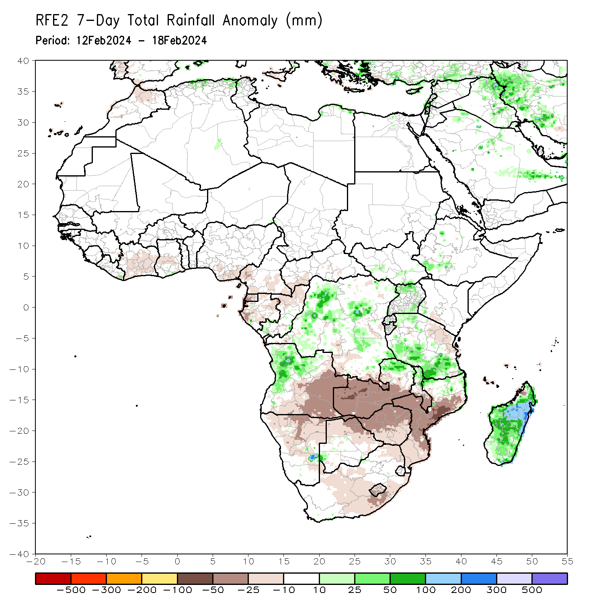
Rainfall Patterns: Last 7 Days
During the past 7 days, in East Africa, rainfall was above-average in southwestern and west-central Ethiopia, northern and southeastern Uganda, parts in southern South Sudan, western and southern Tanzania. Rainfall was below average in southern Kenya and northeastern Tanzania. In central Africa, rainfall was above-average in many areas in DRC and southwestern Congo. Rainfall was below-average in western and southern Cameroon, Equatorial Guinea, most parts in Gabon, northern Congo, southwestern CAR, and southern DRC. In West Africa, rainfall was below-average in Cote d’Ivoire, central Ghana, and southern Nigeria. In southern Africa, rainfall was above-average over northwestern Angola, northern Zambia, pocket areas in eastern Namibia and southwestern Botswana, northern Malawi, areas in northern Mozambique, and much of Madagascar. Rainfall was below-average over eastern and southern Angola, northern Namibia, western and southern Zambia, northern Botswana, Zimbabwe, southern Malawi, central and eastern South Africa, western and southern Mozambique.

Slide 7
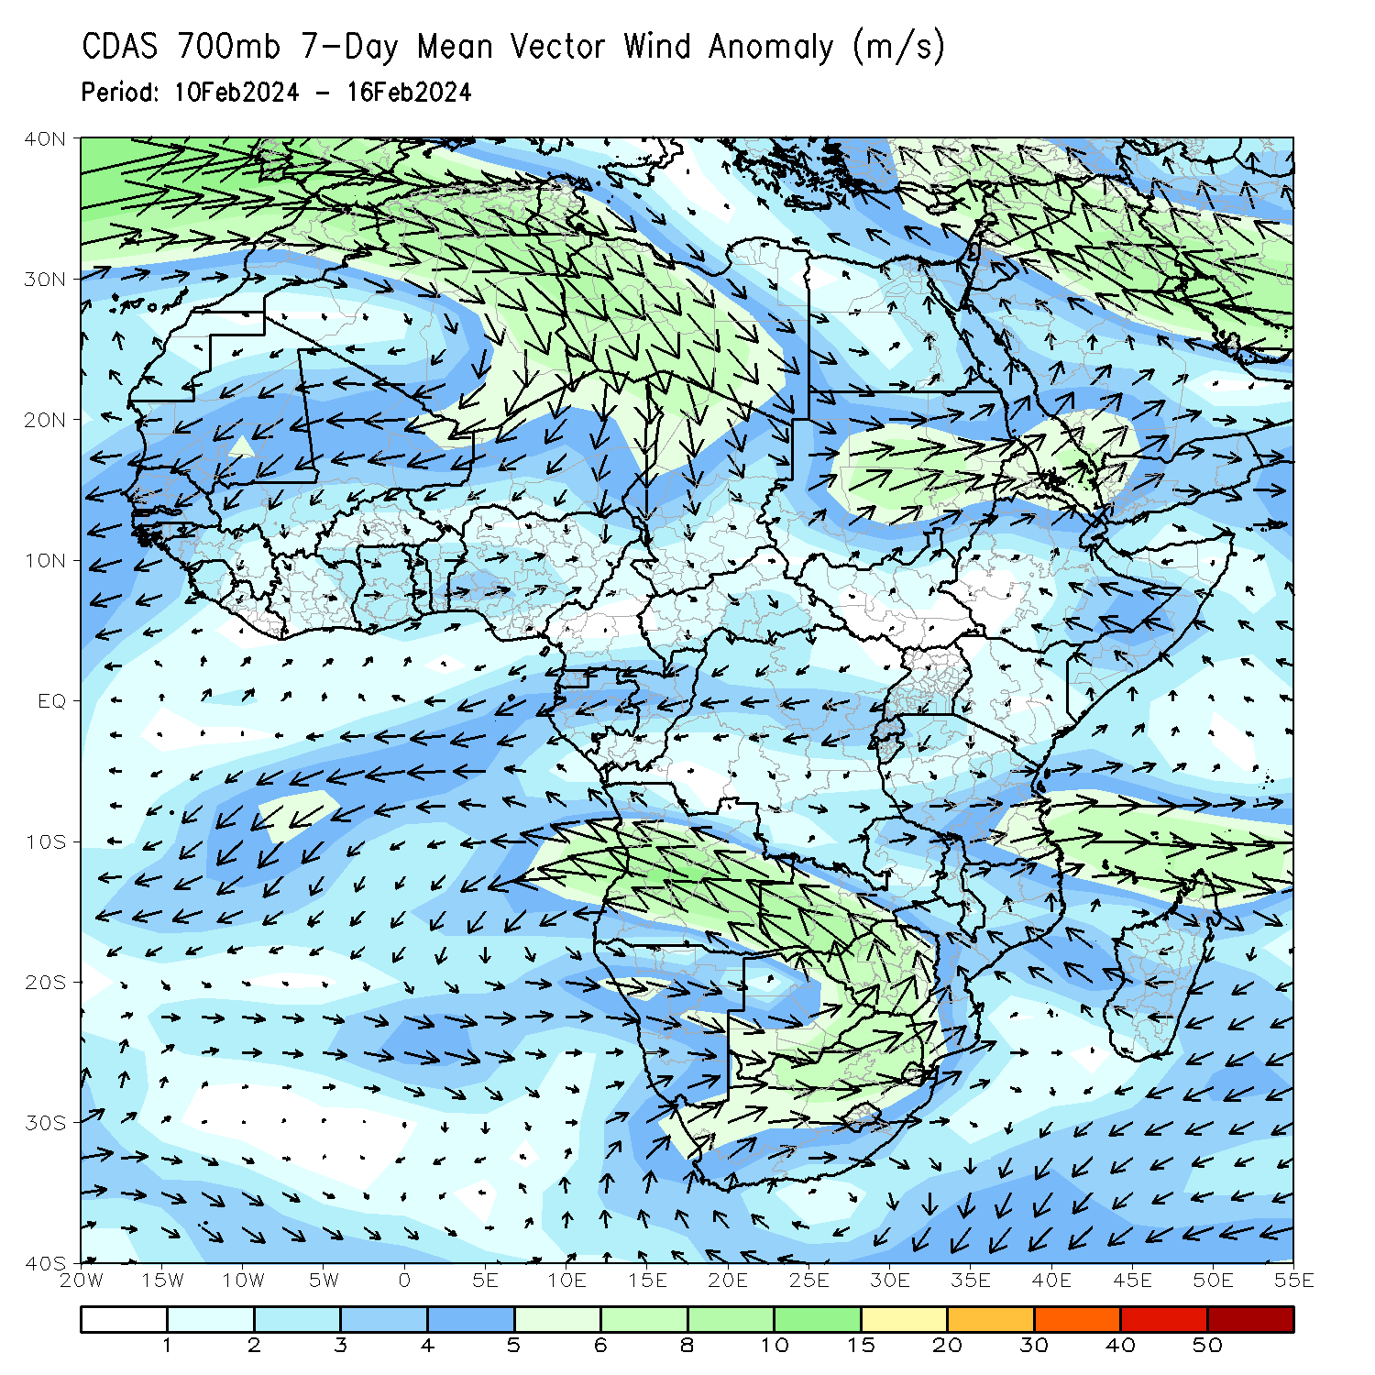
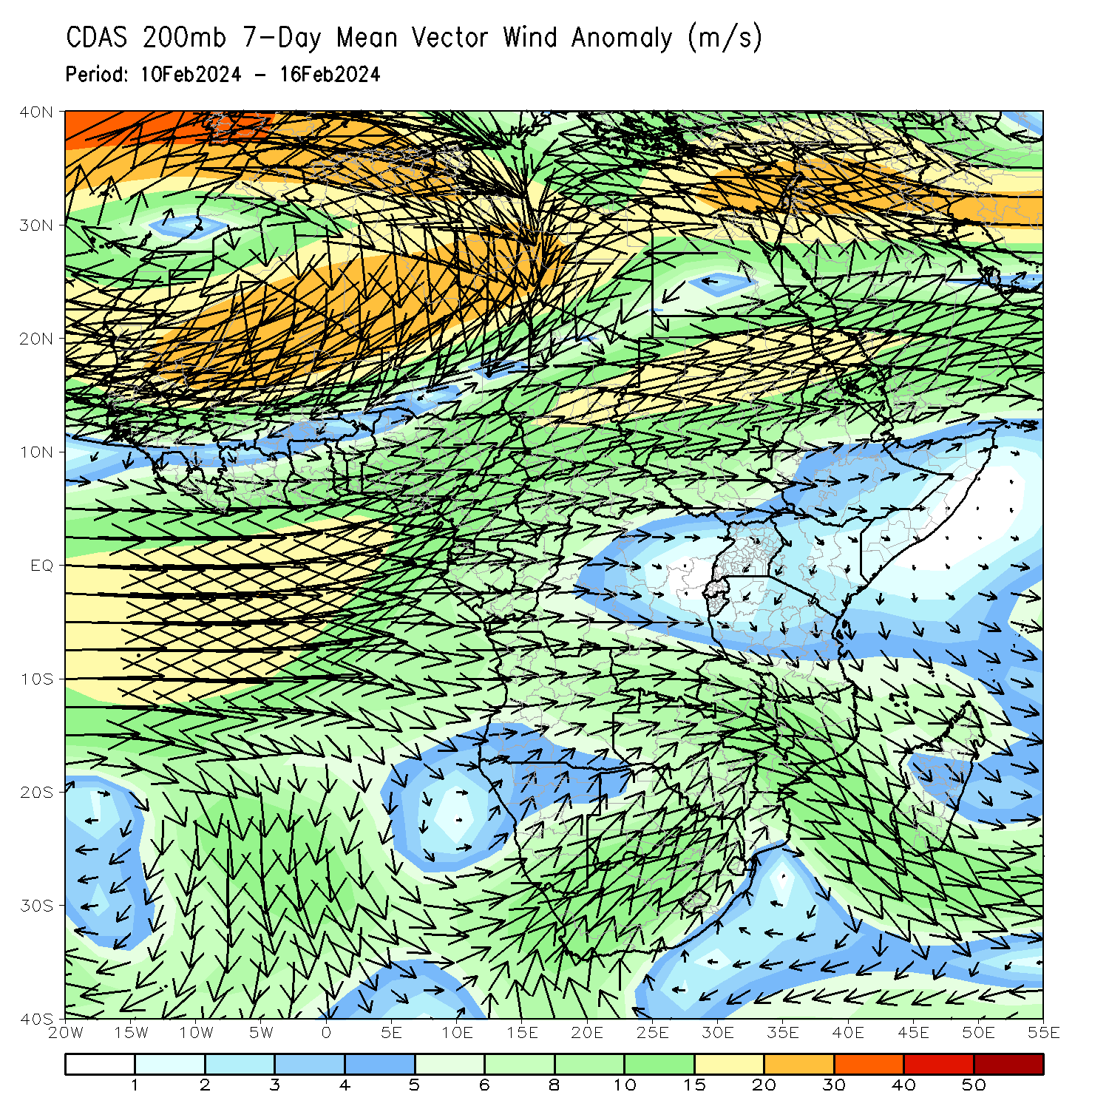
Atmospheric Circulation: Last 7 Days
At 700-hPa level (left panel), the anomalous lower-level cyclonic motion in the Channel of Mozambique may have contributed to the observed above-average rainfall over Madagascar. At 200-hPa level (right panel), anomalous upper-level convergence over eastern Angola, Zambia, Zimbabwe, and Mozambique may have contributed to the below-average rainfall in the region.

Slide 8
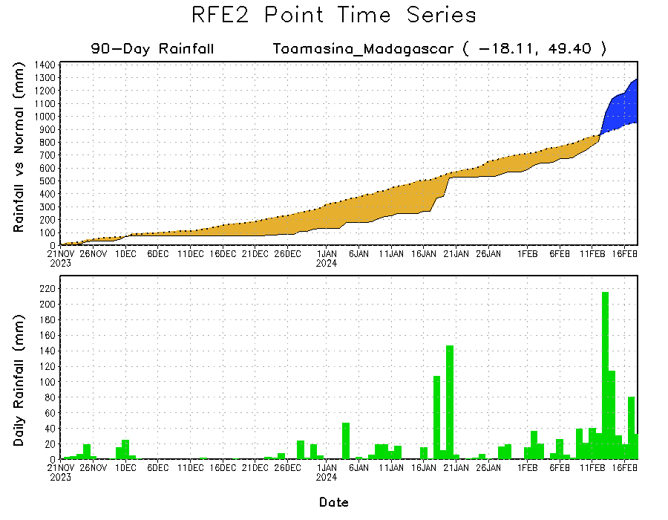
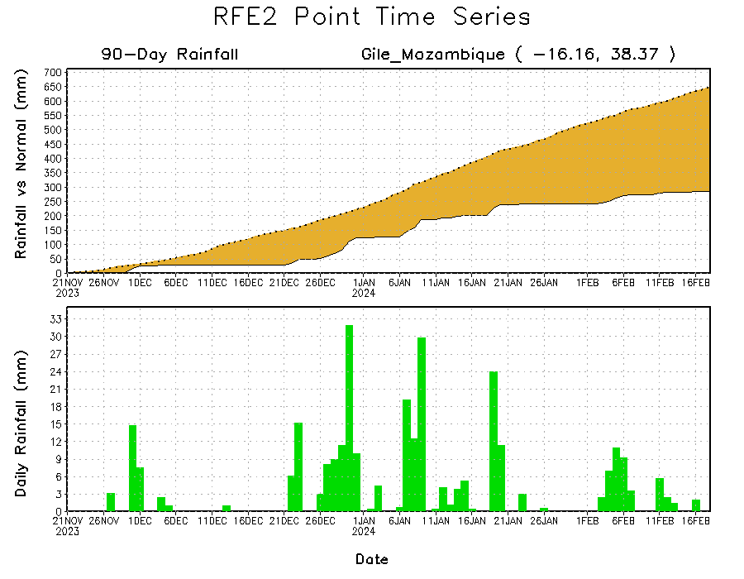
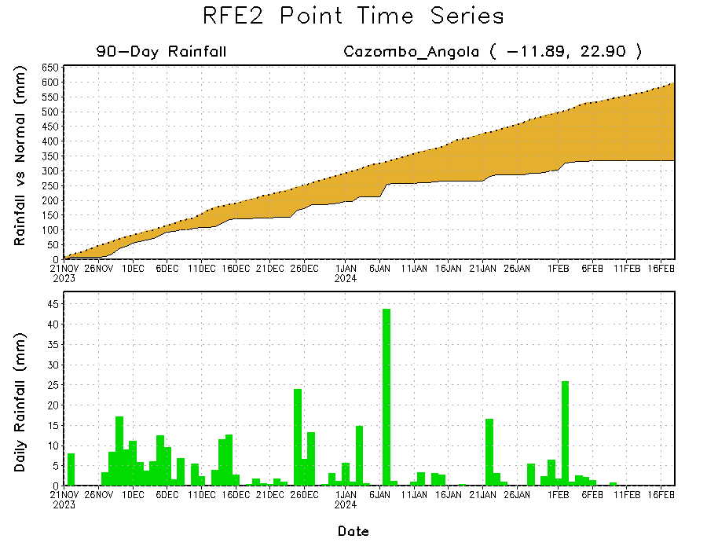
Rainfall Evolution
Daily evolution in rainfall at selected locations over the past 90 days shows growing deficits over parts of eastern Angola (bottom left) and northeastern Mozambique (bottom right). Conversely, rainfall surpluses increased in eastern Madagascar due to heavy and above-average rainfall during mid-February (top right).

Slide 9
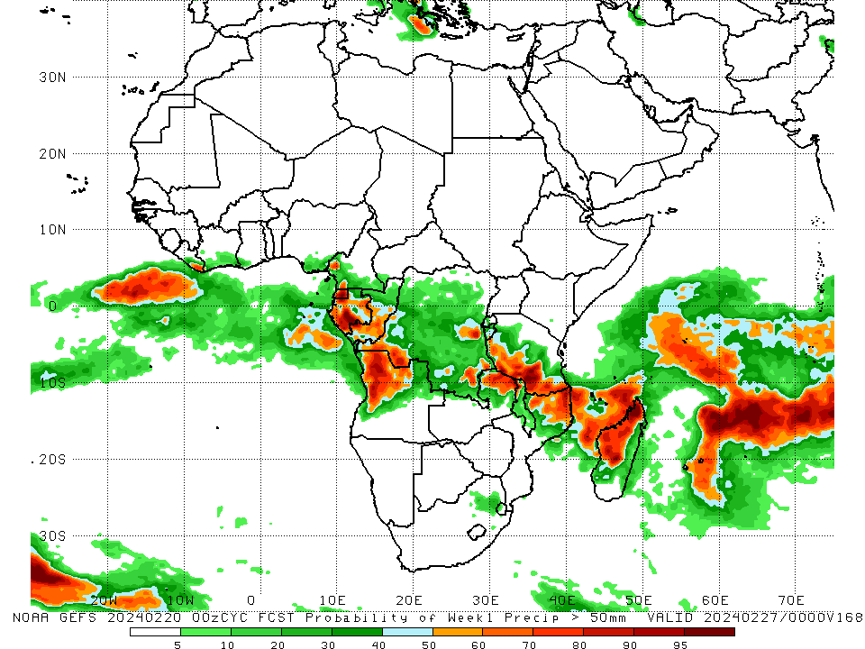
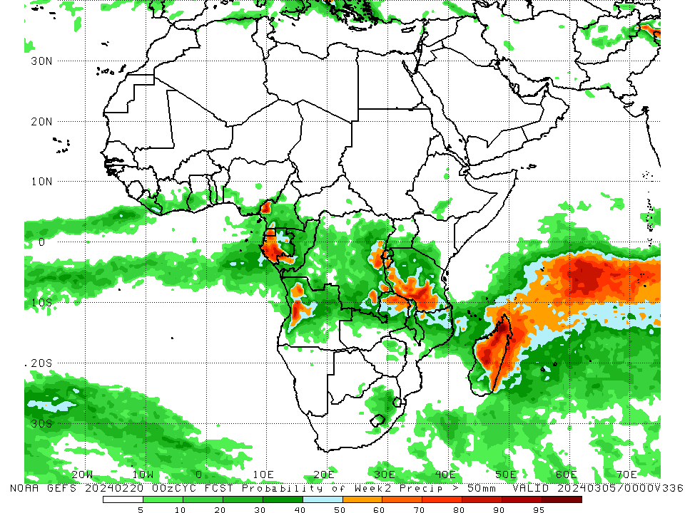
NCEP GEFS Model Forecasts Non-Bias Corrected Probability of precipitation exceedance
Week-1, Valid: 21 – 27 Feb 2024
Week-2, Valid: 28 Feb – 5 Mar 2024
For week-1 (left panel) the GEFS forecasts indicate a moderate to high chance (over 70%) for rainfall to exceed 50 mm over pocket areas in eastern Liberia, western Cameroon, Equatorial Guinea, Gabon, central Congo, western Angola, parts in western and eastern DRC, northern Zambia, southern Tanzania, northern Malawi, northern Mozambique, western and northern Madagascar. For week-2 (right panel), the GEFS forecasts indicate a moderate to high chance (over 70%) for rainfall to exceed 50 mm over northwestern Cameroon, west-central Angola, eastern DRC, western Rwanda, Burundi, southern Tanzania, northeastern Zambia, central, northern, and eastern Madagascar.
Notes:
9

Slide 10
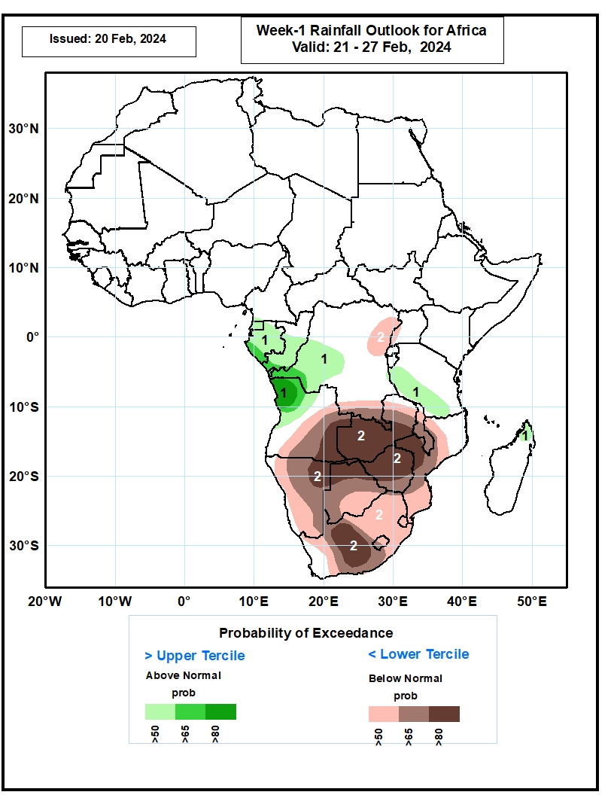
Week-1 Precipitation Outlooks
21 – 27 Feb 2024
1) The probabilistic forecasts call for above 50%
chance for weekly rainfall to be above-normal
(above the upper tercile) over Equatorial Guinea,
Gabon, central and southern Congo, western DR
Congo, northwestern Angola, western and southern
parts of Tanzania, and northern Madagascar. There
is above 80% chance for above-normal rainfall over
northwestern Angola.
2) The probabilistic forecasts call for above 50%
chance for weekly total rainfall to be below-normal
(below the lower tercile) over northeastern and
southern parts of DR Congo, western part of
Uganda, central and eastern parts of Angola, much
of Zambia, much of Malawi, much of Mozambique,
Namibia, Botswana, Zimbabwe, much of South
Africa, Lesotho, and Eswatini. There is above 80%
chance for below-normal rainfall over eastern part
of Angola, western and central parts of Zambia,
northeastern Namibia, northern Botswana, much of
Zimbabwe, western Mozambique, and western
South Africa.
Notes:
10

Slide 11
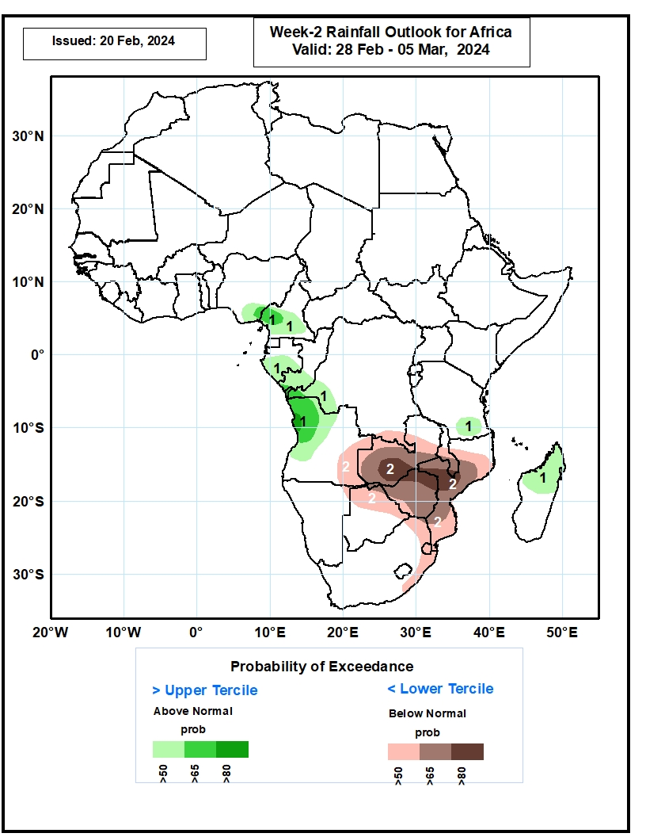
Week-2 Precipitation Outlooks
28 Feb – 5 Mar 2024
1) The probabilistic forecasts call for above 50%
chance for weekly rainfall to be above-normal
(above the upper tercile) over southeastern Nigeria,
southern Cameroon, southern Gabon, southern
Congo, western DR Congo, northern and western
parts of Angola, southern part of Tanzania, and
northern and central parts of Madagascar. There is
above 80% chance for above-normal rainfall over
western part of Angola.
2) The probabilistic forecasts call for above 50%
chance for weekly total rainfall to be below-normal
(below the lower tercile) over eastern Angola,
southern part of DR Congo, much of Zambia, central
and southern Malawi, much of Mozambique,
northeastern Namibia, northern and central parts of
Botswana, Zimbabwe, northern and eastern parts of
South Africa, and Eswatini. There is above 80%
chance for below-normal rainfall over western part
of Zambia, northern Zimbabwe, and western part of
Mozambique.
Notes:
11

Slide 12
Summary
Over the past 30 days, in East Africa, rainfall was above-average in west-central Ethiopia, Uganda, southwestern Kenya, Rwanda, Burundi, and much of Tanzania. In Central Africa, rainfall was above-average over parts of central and eastern DRC, part in western Gabon, and south-central Congo. Rainfall was below-average across southern Cameroon, Equatorial Guinea, northern Gabon, northern Congo, northern and southern DRC, and southern CAR. In West Africa, rainfall was below-average along the Gulf of Guinea from eastern Liberia to southern Nigeria. In southern Africa, rainfall was above-average in western Angola, northwestern and parts in central Namibia, northeastern and parts in south-central Mozambique, central and eastern Madagascar. Rainfall was below-average in northwestern and eastern Angola, western Zambia, northeastern Namibia, western Botswana, Zimbabwe, central, eastern, and northeastern South Africa, western and central Mozambique, Lesotho, Eswatini, coastal western and parts in southern Madagascar.
During the past 7 days, in East Africa, rainfall was above-average in southwestern and west-central Ethiopia, northern and southeastern Uganda, parts in southern South Sudan, western and southern Tanzania. Rainfall was below average in southern Kenya and northeastern Tanzania. In central Africa, rainfall was above-average in many areas in DRC and southwestern Congo. Rainfall was below-average in western and southern Cameroon, Equatorial Guinea, most parts in Gabon, northern Congo, southwestern CAR, and southern DRC. In West Africa, rainfall was below-average in Cote d’Ivoire, central Ghana, and southern Nigeria. In southern Africa, rainfall was above-average over northwestern Angola, northern Zambia, pocket areas in eastern Namibia and southwestern Botswana, northern Malawi, areas in northern Mozambique, and much of Madagascar. Rainfall was below-average over eastern and southern Angola, northern Namibia, western and southern Zambia, northern Botswana, Zimbabwe, southern Malawi, central and eastern South Africa, western and southern Mozambique.
The Week-1 outlook calls for above-average rainfall in part of southern Nigeria, the western portion of Central Africa and northwestern Angola. In contrast, there is an increased chance for below-average rainfall over parts of Liberia and Guinea-Conakry and most places in the central and southern sector in southern Africa. The Week-2 outlook calls for above-average rainfall in pocket areas in southern Togo, southern Nigeria, western and central Cameroon, western CAR, Gabon, southwestern Congo, western and central DRC, western Angola, and southern Tanzania. In contrast, there is an increased chance for below-average rainfall in southeastern Guinea-Conakry, western Liberia, the central and eastern region in southern Africa, and southern Madagascar.

