Slide 1
The African Monsoon Recent Evolution and Current Status Include Week-1 and Week-2 Outlooks
Update prepared
01 April 2024
For more information, visit:
http://www.cpc.ncep.noaa.gov/products/Global_Monsoons/African_Monsoons/precip_monitoring.shtml

Slide 2
Outline
Highlights
Recent Evolution and Current Conditions
NCEP GEFS Forecasts
Summary

Slide 3
Highlights: Last 7 Days
During the past 7 days, in East Africa, rainfall was above-average in central and southwestern Ethiopia, eastern Eritrea, Djibouti, southeastern South Sudan, western and southern Kenya, northwestern Somalia, east-central Uganda, and western, central, and parts of southern Tanzania. Rainfall was below average in parts of western Ethiopia, western and central South Sudan, western and southeastern Uganda, eastern Burundi, eastern Rwanda, and far southwestern Kenya. In central Africa, rainfall was above-average in south-central Central African Republic (CAR), parts of northwestern and northeastern Democratic Republic of Congo (DRC), central Gabon, parts of southwestern Congo, and southwestern Cameroon. Rainfall was below-average in Equatorial Guinea, central and southeastern Cameroon, northern and central Congo, western and southeastern Central African Republic (CAR), western and eastern Gabon, and north-central, central, and southern DRC. In West Africa, rainfall was above-average in northwestern Cote d’Ivoire, central Ghana, southeastern Guinea, and central and southern Togo. Rainfall was below-average in parts of southwestern and southeastern Cote d’Ivoire, southwestern Ghana, and southern Nigeria. In southern Africa, rainfall was above-average in west-central Angola, northwestern and central Namibia, west-central Botswana, northwestern, parts of central, and southern Mozambique, northern Malawi, eastern Eswatini, southeastern and parts of central South Africa, and northern and eastern Madagascar. Rainfall was below-average in northwestern, central, southern, and eastern Angola, Zambia, most of Malawi, most of northern and central Mozambique, central and southwestern Zimbabwe, eastern Botswana, and west-central and southern Madagascar.
The Week-1 outlook calls for above-average rainfall in the majority of eastern, central, and southern Africa, as well as southeastern Guinea, eastern Sierra Leone, northeastern Ghana, northern Togo, northwestern Benin, and central Nigeria. Anomalies greater than 50mm could be observed in southeastern DRC, western, northern, and parts of eastern Tanzania, southwestern Uganda, southwestern, central, northeastern, and parts of southeastern Kenya, and east-central and southwestern Ethiopia In contrast, there is an increased chance for below-average rainfall from coastal Liberia to coastal Nigeria, western Gabon, northwestern Angola, southeastern Zambia, northern and central Malawi, central Mozambique, and northern and western Madagascar. The Week-2 outlook calls for above-normal rainfall in much of the Gulf of Guinea region, southern Cameroon, Equatorial Guinea, Gabon, central Congo, eastern and southern DRC, western and southeastern CAR, southern South Sudan, southwestern and north-central Ethiopia, western Uganda, Rwanda, Burundi, northwestern and southeastern Kenya, Tanzania, Zambia, Malawi, western Mozambique, Zimbabwe, eastern Botswana, eastern and central Angola, and northeastern and south-central South Africa. In contrast, there is an increased chance for below-average in eastern and northern Madagascar, northeastern and east-central Mozambique, the Lake Victoria region, much of southern Ethiopia, northern and central Somalia, and coastal Liberia.

Slide 4
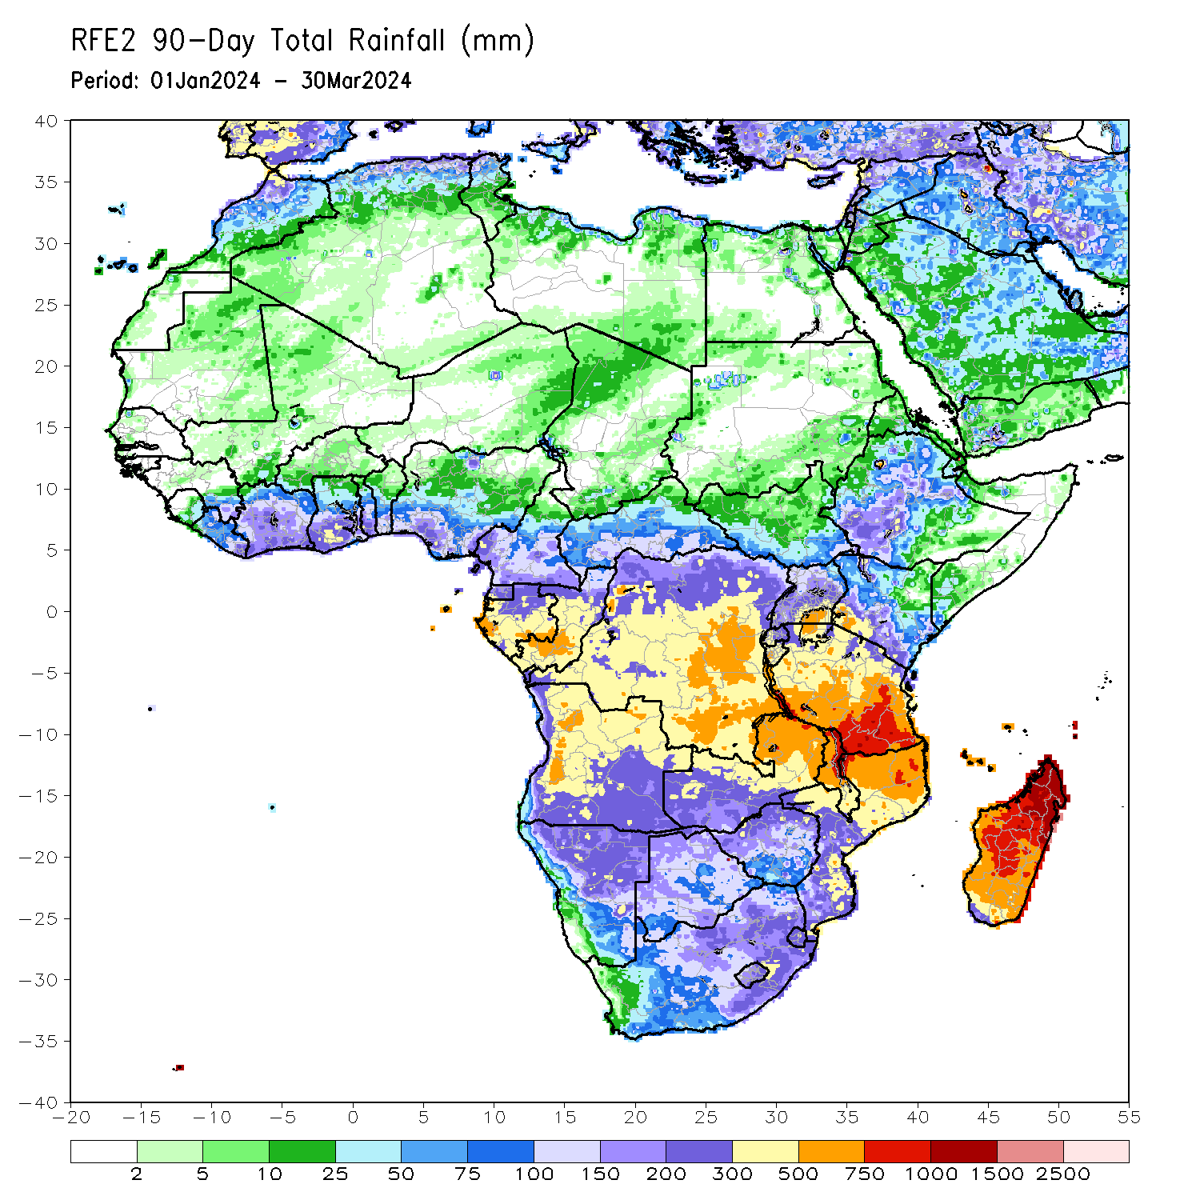
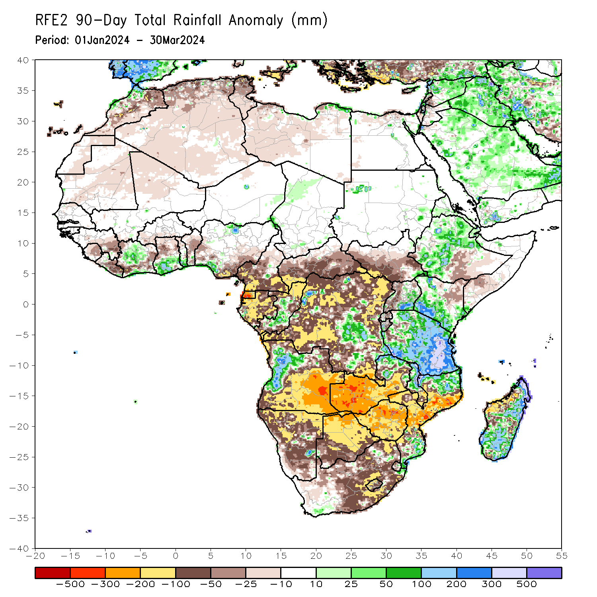
Rainfall Patterns: Last 90 Days
Over the past 90 days, in East Africa, rainfall was above-average in parts of northern, central, and southwestern Ethiopia, southwestern and central Eritrea, northwestern and southern Kenya, east-central and southeastern Uganda, many parts of Tanzania, western Burundi, fsr southeastern South Sudan, and pockets of southeastern Somalia. Rainfall was below-average in western, southern, and central South Sudan, parts of west-central and south-central Ethiopia, southwestern Somalia, western Uganda, eastern and central Rwanda, eastern Burundi, parts of northwestern Tanzania, and northeastern Kenya. In Central Africa, rainfall was above-average in some regions in central and southeastern Democratic Republic of the Congo (DRC), central Congo, and pockets of southern Gabon. Rainfall was below-average in western and southern Cameroon, Equatorial Guinea, many parts of Gabon, northern and southern Congo, western, southern, and central parts of Central African Republic (CAR), and many parts of northern, western, northeastern, and southern DRC. In West Africa, rainfall was above-average in central and coastal Cote d’Ivoire, southern parts of Ghana and Togo, southeastern Liberia, and pockets of southwestern and north-central Nigeria. Rainfall was below-average in eastern Guinea, Sierra Leone, central and eastern Liberia, western, southern, and eastern Cote d’Ivoire, northern parts of Ghana, northern Togo, most of Benin, southern Burkina Faso, southeastern and west-central Nigeria, northern Mali, and central Mauritania. In southern Africa, rainfall was above-average over west-central Angola, northeastern Zambia, northern and central Malawi, some regions in northern and southern Mozambique, some parts of southwestern and southeastern South Africa, and southern, central and eastern Madagascar. Rainfall was below-average across southern, central, northwestern, and eastern Angola, many parts of Namibia, Botswana, Zimbabwe and Lesotho, western, central, southern and eastern Zambia, southern Malawi, central and western Mozambique, most of central and eastern South Africa, western Eswatini, and northwestern and parts of southwestern Madagascar.
Notes:
4

Slide 5
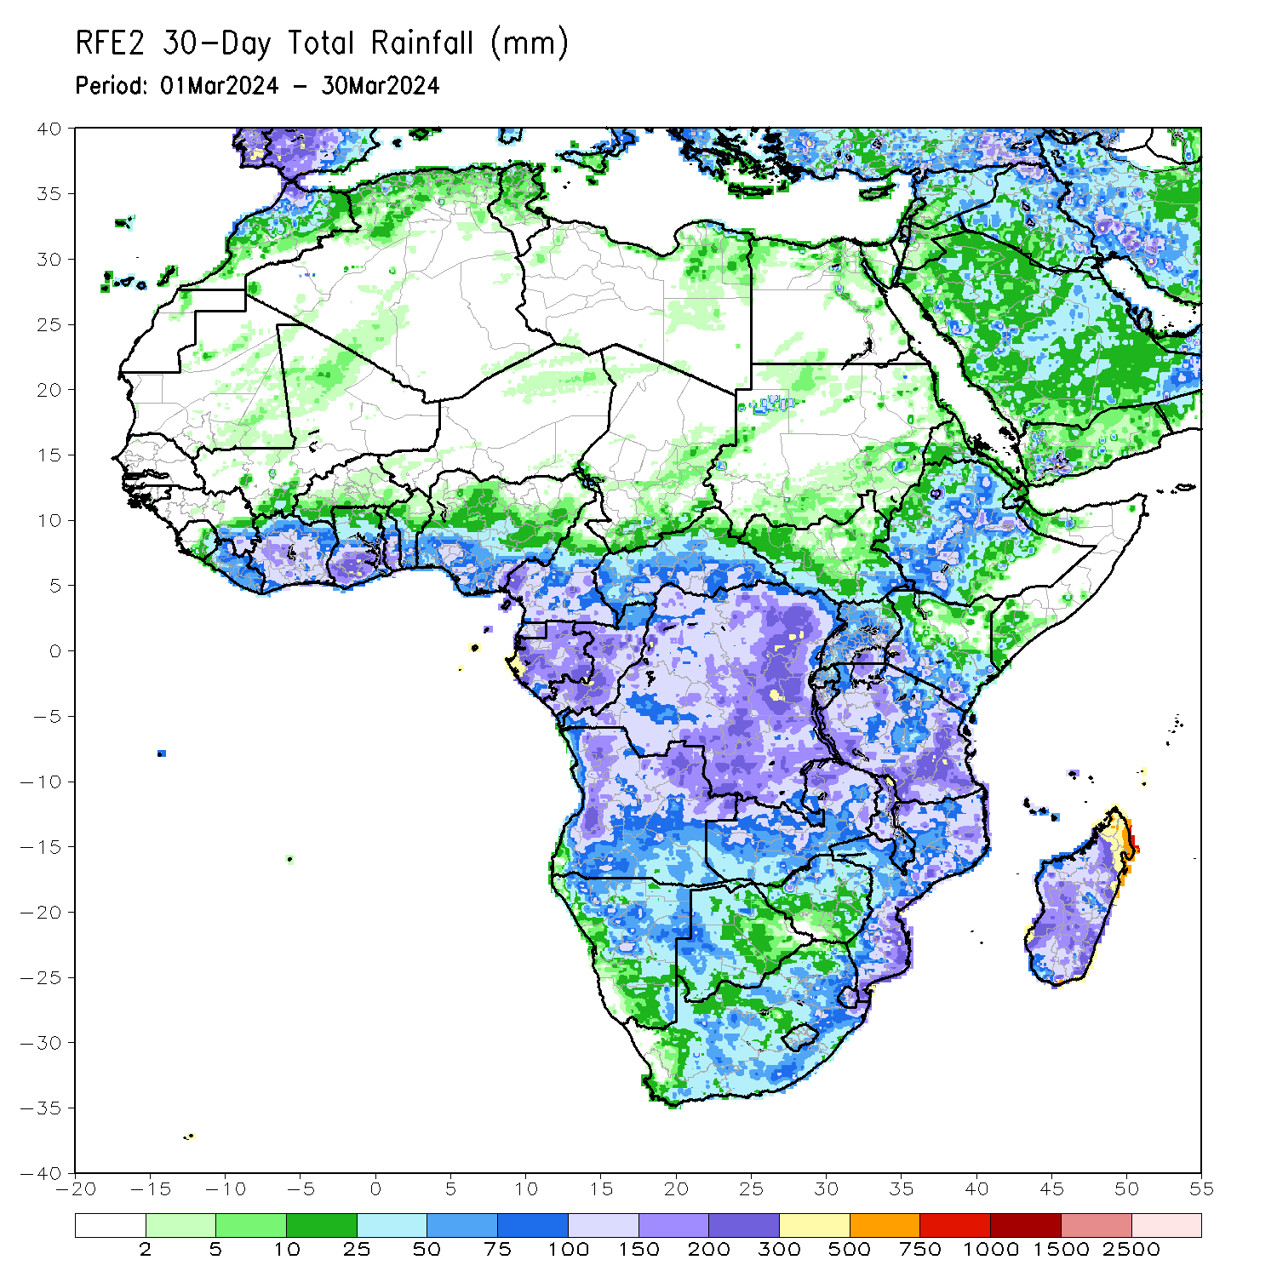
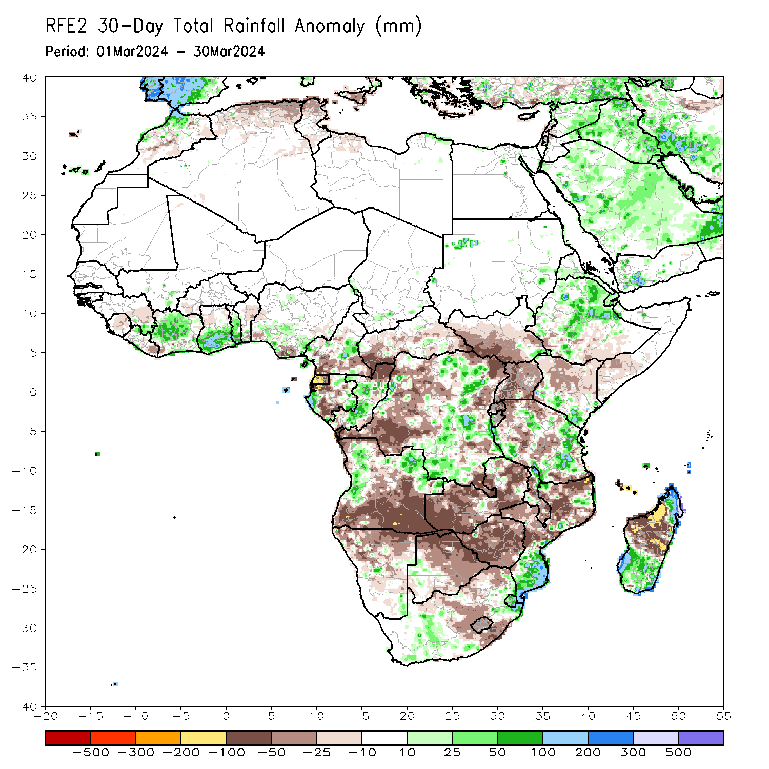
Rainfall Patterns: Last 30 Days
Over the past 30 days, in East Africa, rainfall was above-average in northern, parts of western, and central Ethiopia, southwestern and central Eritrea, southern Kenya, parts of central, southern, and eastern Tanzania, southeastern South Sudan, Djibouti, parts of far northwestern Somalia, and western Burundi. Rainfall was below-average in western, central, and most of southern South Sudan, southern Somalia, most of Uganda, southwestern and south-central Ethiopia, northern and central Kenya, Rwanda, eastern Burundi, and some regions in northern, central, and southern Tanzania. In Central Africa, rainfall was above-average in some parts of western and eastern Gabon, central Congo, east-central Cameroon, and some parts of central and eastern DRC. Rainfall was below-average in southern Cameroon, Equatorial Guinea, central and southern Gabon, northern Congo, southwestern, southern and central CAR, and most of western, northeastern, and parts of southeastern DRC. In West Africa, rainfall was above-average in parts of northwestern, central, and coastal Cote d’Ivoire, southern parts of Ghana, central and southern Togo, parts of southern Benin, northwestern Liberia, southeastern Guinea, and parts of southern Nigeria. Rainfall was below-average in east-central parts of Guinea, central and northern Sierra Leone, eastern Liberia, southwestern Cote d’Ivoire, northern parts of Ghana and Togo, northern and central Benin, southwestern Burkina Faso, and southwestern and south-central portions of coastal Nigeria. In southern Africa, rainfall was above-average in many parts of west-central, northern, and east-central Angola, some parts of northeastern Zambia, northern and parts of central Malawi, some parts of northern and southern Mozambique, Eswatini, west-central and eastern South Africa, and northern and southern Madagascar. Rainfall was below-average in southern, central, and far northwestern Angola, northern and central Namibia, most of Botswana, Zimbabwe, many parts of western, most of Zambia, northern and central Mozambique, central and southern Malawi, central and northeastern South Africa, Lesotho, and northwestern and central Madagascar.
Notes:
5

Slide 6
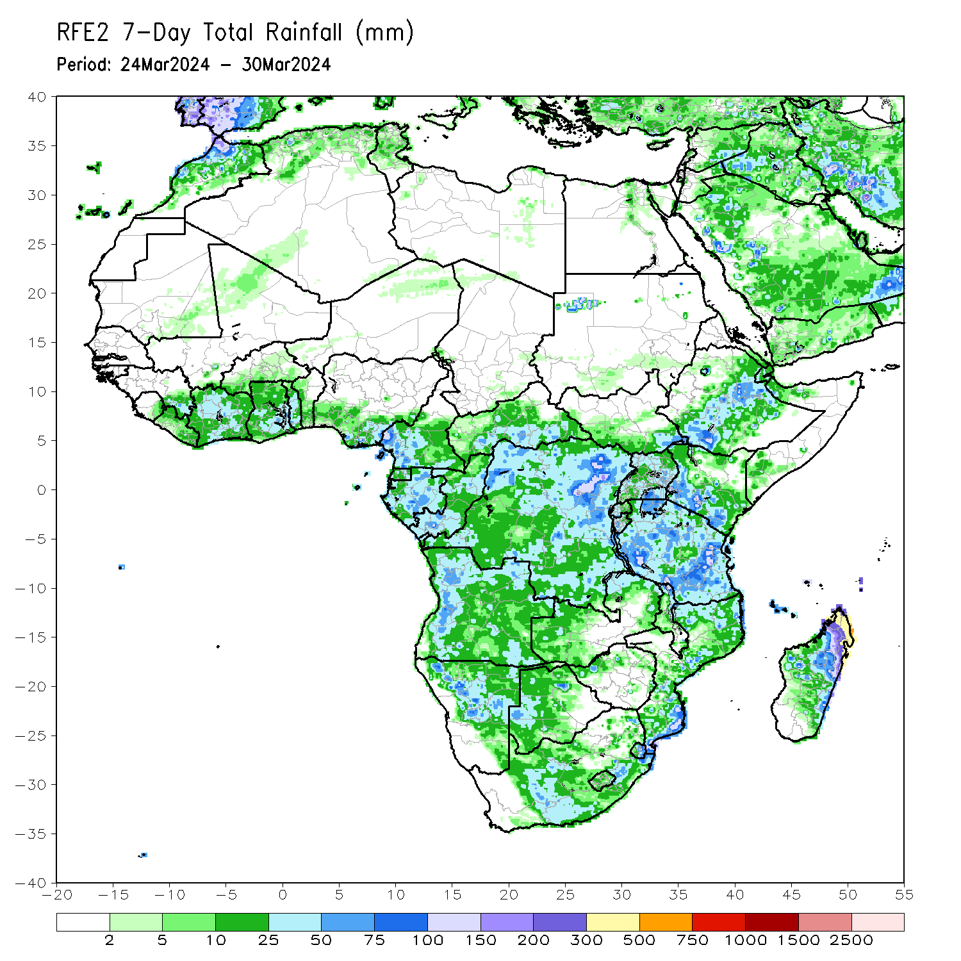
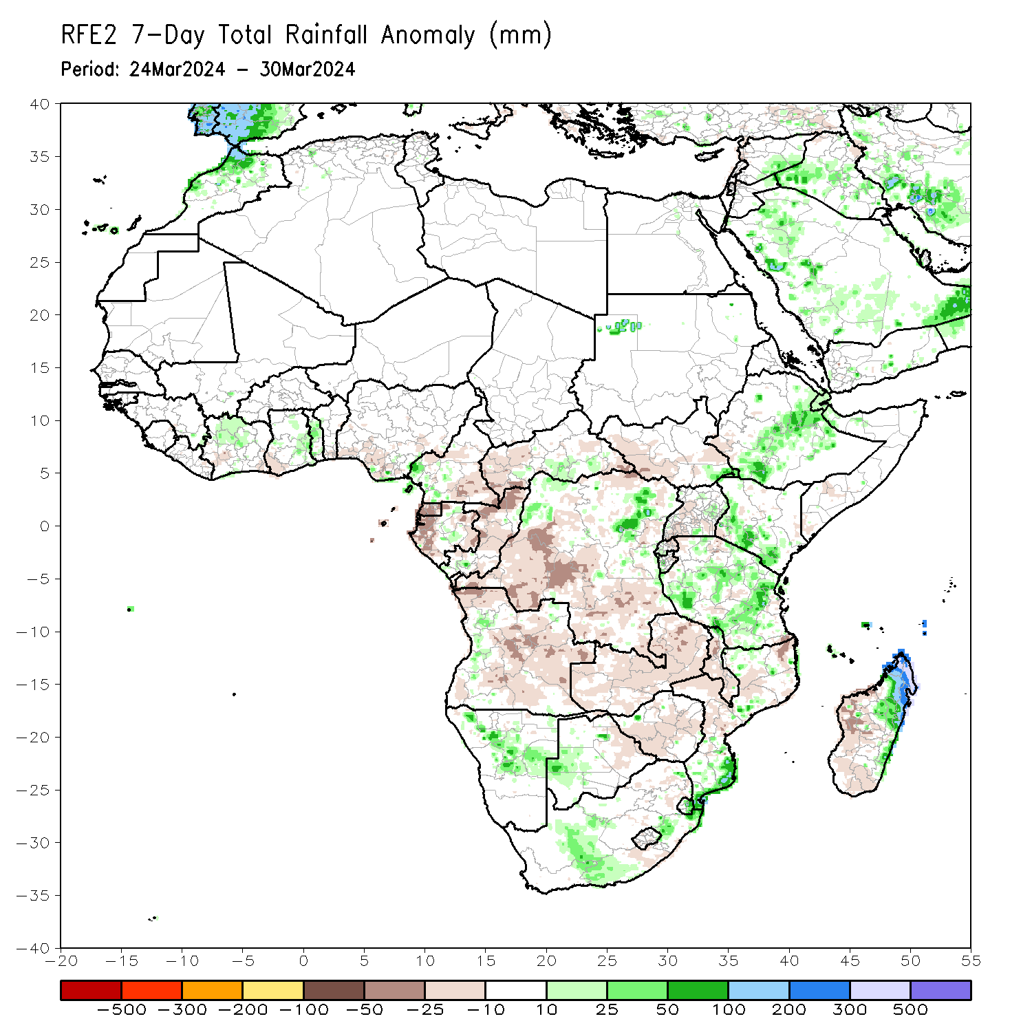
Rainfall Patterns: Last 7 Days
During the past 7 days, in East Africa, rainfall was above-average in central and southwestern Ethiopia, eastern Eritrea, Djibouti, southeastern South Sudan, western and southern Kenya, northwestern Somalia, east-central Uganda, and western, central, and parts of southern Tanzania. Rainfall was below average in parts of western Ethiopia, western and central South Sudan, western and southeastern Uganda, eastern Burundi, eastern Rwanda, and far southwestern Kenya. In central Africa, rainfall was above-average in south-central Central African Republic (CAR), parts of northwestern and northeastern Democratic Republic of Congo (DRC), central Gabon, parts of southwestern Congo, and southwestern Cameroon. Rainfall was below-average in Equatorial Guinea, central and southeastern Cameroon, northern and central Congo, western and southeastern Central African Republic (CAR), western and eastern Gabon, and north-central, central, and southern DRC. In West Africa, rainfall was above-average in northwestern Cote d’Ivoire, central Ghana, southeastern Guinea, and central and southern Togo. Rainfall was below-average in parts of southwestern and southeastern Cote d’Ivoire, southwestern Ghana, and southern Nigeria. In southern Africa, rainfall was above-average in west-central Angola, northwestern and central Namibia, west-central Botswana, northwestern, parts of central, and southern Mozambique, northern Malawi, eastern Eswatini, southeastern and parts of central South Africa, and northern and eastern Madagascar. Rainfall was below-average in northwestern, central, southern, and eastern Angola, Zambia, most of Malawi, most of northern and central Mozambique, central and southwestern Zimbabwe, eastern Botswana, and west-central and southern Madagascar.

Slide 7
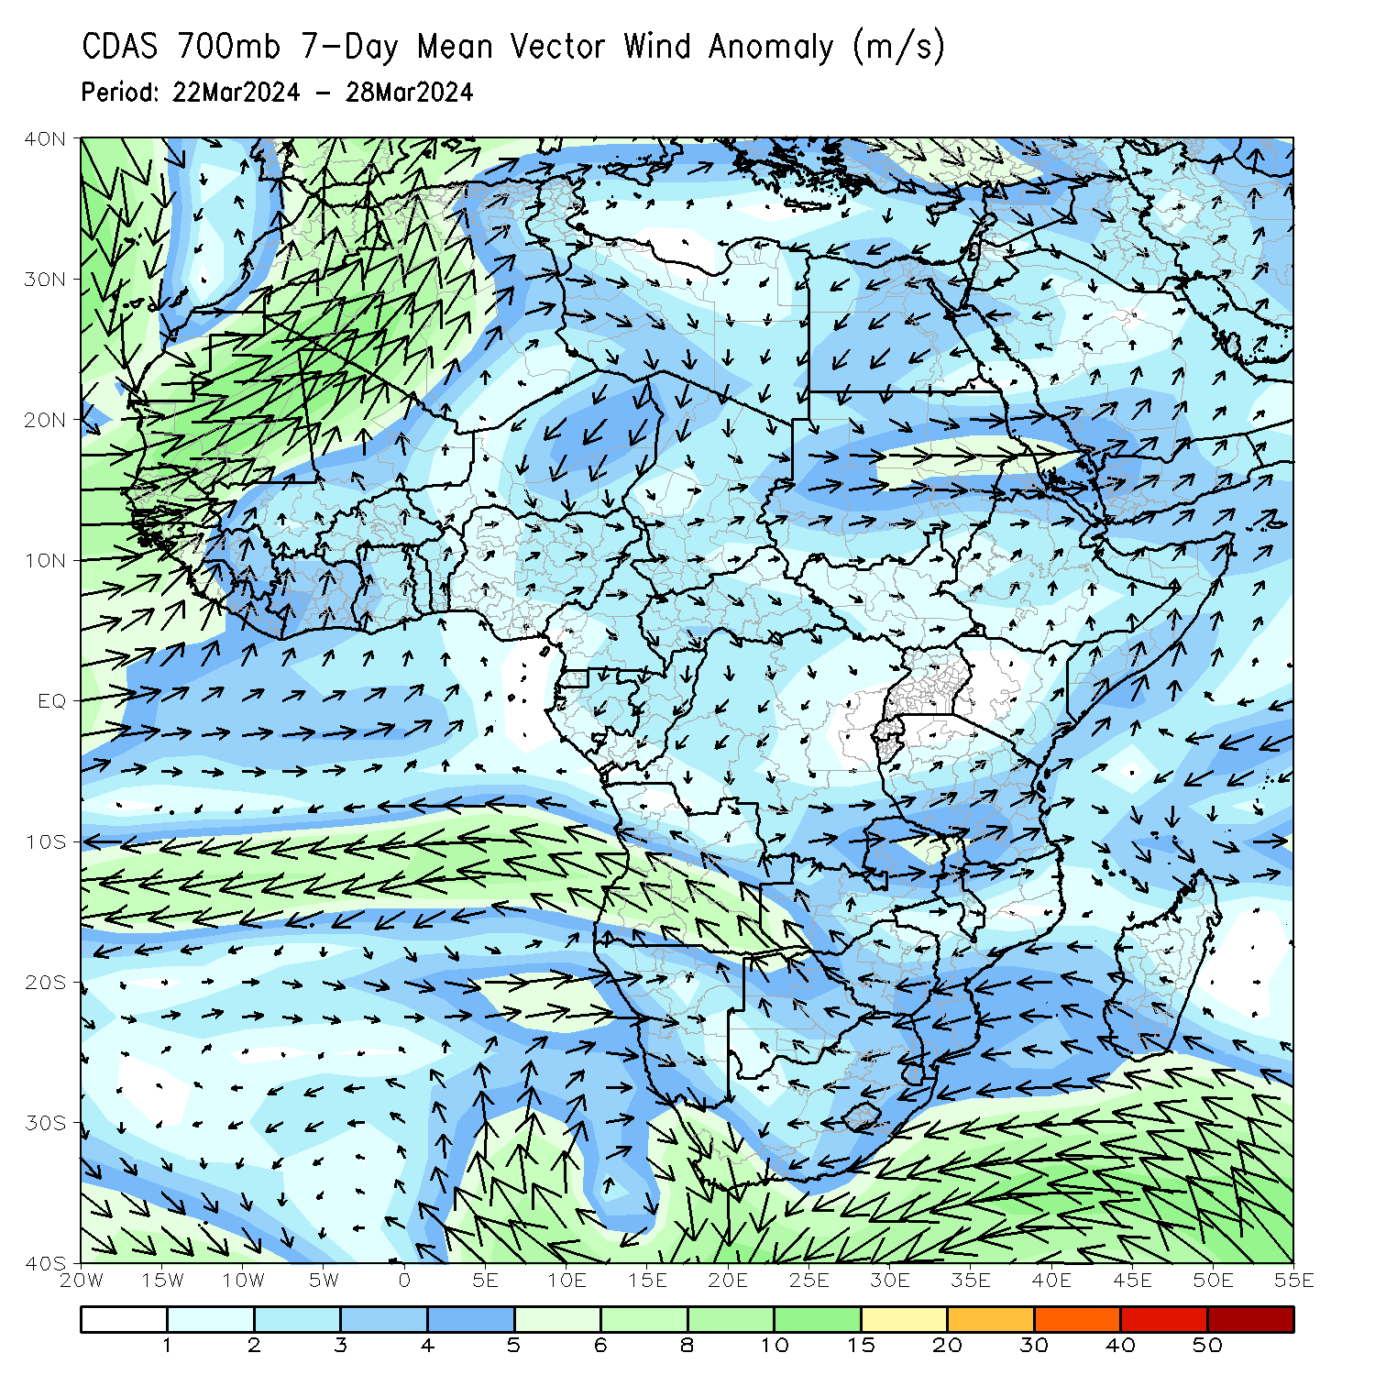
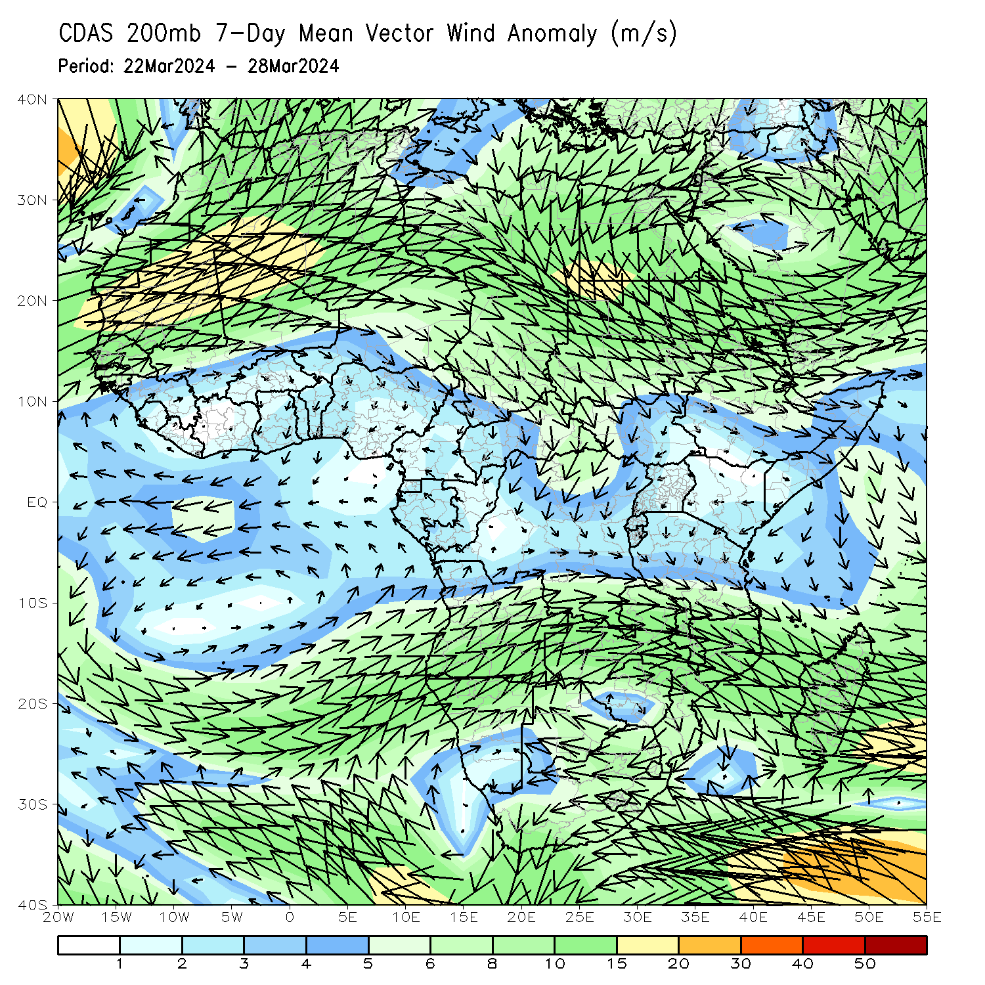
Atmospheric Circulation: Last 7 Days
At 700-hPa level (left panel), an area of cyclonic circulation at 700hPa (left panel) was observed across western South Africa that may have contributed to the observed above-average rainfall in central portions of the country. Cyclonic circulation was also observed near Mozambique and Madagascar, which was associated with Tropical Cyclone Gamane. Anomalous wind divergence at 700hPa across southern DRC, Zambia, and Angola may have resulted in the observed below-average rainfall across that region. At 200-hPa (right panel), and area of upper level divergence was observed in western and central portions of South Africa, likely contributing to the above-average rainfall. Upper-level convergence was observed in DRC and eastern Angola, likely contributing to the below-average rainfall.

Slide 8
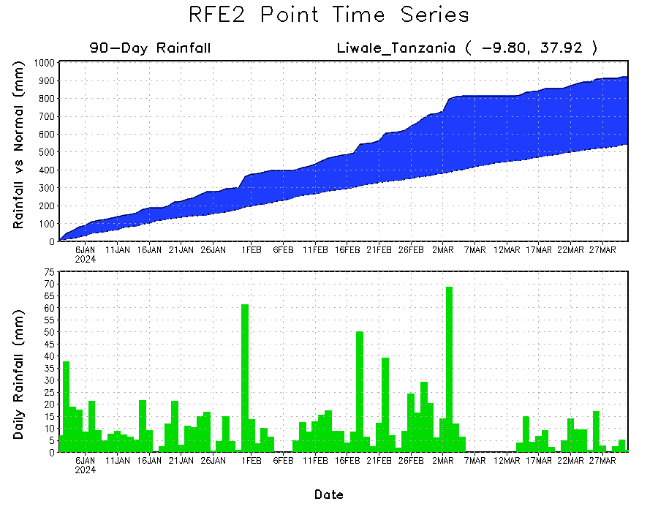
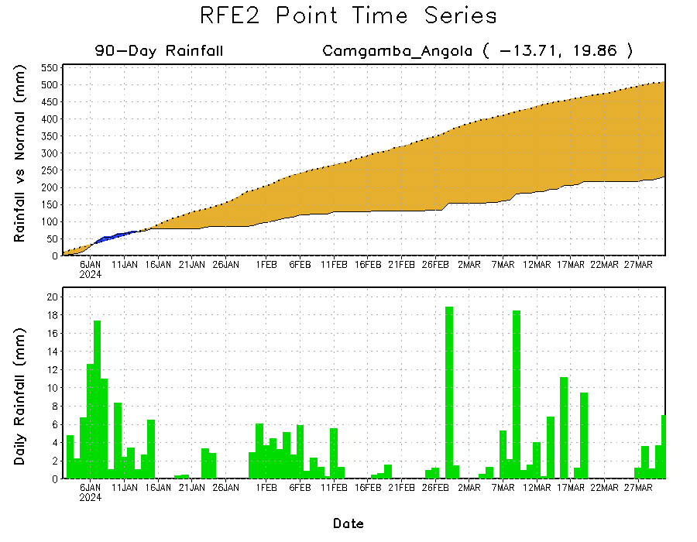
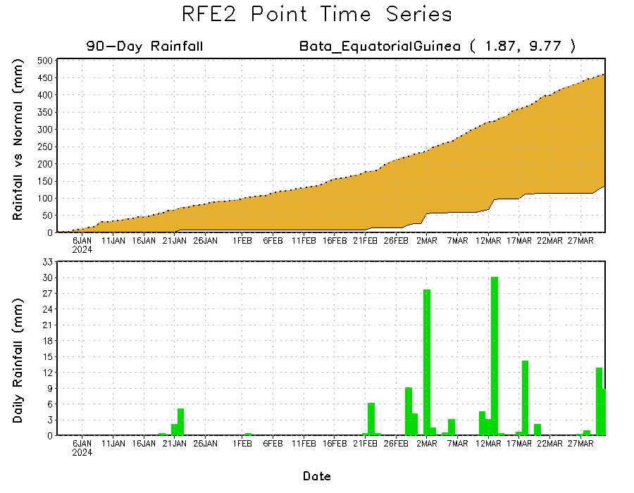
Rainfall Evolution
Daily evolution in rainfall at selected locations over the past 90 days shows growing deficits over much of Equatorial Guinea (bottom left) and eastern Angola (bottom right). Conversely, rainfall surpluses persist in central, southern, and eastern Tanzania due to heavy and above-average rainfall during last 3 months (top right).

Slide 9
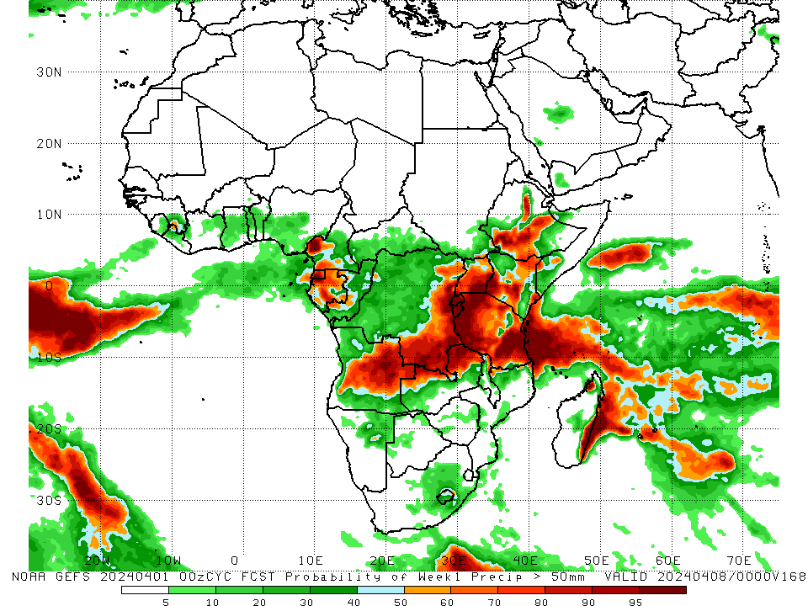
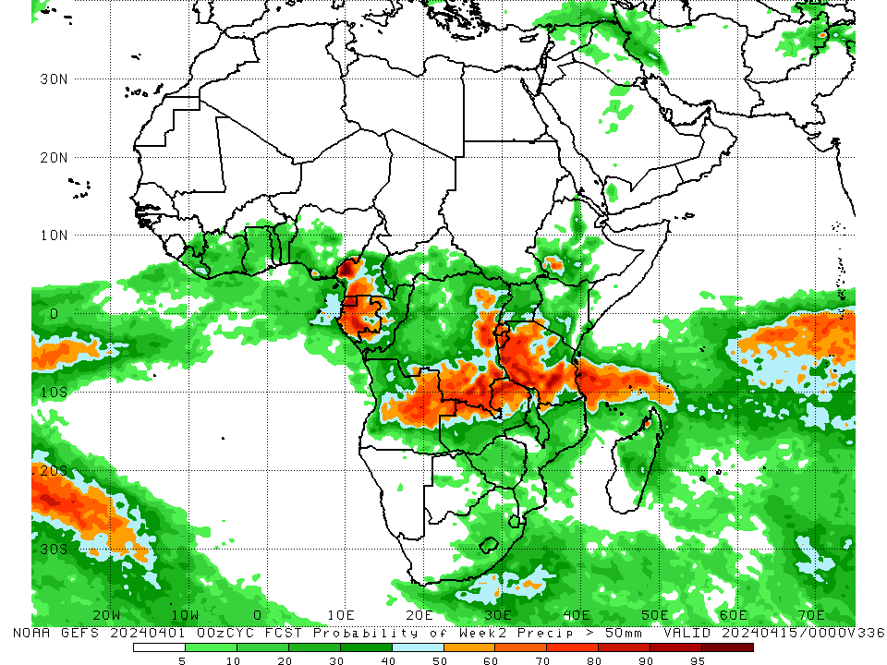
NCEP GEFS Model Forecasts Non-Bias Corrected Probability of precipitation exceedance
Week-1, Valid: 02 – 08 Apr 2024
Week-2, Valid: 09 – 15 Apr 2024
For week-1 (left panel) the NCEP GEFS indicates a moderate to high chance (over 70%) for rainfall to exceed 50 mm over Equatorial Guinea, parts of central Gabon, southwestern Cameroon, eastern DRC, northeastern and central Angola, Rwanda, Burundi, central and southern Uganda, northern, western, eastern, and southern Tanzania, northern Zambia, northeastern Malawi, northeastern, southwestern, parts of central, and southeastern Kenya, parts of southwestern Somalia, central, southwestern, and south-central Ethiopia, and parts of eastern and northwestern Madagascar. For week-2 (right panel), NCEP GEFS indicates a moderate to high chance (over 70%) for rainfall to exceed 50 mm in southwestern Cameroon, Equatorial Guinea, western and south-central Gabon, east-central and southeastern DRC, western Rwanda, Burundi, east-central Angola, northern Zambia, and western, parts of south-central, and parts of southeastern Tanzania.
Notes:
9

Slide 10
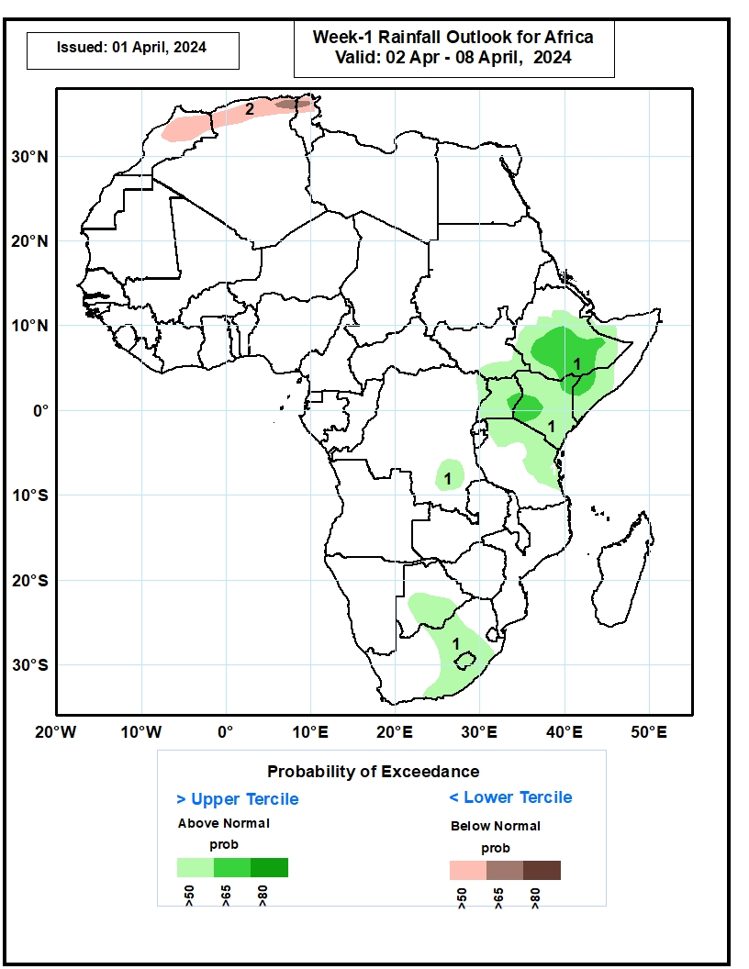
Week-1 Precipitation Outlooks
02 – 08 Apr 2024
1. The probabilistic forecasts call for above 50% chance for weekly rainfall to be above-normal (above the upper tercile) over central and southern Ethiopia, Uganda, Kenya, southern Somalia, northern Tanzania, parts of southern DRC, southern Botswana, parts of southern Africa, and Lesotho. Enhanced probabilities (>65%) are indicated for above normal rainfall over southern Ethiopia and southwestern Kenya.
2. The probabilistic forecasts call for above 50% chance for weekly total rainfall to be below-normal (below the lower tercile) over parts of Morocco and coastal Algeria. Probabilities are enhanced (>65%) for below normal rainfall over northern Algeria.
Notes:
10

Slide 11
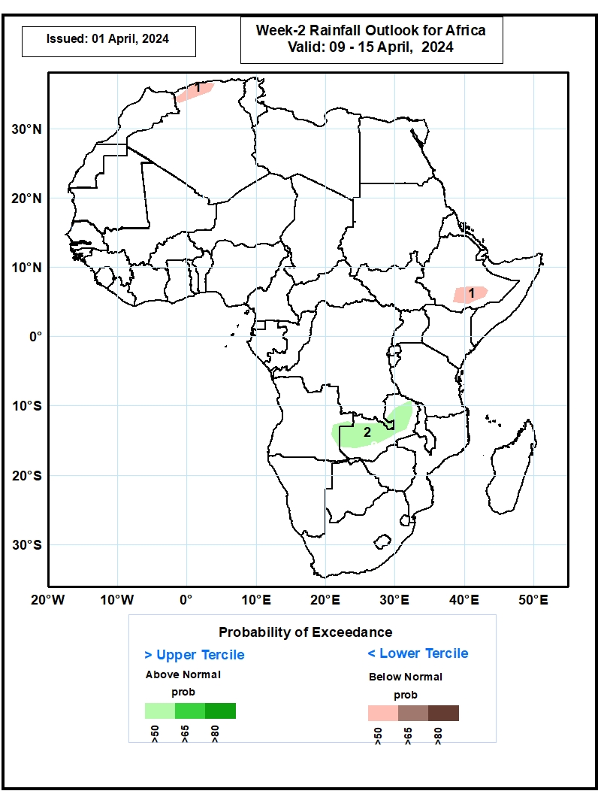
Week-2 Precipitation Outlooks
09 – 15 Apr 2024
1. The probabilistic forecasts call for above 50% chance for weekly rainfall to be below-normal (below the lower tercile) over parts of southern Ethiopia and coastal Algeria.
2. The probabilistic forecasts call for above 50% chance for weekly rainfall to be above-normal (above the upper tercile) over the northern parts of Zambia and eastern parts of Angola.
Notes:
11

Slide 12
Summary
Over the past 30 days, in East Africa, rainfall was above-average in northern, parts of western, and central Ethiopia, southwestern and central Eritrea, southern Kenya, parts of central, southern, and eastern Tanzania, southeastern South Sudan, Djibouti, parts of far northwestern Somalia, and western Burundi. Rainfall was below-average in western, central, and most of southern South Sudan, southern Somalia, most of Uganda, southwestern and south-central Ethiopia, northern and central Kenya, Rwanda, eastern Burundi, and some regions in northern, central, and southern Tanzania. In Central Africa, rainfall was above-average in some parts of western and eastern Gabon, central Congo, east-central Cameroon, and some parts of central and eastern DRC. Rainfall was below-average in southern Cameroon, Equatorial Guinea, central and southern Gabon, northern Congo, southwestern, southern and central CAR, and most of western, northeastern, and parts of southeastern DRC. In West Africa, rainfall was above-average in parts of northwestern, central, and coastal Cote d’Ivoire, southern parts of Ghana, central and southern Togo, parts of southern Benin, northwestern Liberia, southeastern Guinea, and parts of southern Nigeria. Rainfall was below-average in east-central parts of Guinea, central and northern Sierra Leone, eastern Liberia, southwestern Cote d’Ivoire, northern parts of Ghana and Togo, northern and central Benin, southwestern Burkina Faso, and southwestern and south-central portions of coastal Nigeria. In southern Africa, rainfall was above-average in many parts of west-central, northern, and east-central Angola, some parts of northeastern Zambia, northern and parts of central Malawi, some parts of northern and southern Mozambique, Eswatini, west-central and eastern South Africa, and northern and southern Madagascar. Rainfall was below-average in southern, central, and far northwestern Angola, northern and central Namibia, most of Botswana, Zimbabwe, many parts of western, most of Zambia, northern and central Mozambique, central and southern Malawi, central and northeastern South Africa, Lesotho, and northwestern and central Madagascar.
During the past 7 days, in East Africa, rainfall was above-average in central and southwestern Ethiopia, eastern Eritrea, Djibouti, southeastern South Sudan, western and southern Kenya, northwestern Somalia, east-central Uganda, and western, central, and parts of southern Tanzania. Rainfall was below average in parts of western Ethiopia, western and central South Sudan, western and southeastern Uganda, eastern Burundi, eastern Rwanda, and far southwestern Kenya. In central Africa, rainfall was above-average in south-central Central African Republic (CAR), parts of northwestern and northeastern Democratic Republic of Congo (DRC), central Gabon, parts of southwestern Congo, and southwestern Cameroon. Rainfall was below-average in Equatorial Guinea, central and southeastern Cameroon, northern and central Congo, western and southeastern Central African Republic (CAR), western and eastern Gabon, and north-central, central, and southern DRC. In West Africa, rainfall was above-average in northwestern Cote d’Ivoire, central Ghana, southeastern Guinea, and central and southern Togo. Rainfall was below-average in parts of southwestern and southeastern Cote d’Ivoire, southwestern Ghana, and southern Nigeria. In southern Africa, rainfall was above-average in west-central Angola, northwestern and central Namibia, west-central Botswana, northwestern, parts of central, and southern Mozambique, northern Malawi, eastern Eswatini, southeastern and parts of central South Africa, and northern and eastern Madagascar. Rainfall was below-average in northwestern, central, southern, and eastern Angola, Zambia, most of Malawi, most of northern and central Mozambique, central and southwestern Zimbabwe, eastern Botswana, and west-central and southern Madagascar.
The Week-1 outlook calls for above-average rainfall in the majority of eastern, central, and southern Africa, as well as southeastern Guinea, eastern Sierra Leone, northeastern Ghana, northern Togo, northwestern Benin, and central Nigeria. Anomalies greater than 50mm could be observed in southeastern DRC, western, northern, and parts of eastern Tanzania, southwestern Uganda, southwestern, central, northeastern, and parts of southeastern Kenya, and east-central and southwestern Ethiopia In contrast, there is an increased chance for below-average rainfall from coastal Liberia to coastal Nigeria, western Gabon, northwestern Angola, southeastern Zambia, northern and central Malawi, central Mozambique, and northern and western Madagascar. The Week-2 outlook calls for above-normal rainfall in much of the Gulf of Guinea region, southern Cameroon, Equatorial Guinea, Gabon, central Congo, eastern and southern DRC, western and southeastern CAR, southern South Sudan, southwestern and north-central Ethiopia, western Uganda, Rwanda, Burundi, northwestern and southeastern Kenya, Tanzania, Zambia, Malawi, western Mozambique, Zimbabwe, eastern Botswana, eastern and central Angola, and northeastern and south-central South Africa. In contrast, there is an increased chance for below-average in eastern and northern Madagascar, northeastern and east-central Mozambique, the Lake Victoria region, much of southern Ethiopia, northern and central Somalia, and coastal Liberia.

