Slide 1
The African Monsoon Recent Evolution and Current Status Include Week-1 and Week-2 Outlooks
Update prepared
15 April 2024
For more information, visit:
http://www.cpc.ncep.noaa.gov/products/Global_Monsoons/African_Monsoons/precip_monitoring.shtml

Slide 2
Outline
Highlights
Recent Evolution and Current Conditions
NCEP GEFS Forecasts
Summary

Slide 3
Highlights: Last 7 Days
During the past 7 days, in East Africa, rainfall was above-average in southwestern Ethiopia, parts of southeastern South Sudan, northwestern and southern Kenya, southeastern Somalia, southeastern Uganda, central and southern Burundi, and western, east-central, and northern Tanzania. Rainfall was below average in parts of western, south-central, and east-central Ethiopia, western, east-central, and south-central South Sudan, parts of central and northern Uganda, most of eastern and southern Tanzania, southern Djibouti, northwestern and southwestern Somalia, and west-central and northeastern Kenya. In central Africa, rainfall was above-average in parts of southeastern Democratic Republic of Congo (DRC), eastern and parts of central Gabon, parts of west-central Congo, and parts of central and southwestern Cameroon. Rainfall was below-average in Equatorial Guinea, far southwestern and east-central Cameroon, northern, eastern, and southwestern Congo, most of Central African Republic (CAR), western Gabon, and northern, central, and southwestern DRC. In West Africa, rainfall was above-average in north-central and west-central Cote d’Ivoire, eastern Ghana, southeastern Guinea, southwestern and southeastern Burkina Faso, Togo, northern and central Benin, and parts of western, southeastern, and central Nigeria. Rainfall was below-average in parts of eastern and southern Cote d’Ivoire, parts of southern and western Ghana, and southwestern Nigeria. In southern Africa, rainfall was above-average in central and southeastern Angola, northeastern Namibia, parts of northern and south-central Botswana, central Mozambique, northern and parts of southern Malawi, western Eswatini, Lesotho, southwestern, central, and parts of northeastern South Africa, Zambia, and western, southern, and northern Zimbabwe. Rainfall was below-average in western and northeastern Angola, far northeastern Malawi, most of northern Mozambique, southeastern Botswana, central and northwestern Namibia, and far northern, central, and southeastern Madagascar.
The Week-1 outlook calls for above-average rainfall in much of eastern Africa (northern and central Uganda, central, southern, and eastern Ethiopia, western and southern Kenya, Somalia, eastern Tanzania), as well as northern Mozambique, northeastern Madagascar, northeastern DRC, eastern Liberia, and southern Cote d’Ivoire. Anomalies greater than 50mm could be observed in southwestern Kenya and eastern Tanzania. In contrast, there is an increased chance for below-average rainfall in eastern Sierra Leone, western Liberia, northern Cote d’Ivoire, northern Ghana, Togo, southern Benin, southern Nigeria, southeastern Cameroon, southern and eastern CAR, northern and southern Congo, central and southern Angola, western Zambia, northwestern, central, and southern Namibia, Zimbabwe, western, southern, and eastern South Africa, western Ethiopia, and the Lake Victoria region. The Week-2 outlook calls for above-normal rainfall in much of eastern Africa, eastern Liberia, southern and eastern Cote d’Ivoire, and central and southern Ghana. Anomalies greater than 50mm could be observed in southwestern Kenya and northeastern Tanzania. In contrast, there is an increased chance for below-average rainfall in western Ethiopia, South Africa, Lesotho, southern Botswana, central Mozambique, northern and central Angola, northern DRC, CAR, western South Sudan, Equatorial Guinea, central and southern Cameroon, northwestern Cote d’Ivoire, western Liberia, Sierra Leone, and southeastern Guinea.

Slide 4
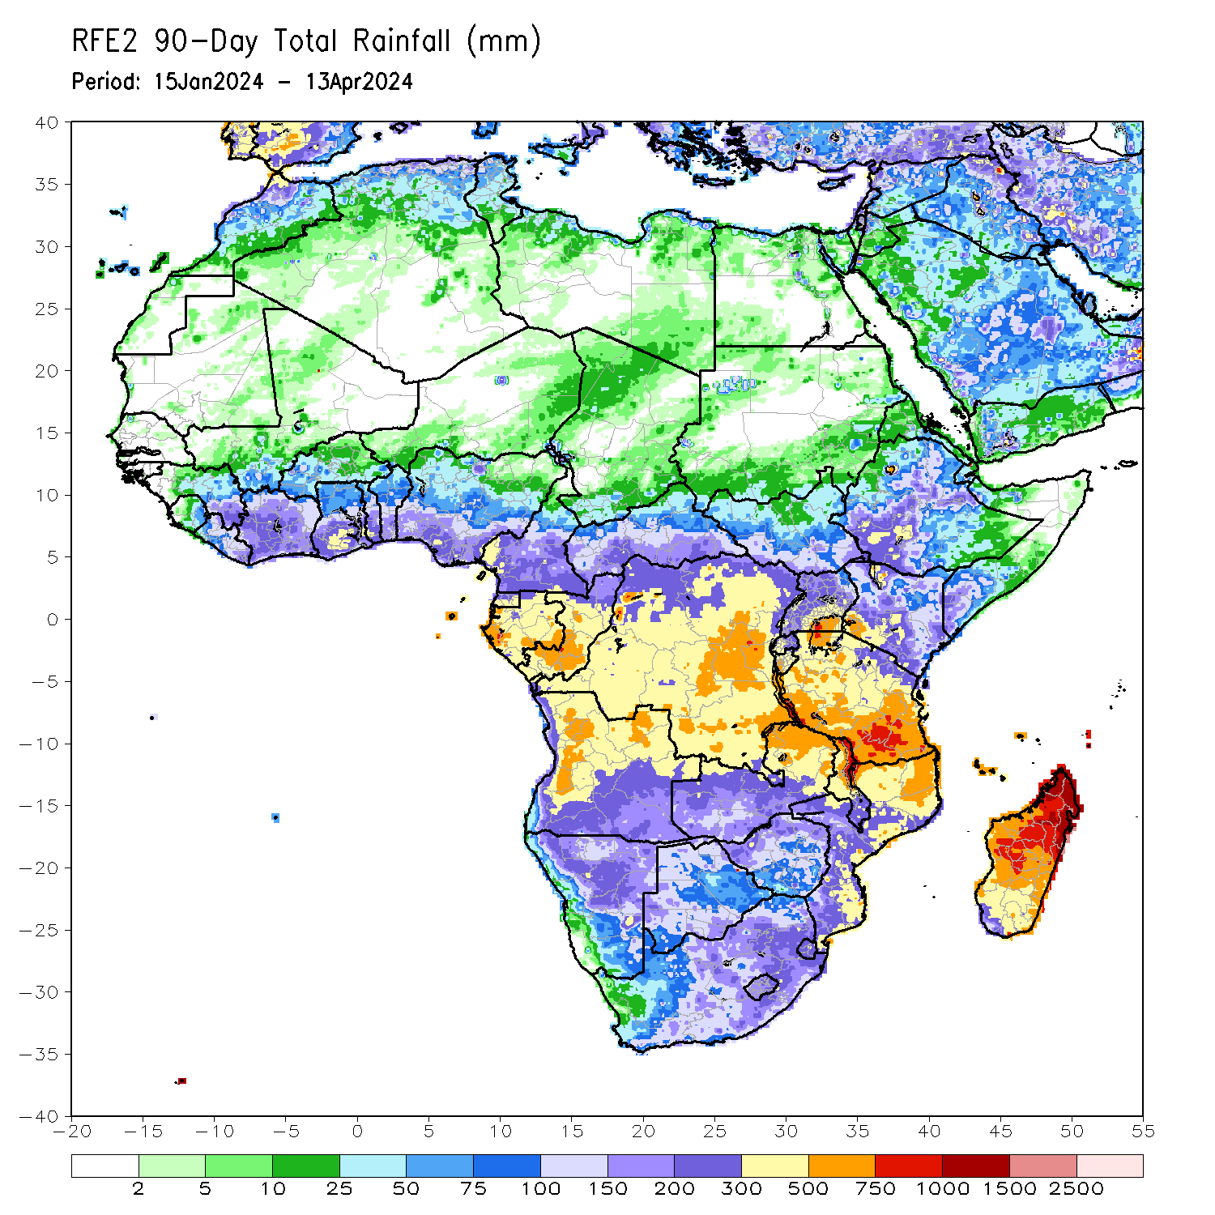
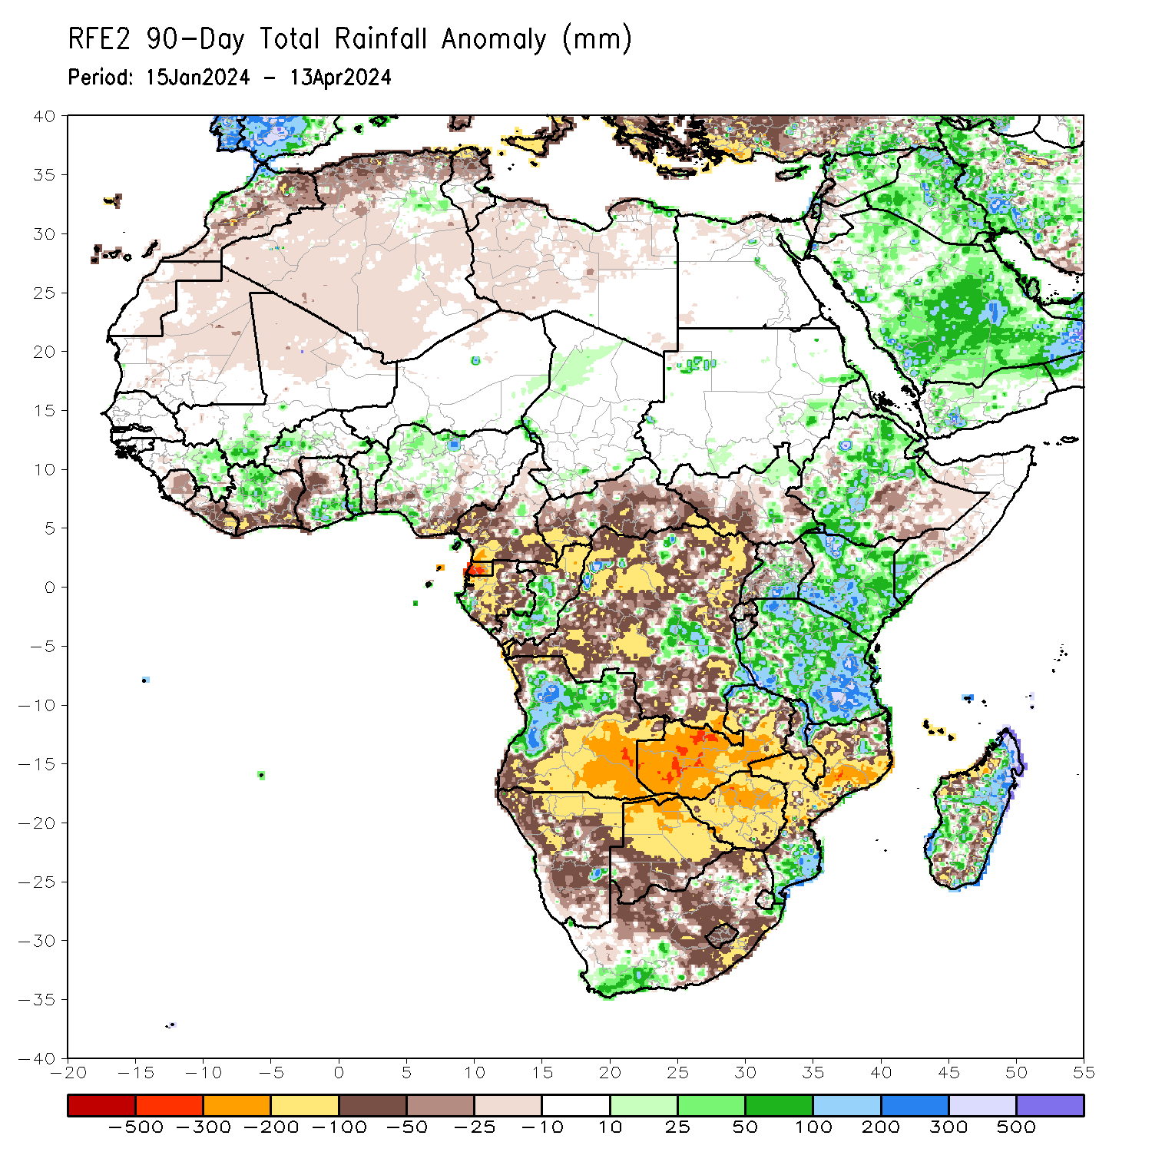
Rainfall Patterns: Last 90 Days
Over the past 90 days, in East Africa, rainfall was above-average in parts of northern, central, and southwestern Ethiopia, southwestern and central Eritrea, most of Kenya, central and southeastern Uganda, most of Tanzania, western Burundi, northeastern and southeastern South Sudan, Djibouti, and southern Somalia. Rainfall was below-average in western, southern, and central South Sudan, parts of west-central, south-central, and southeastern Ethiopia, northwestern and south-central Somalia, western and northeastern Uganda, eastern and central Rwanda, and eastern Burundi, In Central Africa, rainfall was above-average in parts of north-central and southeastern Democratic Republic of the Congo (DRC), central and southern Congo, and pockets of eastern and western Gabon. Rainfall was below-average in western and southern Cameroon, Equatorial Guinea, many parts of Gabon, northern Congo, Central African Republic (CAR), and many parts of northern, western, northeastern, and southern DRC. In West Africa, rainfall was above-average in central and northwestern Cote d’Ivoire, southern parts of Ghana and Togo, northeastern Benin, eastern Guinea, western and southeastern Burkina Faso, and pockets of southwestern and northwestern Nigeria. Rainfall was below-average in Sierra Leone, Liberia, southern and eastern Cote d’Ivoire, central parts of Ghana, parts of southwestern Burkina Faso, much of southern Nigeria, northern Mali, and northern and central Mauritania. In southern Africa, rainfall was above-average over west-central and parts of northern Angola, northeastern Zambia, northern and central Malawi, some regions in northern and southern Mozambique, some parts of southwestern and eastern South Africa, and southern, central and eastern Madagascar. Rainfall was below-average across southern, central, northwestern, and eastern Angola, many parts of Namibia, Botswana, Zimbabwe and Lesotho, western, central, southern and eastern Zambia, southern Malawi, central and western Mozambique, most of central and parts of southeastern South Africa, northeastern Eswatini, and northwestern and parts of southwestern Madagascar.
Notes:
4

Slide 5
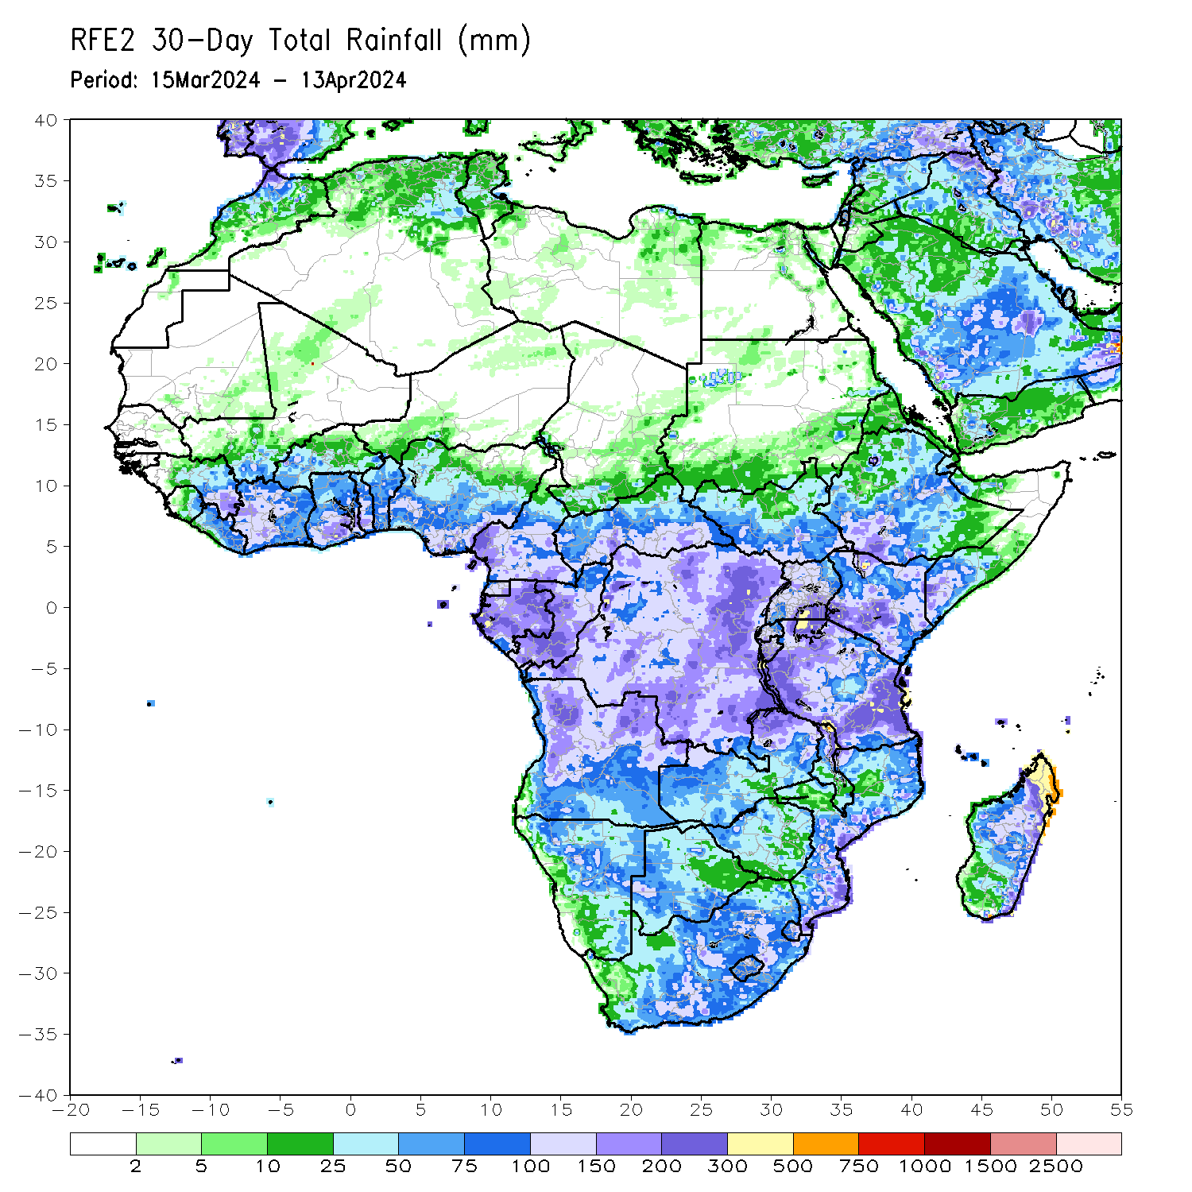
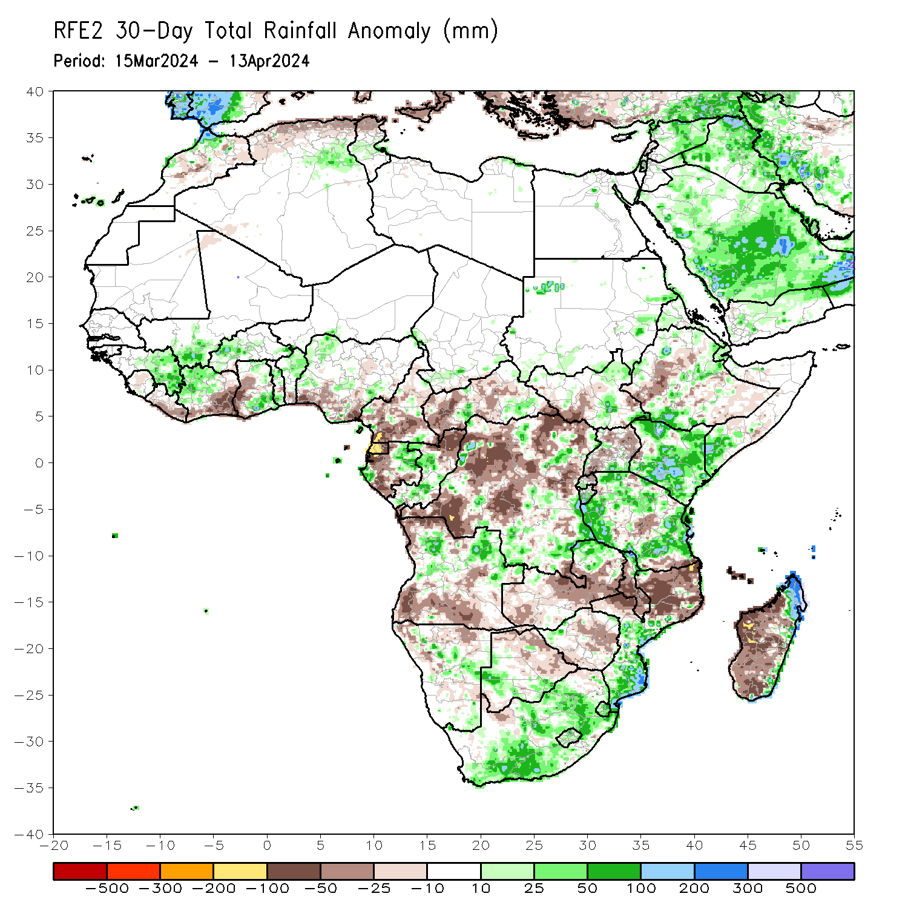
Rainfall Patterns: Last 30 Days
Over the past 30 days, in East Africa, rainfall was above-average in northern and parts of southwestern and central Ethiopia, southwestern and central Eritrea, Kenya, most of Tanzania, southeastern and northeastern South Sudan, Djibouti, southern Somalia, western Rwanda, and central and southern Burundi. Rainfall was below-average in parts of western and central South Sudan, central Somalia, northern, central, and southwestern Uganda, southwestern, parts of central, and southeastern Ethiopia, west-central Kenya, eastern Rwanda, and some regions in central Tanzania. In Central Africa, rainfall was above-average in some parts of west-central and eastern Gabon, central and southern Congo, parts of southeastern Cameroon, and some parts of northern and southeastern DRC. Rainfall was below-average in most of central and southern Cameroon, Equatorial Guinea, most of western and southern Gabon, northern Congo, most of western and central CAR, and most of western, northeastern, central, and parts of far southeastern DRC. In West Africa, rainfall was above-average in parts of northwestern and central Cote d’Ivoire, southeastern parts of Ghana, northern and southern Togo, northern Benin, central and eastern Guinea, southwestern Mali, western and southeastern Burkina Faso, and northwestern Nigeria. Rainfall was below-average in central Sierra Leone, southern and eastern Liberia, southern and eastern Cote d’Ivoire, west-central and southwestern Ghana, southern Benin, and southwestern and south-central portions of Nigeria. In southern Africa, rainfall was above-average in parts of west-central, northern, and east-central Angola, some parts of northeastern Zambia, northern parts of Malawi, central and southern Mozambique, Eswatini, Lesotho, southern, central, and parts of eastern South Africa, south-central and west-central Botswana, parts of central Namibia, parts of west-central Zimbabwe, and northern and eastern Madagascar. Rainfall was below-average in southern, central, and far northwestern Angola, northern and parts of central Namibia, eastern and northern Botswana, central and southern Zimbabwe, western and central Zambia, northern Mozambique, central and southern Malawi, parts of northwestern and northeastern South Africa, and western, southern, and central Madagascar.
Notes:
5

Slide 6
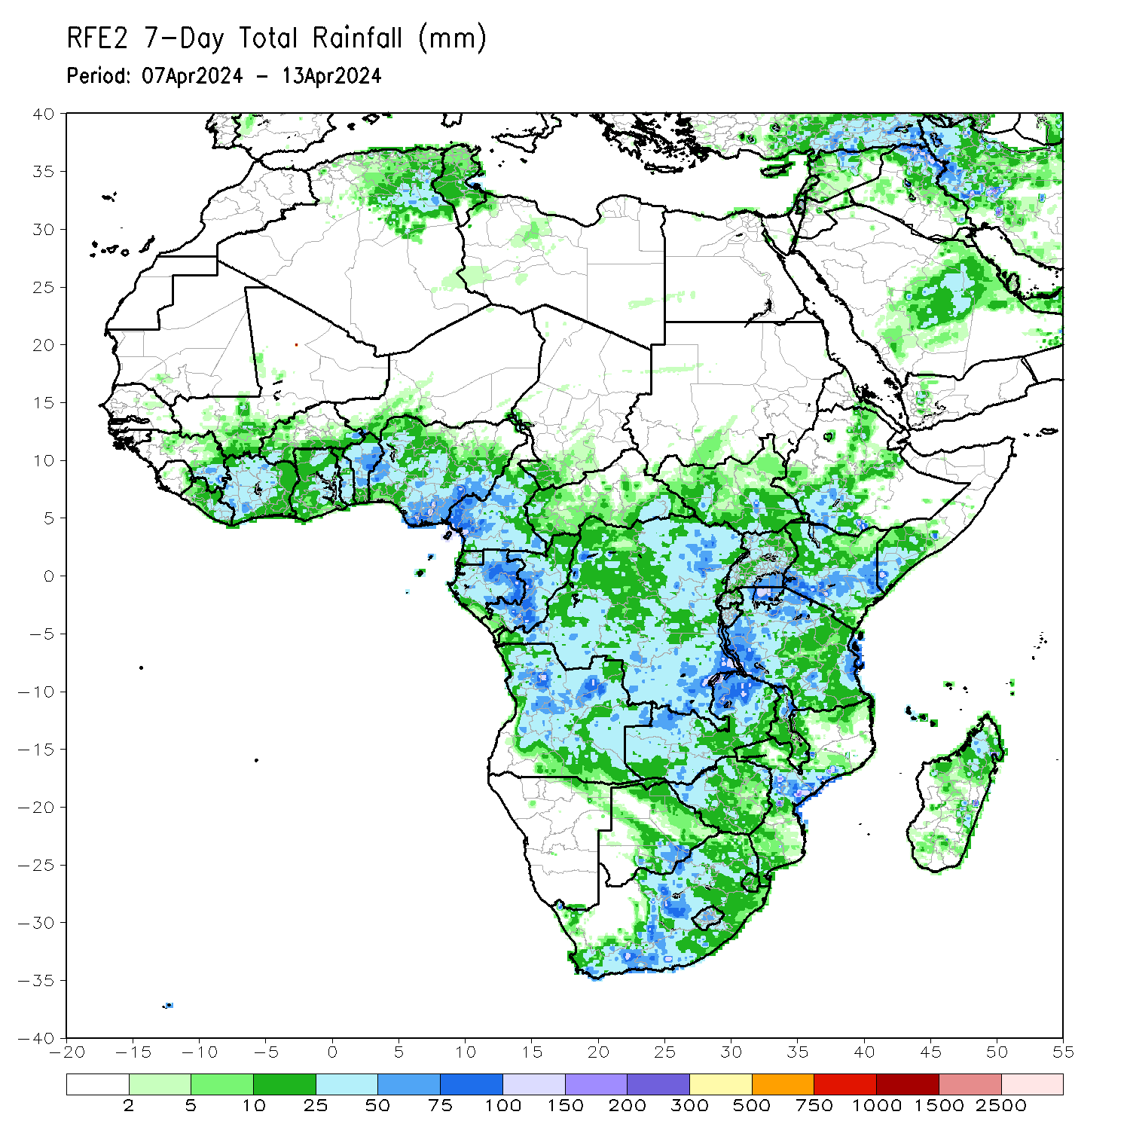
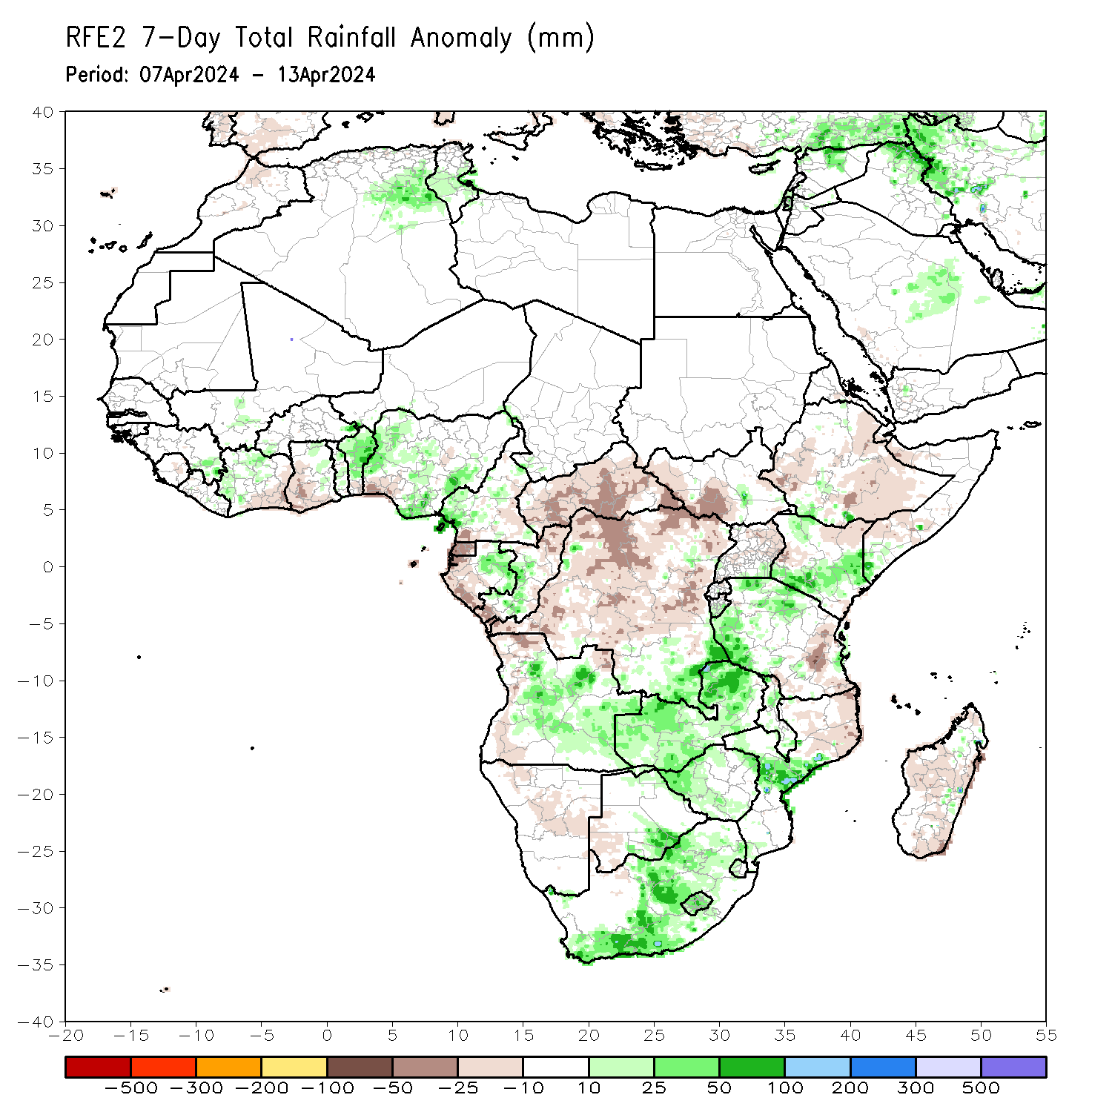
Rainfall Patterns: Last 7 Days
During the past 7 days, in East Africa, rainfall was above-average in southwestern Ethiopia, parts of southeastern South Sudan, northwestern and southern Kenya, southeastern Somalia, southeastern Uganda, central and southern Burundi, and western, east-central, and northern Tanzania. Rainfall was below average in parts of western, south-central, and east-central Ethiopia, western, east-central, and south-central South Sudan, parts of central and northern Uganda, most of eastern and southern Tanzania, southern Djibouti, northwestern and southwestern Somalia, and west-central and northeastern Kenya. In central Africa, rainfall was above-average in parts of southeastern Democratic Republic of Congo (DRC), eastern and parts of central Gabon, parts of west-central Congo, and parts of central and southwestern Cameroon. Rainfall was below-average in Equatorial Guinea, far southwestern and east-central Cameroon, northern, eastern, and southwestern Congo, most of Central African Republic (CAR), western Gabon, and northern, central, and southwestern DRC. In West Africa, rainfall was above-average in north-central and west-central Cote d’Ivoire, eastern Ghana, southeastern Guinea, southwestern and southeastern Burkina Faso, Togo, northern and central Benin, and parts of western, southeastern, and central Nigeria. Rainfall was below-average in parts of eastern and southern Cote d’Ivoire, parts of southern and western Ghana, and southwestern Nigeria. In southern Africa, rainfall was above-average in central and southeastern Angola, northeastern Namibia, parts of northern and south-central Botswana, central Mozambique, northern and parts of southern Malawi, western Eswatini, Lesotho, southwestern, central, and parts of northeastern South Africa, Zambia, and western, southern, and northern Zimbabwe. Rainfall was below-average in western and northeastern Angola, far northeastern Malawi, most of northern Mozambique, southeastern Botswana, central and northwestern Namibia, and far northern, central, and southeastern Madagascar.

Slide 7
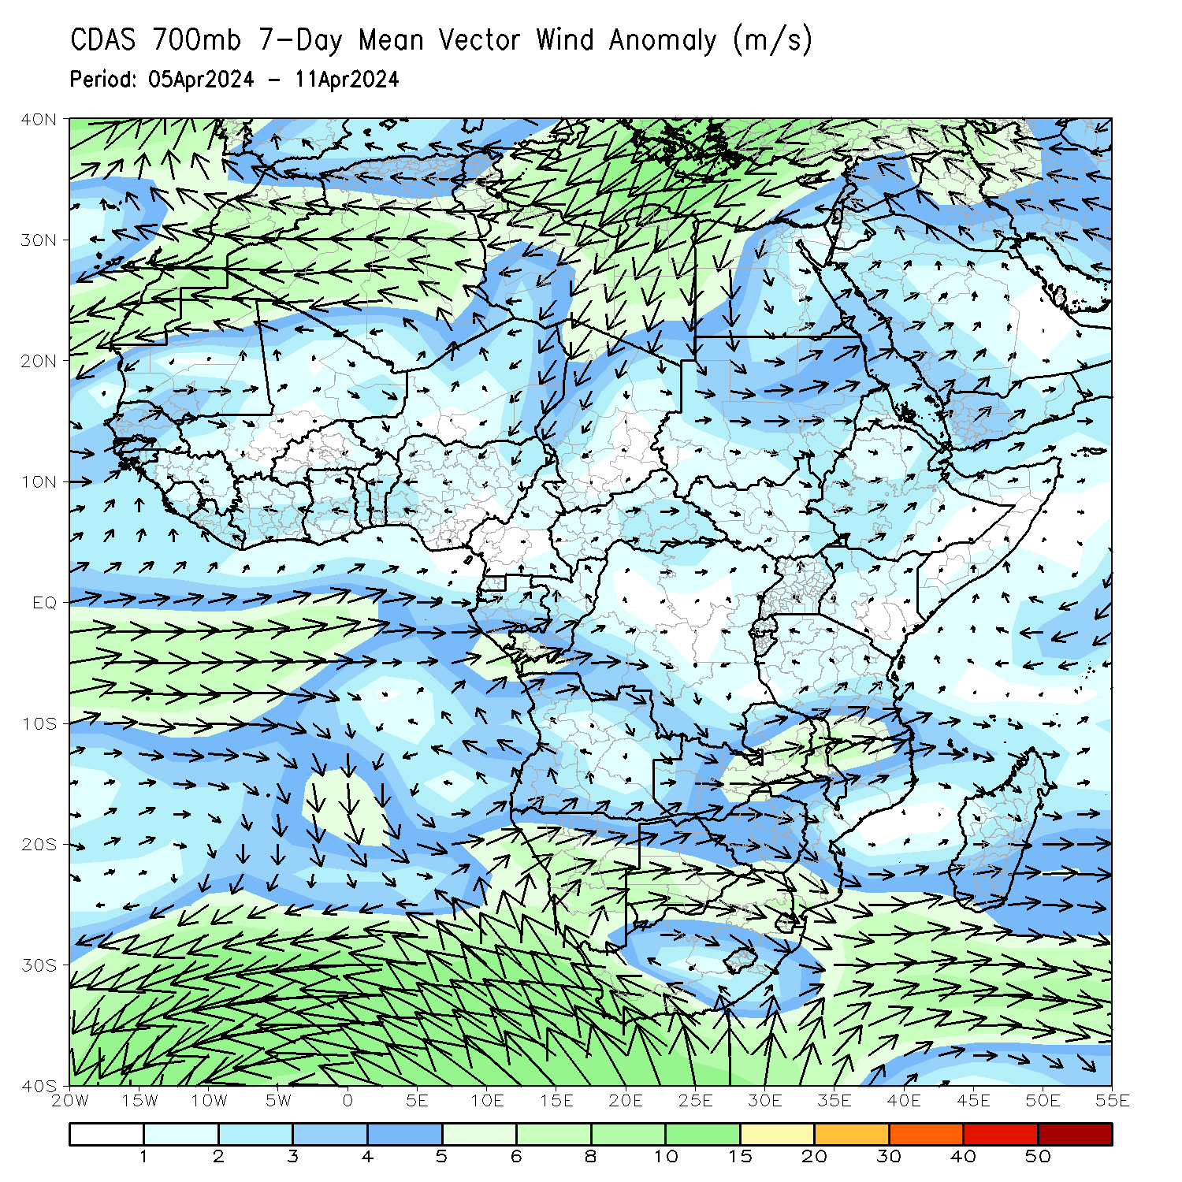
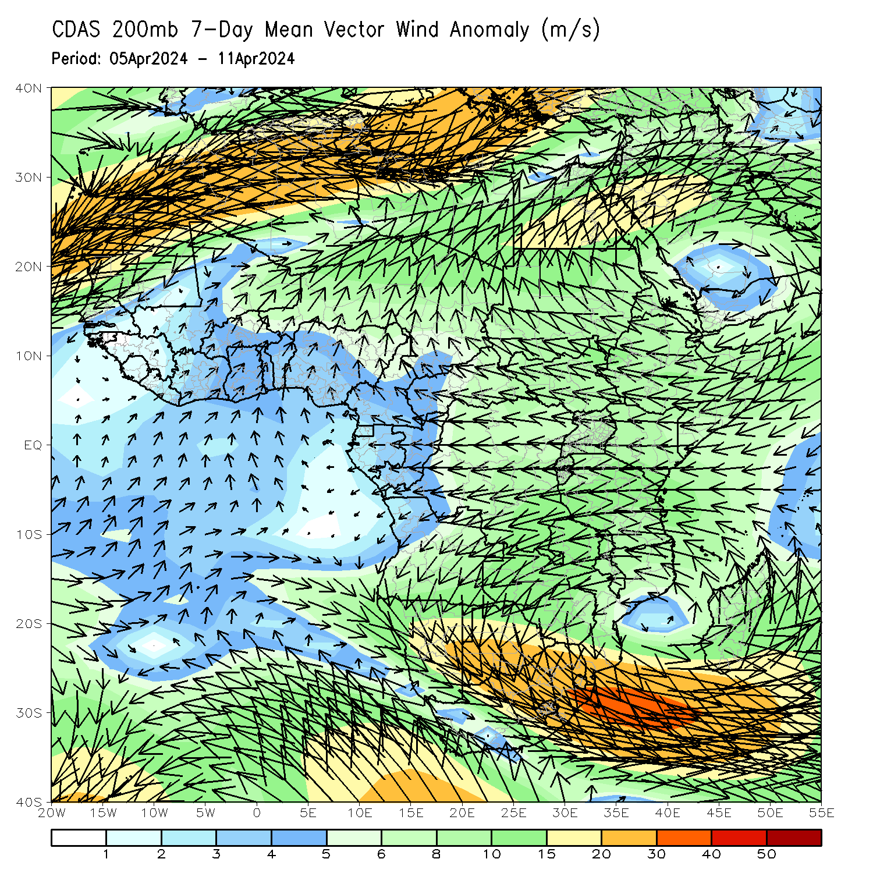
Atmospheric Circulation: Last 7 Days
At 700-hPa level (left panel), lower-level convergence at 700hPa (left panel) was observed across central South Africa, southern Gabon, and Congo may have contributed to the observed above-average rainfall in central and southern portions of Africa. Anomalous wind divergence at 700hPa across northern DRC and southern CAR may have resulted in the observed below-average rainfall across that region. At 200-hPa (right panel), and area of upper level anticyclonic flow (and divergence) was observed in Zambia, Zimbabwe, Mozambique, Botswana, Angola, Malawi, South Africa, Lesotho, and Eswatini, likely contributing to the above-average rainfall in those countries.

Slide 8
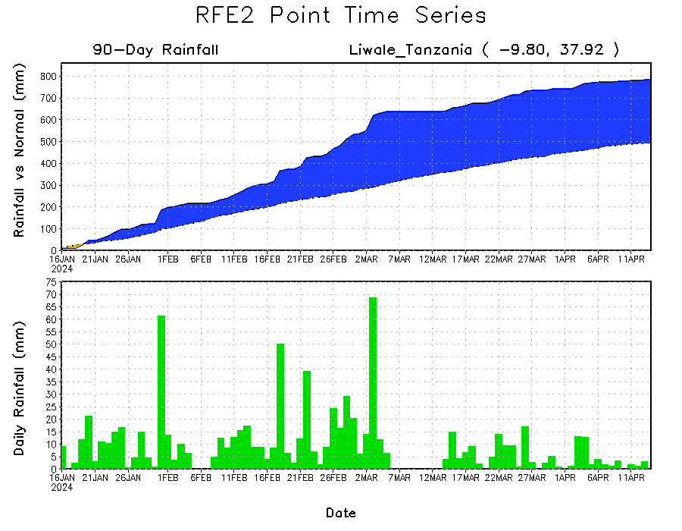
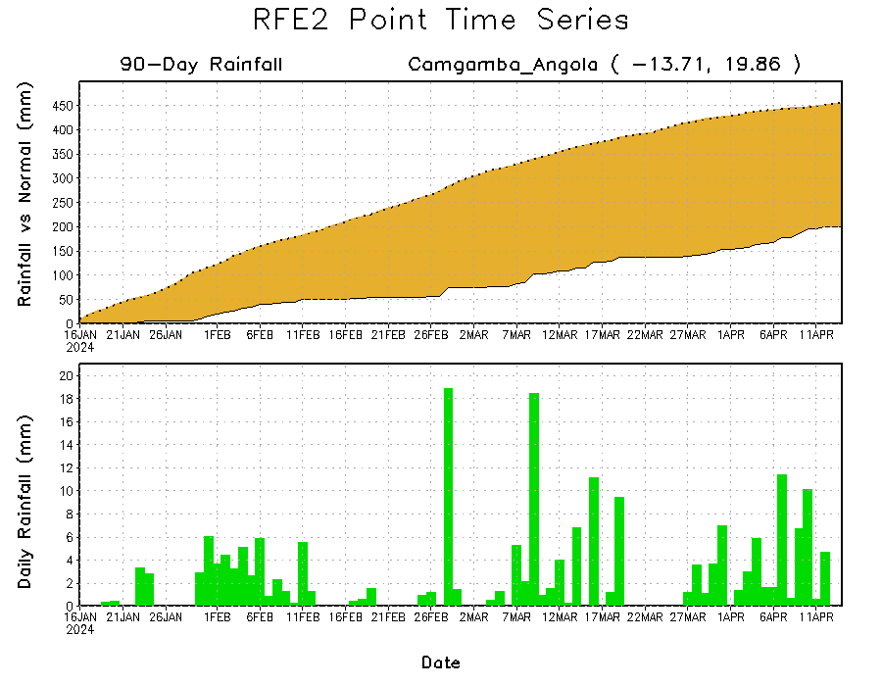
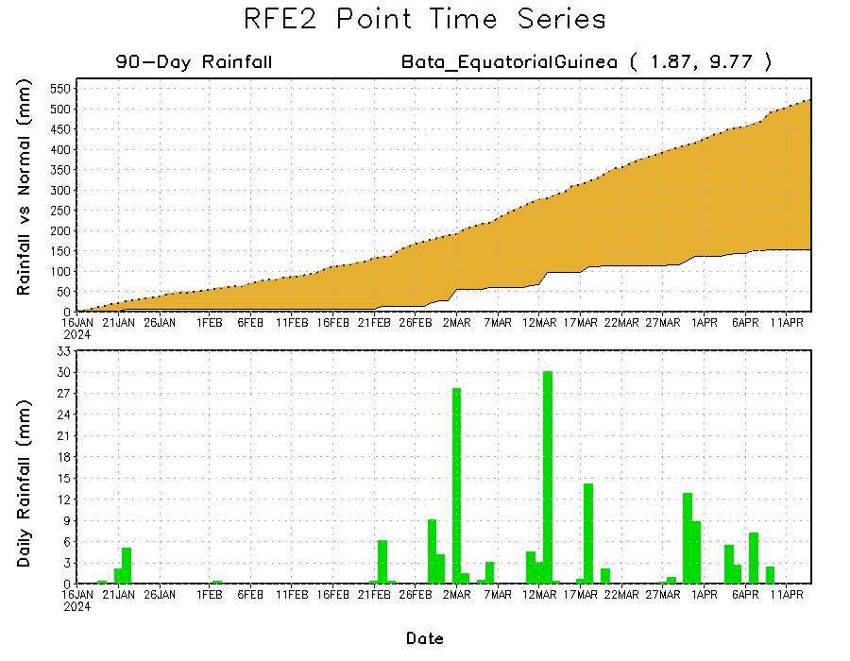
Rainfall Evolution
Daily evolution in rainfall at selected locations over the past 90 days shows growing deficits over much of Equatorial Guinea (bottom left) and eastern Angola (bottom right). Conversely, rainfall surpluses persist in Tanzania (top right).

Slide 9
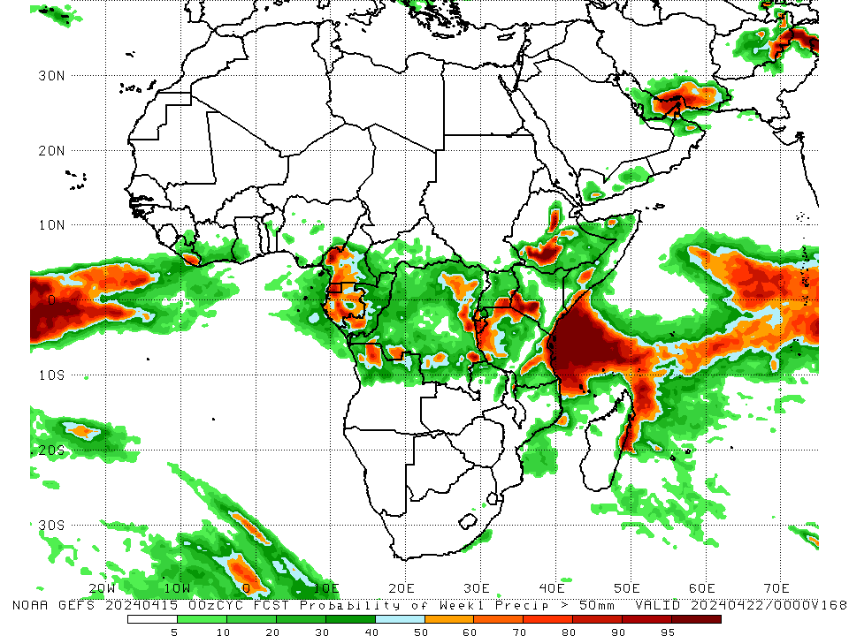
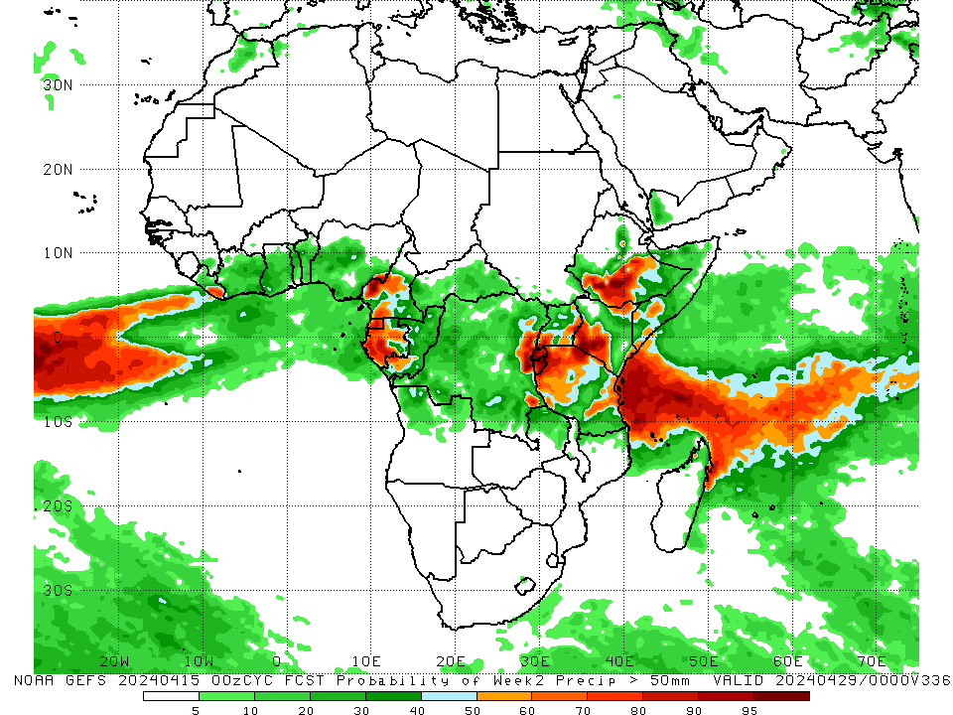
NCEP GEFS Model Forecasts Non-Bias Corrected Probability of precipitation exceedance
Week-1, Valid: 16 – 22 Apr 2024
Week-2, Valid: 23 – 29 Apr 2024
For week-1 (left panel) the NCEP GEFS indicates a moderate to high chance (over 70%) for rainfall to exceed 50 mm over Equatorial Guinea, parts of western Gabon, west-central and southwestern Cameroon, southwestern Congo, northwestern Angola, eastern Liberia, parts of southwestern, east-central, and southeastern DRC, western Rwanda, Burundi, southeastern Uganda, northern, western, eastern, and parts of southern Tanzania, southwestern and southeastern Kenya, parts of southern Somalia, southwestern and central Ethiopia, and parts of northeastern Madagascar. For week-2 (right panel), NCEP GEFS indicates a moderate to high chance (over 70%) for rainfall to exceed 50 mm in west-central and southwestern Cameroon, Equatorial Guinea, western and south-central Gabon, east-central and southeastern DRC, Rwanda, Burundi, eastern Liberia, southwestern Congo, east-central and southwestern Uganda, southwestern and central Ethiopia, southwestern and southeastern Kenya, northern and eastern Tanzania, and parts of northeastern Madagascar.
Notes:
9

Slide 10
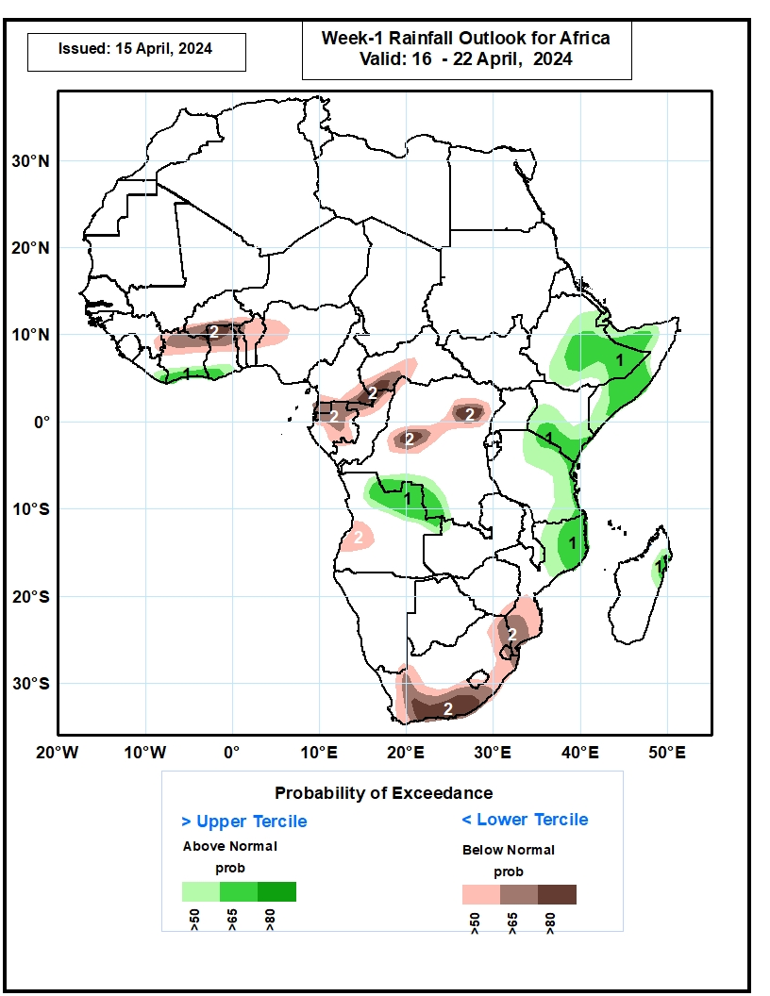
Week-1 Precipitation Outlooks
16 – 22 Apr 2024
1. The probabilistic forecasts call for above 50% chance for weekly rainfall to be above-normal (above the upper tercile) over southern Liberia, Cote d’Ivoire, Ghana, Ethiopia, Somalia, southern Kenya, eastern Tanzania, northern Mozambique, southern DRC, northern Angola, and northern Madagascar. There is above 65% chance for above-normal rainfall over Liberia, Cote d’Ivoire, Ghana, southern DRC, northern Angola, eastern Ethiopia, Somalia, southern Kenya, and northeastern Mozambique.
2. The probabilistic forecasts call for above 50% chance for weekly total rainfall to be below-normal (below the lower tercile) over northern Cote d’Ivoire, Ghana, Togo, Benin, Equatorial Guinea, Gabon, Cameroon, CAR, central DRC, western Angola, southern South Africa and Mozambique. There is above 80% chance for below-normal rainfall over northern Ghana, southwestern CAR, central DRC and southern South Africa.
Notes:
10

Slide 11
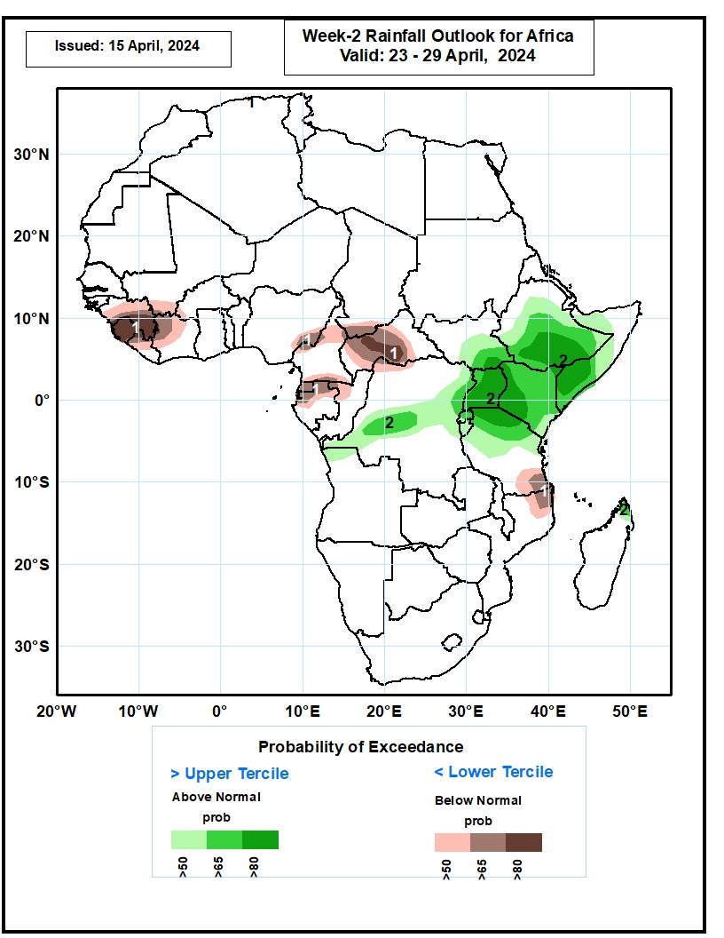
Week-2 Precipitation Outlooks
23 – 29 Apr 2024
1. The probabilistic forecasts call for above 50% chance for weekly rainfall to be below-normal (below the lower tercile) over Guinea, Sierra Leone, Cote d’Ivoire, eastern Nigeria, northern Cameroon, CAR, Equatorial Guinea, southeastern Tanzania, and northeastern Mozambique. There is above 80% chance for below-normal rainfall over Sierra Leone, Guinea, and central CAR.
2. The probabilistic forecasts call for above 50% chance for weekly total rainfall to be above-normal (above the upper tercile) over Ethiopia, Somalia, Kenya, southeastern South Sudan, Uganda, Rwanda, Burundi, northern Tanzania, central DRC, northern Angola and Madagascar. There is above 80% chance for above-normal rainfall over southern Ethiopia and Somalia, southeastern South Sudan, Uganda, western Kenya, and northern Tanzania.
Notes:
11

Slide 12
Summary
Over the past 30 days, in East Africa, rainfall was above-average in northern and parts of southwestern and central Ethiopia, southwestern and central Eritrea, Kenya, most of Tanzania, southeastern and northeastern South Sudan, Djibouti, southern Somalia, western Rwanda, and central and southern Burundi. Rainfall was below-average in parts of western and central South Sudan, central Somalia, northern, central, and southwestern Uganda, southwestern, parts of central, and southeastern Ethiopia, west-central Kenya, eastern Rwanda, and some regions in central Tanzania. In Central Africa, rainfall was above-average in some parts of west-central and eastern Gabon, central and southern Congo, parts of southeastern Cameroon, and some parts of northern and southeastern DRC. Rainfall was below-average in most of central and southern Cameroon, Equatorial Guinea, most of western and southern Gabon, northern Congo, most of western and central CAR, and most of western, northeastern, central, and parts of far southeastern DRC. In West Africa, rainfall was above-average in parts of northwestern and central Cote d’Ivoire, southeastern parts of Ghana, northern and southern Togo, northern Benin, central and eastern Guinea, southwestern Mali, western and southeastern Burkina Faso, and northwestern Nigeria. Rainfall was below-average in central Sierra Leone, southern and eastern Liberia, southern and eastern Cote d’Ivoire, west-central and southwestern Ghana, southern Benin, and southwestern and south-central portions of Nigeria. In southern Africa, rainfall was above-average in parts of west-central, northern, and east-central Angola, some parts of northeastern Zambia, northern parts of Malawi, central and southern Mozambique, Eswatini, Lesotho, southern, central, and parts of eastern South Africa, south-central and west-central Botswana, parts of central Namibia, parts of west-central Zimbabwe, and northern and eastern Madagascar. Rainfall was below-average in southern, central, and far northwestern Angola, northern and parts of central Namibia, eastern and northern Botswana, central and southern Zimbabwe, western and central Zambia, northern Mozambique, central and southern Malawi, parts of northwestern and northeastern South Africa, and western, southern, and central Madagascar.
During the past 7 days, in East Africa, rainfall was above-average in southwestern Ethiopia, parts of southeastern South Sudan, northwestern and southern Kenya, southeastern Somalia, southeastern Uganda, central and southern Burundi, and western, east-central, and northern Tanzania. Rainfall was below average in parts of western, south-central, and east-central Ethiopia, western, east-central, and south-central South Sudan, parts of central and northern Uganda, most of eastern and southern Tanzania, southern Djibouti, northwestern and southwestern Somalia, and west-central and northeastern Kenya. In central Africa, rainfall was above-average in parts of southeastern Democratic Republic of Congo (DRC), eastern and parts of central Gabon, parts of west-central Congo, and parts of central and southwestern Cameroon. Rainfall was below-average in Equatorial Guinea, far southwestern and east-central Cameroon, northern, eastern, and southwestern Congo, most of Central African Republic (CAR), western Gabon, and northern, central, and southwestern DRC. In West Africa, rainfall was above-average in north-central and west-central Cote d’Ivoire, eastern Ghana, southeastern Guinea, southwestern and southeastern Burkina Faso, Togo, northern and central Benin, and parts of western, southeastern, and central Nigeria. Rainfall was below-average in parts of eastern and southern Cote d’Ivoire, parts of southern and western Ghana, and southwestern Nigeria. In southern Africa, rainfall was above-average in central and southeastern Angola, northeastern Namibia, parts of northern and south-central Botswana, central Mozambique, northern and parts of southern Malawi, western Eswatini, Lesotho, southwestern, central, and parts of northeastern South Africa, Zambia, and western, southern, and northern Zimbabwe. Rainfall was below-average in western and northeastern Angola, far northeastern Malawi, most of northern Mozambique, southeastern Botswana, central and northwestern Namibia, and far northern, central, and southeastern Madagascar.
The Week-1 outlook calls for above-average rainfall in much of eastern Africa (northern and central Uganda, central, southern, and eastern Ethiopia, western and southern Kenya, Somalia, eastern Tanzania), as well as northern Mozambique, northeastern Madagascar, northeastern DRC, eastern Liberia, and southern Cote d’Ivoire. Anomalies greater than 50mm could be observed in southwestern Kenya and eastern Tanzania. In contrast, there is an increased chance for below-average rainfall in eastern Sierra Leone, western Liberia, northern Cote d’Ivoire, northern Ghana, Togo, southern Benin, southern Nigeria, southeastern Cameroon, southern and eastern CAR, northern and southern Congo, central and southern Angola, western Zambia, northwestern, central, and southern Namibia, Zimbabwe, western, southern, and eastern South Africa, western Ethiopia, and the Lake Victoria region. The Week-2 outlook calls for above-normal rainfall in much of eastern Africa, eastern Liberia, southern and eastern Cote d’Ivoire, and central and southern Ghana. Anomalies greater than 50mm could be observed in southwestern Kenya and northeastern Tanzania. In contrast, there is an increased chance for below-average rainfall in western Ethiopia, South Africa, Lesotho, southern Botswana, central Mozambique, northern and central Angola, northern DRC, CAR, western South Sudan, Equatorial Guinea, central and southern Cameroon, northwestern Cote d’Ivoire, western Liberia, Sierra Leone, and southeastern Guinea.

