Slide 1
The African Monsoon Recent Evolution and Current Status Include Week-1 and Week-2 Outlooks
Update prepared by
11 April 2022
For more information, visit:
http://www.cpc.ncep.noaa.gov/products/Global_Monsoons/African_Monsoons/precip_monitoring.shtml

Slide 2
Outline
Highlights
Recent Evolution and Current Conditions
NCEP GEFS Forecasts
Summary

Slide 3
Highlights: Last 7 Days
During the past 7 days, in East Africa, rainfall was above-average over pockets of South Sudan and western Ethiopia. Below-average rainfall was observed over southern, central and eastern Ethiopia, and much of Uganda, Kenya and Tanzania. In central Africa, rainfall was above-average over many parts of DRC, Gabon, parts of Cameroon, and central and eastern CAR. Below-average rainfall was observed over western CAR, northern Congo, and parts of DRC. In Southern Africa, rainfall was above-average over many parts of Angola, much of Zambia, Malawi, northern Mozambique, northern Zimbabwe, southern Botswana, and eastern South Africa. Rainfall was below-average over pockets of western Angola, parts of Namibia, and much of Madagascar. In West Africa, above-average rainfall was observed over parts of Cote d’Ivoire and Nigeria.
Week-1 and Week-2 outlooks call for an increased chance for above average rainfall along the Gulf of Guinea coast, and the western portion of Central Africa. In contrast, there is an increased chance for below-average rainfall across much of equatorial East Africa, including southern and eastern Ethiopia.

Slide 4
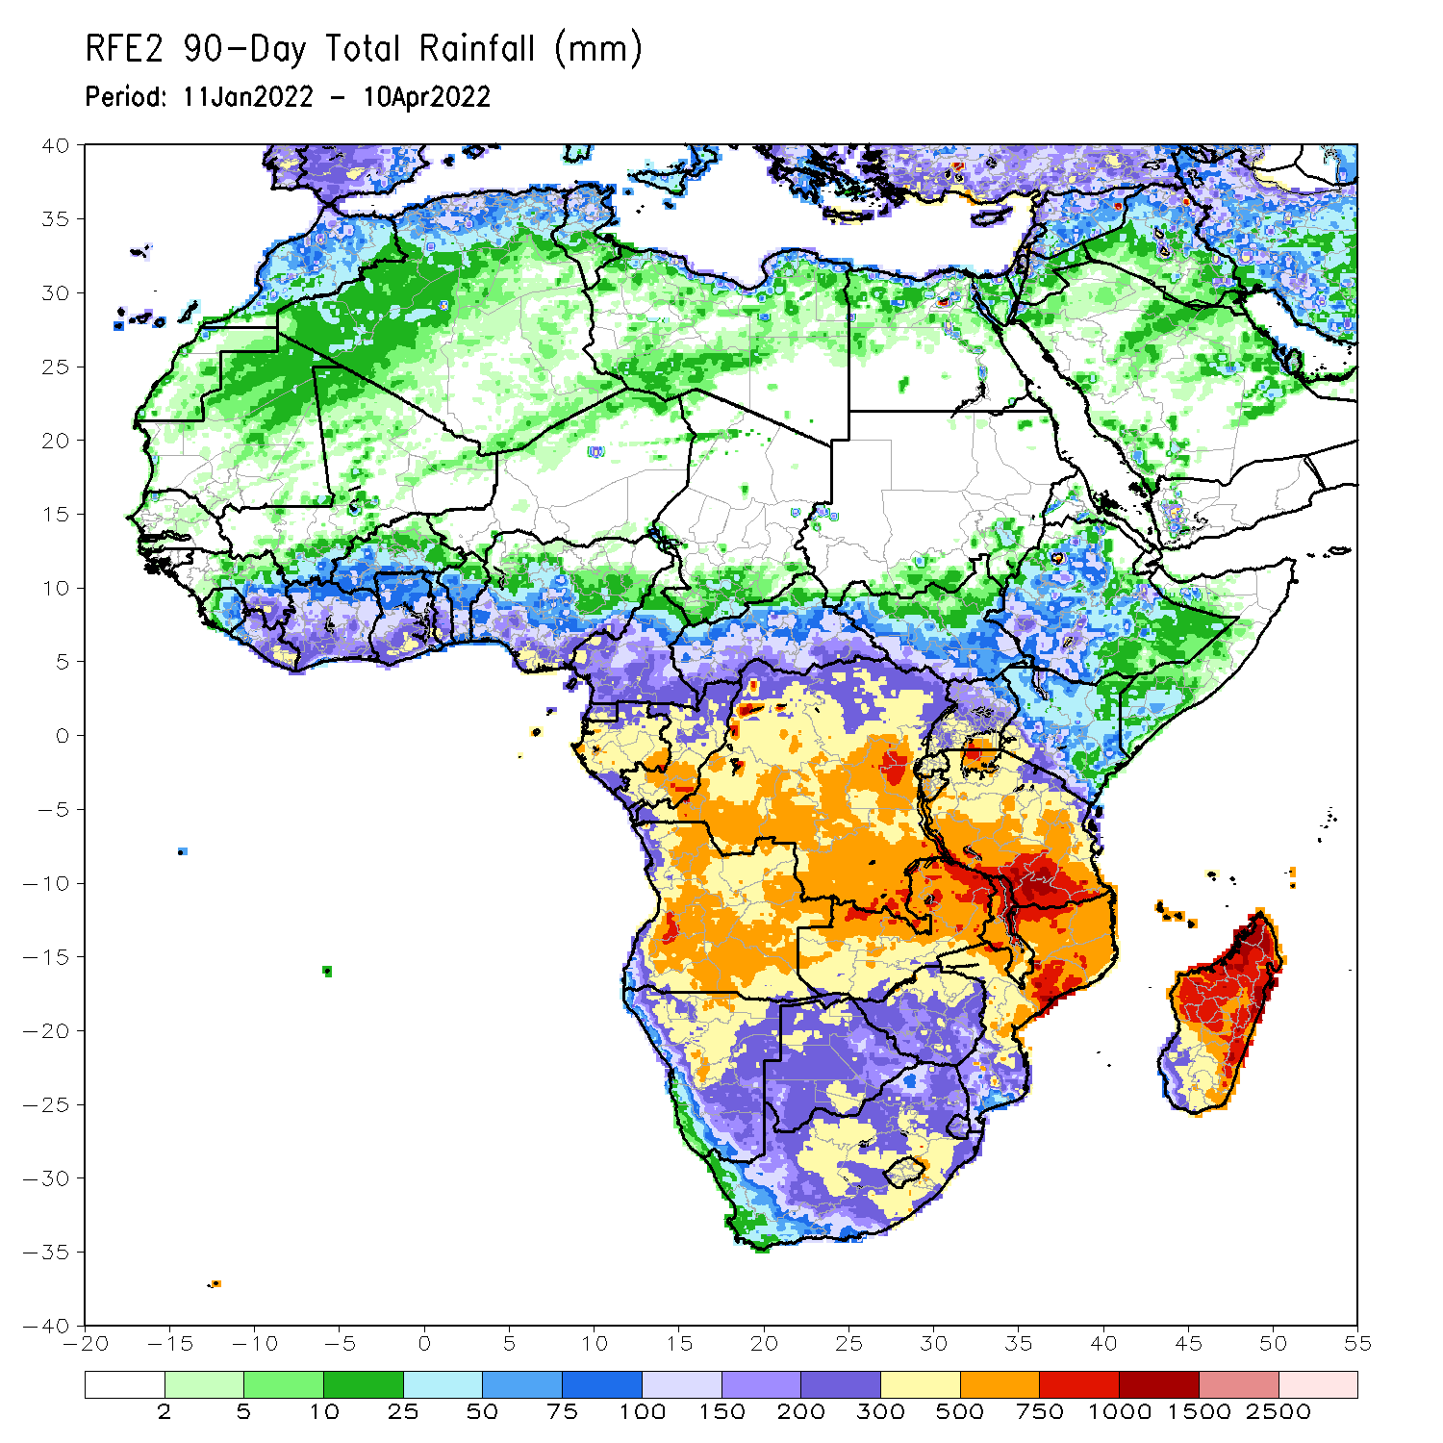
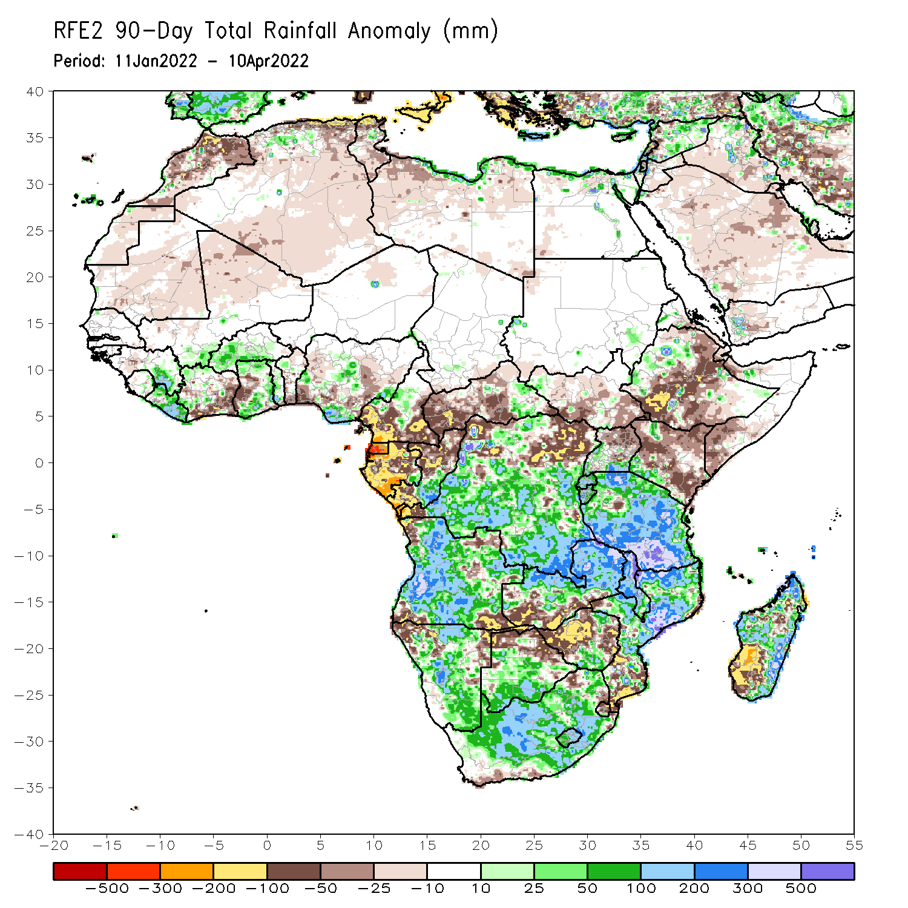
Rainfall Patterns: Last 90 Days
Over the past 90 days, in East Africa, above-average rainfall was observed over pockets of northwestern Ethiopia, Rwanda, Burundi, pockets of southern Uganda, pockets of Kenya, and much of Tanzania. Rainfall was below-average over central, southwestern and eastern Ethiopia, much of Kenya, southwestern Somalia, and northern Uganda. In southern Africa, above-average rainfall was observed over much of Angola, central and southern Botswana, much of Namibia, portions of Zimbabwe, much of Zambia, Malawi, central and northern Mozambique, northern and eastern Madagascar, and much of South Africa. Below-average rainfall was observed over pockets of northeastern and southwestern Angola, northwestern and eastern Namibia, southwestern Zambia, northern Botswana, western and the far eastern Zimbabwe, southern Mozambique and southwestern Madagascar. In Central Africa, rainfall was above-average over many parts of DRC and southern Congo. Rainfall was below-average over southern Cameroon, parts of northern DRC, Equatorial Guinea, much of Gabon, CAR, and northern Congo. In West Africa, rainfall was below-average over portions of Cote d’Ivoire, western Ghana and pockets of Nigeria, while above-average rainfall was observed over eastern Guinea, much of Liberia, western Burkina Faso, parts of Ghana and pockets of Nigeria.
Notes:
4

Slide 5
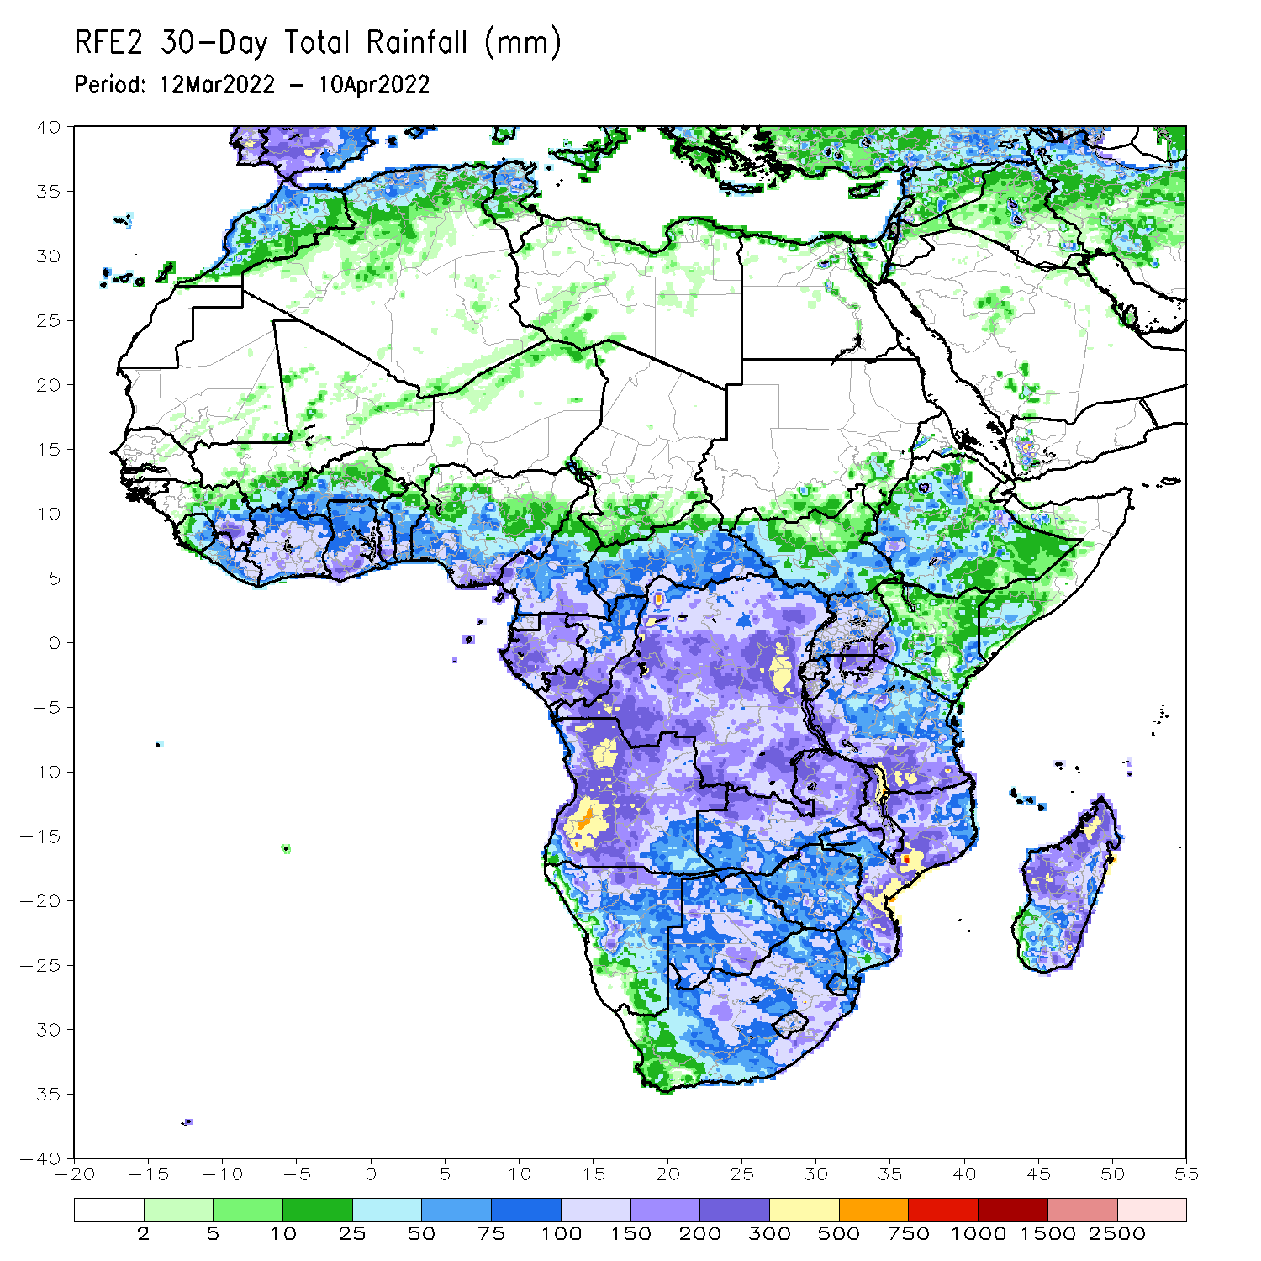
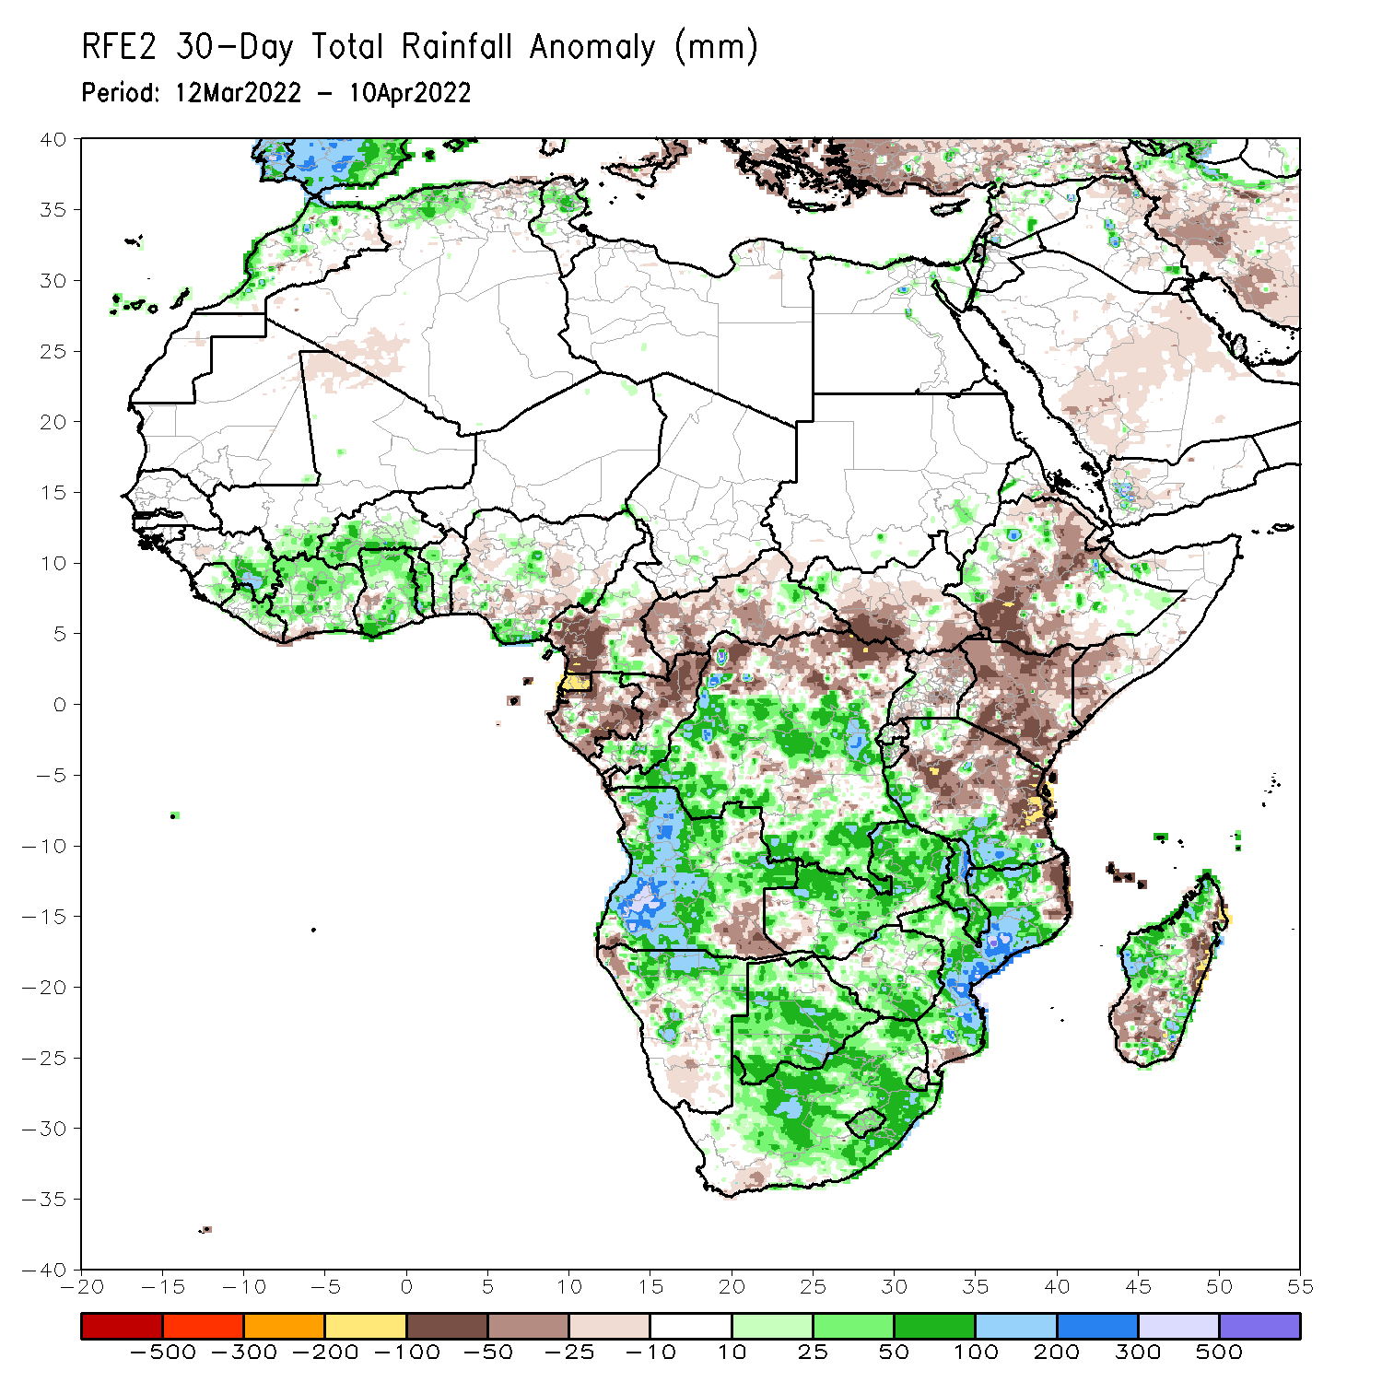
Rainfall Patterns: Last 30 Days
During the past 30 days, in East Africa, above-average rainfall was observed over pockets of northern and western Ethiopia, and western and southern Tanzania. Rainfall was below-average over southwestern, central and eastern Ethiopia, southern South Sudan, much of Kenya, northern and eastern Tanzania, and much of Uganda. In Central Africa, rainfall was below-average over Equatorial Guinea, Gabon, western and central CAR and northern DRC. Rainfall was above-average over southern Cameroon, southern Congo, and much of DRC. In Southern Africa, above-average rainfall was observed over much of Angola, Namibia, much of Zambia, northern Malawi, much of Mozambique, portions of Madagascar, and much of Botswana and South Africa. Below-average rainfall was observed over pockets of southwestern and southeastern Angola, southwestern Zambia, and southern and the far eastern Madagascar. In West Africa, rainfall was above-average over parts of the Gulf of Guinea region.
Notes:
5

Slide 6
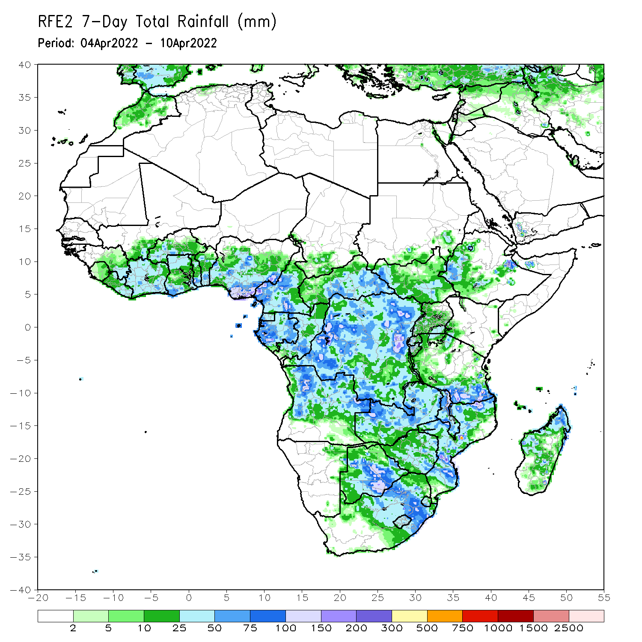
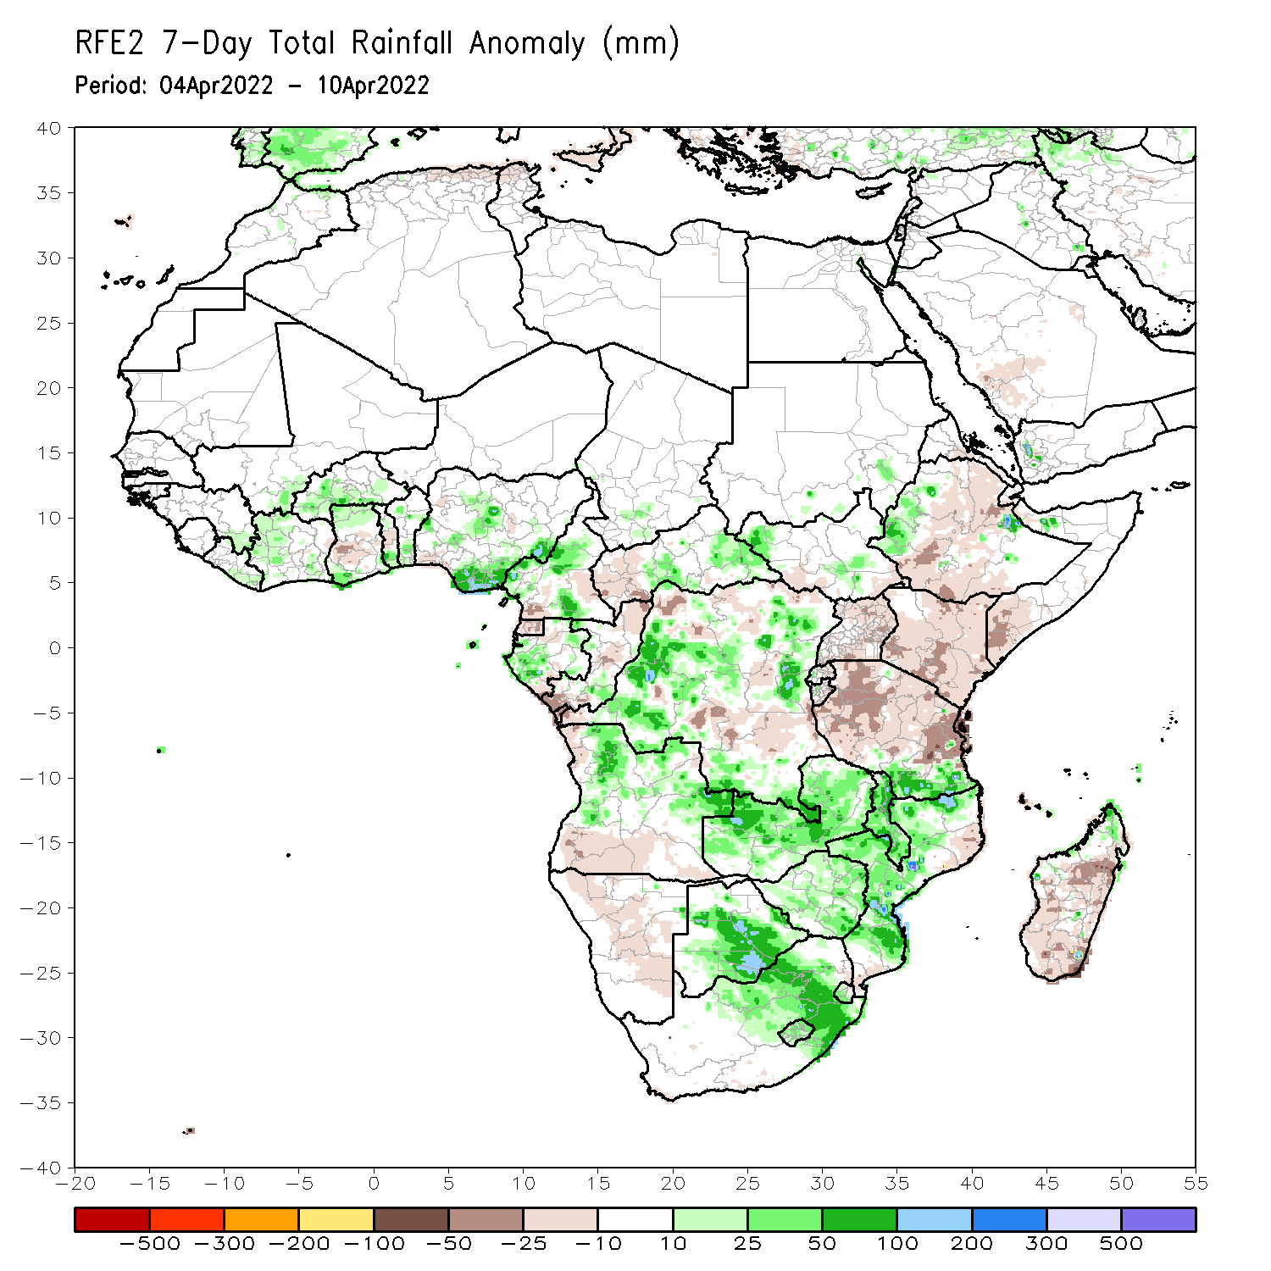
Rainfall Patterns: Last 7 Days
During the past 7 days, in East Africa, rainfall was above-average over pockets of South Sudan and western Ethiopia. Below-average rainfall was observed over southern, central and eastern Ethiopia, and much of Uganda, Kenya and Tanzania. In central Africa, rainfall was above-average over many parts of DRC, Gabon, parts of Cameroon, and central and eastern CAR. Below-average rainfall was observed over western CAR, northern Congo, and parts of DRC. In Southern Africa, rainfall was above-average over many parts of Angola, much of Zambia, Malawi, northern Mozambique, northern Zimbabwe, southern Botswana, and eastern South Africa. Rainfall was below-average over pockets of western Angola, parts of Namibia, and much of Madagascar. In West Africa, above-average rainfall was observed over parts of Cote d’Ivoire and Nigeria.

Slide 7
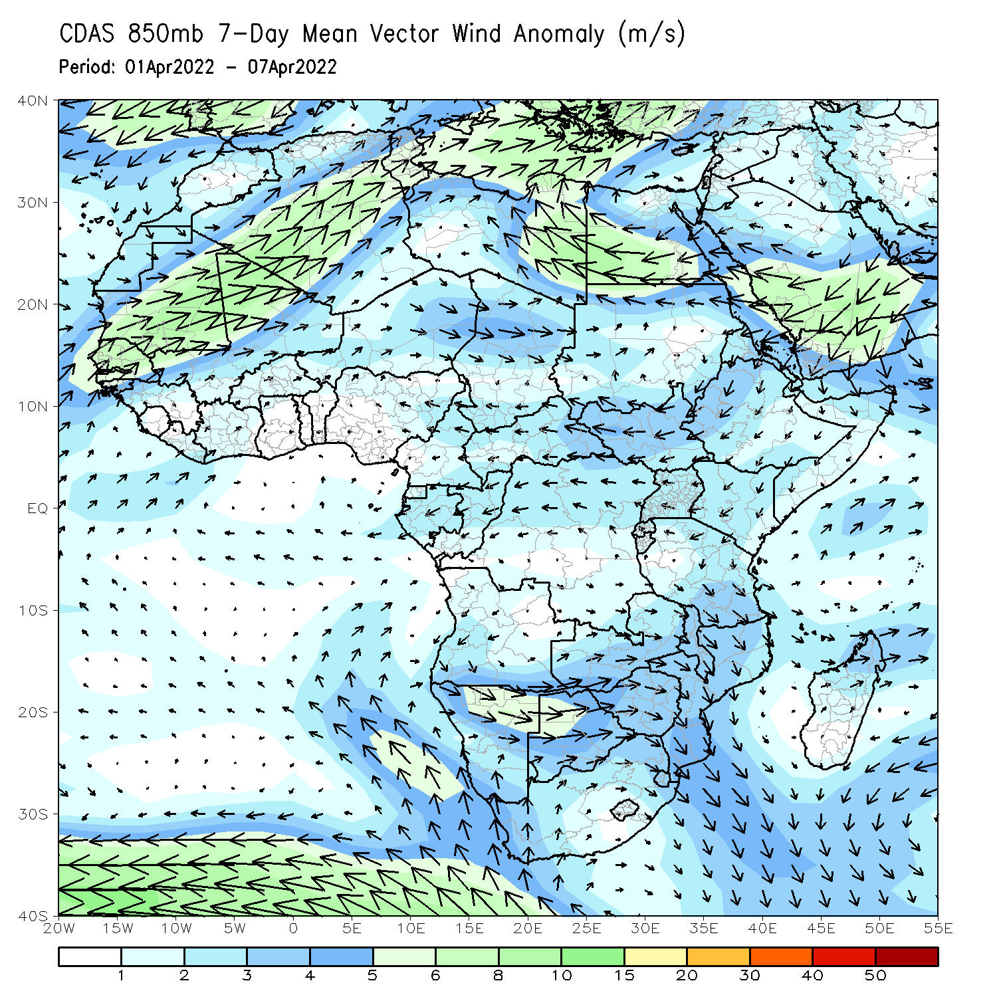
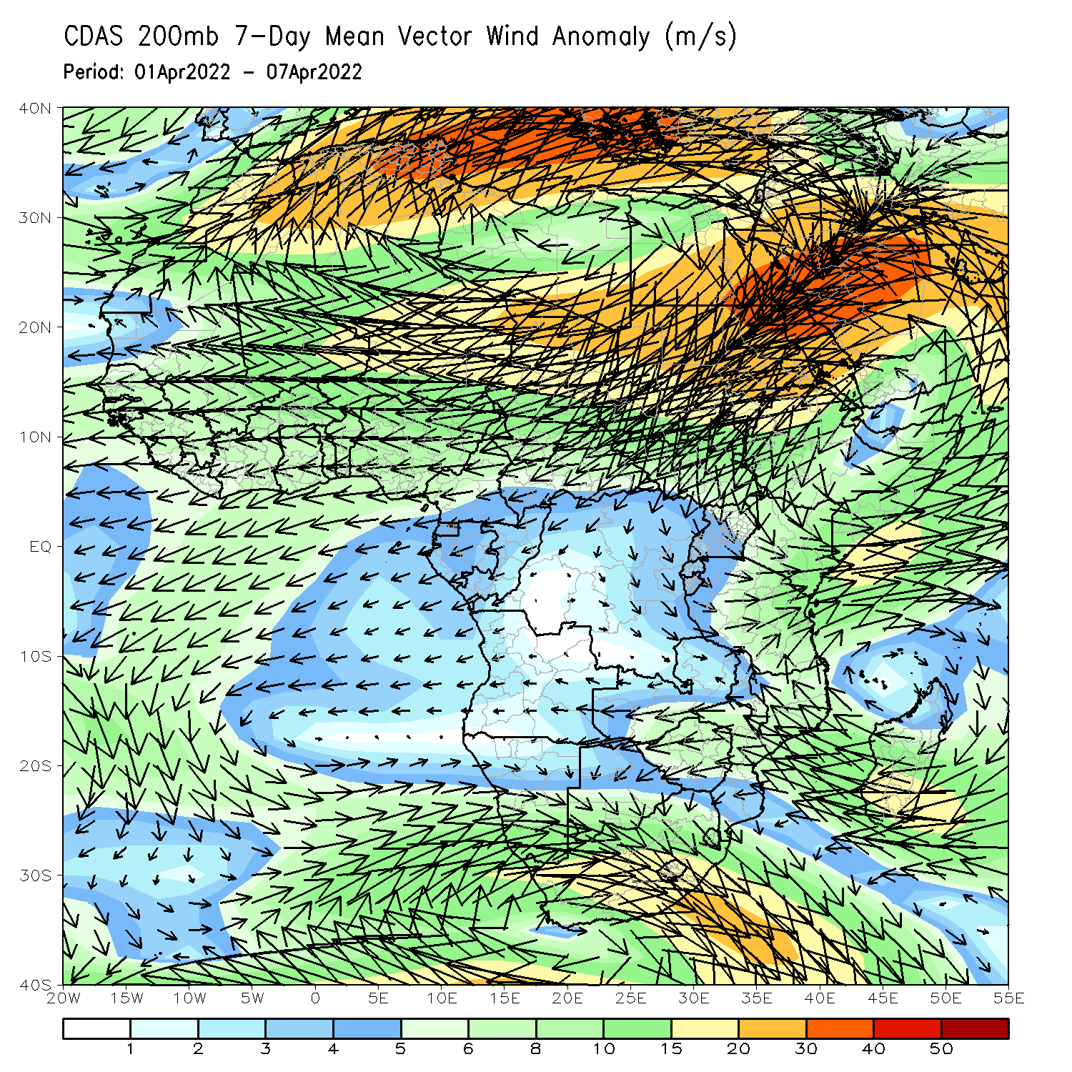
Atmospheric Circulation: Last 7 Days
At 850-hPa level (left panel), anomalous northerly flow and its associated lower-level divergence may have contributed to the observed below-average rainfall across East Africa.

Slide 8
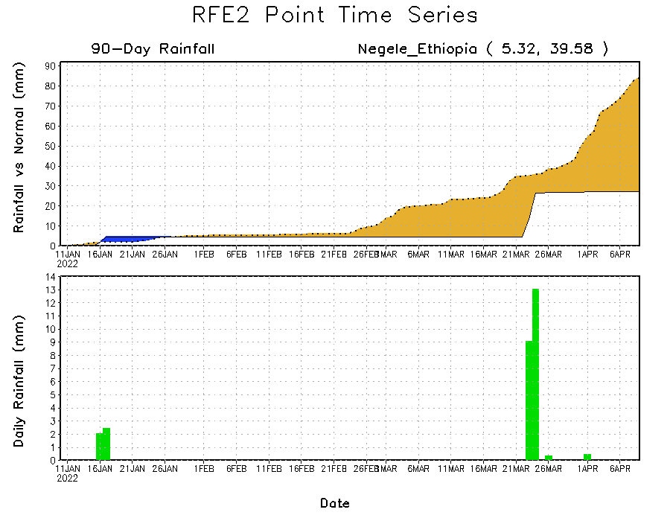
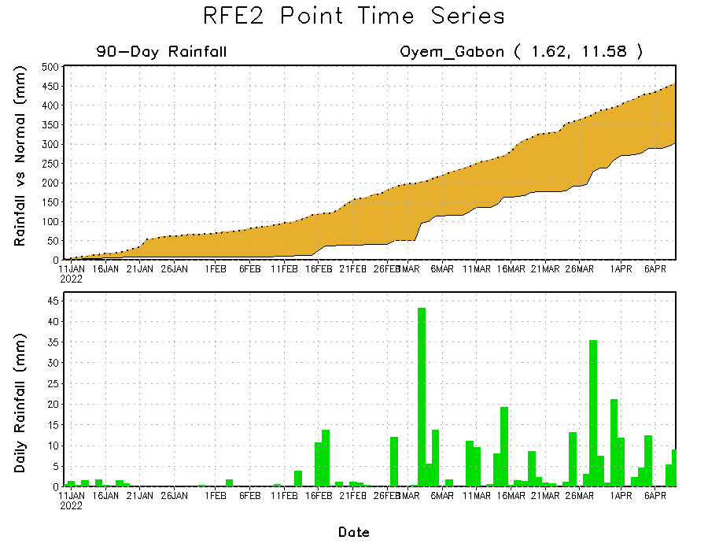
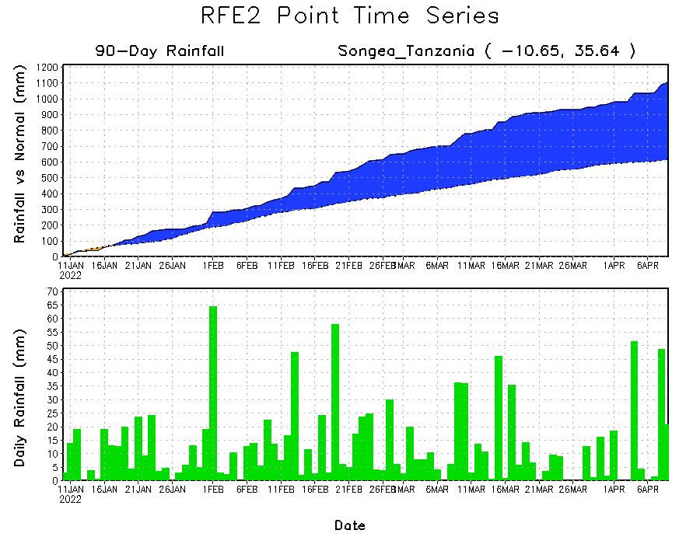
Rainfall Evolution
Daily evolution of rainfall over the last 90 days at selected locations shows moderate to heavy rainfall sustained moisture surpluses over parts of Tanzania (bottom right). Seasonal total rainfall remained below-average over parts of Ethiopia (top right) and Gabon (bottom left).

Slide 9
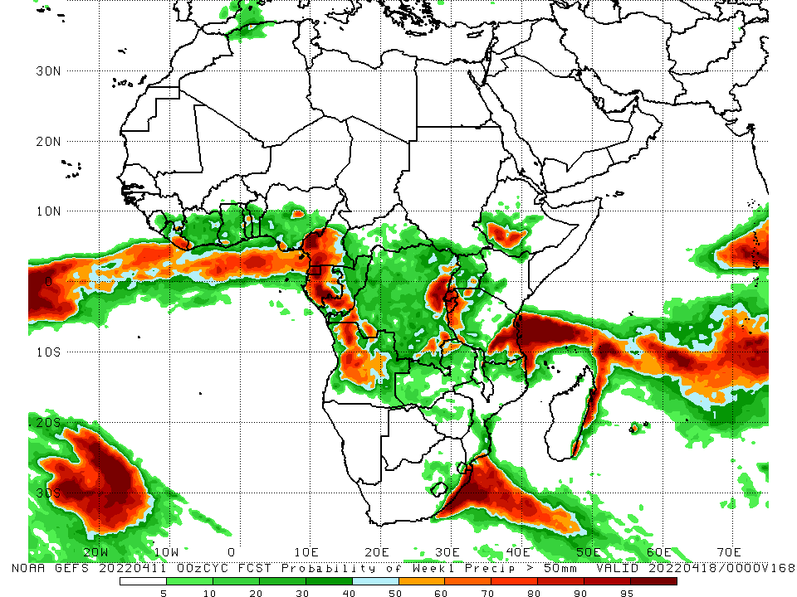
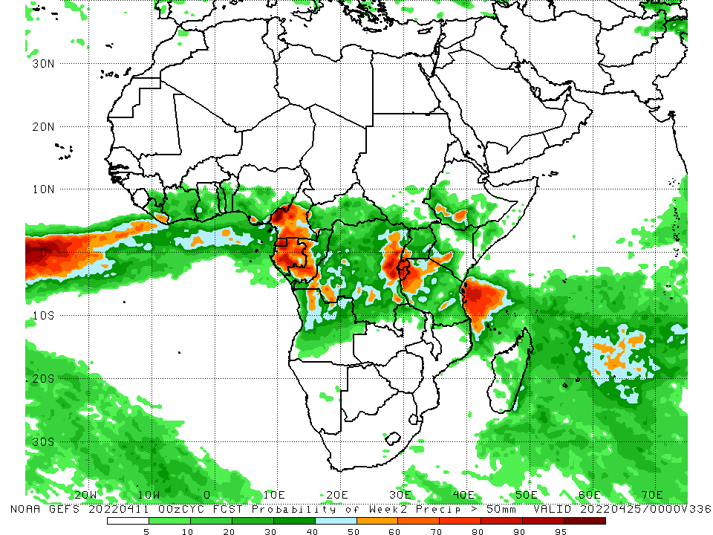
NCEP GEFS Model Forecasts Non-Bias Corrected Probability of precipitation exceedance
Week-1, Valid: 12 – 18 Apr, 2022
Week-2, Valid: 19 – 25 Apr, 2022
For week-1 (left panel) and week-2 (right panel), the NCEP GEFS indicates a moderate to high chance (over 70%) for rainfall to exceed 50 mm over the western portion of Central Africa, eastern DRC, Rwanda, Burundi, western Tanzania, and the far southern Ethiopia.
Notes:
9

Slide 10
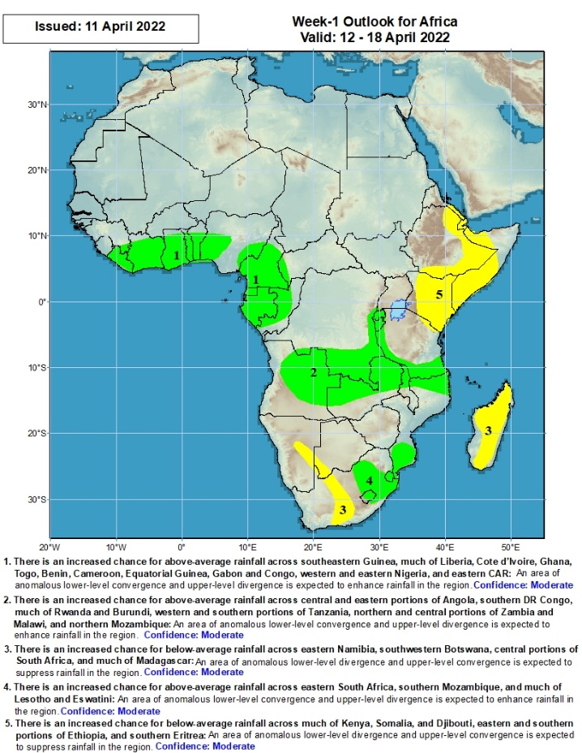
Week-1 Precipitation Outlooks
There is an increased chance for above-average rainfall across southeastern Guinea, much of Liberia, Cote d’Ivoire, Ghana, Togo, Benin, Cameroon, Equatorial Guinea, Gabon and Congo, western and eastern Nigeria, and eastern CAR: An area of anomalous lower-level convergence and upper-level divergence is expected to enhance rainfall in the region. Confidence: Moderate
There is an increased chance for above-average rainfall across central and eastern portions of Angola, southern DR Congo, much of Rwanda and Burundi, western and southern portions of Tanzania, northern and central portions of Zambia and Malawi, and northern Mozambique: An area of anomalous lower-level convergence and upper-level divergence is expected to enhance rainfall in the region. Confidence: Moderate
There is an increased chance for below-average rainfall across eastern Namibia, southwestern Botswana, central portions of South Africa, and much of Madagascar: An area of anomalous lower-level divergence and upper-level convergence is expected to suppress rainfall in the region. Confidence: Moderate
There is an increased chance for above-average rainfall across eastern South Africa, southern Mozambique, and much of Lesotho and Eswatini: An area of anomalous lower-level convergence and upper-level divergence is expected to enhance rainfall in the region. Confidence: Moderate
There is an increased chance for below-average rainfall across much of Kenya, Somalia, and Djibouti, eastern and southern portions of Ethiopia, and southern Eritrea: An area of anomalous lower-level divergence and upper-level convergence is expected to suppress rainfall in the region. Confidence: Moderate
12 – 18 Apr, 2022
Notes:
10

Slide 11
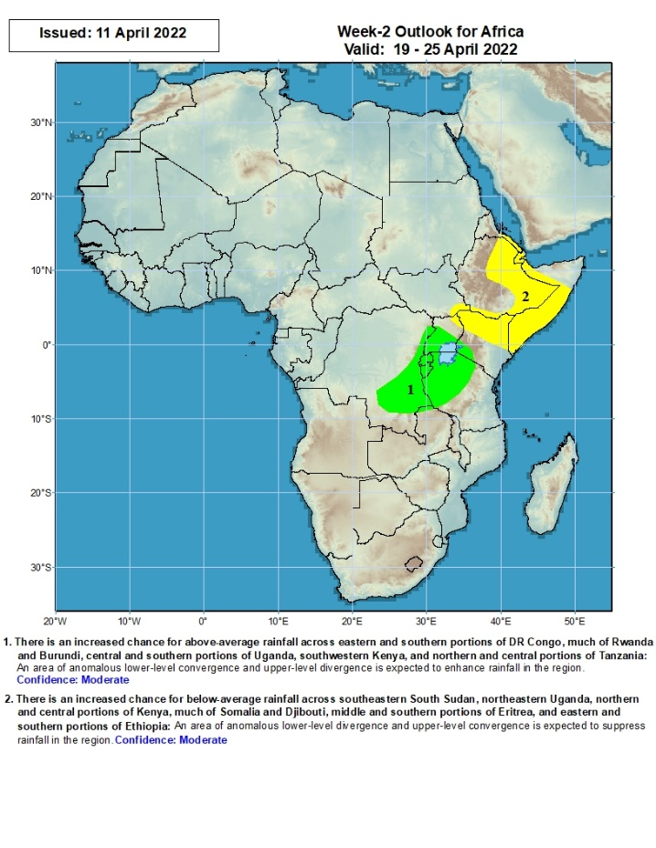
Week-2 Precipitation Outlooks
19 – 25 Apr, 2022
There is an increased chance for above-average rainfall across eastern and southern portions of DR Congo, much of Rwanda and Burundi, central and southern portions of Uganda, southwestern Kenya, and northern and central portions of Tanzania: An area of anomalous lower-level convergence and upper-level divergence is expected to enhance rainfall in the region. Confidence: Moderate
There is an increased chance for below-average rainfall across southeastern South Sudan, northeastern Uganda, northern and central portions of Kenya, much of Somalia and Djibouti, middle and southern portions of Eritrea, and eastern and southern portions of Ethiopia: An area of anomalous lower-level divergence and upper-level convergence is expected to suppress rainfall in the region. Confidence: Moderate
Notes:
11

Slide 12
Summary
During the past 30 days, in East Africa, above-average rainfall was observed over pockets of northern and western Ethiopia, and western and southern Tanzania. Rainfall was below-average over southwestern, central and eastern Ethiopia, southern South Sudan, much of Kenya, northern and eastern Tanzania, and much of Uganda. In Central Africa, rainfall was below-average over Equatorial Guinea, Gabon, western and central CAR and northern DRC. Rainfall was above-average over southern Cameroon, southern Congo, and much of DRC. In Southern Africa, above-average rainfall was observed over much of Angola, Namibia, much of Zambia, northern Malawi, much of Mozambique, portions of Madagascar, and much of Botswana and South Africa. Below-average rainfall was observed over pockets of southwestern and southeastern Angola, southwestern Zambia, and southern and the far eastern Madagascar. In West Africa, rainfall was above-average over parts of the Gulf of Guinea region.
During the past 7 days, in East Africa, rainfall was above-average over pockets of South Sudan and western Ethiopia. Below-average rainfall was observed over southern, central and eastern Ethiopia, and much of Uganda, Kenya and Tanzania. In central Africa, rainfall was above-average over many parts of DRC, Gabon, parts of Cameroon, and central and eastern CAR. Below-average rainfall was observed over western CAR, northern Congo, and parts of DRC. In Southern Africa, rainfall was above-average over many parts of Angola, much of Zambia, Malawi, northern Mozambique, northern Zimbabwe, southern Botswana, and eastern South Africa. Rainfall was below-average over pockets of western Angola, parts of Namibia, and much of Madagascar. In West Africa, above-average rainfall was observed over parts of Cote d’Ivoire and Nigeria.
Week-1 and Week-2 outlooks call for an increased chance for above average rainfall along the Gulf of Guinea coast, and the western portion of Central Africa. In contrast, there is an increased chance for below-average rainfall across much of equatorial East Africa, including southern and eastern Ethiopia.

