Slide 1
The African Monsoon Recent Evolution and Current Status Include Week-1 and Week-2 Outlooks
Update prepared
22 April 2024
For more information, visit:
http://www.cpc.ncep.noaa.gov/products/Global_Monsoons/African_Monsoons/precip_monitoring.shtml

Slide 2
Outline
Highlights
Recent Evolution and Current Conditions
NCEP GEFS Forecasts
Summary

Slide 3
Highlights: Last 7 Days
During the past 7 days, in East Africa, rainfall was above-average in some region in central and eastern Ethiopia. Rainfall was below average in parts of western Ethiopia, southwestern and northeastern South Sudan, southwestern Uganda, Rwanda, and western and northern Burundi. In central Africa, rainfall was below-average in eastern Central African Republic (CAR), and parts of northern, western and eastern Democratic Republic of the Congo (DRC). In West Africa, rainfall was below-average in Sierra Leone, eastern Guinea, western Cote d’Ivoire, southern parts of Ghana, Togo and Benin, and southwestern Nigeria. In southern Africa, rainfall was above-average in central and eastern Angola, central-eastern Madagascar, and some eastern region of South Africa and Mozambique. Rainfall was below-average in southeastern Madagascar.
The Week-1 outlook calls for above-average rainfall in many parts of eastern Africa, central South Africa, Lesotho, and central parts of Nigeria and Cote d’Ivoire. In contrast, there is an increased chance for below-average in many parts of Central African Republic (CAR) and South Sudan, western Ethiopia, northern and southern Cameroon, Equatorial Guinea, Gabon. Congo, northern, northwestern and southern DRC, northern, central and eastern Angola, northern Zambia, central and southern Botswana, southern South Africa, Malawi, Mozambique, central and southern Madagascar, eastern Guinea, Sierra Leone, northern Ghana, Togo, central and southern Benin, and southern Nigeria. The Week-2 outlook calls for above-average rainfall in many parts of Somalia, Kenya and Burkina Faso, and along the Gulf Guinea coast countries. In contrast, there is an increased chance for below-average in many parts of the Central African Republic (CAR), South Sudan, western Ethiopia, Gabon, Congo, northwestern, western, central, southern and southeastern Democratic Republic of the CONGO (DRC), Rwanda, Burundi, northern and central Angola, northern Zambia, western, central and eastern South Africa, Eswatini and Lesotho.

Slide 4
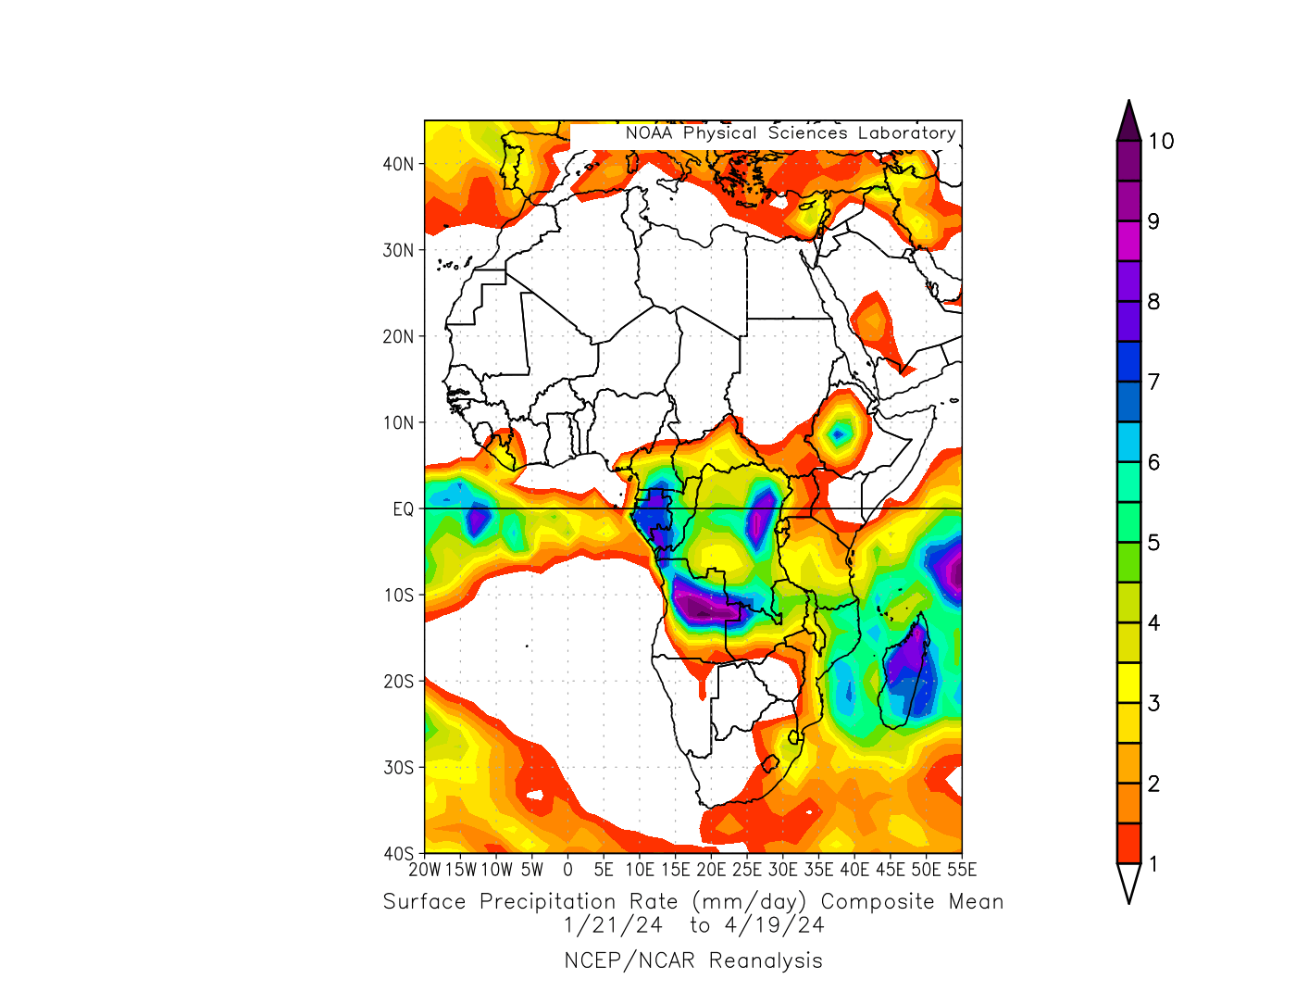
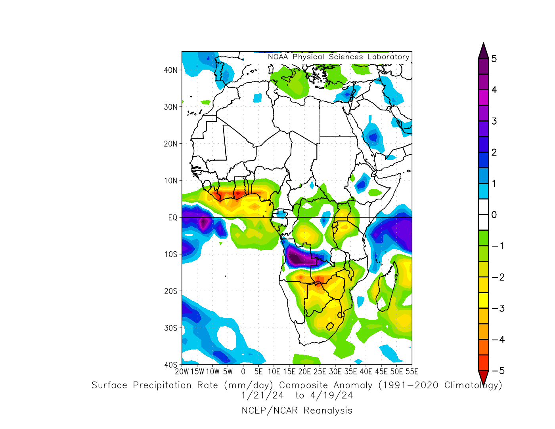
Rainfall Patterns: Last 90 Days
Over the past 90 days, in East Africa, rainfall was above-average in central Ethiopia. Rainfall was below-average in some parts of western and southeastern South Sudan, Uganda, western Kenya, Rwanda, Burundi, western and northern-central Tanzania, and pockets of region in southeastern Ethiopia. In Central Africa, rainfall was above-average in northern Gabon and central and southern Democratic Republic of the CONGO (DRC), and pocket of region in northern Central African Republic (CAR). Rainfall was below-average in southern Gabon, northern and southwestern Congo, southwestern Cameroon, southern and eastern CAR, and some parts of northern, western, southwestern and eastern DRC. Rainfall was below-average in eastern parts of Guinea and Sierra Leone, Liberia, many parts of Cote d’Ivoire, Ghana and Togo, central and southern Benin, southwestern, southern and central Nigeria. In southern Africa, rainfall was above-average over northern and central-eastern Angola and northwestern Zambia. Rainfall was below-average across southeastern Angola, northeastern and eastern Namibia, southwestern, southern and central Zambia, central and southern Malawi, western, central and southern Mozambique, Botswana, Zimbabwe, northern, western, central and eastern South Africa, Lesotho, Eswatini, and western, central and southeastern Madagascar.
Notes:
4

Slide 5
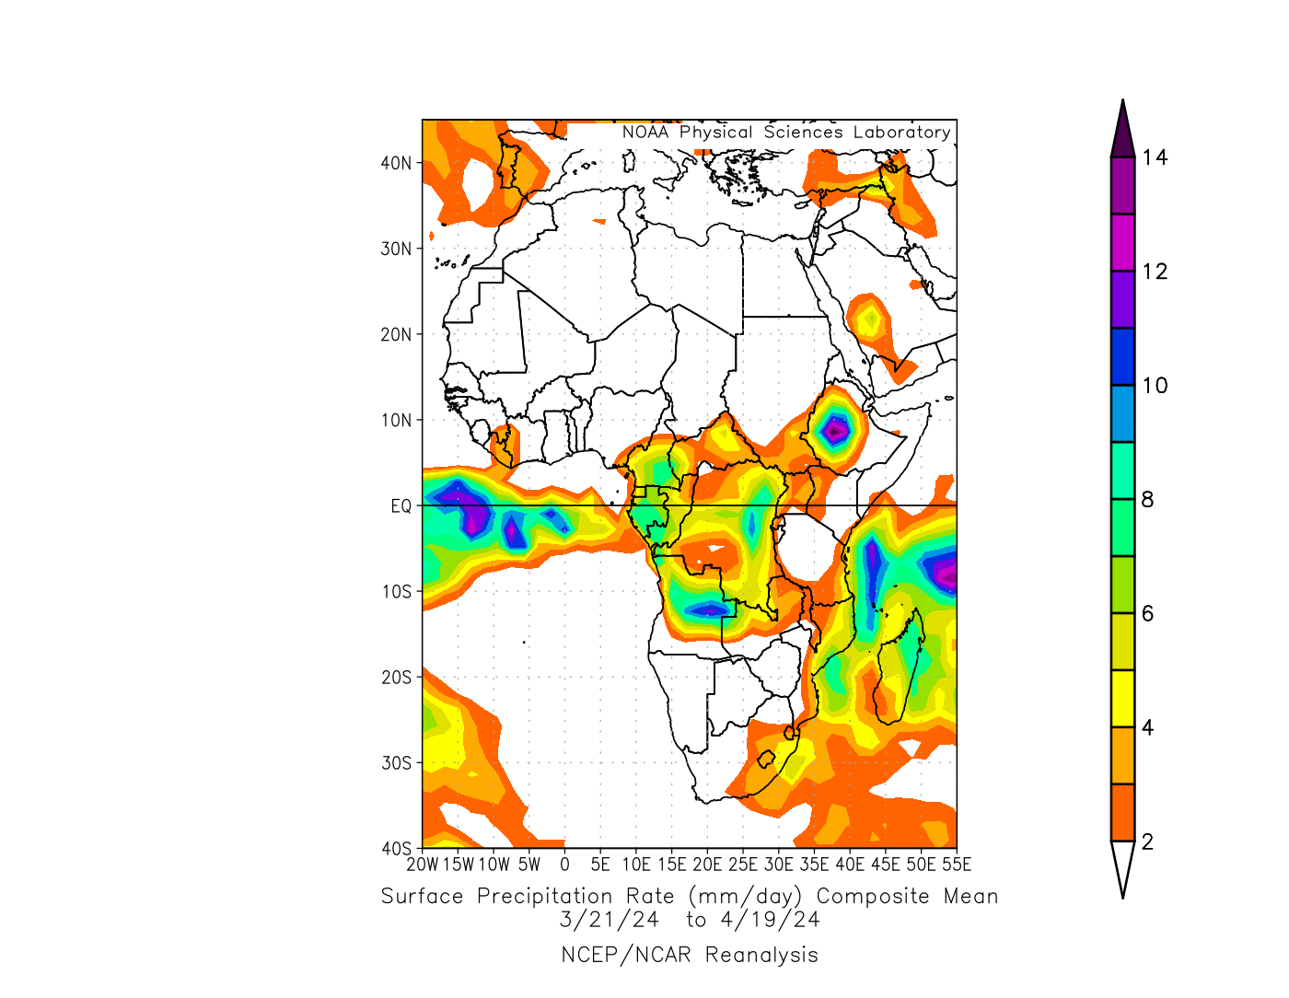
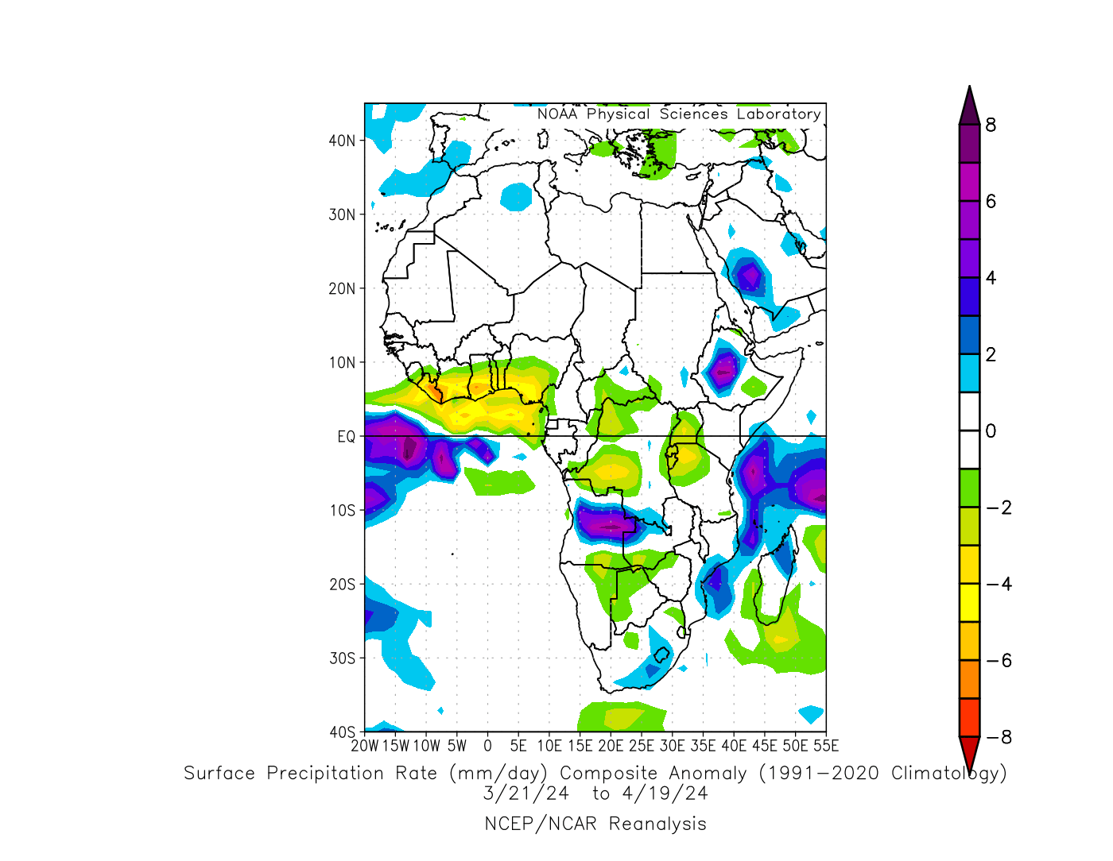
Rainfall Patterns: Last 30 Days
Over the past 30 days, in East Africa, rainfall was above-average in many parts of central Ethiopia, pocket of region in southeastern Somalia, and eastern South Sudan. Rainfall was below-average in southeastern Ethiopia, many parts of Uganda, Rwanda, Burundi, and northern and western-central Tanzania. In Central Africa, rainfall was above-average in some parts of southern DRC. Rainfall was below-average in southwestern Cameroon, northern and southwestern Congo, central, southern and southeastern CAR, and some parts northern, western, southwestern and eastern DRC, In West Africa, Rainfall was below-average in eastern parts of Guinea and Sierra Leone, Liberia, many parts of Cote d’Ivoire, Ghana and Togo, central and southern Benin, southwestern, southern and central Nigeria. In southern Africa, rainfall was above-average over western and central-eastern Angola, northwestern Zambia, eastern Mozambique, central and southeastern South Africa, Lesotho, and northern and northeastern Madagascar. Rainfall was below-average across southeastern Angola, northeastern and eastern Namibia, southwestern Zambia, northern and western Botswana, western and northwestern Zimbabwe, some parts of southern Madagascar, and pockets of regions in western and northern South Africa.
Notes:
5

Slide 6
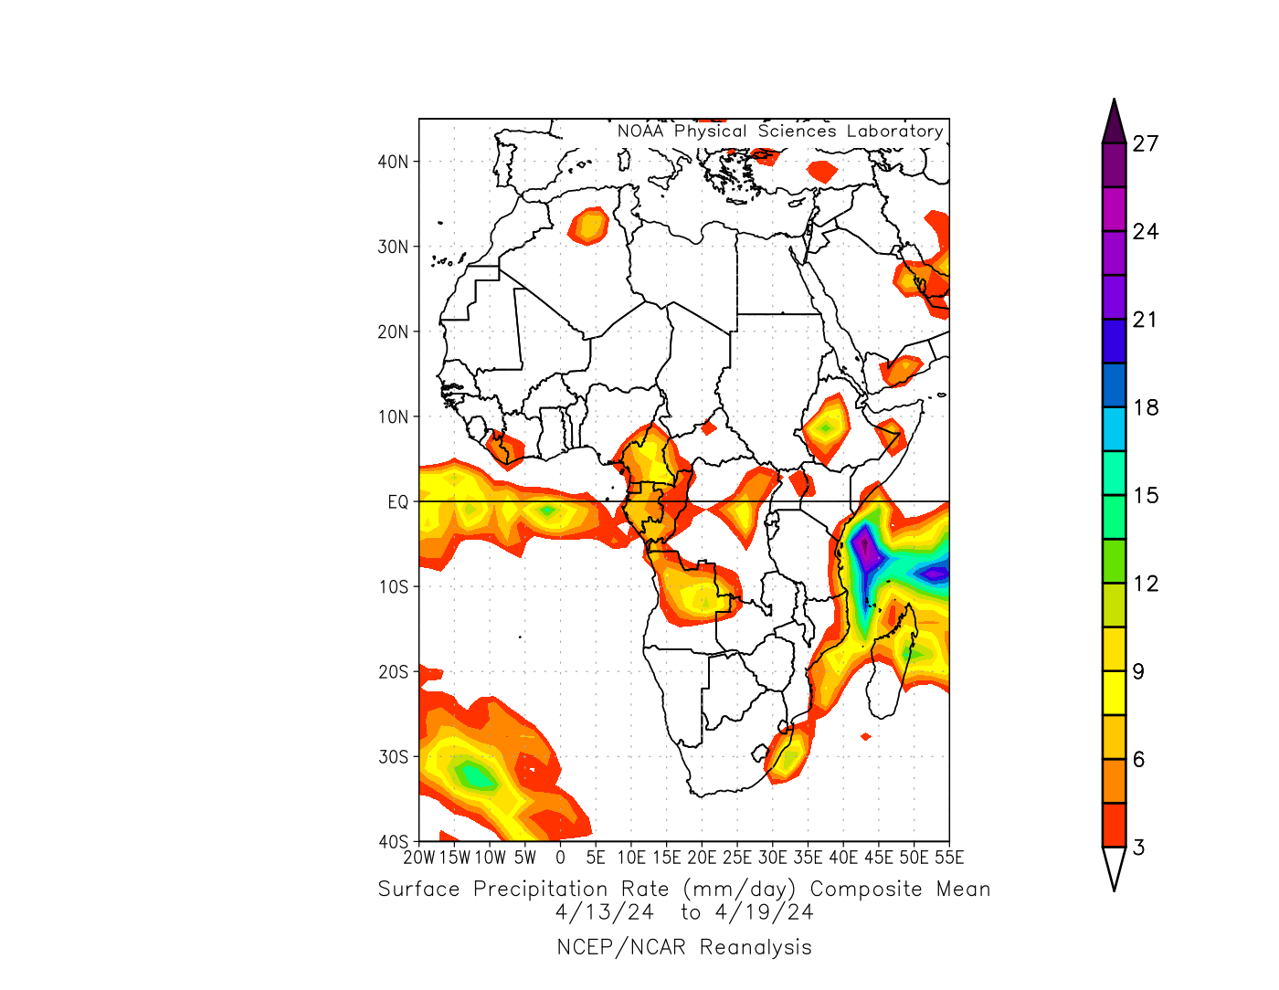
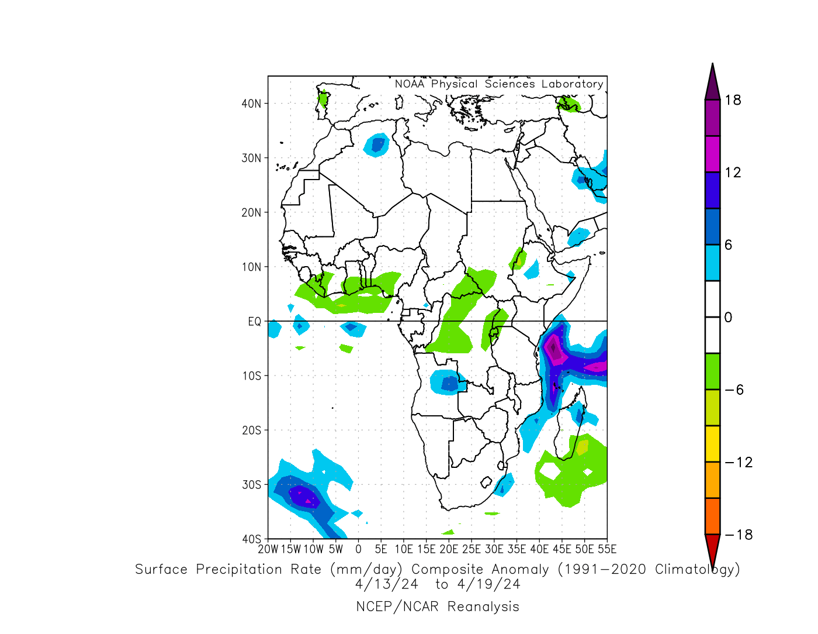
Rainfall Patterns: Last 7 Days
During the past 7 days, in East Africa, rainfall was above-average in some region in central and eastern Ethiopia. Rainfall was below average in parts of western Ethiopia, southwestern and northeastern South Sudan, southwestern Uganda, Rwanda, and western and northern Burundi. In central Africa, rainfall was below-average in eastern Central African Republic (CAR), and parts of northern, western and eastern Democratic Republic of the Congo (DRC). In West Africa, rainfall was below-average in Sierra Leone, eastern Guinea, western Cote d’Ivoire, southern parts of Ghana, Togo and Benin, and southwestern Nigeria. In southern Africa, rainfall was above-average in central and eastern Angola, central-eastern Madagascar, and some eastern region of South Africa and Mozambique. Rainfall was below-average in southeastern Madagascar.

Slide 7
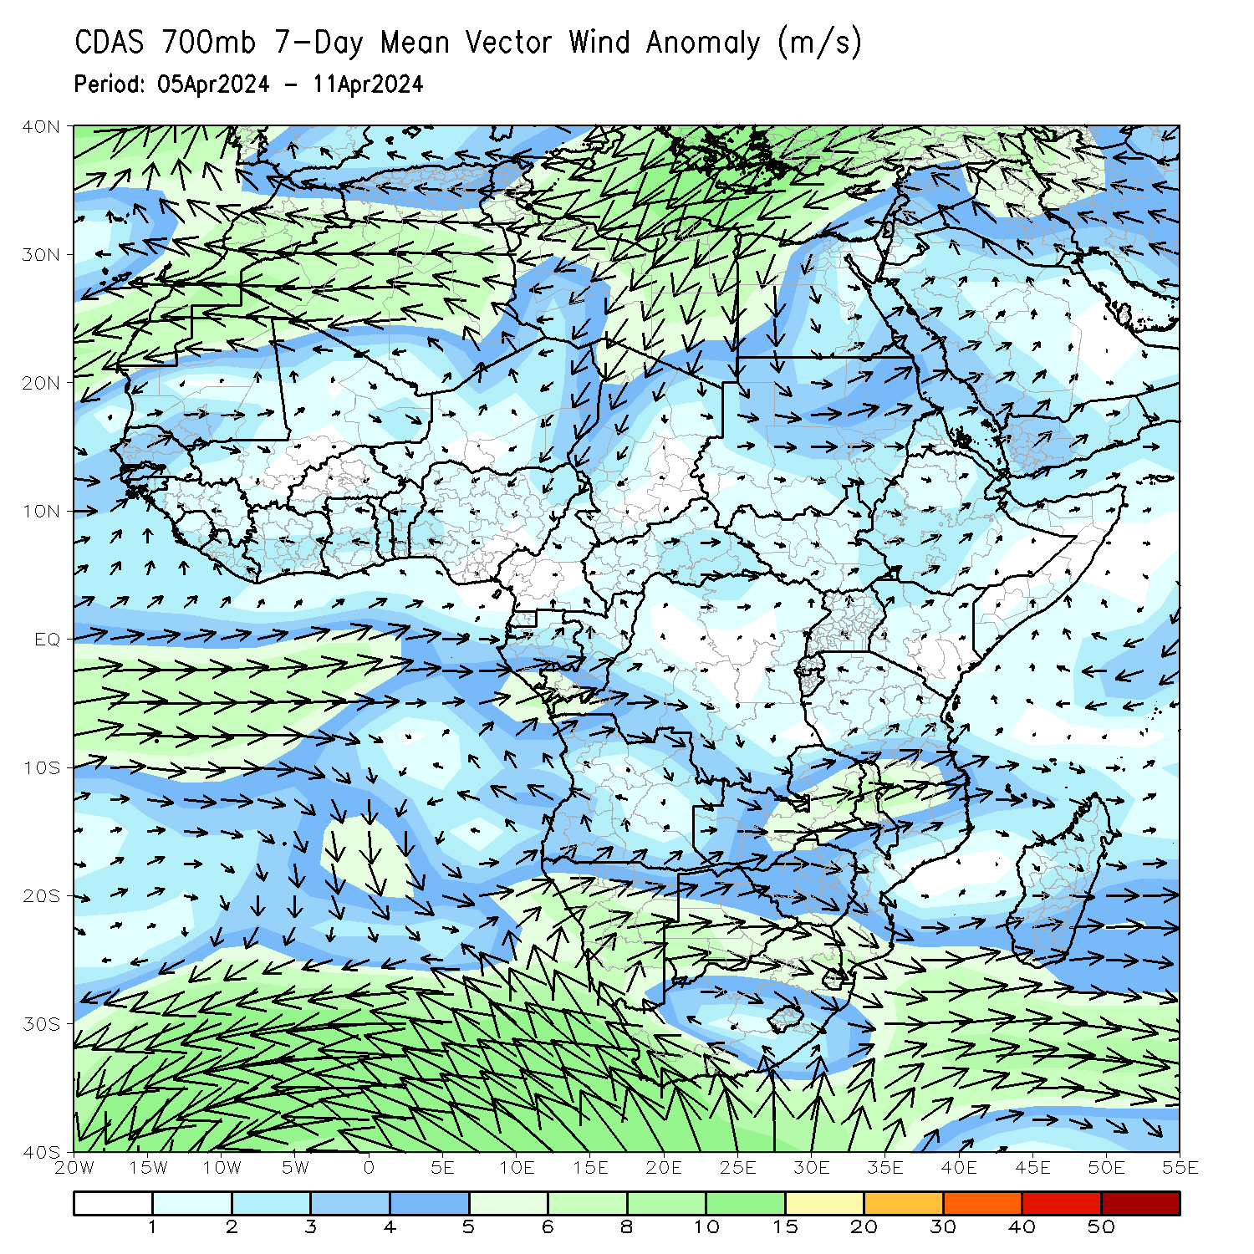
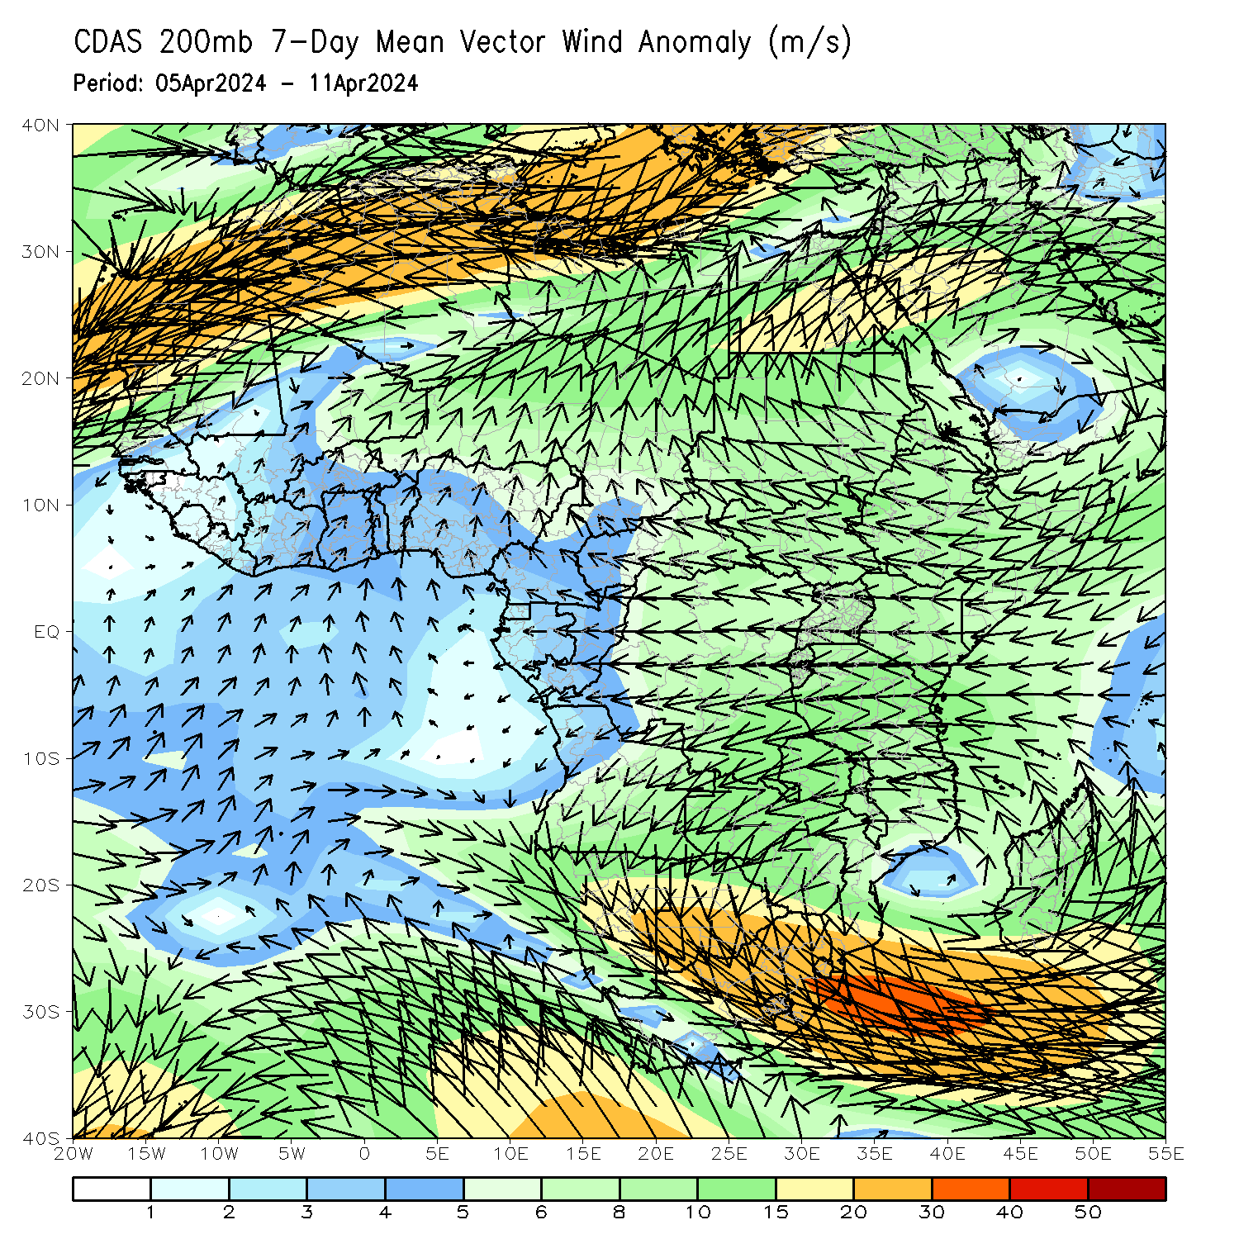
Atmospheric Circulation: Last 7 Days
At 700-hPa level (left panel), lower-level convergence at 700hPa (left panel) was observed across central South Africa, southern Gabon, and Congo may have contributed to the observed above-average rainfall in central and southern portions of Africa. Anomalous wind divergence at 700hPa across northern DRC and southern CAR may have resulted in the observed below-average rainfall across that region. At 200-hPa (right panel), and area of upper level anticyclonic flow (and divergence) was observed in Zambia, Zimbabwe, Mozambique, Botswana, Angola, Malawi, South Africa, Lesotho, and Eswatini, likely contributing to the above-average rainfall in those countries.

Slide 8
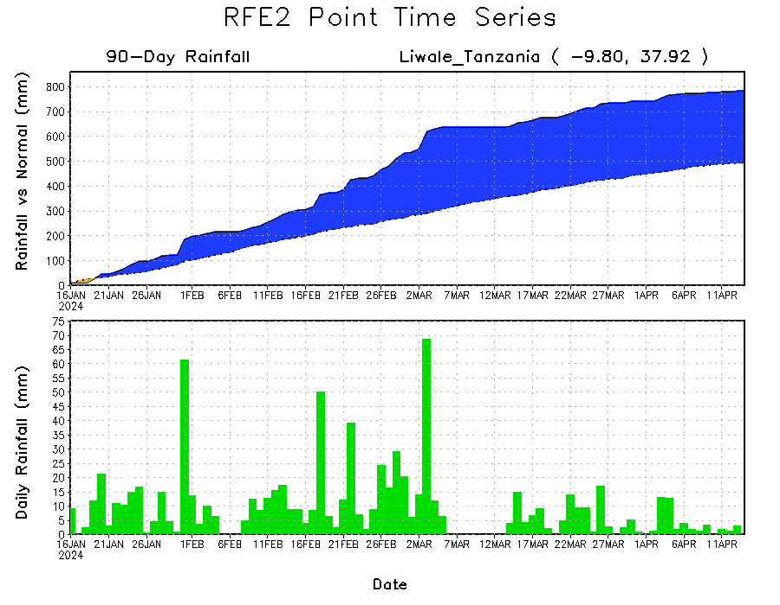
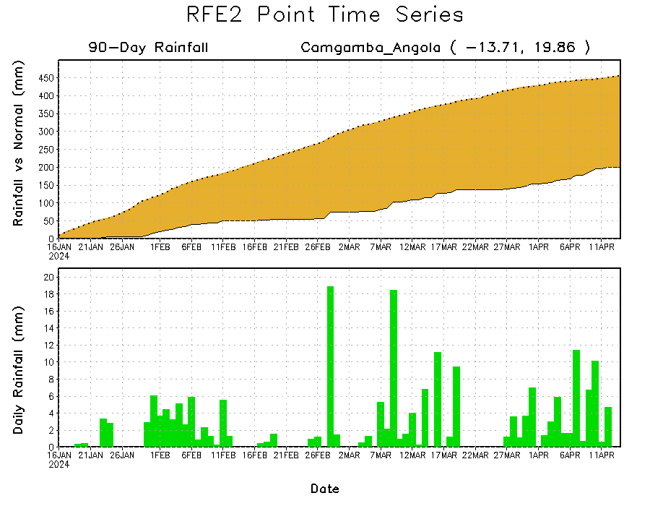
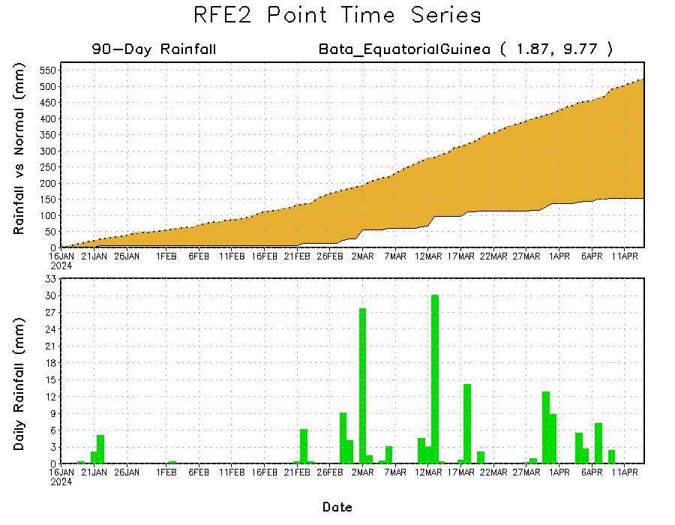
Rainfall Evolution
Daily evolution in rainfall at selected locations over the past 90 days shows growing deficits over much of Equatorial Guinea (bottom left) and eastern Angola (bottom right). Conversely, rainfall surpluses persist in Tanzania (top right).

Slide 9
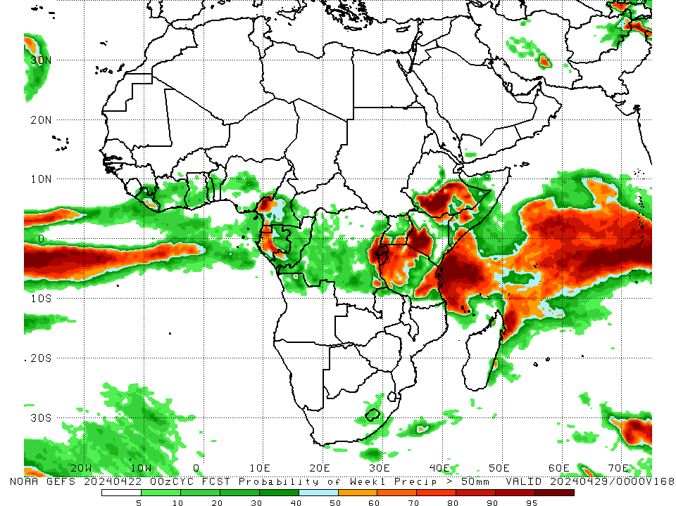
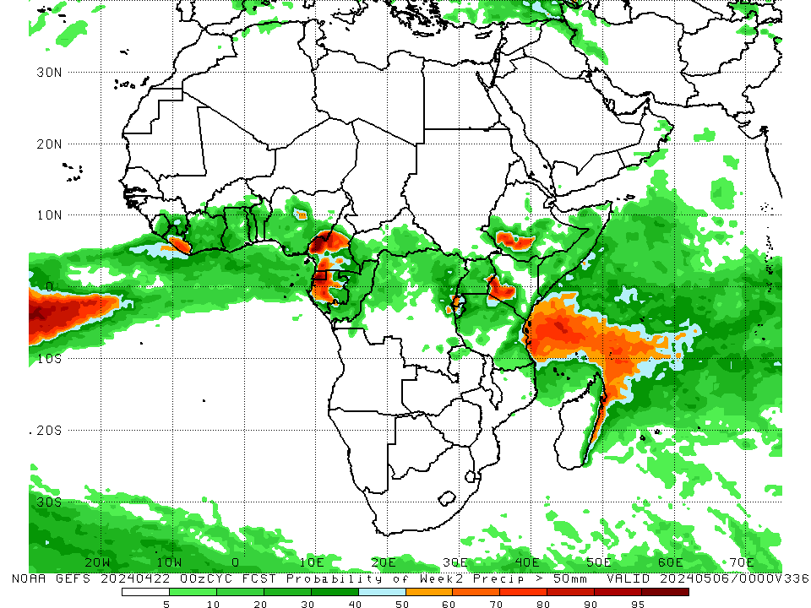
NCEP GEFS Model Forecasts Non-Bias Corrected Probability of precipitation exceedance
Week-1, Valid: 23 – 29 Apr 2024
Week-2, Valid: 30 Apr – 06 May 2024
For week-1 (left panel) the GEFS forecasts indicate a moderate to high chance (over 70%) for rainfall to exceed 50 mm across central and southern Ethiopia, some parts of southern Somalia, southwestern Kenya, Rwanda, Burundi, and some parts of western, northwestern and eastern Tanzania, and pockets of region in eastern DRC, southwestern Cameroon, Equatorial Guinea, and western Gabon. For week-2 (right panel), the GEFS forecasts indicate a moderate to high chance (over 70%) for rainfall to exceed 50 mm over Equatorial Guinea, western Gabon, central and southwestern Cameroon, eastern Liberia, southwestern parts of Ethiopia and Kenya, and western Rwanda.
Notes:
9

Slide 10
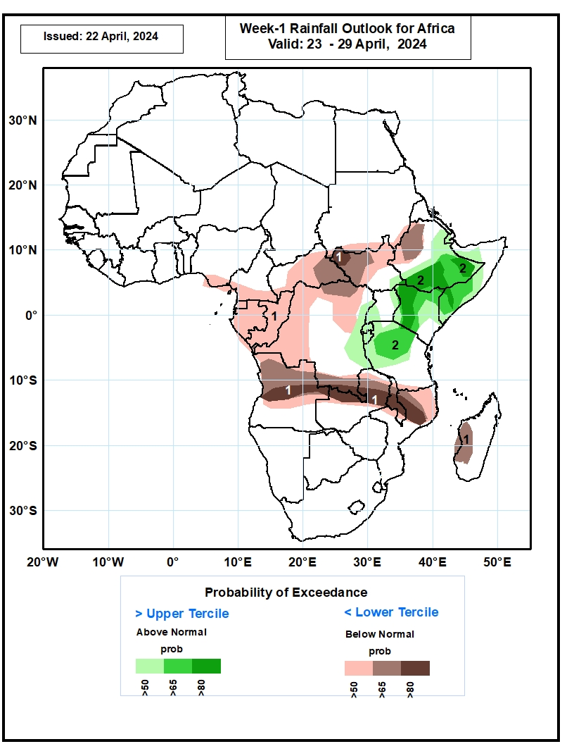
Week-1 Precipitation Outlooks
23 – 29 Apr 2024
The probabilistic forecasts call for above 50% chance for weekly total rainfall to be below-normal (below the lower tercile) over southern Nigeria, southern Cameroon, Equatorial Guinea, Gabon, Congo, CAR, South Sudan, Western Ethiopia, northern Angola, parts of northern western and southern DRC, northern and eastern Zambia, Malawi, northern Mozambique and western Madagascar. There is above 80% for below-normal rainfall over northwestern South Sudan, central Angola, northern Zambia,, Malawi and parts of northern Mozambique.
The probabilistic forecasts call for above 50% chance for weekly rainfall to be above-normal (above the upper tercile) across equatorial Eastern Africa. There is above 80% chance for above-normal rainfall over parts of southern Ethiopia and western Kenya.
Notes:
10

Slide 11
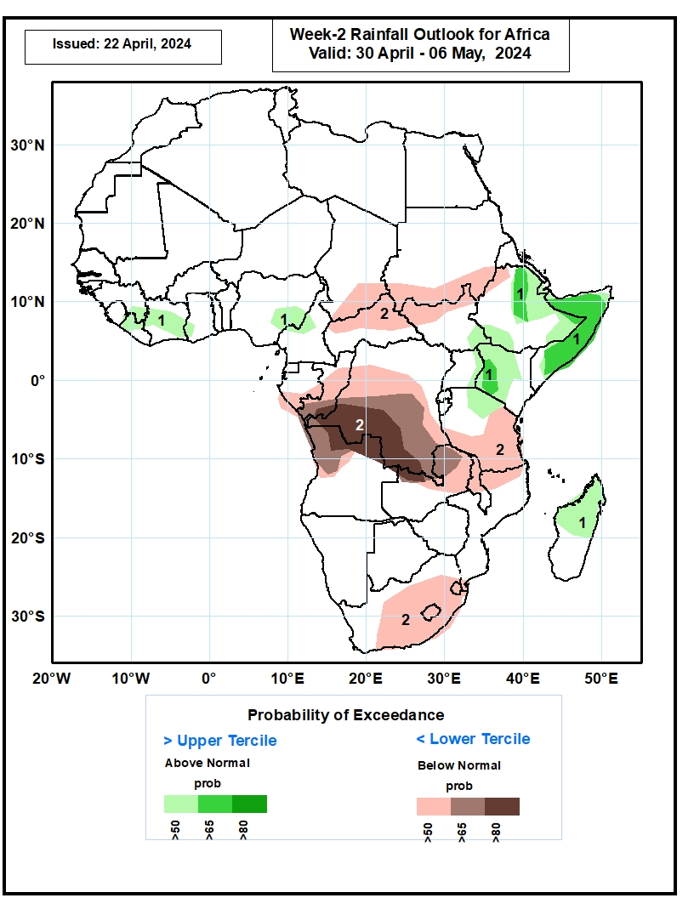
Week-2 Precipitation Outlooks
30 April – 06 May, 2024
The probabilistic forecasts call for above 50% chance for weekly total rainfall to be above-normal (above the upper tercile) over parts of Liberia, Cote d’Ivoire, eastern Nigeria, parts of eastern and southern Ethiopia, western Kenya, Somalia, and northern Madagascar. There is above 65% chance for above-average rainfall over northeastern Ethiopia, Somalia, and western Kenya.
The probabilistic forecasts call for above 50% chance for weekly rainfall to be below-normal (below the lower tercile) over southern Chad, northern CAR, southern Sudan, northern South Sudan, Congo, portions of DRC, northern Angola, northern and eastern Zambia, portions of Tanzania, Malawi, portions of South Africa, and Lesotho and Swaziland. There is above 80% chance for below-normal rainfall over southwestern DRC.
Notes:
11

Slide 12
Summary
Over the past 30 days, in East Africa, rainfall was above-average in many parts of central Ethiopia, pocket of region in southeastern Somalia, and eastern South Sudan. Rainfall was below-average in southeastern Ethiopia, many parts of Uganda, Rwanda, Burundi, and northern and western-central Tanzania. In Central Africa, rainfall was above-average in some parts of southern DRC. Rainfall was below-average in southwestern Cameroon, northern and southwestern Congo, central, southern and southeastern CAR, and some parts northern, western, southwestern and eastern DRC, In West Africa, Rainfall was below-average in eastern parts of Guinea and Sierra Leone, Liberia, many parts of Cote d’Ivoire, Ghana and Togo, central and southern Benin, southwestern, southern and central Nigeria. In southern Africa, rainfall was above-average over western and central-eastern Angola, northwestern Zambia, eastern Mozambique, central and southeastern South Africa, Lesotho, and northern and northeastern Madagascar. Rainfall was below-average across southeastern Angola, northeastern and eastern Namibia, southwestern Zambia, northern and western Botswana, western and northwestern Zimbabwe, some parts of southern Madagascar, and pockets of regions in western and northern South Africa.
During the past 7 days, in East Africa, rainfall was above-average in some region in central and eastern Ethiopia. Rainfall was below average in parts of western Ethiopia, southwestern and northeastern South Sudan, southwestern Uganda, Rwanda, and western and northern Burundi. In central Africa, rainfall was below-average in eastern Central African Republic (CAR), and parts of northern, western and eastern Democratic Republic of the Congo (DRC). In West Africa, rainfall was below-average in Sierra Leone, eastern Guinea, western Cote d’Ivoire, southern parts of Ghana, Togo and Benin, and southwestern Nigeria. In southern Africa, rainfall was above-average in central and eastern Angola, central-eastern Madagascar, and some eastern region of South Africa and Mozambique. Rainfall was below-average in southeastern Madagascar.
The Week-1 outlook calls for above-average rainfall in many parts of eastern Africa, central South Africa, Lesotho, and central parts of Nigeria and Cote d’Ivoire. In contrast, there is an increased chance for below-average in many parts of Central African Republic (CAR) and South Sudan, western Ethiopia, northern and southern Cameroon, Equatorial Guinea, Gabon. Congo, northern, northwestern and southern DRC, northern, central and eastern Angola, northern Zambia, central and southern Botswana, southern South Africa, Malawi, Mozambique, central and southern Madagascar, eastern Guinea, Sierra Leone, northern Ghana, Togo, central and southern Benin, and southern Nigeria. The Week-2 outlook calls for above-average rainfall in many parts of Somalia, Kenya and Burkina Faso, and along the Gulf Guinea coast countries. In contrast, there is an increased chance for below-average in many parts of the Central African Republic (CAR), South Sudan, western Ethiopia, Gabon, Congo, northwestern, western, central, southern and southeastern Democratic Republic of the CONGO (DRC), Rwanda, Burundi, northern and central Angola, northern Zambia, western, central and eastern South Africa, Eswatini and Lesotho.

