Slide 1
Consolidated Seasonal Rainfall Guidance for Global Tropics, October 2014 Initial Conditions Issued 14 October 2014
Forecast Background
ENSO update
Current State of the global climate
SST Forecasts
Regional Rainfall Forecast maps
Summary

Slide 2
CPC ENSO Update
CPC ENSO Alert System Status: El Niño Watch
Synopsis: El Niño is favored to begin in the next 1-2 months and last into the Northern Hemisphere spring 2015.
(Updated on October 9, 2014)
http://www.cpc.ncep.noaa.gov/products/analysis_monitoring/enso_advisory/index.shtml

Slide 3
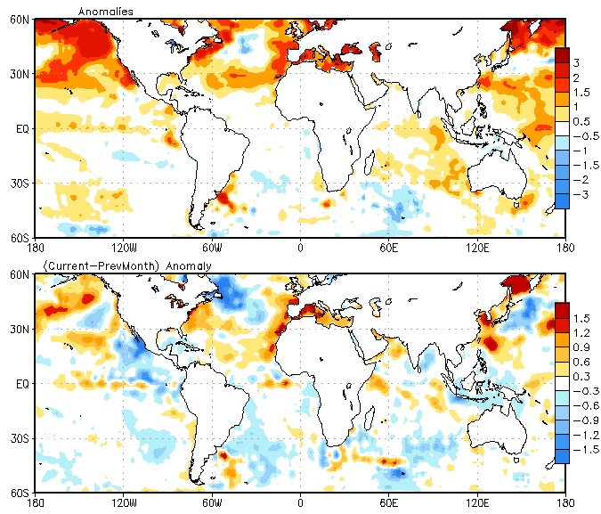
Current State of the Global Ocean
Last Month
SST Anomaly (top) for September 2014
and Tendency (bottom) for September minus August
Above-average SST was observed across northern Pacific.
Sea surface temperatures (SST) were above-average across the equatorial eastern Pacific Ocean.
Positive SST anomalies persisted over central and southern Indian Ocean.
SST tendency was positive over portions of the southern the Indian Ocean.
Changes in equatorial SST anomalies were positive in portions of the equatorial Pacific, with a slight negative SST tendency present in in the eastern end of the equatorial Pacific.

Slide 4
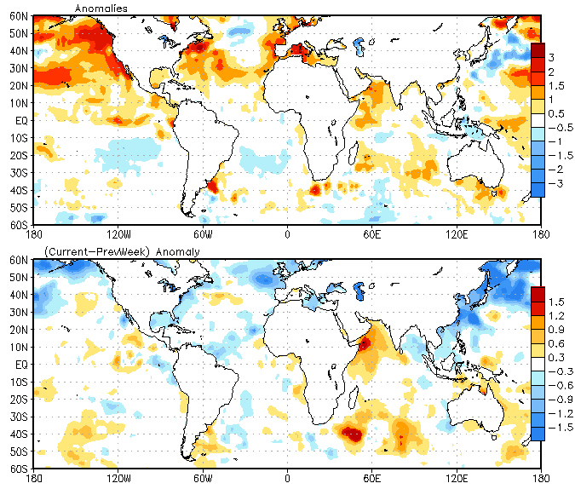
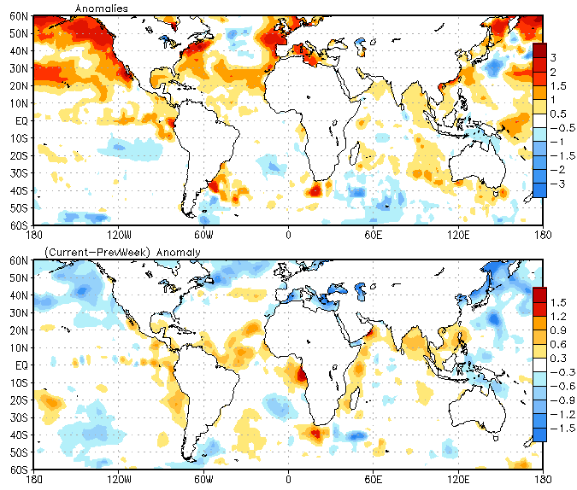
Current State of the Global Ocean
Last Week
Weekly SST Anomaly 5 - 11 October 2014 and
Tendency for 5 - 11 October minus 28 September – 04 October 2014
SST was above-average across the equatorial eastern Pacific Ocean.
Positive SST anomalies were present over much of the Indian Ocean.
Weak positive SST tendency was observed over portions of the equatorial eastern Pacific Ocean

Slide 5
OLR Anomaly, September 2014
Negative OLR anomalies (enhanced convection and precipitation, blue shading) was observed over the central and eastern Sahel, parts of Sudan and Ethiopia, and in the vicinity of Lake Victoria. Convection was also enhanced over the western Indian Ocean, the South Pacific Convergence Zone east of Australia, central South America, Central America and Mexico.
Precipitation was suppressed (orange-red shading) over Indonesia and portions of the western Pacific, as well eastern Indian Ocean.

Slide 6
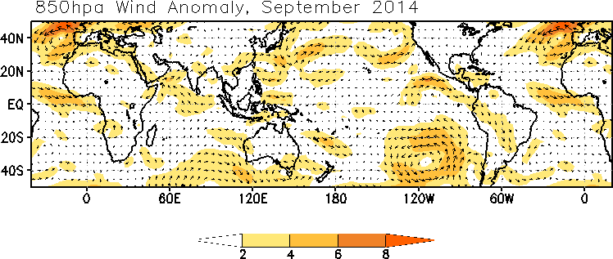
Low Level 850 mb Wind Anomaly
Anomalous low-level westerly winds were observed across the equatorial eastern Pacific, and equatorial Atlantic.
Anomalous southeasterly winds were present across northern Indian Ocean.

Slide 7
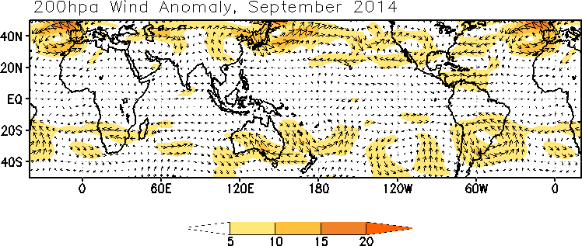
Upper Level 200 mb Wind Anomaly
Near average upper-level (200-hPa) wind anomalies were observed over most of the Pacific.

Slide 8
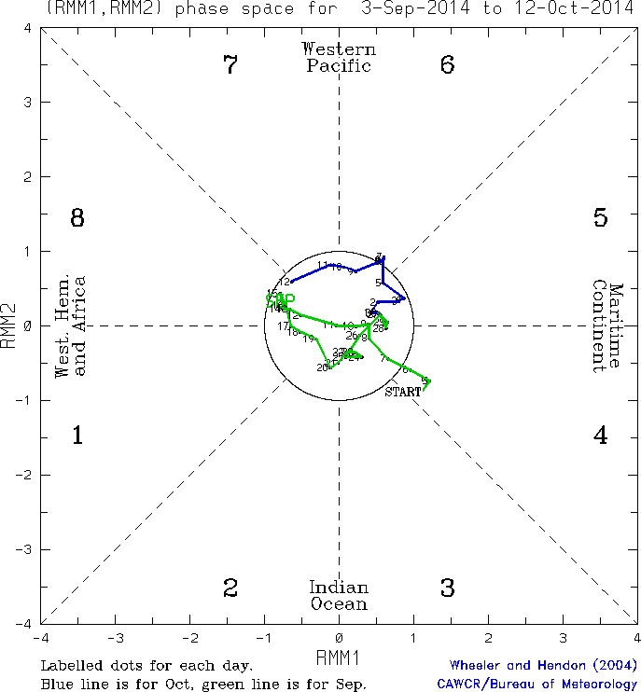
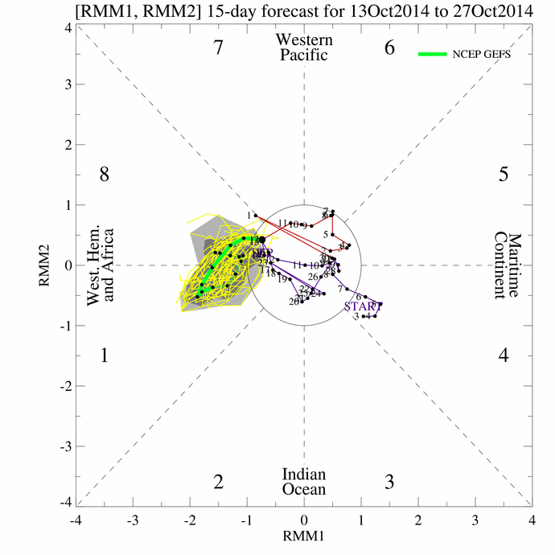
Monitoring the Madden Julian Oscillation
Time
The amplitude of the MJO index remained low over the past week(left panel). The ensemble GFS forecast indicates strengthening of the MJO signal during week-1. (right panel).
Longitude
Notes:
8

Slide 9
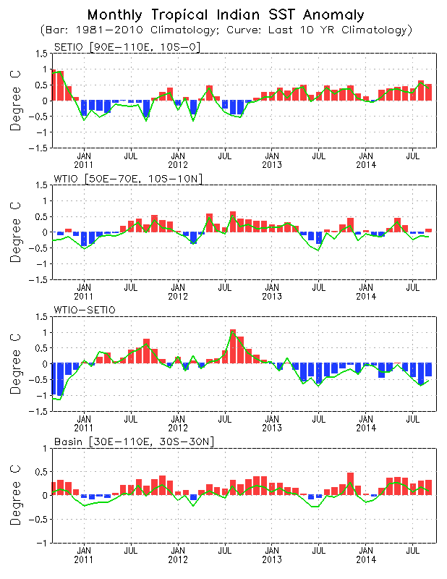
Evolution of Indian Ocean SST Indices
The Indian Ocean Dipole (IOD) has returned to neutral values over the last month
The latest weekly index value as of 14 September 2014 is –0.3 °C

Slide 10
Summary of State of the Global Climate in September 2014
ENSO neutral condition continued, with the most recent Ocean Nino Index (ONI) value (July – September 2014) is 0.0ºC
Positive equatorial sea surface temperature (SST) anomalies continue across most of the Pacific Ocean.
SST was above-average in the central and southern Indian Ocean. The Indian Ocean Dipole (IOD) has returned to neutral values over the last month.
Enhanced precipitation was observed over the central and eastern Sahel, parts of Sudan and Ethiopia, and in the vicinity of Lake Victoria. Convection was also enhanced over the western Indian Ocean, the South Pacific Convergence Zone east of Australia, central South America, Central America and Mexico.
Precipitation was suppressed across Indonesia and portions of the western Pacific, as well eastern Indian Ocean.

Slide 11
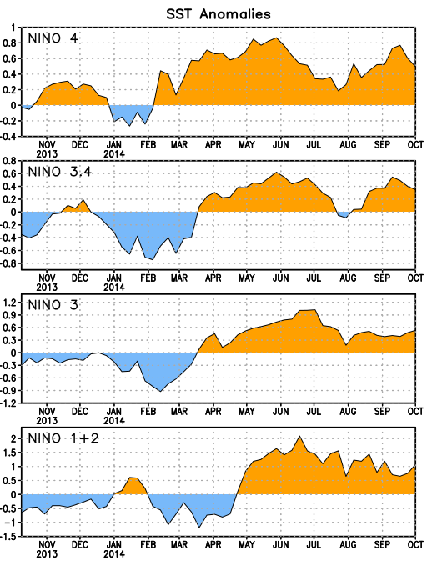
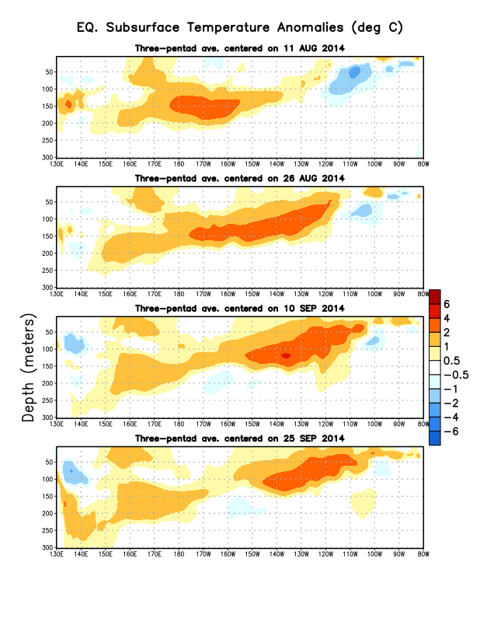
Eq. Subsurface temperature Anomalies
Nino region SST departures

Slide 12
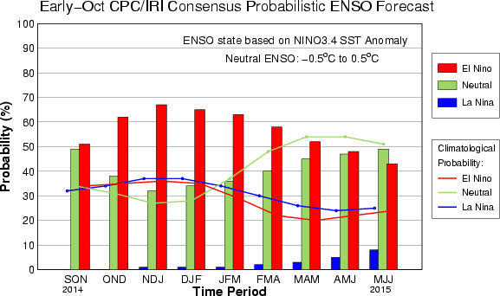
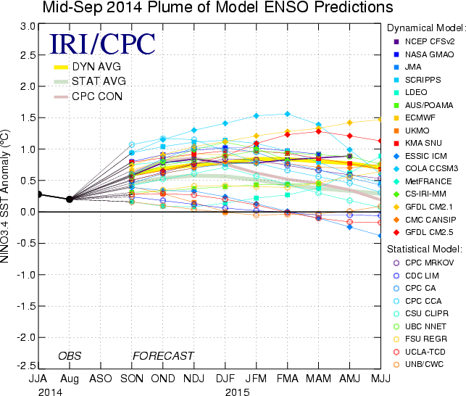
IRI/CPC NINO3.4 Forecast Plume
Season | La Niña | Neutral | El Niño
SON 2014 | ~0% | 49% | 51%
OND 2014 | ~0% | 38% | 62%
NDJ 2014 | 1% | 32% | 67%
DJF 2014 | 1% | 34% | 65%
JFM 2015 | 1% | 36% | 63%
FMA 2015 | 2% | 40% | 58%
MAM 2015 | 3% | 45% | 52%
AMJ 2015 | 5% | 47% | 48%
MJJ 2015 | 8% | 49% | 43%
Most models predict El Niño to develop during October-December 2014 and to continue into early 2015 .

Slide 13
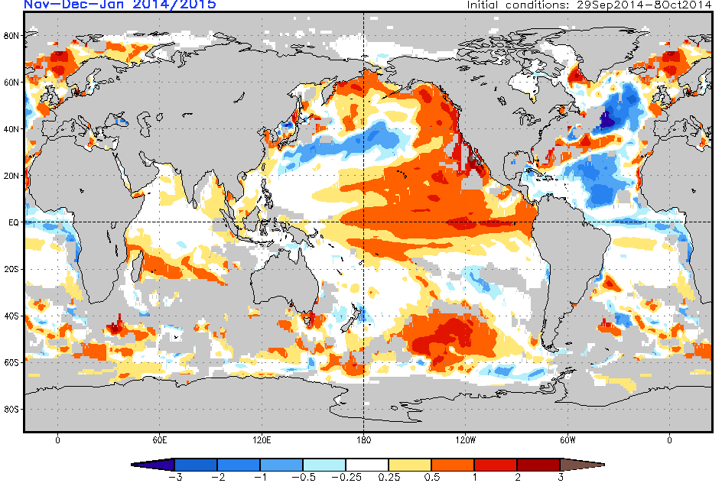
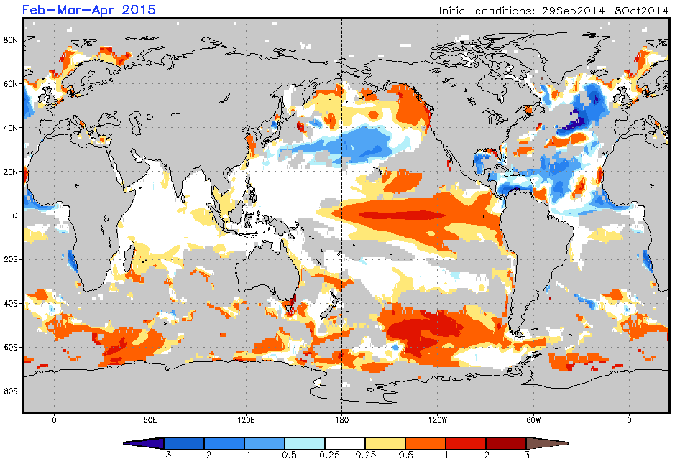
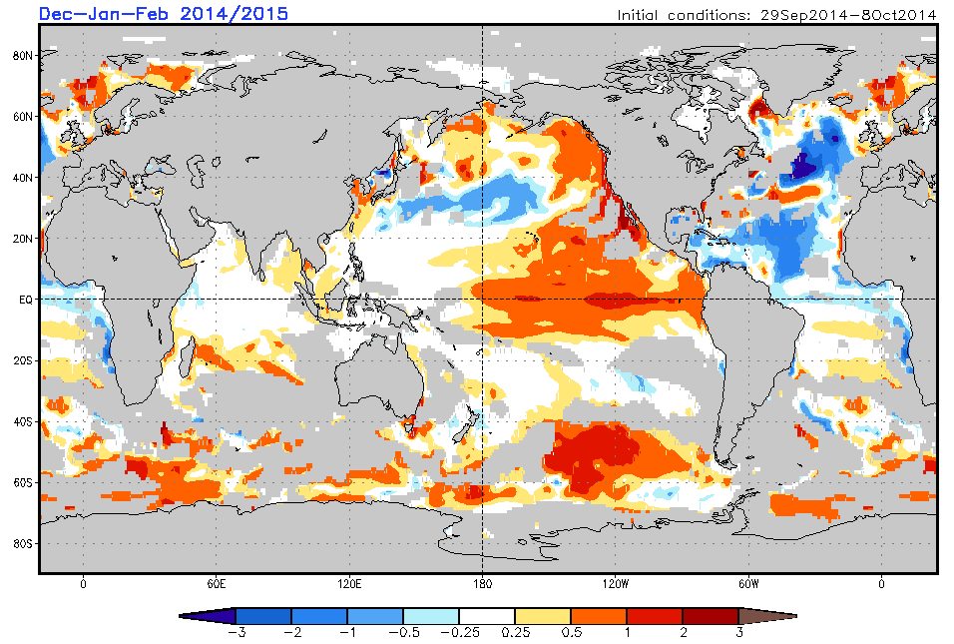
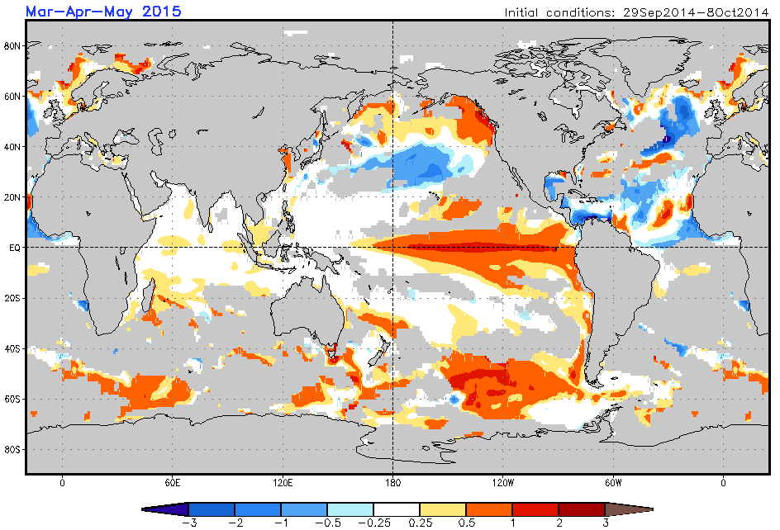
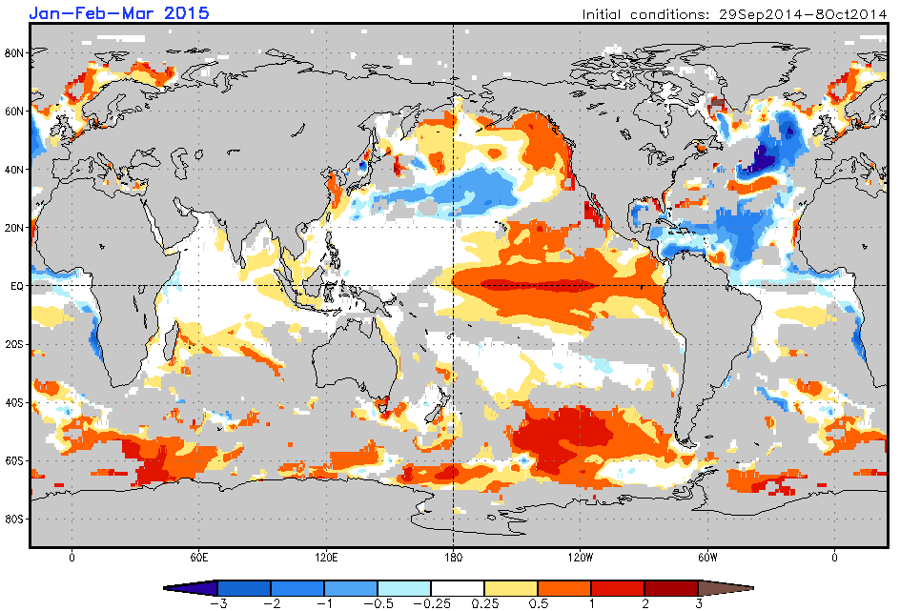
Global SST Outlook: NCEP CFS.v2 Forecast Initial Conditions 29 September – 08 October 2014
Nov 2014 - Jan 2015
Feb - Apr 2015
Caution: Ocean areas
with skill less than 0.3
are shaded in gray
Dec 2014 - Feb 2015
Mar - May 2015
Jan - Mar 2015
CFS.v2 predicts warmer than normal SST across equatorial Pacific Ocean, and portions of southern Indian Ocean.
Additional forecast resources are found here:
http://www.cpc.ncep.noaa.gov/products/african_desk/cpc_intl/index.shtml
http://origin.cpc.ncep.noaa.gov/products/people/wwang/cfsv2fcst/

Slide 14
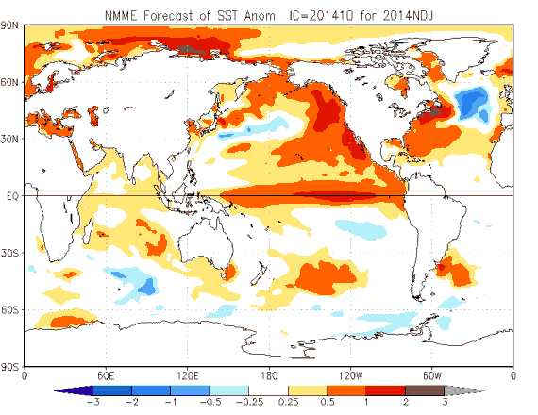
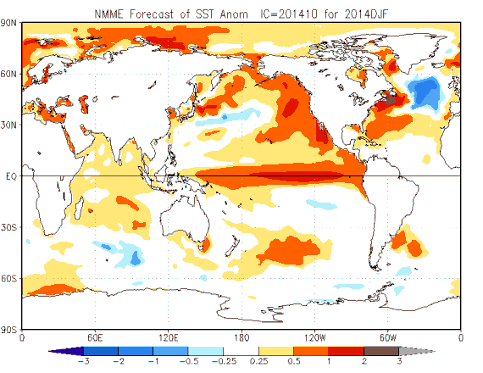
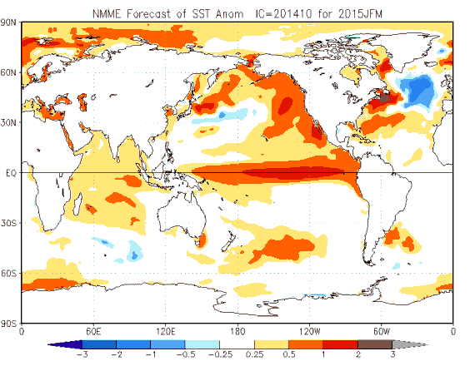
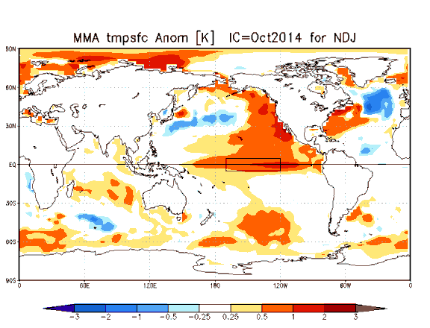
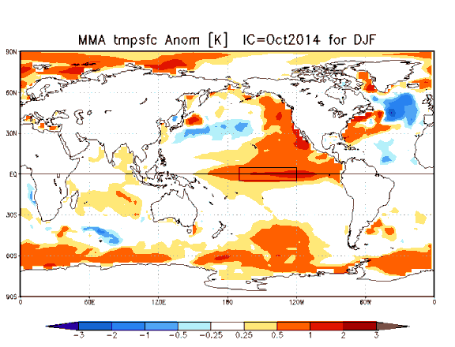
Global SST Outlook: NMME (top panel) & IMME (bottom panel)
Nov 2014 - Jan 2015
Dec 2014 - Feb 2015
Jan - Mar 2015
NMME
IMME

Slide 15
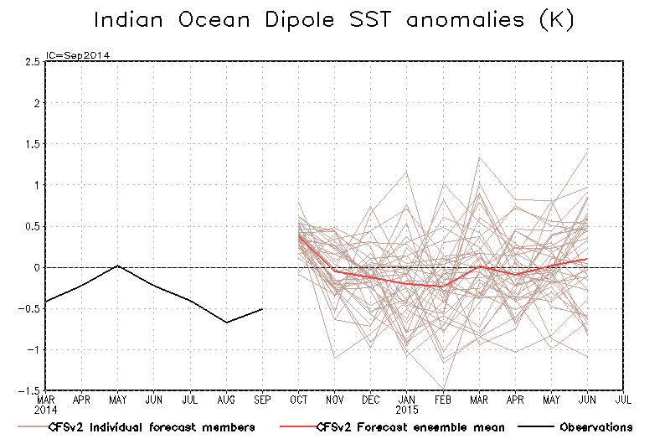

Slide 16
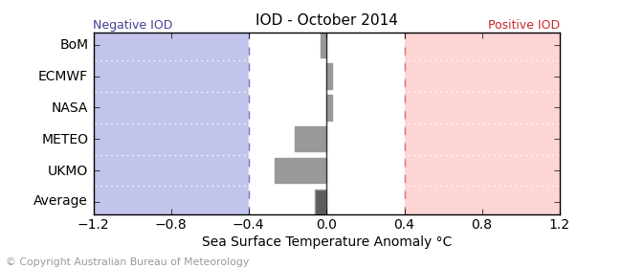
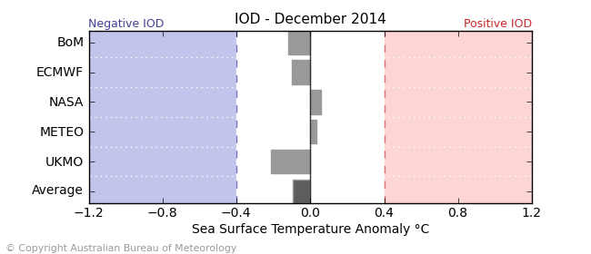
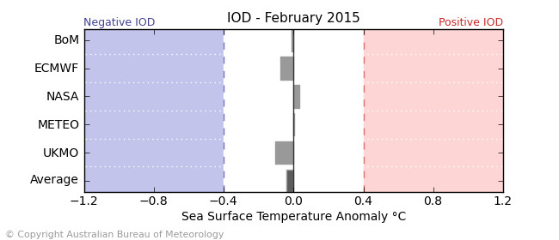
IOD Outlook (source: Australian Bureau of Meteorology)
Model outlooks suggest near-average IOD index for the remainder of 2014.

Slide 17
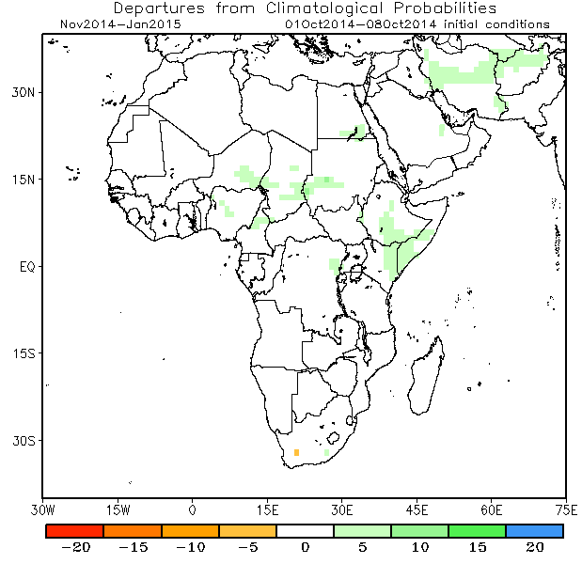
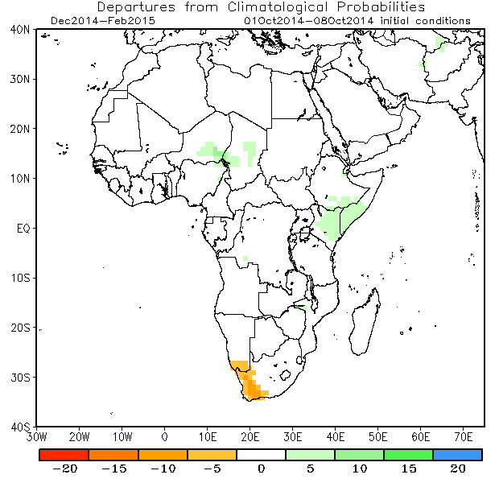
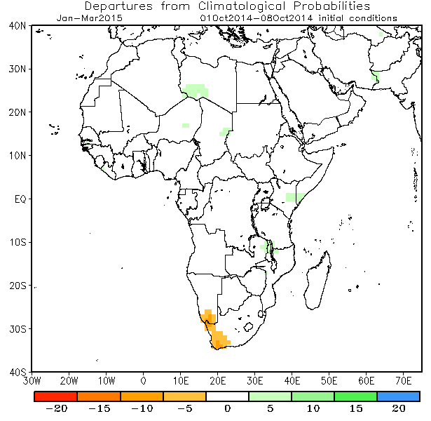
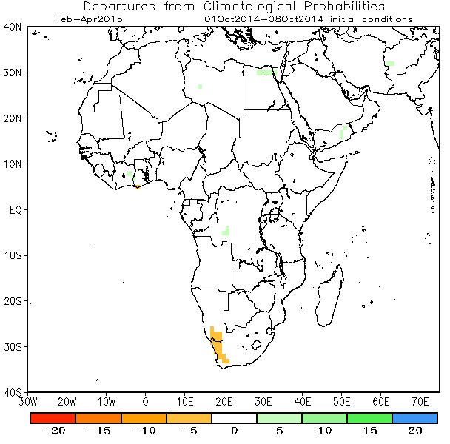
Rainfall Guidance, Africa: NMME, Precipitation Probability Forecasts,
(01 – 08 October 2014 IC)
Nov 2014 - Jan 2015
Dec 2014 - Feb 2015
The forecasts call for climatology over much of Africa, except for a slight tilt in the odds to favor above-average rainfall over portions of southeastern Ethiopia, eastern Kenya and southern Somalia. In contrast, below average rainfall is slightly favored over portions of western South Africa and southern Namibia.
Jan - Mar 2015
Feb - Apr 2015
Individual model forecasts can be found here:
http://www.cpc.ncep.noaa.gov/products/international/nmme/nmme1.shtml

Slide 18
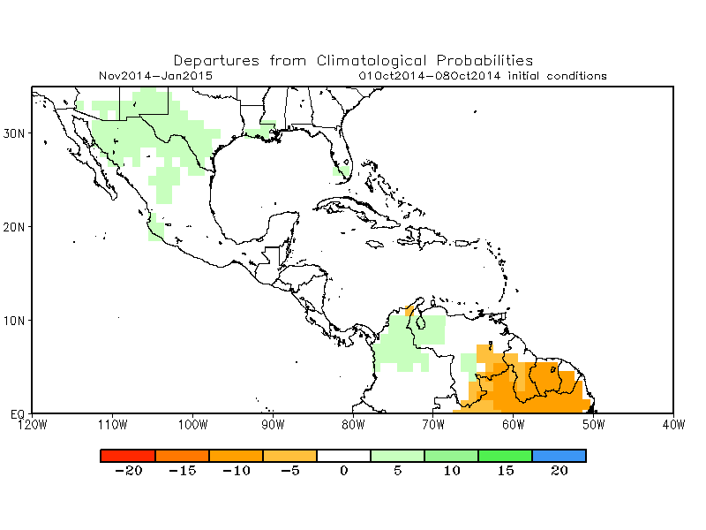
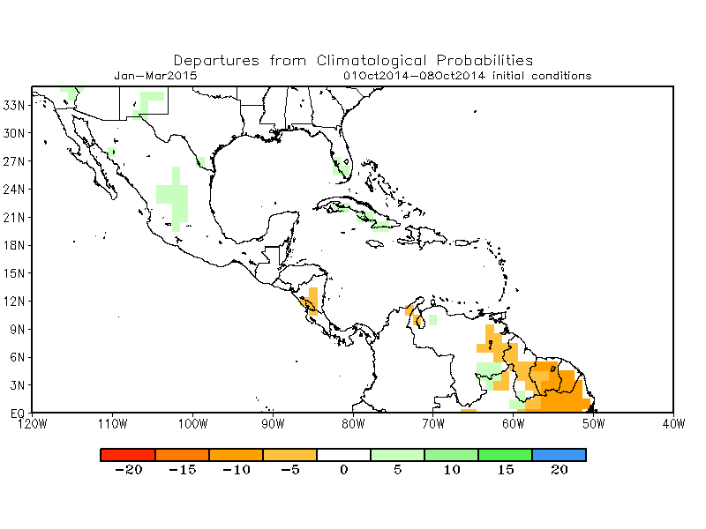
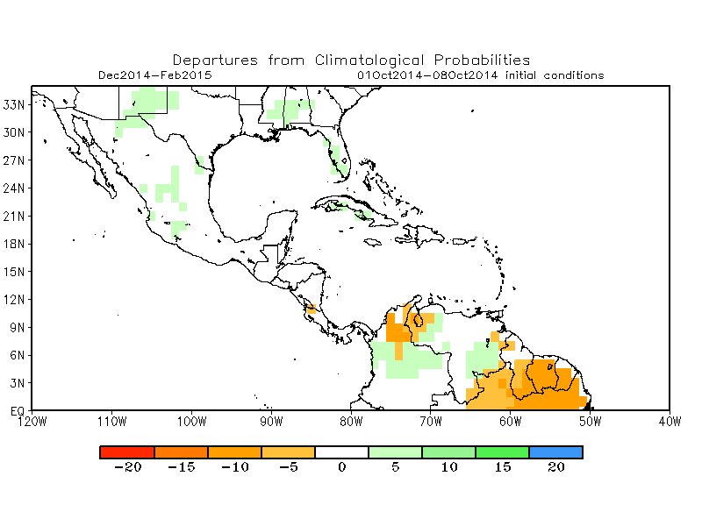
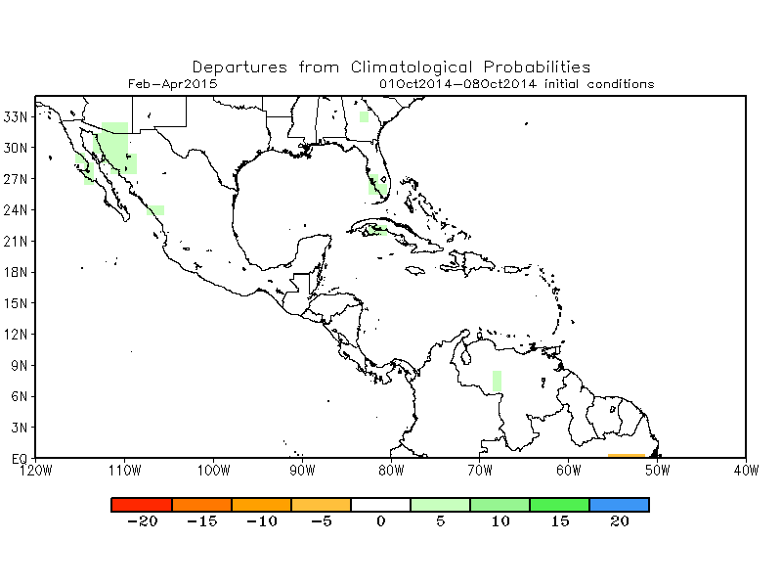
Rainfall Guidance, CAM and Caribbean: NMME, Precipitation Probability Forecasts,
(01 – 08 October 2014 IC)
Nov 2014 - Jan 2015
Dec 2014 - Feb 2015
The forecasts call for climatology over much of Central America and Caribbean regions.
Jan - Mar 2015
Feb - Apr 2015
Individual model forecasts can be found here:
http://www.cpc.ncep.noaa.gov/products/international/nmme/nmme1.shtml

Slide 19
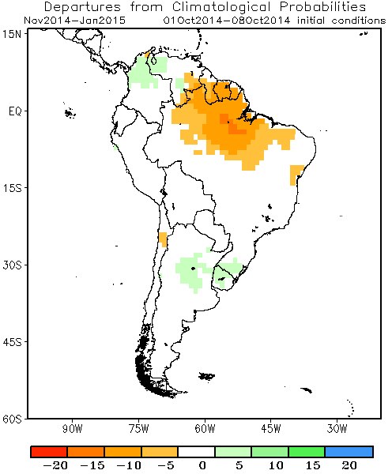
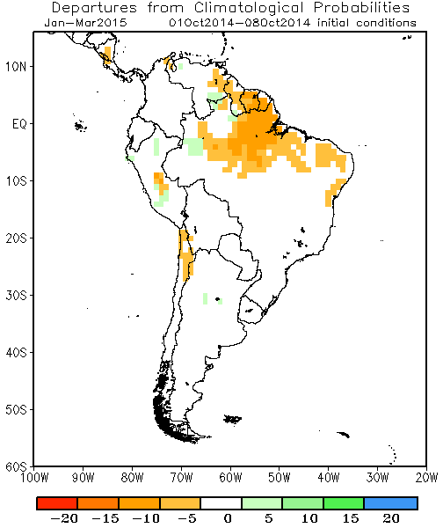
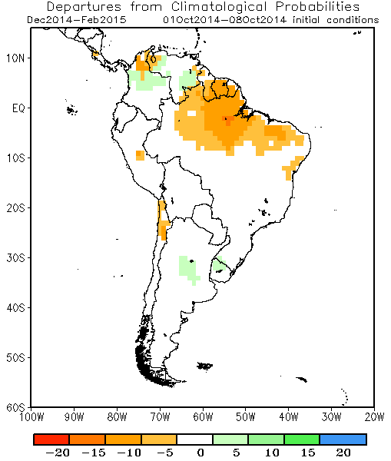
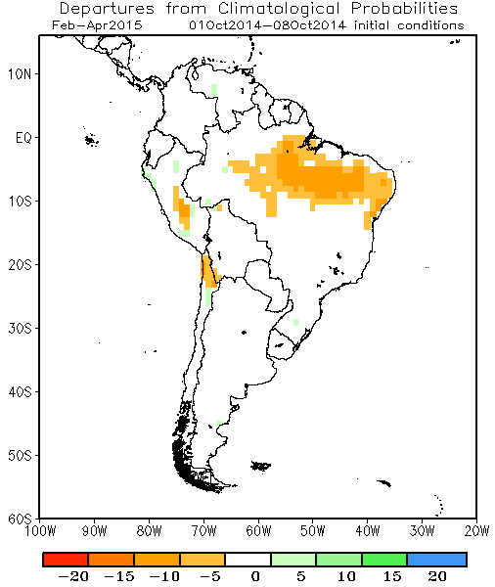
Rainfall Guidance, South America: NMME, Precipitation Probability Forecasts,
(01 – 08 October 2014 IC)
Nov 2014 - Jan 2015
Dec 2014 - Feb 2015
The forecasts call for a slight to moderate tilt in the odds to favor below-average rainfall across northern South America. In contrast, above average rainfall is slightly favored over portions of northern Colombia and western Venezuela.
Jan - Mar 2015
Feb - Apr 2015
Individual model forecasts can be found here:
http://www.cpc.ncep.noaa.gov/products/international/nmme/nmme1.shtml

Slide 20
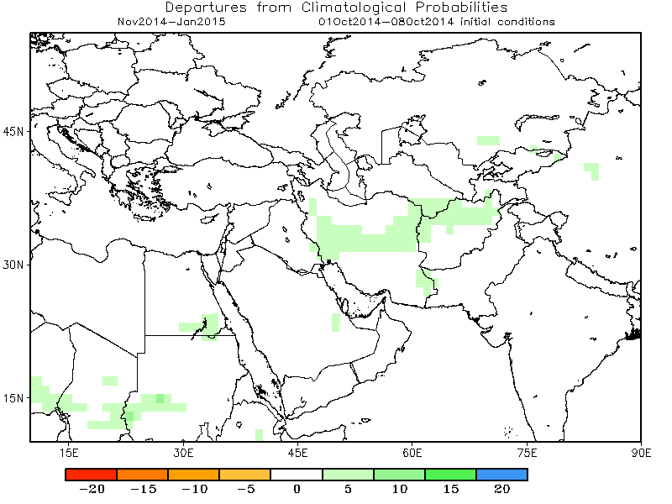
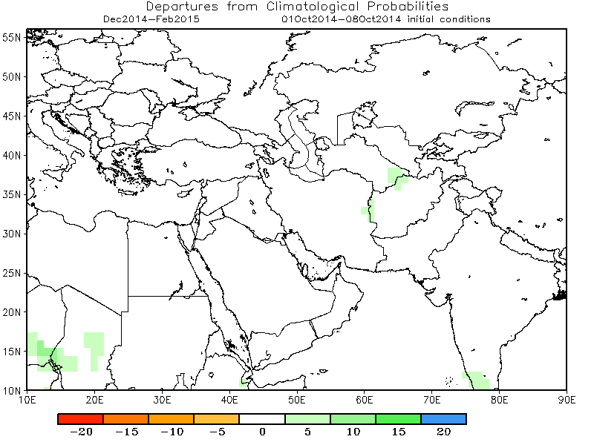
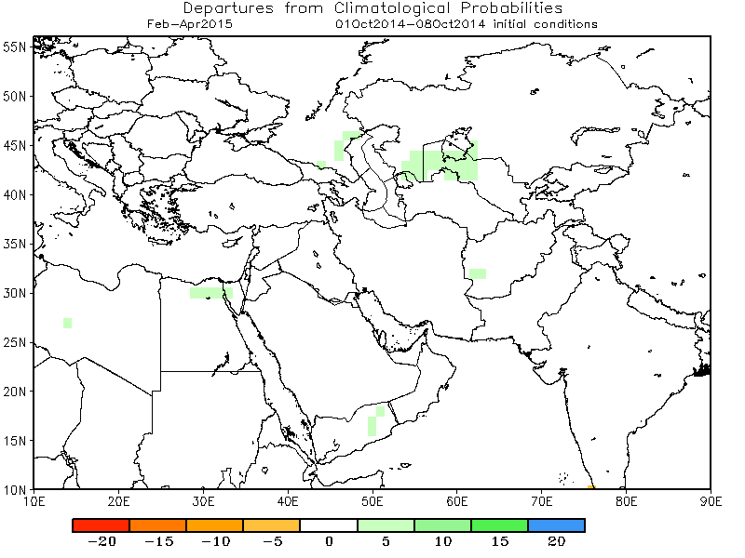
Rainfall Guidance, Central Asia: NMME, Precipitation Probability Forecasts,
(01 – 08 October 2014 IC)
Nov 2014 - Jan 2015
Dec 2014 - Feb 2015
The forecasts call for climatology over much of Central Asia, except for portions of Iran and Afghanistan, where there is slight tilt in the odds to favor above-average rainfall.
Jan - Mar 2015
Feb - Apr 2015
Individual model forecasts can be found here:
http://www.cpc.ncep.noaa.gov/products/international/nmme/nmme1.shtml

Slide 21
Summary
Neutral ENSO state continued to prevail in September 2014. Above-average Sea surface temperatures (SST) was observed over the equatorial eastern Pacific Ocean. Positive SST anomalies persisted over the central and southern Indian Ocean.
El Niño is favored to begin in the next 1-2 months and last into the Northern Hemisphere spring 2015.
The precipitation probability forecasts slightly favor above-average rainfall over portions of southeastern Ethiopia, eastern Kenya and southern Somalia. In contrast, there is a moderate tilt in the odds to favor below average rainfall over northern South America.
Additional forecast resources can be found here:
http://www.cpc.ncep.noaa.gov/products/african_desk/cpc_intl/index.shtml
http://www.cpc.ncep.noaa.gov/products/NMME/
http://origin.cpc.ncep.noaa.gov/products/people/wwang/cfsv2fcst/

