Slide 1
Drought Monitoring with the NCEP
North American Land Data Assimilation (NLDAS):
Implications and Challenges of
Extending the Length of the Climatology
by
Youlong Xia¹ and Bala Narapusetty²
¹ NCEP Environmental Modeling Center (EMC)
² NASA GSFC Hydrological Sciences Lab (HSL)

Slide 2

Presenter
Ken Mitchell ^{1,2}
¹ Retired: NCEP Environmental Modeling Center (EMC)
-- EMC member: Nov 1988 to Jan 2009 (20 years)
² Current: Prescient Weather Ltd.
-- located in Innovation Park at Penn State University
-- URL: www.prescientweather.com
-- currently has NOAA/SBIR contract

Slide 3
Motivation for this Presentation
  Recent EMC derivation of new 36-Year NLDAS-2 Climatology (1979-2014)
    candidate to replace current operational 30-year climatology (1980-2009)
  Percentiles and anomalies show surprising sensitivity to choice between the two climatologies
  How to largely eliminate such sensitivity?

Slide 4
Outline of Presentation
1— What is NLDAS:
  Description
  History
2 – Drought monitoring with ops NLDAS-2
  AND experimental drought prediction
3 – The current ops NLDADS-2 climatology
4 – The new NLDAS-2 climatology
  Implications
  Challenges
  Preliminary Results from proposed solution (via B. Narapusetty et al. 2009, J. Climate)
5 – Future Work

Slide 5
What is NLDAS?

Slide 6
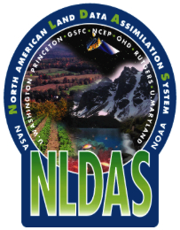
North American Land Data Assimilation System (NLDAS)
• Multi-land-modeling & land data assimilation system.
• Uncoupled land model runs driven by atmospheric forcing using surface meteorology data sets.
• Long-term retrospective and near real-time runs.
• Land model output of water and energy budgets.
• 30-year land model runs provide climatology.
• Anomalies used for drought monitoring.
• Multi-institute collaboration (NCEP, OHD, NASA, Princeton, Univ. Wash.).

Slide 7
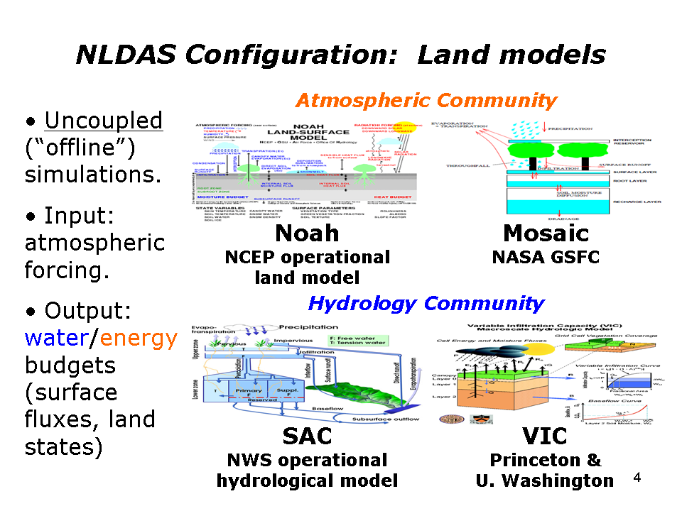
NLDAS: Applies Four Land Models
to yield ensemble products
Operational Model
Research Model

Slide 8
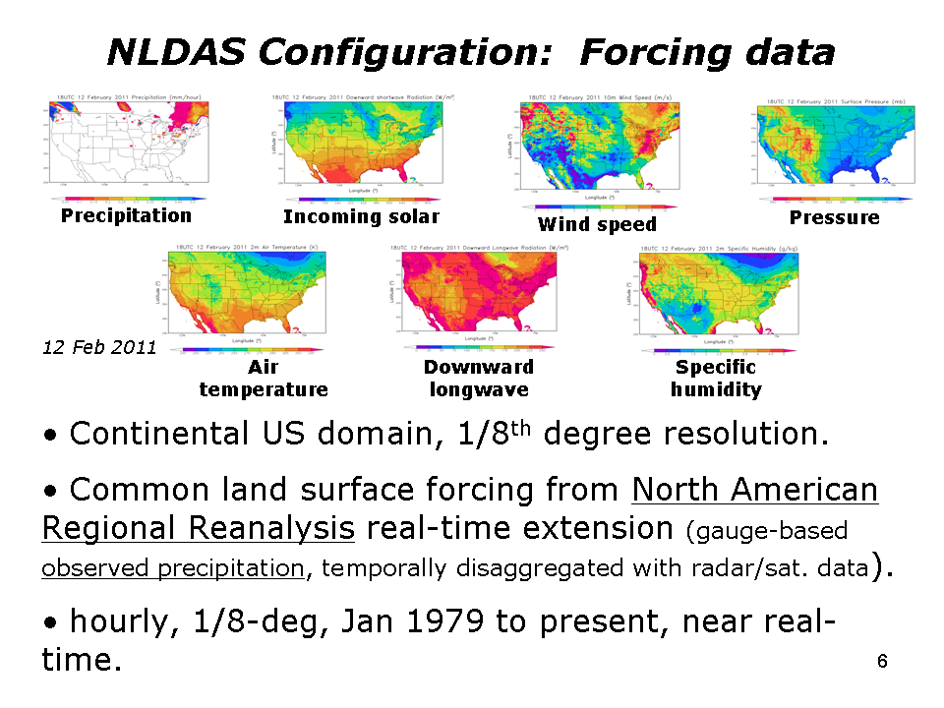
NLDAS: Atmospheric Forcing
Common atmospheric forcing from Regional Climate Data Assimilation System (real time extension of North American Regional Reanalysis -NARR) - backbone.
CPC gauge-based observed precipitation, temporally disaggregated using radar/satellite data (stage IV, CMORPH), bias-corrected with PRISM monthly values.
Bias-corrected NARR solar radiation with GOES retrievals

Slide 9
Operational NLDAS Configuration
Uncoupled land model simulations
  four land models: Noah, VIC, Mosaic, SAC
CONUS domain
  1/8th degree resolution (daily gauge precipitation)
Common land surface forcing
  hourly and 1/8th degree
  Jan 1979 to present realtime
Retrospective mode
  30-year: 1979-2008
  15-year spin-up
  30-year climatology for each land model (1979-2008)

Slide 10
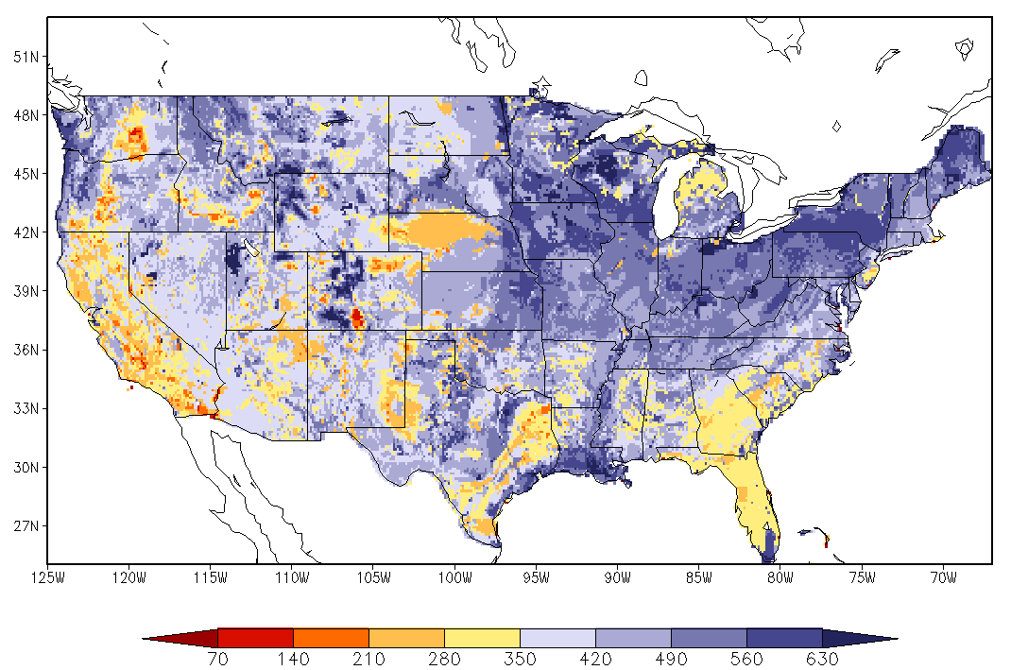
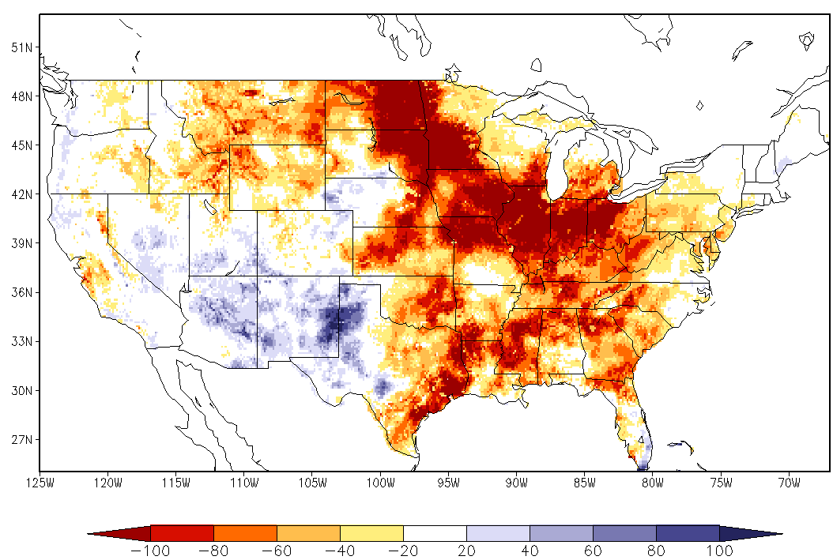
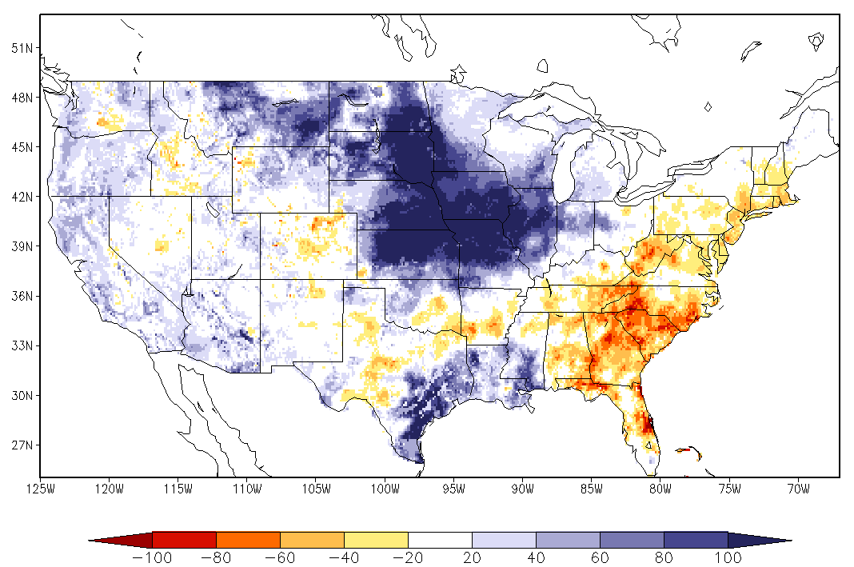
NLDAS: Simulations
30-year retrospective land model runs, Oct 1979 – Sep 2008 (after 15-year spin-up) to provide land model climatologies.
Quasi-operational near real-time, Sep 2008–present; hourly, 0.125-deg, CONUS domain.
Land model output: surface fluxes (latent, sensible & soil heat fluxes, & net radiation), soil states (soil moisture, temperature & ice), runoff/streamflow.
Depict conditions as anomalies and percentiles.
Ek et al., GEWEX Newsletter, 2011
July 30-year climatology
July 1988 (drought year)
July 1993 (flood year)
NLDAS four-model ensemble monthly soil moisture anomaly

Slide 11
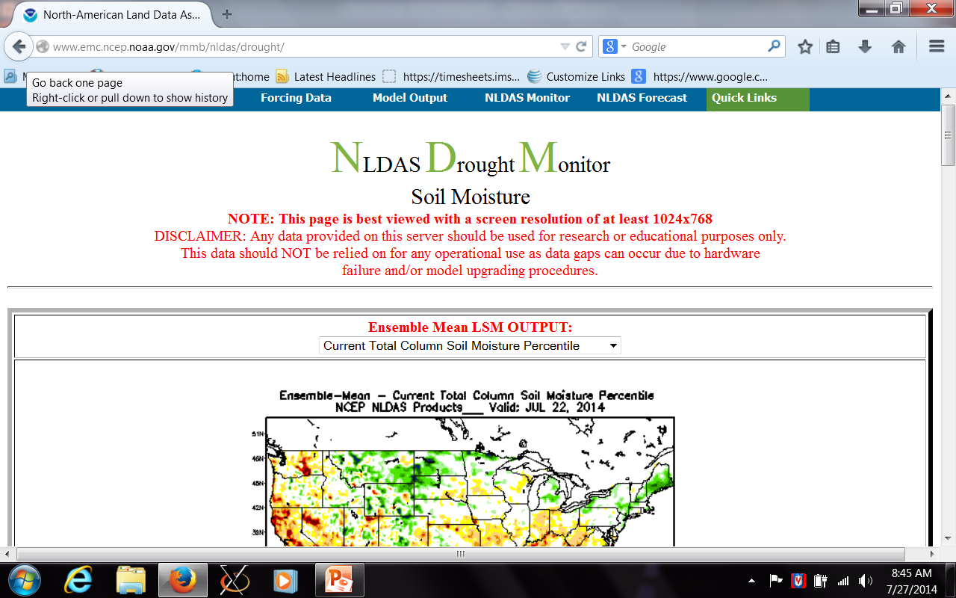
NLDAS v2.0.0 Products(NLDAS-2): Users & Applications
www.emc.ncep.noaa.gov/mmb/nldas

Slide 12
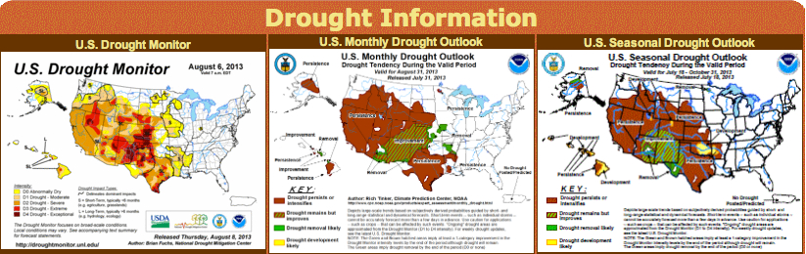
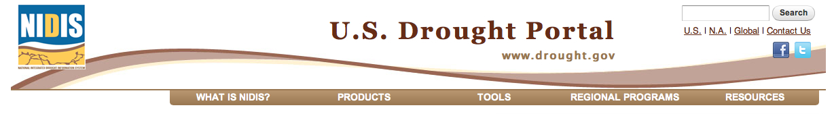
NLDAS: Users
NCEP/CPC Drought Monitoring & Drought Outlook (www.cpc.ncep.noaa.gov/products/Drought)
US Drought Monitor (www.droughtmonitor.unl.edu)
US Drought Portal/National Integrated Drought Information System (NIDIS) (www.drought.gov)
Other government, academic, private users.

Slide 13
NOAA Climate Program Office (CPO):
Long Term Supporter of NLDAS & GLDAS Development
(significantly augments EMC in-house support)
GCIP
GAPP
CPPA
MAPP
CTB

Slide 14
NOAA Climate Program Office (CPO):
Long Term Supporter of NLDAS & GLDAS Development
(significantly augments EMC in-house support)
NLDAS & GLDAS (land only): monitoring
NAM (NDAS): short-range mesoscale /4-day
GFS (GDAS): medium-range global /2-weeks
CFS (CFSRR): seasonal /9 months
CFSRR (global reanalysis) monitoring & historical assessment
NARR: N. American Regional Reanalysis monitoring & historical assessment

Slide 15
Long Term Support from NASA/GFSC/HSL
Hydrological Sciences Lab: Christa Peters-Lidard
via NASA Terrestrial Hydrology Program: THP
  David Mocko
  Sujay Kumar – Team Leader for HSL Land Information System (LIS)
  Brian Cosgrove (during 1990s)

Slide 16
NLDAS: Partners
and their many NLDAS publications
Xia et al. (2013, Chapter in book published by World Scientific)
NLDAS, Data Sets, Land Model Development:
− M. Ek, Y. Xia, H.Wei, J. Dong, J. Meng (NCEP/EMC)
− J. Sheffield, E. Wood et al (Princeton U.)
− D. Mocko, C. Peters-Lidard (NASA/GSFC)
− V. Koren, B. Cosgrove (NWS/OHD)
− D. Lettenmaier et al (U. Washington)
− L. Luo (U. Michigan, formerly Princeton)
− Z-L Yang et al (UT-Austin); F. Chen et al (NCAR), etc.
NLDAS Maintenance and Operational Transition:
− Y. Xia (NCEP/EMC), Yuqiu Zhu (NCEP/EMC), Simon Hsiao (NCO)
NLDAS Products Application:
− K. Mo, L.-C. Chen (NCEP/CPC)
− M. Rosencrans (CPC), Eric Luebehusen (USDA),US
Drought Monitor Author Group

Slide 17
Future Work: NLDAS-3 Generation
Upgrade all four NLDAS LSMs
  Noah MP
  NASA “Catchment” LSM replacing “Mosaic” LSM
  SAC MP
  VIC generational upgrade
Expand the NLDAS domain (entire North America)
Expand validation tools
Extend Land 4DDA
  snowpack, soil moisture, GRACE TWS
Higher spatial and temporal resolution
  3-km grid (vs. current 14-km grid)
  1-hour output (vs. current 3-hour)
  improve downscaling methods
Seasonal prediction component
  Add 1-2 additional LSMs (e.g. will add Noah LSM) to complement VIC LSM
  Upgrade to formally operational status (vs. current xperimental realtime demonstration)

Slide 18
Drought Monitoring with the
Operational NLDAS-2

Slide 19
Characteristics of Next Two Slides
Next Slide: weekly CONUS-wide soil moisture percentile:
- Ensemble mean of four land models: (Noah, Mosaic, VIC, SAC)
- Left Frame: 01 Jan 2013 to 24 Aug 2014 (about 20 months)
-- Depicts:
  Texas/Great Plains drought
  California drought (especially winter 2014)
- Right Frame: 05 Jan 2011 to 14 Sep 2011 (about 9 months)
-- Depicts:
  Texas Drought
  Severe New England flooding in Sep 2011 from two successive tropical storms
Subsequent Slide: as in above slide except for daily streamflow anomaly
- Left Frame: 20 Aug - 20 Sep 2011 (~30 days) - Right Frame: 01-30 Sep 2013 (~30 days)

Slide 20
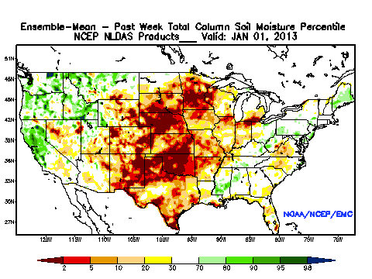
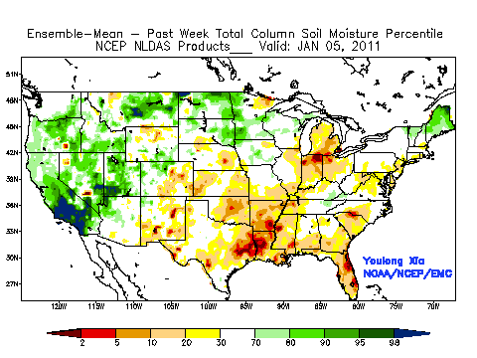
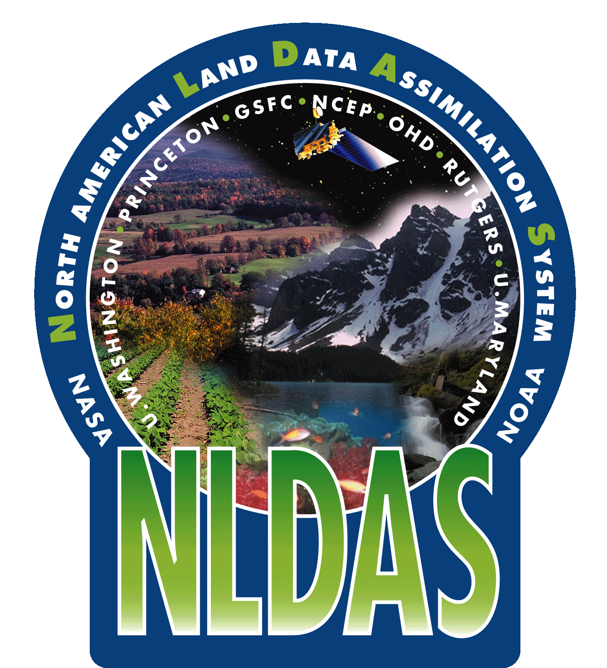
NLDAS Drought Monitoring Examples (4 LSM ensemble mean)
From Texas and California droughts: Jan-Sep 2011 and 2014
NOTE: both of these severe droughts occur after 2009
Weekly Soil Moisture Percentile (%)
California Drought
US drought
Texas Drought

Slide 21
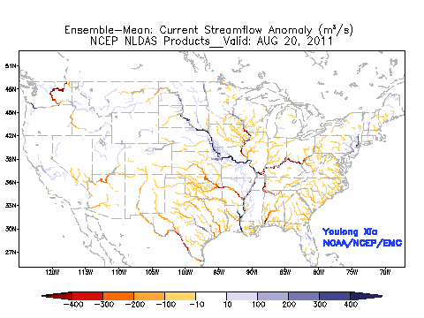
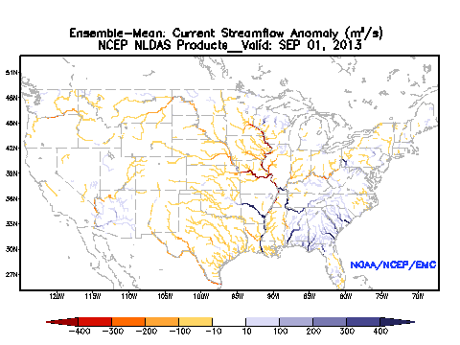
NLDAS Flood Monitoring Examples (4 LSM ensemble mean)
From New England and Lower Mississippi Floods of Aug-Sep 2011 & 2013
NOTE: both of these flood episodes occur after 2009
Daily Streamflow Anomaly (m³/s)
Hurricane Irene and Storm Lee
in the end of August and beginning of September 2011
Colorado Front Range Flooding
in September 2013

Slide 22
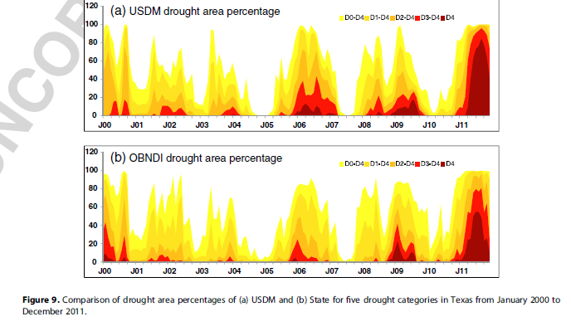
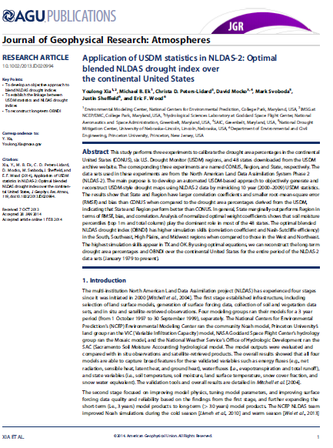
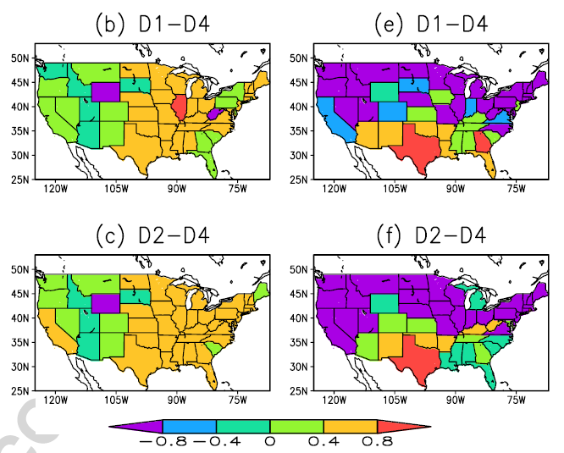
Objective Blended NLDAS Drought Index – OBNDI
Drought Extent in Texas:
US Drought Monitor vs NLDAS
To develop an automated and objective framework to blend multiple drought indices to support operational
drought monitoring task
Nash-Sutcliffe Efficiency for two USDM drought categories
2000-2009
2010-2011
No Skill

Slide 23
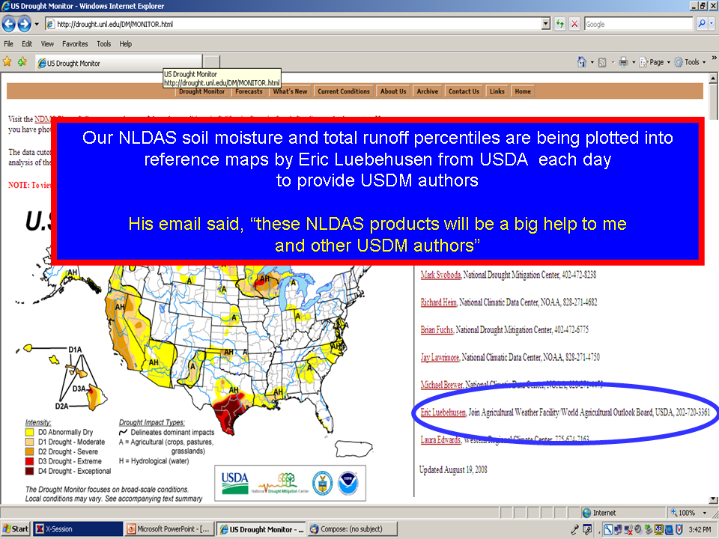
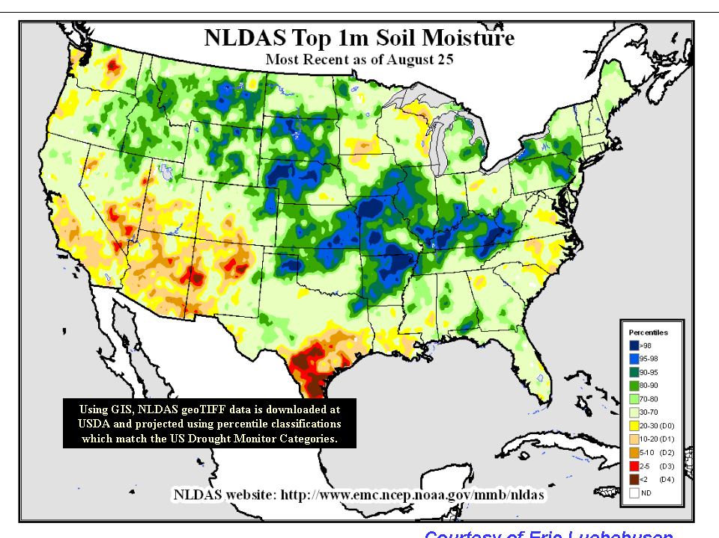
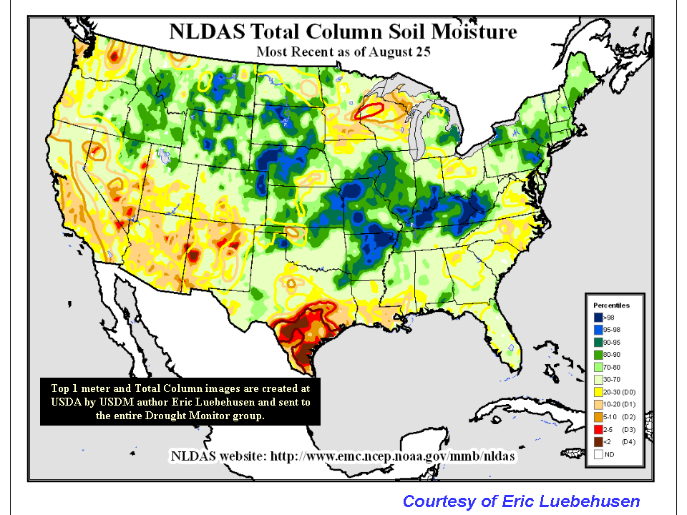
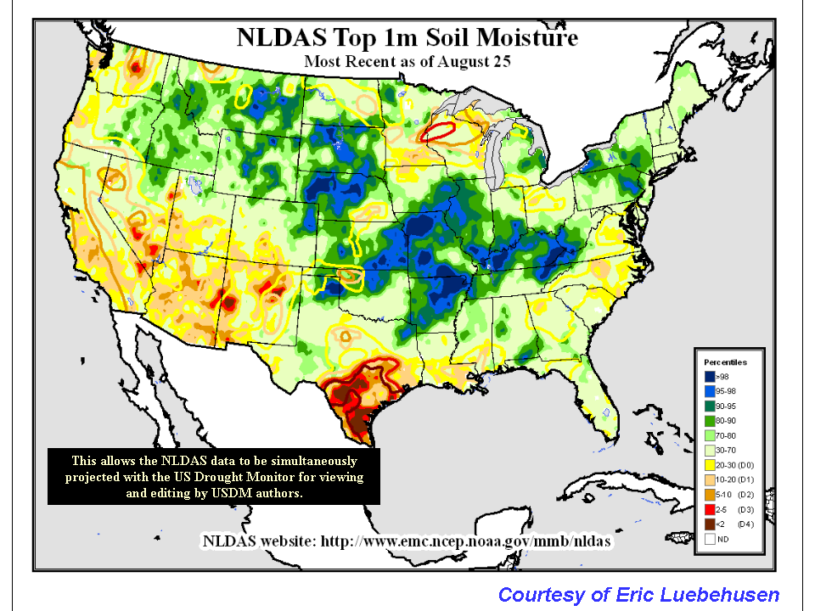
Direct application of NLDAS products to USDM
NLDAS soil moisture and total runoff products are provided to Eric Lubehusen at USDA who is one of the authors of the US drought Monitor. He created top 1m and total column soil moisture images and sent them to the entire Drought Monitor group (contour – US Drought Monitor boundary, and shaded plot is NCEP NLDAS ensemble mean percentile).

Slide 24
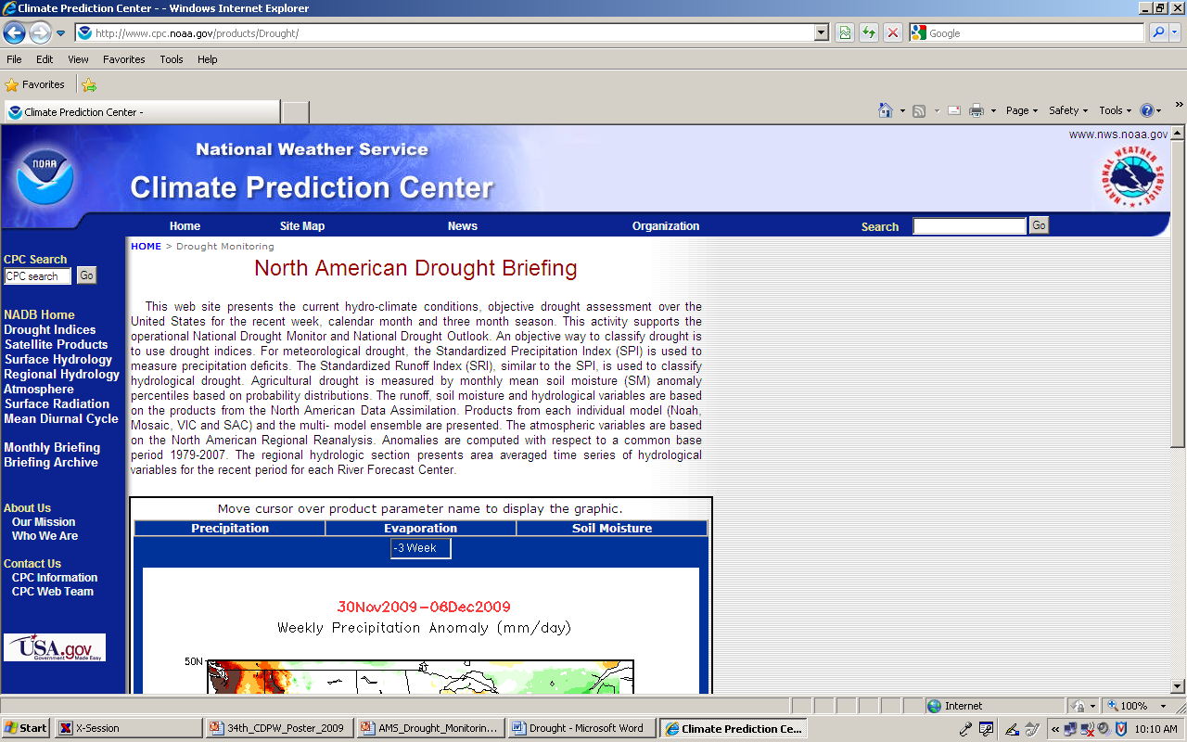
NLDAS Products Directly Support
CPC Monthly Drought Briefing

Slide 25
The current and new NLDADS-2 climatologies:
Operational: 30-year (1980-2009)
Experimental: 36-year (1979-2014)
How created
Implications & Challenges of adding more years
  Percentiles & anomalies show surprising sensitivity to choice between the two climatologies
  How to largely eliminate such sensitivity?
Preliminary results from proposed solution (via B. Narapusetty et al. 2015)

Slide 26
Table 1: Contour levels of anomalies and percentiles for three time scales used in current NLDAS-DM
Precipitation anomaly (mm/day)
Level | -5 | -4 | -3 | -2 | -1 | 1 | 2 | 3 | 4 | 5
Top 1-meter soil moisture anomaly (mm)
Level | -125 | -75 | -50 | -25 | -12 | 12 | 25 | 50 | 75 | 125
Total column soil moisture anomaly (mm)
Level | -250 | -150 | -100 | -50 | -25 | 25 | 50 | 100 | 150 | 200
Snow water equivalent anomaly (mm)
Level | -200 | -150 | -100 | -50 | -5 | 5 | 50 | 100 | 150 | 200
Total runoff and evapotranspiration anomaly (mm/day)
Level | -3 | -2.1 | -1.5 | -0.9 | -0.3 | 0.3 | 0.9 | 1.5 | 2.1 | 3
Streamflow anomaly (m³/s)
Level | -400 | -300 | -200 | -100 | -10 | 10 | 100 | 200 | 300 | 400
Percentile for all variables except for precipitation (%)
Level | 2 | 5 | 10 | 20 | 30 | 70 | 80 | 90 | 95 | 98

Slide 27
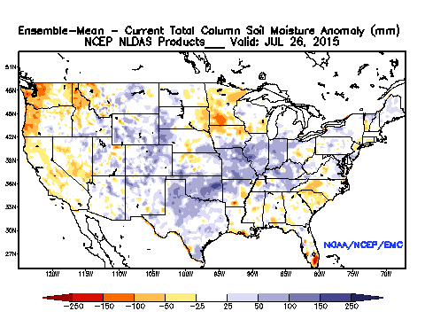
NC
NW
GL
NE
KS
A
C
CA
TX
D
FL
B
Figure 1: Four-model ensemble mean total soil moisture anomaly (mm) in current NLDAS Drought Monitor website (1980-2007, 28-year climatology). Four regions: Northwest (NW), North Central (NC), Great Lakes (GL), Northeast (NE) for snow water equivalent comparison. Four states: California (CA), Kansas (KS), Florida (FL), and Texas (TX) are used as examples for this study. Four points: A, B, C, and D are used for cumulative Density Function (CDF) comparison analysis.

Slide 28
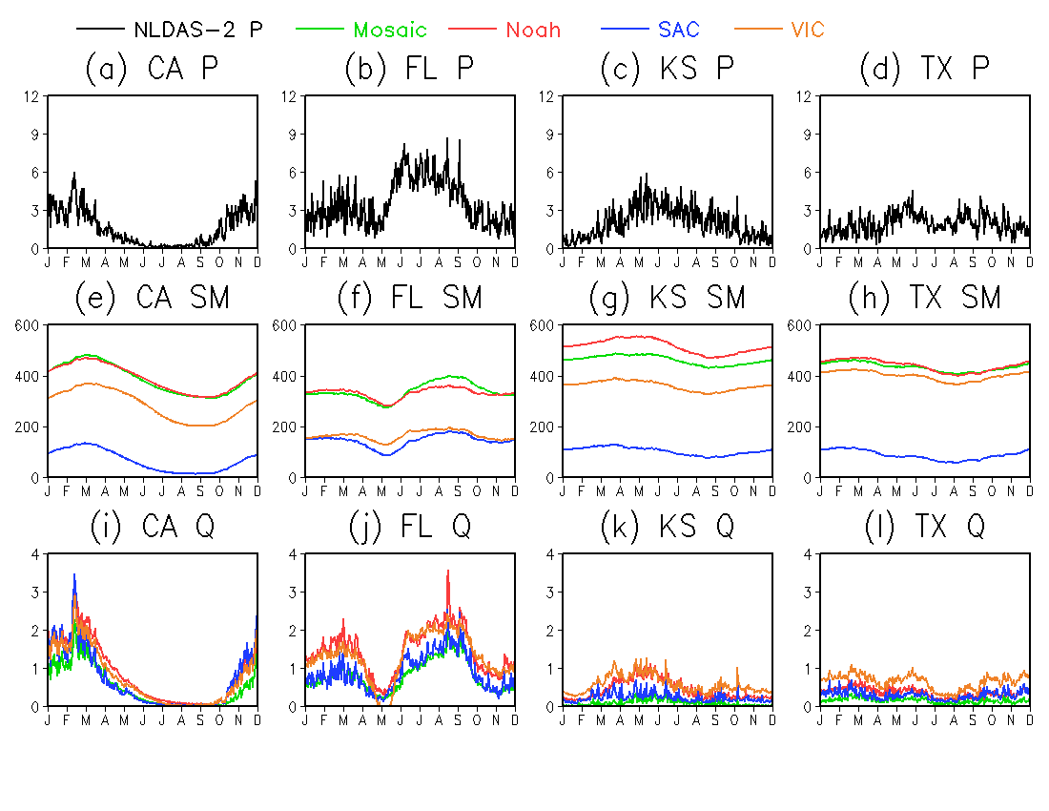
mm/day mm mm/day
Figure 2: 28-year (1980-2007) daily climatology for: precipitation ( top, unit: mm/day), total column soil moisture (middle, unit: mm), and total runoff (bottom, unit: mm/day) for the four states of CA, FL, KS, and TX (from left to right)

Slide 29
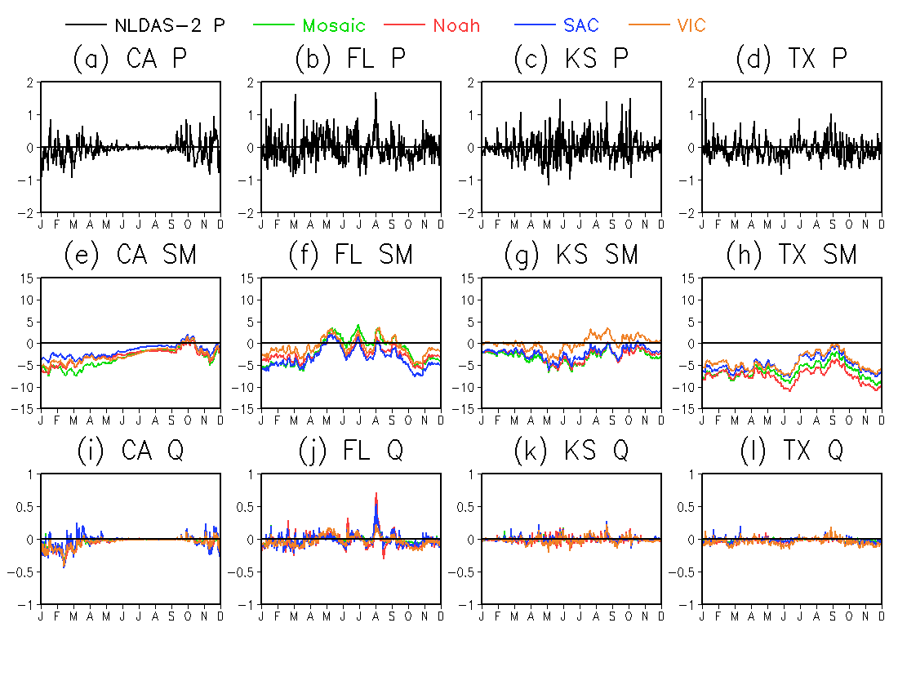
mm/day mm mm/day
Figure 4: Mean daily difference between 36-yr (1979-2014) and 28-yr (1980-2007) daily climatology for precipitation (mm/day, top panel), total column soil moisture (mm, middle panel), and total runoff (mm/day, bottom panel) for the four states of CA, FL, KS, and TX (from left to right).

Slide 30
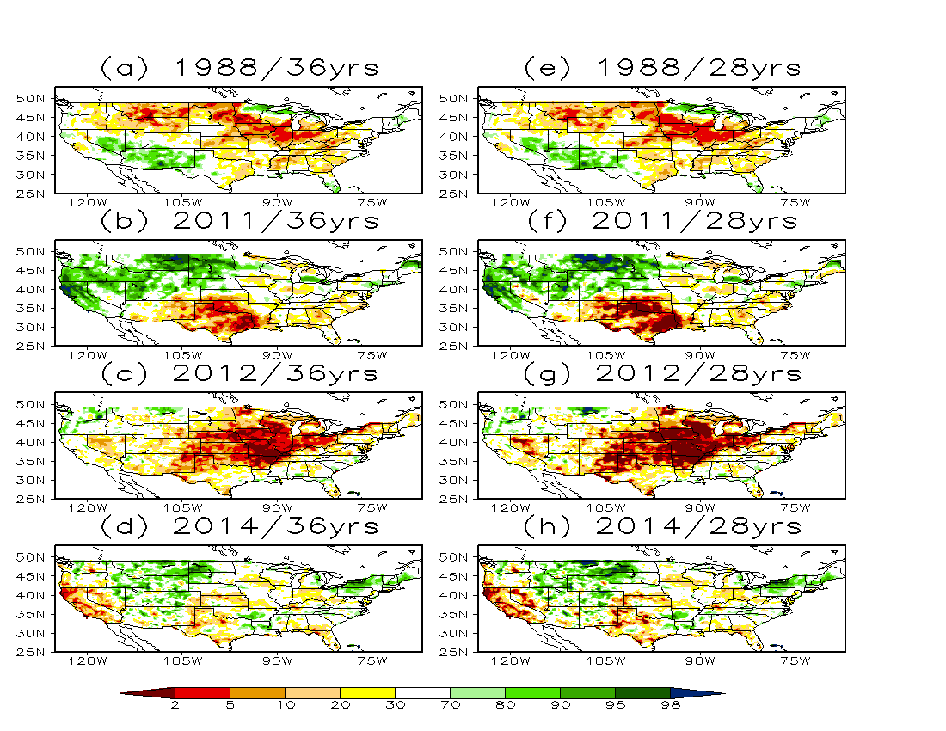
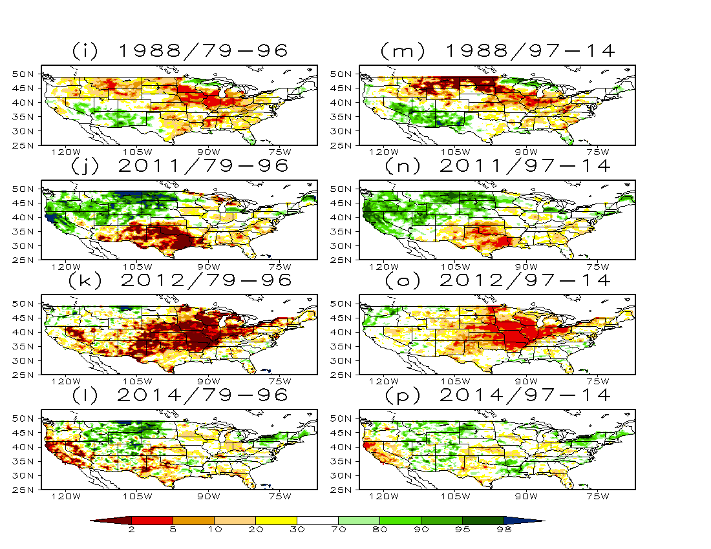
Noah Model
Figure 15: Comparison of monthly total column soil moisture percentiles simulated from Noah when different climatologies are used.

Slide 31
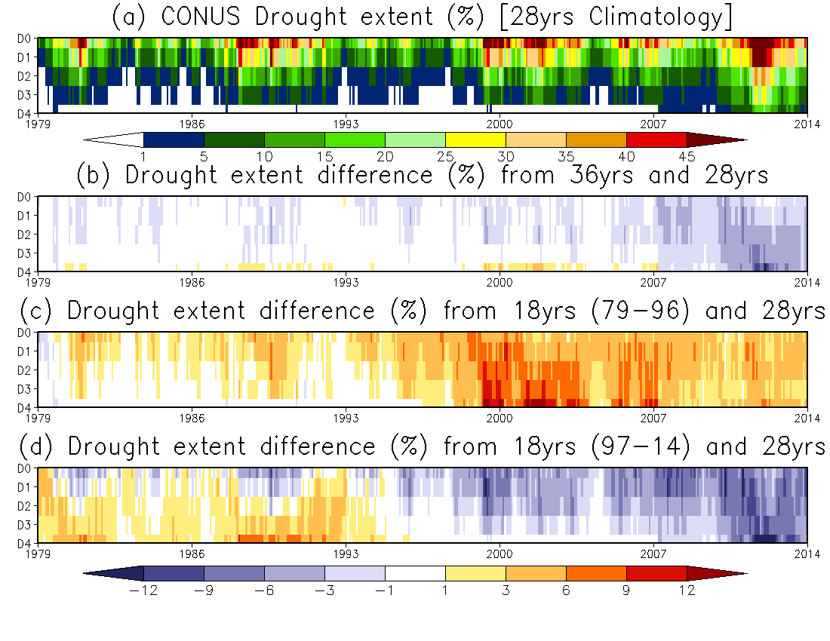
Noah Model
Northern US
Southern US
Figure 17: Monthly variation of drought extent over CONUS calculated from 28yrs CDF climatology and drought extent differences during 1979 and 2014 .

Slide 32
Summary and Conclusion
Using 36yrs climatology average for NLDAS Drought monitor has small-to-moderate effects (based on contour levels) on anomaly metrics at three time scales when compared with current NLDAS drought monitor with 28yrs climatology average.
Using 36yrs climatology CDF to calculate percentiles for NLDAS drought monitor shows large impacts for extreme events when compared with current NLDAS drought monitor with a 28yrs CDF. As many extremely strong drought events in recent several years are introduced to CDF climatology, if updated, both drought extents and intensity will be decreased as expected. This case is true for both agricultural and hydrological drought monitoring.
To compare the inter-length spread (from different climatologies) with inter-model spread (from different models), models have larger uncertainties than different climatologies for both agricultural and hydrological drought extents. As demonstrated in Xia et al. (2012a, 2014), hydrological drought extents have the largest uncertainties as they have the largest spread values.
The further investigation with two independent 18 years (1979-1996, 1997-2014) for Noah model displays that CONUS drought extent has large differences when compared to 28yrs CDF climatology, suggesting significant impact on drought area and intensity estimates.

Slide 33
Optimal estimation of NLDAS climatology
Bala Narapusetty^{1,2}, David Mocko^{2,3}, Sujay Kumar^{2,3}, Kristi Arsenault^{2,3},Youlong Xia⁴, Ken Mitchell⁵
1 – ESSIC, UMD
2 – Hydrological Sciences Laboratory, NASA/GSFC
3 – SAIC
4 – I. M. System Group/EMC/NCEP
5 – Prescient Weather Ltd, State College, Pennsylvania

Slide 34
Estimate Climatology:
More parameters are needed with Simple Averaging (SA) compared to Spectral Method (SM)
Simple averaging: Estimate climatology by averaging the data with
fixed annual cycle.
Spectral method: Estimate climatology by regressing the data
onto few harmonics

Slide 35
Application of Spectral Method to derive a climatology for
the Noah LSM in NLDAS-2
Precipitation
Root-Zone Soil Moisture (RZSM)
The hourly data is averaged to produce daily data
Climatologies are based on:
30 years: 1980-2009
36 years: 1979-2014
Notes:
Based on area-averaged cross-validation error, the truncation parameter H=4 will produce optimal climatology.
That means we need to consider 9 (2*H+1) parameters with spectral method compared to usual 12 parameters with simple averaging.

Slide 36
The optimal number for ‘H’ is 6 based on area-averaged
Cross-validation error over CONUS
Notes:
The RMSE differences in top-layer soil moisture climatology between spectral method and simple averaging are shown above.
In both the approaches, the climatology is estimated based on 30-years of data from 1980-2009.

Slide 37
Application of “Spectral Method” to
Precipitation Fields
in NLDAS-2:
Notes:
Based on area-averaged cross-validation error, the truncation parameter H=4 will produce optimal climatology.
That means we need to consider 9 (2*H+1) parameters with spectral method compared to usual 12 parameters with simple averaging.

Slide 38
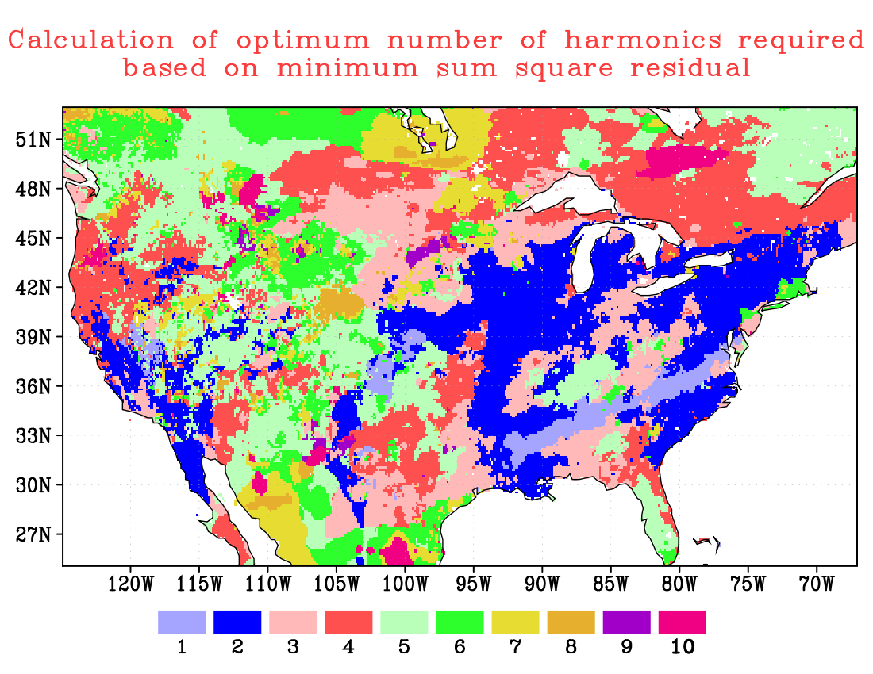
The gridded map of truncation parameter ‘H’ as
required in spectral approach (based on 1979-2014)
Notes:
The truncation parameter H based on sum-squared Based on sum-squared cross-validation error.
We will need “2*H+1” parameters to construct the spectral climatology compared to fixed 366 parameters using the simple averaging.
since H<=9, “2*H+1” is always less than 19.
Note: In the higher latitudes, the total column soil-moisture looks like a step-function, therefore we need higher H to resolve them.

Slide 39
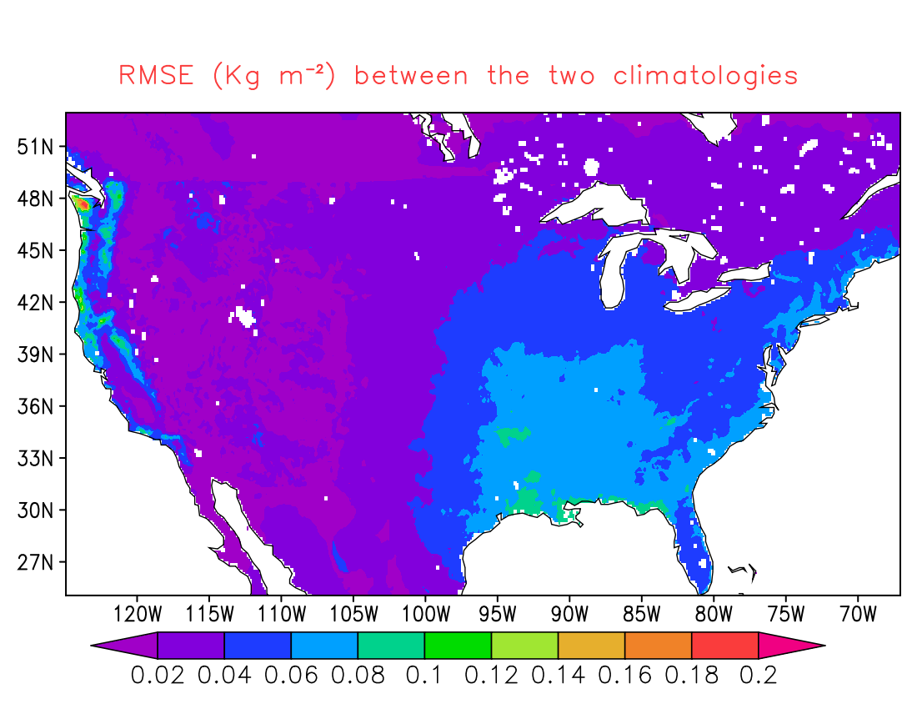
RMSE of two PRECIP climatologies
Notes:
The RMSE differences in top-layer soil moisture climatology between spectral method and simple averaging are shown above.
In both the approaches, the climatology is estimated based on 30-years of data from 1980-2009.

Slide 40
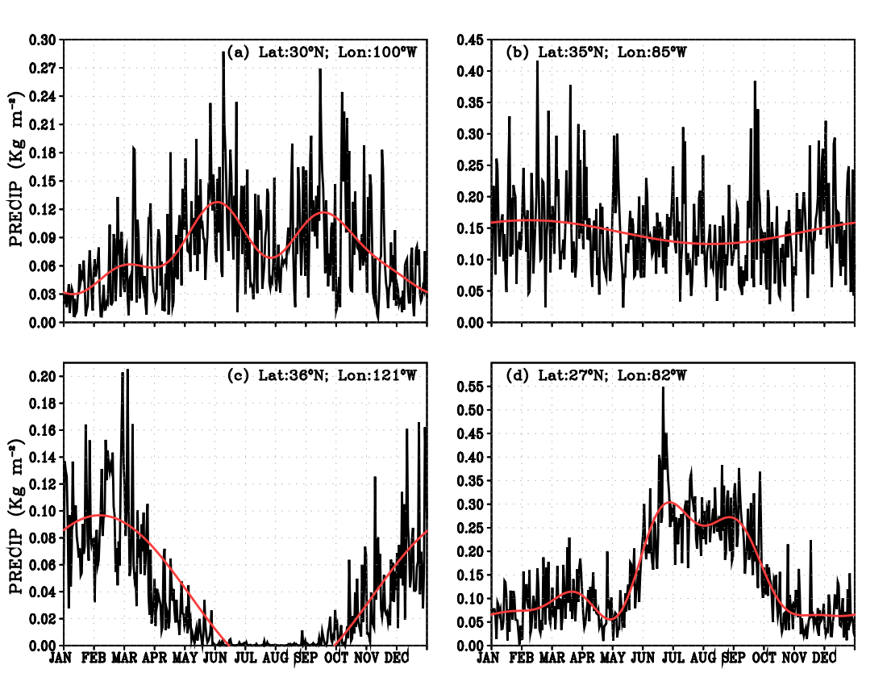
The two climatologies at different
locations over CONUS (based on 1980-2009)
Notes:
The climatology estimated with simple averaging always produces jagged time-series and differ up to 20% with the climatology estimated with spectral approach.

Slide 41
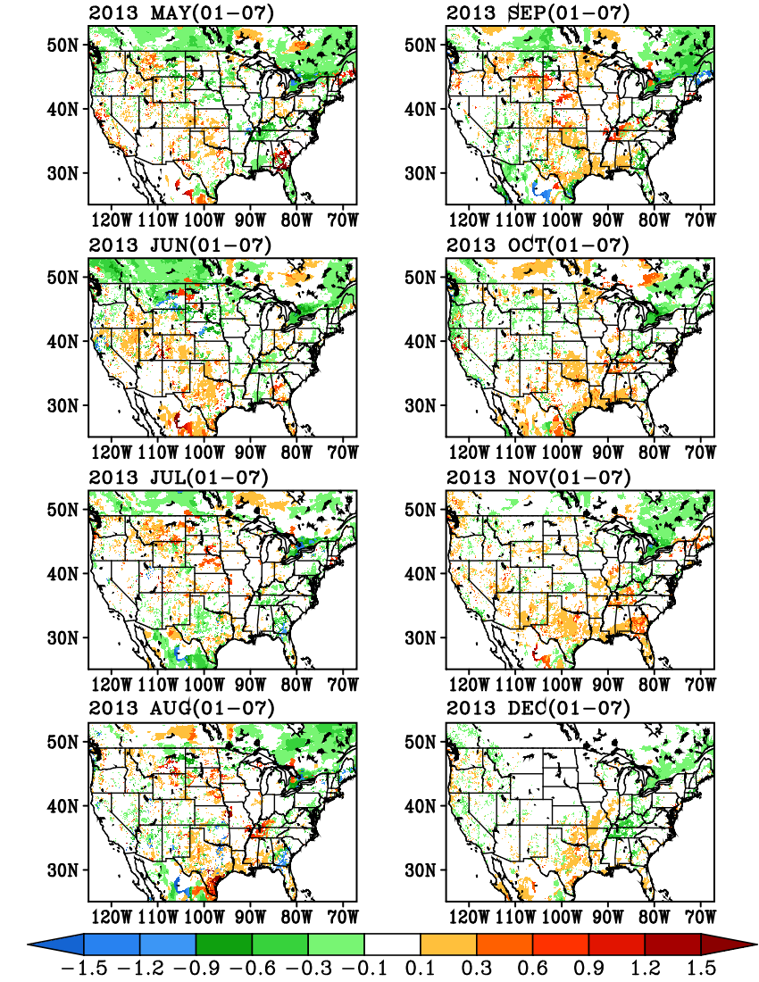
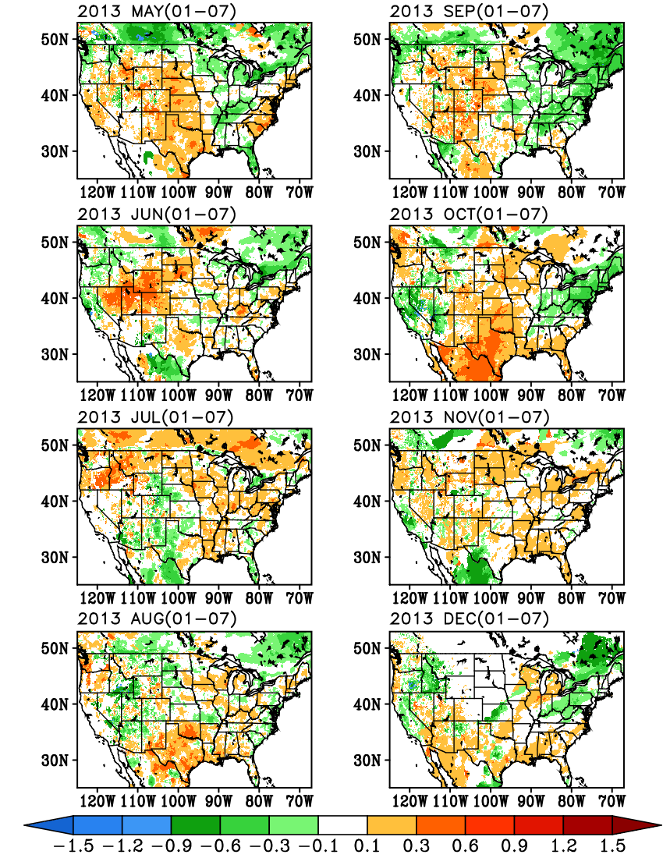
Differences in standardized anomalies (*5) computed based
on 30-year (1980-2009) and 36-year (1979-2014) climatologies
Spectral approach
Simple Averaging

Slide 42
Application of “Spectral Method” to
Root Zone Soil Moisture
in NLDAS-2:
Notes:
Based on area-averaged cross-validation error, the truncation parameter H=4 will produce optimal climatology.
That means we need to consider 9 (2*H+1) parameters with spectral method compared to usual 12 parameters with simple averaging.

Slide 43
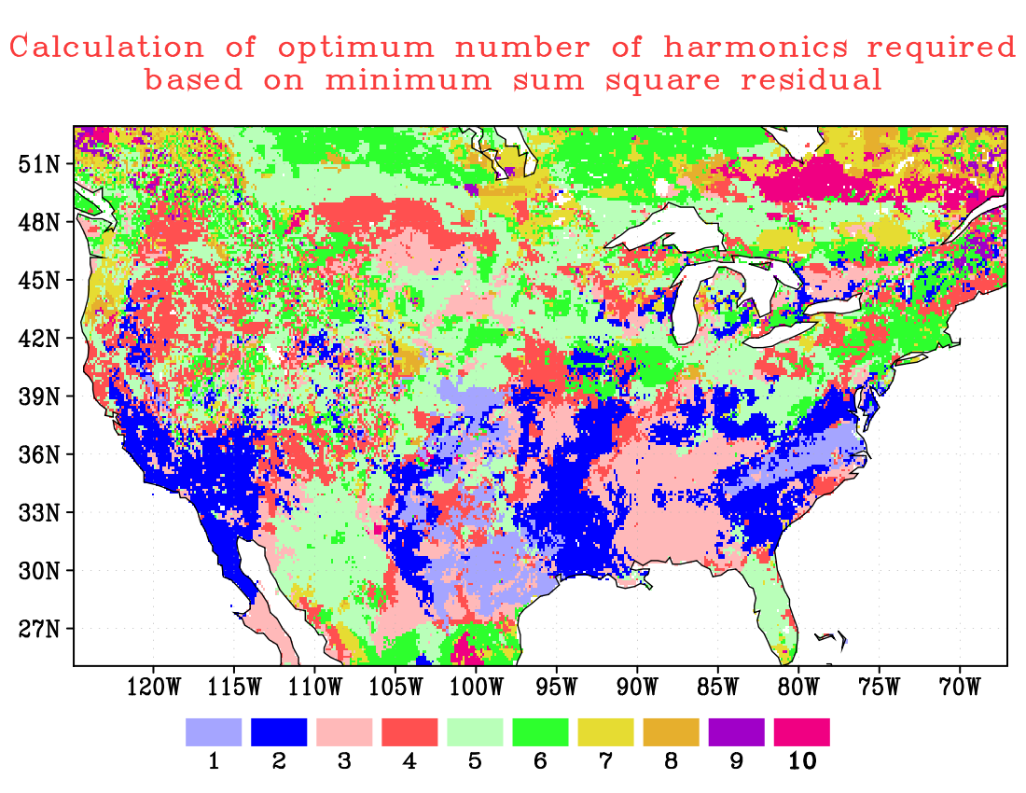
The gridded map of truncation parameter ‘H’ as
required in spectral approach (based on 1979-2014)
Notes:
The truncation parameter H based on sum-squared Based on sum-squared cross-validation error.
We will need “2*H+1” parameters to construct the spectral climatology compared to fixed 366 parameters using the simple averaging.
since H<=9, “2*H+1” is always less than 19.
Note: In the higher latitudes, the total column soil-moisture looks like a step-function, therefore we need higher H to resolve them.

Slide 44
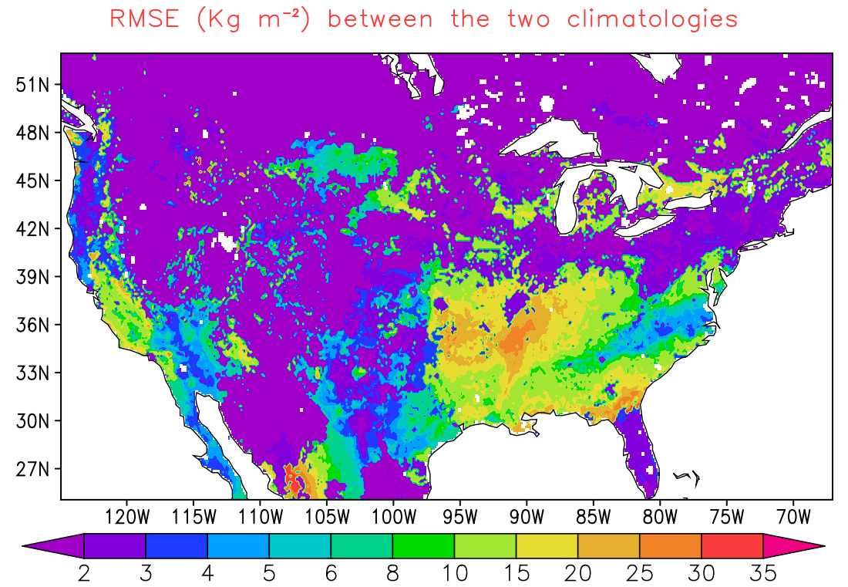
RMSE between two RZMC climatologies
Notes:
The RMSE differences in top-layer soil moisture climatology between spectral method and simple averaging are shown above.
In both the approaches, the climatology is estimated based on 30-years of data from 1980-2009.

Slide 45
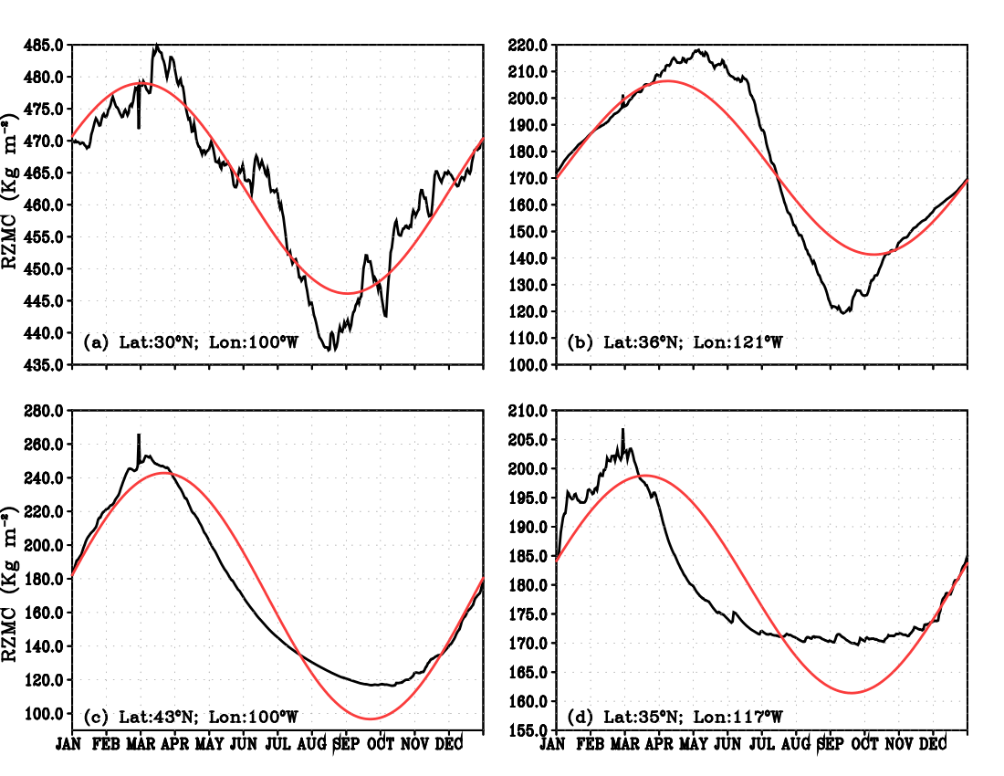
The two climatologies at different
locations over CONUS (based on 1980-2009)
Notes:
The climatology estimated with simple averaging always produces jagged time-series and differ up to 20% with the climatology estimated with spectral approach.

Slide 46
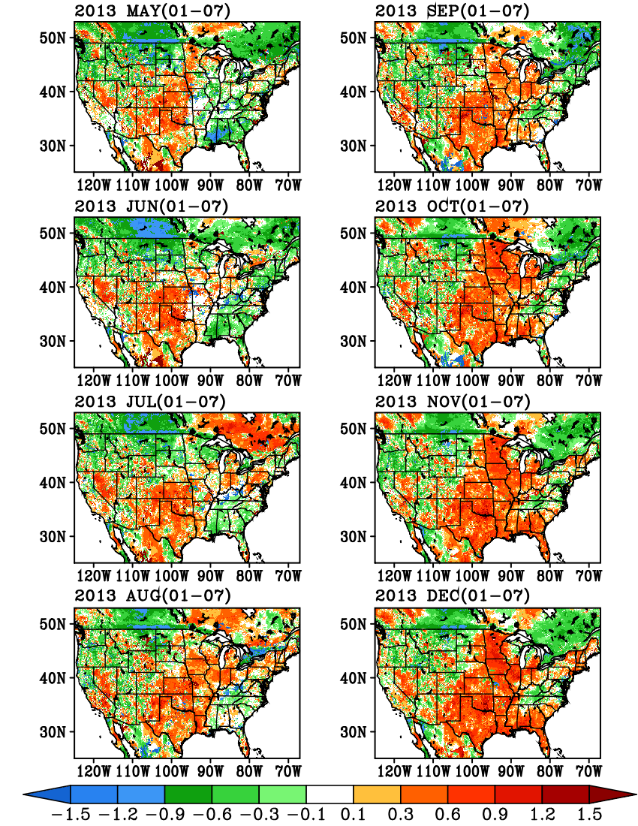
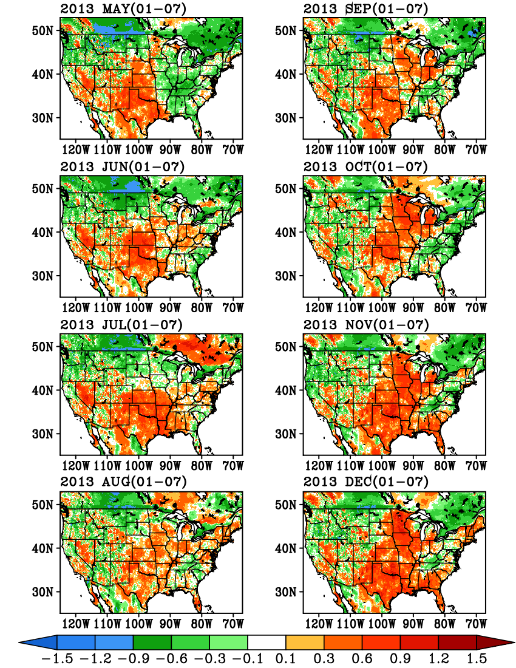
Differences in standardized anomalies (*5) computed based
on 30-year (1980-2009) and 36-year (1979-2014) climatologies
Simple Averaging
Spectral approach
Simple Averaging
Spectral approach

Slide 47
Summary
Spectral Method estimates climatology with
2H+1 parameters, while the Simple Averaging requires 365
independent parameters for daily and 12 independent parameters
for monthly climatology.
Spectral method is far-less sensitive to leap years and missing data.
The cross validation error calculations show Spectral Method
represents independent data with less mean square error.
Spectral Method is ideal for smaller datasets.
Spectral Method is useful for hypotheses testing.

Slide 48
Future Work
Extend the Spectral Method based climatology estimations to
total column moistures, Runoff and Evapotranspiration and apply
the method to update the NLDAS drought monitor
Estimate the required number of optimal parameters based on
cross-validation errors over seasonal time-scales and area averages
Extend the new optimal estimation based climatology based
estimations to the other participating LSMs in NLDAS

