Slide 1
Flash Droughts over the United States
Kingtse C. Mo
Climate Prediction Center
&
Dennis P. Lettenmaier
UCLA

Slide 2
What is flash drought?
Heat waves
meet
Lack of soil moisture
It occurs in Spring or summer (April-September)
It does not last long (flash)

Slide 3
Why should we study flash droughts ?
It tends to occur in spring and summer which are the crop growing season
High temperature and sudden drop of soil moisture withered the just panned crops
The economic losses to crops and livestock reported by the USDA are in the billions of $US [Wallander et al. 2012 and USDA Risk Management agency (http://www.rma.usda.gov/data)].

Slide 4
A story : how did flash drought become a hot topic ?
In 2012 late May, heat waves and low soil moisture wither just planned crops
When reporters knocked on the CPC door, our Anthony Artusa called that Flash Drought
Meanwhile, Jason Otkins and Martha Anderson also detected the 2012 event using the satellite derived Evaporative Stress Index (ESI)
Now, the flash drought had arrived

Slide 5
T2m ET SMP
2012 case
May
11-15
Temperature increased and reached a maximum in 21-25May
ET followed T2m and increased
SM started to drop when T2m reached a max
Heat waves did not last but SM continued
May
16-20
May
21-25
May
26-30

Slide 6
Flash drought is----
Flash droughts can be defined as
Heat waves -- high temperature Tair>1SD
ET--- increases so ET anomalies are positive ET anom >0
SM drops --- SM% is below 30%
Heat wave flash drought

Slide 7
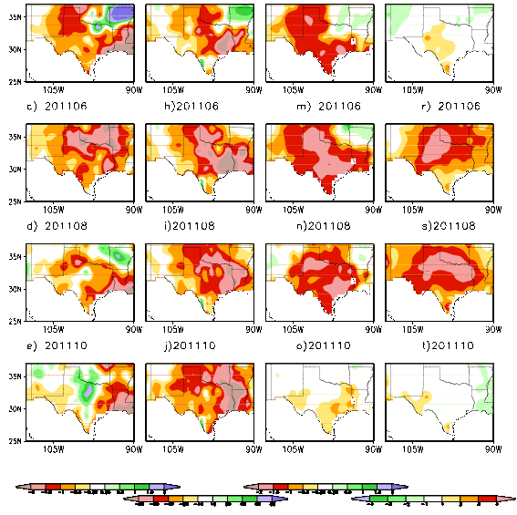
P SM ET Tair
TEXAS 2011 drought
Rong Fu , Yang
Also called the 2011 Texas drought a flash drought
May
Jun
It started with the Lack of P=> SM decreases
ET decreased=>
Tair increased
Occur in regions
SM & ET are related
aug
Oct

Slide 8
Precipitation Deficit flash drought
T>1SD
ET anom <0
P < 40%
Heat waves are the consequence of the lack of Precipitation

Slide 9
Two types of flash droughts
The similarities are
High temperature
And Decrease of SM
Differences
Physical mechanisms
One starts with heat waves--- Heat wave flash drought
One starts with P deficits----P deficit flash drought

Slide 10
Data sets from UCLA/UW
Data period: 1916-2013
Interval: Pentads (5-day means)
Four variables (T_{air}, P, ET and SM ):
T_{air} , P (from observed stations),
ET and total SM (reconstructed from land models: Noah, Catchment, SAC and VIC).
we will use ensemble mean of four models for our study

Slide 11
variables
T -- standardized anomalies
P --percentiles
ET -- anomalies
SM –percentiles
We processed for each model and compute frequency of occurrence
All composites are the ensemble means of four models

Slide 12
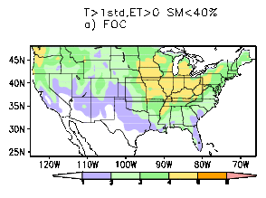
Heat wave flash drought
Frequency of occurrence=
Number of events/record length
4-5% max
Definition
High temperature == Tair> 1 standard dev
ET increases (anomaly >0.)
SM decreases– to 30% or lower

Slide 13
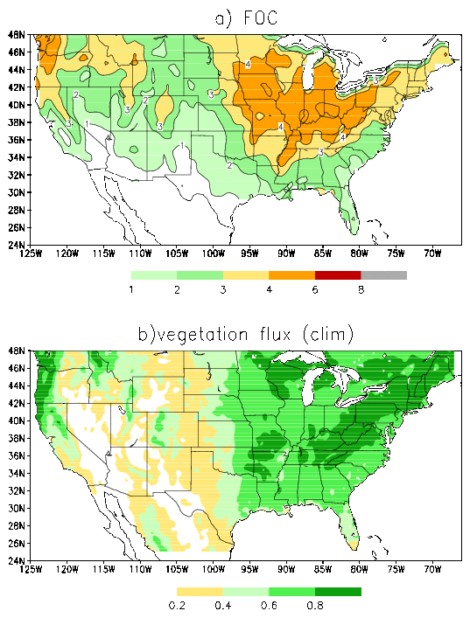
Heat wave flash drought
High temperature=>
Increase of the transpiration and (ET)
That needs vegetation
heat wave flash drought occurs in the vegetation dense areas
Vegetation coverage (Clim)
Let us look at the evolution—next slide

Slide 14
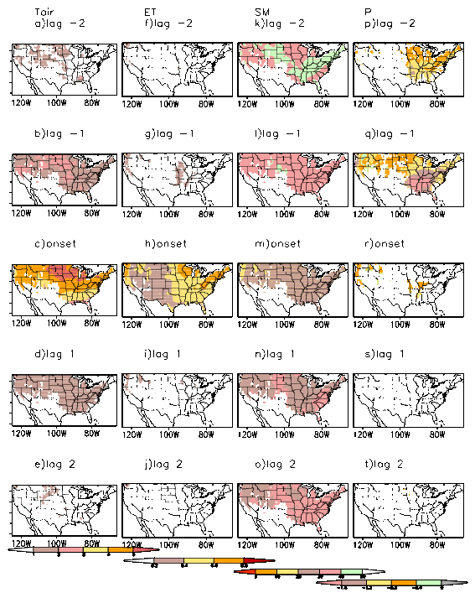
P deficits appear and SM anom is negative at Lag -2 pentads
Lag -2
Tair starts to increase at Lag -1
Sm is >40%
P deficits
ET responds and increases and SM drops to below 30% at onset
Lag +2
P is negative before the onset of droughts
Evolution of heat wave flash droughts

Slide 15
Heat wave flash droughts
Occur over the North Central and the Pacific Northwest over the vegetation dense areas
Start from High temperature=> increase of ET anomalies=> decreases of SM
P deficits start before the occurrence of heat wave flash drought to drive down SM to create favorable conditions for drought to occur
P plays an indirect but important role

Slide 16
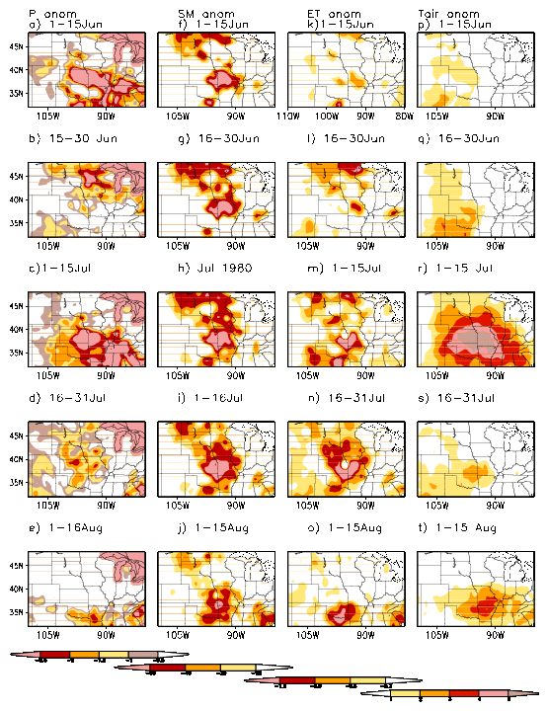
1980 case
P SM ET Tair
a) 1-15Jun
1-15Jul
P deficits=> drop of SM
SM deficits=> ET decreases=> high temperature
P deficit flash droughts

Slide 17
P deficit flash droughts
Different from the heat wave flash droughts
It starts from the lack of precipitation (P)
P deficits = > decreases of SM
=> decreases of ET
=> balanced by increases of sensible heat
=> increases of Temperature
The critical element ➔
relationship btw SM and ET

Slide 18
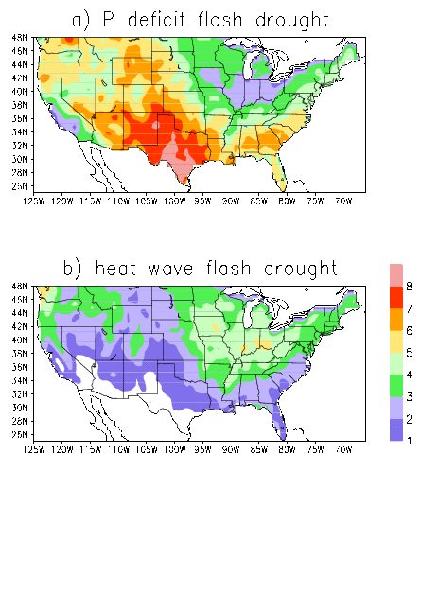
Two types of flash droughts
Definition
P<40%
ET<0
Tair>1SD
SM<40%
ET>0
Tair<1SD

Slide 19
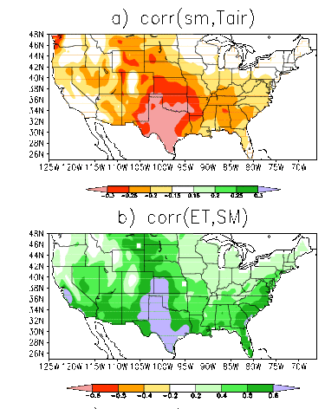
Physical mechanisms for P deficit flash drought
In the areas where the lack of SM=> increase of Tair
Pathway through ET
Only occurs in the areas where ET and SM have a near linear relationship
Too dry
Lack of variability
Koster et al 2009
Monthly mean correlation (apr-sep)

Slide 20
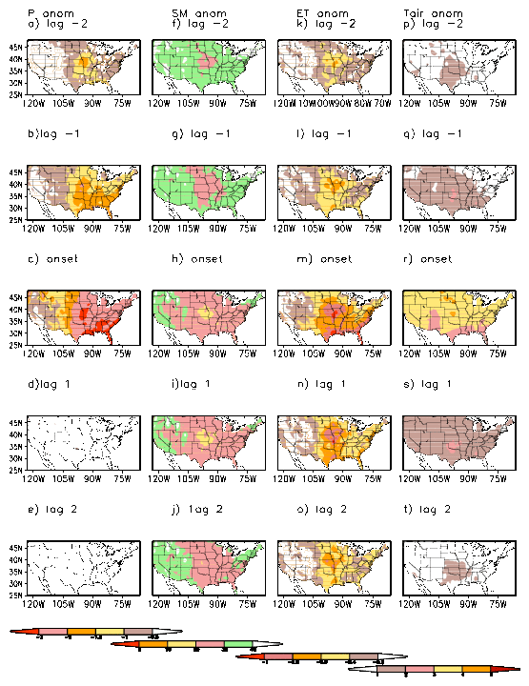
P SM ET Tair
P SM ET Tair
At lag -2 P deficits appear , SM negative and ET starts to decrease
At lag -1, P deficits and SM deficits increase and ET decreases more
At onset, P and SM deficits reach maxima and ET decreases => T increases
Evolution of P deficit drought

Slide 21
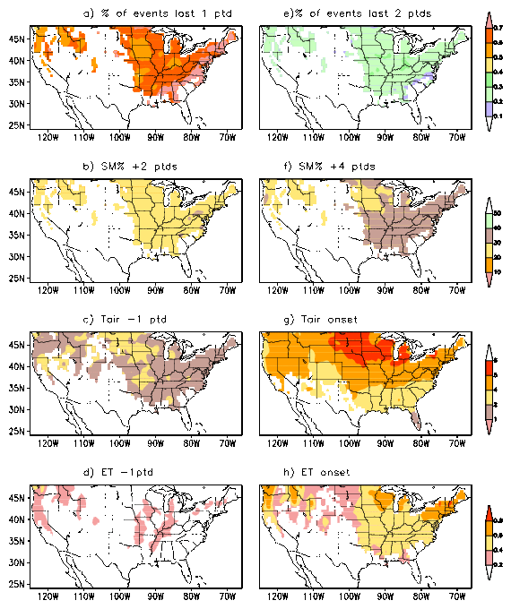
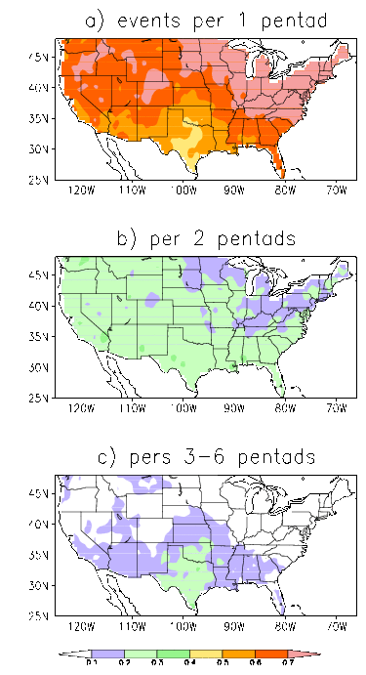
Persistence 1-2 pentads
Heat wave flash drought
P deficit flash drought

Slide 22
Differences between flash droughts and agricultural droughts
Flash droughts do not last. The duration is about few pentads. Agricultural drought lasts longer than 3 months or longer
Flash droughts are linked to heat waves, but heat waves do not always develop during agricultural drought.

Slide 23
trends
Do heat wave or P deficit flash drought events have trends?
If so, do the trends related to trends of forcing such as P or T_{air}?
We use the Mann-Kendall test to detect trends and assess the statistical significance.

Slide 24

Mann Kendall test of trends
For time series T of length n , we test sign of difference of any two pairs.
If T_{j}>T_{i} sign is +1; If T_{j} < T_{i} sign is -1
$$S= \sum_{i=1}^{n−1}{\sum_{j=i+1}^{n}{sign({T_{ }}_{j}}}− T_{i})$$
S>0 increase trend
S<0 decrease trends
Point i
Point j
Ref
Lettenmaier et al 1994

Slide 25
# of heat wave flash drought events/yr North central
(36-42N, 80-100W)
Example of trends
Heat wave flash drought events/yr

Slide 26
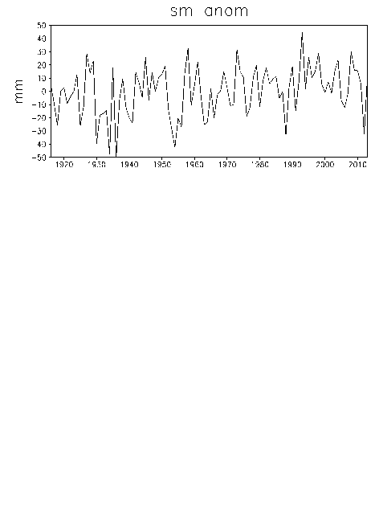
# of Heat wav flash drought events/year
Trends: decreasing
SM anom increasing
Over the North Central
ref Andreadis et at 2005

Slide 27
Heat wave drought Annual events
Mann Kendall tests
decreasing
Increasing wetness
Orange – decreasing trends
Green – increasing trends
Increase of P trends=> increase of SM trends=> less heat wave flash drought events

Slide 28
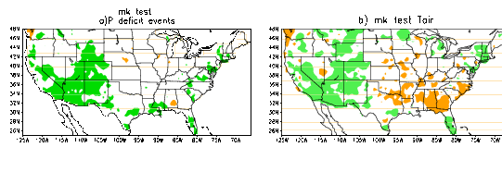
Trends in P deficit flash drought events
MK test events
MK test Tair
warming
Increases of occurrence
Upward trends in the Southwest related to trends in Tair
T increases , it is easier to reach Tanom>1SD so more P deficit flash droughts

Slide 29
Comparison between heat wave and P deficit flash droughts
Features Heat wave flash drought P deficit flash drought
Forcing Temperature driven P deficit driven
Conditions
Temperature above 1SD above 1SD
Soil moisture below 40% below 40%
Precipitation below normal before onset below normal before onset
reaches a min during onset
ET anomalies positive negative
Locations of North Central and Great Plains and southern
Max occurrence the Pacific Northwest states
Max FOC 4-5% 8-9%
Persistence 1 pentad 1pentad
Trends decreasing over the increasing over the
North Central Southwest

Slide 30
Can CFSv2 seasonal forecasts predict flash droughts?
CFSv2 seasonal (first 90-day) forecasts from April to July
A) whether forecasts can predict the preferred regions for flash droughts to occur?
B) whether the CFSV2 can predict each event?
C) if B is too much to ask, then whether the CFSV2 can predict the occurrence of flash droughts in 3 categories: below, normal and above?

Slide 31
Data from CFSV2 hindcasts
For each month and each year, we took total 12 ensemble members
Each season has 18 pentads (90day)
There are 29 years (1982-2010) so we have total 12 x 18 *29 members
For example April 1 case
we have forecasts with initial conditions ( April 1 0z,6z,12z and 18z) and 4 cases from March 27 and 4 cases from March 11

Slide 32
Procedures to get ET and SM
CFSv2 seasonal forecast daily archive from 1982-2010 with runs from ICs from April 1, May 1, June 5 and July 5
Bias corrected monthly mean P and T2m and equally distribute values to daily P and T anomalies
Derive daily forcing from P and T (wind speed taken from climatological 850 winds from CDAS)
Drive VIC model to get daily SM and ET
Bias corrected SM and ET anomalies
Using 12 members (e.g. April 1: April 1, March 27 and March 22)

Slide 33
Model forecasted flash droughts
We pool all 12 members
Calculate the ET anomalies, T2m standardized anomalies, SM and P percentiles in a cross validated way
Use the same criteria as analysis to select heat wave flash drought and P deficit flash drought events
We compare with VIC (SIM)

Slide 34
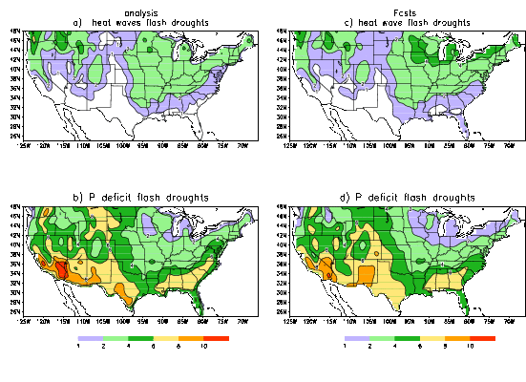
FOC predicted by the CFSv2 seasonal fcsts

Slide 35
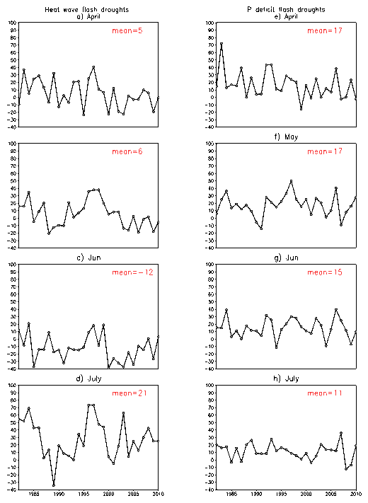
Heidke skill in the 3-category forecasts averaged over the U.S.

Slide 36
Can CFSv2 seasonal forecasts predict flash droughts?
A) whether forecasts can predict the preferred regions for flash droughts to occur? YES
B) whether the CFSV2 can predict each event? NO
C) if B is too much to ask, then whether the CFSV2 can predict whether there are flash drought events in the coming season?
Skill is similar to the 5-10 day forecasts of temperature and precipitation

Slide 37
Next??
1. Are there flash droughts over South America? Or other places around the globe?
2. If so, can the same criteria apply? are the physical mechanisms associated with flash droughts still the same?
3. Can the GEFS (short term forecasts ) predict flash droughts ? So we can issue warning
4. are flash droughts forced? Sst forcing? (our first look did not find enso connection, but ----

Slide 38
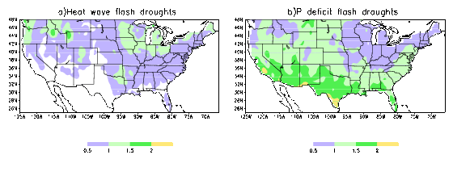
rms of total flash drought events/yr
RMS are normalized by the standard dev of events

Slide 39
ETS score of total flash drought /yr
ETS= hit/(hit+miss+false alarm)
Corrected for the random chances
Hit--- both obs and fcst indicate there are flash drought events in the following season
Miss- obs indicates events, but not forecasts
False alarm- fcst indicates events, but not obs

Slide 40
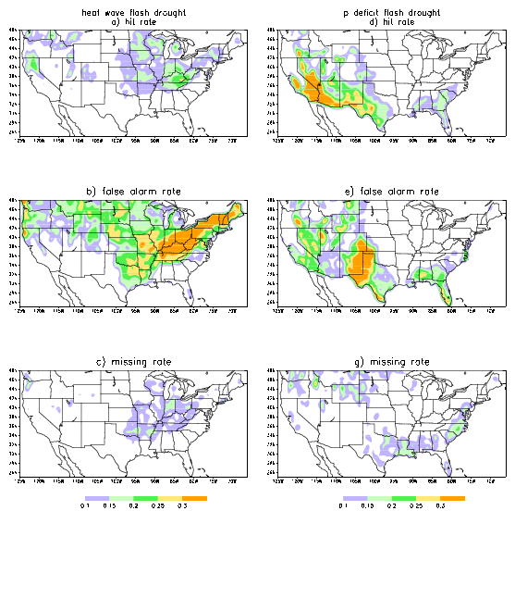

Slide 41
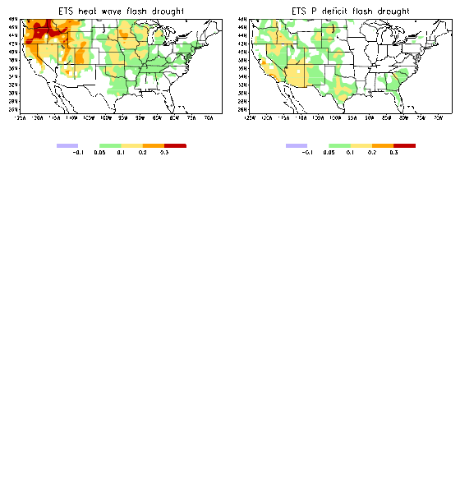
ETS scores

Slide 42
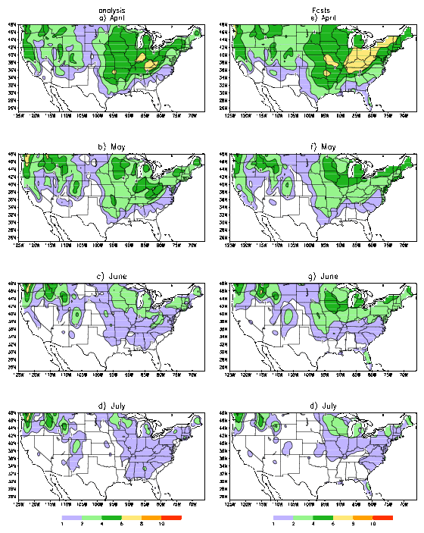
Analysis Forecasts
April
Forecast FOC for heat wave flash droughts
May
Cfsv2 is a able to capture the patterns of the FOC
It also capture the seasonal variability of the FOC
Forecasts have more events than analysis
June
July

Slide 43
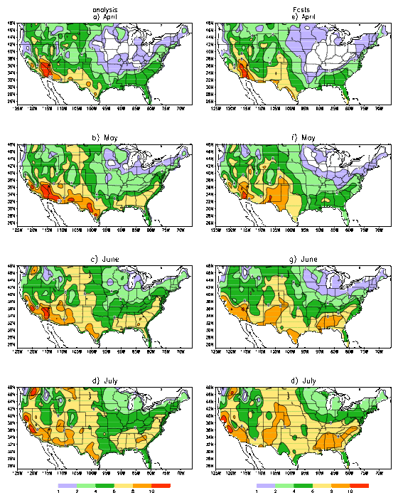
Analysis Forecasts
April
FOC for P deficit flash droughts
May
Cfsv2 is able to capture the patterns of the FOC well
Cfsv2 has more flash drought events than VIC(SIM)
June
July

Slide 44
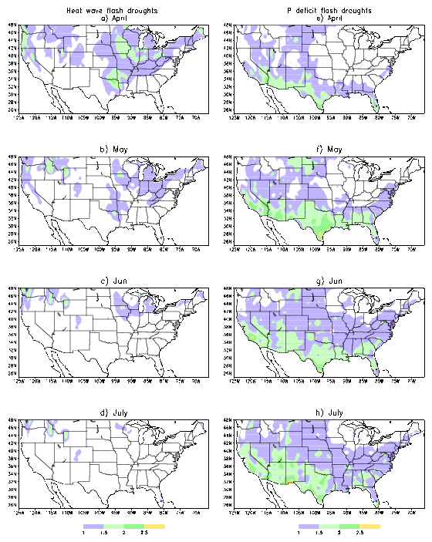

Slide 45
Summary
There are two types of flash droughts
1. Heat wave flash drought
Occurs in the North Central and the Pacific Northwest
Max frequency of occurrence is 4-5%
Temperature driven
High temp=> increasing ET=> decreasing SM
2. P deficit flash drought
Occur over the Great Plains and southern states with a maximum over Texas
Max frequency of occurrence is 8-10%
Precipitation driven
P deficits=> Decreasing SM=> decreasing ET => Temp increases

Slide 46
annual total events
For each year, we have 12 members and 18 pentads
(e.g. for 1982 April 1 initial conditions, we have 90days (seasonal forecasts) so 18 pentads and we have 12 members)
We can compute the flash drought events for each year, each member and each pentad
We took the ensemble mean of 12 members and compute the number of events/per year (add up 18 pentads)
And compare with VIC (SIM)
the next slide displays
Root mean square difference bwt the number of events(yr) from CFSv2 and the number of events/yr (vic(sim))

Slide 47
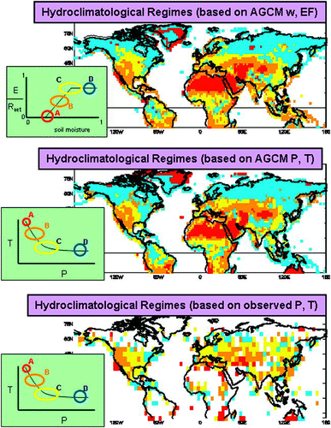
Areas where ET and SM interact
Koster et al. 2009

Slide 48
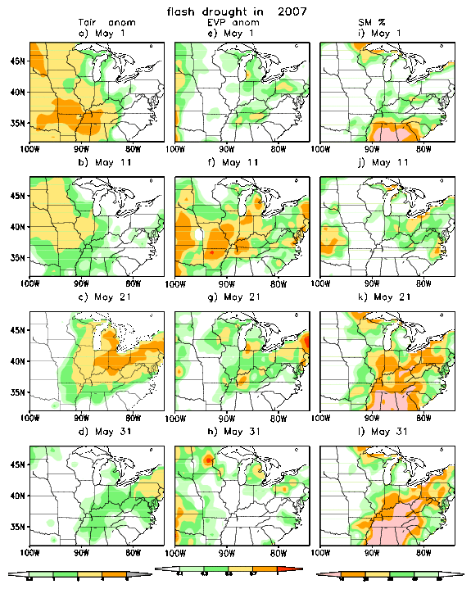
Tair ET SM
2007 case
May 1: high Tair
May 11: ET increased
May 21: SM decreased
May 31: Temp cooled down, only SM was positive
High Tair increases ET

Slide 49
Tair ET SM
2007 case
May 1: high Tair
May 11: ET increased
May 21: SM decreased
May 31: Temp cooled down, only SM was positive
High Tair increases ET

Slide 50
P deficit flash drought
Definition
P deficits < 40%
Tair> 1std
ET anom<0
Max 8-10% in the Great Plains and southern states.
Min at locations that have large heat wave flash drought events.
Max in the areas where atmosphere-land interaction is strong

