Slide 1
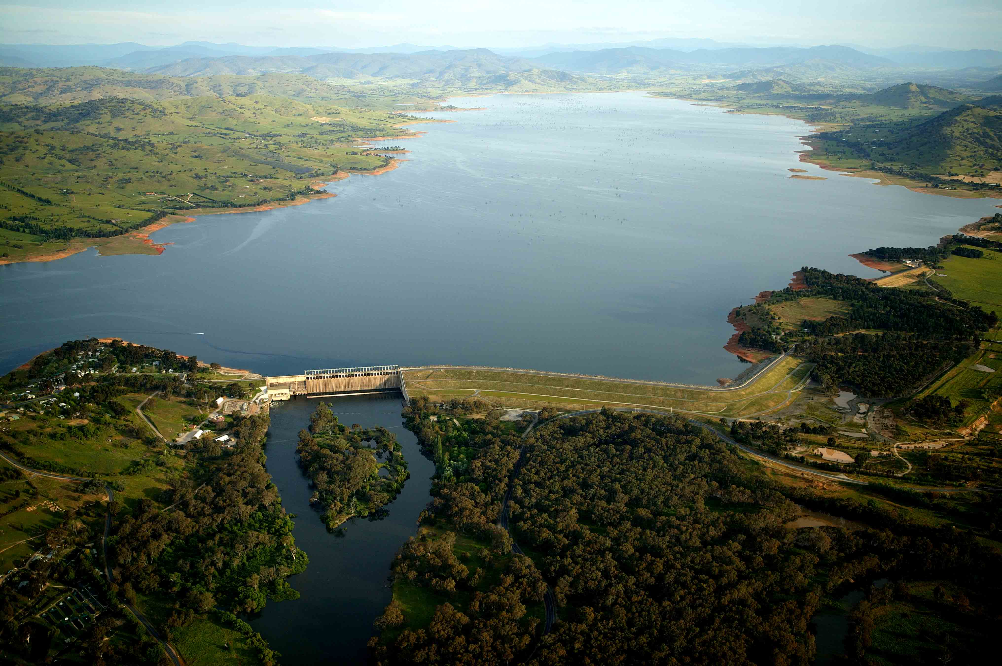
CBaM for post-processing seasonal climate forecasts
QJ Wang and Andrew Schepen
LAND AND WATER

Slide 2
Seasonal streamflow forecasting
Water management needs
  Ensemble time series forecasts to long lead times
  Forecasts to be as skilful as possible and reliable
Most skill from initial catchment condition
Additional skill from climate forecasts
Reliability as well as skill important

Slide 3
Need to post-process GCM forecasts
Biases – unconditional and conditional
Ensemble spread - unreliable
Forecast skill – generally low, sometimes negative
Mismatch in scale for hydrological applications

Slide 4
Available post-processing methods
Mean correction
Multiplicative mean correction
Quantile-quantile mapping
Ensemble regression
Model output statistics

Slide 5
CBaM for post-processing GCM forecasts
Calibration
  Bridging
  and
Merging

Slide 6
CBaM was developed to
Remove bias from GCM forecasts
Improve ensemble spread and reliably represent forecast uncertainty
Remove negative skill
Improve spatiotemporal coverage of positive skill
Combine forecasts from multiple GCMs
Downscale forecasts

Slide 7
Extensively evaluated
Precipitation, maximum and minimum temperatures
Monthly and seasonal resolutions
Zero to long-lead times
Continental and catchment scales
POAMA2.4, ECMWF Sys4, NOAA CFS2
Australia and China

Slide 8
Evaluations published
Schepen, A., Q. J. Wang, and Y. Everingham (In Press): Calibration, bridging and merging to improve GCM seasonal temperature forecasts in Australia. Monthly Weather Review, 142, 1758-1770
Schepen, A., Q. J. Wang, and D. E. Robertson, 2014: Seasonal forecasts of Australian rainfall through calibration and bridging of coupled GCM outputs. Monthly Weather Review, 142, 1758-1770.
Schepen, A., and Q. Wang, 2014: Ensemble forecasts of monthly catchment rainfall out to long lead times by post-processing coupled general circulation model output. Journal of Hydrology, http://dx.doi.org/10.1016/j.jhydrol.2014.03.017.
Peng, Z., Q. J. Wang, J. C. Bennett, A. Schepen, F. Pappenberger, P. Pokhrel, and Z. Wang, 2014: Statistical calibration and bridging of ECMWF System4 outputs for forecasting seasonal precipitation over China. Journal of Geophysical Research - Atmospheres, 119, 2013JD021162.
Hawthorne, S., Q. J. Wang, A. Schepen, and D. Robertson, 2013: Effective use of general circulation model outputs for forecasting monthly rainfalls to long lead times. Water Resources Research, 49, 5427-5436.

Slide 9
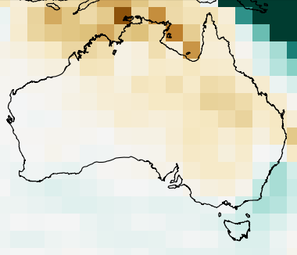
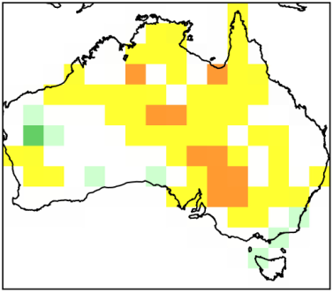
Calibration
Raw GCM output
Calibration forecast
BJP

Slide 10
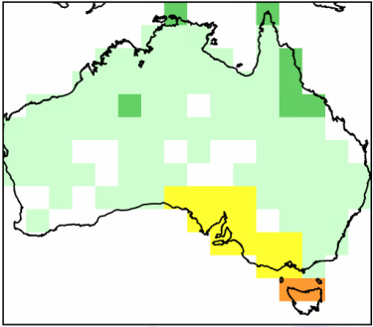
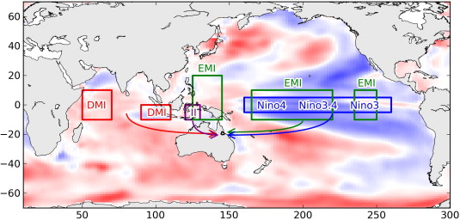
Bridging
Bridging forecast
GCM SSTs
BJP

Slide 11
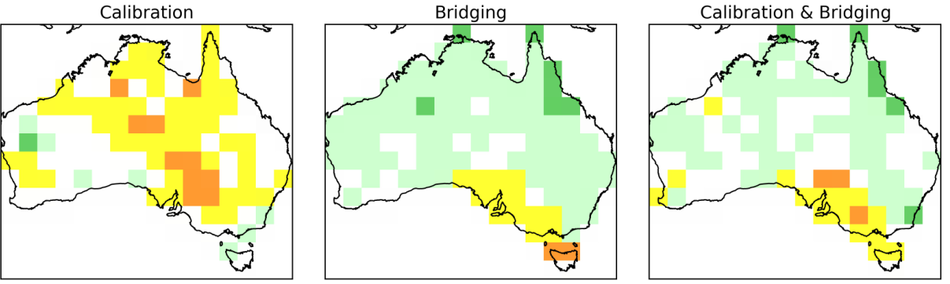
Merging
Bayesian Model Averaging (Wang et al. J of Climate, 2012)

Slide 12
Computing implementation
BJP core implemented in Fortran
CBaM software implemented in Python
  Data handling
  Model running
  Cross-validation and verification

Slide 13
Recent applications
POAMA 2.4, ECMWF Sys4, NOAA CFS2
Seasonal rainfall, Tmin, Tmax
1 month lead time
2.5 degree grid across Australia
1983 – 2010
Leave 1-year-out cross-validation
  BJP models
  BMA weights

Slide 14
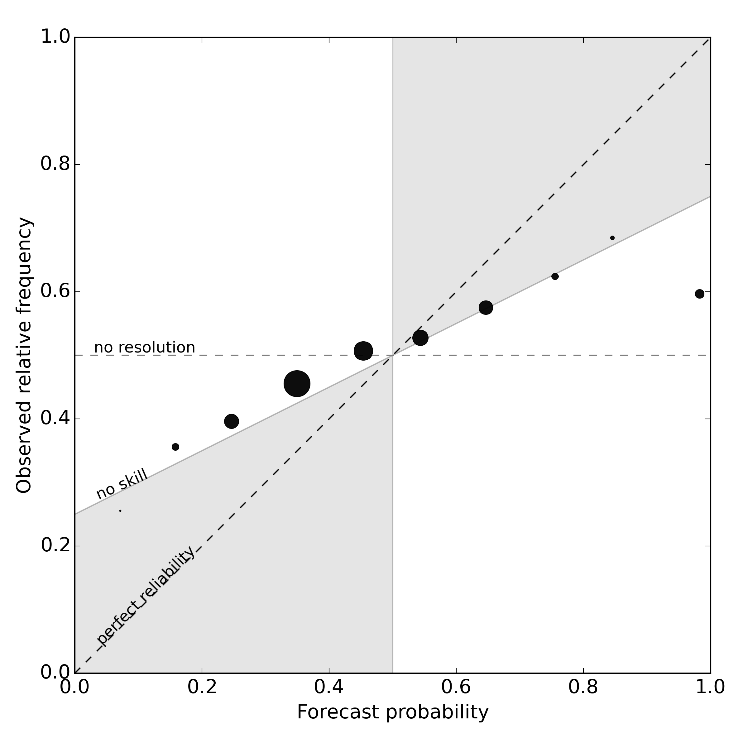
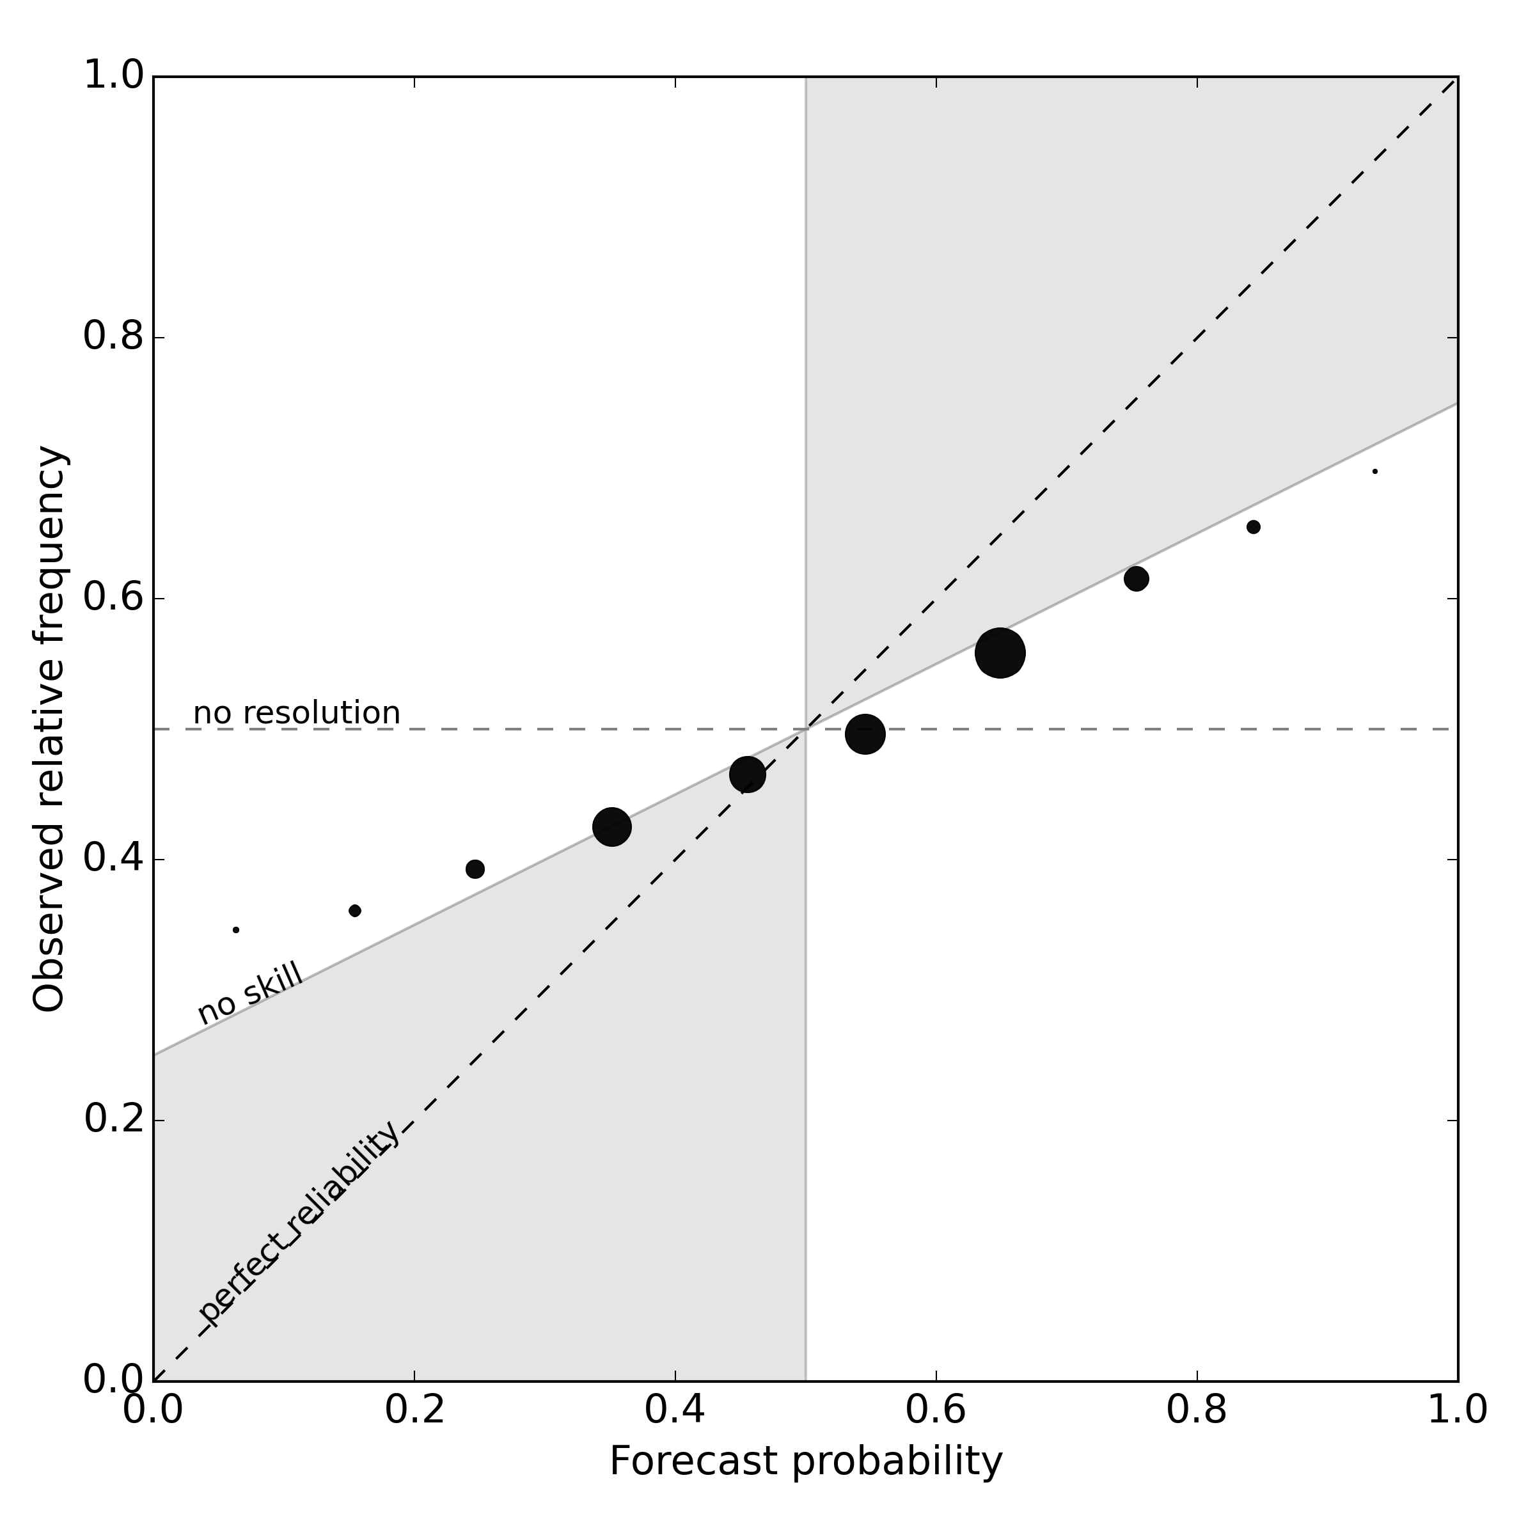
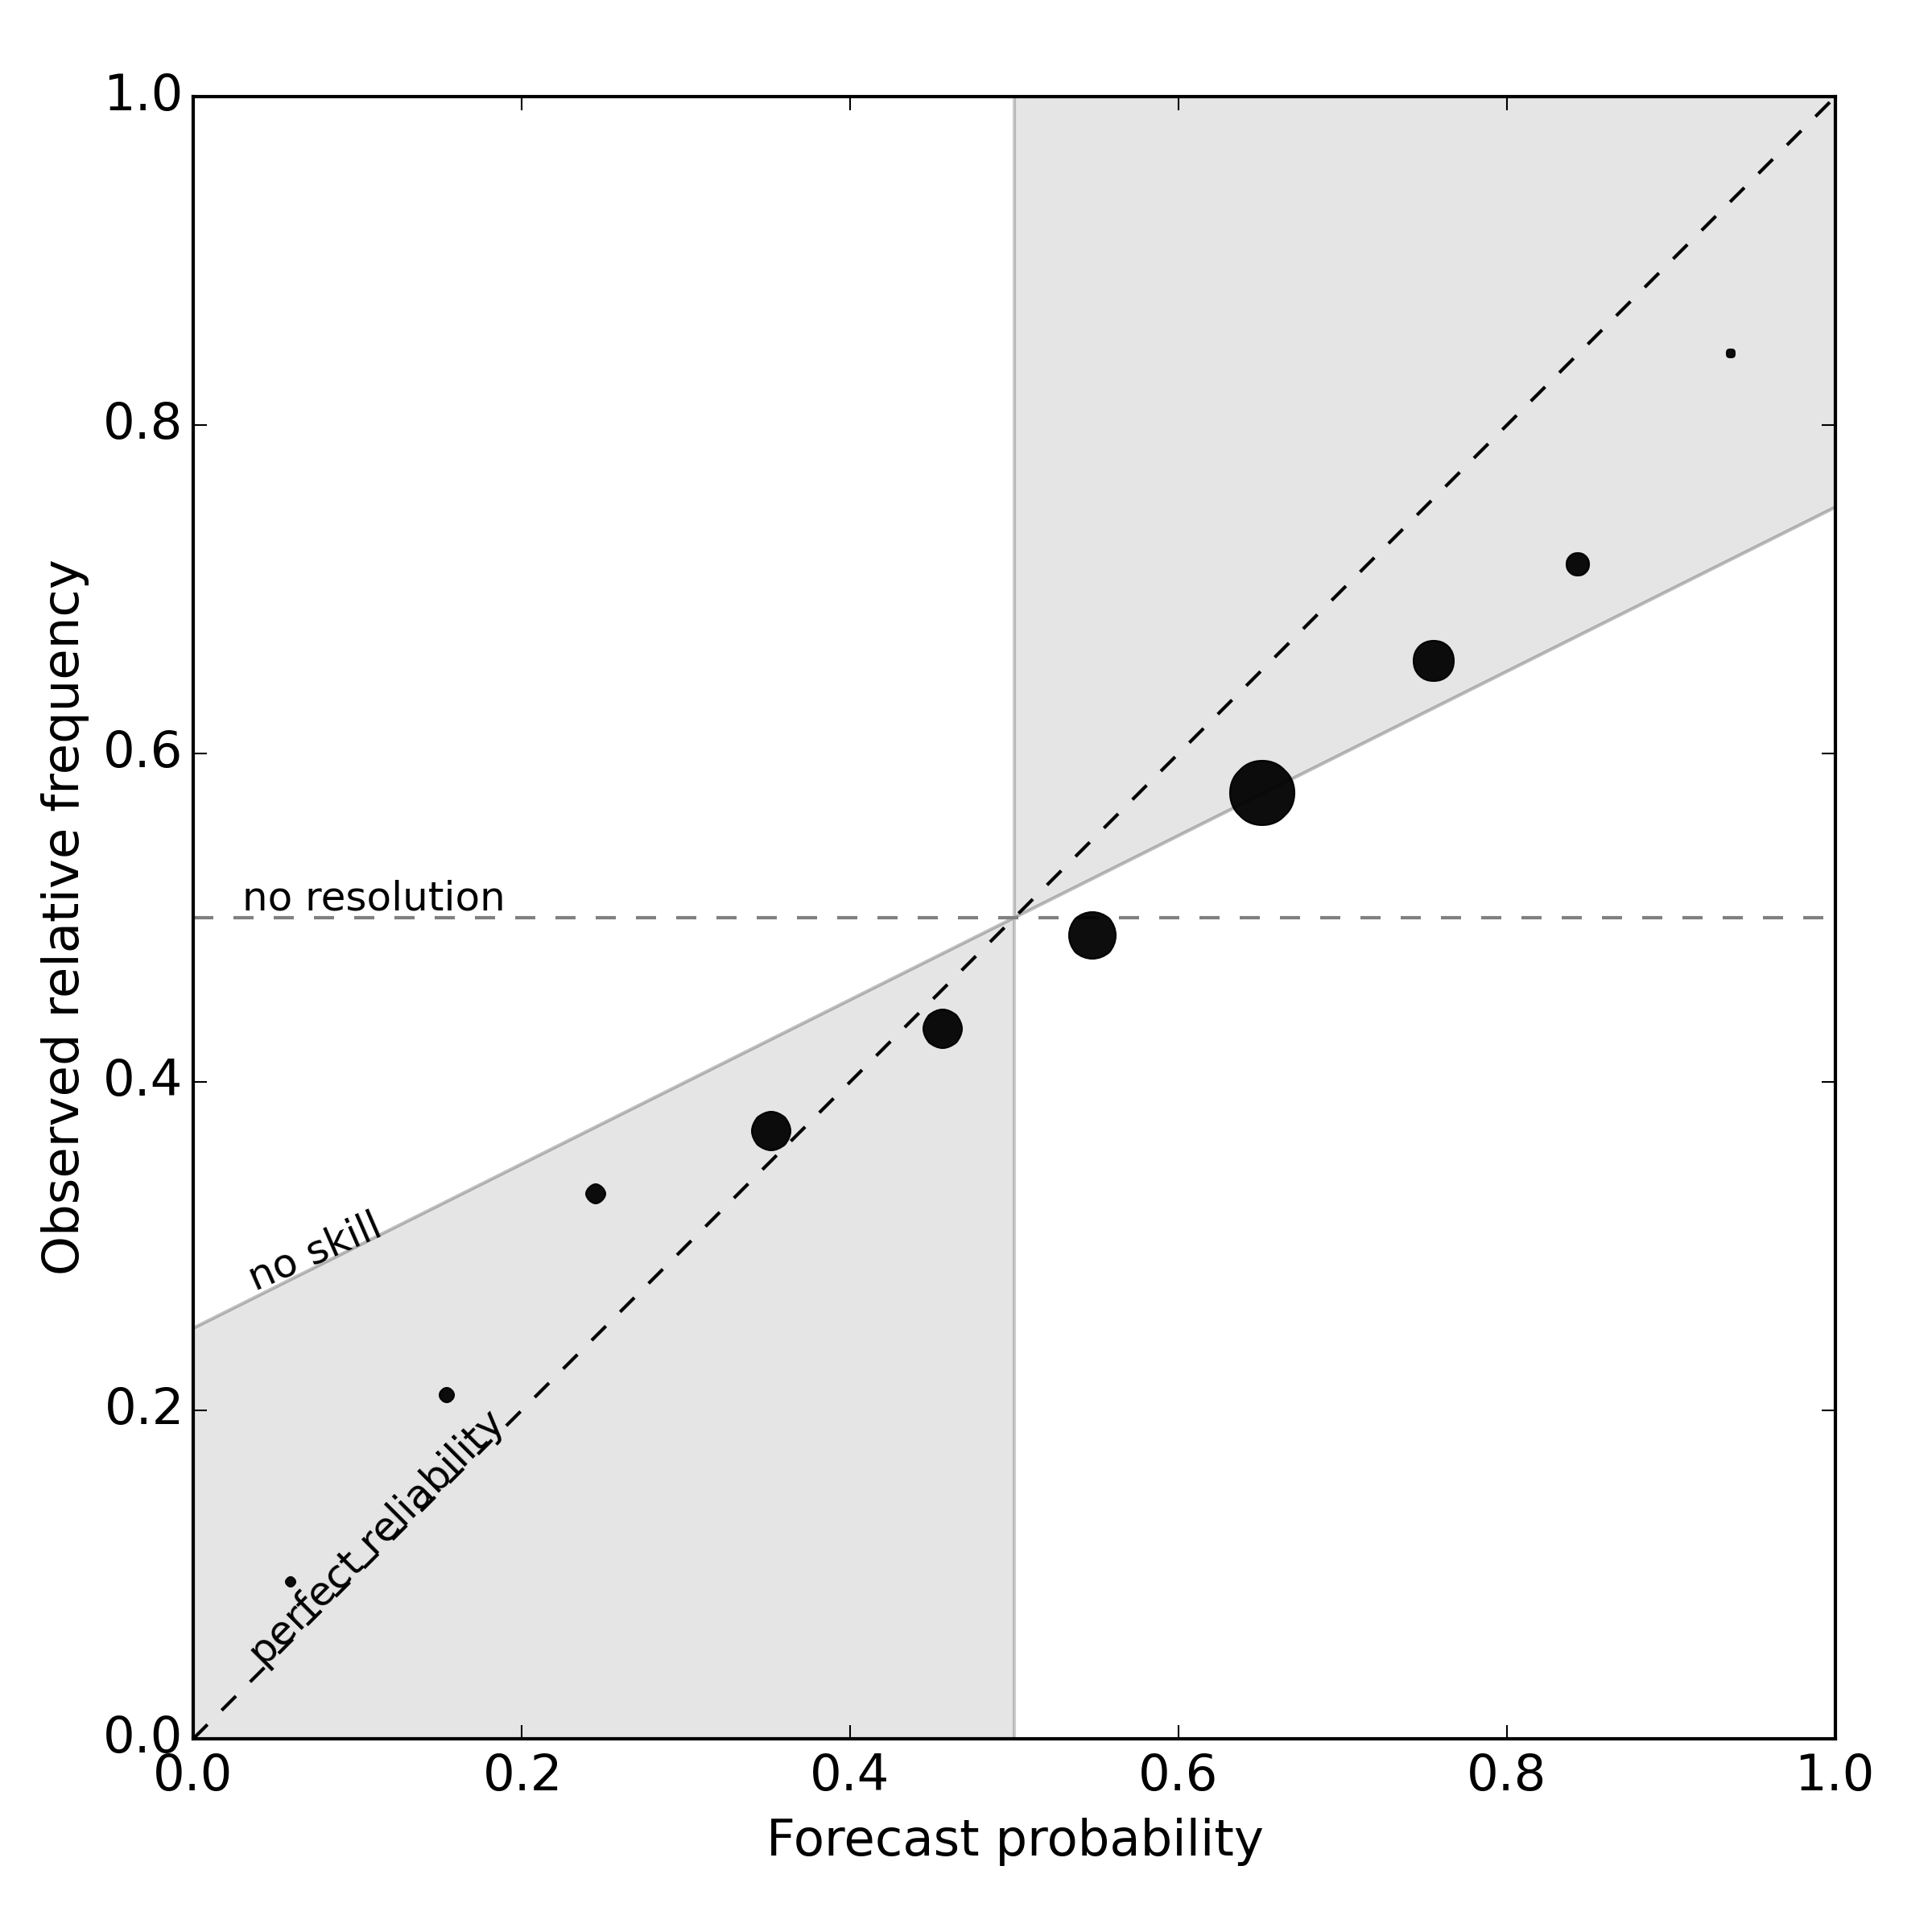
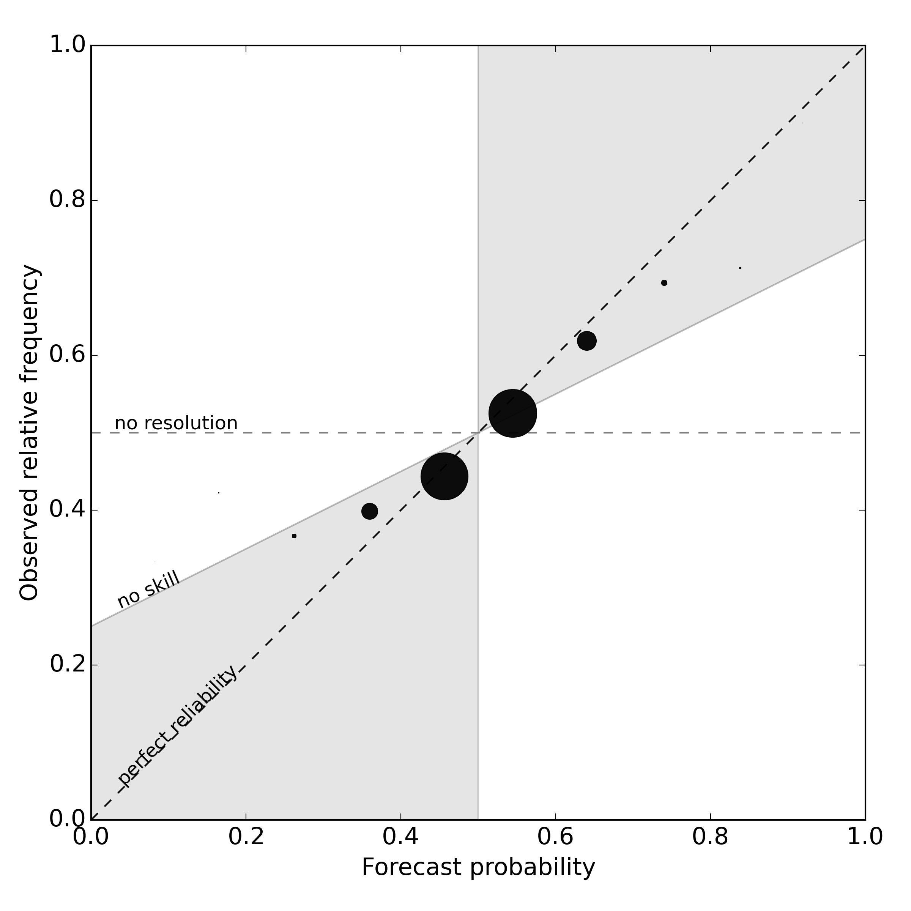
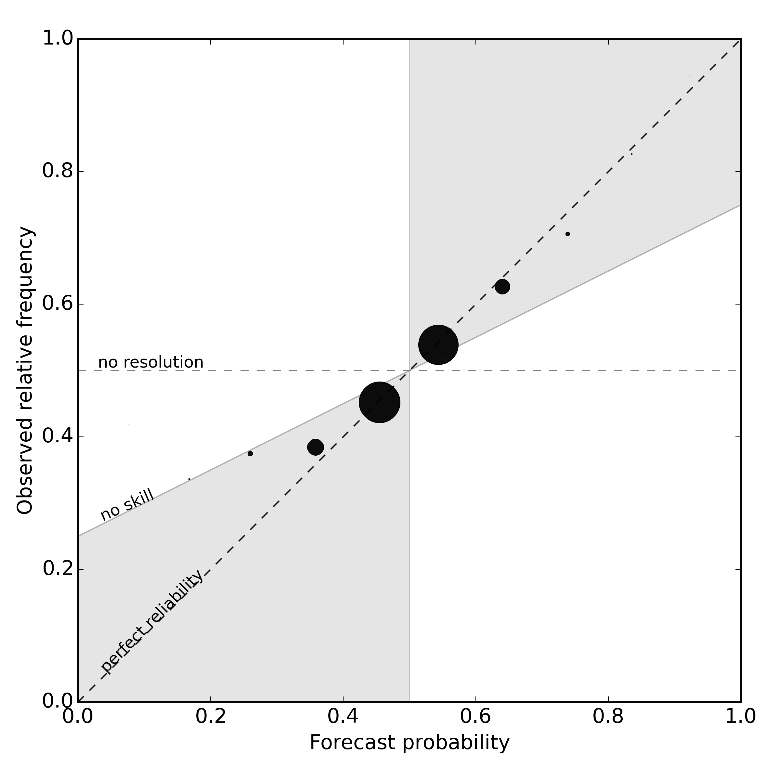
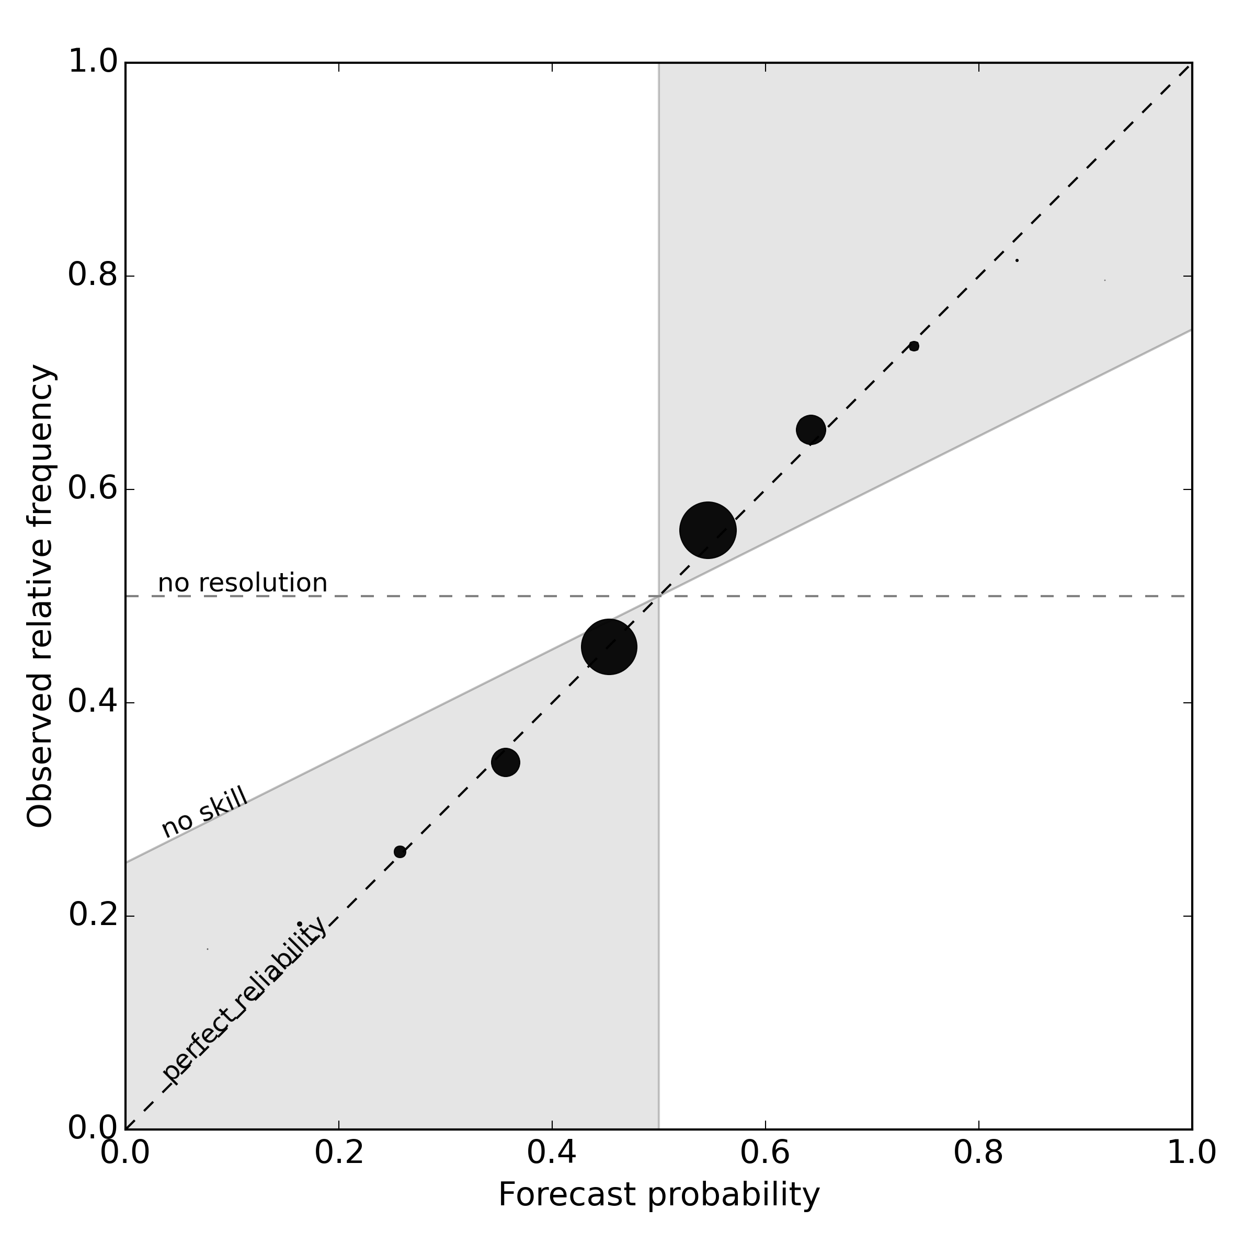
Improvement to reliability (POAMA2.4)
Rainfall
Tmin
Tmax
Raw
mean-corrected
CBaM
post-processed

Slide 15
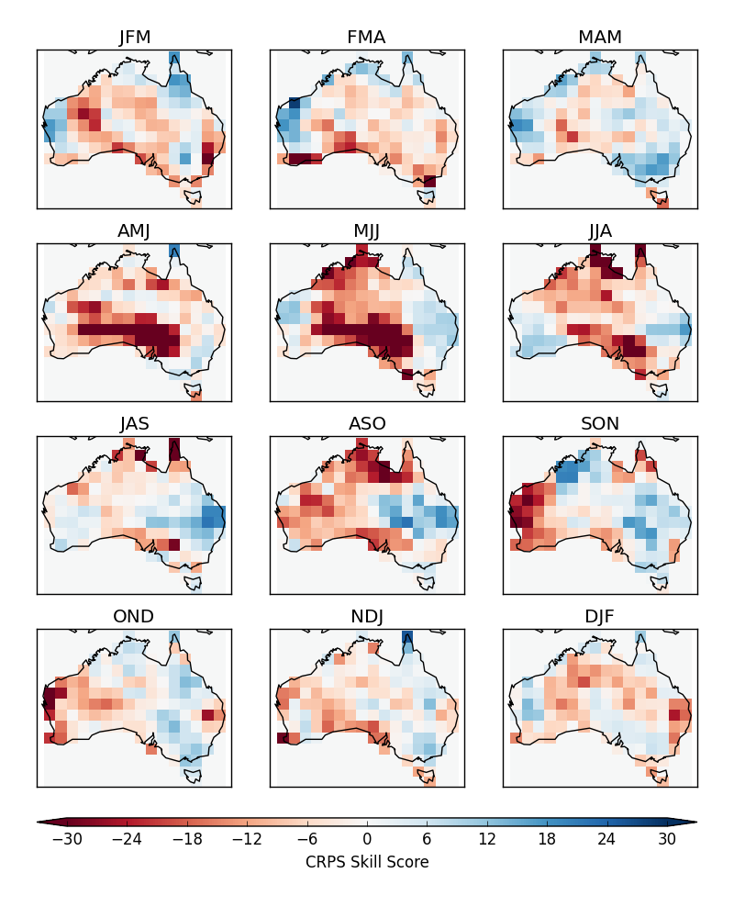
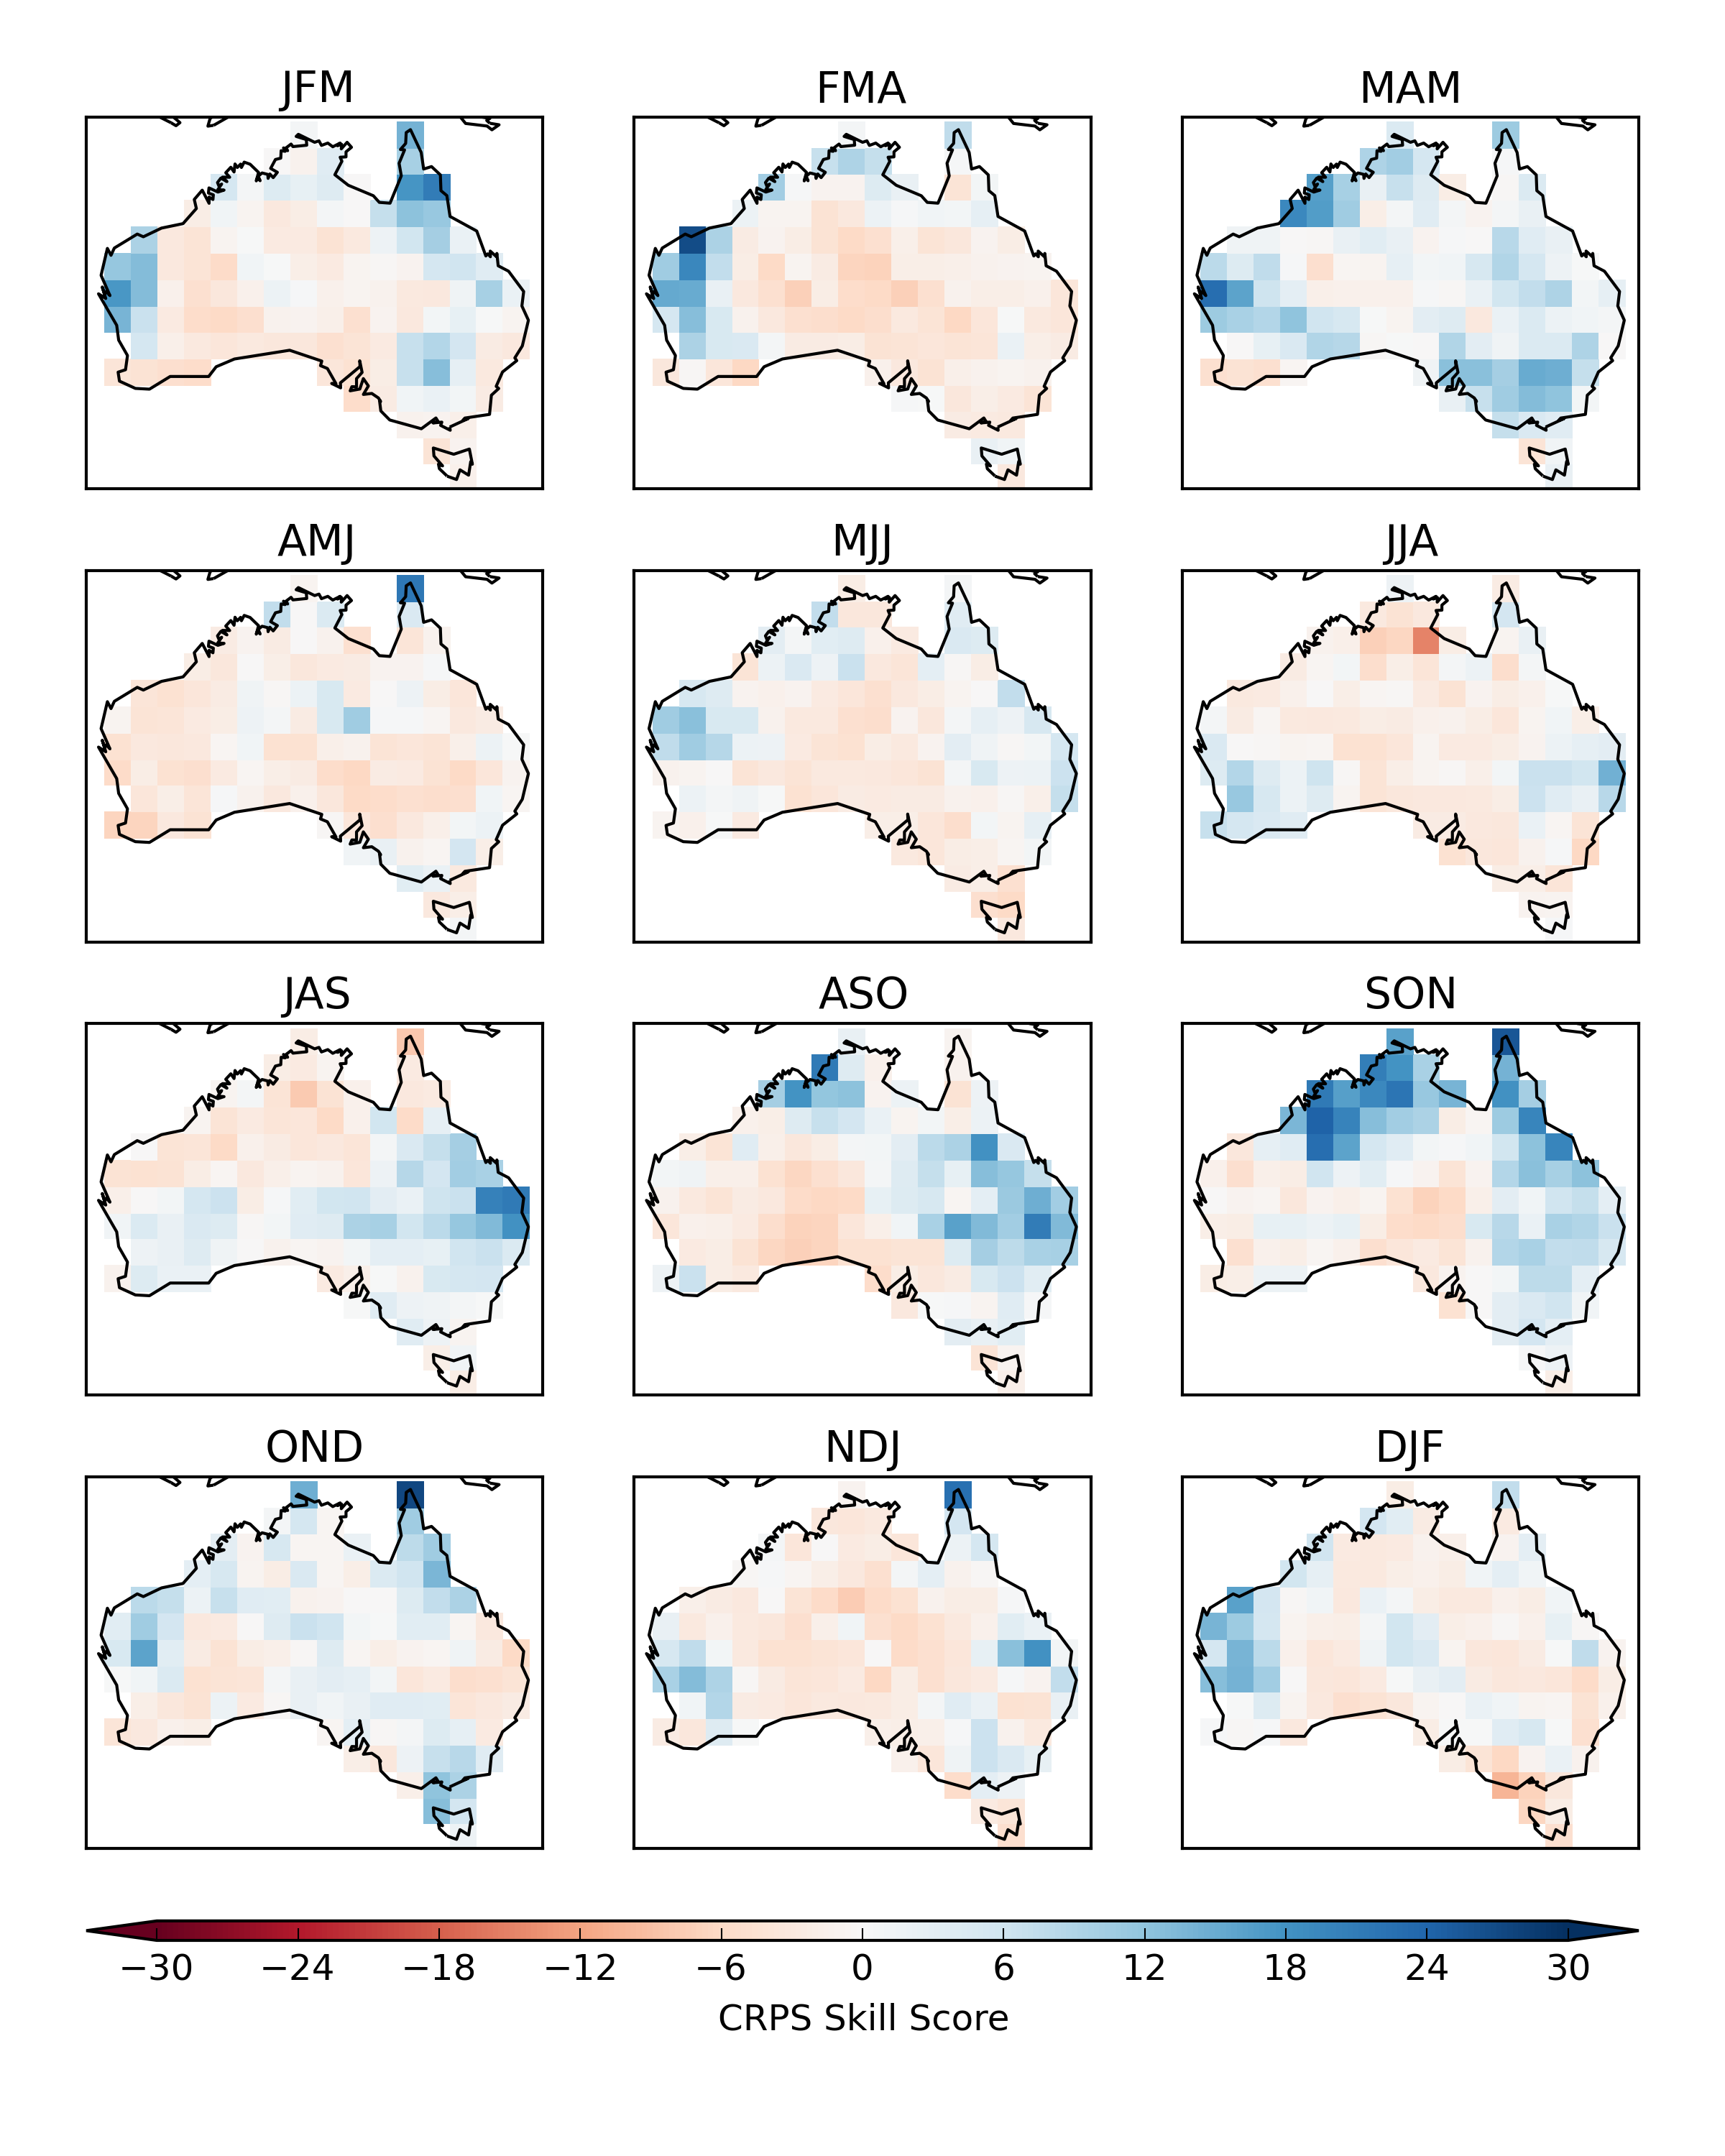
CRPS skill score – POAMA 2.4 rainfall
Raw (mean-corrected)
CBaM calibration

Slide 16
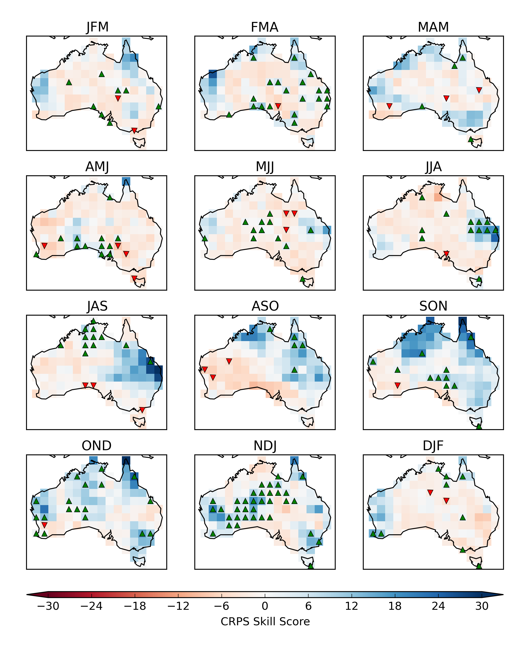
CRPS skill score – POAMA 2.4 rainfall
Calibration (CBaM)
CBaM calibration + bridging

Slide 17
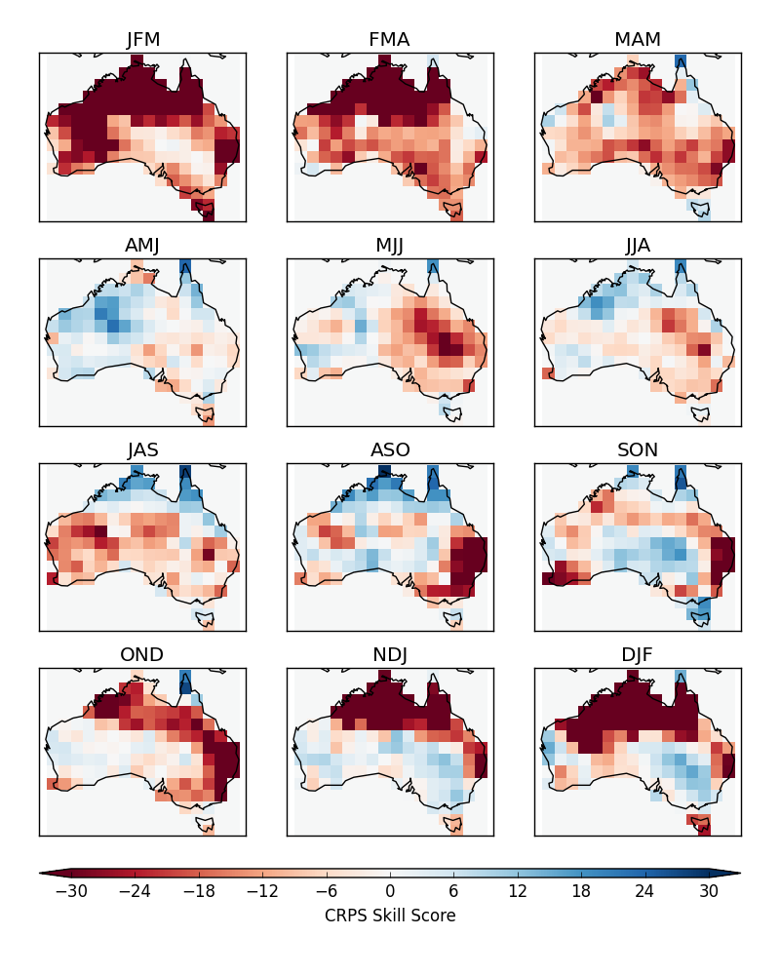
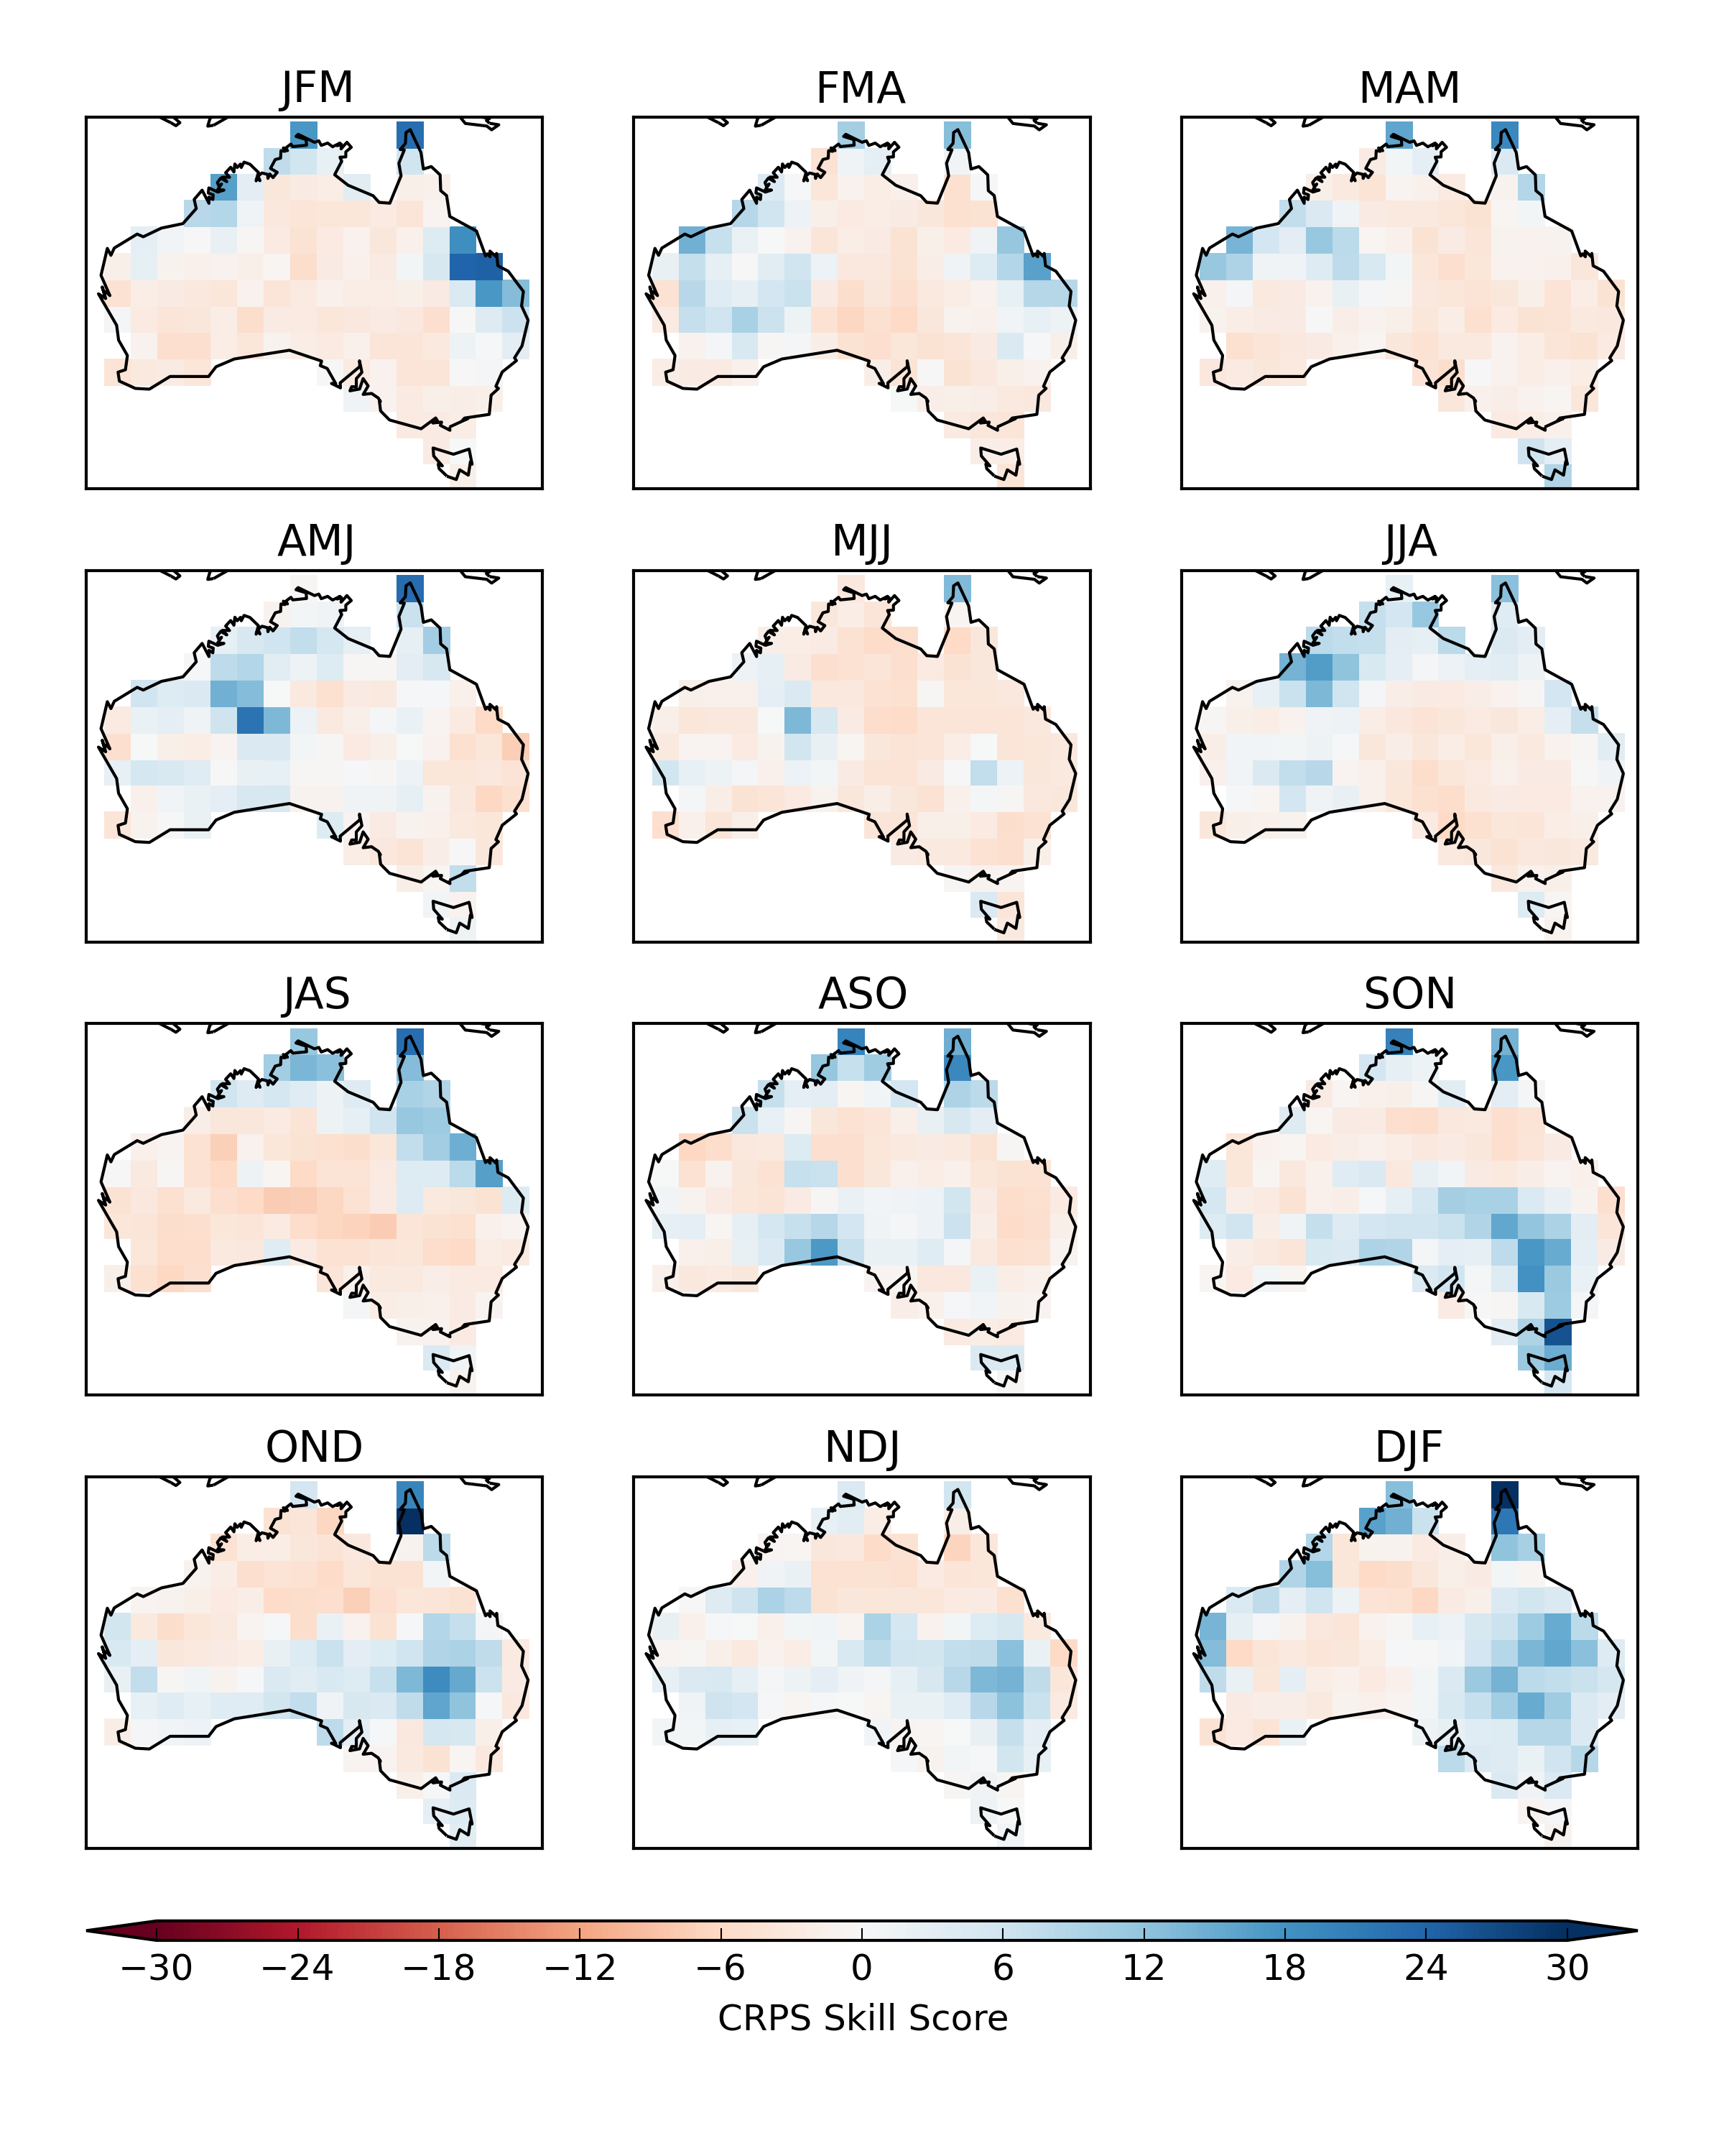
CRPS skill score – POAMA 2.4 Tmin
Raw (mean-corrected)
CBaM calibration

Slide 18
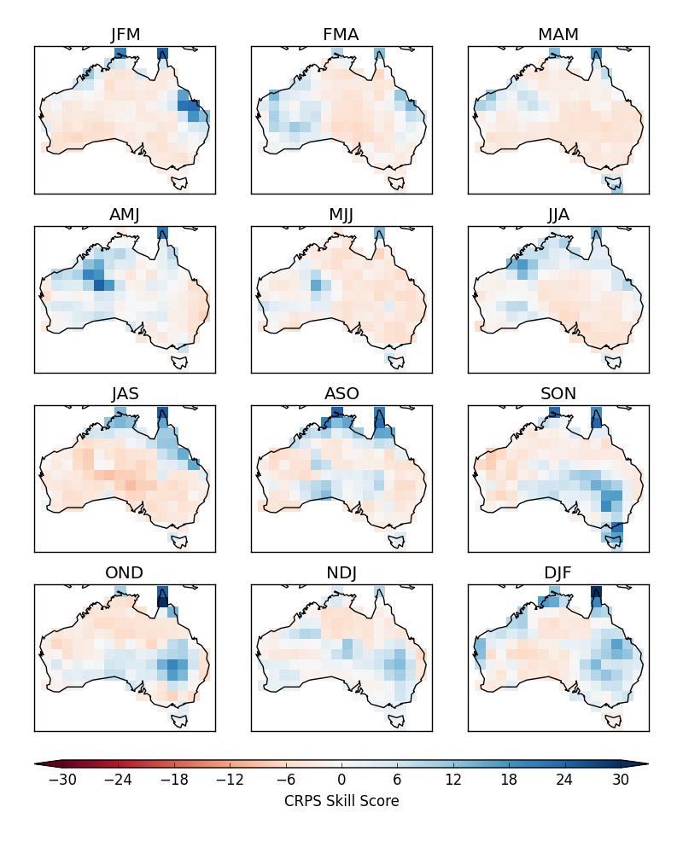
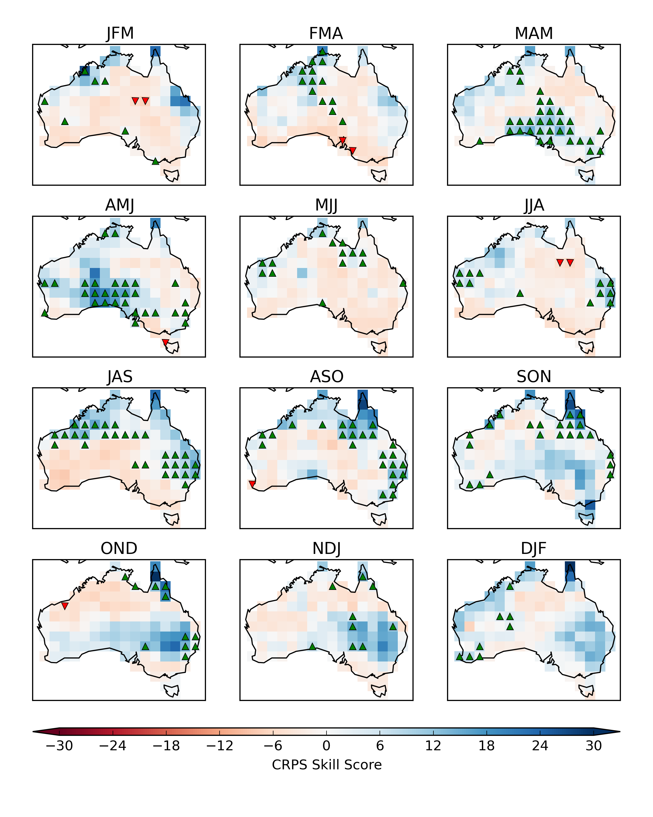
CRPS skill score – POAMA 2.4 Tmin
CBaM calibration
CBaM calibration + bridging

Slide 19
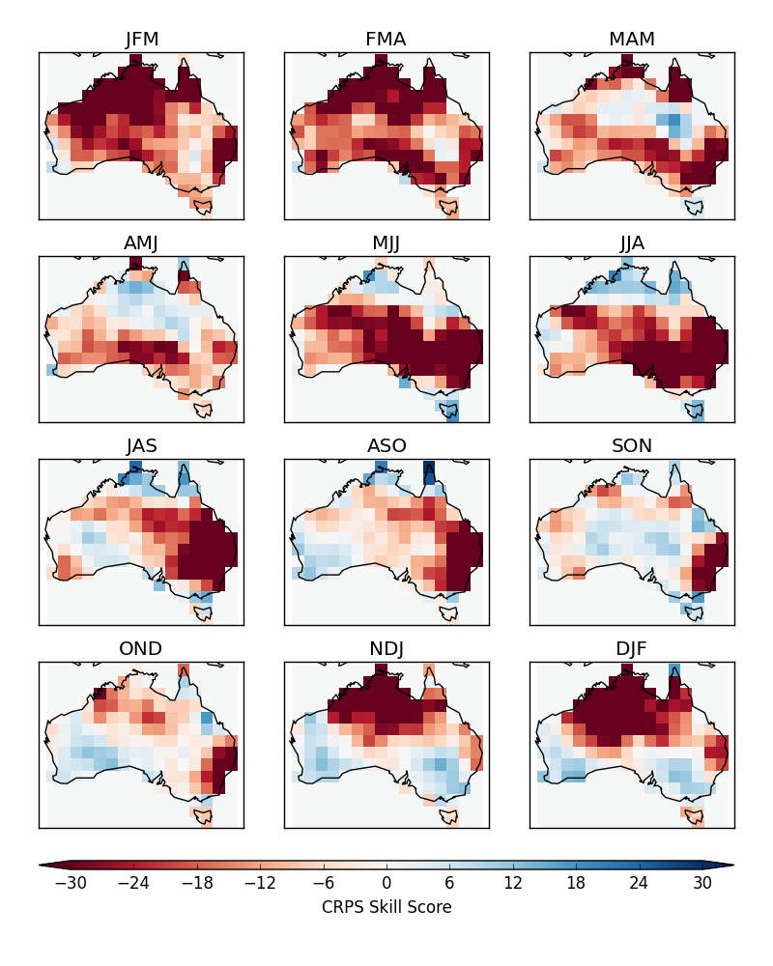
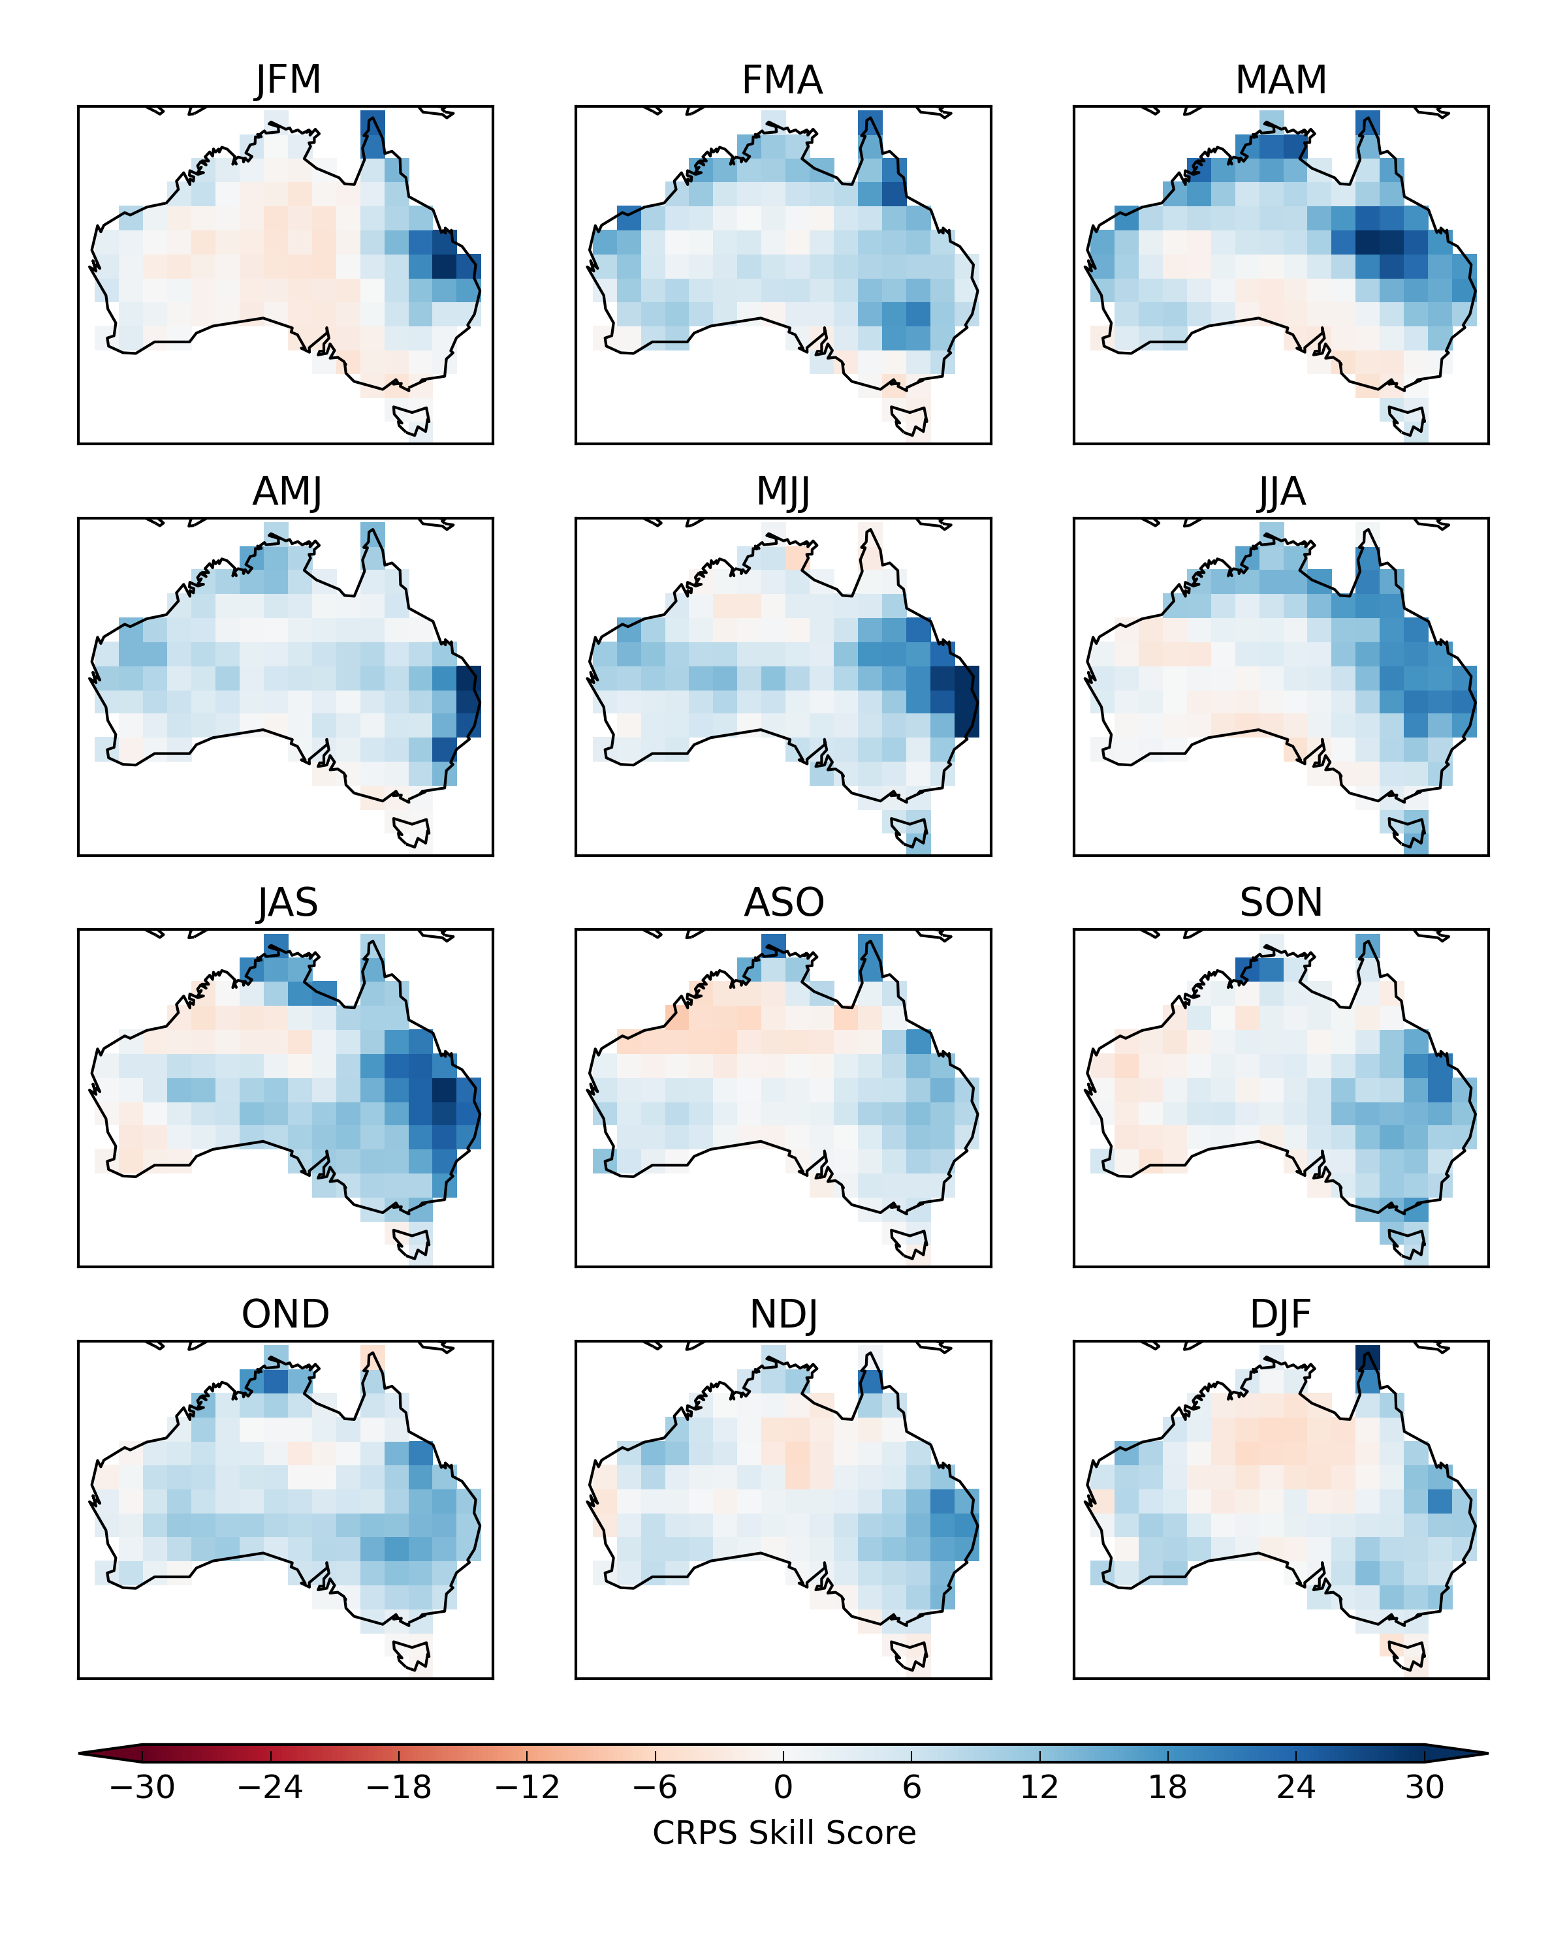
CRPS skill score – POAMA 2.4 Tmax
Raw (mean-corrected)
CBaM calibration

Slide 20
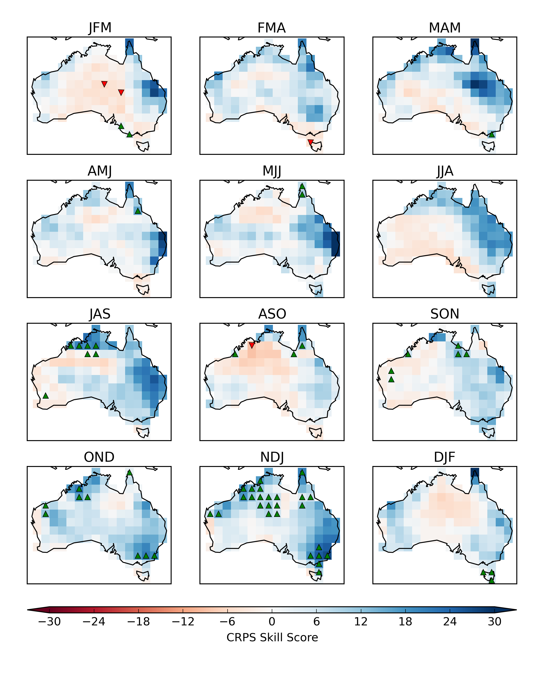
CRPS skill score – POAMA 2.4 Tmax
CBaM calibration
CBaM calibration + bridging

Slide 21
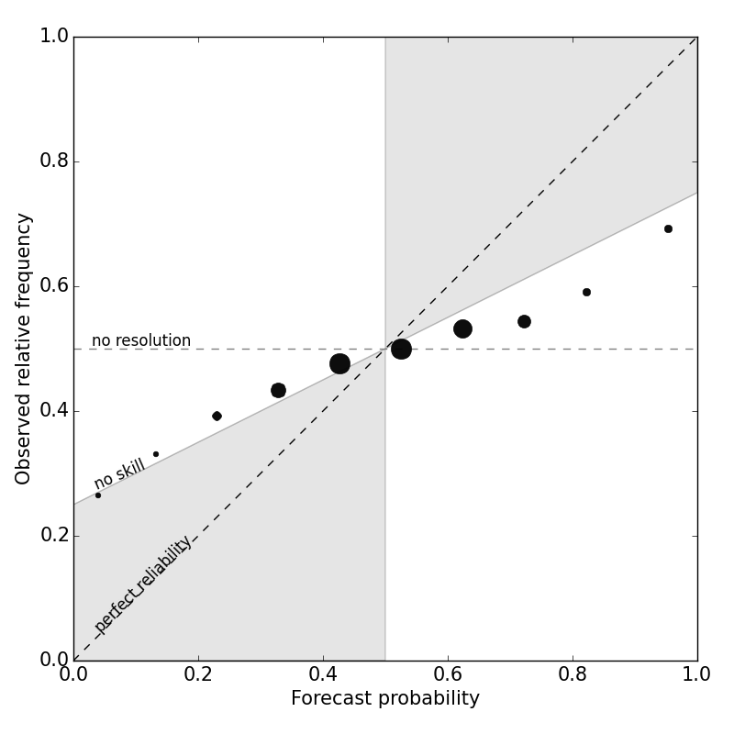
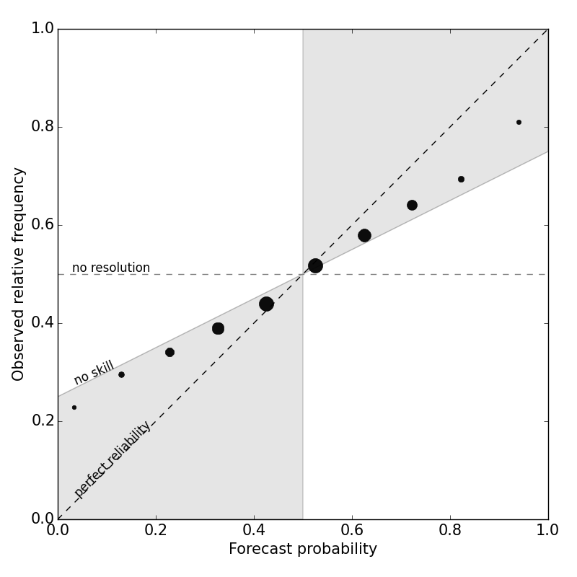
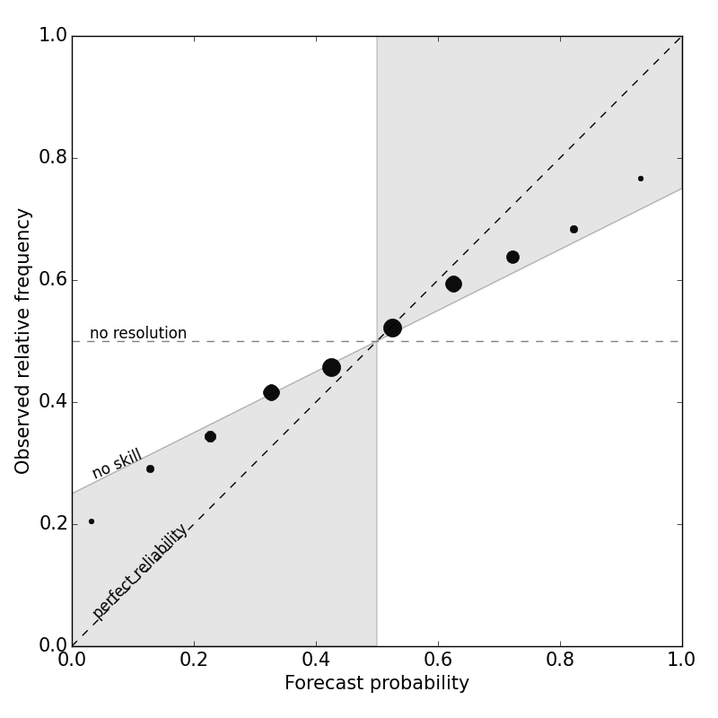
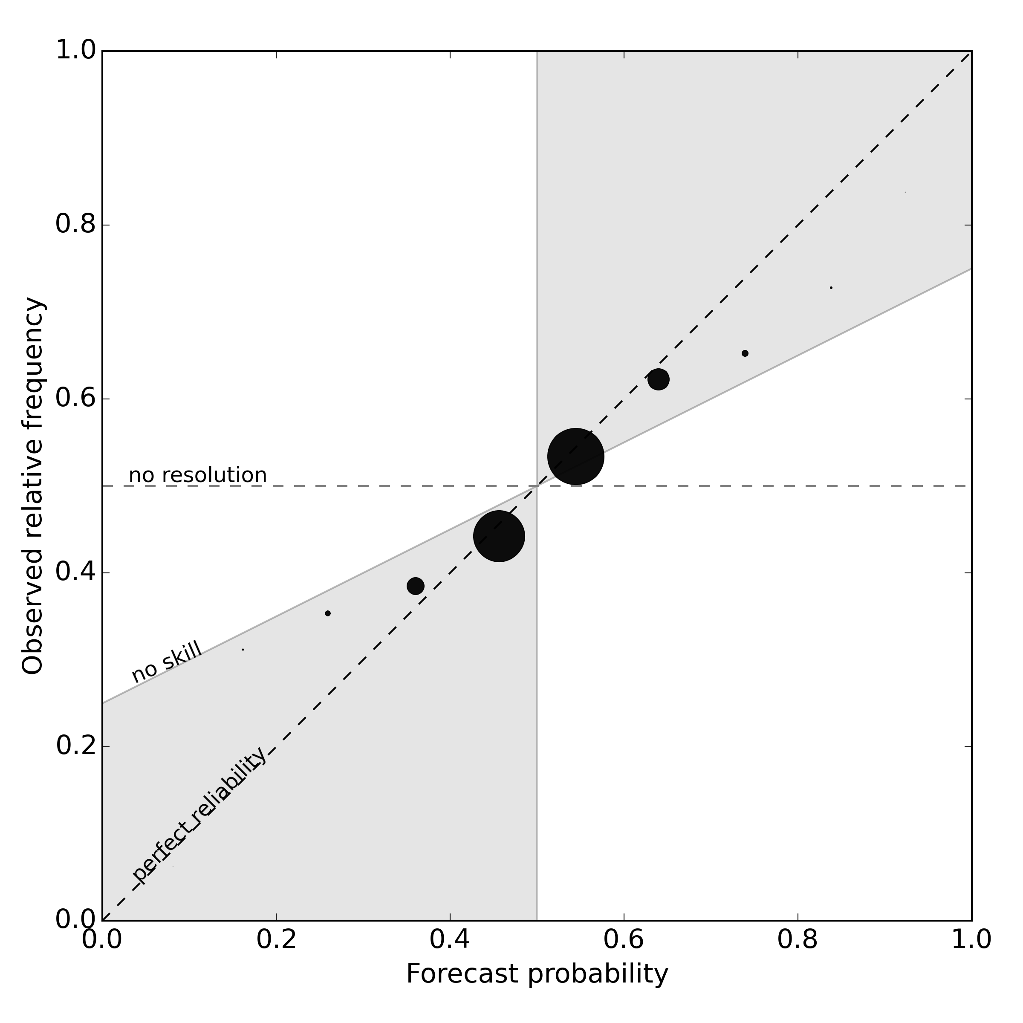


Improvement to reliability (CFS2)
Rainfall
Tmin
Tmax
Raw
mean-corrected
CBaM
post-processed

Slide 22
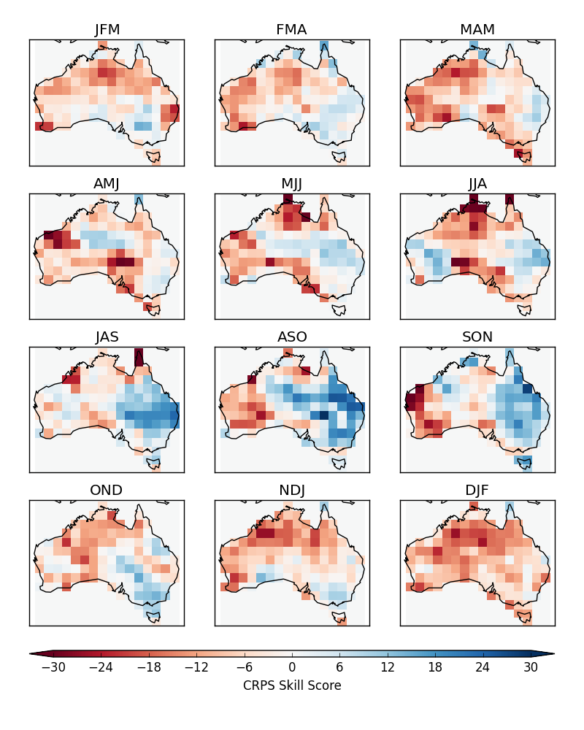
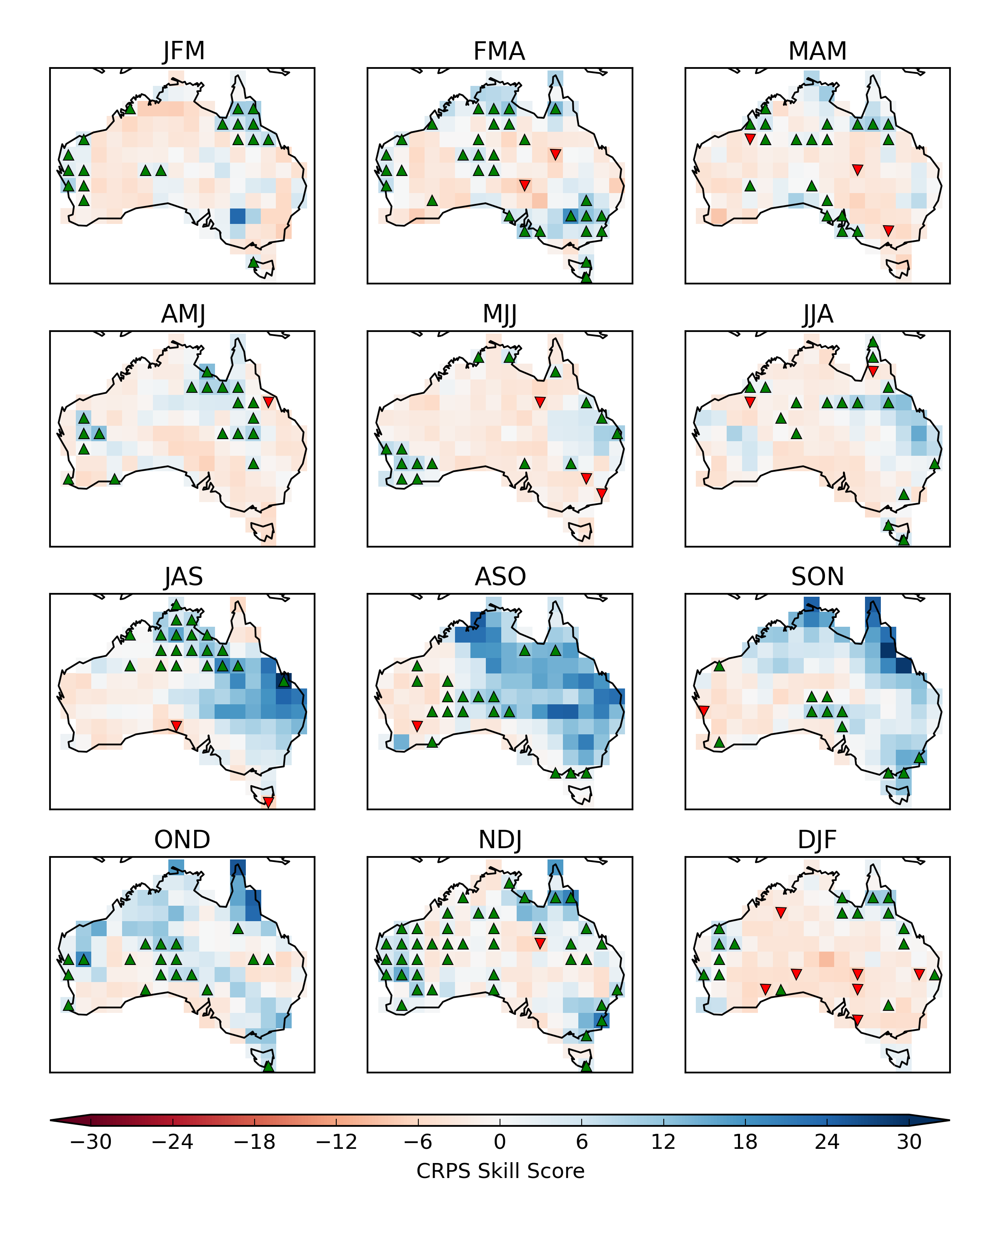
CRPS skill score – CFS2 rainfall
Raw (mean-corrected)
CBaM calibration + bridging

Slide 23
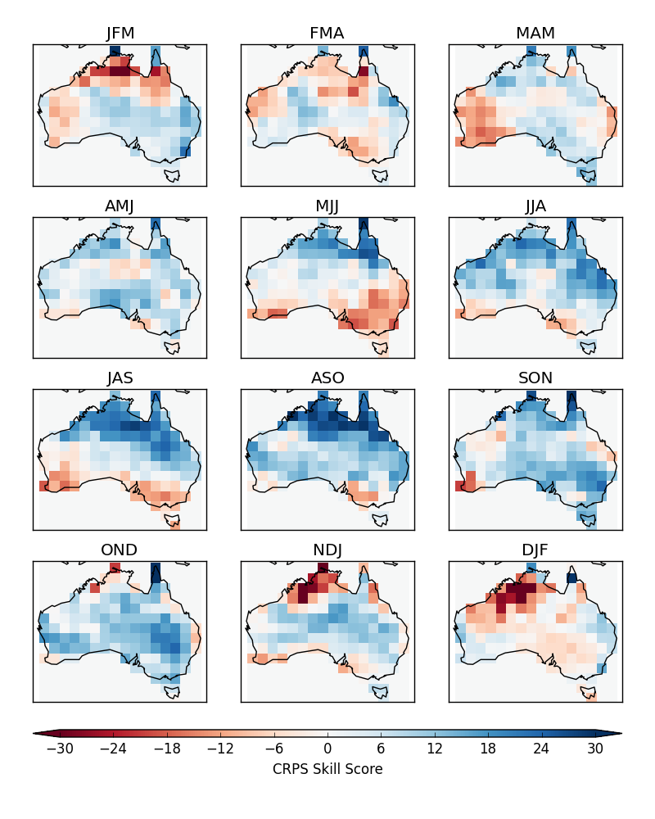
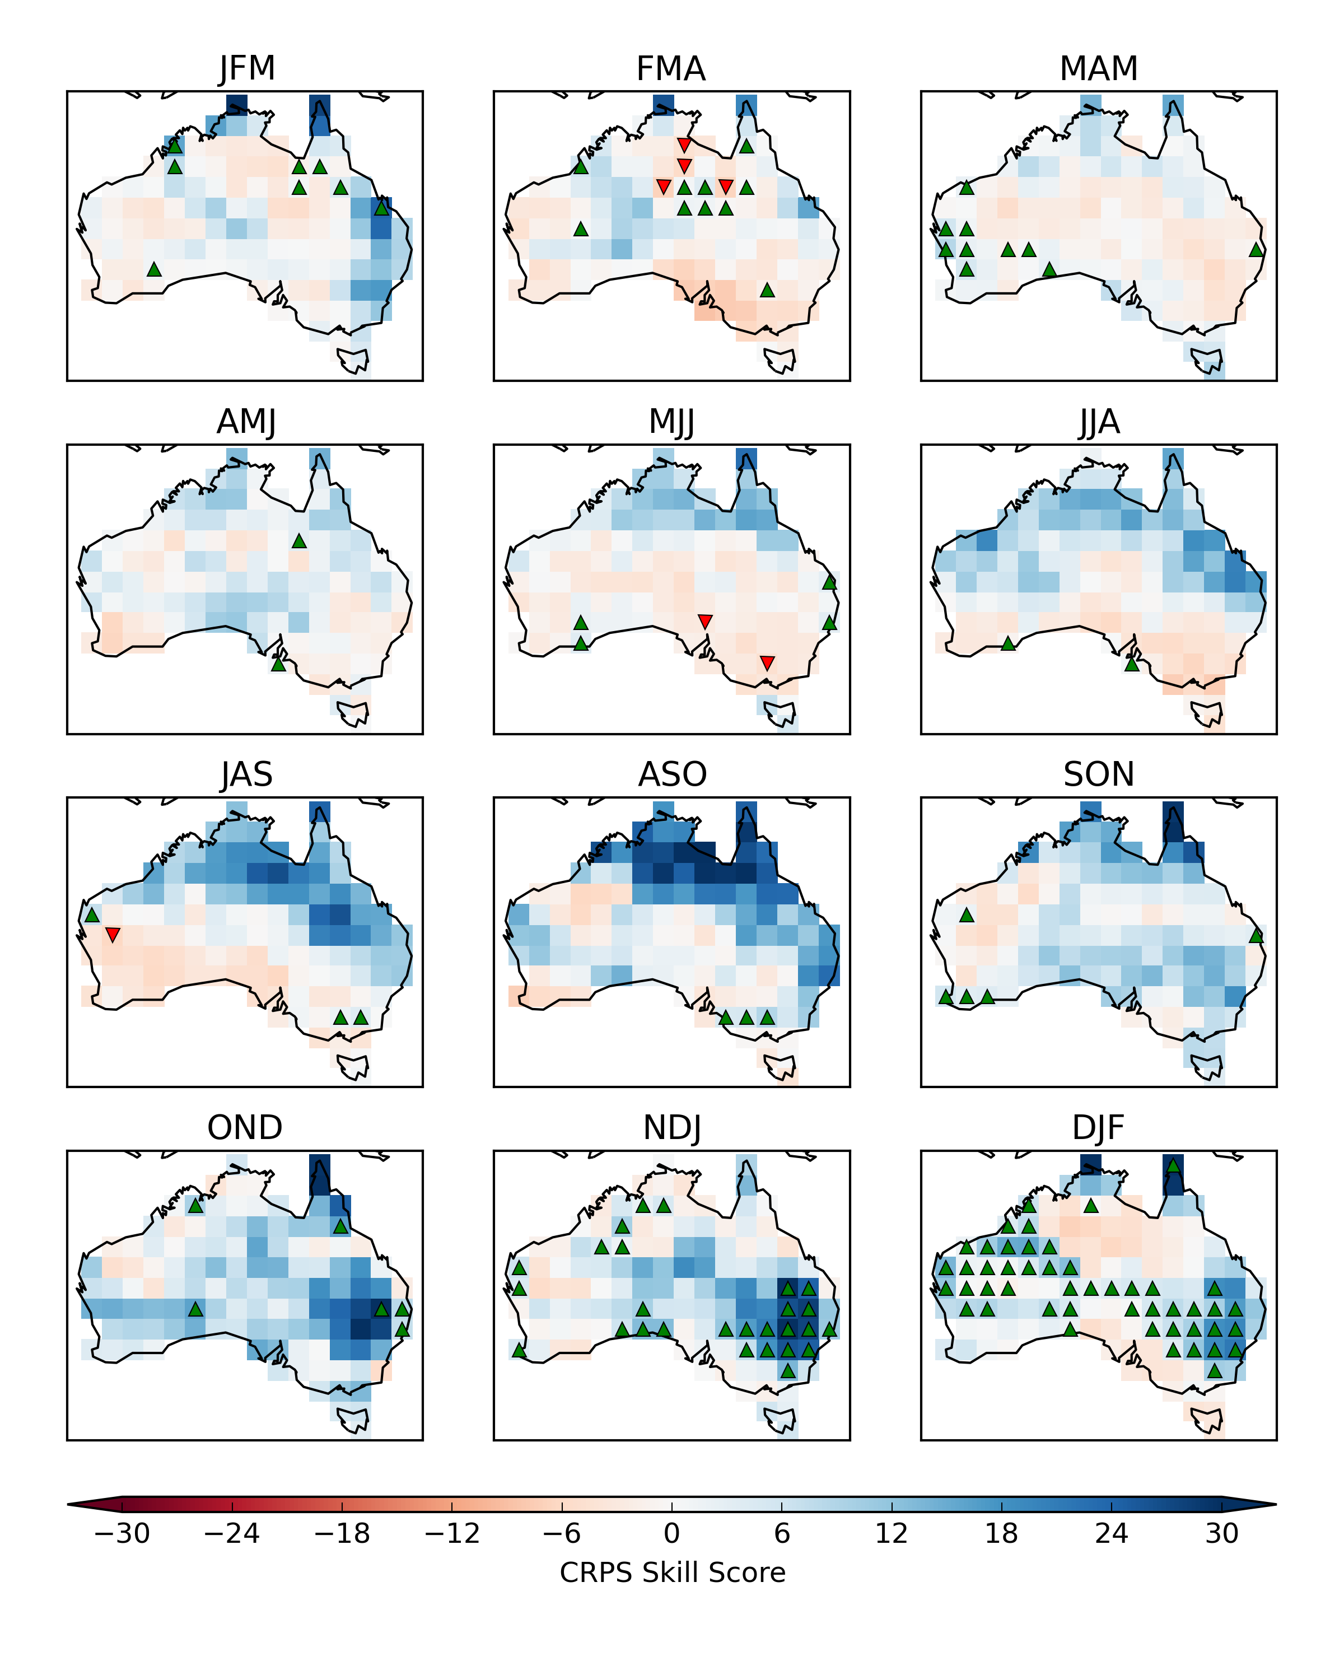
CRPS skill score – CFS2 Tmin
Raw (mean-corrected)
CBaM calibration + bridging

Slide 24
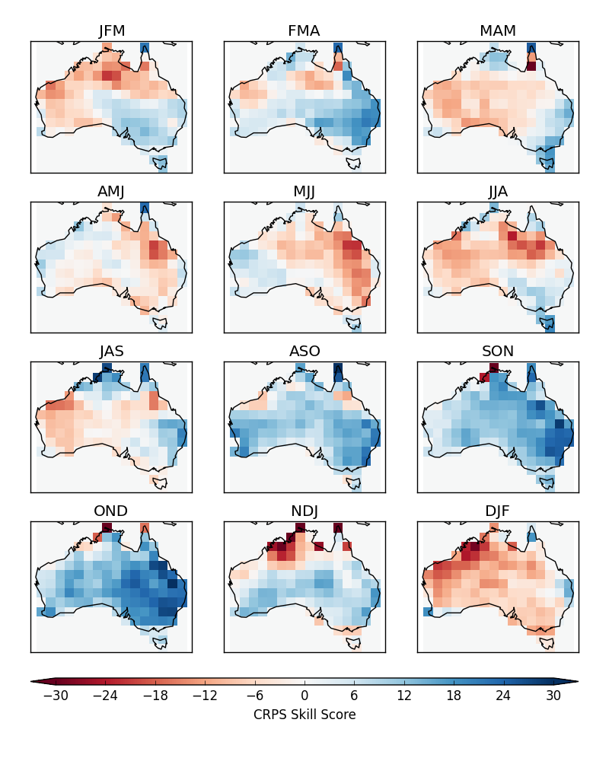
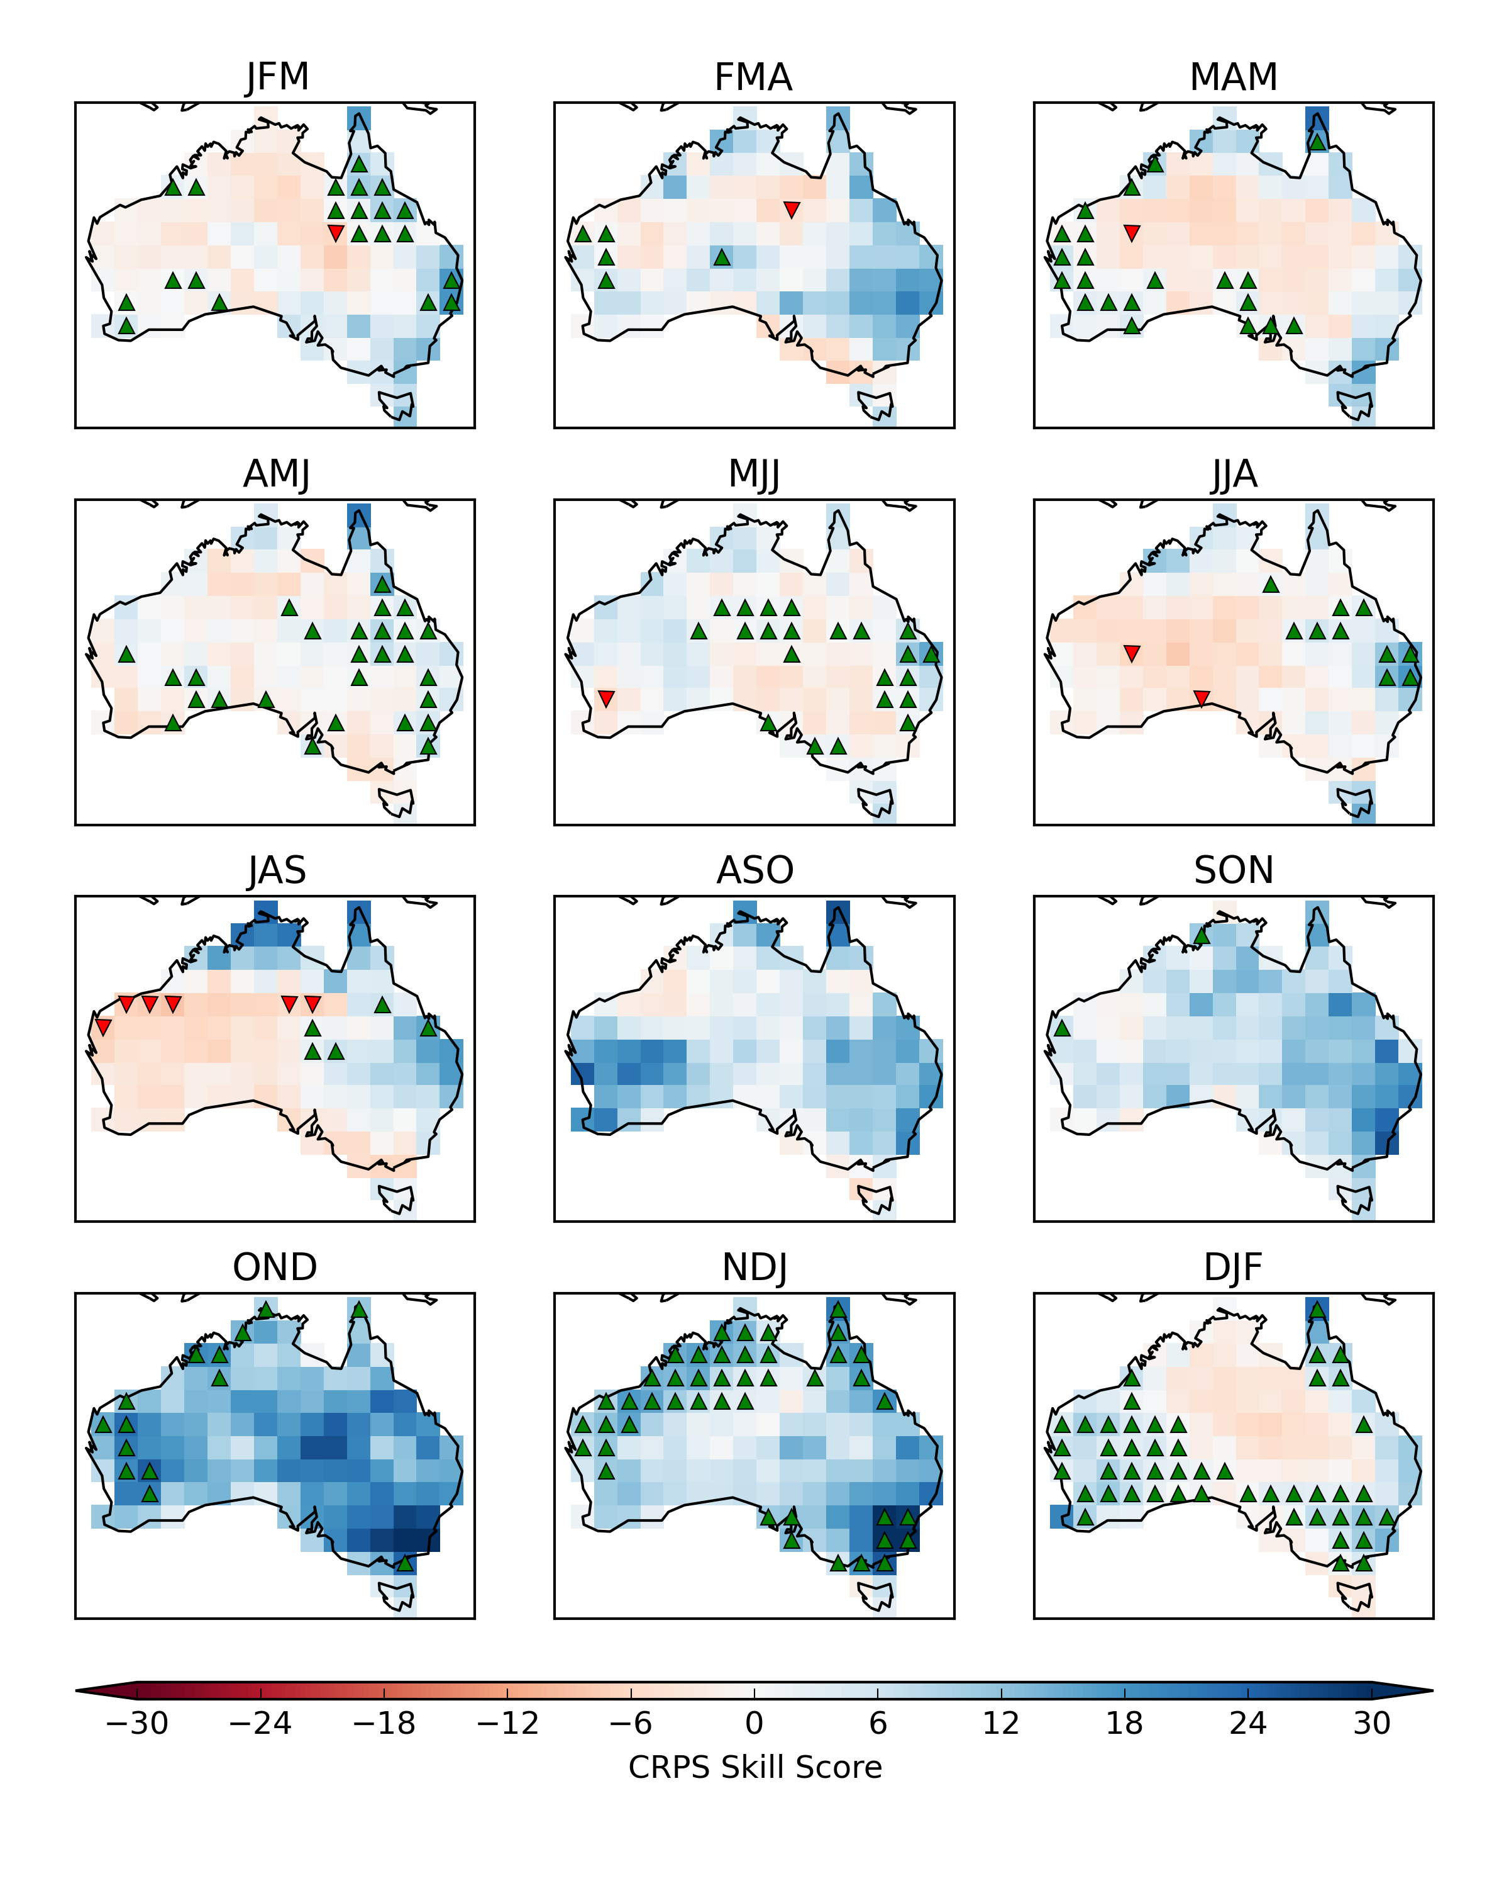
CRPS skill score – CFS2 Tmax
Raw (mean-corrected)
CBaM calibration + bridging

Slide 25
Bridging improves skill for multiple GCMs

Slide 26
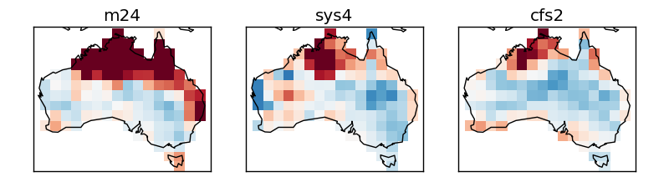
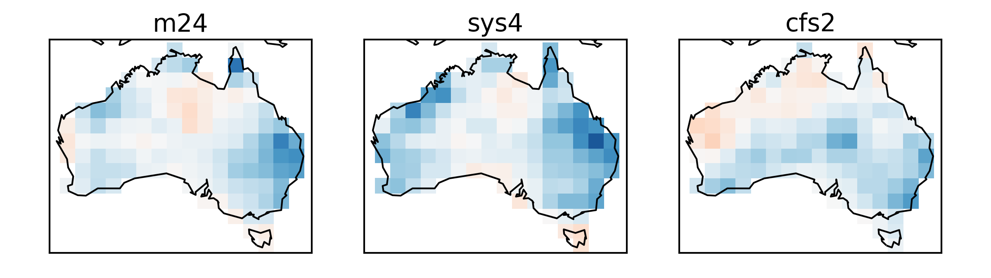
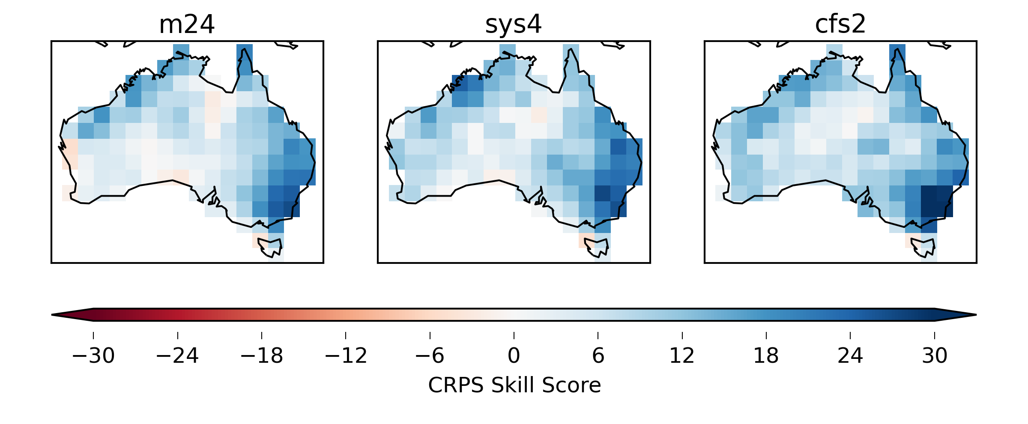
CBaM can make skill similar – NDJ Tmax
Raw (mean-corrected)
Calibration
CBaM calibration + bridging

Slide 27
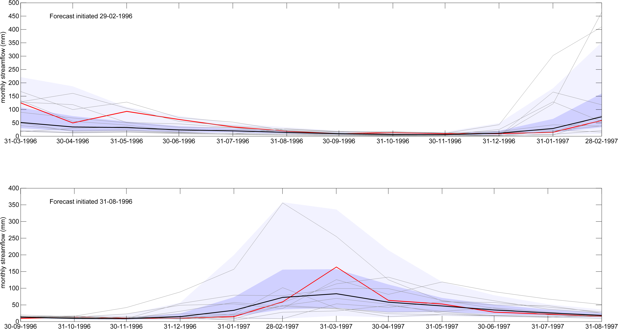
CBaM forecasts for streamflow forecasting

Slide 28
Summary - CBaM
Calibration leads to fully reliable forecasts
Calibration improves skill; removes negative skill
Calibration is an essential step
Bridging augments skill in many regions and seasons
CBaM may be used for combining multiple GCMs
Useful for both large scale and catchment scale applications

Slide 29
Work in progress
The method of ensemble link functions
  Using all ensemble members
  Allowing for non-exchangeable members (forecasts/hindcasts of different lead-times)
  Allowing data to decide information content of ensemble spread in representing uncertainty

Slide 30
Thank you
  Q.J. Wang – Senior Principal Research Scientist (QJ.Wang@csiro.au)
  Andrew Schepen – Research Scientist (Andrew.Schepen@csiro.au)
LAND AND WATER flagship

