Slide 1
Drought Outlook Discussion August 2017
Climate Prediction Center/NCEP/NOAA
http://www.cpc.ncep.noaa.gov/products/Drought
Phone: 1-877-680-3341
Pwd: 858747

Slide 2
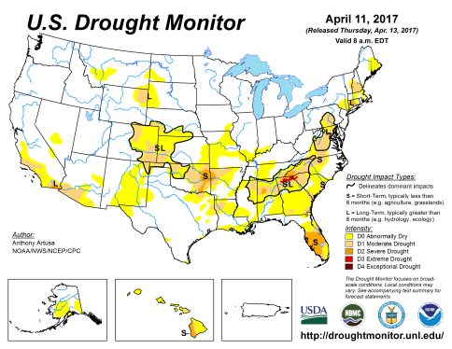
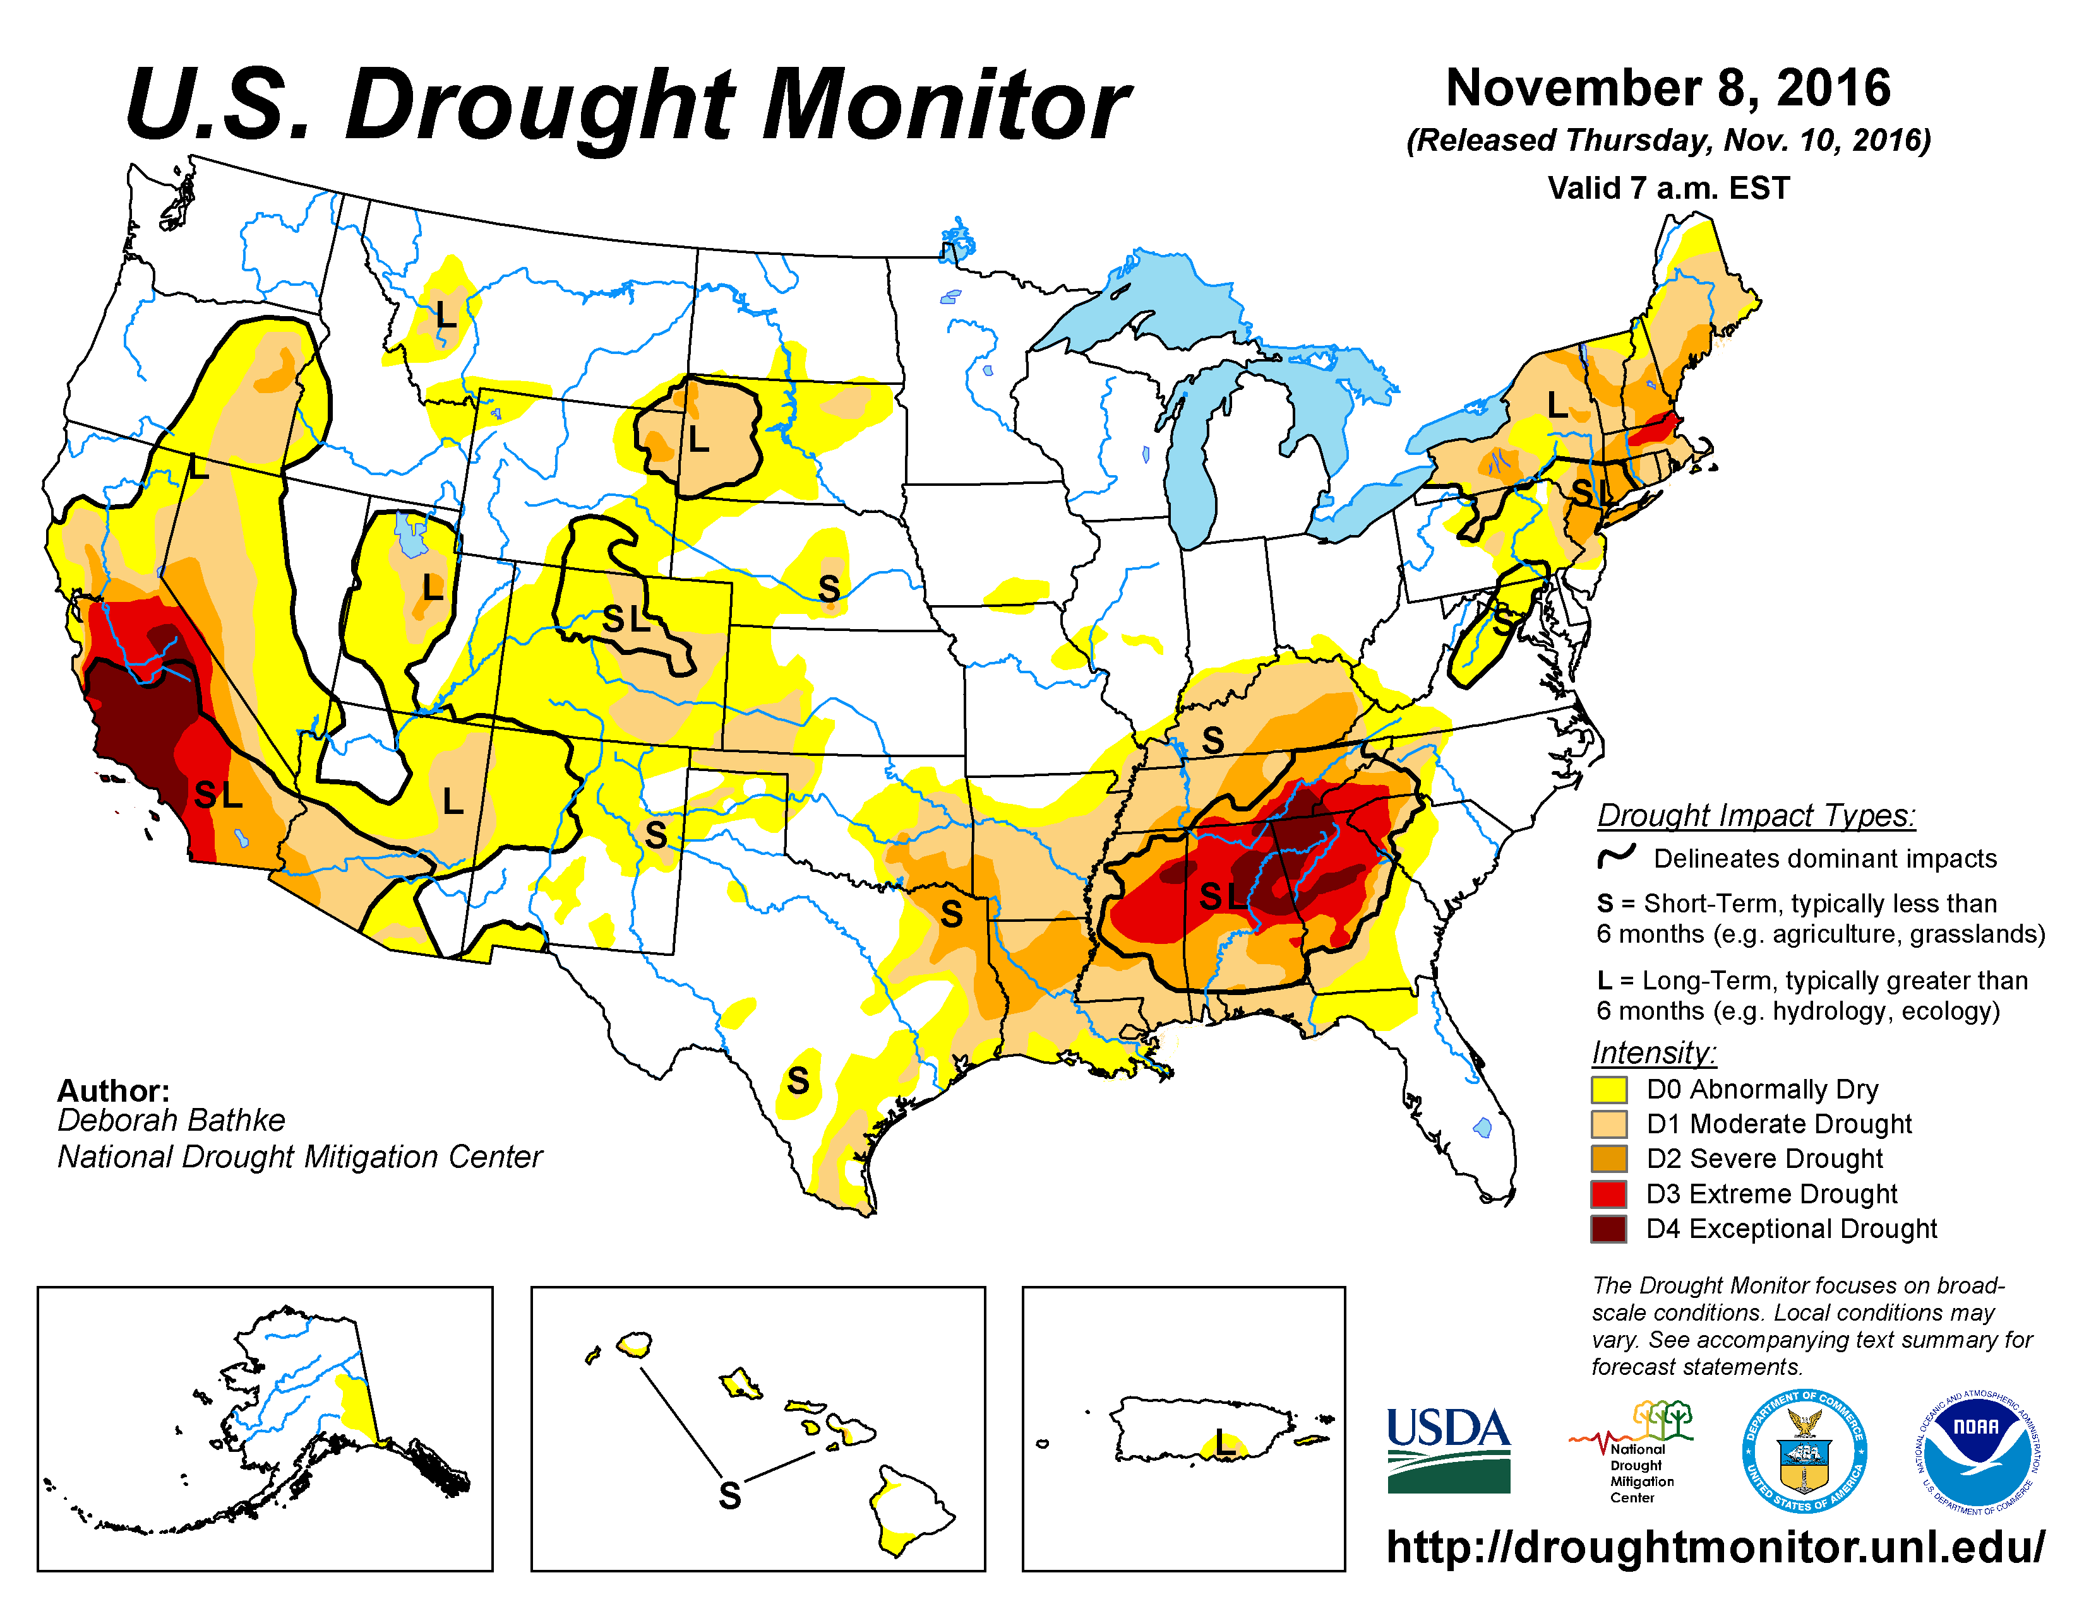
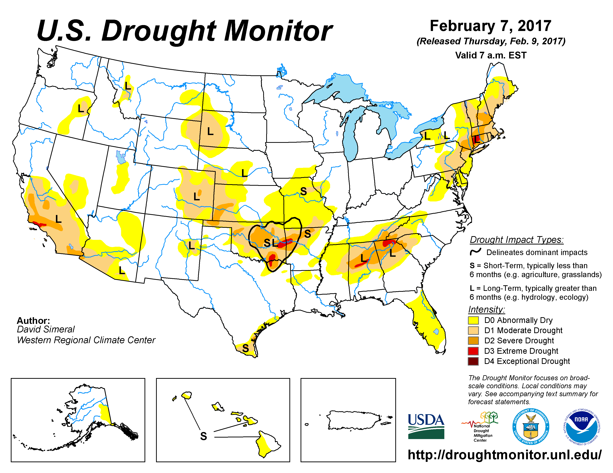
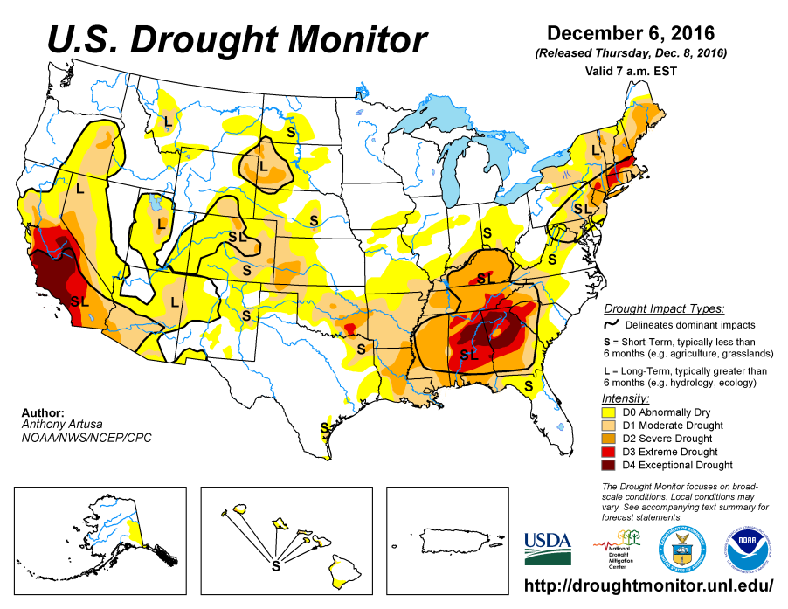
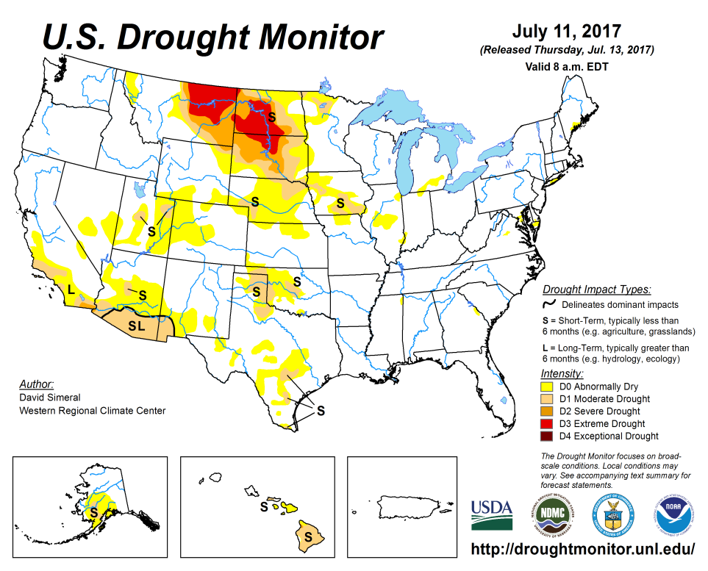
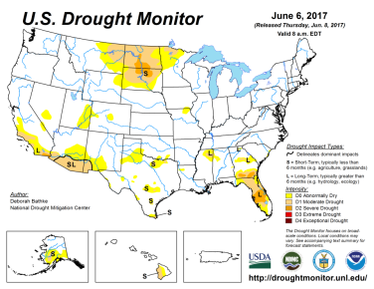
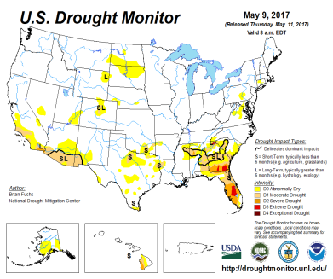
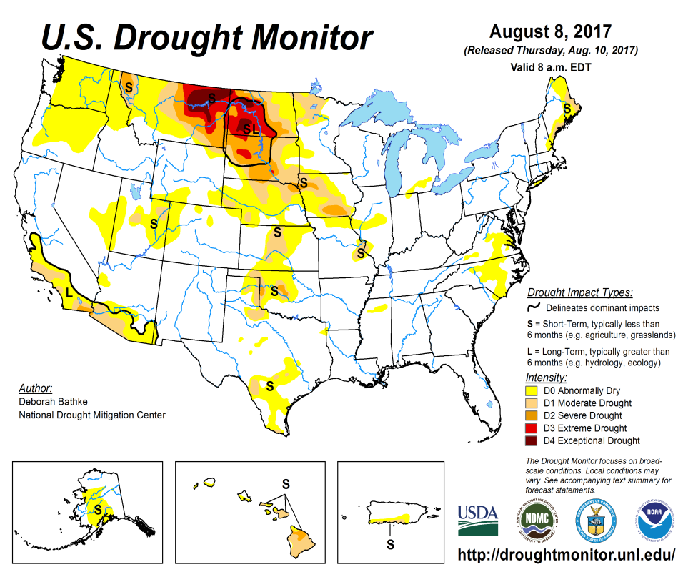
Drought Monitor
Previous
Currently a) one major Drought region in the Dakotas and eastern Montana and weakly extending into NE/IA possibly a developing one in the Pacific Northwest, a long term drought in southern CA and AZ, and pockets of isolated and small areas of minor droughts in the west.
Latest

Slide 3
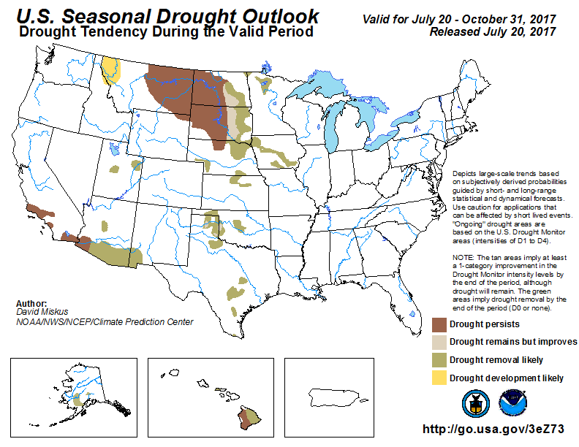
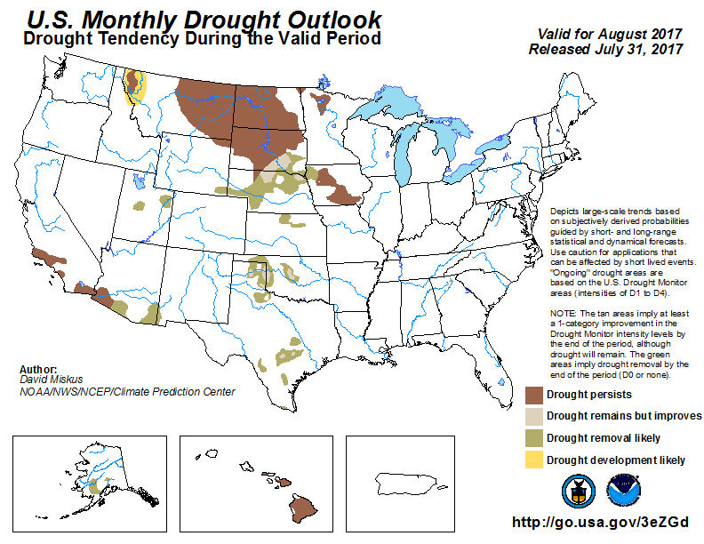
(Prev) Monthly/Seasonal outlook
Seasonal outlook
issued 7/20/17
Monthly outlook
issued 7/31/17
The 1000 lb …… in the room is the Northern Plains drought. What is going to happen to this? What do the various models say?

Slide 4
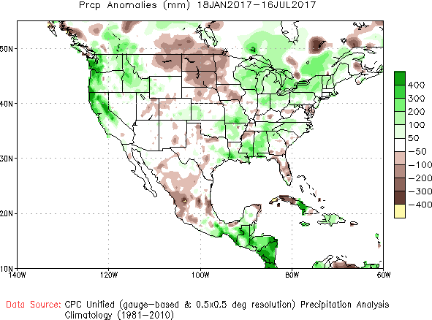
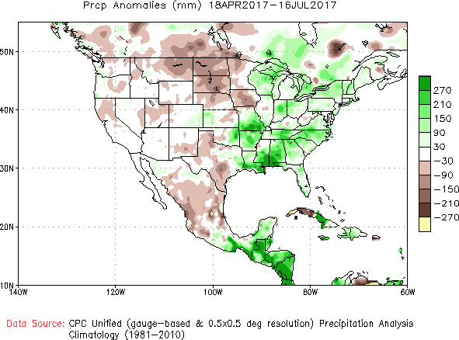
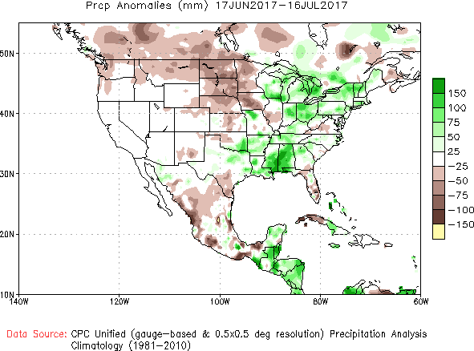
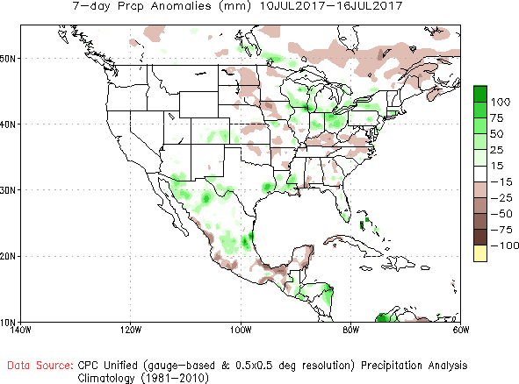
Recent Precipitation Anomalies 6 months, 3 months, 1 month and 7days -These maps pretty much tell the story behind the current/recent drought
----- LAST MONTH
6 mon
3 mon
1 mon
7 dy

Slide 5
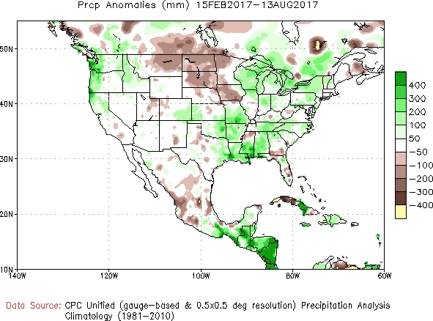
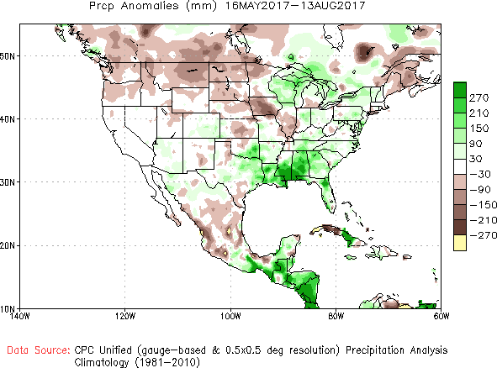
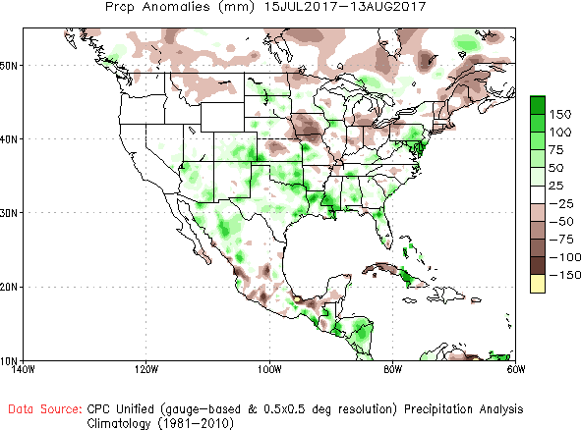
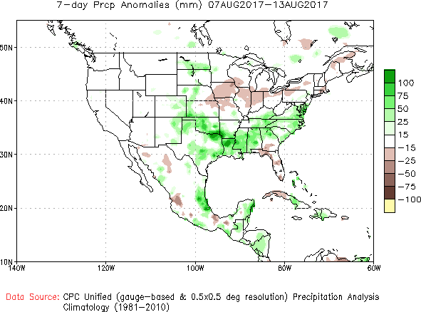
Recent Precipitation Anomalies 6 months, 3 months, 1 month and 7days -These maps pretty much tell the story behind the current/recent drought
----- NOW
6 mon
3 mon
Decent rains lately, but is it good enough?
Also western Montana,
WA/OR deficits in last 3 months….
1 mon
7 dy

Slide 6
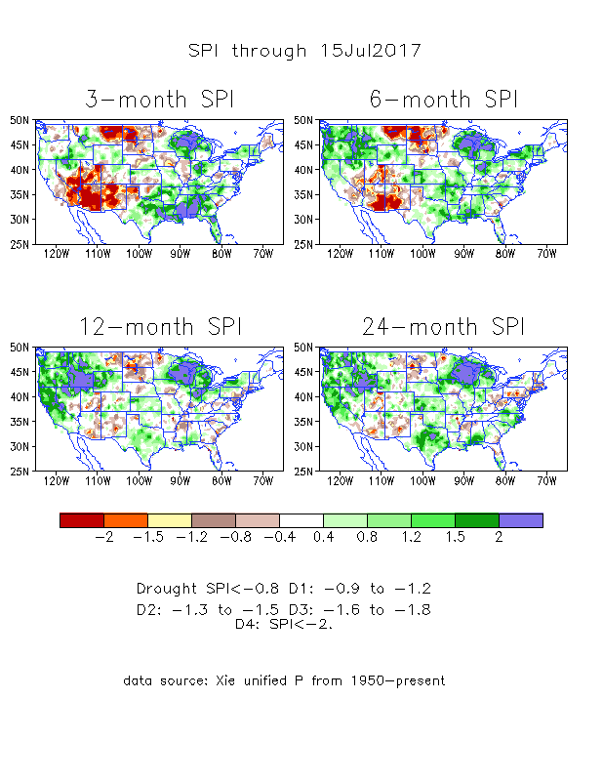
The Standardized Precipitation Index SPI (based on Observed P)
----- LAST MONTH
Consistent with the below normal precip in the Dakotas and eastern Montana, the observed 3-month and 6-month SPI values show large –ve SPI values in the region..

Slide 7
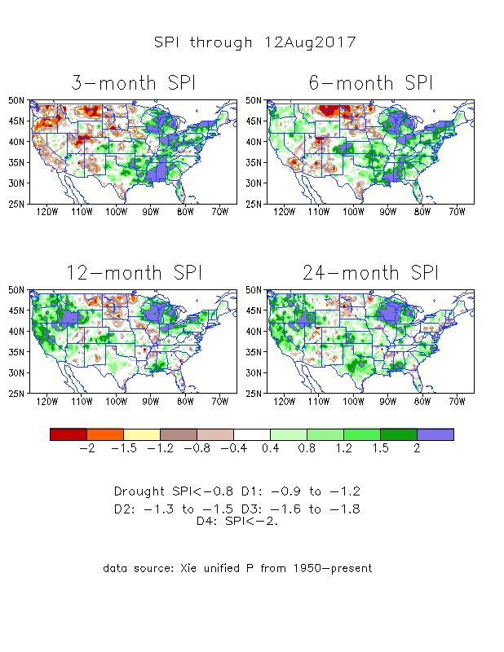
The Standardized Precipitation Index SPI (based on Observed P)
----- NOW
Relatively better situation overall compared to same slide for last month (prev. slide here in this ppt).

Slide 8
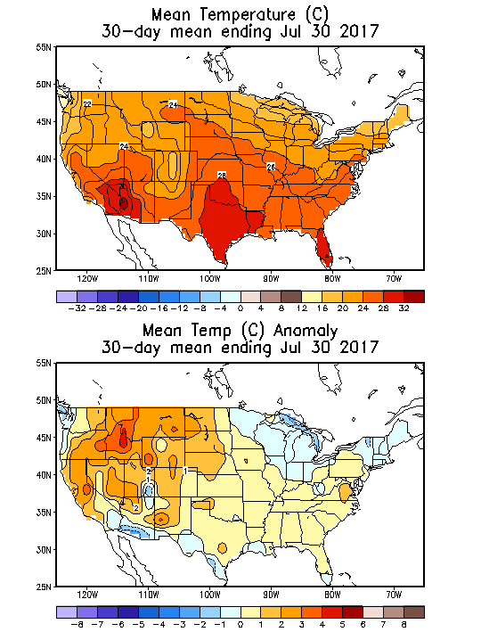
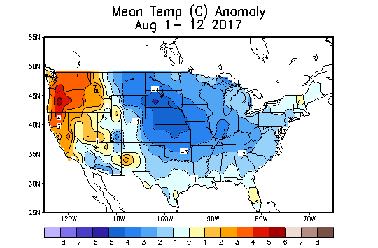
Recent US Temperatures
July mean T was generally slightly warmer than normal most of the country (except east north central and northeast) and southwest border.
So far, in August, the central to eastern tow thirds of the country was colder than normal, while the western one third of the country was warm.

Slide 9
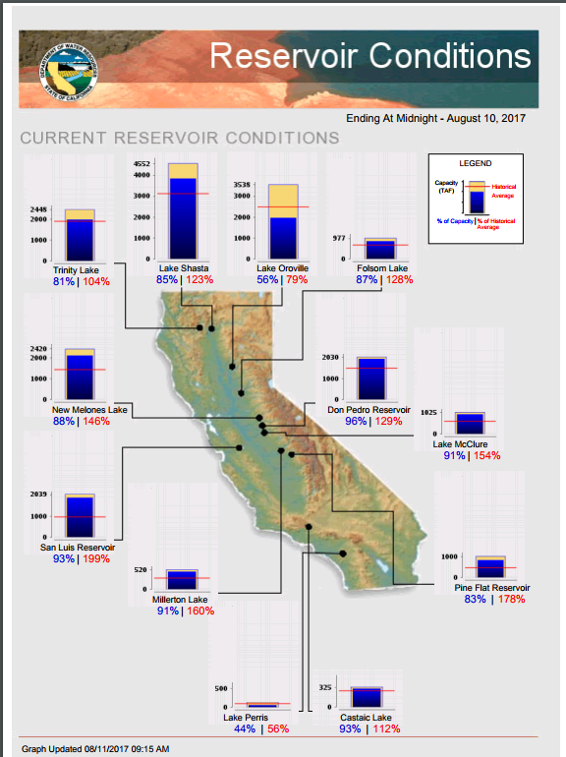
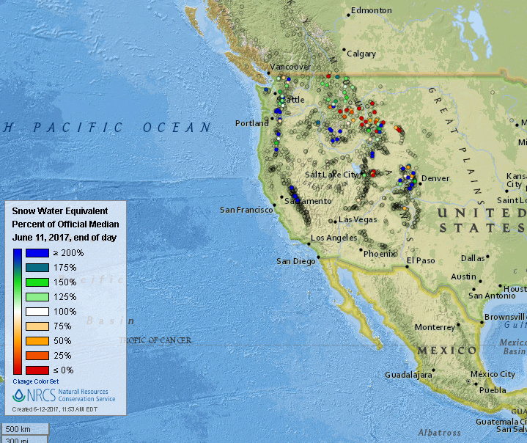
In CA, with the rainy season still far away, most of the reservoirs are at satisfactory levels, except in deep southern CA, where pockets of drought are there and have not gone away.
Snow forecast in the Sierra Nevada?
CA Skiing season in some resorts possibly kept open till late August? ☺
The NRCS (SNOWTEL) suggests the Snow water equivalent (SWE) are above normal at a few spots in the Sierra Nevada and in Cascade Range. Elsewhere fin the Rockies, most snow has melted, and SWE is below normal.

Slide 10
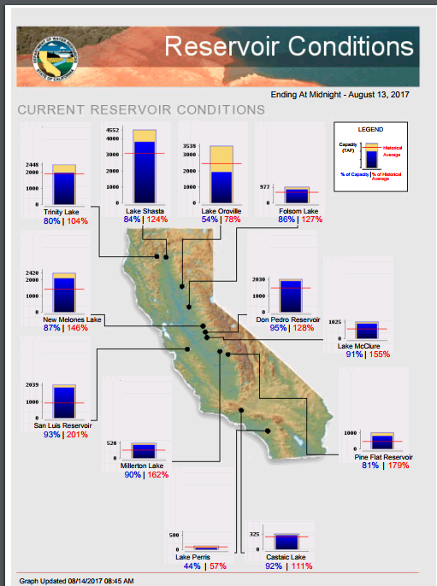
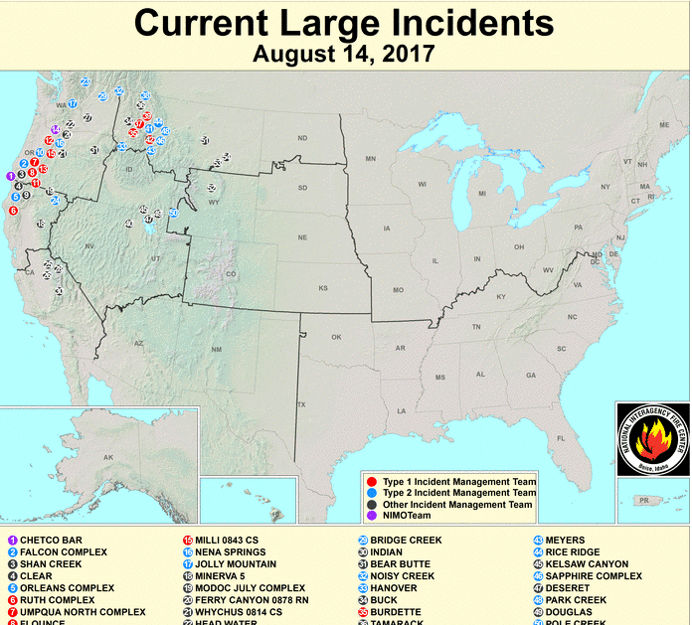
In CA, with the rainy season still far away, while most of the reservoirs are at satisfactory levels, there are quite a few reported fire incidents, including western MT, WA,OR and northern CA..
https://fsapps.nwcg.gov/afm/index.php
http://cdec.water.ca.gov/cgi-progs/products/rescond.pdf

Slide 11
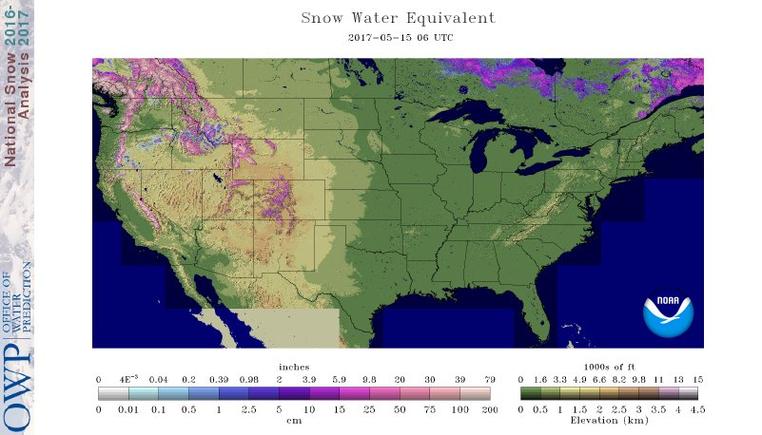
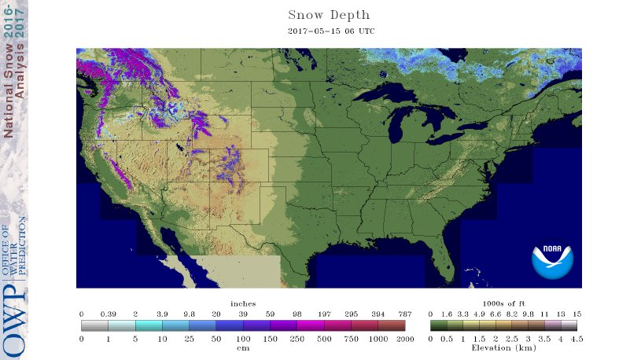
Data from the NOHRSC (National Operational Hydrologic Remote Sensing Center) / OWP (Office of Water Predictions)
Snow water Equivalent
Snow Depth
There is very little snow (from winter/spring) on the ground across the US.

Slide 13
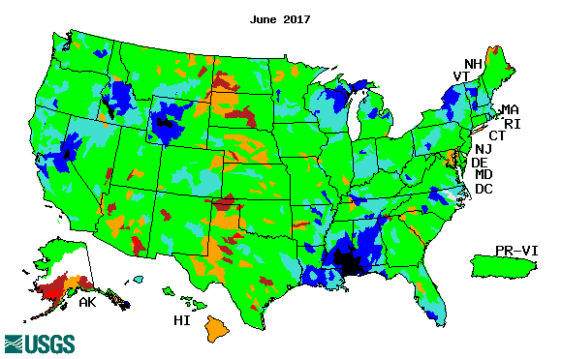
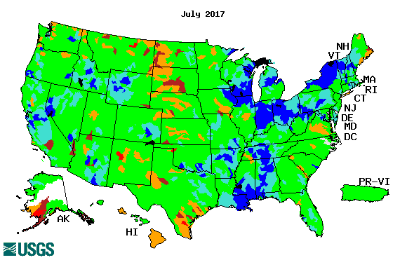
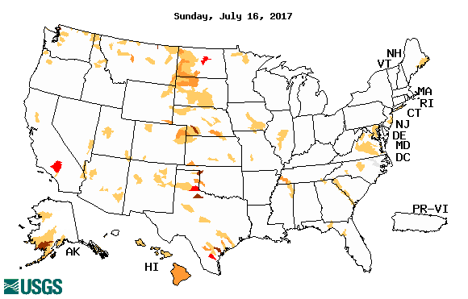
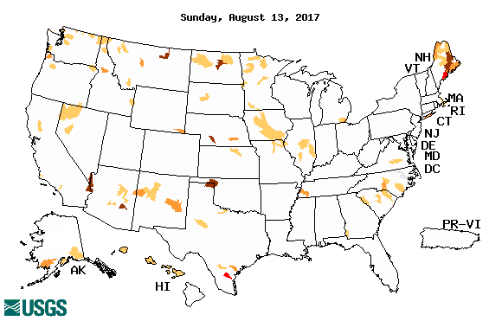
Streamflow (USGS)
Compared to June (top left panel), the stream flows have increased over much of eastern states in July, except along the coastal Gulf states.
Little difference in stream flow levels from June to July in the drought Dakotas areas.
Improvement noted in Arizona from the North American monsoon rains, which sometimes caused localized flooding there.
In the short term at least, the far northeast shows weakness in streamflow levels.
Map shows only below normal 7-day average streamflow compared to historical streamflow for the day of year (United States)
One month ago (left) & Now (below)

Slide 14
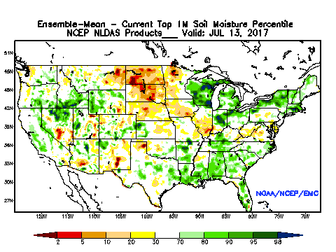
NLDAS Soil Moisture -delayed mode
The NCEP NLDAS based soil moisture are in very low percentiles across the drought ridden Dakotas, western Minnesota, and eastern Montana.
General weakness in SM is noted in the four corner states, and NV.

Slide 15
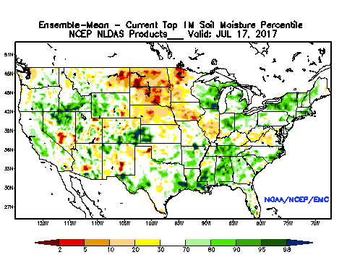
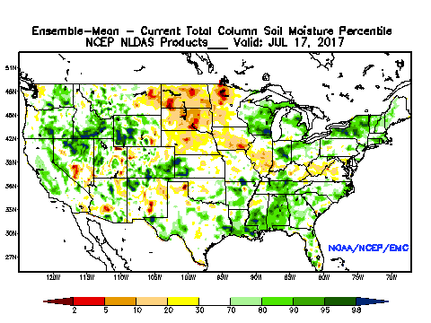
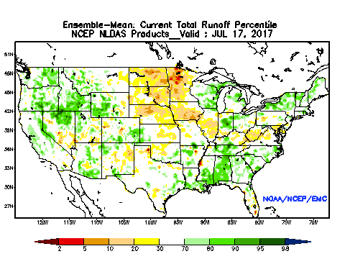
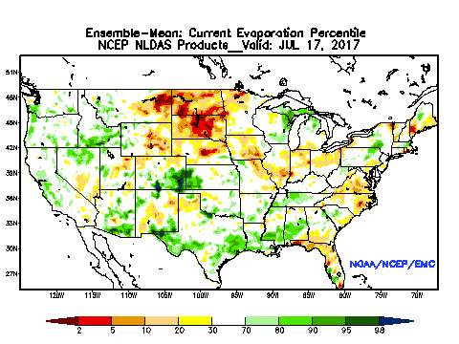
NLDAS Products (Exptl?) - (Near?) Real Time

Slide 16
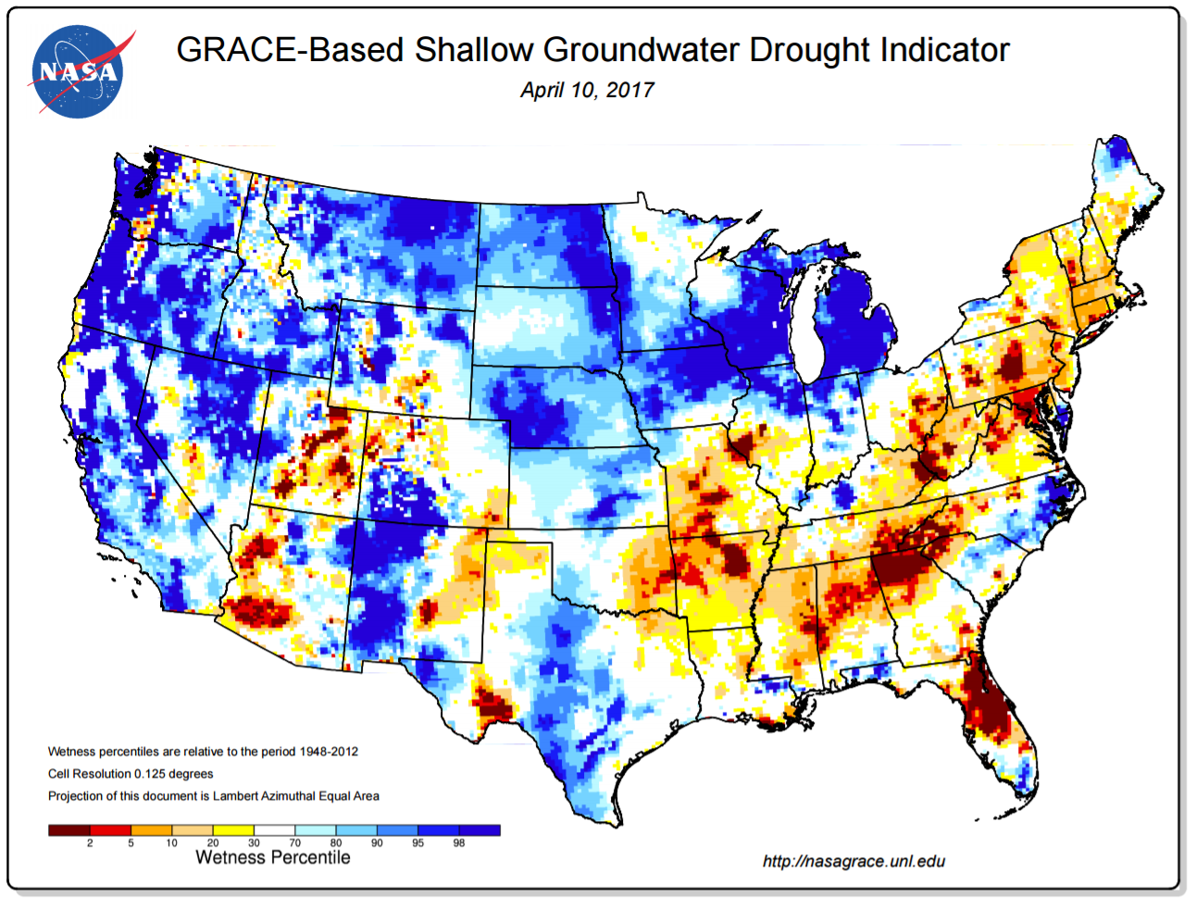
Groundwater Conditions from GRACE Data Assimilation

Slide 17
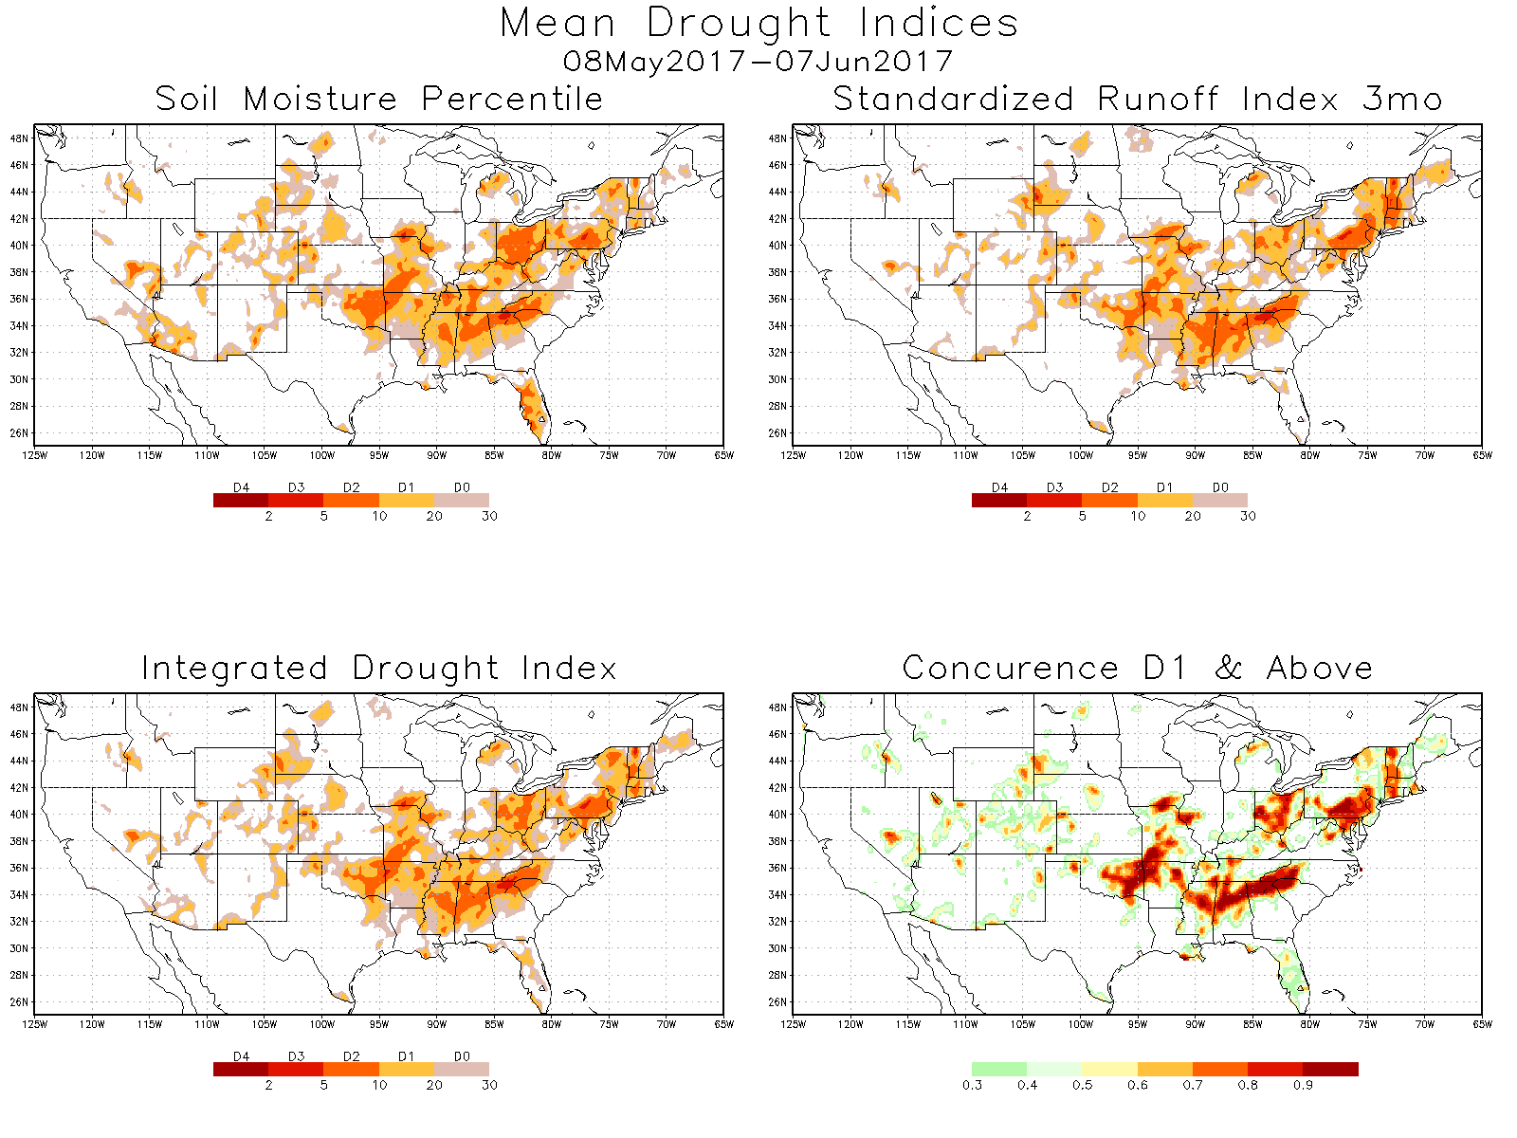
Integrated drought index
This integrated drought measure using both soil moisture percentile and standardized runoff index, suggests that the, all the NLDAS models, at least to the D1 level & above, suggest the following areas, mainly to the east and south.

Slide 18
EL NIÑO/SOUTHERN OSCILLATION (ENSO)
DIAGNOSTIC DISCUSSION
issued by CLIMATE PREDICTION CENTER/NCEP/NWS and the International Research Institute for Climate and Society
14 August 2017
ENSO Alert System Status: NOT ACTIVE , ENSO-Neutral conditions are present
Synopsis: Equatorial sea surface temperatures (SSTs) are near-average across most of the Pacific Ocean. ENSO-Neutral is favored (~85% chance during Jul-Sep, decreasing to ~55% during Dec-Feb) through the Northern Hemisphere winter 2017-18.

Slide 19
Year | DJF | JFM | FMA | MAM | AMJ | MJJ | JJA | JAS | ASO | SON | OND | NDJ
2010 | 1.3 | 1.2 | 0.9 | 0.5 | 0.0 | -0.4 | -0.9 | -1.2 | -1.4 | -1.5 | -1.4 | -1.4
2011 | -1.3 | -1.0 | -0.7 | -0.5 | -0.4 | -0.3 | -0.3 | -0.6 | -0.8 | -0.9 | -1.0 | -0.9
2012 | -0.7 | -0.5 | -0.4 | -0.4 | -0.3 | -0.1 | 0.1 | 0.3 | 0.3 | 0.3 | 0.1 | -0.2
2013 | -0.4 | -0.4 | -0.3 | -0.2 | -0.2 | -0.2 | -0.3 | -0.3 | -0.2 | -0.3 | -0.3 | -0.3
2014 | -0.5 | -0.5 | -0.4 | -0.2 | -0.1 | 0.0 | -0.1 | 0.0 | 0.1 | 0.4 | 0.5 | 0.6
2015 | 0.6 | 0.5 | 0.6 | 0.7 | 0.8 | 1.0 | 1.2 | 1.4 | 1.7 | 2.0 | 2.2 | 2.3
2016 | 2.2 | 2.0 | 1.6 | 1.1 | 0.6 | 0.1 | -0.3 | -0.6 | -0.8 | -0.8 | -0.8 | -0.7
2017 | -0.4 | -0.1 | 0.2 | 0.4 | 0.4 | 0.3
http://www.cpc.ncep.noaa.gov/products/analysis_monitoring/ensostuff/ensoyears.shtml

Slide 20
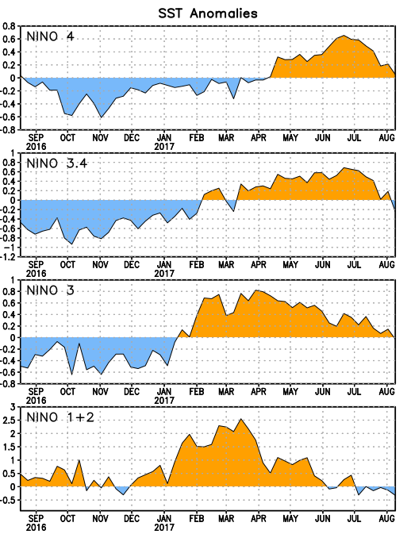
Latest values of SST indices in the various Nino Regions.
Negative subsurface temperature anomalies were present from March 2016 through December 2016. Positive anomalies were present from mid-January through March 2017. Recently the anomalies have been near zero.
SSTs were near-average cross the central equatorial Pacific, while strong positive SSTA continued near the S. American coast.

Slide 21
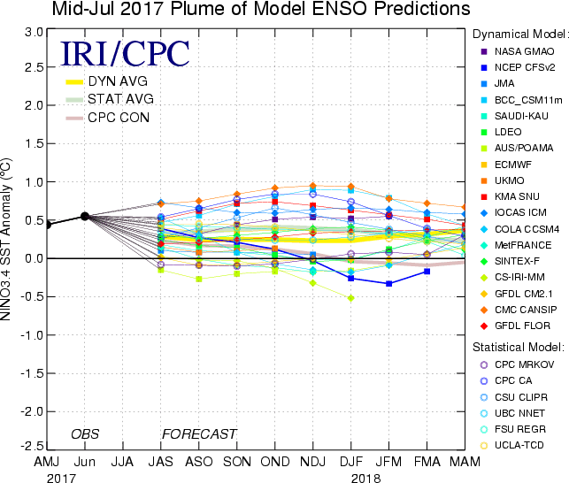
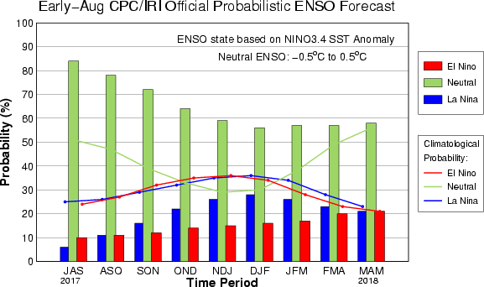
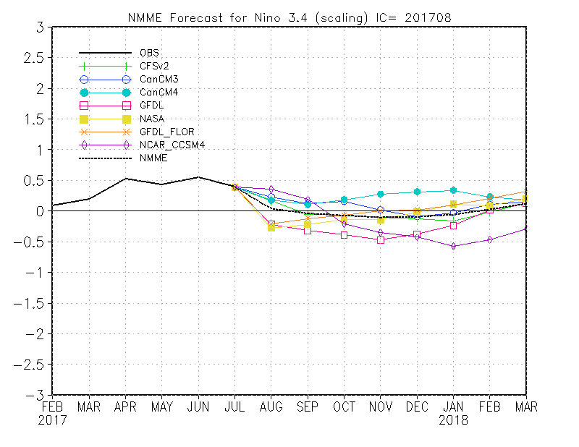
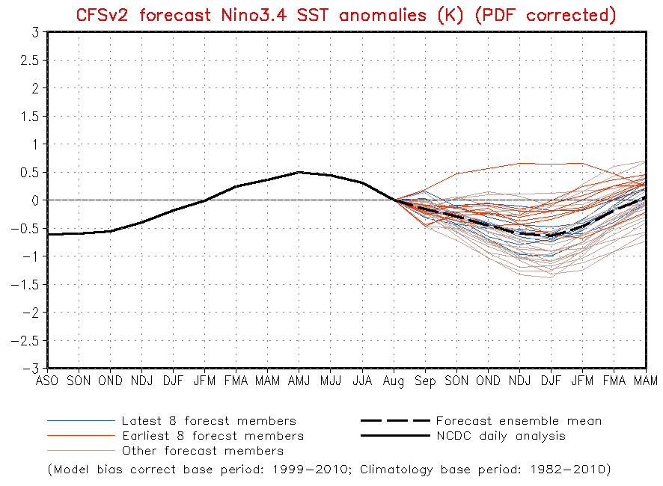
ENSO Forecasts
Early- Aug CPC/IRI forecast
NMME - Ensemble Mean
ENSO-neutral is slightly favored through fall/winter-2017.

Slide 22
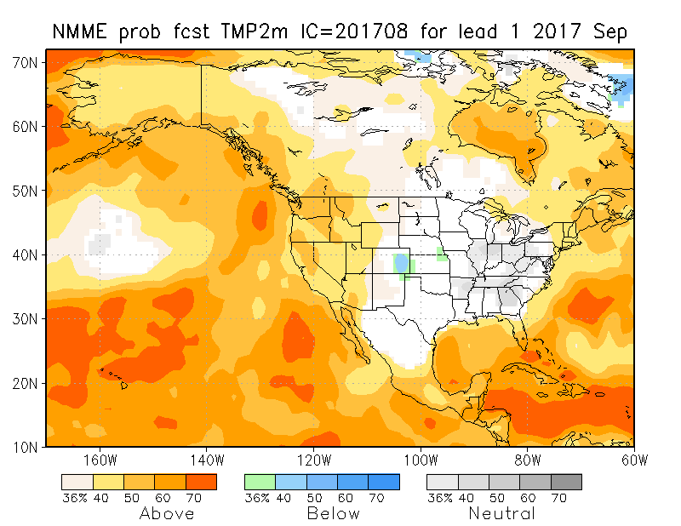
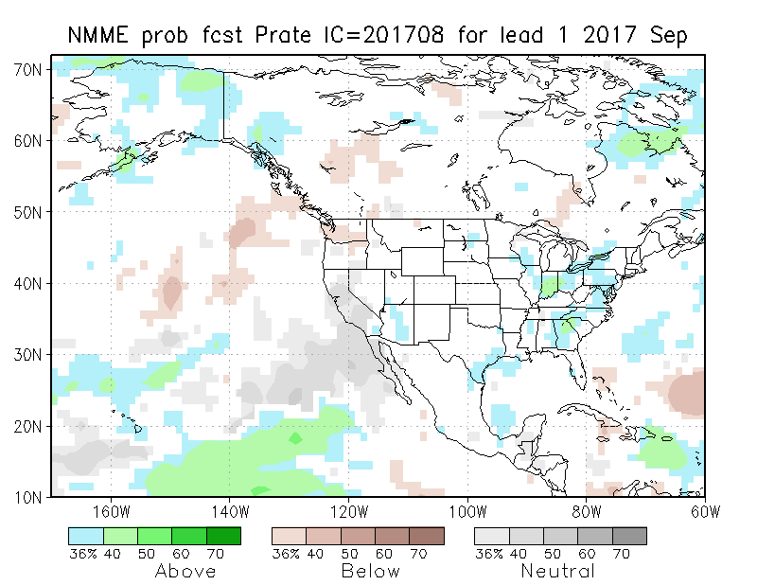
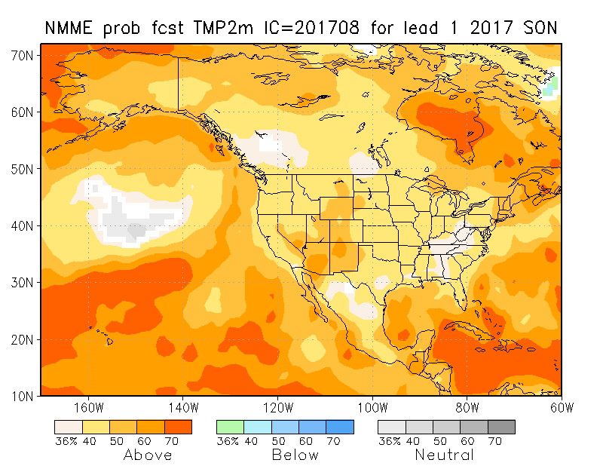
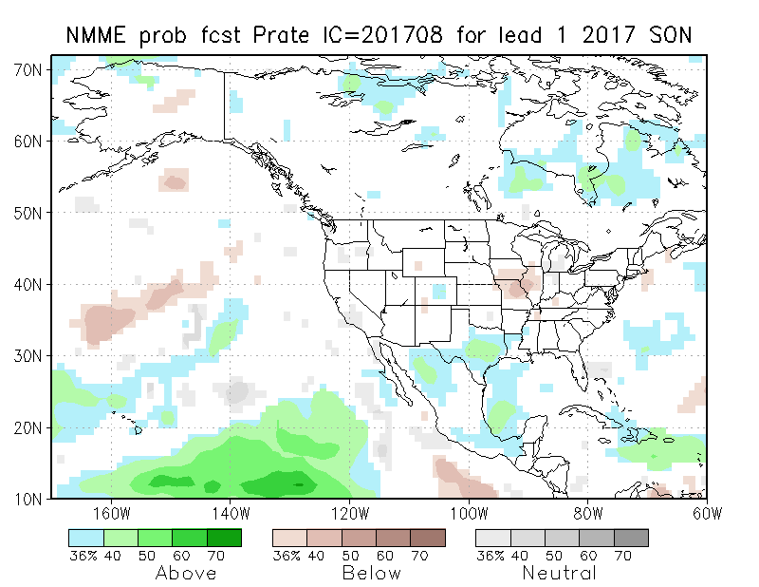
NMME T & P EnsMean forecasts
Sep
SON
The monthly (Sep) and seasonal (SON) T forecasts look different with warmth coming back. Very little Precip signal. – typically what we can expect in the absence of strong boundary forcing such as ENSO.

Slide 23
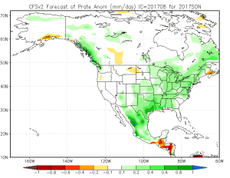
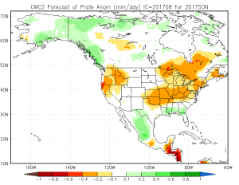
Look at the uncertainty among the diff. models’ fcsts!!!

Slide 24
CPC’s official Monthly (Aug) /Seasonal(ASO)
Precipitation outlook
Made July 31st
Made 20^{h} July

Slide 25
CPC’s official Monthly (Aug) /Seasonal(ASO)
Temperature outlook
Made
July 31th
Relatively a good T fcst for August so far. ☺
Made 20th July

Slide 26
Next 7 days QPF Forecast
In the next 7 days, the Dakotas, eastern Montana (to a lesser extent) will get some relief, as well as the four-corner SW states.
GFS Model Guidance for next 16 days.
According to the GFS, in the following two weeks (below), precip. in the Gulf/Atlantic coastal states..
Reinforcement and more precip as noted in the QPF above in the northern drought area(MT/ND/SD) and in the southwest.

Slide 27
Rainy Season

Slide 28
SPI3
SPI6
SPI3 & SPI6
Forecasts from 6NMME Models
(uses obs. P up to past month(Jan), and forecast months’ P from NMME models)
NMME Ensemble Mean (6 models)
SPI Forecasts for MJJ
Left Panels: SPI3
Right Panels: SPI6
In general, SPI3 can be somewhat more trusted than SPI6, to the extent the NMME models have any skill at all in the 1-3 months.
Having said that, the northern (Plains) MT/ND/SD drought, will likely improve in the short term (with the expected rain in the next 1-2 weeks) but getting better after that, according to these models.

Slide 29
NLDAS Drought Forecast Analysis
The system developed by Princeton University and University of Washington was transitioned to NCEP/EMC as the experimental forecast system.
Forecast using 201708 Initial Condition- Soil Moisture Percentile forecast
General improvement in SM conditions over the next couple of months is forecast by
NCEP’s NLDAS models.

Slide 30
Hydrological Monitoring and Seasonal Forecasting @ MSU (Michigan State University ) NLDAS model
http://drought.geo.msu.edu/research/forecast/smi.monthly.php
Monthly Soil Moisture Percentile Prediction issued on 201708
N/S Dakota & Vicinity:
Drought likely to get better in the next couple of months, season, but uncertainty exists.
The inter quartile range suggest greater uncertainty about the forecast in these shaded regions.

Slide 31
NASA GEOS5 Forecasts - Aug/Sep/Oct 2017
Generally less rain is forecast in the drought regions, central plains, and in south – leading to very dry soil moisture conditions in Texas in October ?????? – opposite of other models’ forecast…!!
Precip
Soil Moisture Percentile
???

Slide 32
Summary
Current ENSO status and forecast.
ENSO status – NOT ACTIVE. Equatorial sea surface temperatures (SSTs) are near-average across most of the Pacific Ocean. ENSO-Neutral is favored (~85% chance during Jul-Sep, decreasing to ~55% during Dec-Feb) through the Northern Hemisphere winter 2017-18.
Current Drought conditions:
The drought that has emerged quickly and recently since June across N/S Dakotas, eastern Montana continues. But recent August rains in that region has contained further intensification of the drought in that region. But this northern drought is beginning to extend in to parts of NE/IA.
The dryness that has developed recently in the Pacific northwest and western Montana is of some concern, thus possibly signaling the short term drought development in those regions.
Some precip deficit is developing in the Northeast, and stream flows are weak.
Prediction:
Since the boundary (ENSO/SST) forcing is none, dynamical model forecasts of precip do not have much signal in them, and are of not much help.
However, most NLDAS models, which make use of available model/official forecast precip as forcing, is suggesting improvement of drought conditions in the northern Plains, while uncertainty about these remains.
The short/long term drought in southern CA/AZ will likely continue, but with the recent monsoon rains, at least the AZ part of the drought may improve.
With short term rainfall deficits, stream flows are developing weakness in the far northeast and have to be monitored with caution.

