Slide 1
Drought Outlook Discussion
December 2017
Climate Prediction Center/NCEP/NOAA
http://www.cpc.ncep.noaa.gov/products/Drought
Phone: 1-877-680-3341
Pwd: 858747

Slide 2
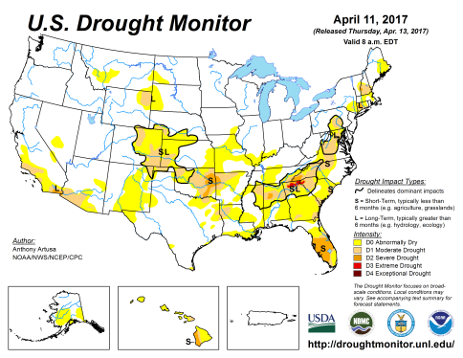
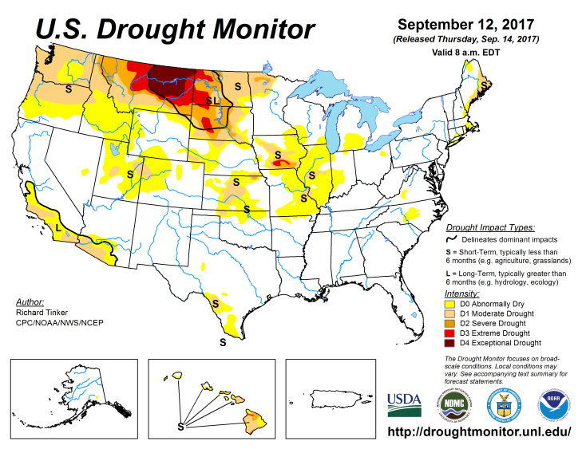
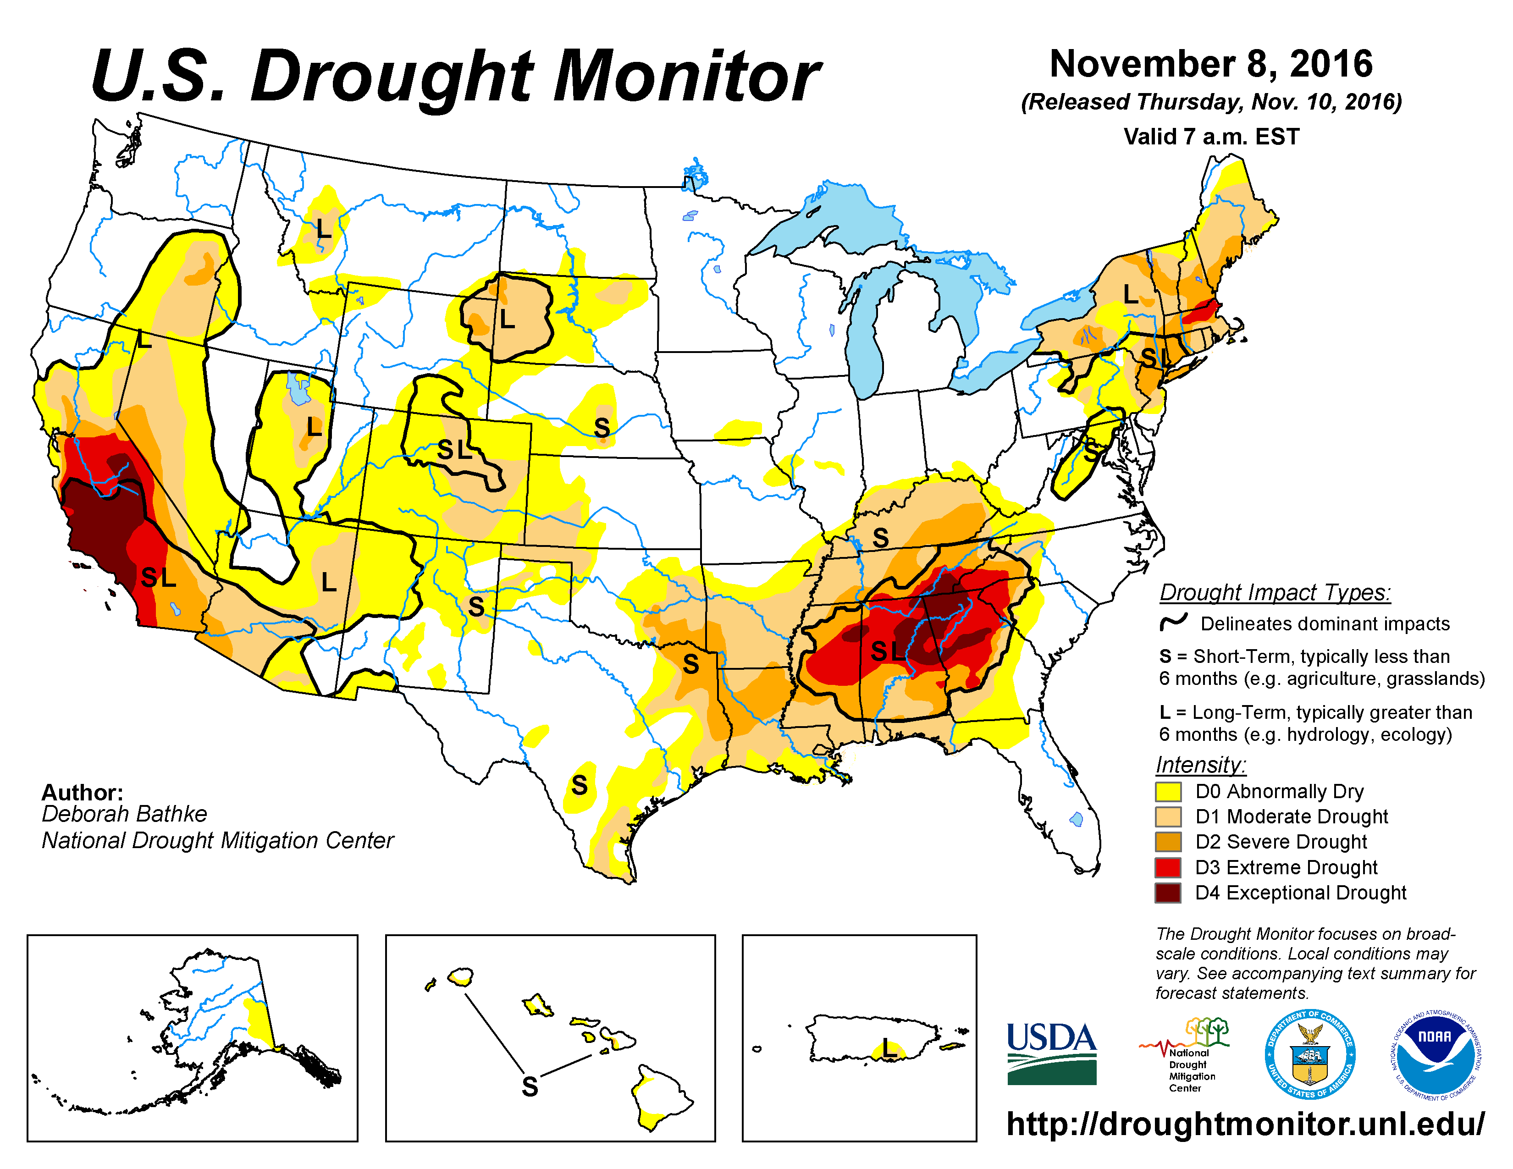
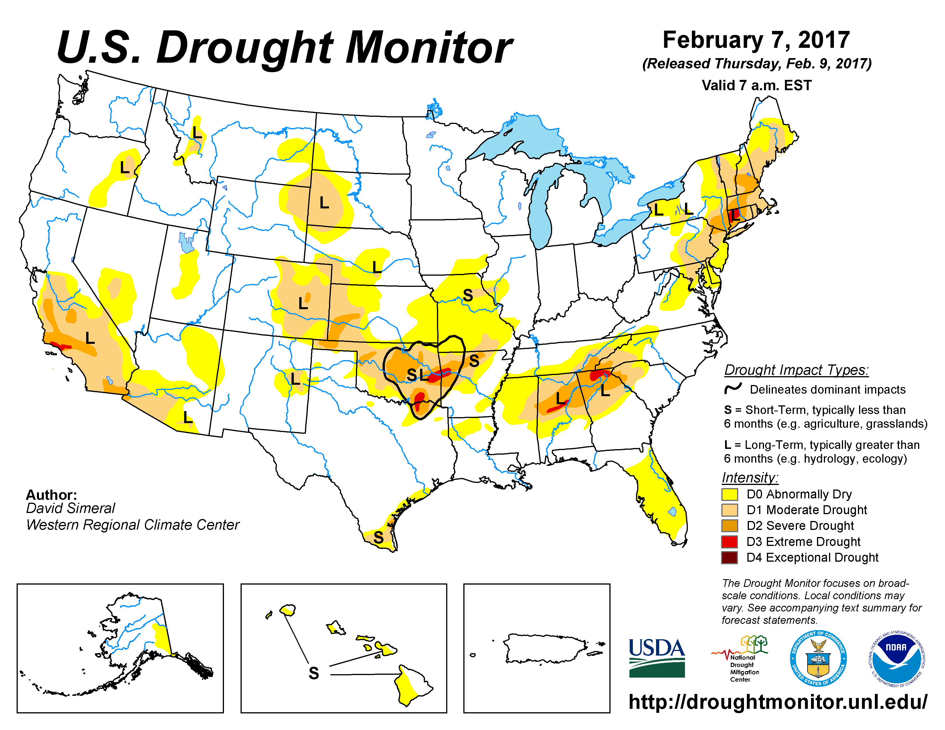
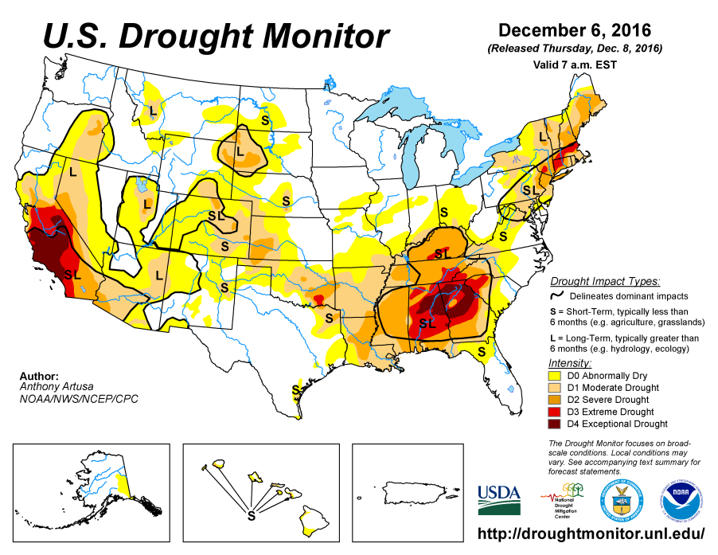
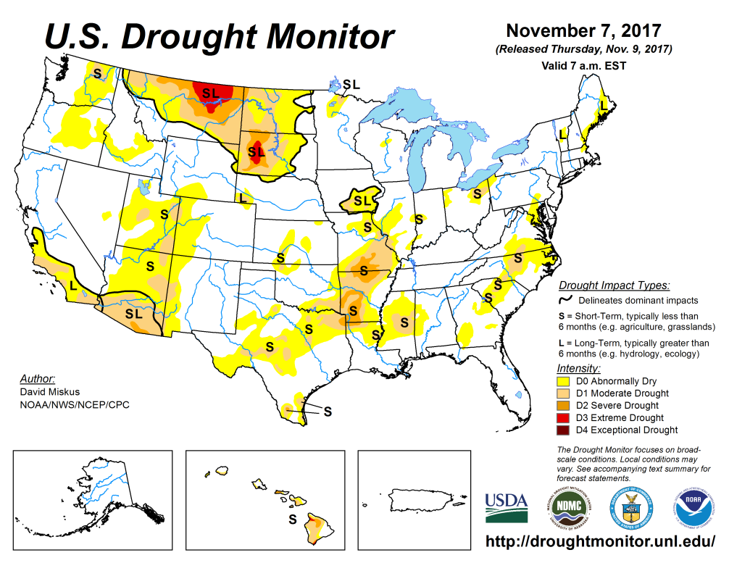
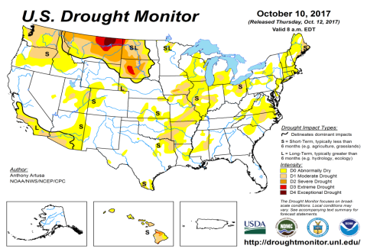
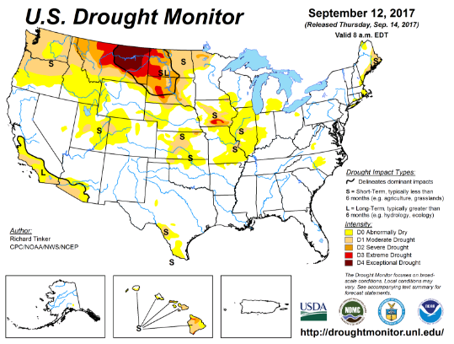
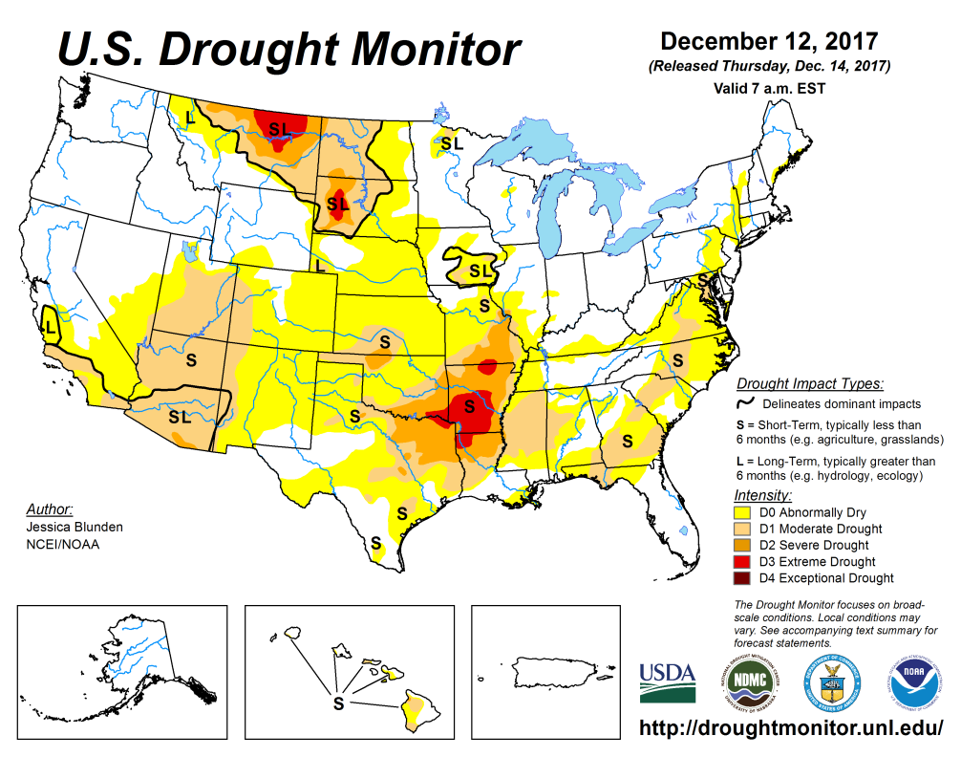
Drought Monitor
Oct
Previous
Sep
The ongoing major drought in the Northern Plains is getting better, particularly in the Pacific Northwest.
The short/long term drought in southern CA/AZ continues (for ever!)
New areas of severe drought in MO/AR is getting worse.
Elsewhere small pockets of dryness...
Latest

Slide 3
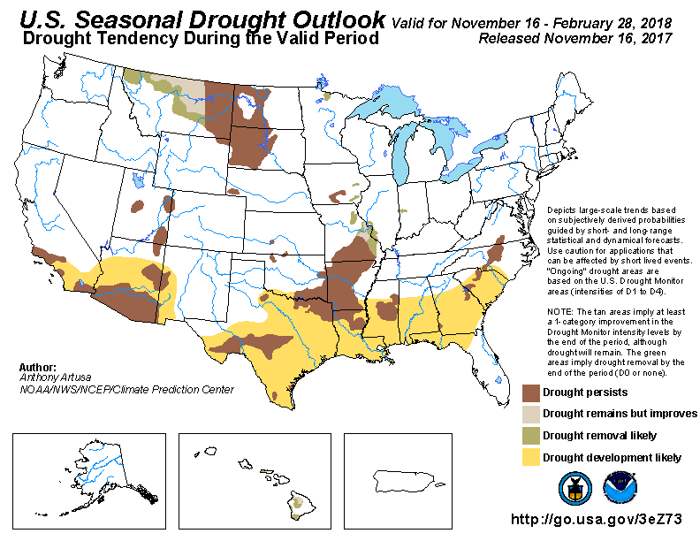
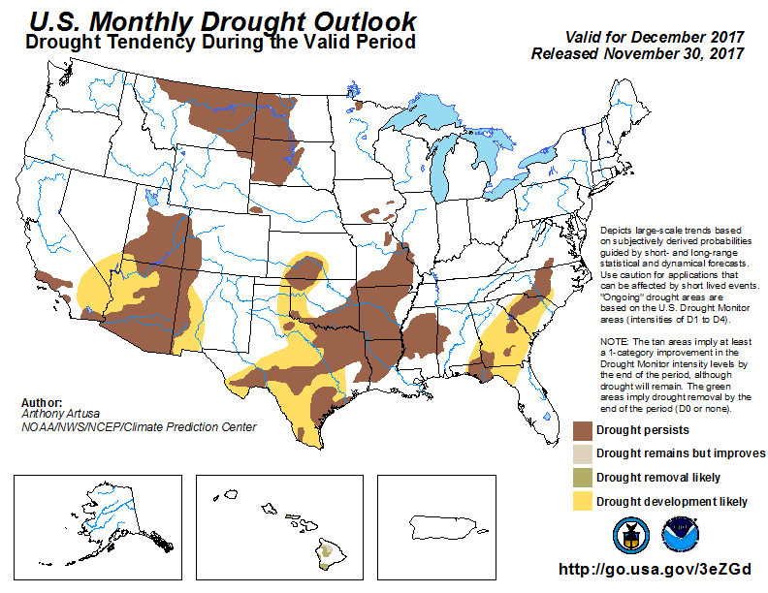
(Prev) Seasonal/Monthly Drought outlooks
Seasonal Outlook (MidNov-Feb 2017)
issued 11/16/17
Monthly outlook
(December 2017)
issued 11/30/17
The outlooks issued last month called for improving drought conditions in WA/OR and western MT. – looks good so far.
Improving drought conditions in northeastern TX, MO, LA?
Drought development in southern AZ and interior NC/SC ?

Slide 4
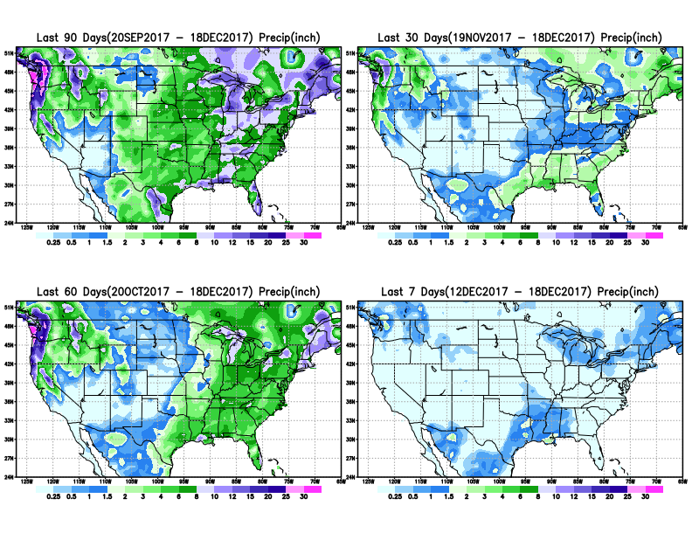
Total precipitation amounts during last 7, 30, 60 & 90 days.

Slide 5
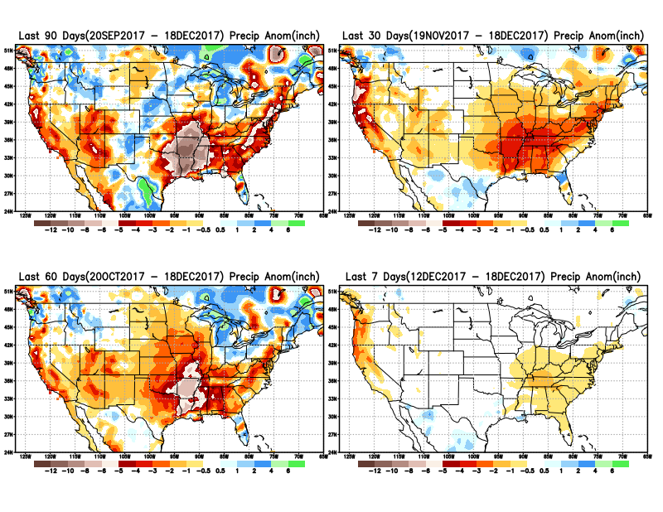
Total precipitation ANOM during last 7, 30, 60 & 90 days.
Short term improvement in Northern Plains. But in long term?
Shorty term rainfall deficits accrue in UT/CO AZ/NM/
Also in southeastOK AR/MO/LA

Slide 6
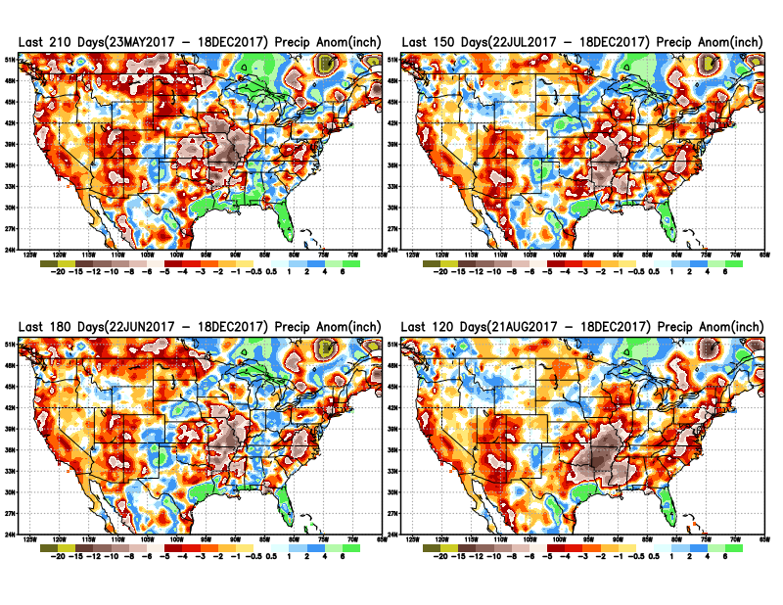

Slide 7
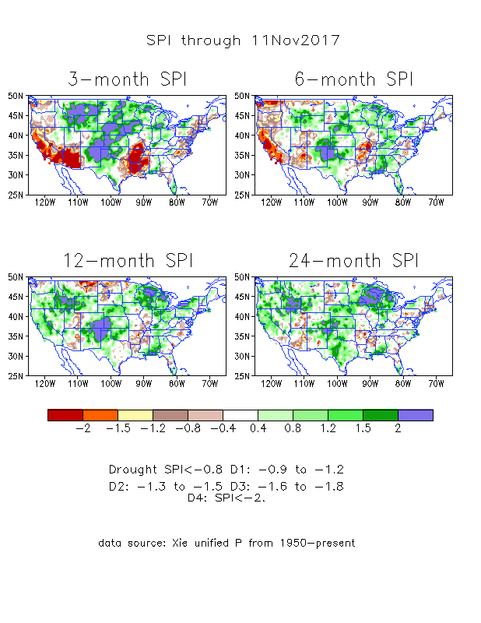
The Standardized Precipitation Index SPI
(based on Observed P)
-Last Month
The three month SPI, with its large negative values in the Northern Plains drought area and the Pacific NW, looked really bad last month.
Big changes in one month!!
The 24month long term SPI does not show any serious deficits(including CA) – good!
The 12/6 month SPI obviously shows the lack of AMJJ rainfall deficit in the Northern Plains.
With existing short term deficit in southern states, combined with the expected La Nina impacts – something to keep an eye!!

Slide 8
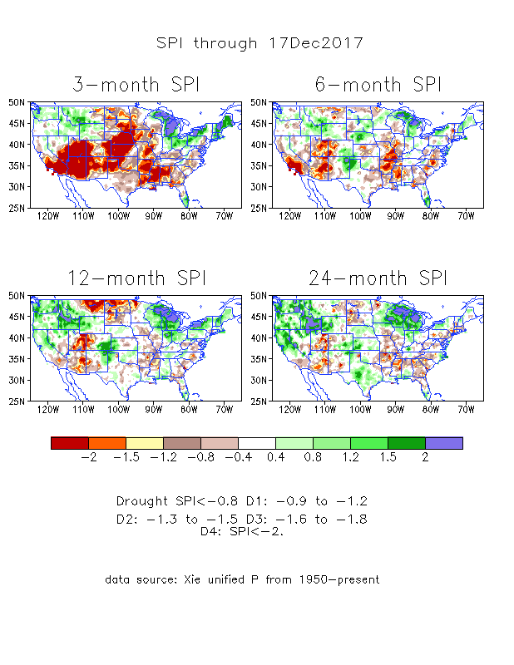
The Standardized Precipitation Index SPI
(based on Observed P)
----- NOW

Slide 9
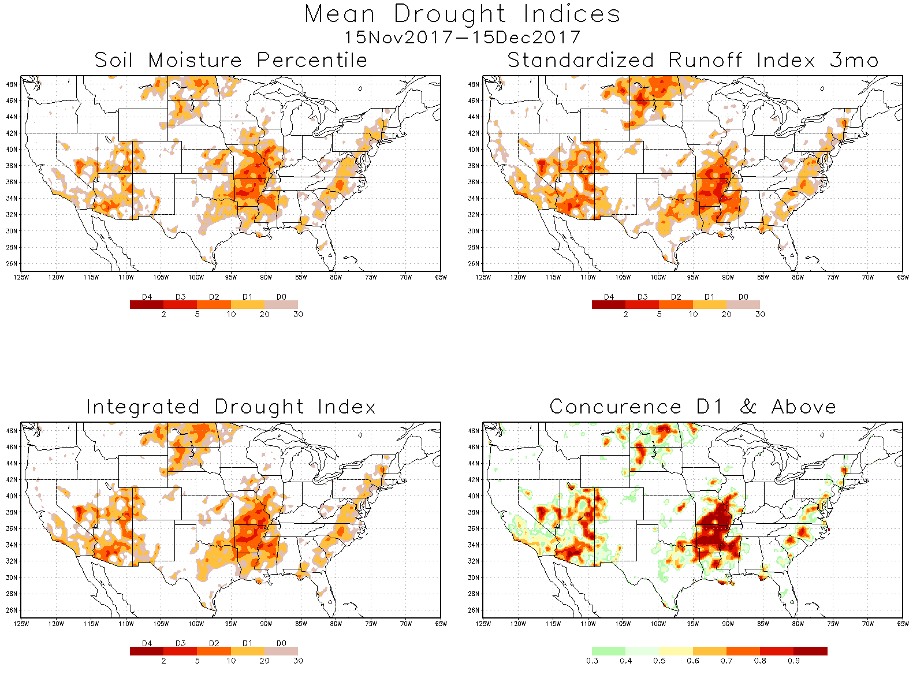

Slide 10
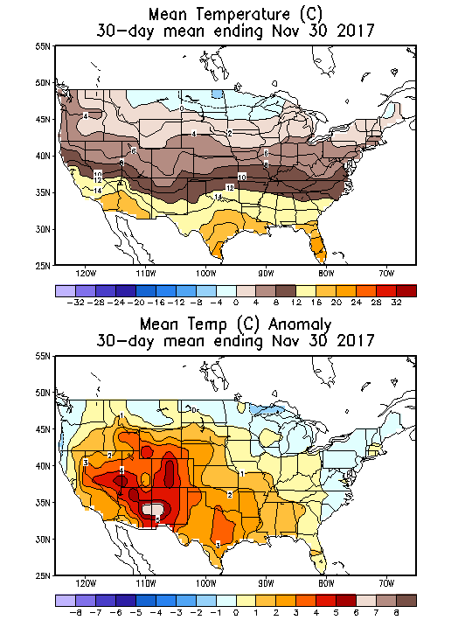
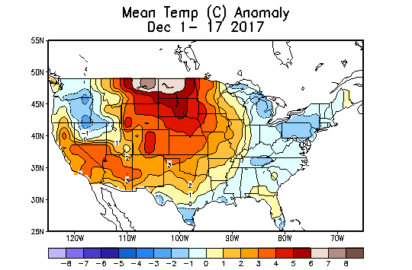
Recent US Temperatures
November mean T is large warm in the south west and south, but somewhat cool in the northeasr.
So far, in December, it is a cool northwest and east, and large warmth in the middle, especially in the northern plains.

Slide 11
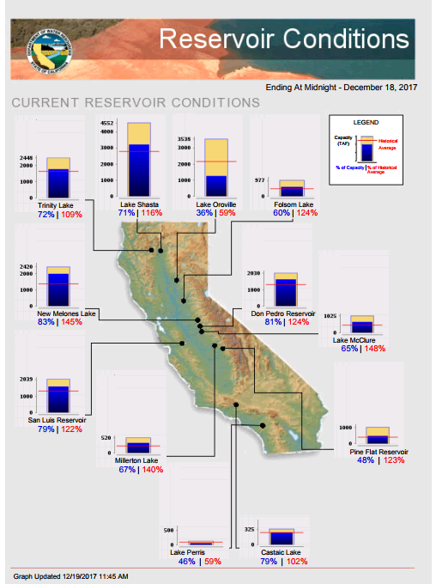
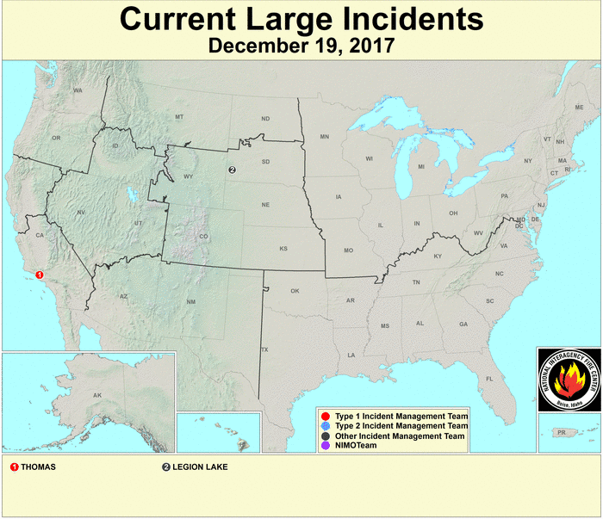
Before the upcoming La Nina in winter, at least most of the CA reservoirs are full.
But then again, what happened during this past winter? And the El Nino winter before that ?
https://fsapps.nwcg.gov/afm/index.php
FIRE
http://cdec.water.ca.gov/cgi-progs/products/rescond.pdf

Slide 12
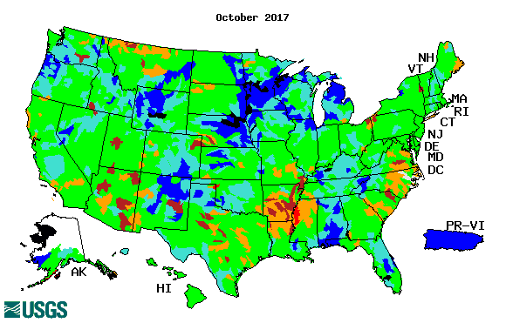

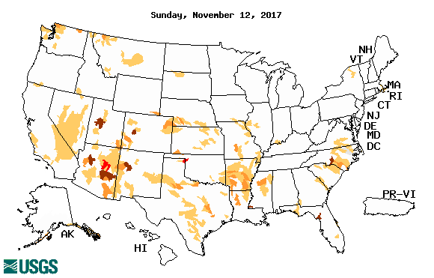
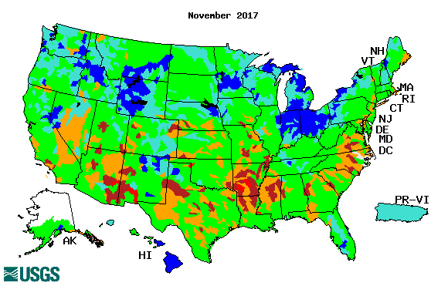
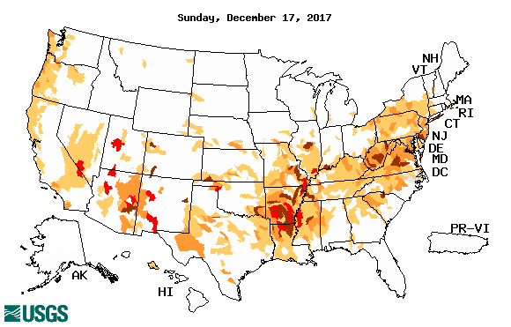
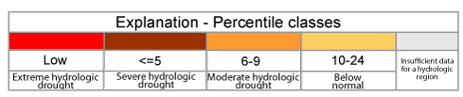
Streamflow (USGS)
Compared to October (top left panel), the stream flows actually look worse in November & December so far particularly across the southern states & along the Atlantic coastal states.
Last month’s weaker streamflow in the Northern Plains Drought area in MT, NS & SD is all but gone.
Map shows only below normal 7-day average streamflow compared to historical streamflow for the day of year (United States)
One month ago (left) & Now (below)

Slide 13
EL NIÑO/SOUTHERN OSCILLATION (ENSO)
DIAGNOSTIC DISCUSSION
issued by CLIMATE PREDICTION CENTER/NCEP/NWS and the International Research Institute for Climate and Society
14 December 2017
ENSO Alert System Status: La Niña Advisory !!
Synopsis: La Niña is likely (exceeding ~80%) through the Northern Hemisphere winter 2017-18, with a transition to ENSO-neutral most likely during the mid-to-late spring.

Slide 14

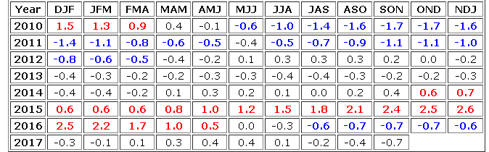
http://www.cpc.ncep.noaa.gov/products/analysis_monitoring/ensostuff/ensoyears.shtml

Slide 15
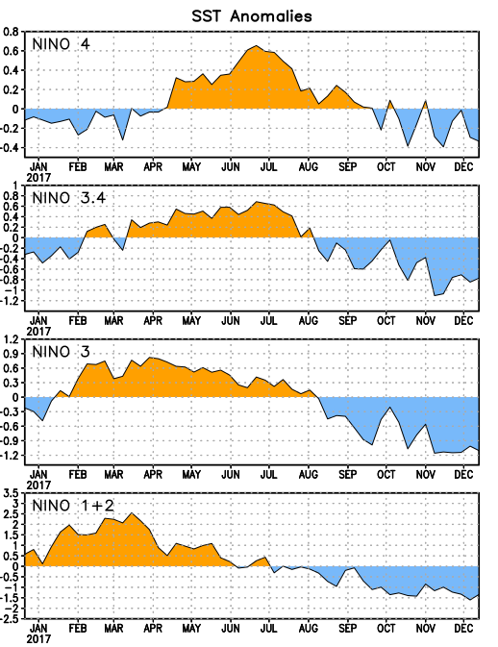
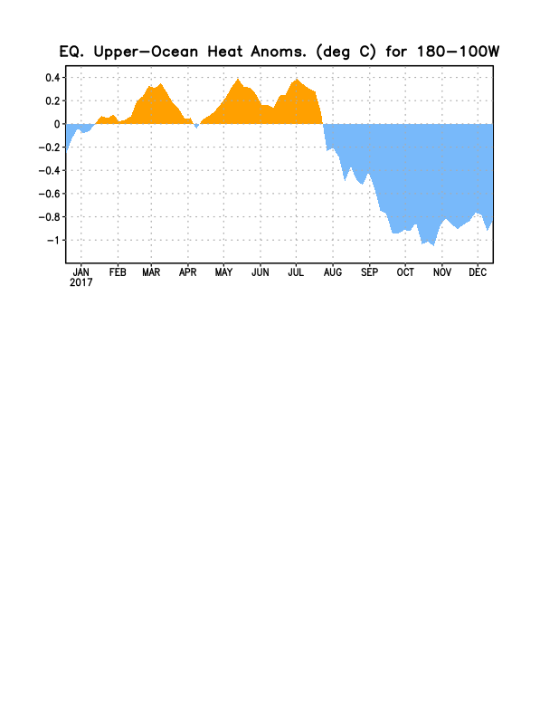
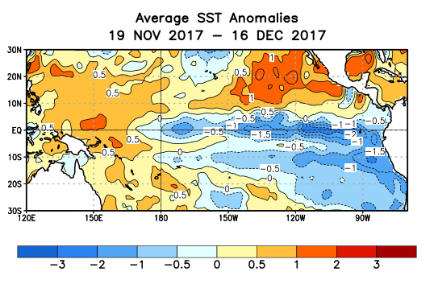
Latest values of SST indices in the various Nino Regions.
Since mid-July, sub surface anomalies have decreased and are staying negative
SSTs have fallen across the central and east Pacific. As well as the –ve upper ocean heat content, and –ve subsurface anomalies.

Slide 16
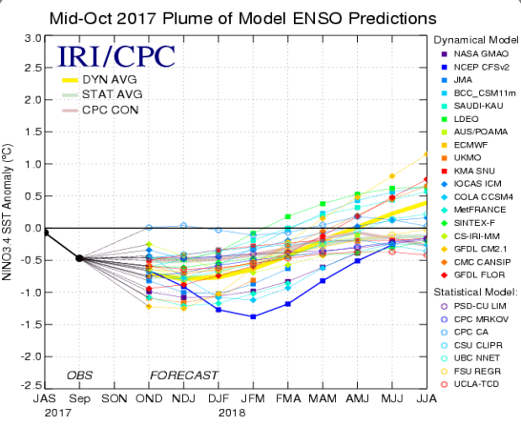
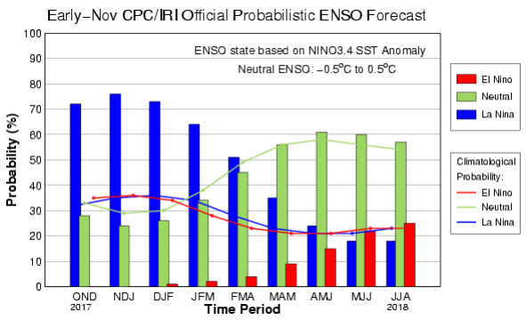
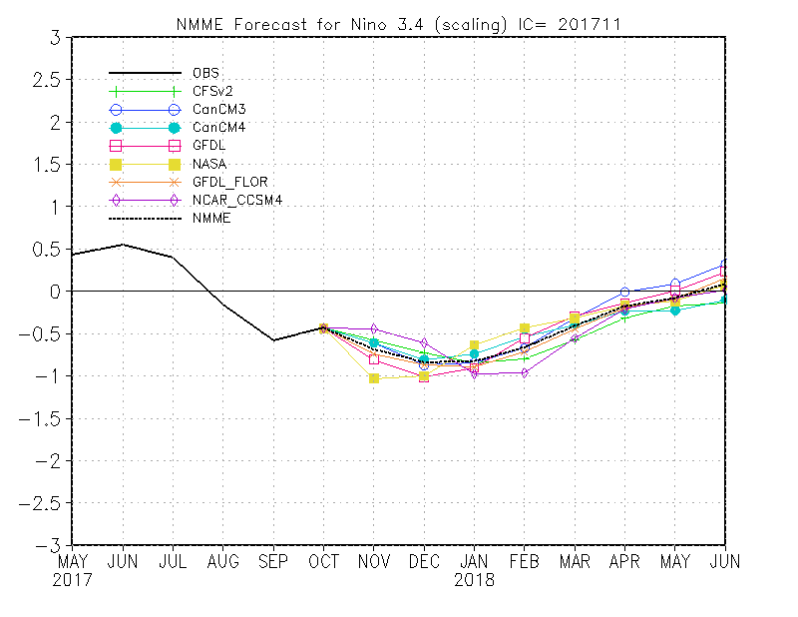
ENSO Forecasts
Early- Nov CPC/IRI forecast
NMME Models’ – Nino 3.4 forecasts
Early- Nov CPC/IRI forecast
Probs slightly higher

Slide 17
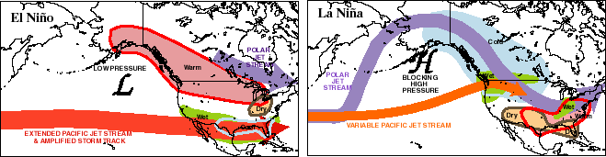
Dec-Feb
Expected
Impacts
If a La Nina
develops…
& its normal

Slide 18
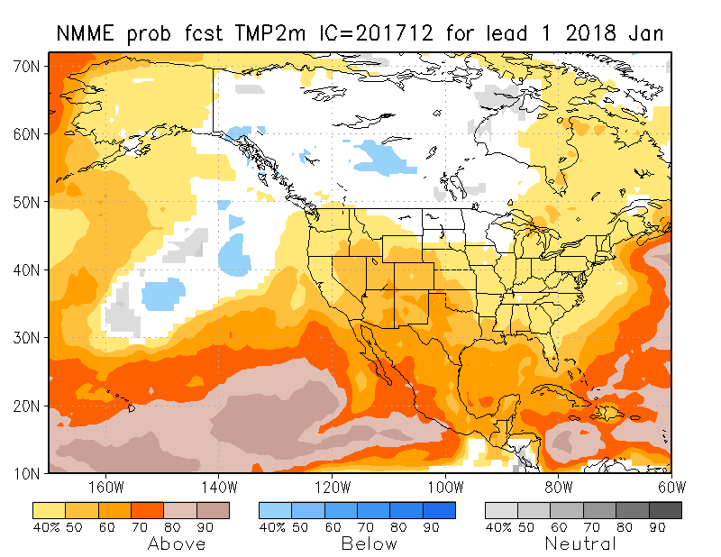
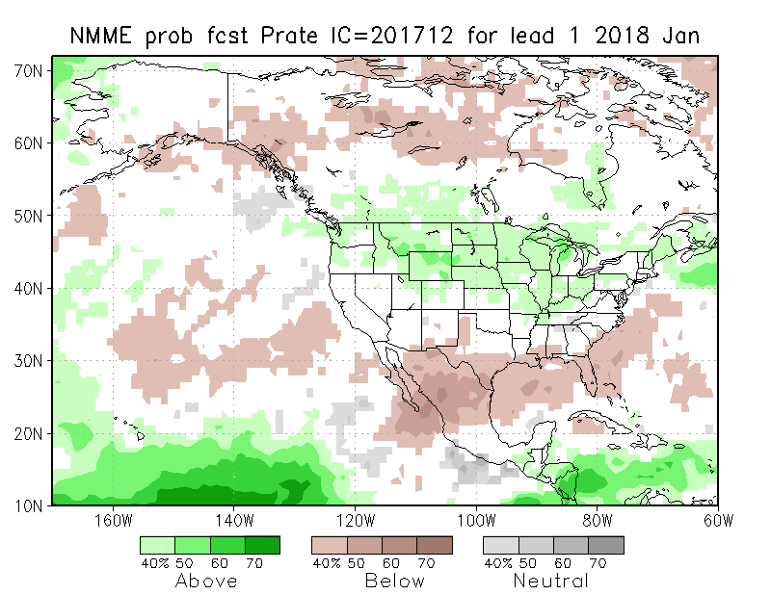
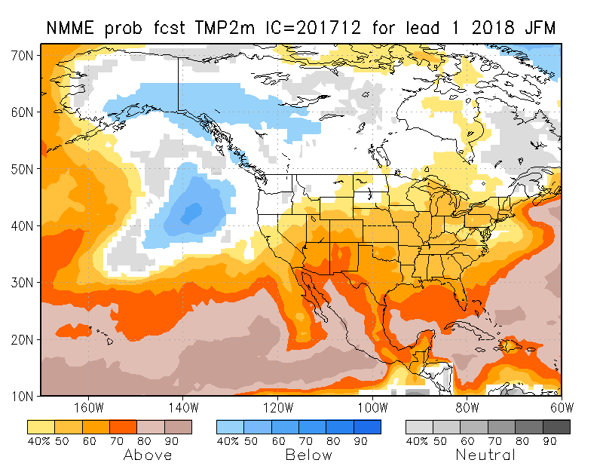
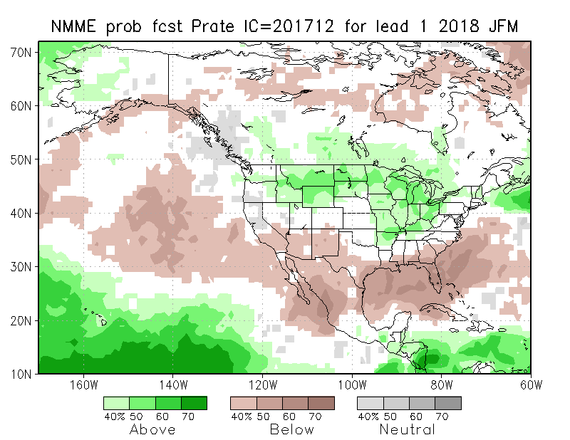
NMME T & P
EnsMean forecasts
Jan
JFM
The monthly (Jan) and seasonal (JFM) T are for more warmth across the country, except in NW. Overall, models are predicting/implying somewhat typical La Nina Impact for Precip for Dec/DJF.

Slide 19
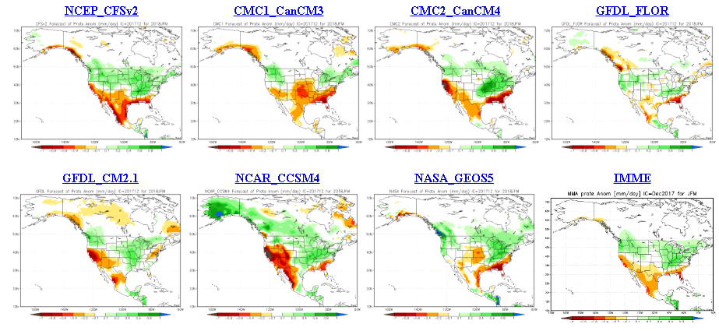
The agreement/uncertainty among the diff. NMME models’ forecasts for
Jan-Feb-Feb Precipitation!!!

Slide 20
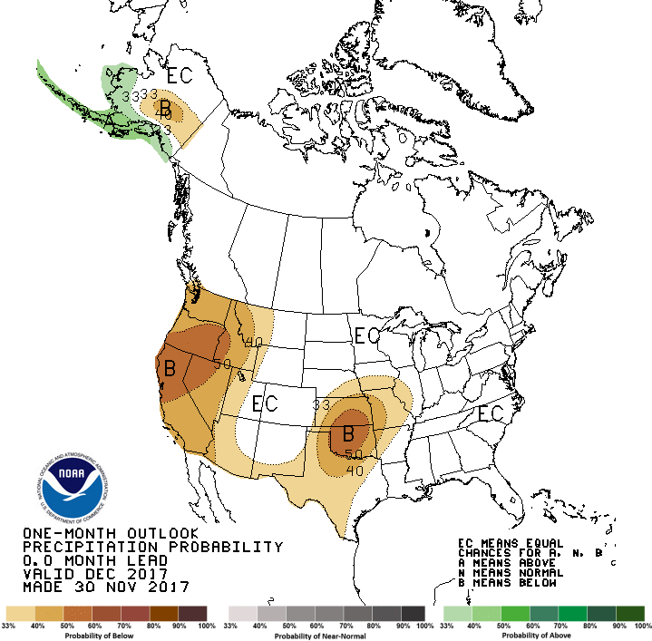
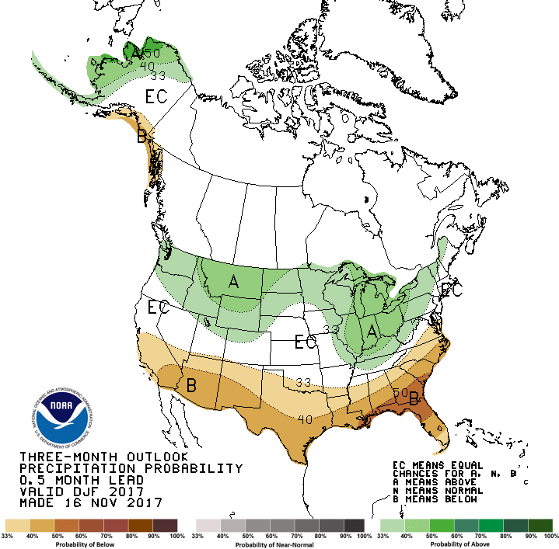
Previous CPC’s official
Monthly (Dec) /Seasonal (DJF)
Precipitation outlook
Released Nov 30th
Released Nov 16th

Slide 21
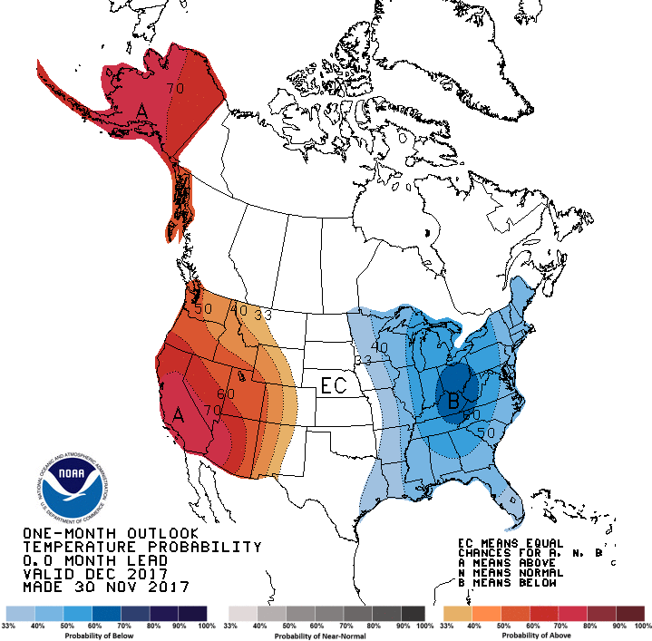
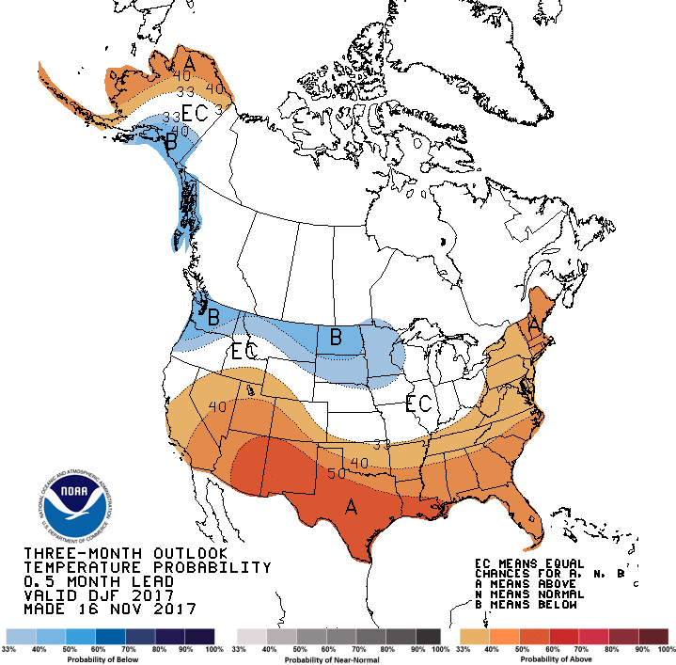

CPC’s official
Monthly (Dec) /Seasonal (DJF)
Temperature outlook
Made
Nov 30th
Relatively a good T fcst for so far, except in the northwest and northern plains.
Made Nov 16th

Slide 22
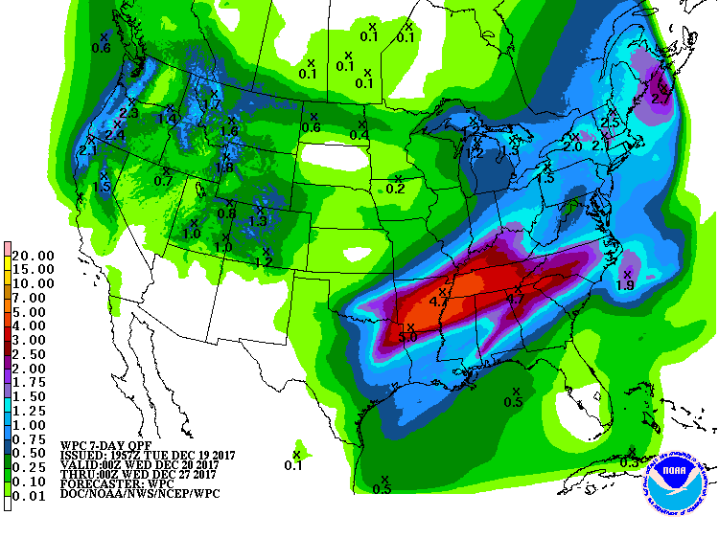
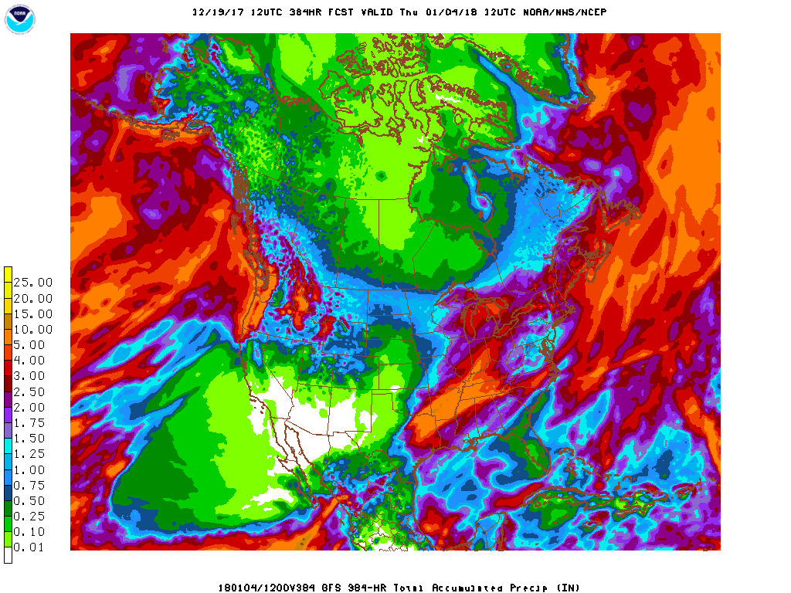
Next 7 days QPF Forecast
In the next 7 days, the Pacific NW, northern/central CA , and the NE is poised to get good rainfall.
Forecast rains in UT/CO will help the developing dry conditions there, and in MO/AR/LA region.
GFS Model Guidance for next 16 days.
According to the GFS,.. Reinforcement and more precip as noted in the QPF above in the northern dry/drought area(WA/OR/MT), CA, and in the northeast as well.

Slide 23
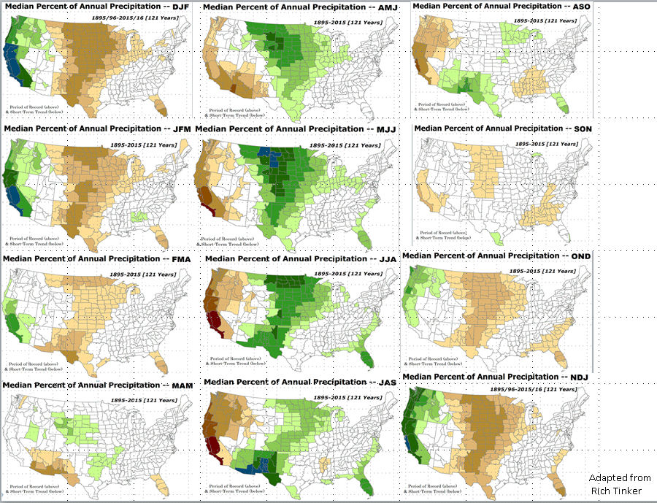

Rainy Season

Slide 24
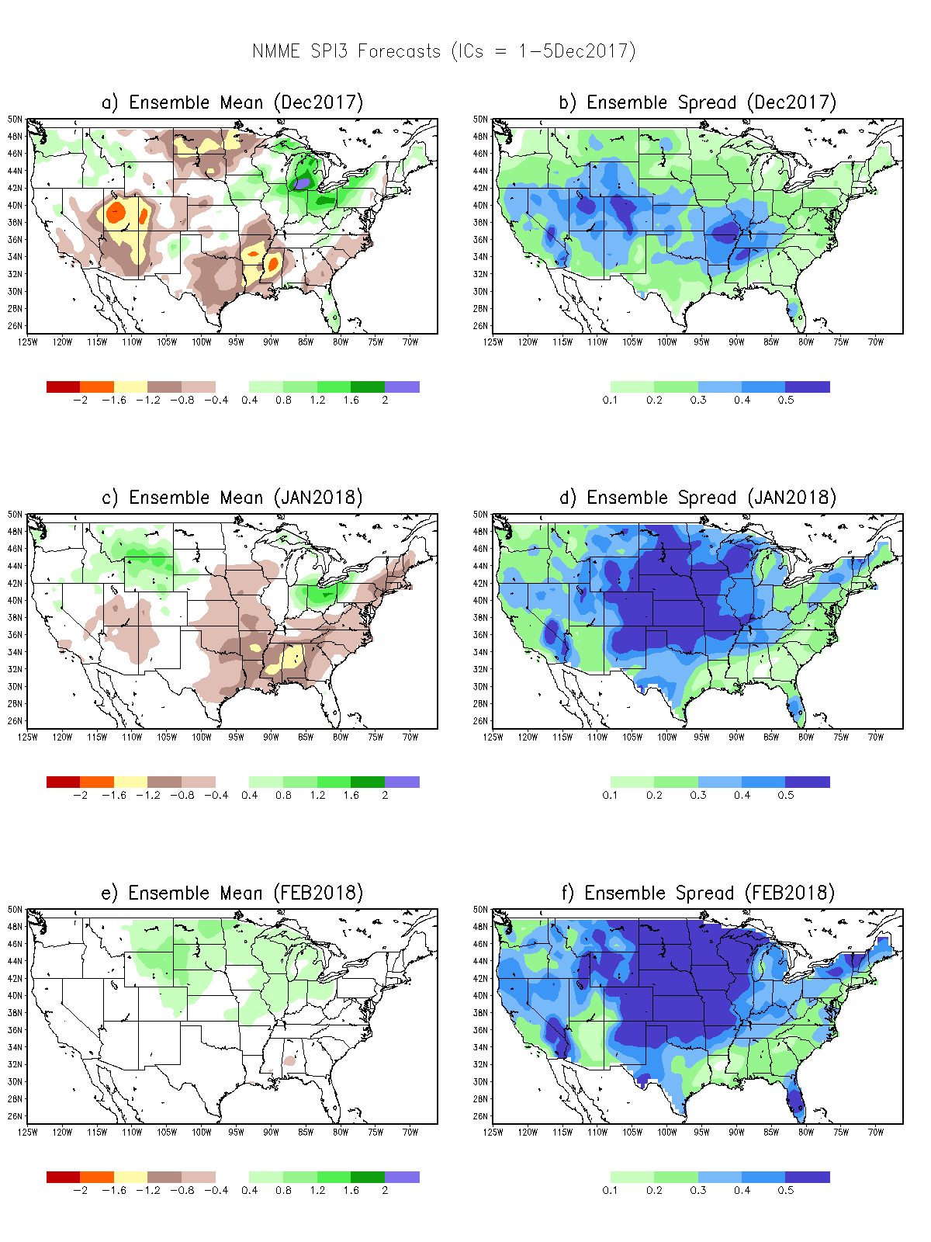
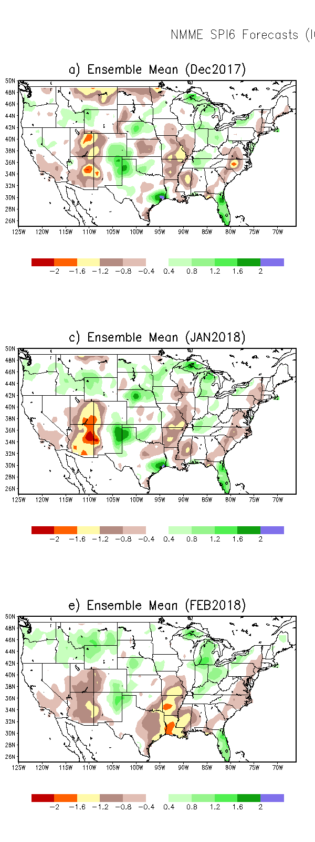
SPI3
SPI6
SPI3 & SPI6
Forecasts from 6NMME Models
(uses obs. P up to past month, and forecast months’ P from NMME models)
NMME Ensemble Mean (6 models)
SPI Forecasts for MJJ
Left Panels: SPI3
Right Panels: SPI6
In the past these NMME models and their forecasts always did not extend/intensify the Northern plains drought, and ended it repeatedly prematurely!!

Slide 25
SPI3
Ensemble
Forecast
MEAN
SPI3
Ensemble
Forecast
SPREAD
-Sometimes, over large areas, the
spread is as large as the mean

Slide 26
Next 3 slides are probabilistic drought forecasts (Drs. Kingtse Mo & Li Xu at CPC)
Making use of the agreement(disagreement) in the 60 ensemble members of the 6 NMME models (10 members each) – their respective SPI6 forecasts – as compared to the grand mean - converting them to probabilities.
At each grid point:
If all ensemble members agree – 100% probability.
If only half of the members agree – 50% probability
These plots will be modified further (instead of just D1-to–D1 & above) in the upcoming months
No past skill scores developed yet. But will be made available soon.!!

Slide 27
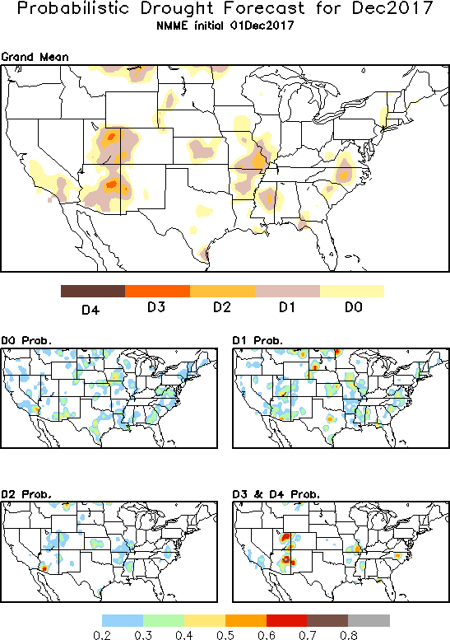
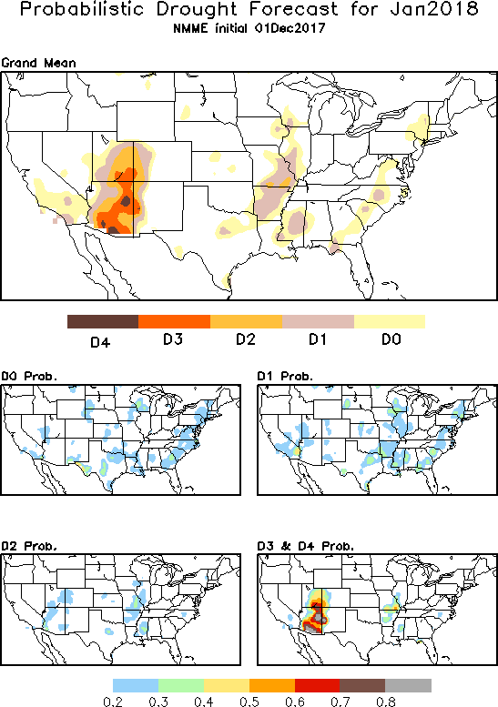

Slide 28



Slide 29


JFM 2018
In the DO Tendency Format!!
Jan 2018

Slide 30

NLDAS Drought Forecast Analysis
The system developed by Princeton University and University of Washington was transitioned to NCEP/EMC as the experimental forecast system.
Forecast using 201711 Initial Condition- Soil Moisture Percentile forecast
NOT AVAILABLE/UPDATED THIS MONTH

Slide 31


Hydrological Monitoring and Seasonal Forecasting @ MSU (Michigan State University ) NLDAS model
http://drought.geo.msu.edu/research/forecast/smi.monthly.php
Monthly Soil Moisture Percentile Prediction issued on 201712
The inter quartile range suggest greater uncertainty about the forecast in these shaded regions.
But not much uncertainty for the two major drought regions in the south..

Slide 32


NASA GEOS5 Forecasts
Precip
Soil Moisture Percentile

Slide 33
Summary
Current ENSO status and forecast.
ENSO status – La Nina Advisory. La Niña conditions are predicted to continue (~65-75% chance) at least through the Northern Hemisphere winter 2017-18.
Current Drought conditions:
  The Northern Plains drought in the MT/Dakotas region, that recently expanded further west in to Pacific NW into WA & OR states, got contained/squashed from last month’s rains to the extent that the drought in WA/OR should not be a threat anymore. However, the long term rainfall deficit (MJJ rains) in the eastern MT, western Dakotas will probably continue to stay/exist, until the onset of the next year’s rainy season in these regions.
  The short/long term dryness/drought in far southern CA/AZ continues to hang in there, and has even expanded further north in the 4-corner states UT/CO/AZ/NM region.
  Severe dryness has enhanced/developed in the MO/AR/LA region, which has to be kept an eye on. For now, the many water reservoirs across CA are at satisfactory levels.
Prediction:
  As winter is approaching, the developing La Nina’s impacts and the relative magnitude of its impact is of some interest/concern to the drought in many southern states region. But observed precip impacts during most recent El Nino(2015/16)/La Nina(2016/17) – not following the expected canonical pattern -must also be taken into consideration.
  In the short term, Northern/Central CA, WA and OR is expected to get good rainfall amounts.

