Slide 1
Drought Outlook Discussion
February 2018
Climate Prediction Center/NCEP/NOAA
http://www.cpc.ncep.noaa.gov/products/Drought
Phone: 1-877-680-3341
Pwd: 858747

Slide 2
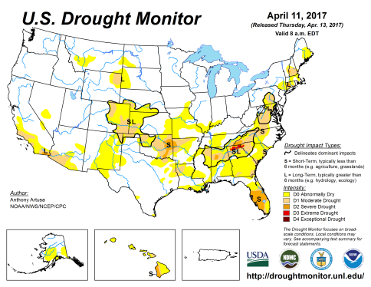
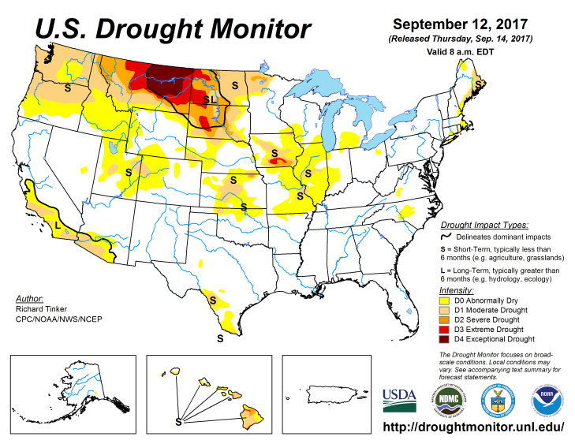
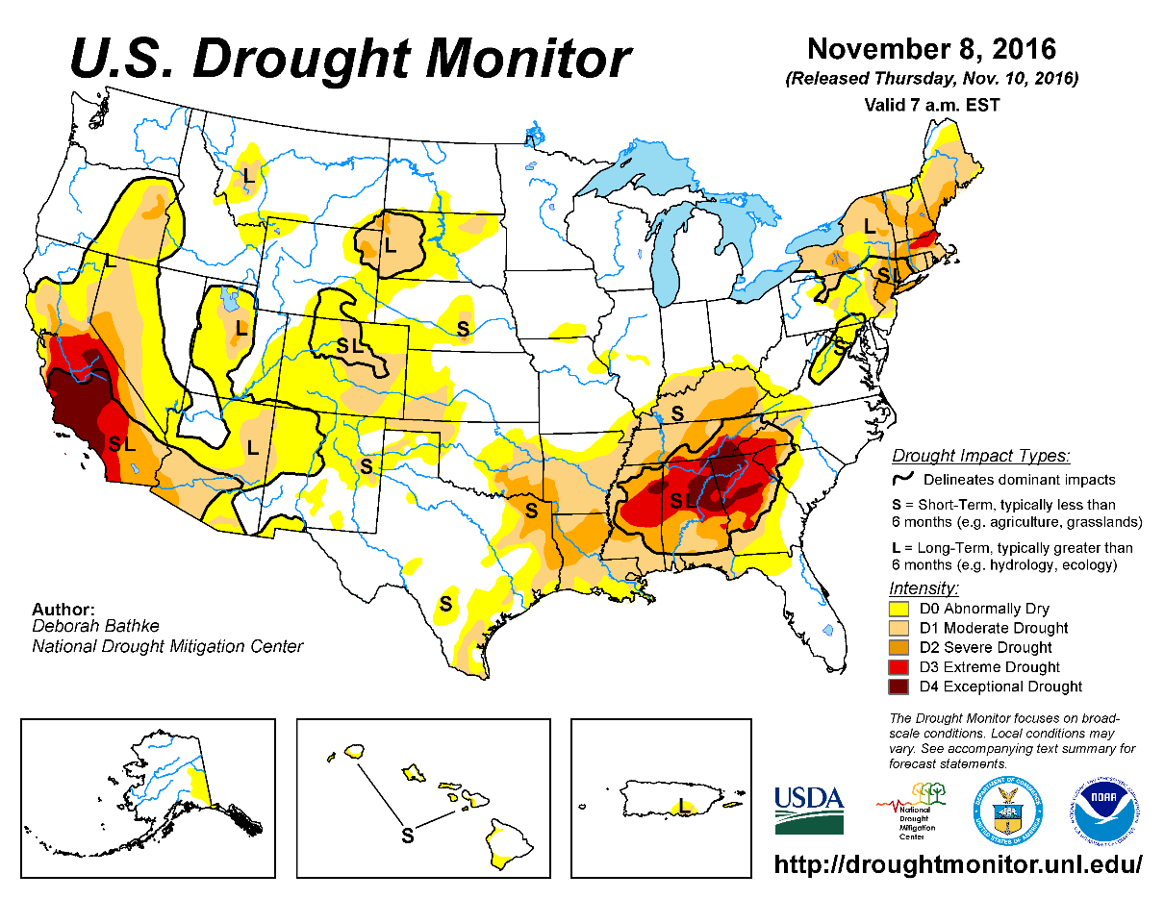
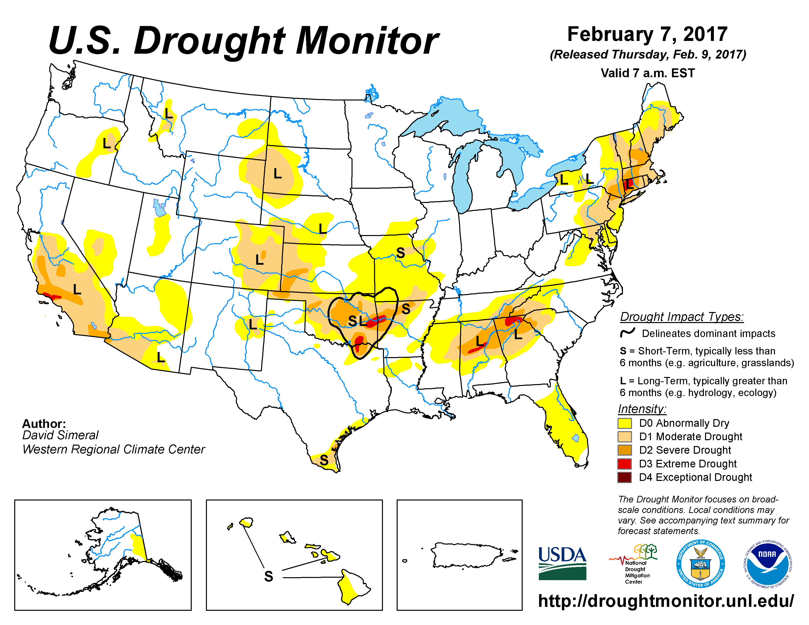
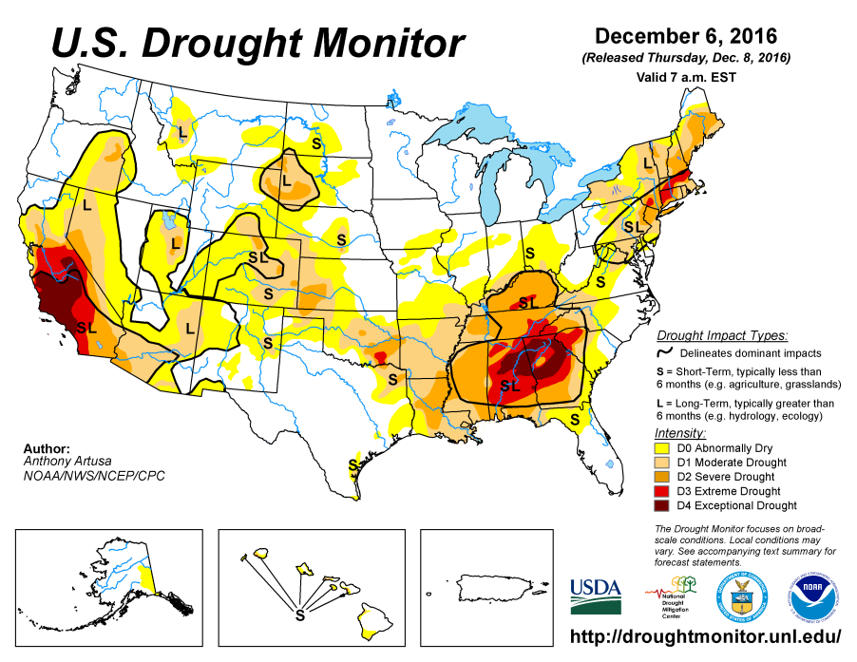
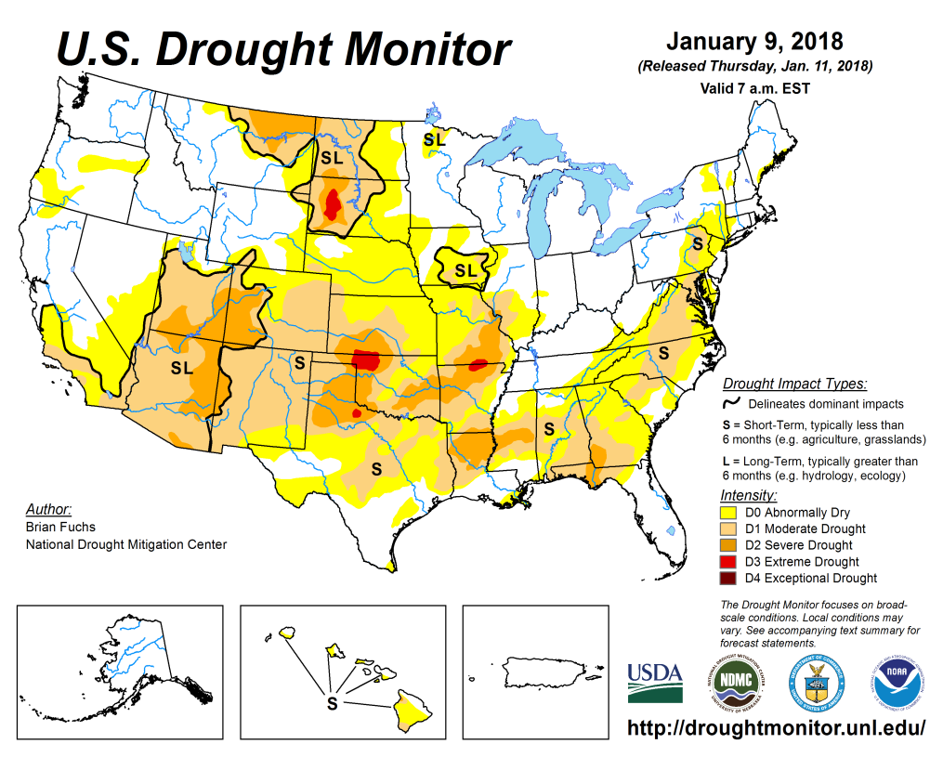
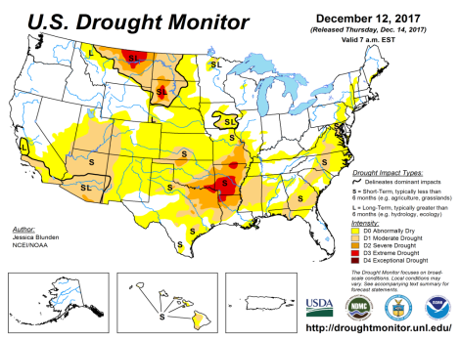
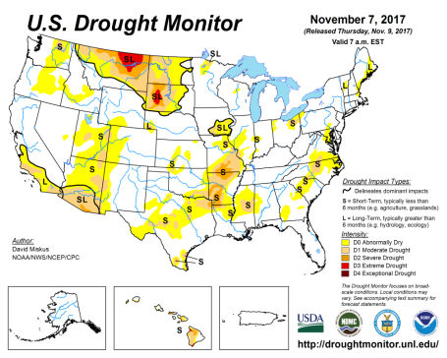
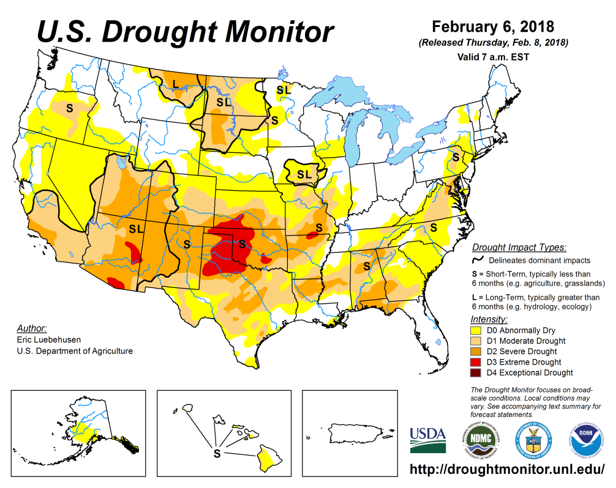
Drought Monitor
Dec
Previous
Nov
Since the onset of the ongoing La Nina, overall, the area, severity and extent of the S/L drought regions across the southern states has increased in the last few months.
This is a consequence of the lack of rainfall in recent months associated with the La Nina, and the accruing rainfall deficits in these regions from earlier periods.
Latest/Recent

Slide 3
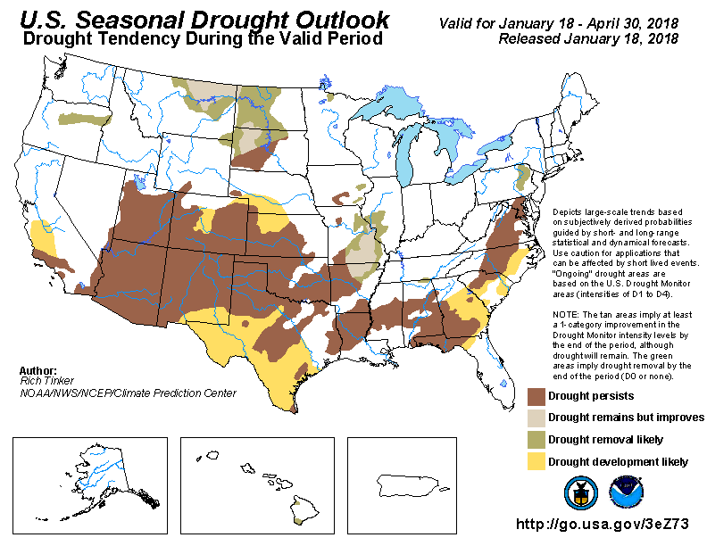
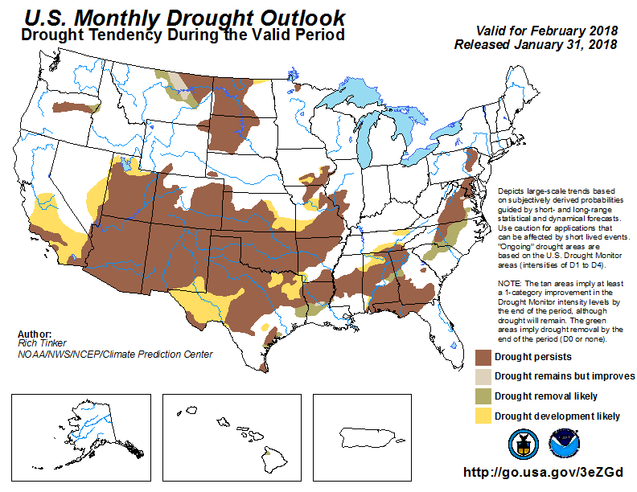
(Prev) Seasonal/Monthly Drought outlooks
Seasonal Outlook (Mid Jan 2018 - April 2018)
issued 01/18/18
Monthly outlook
(February 2018)
issued 01/31/18
The general overall drought development in the recent months and ongoing of the same, was correctly forecast earlier – Presence of strong low frequency climate variability such as ENSO, makes this somewhat easy!

Slide 4
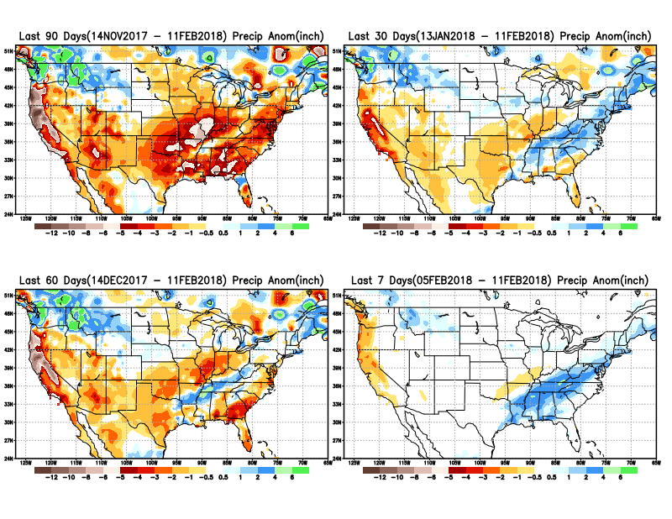
Total precipitation ANOM during last 7, 30, 60 & 90 days.
11
Recent rains, above normal rains in the Midwest, and along the coastal Atlantic states, is a welcome relief to the existing very dry conditions here.

Slide 5
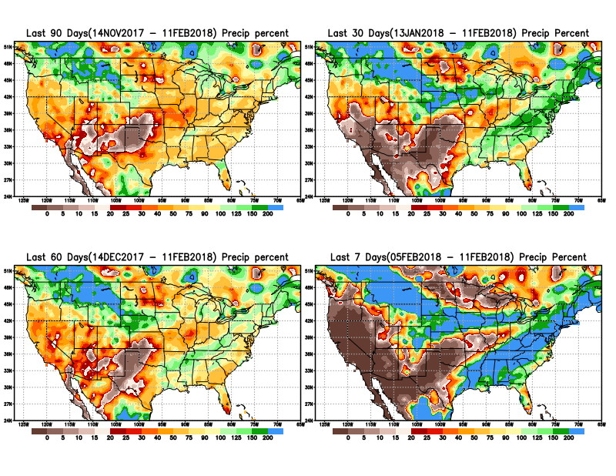
Total precipitation Percent during last 7, 30, 60 & 90 days.
Supposed to be in the midst of CA’s rainy season? – we know, it it is the La Nina!! But last year was also La Nina at this time!! But then, we got record rainfall!!

Slide 6
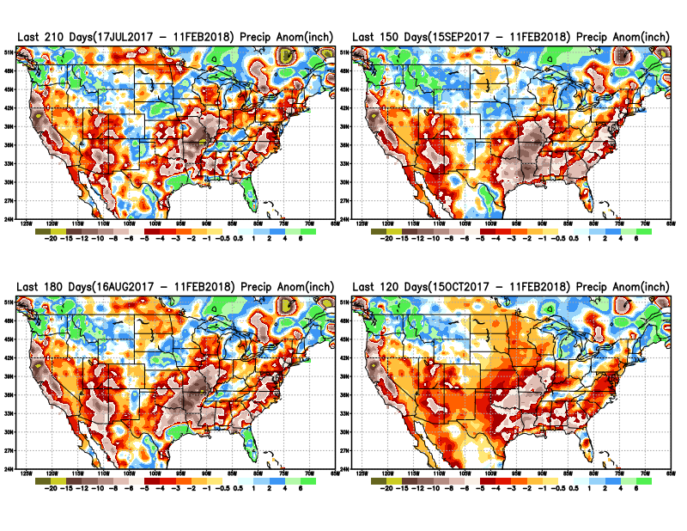
Total precipitation ANOM during last 4, 5, 6, and 7 months.
Except for remnants of Harvey and Irma in/near Texas and Florida, longer term deficits exist over much of the country, not to mention the missed rainfall season in the northern plains.

Slide 7
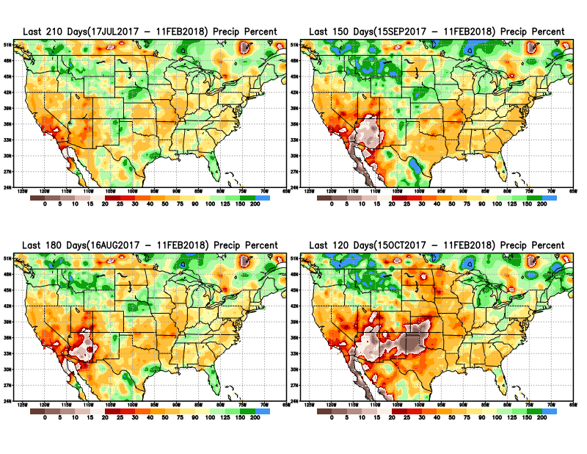
Total precipitation Percent during last 4, 5, 6, and 7 months.

Slide 8
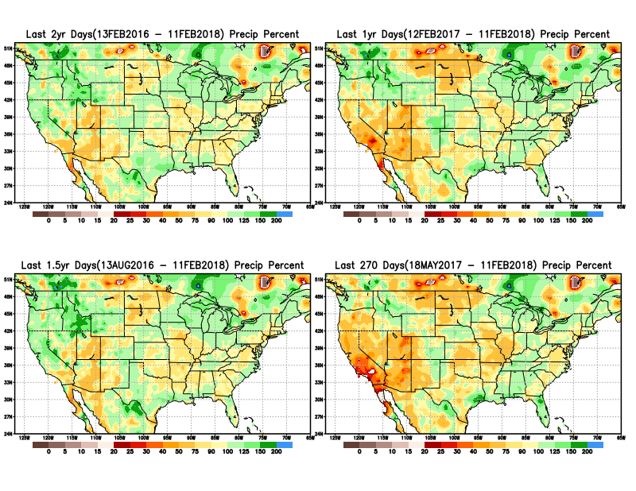
Total precipitation Percent during last 9 months, 1 yr, 1.5yrs, & 2 yrs.
There are many long term rainfall deficit regions in the country, particularly deficits in UT/AZ, southern CA, and parts of NM/CO are long term.

Slide 9
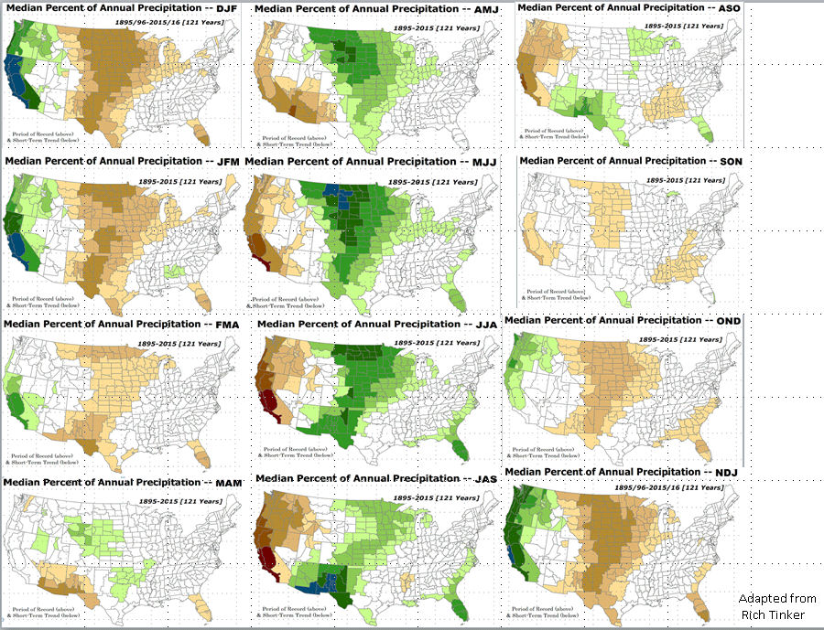

Rainy Season

Slide 10
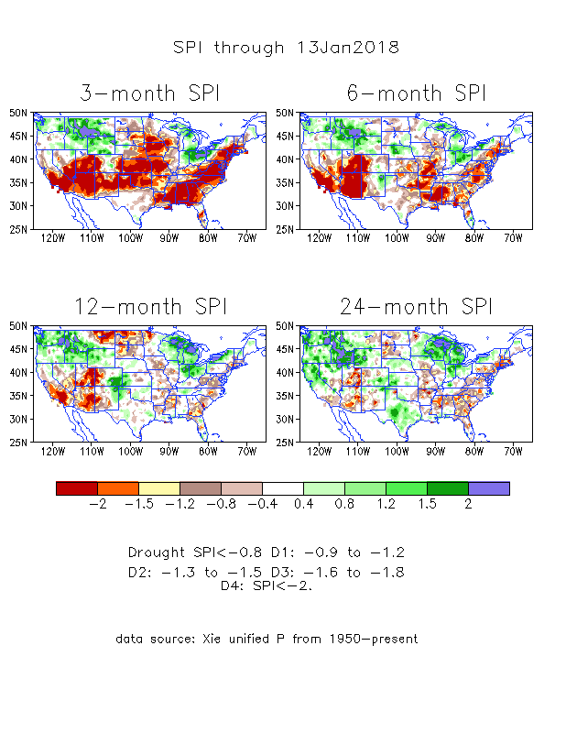
The Standardized Precipitation Index SPI
(based on Observed P)
----- Last month
Large areas of short term rainfall deficit (SPI3 !) developing quickly –across much of the central and southern tier states.
How long will this last or continue? And /or how much of this continue/persist to long term?
It depends on when where the ‘rainfall season’ is and
Second blip to the La Nina after the current ongoing La Nina!!

Slide 11
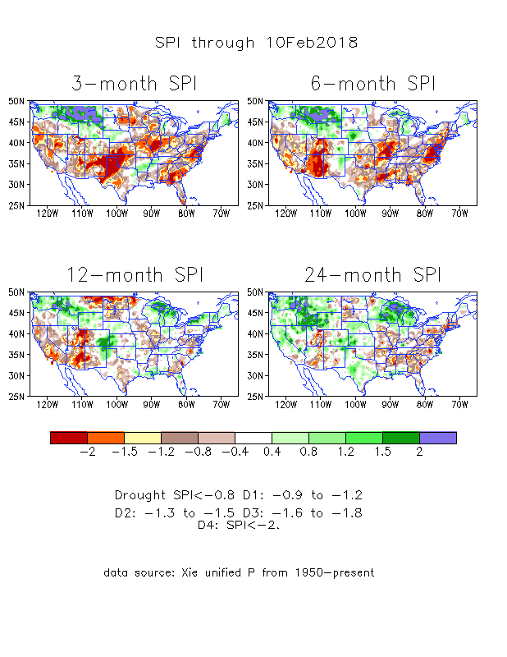
The Standardized Precipitation Index SPI
(based on Observed P)
----- NOW
Large areas of short term rainfall deficit (SPI3 !) developing quickly –across much of the central and southern tier states.
-situation improved since last month.

Slide 12
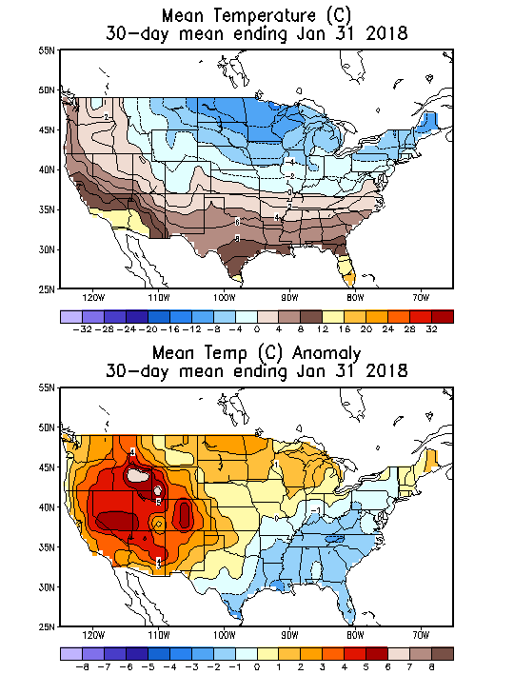
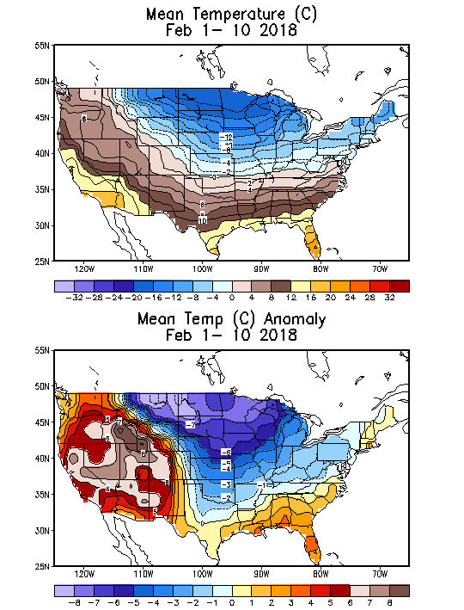
Recent US Temperatures
December mean T is warm in the south west and south, but cool in the northeast and northwest
So far, in January, it is a much cooler east and midwest and northeast, and a warm west!!

Slide 13
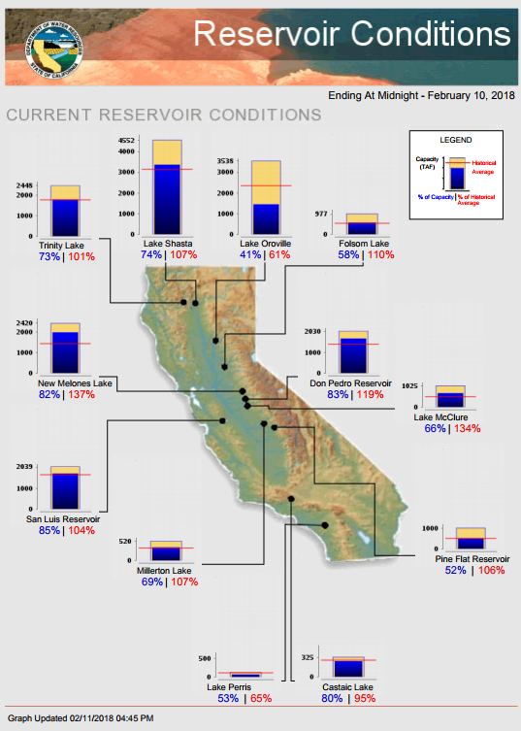
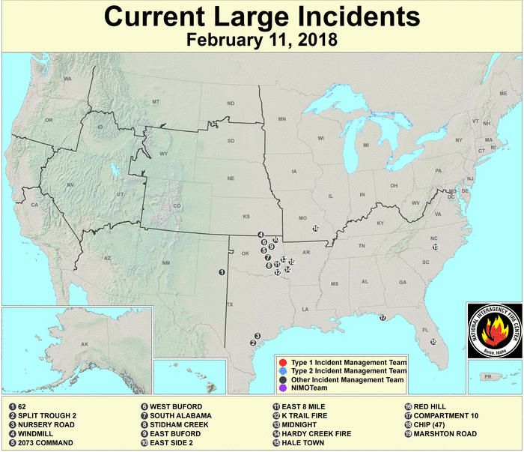
Most of the CA reservoirs are at satisfactory levels, except for the Lake Oroville near northern Sierra Nevada.
Earlier fires in CA! due to the dry downslope disastrous Santa Ana winds have made the situation worse for the recent flooding there due to early January storms.
FIRE
http://cdec.water.ca.gov/cgi-progs/products/rescond.pdf
https://fsapps.nwcg.gov/afm/index.php

Slide 14
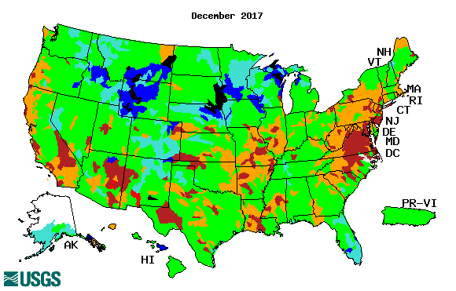

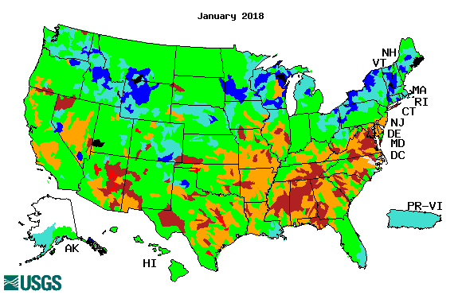
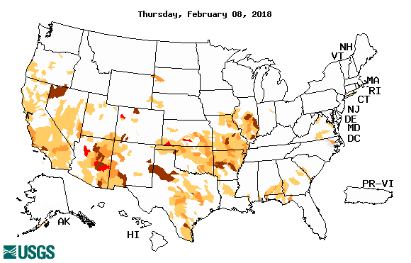
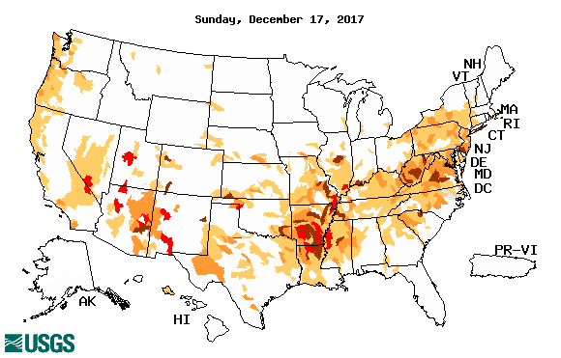
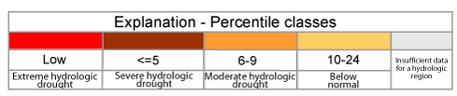
Streamflow (USGS)
Compared to (top left panel), the stream flows actually look worse in December so far particularly across the southern states & along the Atlantic coastal states.
The weaker streamflow in the Northern Plains Drought area in MT, NS & SD is all but gone.
New weaker streamflow development along coastal OR/CA, and southern CA and AZ.
Map shows only below normal 7-day average streamflow compared to historical streamflow for the day of year.
One month ago (left) & Now (below)

Slide 15
EL NIÑO/SOUTHERN OSCILLATION (ENSO)
DIAGNOSTIC DISCUSSION
issued by CLIMATE PREDICTION CENTER/NCEP/NWS and the International Research Institute for Climate and Society
08 February 2018
ENSO Alert System Status: La Niña Advisory !!
Synopsis: A transition from La Niña to ENSO-neutral is most likely during the Northern Hemisphere spring (~55% chance of ENSO-neutral during the March-May season). Equatorial sea surface temperatures (SSTs) are below average across the central and eastern Pacific Ocean. La Niña is likely (~85-95%) through Northern Hemisphere winter, with a transition to ENSO-neutral expected during the spring.

Slide 16

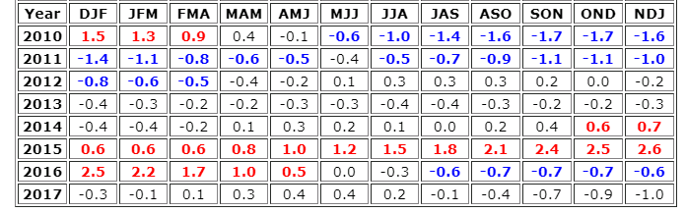
http://www.cpc.ncep.noaa.gov/products/analysis_monitoring/ensostuff/ensoyears.shtml

Slide 17
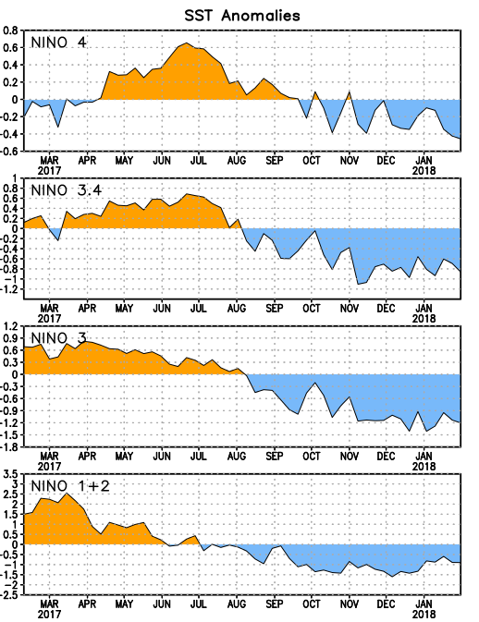
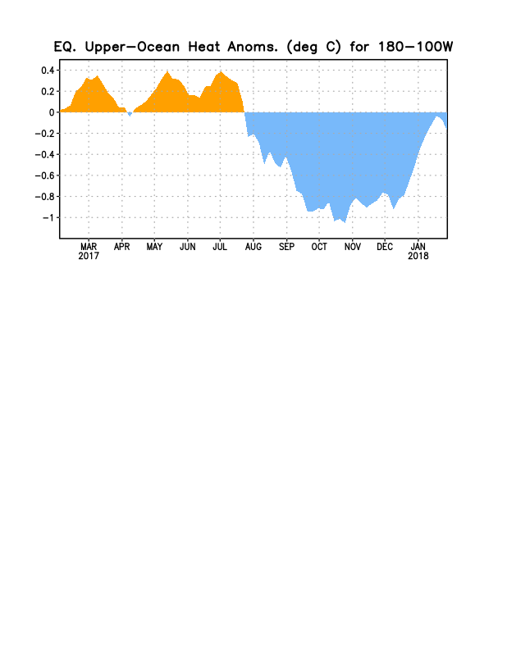
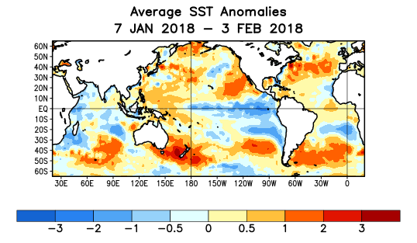
Latest values of SST indices in the various Nino Regions.
The sub surface cold anomaly has almost depleted, and is at near-neutral conditions.
SSTs have fallen across the central and east Pacific since late summer.

Slide 18
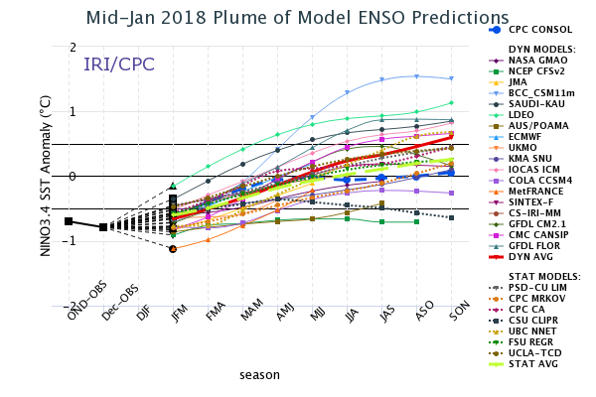
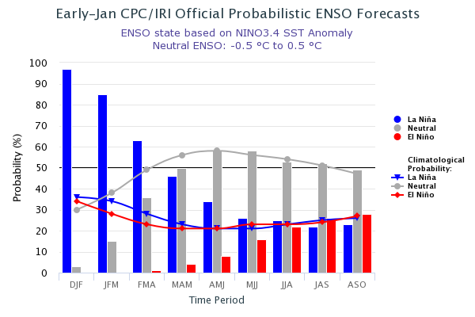
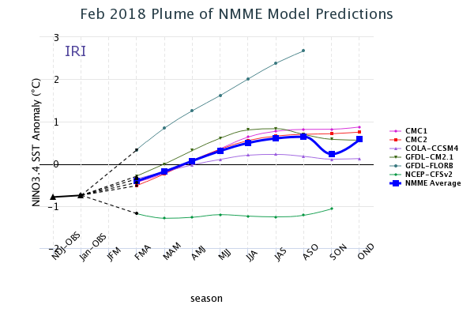
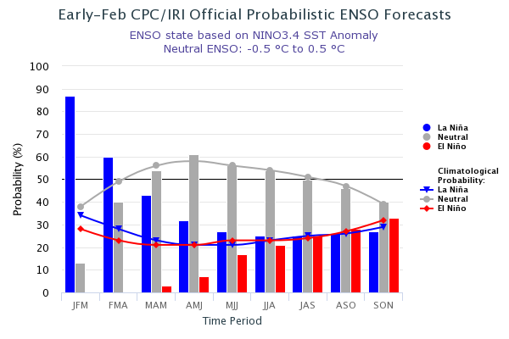
ENSO Forecasts
Early- Jan CPC/IRI forecast
NMME Models’ – Nino 3.4 forecasts
Early Feb CPC/IRI forecast
Anything is possible this summer/fall?
Neutral, El Nino, La Nino ? ☺

Slide 19
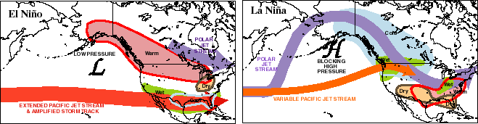
Dec-Feb
Expected
Impacts
If a La Nina
develops…
& its normal

Slide 20
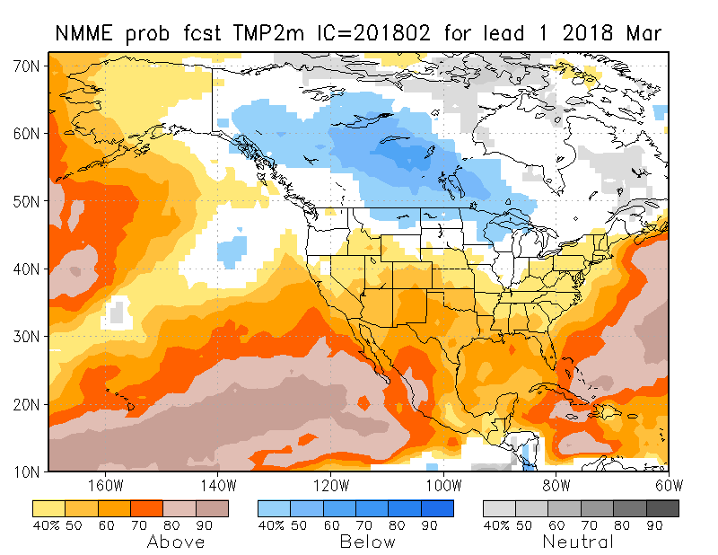
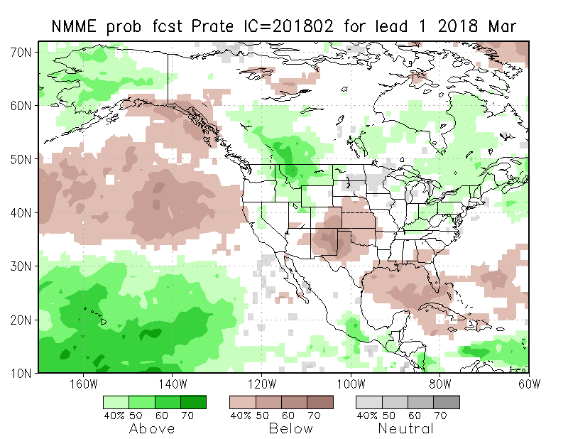
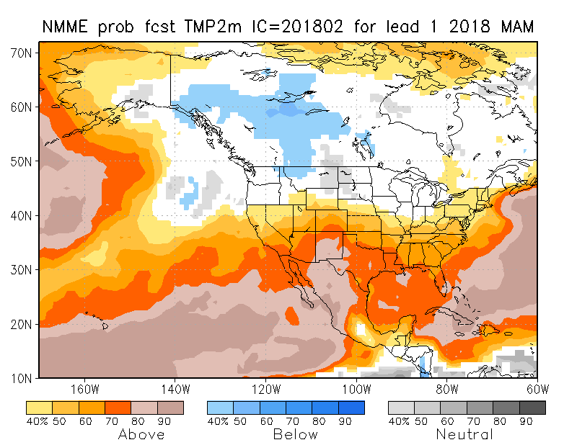
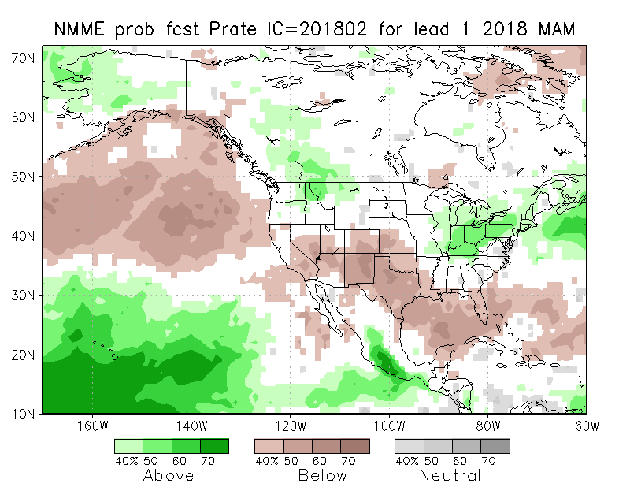
NMME T & P
EnsMean forecasts
Mar
MAM
The monthly (Mar) and seasonal (MAM) T are for more warmth across much of the country except in the north and northwest. Overall, models are predicting/implying somewhat typical La Nina Impact for Precip for next month and next 3-month season, even though La Nina is expected to be weakening.

Slide 21
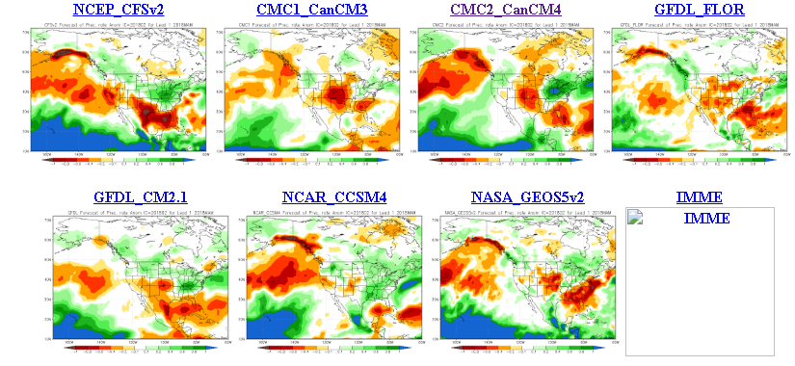
The agreement/uncertainty among the diff. NMME models’ forecasts for
Mar-Apr-May Precipitation!!!

Slide 22
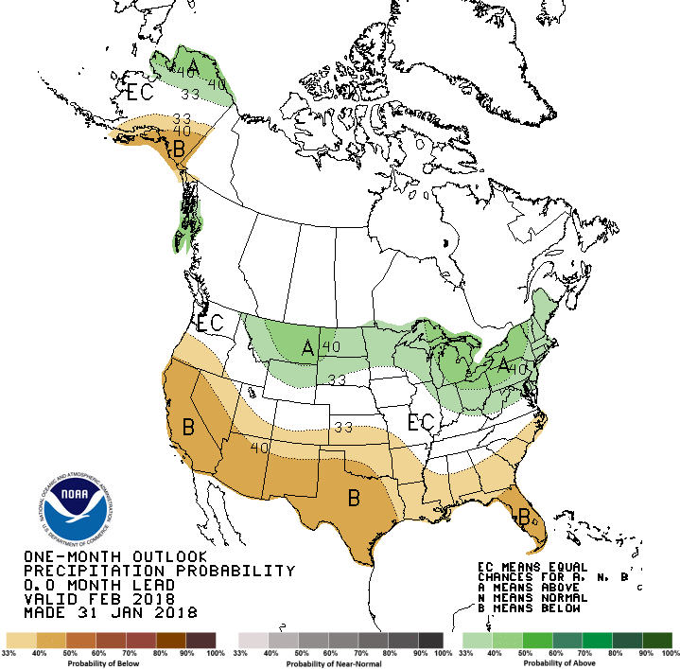
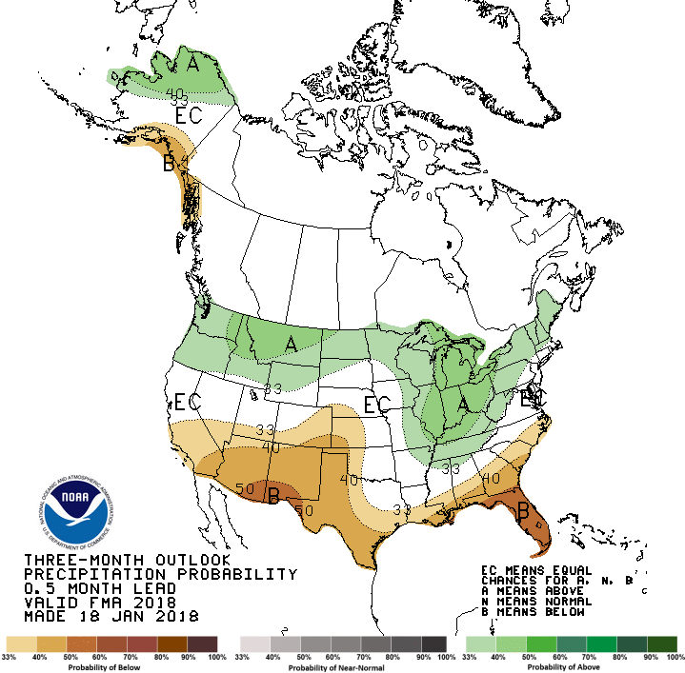
Previous CPC’s official
Monthly (Jan) /Seasonal (JFM)
Precipitation outlook
Released Jan 31st
Released Jan 18th

Slide 23
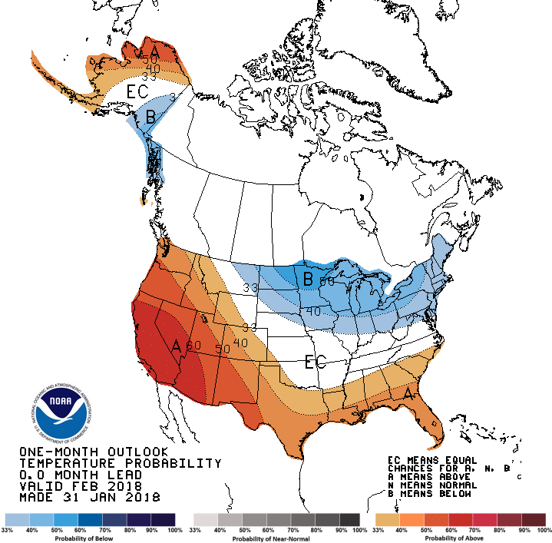
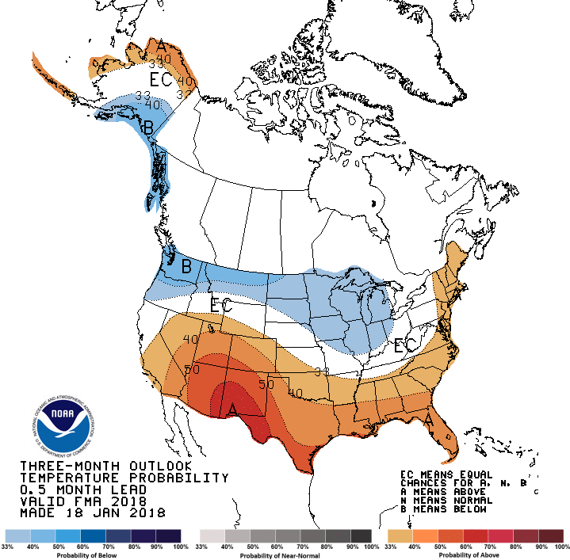
CPC’s official
Monthly (Jan) /Seasonal (JFM)
Temperature outlook
Made
Jan 31st
Made Jan 18th
Relatively a good T fcst for so far, but it is bot even mid February yet!

Slide 24
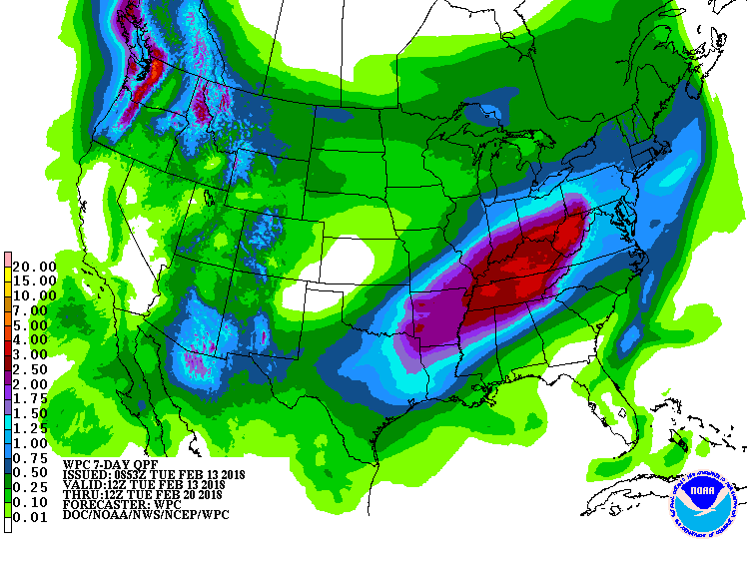
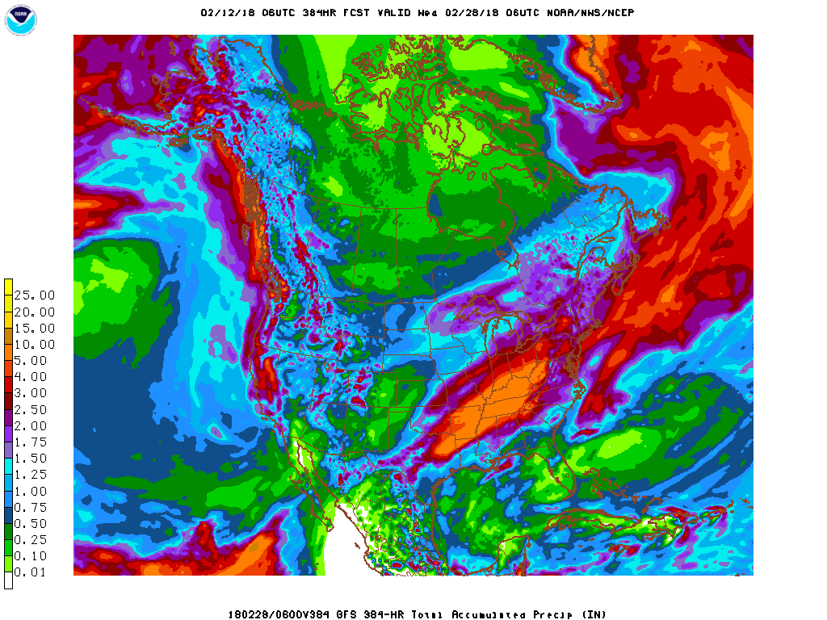
Next 7 days QPF Forecast
In the next 7 days, the Pacific NW, The Northern Plains, coastal southern CA is expected to get some rain. Big hole in the middle of the country! The Midwest, the eastern coastal states, extern TX extending northeastward onto AR,TN, KY, and onward is expected to get some rain.
GFS Model Guidance for next 16 days.
Reinforcement of precip forecast over the next seven days. Rain in California is expected, but amounts vary from one model run to another.

Slide 25
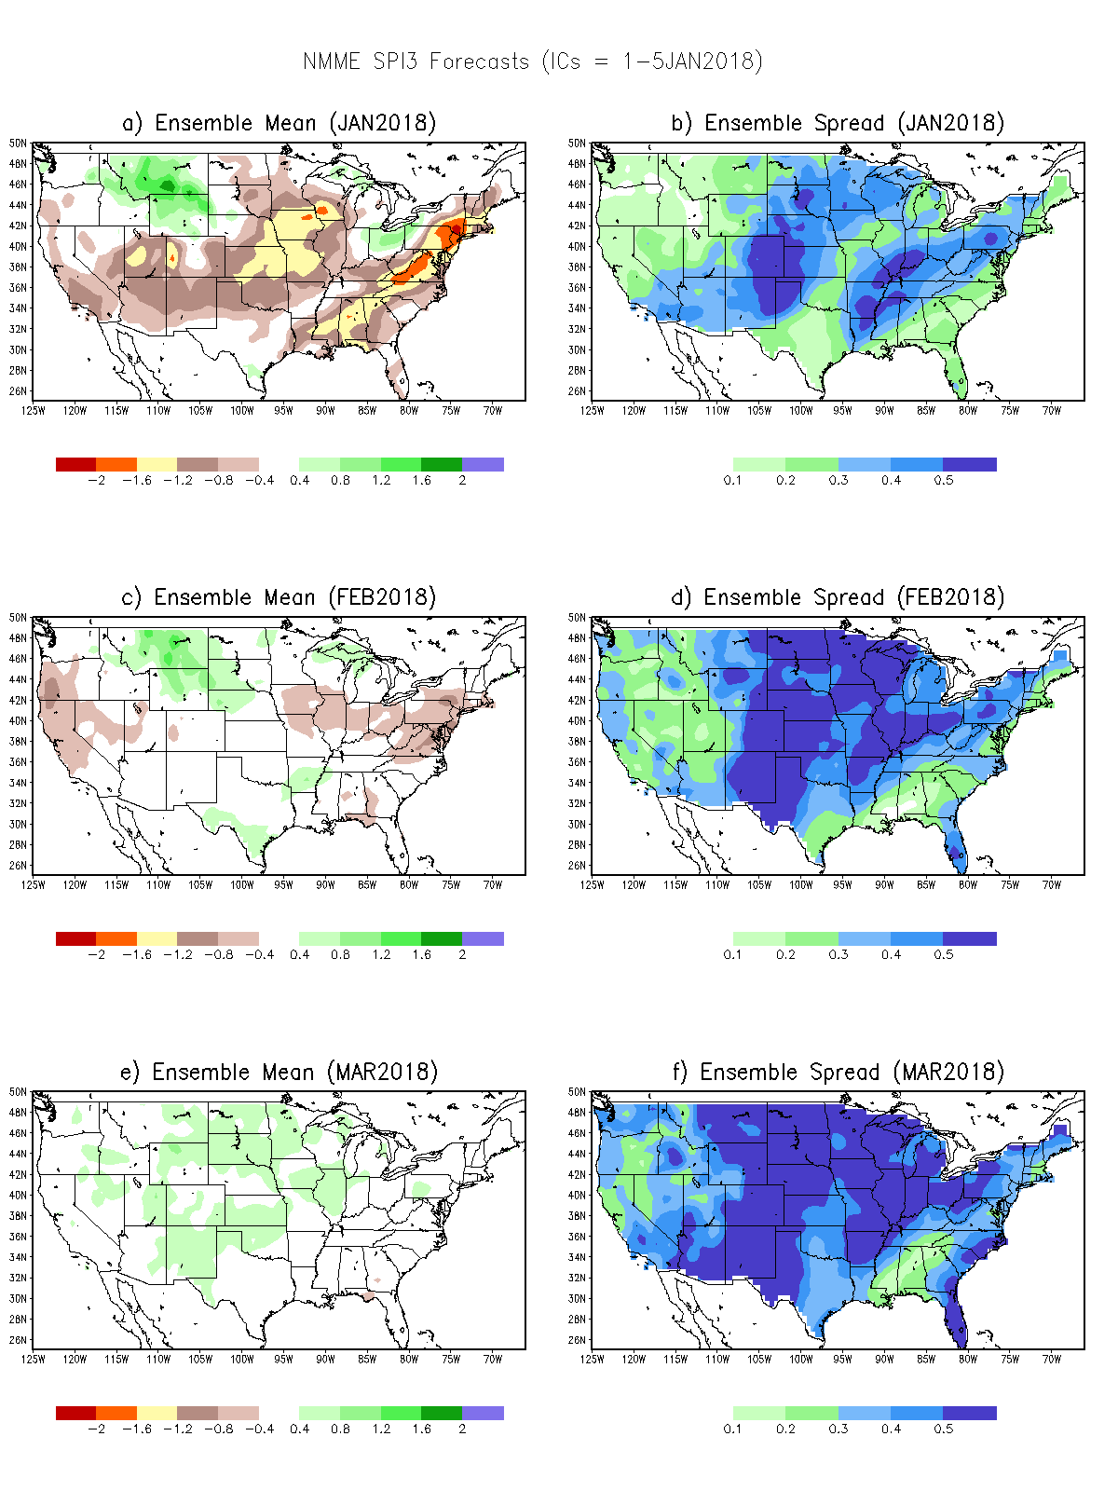
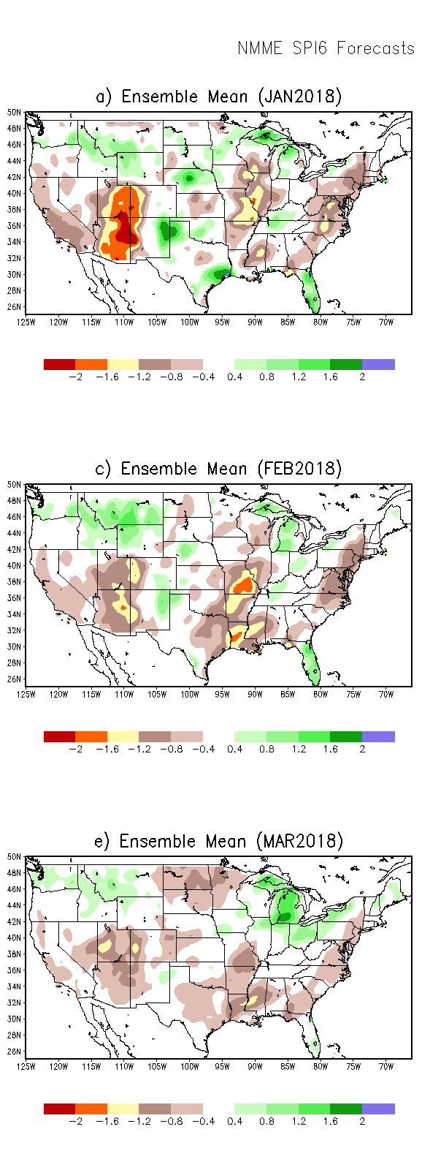

SPI3
SPI6
SPI12
SPI3, SPI6
& SPI12
Forecasts from 6NMME Models
(uses obs. P up to past month, and forecast months’ P from NMME models)
Not Available this month
In the past these NMME models and their forecasts always did not extend/intensify the Northern plains drought, and ended it repeatedly prematurely!!
The goodness and skill of these SPI’s forecasts depend directly on these models’ skill in predicting precip!!!

Slide 26
Not Available this month
SPI3
Ensemble
Forecast
MEAN
SPI3
Ensemble
Forecast
SPREAD
-Sometimes, over large areas, the
spread is as large as the mean

Slide 27

NLDAS Drought Forecast Analysis
The system developed by Princeton University and University of Washington was transitioned to NCEP/EMC as the experimental forecast system.
Forecast using 201801 Initial Condition- Soil Moisture Percentile forecast

Slide 28


Hydrological Monitoring and Seasonal Forecasting @ MSU (Michigan State University ) NLDAS model
http://drought.geo.msu.edu/research/forecast/smi.monthly.php
Monthly Soil Moisture Percentile Prediction issued on 201801
The inter quartile range suggest greater uncertainty about the forecast in these shaded regions.
But not much uncertainty for the two major drought regions in the south..

Slide 29


NASA GEOS5 Forecasts
Precip
From Last Month…..
Soil Moisture Percentile

Slide 30


NASA GEOS5(Still 5?) Forecasts
Precip
New Fcst System this month from NASA..
Will keep watching this…
The soil moisture (%) maps are too patchy!
Soil Moisture Percentile
Less rain in CA is fcst in Feb (happening)
More rain in CA is fcst in March (?)

Slide 31
Summary
Current ENSO status and forecast.
La Niña Advisory !! A transition from La Niña to ENSO-neutral is most likely during the Northern Hemisphere spring (~55% chance of ENSO-neutral during the March-May season). Equatorial sea surface temperatures (SSTs) are below average across the central and eastern Pacific Ocean. La Niña is likely (~85-95%) through Northern Hemisphere winter, with a transition to ENSO-neutral expected during the spring.
Current Drought conditions:
  - The S/L term Northern Plains drought in the eastern MT/Dakotas region due to deficit in 2017 rainfall season continues to stay/exist, until probably the onset of 2018 rainy season(Apr-) in these regions, even though in the very short term, some improvement may be noticed locally.
  - Outside of these Northern Plains, across the United States, over the course of last few months, there has been a general increase in the areal extent, as well as in severity, of the short/long term drought conditions. In particular, the drought has become severe in northwestern TX/OK, southern KS, and in the four corners states of UT,AZ, CO and NM, as well as southern CA. In much of these regions, there also prevails a longer term (longer than a few months) rainfall deficit, which may outlast the current ongoing La Nina. The current stream flows across the south and the Midwest are more dry now than it has been before in the past few months.
Prediction:
  - As the current La Nina is expected to transition to neutral conditions, so will be the associated rainfall impact across the United States. Hence there is uncertainty in the rainfall amounts and where they may fall, especially considering the nature and reliability of these forecasts in the spring season. Severe drought regions in the south, noted above, are likely to persist/stay, with little improvement in the next month or two. But there could be short term improvement in the Northern Plains Drought during the upcoming three month season. The rainfall season in CA is ending soon, but big shortfalls already exist.
  - In the immediate short term, in the next couple of weeks, according to the models, the expected rainfall in the south/Midwest and along the southeast combined with the very recent rains will likely ease the drought conditions there. California and neighboring western states is also forecast to receive some rainfall, probably not enough to make up the existing rainfall deficits.

