Slide 1
Drought Outlook Discussion January 2018
Climate Prediction Center/NCEP/NOAA
http://www.cpc.ncep.noaa.gov/products/Drought
Phone: 1-877-680-3341
Pwd: 858747

Slide 2
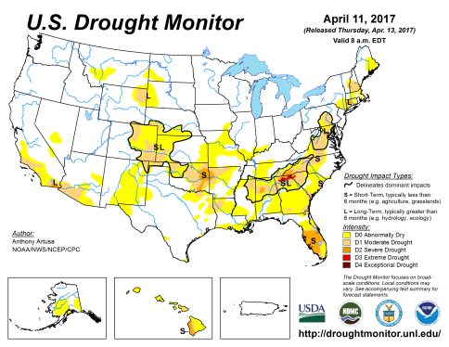
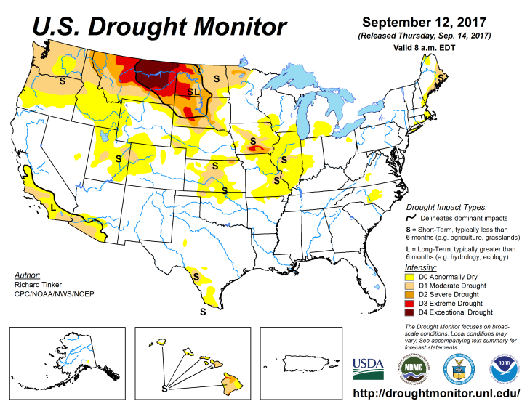
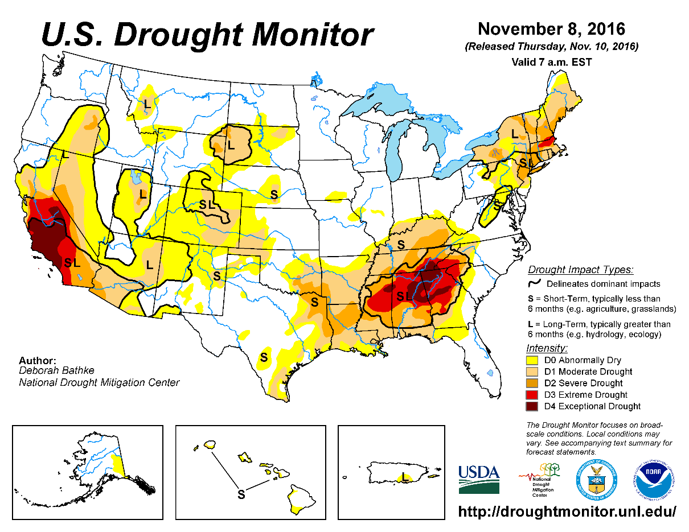
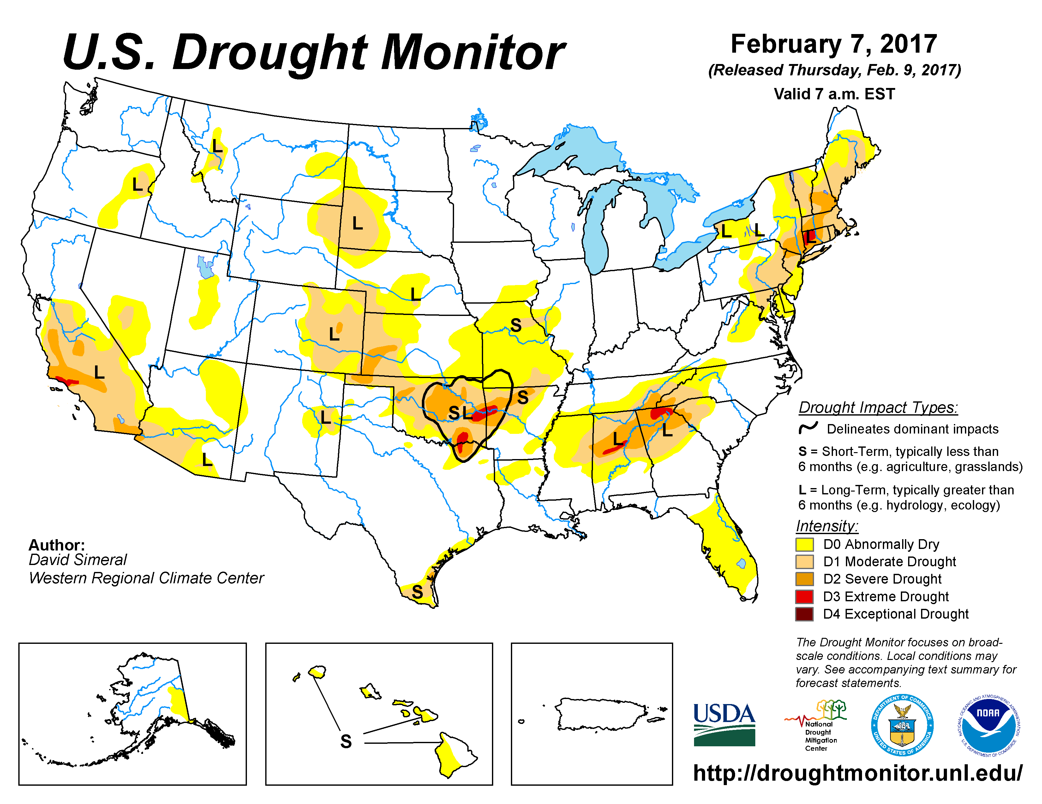
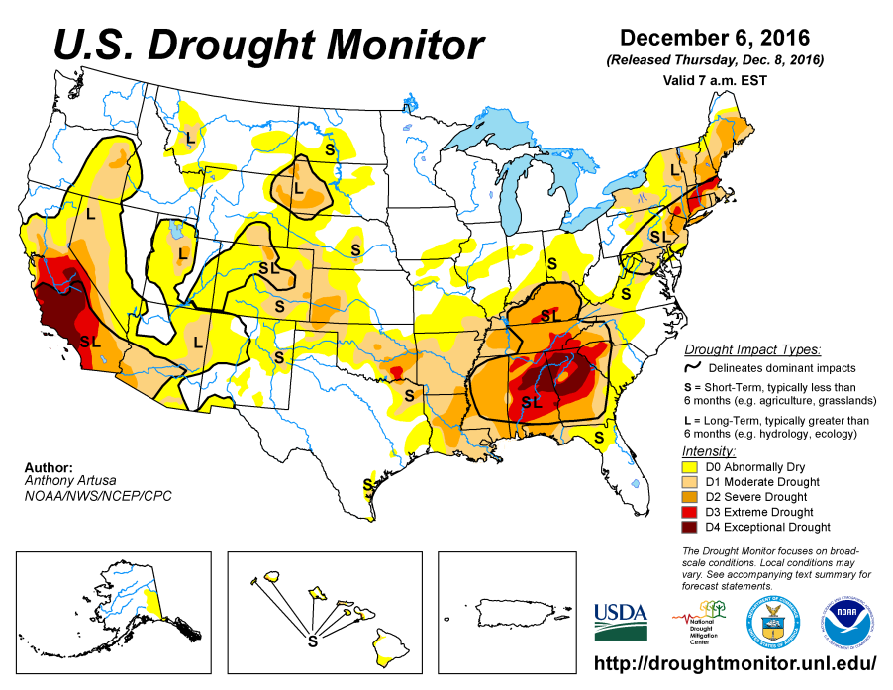
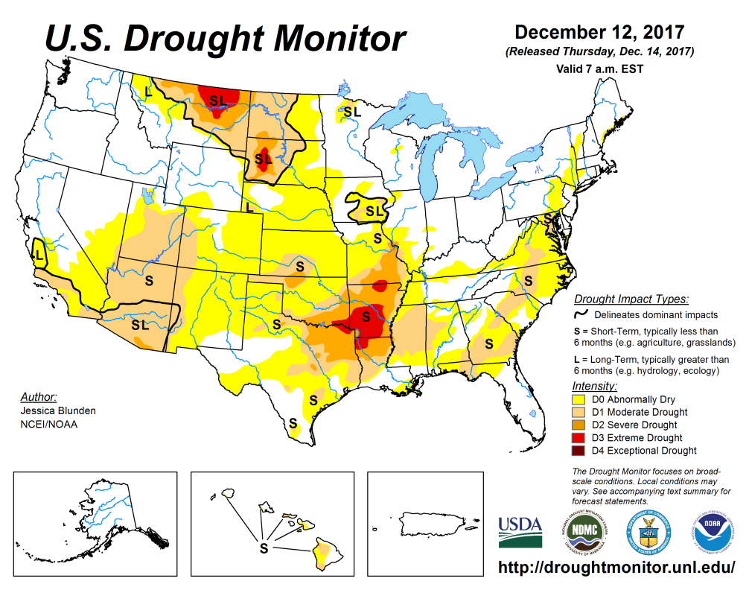
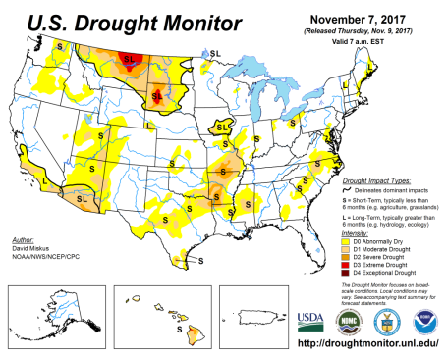
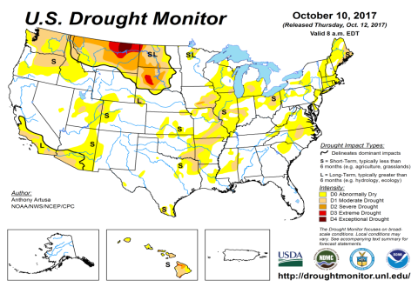
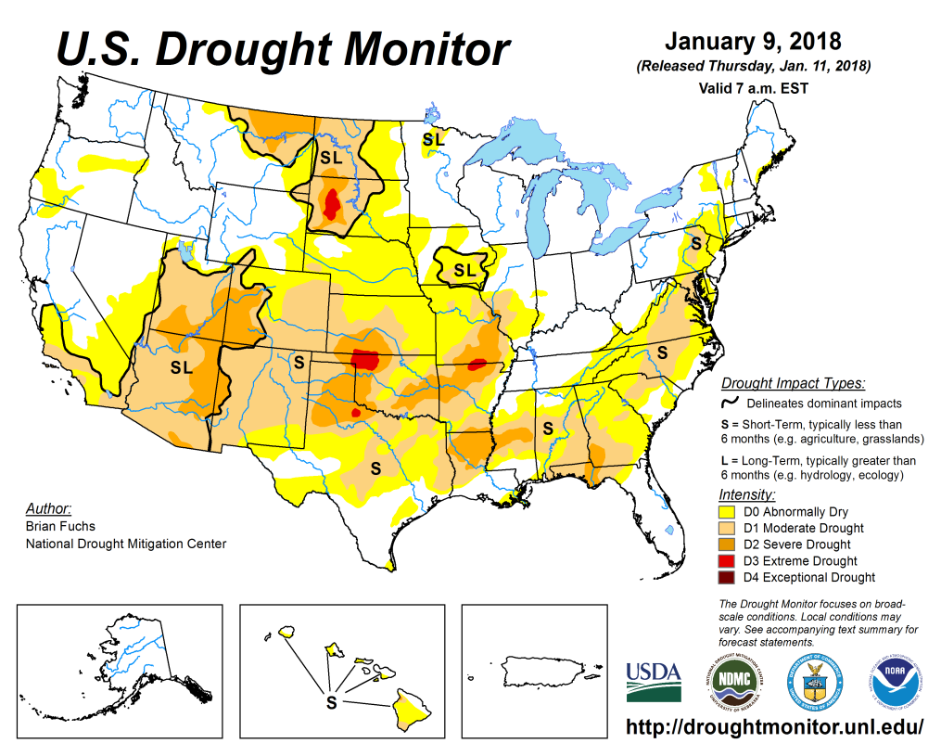
Drought Monitor
Nov
Previous
Oct
The Long term drought in the Northern Plains is ongoing and will probably stay that way until the start of the next rainy season (beginning in late Apr/May 2018)
Short term drought is rapidly developing and spreading across the southern tier states – consistent with the developing La Nina and the accompanying rainfall deficit in these regions – which was forecast earlier.
Latest/Recent

Slide 3
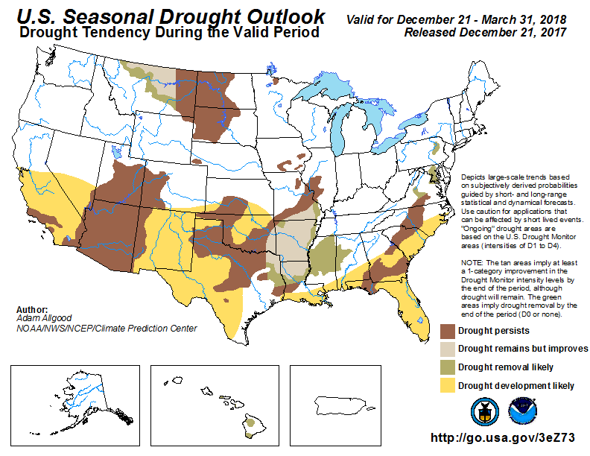
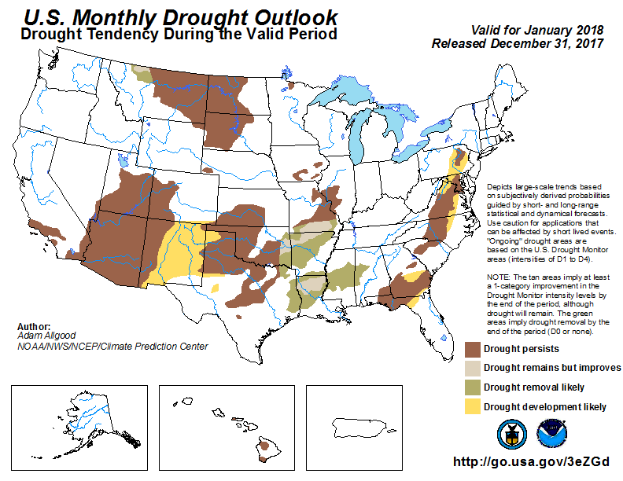
(Prev) Seasonal/Monthly Drought outlooks
Seasonal Outlook (Mid Dec 2017 - Mar 2018)
issued 12/21/17
Monthly outlook
(January 2018)
issued 12/31/17
The overall drought development in the recent months and ongoing of the same, was correctly forecast earlier.

Slide 4
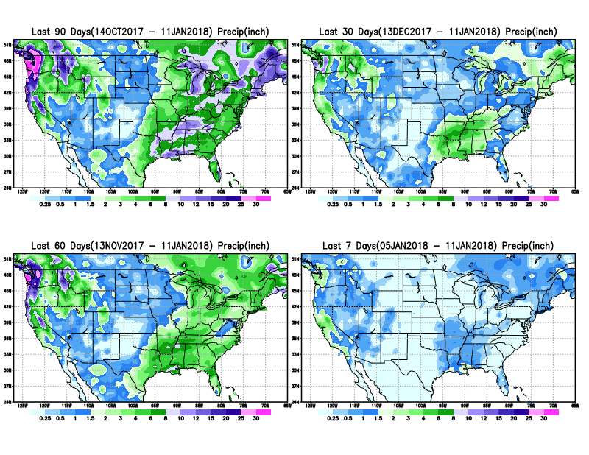
Total precipitation amounts during last 7, 30, 60 & 90 days.

Slide 5
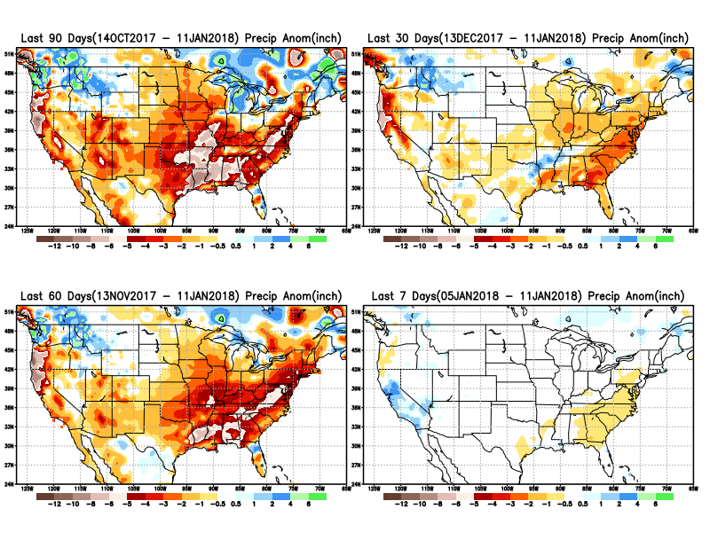
Total precipitation ANOM during last 7, 30, 60 & 90 days.
11
Large P deficits developing and accumulating
across much of the south over the past 7, 30, 60, and 90 days and beyond?

Slide 6
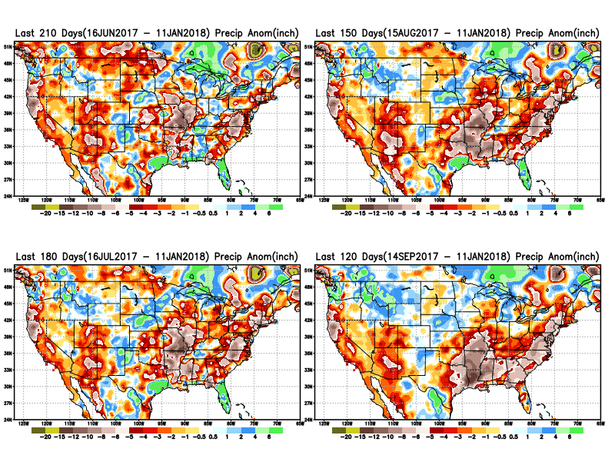
Total precipitation ANOM during last 4, 5, 6, and 7 months.
Except for remnants of Harvey and Irma in/near Texas and Florida, longer term deficits exist over much of the country, not to mention the missed rainfall season in the northern plains.

Slide 7
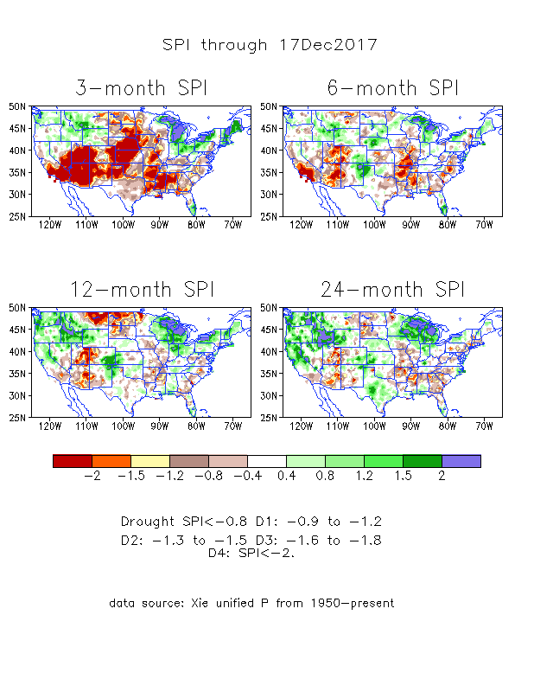
The Standardized Precipitation Index SPI (based on Observed P)
-Last Month
Large areas of short term rainfall deficit (SPI3 !) developing quickly –across much of the central and southern tier states.
How long will this last or continue? And /or how much of this continue/persist to long term?

Slide 8
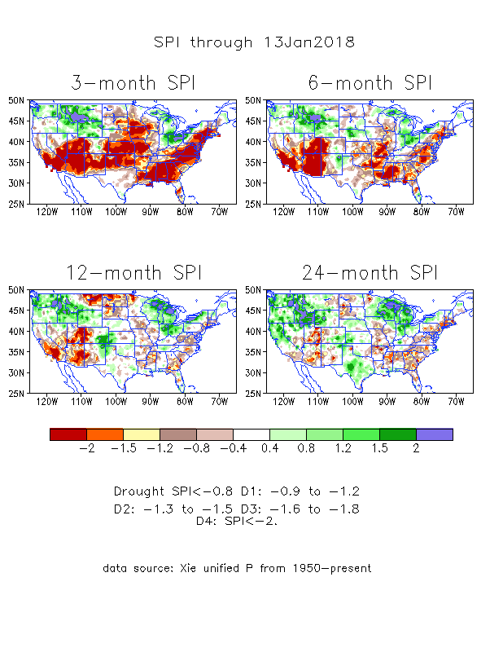
The Standardized Precipitation Index SPI (based on Observed P)
----- NOW
Large areas of short term rainfall deficit (SPI3 !) developing quickly –across much of the central and southern tier states.
How long will this last or continue? And /or how much of this continue/persist to long term?
It depends on when where the ‘rainfall season’ is and
Second blip to the La Nina after the current ongoing La Nina!!

Slide 9
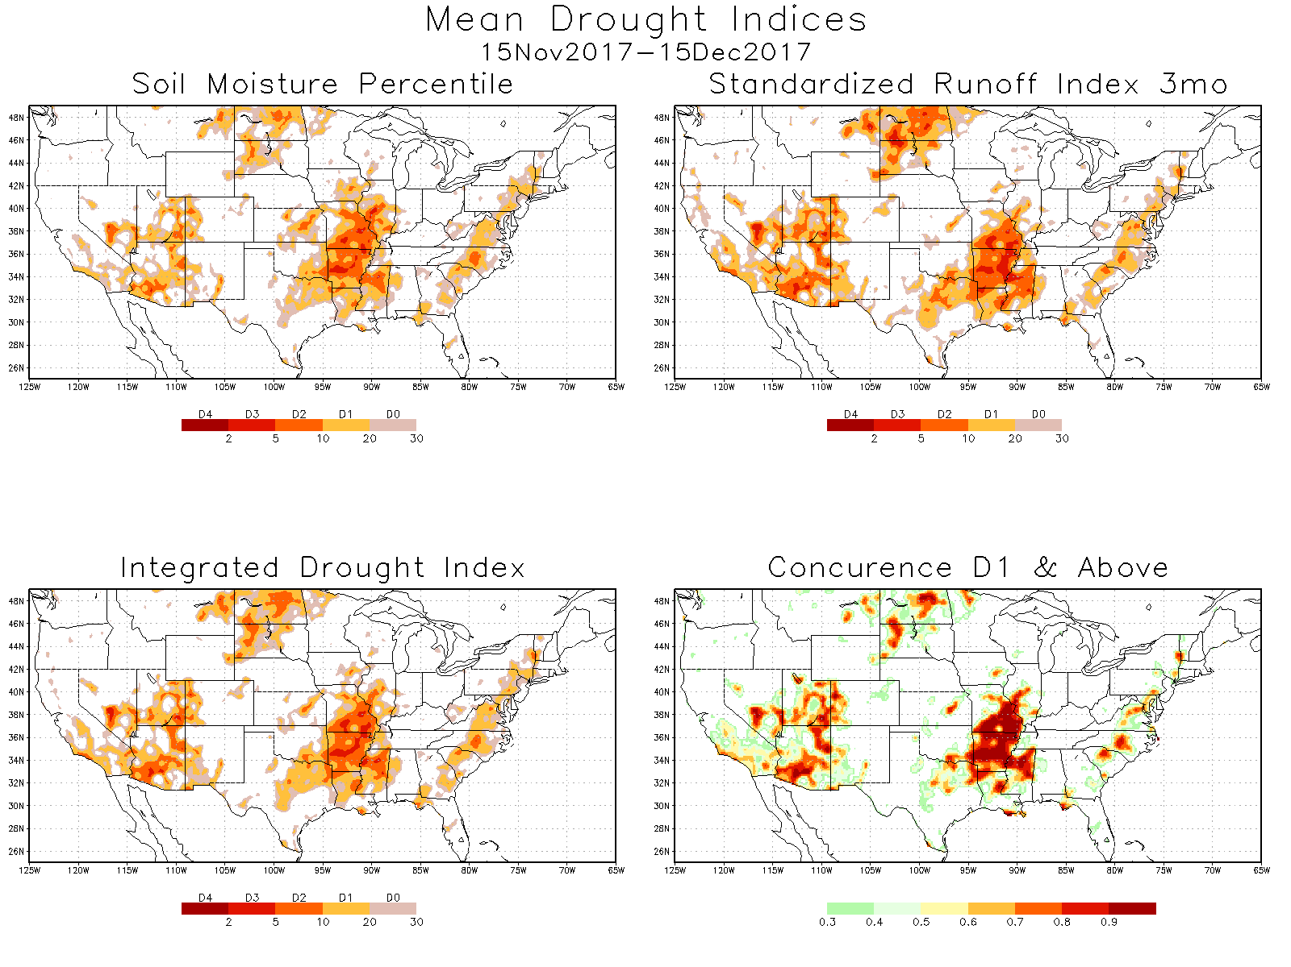
Three major drought areas

Slide 10
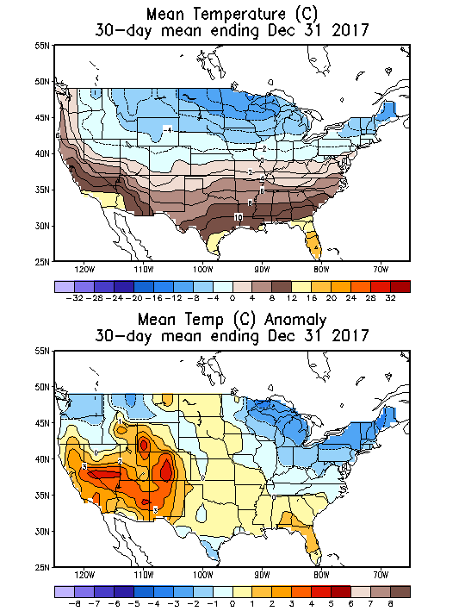
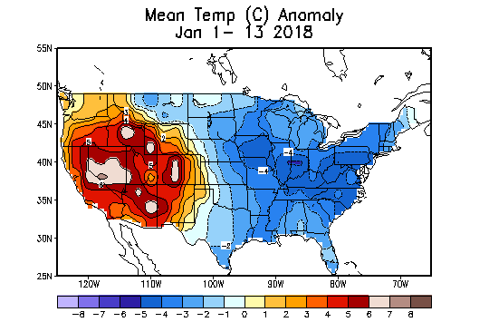
Recent US Temperatures
December mean T is warm in the south west and south, but cool in the northeast and northwest
So far, in January, it is a much cooler east and midwest and northeast, and a warm west!!

Slide 11
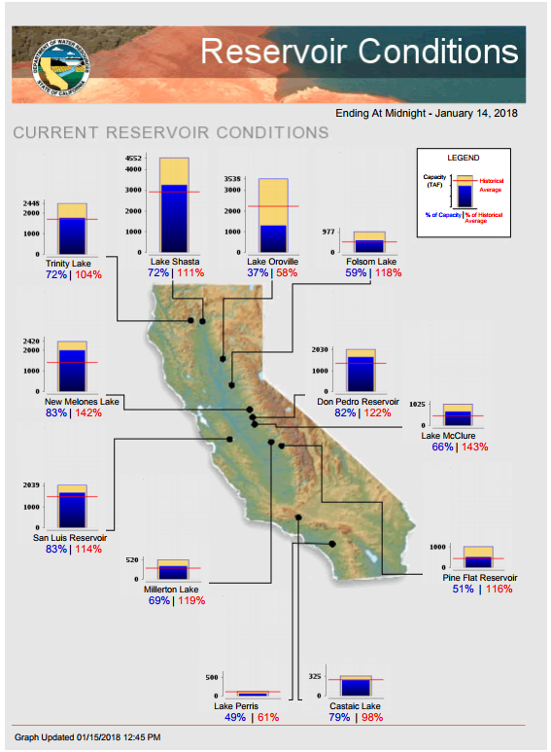
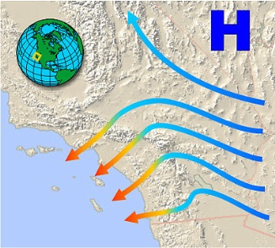
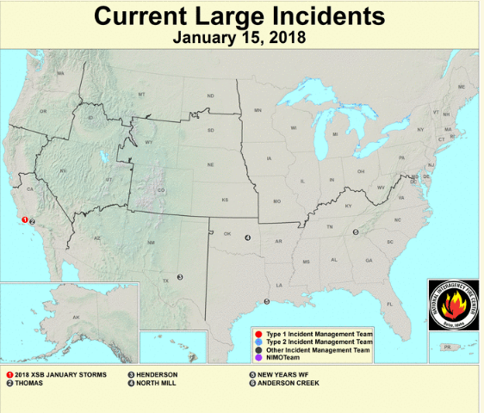
Most of the CA reservoirs are at satisfactory levels, except for the Lake Oroville near northern Sierra Nevada.
Earlier fires in CA! due to the dry downslope disastrous Santa Ana winds have made the situation worse for the recent flooding there due to early January storms.
https://fsapps.nwcg.gov/afm/index.php
FIRE
http://cdec.water.ca.gov/cgi-progs/products/rescond.pdf

Slide 12
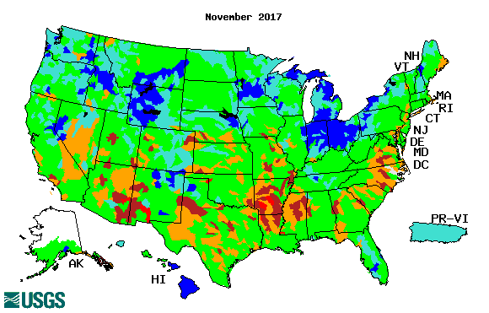
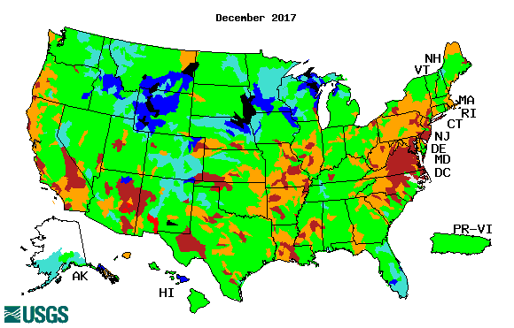
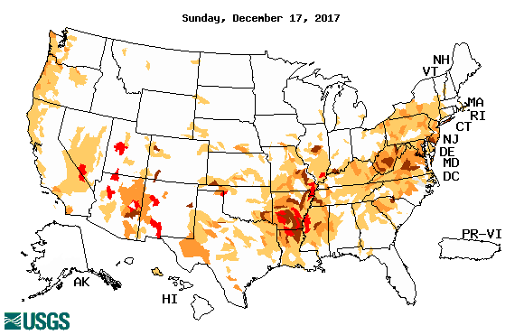
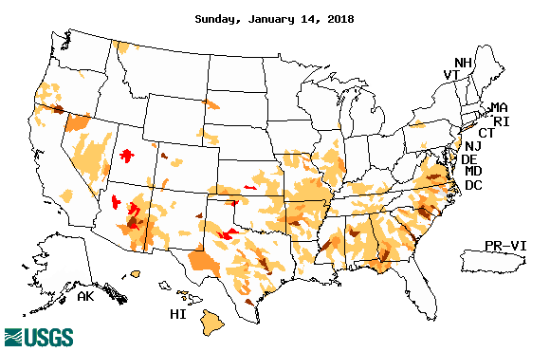
Streamflow (USGS)
Compared to (top left panel), the stream flows actually look worse in December so far particularly across the southern states & along the Atlantic coastal states.
The weaker streamflow in the Northern Plains Drought area in MT, NS & SD is all but gone.
New weaker streamflow development along coastal OR/CA, and southern CA and AZ.
Map shows only below normal 7-day average streamflow compared to historical streamflow for the day of year.
One month ago (left) & Now (below)

Slide 13
EL NIÑO/SOUTHERN OSCILLATION (ENSO)
DIAGNOSTIC DISCUSSION
issued by CLIMATE PREDICTION CENTER/NCEP/NWS and the International Research Institute for Climate and Society
15 January 2018
ENSO Alert System Status: La Niña Advisory !!
Synopsis: La Niña conditions are present. Equatorial sea surface temperatures (SSTs) are below average across the central and eastern Pacific Ocean. La Niña is likely (~85-95%) through Northern Hemisphere winter, with a transition to ENSO-neutral expected during the spring.

Slide 14
http://www.cpc.ncep.noaa.gov/products/analysis_monitoring/ensostuff/ensoyears.shtml

Slide 15
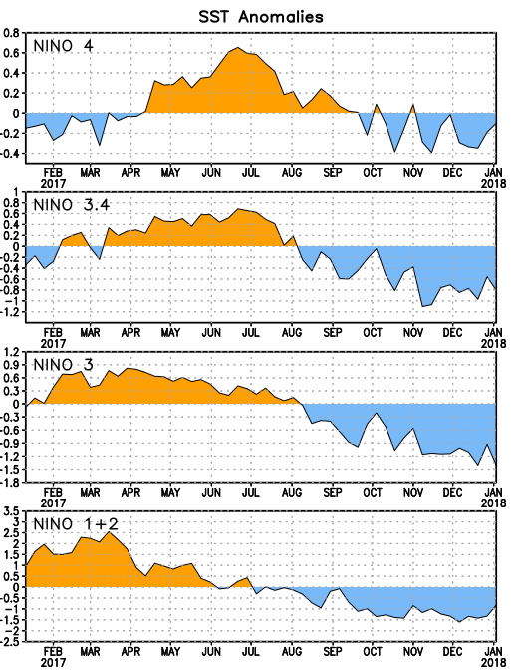
Latest values of SST indices in the various Nino Regions.
The sub surface cold anomaly has suddenly become less cold in the last month.
SSTs have fallen across the central and east Pacific since late summer.

Slide 16
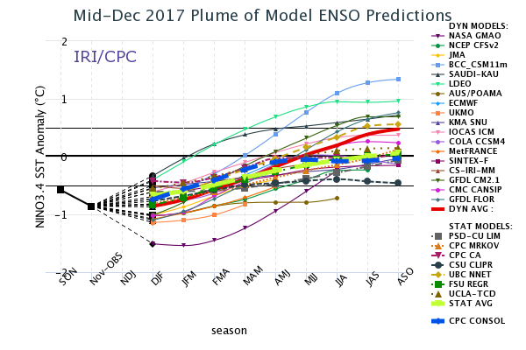
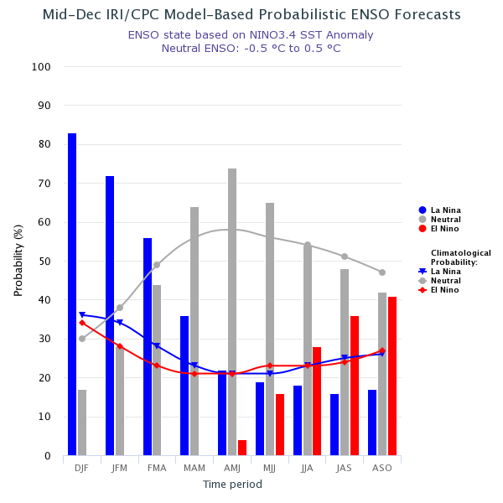
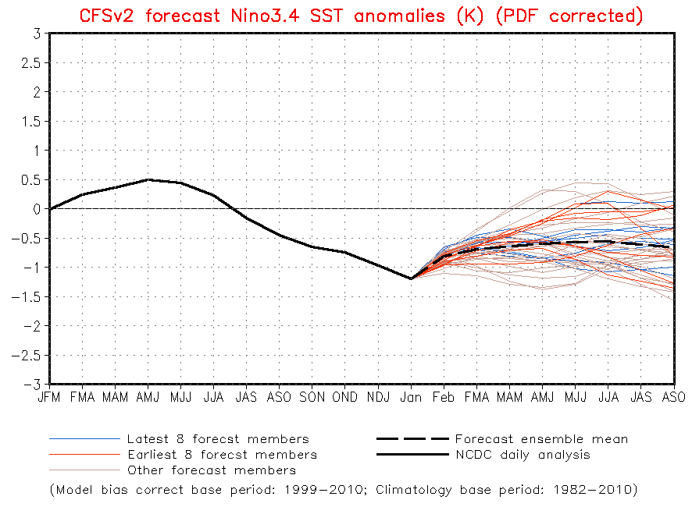
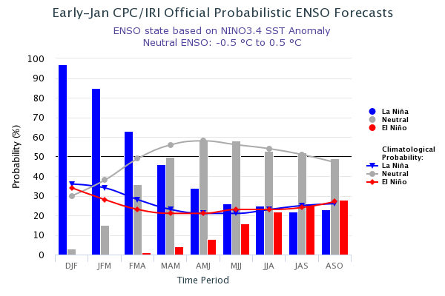
ENSO Forecasts
Mid- Dec CPC/IRI forecast
NMME Models’ – Nino 3.4 forecasts
Early Jan CPC/IRI forecast

Slide 17
Dec-Feb
Expected
Impacts
If a La Nina
develops…
& its normal

Slide 18
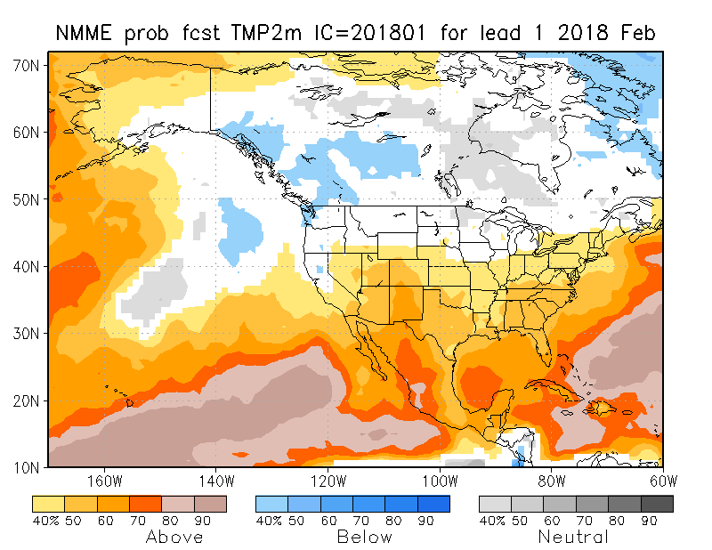
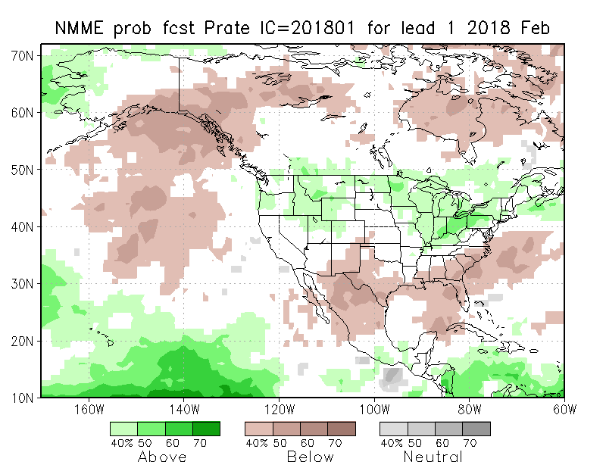
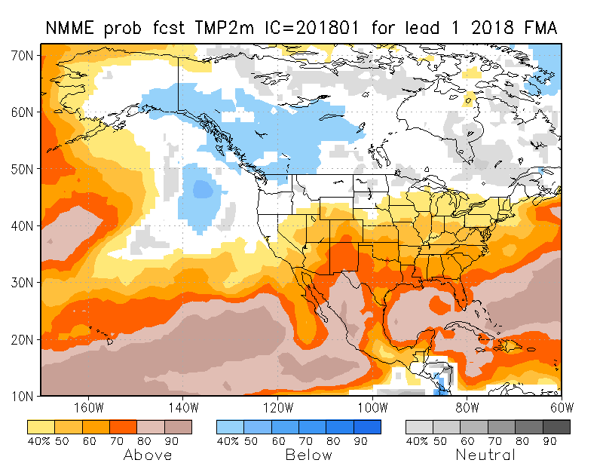
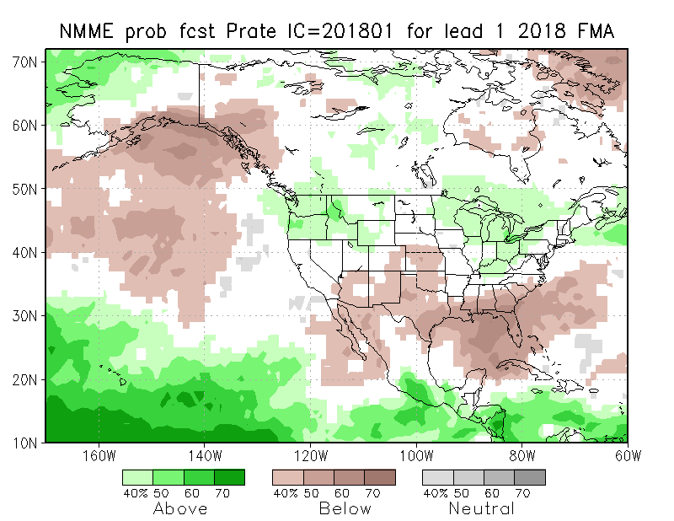
NMME T & P EnsMean forecasts
Feb
FMA
The monthly (Feb) and seasonal (FMA) T are for more warmth across much of the country except in the north and northwest. Overall, models are predicting/implying somewhat typical La Nina Impact for Precip for next month and next 3-month season, even though La Nina is expected to be weakening.

Slide 19
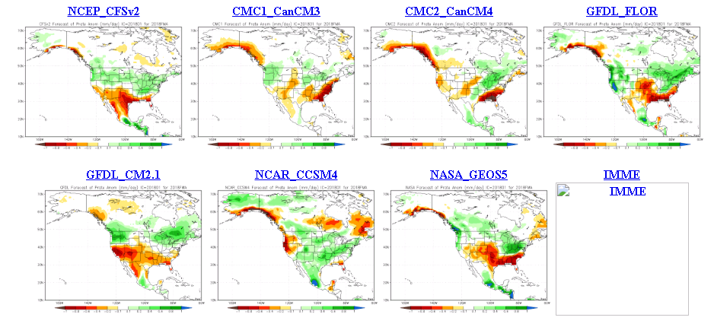
The agreement/uncertainty among the diff. NMME models’ forecasts for Feb-Mar-Apr Precipitation!!!
More agreement among the models in their fcst over the south/east/upper midwest. Even over CA, there is disagreement!

Slide 20
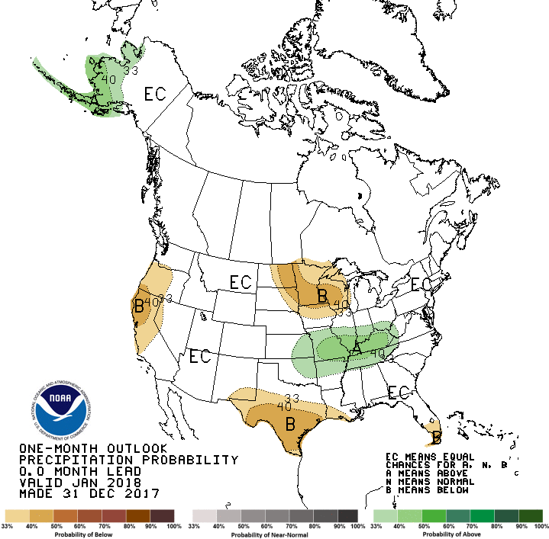
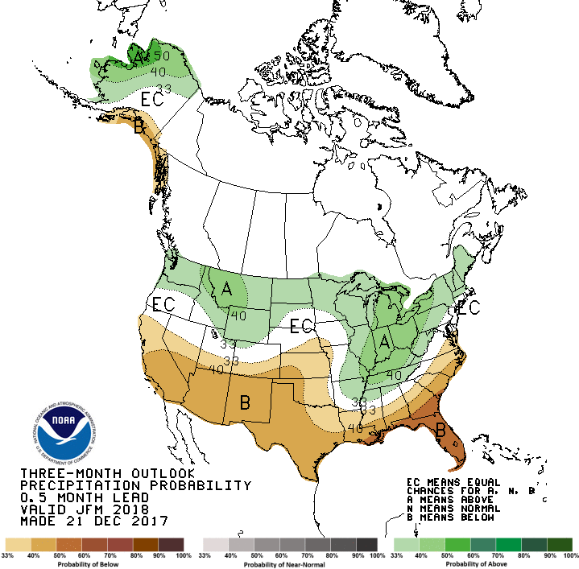
Previous CPC’s official Monthly (Jan) /Seasonal (JFM)
Precipitation outlook
Released Dec 31st
Released Dec 21st

Slide 21
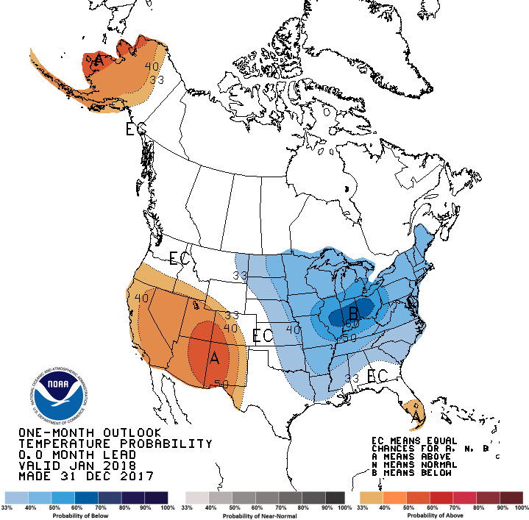
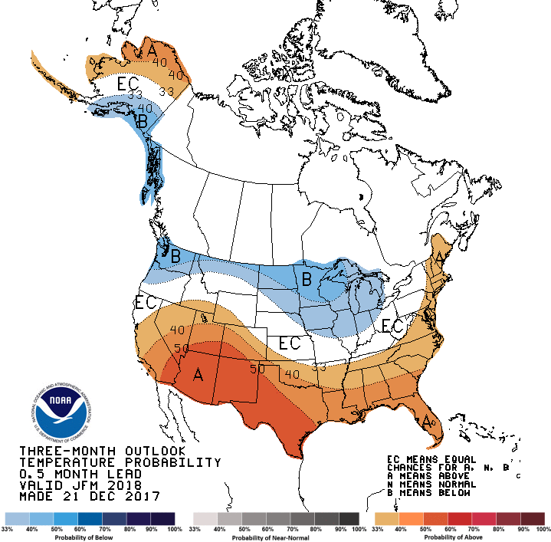
CPC’s official Monthly (Jan) /Seasonal (JFM)
Temperature outlook
Made
Dec 31st
Relatively a good T fcst for so far, but it is only mid-January now.
Made Dec 21st

Slide 22
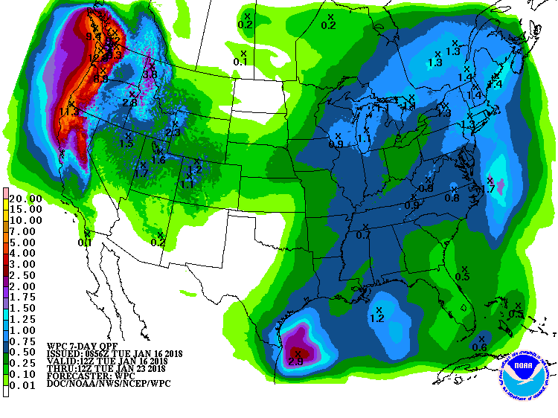
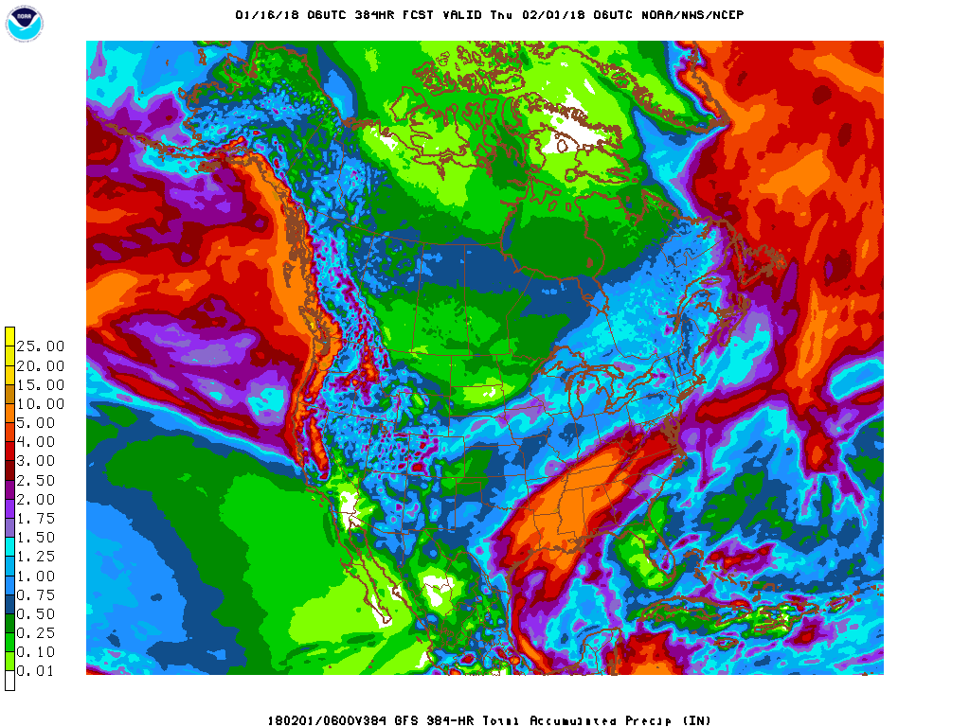
Next 7 days QPF Forecast
In the next 7 days, the Pacific NW, Northern/central CA is expected to get some rain. Big hole in the middle of the country (from yesterday’s run!), which got filled a bit today!
GFS Model Guidance for next 16 days.
Reinforcement of precip forecast over the next seven days in the coastal west, and in the southeast.

Slide 23
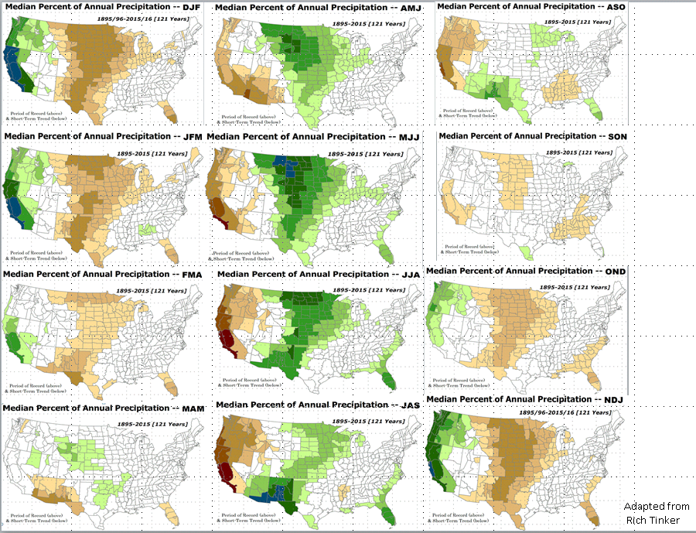
Rainy Season

Slide 24
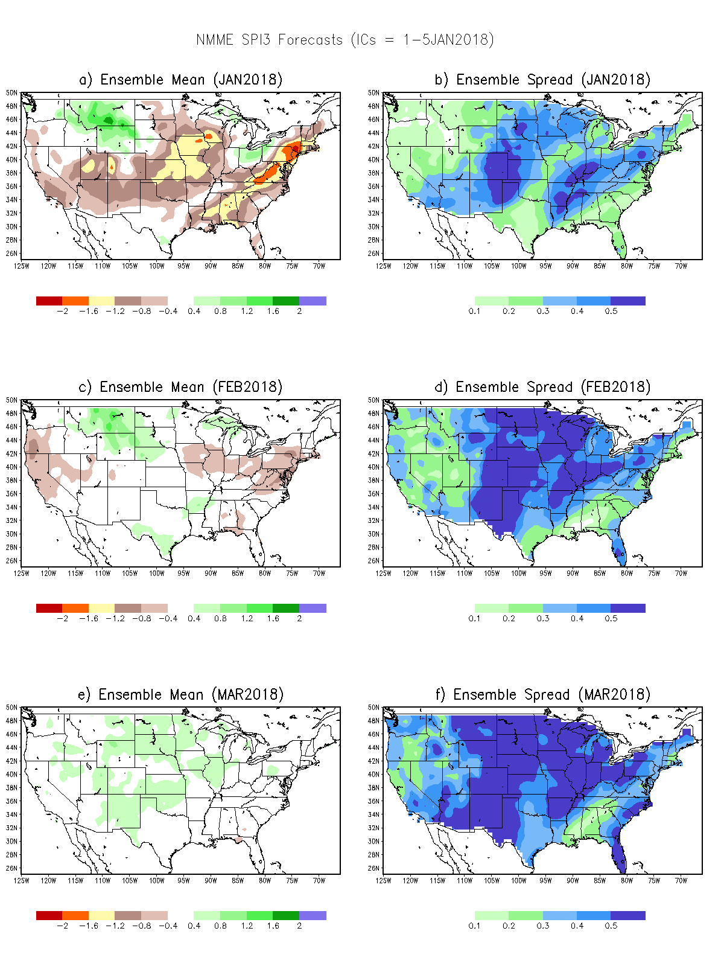
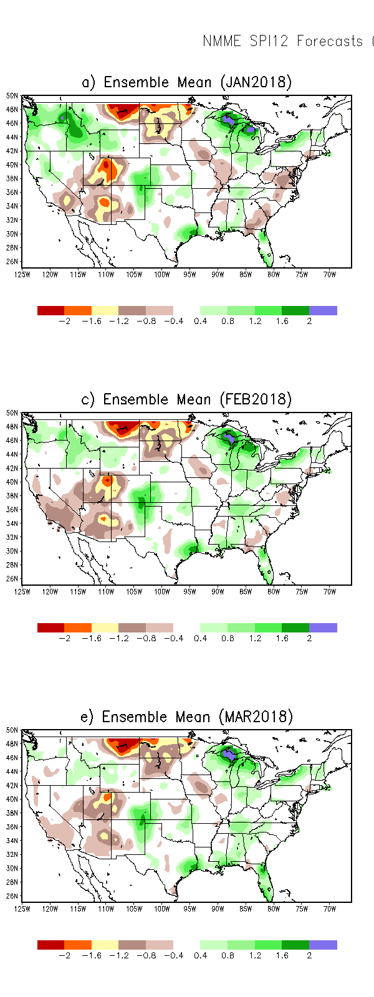
SPI3
SPI6
SPI12
SPI3, SPI6
& SPI12
Forecasts from 6NMME Models
(uses obs. P up to past month, and forecast months’ P from NMME models)
In the past these NMME models and their forecasts always did not extend/intensify the Northern plains drought, and ended it repeatedly prematurely!!
The goodness and skill of these SPI’s forecasts depend directly on these models’ skill in predicting precip!!!

Slide 25
SPI3
Ensemble
Forecast
MEAN
SPI3
Ensemble
Forecast
SPREAD
-Sometimes, over large areas, the
spread is as large as the mean

Slide 26
(We introduced this last month!)
Next 3 slides are probabilistic drought forecasts (Drs. Kingtse Mo & Li Xu at CPC)
Making use of the agreement(disagreement) in the 60 ensemble members of the 6 NMME models (10 members each) – their respective SPI6 forecasts(based on models’ Precip forecast) – as compared to the grand mean - converting them to probabilities.
For ex: At each grid point:
If all ensemble members agree – 100% probability.
If only half of the members agree – 50% probability
These plots will be modified further (instead of just D1-to–D1 & above) in the upcoming months – Done NOW!
No past skill scores developed yet. But will be made available soon.!!

Slide 27
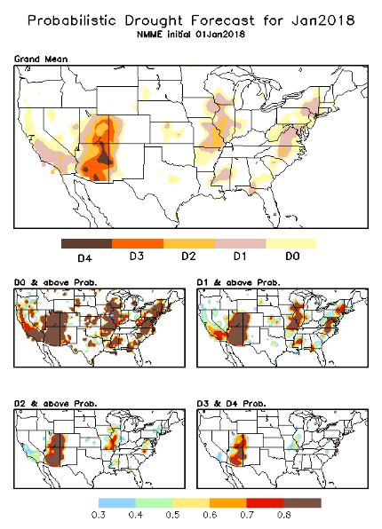
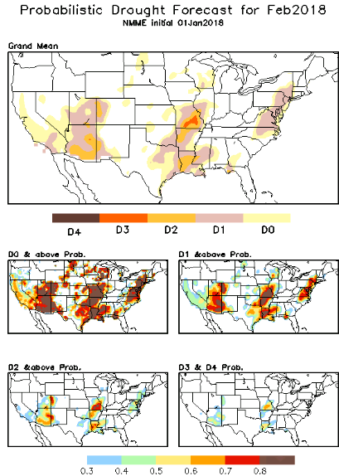

Slide 28
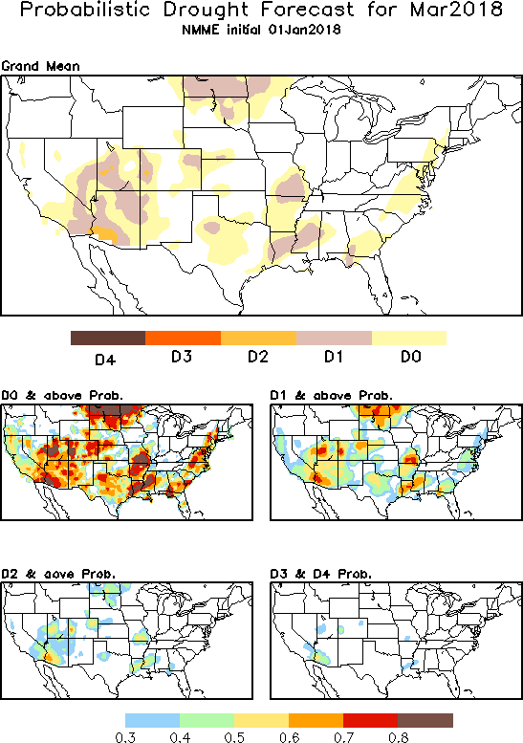
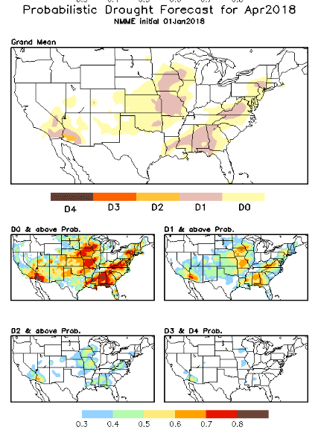

Slide 29
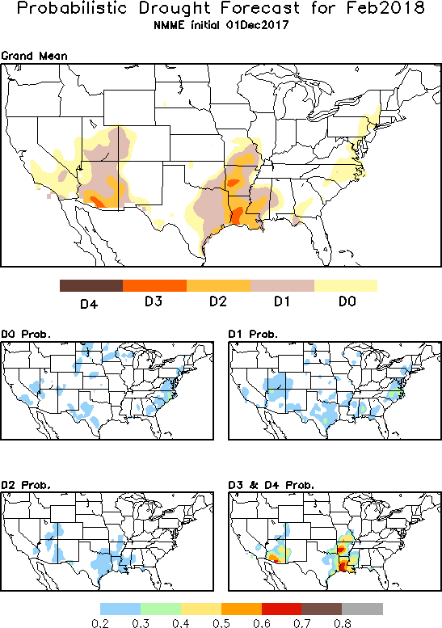

Slide 30
Feb 2018
FMA 2018
In the official
Drought Outlook Tendency Format!!

Slide 31
NLDAS Drought Forecast Analysis
The system developed by Princeton University and University of Washington was transitioned to NCEP/EMC as the experimental forecast system.
Forecast using 201711 Initial Condition- Soil Moisture Percentile forecast
NOT AVAILABLE/UPDATED THIS MONTH

Slide 32
Hydrological Monitoring and Seasonal Forecasting @ MSU (Michigan State University ) NLDAS model
http://drought.geo.msu.edu/research/forecast/smi.monthly.php
Monthly Soil Moisture Percentile Prediction issued on 201801
The inter quartile range suggest greater uncertainty about the forecast in these shaded regions.
But not much uncertainty for the two major drought regions in the south..

Slide 33
NASA GEOS5 Forecasts
Precip
Soil Moisture Percentile

Slide 34
Summary
Current ENSO status and forecast.
ENSO status – La Nina Advisory. La Niña conditions are present. Equatorial sea surface temperatures (SSTs) are below average across the central and eastern Pacific Ocean. La Niña is likely (~85-95%) through Northern Hemisphere winter, with a transition to ENSO-neutral expected during the spring.
Current Drought conditions:
The S/L term Northern Plains drought in the eastern MT/Dakotas region due to deficit in 2017 rainfall season continues to stay/exist, until probably the onset of 2018 rainy season(Apr-) in these regions, even though in the very short term, some improvement may be noticed locally.
Recently, there is a general emergence/spread of major rainfall shortfall and hence dry/short term drought conditions across the central-southern tier states, particularly in the UT/CO/AZ/NM corridor combined with the S/L term drought conditions in far southern CA, as well as the short term drought near OK/AR/LA, further east and up along the Atlantic coastal states..
Prediction:
According to a consensus of model forecasts - the ongoing La Nina is expected to produce the typical canonical Temperature impacts over the southeast, at least through the NH winter, but some uncertainty still exists for the Precip forecast/impact even for southern/central CA, and for the adjoining UT/CO/AZ/NM drought region. Developments in Spring season will be crucial, as to whether ENSO neutral or a second LaNina will follow later in summer and fall with its associated impacts!!
In the immediate short term, in the next few weeks, according to the models, the Pacific Northwest, and the central/uppersoutheast is expected to get good rainfall, but the rainfall totals over northern/central CA will be consequential, not just in the short term, but for throughout this year, since the rainfall season here will soon be fading away after February/March.

