Slide 1
Drought Outlook Discussion March 2018
Climate Prediction Center/NCEP/NOAA
http://www.cpc.ncep.noaa.gov/products/Drought
Phone: 1-877-680-3341
Pwd: 858747#

Slide 2
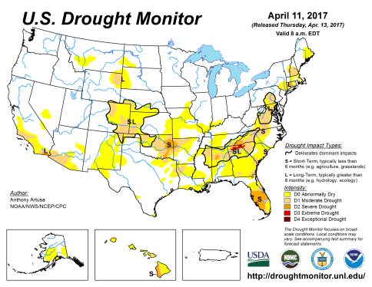
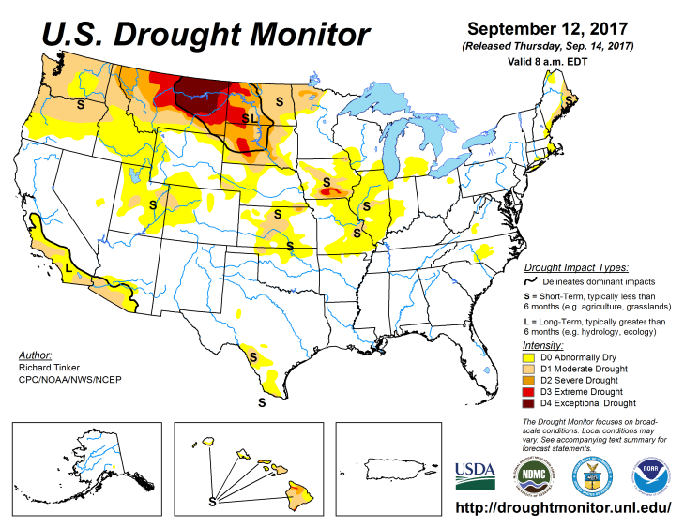
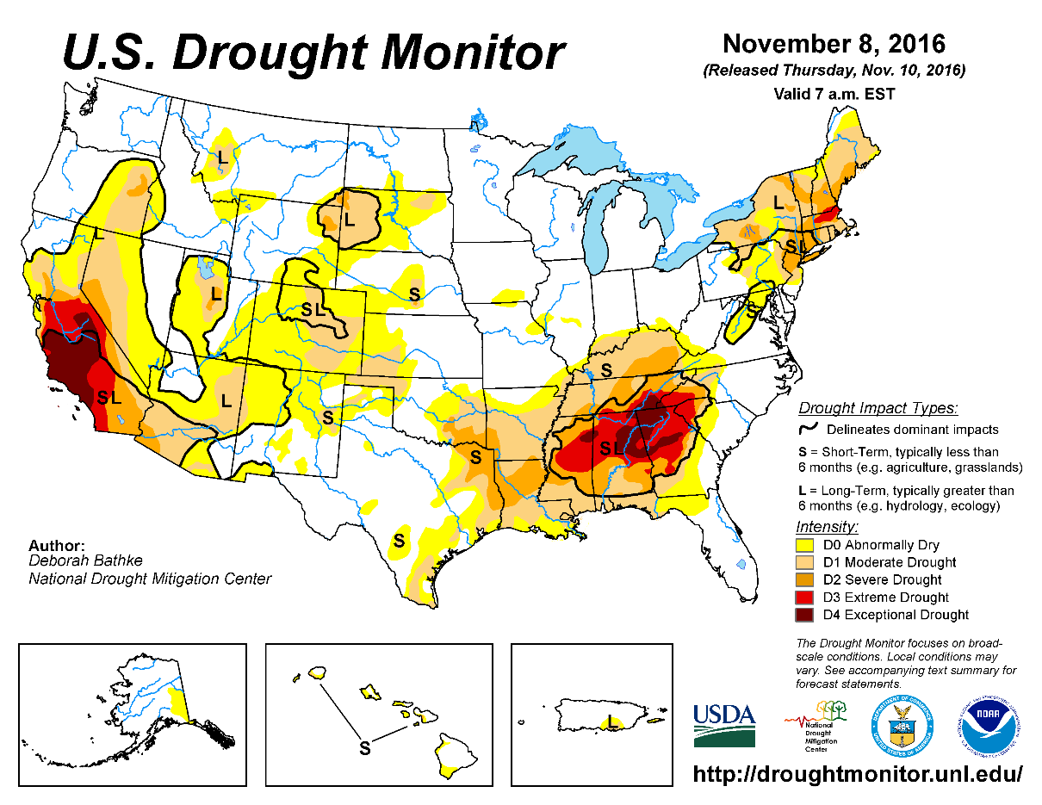
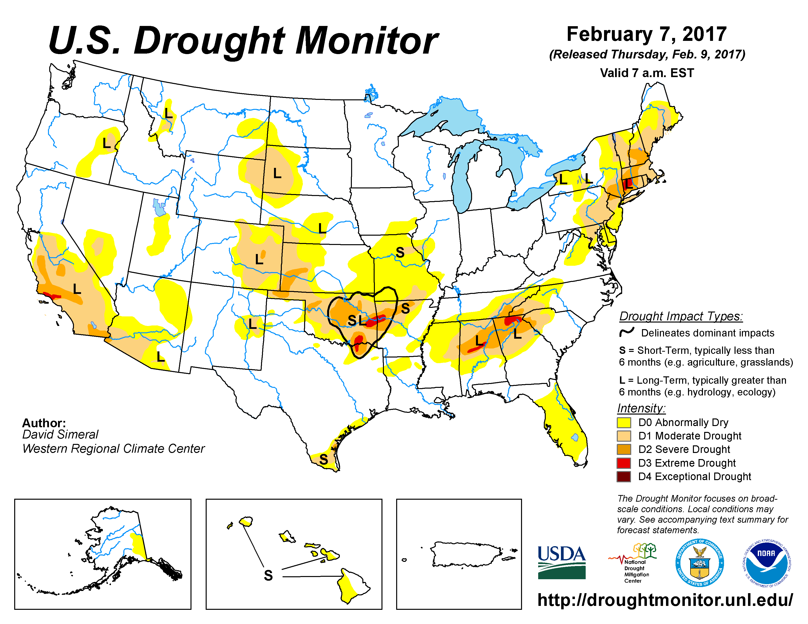
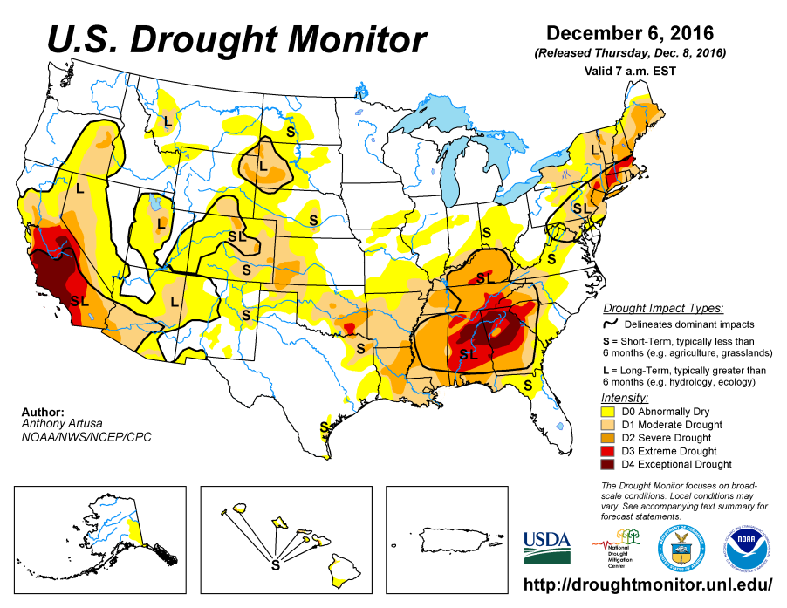
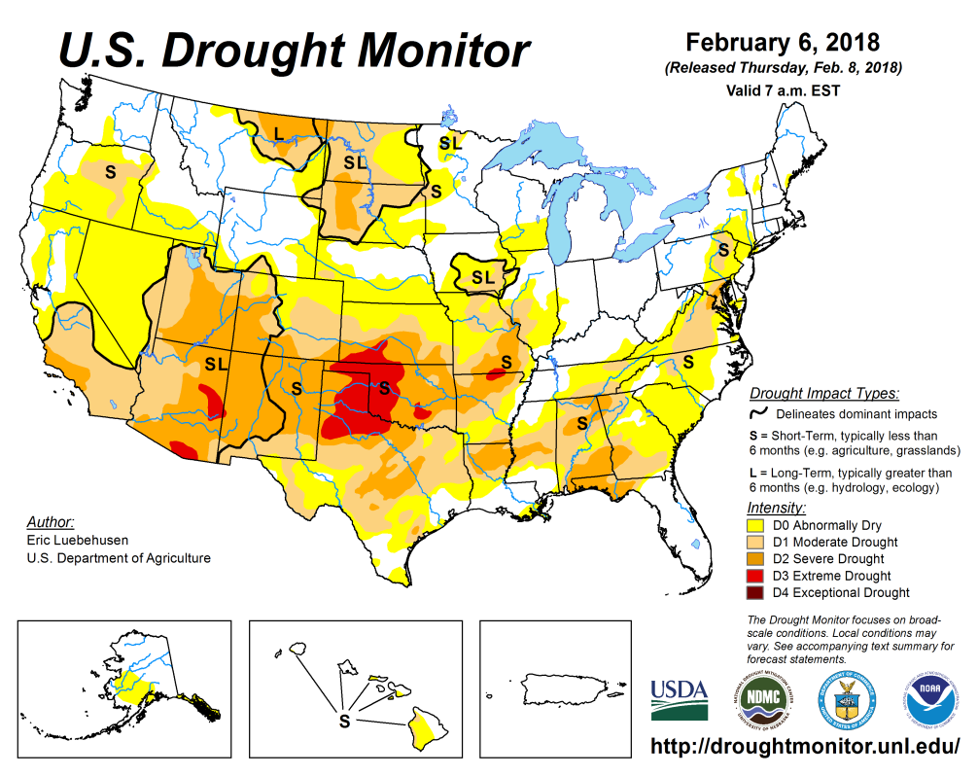
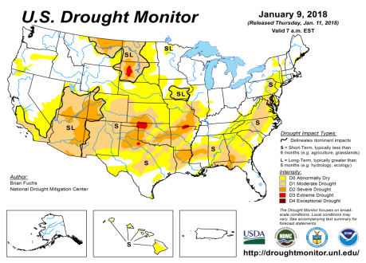
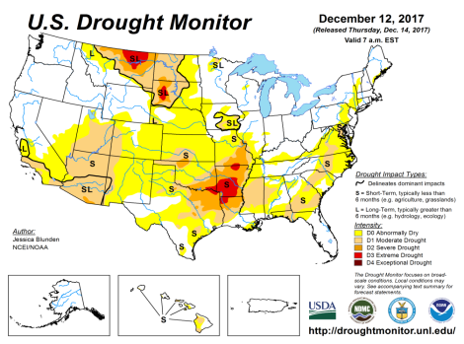
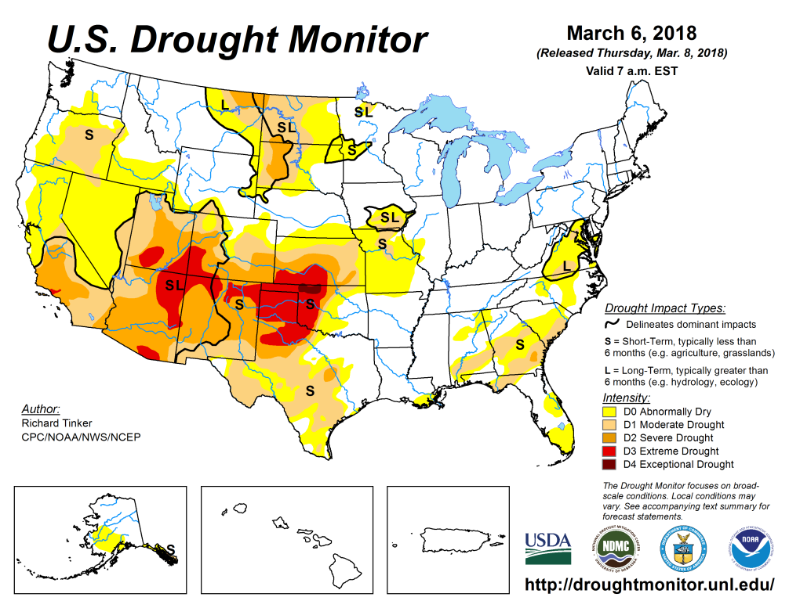
Drought Monitor
Jan
Previous
Dec
In the South the drought associated with the ongoing (but soon ending!) La Nina, is probably at its worst in Feb/Mar, even though in the southeast it has gotten better (in LA/AR/TN/MS/AL/GA/FL’s western pan handle) due to recent rains.
In the north, in eastern MT, ND, SD, the short/long term drought remains in a muted form (frozen solid ground there now!)
Latest/Recent

Slide 3
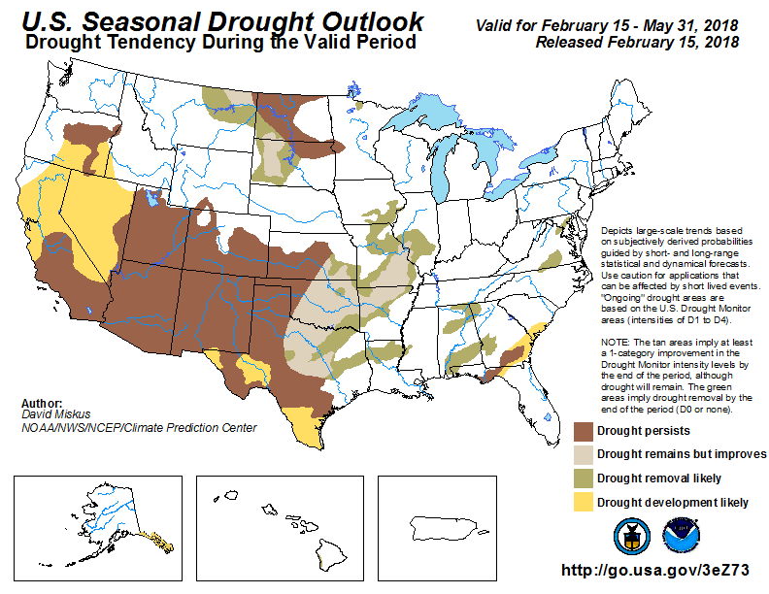
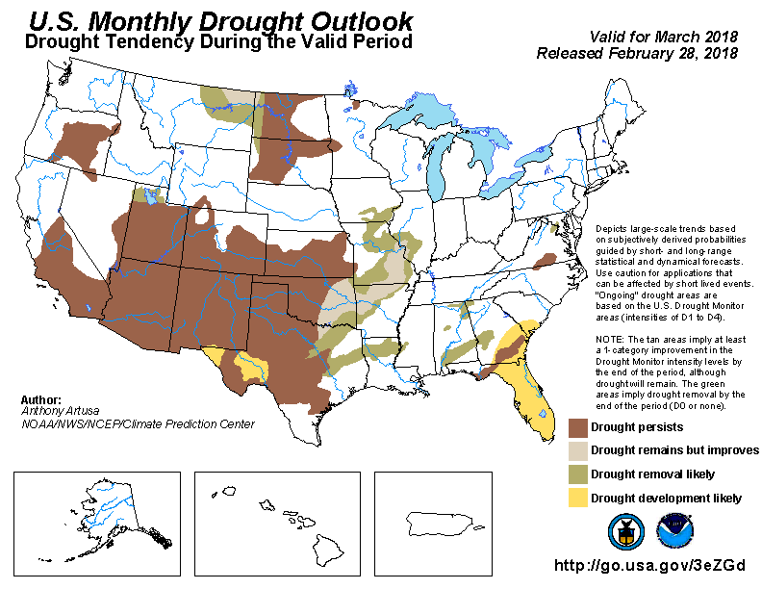
(Prev) Seasonal/Monthly Drought outlooks
Seasonal Outlook (Mid Feb 2018 - May 2018)
issued 02/15/18
Monthly outlook
(March 2018)
issued 02/28/18
The general improvement in the drought conditions forecast last month, across the south(east of Texas) has occurred. On the other hand, it has gotten worse in the southwest, OR, as was expected/forecast. FL, southern GA, SC is also getting dry (next slides).

Slide 4
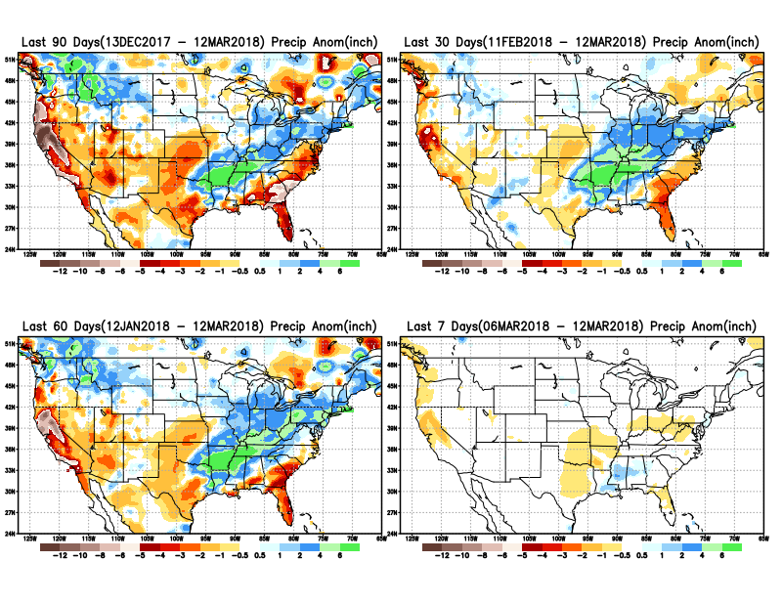
Total precipitation ANOM during last 7, 30, 60 & 90 days.
11
Recent above normal rains from eastern Texas extending northeastward across eastern OK, AR, LA, TN, KY, WV has greatly eased the dry conditions here.
But from NW Texas, KS, and further west, the drought has gotten worse.

Slide 5
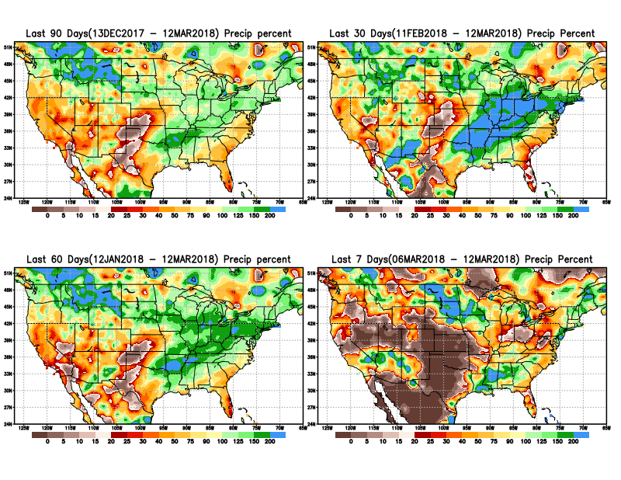
Total precipitation Percent during last 7, 30, 60 & 90 days.

Slide 6
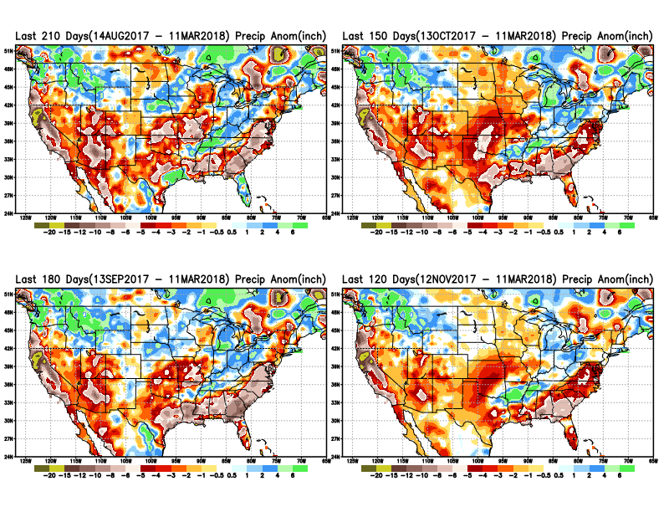
Total precipitation ANOM during last 4, 5, 6, and 7 months.
Except for remnants of Harvey and Irma in/near Texas and Florida, longer term deficits exist over much of the country, not to mention the missed rainfall season in the northern plains.

Slide 7
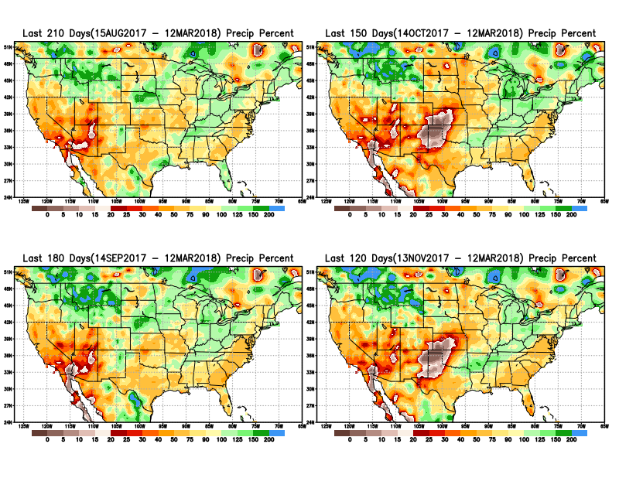
Total precipitation Percent during last 4, 5, 6, and 7 months.
Note growing Precipitation deficits

Slide 8
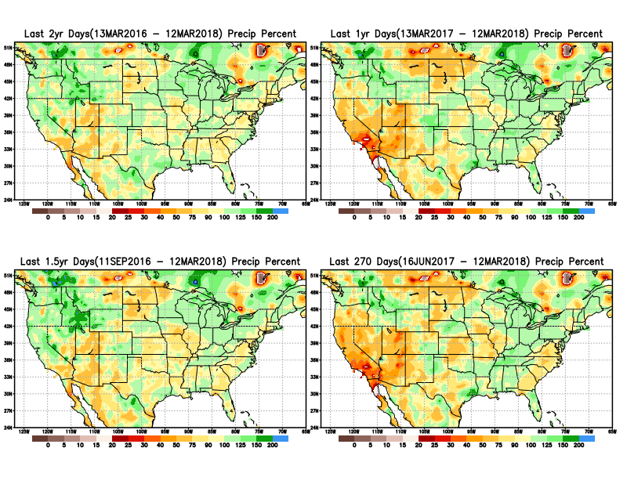
Total precipitation Percent during last 9 months, 1 yr, 1.5yrs, & 2 yrs.
There are many long term rainfall deficit regions in the country, particularly deficits in UT/AZ, southern CA, and parts of NM/CO are long term.

Slide 9
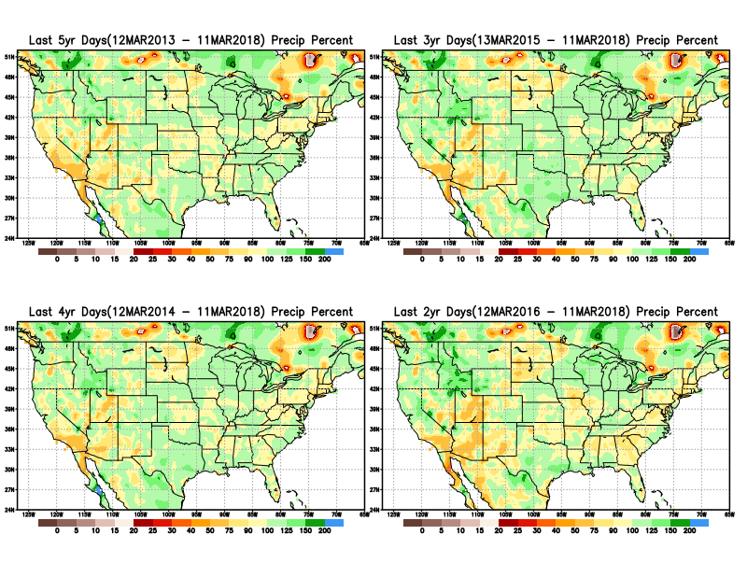
Total precipitation Percent during last 2, 3, 4 & 5 years.
Precipitation in some areas have generally been deficient for last few years.

Slide 10
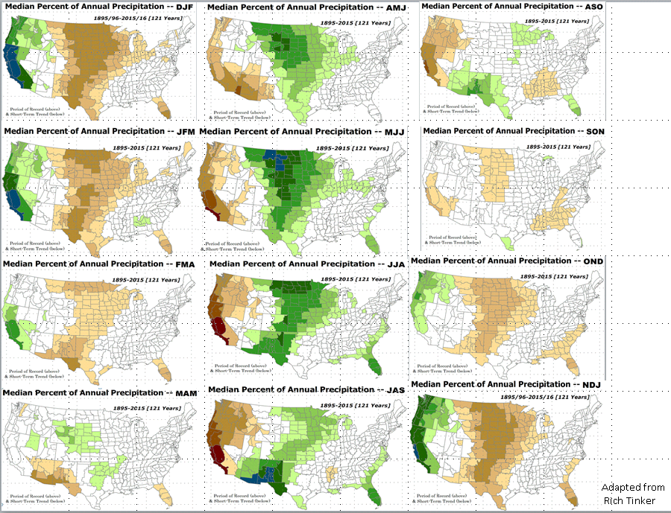
Rainy Season

Slide 11
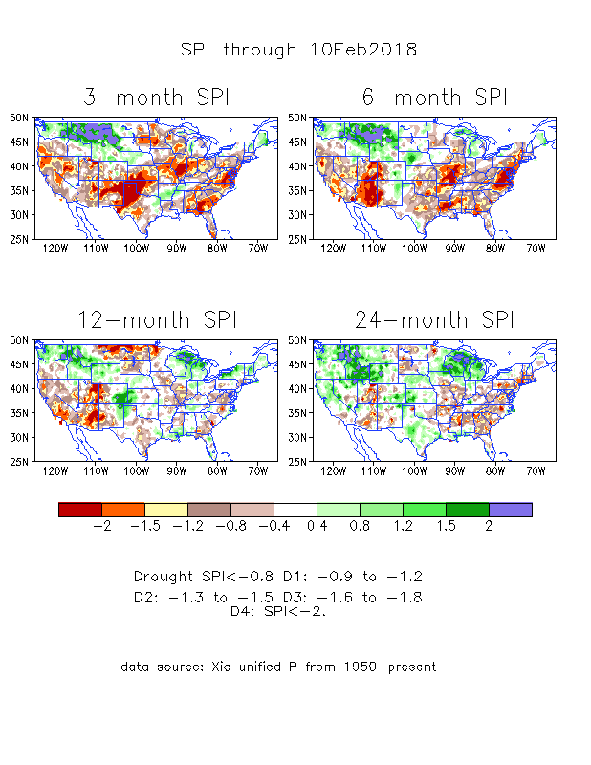
The Standardized Precipitation Index SPI (based on Observed P)
----- Last Month
Large areas of short term rainfall deficit (SPI3 !) developing quickly –across much of the central and southern tier states.
-situation improved since last month.

Slide 12
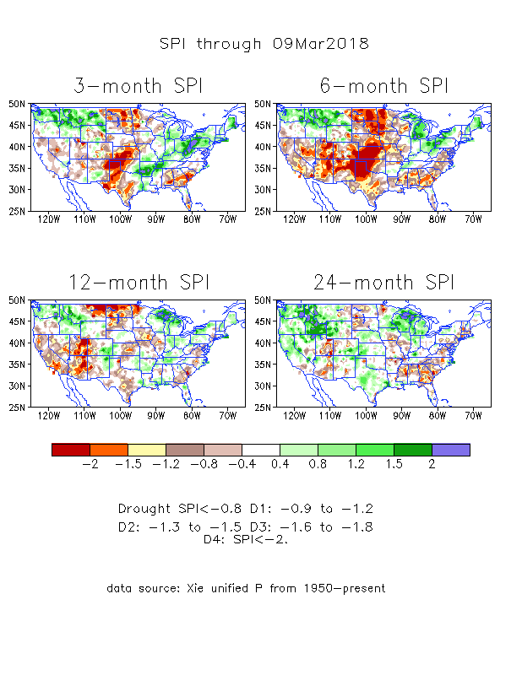
The Standardized Precipitation Index SPI (based on Observed P)
----- NOW
Large areas of short term rainfall deficit (SPI3 !) developing quickly –across much of the central and southern tier states.
-situation improved since last month.

Slide 13
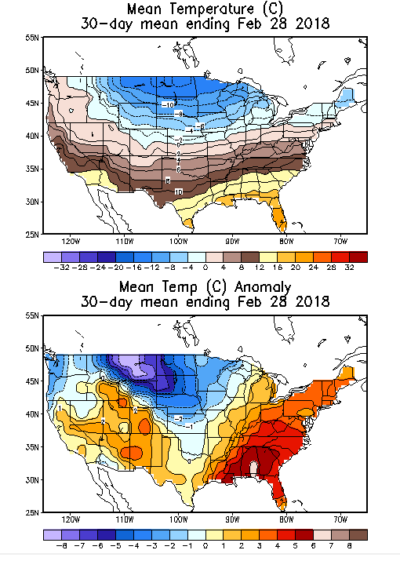
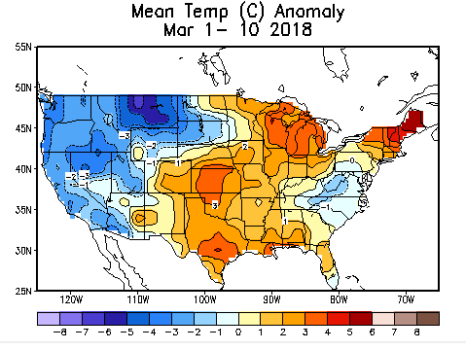
Recent US Temperatures
February mean T is generally warm in the south and cold in the northern Plains.
So far, in March, even the southwest is a little colder than normal.

Slide 14
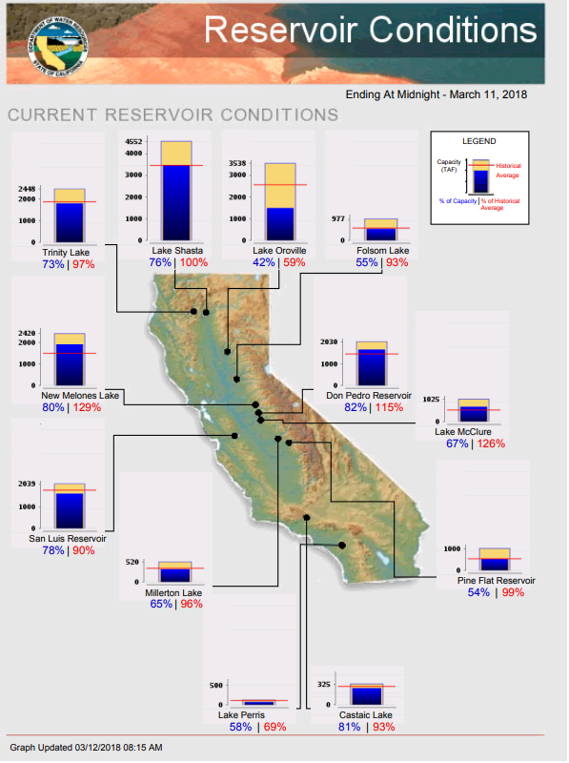
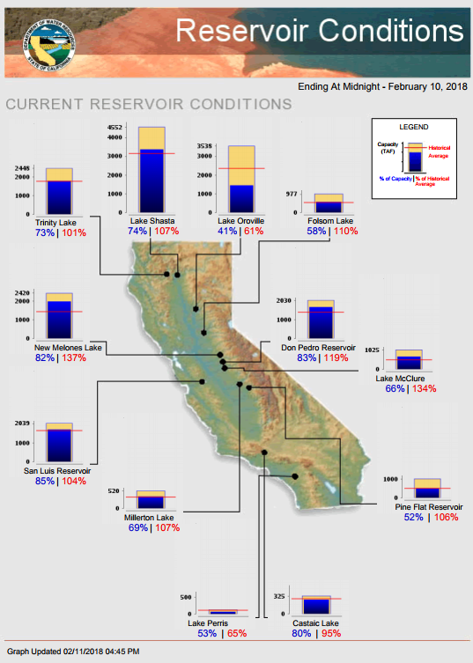
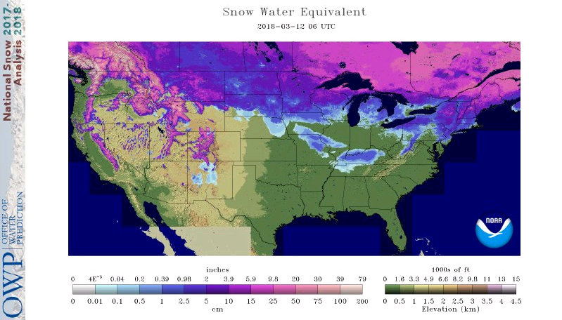
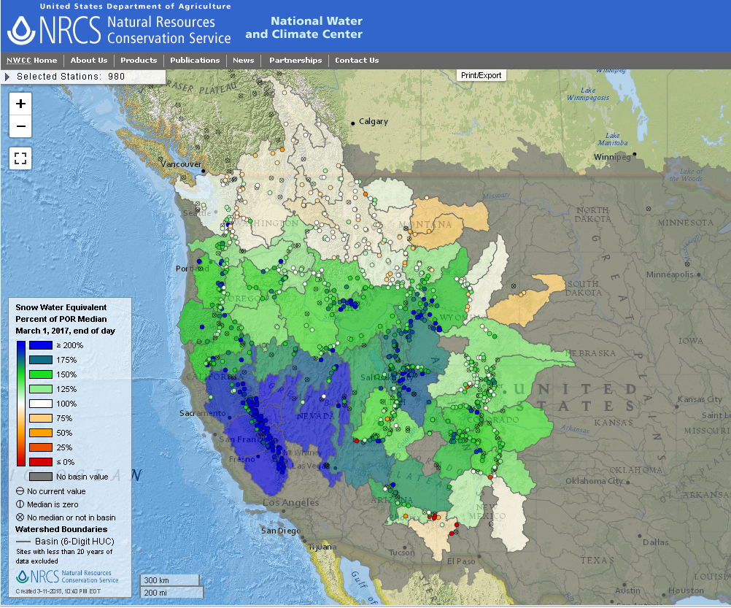
Most of the CA reservoirs are still at satisfactory levels, except for the Lake Oroville near northern Sierra Nevada. Decent snow amounts in the Sierra Nevada (?), ID, western MT. Not much snow on ground ND/SD.
FIRE
Snow Water Equivalent.
http://cdec.water.ca.gov/cgi-progs/products/rescond.pdf
https://fsapps.nwcg.gov/afm/index.php

Slide 15
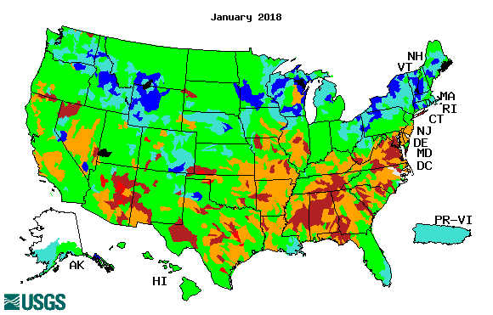
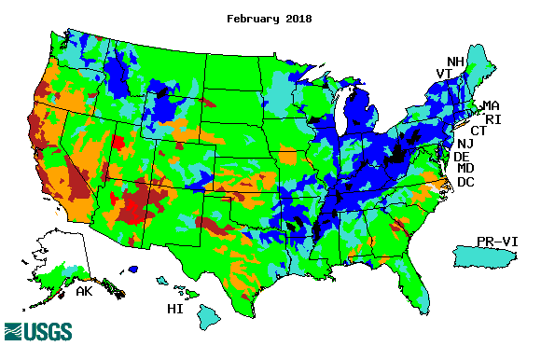
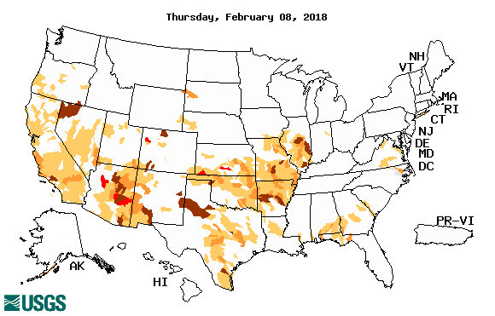
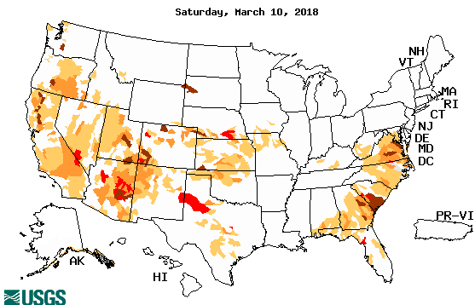
Streamflow (USGS)
Look at the southwest (CA/NV/AZ/NM) and southeast/midwest/midAtlantic states in January and February. The west has gotten much worse, while a total flip flop in the east from Jan to Feb.
Little change in the northwest except in OR.
Map shows only below normal 7-day average streamflow compared to historical streamflow for the day of year.
One month ago (left) & Now (below)

Slide 16
EL NIÑO/SOUTHERN OSCILLATION (ENSO)
DIAGNOSTIC DISCUSSION
issued by CLIMATE PREDICTION CENTER/NCEP/NWS and the International Research Institute for Climate and Society
12 March 2018
ENSO Alert System Status: La Niña Advisory !!
Synopsis: La Niña conditions are present.* Equatorial sea surface temperatures (SSTs) are below average across the central and eastern Pacific Ocean. A transition from La Niña to ENSO-neutral is most likely (~55% chance) during the March-May season, with neutral conditions likely to continue into the second half of the year.

Slide 17
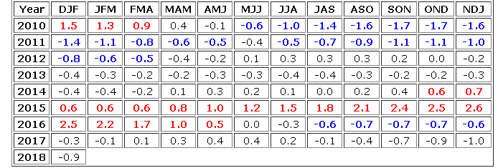
Next month will be font blue!
La Nina on its way out!
http://www.cpc.ncep.noaa.gov/products/analysis_monitoring/ensostuff/ensoyears.shtml

Slide 18
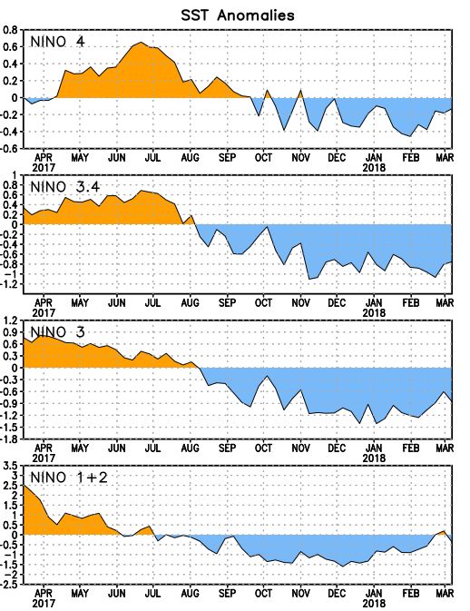
Latest values of SST indices in the various Nino Regions.
The sub surface heat anom has changed sign! .
Relatively short lived!
SST anoms across the basin have increased!
ie., become less cold!!

Slide 19
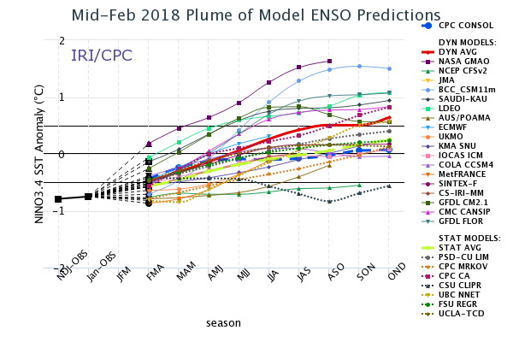
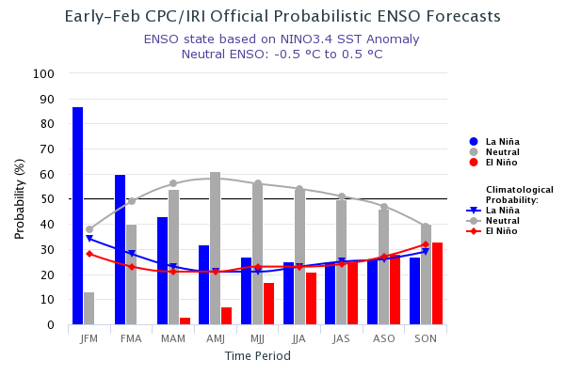
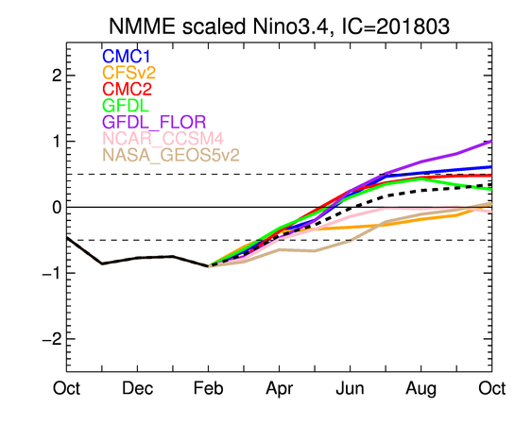
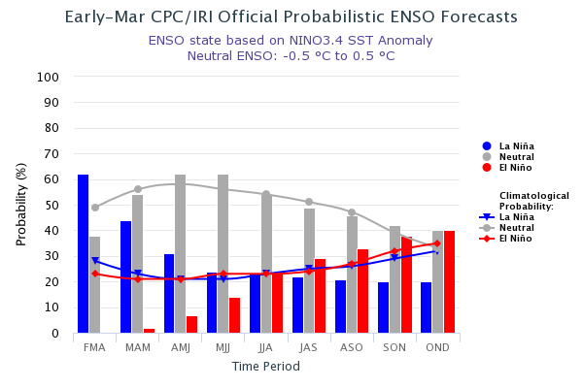
ENSO Forecasts
Early- Feb CPC/IRI forecast
NMME Models’ – Nino 3.4 forecasts
Early Mar CPC/IRI forecast
This upcoming summer/fall - ENSO Neutral or El Nino ? (La Nina out of question?)

Slide 20
Dec-Feb
Expected
Impacts
If a La Nina
develops…
& its normal

Slide 21
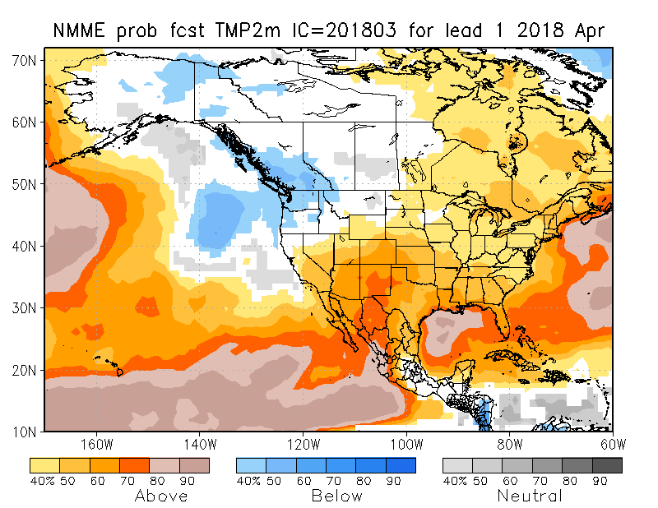
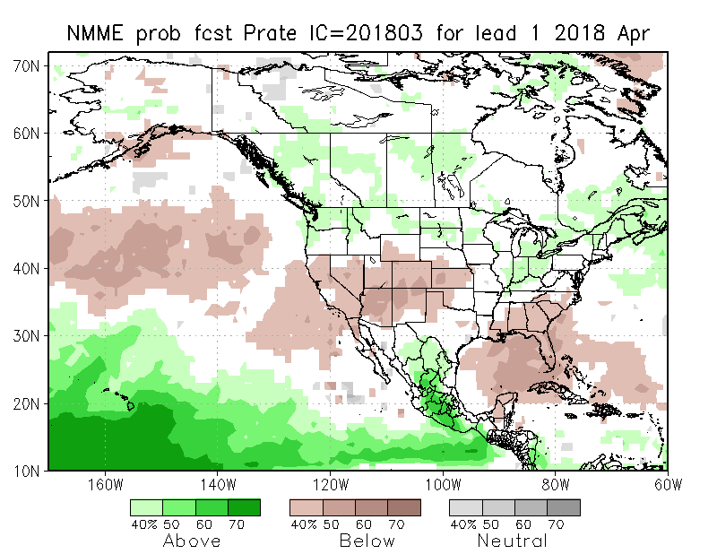
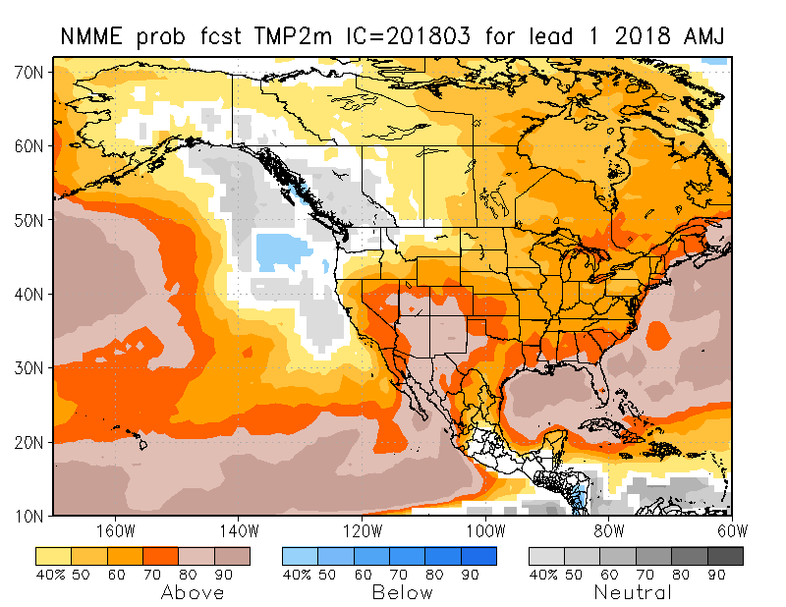
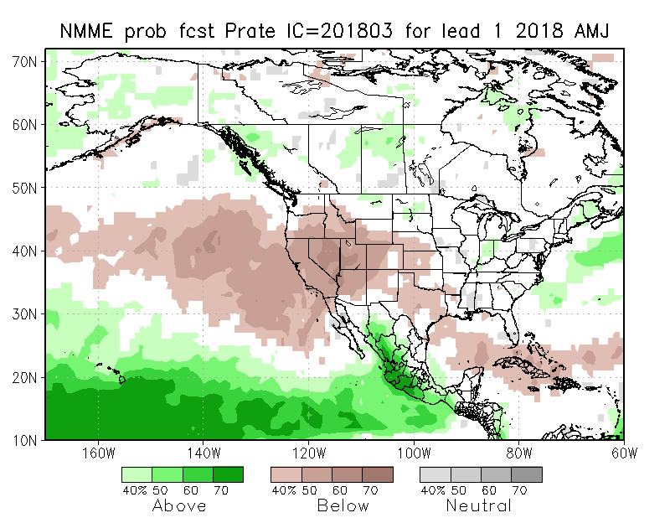
NMME T & P EnsMean forecasts
Apr
AMJ
The monthly (Apr) and seasonal (AMJ) T are for more warmth across much of the country especially in the drought southwest. Overall, models are predicting/implying somewhat typical La Nina Impact for Precip for next month and next 3-month season, even though La Nina is expected to be weakening.

Slide 22
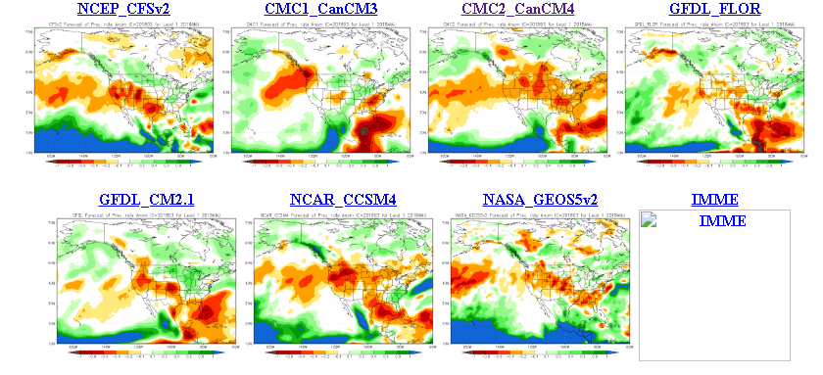
The agreement/uncertainty among the diff. NMME models’ forecasts for Apr-May-June Precipitation!!!

Slide 23
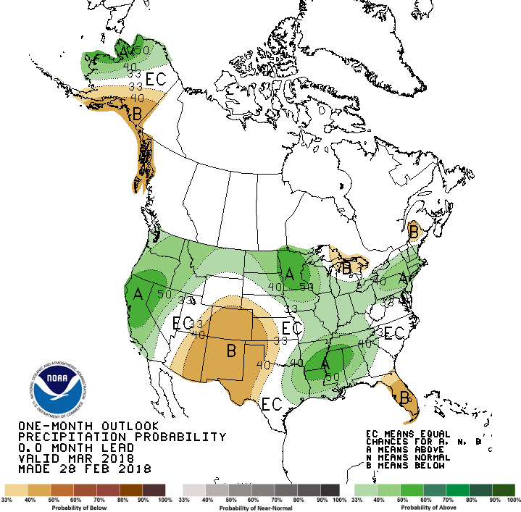
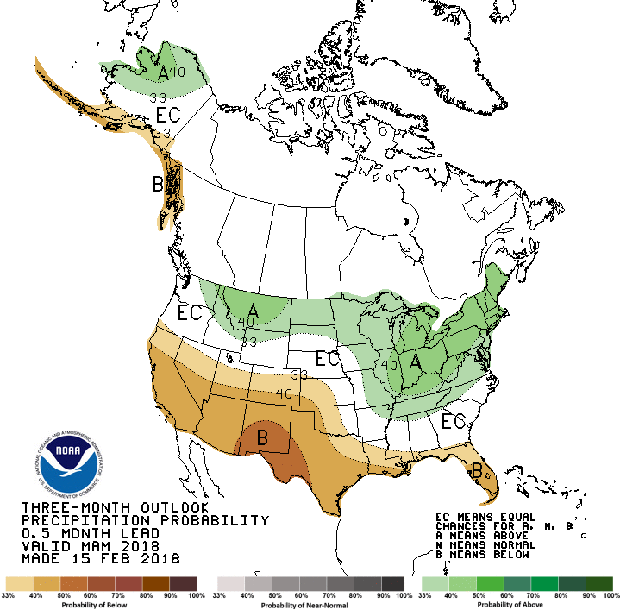
Previous CPC’s official Monthly (Mar) /Seasonal (MAM)
Precipitation outlook
Released Feb 28th
Released Feb 15th

Slide 24
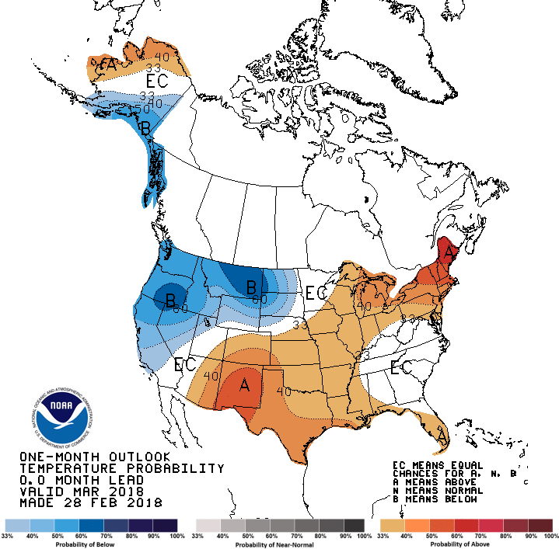
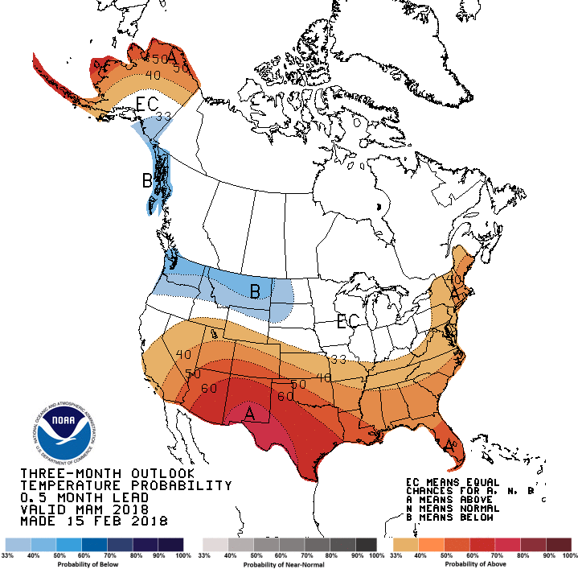
CPC’s official Monthly (Mar) /Seasonal (MAM)
Temperature outlook
Made
Feb 28th
Made Feb 15th
Relatively a good T fcst overall for so far, except in the southwest!

Slide 25
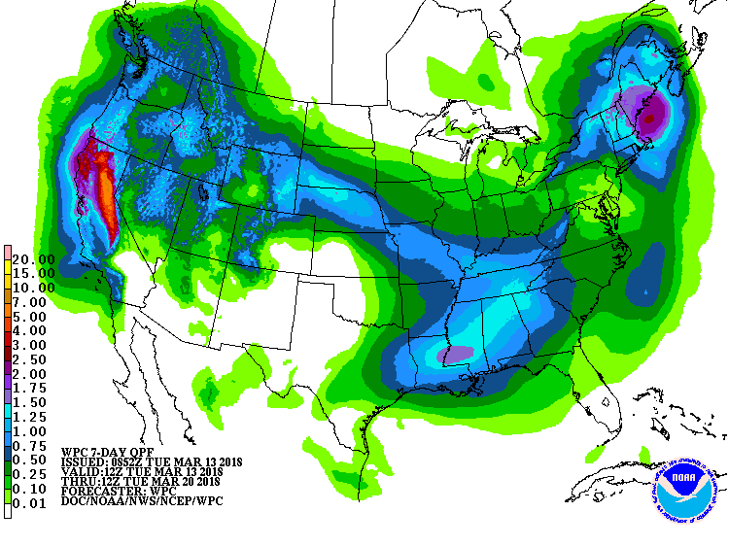
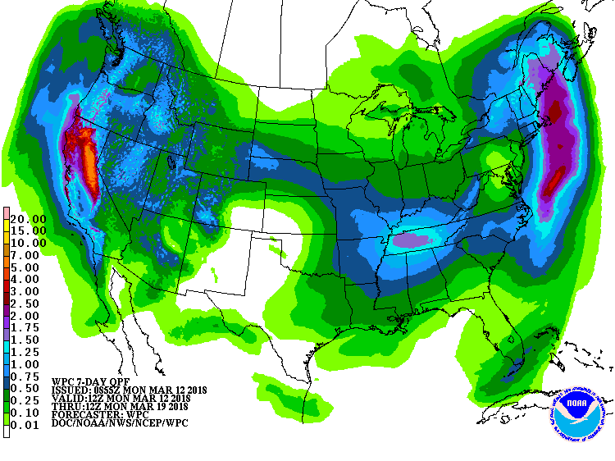
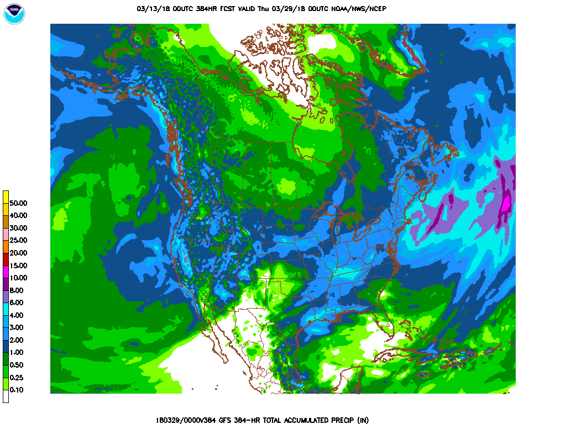
Next 7 days QPF Forecast
In the next 7 days, the Pacific NW, CA is expected to get some decent rain. Big hole in precip around NW Texas and vicinity, where there is ongoing drought! Modest rain in TN valley, and the interior Midwest – inconsequential!! Not much over FL !!
GFS Model Guidance for next 16 days.
Reinforcement of precip forecast over the next seven days. Expected rain in CA, amounts not enough in any way to offset the accrued deficits here, as the rainy season is slowly fading away! Similar arguments around the four states corner region.

Slide 26
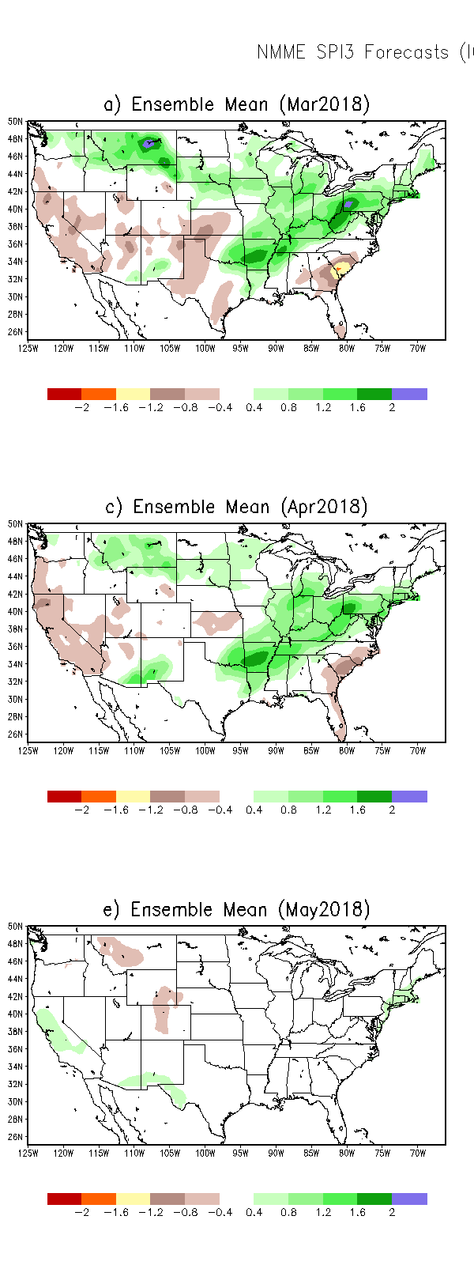
SPI3
SPI6
SPI3, SPI6
& SPI12
Forecasts from 6NMME Models
(uses obs. P up to past month, and forecast months’ P from NMME models)
In the past these NMME models and their forecasts always did not extend/intensify the Northern plains drought, and ended it repeatedly prematurely!!
The goodness and skill of these SPI’s forecasts depend directly on these models’ skill in predicting precip!!!
The NMME models indicate that by May much of the short term deficit (SPI3) may have eased and gone, while the longer term rainfall deficits/drought will continue to stay! But the spread suggests there is great uncertainty in these.

Slide 27
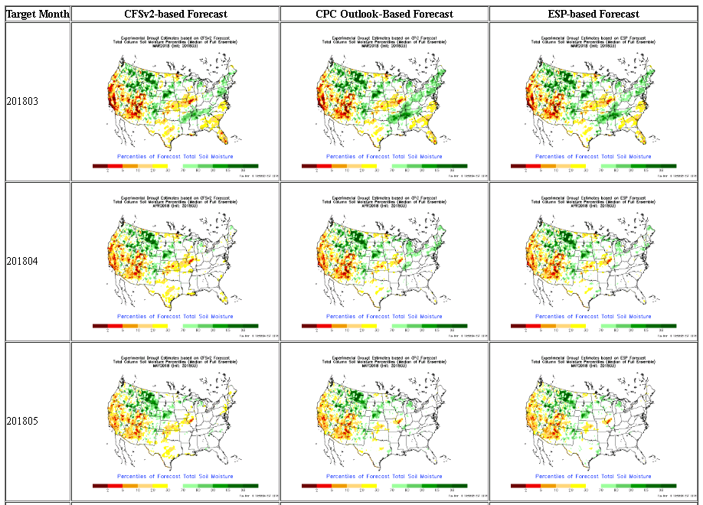
NLDAS Drought Forecast Analysis
The system developed by Princeton University and University of Washington was transitioned to NCEP/EMC as the experimental forecast system.
Forecast using 201803 Initial Condition- Soil Moisture Percentile forecast

Slide 28
Hydrological Monitoring and Seasonal Forecasting @ MSU (Michigan State University ) NLDAS model
http://drought.geo.msu.edu/research/forecast/smi.monthly.php
Monthly Soil Moisture Percentile Prediction issued on 201803
The inter quartile range suggest greater uncertainty about the forecast in these shaded regions.

Slide 29
NASA GEOS5(Still 5?) Forecasts
Precip Fcst
New Fcst System this month from NASA..
Will keep watching this…
The soil moisture (%) maps are too patchy!
Soil Moisture Fcst Percentile
Less rain in CA is fcst in Feb (happened)
More rain in CA is fcst in March (happening)
Near normal rain in CA is fcst in April!

Slide 30
Exptl. Probability Drought Outlook from Kingtse Mo and Li Xu based on NMME ensemble members.

Slide 31
Exptl. Categorical Monthly (April)/Seasonal(AMJ)
Drought Outlook from Kingtse Mo and Li Xu in the CPC drought outlook format

Slide 32
Summary
Current ENSO status and forecast.
La Niña Advisory !! La Niña conditions are present.* Equatorial sea surface temperatures (SSTs) are below average across the central and eastern Pacific Ocean. A transition from La Niña to ENSO-neutral is most likely (~55% chance) during the March-May season, with neutral conditions likely to continue into the second half of the year.
Current Drought conditions:
- The S/L term Northern Plains drought in the eastern MT/Dakotas region due to deficit in 2017 rainfall season continues to exist in a muted state, until (hopefully!) the onset of 2018 rainy season(Apr-) in these regions.
- Across the southern United States, the drought regions and severity are probably at a maximum during the last two months (Jan and Feb) over the South, West, and Southwest. To the extent the drought here are probably and partly a consequence of the ongoing La Nina, observations show and models predict that the La Nina is on its way out. But, the recent rains did alleviate and relieve the short term drought in the Midwest, and parts of southeast.
- Examination of longer term rainfall accumulations maps reveal many areas of long term deficits exist across the country, especially in the south, which has to be taken into account, as the short term, monthly and seasonal forecasts of expected rainfall are considered.
Prediction:
- As the current La Nina is expected to transition to neutral conditions in the next couple of months, so will be the associated rainfall impact across the United States. Hence there is uncertainty in the rainfall amounts, especially considering the nature and reliability of these forecasts in the spring season. Last year, around this time, all models prematurely ended the Northern plains soil moisture dryness and did not forecast the drought looming bigger. There are large accumulated deficits and drought in the South and southwest, which will continue to persist, and may even expand into most of CA, parts of OR, NV, the four corner states, northern Texas and vicinity. Northern Plains Drought may improve, while the drought in FL, and coastal Atlantic states great uncertainty awaits. Persist is a good option here.

