Slide 1
Drought Outlook Discussion October 2017
Climate Prediction Center/NCEP/NOAA
http://www.cpc.ncep.noaa.gov/products/Drought
Phone: 1-877-680-3341
Pwd: 858747

Slide 2
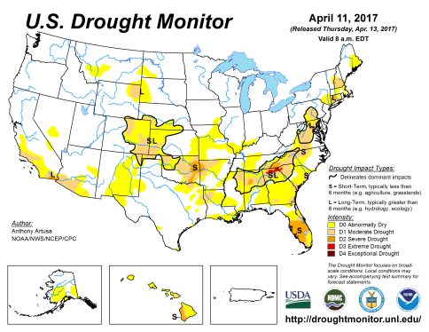
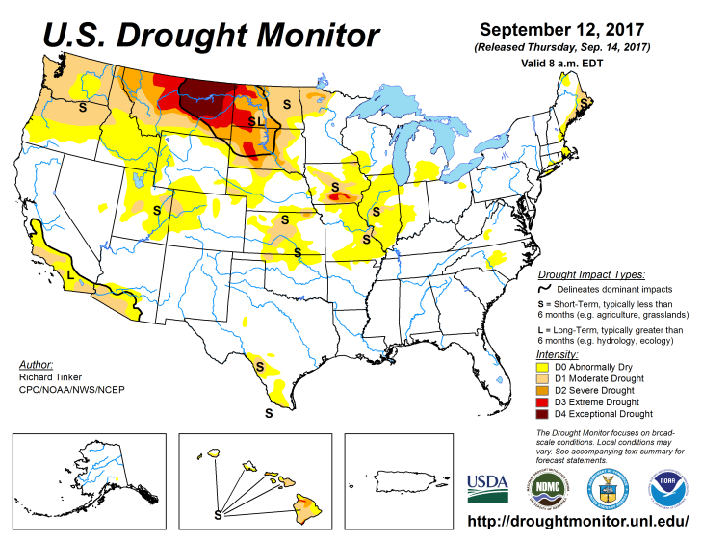
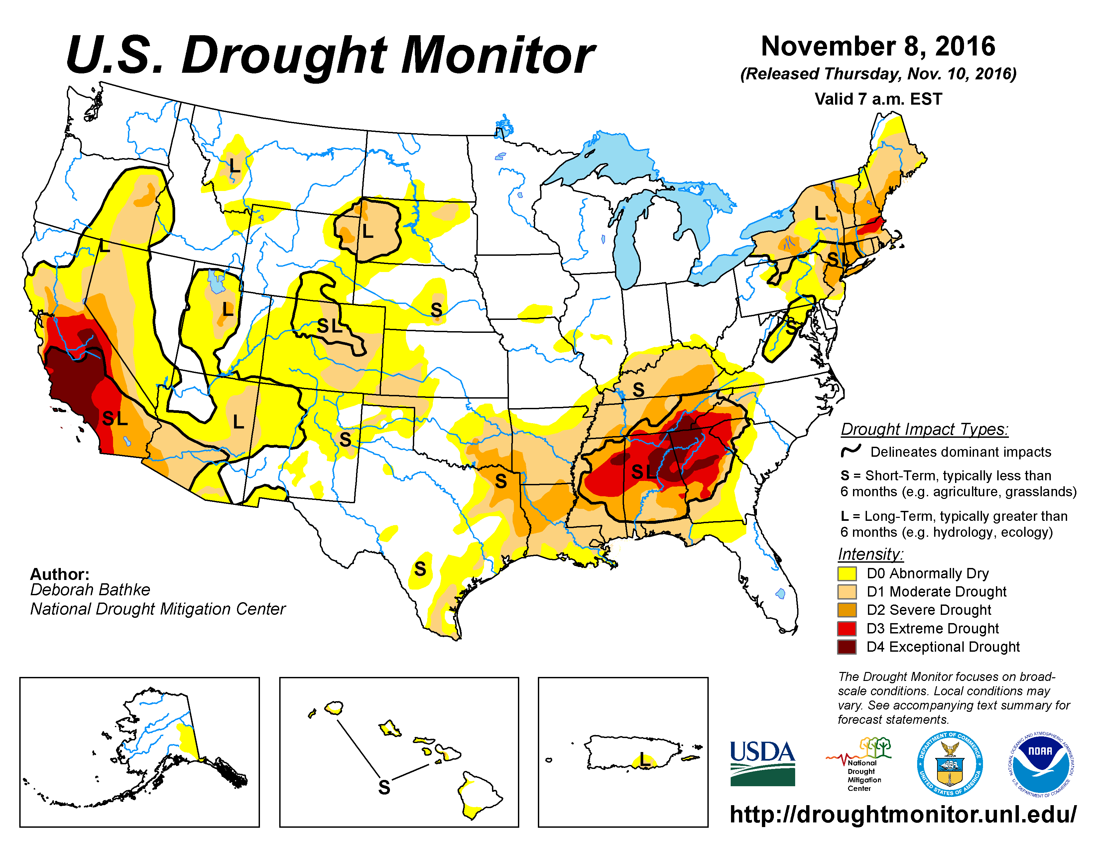
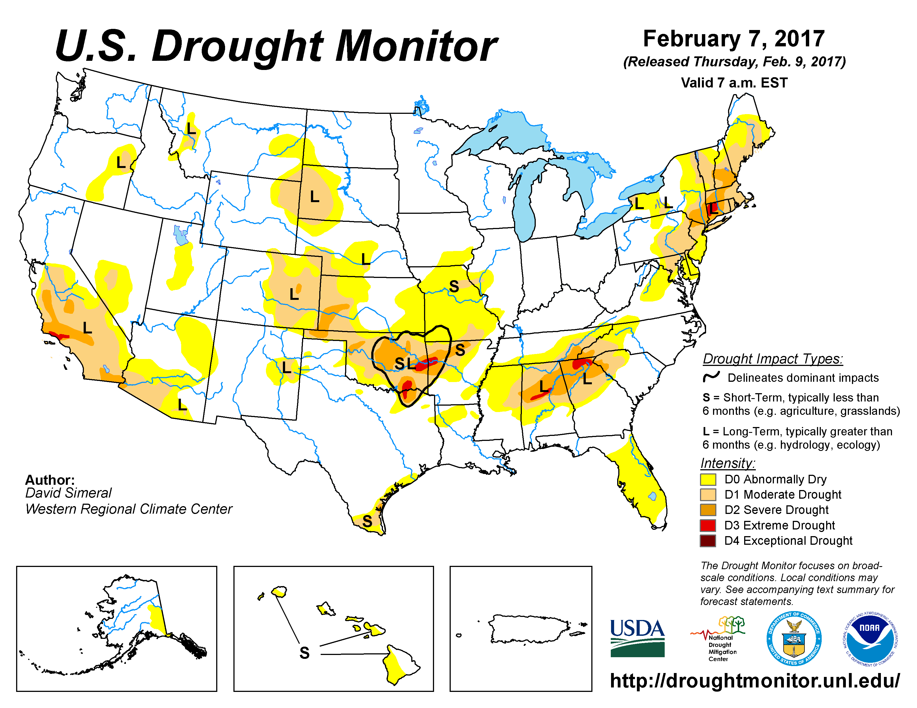
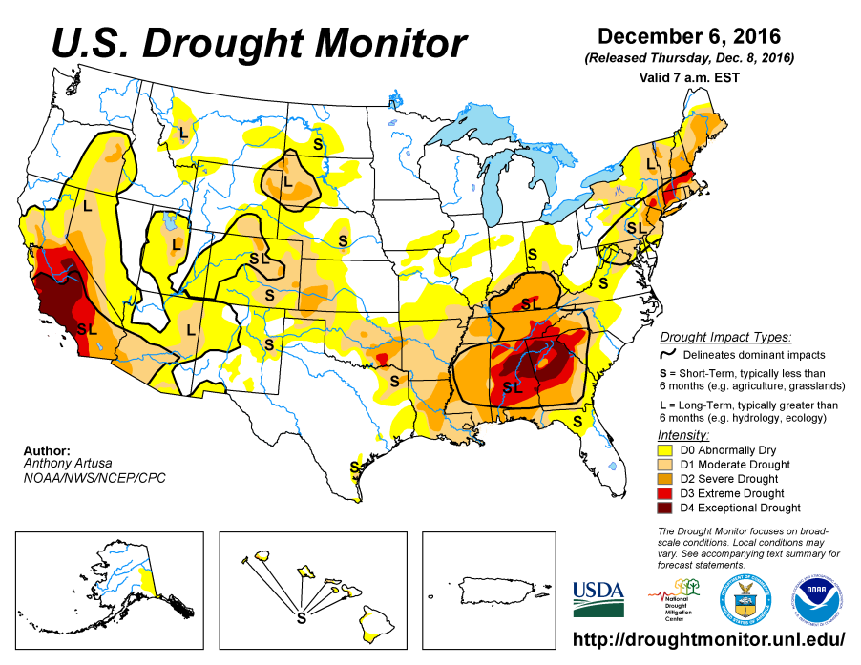
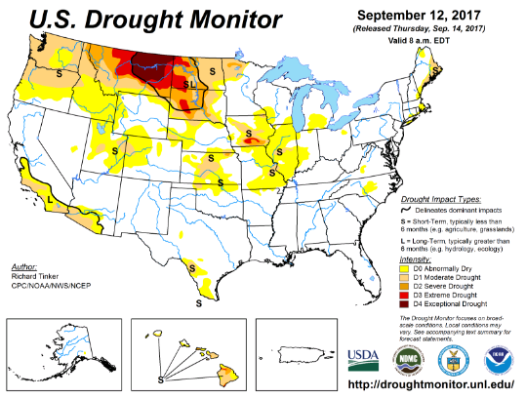
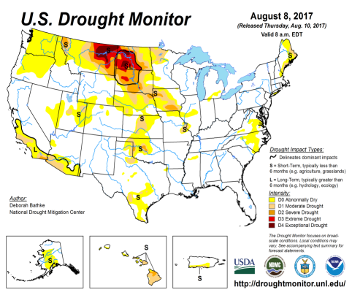
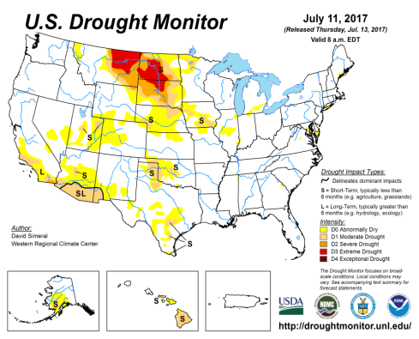
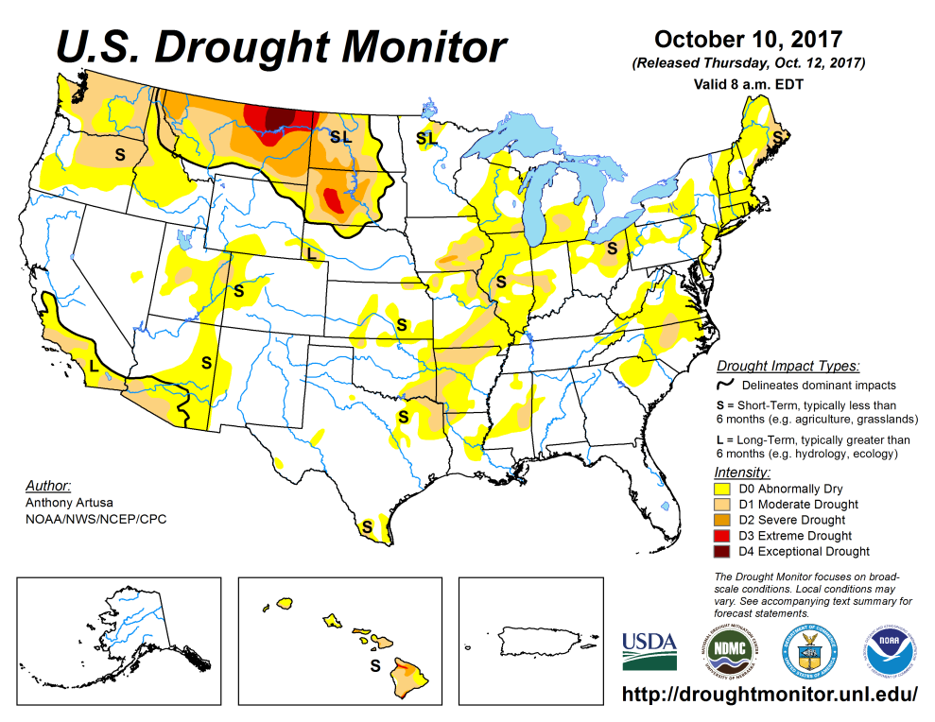
Drought Monitor
Aug
Previous
July
The major Drought region in the western/central Dakotas, Montana and moderate drought in Washington and Oregon, seems to be slightly getting better (as compared to previous couple of months), but the drought per say, still persists in these regions.
Another major news story- Northern CA fires (no drought! Will get to it in a few slides!!)
Latest

Slide 3
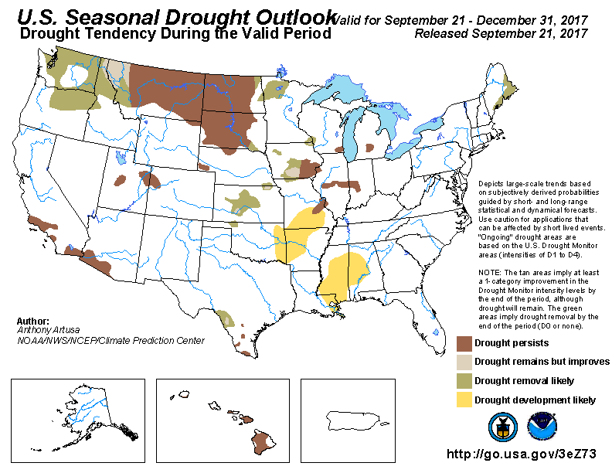
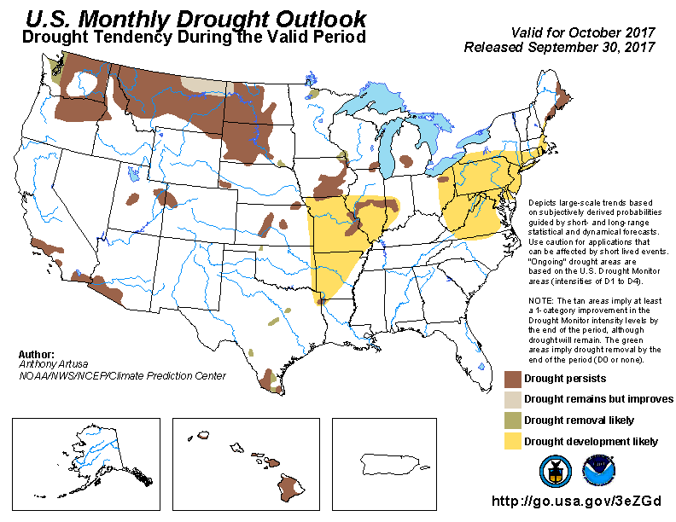
(Prev) Monthly/Seasonal outlook
Seasonal Outlook (OND’17)
issued 9/21/17
Monthly outlook
(October 17)
issued 9/30/17
The major Northern Plains drought, the major drought story in the US, the past few months, is slightly getting better, only a tad better, in terms of severity areas, and overall drought coverage areas, as was forecast.
The monthly outlook called for 2 regions of dryness, possible drought development in the mid-Atlantic states centered around MD and in the midwest near MO and AR.

Slide 4
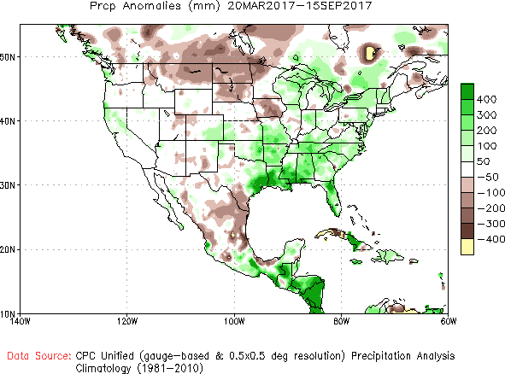
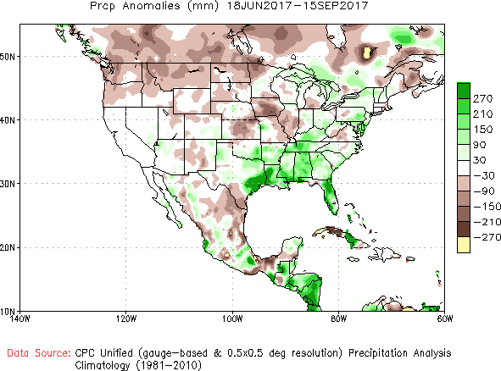
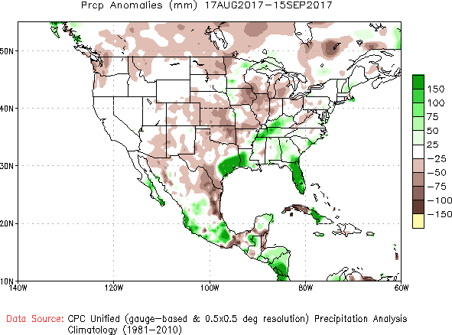
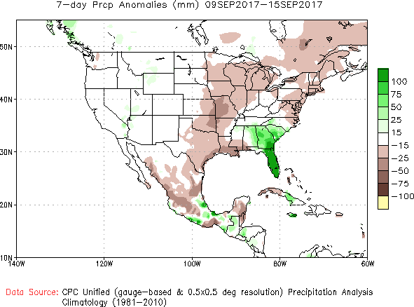
Recent Precipitation Anomalies 6 months, 3 months, 1 month and 7days -These maps pretty much tell the story behind the current/recent drought
-Last Month
6 mon
3 mon
Some rains lately, but not good enough!
Irma
Harvey
1 mon
7 dy

Slide 5
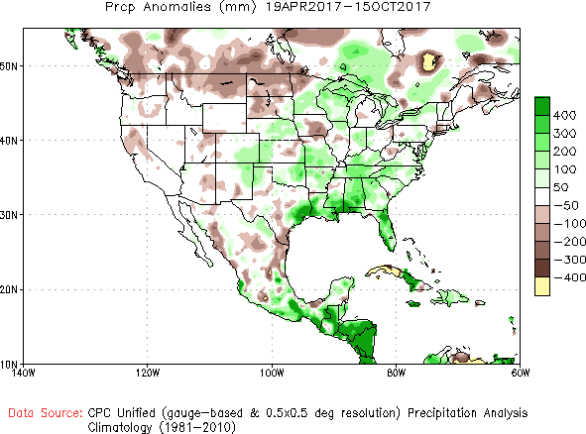
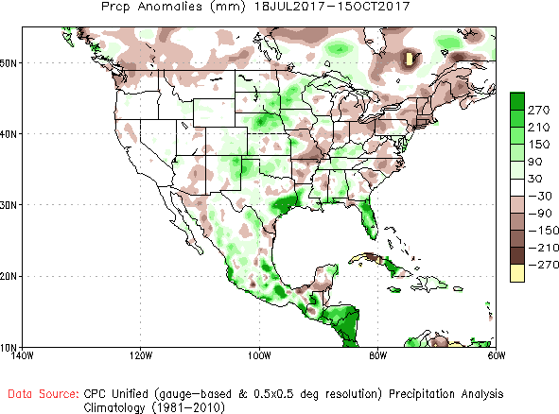
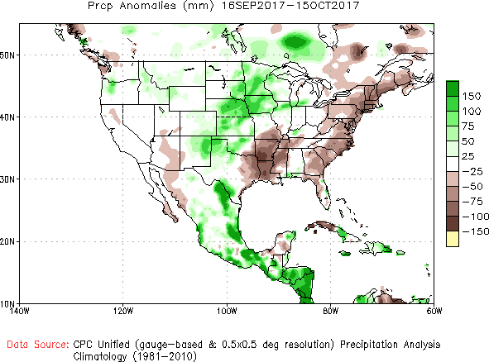
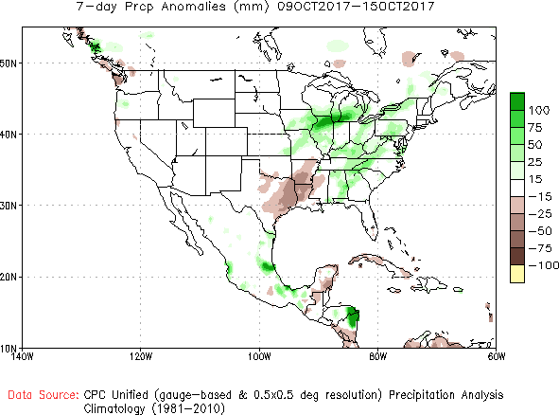
Recent Precipitation Anomalies 6 months, 3 months, 1 month and 7days -These maps pretty much tell the story behind the current/recent drought
----- NOW
6 mon
3 mon
1 mon
7 dy

Slide 6
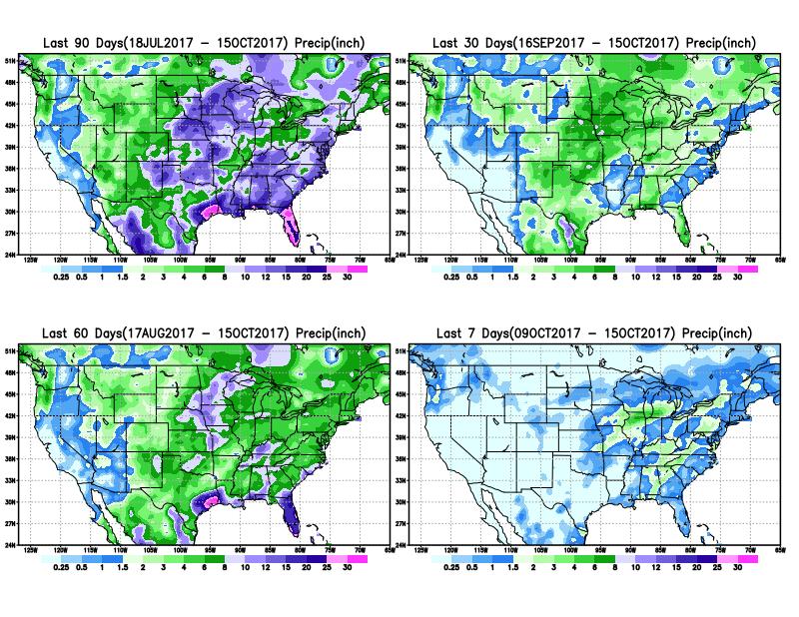

Slide 7
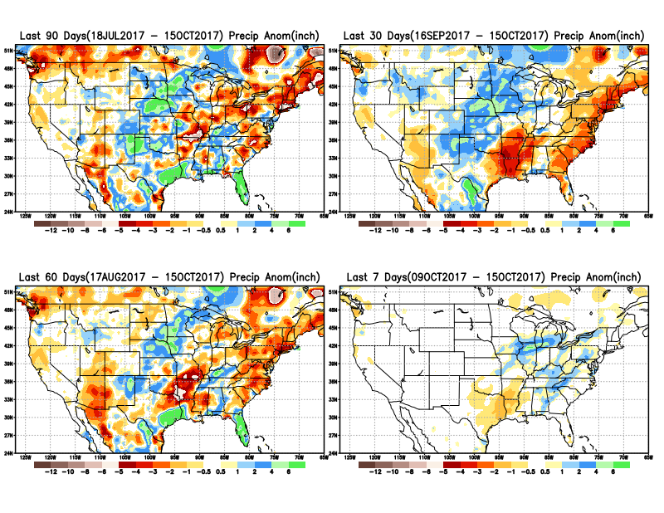

Slide 8
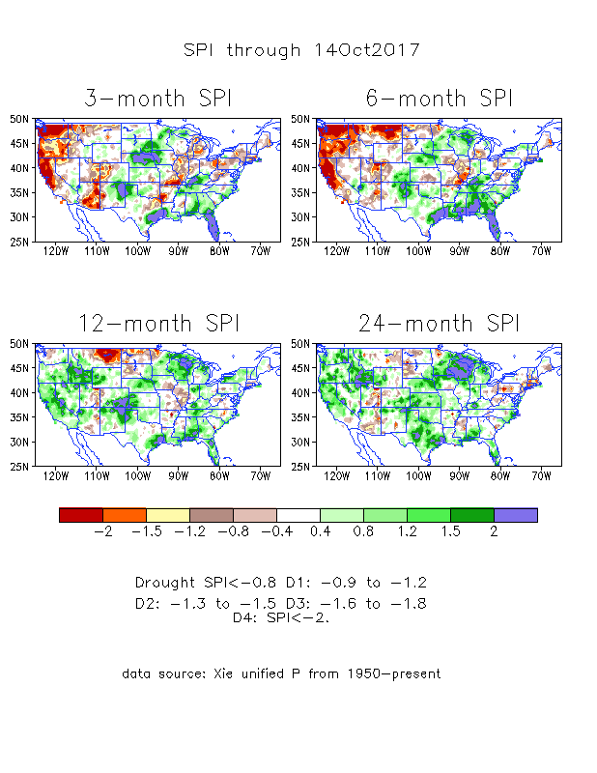
The Standardized Precipitation Index SPI (based on Observed P)
----- NOW
The three month SPI, with its large negative values in the Northern Plains drought area and the Pacific NW, looks worse than it actually is! Is it?

Slide 9
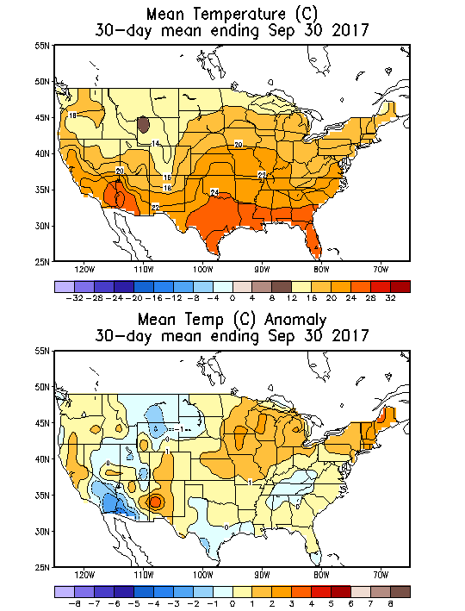
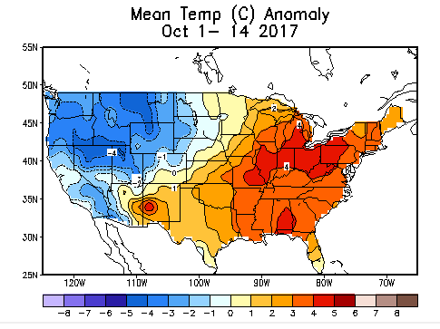
Recent US Temperatures
September mean T is kind of bit warm overall, but generally mixed overall, not extreme in any way!
So far, in October, (just a complete reversal of the first 15 days in September) the coolness in the West and warmth in the east..

Slide 10
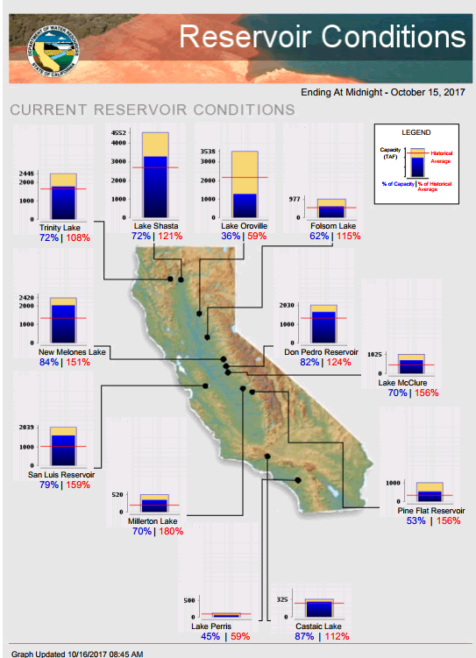
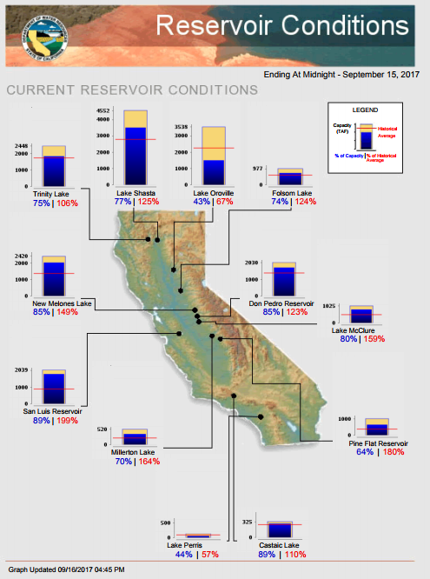
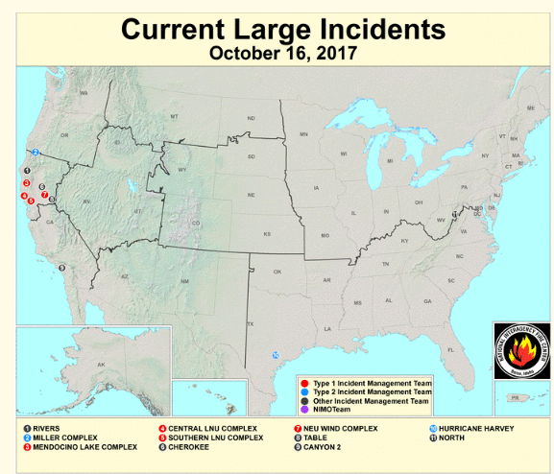
In CA, with the rainy season still far away, while most of the reservoirs are at satisfactory levels, except Oroville which
was purposely lowered to fix spillway &
Lake Perris.
Media reports about severe fire incidences in the west, particularly in WA, OR, western MT, end even in northern CA.
https://fsapps.nwcg.gov/afm/index.php
FIRE
http://cdec.water.ca.gov/cgi-progs/products/rescond.pdf

Slide 11
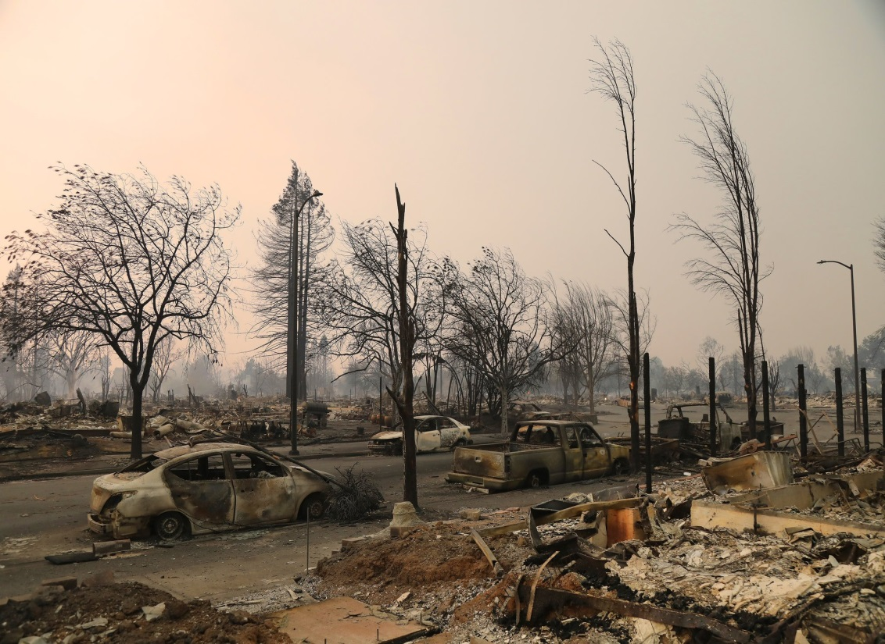
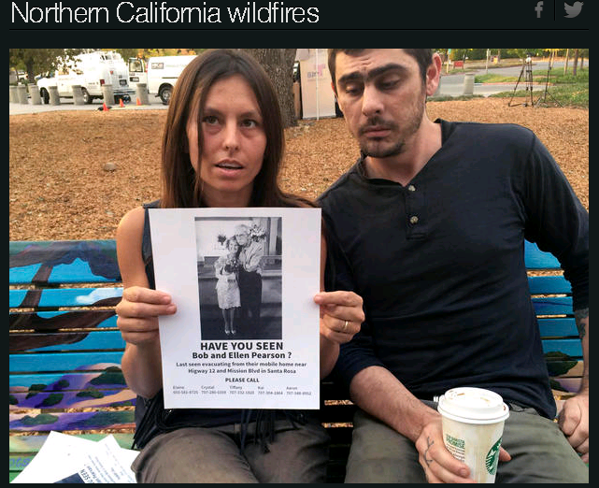
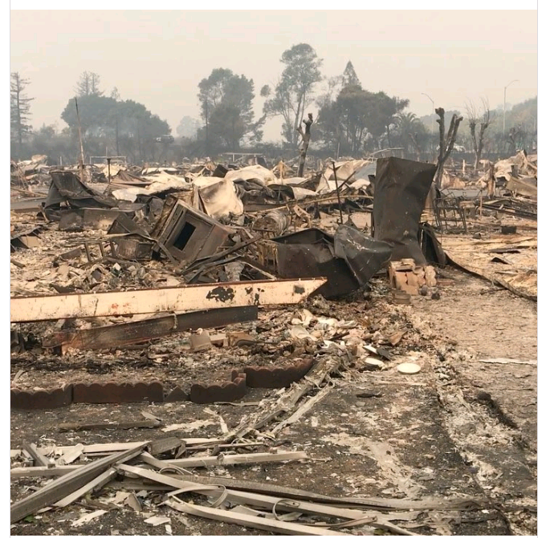
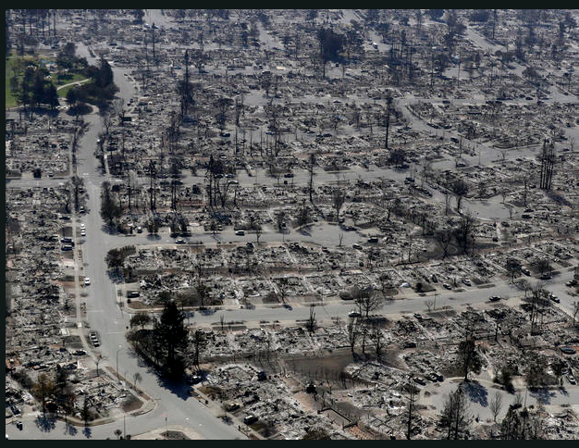
October 2017
Death Toll at 40 so far
Over 6500 homes burnt

Slide 12
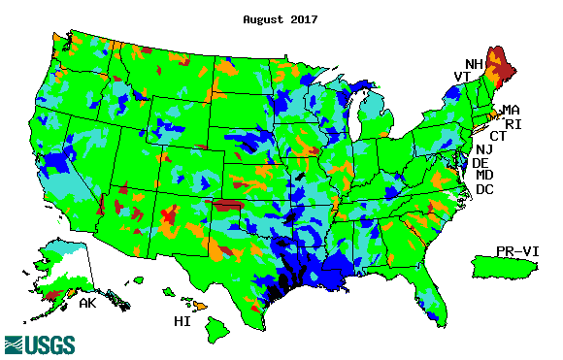
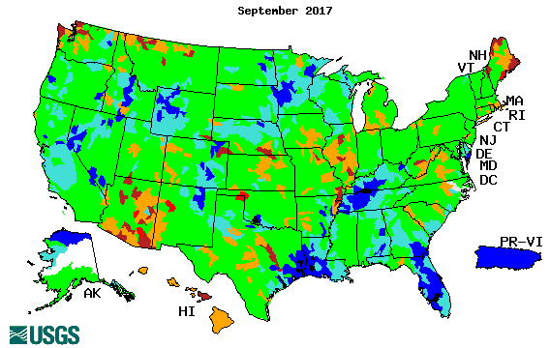
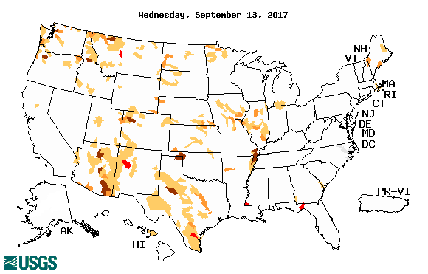
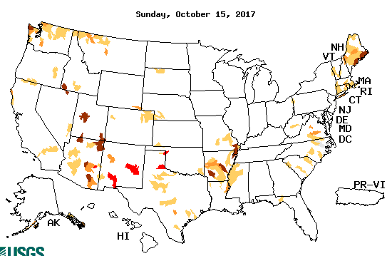
Streamflow (USGS)
Compared to July (top left panel), the stream flows actually look better in August & September so far in the drought regions of northern Plains.
Harvey’ impact can be seen along river flows in TX, LA, and southern Gulf states.
Map shows only below normal 7-day average streamflow compared to historical streamflow for the day of year (United States)
One month ago (left) & Now (below)

Slide 13
EL NIÑO/SOUTHERN OSCILLATION (ENSO)
DIAGNOSTIC DISCUSSION
issued by CLIMATE PREDICTION CENTER/NCEP/NWS and the International Research Institute for Climate and Society
12 October 2017
ENSO Alert System Status: (Surprise from last month’s status!) La Niña Watch !!
Synopsis: La Niña conditions are favored (~55-65%) during the Northern Hemisphere fall and winter 2017-18.

Slide 14
http://www.cpc.ncep.noaa.gov/products/analysis_monitoring/ensostuff/ensoyears.shtml

Slide 15
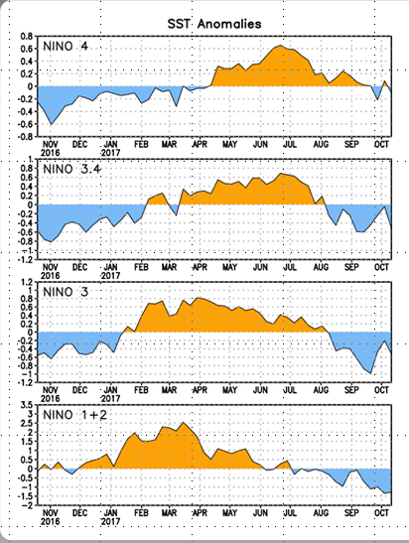
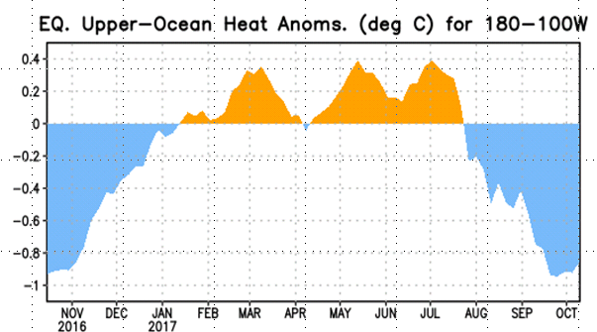
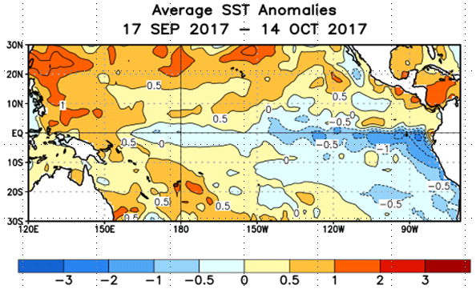
Latest values of SST indices in the various Nino Regions.
Since mid-July, sub surface anomalies have decreased and are negative
SSTs have fallen across the central and east Pacific. As well as the –ve upper ocean heat content, and –ve subsurface anomalies. Will it continue or will it flip ???

Slide 16
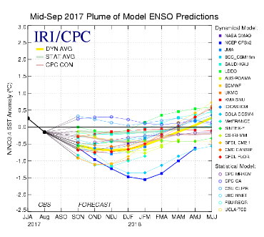
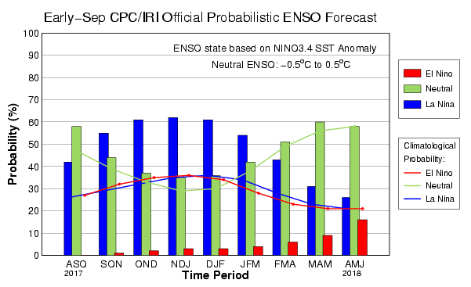
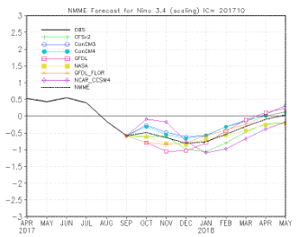
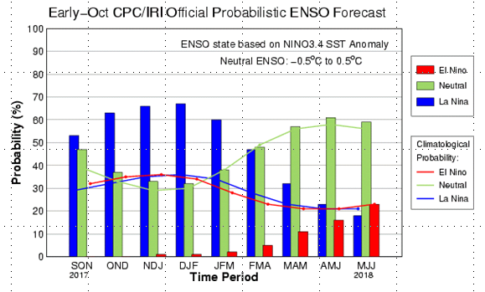
ENSO Forecasts
Early- Sep CPC/IRI forecast
NMME Models’ – Nino 3.4 forecasts
Early- Oct CPC/IRI forecast
Probs slightly higher

Slide 17
Dec-Feb
Expected
Impacts
If a La Nina
develops…
& its normal

Slide 18
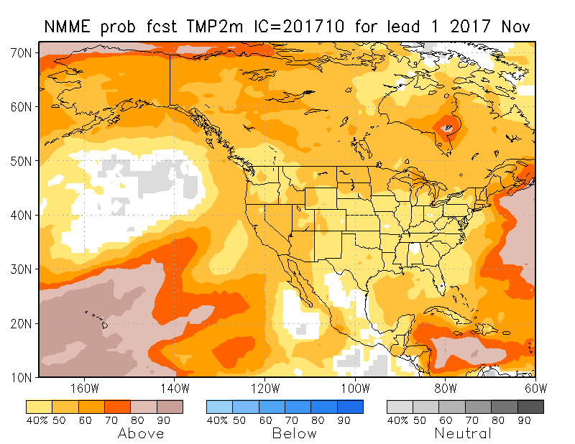
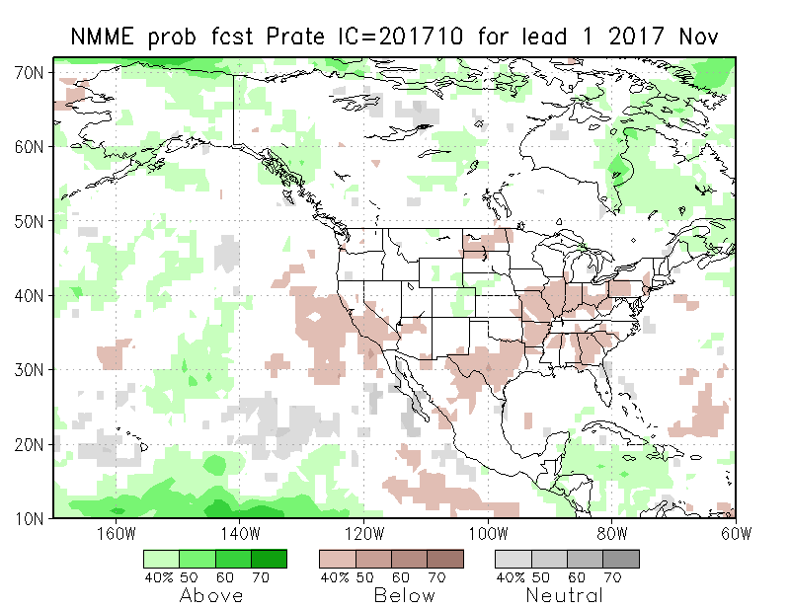
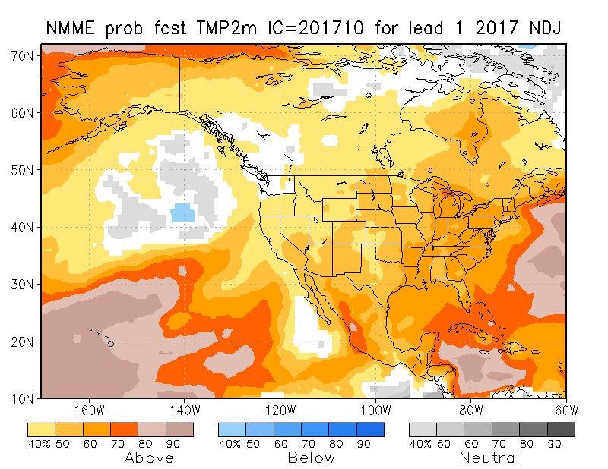
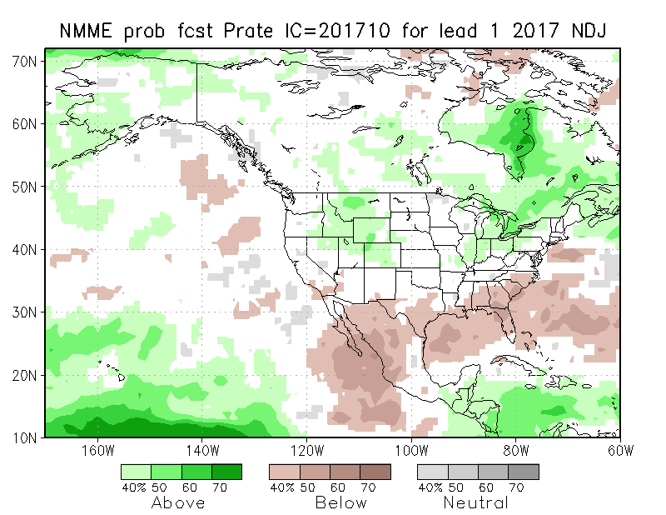
NMME T & P EnsMean forecasts
Nov
NDJ
The monthly (Nov) and seasonal (NDJ) T are for more warmth across the country. Very little tropical boundary forcing. Some precipitation hope in the west, but not in core drought region?

Slide 19
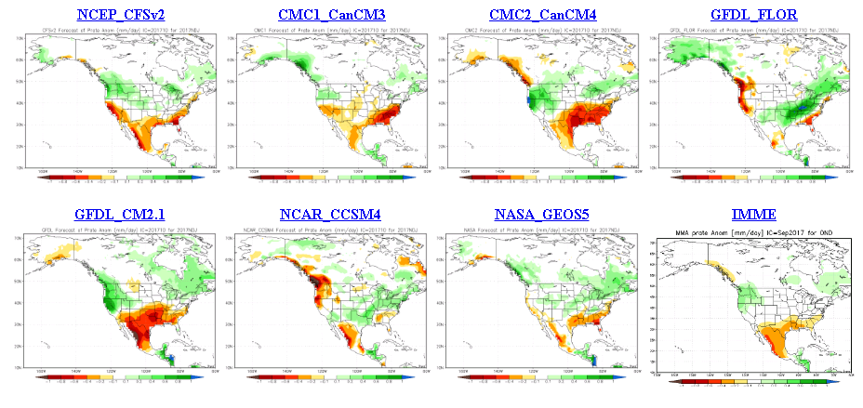
The agreement/uncertainty among the diff. models’ forecasts for Nov-Dec-Jan Precipitation!!!

Slide 20
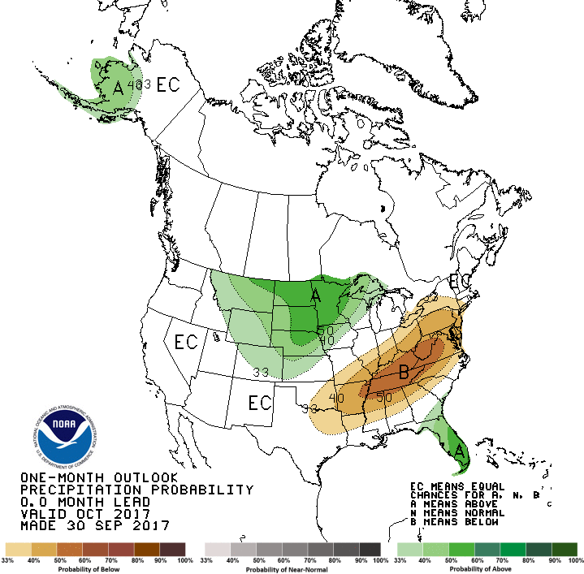
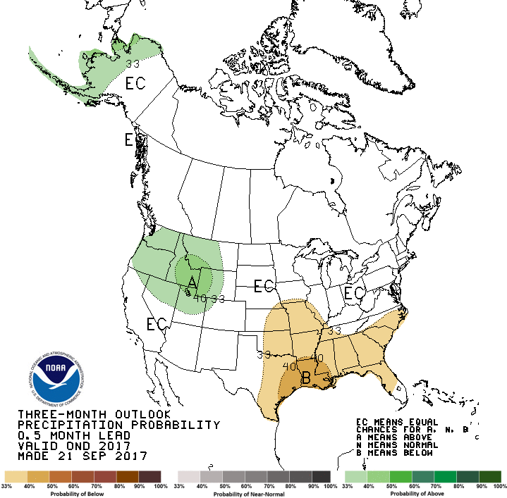
CPC’s official Monthly (Oct) /Seasonal (OND)
Precipitation outlook
Released Sep 30th
Released Sep 21st

Slide 21
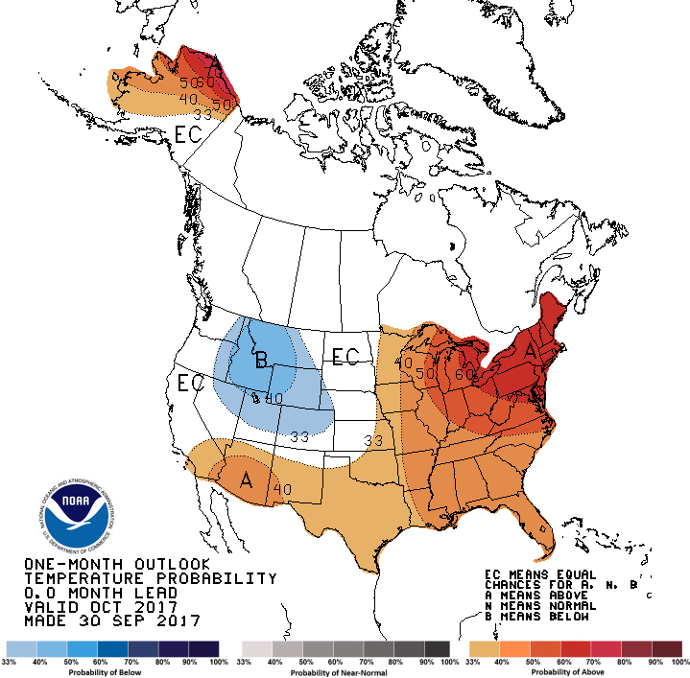
CPC’s official Monthly (Oct) /Seasonal (OND)
Temperature outlook
Made
Sep 30th
Relatively a good T fcst for October so far. ☺
Made 21st Sep

Slide 22
Next 7 days QPF Forecast
In the next 7 days, the Pacific NW, Montana, the Dakotas seems to get some relief. Some improvement in drought may be expected. Also the GFS is indicating a major (temporary) change in circulation in the northwest in the second week, with early cold and more precip in the Pacific NW, and in drought areas
GFS Model Guidance for next 16 days.
According to the GFS,.. Reinforcement and more precip as noted in the QPF above in the northern drought area(MT/ND/SD) and in the southwest
Only CA, NV, and NV seems to be dry in these model forecasts..

Slide 23
Rainy Season

Slide 24
SPI3
SPI6
SPI3 & SPI6
Forecasts from 6NMME Models
(uses obs. P up to past month(Aug), and forecast months’ P from NMME models)
NMME Ensemble Mean (6 models)
SPI Forecasts for MJJ
Left Panels: SPI3
Right Panels: SPI6
In general, SPI3 can be somewhat more trusted than SPI6, to the extent the NMME models have any skill at all in the 1-3 months.
Having said that, the northern (Plains) MT/ND/SD drought, will likely improve in the short term (with the expected rain in the next 1-2 weeks) but getting better after that, according to these models.

Slide 25
NLDAS Drought Forecast Analysis
The system developed by Princeton University and University of Washington was transitioned to NCEP/EMC as the experimental forecast system.
Forecast using 201710 Initial Condition- Soil Moisture Percentile forecast
General improvement in SM conditions over the next couple of months is forecast by NCEP’s NLDAS models.

Slide 26
Hydrological Monitoring and Seasonal Forecasting @ MSU (Michigan State University ) NLDAS model
http://drought.geo.msu.edu/research/forecast/smi.monthly.php
Monthly Soil Moisture Percentile Prediction issued on 201710
N/S Dakota & Vicinity:
Drought likely to get better in the next couple of months, season, but uncertainty exists.
The inter quartile range suggest greater uncertainty about the forecast in these shaded regions.

Slide 27
NASA GEOS5 Forecasts - Oct/Nov/Dec 2017
This model predicts more rain in the northwest and higher SM percentiles in the south.
Precip
Soil Moisture Percentile

Slide 29
Summary
Current ENSO status and forecast.
ENSO status – La Nina Watch. Equatorial sea surface temperatures (SSTs) are near-average across most of the Pacific Ocean. There is an increasing chance (~55-60%) of La Niña during the Northern Hemisphere fall and winter 2017-18.
Current Drought conditions:
The drought that has emerged quickly and recently since June across N/S Dakotas, eastern Montana continues. But recent rains in that region has contained further intensification of the drought in that region.
The dryness that has developed recently in the Pacific Northwest and western Montana is of some concern, thus possibly signaling the short term drought development in those regions.
The precip deficit that has developed previously (last month) in the Northeast, looks ok now, due to precip activity from hurricane remnants along east coast.
Prediction:
The possibly developing La Nina, may be too early to be of any impact in the next month or two.
But the upcoming model forecast rains, and the expected circulation change coming up in the Northwest is likely to lessen/mitigate the drought conditions there – at least not further intensify - in the short term.
Next Drought Briefing Tuesday, October 17.

