Slide 1
Drought Outlook Discussion September 2017
Climate Prediction Center/NCEP/NOAA
http://www.cpc.ncep.noaa.gov/products/Drought
Phone: 1-877-680-3341
Pwd: 858747

Slide 2
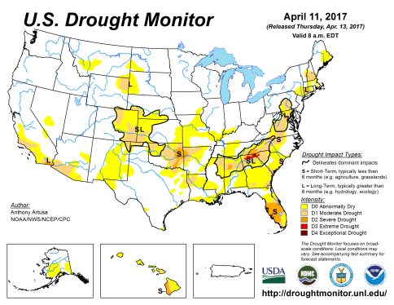
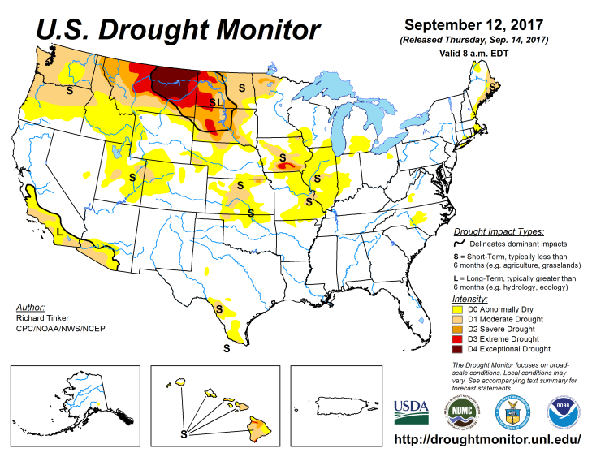
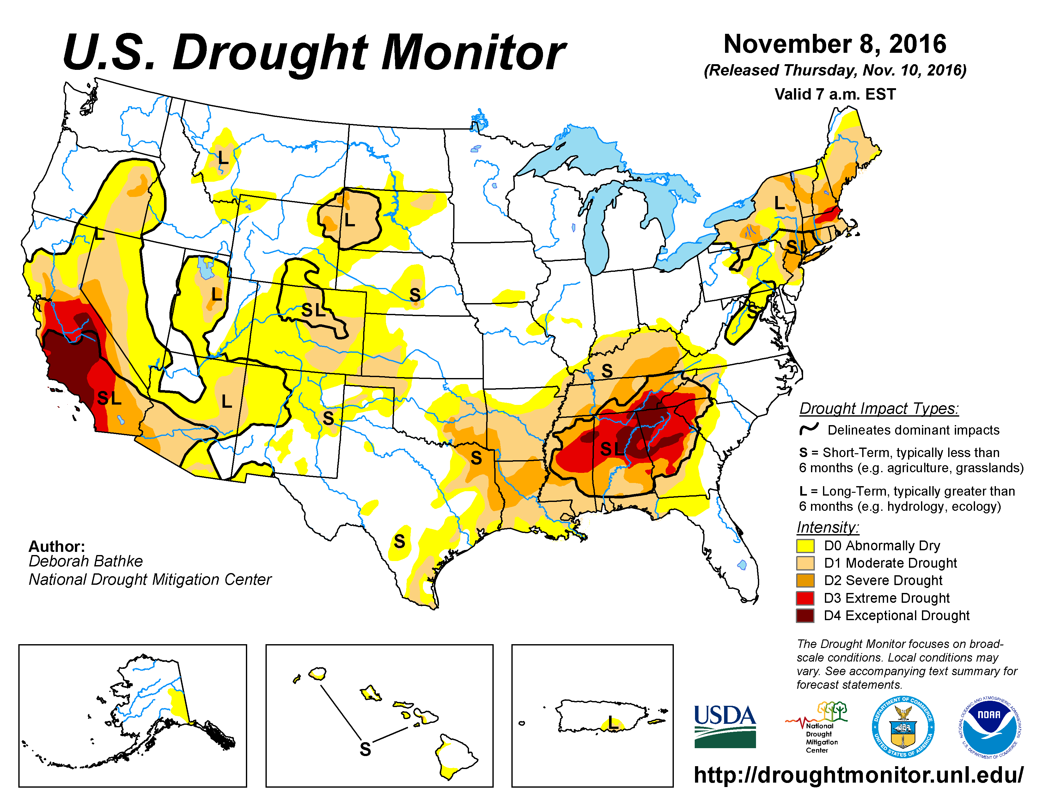
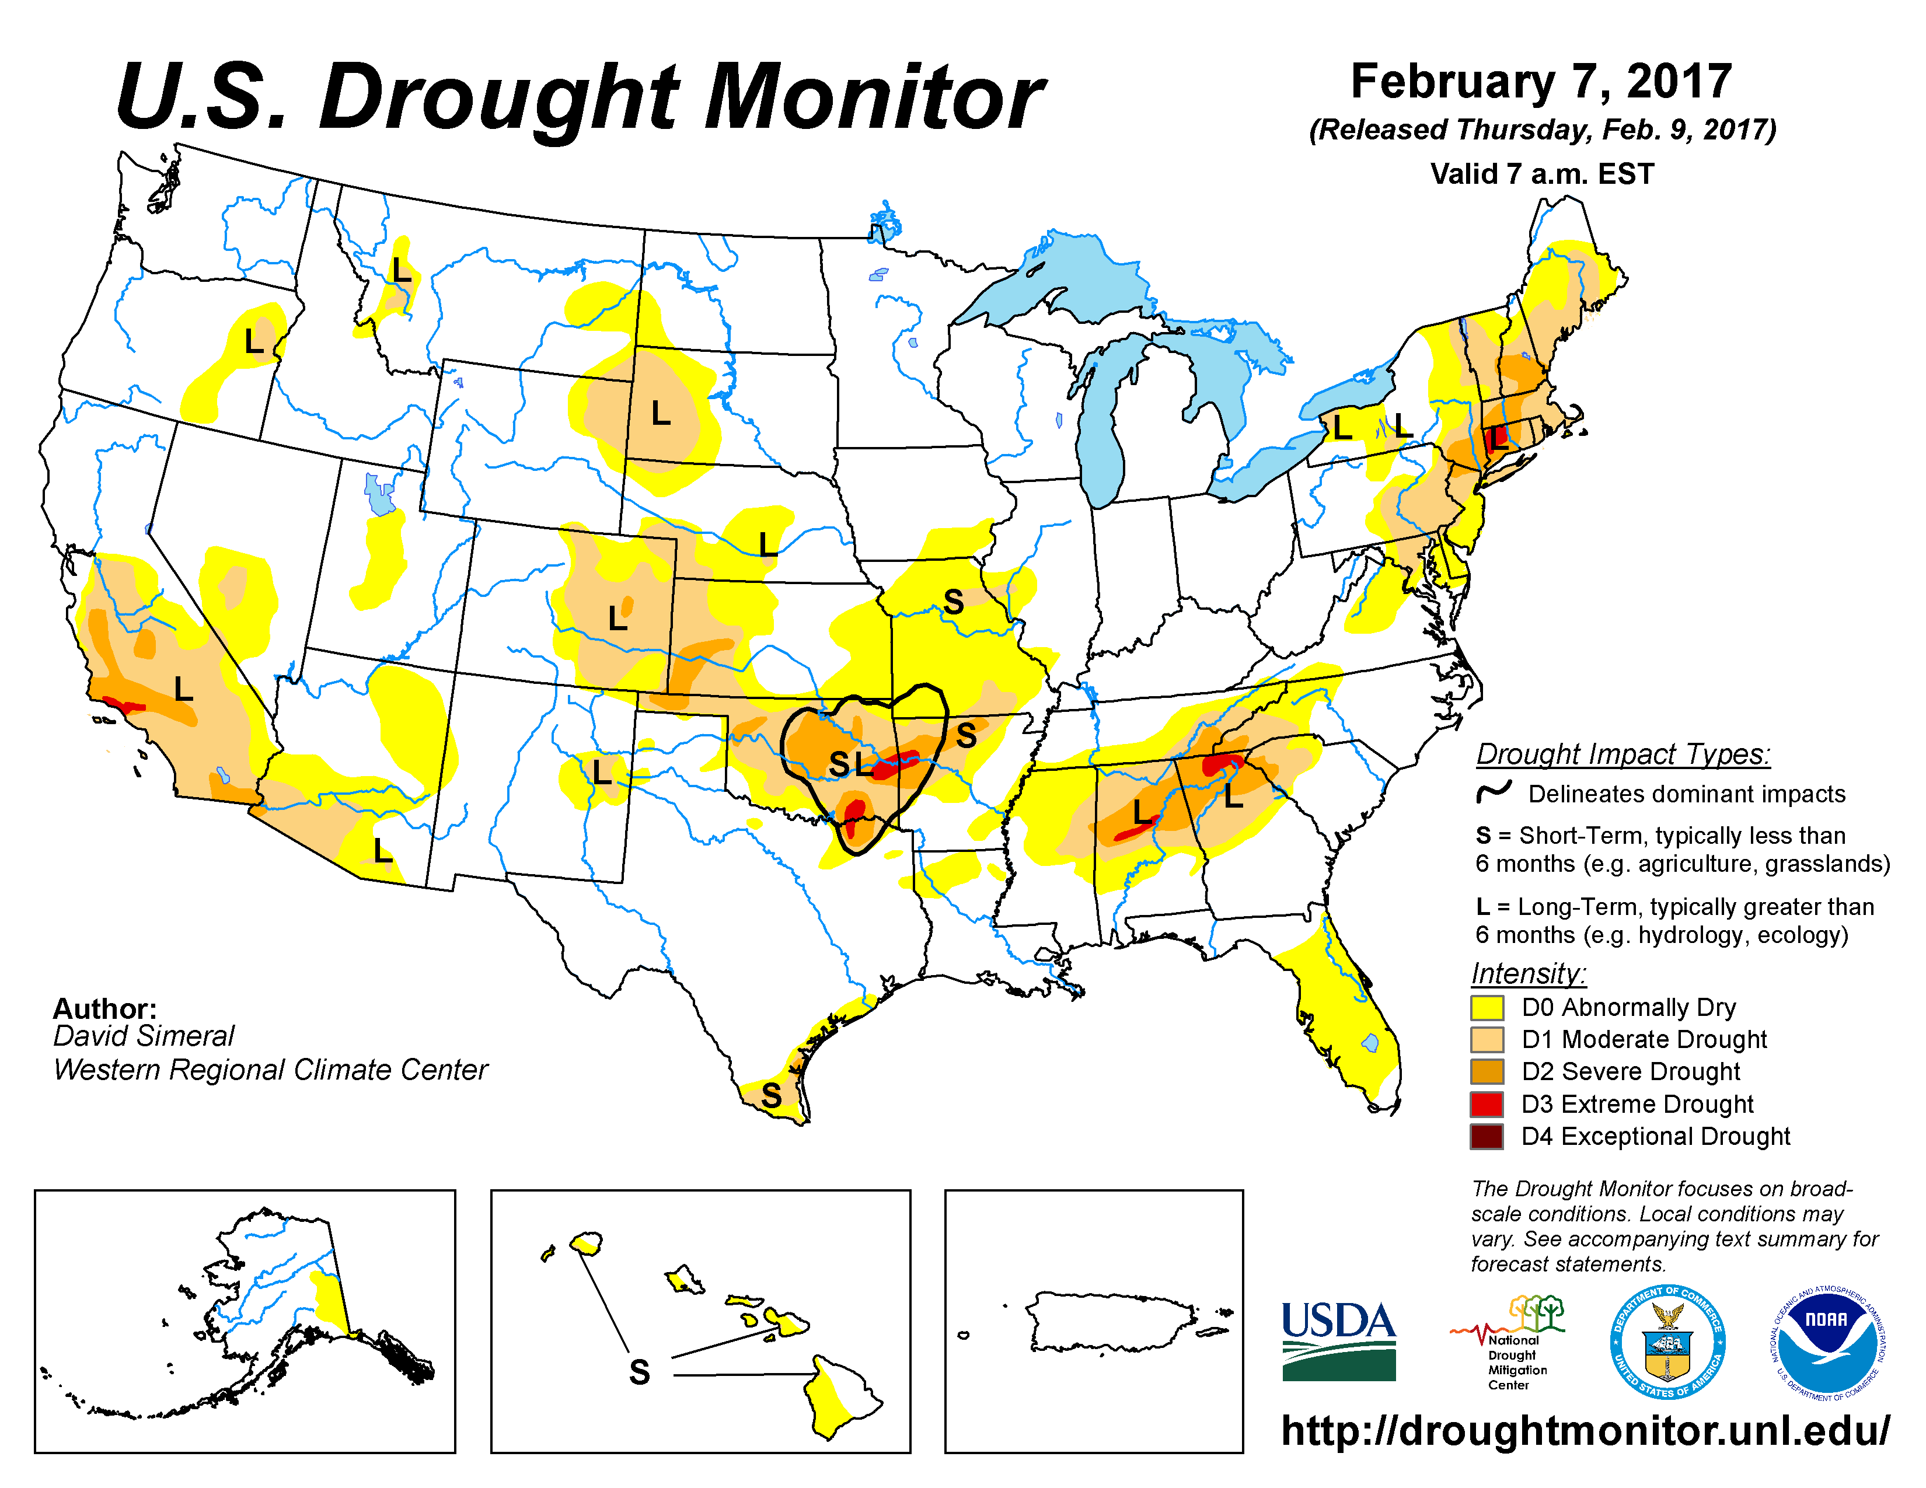
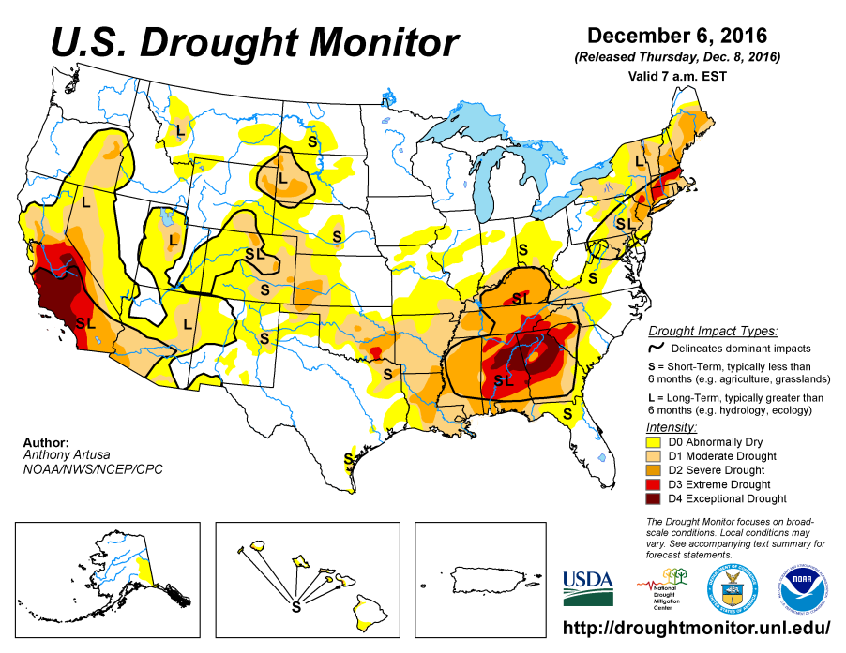
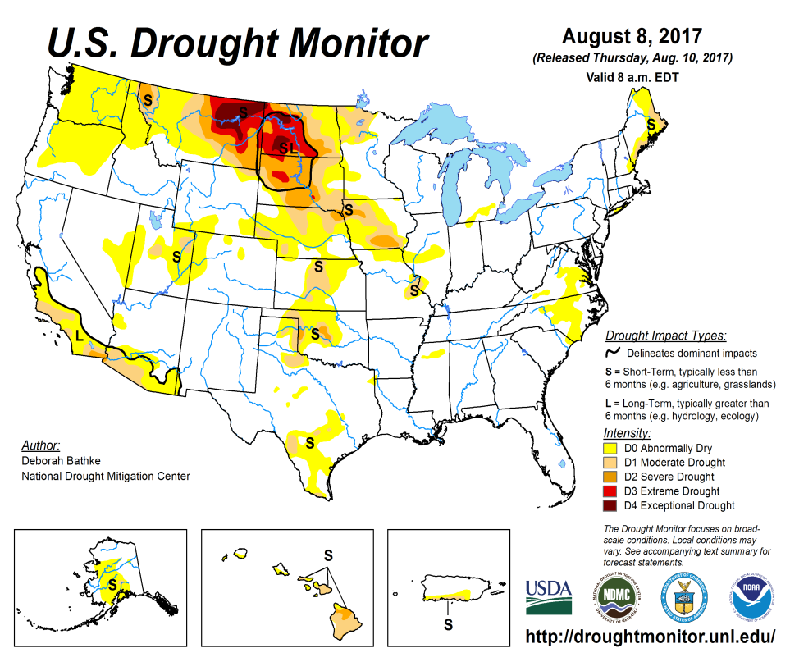
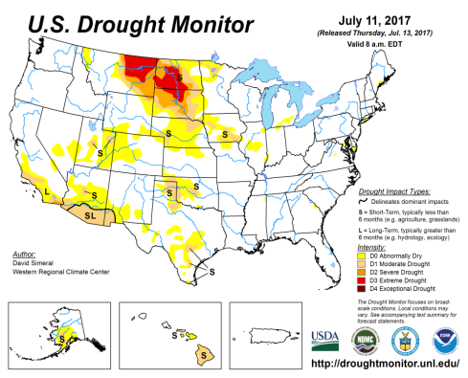
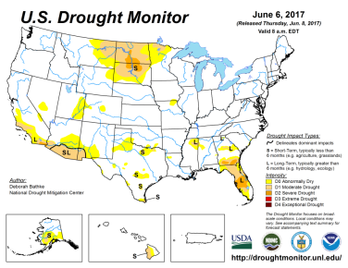
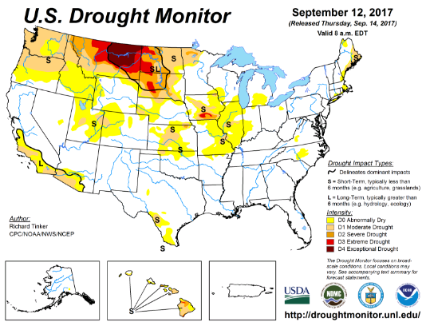
Drought Monitor
July
Previous
June
Currently a) a major Drought region in the Dakotas and eastern Montana and weakly extending into NE/IA possibly a developing one in the Pacific Northwest and small areas of minor isolated droughts in the middle of the country.
Latest
…and then the Northwest
gets a pattern change…..

Slide 3
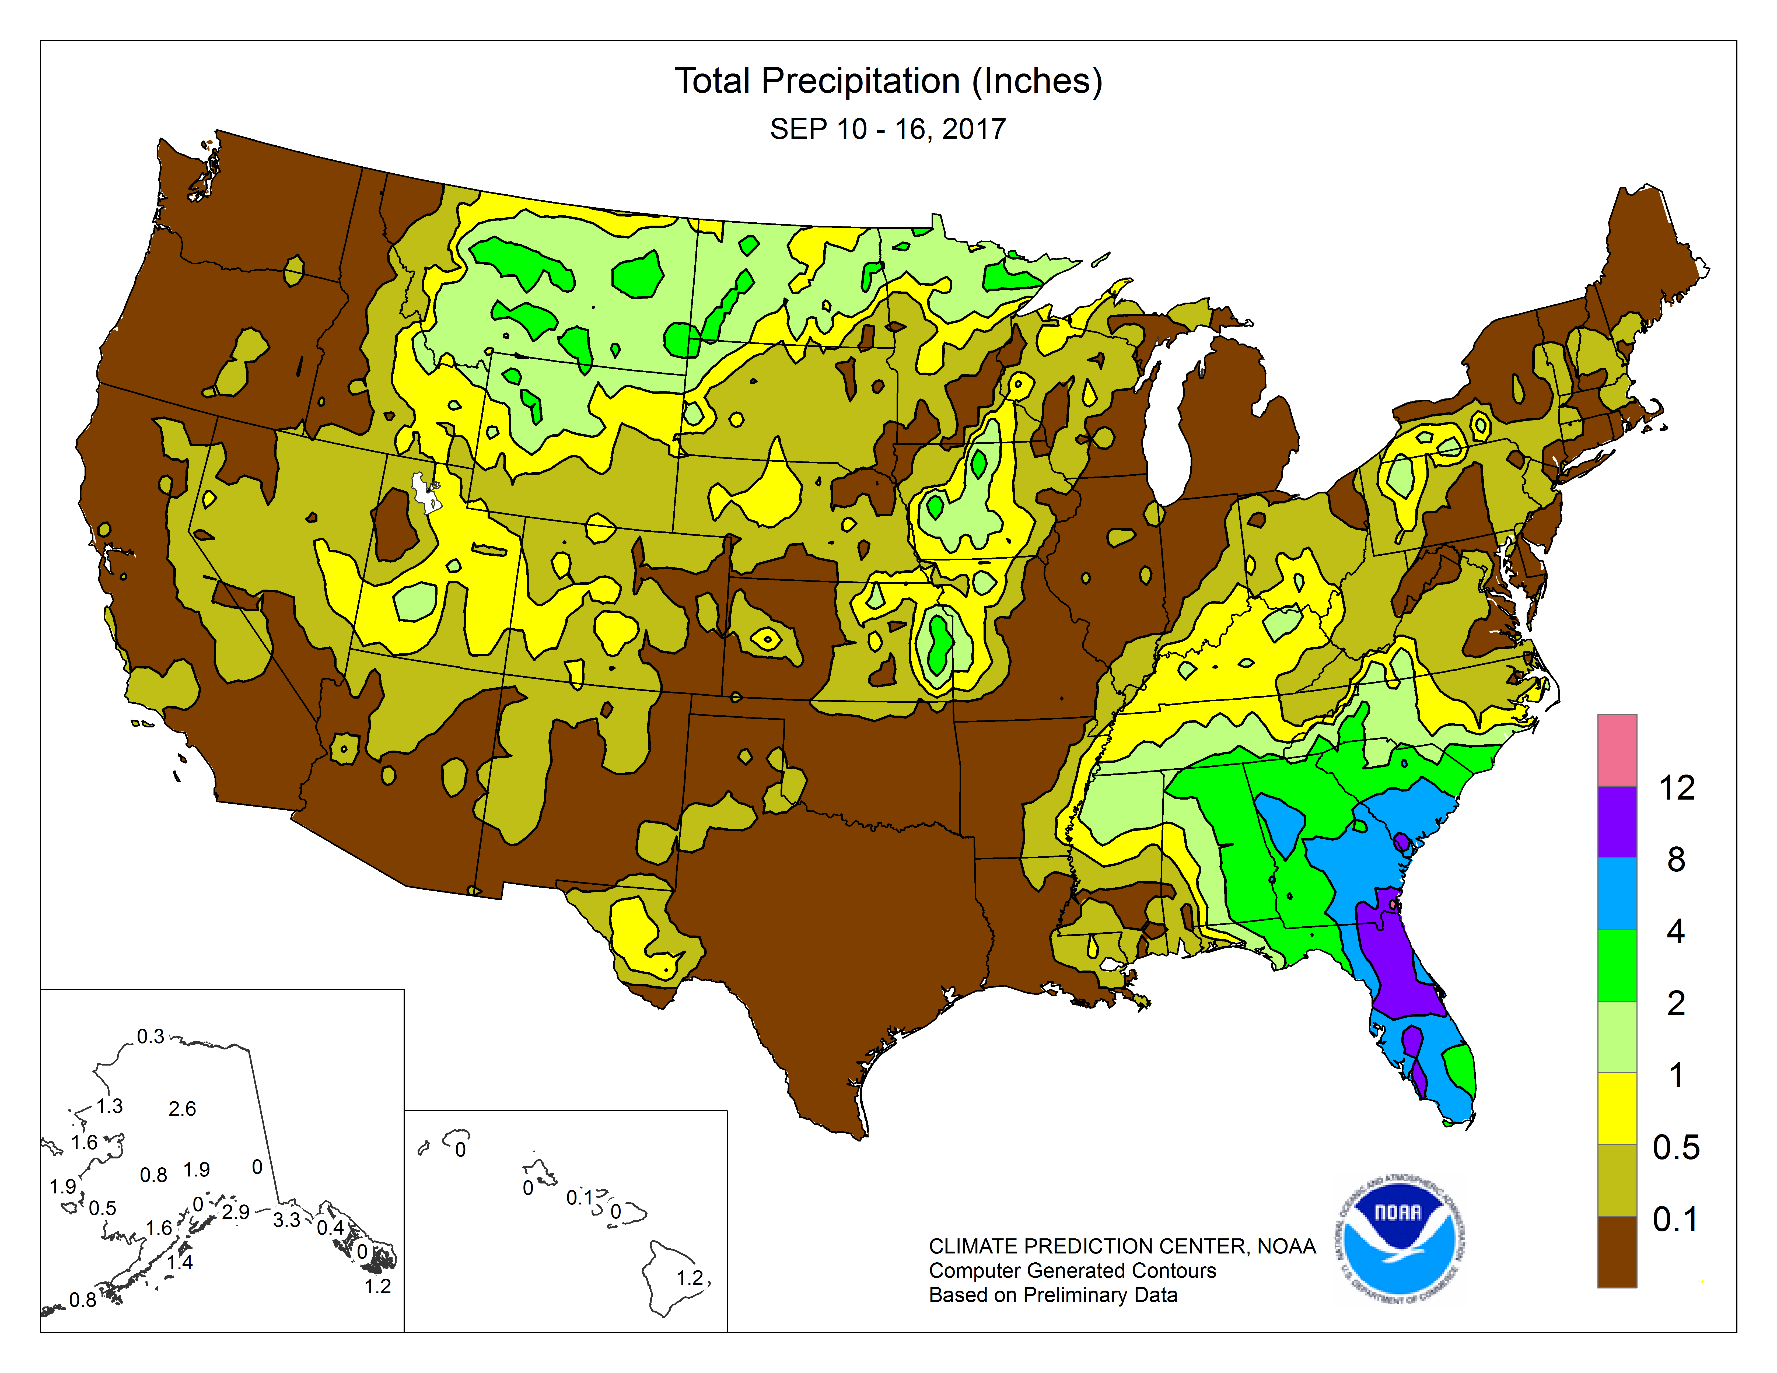
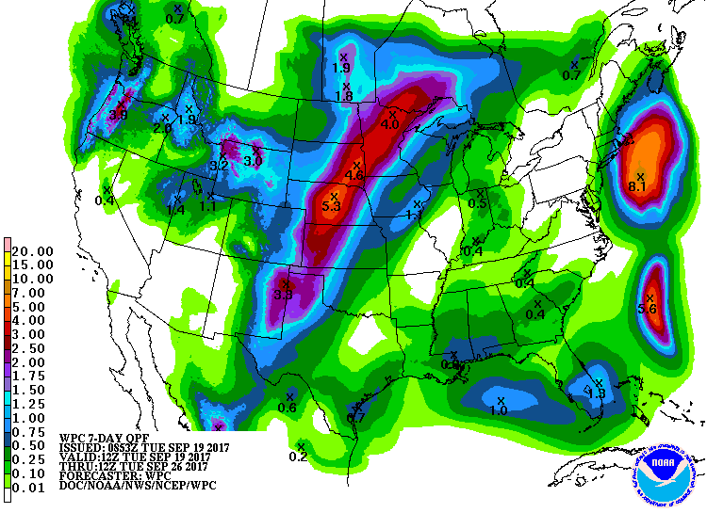
Current Precipitation

Slide 4
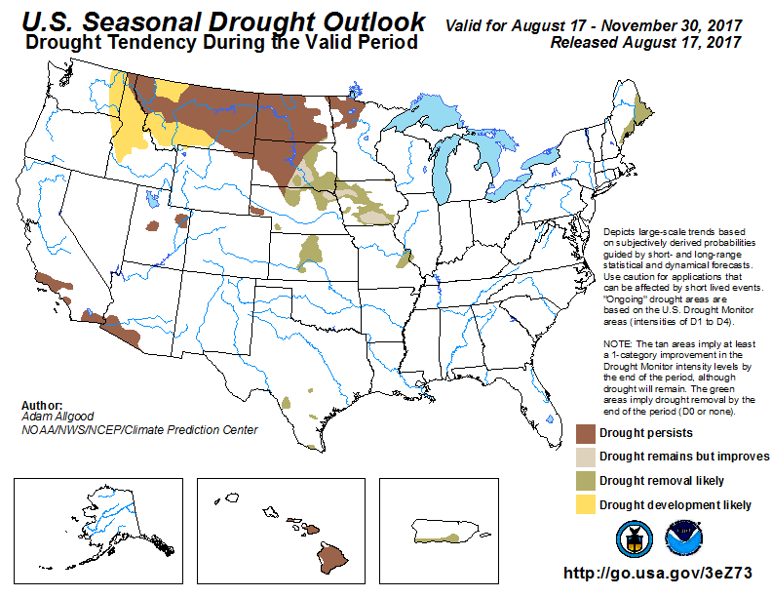
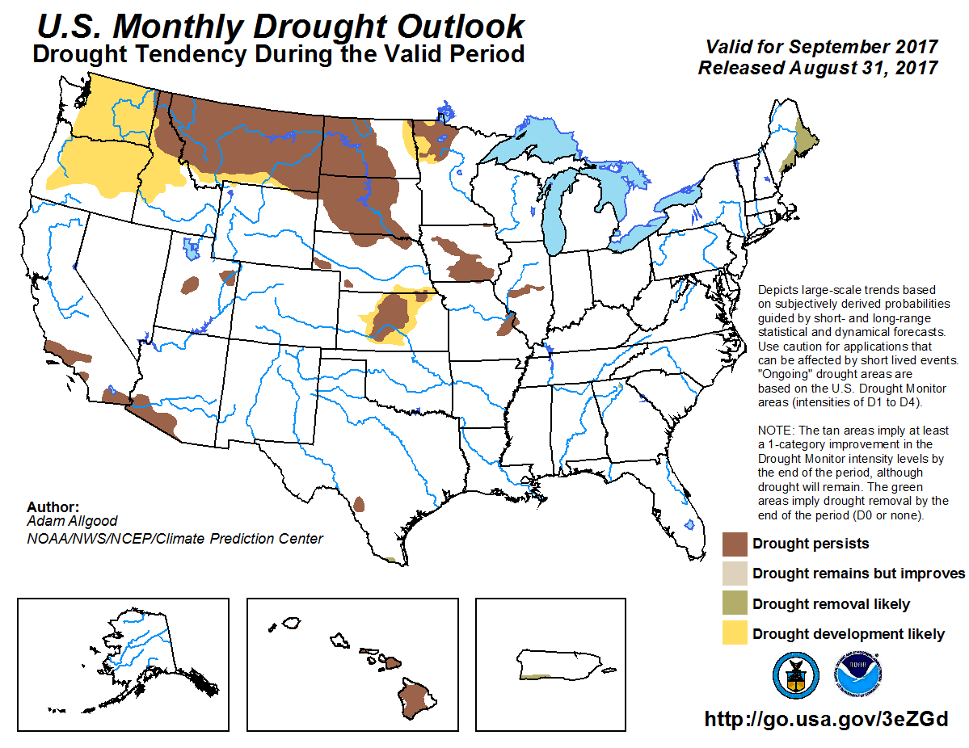
(Prev) Monthly/Seasonal outlook
Seasonal Outlook (SON’17)
issued 8/17/17
Monthly outlook
(Sep’17)
issued 8/31/17
The major Northern Plains drought, now slightly extended into the pacific NW continues to be major drought story! What is going to happen to this? What do the various models say?

Slide 5
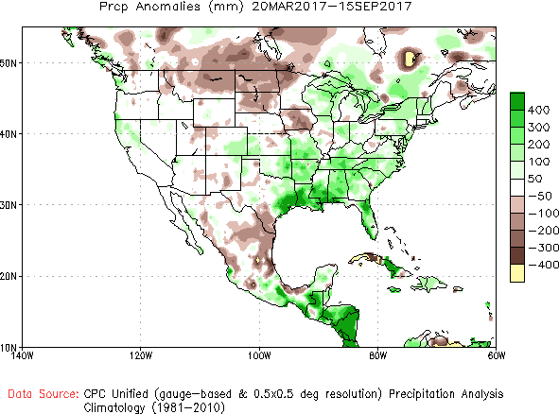
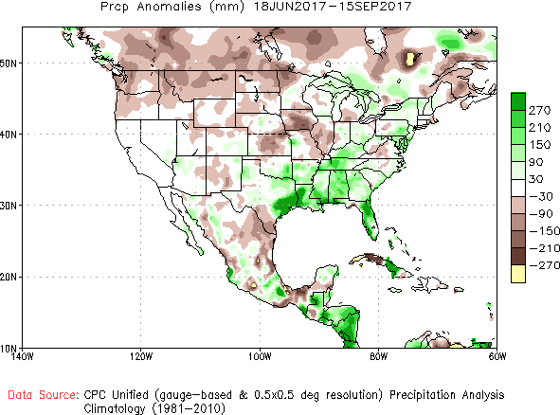
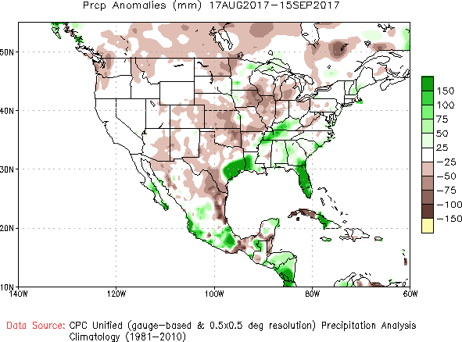
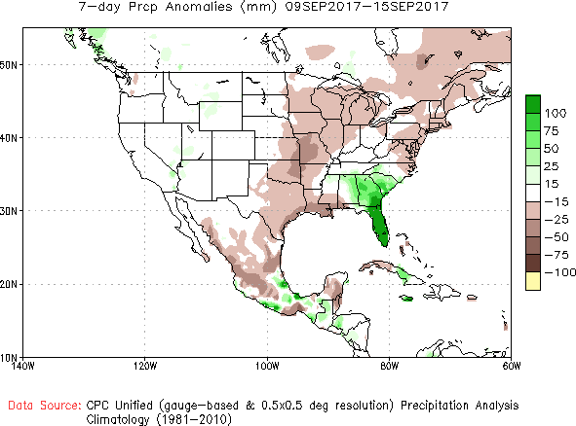
Recent Precipitation Anomalies 6 months, 3 months, 1 month and 7days -These maps pretty much tell the story behind the current/recent drought
----- NOW
6 mon
3 mon
Some rains lately, but not good enough!
Irma
Harvey
1 mon
7 dy

Slide 6
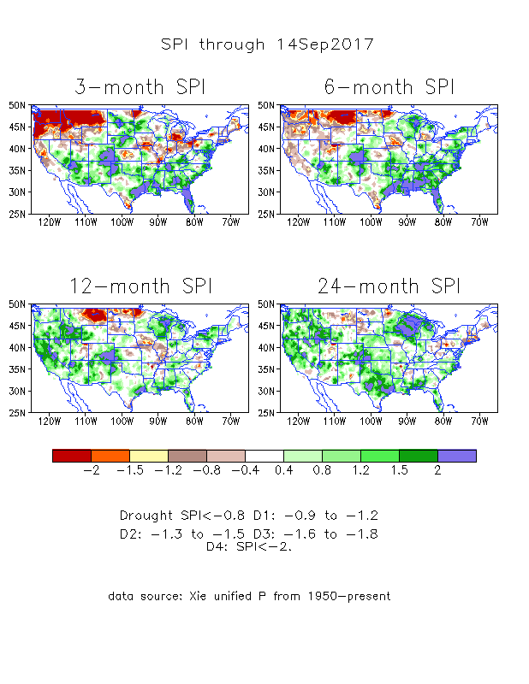
The Standardized Precipitation Index SPI (based on Observed P)
----- NOW
The three month SPI, with its large negative values in the Northern Plains drought area and the Pacific NW, looks worse than it actually is! Is it?

Slide 7
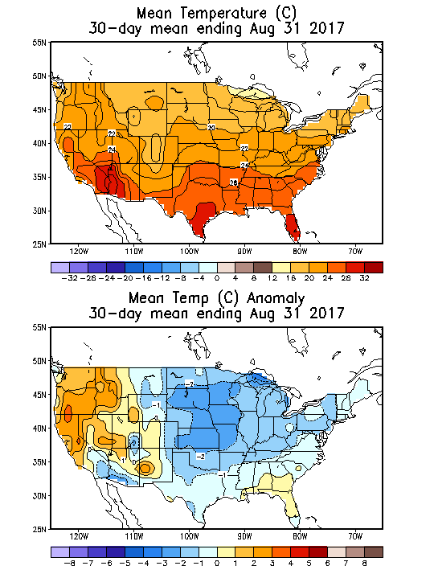
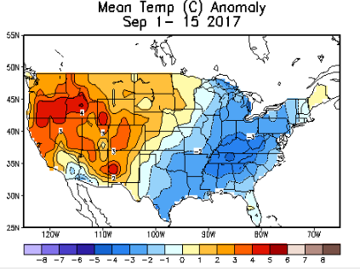
Recent US Temperatures
August mean T was generally cooler over the eastern 2/3 of the country
So far, in September, the coolness in the Midwest and east continues, but the west continues to be warmer than normal.

Slide 8
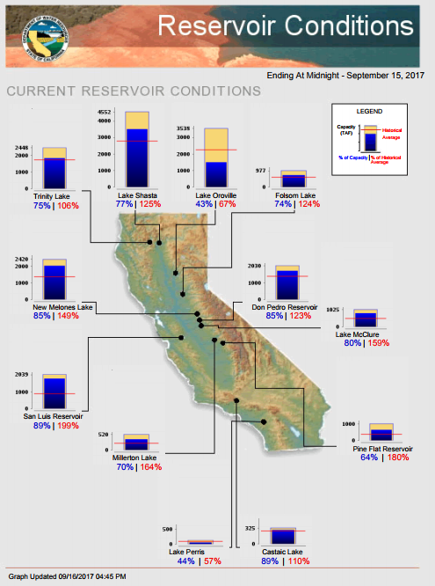
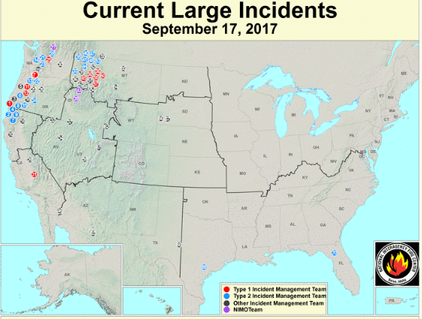
In CA, with the rainy season still far away, while most of the reservoirs are at satisfactory levels, except Oroville which
was purposely lowered to fix spillway &
Lake Perris.
Media reports about severe fire incidences in the west, particularly in WA, OR, western MT, end even in northern CA.
https://fsapps.nwcg.gov/afm/index.php
FIRE
http://cdec.water.ca.gov/cgi-progs/products/rescond.pdf

Slide 9
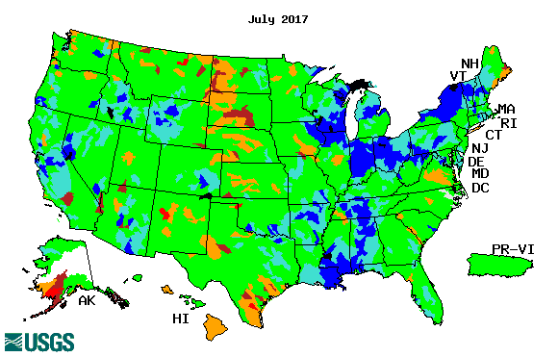
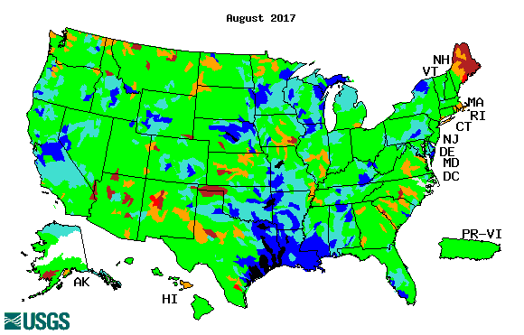
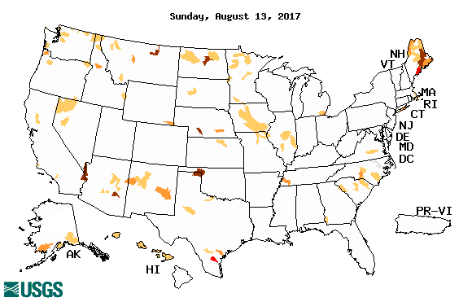
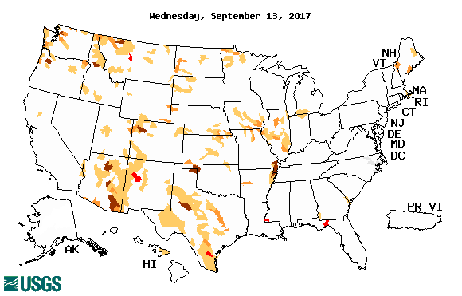
Streamflow (USGS)
Compared to July (top left panel), the stream flows actually look better in August & September so far in the drought regions of northern Plains.
Harvey’ impact can be seen along river flows in TX, LA, and southern Gulf states.
Map shows only below normal 7-day average streamflow compared to historical streamflow for the day of year (United States)
One month ago (left) & Now (below)

Slide 10
EL NIÑO/SOUTHERN OSCILLATION (ENSO)
DIAGNOSTIC DISCUSSION
issued by CLIMATE PREDICTION CENTER/NCEP/NWS and the International Research Institute for Climate and Society
14 September 2017
ENSO Alert System Status: (Surprise from last month’s status!) La Niña Watch !!
Synopsis: There is an increasing chance (~55-60%) of La Niña during the Northern Hemisphere fall and winter 2017-18.

Slide 11
Year | DJF | JFM | FMA | MAM | AMJ | MJJ | JJA | JAS | ASO | SON | OND | NDJ
2010 | 1.3 | 1.2 | 0.9 | 0.5 | 0.0 | -0.4 | -0.9 | -1.2 | -1.4 | -1.5 | -1.4 | -1.4
2011 | -1.3 | -1.0 | -0.7 | -0.5 | -0.4 | -0.3 | -0.3 | -0.6 | -0.8 | -0.9 | -1.0 | -0.9
2012 | -0.7 | -0.5 | -0.4 | -0.4 | -0.3 | -0.1 | 0.1 | 0.3 | 0.3 | 0.3 | 0.1 | -0.2
2013 | -0.4 | -0.4 | -0.3 | -0.2 | -0.2 | -0.2 | -0.3 | -0.3 | -0.2 | -0.3 | -0.3 | -0.3
2014 | -0.5 | -0.5 | -0.4 | -0.2 | -0.1 | 0.0 | -0.1 | 0.0 | 0.1 | 0.4 | 0.5 | 0.6
2015 | 0.6 | 0.5 | 0.6 | 0.7 | 0.8 | 1.0 | 1.2 | 1.4 | 1.7 | 2.0 | 2.2 | 2.3
2016 | 2.2 | 2.0 | 1.6 | 1.1 | 0.6 | 0.1 | -0.3 | -0.6 | -0.8 | -0.8 | -0.8 | -0.7
2017 | -0.4 | -0.1 | 0.2 | 0.4 | 0.4 | 0.2 | -0.1
http://www.cpc.ncep.noaa.gov/products/analysis_monitoring/ensostuff/ensoyears.shtml

Slide 12
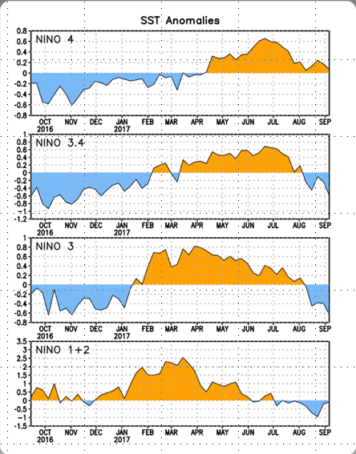
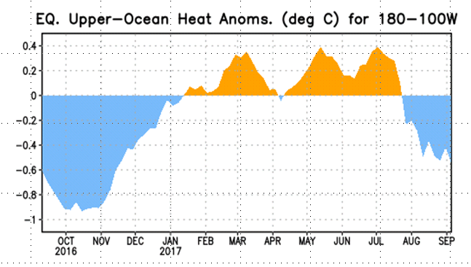
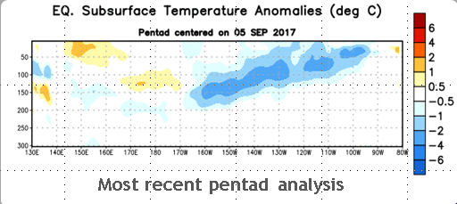
Latest values of SST indices in the various Nino Regions.
Negative subsurface temperature anomalies were present from March 2016 through December 2016. Positive anomalies were present from mid-January through March 2017. Recently the anomalies have been near zero.
SSTs have fallen across the central and east Pacific. As well as the –ve upper ocean heat content, and –ve subsurface anomalies. Will it continue or will it flip ???

Slide 13
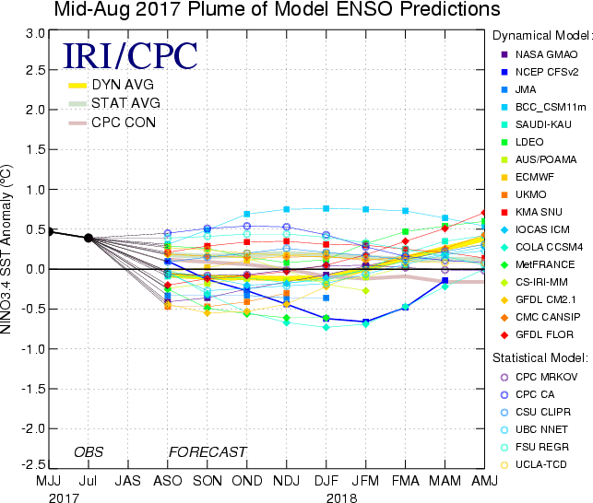
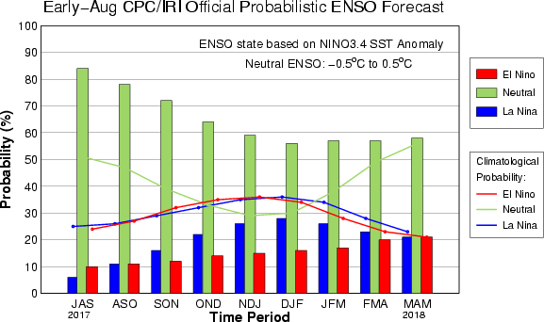
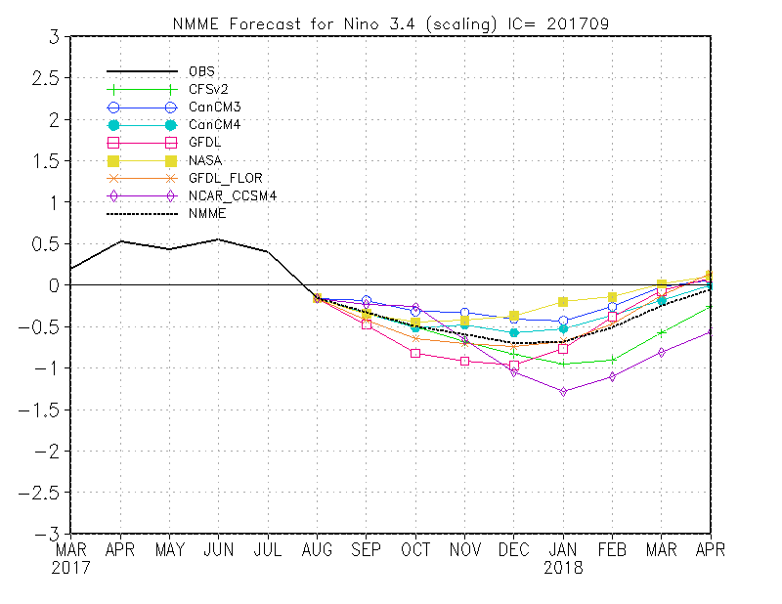
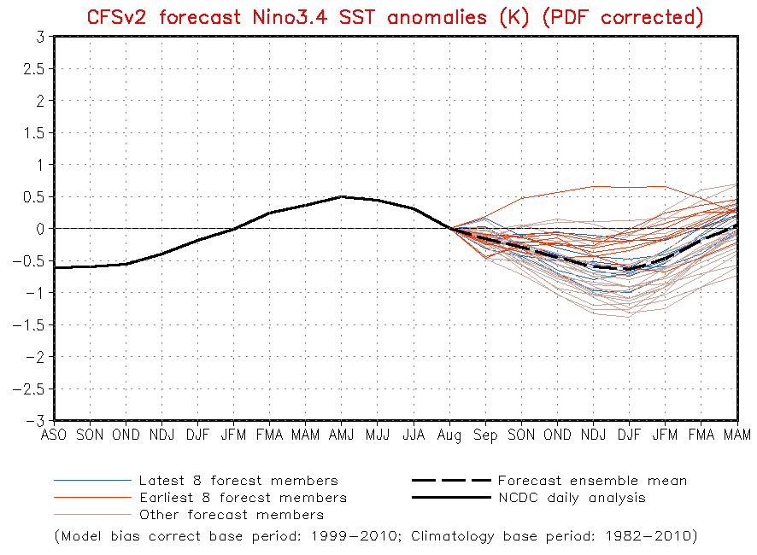
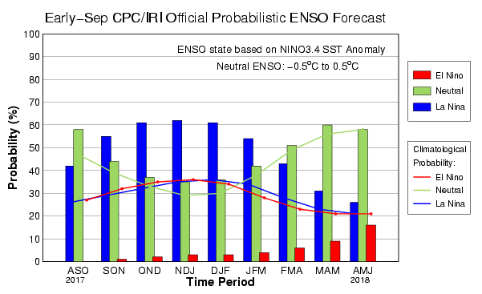
ENSO Forecasts
Early- Aug CPC/IRI forecast
NMME - Ensemble Mean
Early- Sep CPC/IRI forecast
What a change in 1 month ?

Slide 14
Dec-Feb
Expected
Impacts
If a La Nina
develops…
& its normal

Slide 15
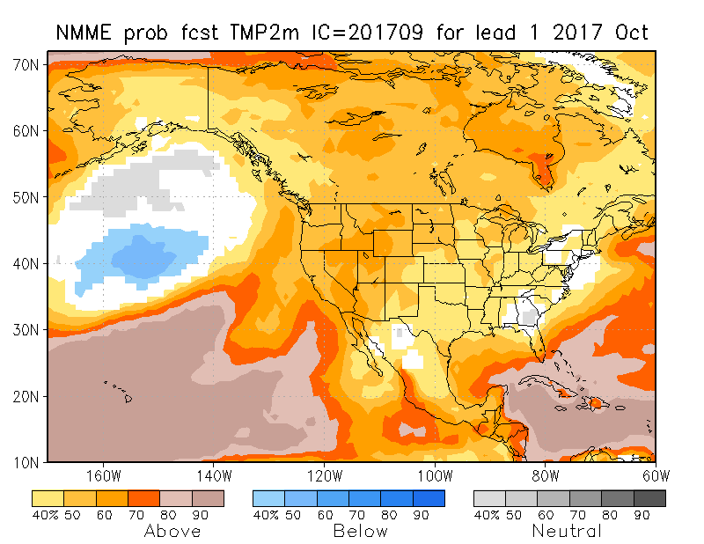
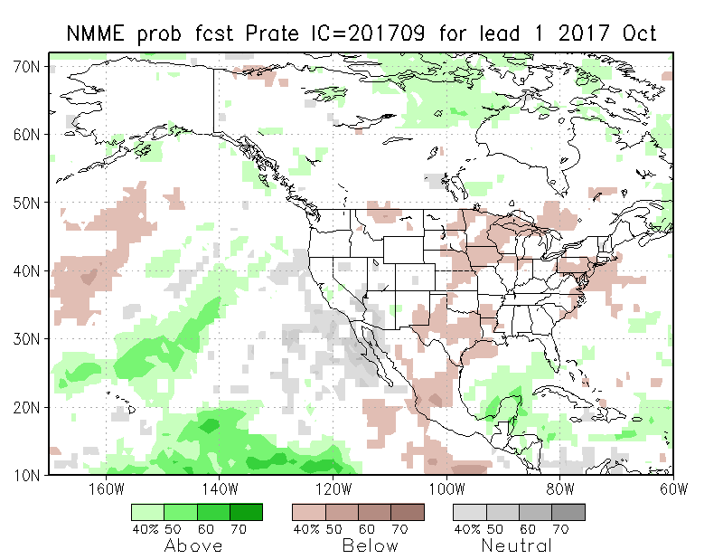
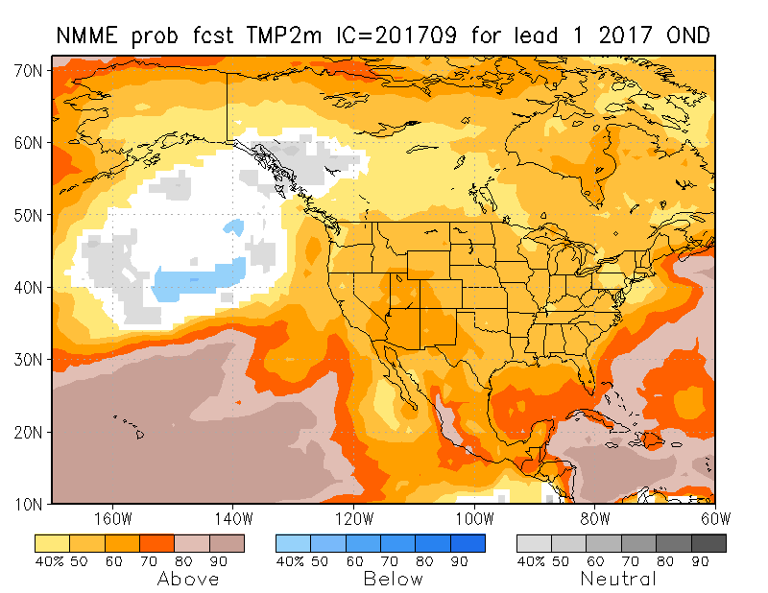
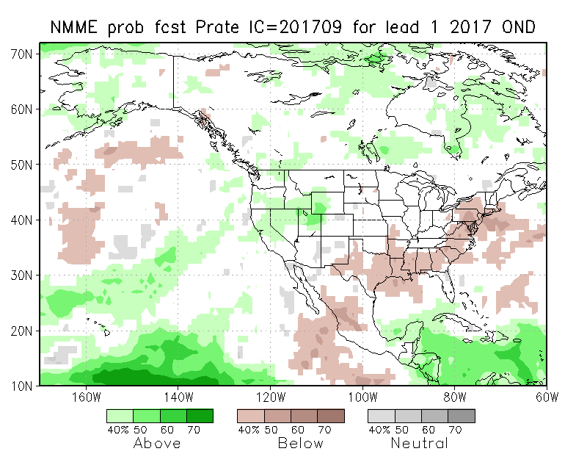
NMME T & P EnsMean forecasts
Oct
OND
The monthly (Oct) and seasonal (OND) T are for more warmth across the country. Very little tropical boundary forcing. Some precipitation hope in the west, but not in core drought region?

Slide 16
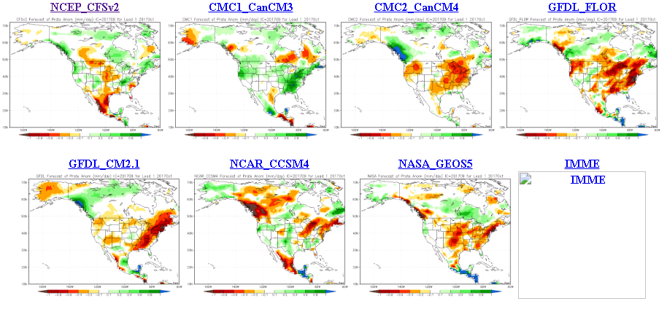
Look at the uncertainty among the diff. models’ forecasts even for October!!!

Slide 17
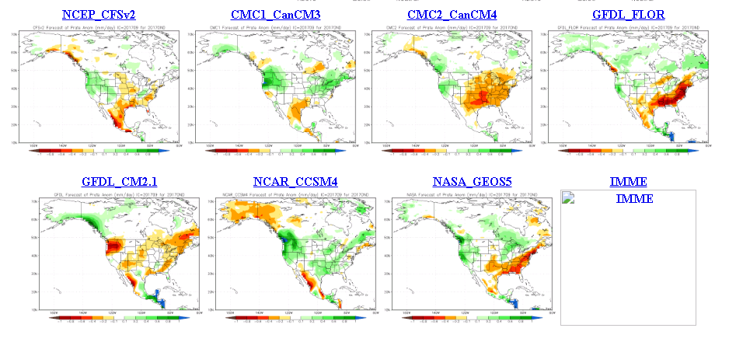
Less uncertainty and slightly more agreement among the diff. models’ fcsts for Oct-Nov-Dec!!!

Slide 18
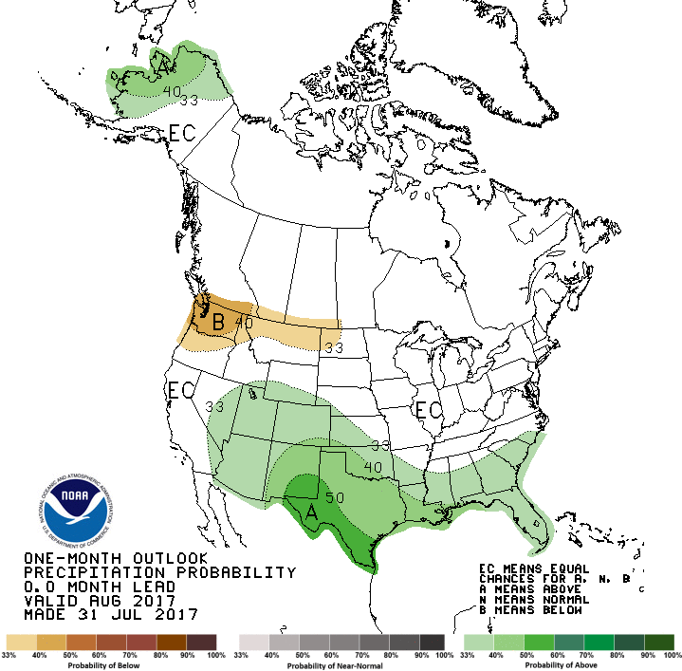
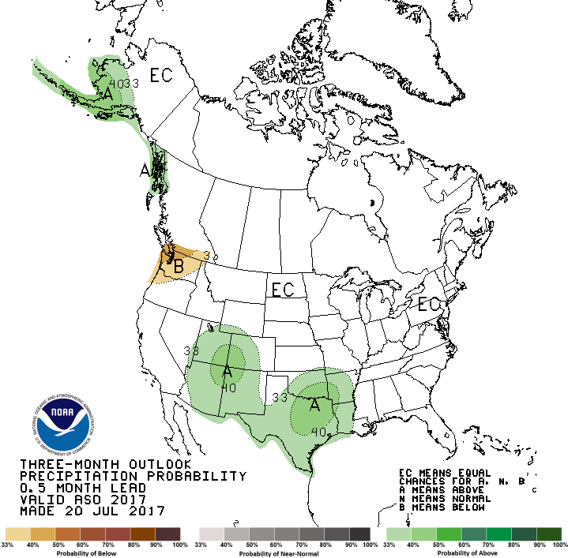
CPC’s official Monthly (Aug) /Seasonal (ASO)
Precipitation outlook
Released July 31st
Released 20th July

Slide 19
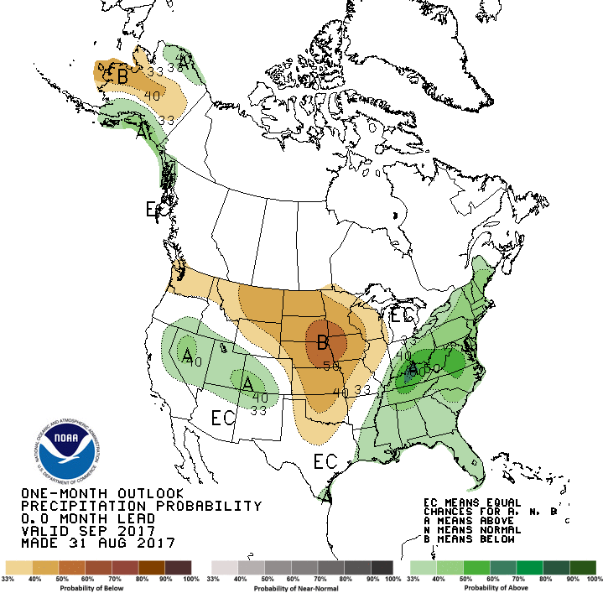
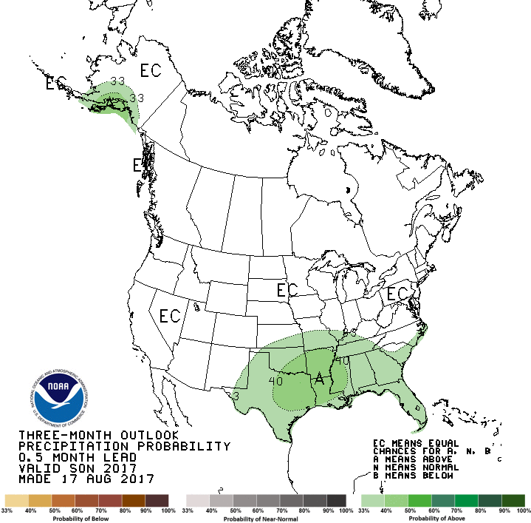
CPC’s official Monthly (Sep) /Seasonal (SON)
Precipitation outlook
Released Aug 31st
Released 17th August

Slide 20
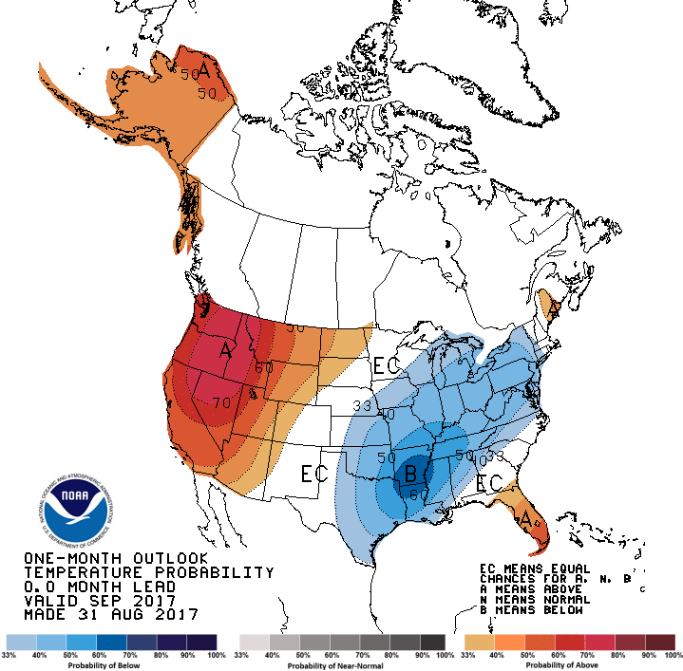
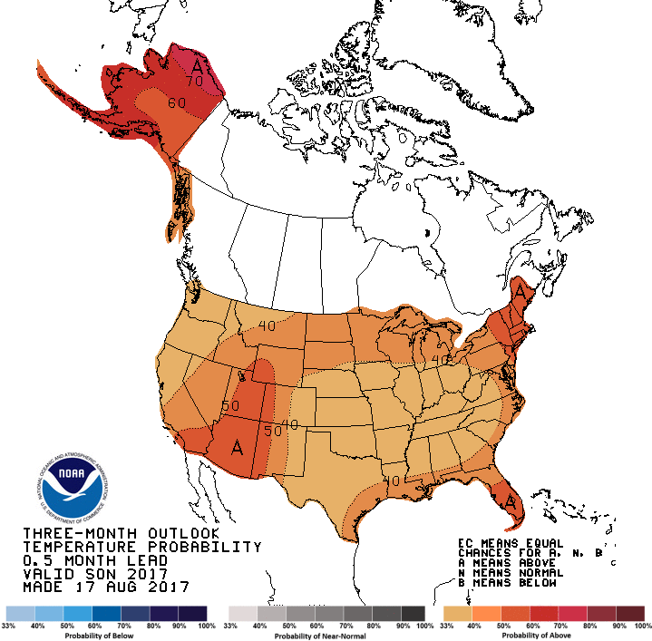
CPC’s official Monthly (Sep) /Seasonal (SON)
Temperature outlook
Made
Aug 31th
Relatively a good T fcst for September so far. ☺
Made 17th Aug

Slide 21
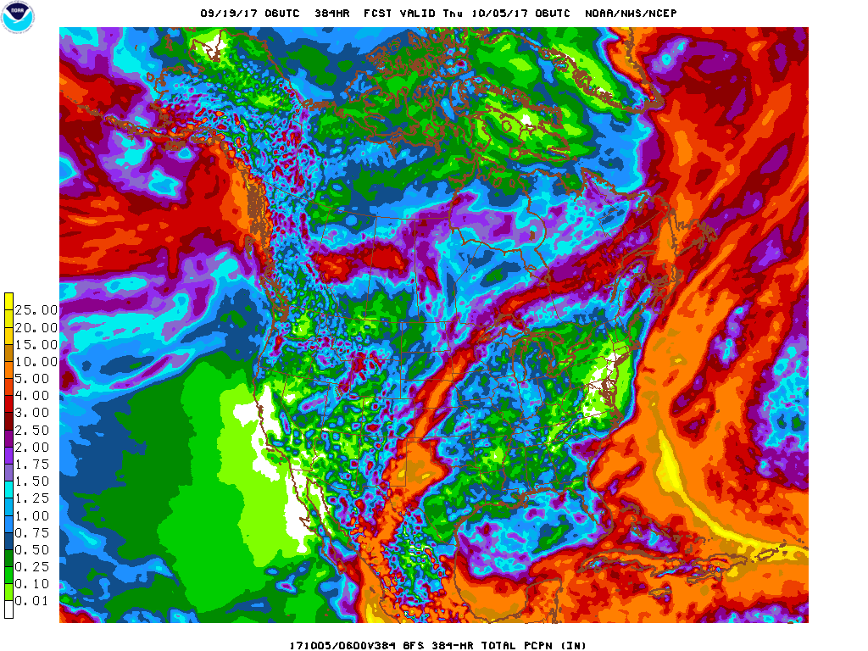
Next 7 days QPF Forecast
In the next 7 days, the Pacific NW, Montana, the Dakotas seems to get some relief. Some improvement in drought may be expected. Also the GFS is indicating a major (temporary) change in circulation in the northwest in the second week, with early cold and more precip in the Pacific NW, and in drought areas
GFS Model Guidance for next 16 days.
According to the GFS,.. Reinforcement and more precip as noted in the QPF above in the northern drought area(MT/ND/SD) and in the southwest
Only CA, NV, and NV seems to be dry in these model forecasts..

Slide 22
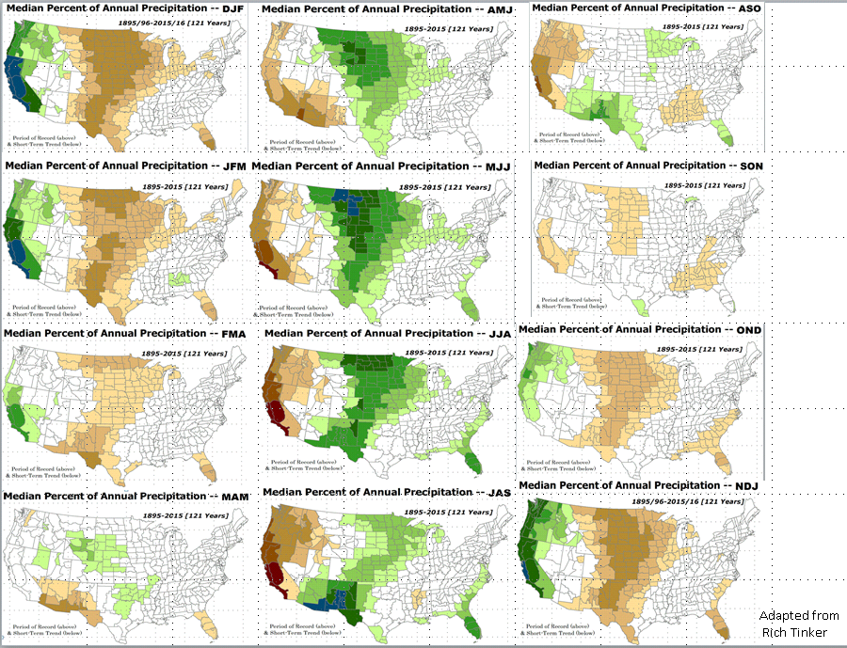
Rainy Season

Slide 23
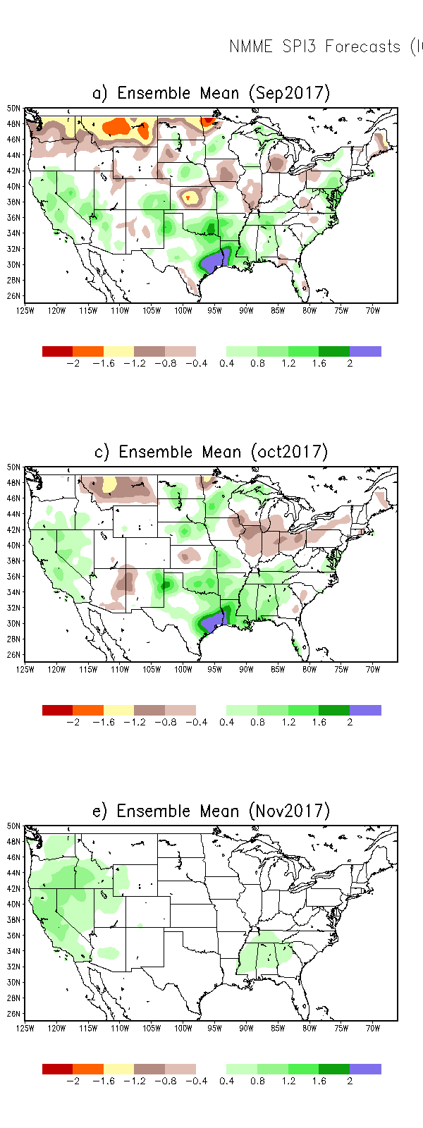
SPI3
SPI6
SPI3 & SPI6
Forecasts from 6NMME Models
(uses obs. P up to past month(Aug), and forecast months’ P from NMME models)
NMME Ensemble Mean (6 models)
SPI Forecasts for MJJ
Left Panels: SPI3
Right Panels: SPI6
In general, SPI3 can be somewhat more trusted than SPI6, to the extent the NMME models have any skill at all in the 1-3 months.
Having said that, the northern (Plains) MT/ND/SD drought, will likely improve in the short term (with the expected rain in the next 1-2 weeks) but getting better after that, according to these models.

Slide 24
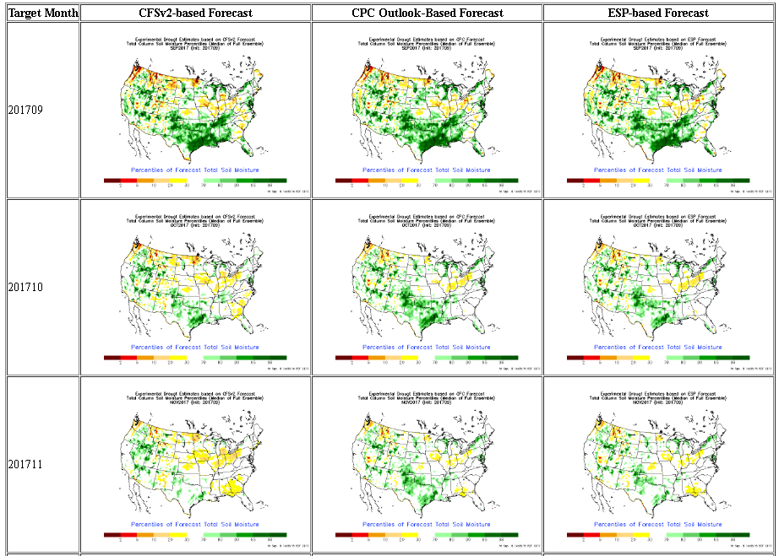
NLDAS Drought Forecast Analysis
The system developed by Princeton University and University of Washington was transitioned to NCEP/EMC as the experimental forecast system.
Forecast using 201709 Initial Condition- Soil Moisture Percentile forecast
General improvement in SM conditions over the next couple of months is forecast by NCEP’s NLDAS models.

Slide 25
Hydrological Monitoring and Seasonal Forecasting @ MSU (Michigan State University ) NLDAS model
http://drought.geo.msu.edu/research/forecast/smi.monthly.php
Monthly Soil Moisture Percentile Prediction issued on 201709
N/S Dakota & Vicinity:
Drought likely to get better in the next couple of months, season, but uncertainty exists.
The inter quartile range suggest greater uncertainty about the forecast in these shaded regions.

Slide 26
NASA GEOS5 Forecasts - Aug/Sep/Oct 2017
This model predicts more rain in the northwest and higher SM percentiles in the south.
Precip
Soil Moisture Percentile

Slide 28
Summary
Current ENSO status and forecast.
ENSO status – La Nina Watch. Equatorial sea surface temperatures (SSTs) are near-average across most of the Pacific Ocean. There is an increasing chance (~55-60%) of La Niña during the Northern Hemisphere fall and winter 2017-18.
Current Drought conditions:
The drought that has emerged quickly and recently since June across N/S Dakotas, eastern Montana continues. But recent rains in that region has contained further intensification of the drought in that region.
The dryness that has developed recently in the Pacific Northwest and western Montana is of some concern, thus possibly signaling the short term drought development in those regions.
The precip deficit that has developed previously (last month) in the Northeast, looks ok now, due to precip activity from hurricane remnants along east coast.
Prediction:
The possibly developing La Nina, may be too early to be of any impact in the next month or two.
But the upcoming model forecast rains, and the expected circulation change coming up in the Northwest is likely to lessen/mitigate the drought conditions there – at least not further intensify - in the short term.
Next Drought Briefing Tuesday, October 17.

