Slide 1
Drought Outlook Support Briefing (formerly Drought Outlook Discussion) April 2018
Climate Prediction Center/NCEP/NOAA
http://www.cpc.ncep.noaa.gov/products/Drought
Phone: 1-877-680-3341
Pwd: 858747#

Slide 2
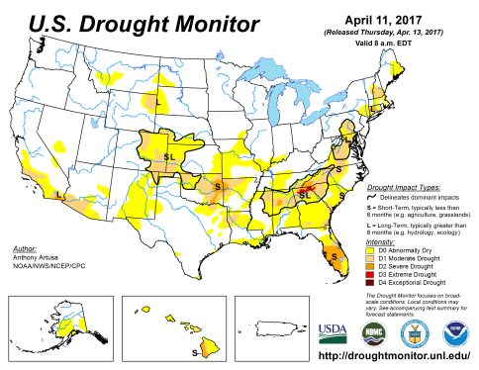
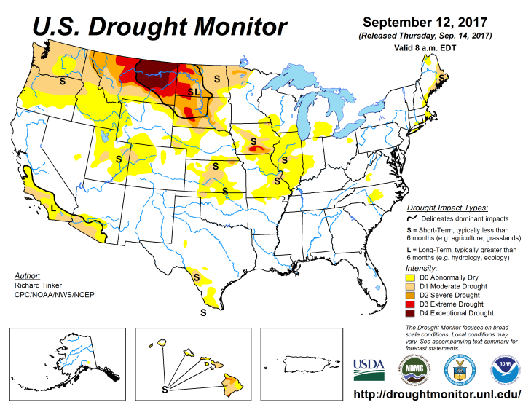
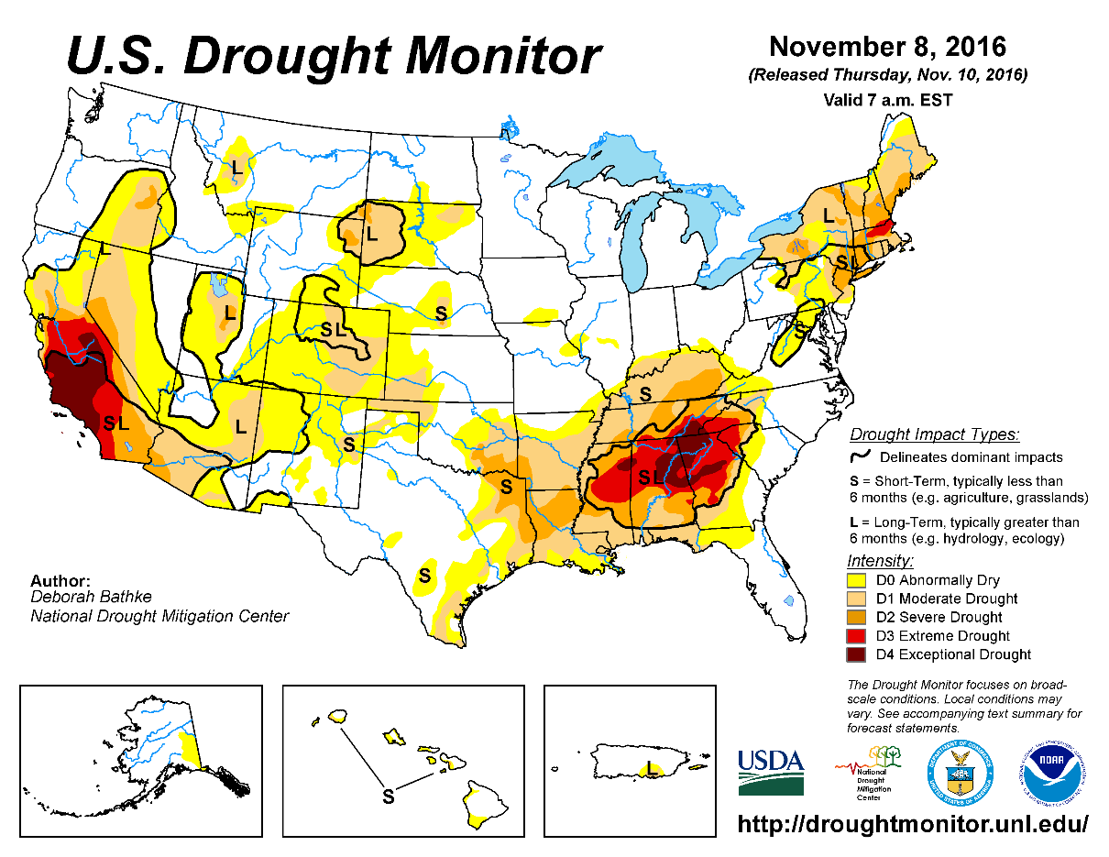
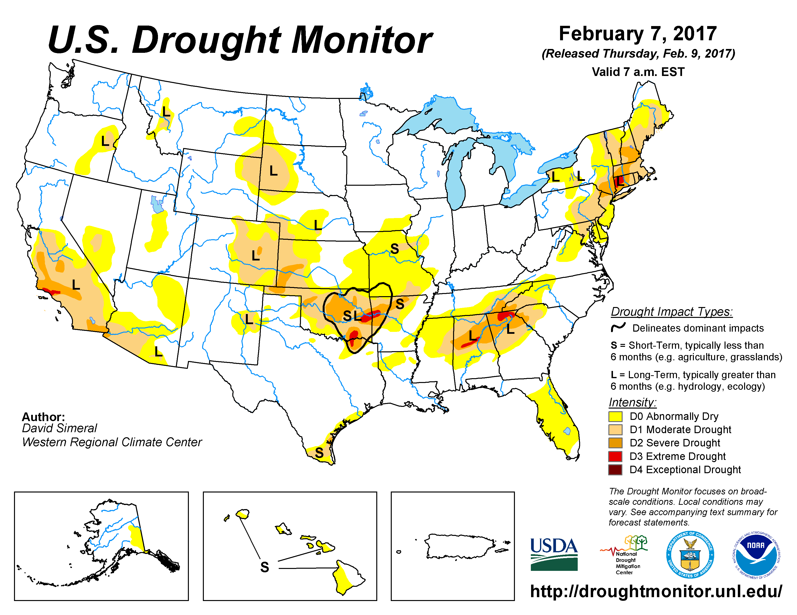
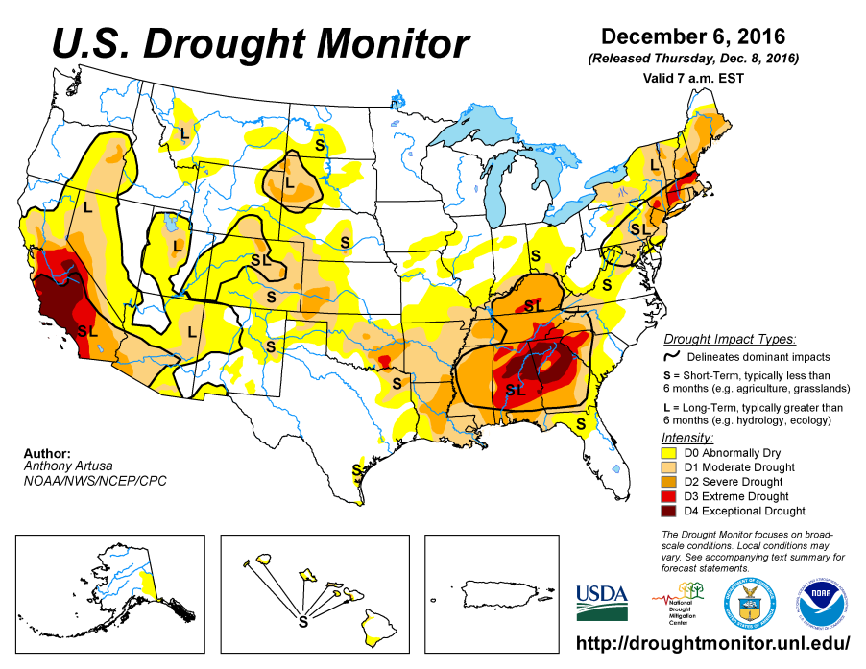
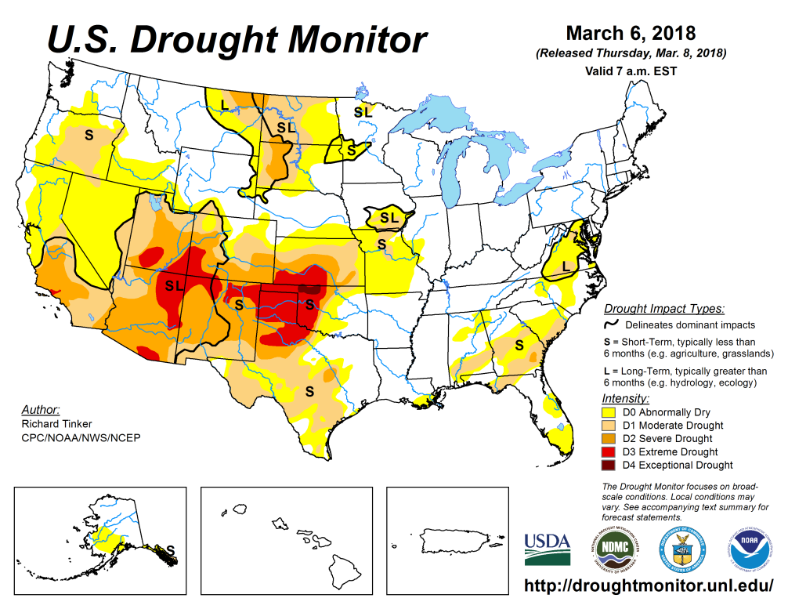
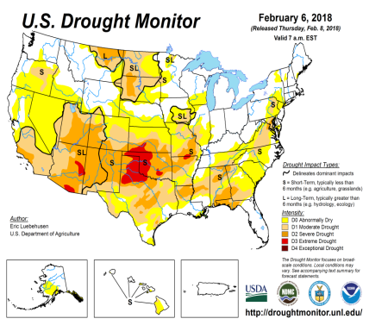
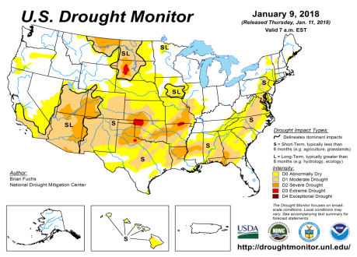
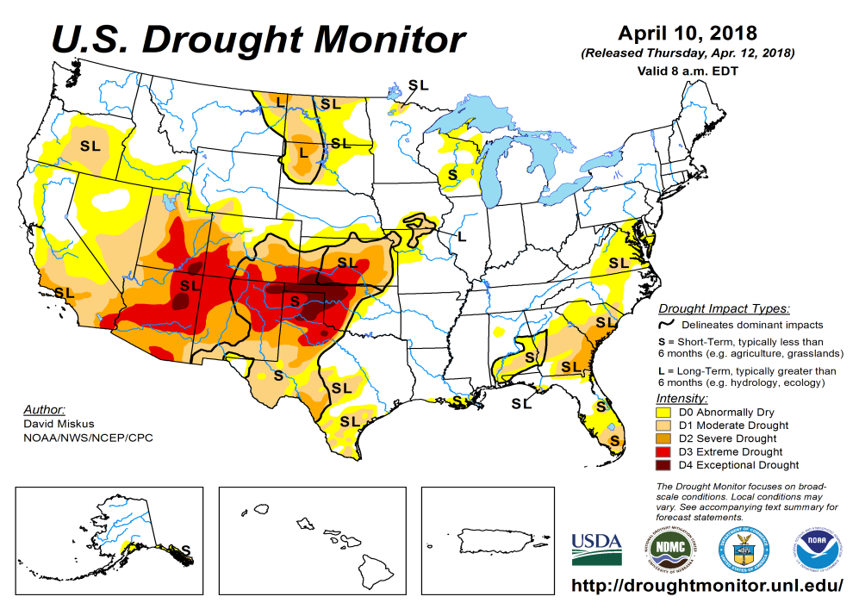
Drought Monitor
Mar
Feb
Previous
Jan
La Nina, which was probably at its peak in N/D/J/F months, is on its way out, but its precip/drought impacts in the south/west is not waning, but getting worse!
In the north, while WA, ID, and western MT has done well, in eastern MT, ND, SD, the short/long term drought continues to remain in a muted form, but is, and should be, gradually getting better with the hopeful arrival of this year’s (normal ?) rainy season.
Latest/Recent

Slide 3
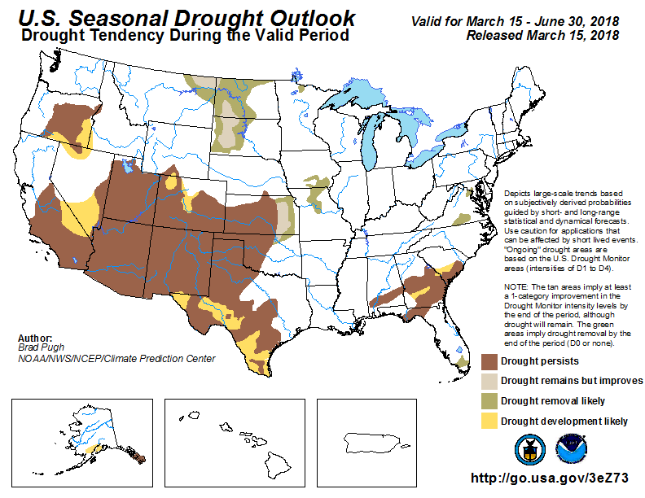
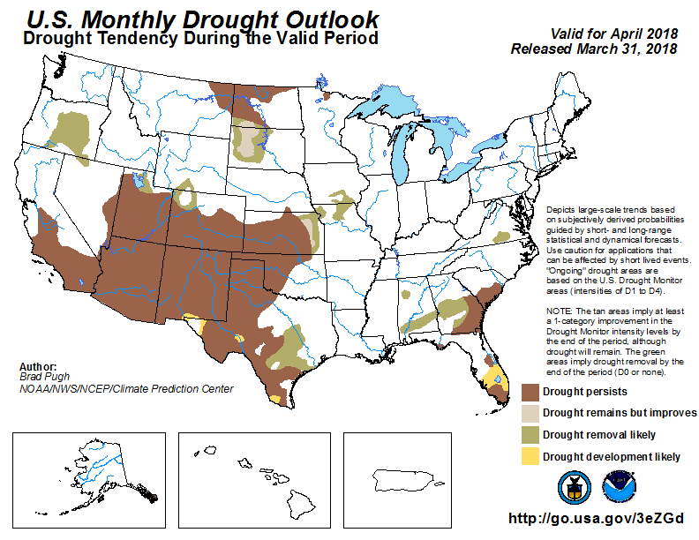
(Prev) Seasonal/Monthly Drought outlooks
Seasonal Outlook (Mid March 2018 - June 2018)
issued 03/15/18
Monthly outlook
(April 2018)
issued 03/31/18
Almost the western half of the southern tier states of United States, except parts of northern CA and AZ, was forecast to continue to remain/continue in the grip of drought. Recall, at this same time last year, the (later major) Northern Plains drought was lurking behind the scenes!!
Improved drought conditions (monthly) forecast in eastern Kansas, seems to be in question.
Parts of the Atlantic coastal southeast will continue experience some S/L dryness!

Slide 4
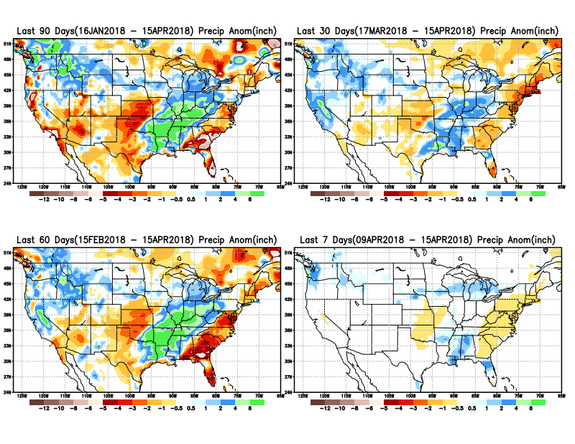
Total precipitation ANOM during last 7, 30, 60 & 90 days.
A dry-wet-dry 3-cell pattern continues to dominate the south central-eastern US, while CA overall had a decent rainfall the past couple of months.
Rainfall in the Pacific NW and interior areas including ID and western MT had good rainfall.
Eastern ND and the MN are beginning to develop some dryness.

Slide 5
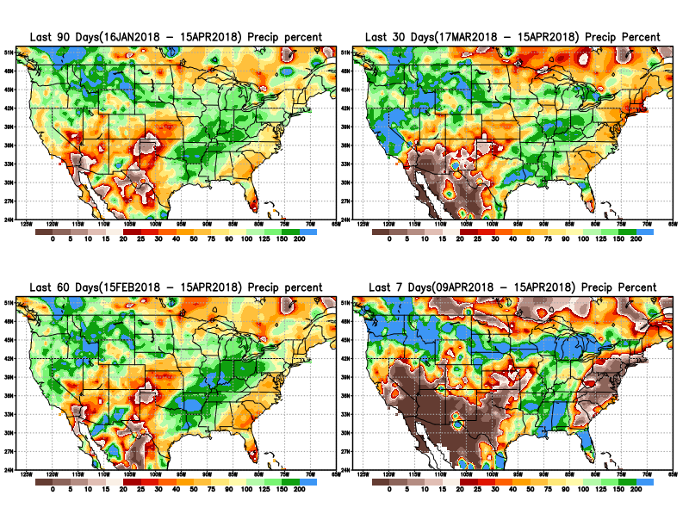
Total precipitation Percent during last 7, 30, 60 & 90 days.
Note percent of precip deficits in around northern TX,
Also keep an eye on developing dryness in MN and vicinity.

Slide 6
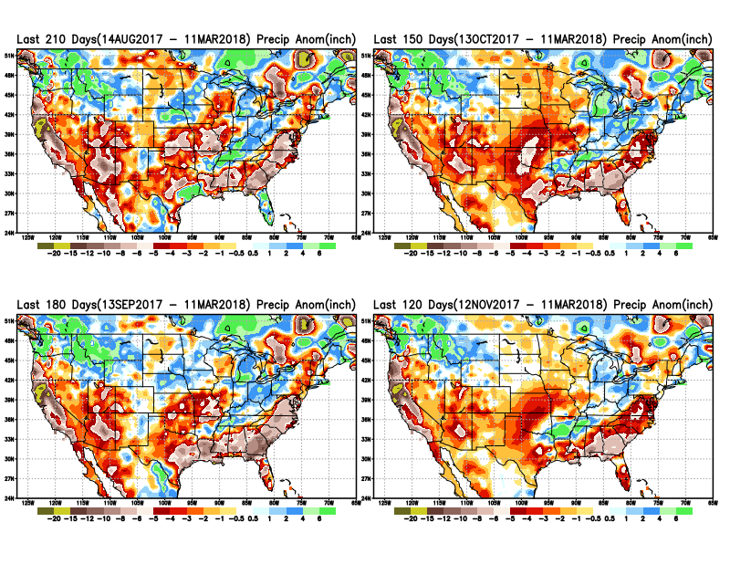
Total precipitation ANOM during last 4, 5, 6, and 7 months.
Except for remnants of Harvey and Irma in/near Texas and Florida, longer term deficits exist over much of the country, not to mention the missed rainfall season in the northern plains.

Slide 7
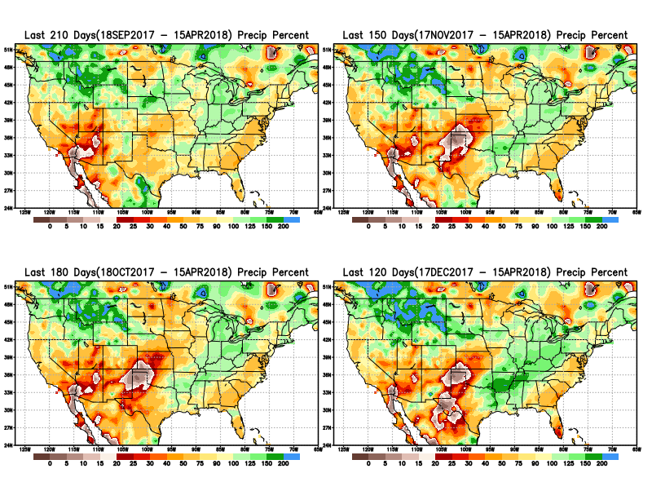
Total precipitation Percent during last 4, 5, 6, and 7 months.
Note Precipitation deficits

Slide 8
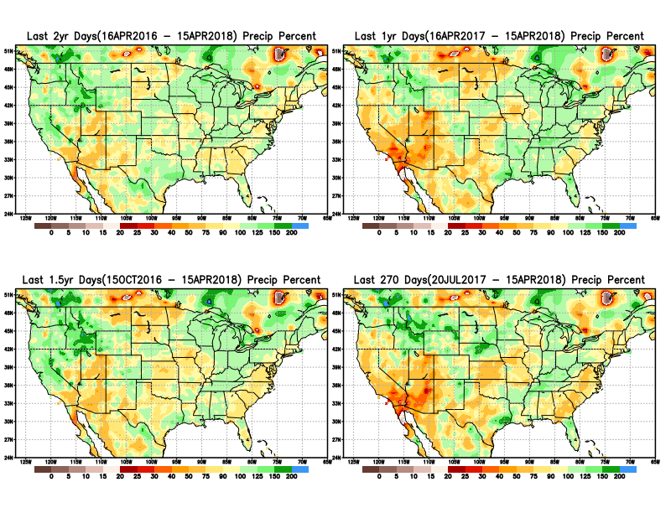
Total precipitation Percent during last 9 months, 1 yr, 1.5yrs, & 2 yrs.
There are many long term rainfall deficit regions in the country, particularly deficits in UT/AZ, southern CA, and parts of NM/CO are long term.

Slide 9
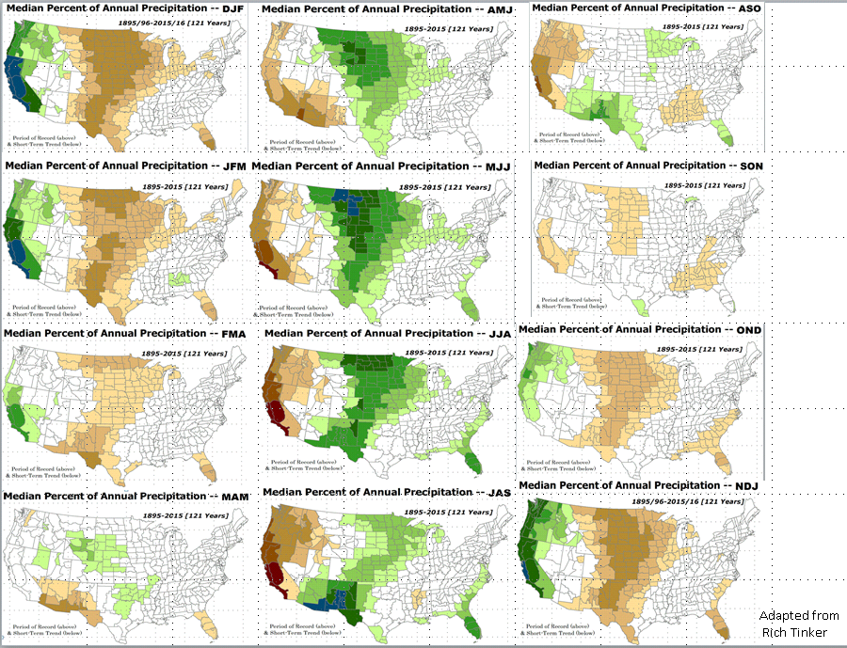
Rainy Season across the US

Slide 10
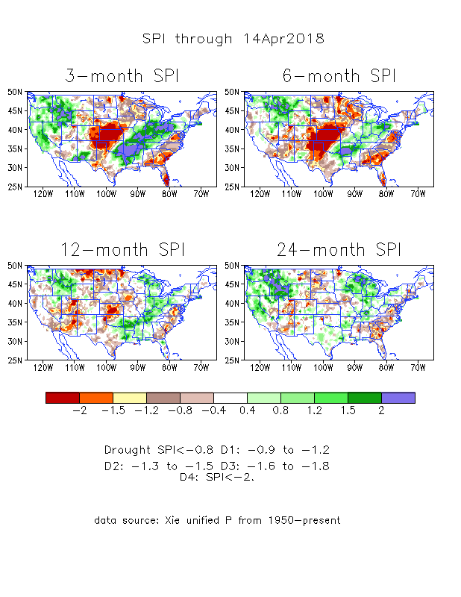
The Standardized Precipitation Index SPI (based on Observed P)
----- NOW
Very interesting graphic & details for the drought across the US based on the more generalized precip deficit/excess, the Standardized Precipitation Index (SPI).
Based on this measure, severe drought (D3+D4 areas and worse) exists mainly in that large contiguous region in the middle of the country including large parts of KS, OK, northern TX, eastern CO, northeastern NM. Small pockets of severe drought
also in southeastern US and in MN/IA.

Slide 11
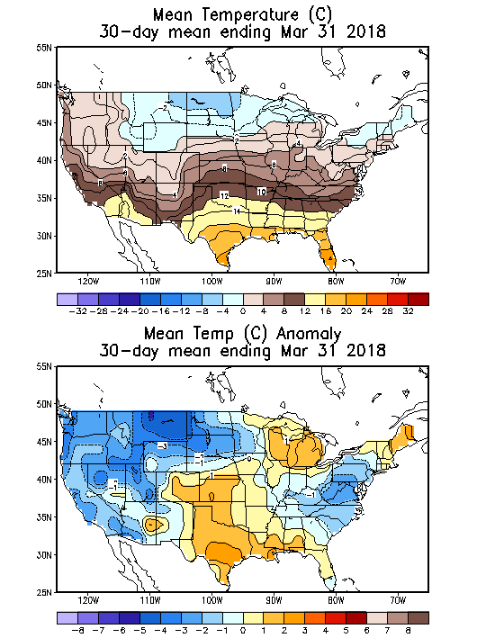
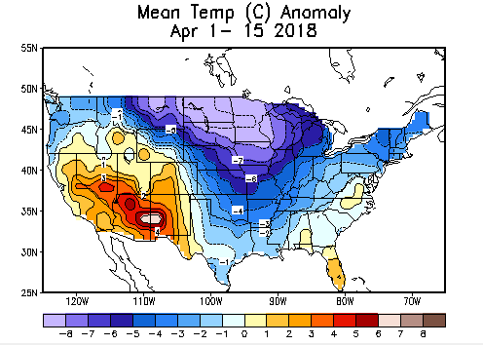
Recent US Temperatures
Overall March Mean T across the US was cooler in slightly more parts of the country than in places which were warmer.
But so far, in April, it is more cooler, particularly in the north central states bordering Canada.

Slide 12
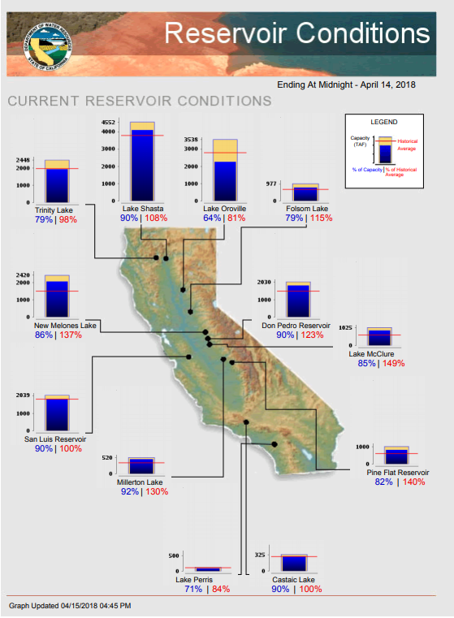
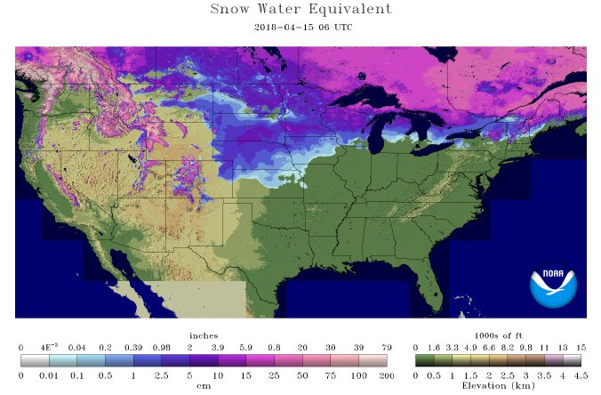
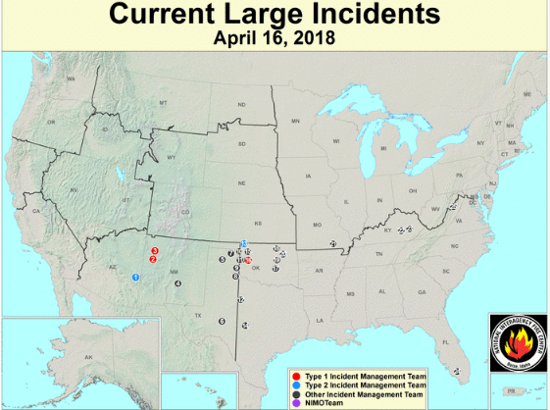
Most of the CA reservoirs are at better than satisfactory levels, except for the Lake Oroville near northern Sierra Nevada. Snow amounts in Dakotas, MN are below normal ? (see precip deficits earlier in this region!) .
FIRE
http://cdec.water.ca.gov/cgi-progs/products/rescond.pdf
https://fsapps.nwcg.gov/afm/index.php

Slide 13
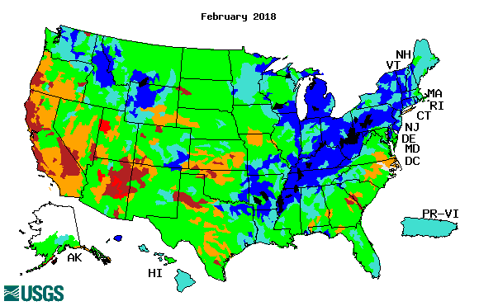
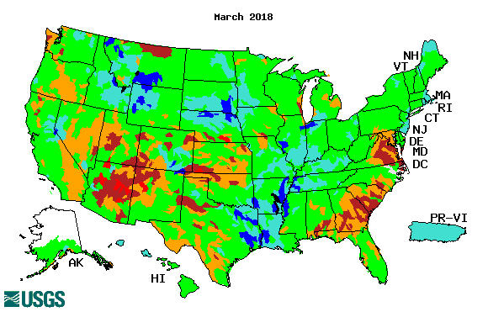
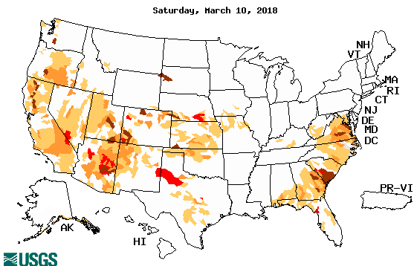
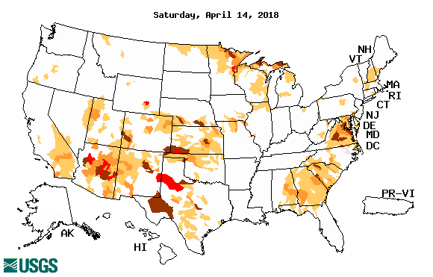
Streamflow (USGS)
Streamflow conditions across CA have overall improved.
Worsened in four (AZ/NM/CO/NM) corner states, northern TX, OK, MO, and along the Atlantic coastal states.
Map shows only below normal 7-day average streamflow compared to historical streamflow for the day of year.
One month ago (left) & Now (below)

Slide 14
EL NIÑO/SOUTHERN OSCILLATION (ENSO)
DIAGNOSTIC DISCUSSION
issued by CLIMATE PREDICTION CENTER/NCEP/NWS and the International Research Institute for Climate and Society
12 April 2018
ENSO Alert System Status: La Niña Advisory !!
Synopsis: La Niña conditions are present.* La Niña is expected to transition to ENSO-neutral during April-May, with ENSO-neutral then likely (greater than 50% chance) to continue through the Northern Hemisphere summer 2018.

Slide 15
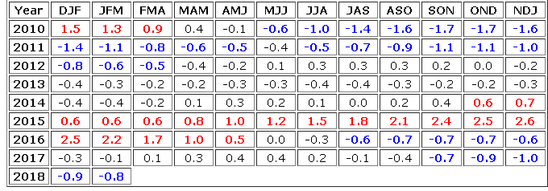
La Nina on its way out!
http://www.cpc.ncep.noaa.gov/products/analysis_monitoring/ensostuff/ensoyears.shtml

Slide 16
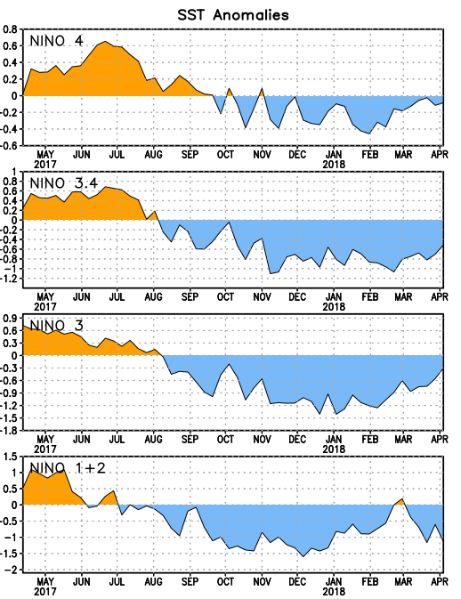
Latest values of SST indices in the various Nino Regions.
The sub surface heat anom has changed sign! .
Relatively short lived!
SST anoms across the basin have increased!
ie., become less cold!!

Slide 17
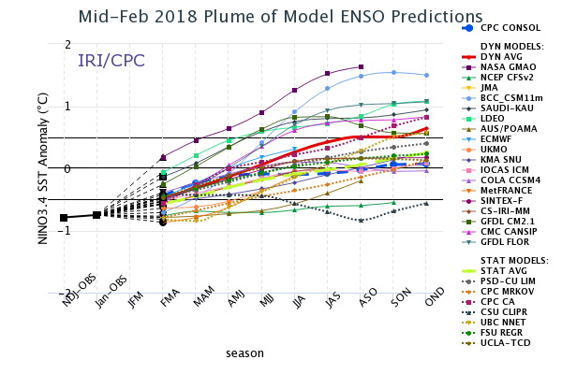
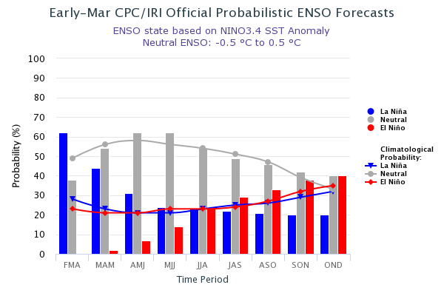
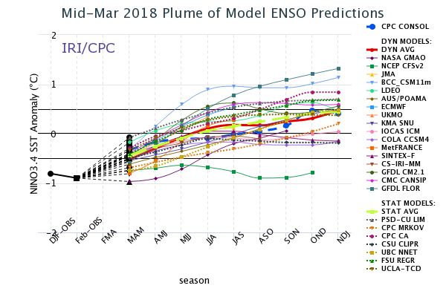
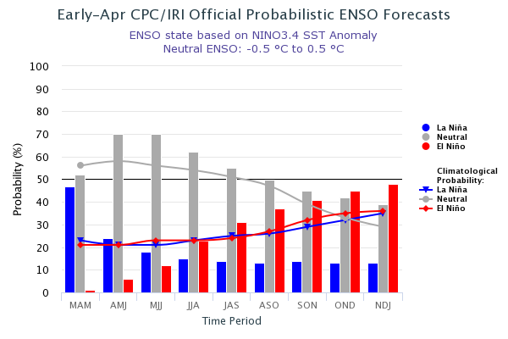
ENSO Forecasts
Early- Mar CPC/IRI forecast
NMME Models’ – Nino 3.4 forecasts
Early Apr CPC/IRI forecast
This upcoming summer/fall - ENSO Neutral or El Nino ? (La Nina out of question?)

Slide 18
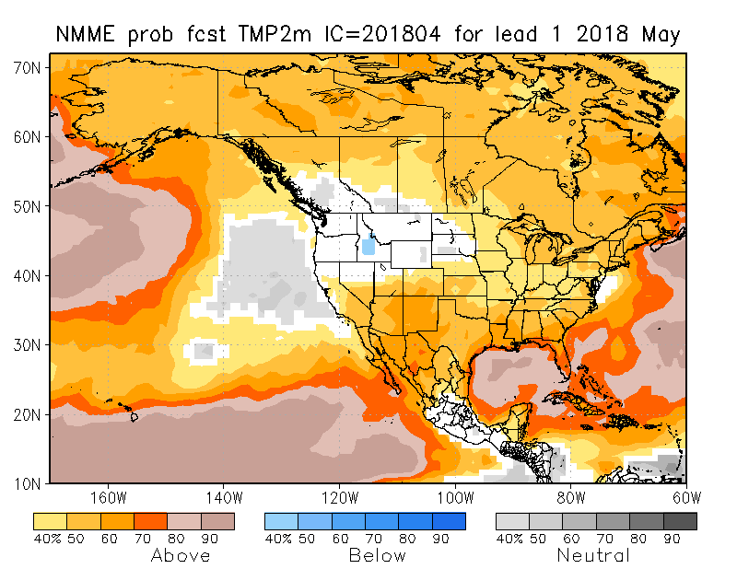
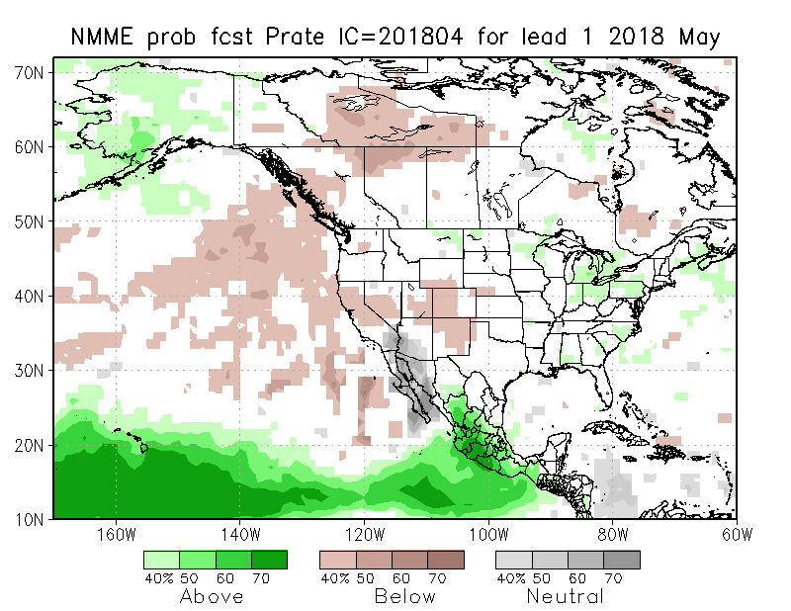
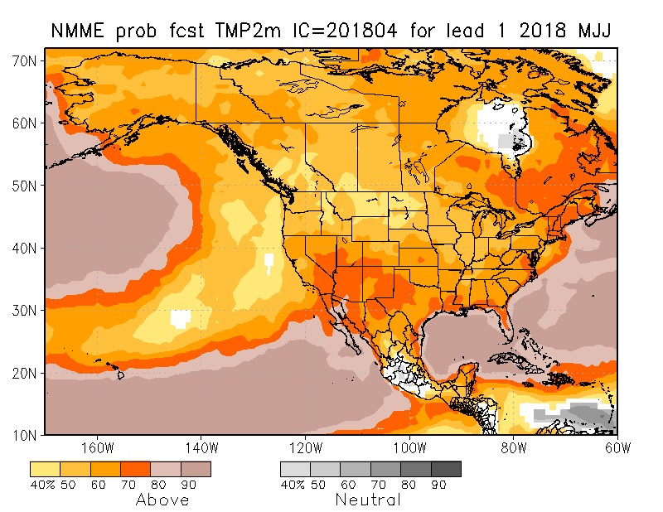
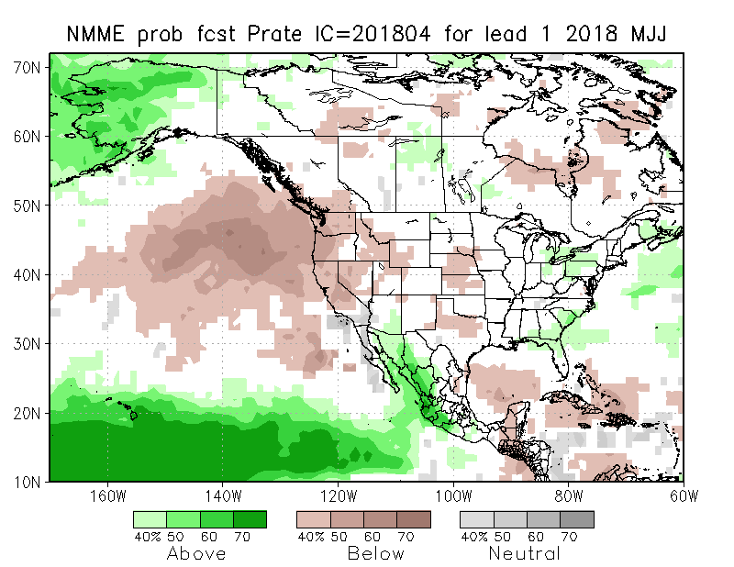
NMME T & P EnsMean forecasts
May
MJJ
As the La Nina is weakening and transitioning to neutral conditions, the monthly (May) and seasonal (MJJ) T are for more warmth across much of the country especially in the drought southwest, which could be the trend. Weak/Nil boundary forcing -> less Precip skill in forecast ?

Slide 19
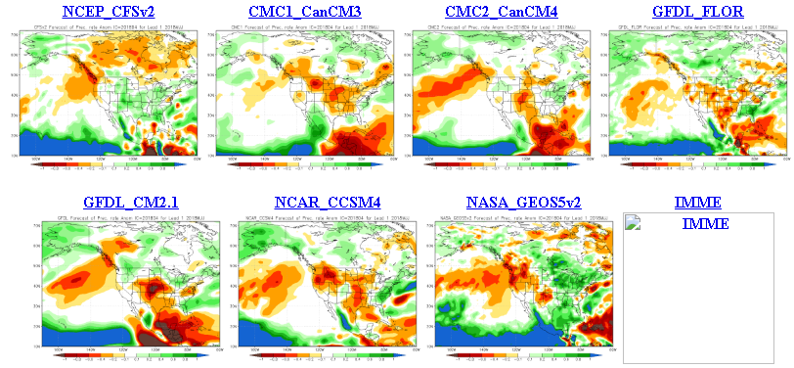
The agreement/uncertainty among the diff. NMME models’ forecasts for May-June-July Precipitation!!!

Slide 20
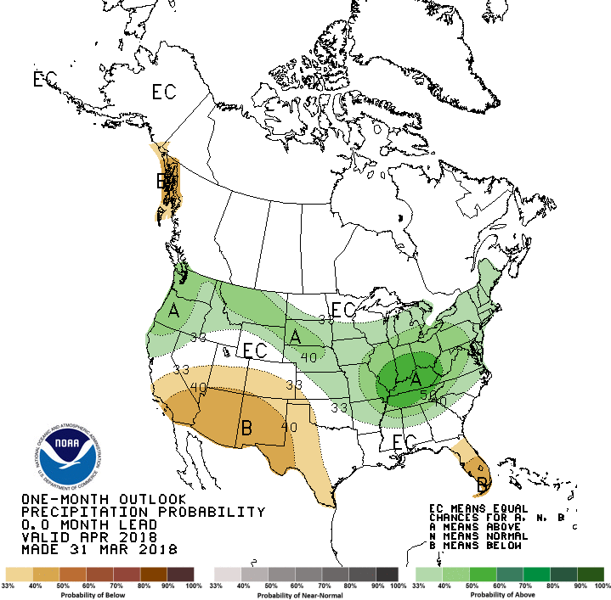
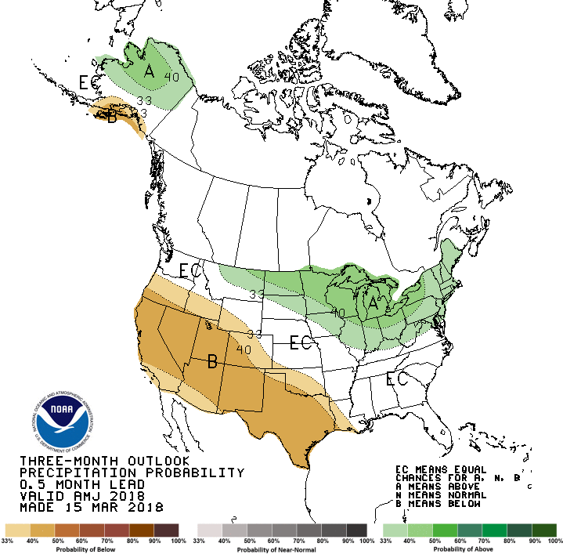
Previous CPC’s official Monthly (Apr) /Seasonal (AMJ)
Precipitation outlook
Released Mar 31st
Released Mar 15th

Slide 21
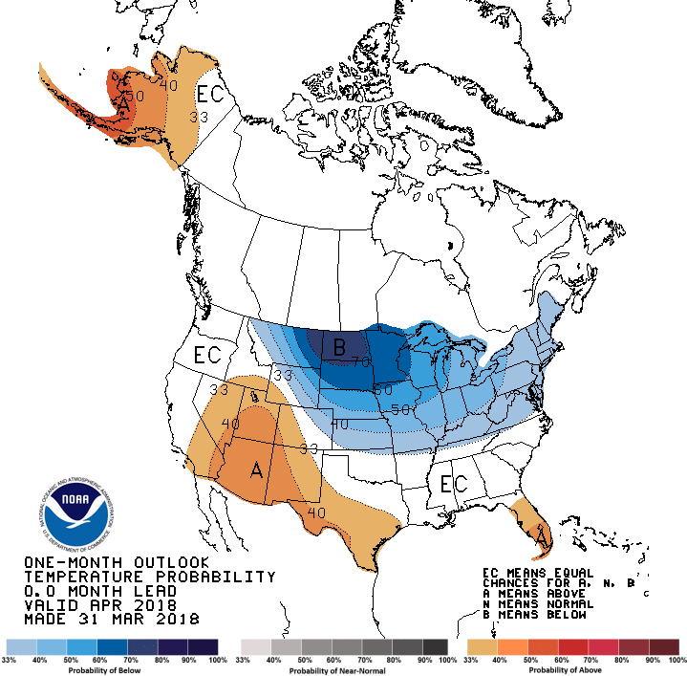
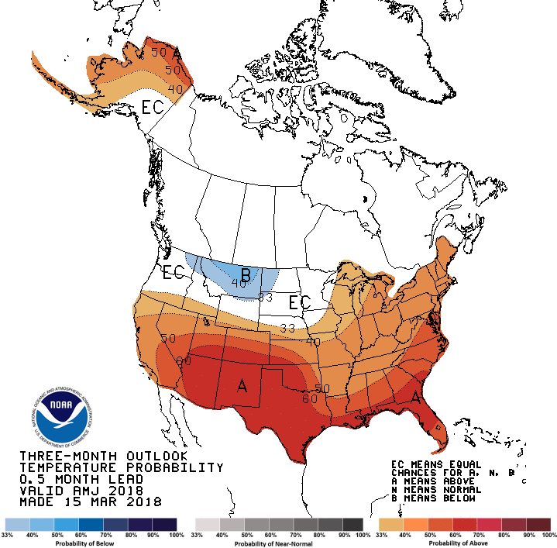
CPC’s official Monthly (Apr) /Seasonal (AMJ)
Temperature outlook
Made
Mar 31st
Made Mar 15th
Relatively a good T fcst overall for
so far.

Slide 22
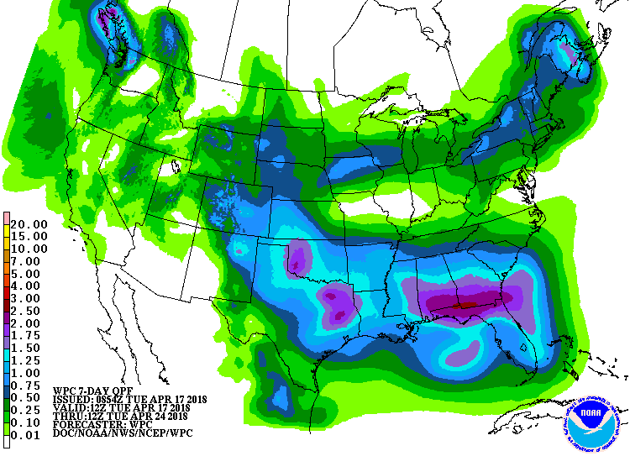
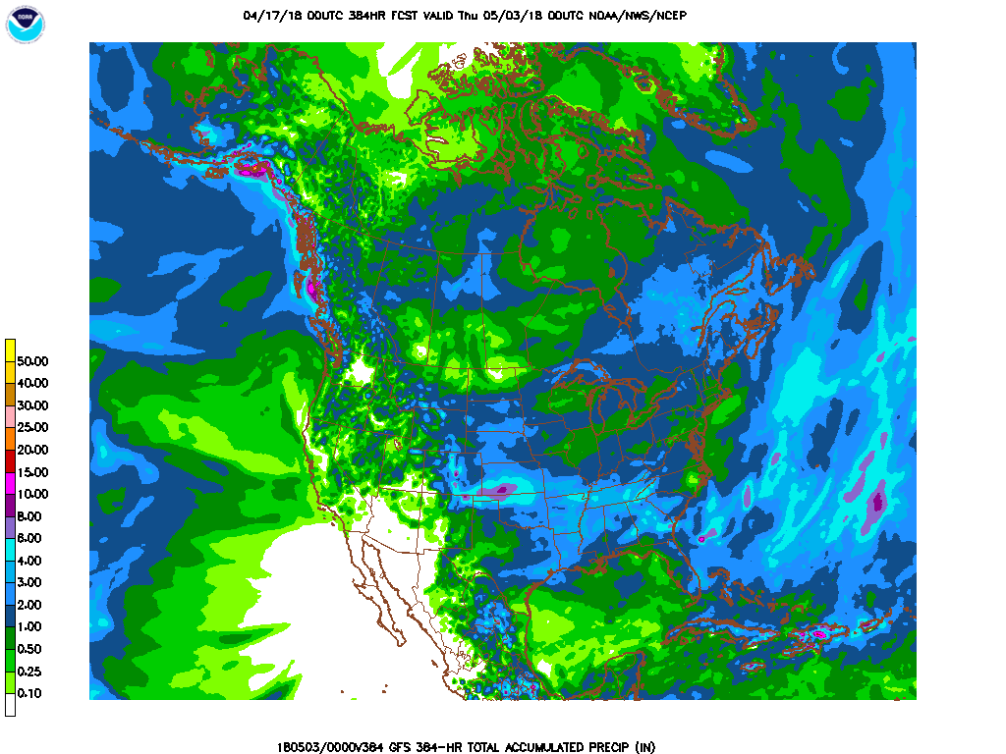
Next 7 days QPF Forecast
In the next 7 days, western OK, eastern TX, western KS, Gulf coast states are expected to receive good rainfall, thus helping the drought situation there.
GFS Model Guidance for next 16 days.
Further reinforcement of precip forecast over the next seven days. Over 5” is expected in western KS.
Not much rain over the southwest. In AZ/NM and far southern CA drought region.

Slide 23
SPI3
SPI6
SPI3 & SPI6
Forecasts from 6NMME Models
(uses obs. P up to past month, and forecast months’ P from NMME models)
In the past these NMME models and their forecasts always did not extend/intensify the Northern plains drought, and ended it repeatedly prematurely!!
The goodness and skill of these SPI’s forecasts depend directly on these models’ skill in predicting precip!!!
The NMME models indicate that by June much of the short term deficit (SPI3), across the US south, may have eased and gone, while the longer term rainfall deficits/drought(SPI6) may continue to improve, but will not go away!

Slide 24
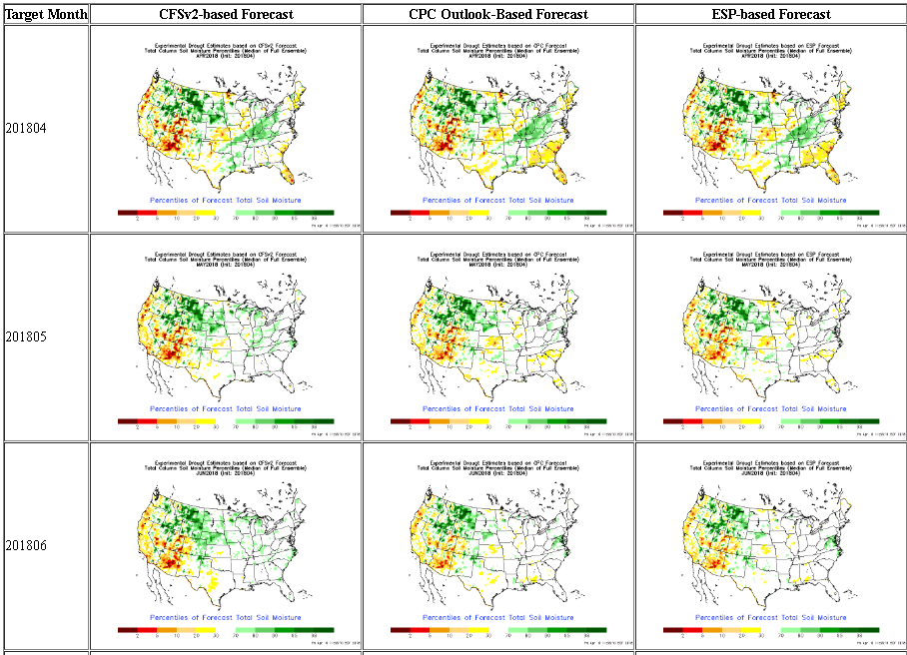
NLDAS Drought Forecast Analysis
The system developed by Princeton University and University of Washington was transitioned to NCEP/EMC as the experimental forecast system.
Forecast using 201804 Initial Condition- Soil Moisture Percentile forecast

Slide 25
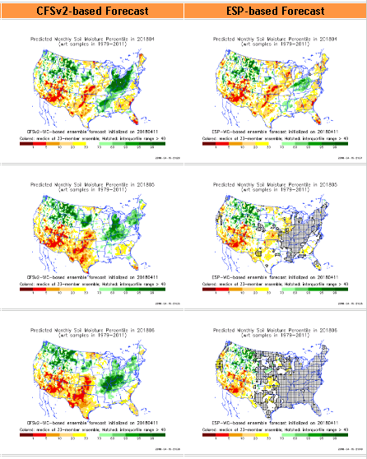
Hydrological Monitoring and Seasonal Forecasting @ MSU (Michigan State University ) NLDAS model
http://drought.geo.msu.edu/research/forecast/smi.monthly.php
Monthly Soil Moisture Percentile Prediction issued on 201803
The inter quartile range suggest greater uncertainty about the forecast in these shaded regions.

Slide 26
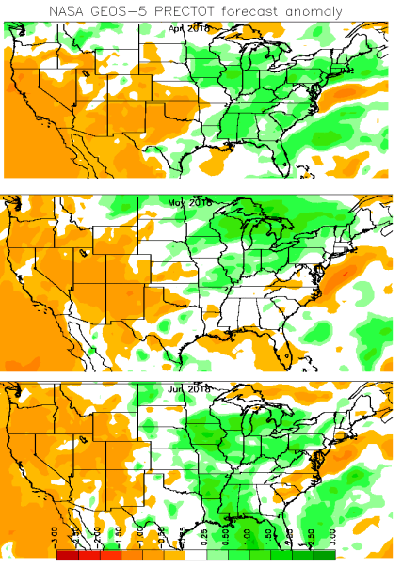
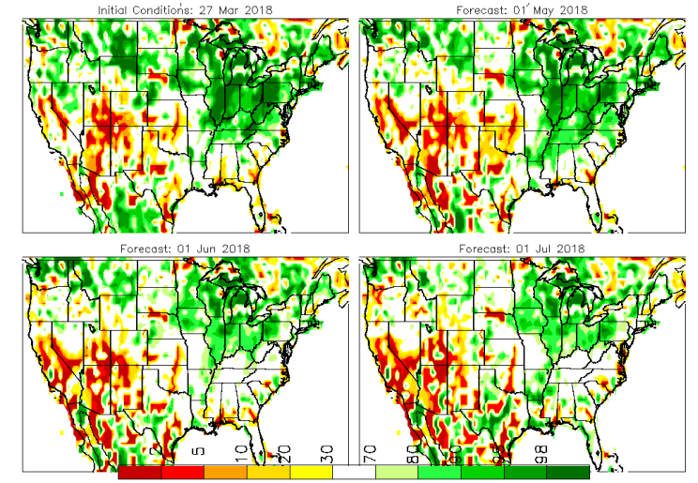
Precip Forecast
NASA GEOS5 Forecasts
NASA still adjusting to their new global forecast system
April
April
Soil Moisture Forecast Percentile
May
IC
April
Jun
Less rain in CA is fcst in Feb (happened)
More rain in CA is fcst in March (happening)
Near normal rain in CA is fcst in April!
May
Jun

Slide 27
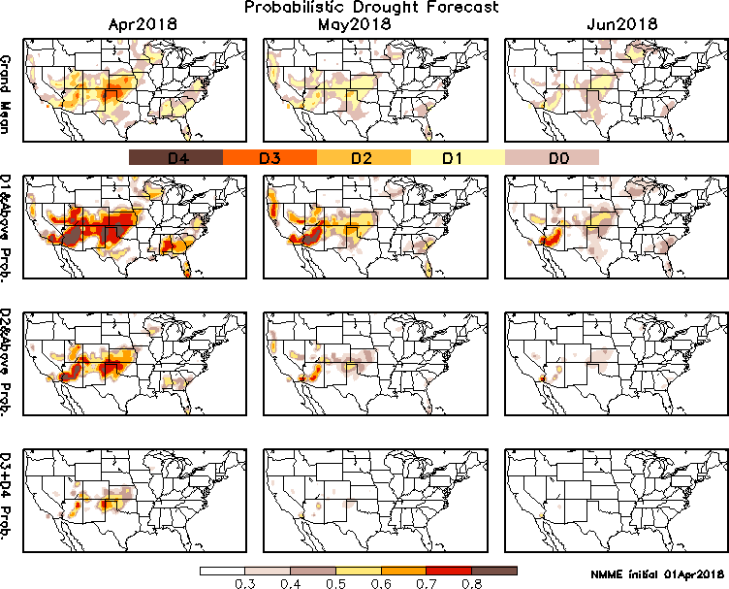
Exptl. Probability Drought Outlook from Kingtse Mo and Li Xu based on NMME ensemble members’ Precip forecast .

Slide 28
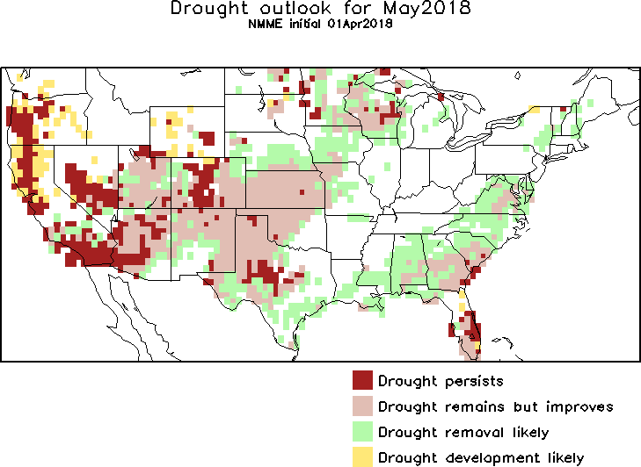
May 2018
MJJ 2018
In the official
Drought Outlook Tendency Format!!

Slide 29
Summary
Current ENSO status and forecast. La Niña Advisory !! La Niña conditions are present. La Niña is expected to transition to ENSO-neutral during April-May, with ENSO-neutral then likely (greater than 50% chance) to continue through the Northern Hemisphere summer 2018.
Current Drought conditions:
The S/L term Northern Plains drought in the eastern MT/large parts of Dakotas region due to deficit in 2017 rainfall season – which existed in a muted state during winter, is beginning to thaw and improve for better. But dryness is developing in parts of neighboring states MN/IA and vicinity.
Across the southern/southwestern United States (except CA), the drought regions and severity [which I said last month(March) were probably at a maximum during the previous two months (Jan and Feb)] – now continued to increase/get worse in March and early April. To the extent the drought here are probably and partly a consequence of the ongoing La Nina, observations show and models predict that the La Nina is on its way out. But in California, the recent rains have considerably improved the short term rainfall deficits, improving the many reservoirs’ water levels in northern and central parts of the state. Examination of longer term rainfall accumulations maps reveal many areas of long term deficits exist across the country, especially in the south/west, which has to be taken into account, as the short term, monthly and seasonal forecasts of expected rainfall are considered.
Prediction:
- As the current La Nina is expected to transition to neutral conditions in the next couple of months, and continue to stay neutral through summer, so will be the skill/reliability of the various models’ rainfall forecast, due to lack of boundary forcing and associated forecast volatility/spread. The Northern plains drought in eastern MT and the Dakotas may improve, while in MN there is a possibility of emerging mild drought conditions during the upcoming season. In the short term in northern/central CA drought may further improve, but in the longer term the higher forecast temperatures in CA and elsewhere in the west/south of US will increase evaporation levels leading to dryer soil moisture conditions. The longer term rainfall deficits and the existing drought conditions in these already severe drought regions in the south will likely continue/persist through the season. Due to expected rains in the short term, in OK/KS drought may improve but will remain, while the drought in the Atlantic coastal states may improve. ***

