Slide 1
Drought Outlook Support Briefing (formerly Drought Outlook Discussion) April 2019
Climate Prediction Center/NCEP/NOAA
http://www.cpc.ncep.noaa.gov/products/Drought
Phone: 1-877-680-3341
Pwd: 858747#

Slide 2
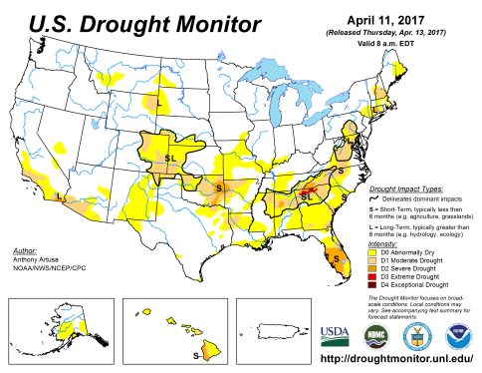
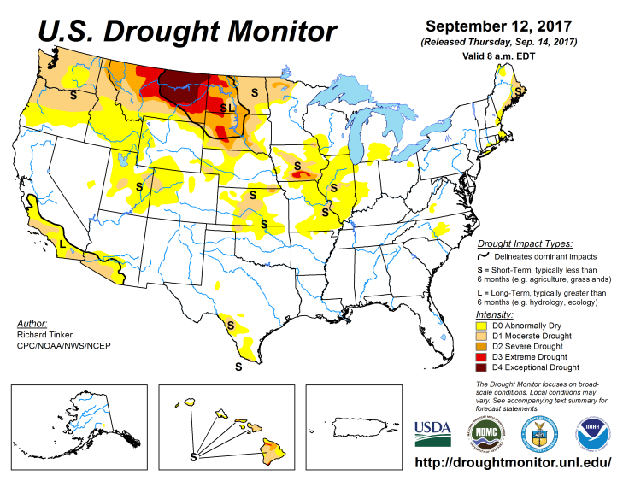
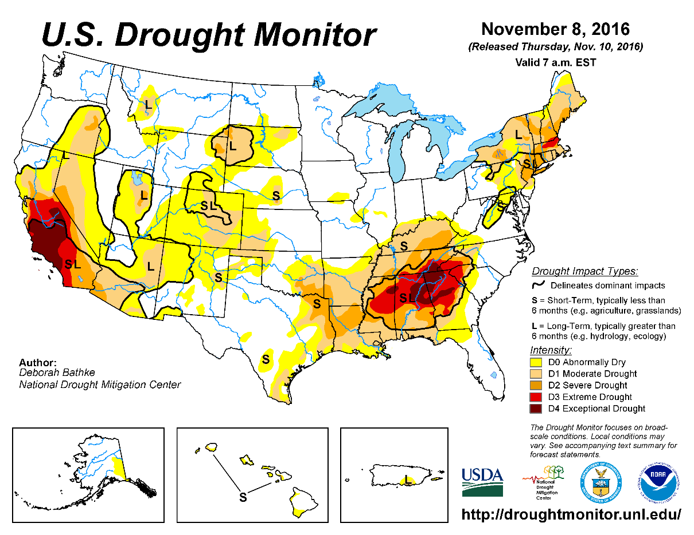
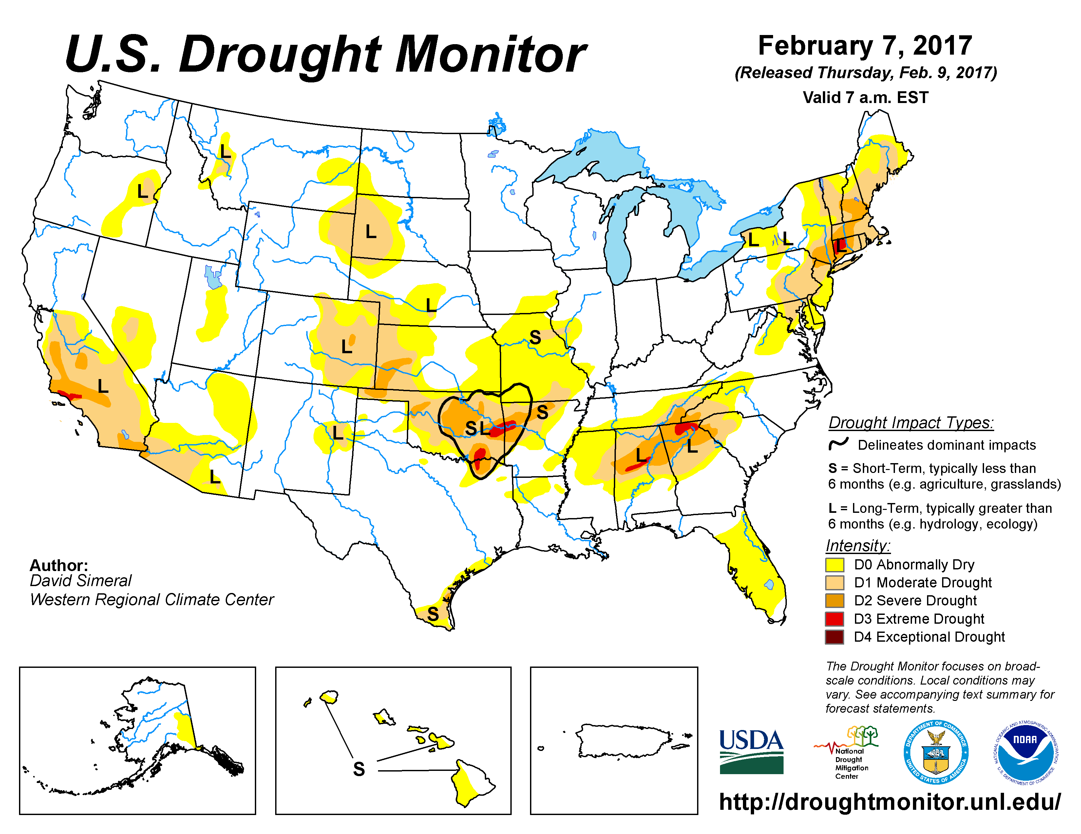
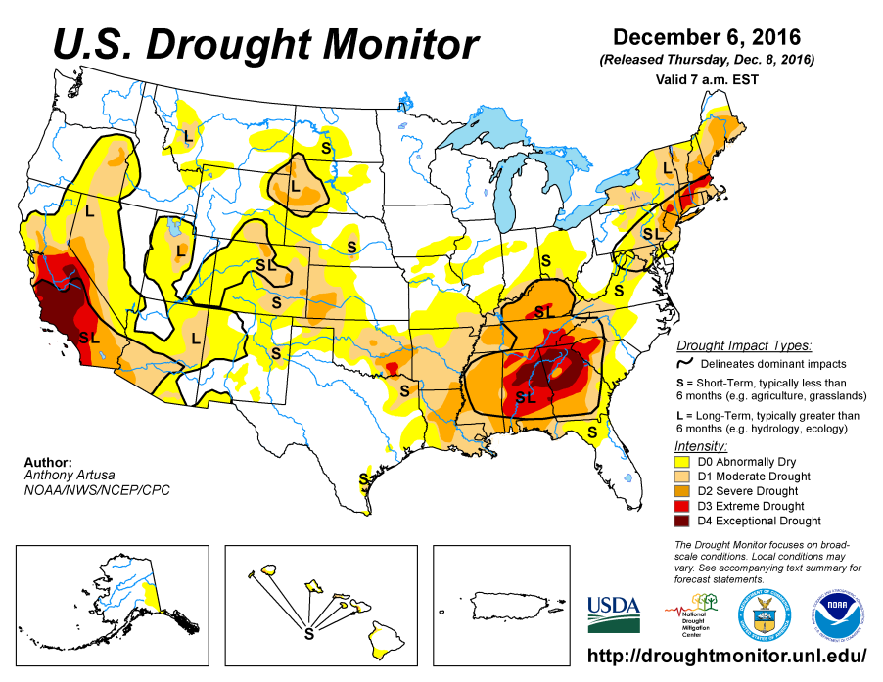
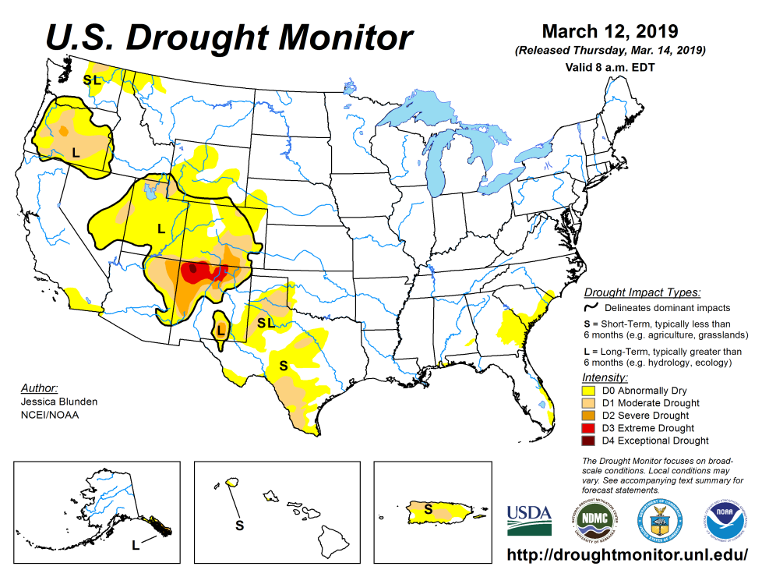
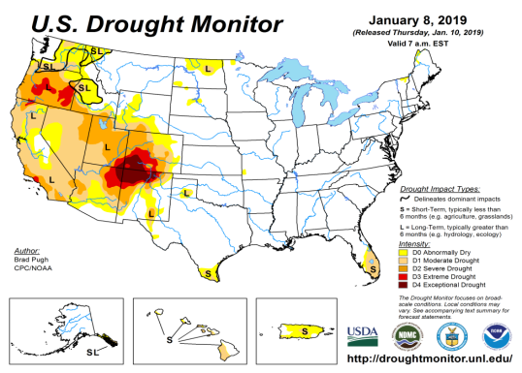
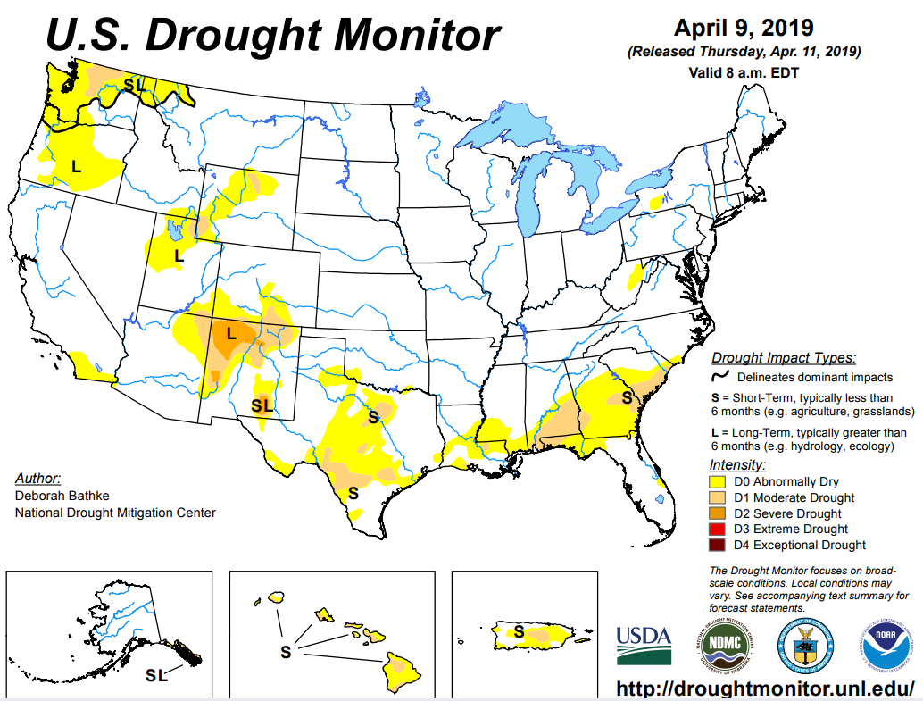
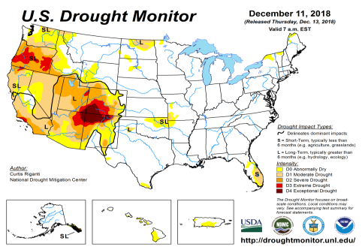
Drought Monitor
The sequence of drought monitor maps, month apart, over the last 5 months, shows the gradual and steady improvement in the drought conditions .
According to the DM:
California is almost virtually drought free, as well as Florida, another big state, where drought related impacts are huge.
Drought Development in the southeast along the coast. But Was it forecast?
March
February
January
Recent/Latest
December
Will this go away before end of April?

Slide 3
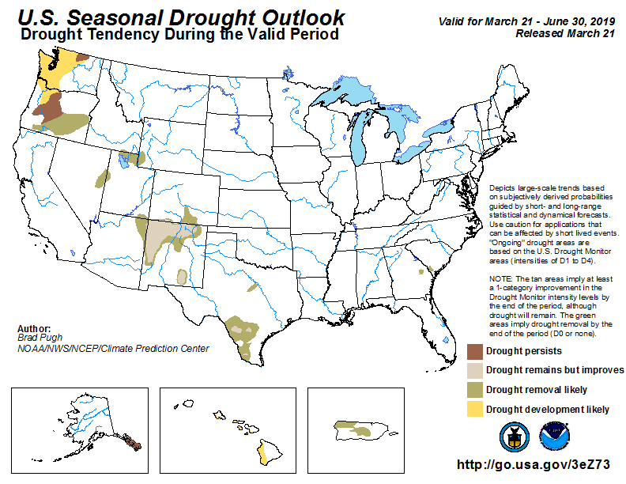
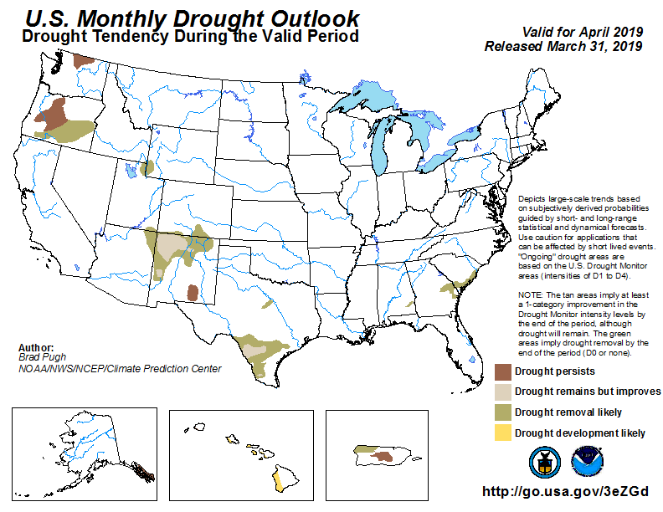
(Prev) Seasonal/Monthly Drought outlooks
(New Seasonal Drought Outlook to be released in 2 days!)
Seasonal Outlook (Mid March 2019 - June 2019)
issued 3/21/19
Monthly outlook
(for April 2019)
issued 3/31/19
General improvement in the drought conditions overall has been forecast by both Monthly and Seasonal Drought Outlooks.
?

Slide 4
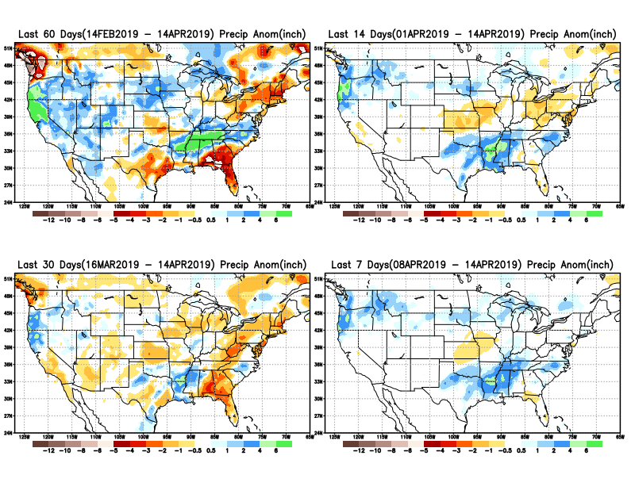
Precipitation ANOM during last 7, 14, 30, & 60 days.
Developing dryness along the Gulf coast and south central TX.
Big deficits in western WA and OR.

Slide 5
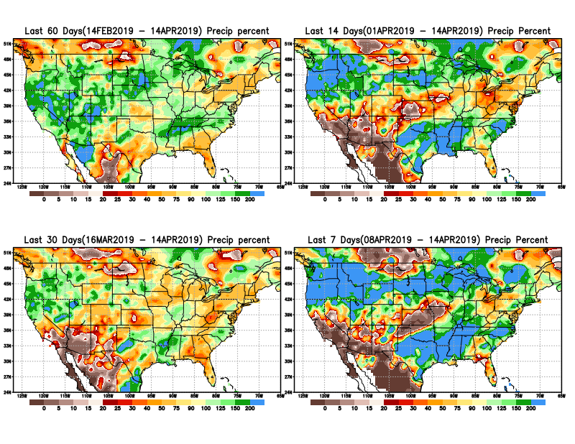
Precipitation Percent during last 7, 14, 30, & 60 days.
NOW !

Slide 6
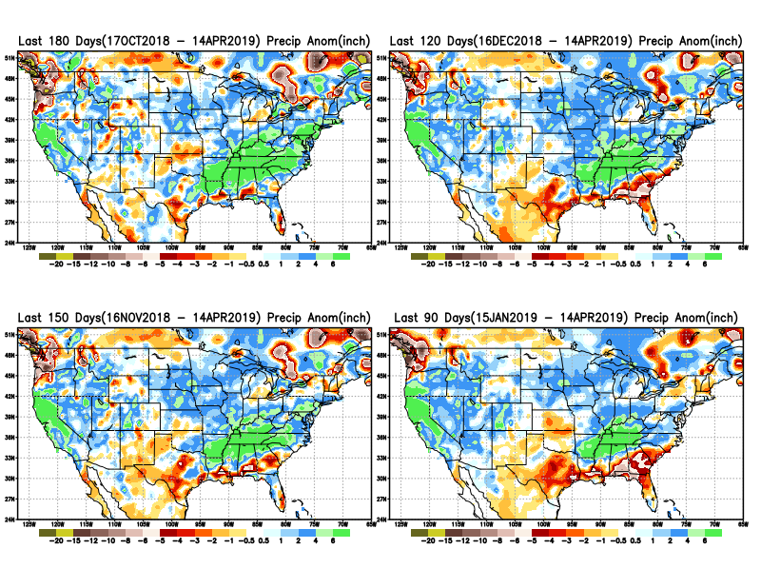
Total precipitation ANOM during last 3, 4, 5, and 6 months.
6 M
4 M
5 M
3 M

Slide 7
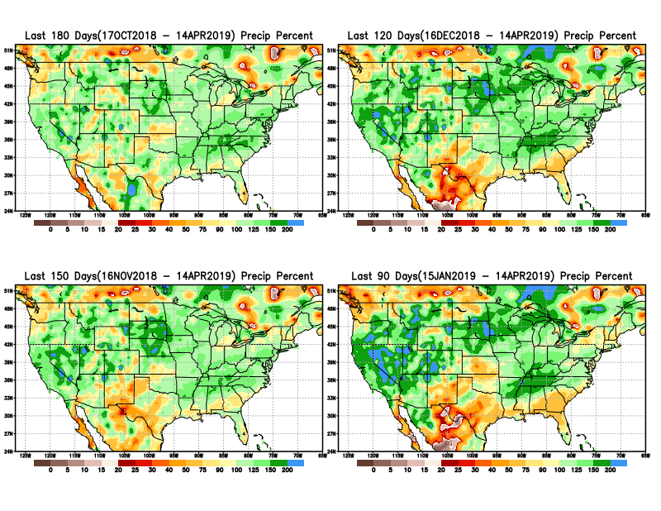
Total precipitation Percent during last 3, 4, 5, and 6 months.
6 M
4 M
Caution:
In 2017 Northern Plains Drought here started with similar deficits at about this time.
M
3 M
I made this remark last month:
“Need to keep an eye for possible developing drought here and in general along the Gulf coast.”

Slide 8
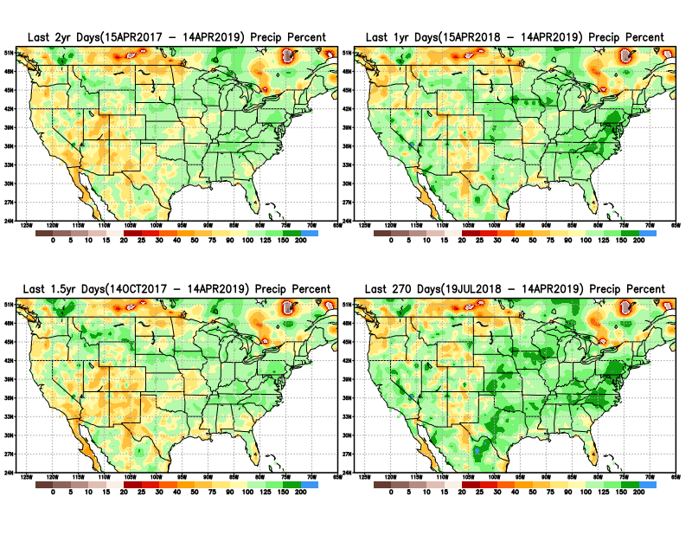
Total precipitation Percent during last 9 months, 1 yr, 1.5yrs, & 2 yrs.
2 Y
1 Y
Rainfall Data issues? Few observations, rugged terrain, interpolation problems!!
1. Y
9 M
Long term rainfall deficits >1 year still exist in the southwest.
Does this really matter or not? Since it does not matter much to Drought Monitor!!

Slide 9
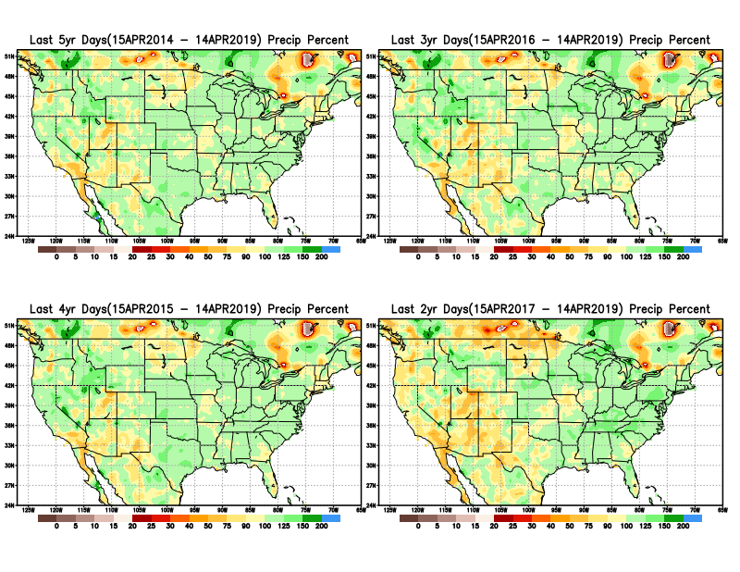
Total precipitation Percent during last 2 yrs, 3 yrs, 4 yrs, & 5 yrs.
5 Y
3 Y
Still longer term rainfall deficit variability in play? Especially in the southwest!
Will these deficits ever go away, OR is these part of the new norm??
4 Y
2 Y

Slide 10
Rainy (3-month)Season across the US

Slide 11
Upcoming rainfall season MJJ in the Northern Plains? Remember 2017!!
Adapted from Rich Tinker.

Slide 12
Adapted from
Rich Tinker

Slide 13
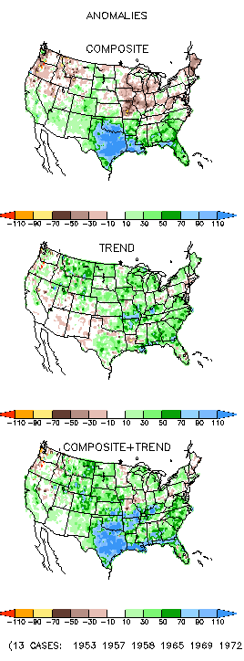
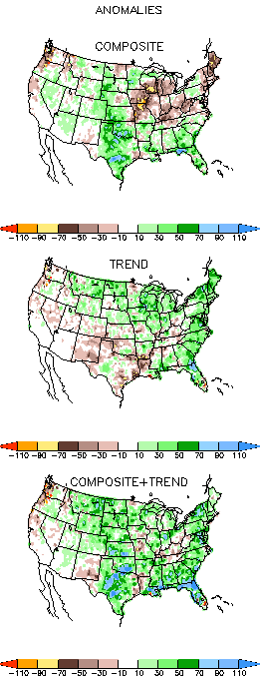
EL NINO Precip COMPOSITES
AMJ
MJJ
Next 2-3 months is critical for signs of any developing dryness in the Northern Plains and the southeast Gulf coast – especially with the ongoing El Nino impacts!!

Slide 14
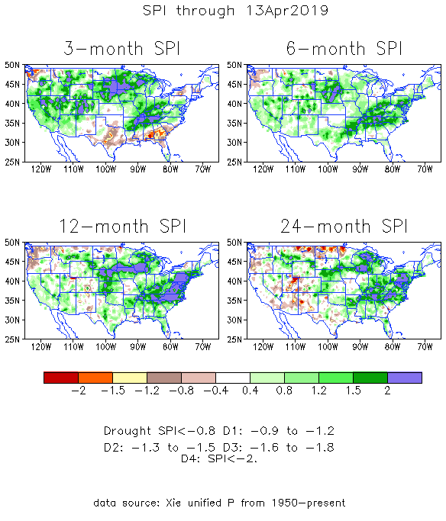
The Standardized Precipitation Index SPI (based on Observed P)
----- NOW
Very interesting graphic & details for the drought across the US based on the more generalized precip deficit/excess, the Standardized Precipitation Index (SPI).
The dark brown and red colors, indicating standardized precipitation deficits, in the various time periods, approximately correspond to the appropriate short/long term drought monitor regions and their intensities
In the short term (~3 mo) dryness is developing along Gulf coast and in southern TX.
In the 6m-9m time scale, drought in OR/WA continues.
In the longer term ~12m-24m and longer, rainfall deficits remain in the AZ/NM/UT/CO states area.

Slide 15
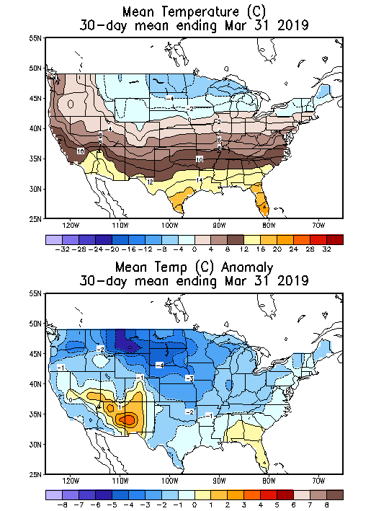
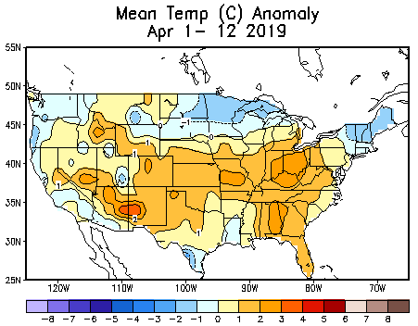
Recent US Temperatures
The NorthernPlains Temps. are not that warm at least so far! How will it be in the upcoming months!!

Slide 16
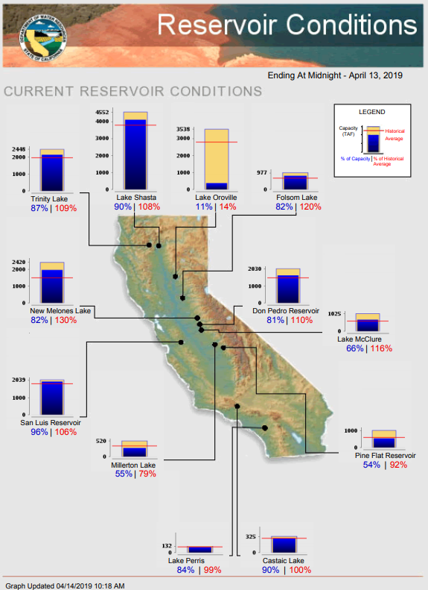
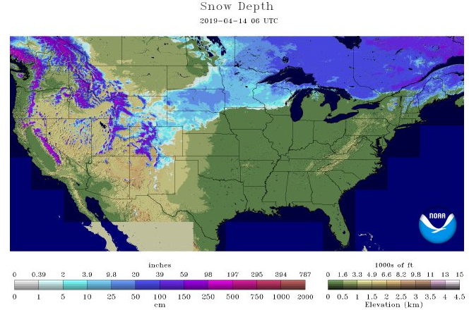
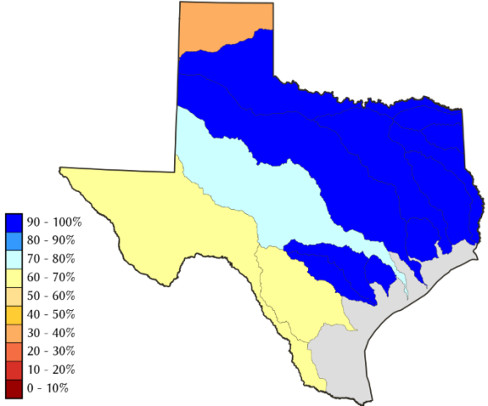
Water Reservoir Levels in some Western/Southern States! And Snow Depth!!
Northern CA reservoirs beginning to show
Weakness, but rainy season coming up!
Reservoir Storage Summary for River Basins
TX
https://fsapps.nwcg.gov/afm/index.php

Slide 17
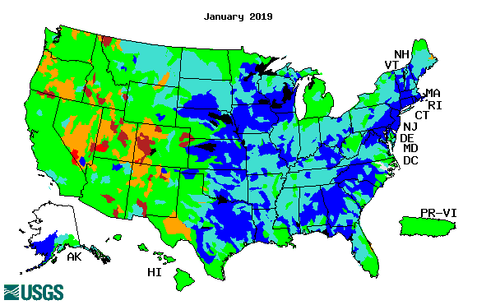
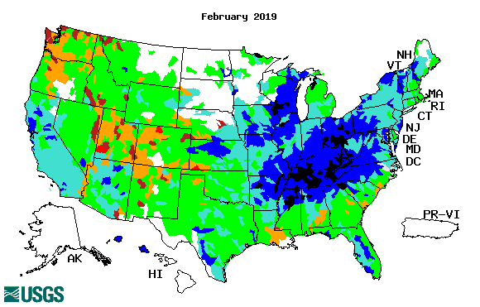
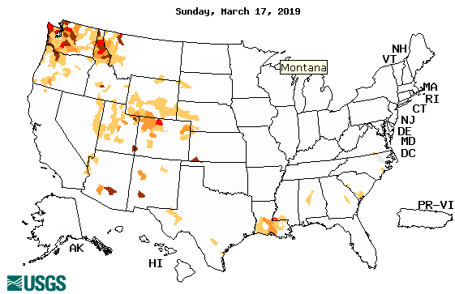
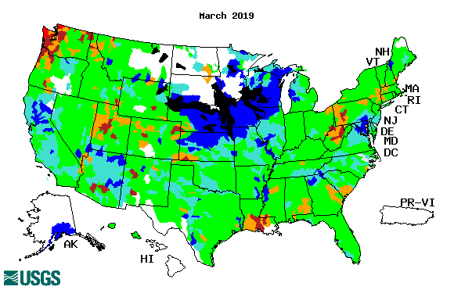
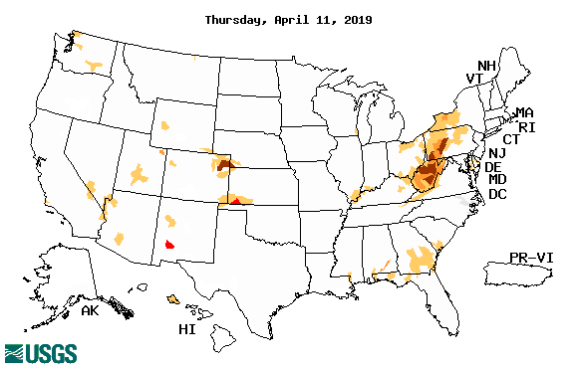
Streamflow (USGS)
Streamflow very good in Texas & eastward.!
Washington and Oregon stream flows slightly worse than last month.
New weakened streamflows along/near Gulf coast in February and in March.
Map shows only below normal 7-day average streamflow compared to historical streamflow for the day of year.
One month ago (left) &
Now (below)
17

Slide 18
EL NIÑO/SOUTHERN OSCILLATION (ENSO)
DIAGNOSTIC DISCUSSION
issued by CLIMATE PREDICTION CENTER/NCEP/NWS and the International Research Institute for Climate and Society
11 April 2019
ENSO Alert System Status: El Nino Advisory
Synopsis: A weak El Nino is likely to continue through the Northern Hemisphere summer 2019 (65% chance) and possibly fall (50-55% chance).

Slide 19
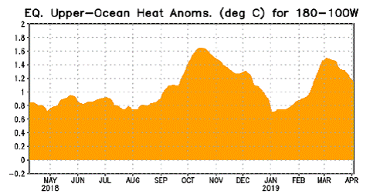
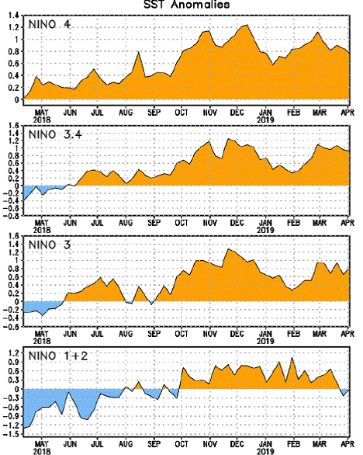
Latest values of SST indices in the various Nino Regions.
The sub surface heat anom continues to stay in the +ve territory! .
?
Relatively short lived!

Slide 20
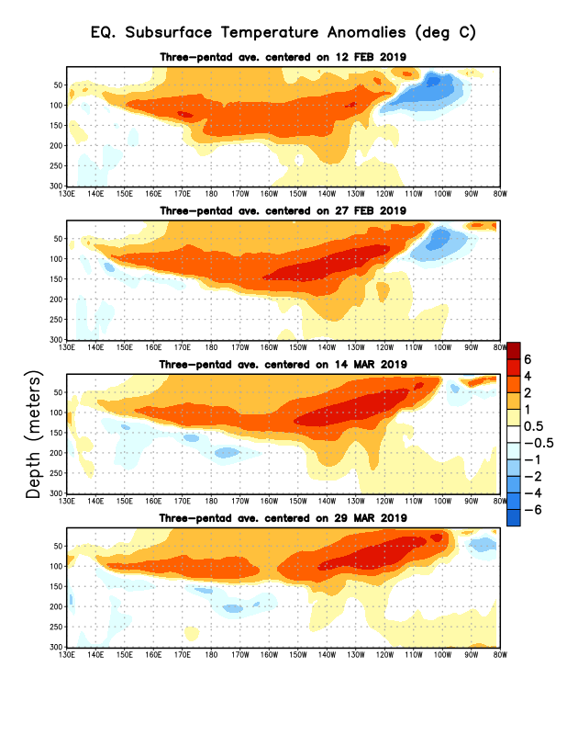
Sub-Surface Temperature Departures in the Equatorial Pacific
Where are we in the EL Nino cycle? Near peak? Will it strengthen further?
Most recent pentad analysis

Slide 21
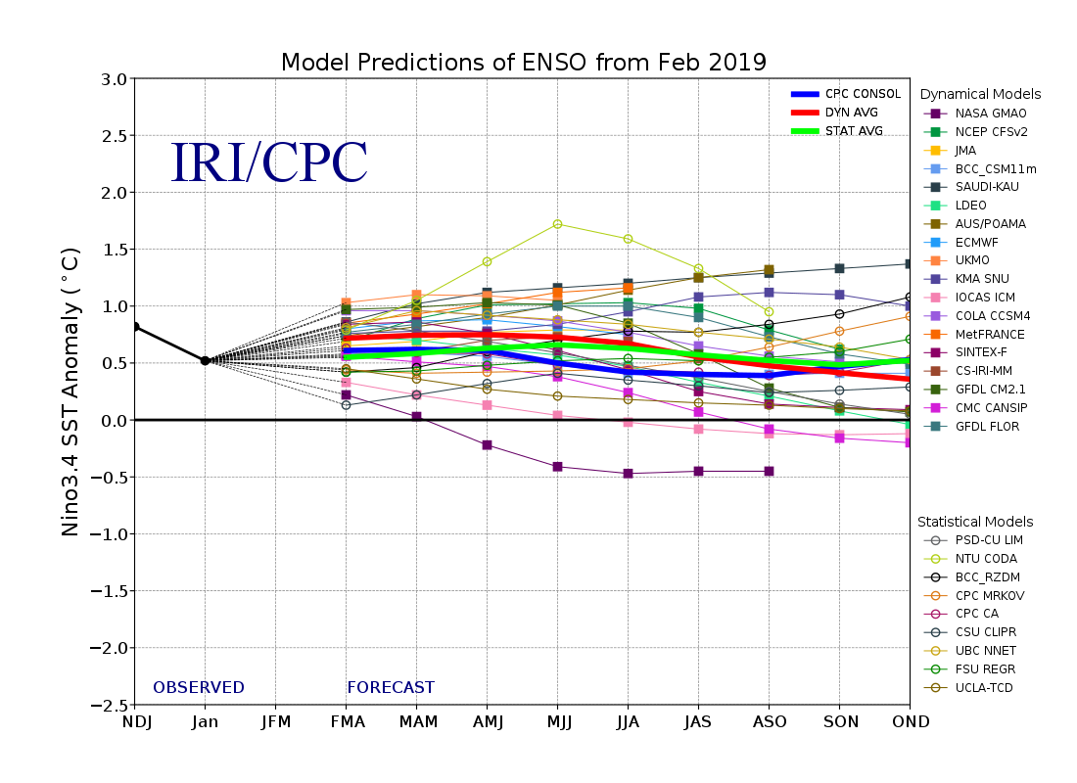
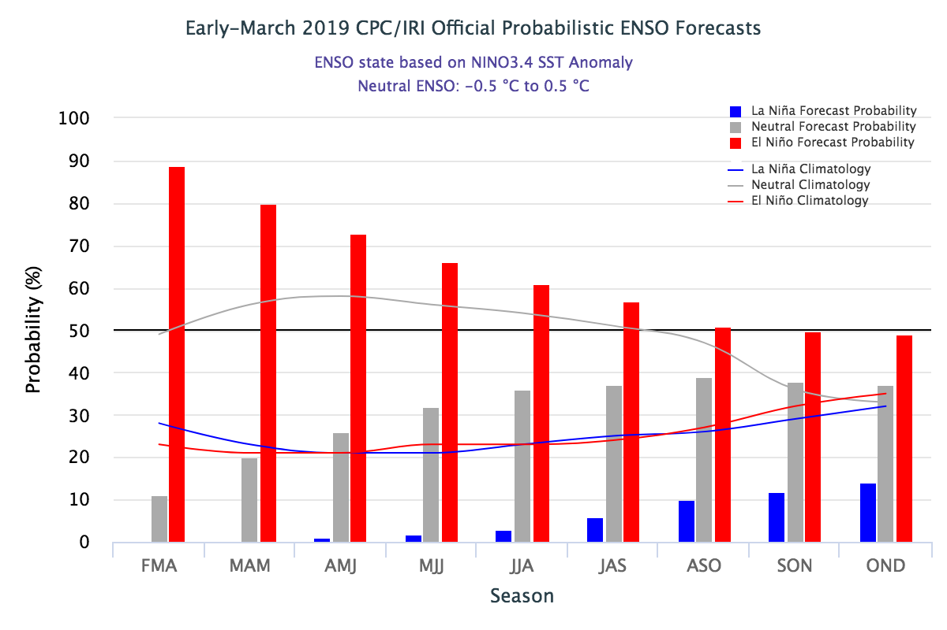
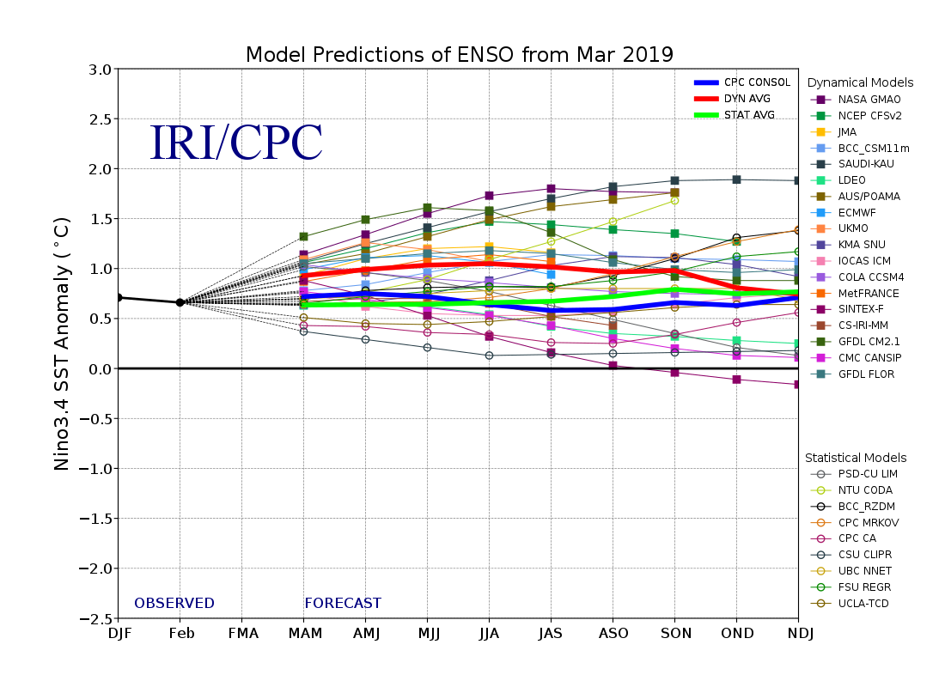
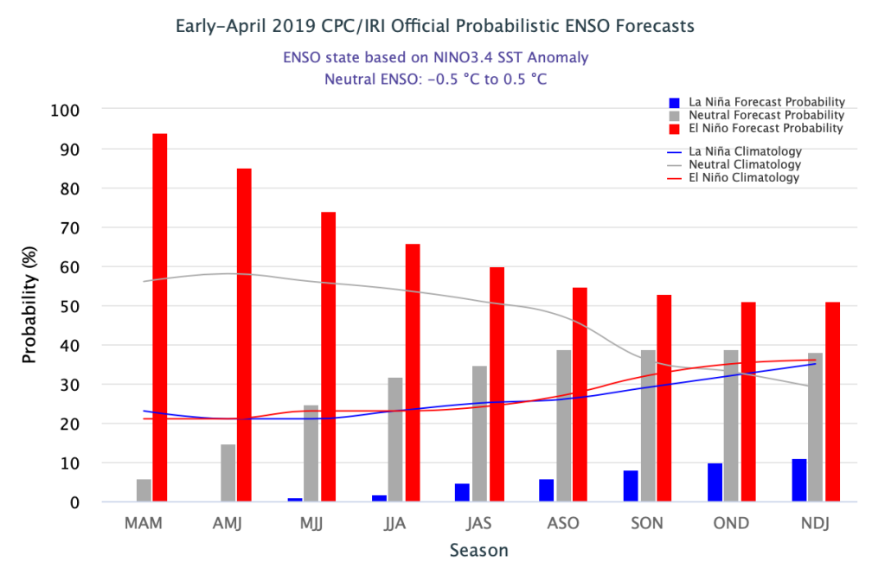
ENSO Forecasts
Early- March CPC/IRI forecast
Early- April CPC/IRI forecast
A renewed kick upward this past month in ElNino continuance probability through Spring.

Slide 22
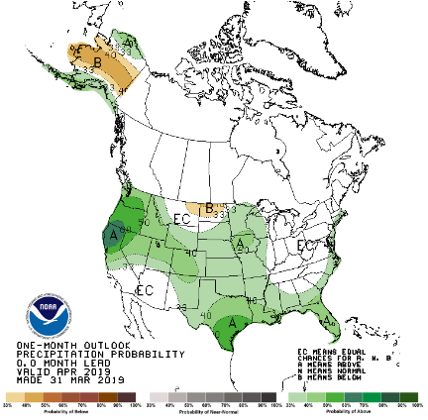
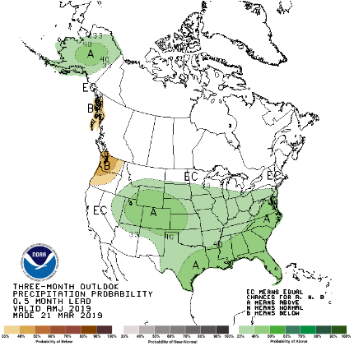
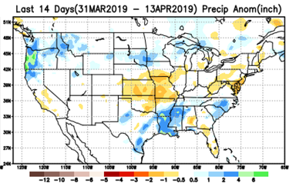
Previous(Last month)
CPC’s official Monthly (Apr)/Seasonal (AMJ)
Precipitation outlook
Released Mar 31st
Released Mar 21st
Observed so far this month!!
☺

Slide 23
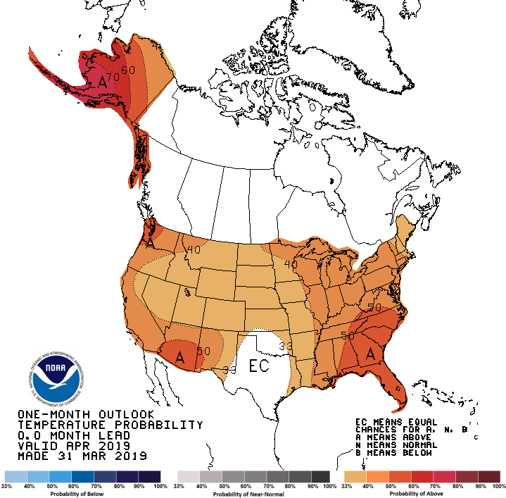
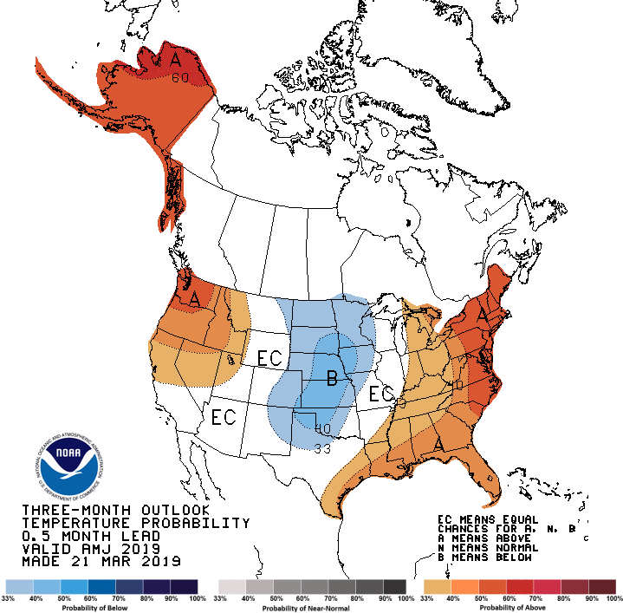
Previous CPC’s official Monthly (Apr)/Seasonal (AMJ)
Temperature outlook
Made
Mar 31st
Observed so far this month!! ☺
Made Mar 21st

Slide 24
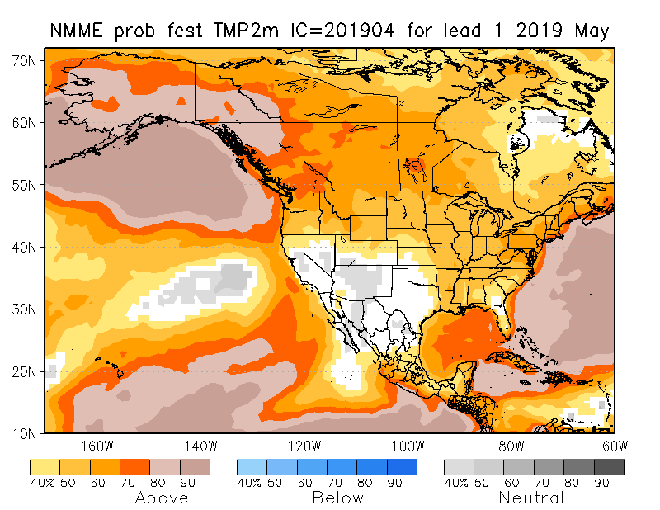
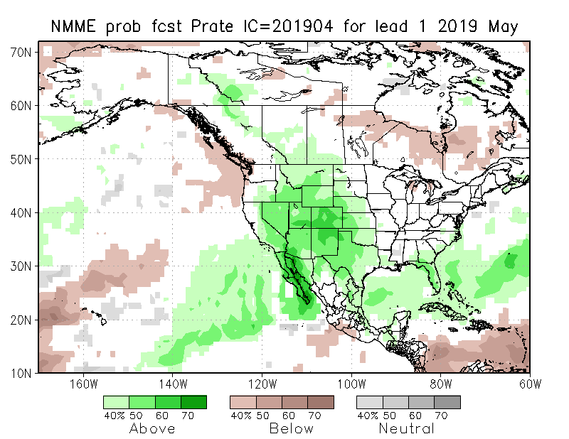
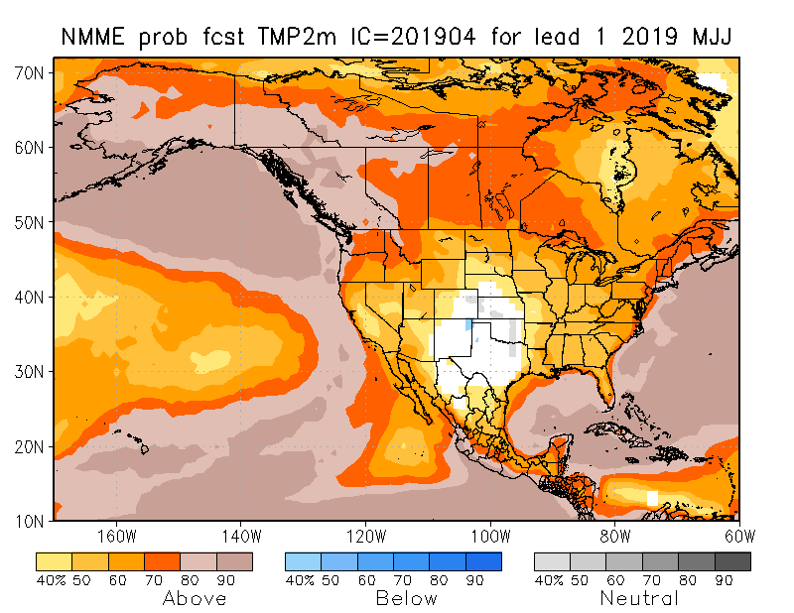
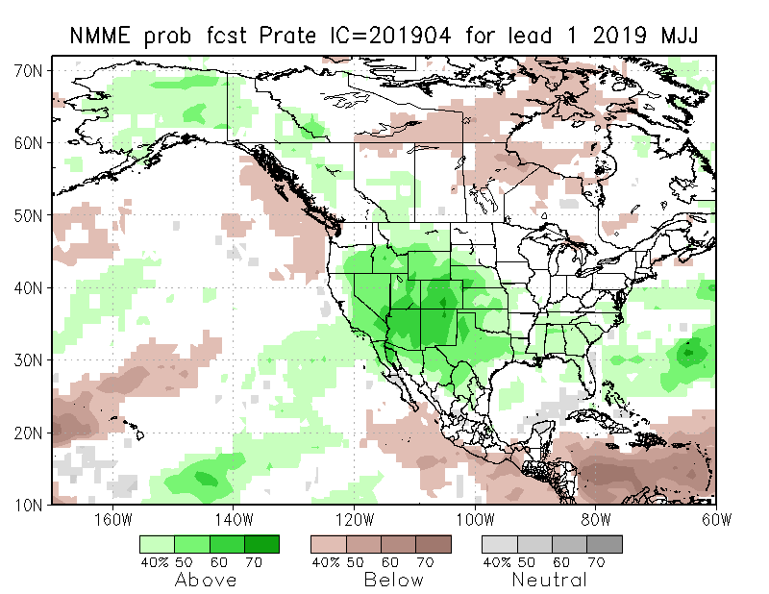
NMME T & P EnsMean forecasts
May
MJJ
If this verifies will very much help conditions here.
Forecast is based on El Nino conditions!! El Nino is expected to continue through Spring.

Slide 25
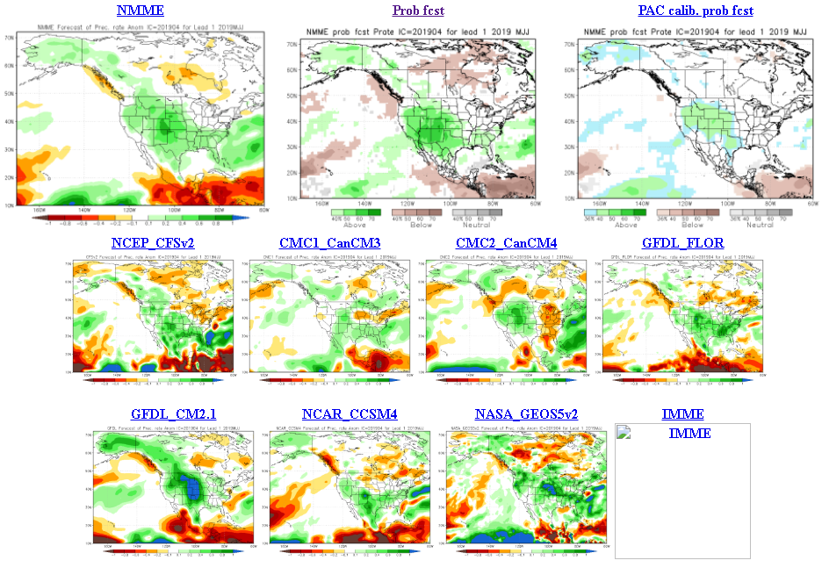
The agreement/uncertainty among the diff. NMME models’ forecasts (middle and bottom panels) for Mar-Apr-May Precipitation!!!
25

Slide 26
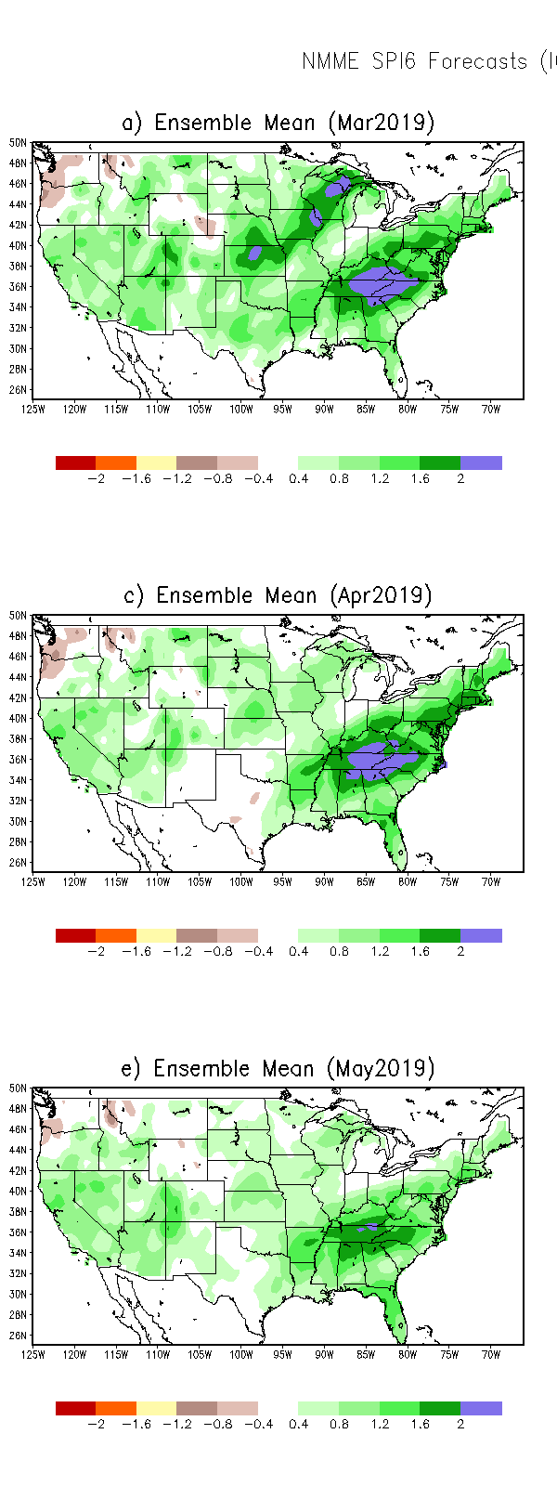
SPI3
SPI6
SPI12
SPI3, SPI6
& SPI12
Forecasts from 6NMME Models
(uses obs. P up to past month, and forecast months’ P from NMME models)
The goodness and skill of these SPI’s forecasts depend directly on the NMME models’ skill in predicting precipitation!!!

Slide 27
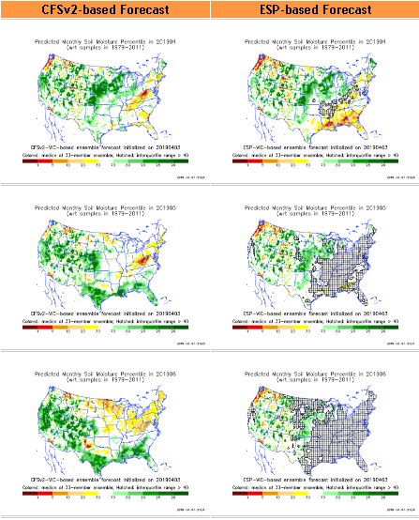
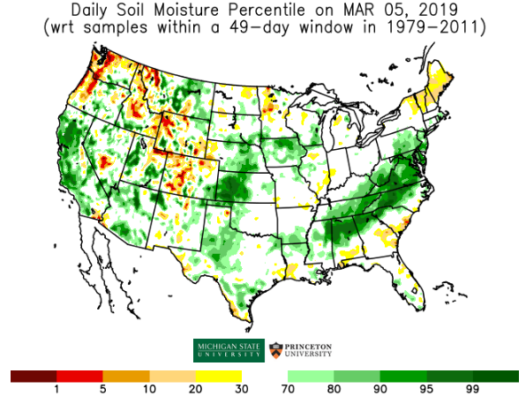
http://drought.geo.msu.edu/research/forecast/smi.monthly.php
Predicted Monthly Soil Moisture Percentile
With Soil Moisture Percentile
Initial Conditions: 3/5/2019
Latest Initial Conditions: 4/2/2019
Developing dryness here by June
Before
Recent Rains
Here!!
The inter quartile range suggest greater uncertainty about the forecast in these shaded regions.

Slide 28
Recent 30 days mean SM percentile.
dryness in the southeast Gulf coast is evident. Quite a bit of variability among models.

Slide 29
Precipitation
NASA GEOS 5 Model
Precipitation & Soil Moisture Forecast
Apr 2019
Soil Moisture
May 2019
IC
4/19
Jun 2019
5/19
2018
6/19

Slide 30
Monthly Drought Tendency in Probability
made this month for next month(May)
made last month for this month(April)
Based on NMME models’ (dis)agreement in their precipitation forecasts’ computed SPI!!

Slide 31
Seasonal Drought Tendency in Probability
Based on NMME models’ (dis)agreement in their precip forecasts’ computed SPI!!

Slide 32
Summary
Current ENSO status and forecast. Weak A weak El Nino is likely to continue through the Northern Hemisphere summer 2019 (65% chance) and possibly fall (50-55% chance).
Current Drought conditions:
According to the two weekly Drought Monitors in April, D0-D1 drought conditions have begun to develop along the Gulf Coast and in large parts of Texas, consistent with 2-3 months rainfall deficits in the region.
Slowly, but steadily the recent winter rains has made a big dent thus leading to marked improvement and even elimination of drought in some areas over the western states and parts of the Southwest.
Compared to previous couple of months, the state reservoirs are more full, stream flow has now improved in California and near the four corner states area, but slightly worsened in the far northwest and over parts of Oregon and Washington states. Small pockets of weakness in streamflow are also emerging along/near the Gulf coast, consistent with below normal rainfall in the region over the past 3-4 months.
However, in the 12m-24m and even longer time scales, rainfall deficits still remain over large areas in the southwest and west, which is not completely reflected in the drought monitor!
Prediction:
The relative dry conditions in portions of Northern Plains at this time is somewhat similar to the conditions that existed in 2017 prior to the drought that followed later. Hence rainfall as well as temperature forecasts on all time scales (from week/s to season) have to be watched with great care, so a repeat of 2017 does not happen this year, given that the rainfall season(MJJ) in this region is coming up. At this point development of D0/D1 conditions is probably likely within the next month!
The ongoing weak El Nino conditions to continue in that form through the Spring/Summer season, if it has the typical canonical rainfall impacts from southeastern Texas eastward (LA?) will considerably ease and even remove the drought conditions here for the upcoming season (MJJ), but for the month of May, it may stay but improve!
Overall, short term improvement is expected in the drought conditions over much of the western states especially OR and CA and in the four corner states of AZ/NM/UT/CO region, but the longer term drought is likely to persist but improve.
**END***

Slide 33
WPC Next 7 days QPF Forecast
GFS Model Guidance for next 16 days.

Slide 34
Miscellaneous maps

