Slide 1
Drought Outlook Support Briefing
April 2020
Climate Prediction Center/NCEP/NOAA
http://www.cpc.ncep.noaa.gov/products/Drought
Phone: 1-877-680-3341
Pwd: 858747#

Slide 2
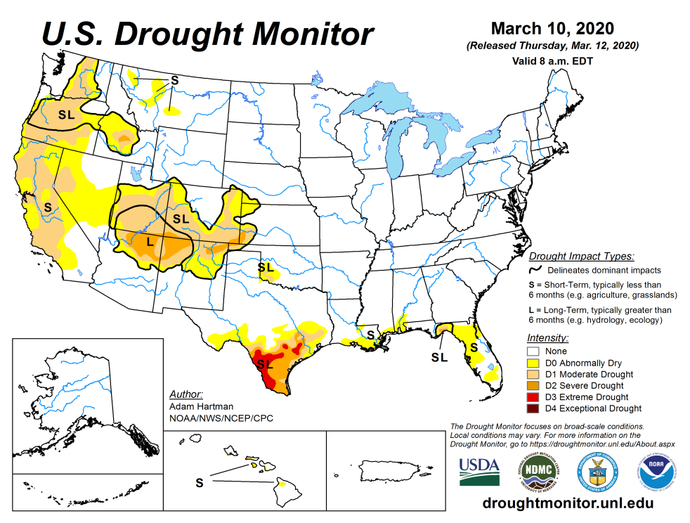
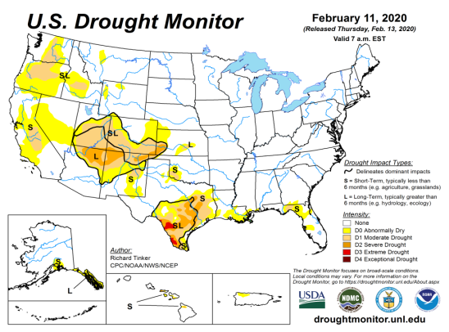
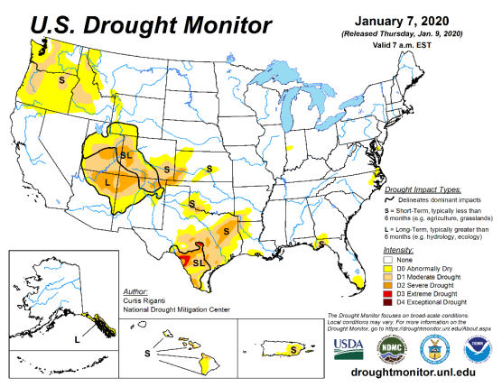
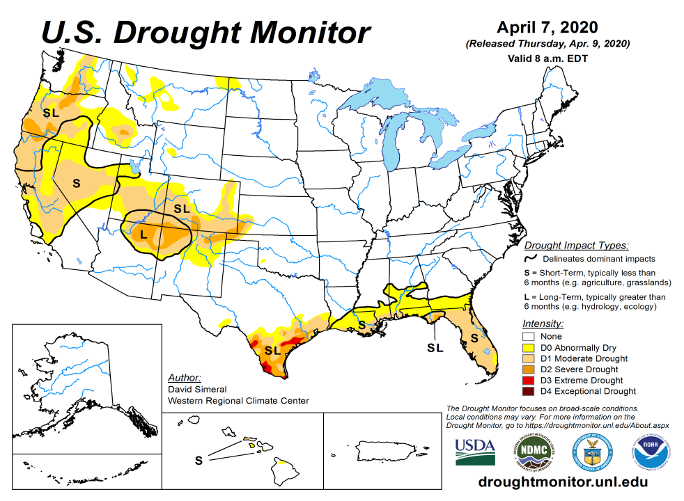
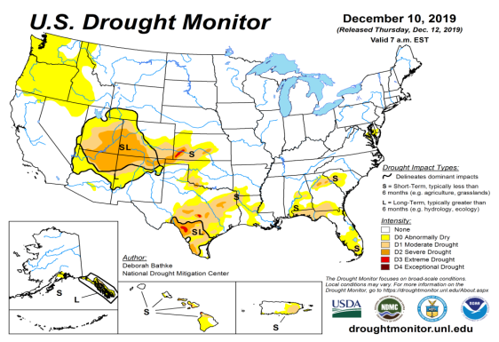
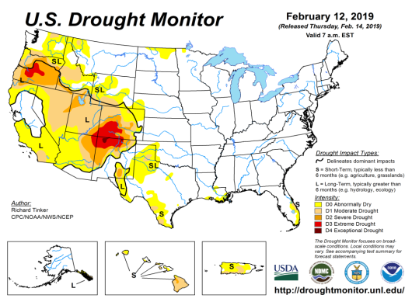
Drought Monitor
March
February
Monitoring is important because, unlike US T/P fcsts, for drought forecasts, we have to know where we are, before we can tell where we are going!!
Drought forecasts are tendency forecasts.
Over the last several months, drought, overall has increased in area across the South and the West.
The short/long term drought in the four corner states area (AZ/NM/ UT/CO) continues to present/survive in some form/shape or other.
Existing and new Drought in CA/OR/WA/NV/ is slowly getting bigger and in strength.
Drought in southern TX has shrunk in size, but new short term drought has recently emerged along the Gulf coast.
January
April
(Recent/Latest)
December
February

Slide 3
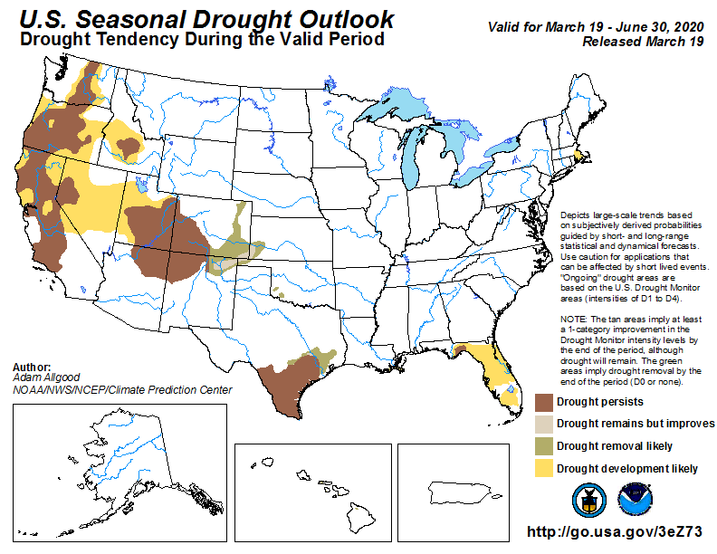
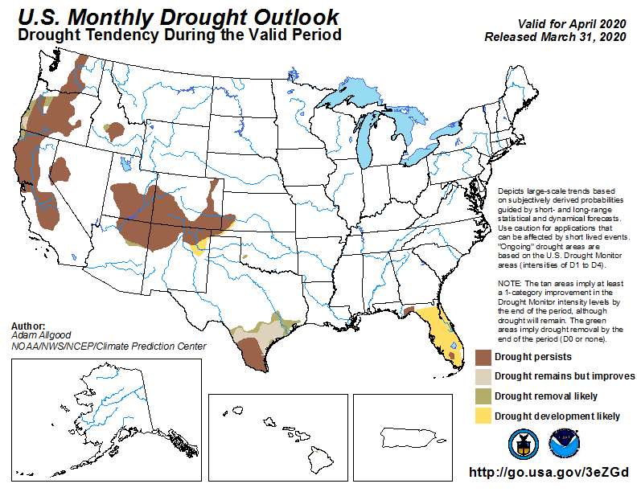
(Prev) Seasonal/Monthly Drought outlooks
(New Seasonal Drought Outlook to be released in 2 days!)
Seasonal Outlook
(Mid Mar 2020- June 2020)
issued 03/19/20
Monthly outlook
(for April 2020)
issued 03/31/20
  It was recommended at this briefing last month, “Very small pockets of drought in the southeast may continue to linger, and the FL dryness may worsen in the short term (month) before it gets better by the end of the forecast (AMJ) season, when seasonal rains will begin”.
  Also I suggested, “Parts of NV will likely see emergence of new dry/drought regions.”

Slide 4
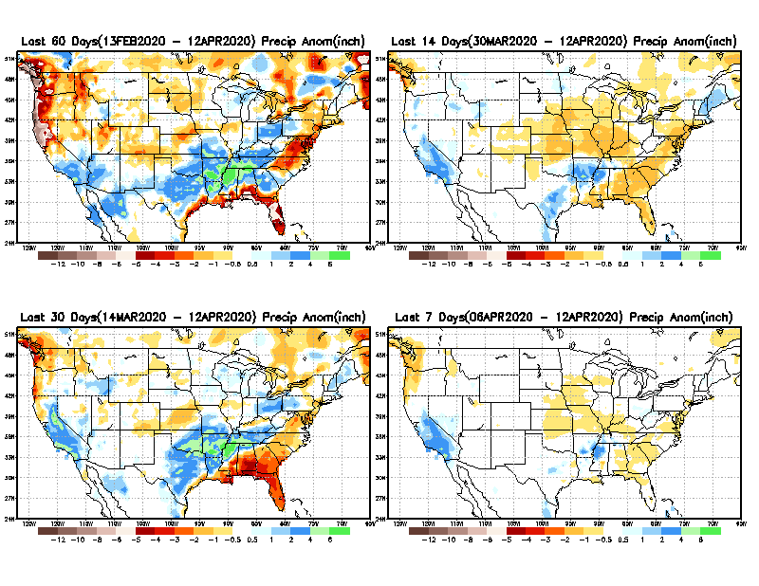
Precipitation ANOM during last 7, 14, 30, & 60 days.
60 Days
14 Days
These maps in this and following slides, including
a) Anom and b) Percent of precip. in these and other longer time ranges. Now daily updated at:
30 Days
7 Days
Alaska was also added here as separate maps recently
From: Recent Accumulated Precipitation https://www.cpc.ncep.noaa.gov/products/Drought/briefing_prcp.shtml

Slide 5
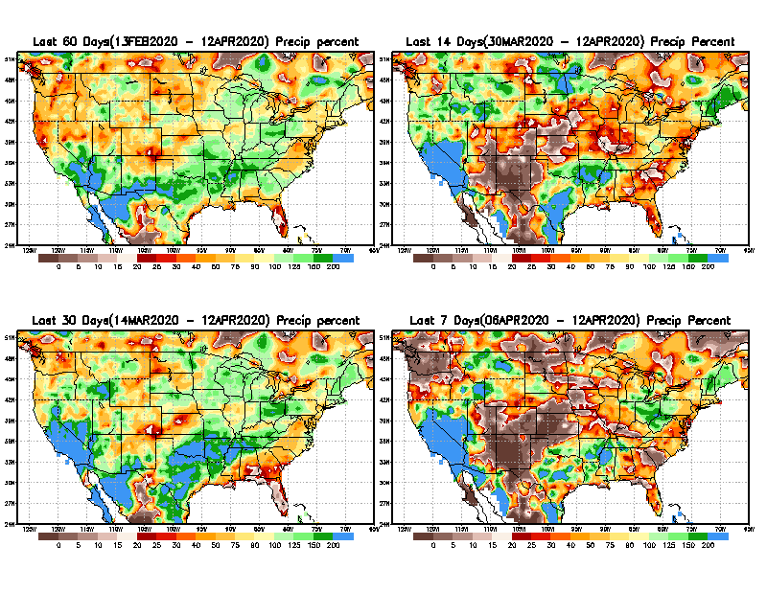
Precipitation Percent during last 7, 14, 30, & 60 days.
60 Days
14 Days
In regions, where the main rainfall season is limited to a few (3-4) months of the year, even one month of large rainfall deficit can be of concern !!
In other regions of relatively broad rainfall months, this need not be a big issue!!
Not yet!
already
30 days
7 Days
Recent rains
already
From: Recent Accumulated Precipitation https://www.cpc.ncep.noaa.gov/products/Drought/briefing_prcp.shtml

Slide 6
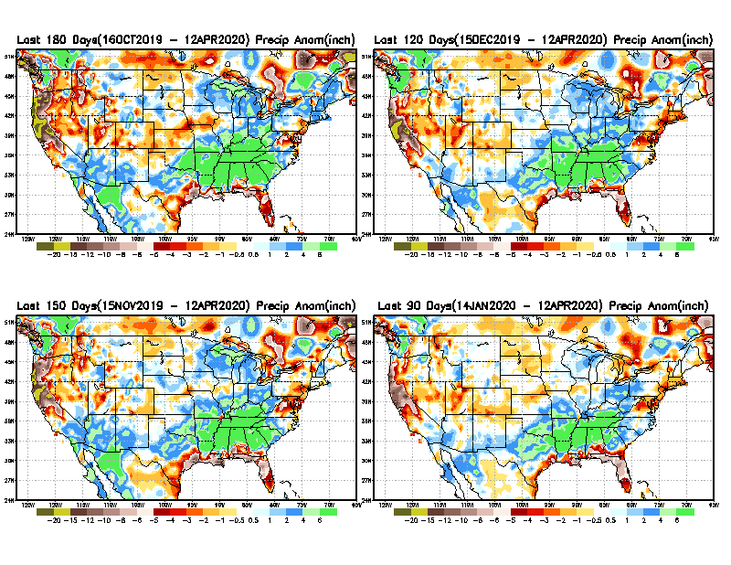
Total precipitation ANOM during last 3, 4, 5, and 6 months.
6 M
4 M
While the Precipitation anomalies deficit may seem large in some regions (compared to others), it is the % of normal precip (next slide) that matters more!!
5 M
3 M
111
From: Recent Accumulated Precipitation https://www.cpc.ncep.noaa.gov/products/Drought/briefing_prcp.shtml

Slide 7
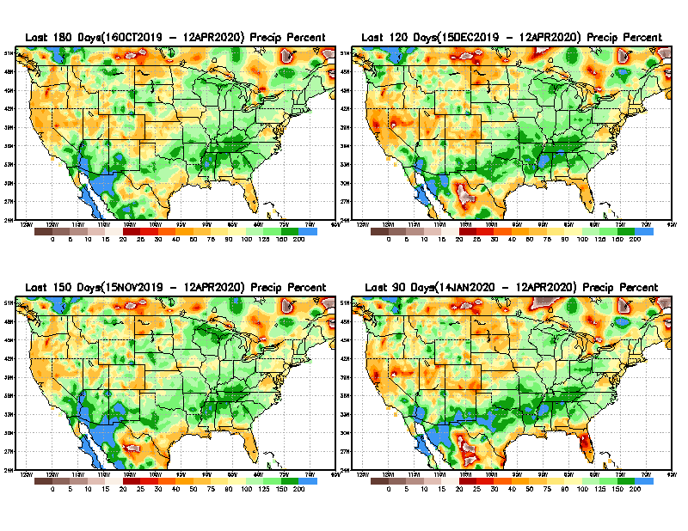
Total precipitation Percent during last 3, 4, 5, and 6 months.
6 M
4 M
In these interim time scale 3-6 months, we need to pay attention to regions, which are dark-red /red & brown (<50%)
5 M
3M
While accrued precipitation deficits are real & objective,
droughts are subjective declarations!!
East vs West!
Broad vs Narrow rainfall season.
With these various rainfall deficits in diff. time ranges, where and how exactly does one declare drought? Other factors (T/SM/E, etc..) do matter, but is cumulative precip. deficits ultimately more important?

Slide 8
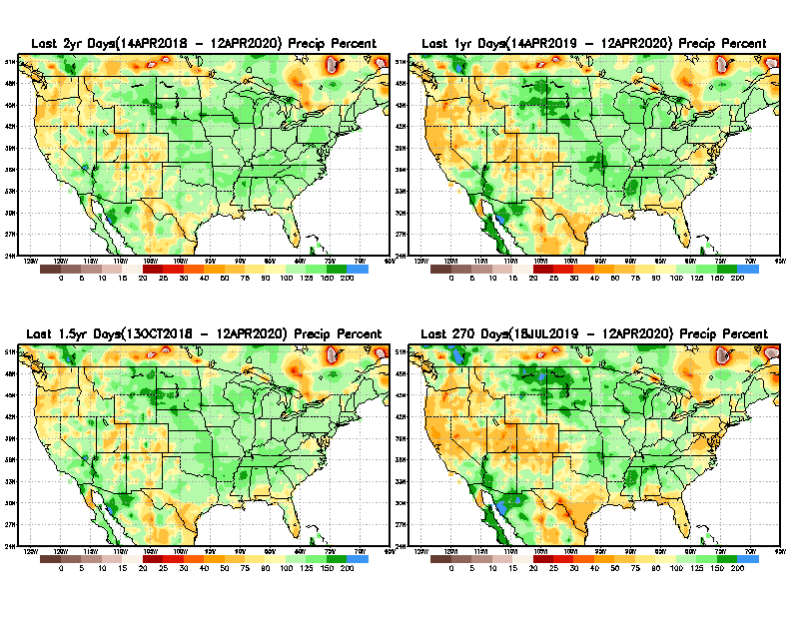
Total precipitation Percent during last 9 months, 1 yr, 1.5yrs, & 2 yrs.
2 Y
1 Y
1.5 Y
9 M
What exactly are the time scales for short(S) and long(L) term drought?
From: Recent Accumulated Precipitation https://www.cpc.ncep.noaa.gov/products/Drought/briefing_prcp.shtml

Slide 9
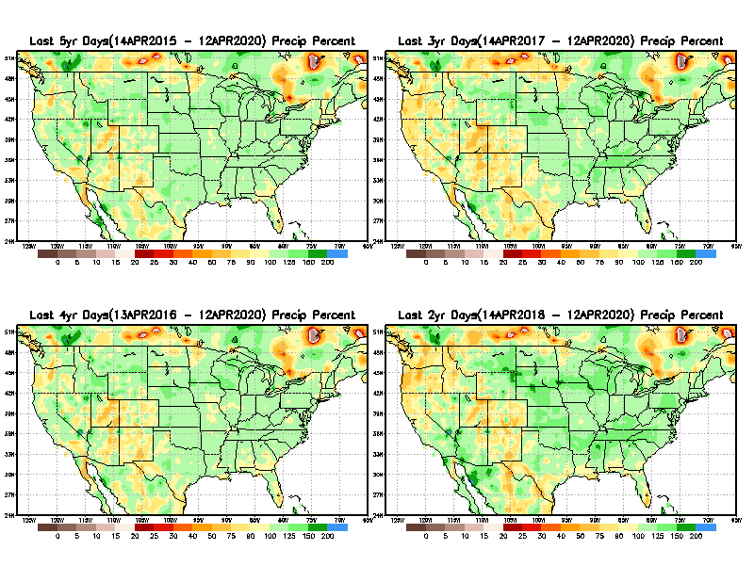
Total precipitation Percent during last 2 yrs, 3 yrs, 4 yrs, & 5 yrs.
5 Y
3 Y
Still longer term rainfall deficit variability in play? Especially in the southwest!
4 Y
2 Y
From: Recent Accumulated Precipitation https://www.cpc.ncep.noaa.gov/products/Drought/briefing_prcp.shtml

Slide 10
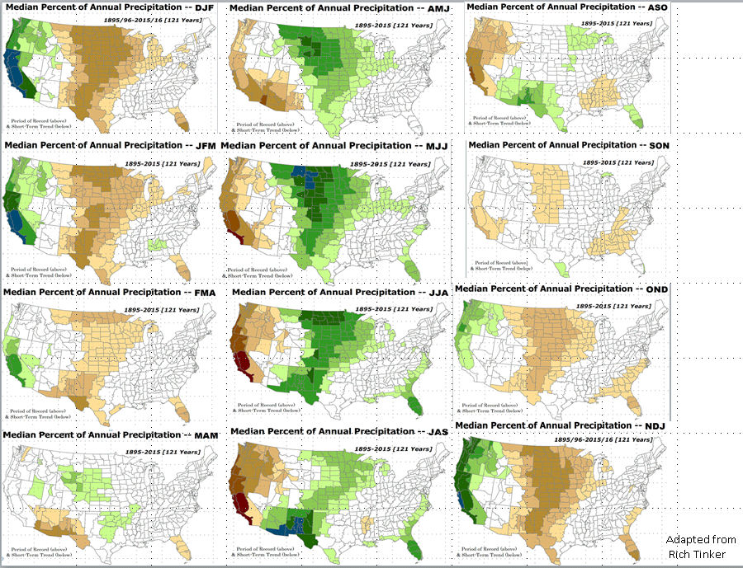

Rainy (3-month)Season across the US
East vs West!
Overall, more white space in the east -> distributed rainfall season (except ~FL).

Slide 11
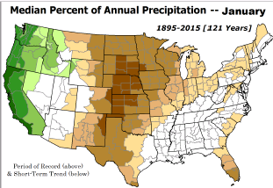
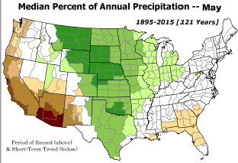
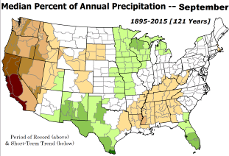
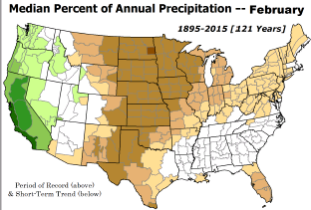
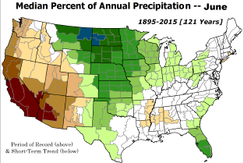
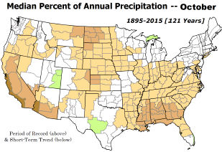

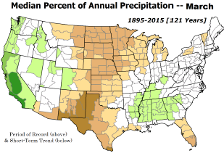
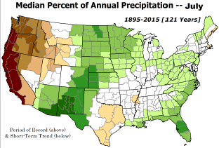
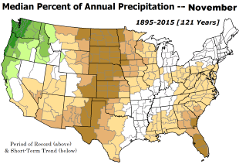
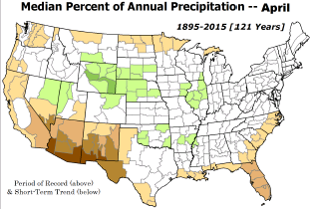
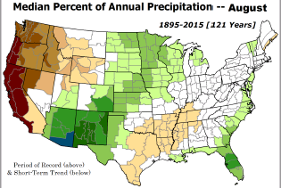
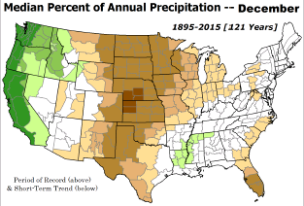
*********
EAST vs
CTR/WEST
Behavior in Drought is loosely tied to rainfall climo!!
*********
Adapted from Rich Tinker.

Slide 12
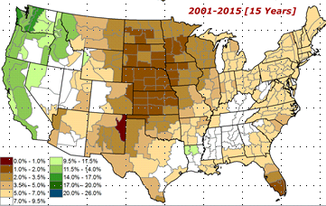
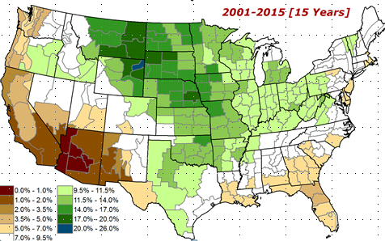
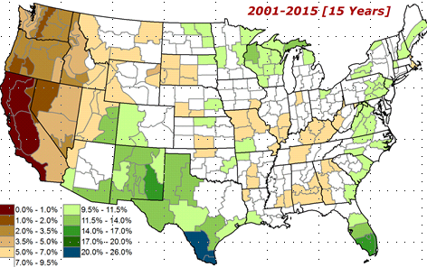
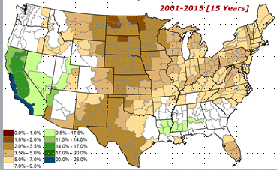
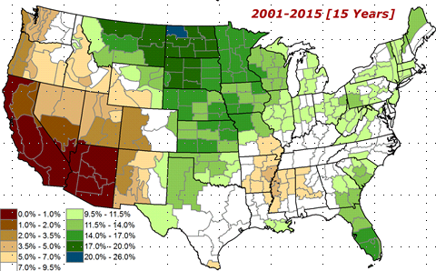
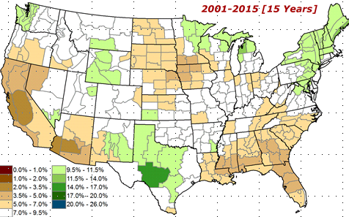

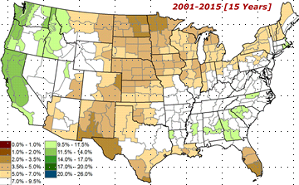
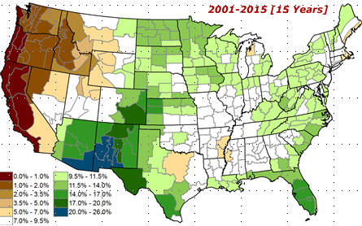
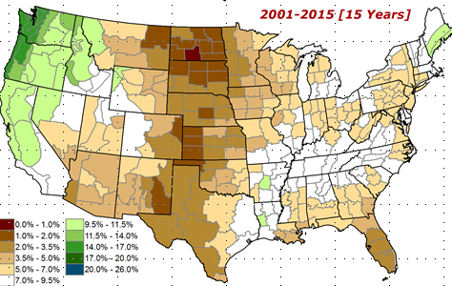
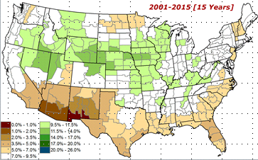
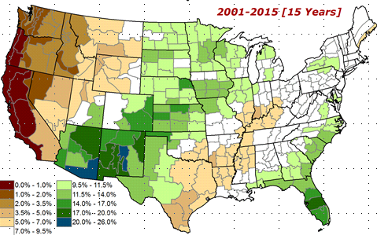
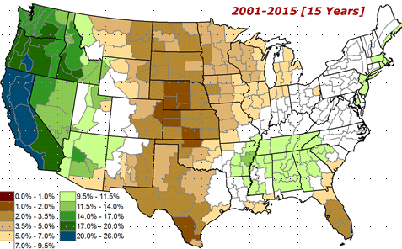
Adapted from
Rich Tinker

Slide 13
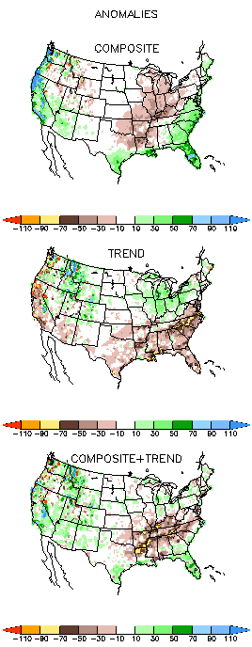
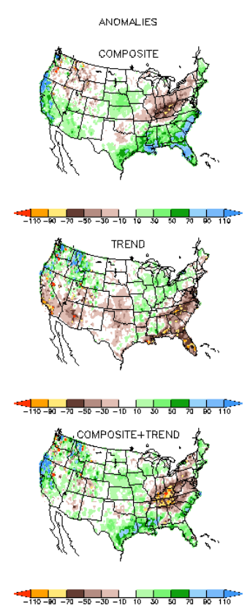
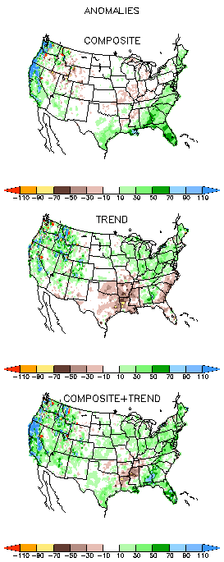
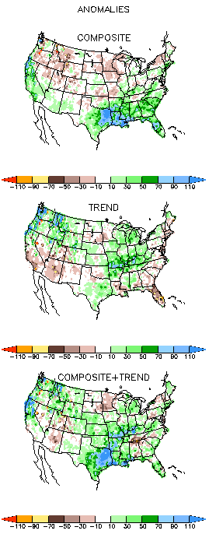
EL NINO Precip COMPOSITES & Trend maps
JFM
FMA
Only this is of relevance to us now due to neutral ENSO status.

Slide 14
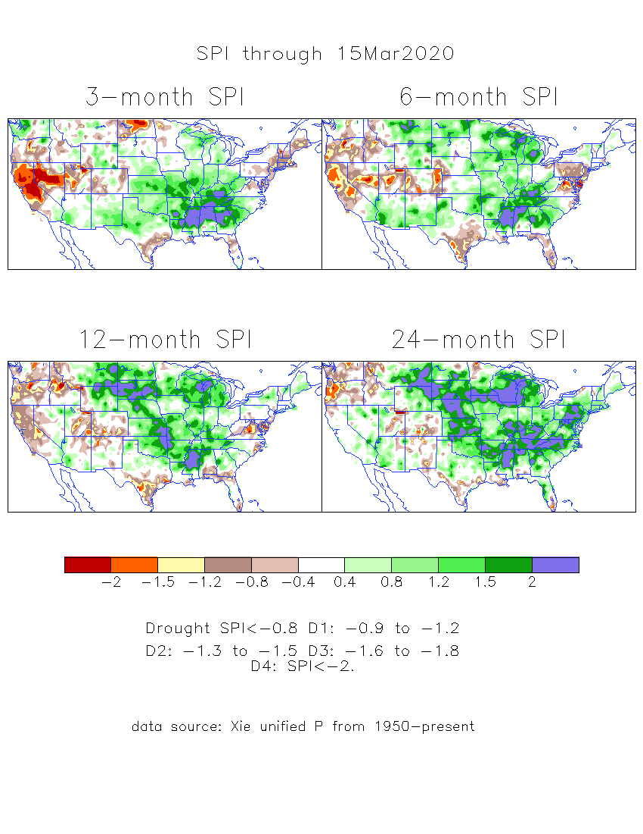
The Standardized Precipitation Index SPI
(based on Observed P)
----- Last Month
Very interesting graphic & details for the drought across the US based on the more generalized precip deficit/excess, the Standardized Precipitation Index (SPI).
The dark brown and red colors, indicating standardized precipitation deficits, in the various time periods, approximately correspond to the appropriate short/long term drought monitor regions and their intensities
Have to keep an eye on this region!!

Slide 15
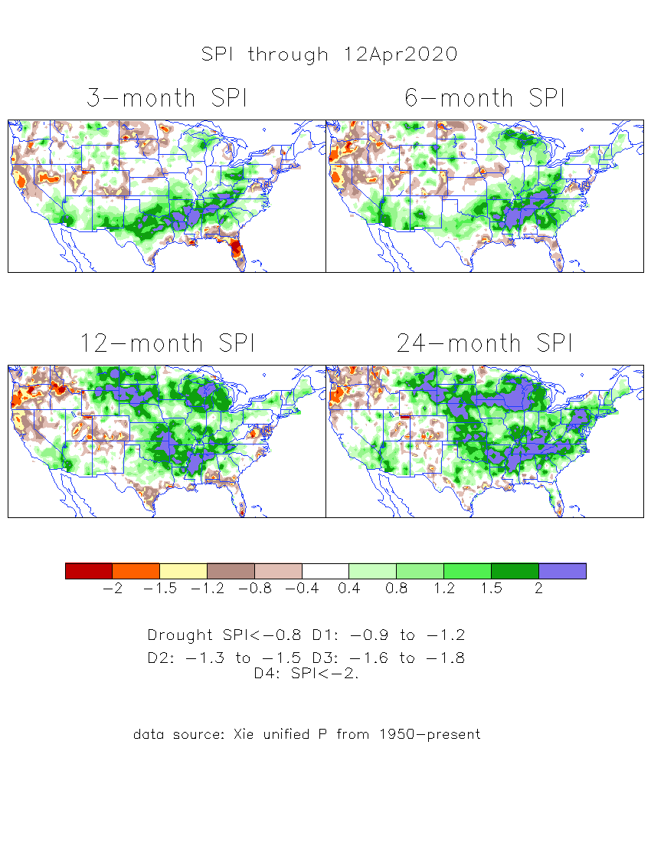
The Standardized Precipitation Index SPI
(based on Observed P)
----- NOW
Very interesting graphic & details for the drought across the US based on the more generalized precip deficit/excess, the Standardized Precipitation Index (SPI).
The dark brown and red colors, indicating standardized precipitation deficits, in the various time periods, approximately correspond to the appropriate short/long term drought monitor regions and their intensities
Have to keep an eye on this region!!
How does one negotiate and reconcile declaring short term vs long term drought when precip. deficiencies exist on many different time scales.

Slide 16
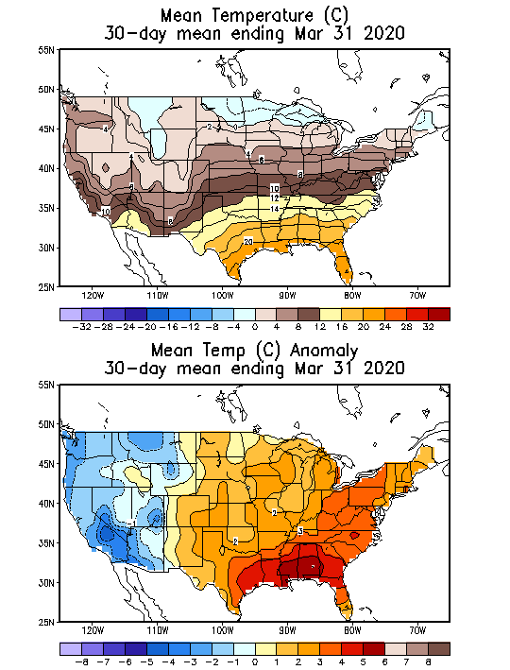
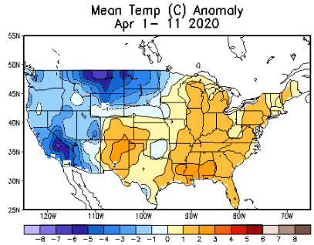
Recent US Temperatures

Slide 17
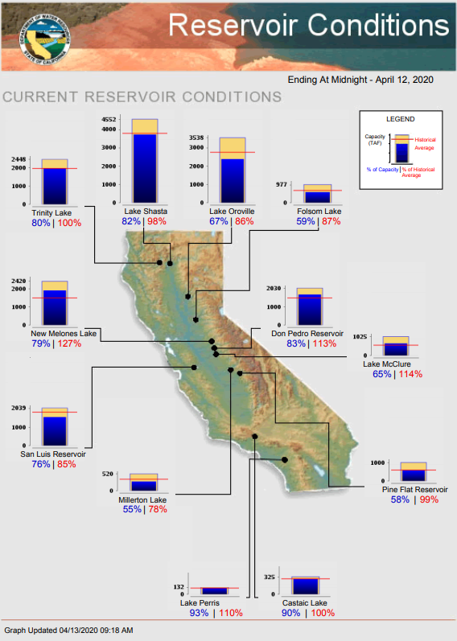
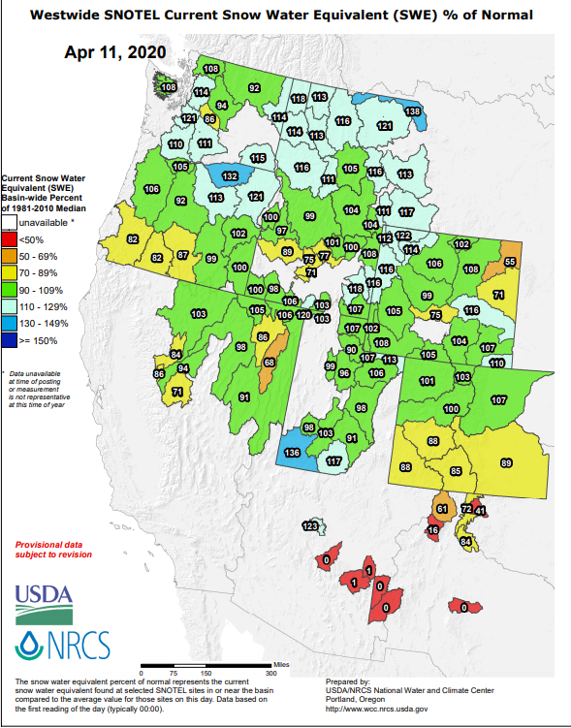
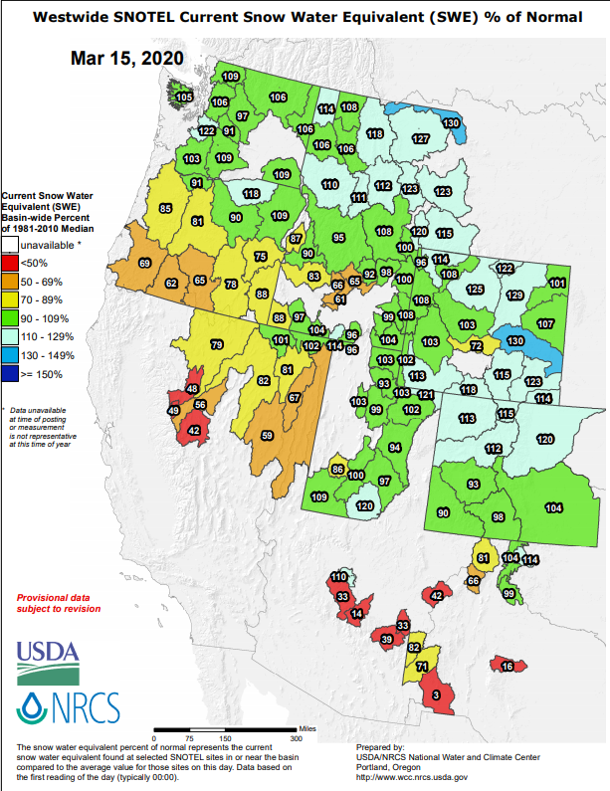



https://www.nrcs.usda.gov/wps/portal/wcc/
All California reservoirs levels are BELOW last month’s values!! (shown in parentheses!)
TX

Slide 18







Streamflow (USGS)
Improving conditions in the southwest, getting bad.
Pacific NW much improved now.
Map shows only below normal 7-day average streamflow compared to historical streamflow for the day of year.
One month ago (left) &
Now (below)
18

Slide 19



[Now]
NCEP Ensemble mean NLDAS2 models’ Soil Moisture tendency/trend
7 days
14 days
30 days
Drying soil moisture tendency over the last month in the drought affected regions, in the west.

Slide 20


Snow cover & Soil Moisture Anomalies

Slide 21
EL NIÑO/SOUTHERN OSCILLATION (ENSO)
DIAGNOSTIC DISCUSSION
issued by CLIMATE PREDICTION CENTER/NCEP/NWS and the International Research Institute for Climate and Society
13 February 2020
ENSO Alert System Status: Not Active
Synopsis: ENSO-neutral is favored for the Northern Hemisphere summer 2020 (~60% chance), remaining the most likely outcome through autumn.

Slide 22




Latest values of SST indices in the various Nino Regions.
Officially in ENSO neutral territory now and for next 3-months. But overall SST anom map looks lot more warm!!

Slide 23


Sub-Surface Temperature Departures in the Equatorial Pacific
Tropical Pacific (Nino 3.4) surface SST in ENSO neutral status vs Subsurface
Most recent pentad analysis

Slide 24




ENSO Forecasts
Early- March CPC/IRI forecast
Early- April CPC/IRI forecast
CPC consolidation fcst should stop here..
ENSO Neutral for this forecast season. Not much help here to models for seasonal forecast signal!!

Slide 25



Released Mar 31st
Previous(Last month)
CPC’s official
Precipitation OUTLOOK for
Monthly (Apr)/Seasonal (AMJ)
Released Mar 19th
Observed so far this month!!
Monthly P/T forecasts verified at mid-month are generally good! Why? ☺ (becoz they r mostly based on GFS’ 2-wk fcsts)
But this month, so far ????

Slide 26



WPC Next 7 days QPF Forecast
GFS Model Guidance for next 16 days.

Slide 27


Made
Mar 31st
Previous (Last Month)
CPC’s official
Temperature outlook for
Monthly (Apr)/Seasonal (AMJ)
Made
Mar 19th
Observed so far this month!! ☺

Slide 28




NMME T & P
Ens.Mean forecasts
May
These warm (red) fcsts for Temp. – are generally made and verify too mostly!!
MJJ
Will these Precip fcsts turn out to be true? Remember the 2017 Spring the Northern Great Plains drought forecast ??

Slide 29

Ageement/Disagreement in the various NMME models’ MJJ seasonal Precip. Forecst.
??

Slide 30

Forecast uncertain in Hatched areas.

Slide 31


Slide 32


Slide 33




Initial Conditions:
04/07/2020
http://drought.geo.msu.edu/research/forecast/smi.monthly.php
Predicted Monthly Soil Moisture Percentile
Initial Conditions 1 months ago:
03/03/2020
The inter quartile range suggest greater uncertainty about the forecast in these shaded regions.

Slide 34
Summary
Current ENSO status and forecast. ENSO-neutral is favored for the Northern Hemisphere summer 2020 (~60% chance), remaining the most likely outcome through autumn.
Current Drought conditions:
  Over the last several months, drought, overall has increased in area across the South and the West.
  The short/long term drought in the four corner states area (AZ/NM/ UT/CO) continues to be present/survive in some form/shape or other, where long term deficiencies have been present.
  Existing and new Drought in CA/OR/WA/NV/ has gotten bigger in area and in strength.
  Drought in southern TX has shrunk in size, but new short term drought has recently emerged along the Gulf coast.
  Much of these were suggested as recommendations from this briefing last month.
  The California reservoirs are at reasonably satisfactory levels, but continued dry/drought conditions there, combined with the ending of the rainy winter season will weigh in heavily on these water resources.
  Prediction:
  The continued expectation, presence and extension of near normal/neutral ENSO conditions in the tropical equatorial Pacific through the rest of spring and summer, is taking away the little edge and confidence via lower Eq. Pacific SST boundary conditions in the model’s seasonal forecasts of precipitation. Also the continued forecast of above normal monthly/seasonal temperatures across the entire US, does not help the drought conditions in the west.
  The drought in the west and the four corners region will continue to persist, due to continued short and long term rainfall deficits in the region.
  Large parts of the Northern Rockies and the Great Plains, including parts of Dakotas and Montana experienced severe drought in MJJA 2017. Currently low to moderate rainfall/snow/soil moisture shortfalls exist in parts of these states, and is of concern. Previous precip forecasts in this region did not verify well. Possible emergence of weak dry conditions is likely here. Forecasters need to look carefully at the precip deficit regions to delineate the dry/drought development regions.
  The drought conditions along the Gulf coast and in Florida will sporadically remain, but will improve across the region in the month of May with the expected rains in the short term. However these drought conditions in the southeast will likely totally disappear with the start of the rainfall season in these regions.
  *********************

Slide 35


Improve
SDO [FMA’20]
(1/7/20 USDM)
Persist
Develop
Persist
Improve
Improve
Considered Development,
but short-term & ERF wetness,
FMA climo dry
Improve
Persist
ERFs wetness; LLFs = EC;
FMA climo ~ dry (west)
Improve
Persist

Slide 36

Miscellaneous maps

Slide 37

Miscellaneous maps

