Slide 1
Drought Outlook Support Briefing April 2021
Climate Prediction Center/NCEP/NOAA
http://www.cpc.ncep.noaa.gov/products/Drought

Slide 2
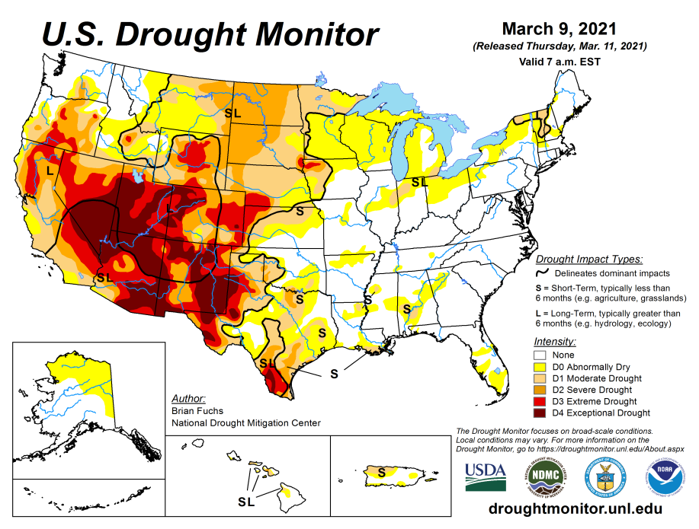
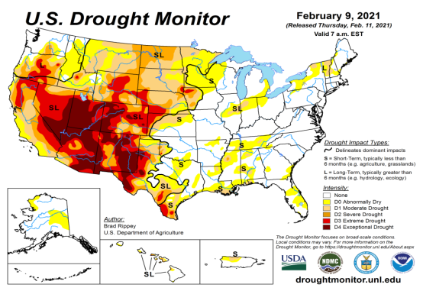
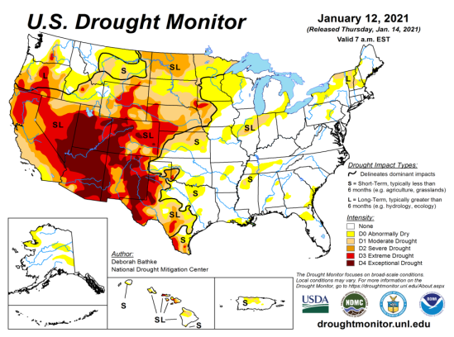
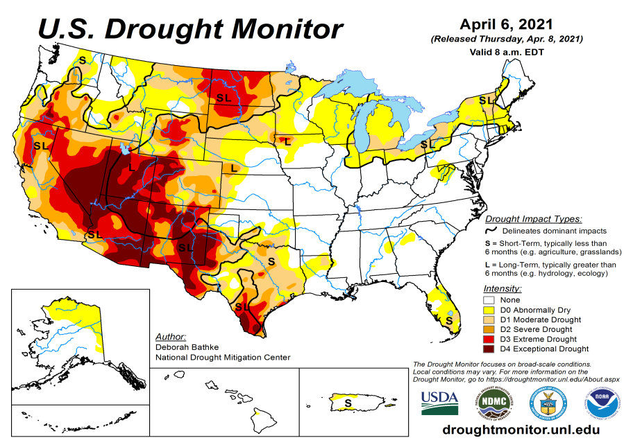
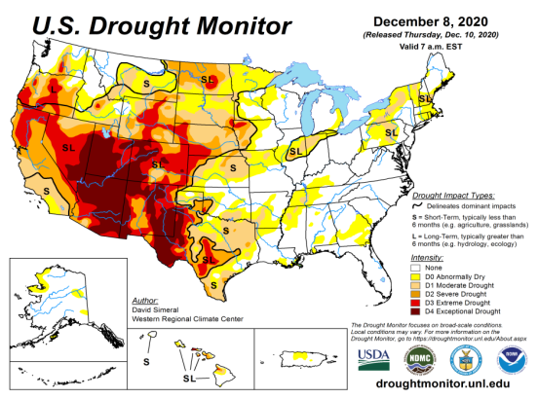
Drought Monitor
Monitoring is important because, unlike US T/P fcsts, for drought forecasts, we have to know where we are, before we can tell where we are going!! Drought forecasts are tendency forecasts.
March
February
Over the last 4-5 months, drought area & severity has overall generally remained about the same. The worse drought conditions are in the border areas of southwest states CA, AZ, NV, UT, CO, and western TX. These are regions are part of the long term drought.
The drought OR, in the Dakotas, MT, ID, Wyoming, Nebraska, Kansas and vicinity which developed in the last year continues to hang in there. Next months rain crucial!
About 50 % of the country is experiencing category D1 or worse drought condition (next side!)
Drought in parts of the New England states trying to make a come back ? Parts of MI/IN/OH/PA ??
January
April
(Recent/Latest)
December
February

Slide 3
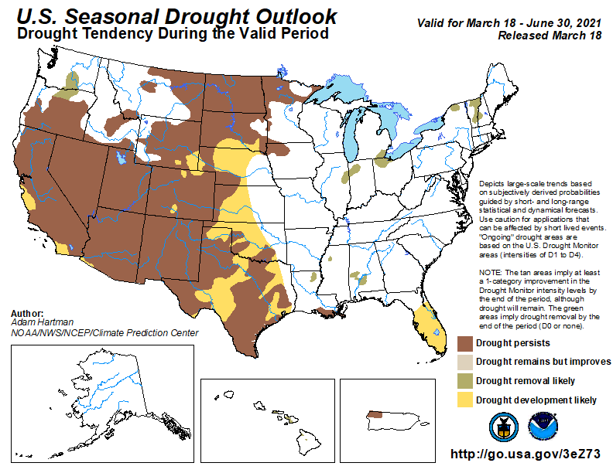
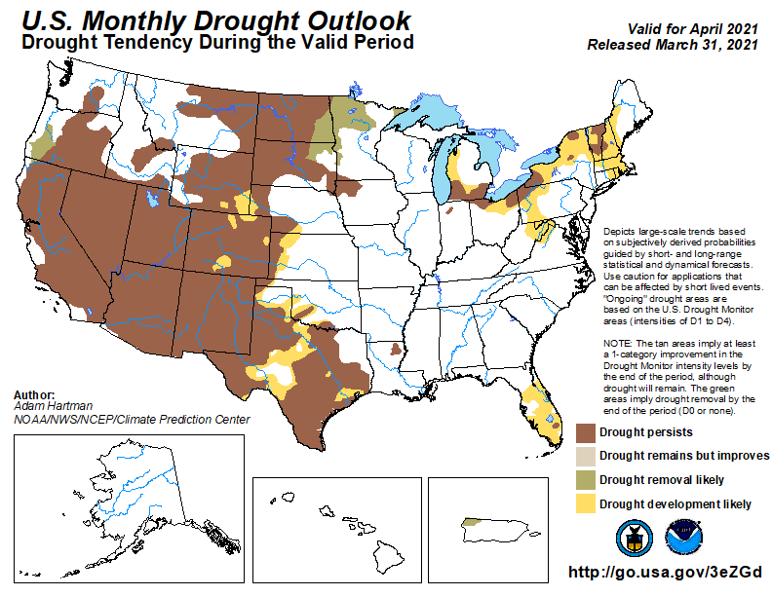
(Prev) Seasonal/Monthly Drought outlooks
(New Seasonal+ Drought Outlook to be released in 2 days!)
(New Monthly Drought Outlook to be released end of this month)
Seasonal Outlook
(Mid Mar 2021- Jun 2021)
issued 03/18/21
Monthly outlook
(for April 2020)
issued 03/31/21
Similar looking Monthly and seasonal outlooks, except in the northeast!
Also compare West vs East.

Slide 4
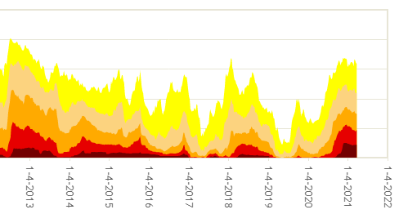
50%
Has the recent drought area % and severity reached a peak and is beginning to come down? (coincident with the ending La Nina?
What about D4??)

Slide 5
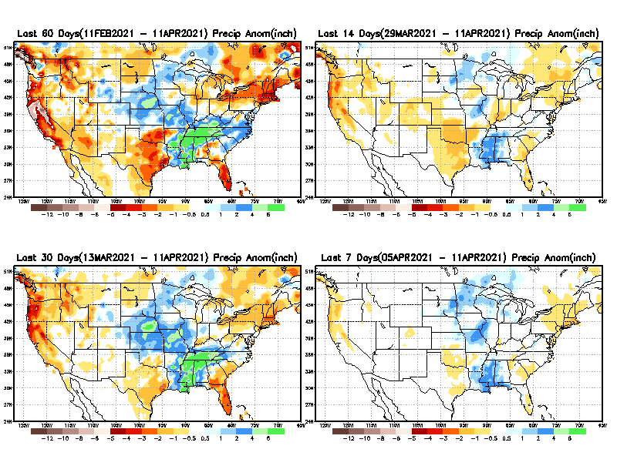
Precipitation ANOM during last 7, 14, 30, & 60 days.
60 Days
14 Days
30 Days
7 Days
These maps in this and following slides, including a) Total,
b) Anom and
c) Percent of Normal precip. in these and other longer time ranges are now (routinely) daily updated at:
From: Recent Accumulated Precipitation https://www.cpc.ncep.noaa.gov/products/Drought/briefing_prcp.shtml

Slide 6
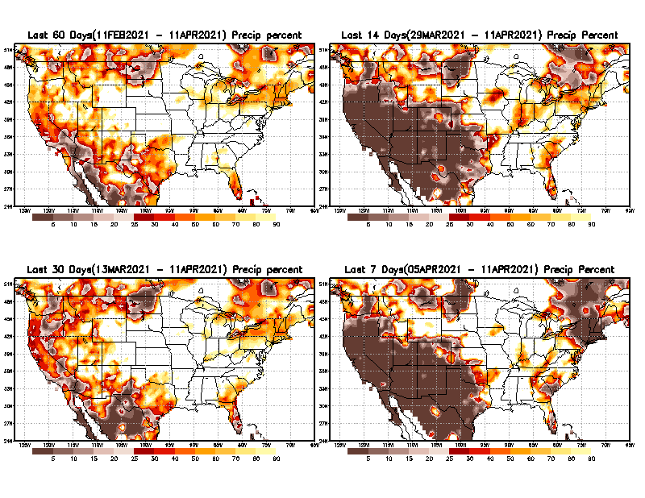
Precipitation Percent during last 7, 14, 30, & 60 days.–Only Deficit Areas shown!! <=90%
60 Days
14 Days
This plot shows only the rainfall deficient regions <= 90% of normal.
-- This shows more clearly possible/likely drought developing region in the future unless there is above normal rainfall in these regions in the future, to offset these shortfalls.
30 days
7 Days
From: Recent Accumulated Precipitation https://www.cpc.ncep.noaa.gov/products/Drought/briefing_prcp.shtml

Slide 7
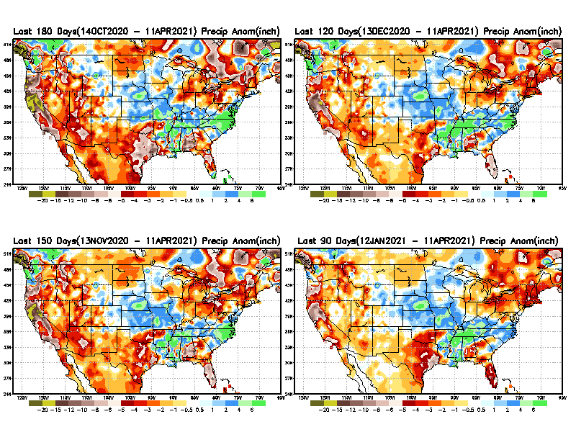
Total precipitation ANOM during last 3, 4, 5, and 6 months.
6 M
4 M
While the Precipitation anomalies deficit may seem large in some regions (compared to others), it is the % of normal precip (next slide) that matters more!!
5 M
3 M
From: Recent Accumulated Precipitation https://www.cpc.ncep.noaa.gov/products/Drought/briefing_prcp.shtml

Slide 8
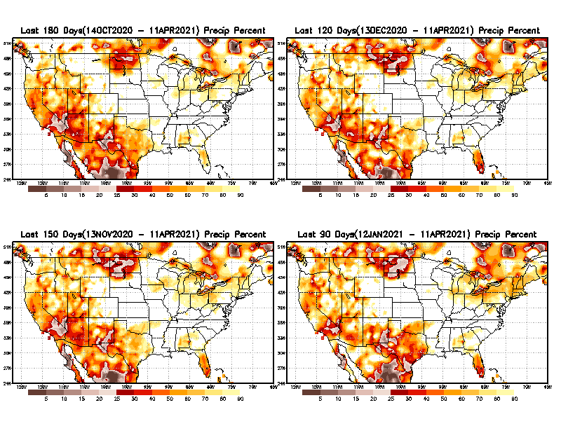
Total precipitation Percent during last 3, 4, 5, and 6 months–Only Deficit Areas!! <=90%
6 M
4 M
In these interim time scale 3-6 months, we need to pay attention to regions, which are dark-brown, red & dark red (<50%).
While accrued precipitation deficits are real & objective,
droughts are subjective declarations!!
5 M
3M
East vs West!
Broad vs Narrow
rainfall season.
In general, West suffers more from frequent and lasting droughts.
With these various rainfall deficits in diff. time ranges, where and how exactly does one declare drought? Other factors (T/SM/E, etc..) do matter, but is cumulative precip. Are deficits/percent_of_normal ultimately more important?

Slide 9
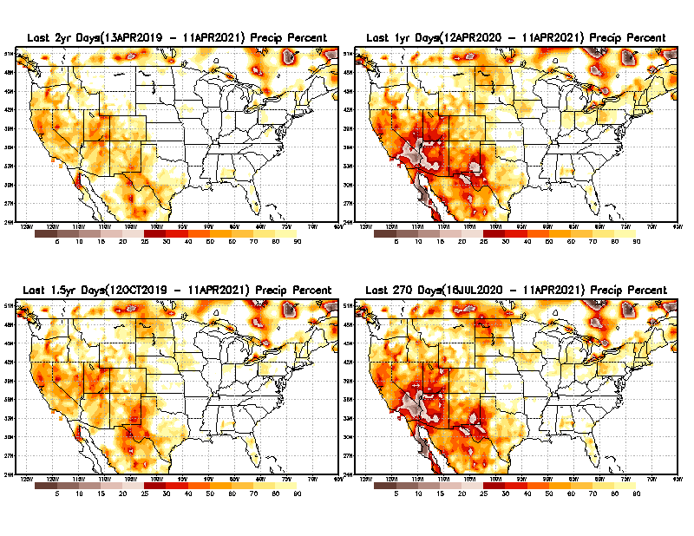
Total precipitation Percent during last 9 months, 1 yr, 1.5yrs, & 2 yrs. .–Only Deficit Areas shown!! <=90%
2 Y
1 Y
Tinderbox areas, where some form of longer term rainfall
deficiencies already, exist !!
-Almost all are in the southwest!
-This & Next slide!!
1.5 Y
9 M
From: Recent Accumulated Precipitation https://www.cpc.ncep.noaa.gov/products/Drought/briefing_prcp.shtml

Slide 10
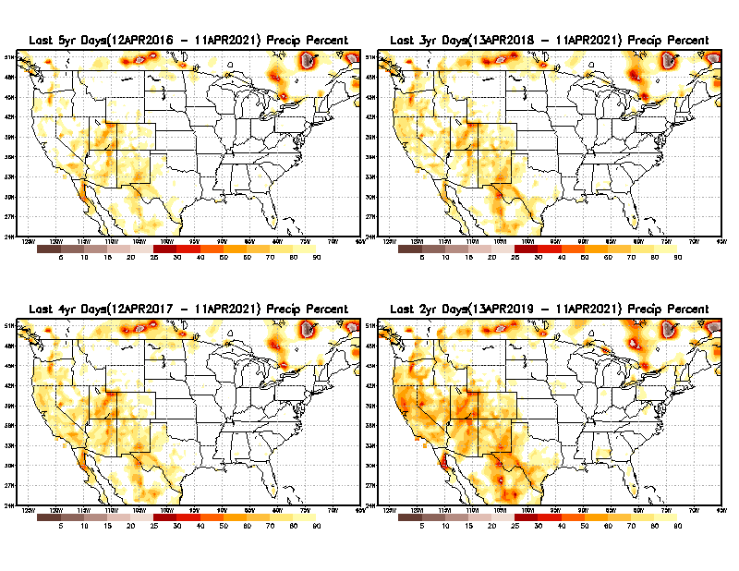
Total precipitation Percent during last 2 yrs, 3 yrs, 4 yrs, & 5 yrs. .–Only Deficit Areas shown!! <=90%
5 Y
3 Y
In these long time ranges (2-5 yrs), there is a general dearth/lack of precipitation in the southwest US. – where the current severe drought ravages!!. At the end of this current ongoing La Nina the long term situation will get even worse!!
4 Y
2 Y
From: Recent Accumulated Precipitation https://www.cpc.ncep.noaa.gov/products/Drought/briefing_prcp.shtml

Slide 11
Rainy (3-month)Season across the US
East vs West!
More darker colors in west/central => narrow rainy season (months)
Overall, more white space in the east => distributed rainfall season (except ~FL).

Slide 12
*********
EAST vs
CTR/WEST
Drought Behavior is loosely tied to rainfall climo!!
*********
Adapted from Rich Tinker.

Slide 13
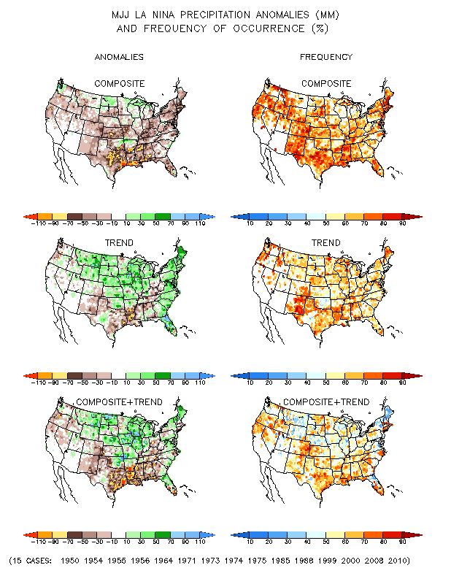
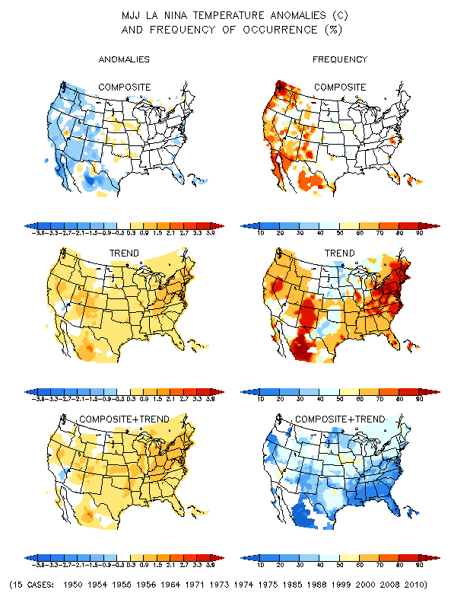
La Nina Precip/Temperature COMPOSITES & Trend map
MJJ
P
T
With expected ENSO-neutral conditions, this row is relevant!!

Slide 14
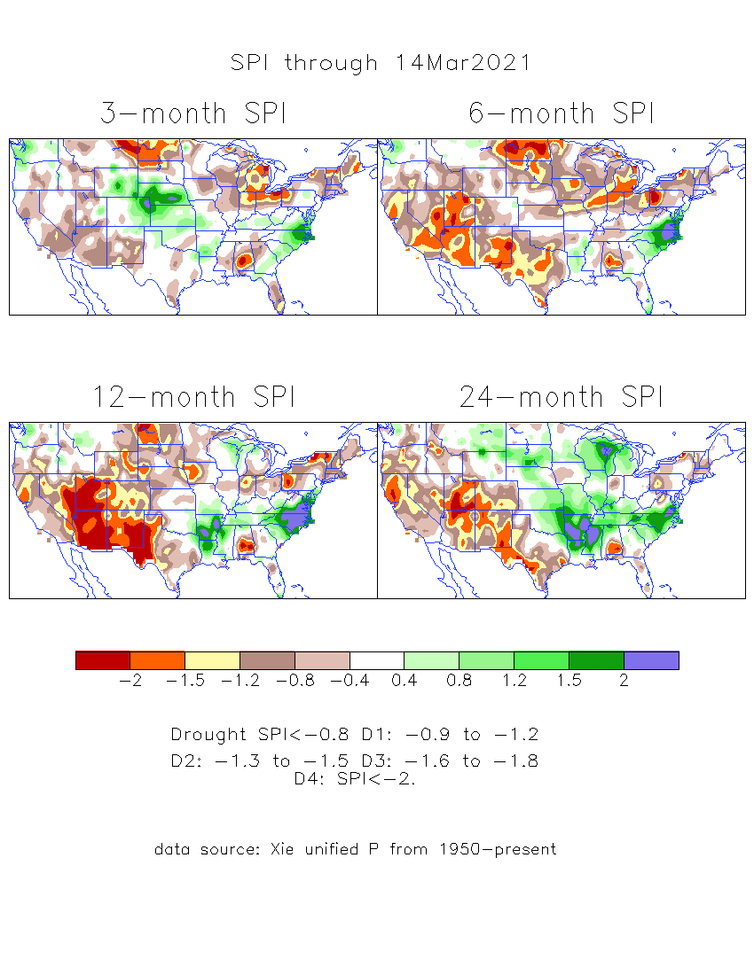
The Standardized Precipitation Index SPI (based on Observed P)
----- Last Month
Very interesting graphic & details for the drought across the US based on the more generalized precip deficit/excess, the Standardized Precipitation Index (SPI).
The dark brown and red colors, indicating standardized precipitation deficits, in the various time periods, approximately correspond to the appropriate short/long term drought monitor regions and their intensities
Short-term situation has gotten slightly better in the west, but long term situation is, and will stay worse -- as we said last month!!

Slide 15
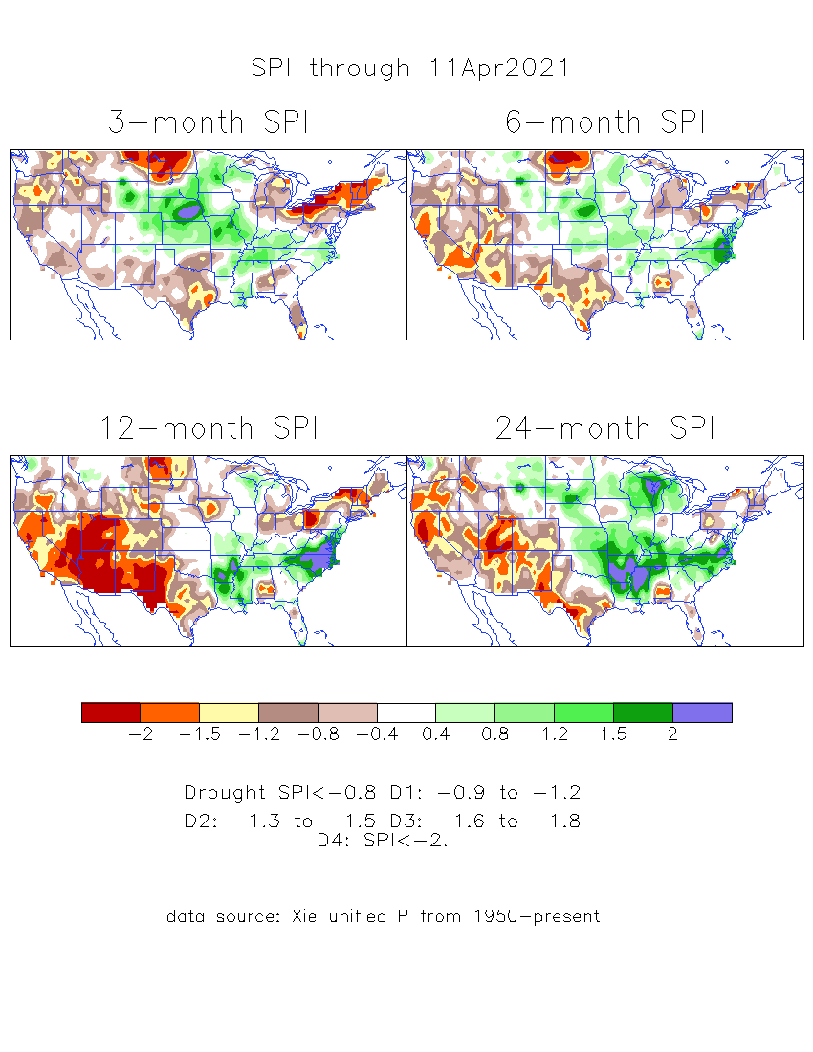
The Standardized Precipitation Index SPI (based on Observed P)
----- NOW
Very interesting graphic & details for the drought across the US based on the more generalized precip deficit/excess, the Standardized Precipitation Index (SPI).
The dark brown and red colors, indicating standardized precipitation deficits, in the various time periods, approximately correspond to the appropriate short/long term drought monitor regions and their intensities
S
----- NOW
L
How does one negotiate and reconcile declaring short term vs long term drought when precip. deficiencies patterns differ on many different time scales locally!!
What is the cutoff delineating time between short VS long term drought!!

Slide 16
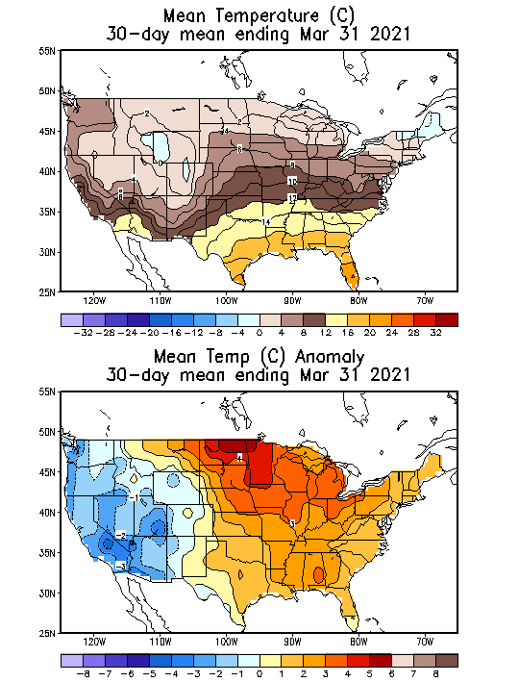
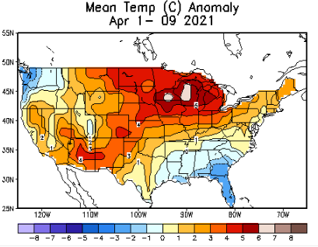
Recent US Temperatures
Such swings in winter Temperatures
Even in the midst of La Nina!!
From Jan –> Feb -> Mar
So far this month !!
Remember, the TX freeze!!

Slide 17
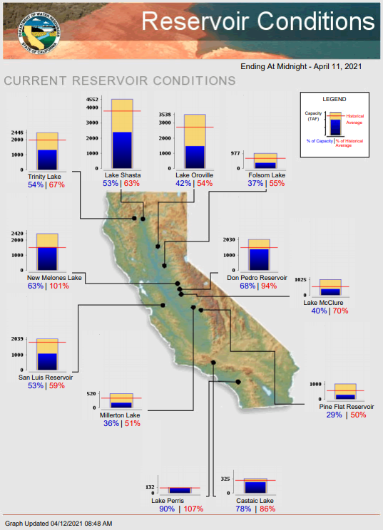
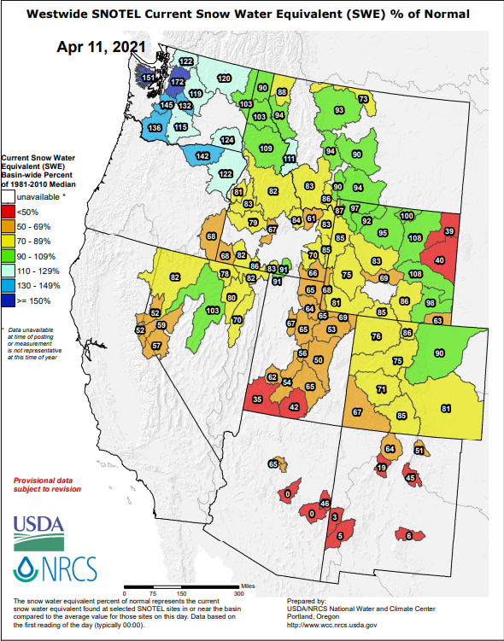
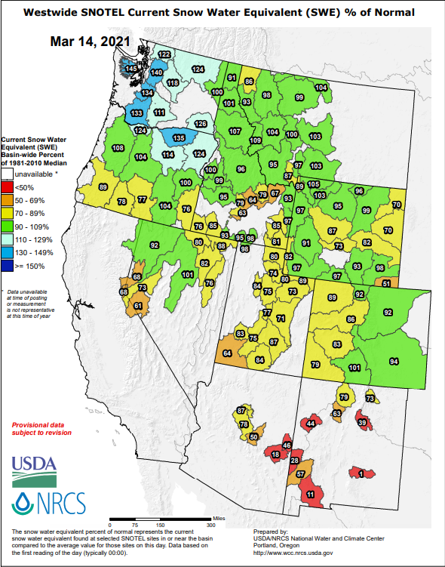
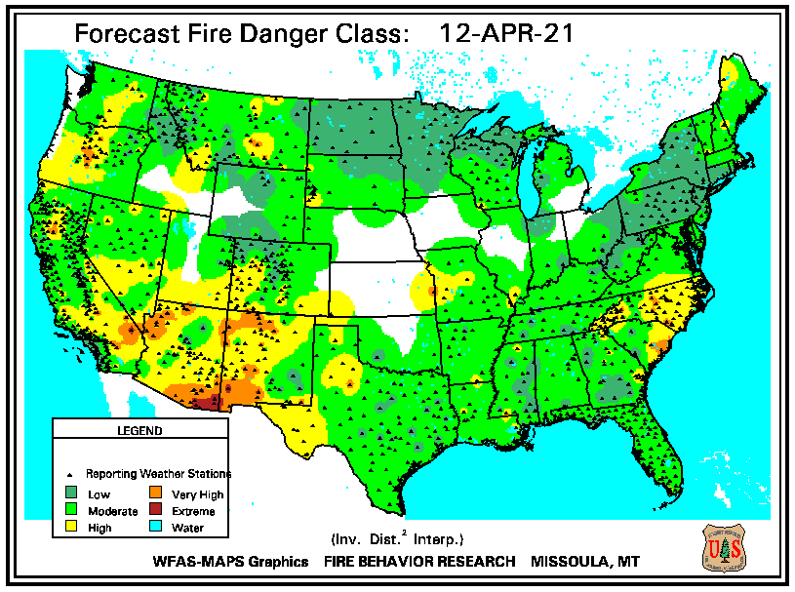
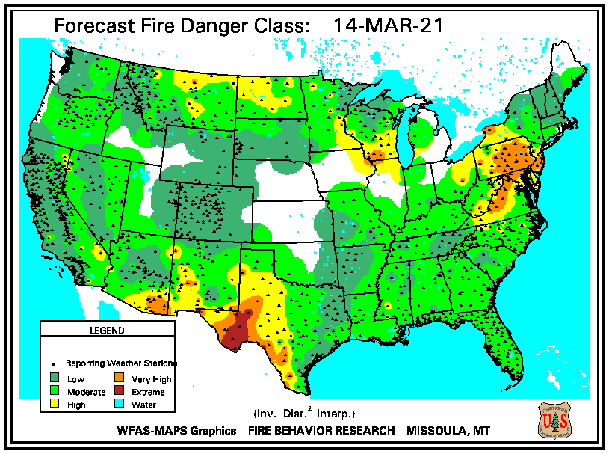
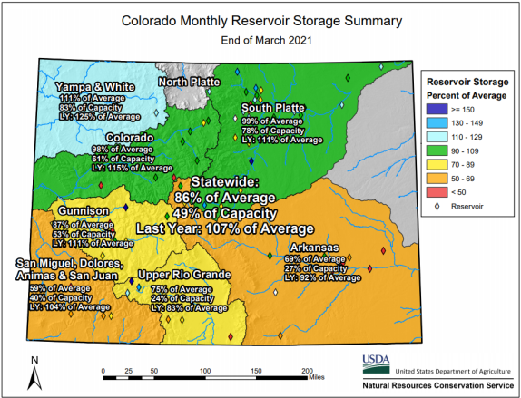
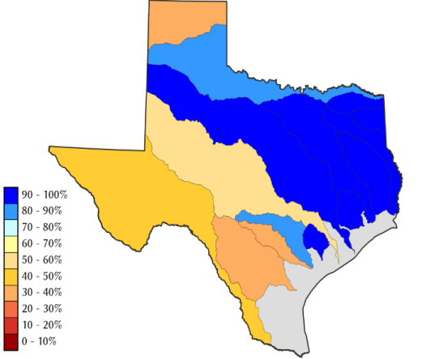
THIS MONTH
1 MONTH ago
https://fsapps.nwcg.gov/
CO
Many CA reservoirs are at low levels”!!
TX
If La Nina continues reappears later this year, it will be a major problem for water in the western states!!!!
ALARM/WARNING!! for this year’s Fire Season for the US West/Southwest states even before that La Nina !!
86 %
of AVG!

Slide 18
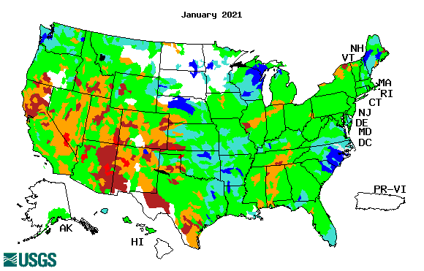
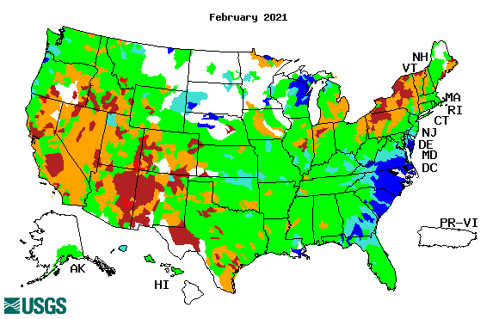
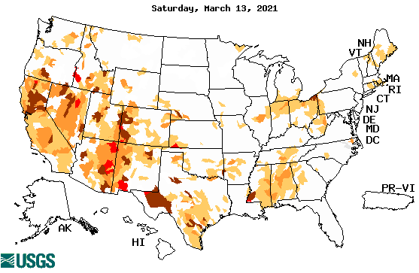
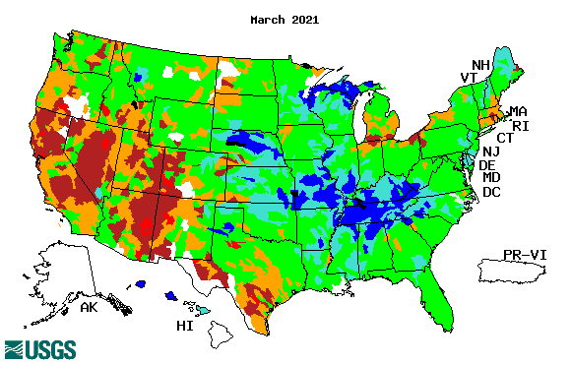
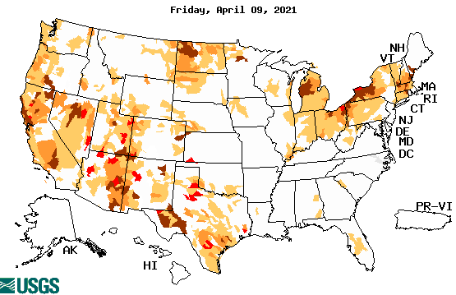
Streamflow (USGS)
Same data source USGS:
Look at the monthly maps for Northeast vs weekly maps in the bottom!!
Map shows only below normal 7-day average streamflow compared to historical streamflow for the day of year.
One month ago (left) &
Now (below)
Note:
CA,
TX,
Northeast
Overall, similar streamflow conditions in the south and west . The white areas in maps (left) indicate no data or frozen land.
18

Slide 19
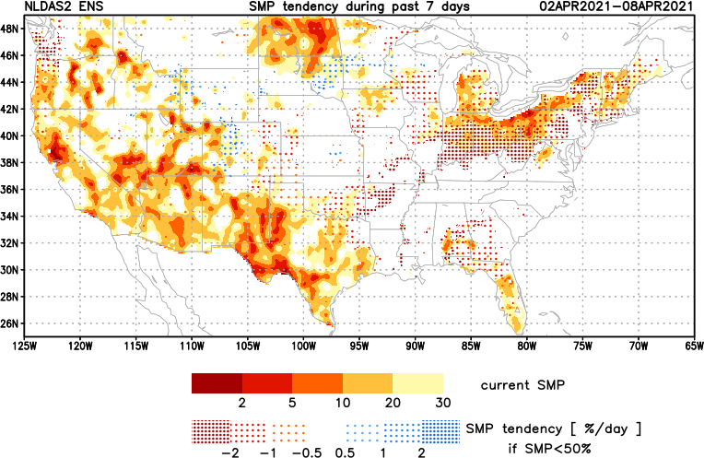
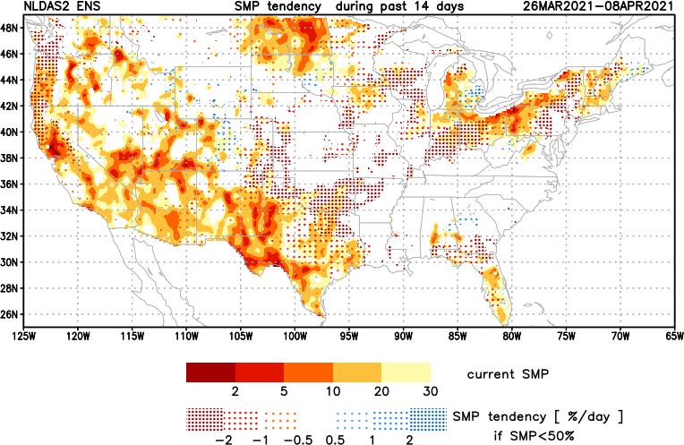
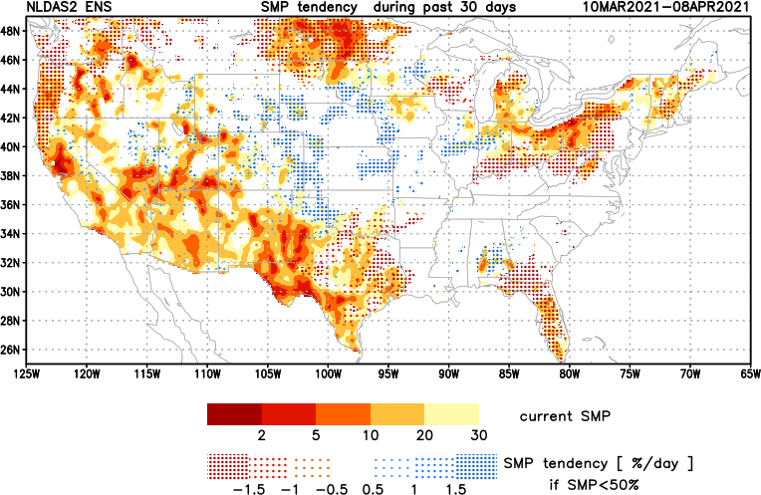
[Now]
NCEP Ensemble mean NLDAS2 models’ Soil Moisture tendency/trend
7 days
14 days
30 days
These NLDAS based SM tendency mas are a few days old!! But note the change in the middle part of the country!! Upper Midwest consistently dry!!

Slide 20
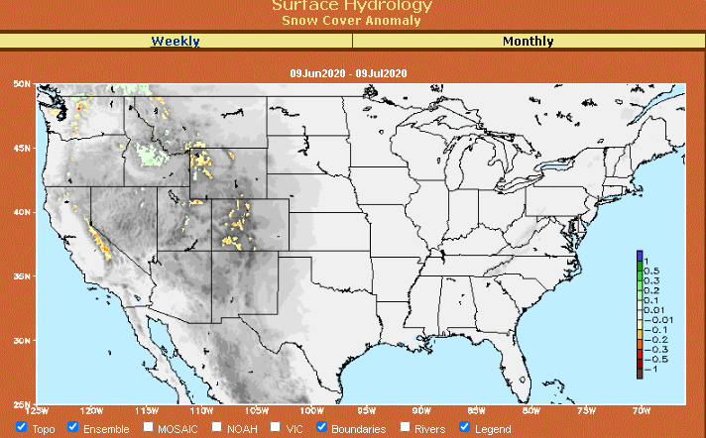
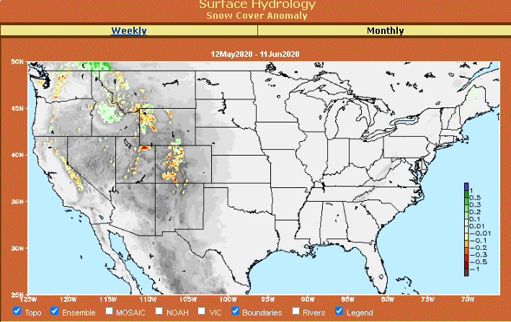
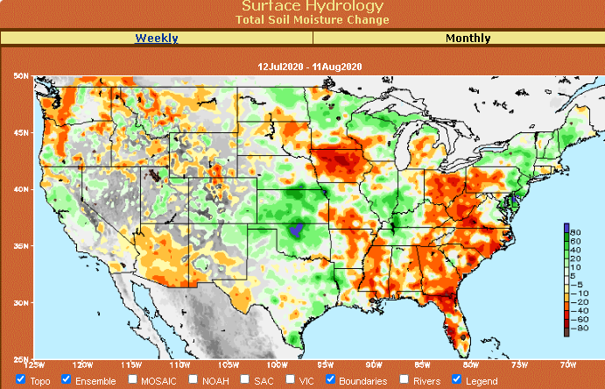
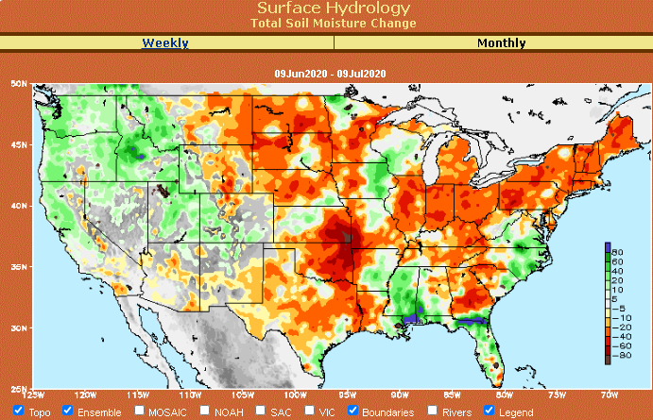
Snow cover & Soil Moisture Anomalies
Snow cover
SLIDE
NOT SHOWN!
Last month ~ this time
Now
Look further for areas of drought development

Slide 21
EL NIÑO/SOUTHERN OSCILLATION (ENSO)
DIAGNOSTIC DISCUSSION
issued by CLIMATE PREDICTION CENTER/NCEP/NWS and the International Research Institute for Climate and Society
8 April 2021
ENSO Alert System Status: La Nina Advisory
Synopsis: A transition from La Niña to ENSO-Neutral is likely in the next month or so, with an 80% chance of ENSO-neutral during May-July 2021. -------- La Niña conditions continued during March…

Slide 22
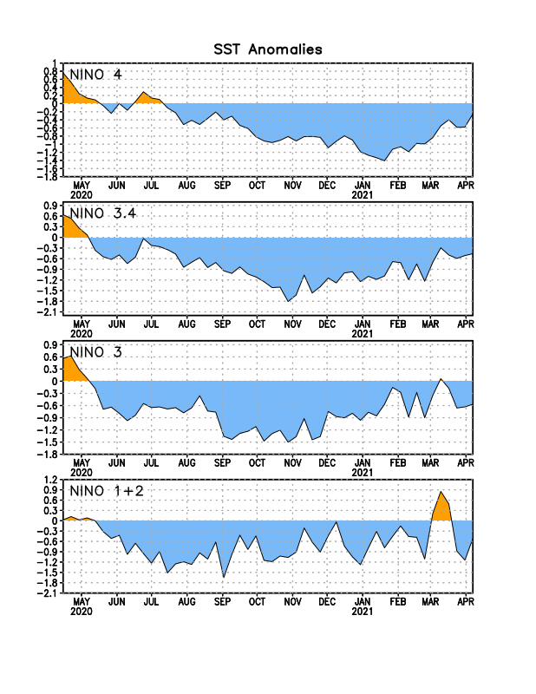
Latest values of SST indices in the various Nino Regions.

Slide 23
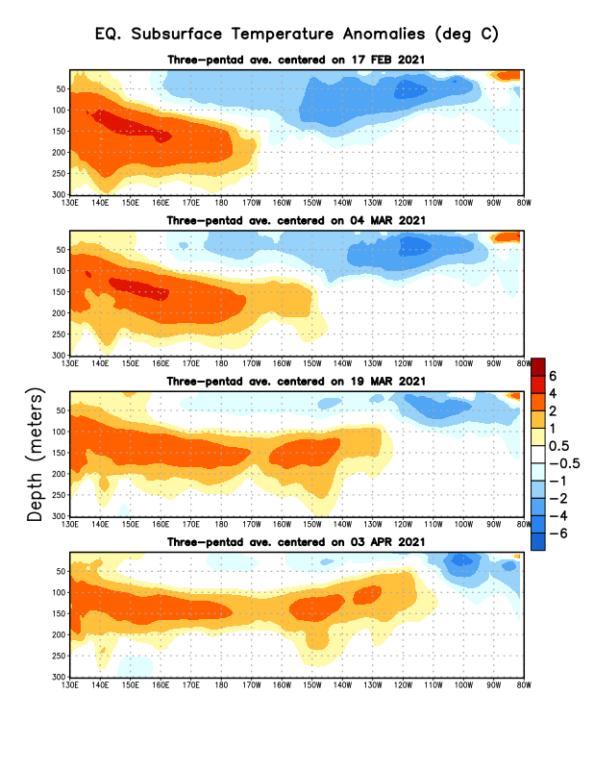
Sub-Surface Temperature Departures in the Equatorial Pacific
The current La Nina conditions is on its way out in a hurry!!
But the forecast suggests that the La Nina will likely come back later in the year? Will it??
Most recent pentad analysis

Slide 24
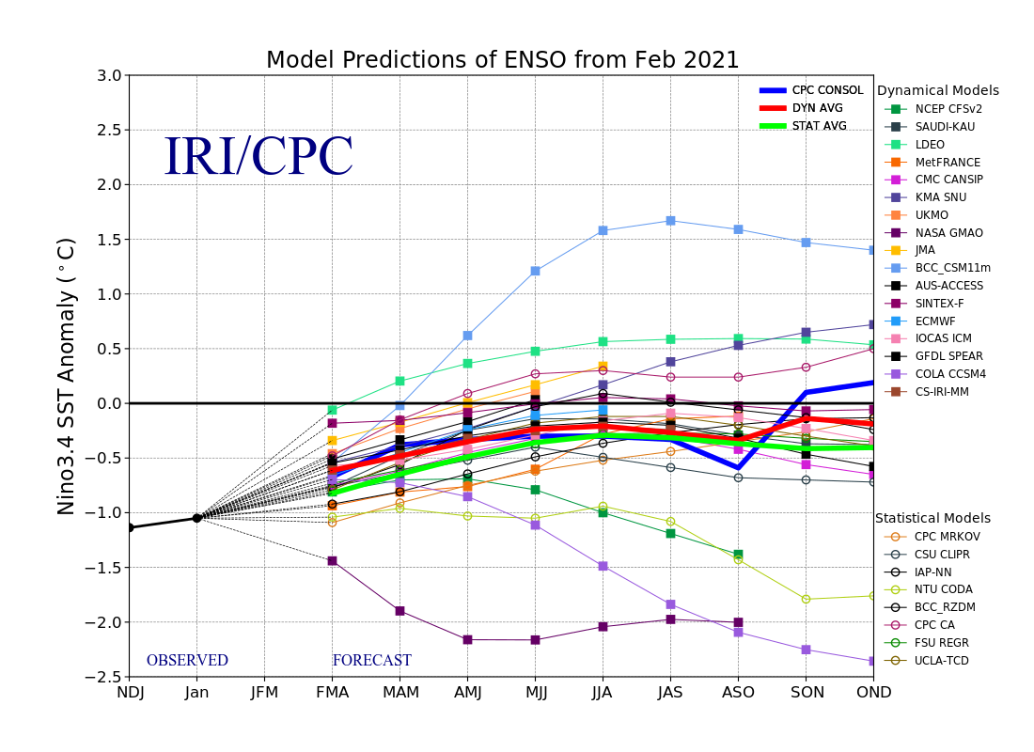
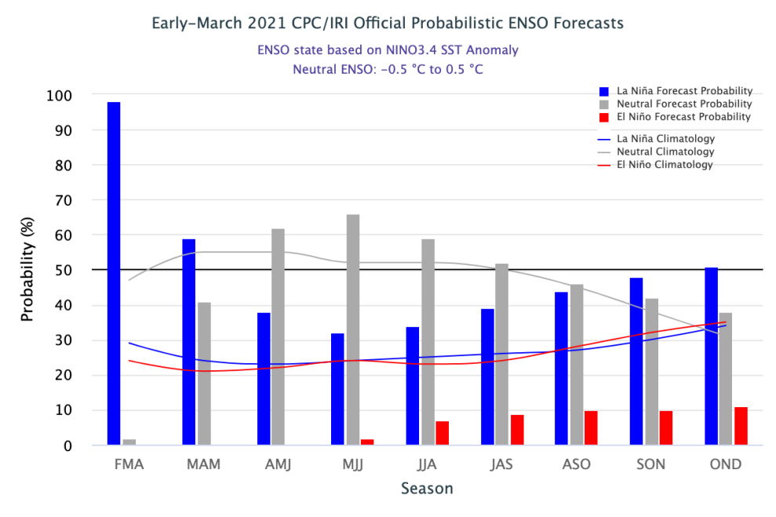
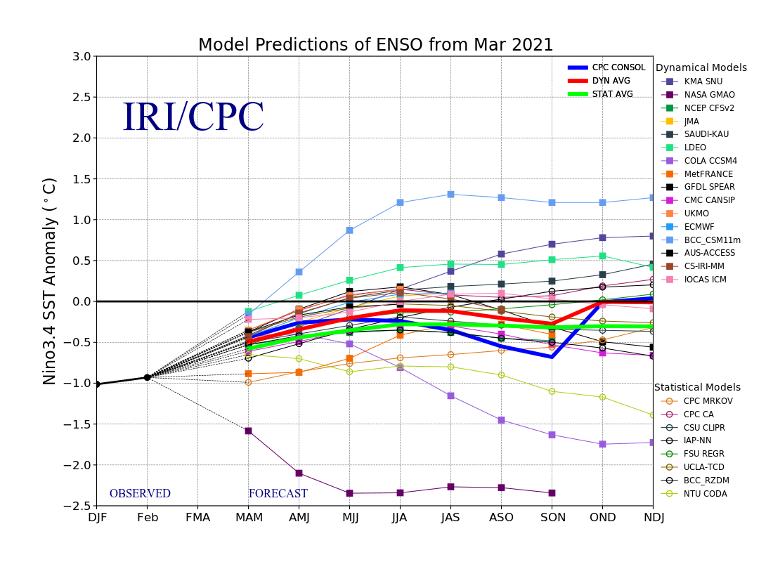
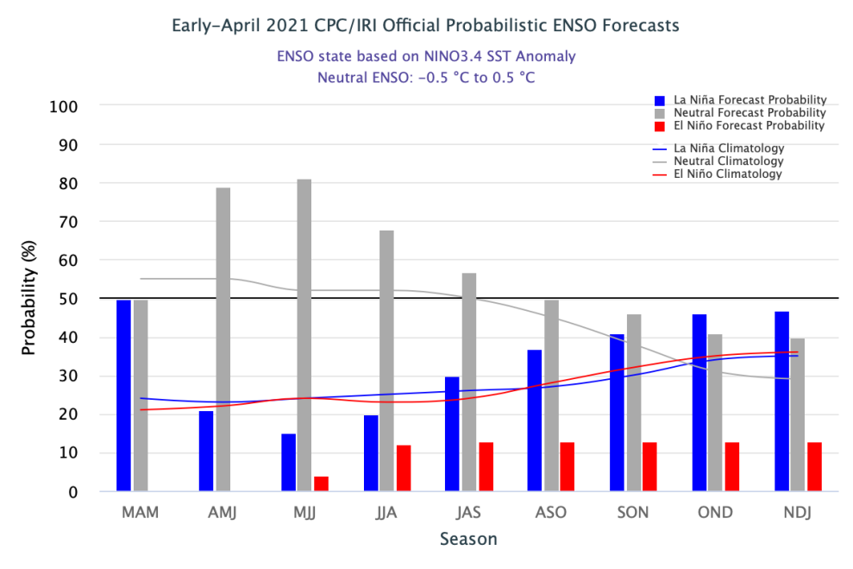
ENSO Forecasts
Early- March CPC/IRI forecast
Early- April CPC/IRI forecast
La Nina is on its way out temporariy? Only to come back later in the year?

Slide 25
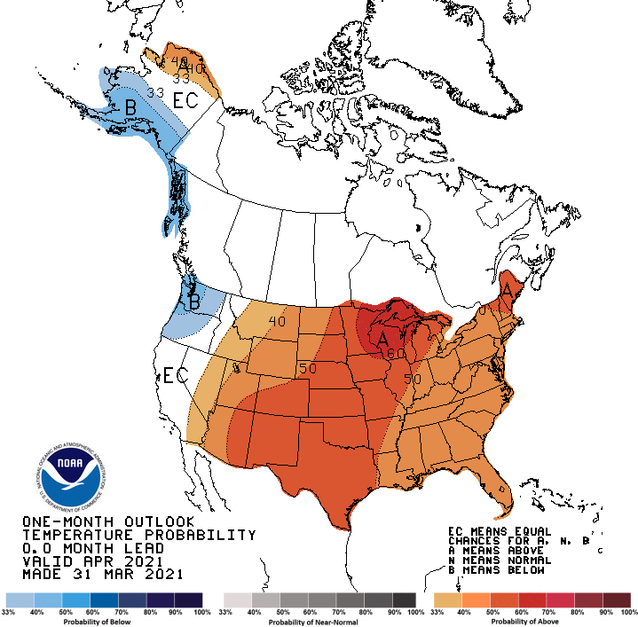
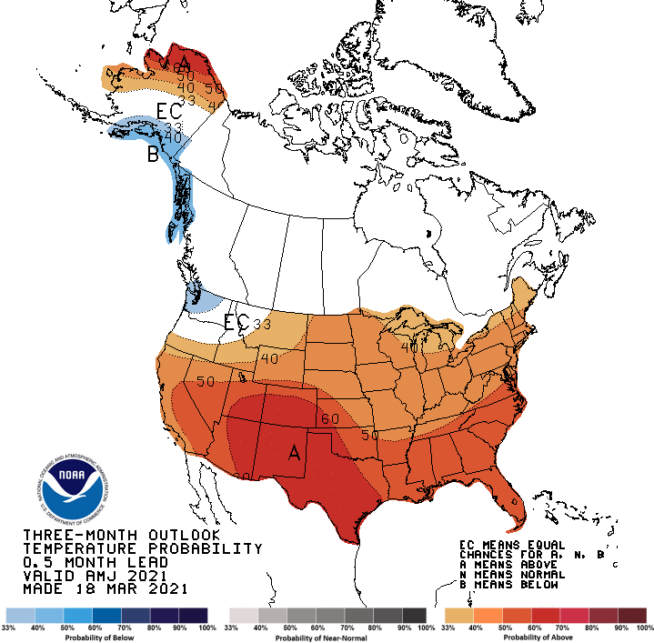
Made
Mar 31st
Previous (Last Month)
CPC’s official
Temperature OUTLOOK for Monthly (Apr)/Seasonal (AMJ)
Made Mar 18st
Observed so far this month!! ☺

Slide 26
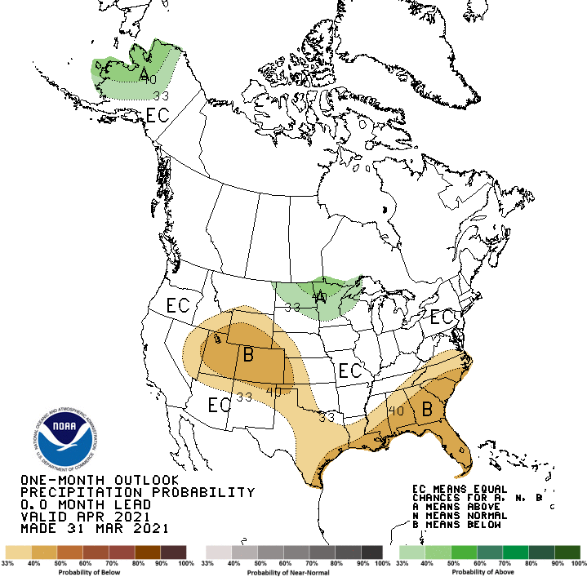
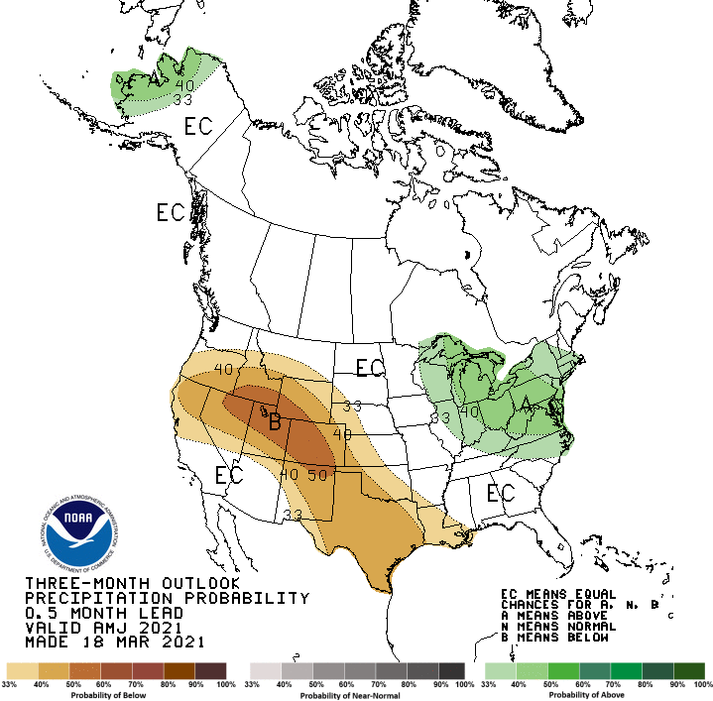
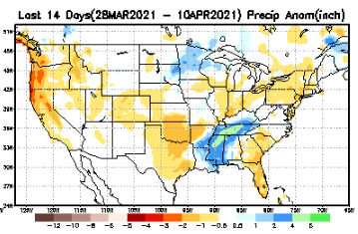
Previous(Last month)
CPC’s official
Precipitation OUTLOOK for Monthly (Apr)/Seasonal (AMJ)
Released Mar 31st
Released Mar 18th
Observed so far this month!! ☹
Monthly P/T forecasts verified at mid-month are generally good! Why? ☺ (becoz they r mostly based on GFS’ 2-wk fcsts). We still have many days to go in the month.

Slide 27
NCEP/WPC Next 7 days QPF Forecast
Actual Precip amounts and region generally varies highly from one model run to next!!
GFS Model Guidance for the
next 16 days.
Almost no rain along the Pacific west coast, and southwest states for the next couple of weeks.

Slide 28
From European Center (EC) Precip forecast (made yesterday, 12 Apr) for next 30 days.

Slide 29
From European Center (EC) Precip forecast (made yesterday, 12 Apr) for next 30 days.

Slide 32
NMME T & P Ens.Mean forecasts for
May
Much of the country is fcst to be warm. The south is WARM+
MJJ
With No ENSO signal!!
Will the drought expand/redevelop further in the NW?

Slide 33
Agreement/Disagreement among the various NMME models’ MJJ seasonal Precip. Forecast.
??

Slide 34
SPI6 Fcst made from last month(background) compared with this month(foreground, red border)
Why is there so fewer hatched areas in SPI6 fcst from NMME models’ based fcst this month as compared to last month (left 2 columns) ? Fcsts more confident now?
Forecast uncertain in Hatched areas.
No change/relief to drought in the south and west! Possible expansion of drought in the Northwest.
SPI6 Fcst made from last month
SPI6 Fcst made from this month

Slide 35
http://drought.geo.msu.edu/research/forecast/smi.monthly.php
Latest Initial Conditions:
04/06/2021
Predicted Monthly Soil Moisture Percentile
MSU stopped updating 06/10/20 ☹
CPC’s soil moisture percentile – Leaky bucket Model
The inter quartile range suggest greater uncertainty about the forecast in these shaded regions.

Slide 36
Summary
Current Drought conditions:
Over the last 4-5 months, drought area & severity has overall generally remained about the same. The worse drought conditions are in the border areas of southwest states CA, AZ, NV, UT, CO, and western TX. These are regions are part of the long term drought.
The drought OR, in the Dakotas, MT, ID, Wyoming, Nebraska, Kansas and vicinity which developed in the last year continues to hang in there. Next months rain crucial!
About 50 % of the country is experiencing category D1 or worse drought condition (next side!)
Drought in parts of the New England states trying to make a come back ? Mixed signal here.
Some/many of California reservoirs levels are below their historical average levels. If a second year La Nina remerge later this year (hope not!) it will worsen the water situation much further!
Current ENSO status and forecast:
La Nina conditions were present in March. A transition from La Niña to ENSO-Neutral is likely in the next month or so, with an 80% chance of ENSO-neutral during May-July 2021.
Prediction:
Sub-surface conditions in the tropical eq. Pacific recently changed/expanded in a hurry into central and east Pacific to warm conditions.
With the likely transition to ENSO neutral conditions during the forecast season, how good will be the model forecasts made in this spring months? It is not clear how long the SST conditions will stay in ENSO neutral phase before reverting to La Nina conditions again (later in the year!), as the models are forecasting.
The S/L term drought in the south and west is so entrenched, it is likely that those conditions will probably stay the same through the forecast season, especially when the forecast temperatures across the country are so warm, particularly in the southwest. These conditions are not very helpful to the fire season for the region this year. The onset of North American monsoon later in the forecast season, if occurs early, may help.
With the beginning of the dry season along the Pacific coast, drought may expand further up north into the remaining parts of WA, OR, ID and MT, and the drought in the Northern Great Plains is likely to persist, even though a short term relief is possible along the far northern and eastern parts of this region.
The drought in the northeast is tricky (remember last year!) and the rainfall trend for the season may help end the drought here. Drought conditions are unlikely to develop in the southeast.
*********************

Slide 37
Miscellaneous maps

Slide 38
Miscellaneous maps

