Slide 1
Drought Outlook Support Briefing April 2022
Climate Prediction Center/NCEP/NOAA
http://www.cpc.ncep.noaa.gov/products/Drought
Points to ponder:
Often, there is a disconnect between the Short term (S) and Long term (L) drought in regions.
Places/regions experiencing Short term drought may (not) be ok in the Long term and vice versa!!
This duality is difficult to reconcile, to convey and even be understood by the public at large.
Public/Forecaster focus tends to be more on the Short term Drought (for good reasons!!)
More importantly the very definitions and timescales associated with S/L term droughts and the declarations in the USDM are by themselves subjective!!
Is the ongoing La Nina going to extend up into the third year winter this year?
How is 2022 southwest monsoon going to be? As active as last year, or as bad as the year before!
Drought forecast season MJJ includes July which includes the first month of the monsoon season!

Slide 2
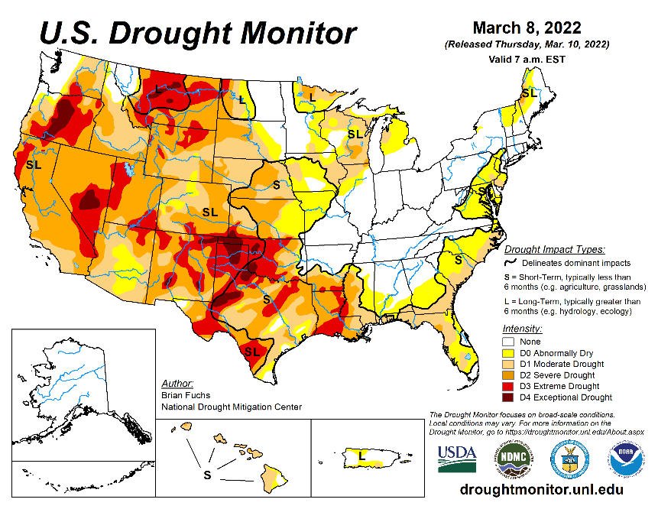
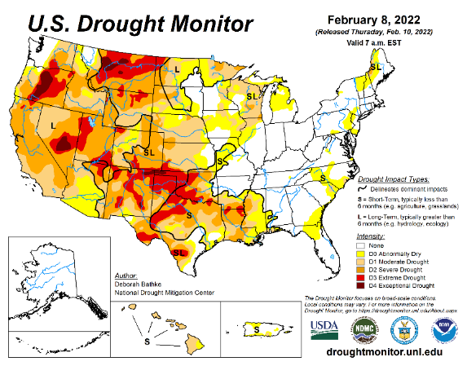
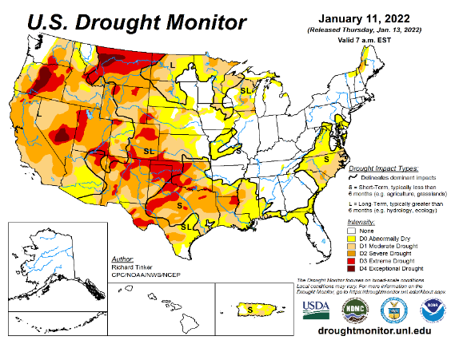
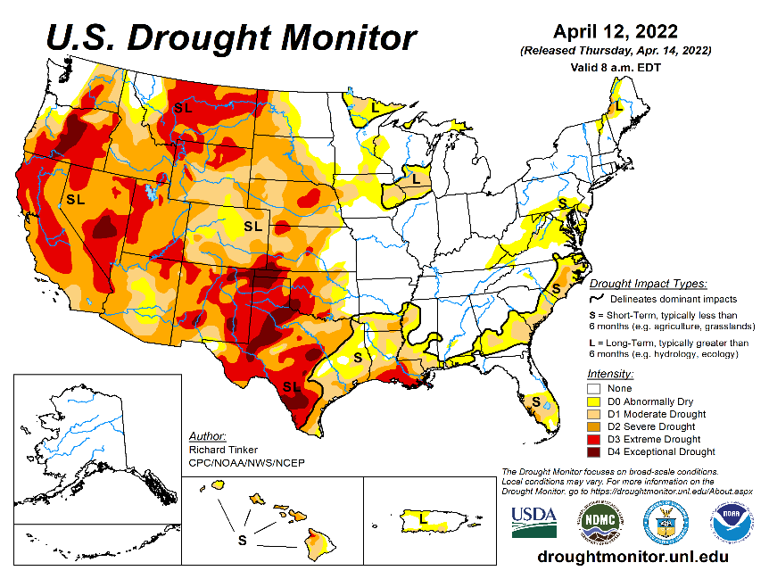
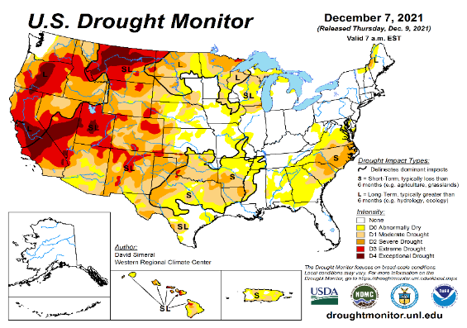
Drought Monitor
Monitoring is important because, unlike US T/P fcsts, for drought forecasts, we have to know where we are, before we can tell where we are going!! Drought forecasts are tendency forecasts.
March
February
As the winter rainfall season is coming to a close along the Pacific West, the severe drought has also expanded further from last month. The excess winter snowfall in/near the Great Lakes region has slightly improved the drought conditions in the region.
Besides this, elsewhere in the west, in the west central mountain and vicinity, and the southwest the overall drought situation has remained the same from last month.
The short and temporary drought conditions along the mid-Atlantic coastal regions, and east coast droughts (unlike the southern/western US droughts) generally do not last long. Hence these droughts go back and forth in intensity and extent, and need not be of much concern, even though their short term effects do matter.
January
April
(Recent/Latest)
December
?

Slide 3
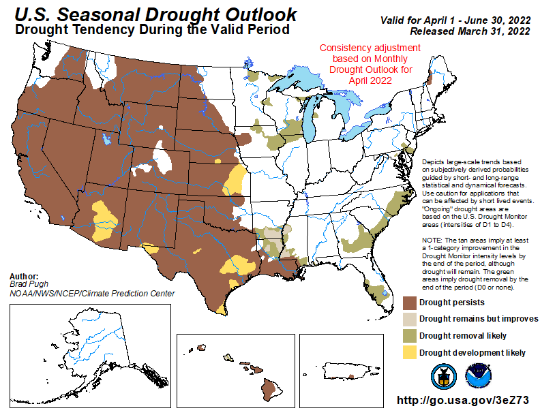
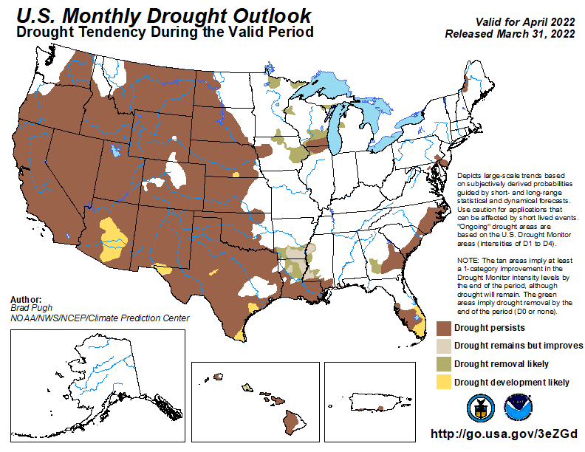
(Previous) Seasonal/Monthly Drought outlooks
New Seasonal+ Drought Outlook to be released in 2 days!
New Monthly Drought Outlook to be released end of this month)
Updated Seasonal Outlook
(1 Apr. – 30 Jun 30, 2022)
issued 3/31/22
Monthly outlook (for April 2022)
issued 3/31/22
It is the classic great West versus East drought paradigm !!
US East droughts are different than West droughts!!
This is mainly related to the rainfall climatology! – Of course ENSO impact matters!

Slide 4
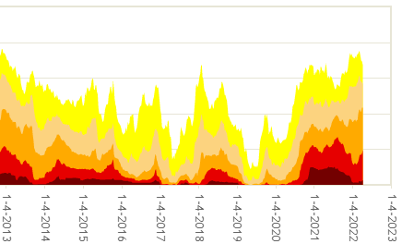
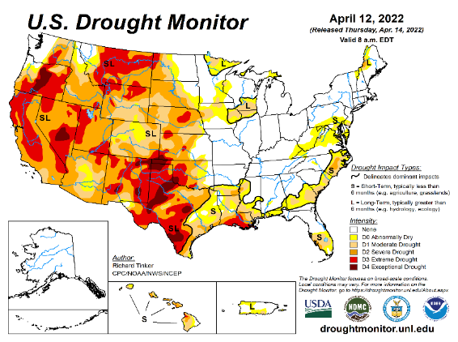
Time series since 2000 spilt into 2 (above & below) panels.
The recent drought has somewhat stagnated ?
Every drought is different.!
Every situation is different!!
D3/D4 areas have decreased.
But, D0/D1/D2 areas increased.
Current drought!
Last month we said: As the La Nina is slowly weakening and is on its way out,
have we seen the worst of the current drought status over the US for now?
Now: Well, Looks like the La Nina is not going away yet! And Drought is expanding!!

Slide 5
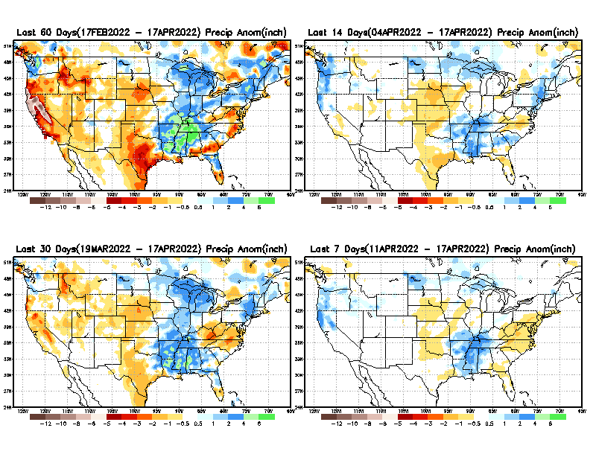
Precipitation ANOM during last 7, 14, 30, & 60 days.
This and next few slides show Precip deficit (excess).
Droughts, for the MOST part, begin and end with precip!! Lately, Temps are becoming (secondarily) important as well.
60 Days
14 Days
30 Day
7 Days
These maps in this and following slides, including a) Total,
b) Anom and
c) Percent of Normal precip. in these and other longer time ranges are now (routinely) daily updated at:
?
From: Recent Accumulated Precipitation https://www.cpc.ncep.noaa.gov/products/Drought/briefing_prcp.shtml

Slide 6
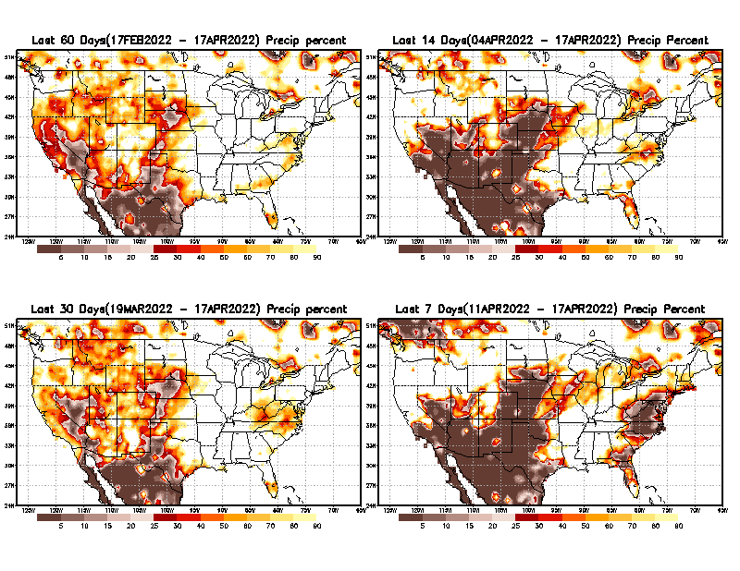
Precipitation Percent (of normal) during last 7, 14, 30, & 60 days - Only Deficit Areas <=90% shown !
60 Days
14 Days
This plot shows only the rainfall deficient regions <= 90% of normal.
-- This shows more clearly possible/likely drought developing region in the future unless there is above normal rainfall in these regions in the future, to offset these shortfalls.
30 days
7 Days
From: Recent Accumulated Precipitation https://www.cpc.ncep.noaa.gov/products/Drought/briefing_prcp.shtml

Slide 7
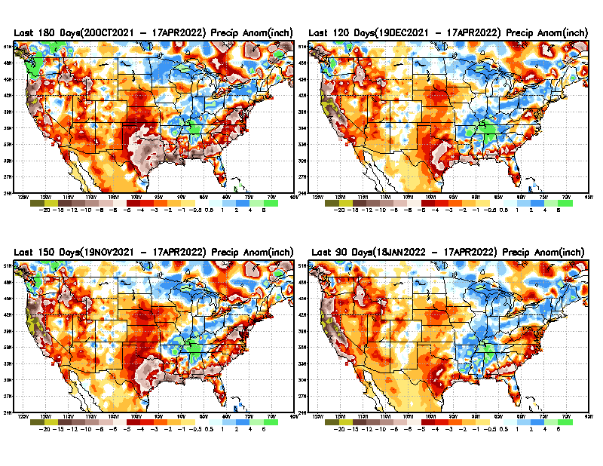
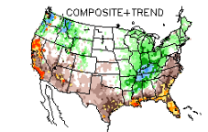
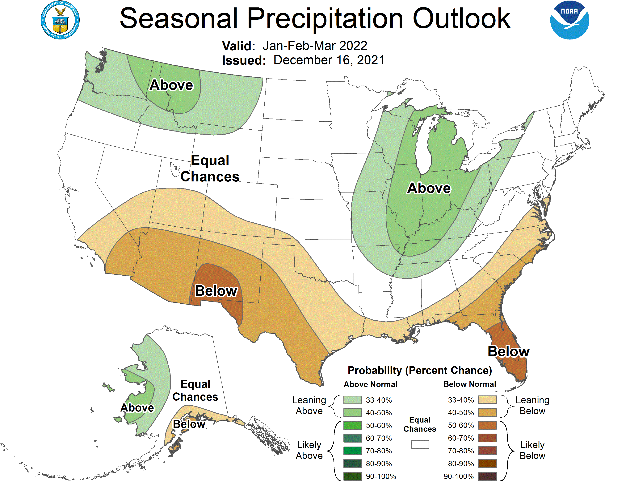
Total precipitation ANOM during last 3, 4, 5, and 6 months.
6 M
4 M
While the Precipitation anomalies deficit may seem large in some regions (compared to others), it is the % of normal precip (next slide) that matters more!!
5 M
3 M
But ~ this happened!!
Typical JFM Precip composite during
La Nina–to be expected!
Fcst
From: Recent Accumulated Precipitation https://www.cpc.ncep.noaa.gov/products/Drought/briefing_prcp.shtml

Slide 8
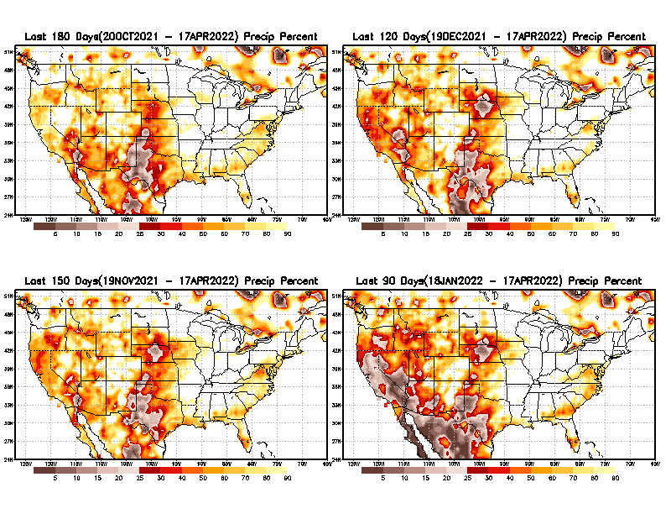
Total precipitation Percent (of normal) during last 3, 4, 5, and 6 months Only Deficit Areas <=90% shown!!
6 M
4 M
In these interim time scale 3-6 months, we need to pay attention to regions, which are dark-brown, red & dark red (<50%).
Not so bad along coast!
in %
While accrued precipitation deficits are real & objective,
droughts are subjective declarations!!
5 M
3M
East vs West!
Broad vs Narrow
rainfall season.
In general, West suffers more from frequent and lasting droughts.
Short term(S) Drought is generally declared when rainfall deficits exist in the 3-6 months time range. { Long term deficits beyond 1 or 2 years is Long term L drought! }

Slide 9
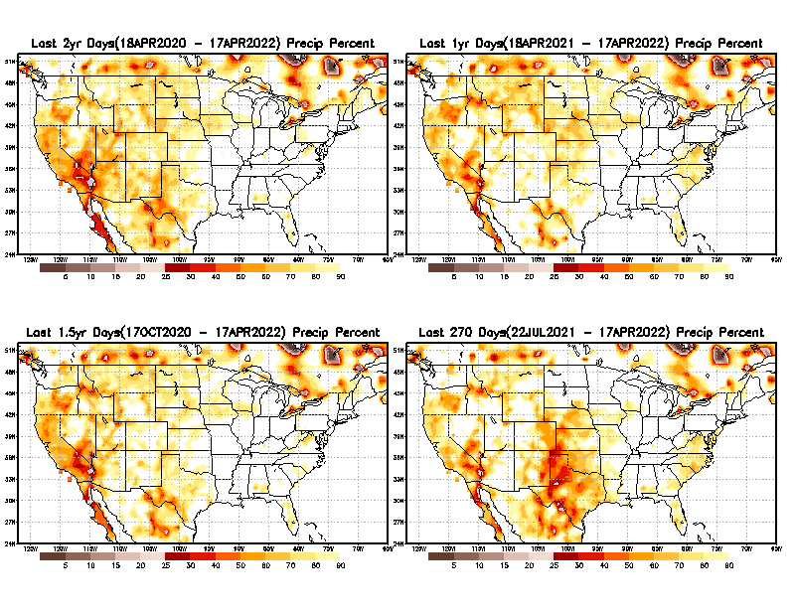
Total precipitation Percent during last 9 months, 1 yr, 1.5yrs, & 2 yrs. .–Only Deficit Areas shown!! <=90%
2 Y
1 Y
Tinderbox areas, where some form of longer term rainfall
deficiencies already, exist !!
-Almost all are in the west!, all part of the long term drought
-This & Next slide!!
1.5 Y
9 M
The character and even location/spatial extent of the short/S and long/L –term droughts are different!!!
From: Recent Accumulated Precipitation https://www.cpc.ncep.noaa.gov/products/Drought/briefing_prcp.shtml

Slide 10
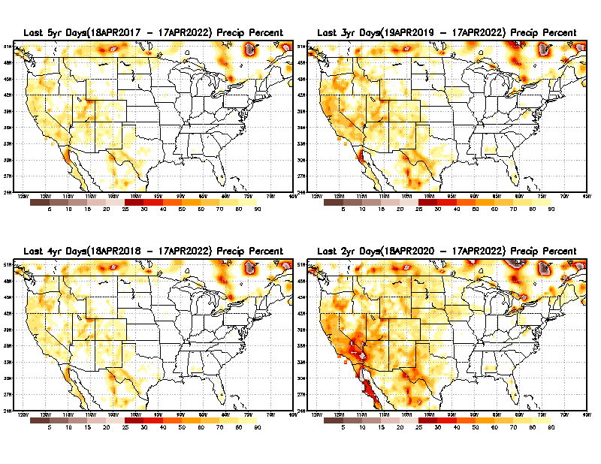
Total precipitation Percent (of normal) during last 2, 3, 4, & 5 yrs. .–Only Deficit Areas <=90% shown !!
5 Y
3 Y
In these long time ranges (2-5 yrs), there is a general dearth/lack of precipitation in the southwest US.
Weather Blog News Today:
A recent study from the University of California, Los Angeles now claims the current drought that started in 2000 for the American Southwest is now the driest 22 years since 800 A.D. Researchers said climate change is to blame. Their proof? Tree rings.
4 Y
2 Y
Ongoing long term drought in the SouthWest!! 3rd year La Nina(?) will make it worse!!.
From: Recent Accumulated Precipitation https://www.cpc.ncep.noaa.gov/products/Drought/briefing_prcp.shtml

Slide 11
AMJ:
End of rainy season in w. coast.
Begin of rainy season in northern & central high plains.
East vs West!
More darker colors in west/central => narrow rainy season (months)
Overall, more white space in the east => distributed rainfall season (except ~FL).
Rainy (3-month)Season across the US

Slide 12
For the forecast season MJJ, we are entering the rainy season for the northern Great Plains and states to the south oninto southwest.
*********
EAST vs
CTR/WEST
Drought Behavior is loosely tied to rainfall climo!! And the limited rainy season in the west
*********
Adapted from Rich Tinker.

Slide 13
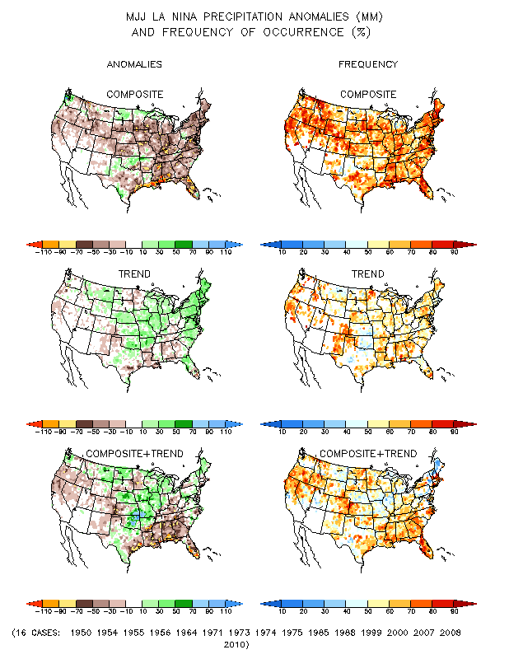
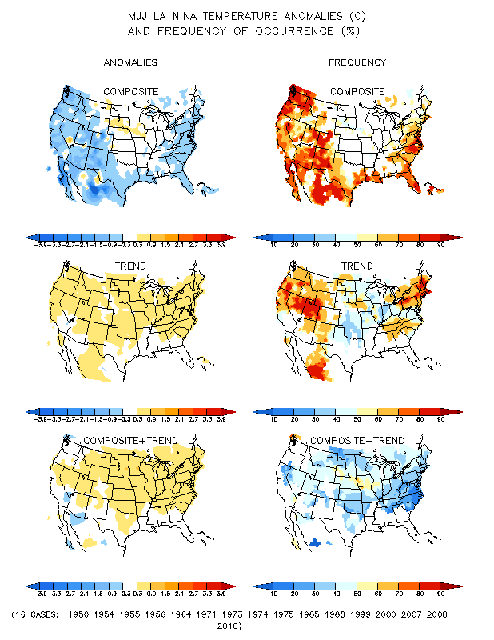
La Nina Precip/Temperature COMPOSITES & Trend map
MJJ
P
T
1
+
1
=
2
Look at frequency along southeast!
Over 70%

Slide 14
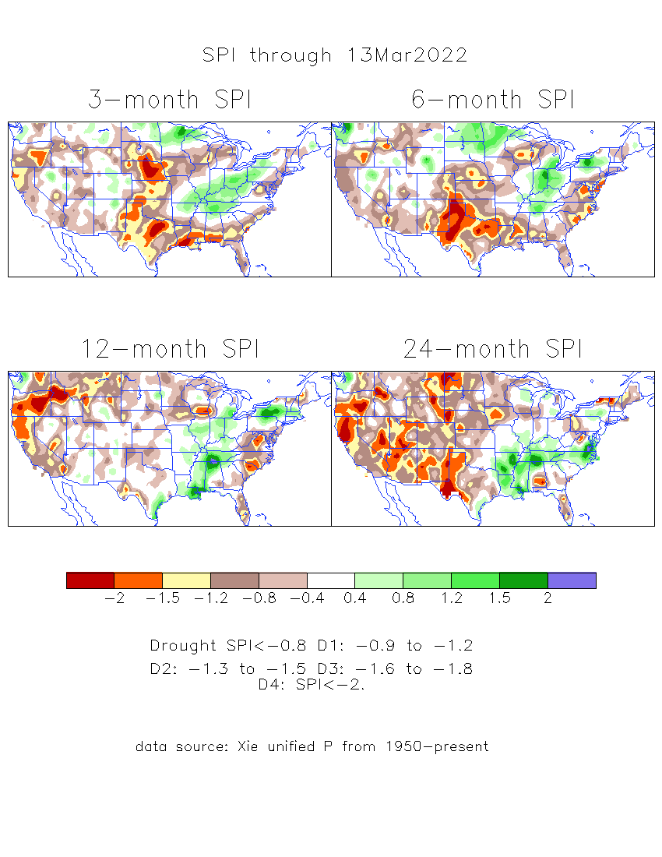
The Standardized Precipitation Index SPI (based on Observed P)
----- Last Month
Very interesting graphic & details for the drought across the US based on the more generalized precip deficit/excess, the Standardized Precipitation Index (SPI).
The dark brown and red colors, indicating standardized precipitation deficits, in the various time periods, approximately correspond to the appropriate short/long term drought monitor regions and their intensities
Don’t let the short term improvement in the southwest fool you!
There is an ongoing long term drought here.

Slide 15
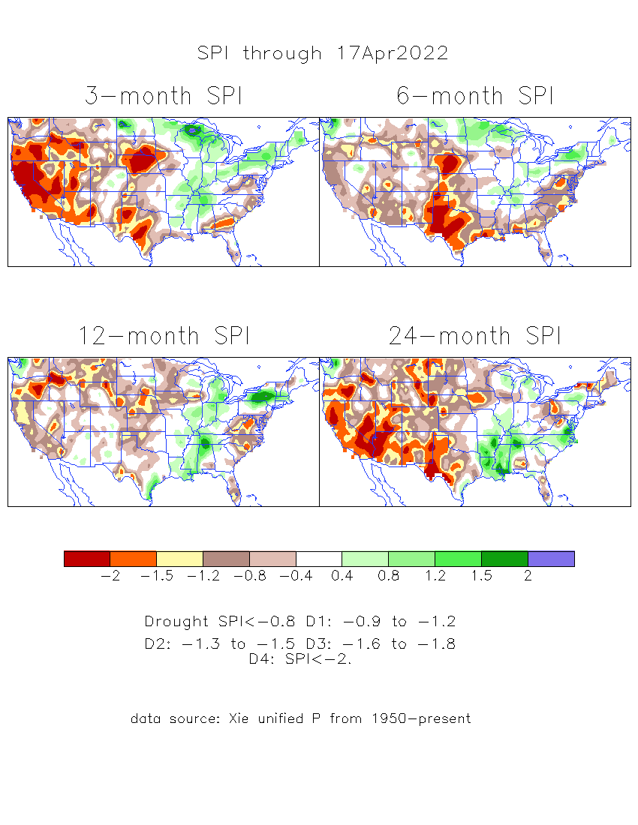
The Standardized Precipitation Index SPI (based on Observed P)
----- NOW
Very interesting graphic & details for the drought across the US based on the more generalized precip deficit/excess, the Standardized Precipitation Index (SPI).
The dark brown and red colors, indicating standardized precipitation deficits, in the various time periods, approximately correspond to the appropriate short/long term drought monitor regions and their intensities
Short
The short term drought has somewhat shifted/extended from southwest to northwest and the northern Plains. But the long term drought in the southwest remains.
Long
How does one negotiate and reconcile declaring short term vs long term drought when precip. deficiencies patterns differ on many different time scales locally!!
What is the cutoff delineating time between short VS long term drought!! Not so clear!!
At exactly where does drought begin?

Slide 16
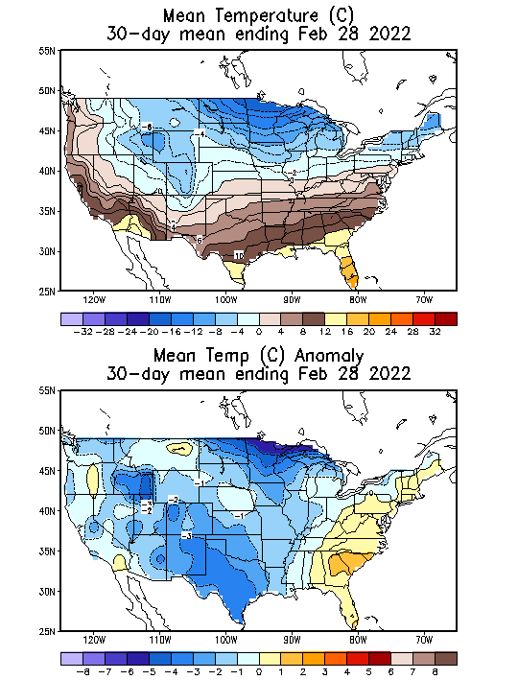
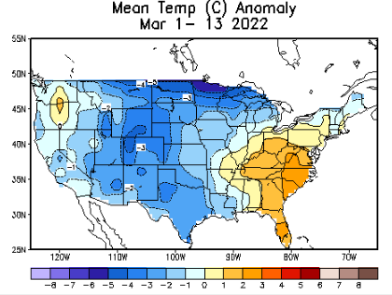
Slide from last month..
-Slide not shown now.
Recent US Temperatures
So far in March, temps. looking similar to February.
There is a lot more going on than just La Nina!!
So far this month !!

Slide 17
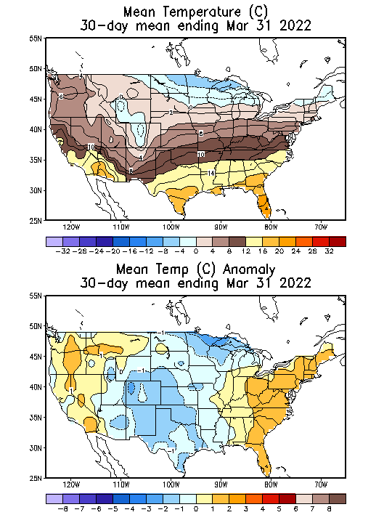
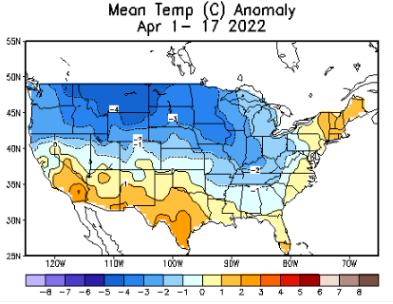
Now..
Recent US Temperatures
So far in April, temps. across much of the northern 2/3rd of country is cold, warm along south and northeast. Lot different than last month/March!
There is a lot more going on than just La Nina!!
So far this month !!

Slide 18
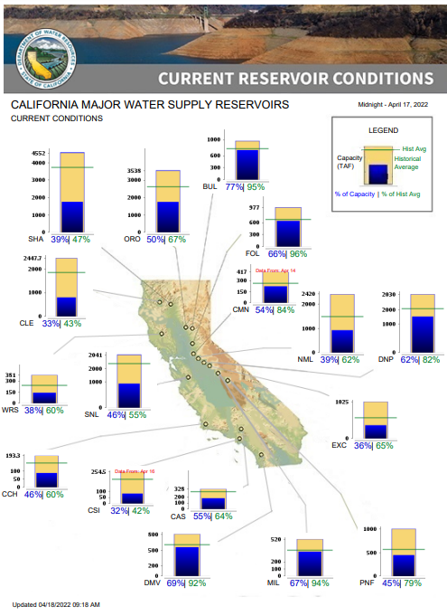
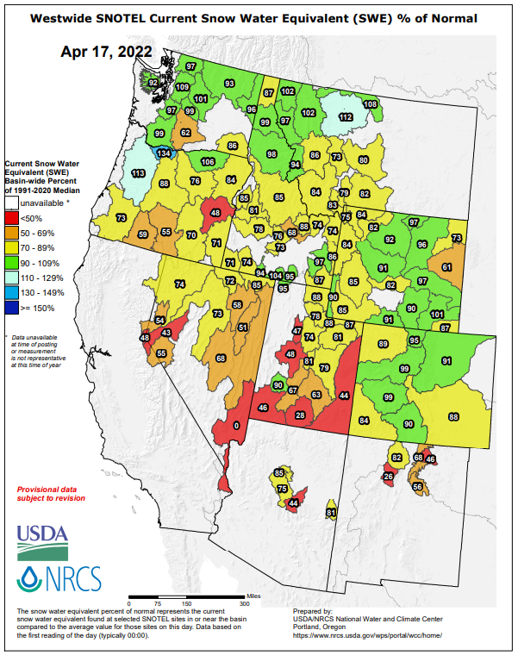
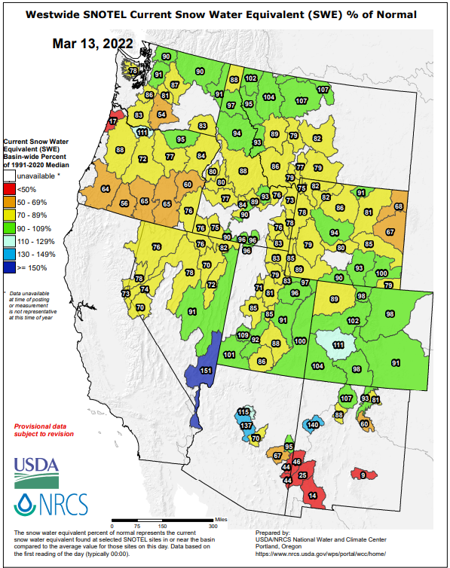
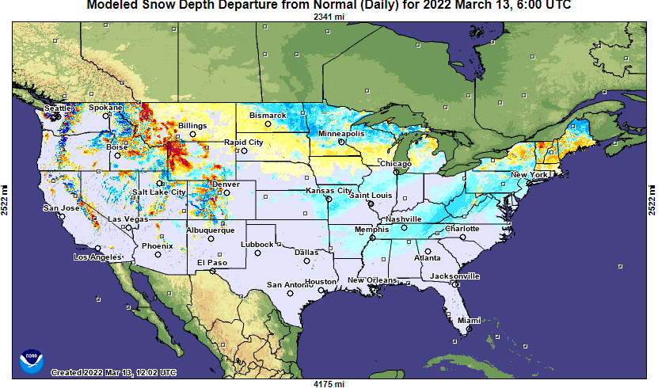
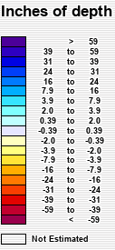
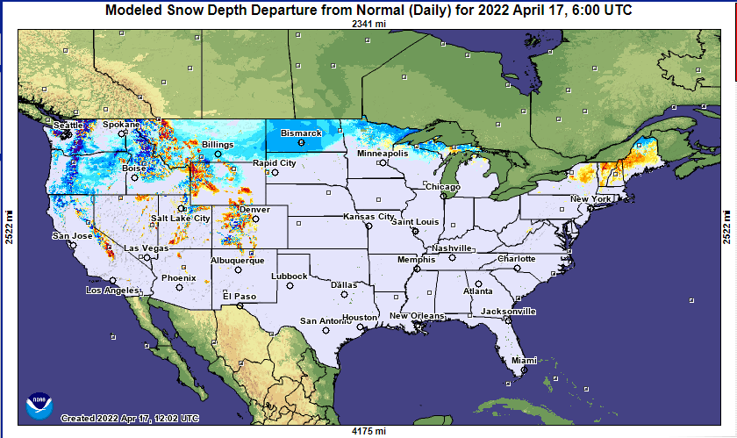
April
March
Last month
This month
Most CA water reservoirs are drastically low!
Third year of La Nina (if it comes!) this coming winter, will make drought conditions even worse for CA!!!

Slide 19
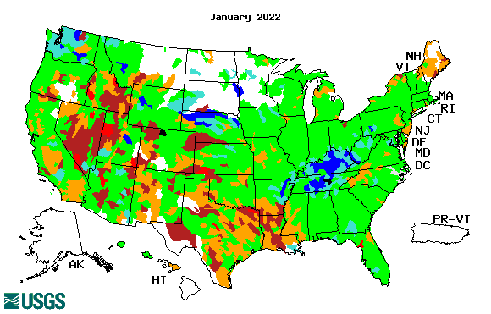
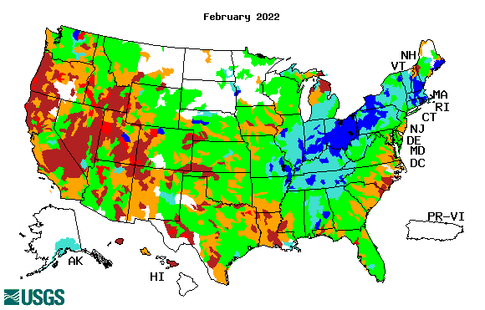
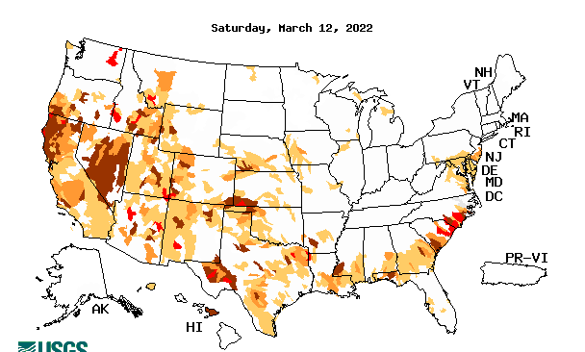
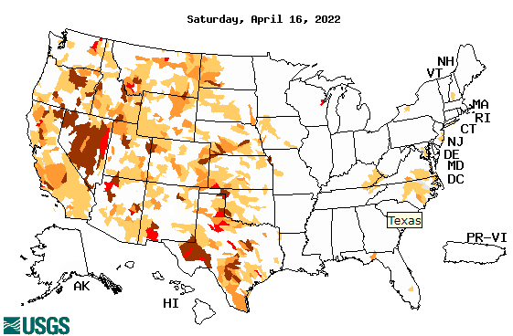
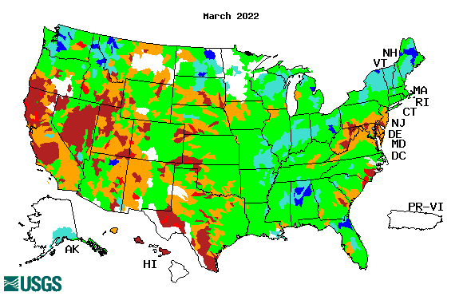
Streamflow (USGS)
Most US east droughts are relatively short lived (as compared to US west). However, if you recall, the drought over the New England states last year was a real surprise!!
Map shows only below normal 7-day average streamflow compared to historical streamflow for the day of year.
One month ago (left) &
Now (below)
Streamflow is only a partial indicator, as it is highly managed.
Look along the Pacific coastal states. If sometimes, the various indicators are confusing, go back to % of rainfall deficit maps – to reinforce!!
19

Slide 20
EL NIÑO/SOUTHERN OSCILLATION (ENSO)
DIAGNOSTIC DISCUSSION
issued by CLIMATE PREDICTION CENTER/NCEP/NWS and the International Research Institute for Climate and Society
14 April 2022
ENSO Alert System Status:
La Nina Advisory
Synopsis: La Niña is favored to continue through the Northern Hemisphere summer (59% chance during June-August 2022), with a 50-55% chance through the fall.
CPC’s Oceanic Niño Index (ONI) [3 month running mean of ERSST.v5 SST anomalies in the Niño 3.4 region (5ºN-5ºS, 120º-170ºW)], based on centered 30-year base periods updated every 5 years.

Slide 21
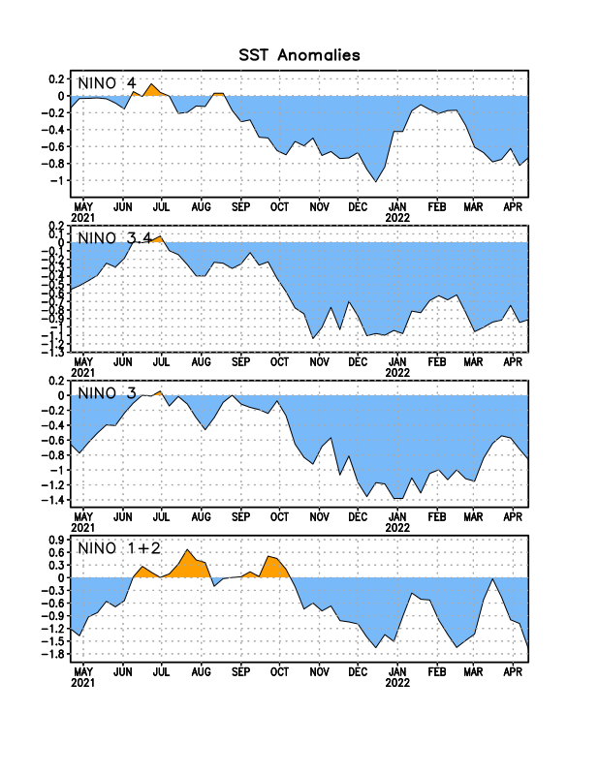
Latest values of SST indices in the various Nino Regions.

Slide 22
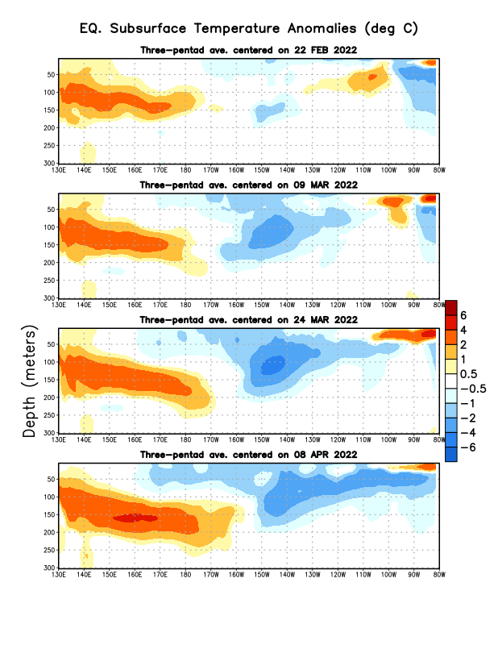
Sub-Surface Temperature Departures in the Equatorial Pacific
The subsurface cold anomalies in east Pacific are slowly strengthening and expanding in space and volume.
Warm waters in the WP/CP that strengthened earlier have recently stalled.
Most recent pentad analysis
Last month we said:
It is not clear which way, the subsurface waters will go in the next few/many months!! That’s why the 50/50 chance…
But NOW, it looks like La Nina odd are higher!!

Slide 23
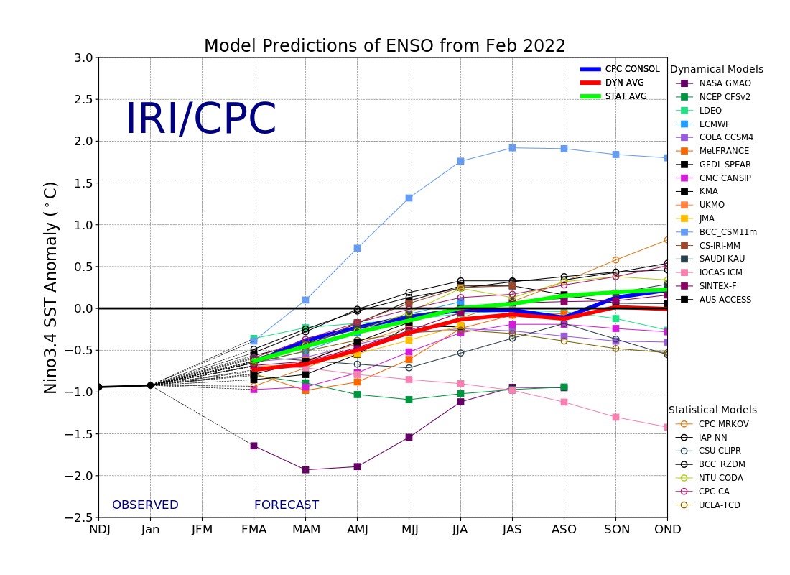
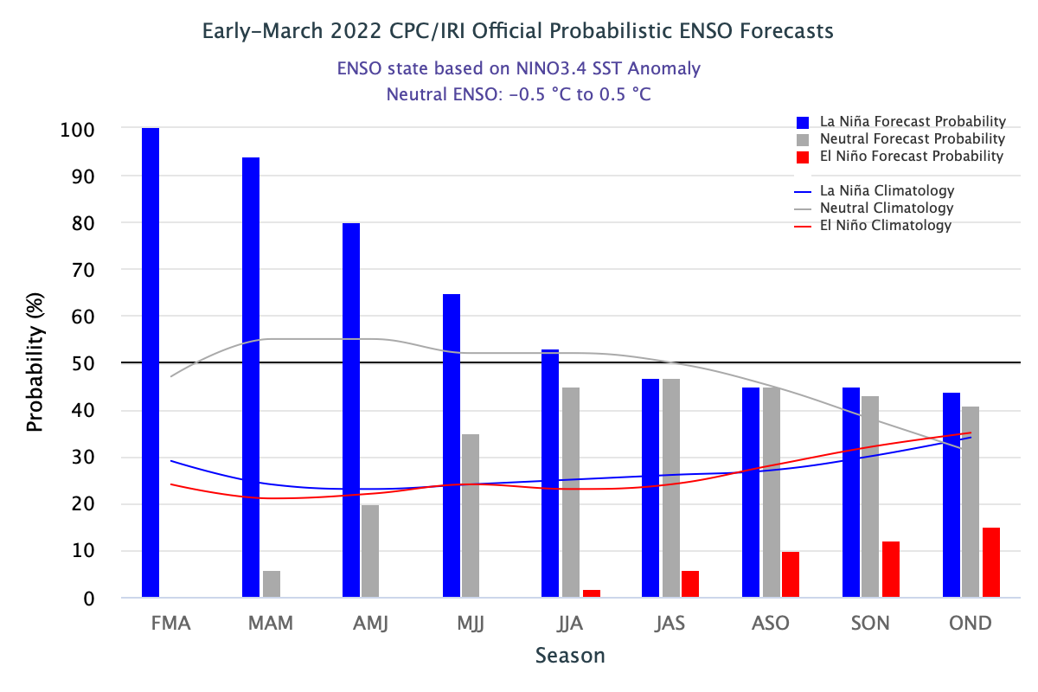
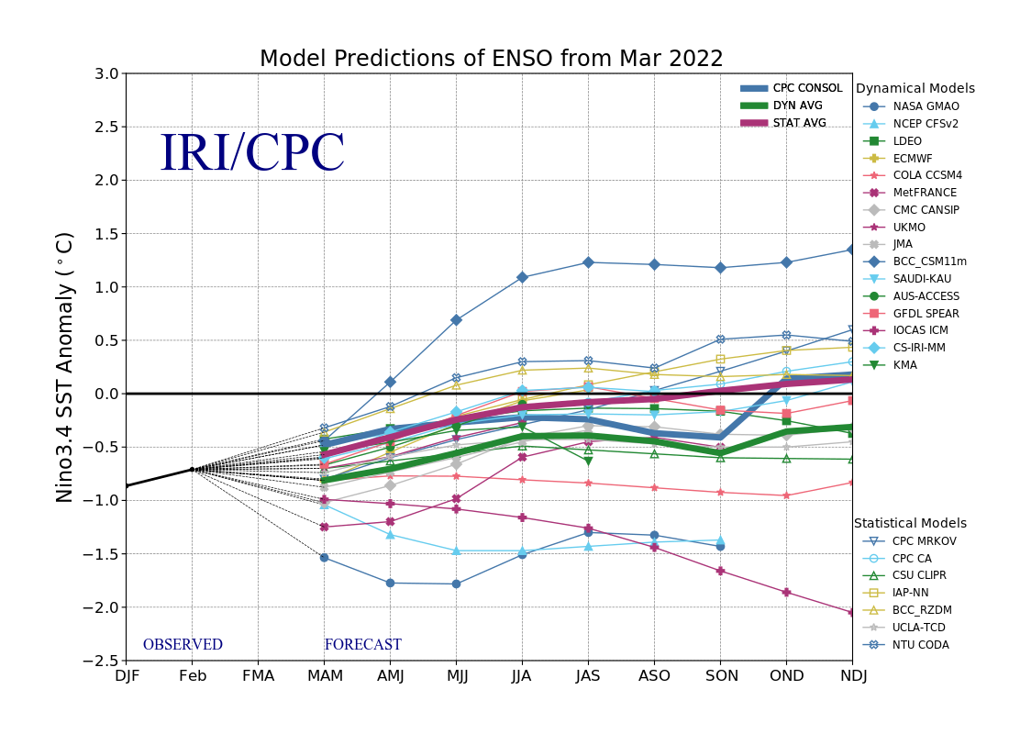
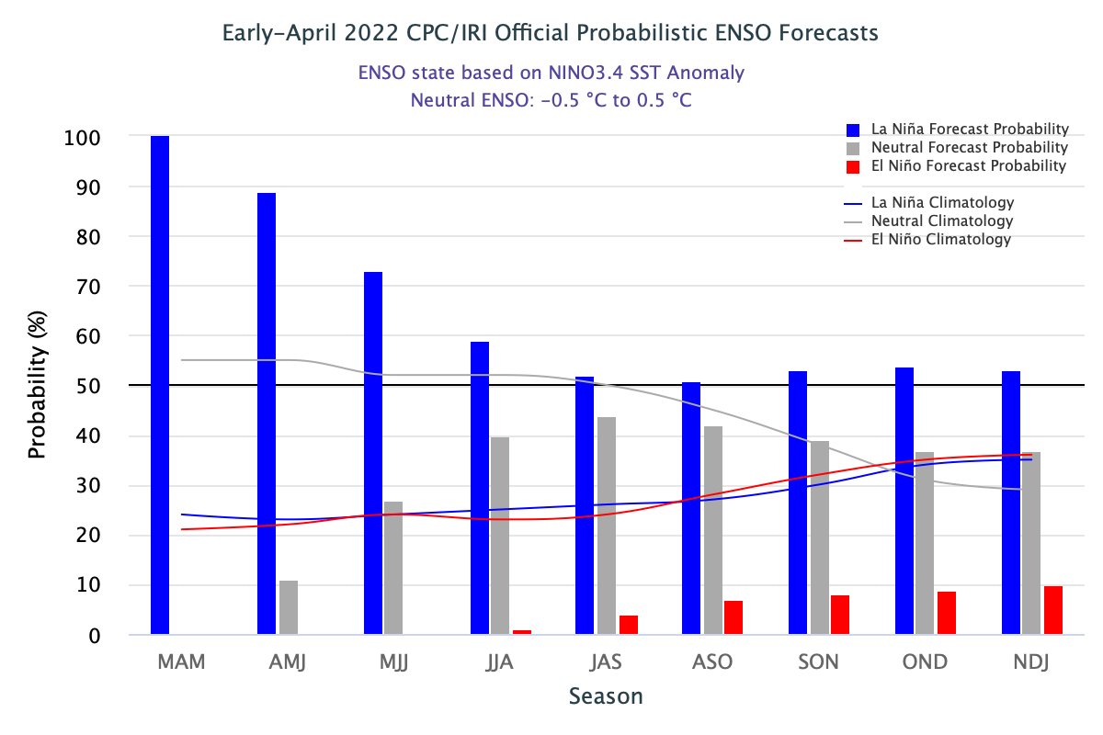
ENSO Forecasts
Early- March CPC/IRI forecast
Early- April CPC/IRI forecast
Dynamical, Statistical, CPC-Consolidated fcsts are coming together!! But still at ~ -0.5C !
As compared to last month, the odds of La Nina (for next several months) has slightly increased !!
But spread/uncertainty (also towards neutral!) is still there.

Slide 24
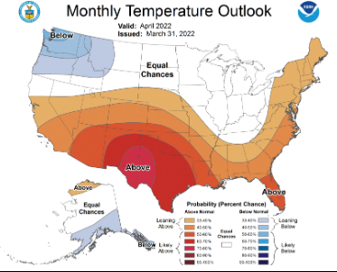
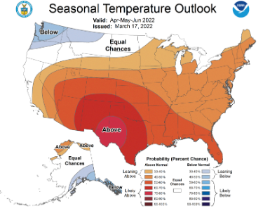
Previous (Last Month’s)
CPC’s official
Temperature OUTLOOK for Monthly (April)/Seasonal (AMJ)
Released Jan 20th
Observed so far this month!! ☹ ☺

Slide 25
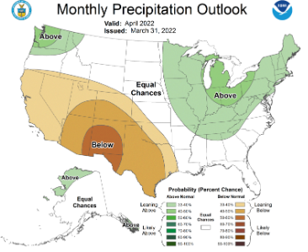
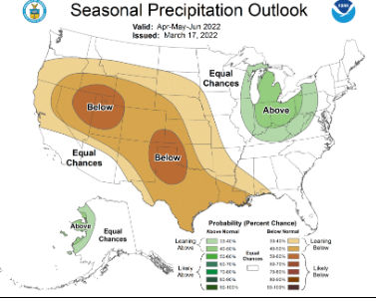
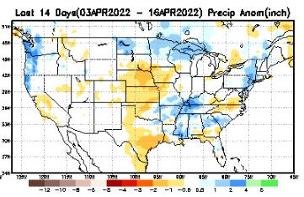
Previous(Last month)
CPC’s official
Precipitation OUTLOOK for Monthly (April)/Seasonal (AMJ)
Released Jan 20th
Very similar looking!
Based on La Nina !!!!
Observed so far this month!!
Monthly P/T forecasts verified at mid-month are generally good! Becoz of good skill upto 2 wks.
But so far ☹, esp. along the west !

Slide 26
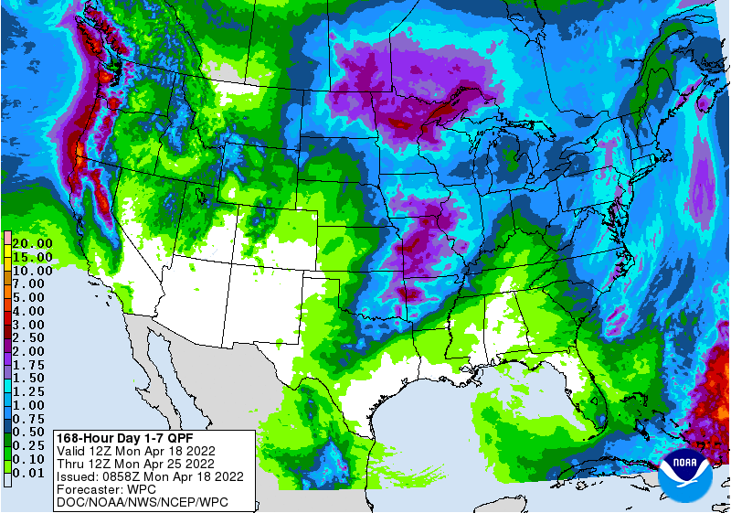
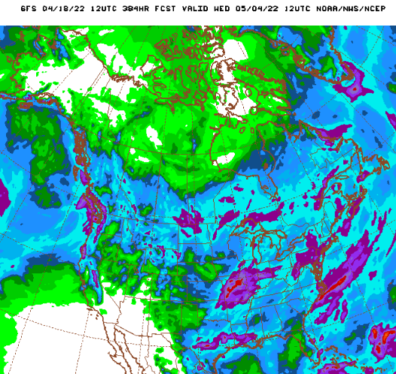
NCEP/WPC Next 7 days QPF (Quantitative Precipitation Forecast)
GFS Model Guidance for the
next 16 days.
A good amount of rain is forecast/expected along the Pacific Northwest in WA/OR/northern CA, as well as over ND, MN, and over MO and adjacent regions.
Mid Atlantic states will get relief from the dry conditions.

Slide 27
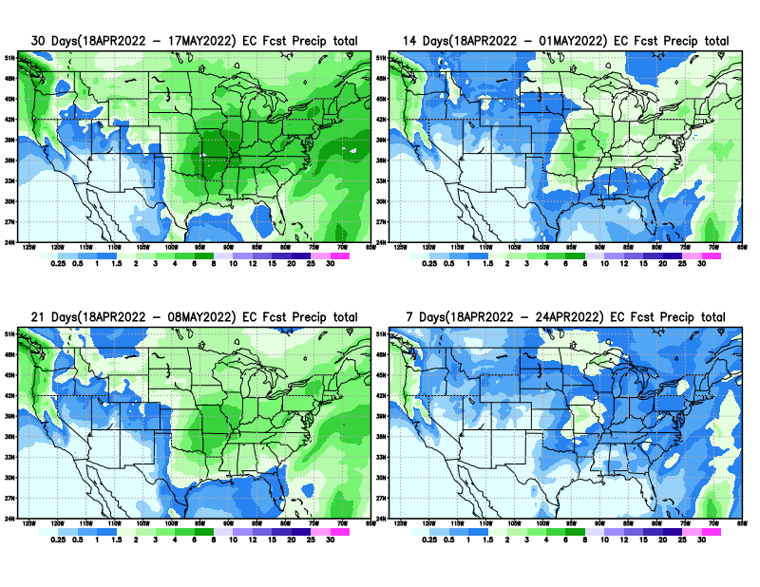
From European Center (EC) Precip forecast (made yesterday, 18 Apr) for next 30 days.

Slide 28
From European Center (EC) Precip forecast (made yesterday, 18 Apr) for next 30 days.
20
40

Slide 29
From European Center (EC) Precip forecast (made yesterday, 18 Apr) for next 30 days.

Slide 30
From European Center (EC) Precip forecast (made yesterday, 18 Apr) for next 30 days.

Slide 31
Week-4 Soil Moisture Percentile (SMP) Fcst based on VIC model forced with ECMWF-extended precipitation forecast!
Now: Yesterday’s IC
??
(From Drs. Li Xu and Yun Fan) More detail at From: https://www.cpc.ncep.noaa.gov/products/people/lxu/flashd/flash_prediction.html

Slide 32
NMME T & P Ens.Mean forecasts for
May
MJJ

Slide 33
Agreement/Disagreement among the various NMME models’ MJJ seasonal Precip. Forecast.
??

Slide 34
(From NMME) compared with this month(foreground, red border)
Why is there so fewer hatched areas in SPI6 fcst from NMME models’ based fcst this month as compared to last month (left 2 columns) ? Fcsts more confident now?
Forecast uncertain in Hatched areas.
These maps are based on NMME models’ precip forecast uncertainty/certainty (among ensemble members) over the next 3 months
SPI6 Fcst made from last month
SPI6 & SPI12 Fcst made from this month

Slide 35
Slide not shown!!
http://drought.geo.msu.edu/research/forecast/smi.monthly.php
Latest Initial Conditions:
12/21/2021
Predicted Monthly Soil Moisture Percentile
MSU Soil Moisture Percentile forecast NOT available this month, NOT updated!
CPC’s soil moisture percentile – Leaky bucket Model
The inter quartile range suggest greater uncertainty about the forecast in these shaded regions. Lots of uncertainty regions!! ☹

Slide 36
BONUS Topic: Discussion continues!! Explanation for the multiyear DROUGHT in the Southwest (CA/AZ/NM/NV/UT/CO & vicinity)!!
More La Nina’s lately ?
More frequent La Ninas lately ?
YES!! The stats in the table below (bottom left) are from the Official CPC ENSO declarations page/table!
Compared to other regions of the globe, the SST warming/trend in the central eq. Pacific (Nino 3.4) is relatively much small. (See Fig. above) – Why is this ?
Does nature try to compensate for the warming else/everywhere by producing more La Ninas in the central eq. Pacific? - Just my thought ! Let’s check !!!
Since the 1997 monster El Nino (stronger than the famous 1982/83 event), just a quick count of CPC’s Nino 3.4 index++ values for the three month overlapping seasons, (Data at CPC site only available only from 1950!)
(25 years) (47 years) (72 years)
1997-2021 1950-1996 1950-2021
La Nina(DJF) 11 16 27
El Nino(DJF) 9 17 26
La Nina(all 3mos) 106 150 256
El Nino(all 3mos) 77 166 243
(Overlapping 3month seasons)
Look at Ratios of La Ninas (vs El Ninos) in the shorter
recent (25 yr) period vs the longer (47 yr) earlier period!!
***Analysis of CPC’s official Nino 3.4 index data over the last 70 years shows that the more frequent La Nina’s in recent decades contributed to less rainfall in the southwest (See La Nina precip composites!, slide#13) and hence the ongoing long term drought in the Southwest!! Hence the long term southwest drought is unlikely to go away any time soon***
++ Barnston, Chelliah and Goldenberg (1997):Documentation of a highly ENSO‐related sst region in the equatorial pacific, Atmosphere-Ocean Volume 35, 1997. https://doi.org/10.1080/07055900.1997.9649597
*** The strong/weak annual monsoon rains in the southwest is just a minor modulator riding on this bigger/long-term signal. ***

Slide 37
Summary
Current Drought conditions:
As the winter rainfall season is coming to a close along the Pacific West, the severe drought has also expanded further from last month. The excess winter snowfall in/near the Great Lakes region has slightly improved the drought conditions in the region.
Besides this, elsewhere in the west, in the west central mountain and vicinity, and the southwest the overall drought situation has remained the same from last month.
The short and temporary drought conditions along the mid-Atlantic coastal regions, and east coast droughts (unlike the southern/western US droughts) generally do not last long. Hence these droughts go back and forth in intensity and extent, and need not be of much concern, even though their short term effects do matter.
Most CA water reservoirs are drastically low! This is particularly consequential as the rainy season is just about to end.
Current ENSO status and forecast: La Niña is favored to continue through the Northern Hemisphere summer (59% chance during June-August 2022), with a 50-55% chance through the fall.
Prediction:
It appears that the La Nina may not be gone after all, and may continue to stay through the next forecast season MJJ and possibly beyond. With this, we can continue to expect the canonical impacts for the season. The observed T/P anomalies even during the past peak La Nina conditions in the winter months resembled only weakly similar/like the forecasts or the past La Nina composites.
In spite of these, especially as the winter rainy season is coming to an end along the west coast states, the long term existing drought in the western and southwestern states will continue to stay and persist during MJJ.
MJJ is the rainy season in the northern Great Plains and the upper central Plains, and we may expect improvement or even removal of drought in some of these regions. But the NMME models do not support this and predicts below normal rainfall, and hence the drought in these regions may persist and may even get worse.
In the southeastern Gulf/Atlantic coastal states, only weak, temporary and short term dryness drought conditions exists now. For the forecast season MJJ, even though the climatology is favorable, the removal of those conditions depends on the nature and strength of the La Nina conditions. The short term rainfall and the NMME models forecast for the season seem to indicate the existing drought conditions in MS eastward onto and along the Atlantic coastal states will likely go away by the end of the forecast season.
However, the near 50% chance of weak La Nina conditions in the upcoming months makes the forecast that much difficult especially in these transition months. *************

