Slide 1
Drought Outlook Support Briefing April 2023
Climate Prediction Center/NCEP/NOAA
http://www.cpc.ncep.noaa.gov/products/Drought
Points to ponder:
Often, there is a disconnect between the Short term (S) and Long term (L) drought in regions, and even with the short term (S) drought, the 3-month and 6-month signals are not quite consistent! With Long term (L) drought, it is even more trickier, as it is open ended, from 1 year and beyond!!!
Places/regions experiencing Short term drought may (not) be ok in the Long term and vice versa!!
This duality is difficult to reconcile, to convey and even be understood well by the public at large.
Public/Forecaster generally tends to focus more on the Short term Drought (for good reasons!!)
More importantly the very definitions and timescales associated with S/L term droughts and the declarations in the USDM are by themselves subjective!!
The S/L term drought conditions in large parts of California, a year ago, even just a few months ago, has now mostly gone. Major improvements in drought conditions are also noted recently in large parts of UT/AZ/NM/CO also.
It may take a long time for drought to develop, but those conditions can end very quickly! Forecast models are yet to (seasonal) correctly forecast these changes in advance!
Short term vs Long term drought need to be clearly distinguished and shown to the public!!
Subjective(delayed) USDM vs Objective(real time) map! A few days or recent heavy precip can change the USDM a lot!
New objective AI/Deep-Learning based Experimental ODI (objective drought indicator, runs daily) compared with Official USDM (US Drought Monitor, produced weekly by USDM authors).

Slide 2
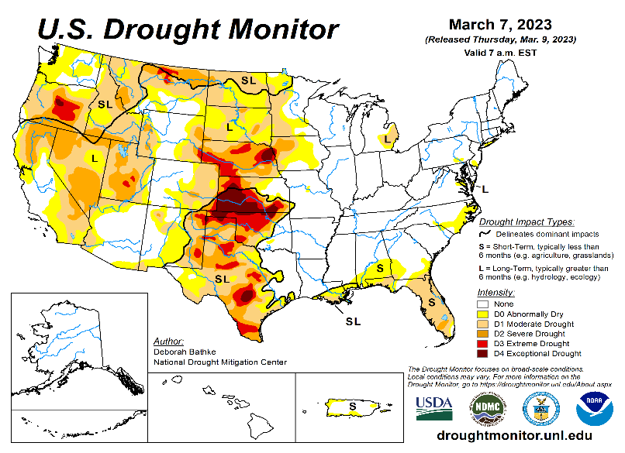
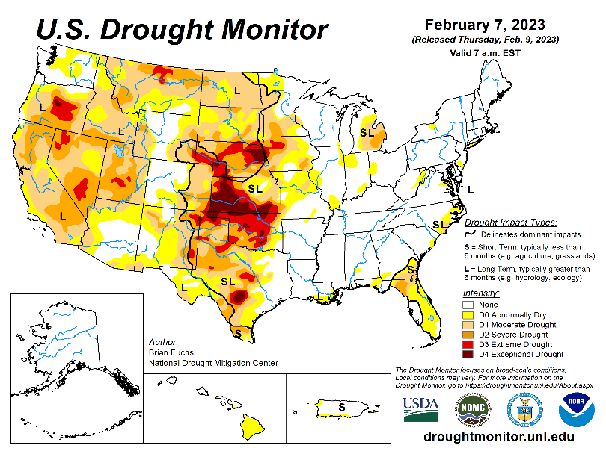
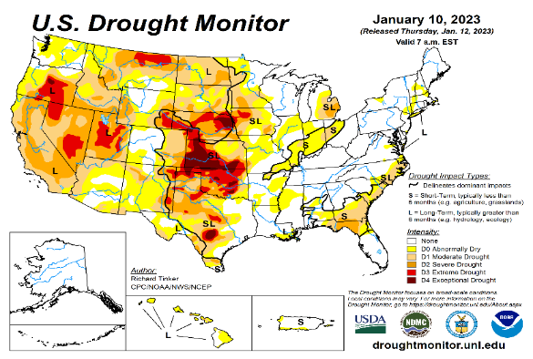
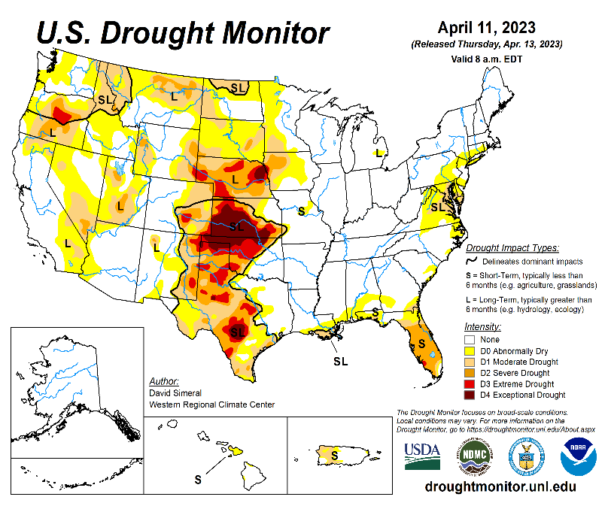
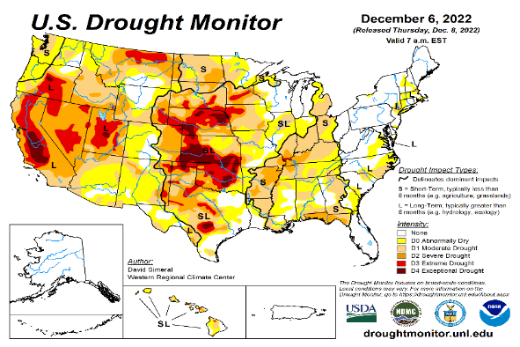
Drought Monitor
Monitoring is important because, unlike US T/P fcsts, for drought forecasts, we have to know where we are, before we can tell where we are going!! Drought forecasts are tendency forecasts.
March
February
Towards the end of last year 2022, until December or so, severe drought conditions remain in the west, mild drought conditions expanded in to portions of the eastern half of the US also, covering most of the country with near high % areas of the entire US affected by drought.
Then with the start of winter season in CA and the west coast states deluge/excess rain over CA and vicinity during the recent weeks and months wiped out not only the short term drought in the region, but also the L-term drought as well. Water levels in many CA reservoirs are now ABOVE their normal levels.
There is a considerable decrease and sudden drop in the areal coverage of all drought categories across the United Unites during the many weeks heavy rainfall during recent winter and continuing!. The area covered by >D1 category drought is under 25%, a relatively small number, compared to December 2022.
The subjectively made, only once a week weekly issued, official USDM map is not able to keep up with the daily heavy deluge of rains, which can change drought to floods and fill up reservoirs.
The drought in south central part of the US, covering large parts of KS/OK/TX has stubbornly persisted with little improvement. The drought in this central part of the US is both short and long term.
Drought in the mid-Atlantic and FL worsened.
January
April
(Recent/Latest)
December
?

Slide 3
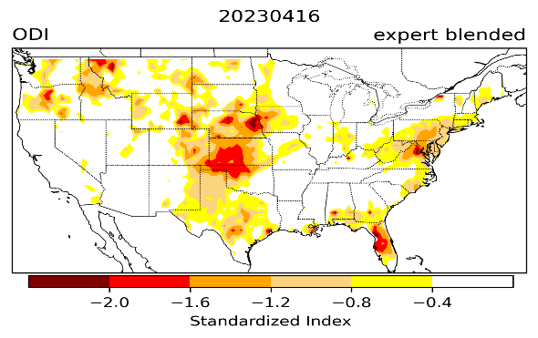
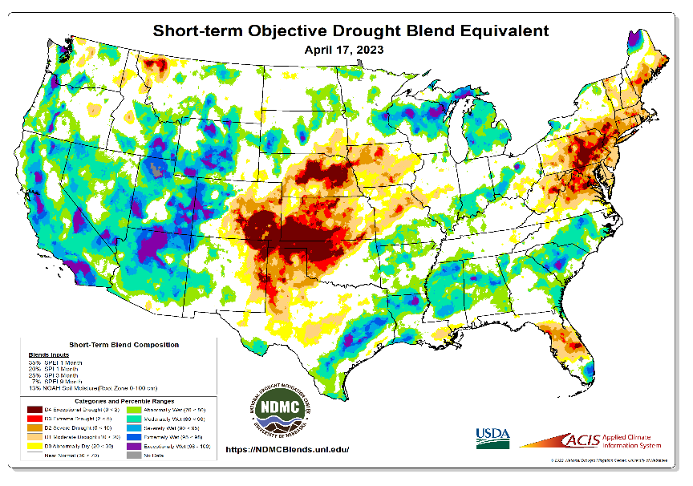
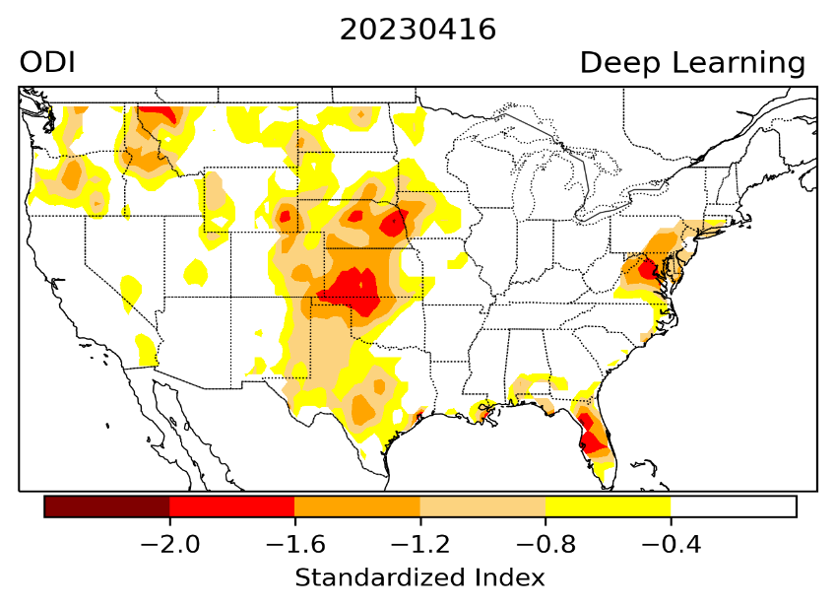
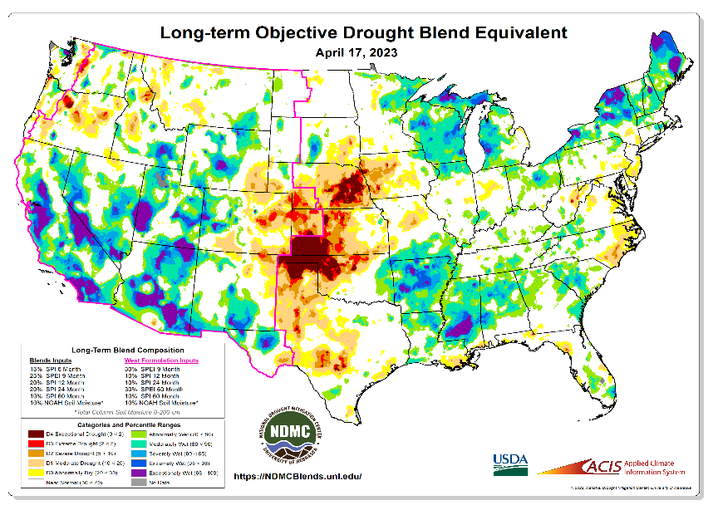
Exptl. Objective Drought Monitor (showing S/term & L/Term separately) from National Drought Mitigation Center (NDMC)
New slide now included in this briefing!
CPC’s own Experimental
Objective Drought Indicator (ODI)
using AI/Deep Learning ! – Updates daily !!
https://www.cpc.ncep.noaa.gov/products/people/lxu/odi/#deep-learning-increment-training
Based on the CPC P/analysis &
VIC (Princeton) NLDAS model assimilation:
Standardize Precipitation index (SPI)
Standardize Precipitation-Evapo –
transpiration index (SPEI)
Evapotranspiration Stress Index (ESI)
Soil Moisture Percentile (SMP)
Standardize Runoff Index (SRI)
-can be split into Short/Long Term Droughts!
https://droughtmonitor.unl.edu/ConditionsOutlooks/CurrentConditions.aspx
Objective &
Runs Daily!
Expert Blended method
Deep Learning method
Both Objective!
Objective &
Runs Weekly!
On Monday!
Objective &
Runs Daily!
* A manuscript (Li Xu & Muthuvel Chelliah) is under preparation.
Official USDM (US Drought Monitor)
NOTE : A few days of heavy precip (as recently in CA!) can make big quick changes to the Short and even Long term drought conditions and hence the USDM.
Subjective &
Runs Weekly!
Objective &
Runs Weekly!
On Monday!
These two maps above, used to be produced at CPC(Rich Tinker!), but recently taken over by NDMC operations!
*Released every Thursday, for conditions as of Tuesday!

Slide 4
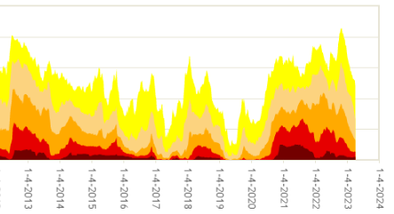
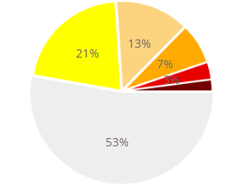
In general, The spatial details of Every drought is different.! Every situation is different!!
Time series since 2000 spilt into 2 (above & below) panels.
Current drought!
In early 2023 (interestingly coincidentally as ten years ago in 2013!) there is such a drastic decrease in the coverage of US drought areas in all categories!! This time, even the many CA reservoirs are well near their historic averages!

Slide 5
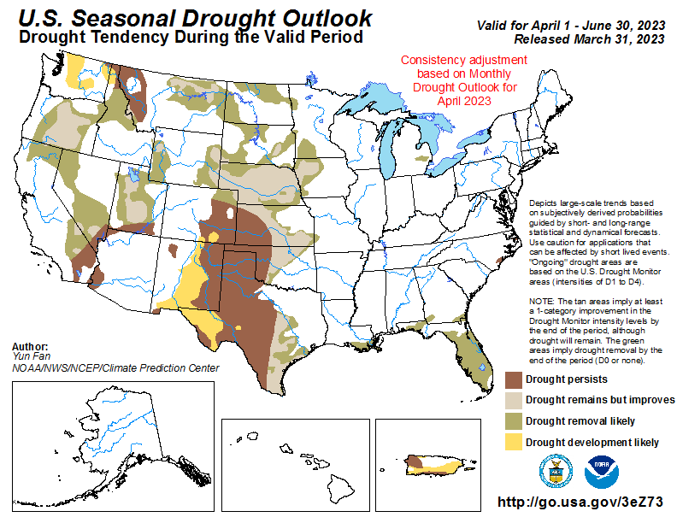
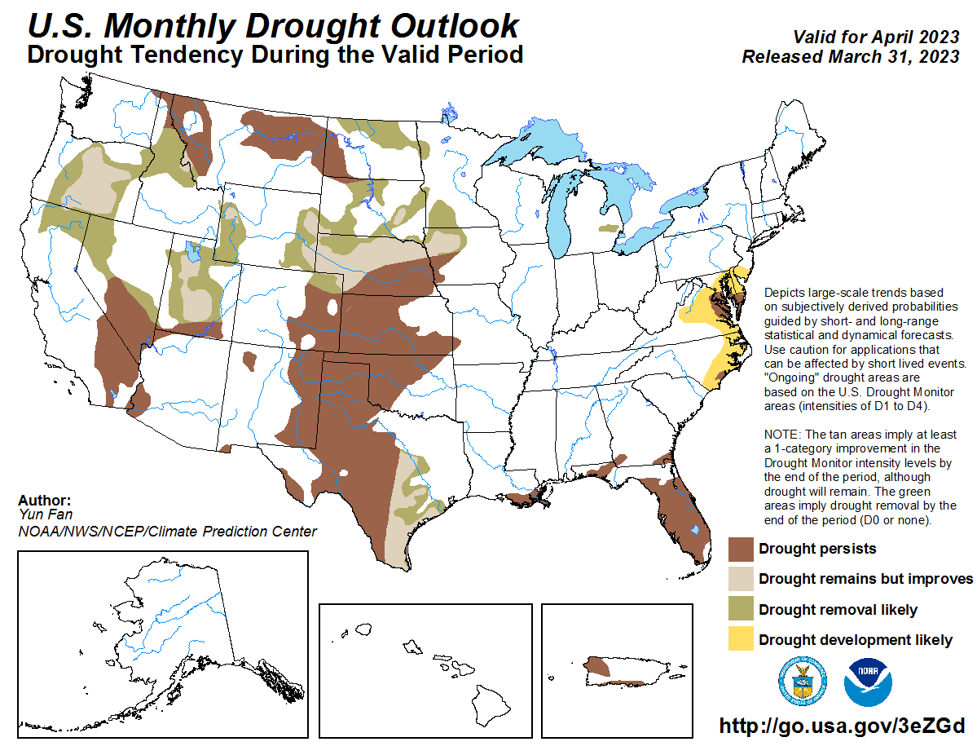
(Previous) Seasonal/Monthly Drought outlooks
New Seasonal+ Drought Outlook(SDO) to be released in 2 days!
(reissued again at end of month for consistency with MDO!)
New Monthly Drought Outlook (MDO) to be released at end of this month)
Updated Seasonal Outlook
( 1 Apr – 30 Jun 2023)
issued 3/31/23
Monthly outlook (for April 2023)
issued 3/31/23
We have been saying:
The ongoing winter rainy season (DJFM) along the west coast states, combined with the weakening/slowly exiting La Nina conditions is likely to improve the overall drought conditions and hence reduce the drought areal coverage in the United States, especially in the west and southwest. But neither the models nor the forecasters expected this kind of quick recovery! BUT Nevada lakes/reservoirs are still extremely low.

Slide 6
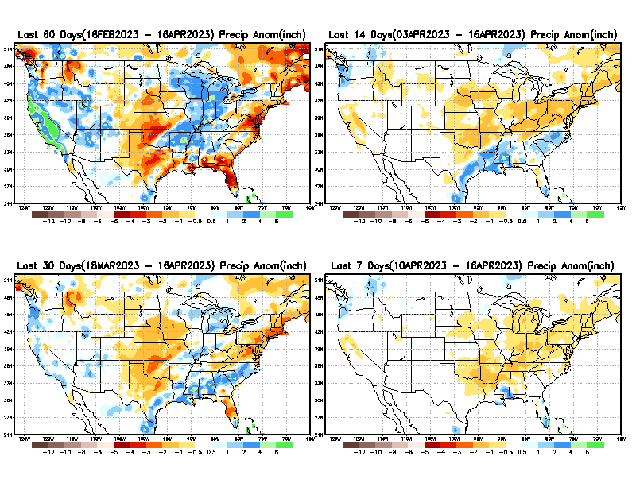
Precipitation ANOM during last 7, 14, 30, & 60 days.
This and next few slides show Precip deficit (excess).
Droughts, for the MOST part, begin and end with precip!! Lately, Temps are becoming (secondarily) important as well.
60 Days
14 Days
30 Days
7 Days
These maps in this and following slides, including a) Total,
b) Anom and
c) Percent of Normal precip. in these and other longer time ranges are now (routinely) daily updated at:
From: Recent Accum./Anom Precipitation https://www.cpc.ncep.noaa.gov/products/Drought/briefing_prcp.shtml

Slide 7
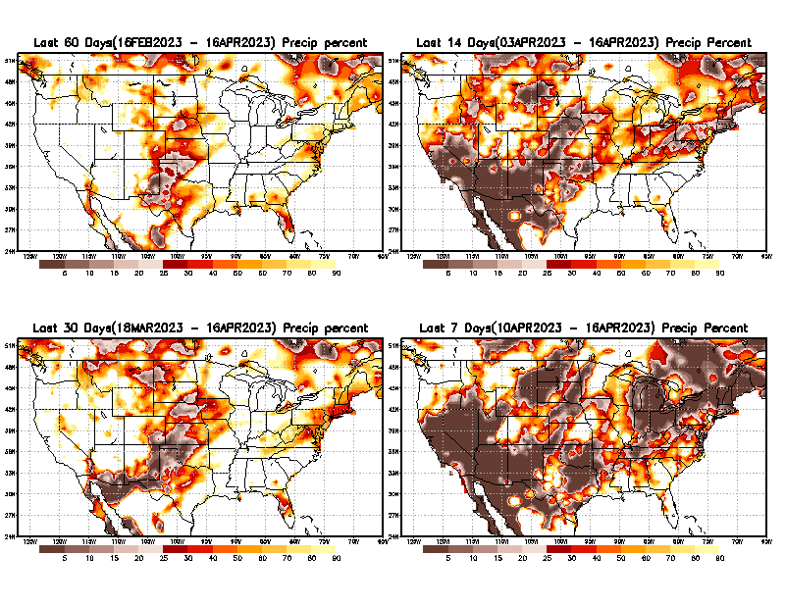
Precipitation Percent (of normal) during last 7, 14, 30, & 60 days - Only Deficit Areas <=90% shown !
60 Days
14 Days
This plot shows only the rainfall deficient regions <= 90% of normal.
-- This shows more clearly possible/likely drought developing region in the future unless there is above normal rainfall in these regions in the future, to offset these shortfalls.
30 days
7 Days
From: Recent Anom/% of normal Precipitation https://www.cpc.ncep.noaa.gov/products/Drought/briefing_prcp.shtml

Slide 8
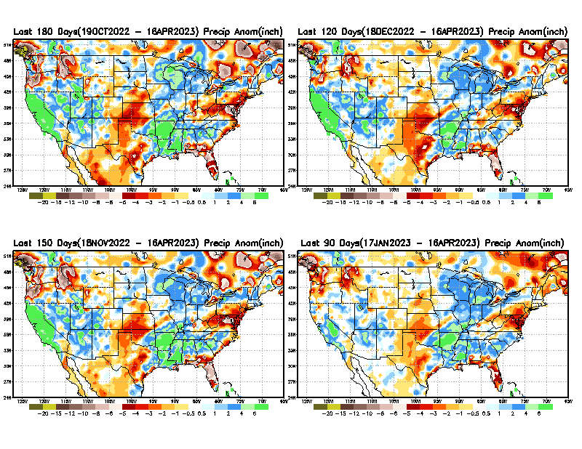
Total precipitation ANOM during last 3, 4, 5, and 6 months.
While the Precipitation anomalies deficit may seem large in some regions (compared to others), it is the % of normal precip (next slide) that matters more!!
6 M
4 M
5 M
3 M
From: Recent % of Normal Precipitation https://www.cpc.ncep.noaa.gov/products/Drought/briefing_prcp.shtml

Slide 9
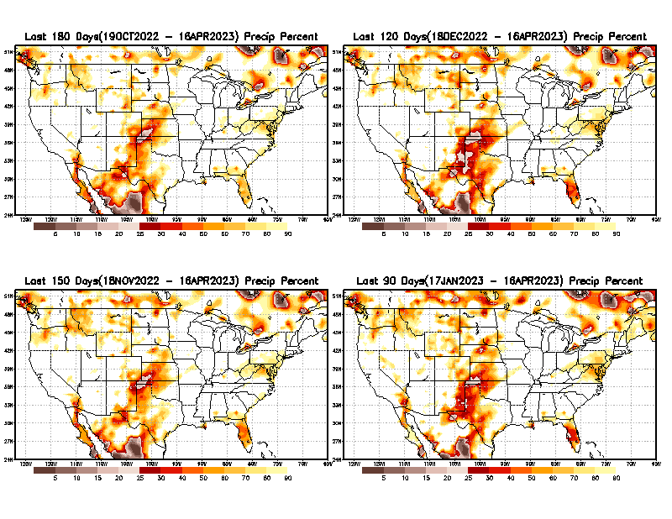
Total precipitation Percent (of normal) during last 3, 4, 5, and 6 months Only Deficit Areas <=90% shown!!
6 M
4 M
In these interim time scale 3-6 months, we need to pay attention to regions, which are dark-brown, red & dark red (<50%).
While accrued precipitation deficits are real & objective,
droughts are subjective declarations!!
5 M
3 M
Hard to believe the switch lately betw. E/W compared to last year!
East vs West!
Broad vs Narrow
rainfall season.
In general, West suffers more from frequent and lasting droughts.
Short term(S) Drought is generally declared when rainfall deficits exist in the 3-6 months time range. {Long term deficits beyond 1 or 2 or more years is Long term L drought! }

Slide 10
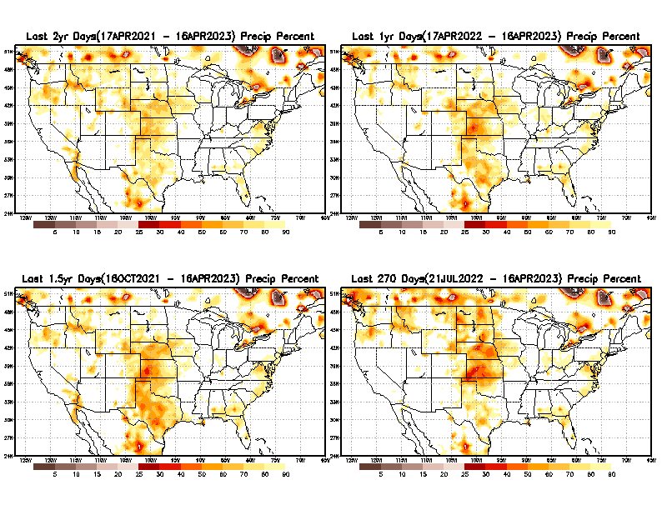
Total precipitation Percent during last 9 months, 1 yr, 1.5yrs, & 2 yrs. .–Only Deficit Areas shown!! <=90%
2 Y
1 Y
1.5 Y
9 M
The character and even location/spatial extent of the short/S and long/L –term droughts are different!!!
From: Recent Accumulated Precipitation https://www.cpc.ncep.noaa.gov/products/Drought/briefing_prcp.shtml

Slide 11
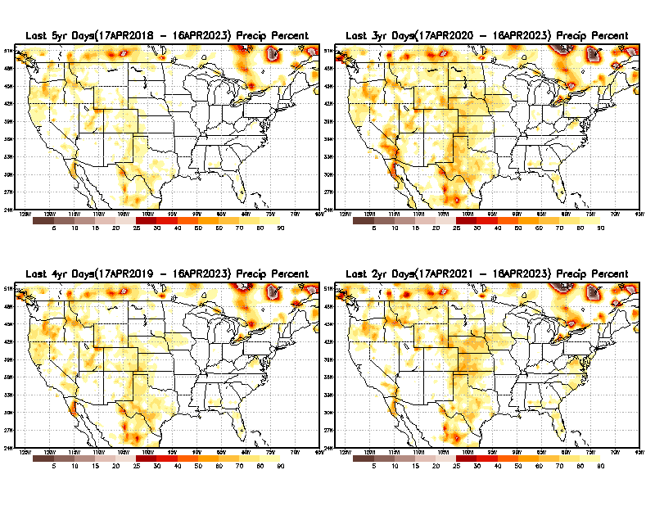
Total precipitation Percent (of normal) during last 2, 3, 4, & 5 yrs. .–Only Deficit Areas <=90% shown !!
5 Y
3 Y
In spite of the recent deluges/floods in California, there still exists a small longer term rainfall deficit in CA and parts of the southwest/ western US.
However, currently, most CA reservoirs are nearing or in excess of their historical averages.
BTW, Not sure if the longer term (20+years) since 2000’s has officially ended! ☺
4 Y
2 Y
From: Recent Accumulated Precipitation https://www.cpc.ncep.noaa.gov/products/Drought/briefing_prcp.shtml

Slide 12
LEAST
Rainy/dry
(3-month) Seasons across the US
MIXED
MOST
East vs West!
More darker colors in west/central => narrow rainy season (months)
Overall, more white space in the east => distributed rainfall season (except ~FL).

Slide 13
Rainy/dry
Months
across the US
*********
EAST vs
CTR/WEST
Drought Behavior is loosely tied to rainfall climo!! And the limited rainy season in the west
*********
Adapted from Rich Tinker.

Slide 14
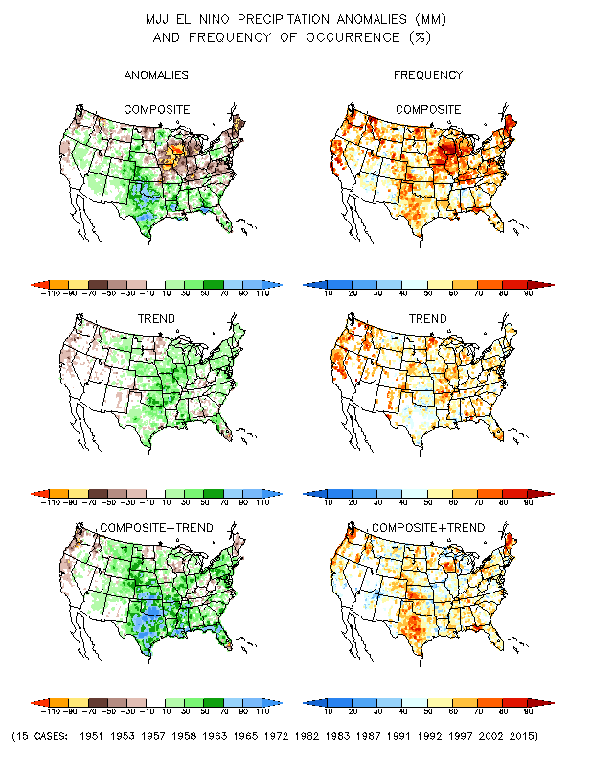
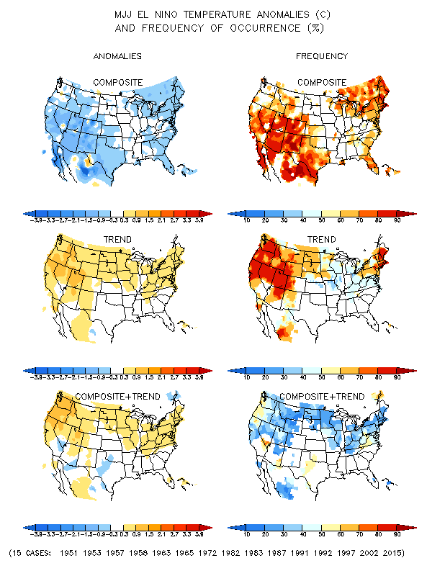
El Nino Precip/Temperature COMPOSITES & Trend map
MJJ
P
T
Transitio-ning to ElNINO conditions
☺

Slide 15
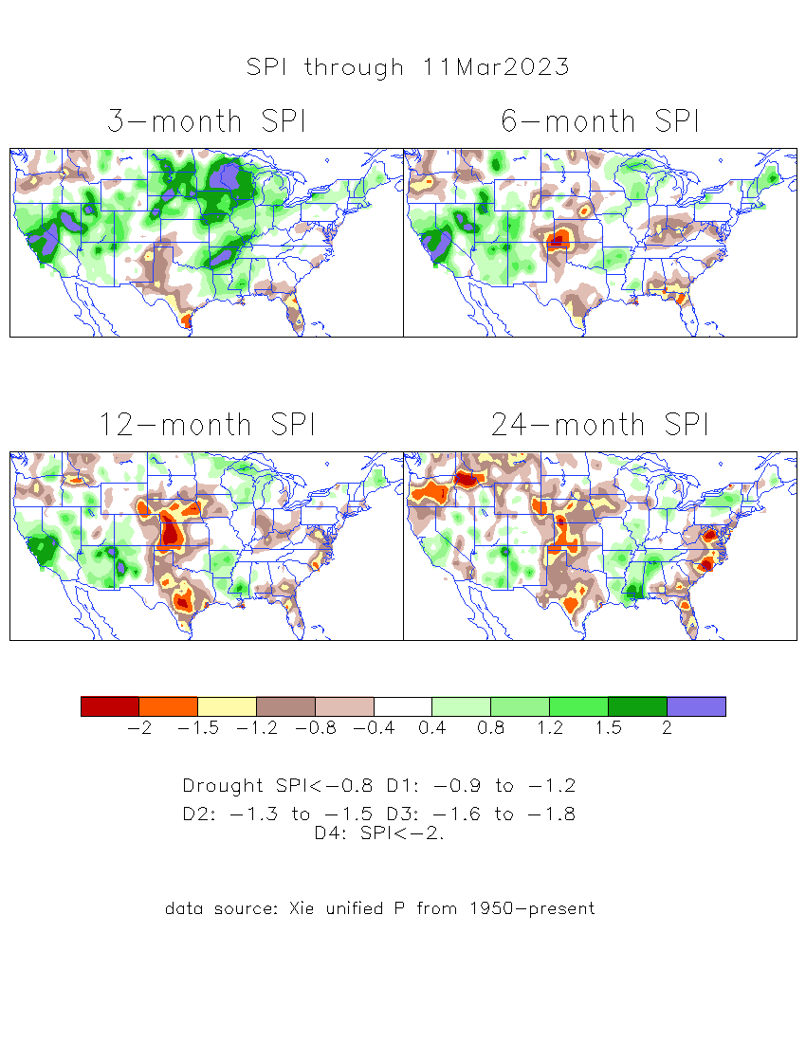
The Standardized Precipitation Index SPI (based on Observed P)
----- Last Month
Very interesting graphic & details for the drought across the US based on the more generalized precip deficit/excess, the Standardized Precipitation Index (SPI).
The dark brown and red colors, indicating standardized precipitation deficits, in the various time periods, approximately correspond to the appropriate short/long term drought monitor regions and their intensities

Slide 16
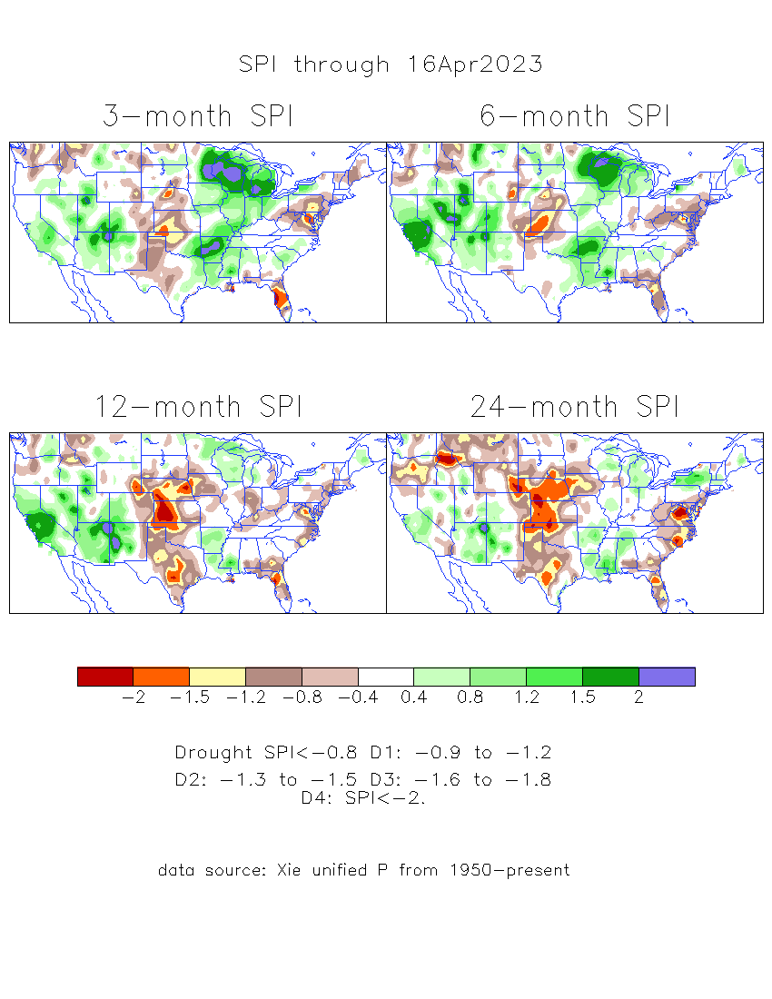
The Standardized Precipitation Index SPI (based on Observed P)
Compare with last month
----- NOW
Very interesting graphic & details for the drought across the US based on the more generalized precip deficit/excess, the Standardized Precipitation Index (SPI).
The dark brown and red colors, indicating standardized precipitation deficits, in the various time periods, approximately correspond to the appropriate short/long term drought monitor regions and their intensities
Short
No S-term drought here! Also big impact on L-term drought in west!
Long
How does one negotiate and reconcile declaring short term vs long term drought when precip. deficiencies patterns differ on many different time scales locally!!
What is the cutoff delineating time between short VS long term drought!! Not so clear!!
At exactly where does drought begin?

Slide 17
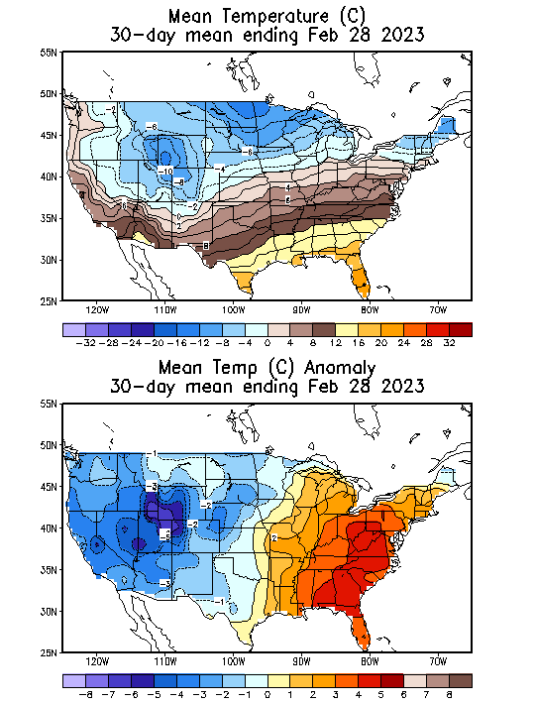
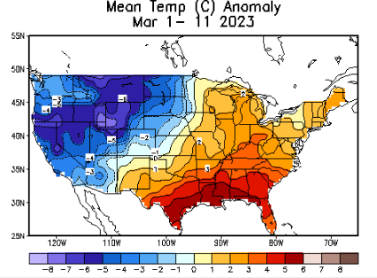
Slide From briefing
Last Month at this time of month!
Recent US Temperatures
.
Large intraseasonal variability from one month to next across US even within the La Nina DJF Winter!
So far this month !!

Slide 18
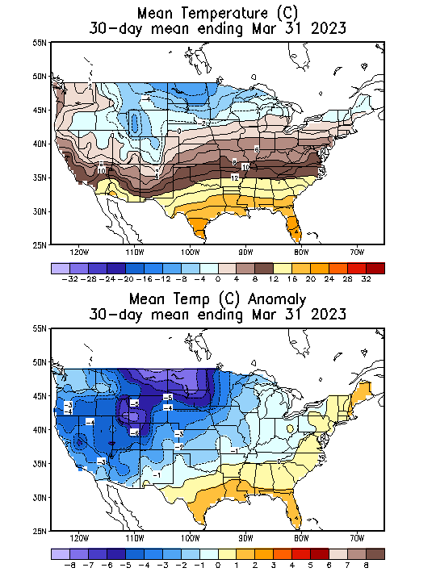
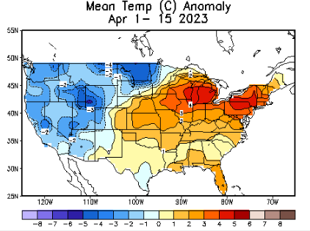
NOW
Recent US Temperatures
.
So far this month !!

Slide 19
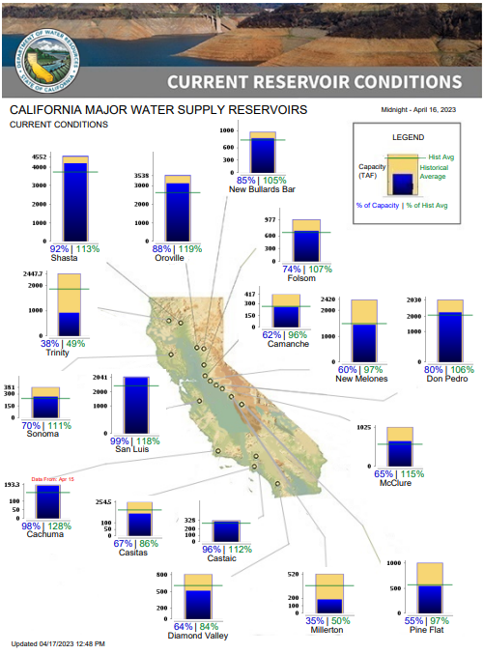
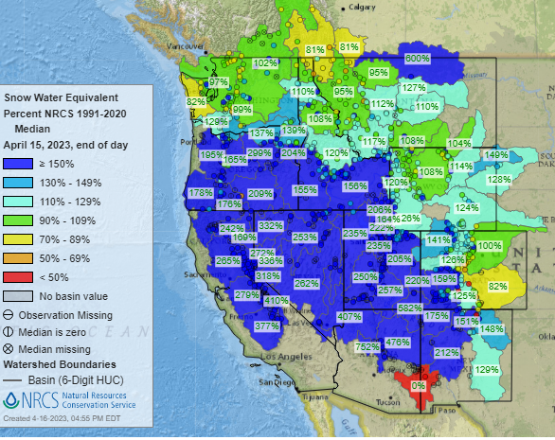
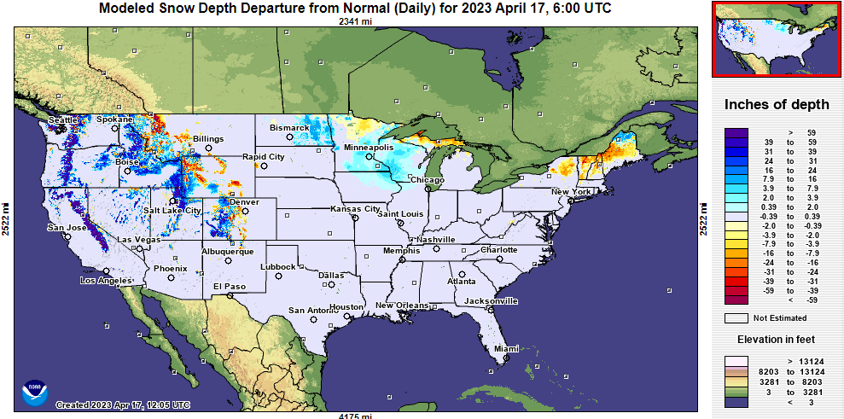
Snow Water Equivalent
% of Capacity
% of Hist. Avg.
of Reservoirs.
https://www.nrcs.usda.gov/wps/portal/wcc/home/
Many CA water reservoirs are AT or ABOVE their historical average capacity levels ! ☺
https://www.nohrsc.noaa.gov/interactive/html/map.html?
And all the recent record snow has not even started melting yet! ☺ ☹

Slide 20
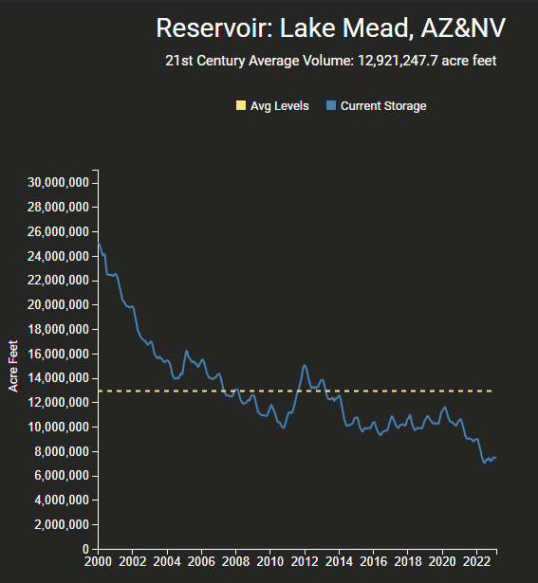
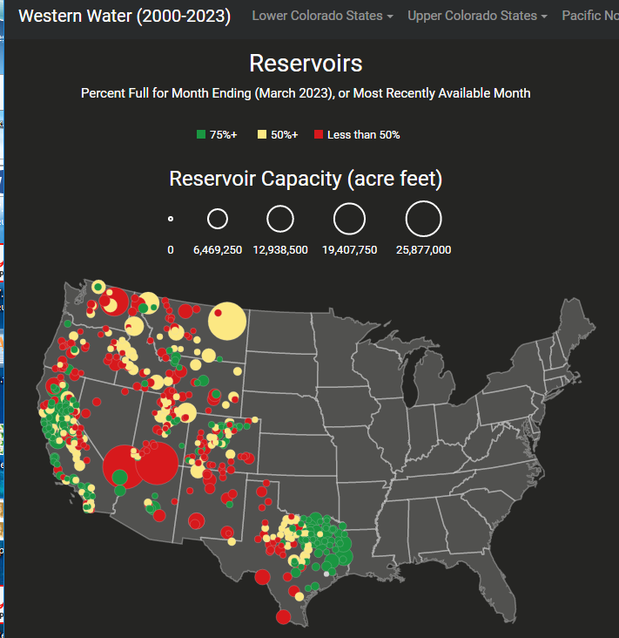
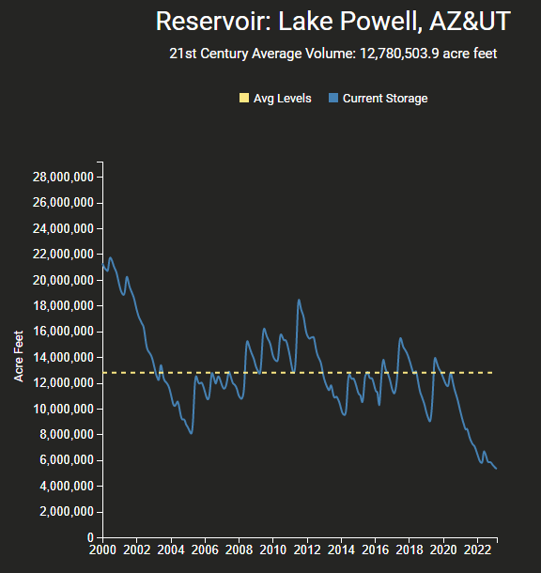
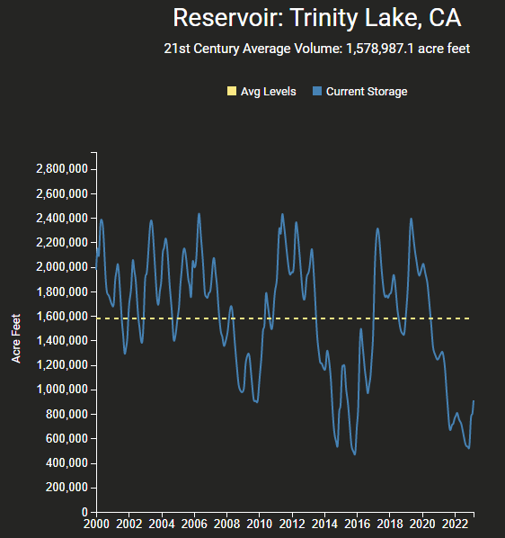
https://www.deanfarr.com/western_water/
Hydro Electric power generating turbines STOP operating at the critical 7 million acre feet level

Slide 21
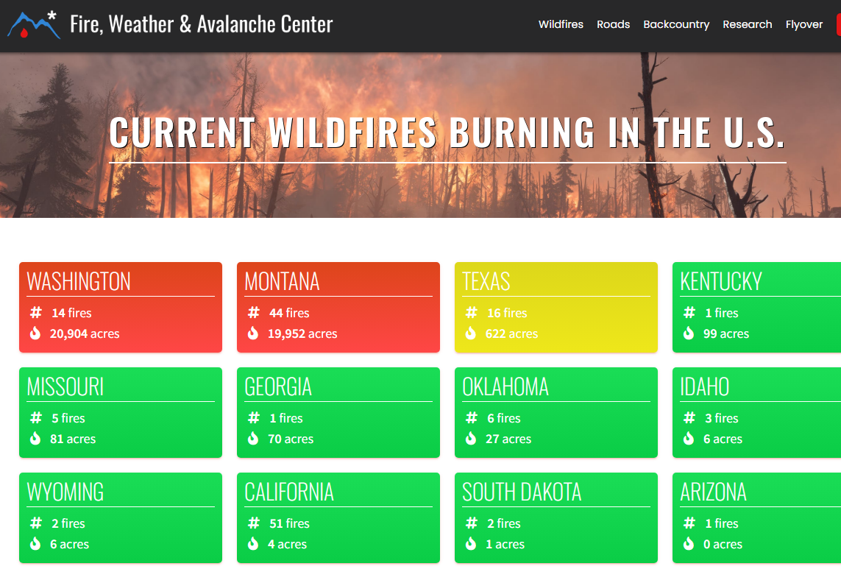
Slide Not shown
THIS MONTH !!
Slide Not shown
THIS MONTH !!
Note: In spite of the ongoing drought, All the fires are gone..
Of course it is getting cold.. ☺
https://www.fireweatheravalanche.org/fire/current-list-of-us-wildfires
(not govt. source! Not sure how good is this data?)

Slide 22
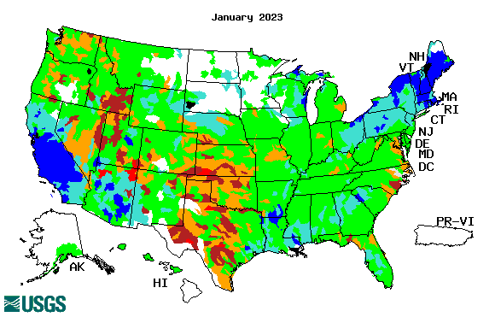
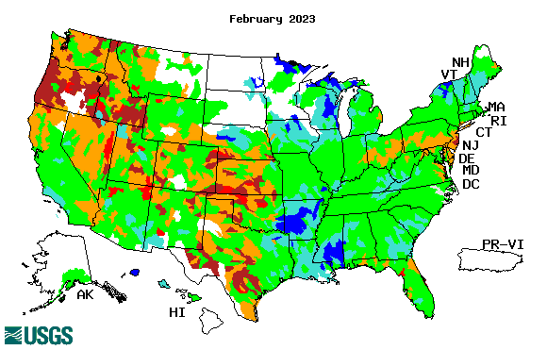
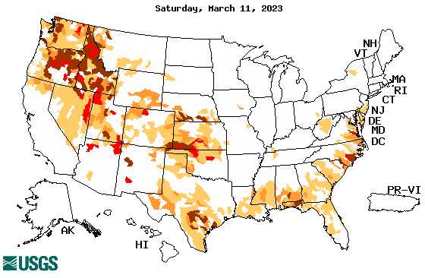
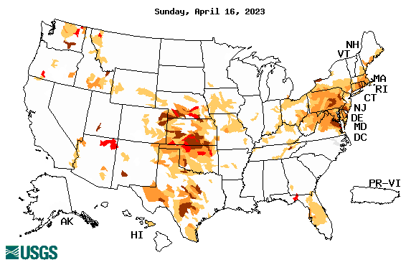
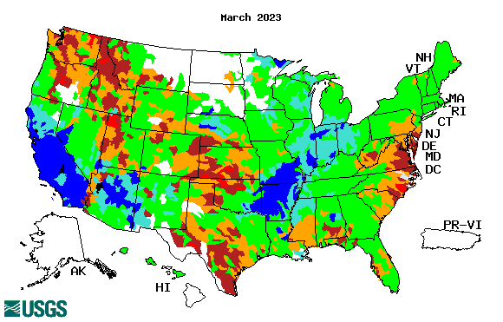
Streamflow (USGS)
Most US east droughts are relatively short lived (as compared to US west). However, if you recall, the drought over the New England states last year was a real surprise!!
Map shows only below normal 7-day average streamflow compared to historical streamflow for the day of year.
One month ago (left) &
Now (below)
Streamflow is only a partial indicator, as sometimes it is highly managed.
If sometimes, the various indicators are confusing, go back to % of rainfall deficit maps – to confirm/reinforce!!
22

Slide 23
EL NIÑO/SOUTHERN OSCILLATION (ENSO)
DIAGNOSTIC DISCUSSION
issued by CLIMATE PREDICTION CENTER/NCEP/NWS and the International Research Institute for Climate and Society
13 April 2023
ENSO Alert System Status: El Niño Watch
Synopsis: ENSO-neutral conditions are expected to continue through the Northern Hemisphere spring, followed by a 62% chance of El Niño developing during May-July 2023.
CPC’s Oceanic Niño Index (ONI) [3 month running mean of ERSST.v5 SST anomalies in the Niño 3.4 region (5ºN-5ºS, 120º-170ºW)], based on centered 30-year base periods updated every 5 years.
?

Slide 24
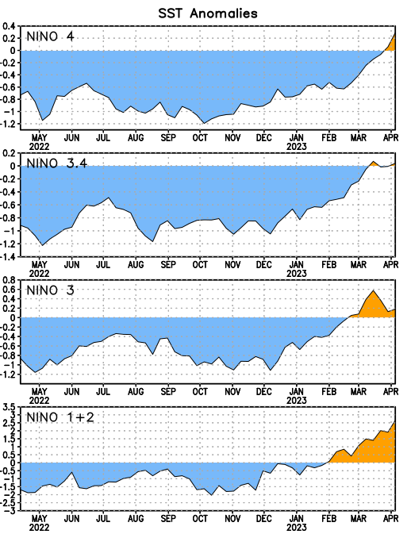
Latest values of SST indices in the various Nino Regions.
Rapidly decreasing Subsurface cold water reserve…

Slide 25
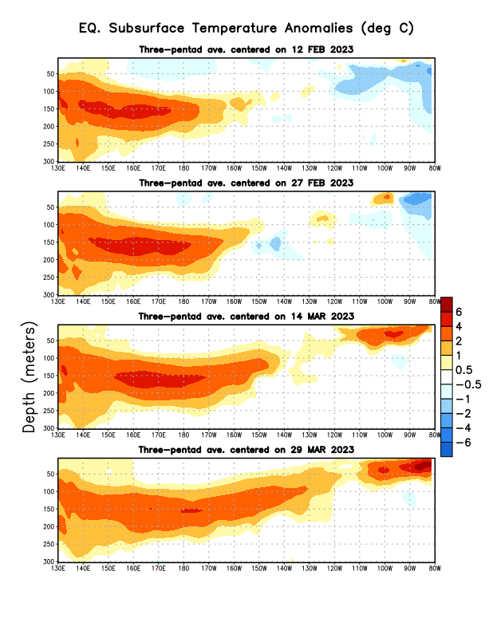
Sub-Surface Temperature Departures in the Equatorial Pacific
The La Nina has ended. Ok, But its latent effects were lingering on until very recently!
But is there transitioning neutral period, and
The El Nino is here in a hurry! ☺
Most recent pentad analysis

Slide 26
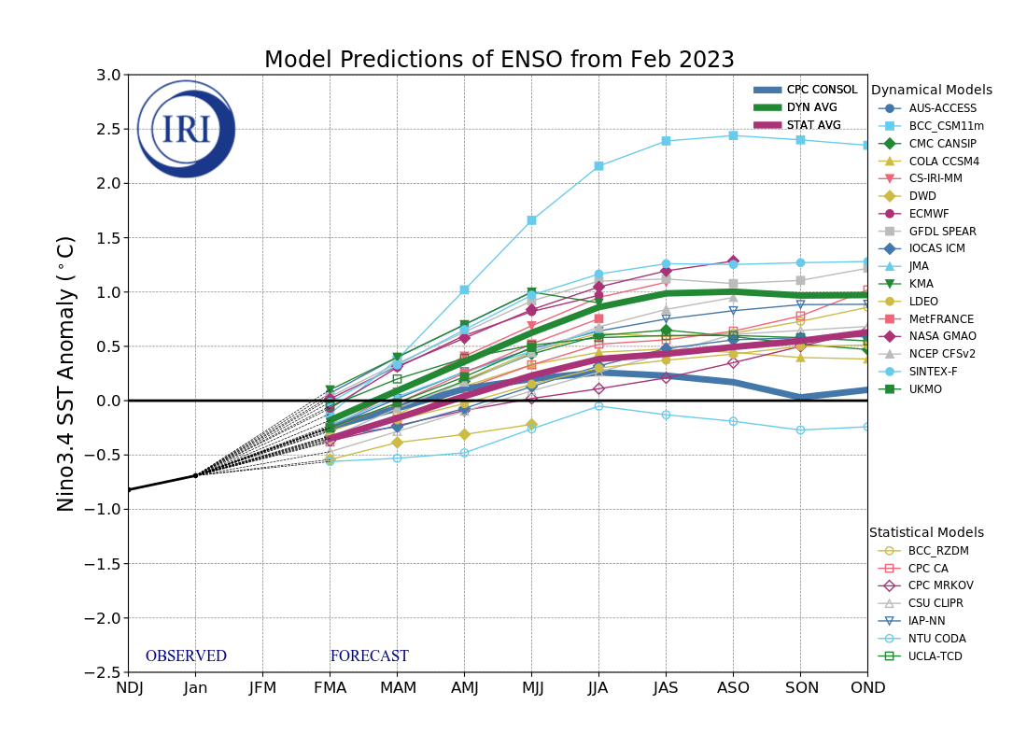
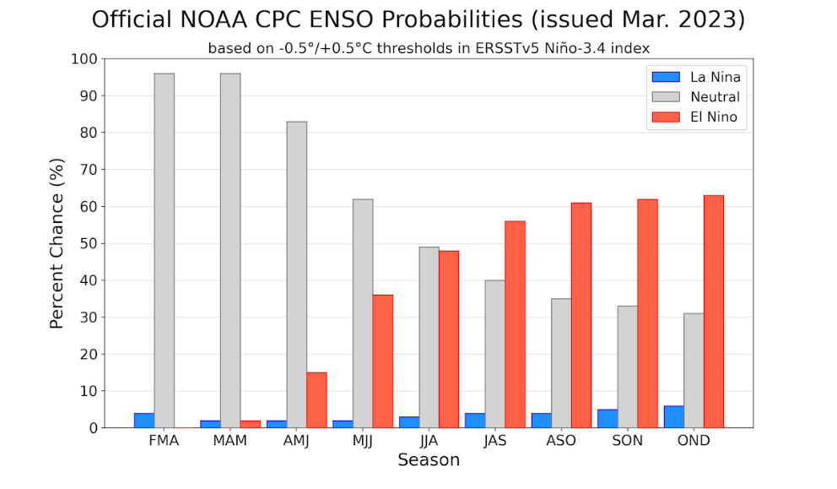
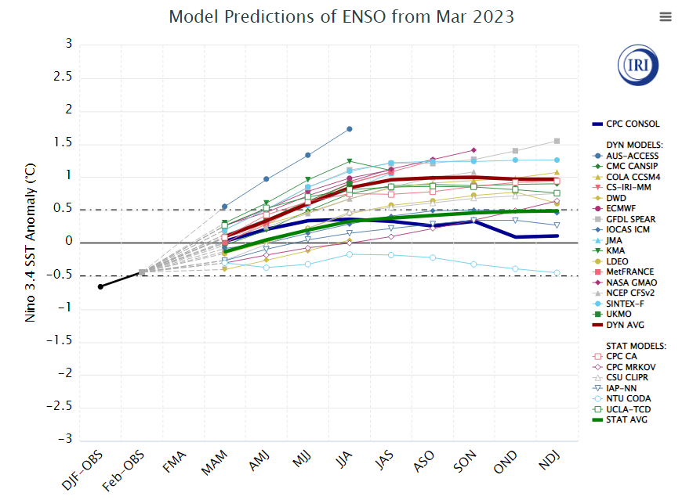
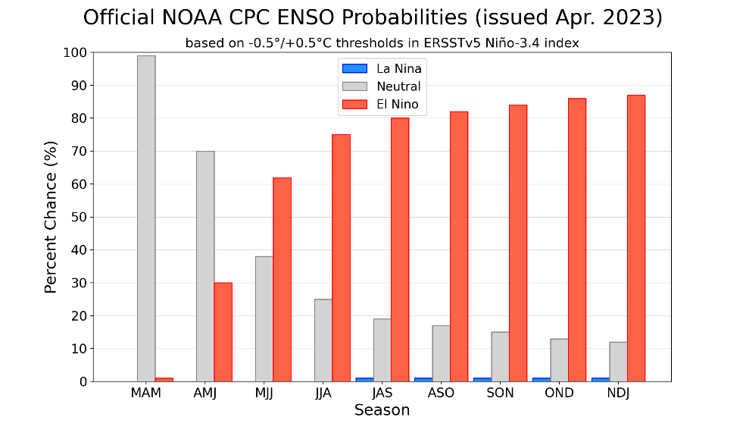
Official ENSO Forecasts
Early-March
Early-April CPC forecast
Both Stat.Avg & CPC-consolidated
are keeping it under 0.5 deg. C ??
~ 62 % chance of El Nino developing during MJJ season.

Slide 27
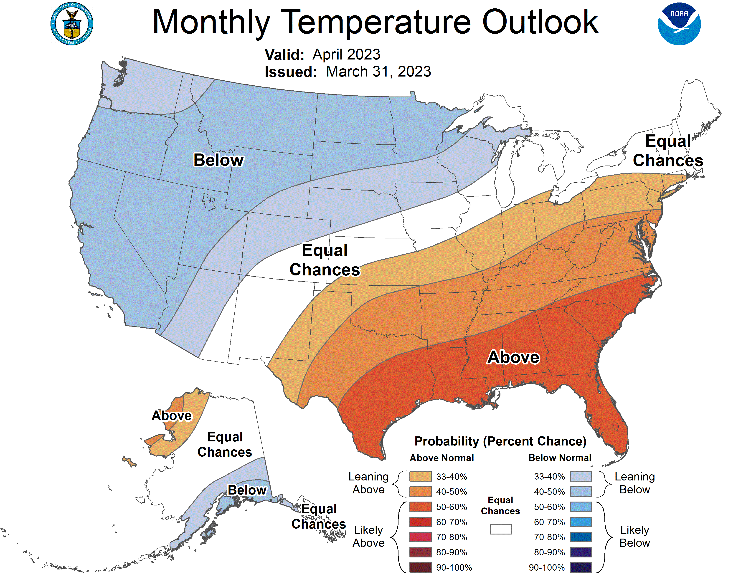
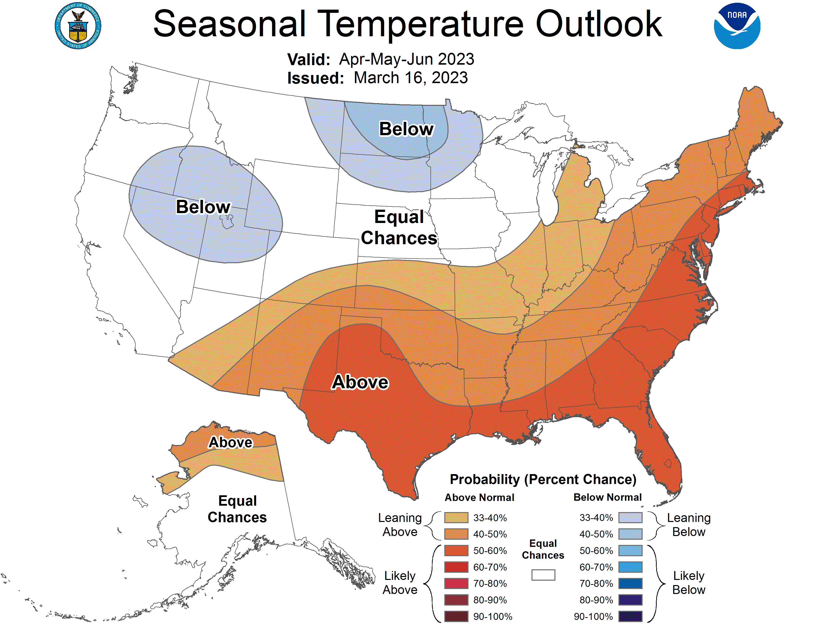
Previous (Last Month’s)
CPC’s official
Temperature OUTLOOK for Monthly (Apr)/Seasonal (AMJ)
Monthly P/T forecasts verified at mid-month are generally good! Becoz of good skill upto 2 wks.
Released Mar 16th
Observed so far this month!! ☺
E/W

Slide 28
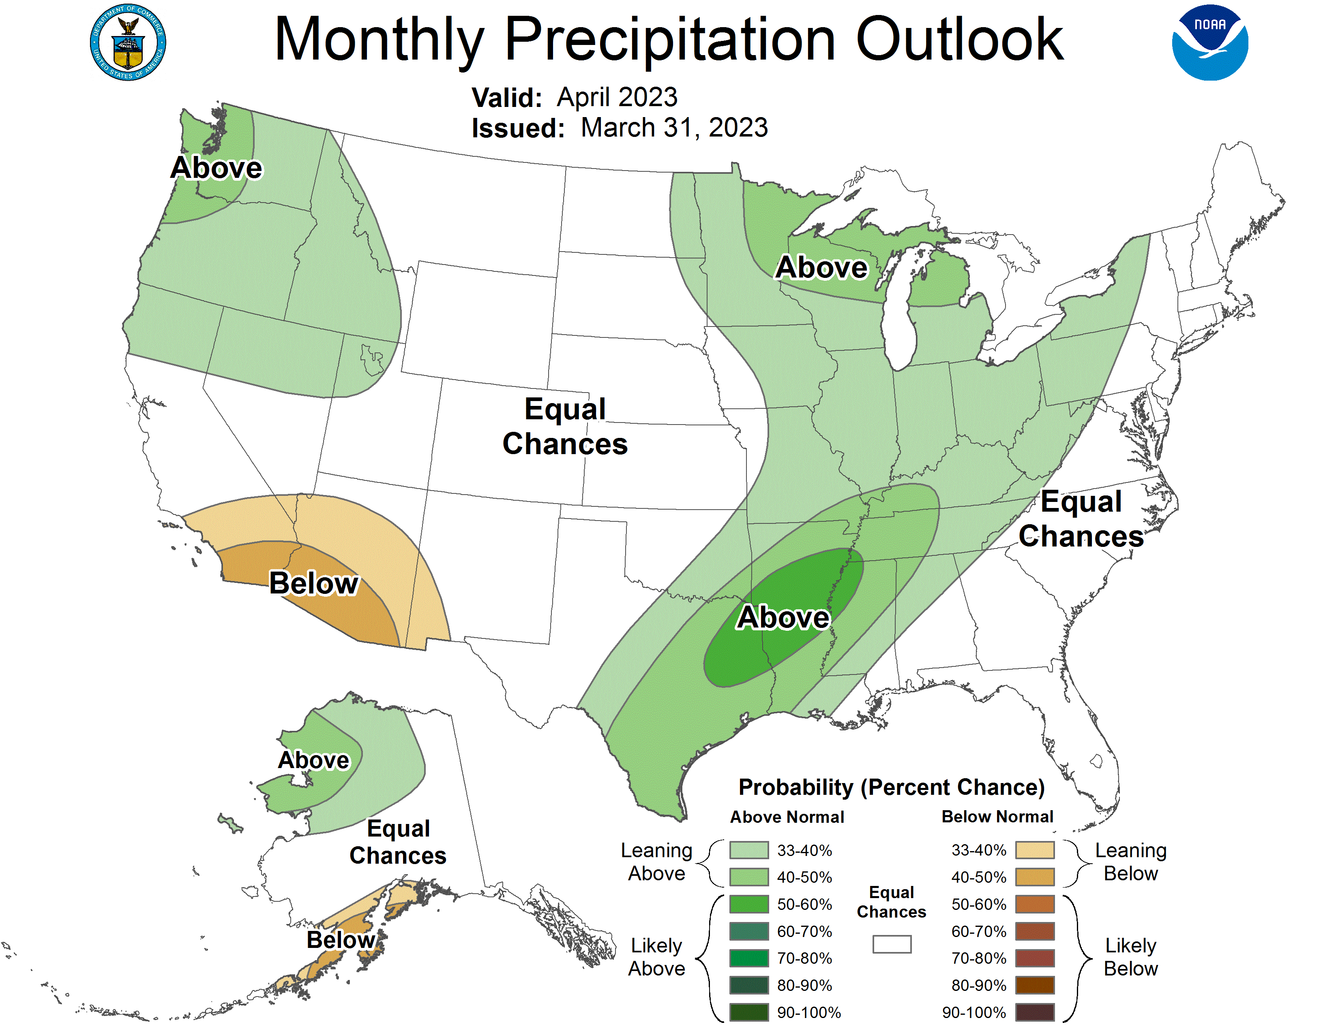
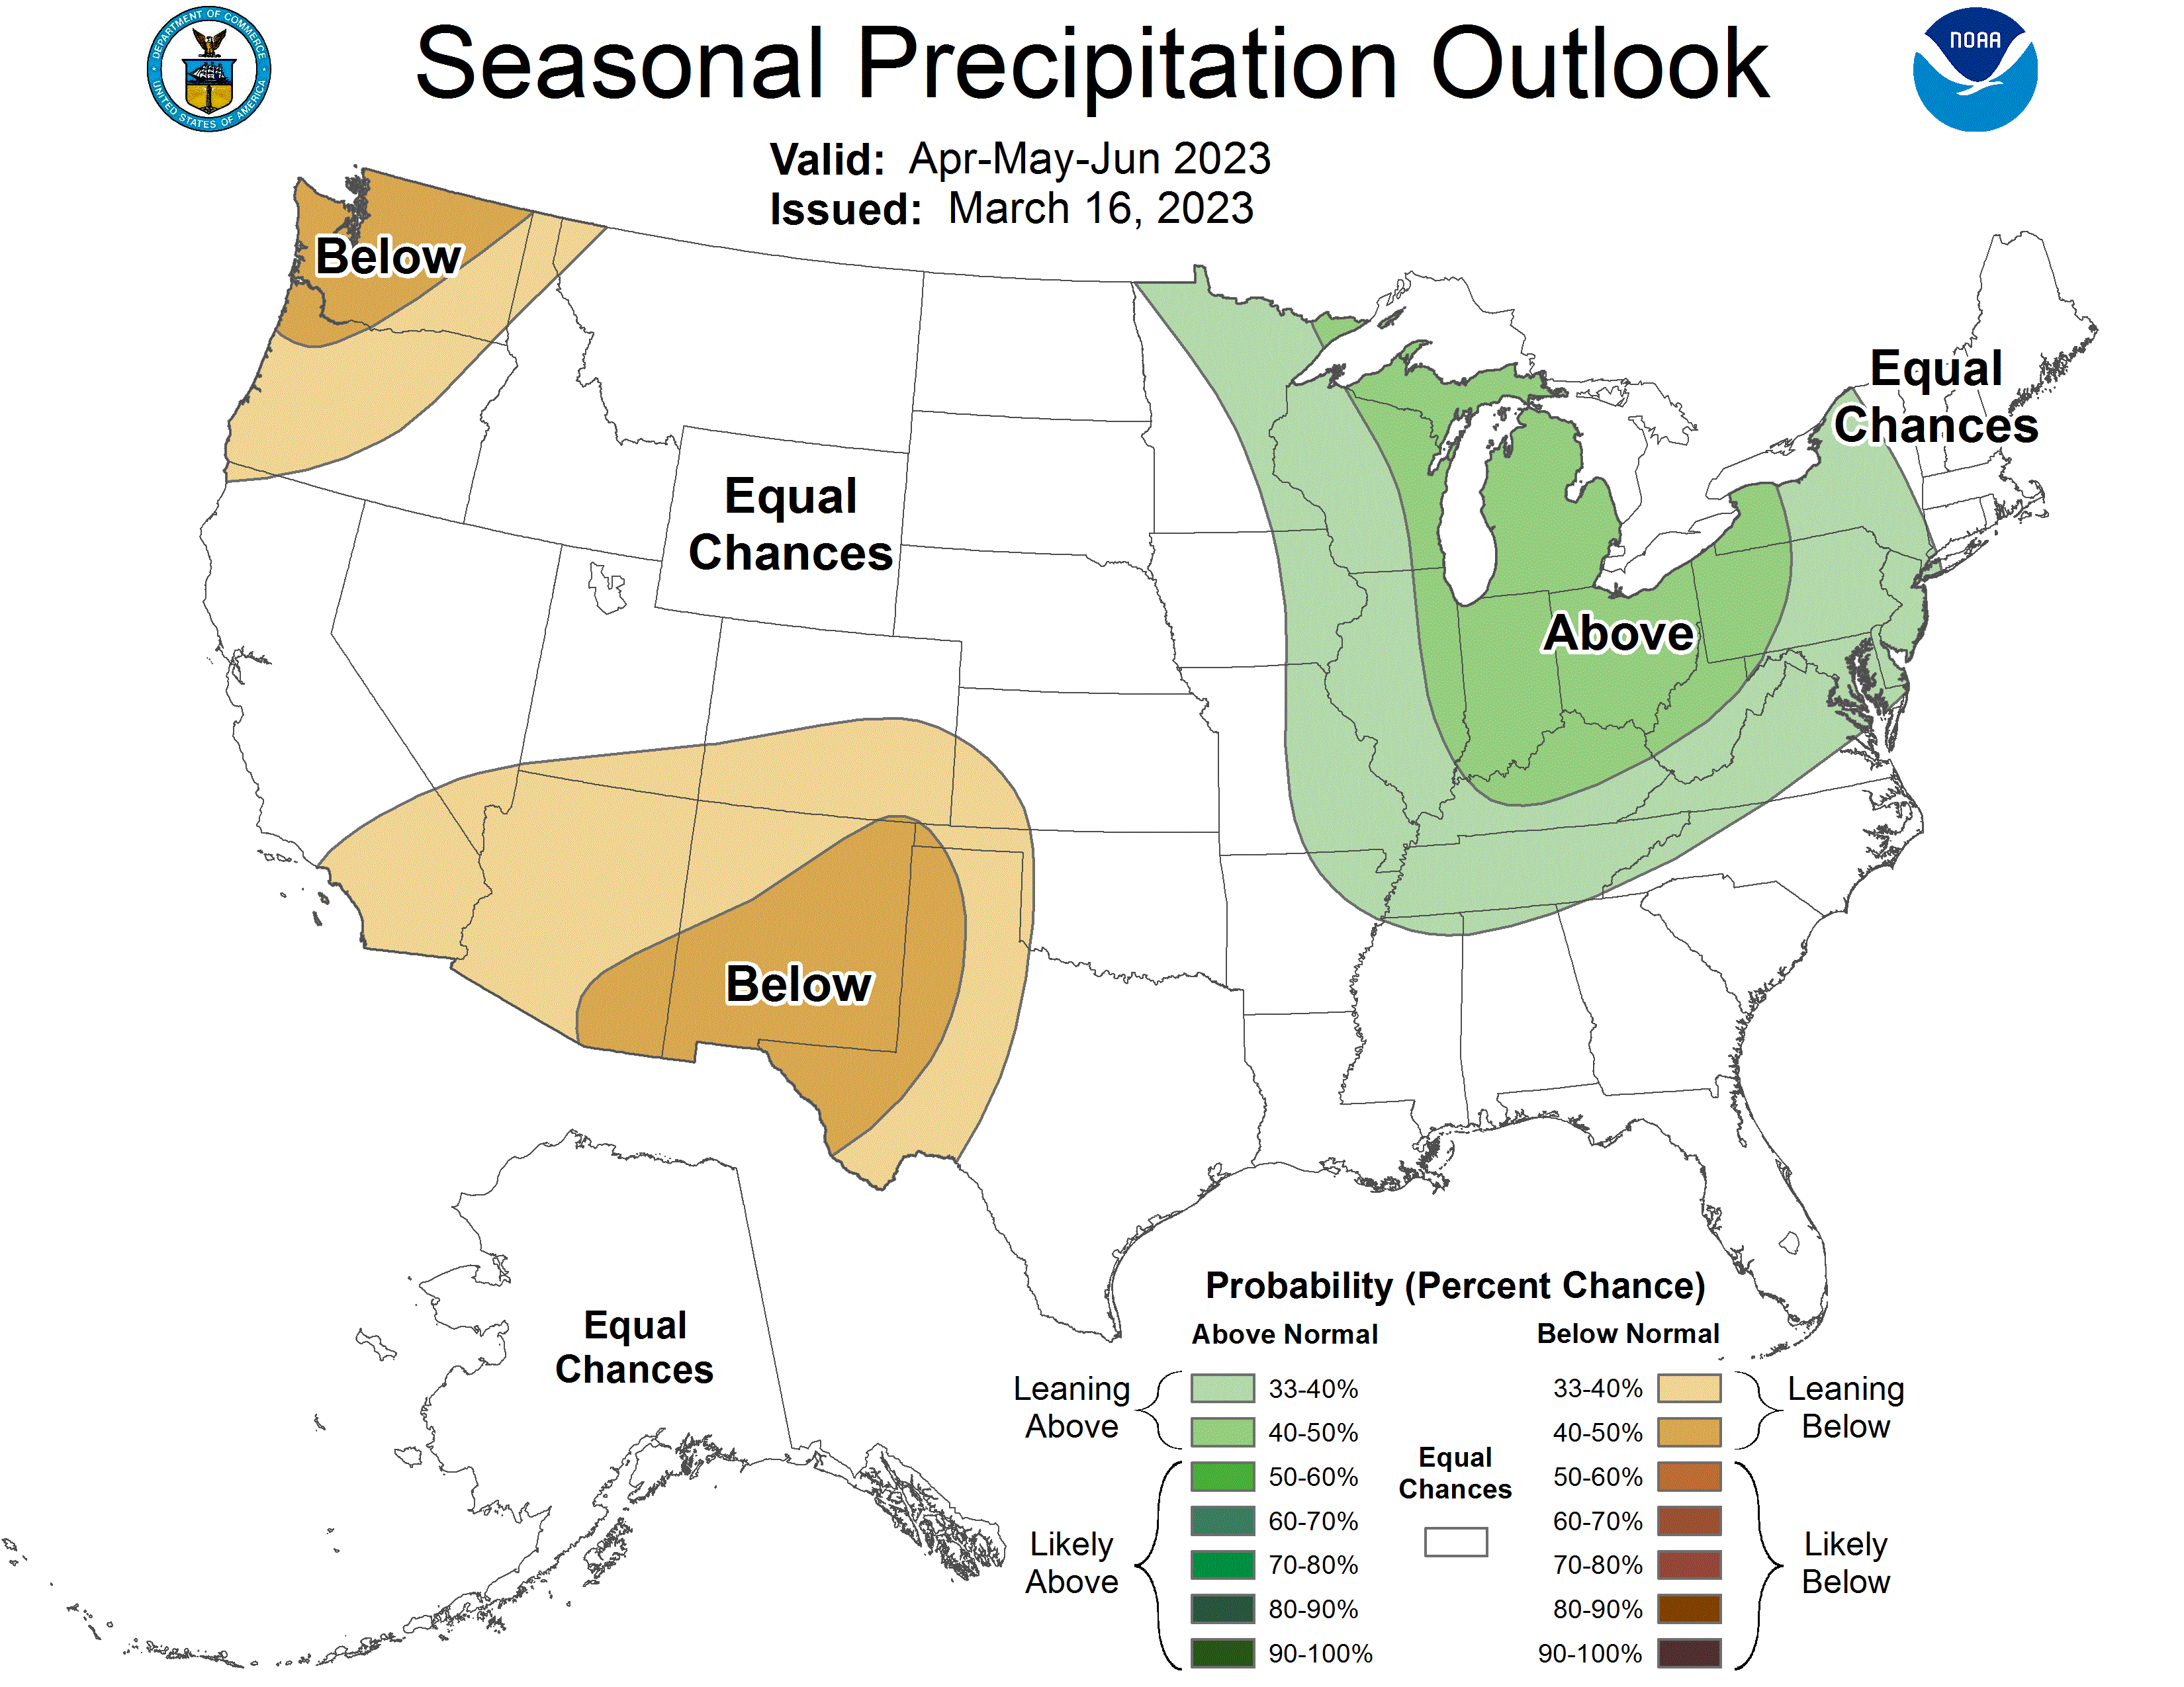
Previous(Last month)
CPC’s official
Precipitation OUTLOOK for Monthly (Apr)/Seasonal (AMJ)
Released Mar 16th
Monthly P/T forecasts verified at mid-month are generally good! (??) Becoz of good skill upto 2 wks.
Observed so far this month!! ☹

Slide 29
NCEP/WPC Next 7 days QPF (Quantitative Precipitation Forecast)
GFS Model Guidance for the
next 16 days.
Reg. California, the severe drought conditions, a year ago, a few months ago, has literally turned into a flood situation!

Slide 30
From 3 Models average Precip forecast (made yesterday 17,16 Apr) for next 30 days.
The 3Models are: CFSV2, GEFS, & EC

Slide 31
From 3 Models average Precip forecast (made yesterday 17,16 Apr) for next 30 days.
20
40
May look bad in SW, But not rainy season!!

Slide 32
From 3 Models average Precip forecast (made yesterday 17,16 Apr) for next 30 days.

Slide 33
Impact of recent/next month rains on S/Term drought in the US west coast states!!
From 3 Models average Precip forecast (made yesterday 17,16 Apr) for next 30 days.

Slide 34
Impact of recent/next month rains on L/Term drought in the US west coast states!!
From 3 Models average Precip forecast (made yesterday 17,16 Apr) for next 30 days.

Slide 35
Week-4 Soil Moisture Percentile (SMP) Fcst based on VIC model forced with ECMWF-extended precipitation forecast!
This month
Now: Based on Yesterday’s IC
While not exactly mapping 1-to-1 with the drought areas, this map is generally connected to the drought areas in some ways, as it is related to soil moisture!!
(From Drs. Li Xu and Yun Fan) More detail at From: https://www.cpc.ncep.noaa.gov/products/people/lxu/flashd/flash_prediction.html#10

Slide 36
NMME* T (left) & P (right) Ens.Mean forecasts for
May
MJJ
NMME* : North American Multi Models Ensemble

Slide 37
Agreement/Disagreement among the various NMME models’ MJJ seasonal Precip. Forecast.
??

Slide 38
(From NMME) compared with this month(foreground, red border)
Why is there so fewer hatched areas in SPI6 fcst from NMME models’ based fcst this month as compared to last month (left 2 columns) ? Fcsts more confident now?
Forecast uncertain in Hatched areas.
These maps are based on NMME models’ precip forecast uncertainty/certainty (among ensemble members) over the next 3 months
SPI6 Fcst made from last month I.C.
SPI6 & SPI12 Fcst made from this month

Slide 39
http://drought.geo.msu.edu/research/forecast/smi.monthly.php
Predicted Monthly Soil Moisture Percentile
Latest Initial Conditions:
DATA not available !
CPC’s soil moisture percentile – Leaky bucket Model
The inter quartile range suggest greater uncertainty about the forecast in these shaded regions in the ESP based forecast!

Slide 40
BONUS Topic: Discussion continues!! Explanation for the multiyear DROUGHT in the Southwest (CA/AZ/NM/NV/UT/CO & vicinity)!!
More La Nina’s lately ?
More frequent La Ninas lately ?
YES!! The stats in the table below (bottom left) are from the Official CPC ENSO declarations page/table!
Compared to other regions of the globe, the SST warming/trend in the central eq. Pacific (Nino 3.4) is relatively much small. (See Fig. above) – Why is this ?
Does nature try to compensate for the warming else/everywhere by producing more La Ninas in the equatorial Pacific? - Just my observation from data! Let’s check !!!
Since the 1997 monster El Nino (stronger than the famous 1982/83 event), just a quick count of CPC’s Nino 3.4 index++ values for the three month overlapping seasons, (Data at CPC site only available only from 1950!)
(27 years) (47 years) (74 years)
1997-2023 1950-1996 1950-2023
La Nina(DJF) 12 16 28
El Nino(DJF) 8 17 25
La Nina(all 3mos) 119 150 269
El Nino(all 3mos) 77 166 243
(Overlapping 3month seasons)
Look at Ratios of La Ninas (vs El Ninos) in the shorter
recent (27 yr) period vs the longer (47 yr) earlier period!!
Compare the ratios of La Nina to El Nino in the squared boxes.
***Analysis of CPC’s official Nino 3.4 index data over the last 70 years shows that the more frequent La Nina’s in recent decades contributed to less rainfall in the southwest (See La Nina precip composites!, slide#13) and hence the ongoing long term drought in the Southwest!! Hence the long term southwest drought is unlikely to go away any time soon***
++ Barnston, Chelliah and Goldenberg (1997):Documentation of a highly ENSO‐related SST region in the equatorial pacific, Atmosphere-Ocean Volume 35, 1997. https://doi.org/10.1080/07055900.1997.9649597
*** The strong/weak annual monsoon rains in the southwest is a minor modulator riding on this bigger/longer-term signal. ***

Slide 41
Summary
Current Drought conditions:
Towards the end of last year 2022, until December or so, severe drought conditions remain in the west, mild drought conditions expanded in to portions of the eastern half of the US also, covering most of the country with near high % areas of the entire US affected by drought.
Then with the start of winter season in CA and the west coast states deluge/excess rain over CA and vicinity during the recent weeks and months wiped out not only the short term drought in the region, but also the L-term drought as well. Water levels in many CA reservoirs are now ABOVE their normal levels.
There is a considerable decrease and sudden drop in the areal coverage of all drought categories across the United Unites during the many weeks heavy rainfall during recent winter and continuing!. The area covered by >D1 category drought is under 25%, a relatively small number, compared to December 2022.
The subjectively made, only once a week weekly issued, official USDM map is not able to keep up with the daily heavy deluge of rains, which can change drought to floods and fill up reservoirs.
The drought in south central part of the US, covering large parts of KS/OK/TX has stubbornly persisted with little improvement. The drought in this central part of the US is both short and long term.
Drought in the mid-Atlantic and FL worsened.
Current ENSO status and forecast: ENSO-neutral conditions are expected to continue through the Northern Hemisphere spring, followed by a 62% chance of El Niño developing during May-July 2023.
Prediction: The third year La Nina is gone. The El Nino is at the door steps, waiting, in a hurry! Forecasts skill scores during/around the Spring (barrier) season are generally lower, now, especially with the very quick transitioning to El Nino conditions.
While the models are lately having difficulty in predicting even during this past winter season under La Nina conditions (look at California deluge!) it will be difficult to know whether the models even know what will happen during the upcoming forecast season MJJ. However, it is interesting that for both the month of May and season MJJ, the NMME models are not forecasting dry/below normal rainfall conditions for especially the southern part of the country, but suggesting near to above normal rainfall, which is generally expected or consistent with El Nino conditions, even though only a transition to El Nino conditions is expected during MJJ.
The forecast season includes month of July, the start of SW monsoon season. Since the last two years the SW monsoon was above normal that helped the region considerably, will it continue this year also? NMME forecast does not indicate a dry SW monsoon. Moreover, the rainy season for Northern Great Plains and central Plains is MJJ, and lot depends on the expected seasonal rainfall here. The rainfall climatology, the trend, the expected El Nino composites appear to be favorable to the northern and central plains down to TX, thus possibly helping the drought conditions in central part of the country.
The drought in the mid-Atlantic states and Florida will likely be gone by the end of MJJ. However, the likelihood of drought developing around the Great Lakes is there. *****

