Slide 1
Drought Outlook Support Briefing (formerly Drought Outlook Discussion) August 2018
Climate Prediction Center/NCEP/NOAA
http://www.cpc.ncep.noaa.gov/products/Drought
Phone: 1-877-680-3341
Pwd: 858747#

Slide 2
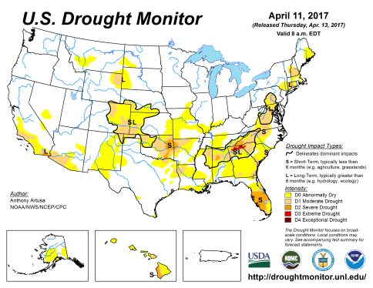
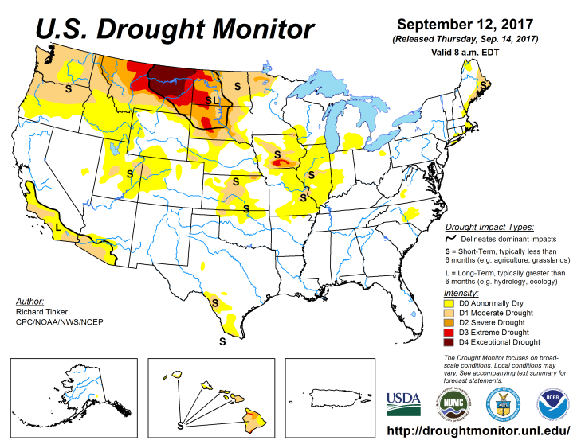
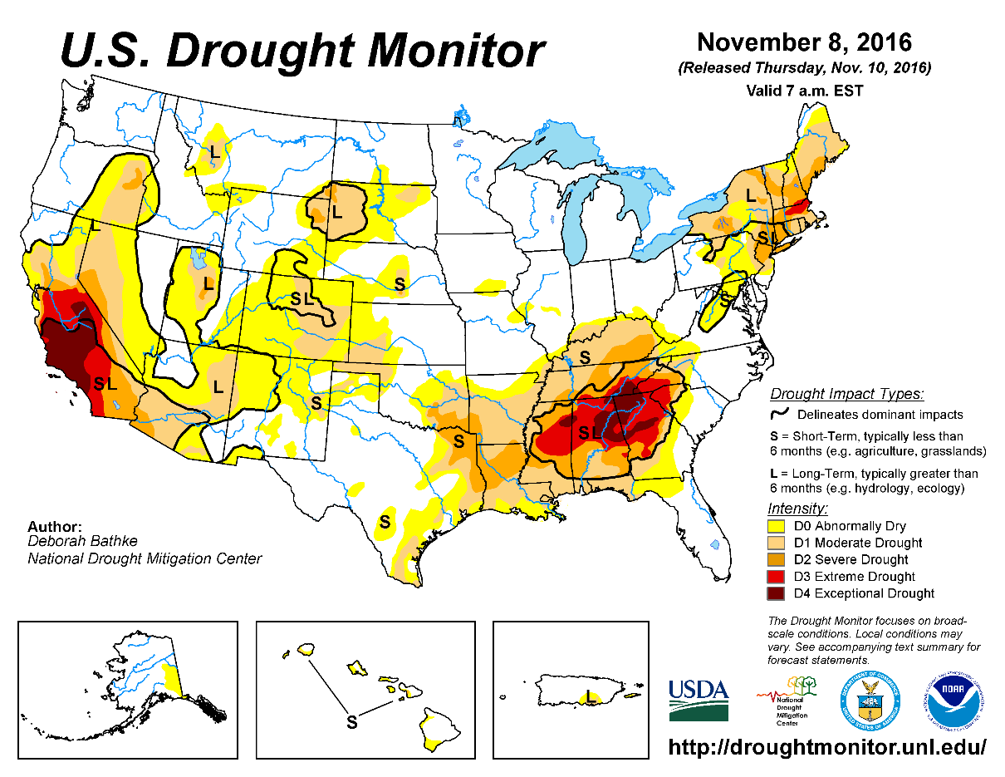
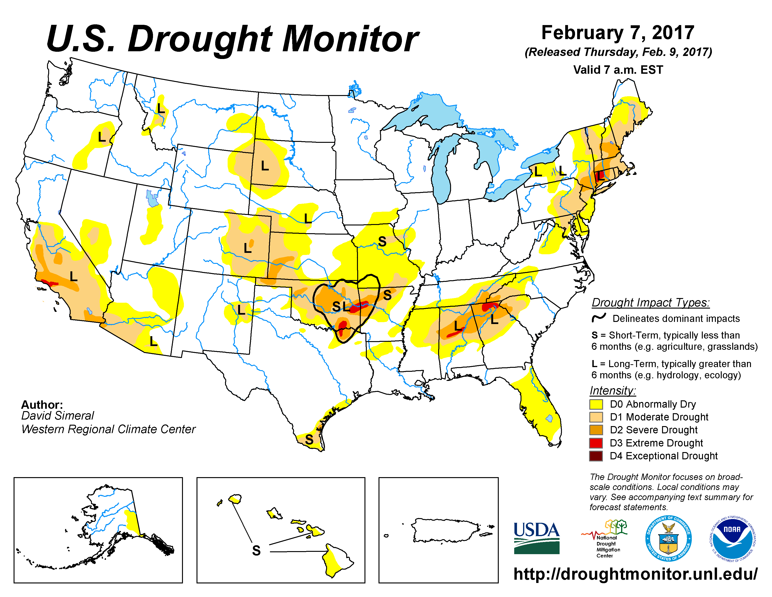
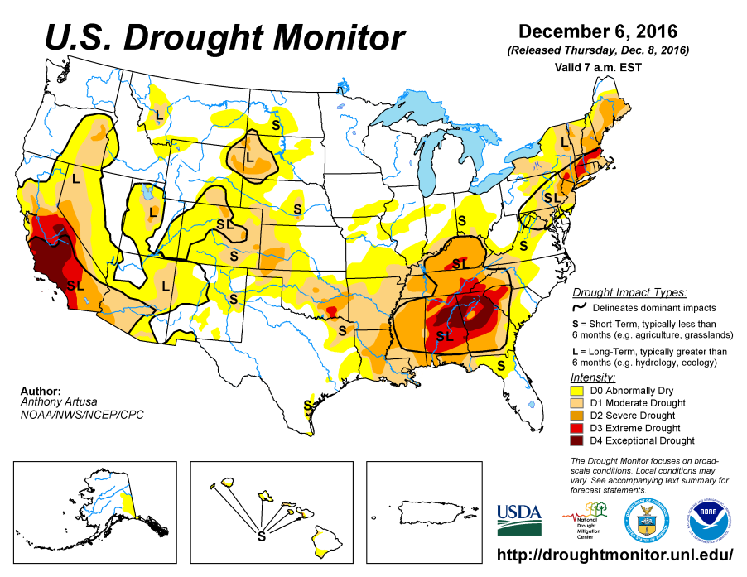
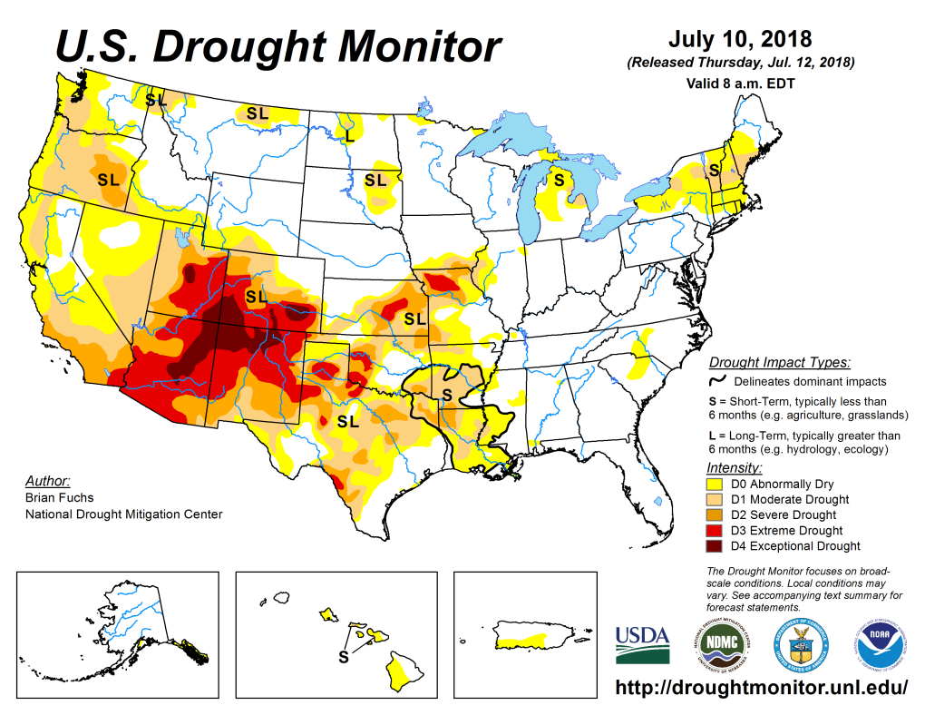
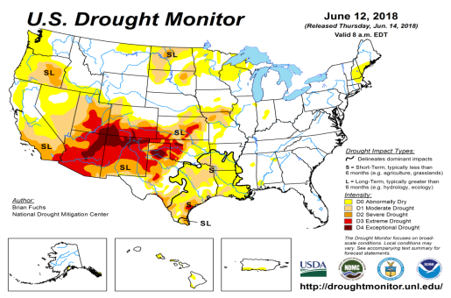
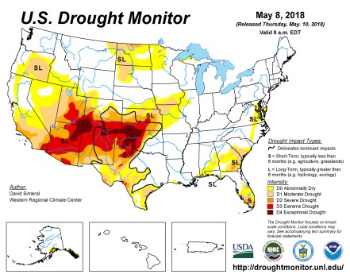
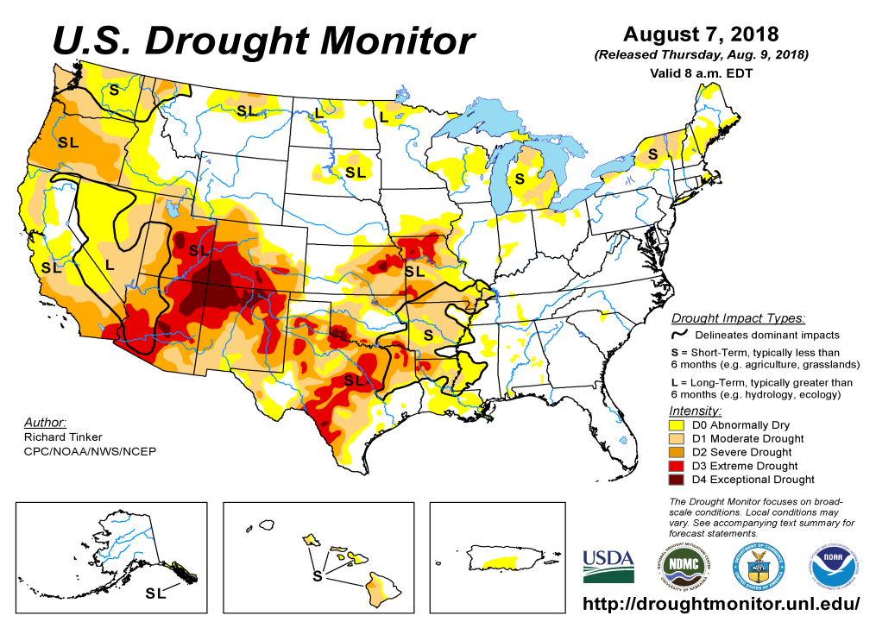
Drought Monitor
July
June
Previous
May
The drought in the south and west, that simply will not go away, and in Texas and the adjacent states to its north and east, the areas under drought keep disappearing and emerging from one month to next. But now, TX has the most drought areas in the past 4 months.
The drought in the Pacific Northwest (WA, OR) has expanded in the last couple of months.
Even though ENSO has already transitioned from La Nina to neutral conditions, the drought impacts in the southwest continue to linger, since the rainfall deficits here are here for more than a year or two (see later!)
Latest/Recent

Slide 3
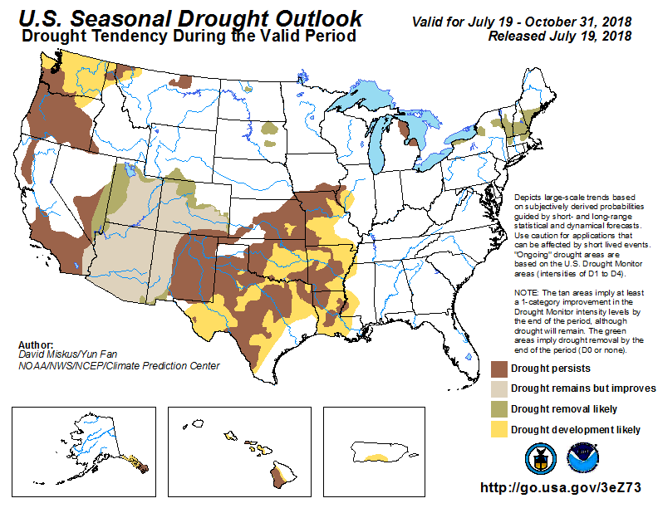
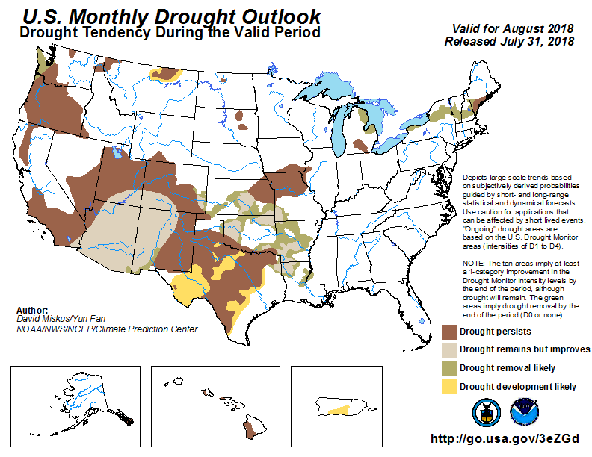
(Prev) Seasonal/Monthly Drought outlooks
Seasonal Outlook (Mid July 2018 - October 2018)
issued 07/19/18
Monthly outlook
(for August 2018)
issued 07/31/18
As noted while the area/extent covered by drought across the south/west has relatively stayed about the same, both the monthly and seasonal forecasts is suggesting various levels of improvement in the short term in parts of the monsoon southwest and adjacent regions.
Drought in WA, OR is correctly forecast to expand.

Slide 4
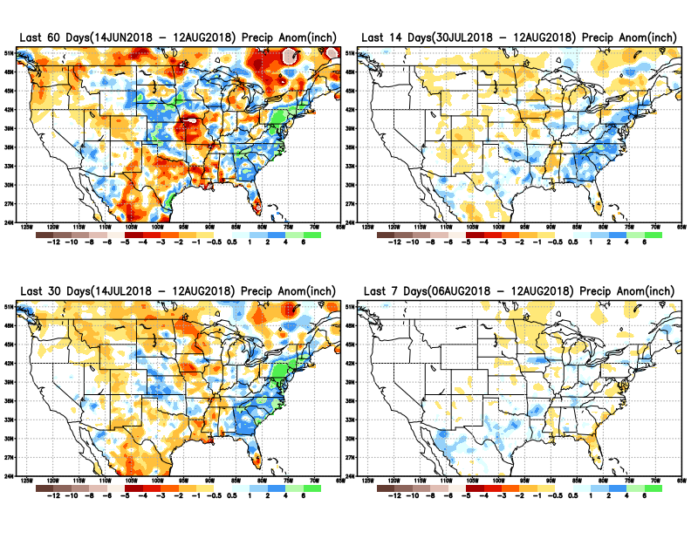
Precipitation ANOM during last 7, 14, 30, & 60 days.
Plenty of rain in the Atlantic coastal states and in parts of WY OK, KS, NE, IA, and MN.
Recent monsoon rains have helped ease drought conditions in AZ, NM.

Slide 5
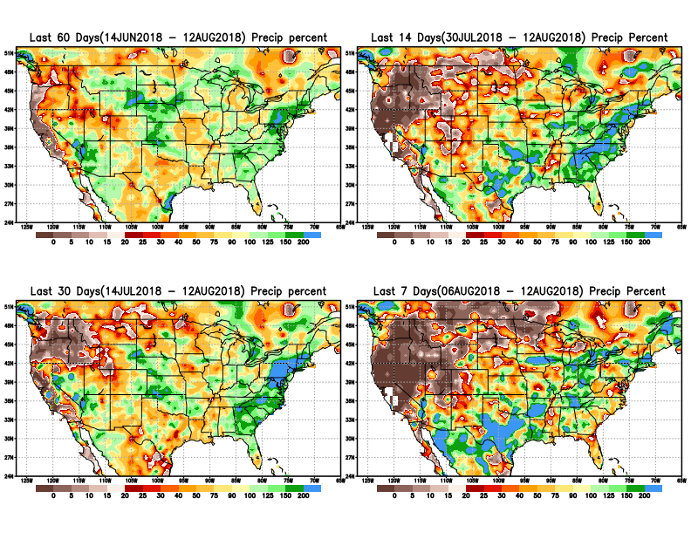
Precipitation Percent during last 7, 14, 30, & 60 days.
This is the dry, fire season in California, and these maps tell us why!
Also, the sw summer monsoon which started early and took off pretty good, went on a relative lull but in the last few weeks.

Slide 6
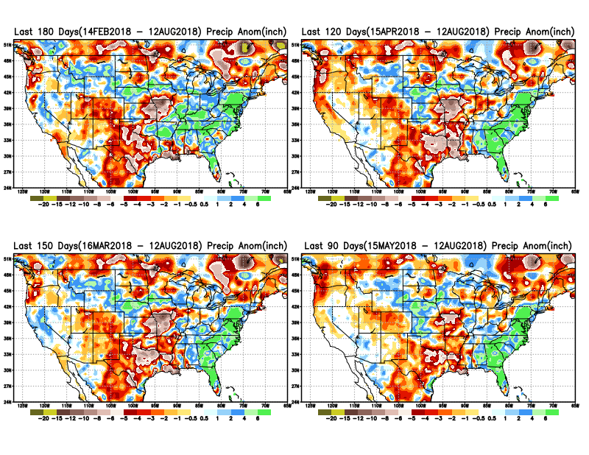
Total precipitation ANOM during last 3, 4, 5, and 6 months.
6 M
4 M
5 M
3 M

Slide 7
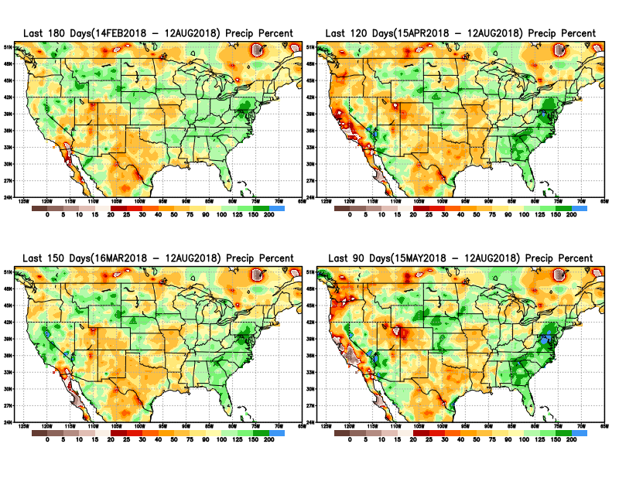
Total precipitation Percent during last 3, 4, 5, and 6 months.
6 M
4 M
5 M
3 M

Slide 8
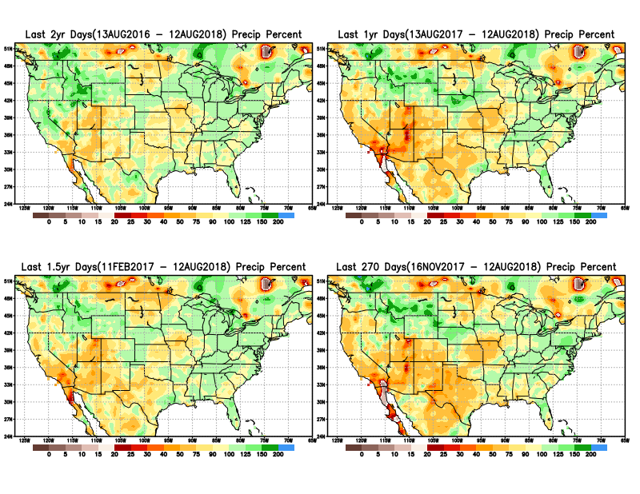
Total precipitation Percent during last 9 months, 1 yr, 1.5yrs, & 2 yrs.
2 Y
1 Y
There are many long term rainfall deficit regions in the country, particularly deficits in UT/AZ, southern CA, and parts of NM/CO are long term – possibly a consequence of the two back to back La Nina’s!
OR
Still longer term variability in play? Especially in the southwest!
1.5 Y
9 M

Slide 9
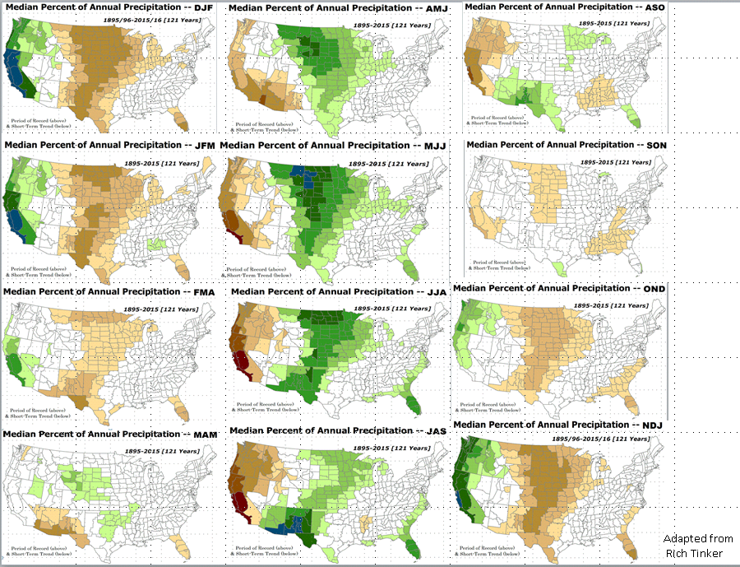
Rainy Season across the US

Slide 10
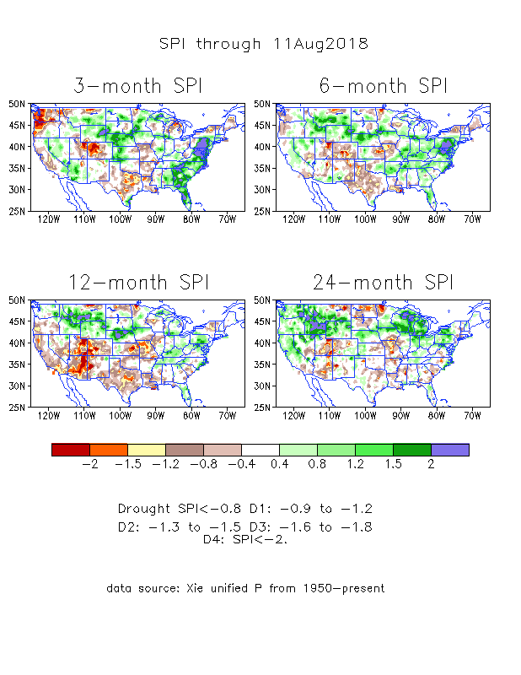
The Standardized Precipitation Index SPI (based on Observed P)
----- NOW
Very interesting graphic & details for the drought across the US based on the more generalized precip deficit/excess, the Standardized Precipitation Index (SPI).
The dark brown and red colors, indicating standardized precipitation deficits, in the various time periods, approximately correspond to the appropriate short/long term drought monitor regions and their intensities
In the short term (~3 mo), overall the drought looks much improved, but in the longer term ~12m, severe deficits remain.

Slide 11
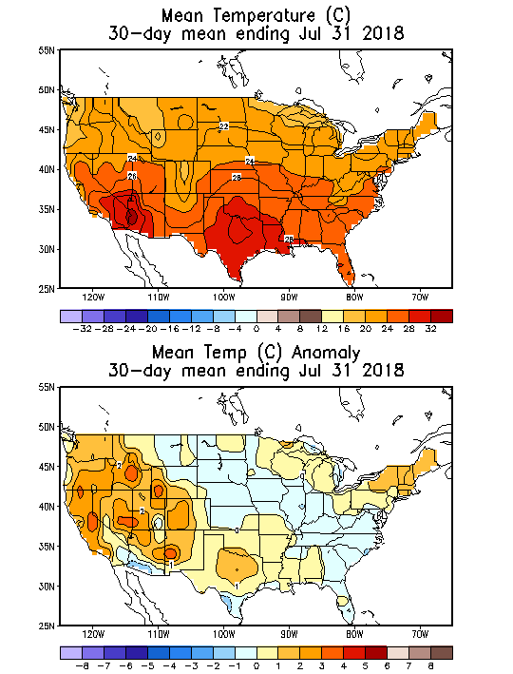
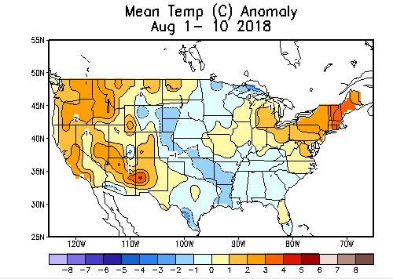
Recent US Temperatures
In July, a pattern with warmth in the west, south and northeast. Relative cool along a northwest to southeast swath.
August so far is somewhat similar to July pattern except probably in the south.

Slide 12
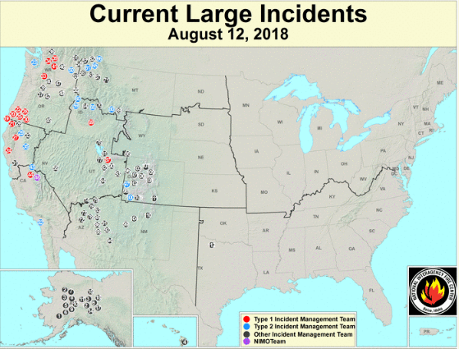
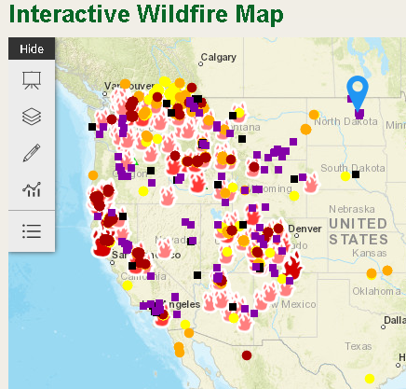
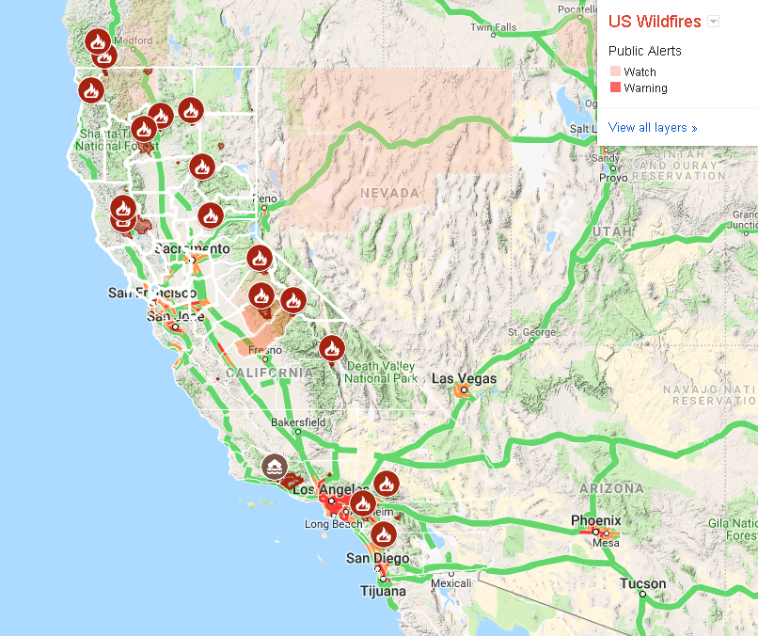
Current Active FIRE
One of the worst, (or probably the worst ?) fire season in CA this year and hence damage/destruction!!
Both from USDA !?
https://fsapps.nwcg.gov/afm/index.php
from Google!
-this morning.
https://www.fs.fed.us/science-technology/fire/information

Slide 13
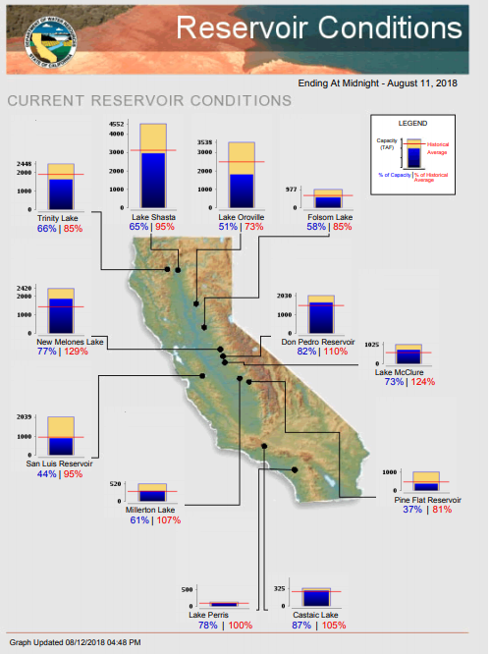
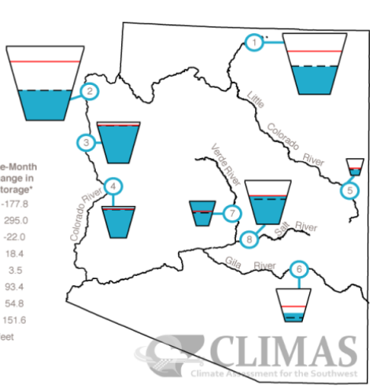
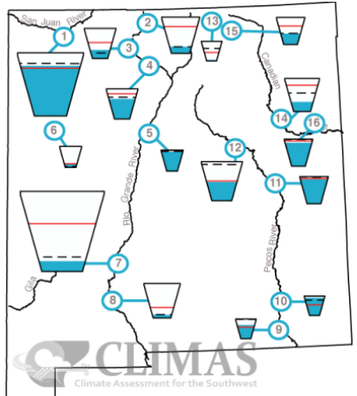
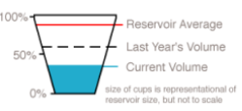
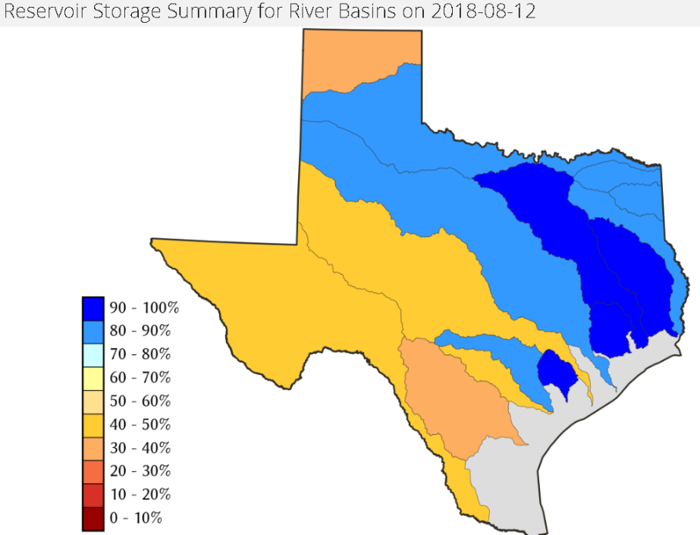
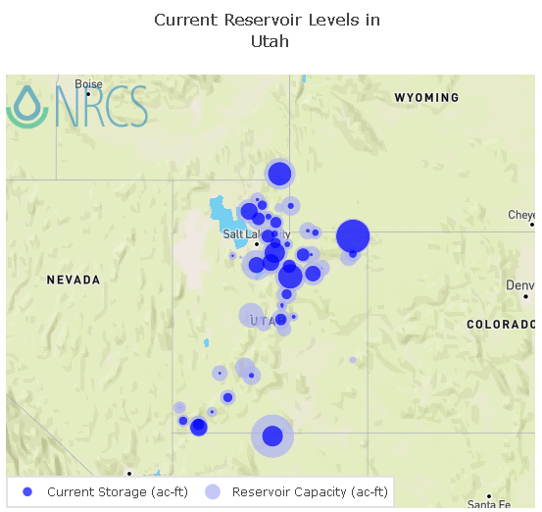
Water Reservoir Levels in some Western/Southern States!
AZ
NM
TX
Most of the CA reservoirs continue to be at reasonably good levels, except for the Lake Oroville near northern Sierra Nevada, nearing completion!
UT
https://fsapps.nwcg.gov/afm/index.php

Slide 14
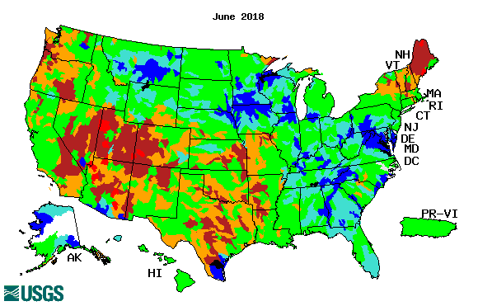
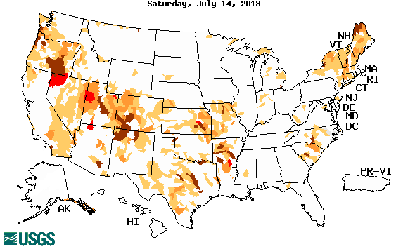
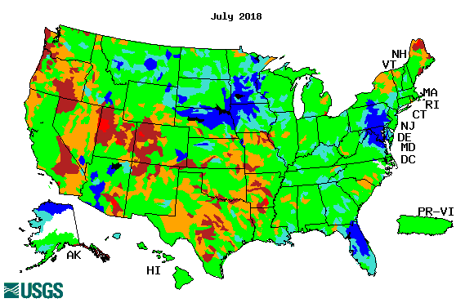
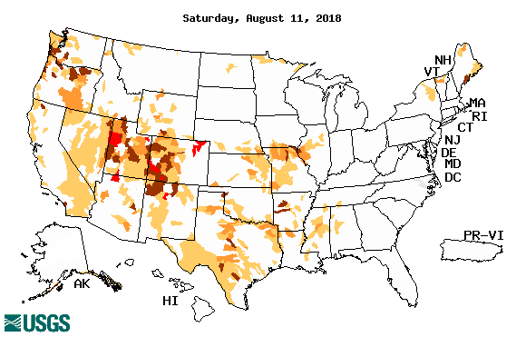
Streamflow (USGS)
Streamflow overall in the South, is slightly better in July, than in June.
Same can be said in the Northeast.
In the Northern Plains, conditions relatively similar in both months.
Map shows only below normal 7-day average streamflow compared to historical streamflow for the day of year.
One month ago (left) &
Now (below)
14

Slide 15
EL NIÑO/SOUTHERN OSCILLATION (ENSO)
DIAGNOSTIC DISCUSSION
issued by CLIMATE PREDICTION CENTER/NCEP/NWS and the International Research Institute for Climate and Society
9 August 2018
ENSO Alert System Status: El Nino Watch !!
Synopsis: There is ~60% chance of El Niño in the Northern Hemisphere fall 2018 (September-November), increasing to ~70% during winter 2018-19.

Slide 16
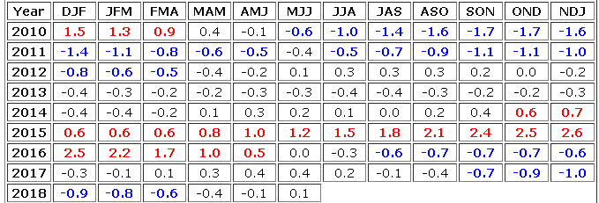
Out of La Nina for sure! And in Neutral Conditions!
But for how long? Trending towards El Nino!!!
http://www.cpc.ncep.noaa.gov/products/analysis_monitoring/ensostuff/ensoyears.shtml

Slide 17
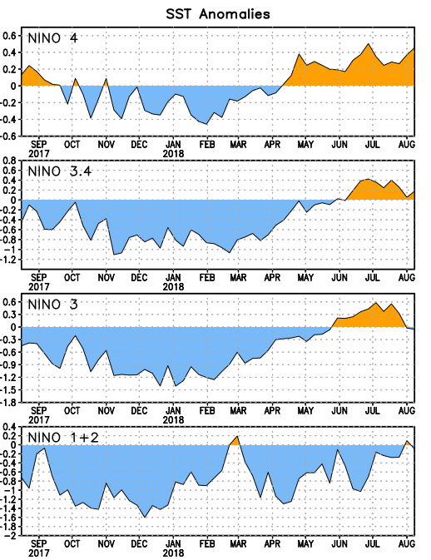
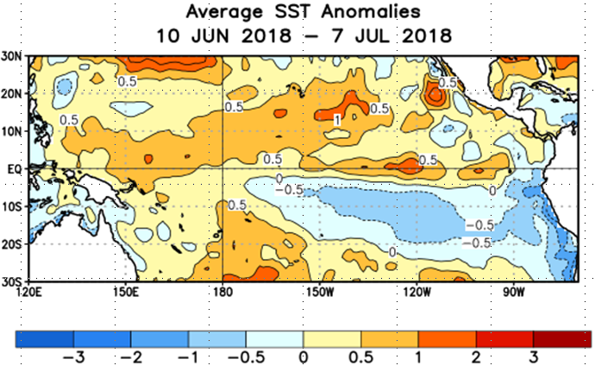
Latest values of SST indices in the various Nino Regions.
The sub surface heat anom is well in the +ve territory! .
Relatively short lived!
Equatorial SST’s are at near to slightly above normal levels in all three ocean basins, except in Nino 4, where it is high!

Slide 18
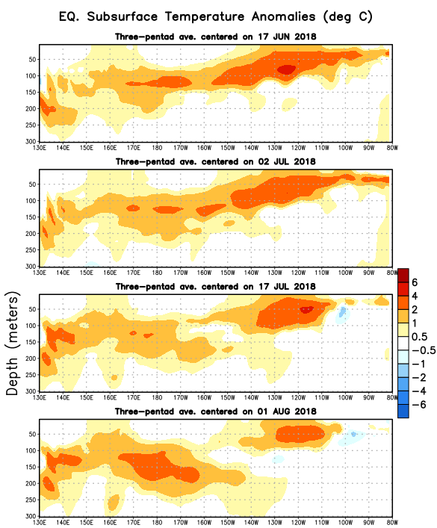
In spite of the recent, relatively weaker SST anomalies, as compared to previous month (previous slide), this is what is happening in sub surface near the equator! Does this mean, still the same probabilities in the upcoming months/seasons for El Nino? Models say:

Slide 19
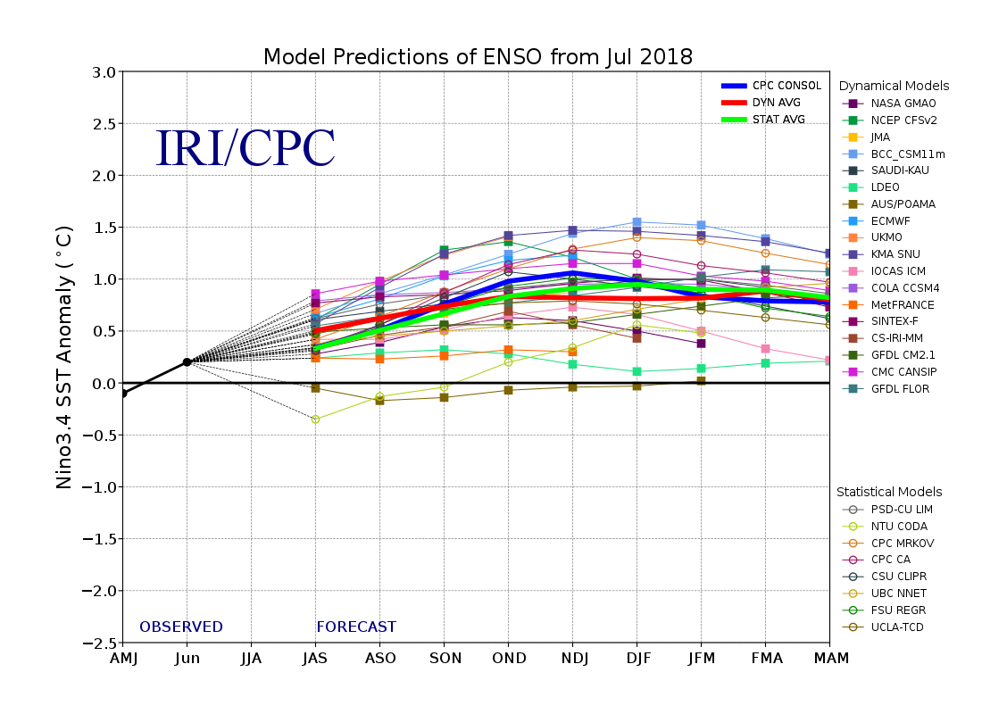
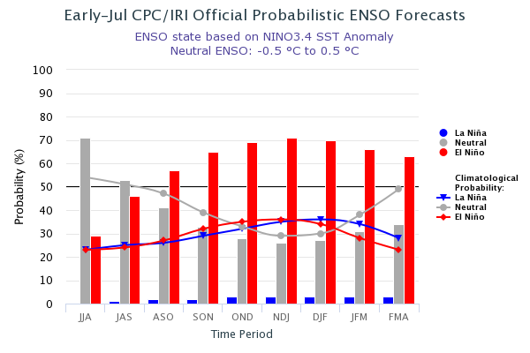
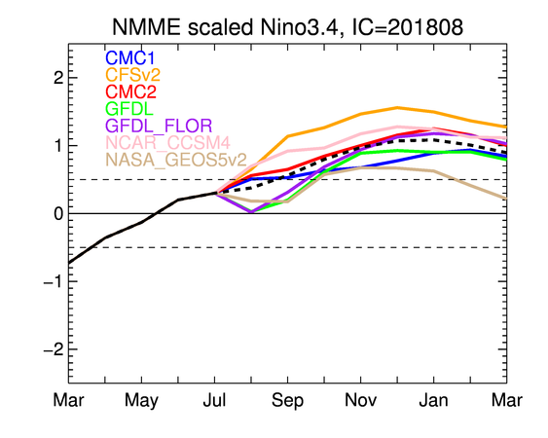
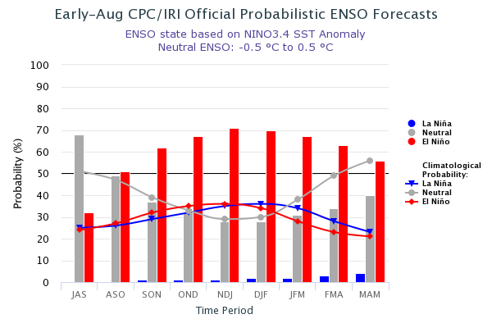
ENSO Forecasts
Early- July CPC/IRI forecast
NMME Models’ – Nino 3.4 forecasts
Early- August CPC/IRI forecast
Current summer: Neutral conditions. Afterwards, slowly trending towards El Nino in upcoming Fall and Winter!

Slide 20
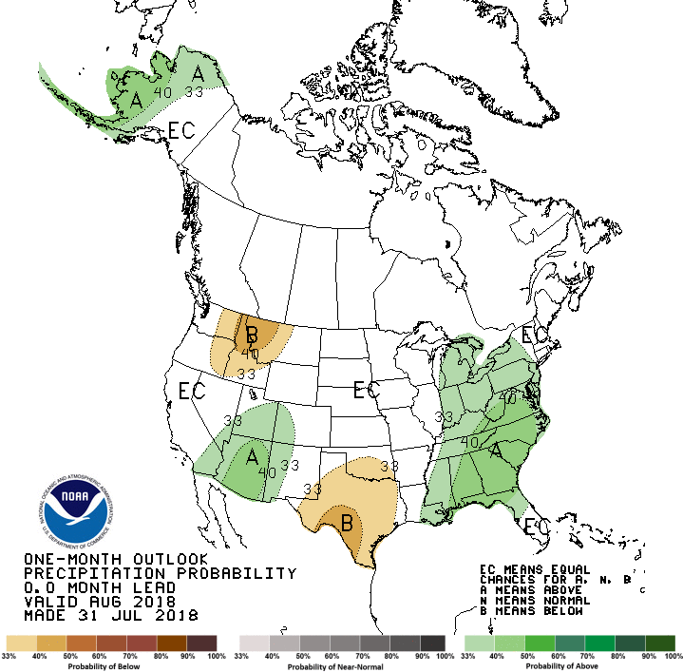
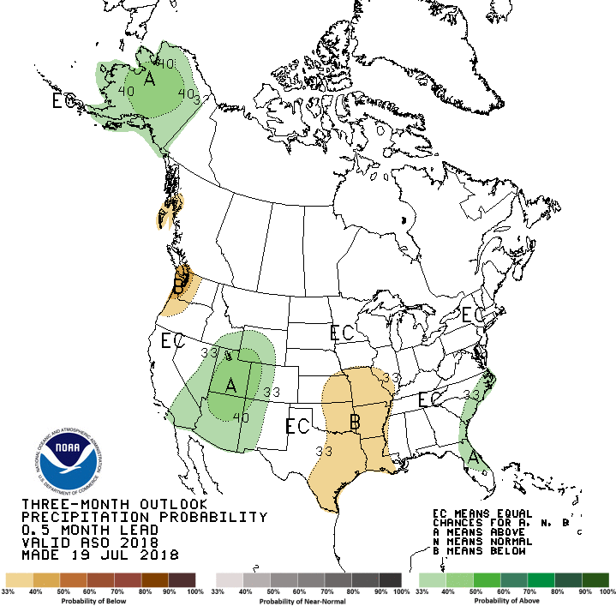
Previous CPC’s official Monthly (August) /Seasonal (ASO)
Precipitation outlook
Released July 31st
Released July 19th

Slide 21
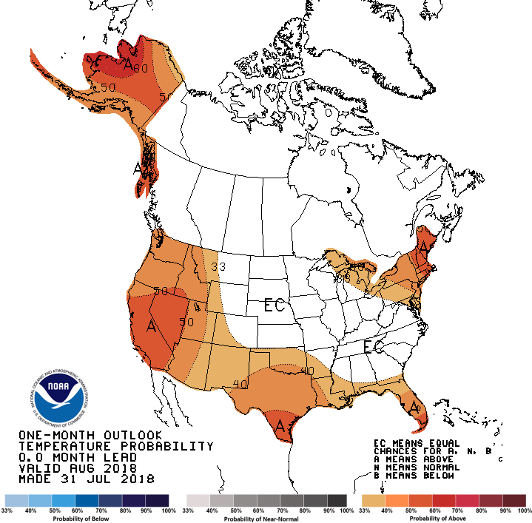
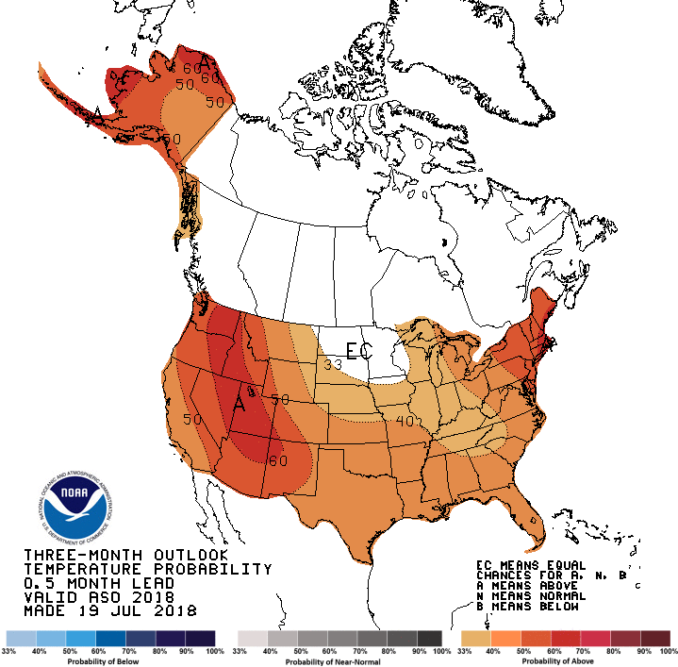
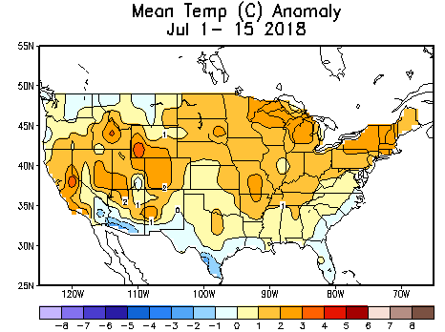
Previous CPC’s official Monthly (Aug) /Seasonal (ASO)
Temperature outlook
Made
July 31st
Made July 19th

Slide 22
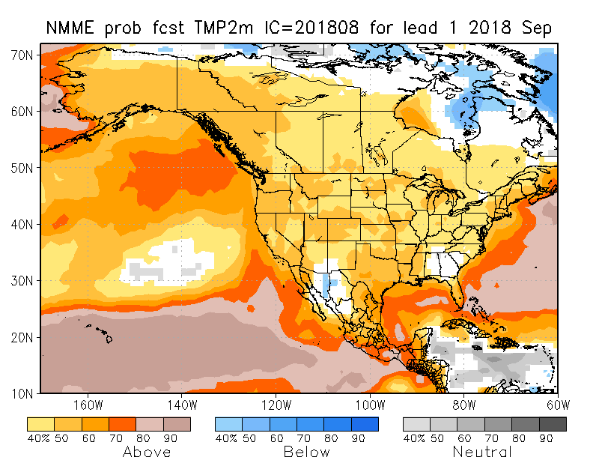
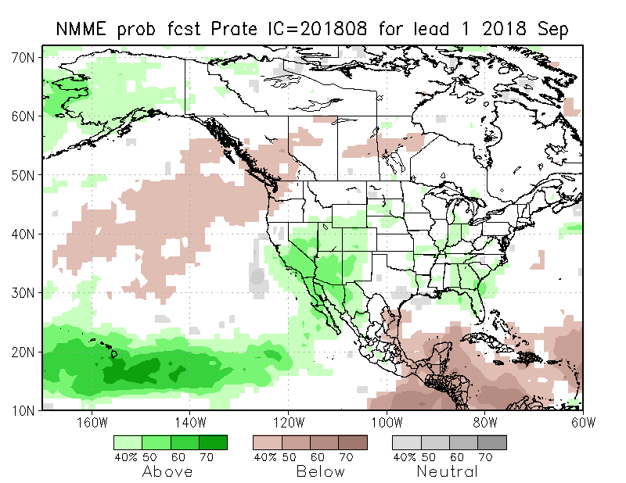
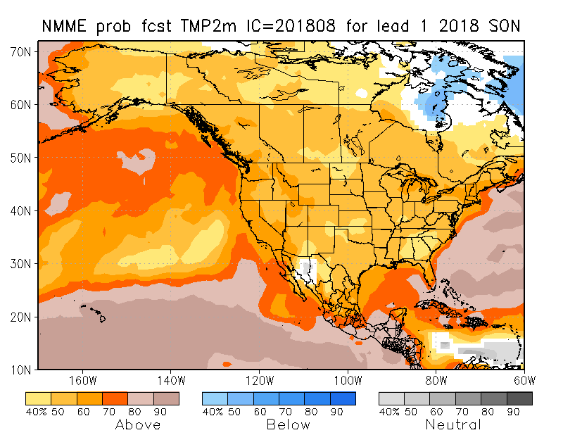
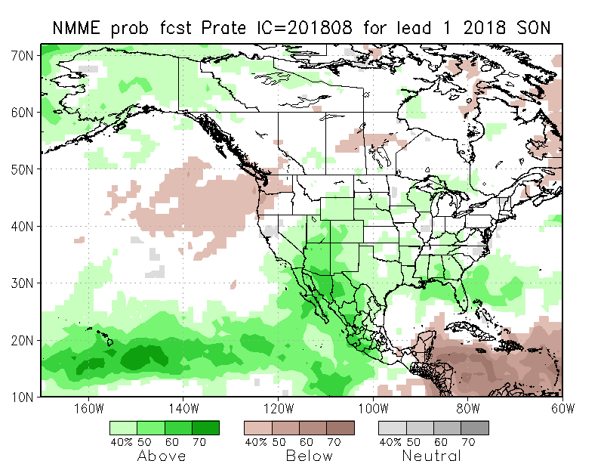
NMME T & P EnsMean forecasts
Sep
SON
Current ENSO state is neutral. Warm over the whole country, and wet across much of the country (except the Pacific NW) is the forecast for the upcoming month and season, especially across the southwest!

Slide 23
Prate ANOM forecast - NMME
23

Slide 24
The agreement/uncertainty among the diff. NMME models’ forecasts for Sep-Oct-Nov Precipitation!!!
?? There is a little bit more agreement for the precip in the southwest, amongst the various models, which the ensemble mean is picking up!!
24

Slide 25
This will take care of developing dryness in NE.
Next 7 days QPF Forecast
GFS Model Guidance for next 16 days.

Slide 26
SPI3
SPI6
SPI3 & SPI6
Forecasts from 6NMME Models
(uses obs. P up to past month, and forecast months’ P from NMME models)
The goodness and skill of these SPI’s forecasts depend directly on these NMME models’ skill in predicting precipitation!!!
The NMME models indicate that by October, the short term SPI(3) will all be in the +ve territory, over the monsoon southwest, and even across entire country ☺, but longer term dryness/drought will stay in some areas. What about even longer term deficits ?

Slide 27
SPI3
SPI6
SPI12
SPI3 & SPI6 & SPI12

Slide 28
Hydrological Monitoring and Seasonal Forecasting @ MSU (Michigan State University ) NLDAS model
Monthly Soil Moisture Percentile Prediction issued on 201808 with this IC.
http://drought.geo.msu.edu/research/forecast/smi.monthly.php
The inter quartile range suggest greater uncertainty about the forecast in these shaded regions.

Slide 29
Precip Forecast
NASA GEOS5 Forecasts
All models suggest/predict heavy rain in September in the southwest pretty much erasing the short term deficits in the region.
Aug
Soil Moisture Forecast Percentile
Sep
IC
Aug
Oct
Sep
Oct

Slide 30
Exptl. Probability Drought Outlook from Kingtse Mo and Li Xu based on NMME ensemble members’ Precip forecast .

Slide 31
Sep 2018
In the official
Drought Outlook Tendency Format!!
SON 2018

Slide 32
Summary
Current ENSO status and forecast. ENSO Alert System Status: El Nino Watch! There is ~60% chance of El Niño in the Northern Hemisphere fall 2018 (September-November), increasing to ~70% during winter 2018-19.
Current Drought conditions:
The great improvement seen in early/middle summer in the Northern Plains drought, that affected eastern Montana, and the North/South Dakotas, is a bit slowed down lately, did not completely recover, and it continues to persist in a weakened form.
The much larger and more important South/Southwest drought, covering parts of far southern CA, NV, UT, AZ, CO, NM, KS, OK, parts of TX and MO, which is predominantly, but not exclusively, a consequence of the rainfall deficit associated with the back to back two La Ninas that just ended, is undergoing changes in intensity and size, especially in the interior states of AZ/NM and along the edges.
It was pointed out last month, that dryness was developing in the Pacific Northwest. Since then, the dryness has expanded continued to expand eastward.
Prediction:
Under El Nino Watch!! In spite of the surface SST weakness, sub surface Pacific conditions are still trending towards El Nino. El Nino conditions are expected in Fall and Winter! Consequently, in the next three months, all models indicate above normal rainfall particularly across the South and West, and an overall short term improvement in the dryness/drought conditions, except in the Pacific Northwest, southern CA, southern TX. However, a possible late season hurricane impacting the TX coast/vicinity may change this. In those regions of the drought where the longer term rainfall deficits exist (see longer term rainfall deficit map) , the longer term drought will continue to exist, and have to wait until hopefully later when the El Nino is fully established. September rainfall is crucial for much of the southern/western states, and models are predicting good rainfall amounts.
The Northern Plains Drought ,in some areas of the N/S Dakotas, may continue to exist in a muted form, since the previous rainfall deficits may not be completely erased.
In the Pacific Northwest, the accruing rainfall deficits, below normal rainfall forecast for the season, above normal temperatures are likely to enhance drought conditions there.
In the east, most regions will likely to be drought free, except along far northeast. ***END***

Slide 33
Miscellaneous maps

