Slide 1
Drought Outlook Support Briefing August 2023
Climate Prediction Center/NCEP/NOAA
http://www.cpc.ncep.noaa.gov/products/Drought
Points to ponder:
Often, there is a disconnect between the Short term (S) and Long term (L) drought in regions, and even with the short term (S) drought, the 3-month and 6-month signals are not quite consistent! With Long term (L) drought, it is even more trickier, as it is open ended from 1 year and beyond!!!
Places/regions experiencing Short term drought may (not) be ok in the Long term and vice versa!!
This duality is difficult to reconcile, to convey and even be clearly understood well by the public at large.
Public/Forecaster generally tends to focus more on the Short term Drought (for good reasons!!)
More importantly the very definitions and timescales associated with S/L term droughts and the declarations in the USDM are by themselves subjective!!
The S/L term drought conditions in large parts of California, a year ago, even just 6 months ago, has now mostly gone. Many/most reservoirs in CA are at or above their historical averages and even near capacity. However, the two large major reservoirs, Lake Mead and Lake Powell in the CA/AZ/UT border area are still at dangerously low levels, thus impacting hydro electric power supply and distribution to nearby states. Even the big snow melt from the record large snow amounts made only a very minor impact to the water flow to these two reservoirs.
It may take a long time for drought to develop, but those conditions can end very quickly! Forecast models are yet to (seasonal) correctly forecast these changes in advance!
Short term vs Long term drought need to be clearly distinguished and shown to the public!!
Subjective(delayed) USDM vs Objective(real time) map! A few days or recent heavy precip can change the USDM a lot!
New objective AI/Deep-Learning based Experimental ODI (objective drought indicator, runs daily) compared with Official USDM (US Drought Monitor, produced weekly by USDM authors).

Slide 2
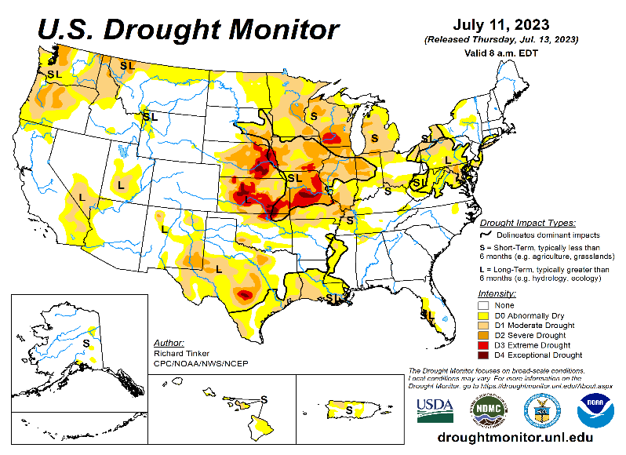
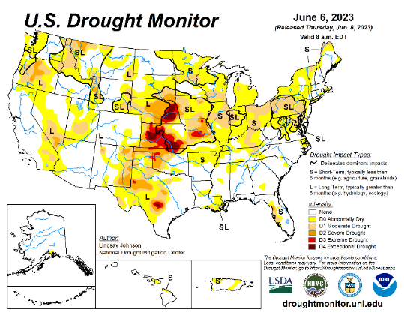
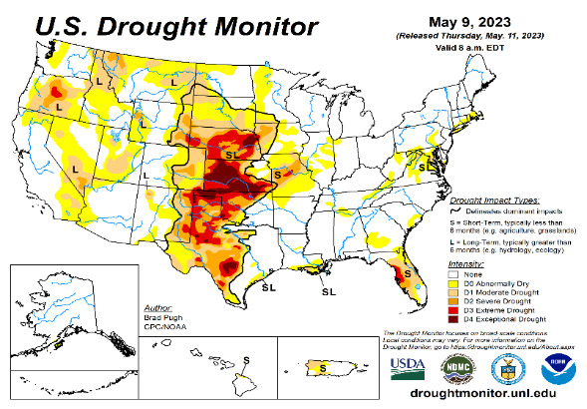
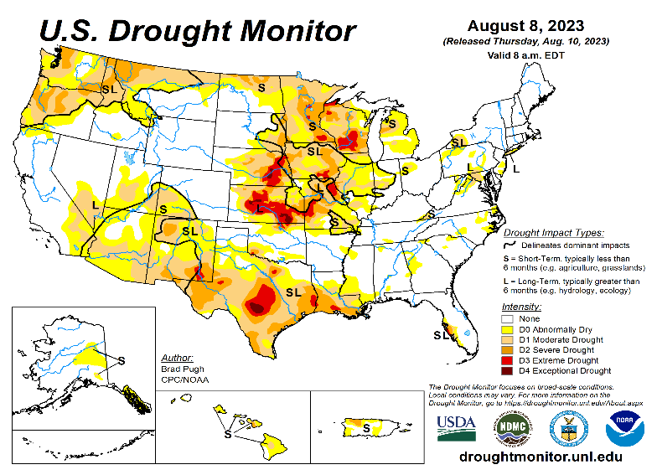
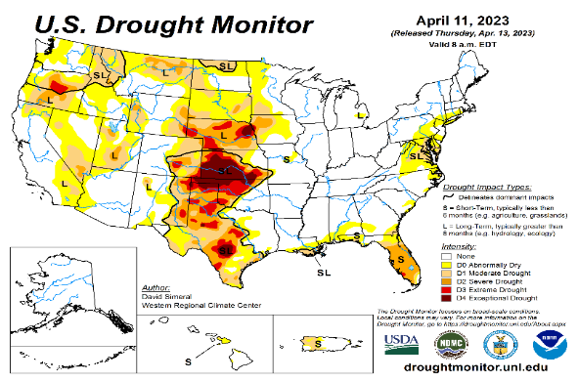
Drought Monitor
Monitoring is important because, unlike US T/P fcsts, for drought forecasts, we have to know where we are, before we can tell where we are going!! Drought forecasts are tendency forecasts.
July
Towards the end of last year 2022, until December or so, severe drought conditions (both short and long term) remained in the west, mild drought conditions expanded in to portions of the eastern half of the US also, covering most of the country with very high % areas of the entire US affected by drought. The situation now is now drastically different due to the extraordinary winter season.
The past winter/early spring rainy season in CA and the west coast states, wiped out not only the S-term drought but also the L-term drought in most areas. Water levels in almost all CA reservoirs are now ABOVE their normal levels. However, the water storage levels in the huge Lakes Powell and Lake Mead in NV continue to be historically low, & decade(s) long hydrological drought still lingers. Recharge into these 2 reservoirs from subsurface stream flows has been severely impacted.
S/L term droughts still remain in parts of northwestern states of WA/OR/ID/MT. Severe drought is entrenched in eastern and central areas of NE/KS/MO. Moderate/Severe drought also appears in MN/WI/IA/IL/IN. The relatively poor monsoon this year in the southwestern states has created short term drought conditions in AZ/NM and in parts of NV/UT/CO.
Area covered by >D1 category drought is now ~ 30%, slightly higher than last month(~25%), mainly due to the poor monsoon, so far. The drought in TX has also spread across the state extending into LA. The eastern one third of the US is almost drought free!
The recent drought/heavy winds related fires, and consequent loss of lives and property in Maui is sad and unfortunate! The whole system is under review.
Recently we have introduced and show here, an exptl. version of an Objective US Drought Indicator based on AI methods, that runs daily at CPC.
June
May
August
(Recent/Latest)
April
?

Slide 3
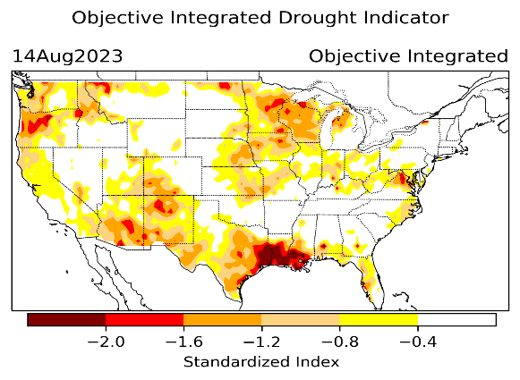
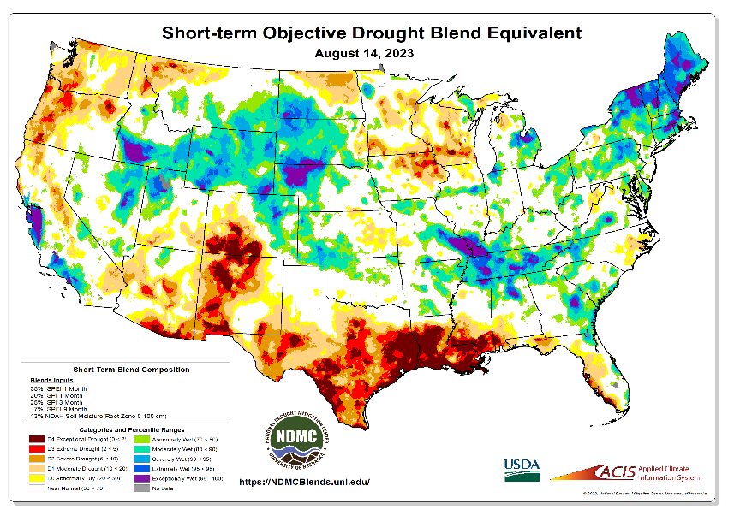
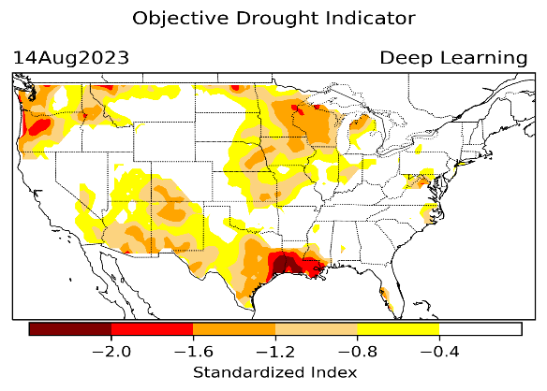
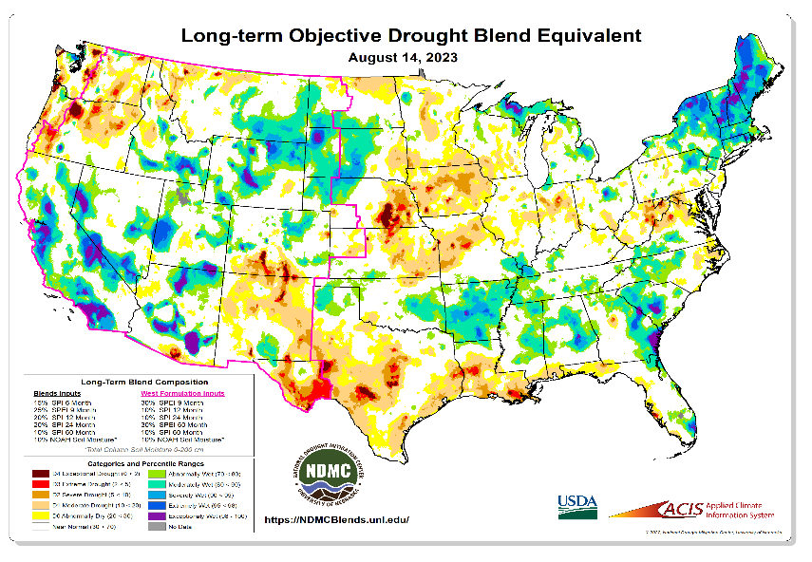
Exptl. Objective Drought Monitor (showing S/term & L/Term separately) from National Drought Mitigation Center (NDMC)
New slide now included in this briefing!
CPC’s own Experimental
Objective Drought Indicator (ODI)
using AI/Deep Learning ! – Updates daily !!
https://www.cpc.ncep.noaa.gov/products/people/lxu/odi/#deep-learning-increment-training
Based on the CPC P/analysis &
VIC (Princeton) NLDAS model assimilation:
Standardize Precipitation index (SPI)
Standardize Precipitation-Evapo –
transpiration index (SPEI)
Evapotranspiration Stress Index (ESI)
Soil Moisture Percentile (SMP)
Standardize Runoff Index (SRI)
-can be split into Short/Long Term Droughts!
https://droughtmonitor.unl.edu/ConditionsOutlooks/CurrentConditions.aspx
Objective &
Runs Daily!
Objectively Integrated
versus Deep Learning
methods. ~ gives |||r results.
Both Objective!
Both update daily!
Objective &
Runs Weekly!
On Monday!
Objective &
Runs Daily!
* A manuscript (Xu & Chelliah) is under preparation.
Latest Official USDM (US Drought Monitor)
Subjective &
Runs Weekly!
Objective &
Runs Weekly!
On Monday!
These two maps above, used to be produced at CPC(Rich Tinker!), but recently officially done by NDMC operations!
*Released every Thursday, for conditions as of Tuesday!

Slide 4
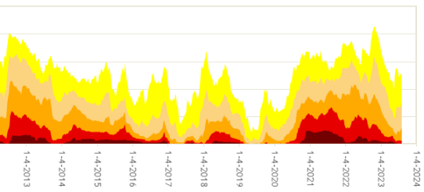
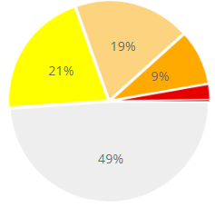
In general, The spatial details of Every drought is different.! Every situation is different!!
Time series since 2000 spilt into 2 (above & below) panels.
CONUS % Land Area
Current drought!

Slide 5
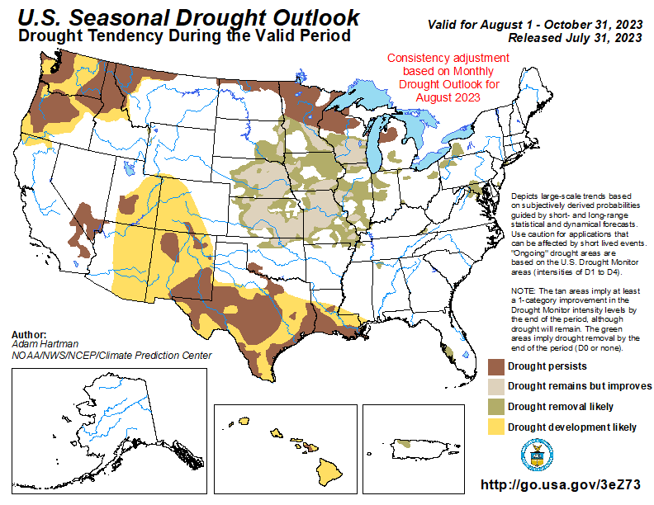
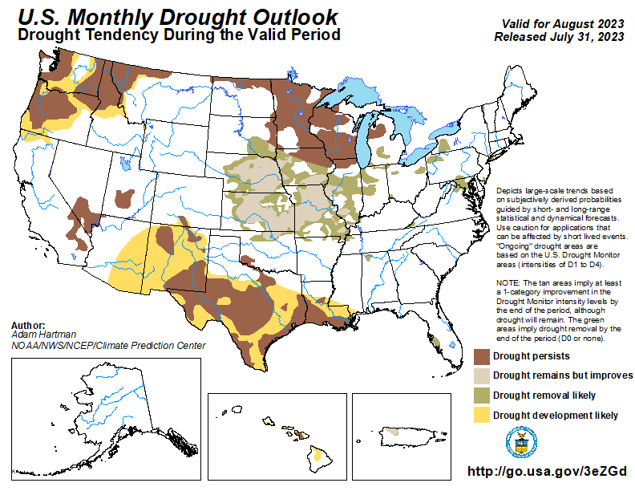
(Previous) Seasonal/Monthly Drought outlooks
New Seasonal+ Drought Outlook(SDO) to be released in 2 days!
(reissued again at end of month for consistency with MDO!)
New Monthly Drought Outlook (MDO) to be released at end of this month)
Updated Seasonal Outlook
( 1 Aug – 31 Oct 2023)
issued 7/31/23
Monthly outlook (for August 2023)
issued 7/31/23

Slide 6
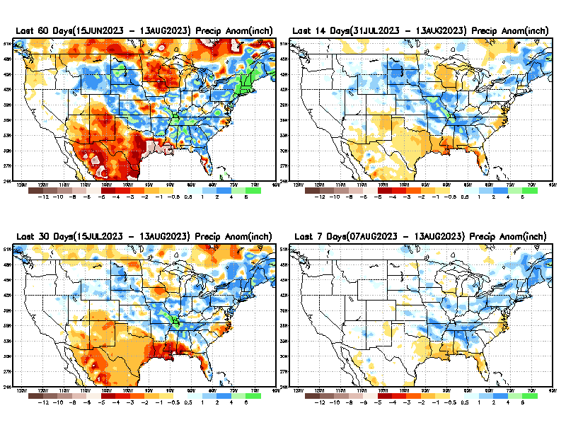
Precipitation ANOM during last 7, 14, 30, & 60 days.
This and next few slides show Precip deficit (excess).
Droughts, for the MOST part, begin and end with precip!! Lately, Temps are becoming (secondarily) important as well.
60 Days
14 Days
Weak monsoon so far!
30 Days
7 Days
These maps in this and following slides, including a) Total,
b) Anom and
c) Percent of Normal precip. in these and other longer time ranges are now (routinely) daily updated at:
From: Recent Accum./Anom Precipitation https://www.cpc.ncep.noaa.gov/products/Drought/briefing_prcp.shtml

Slide 7
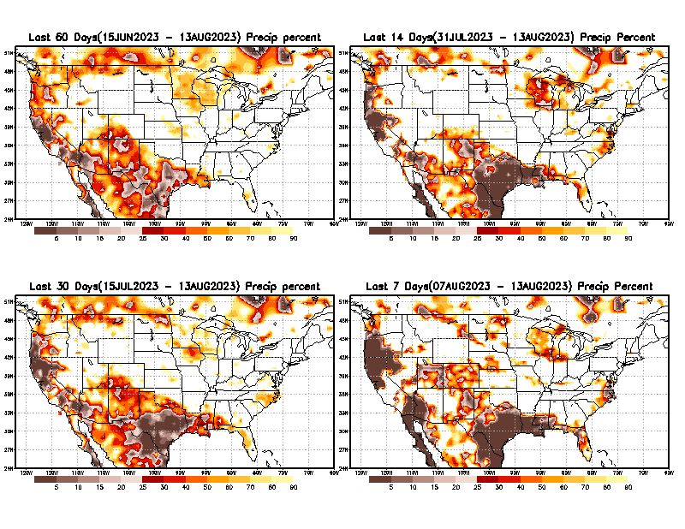
Precipitation Percent (of normal) during last 7, 14, 30, & 60 days - Only Deficit Areas <=90% shown !
60 Days
14 Days
This plot shows only the rainfall deficient regions <= 90% of normal.
-- This shows more clearly possible/likely drought developing region in the future unless there is above normal rainfall in these regions in the future, to offset these shortfalls.
30 days
7 days
From: Recent Anom/% of normal Precipitation https://www.cpc.ncep.noaa.gov/products/Drought/briefing_prcp.shtml

Slide 8
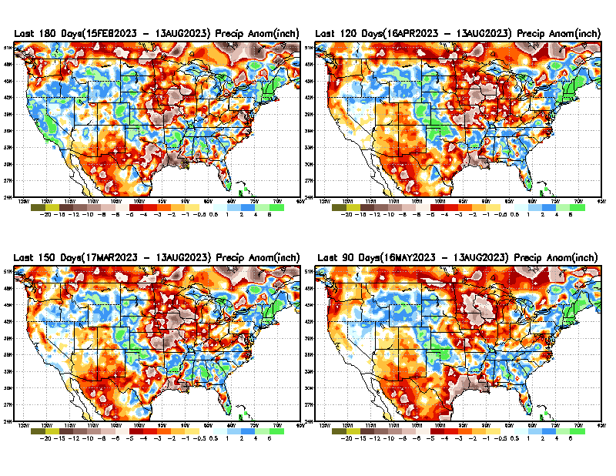
Total precipitation ANOM during last 3, 4, 5, and 6 months.
While the Precipitation anomalies deficit may seem large in some regions (compared to others),
it is the
% of normal precip (next slide) that matters more!!
6 M
4 M
5 M
3 M
From: Recent % of Normal Precipitation https://www.cpc.ncep.noaa.gov/products/Drought/briefing_prcp.shtml

Slide 9
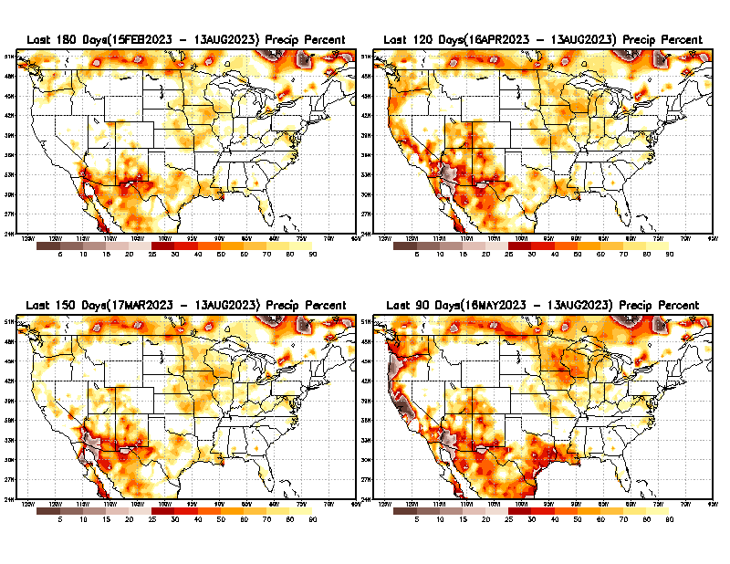
Total precipitation Percent (of normal) during last 3, 4, 5, and 6 months Only Deficit Areas <=90% shown!!
6 M
4 M
In these interim time scale 3-6 months, we need to pay attention to regions, which are dark-brown, red & dark red (<50%).
While accrued precipitation deficits are real & objective,
droughts are subjective declarations!!
5 M
3 M
East vs West!
Broad vs Narrow
rainfall season.
In general, West US suffers more from frequent and lasting droughts. Droughts in East US are less and less lasting!
What about Center ?
More like West than East?
Short term(S) Drought is generally declared when rainfall deficits exist in the 3-6 months time range. {Long term deficits beyond 1 or 2 or more years is Long term L drought! }

Slide 10
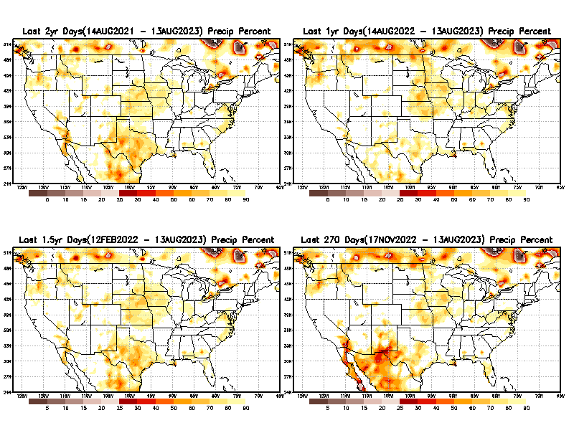
Total precipitation Percent during last 9 months, 1 yr, 1.5yrs, & 2 yrs. .–Only Deficit Areas shown!! <=90%
2 Y
1 Y
1.5 Y
9 M
The character and even location/spatial extent of the short/S and long/L –term droughts are different!!!
From: Recent Accumulated Precipitation https://www.cpc.ncep.noaa.gov/products/Drought/briefing_prcp.shtml

Slide 11
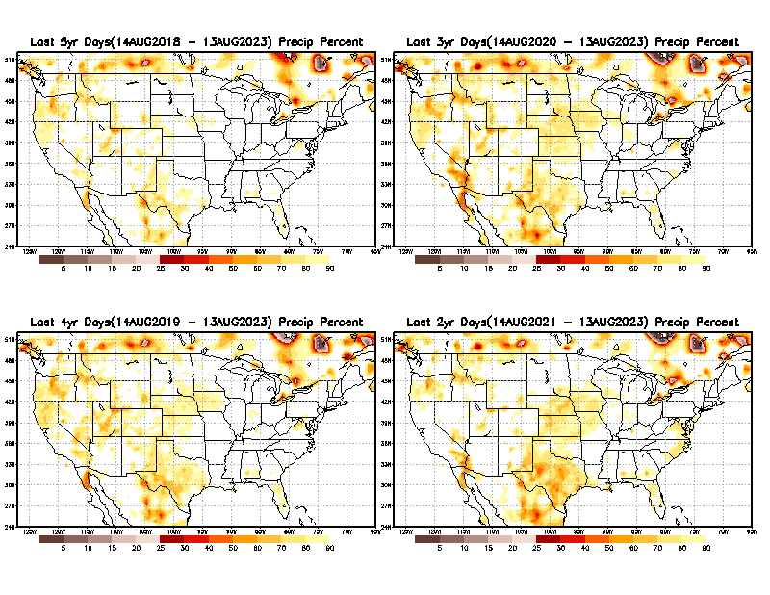
Total precipitation Percent (of normal) during last 2, 3, 4, & 5 yrs. .–Only Deficit Areas <=90% shown !!
5 Y
3 Y
In spite of the recent deluges/floods in California, there still exists a small longer term rainfall deficit in CA and parts of the southwest/ western US.
However, currently, most CA reservoirs are nearing or in excess of their historical averages.
BTW, Not sure if the longer term (20+years) since 2000’s has officially ended! ☺
4 Y
2 Y
From: Recent Accumulated Precipitation https://www.cpc.ncep.noaa.gov/products/Drought/briefing_prcp.shtml

Slide 12
LEAST
Rainy/dry
(3-month) Seasons across the US
MIXED
MOST
East vs West!
More darker colors in west/central => narrow rainy season (months)
Overall, more white space in the east => distributed rainfall season (except ~FL).

Slide 13
October is the driest month of the year for the US!
Least green in map.
Least dark brown also!!
*********
EAST vs
CTR/WEST
Drought Behavior is loosely tied to rainfall climo!! And the limited rainy season in the west
*********
Adapted from Rich Tinker.

Slide 14
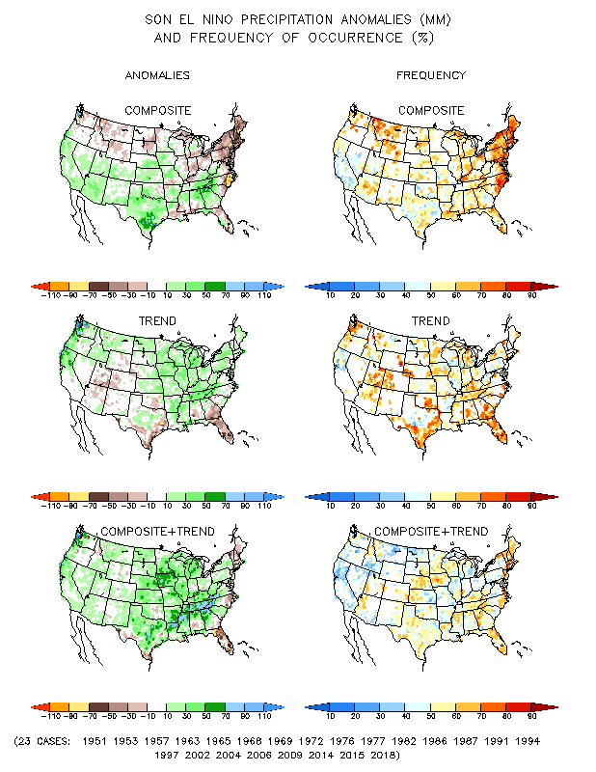
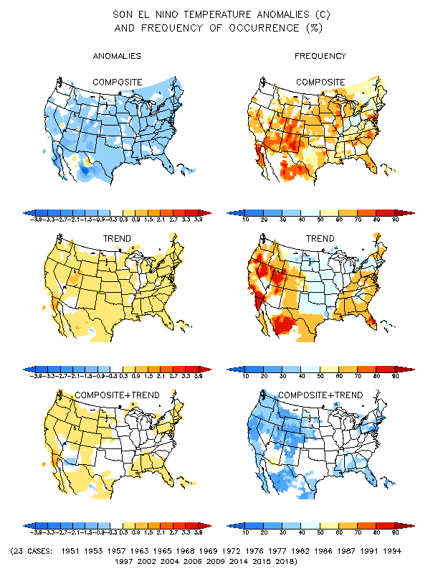
El Nino Precip/Temperature COMPOSITES & Trend map
SON
P
T
Transitio-ning to
ENSO neutral and then to El NINO conditions

Slide 15
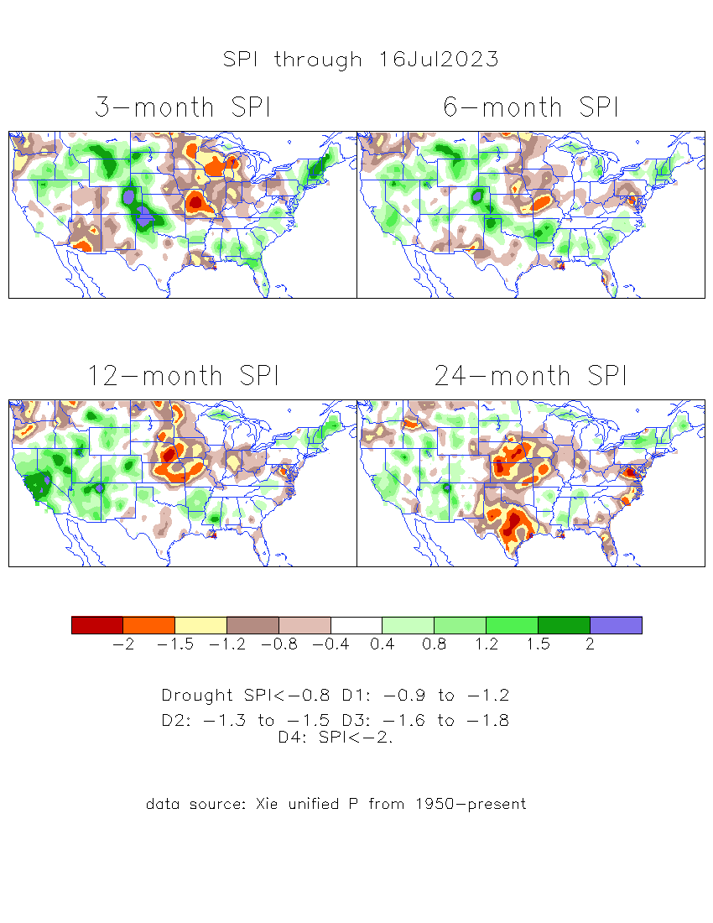
The Standardized Precipitation Index SPI (based on Observed P)
----- Last Month
Very interesting graphic & details for the drought across the US based on the more generalized precip deficit/excess, the Standardized Precipitation Index (SPI).
The dark brown and red colors, indicating standardized precipitation deficits, in the various time periods, approximately correspond to the appropriate short/long term drought monitor regions and their intensities

Slide 16
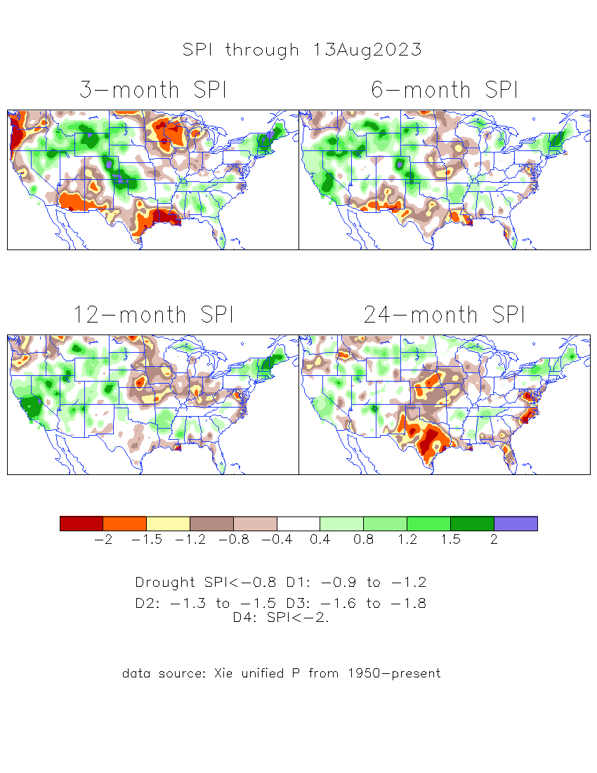
The Standardized Precipitation Index SPI (based on Observed P)
Compare with last month
----- NOW
Very interesting graphic & details for the drought across the US based on the more generalized precip deficit/excess, the Standardized Precipitation Index (SPI).
The dark brown and red colors, indicating standardized precipitation deficits, in the various time periods, approximately correspond to the appropriate short/long term drought monitor regions and their intensities
Short
No S-term drought here! Also big impact on L-term drought in west!
Long
How does one negotiate and reconcile declaring short term vs long term drought when precip. deficiencies patterns differ on many different time scales locally!!
What is the cutoff delineating time between short VS long term drought!! Not so clear!!
At exactly where, does drought begin?

Slide 17
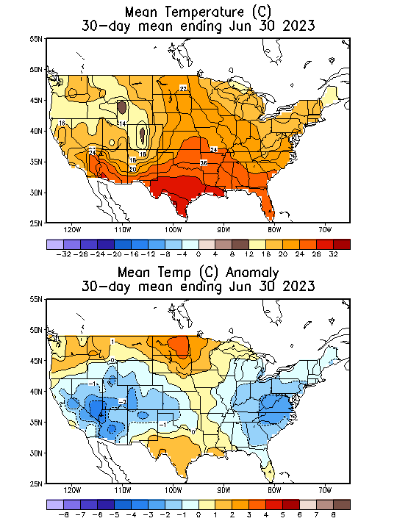
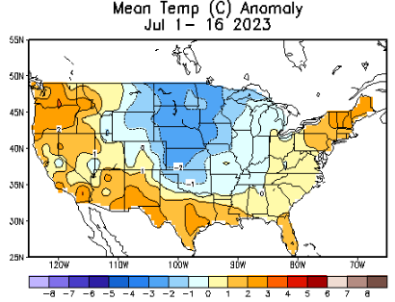
Slide From Last Month’s Briefing!
Recent US Temperatures
.
So far this month !!

Slide 18
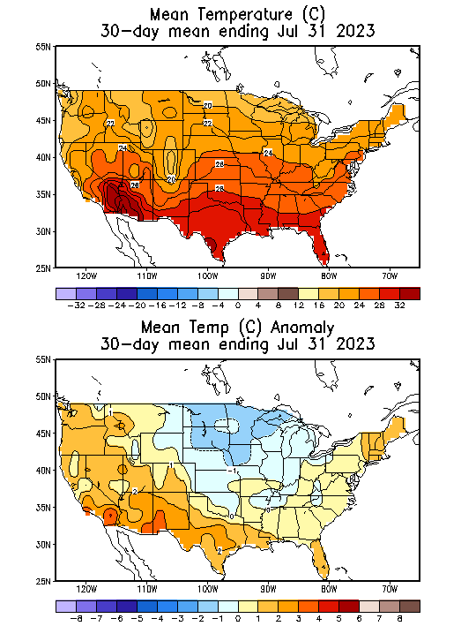
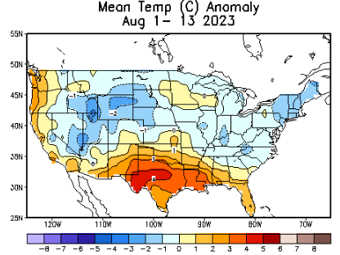
NOW
Recent US Temperatures
.
So far, contrast from last month!
So far this month !!

Slide 19
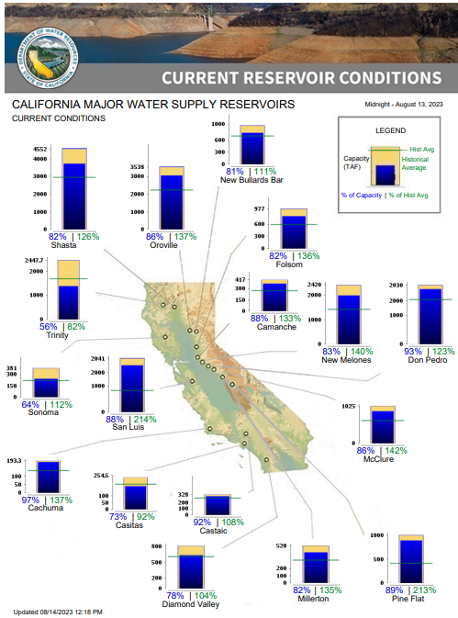
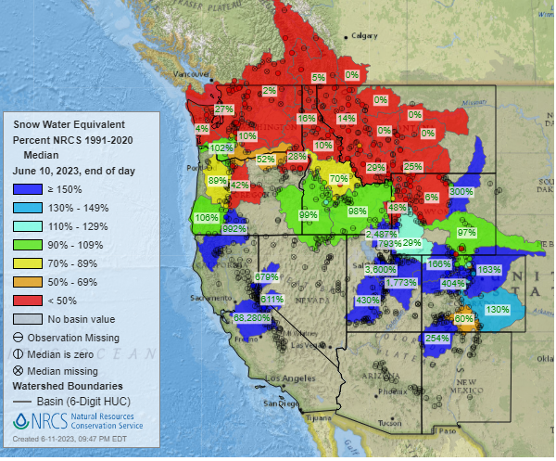
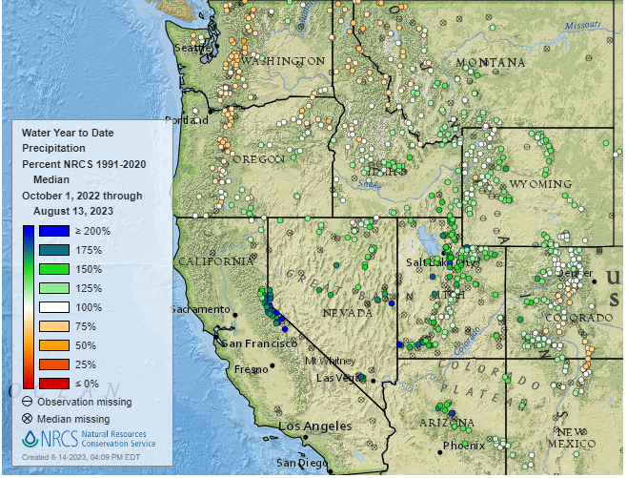
% of Capacity
% of Hist. Avg.
of Reservoirs.
SWE
In June
https://cdec.water.ca.gov/cgi-progs/products/rescond.pdf
https://www.nrcs.usda.gov/wps/portal/wcc/home/
Many CA water reservoirs are AT or ABOVE their historical average/ CAPACITY levels ! ☺
This Month
https://www.nohrsc.noaa.gov/interactive/html/map.html?
WHOEVER though that the California drought/reservoir-water-levels wil turn around in just ONE winter!!
But a very different story for the big lakes Lake Mead & Lake Powell in NV, see next slide! ☹

Slide 20
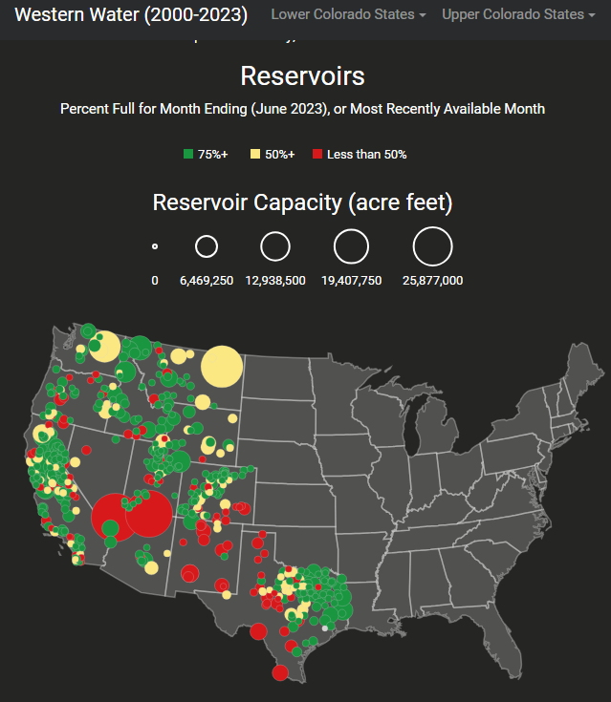
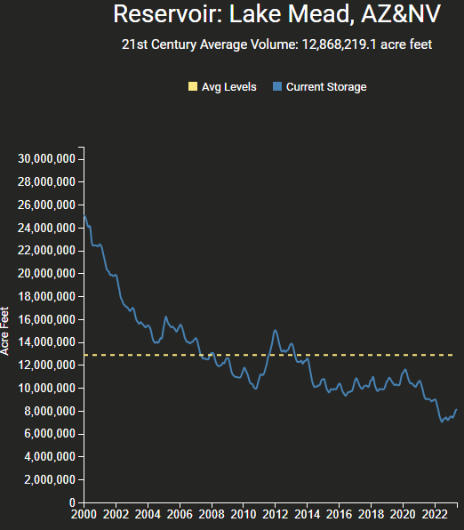
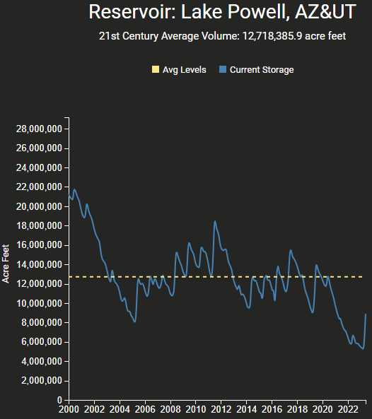
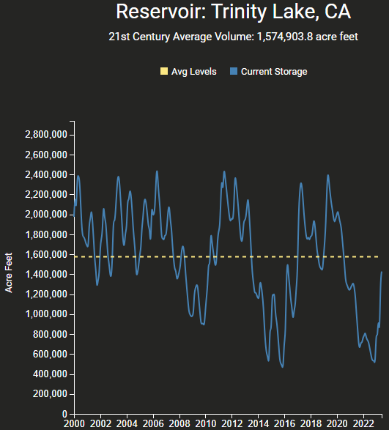
https://www.deanfarr.com/western_water/
https://www.deanfarr.com/western_water/
Hydro Electric power generating turbines STOP operating at the critical 7 million acre feet level
Lakes Mead, Powell in NV/AZ are at historic /dire low levels! ☹ ☹ HUGE consequences for electric power for western states CA/NV/AZ/UT !!
Only very slight improvement in recent months!

Slide 21
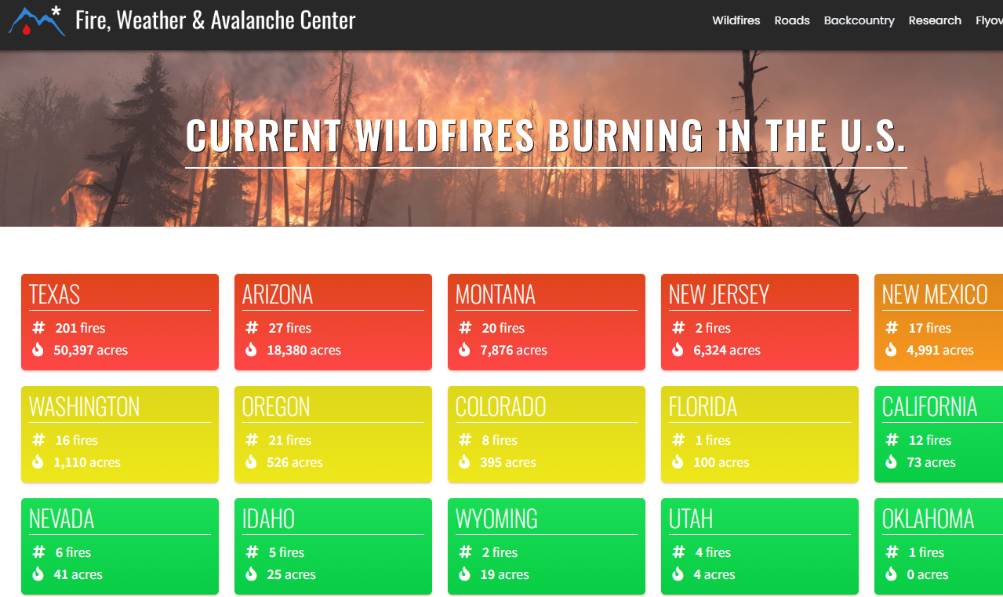
Slide Not shown
THIS MONTH !!
The major Fire Story is
HAWAII, THIS MONTH !! ☹,
An anomaly!! Not shown here!
https://www.fireweatheravalanche.org/fire/current-list-of-us-wildfires
(not govt. source! Not sure how good is this data?)

Slide 22
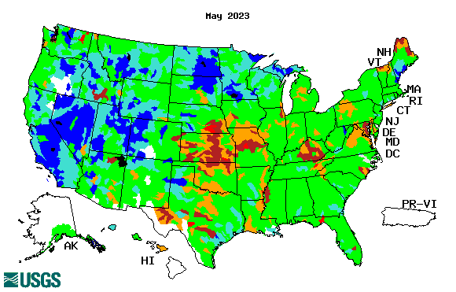
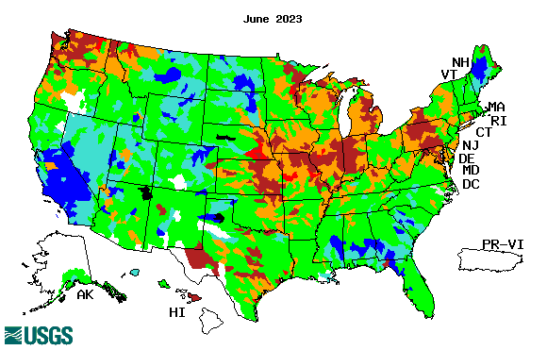
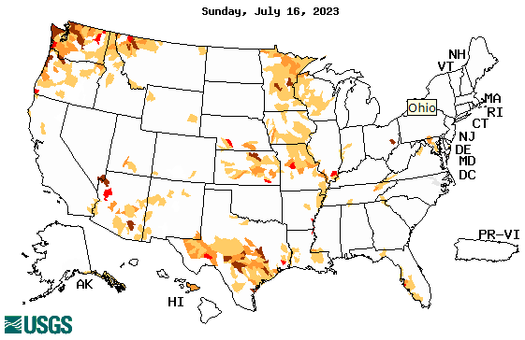
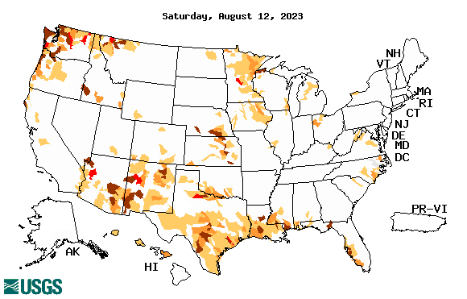
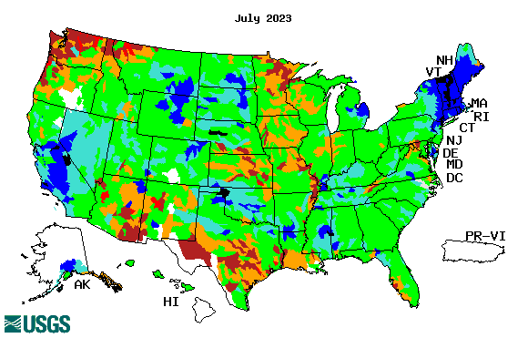
Streamflow (USGS)
Most US east droughts are relatively short lived (as compared to US west). However, if you recall, the drought over the New England states last year was a real surprise!!
Map shows only below normal 7-day average streamflow compared to historical streamflow for the day of year.
One month ago (left) &
Now (below)
Streamflow is only a partial indicator, as sometimes it is highly managed.
If sometimes, the various indicators are confusing, go back to % of rainfall deficit maps – to confirm/reinforce!!
22

Slide 23
EL NIÑO/SOUTHERN OSCILLATION (ENSO)
DIAGNOSTIC DISCUSSION
issued by CLIMATE PREDICTION CENTER/NCEP/NWS and the International Research Institute for Climate and Society
10 August 2023
ENSO Alert System Status: El Niño Advisory
Synopsis: El Niño is anticipated to continue through the Northern Hemisphere winter (with greater than 95% chance through December 2023 -February 2024).
CPC’s Oceanic Niño Index (ONI) [3 month running mean of ERSST.v5 SST anomalies in the Niño 3.4 region (5ºN-5ºS, 120º-170ºW)], based on centered 30-year base periods updated every 5 years.
No red color in this table yet !

Slide 24
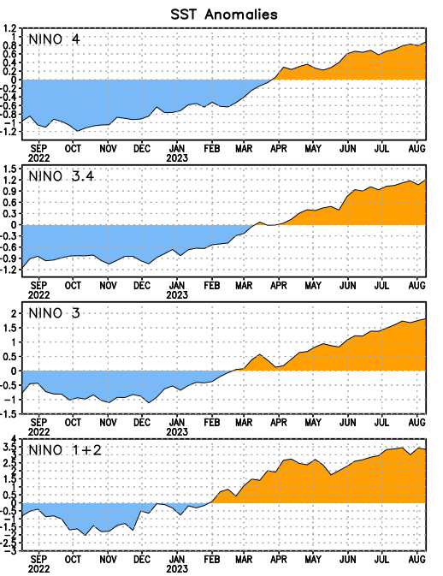
Latest values of SST indices in the various Nino Regions.
Rapidly decreasing Subsurface cold water reserve…

Slide 25
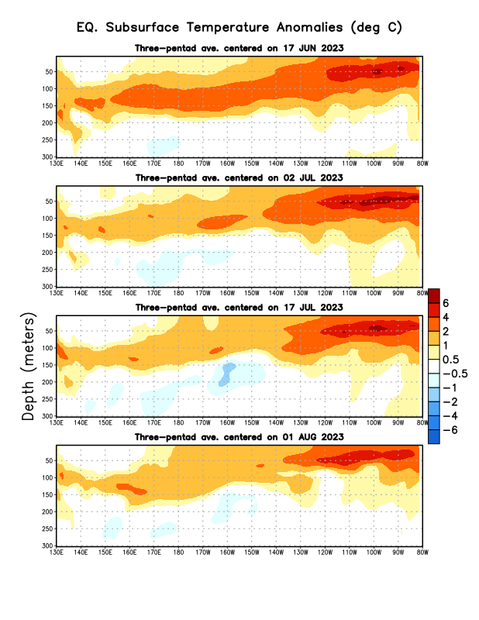
Sub-Surface Temperature Departures in the Equatorial Pacific
Overall, the subsurface Ocean Temps are less warmer than 2 months ago!!
Will the El Nino come/happen as we think it is going to happen?
?
Most recent pentad analysis

Slide 26
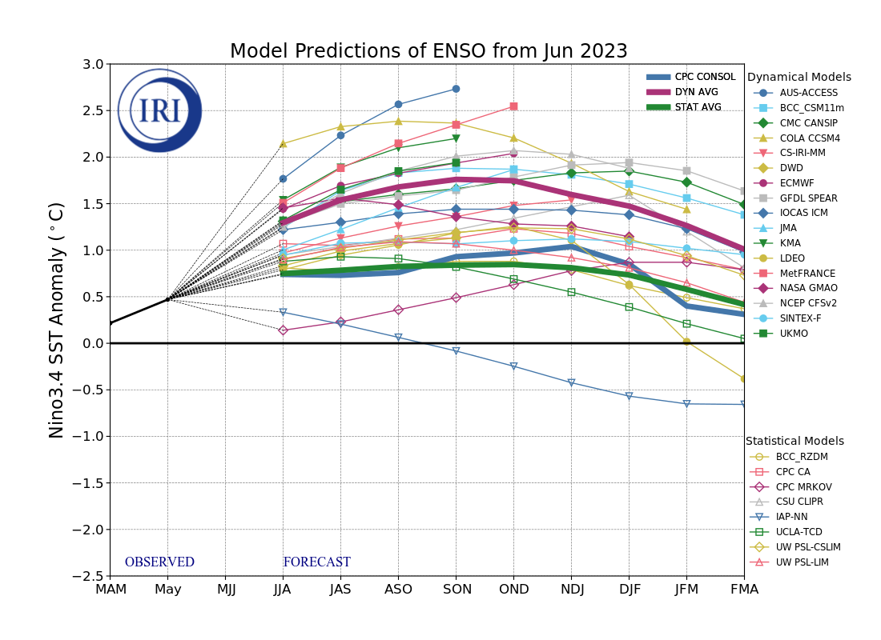
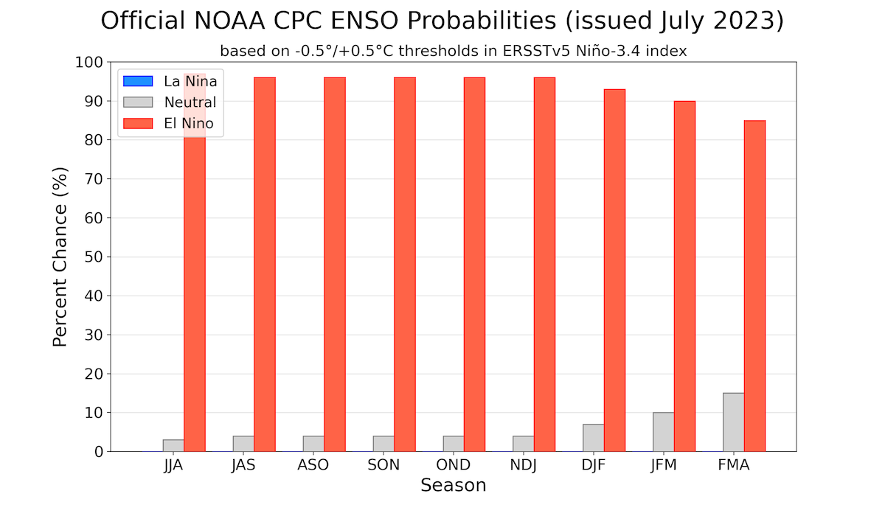
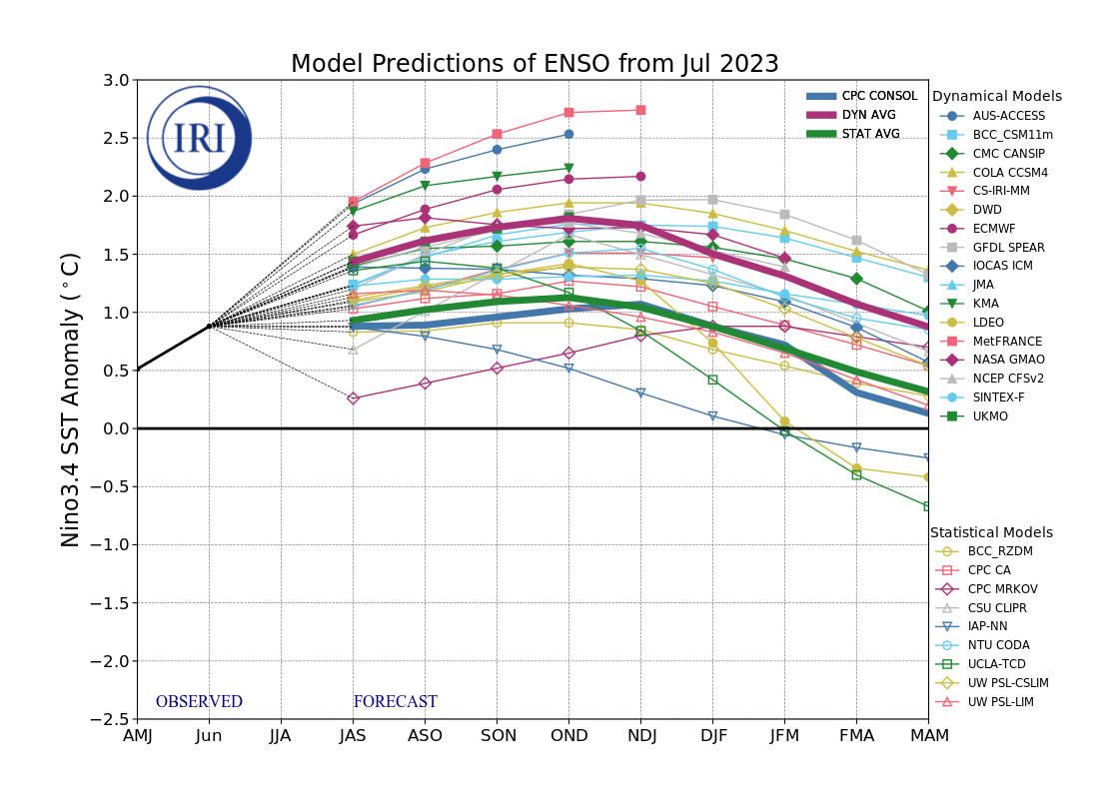
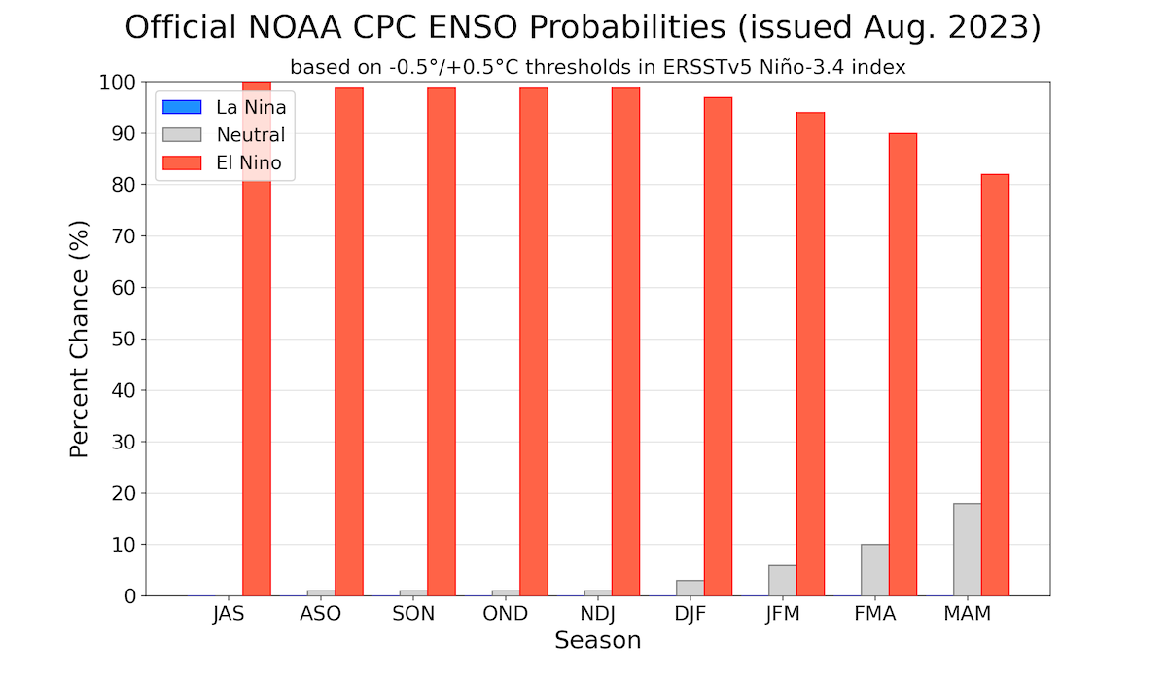
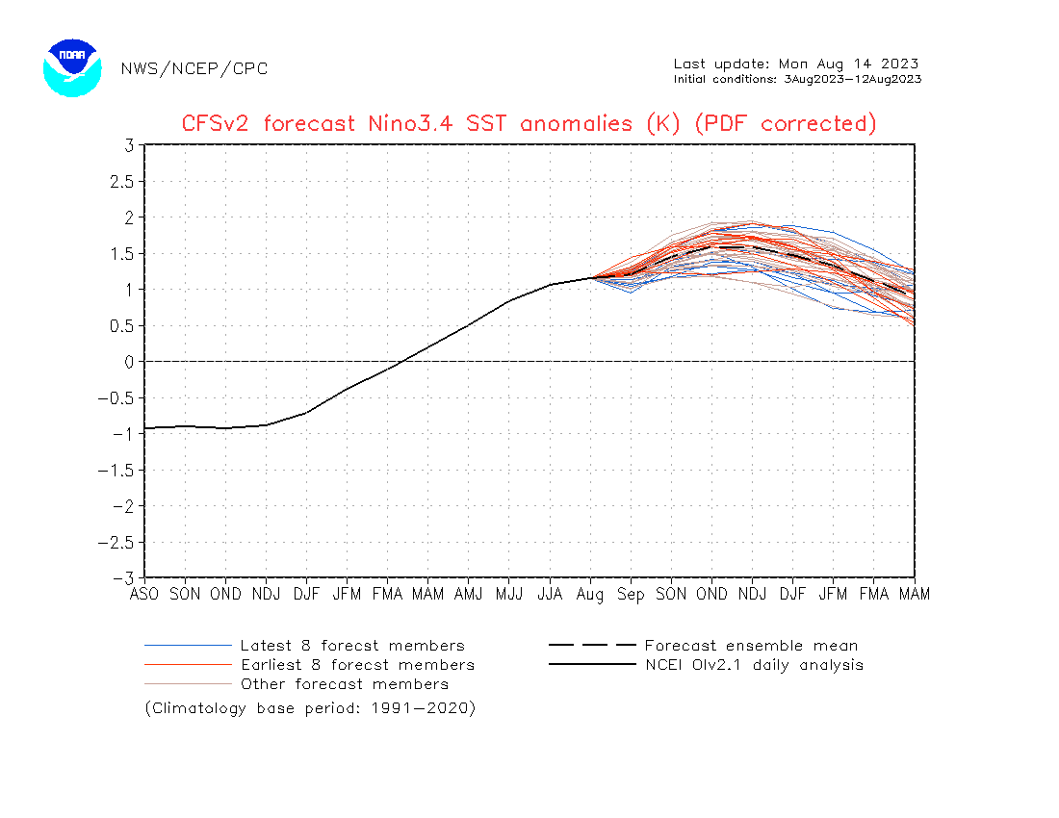
Official ENSO Forecasts
July CPC forecast
August CPC forecast
Latest ensemble members (blue!) show are less bullish

Slide 27
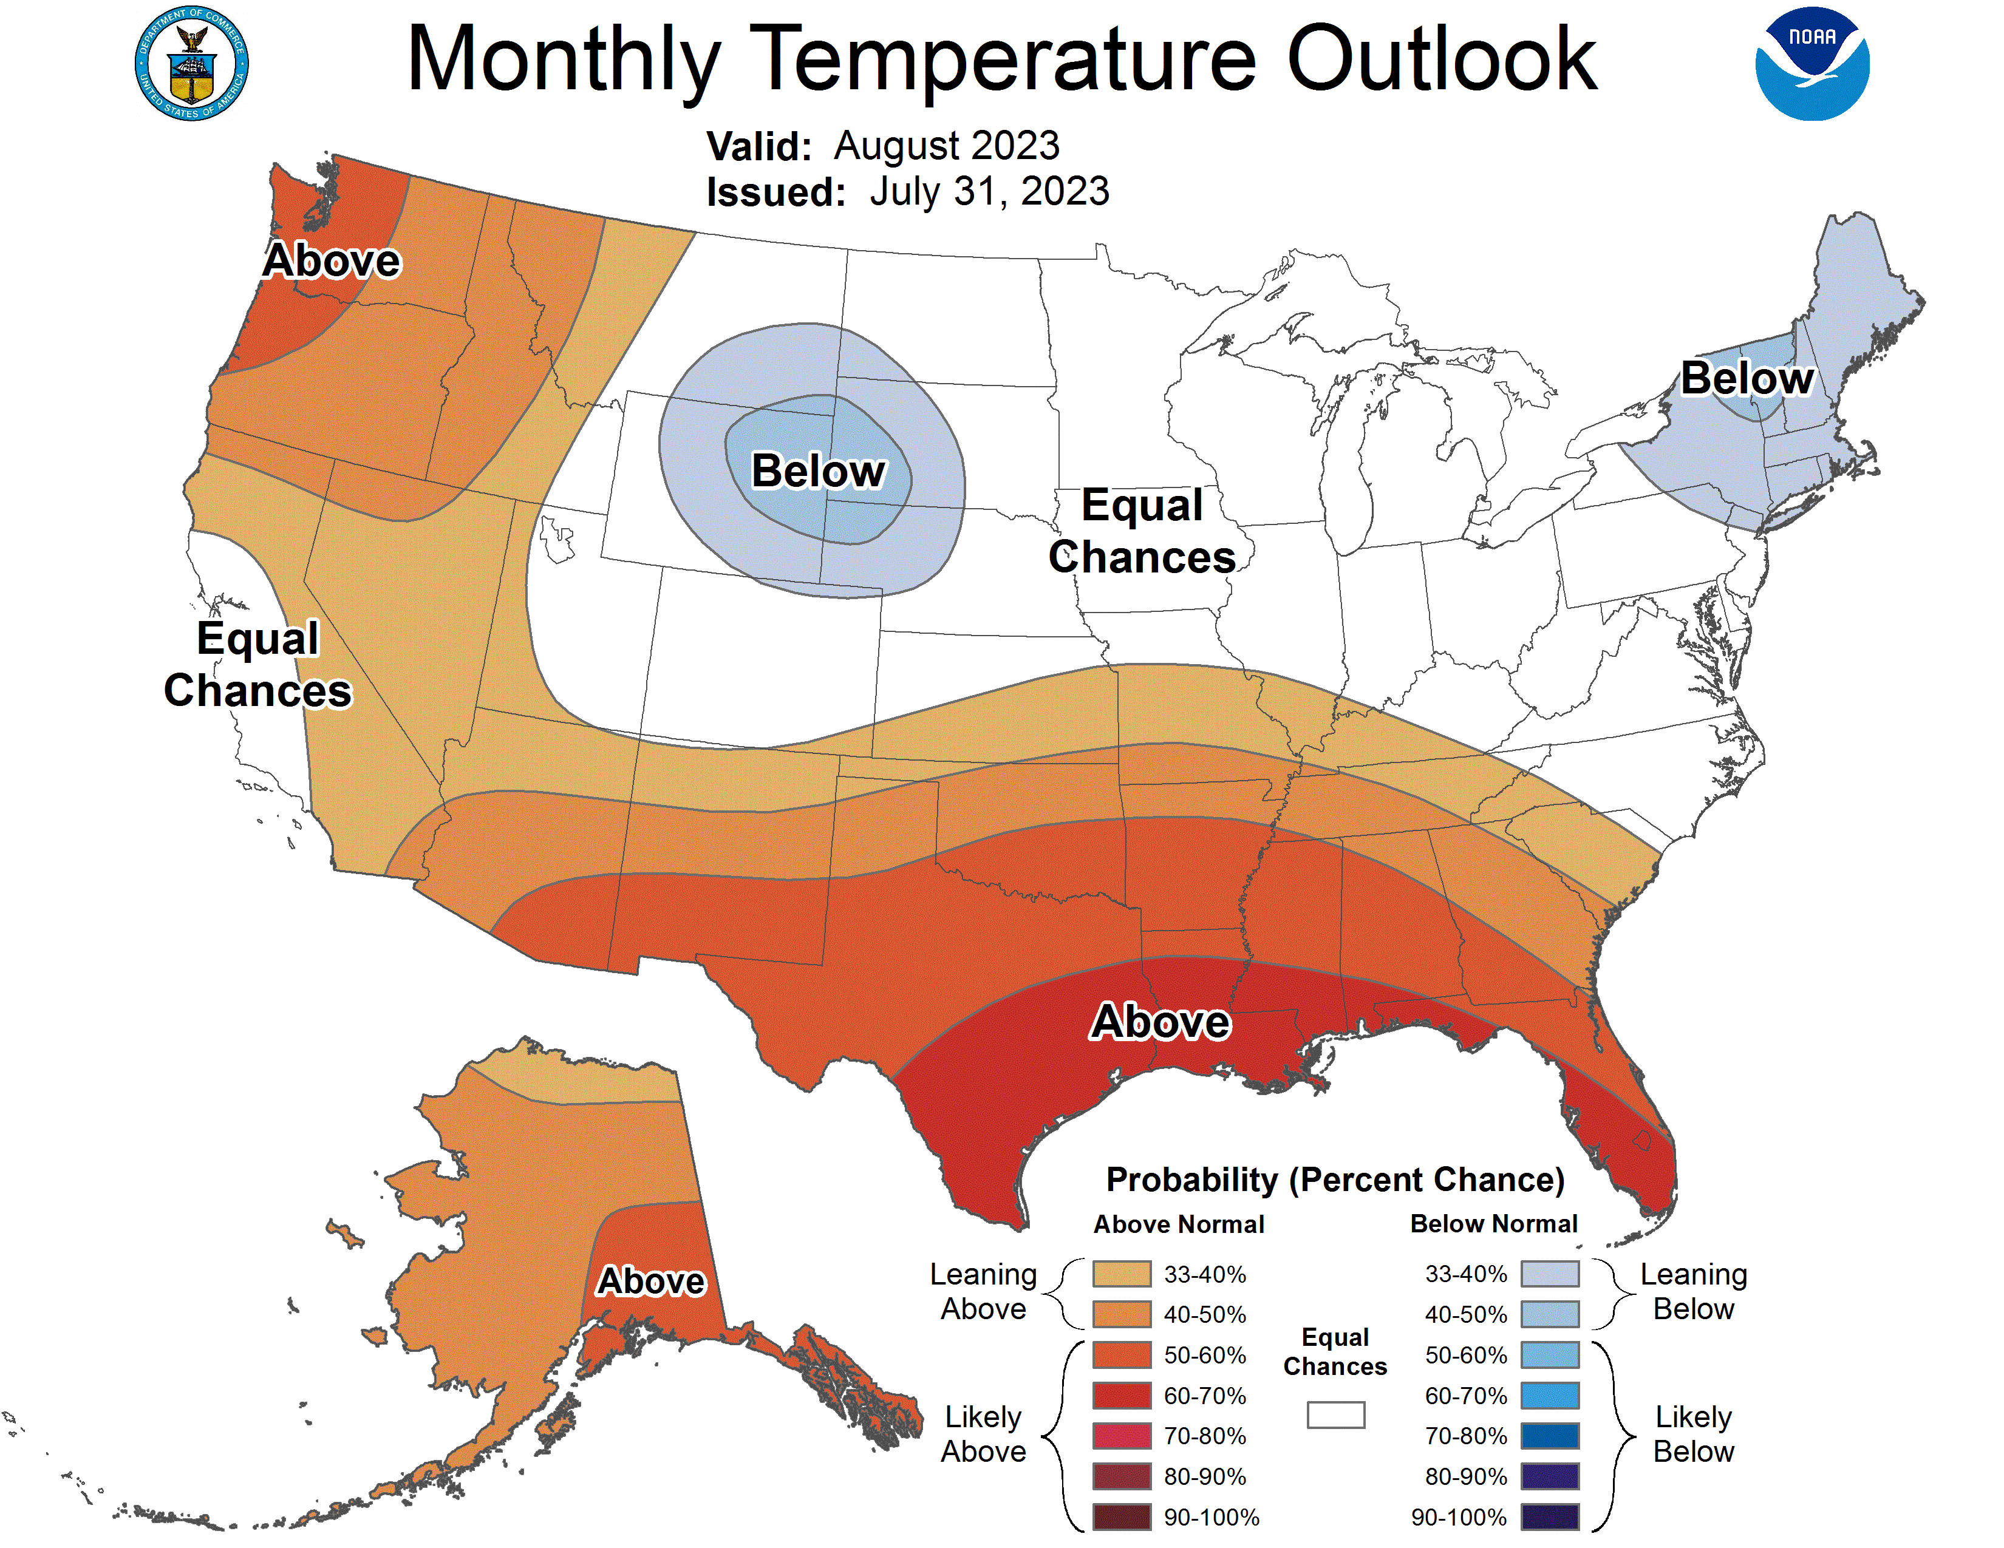
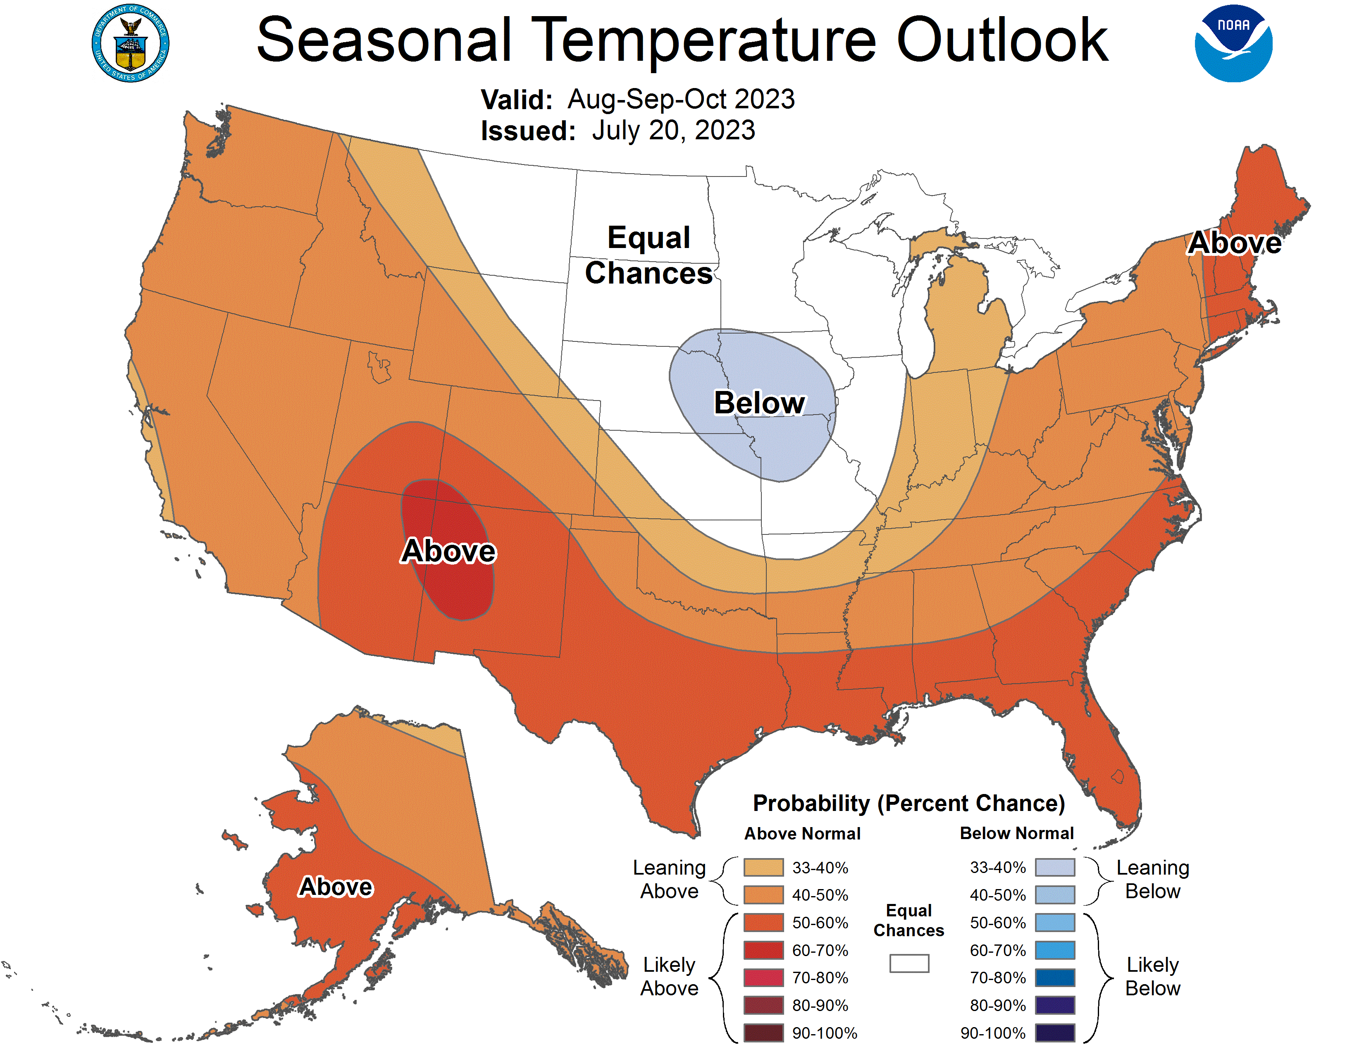
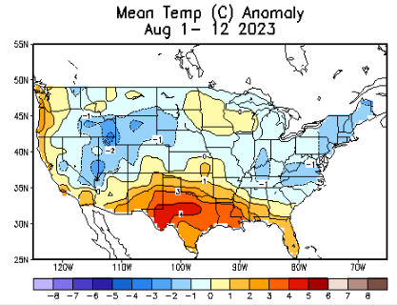
Previous (Last Month’s)
CPC’s official
Temperature OUTLOOK for Monthly (Aug)/Seasonal (ASO)
Monthly P/T forecasts verified at mid-month are generally good! Becoz of good skill upto 2 wks.
Released July 20th
Observed so far this month!! ☺
E/W

Slide 28
Previous(Last month)
CPC’s official
Precipitation OUTLOOK for Monthly (Aug)/Seasonal (ASO)
Monthly P/T forecasts verified at mid-month are generally good! (??) Becoz of good skill upto 2 wks.
Released June 15th
Observed so far this month!! ☺

Slide 29
NCEP/WPC Next 7 days QPF (Quantitative Precipitation Forecast)
GFS Model Guidance for the
next 16 days.
Finally some rains in the southwest monsoon area!
But not much in western/central TX., or potions of interior southeast.
FL is lucky!

Slide 30
From 3 Models average Precip forecast (made 13/14 Aug) for next 30 days.
The 3Models are: CFSV2, GEFS, & EC

Slide 31
From 3 Models average Precip forecast (made 13/14 Aug) for next 30 days.
20
40

Slide 32
From 3 Models average Precip forecast (made yesterday 13/14 Aug) for next 30 days.

Slide 33
From 3 Models average Precip forecast (made yesterday 13/14 Aug) for next 30 days.

Slide 34
From 3 Models average Precip forecast (made yesterday 13/14 Aug) for next 30 days.

Slide 35
Week-4 Soil Moisture Percentile (SMP) Fcst based on VIC model forced with ECMWF-extended precipitation forecast!
This month
Now: Based on Yesterday’s IC
While not exactly mapping 1-to-1 with the drought areas, this map is generally connected to the drought areas in some ways, as it is related to soil moisture!!
Above Slide from last month
(From Drs. Li Xu and Yun Fan) More detail at From: https://www.cpc.ncep.noaa.gov/products/people/lxu/flashd/flash_prediction.html#10

Slide 36
NMME* T (left) & P (right) Ens.Mean forecasts for
Sep
SON
NMME* : North American Multi Models Ensemble

Slide 37
Agreement/Disagreement among the various NMME models’ SON seasonal Precip. Forecast.
??

Slide 38
(From NMME) compared with this month(foreground, red border)
Why is there so fewer hatched areas in SPI6 fcst from NMME models’ based fcst this month as compared to last month (left 2 columns) ? Fcsts more confident now?
Forecast uncertain in Hatched areas.
These maps are based on NMME models’ precip forecast uncertainty/certainty (among ensemble members) over the next 3 months
SPI6 Fcst made from last month I.C.
SPI6 & SPI12 Fcst made from this month

Slide 39
http://drought.geo.msu.edu/research/forecast/smi.monthly.php
Predicted Monthly Soil Moisture Percentile
Latest Initial Conditions:
DATA not available !
CPC’s soil moisture percentile – Leaky bucket Model
The inter quartile range suggest greater uncertainty about the forecast in these shaded regions in the ESP based forecast!

Slide 40
BONUS Topic: Discussion continues!! Explanation for the multiyear DROUGHT in the Southwest (CA/AZ/NM/NV/UT/CO & vicinity)!!
More La Nina’s lately ?
More frequent La Ninas lately ?
YES!! The stats in the table below (bottom left) are from the Official CPC ENSO declarations page/table!
Compared to other regions of the globe, the SST warming/trend in the central eq. Pacific (Nino 3.4) is relatively much small. (See Fig. above) – Why is this ?
Does nature try to compensate for the warming else/everywhere by producing more La Ninas in the equatorial Pacific? - Just my observation from data! Let’s check !!!
Since the 1997 monster El Nino (stronger than the famous 1982/83 event), just a quick count of CPC’s Nino 3.4 index++ values for the three month overlapping seasons, (Data at CPC site only available only from 1950!)
(27 years) (47 years) (74 years)
1997-2023 1950-1996 1950-2023
La Nina(DJF) 12 16 28
El Nino(DJF) 8 17 25
La Nina(all 3mos) 119 150 269
El Nino(all 3mos) 77 166 243
(Overlapping 3month seasons)
Look at Ratios of La Ninas (vs El Ninos) in the shorter
recent (27 yr) period vs the longer (47 yr) earlier period!!
Compare the ratios of La Nina to El Nino in the squared boxes.
***Analysis of CPC’s official Nino 3.4 index data over the last 70 years shows that the more frequent La Ninas in recent decades contributed to less rainfall in the southwest (See La Nina precip composites!, slide#13) and hence the ongoing long term drought in the Southwest!! Hence the long term southwest drought is unlikely to go away any time soon***
++ Barnston, Chelliah and Goldenberg (1997):Documentation of a highly ENSO‐related SST region in the equatorial pacific, Atmosphere-Ocean Volume 35, 1997. https://doi.org/10.1080/07055900.1997.9649597
*** The strong/weak annual monsoon rains in the southwest is a minor modulator riding on this bigger/longer-term signal. ***

Slide 41
Summary
Current Drought conditions:
Towards the end of last year 2022, until December or so, severe drought conditions (both short and long term) remained in the west, mild drought conditions expanded in to portions of the eastern half of the US also, covering most of the country with very high % areas of the entire US affected by drought. The situation now is now drastically different due to the extraordinary winter season.
The past winter/early spring rainy season in CA and the west coast states, wiped out not only the S-term drought but also the L-term drought in most areas. Water levels in almost all CA reservoirs are now ABOVE their normal levels. However, the water storage levels in the huge Lakes Powell and Lake Mead in NV continue to be historically low, & decade(s) long hydrological drought still lingers. Recharge into these 2 reservoirs from subsurface stream flows has been severely impacted.
S/L term droughts still remain in parts of northwestern states of WA/OR/ID/MT. Severe drought is entrenched in eastern and central areas of NE/KS/MO. Moderate/Severe drought also appears in MN/WI/IA/IL/IN. The relatively poor monsoon this year in the southwestern states has created short term drought conditions in AZ/NM and in parts of NV/UT/CO.
Area covered by >D1 category drought is now ~ 30%, slightly higher than last month(~25%), mainly due to the poor monsoon, so far. Drought in TX has also spread across the state extending into LA. The eastern one third of US is almost drought free!
The recent drought/heavy winds related fires, and consequent loss of lives and property in Maui is sad and unfortunate! The whole system is under review. In the last few months, we have introduced and show here, an exptl. version of an Objective US Drought Indicator based on AI methods, that runs daily at CPC.
Current ENSO status and forecast: El Niño is anticipated to continue through the Northern Hemisphere winter (with greater than 95% chance through December 2023 -February 2024).
Prediction: Even though the Nino 3.4 SST index is at or above the requisite 0.5 deg. C and we are officially in an El Nino, the accompanying ocean-atmosphere coupling is slow to evolve and catch up, so much so that the recent August release of the updated Atlantic Hurricane Outlook, revised its hurricane activity upward. While the official forecast for El Nino during the SON forecast season (and through the upcoming winter) is at near 100% probability, is not clear if one can expect the same canonical ENSO impacts around the globe, and especially over the United States, if the more recent ENSO events and their impacts serve as any example. Moreover SON is the transition season, which is a difficult season to forecast in its own right, especially when the teleconnections are generally not as strong as during winter.
The NMME model’s precip guidance for the forecast season SON suggests below normal rainfall amounts for the Pacific Northwest and the monsoon southwest regions, and above normal rainfall amounts for pretty much all across the eastern coastal states and adjacent areas. Given the rainfall climatology, the next one month’s rainfall forecast by the three models, ENSO composites, NMME forecasts for the SON season, the short term drought in the southwest is likely to persist, and may even worsen, in the vicinity of the four corner states, and in large parts of AZ/NM. The drought in the Pacific NW will also persist but conditions will improve, as the season includes month of November. Drought in southern/eastern Texas and LA will likely improve. Drought in/around NE/KS/MO will also improve. Drought around the Great Lakes region will go away.
No development of drought is expected all along the Atlantic coastal states/region including FL, where the confidence is less.

