Slide 1
Drought Outlook Support Briefing (formerly Drought Outlook Discussion) December 2018
Climate Prediction Center/NCEP/NOAA
http://www.cpc.ncep.noaa.gov/products/Drought
Phone: 1-877-680-3341
Pwd: 858747#

Slide 2
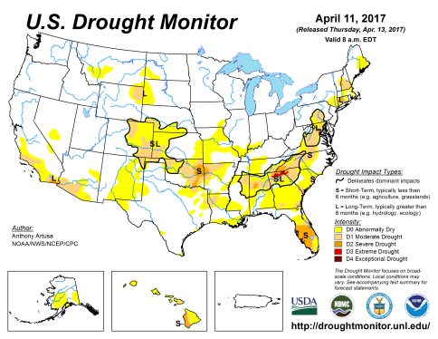
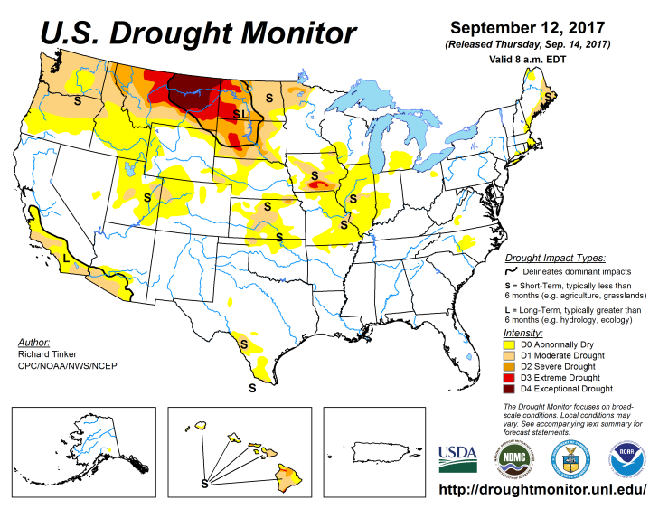
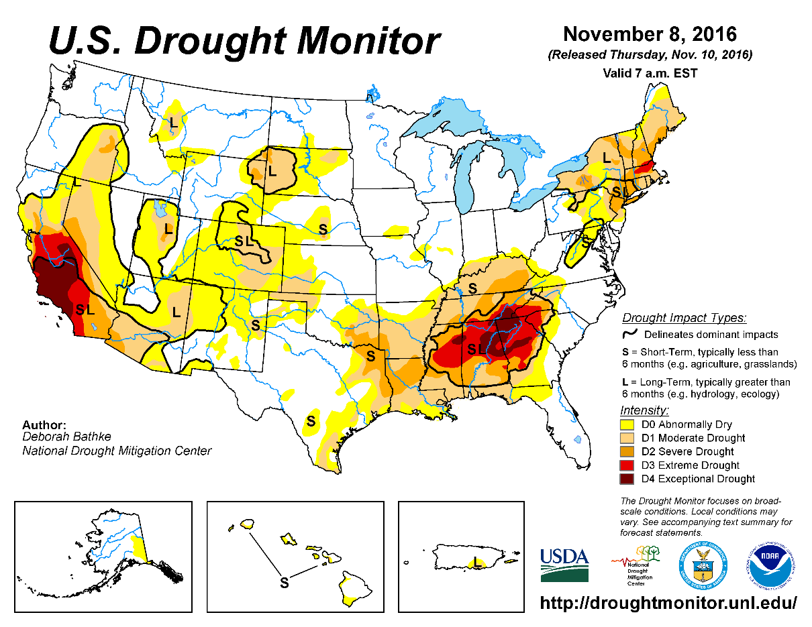
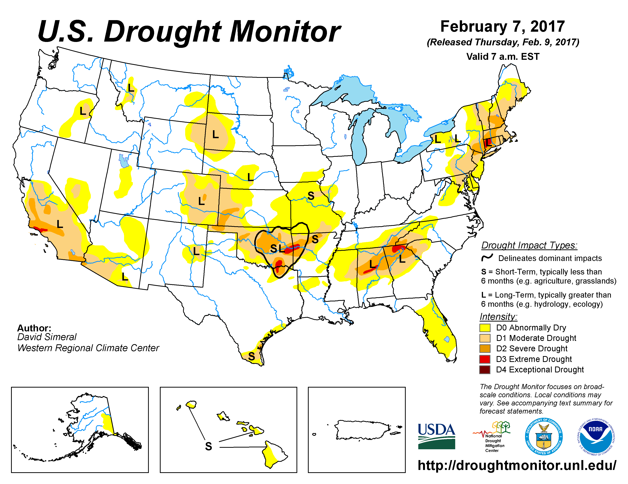
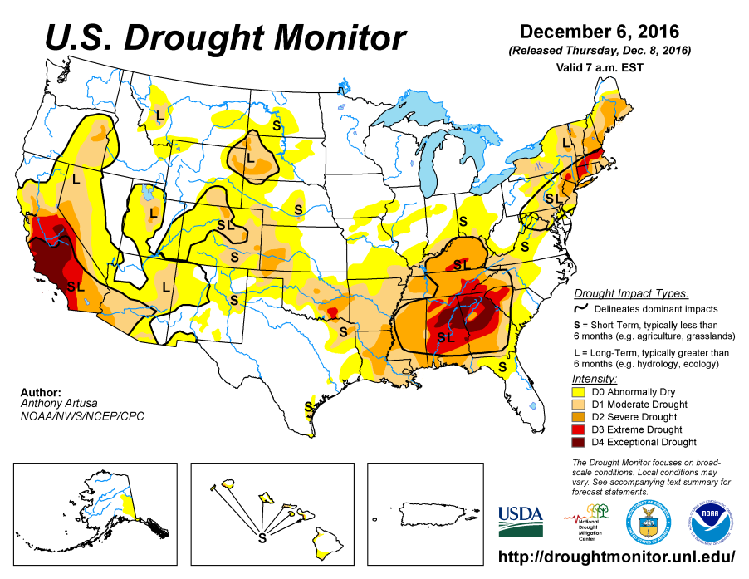
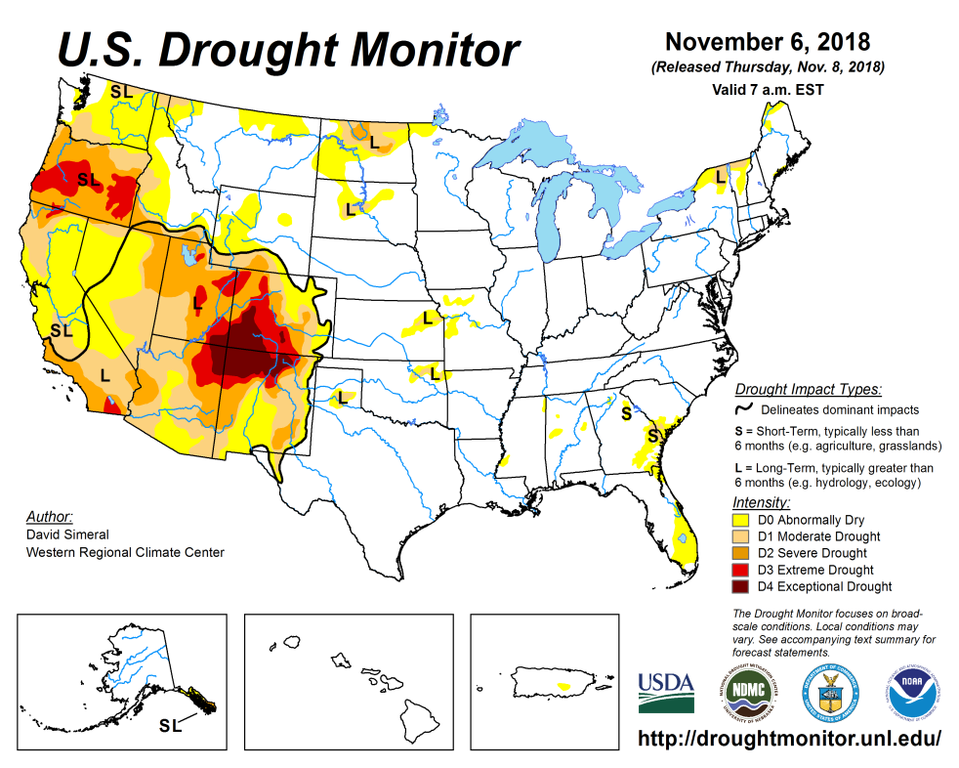
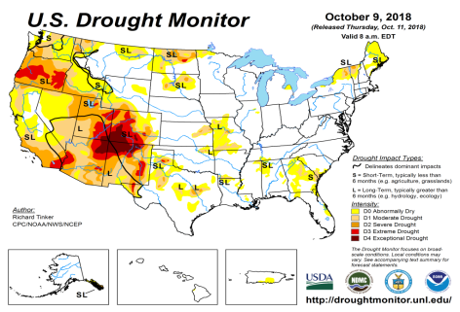
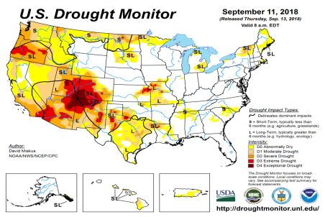
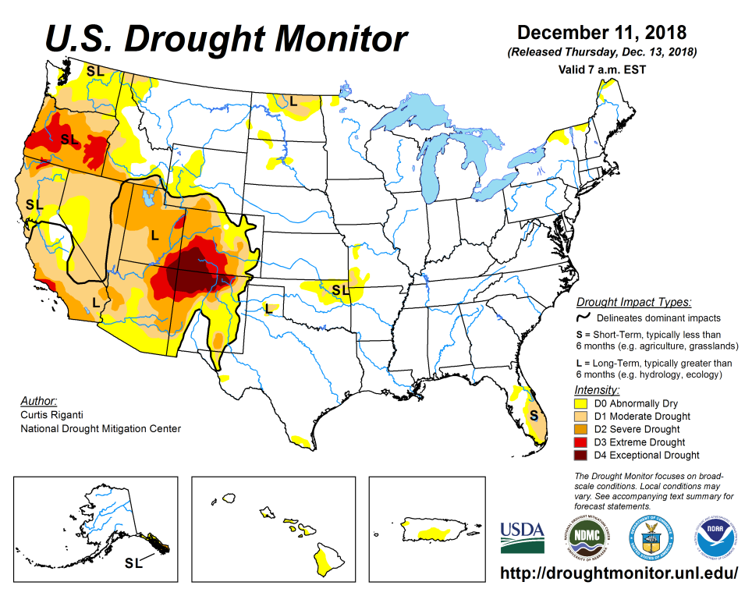
Drought Monitor
November
October
Previous
September
According to the US DM, there is pretty much “no drought to speak of” east of, and including, Texas over the eastern two thirds of the country. However, in the southwest, the severe drought in the four corners area in the states of UT/AZ/CO/NM is pretty much stuck there, with not much improvement over the last many seasons.
But the more recent developing drought in Pacific Northwest particularly in OR, has slightly expanded in recent months.
The drought in Northern Plains, which started in May 2017, appears to be finally subsiding, with very little remaining!
Latest/Recent

Slide 3
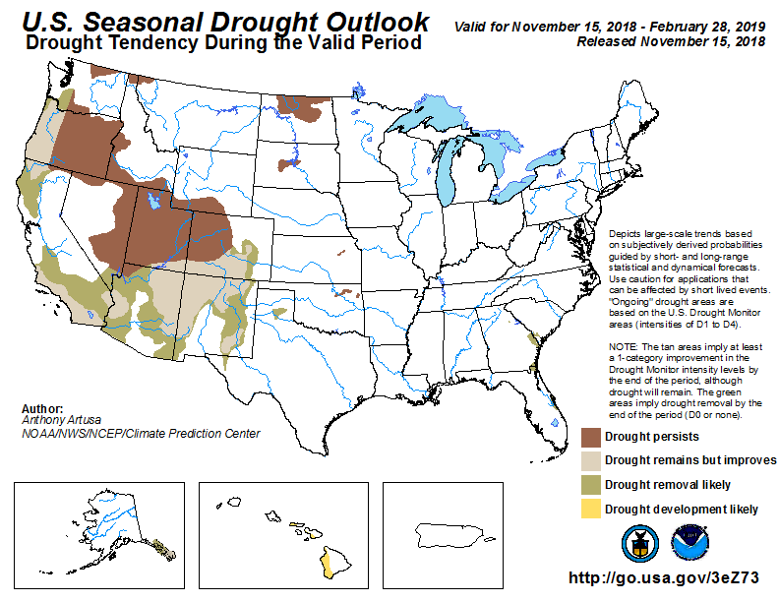
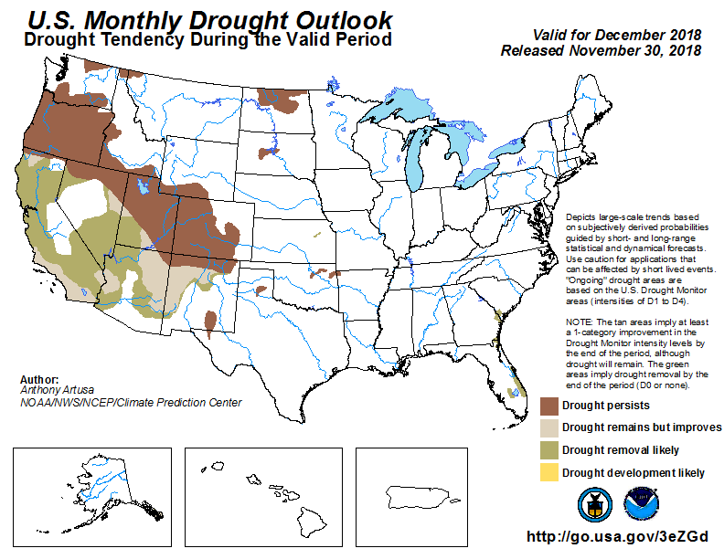
(Prev) Seasonal/Monthly Drought outlooks
(New Seasonal Drought Outlook to be released tomorrow!)
Seasonal Outlook (Mid November 2018 - February 2019)
issued 11/15/18
Monthly outlook
(for December 2018)
issued 11/30/18
The four state corners area in the west continues remain in major drought (see previous slide), in spite of the forecast, since rainfall deficits in these regions have lasted longer (later slides!!).
Much of the “Drought removal likely” forecast did not pan out!!

Slide 4
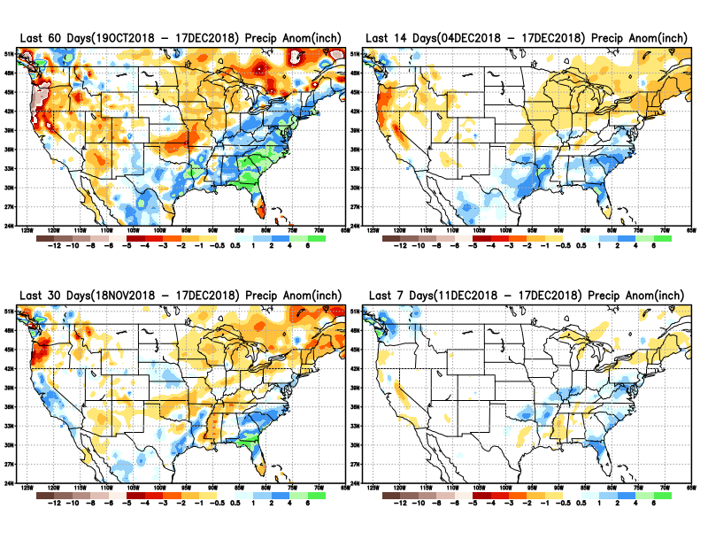
Precipitation ANOM during last 7, 14, 30, & 60 days.
Rainfall, the
East – West
Contrast!!
Overall,
Surplus in the east!
Deficit in
the west!

Slide 5
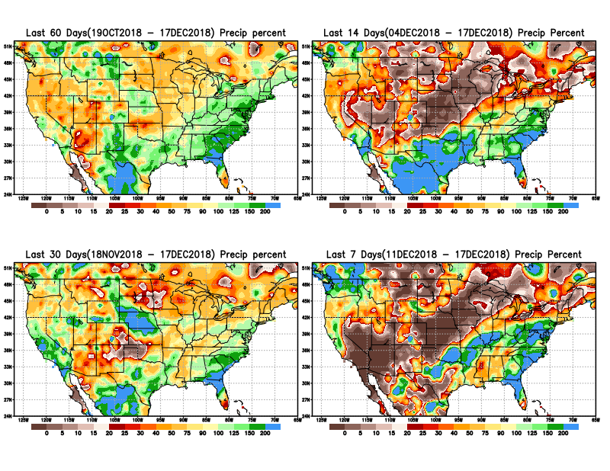
Precipitation Percent during last 7, 14, 30, & 60 days.
NOW !
The impact of the relative rainfall shortfall area, greatly matters only with respect to the rainfall season/extent in that region

Slide 6
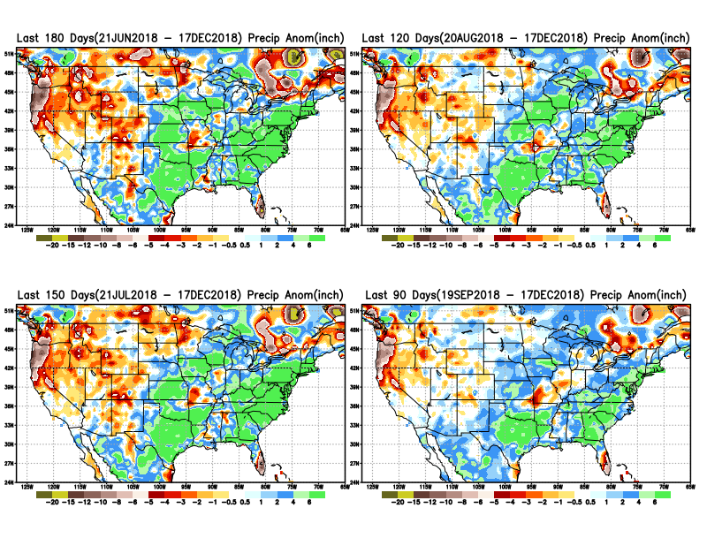
Total precipitation ANOM during last 3, 4, 5, and 6 months.
6 M
4 M
5 M
3 M

Slide 7
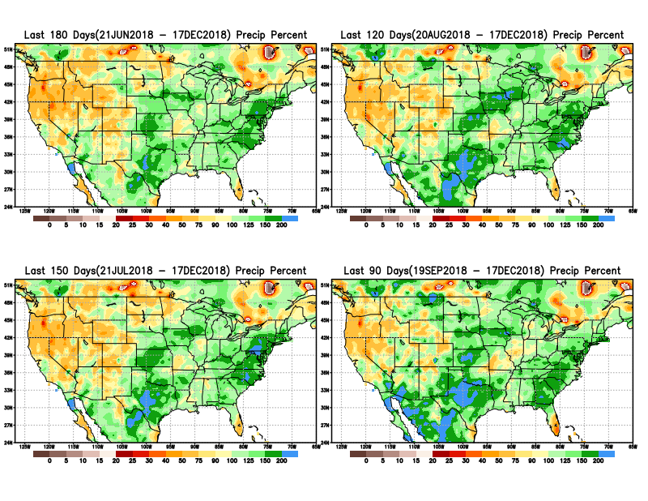
Total precipitation Percent during last 3, 4, 5, and 6 months.
6 M
4 M
5 M
3 M

Slide 8
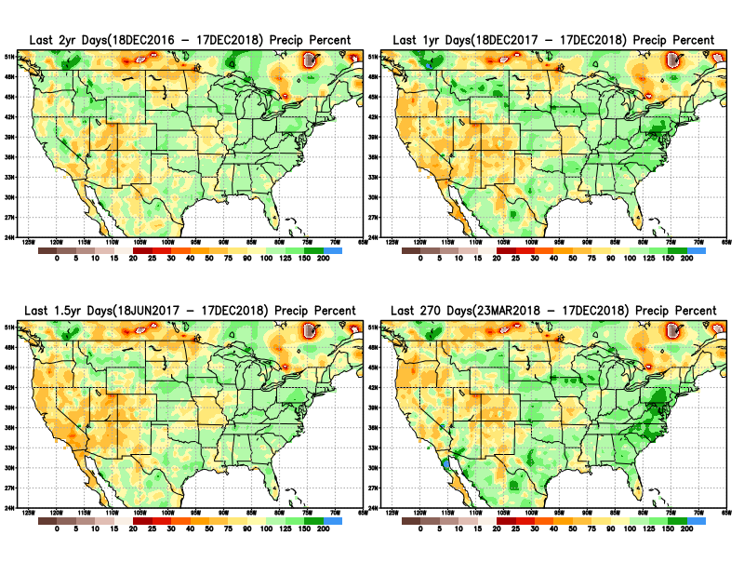
Total precipitation Percent during last 9 months, 1 yr, 1.5yrs, & 2 yrs.
2 Y
1 Y
Rainfall Data issues? Few observations, rugged terrain, interpolation problems!!
The deficits in UT/AZ, southern CA, and parts of NM/CO are long term – possibly a consequence of the two back to back La Nina’s! and even earlier La Ninas!!
1.5 Y
9 M

Slide 9
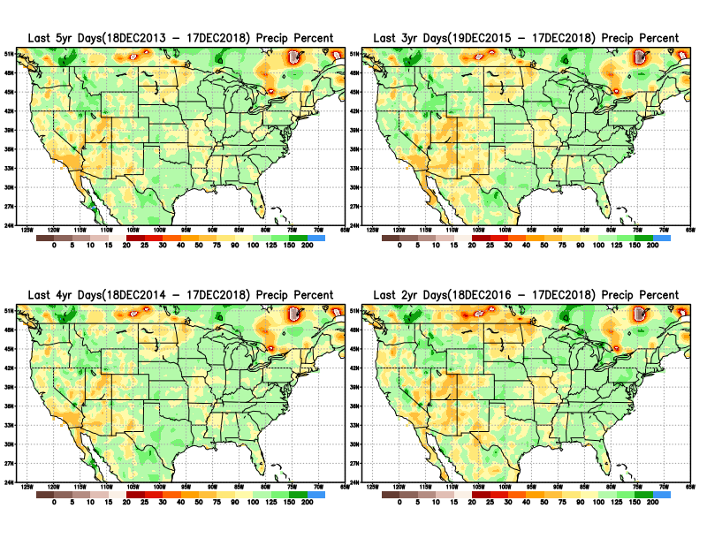
Total precipitation Percent during last 2 yrs, 3 yrs, 4 yrs, & 5 yrs.
5 Y
3 Y
Still longer term rainfall deficit variability in play? Especially in the southwest!
4 Y
2 Y
Quality of data/problem in the Northern High Plains area, especially in interpolation of sparse data in the rugged topography region!

Slide 10
Rainy (3-month)Season across the US

Slide 11
Upcoming 3-m season’s
Rainy areas!
Adapted from Rich Tinker.

Slide 12
Adapted from
Rich Tinker

Slide 13
EL NINO Precip COMPOSITES
DJF
MAM

Slide 14
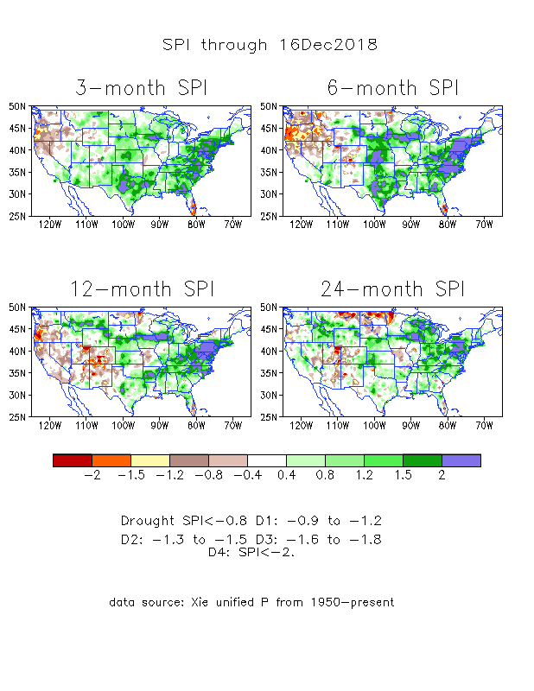
The Standardized Precipitation Index SPI (based on Observed P)
----- NOW
Very interesting graphic & details for the drought across the US based on the more generalized precip deficit/excess, the Standardized Precipitation Index (SPI).
The dark brown and red colors, indicating standardized precipitation deficits, in the various time periods, approximately correspond to the appropriate short/long term drought monitor regions and their intensities
In the short term (~3 mo-6mo), the drought in Pacific Northwest over Oregon, Northern CA looks bad. Fortunately, the wet season just started here.
In the longer term ~12m and longer, rainfall deficits remain in the Southwest

Slide 15
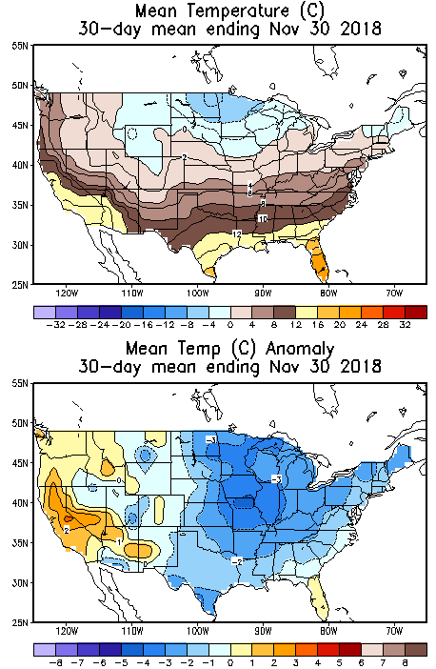
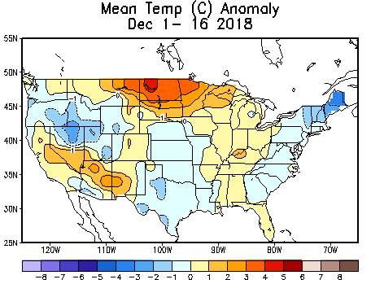
Recent US Temperatures
In November, much of the country has been relatively colder than normal, particularly the upper Midwest. Far southwest is warmer.
December so far is beginning to shape differently than November, with warmer than normal in the northern Plains.

Slide 16
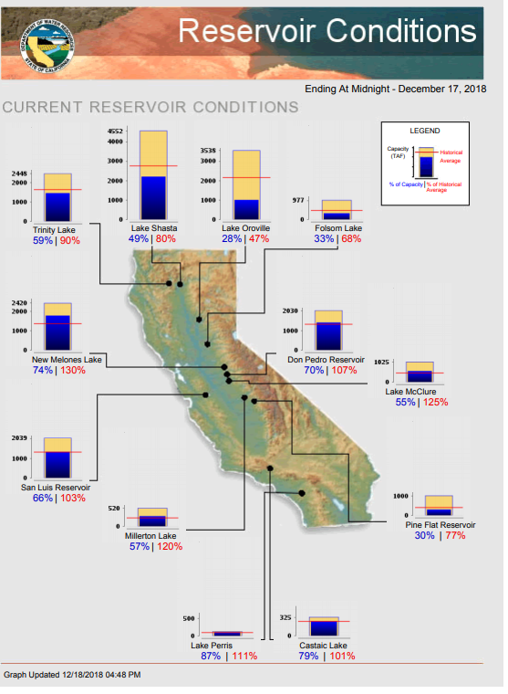
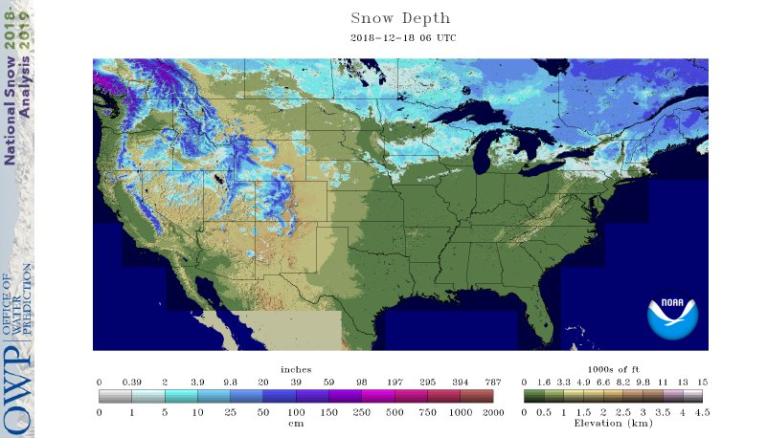
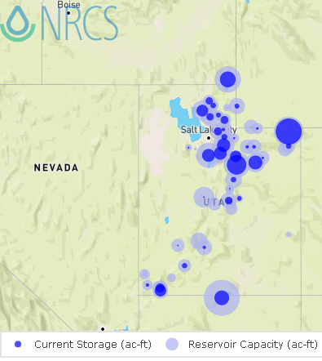
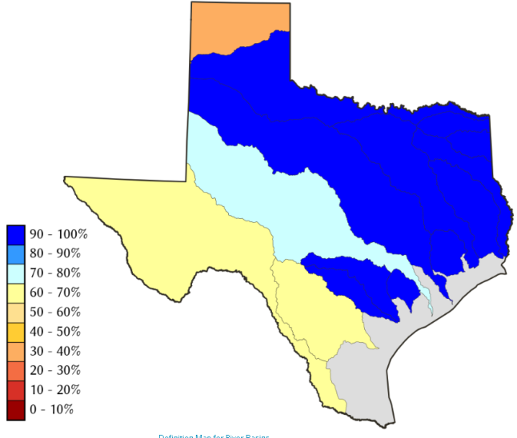
Water Reservoir Levels in some Western/Southern States! And Snow Depth!!
Northern CA reservoirs beginning to show
Weakness, but rainy season coming up!
Reservoir Storage Summary for River Basins
TX
2018-12-17
UT
https://fsapps.nwcg.gov/afm/index.php

Slide 17
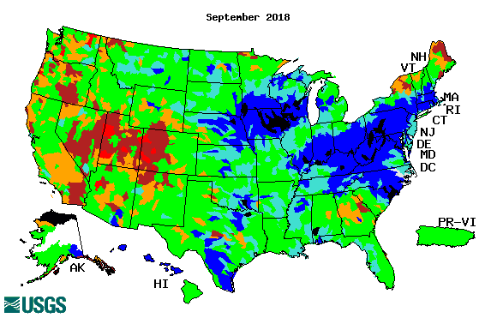
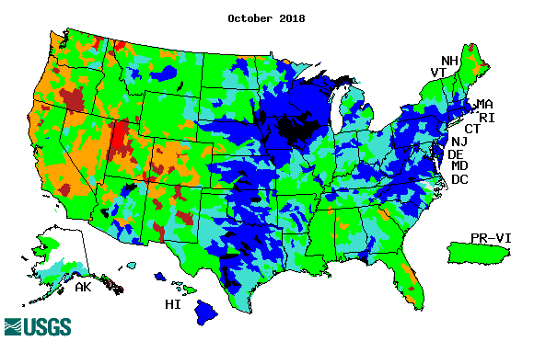
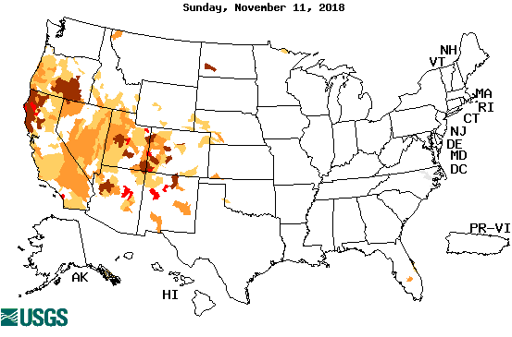
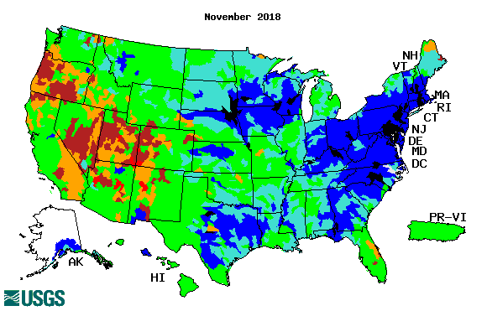
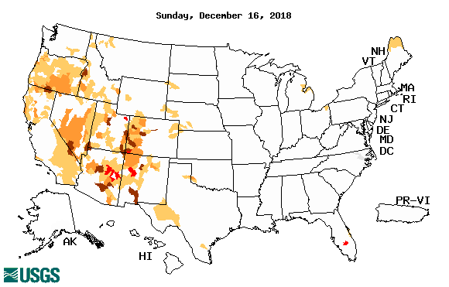
Streamflow (USGS)
Streamflow very good in Texas & eastward.!
In the west, it is generally below and much below normal, but back and forth!
Oregon, worse now in recent months!
Map shows only below normal 7-day average streamflow compared to historical streamflow for the day of year.
One month ago (left) &
Now (below)
17

Slide 18
EL NIÑO/SOUTHERN OSCILLATION (ENSO)
DIAGNOSTIC DISCUSSION
issued by CLIMATE PREDICTION CENTER/NCEP/NWS and the International Research Institute for Climate and Society
17 December 2018
ENSO Alert System Status: El Nino Watch !!
Synopsis: ENSO-neutral conditions are present. Equatorial sea surface temperatures (SSTs) are above average across most of the Pacific Ocean. The patterns of convection and winds are mostly near average over the tropical Pacific. El Niño is expected to form and continue through the Northern Hemisphere winter 2018-19 (~90% chance) and through spring (~60% chance).

Slide 19
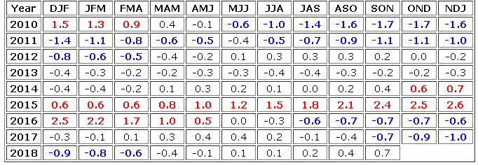
STILL In Neutral Conditions NOW! Expected to turn to
El Nino conditions soon, very soon!
http://www.cpc.ncep.noaa.gov/products/analysis_monitoring/ensostuff/ensoyears.shtml

Slide 20
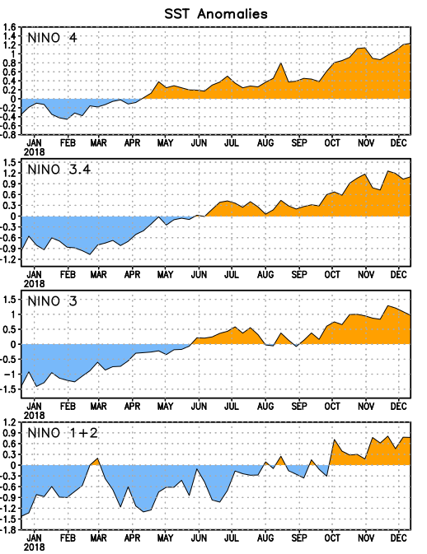
Latest values of SST indices in the various Nino Regions.
The sub surface heat anom continues to stay in the +ve territory! .
Relatively short lived!
Equatorial sea surface temperatures (SSTs) are above average across most of the Pacific Ocean.

Slide 21
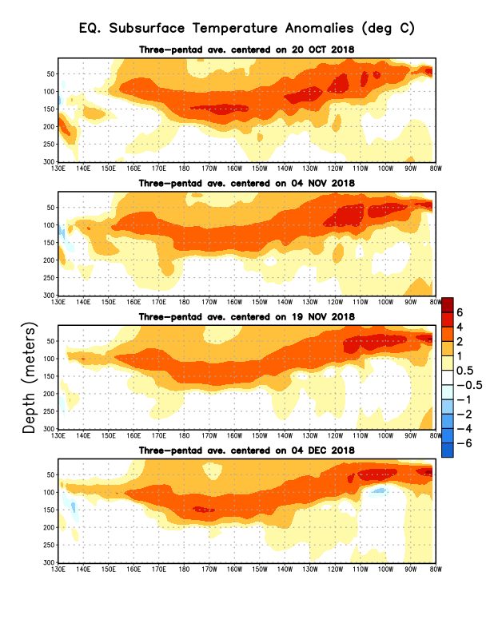
Sub-Surface Temperature Departures in the Equatorial Pacific
The equatorial sub surface temperatures in the tropical Pacific have gradually increased and expanded into the east Pacific.
El Nino is imminent!!

Slide 22
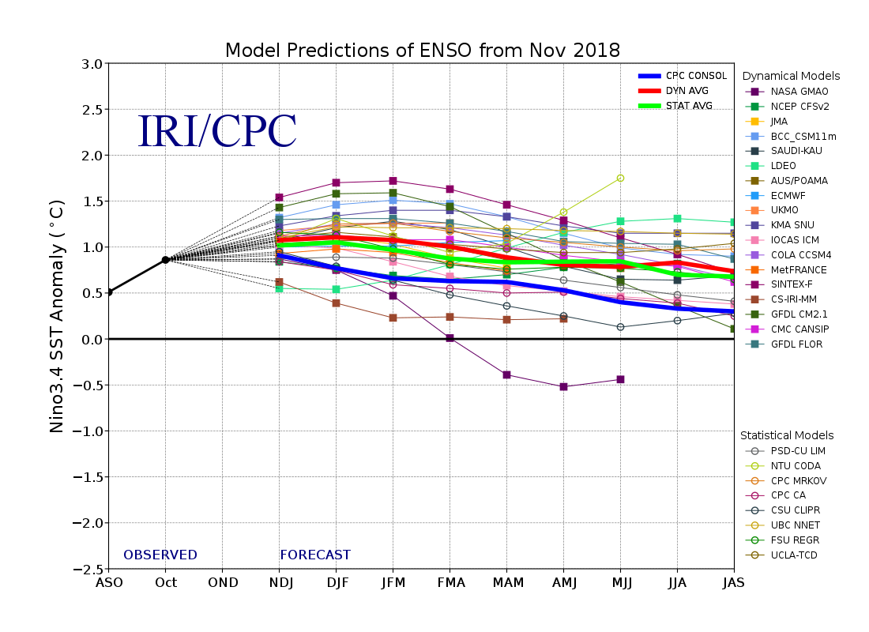
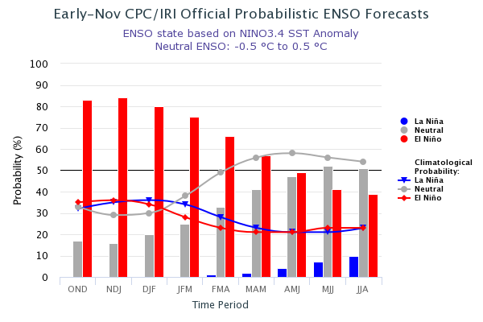
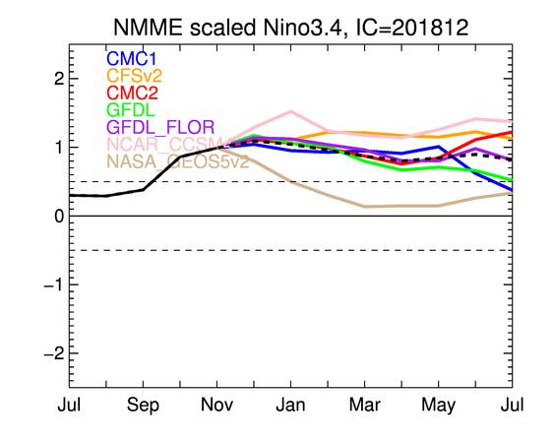
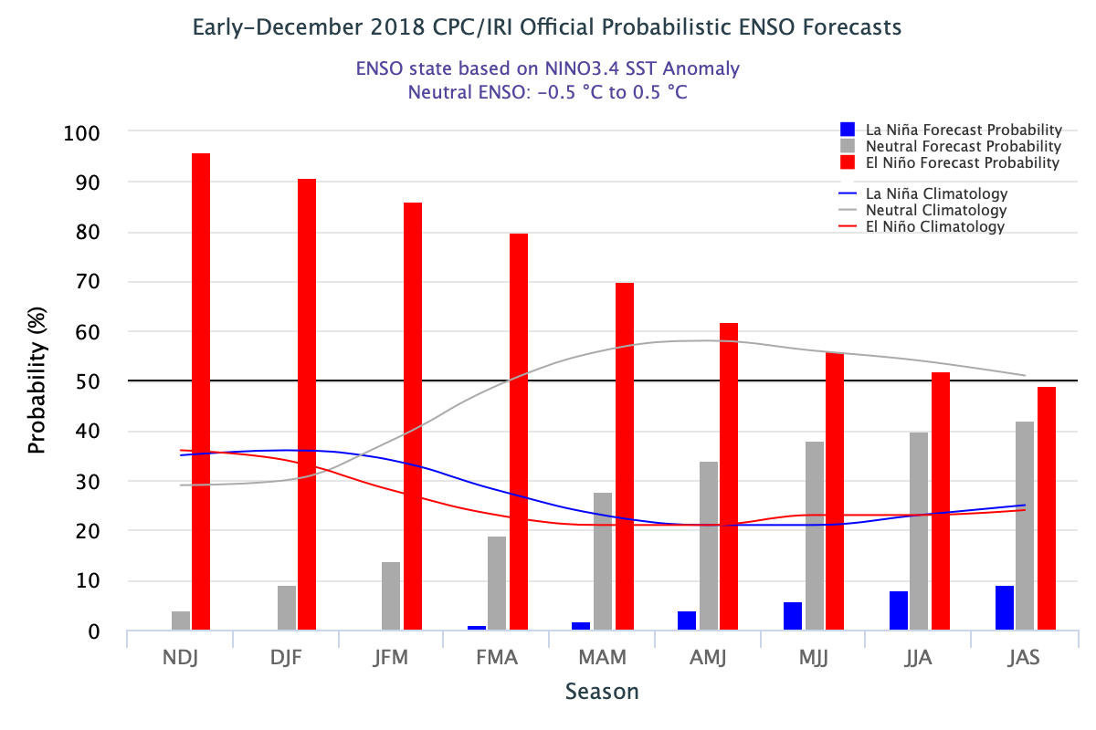
ENSO Forecasts
Early- November CPC/IRI forecast
NMME Models’ – Nino 3.4 forecasts
Early- December CPC/IRI forecast
Probability of developing El Nino in NH Winter DJF 2018/19 ~ 90 %. Increased from last month!

Slide 23
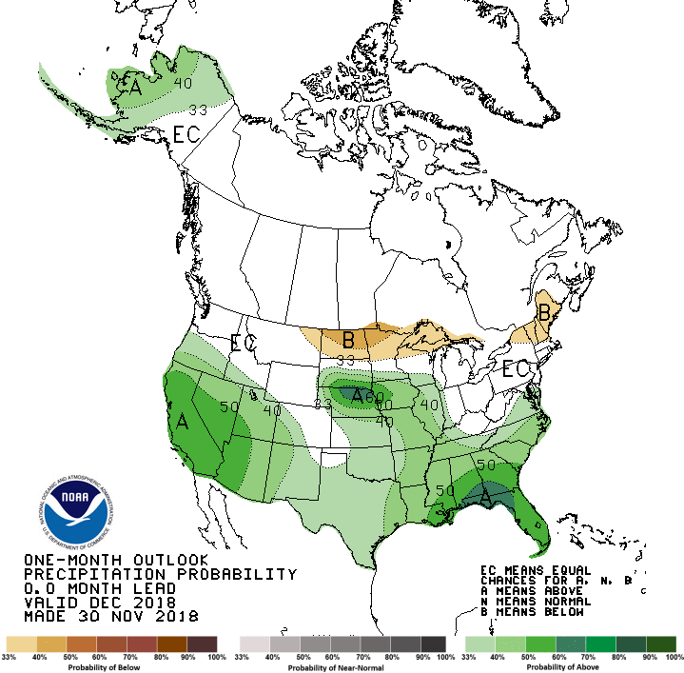
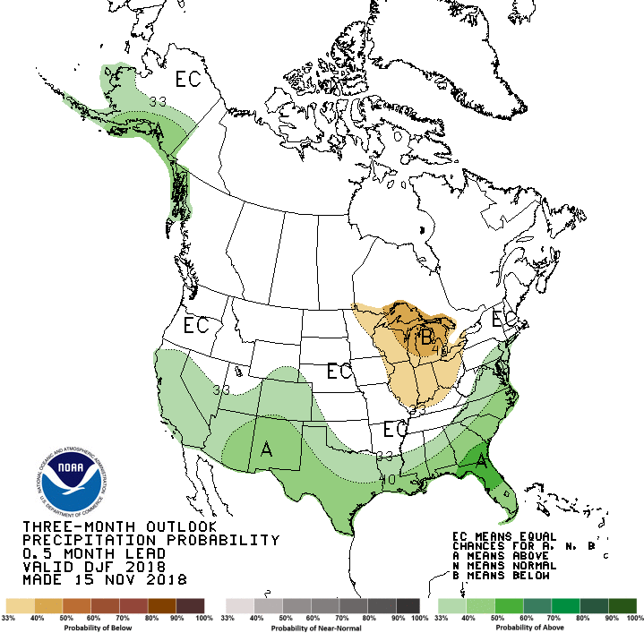
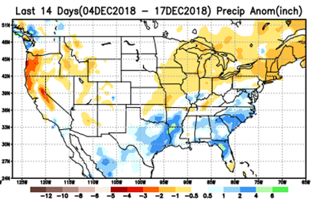
Previous(Last month)
CPC’s official Monthly (Dec)/Seasonal (DJF)
Precipitation outlook
Released November 30
Released Nov 15th
☺
Observed so far this month!!

Slide 24
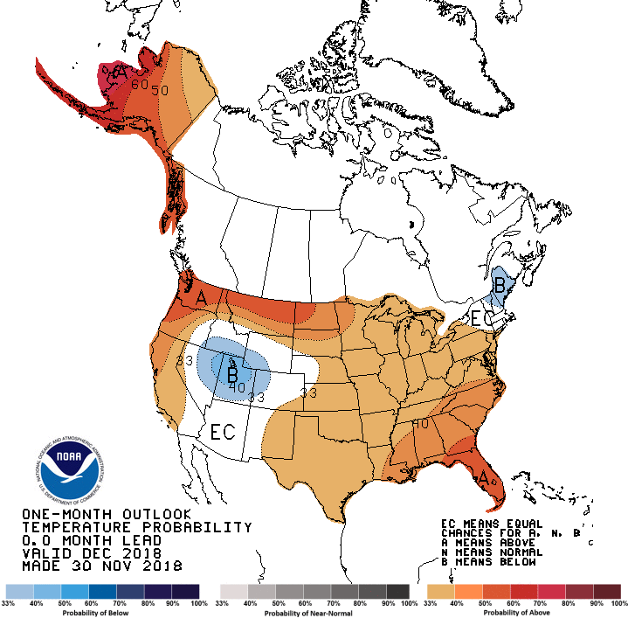
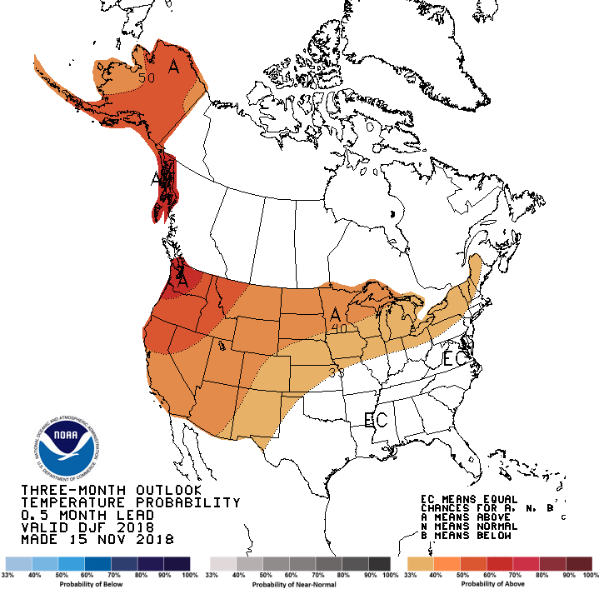
Previous CPC’s official Monthly (Dec)/Seasonal (DJF)
Temperature outlook
Made
Nov 30th
Observed so far this month!!
Made Nov 15th

Slide 25
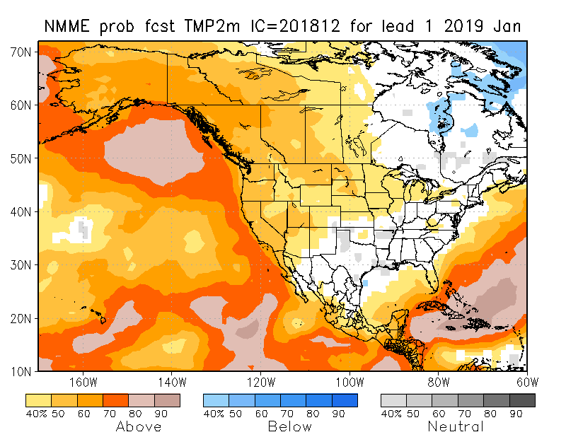
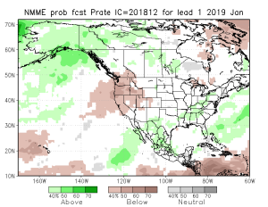
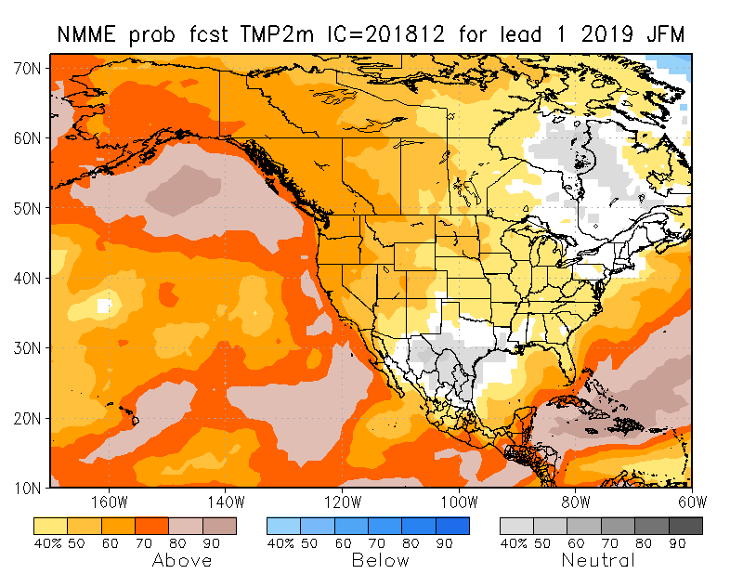
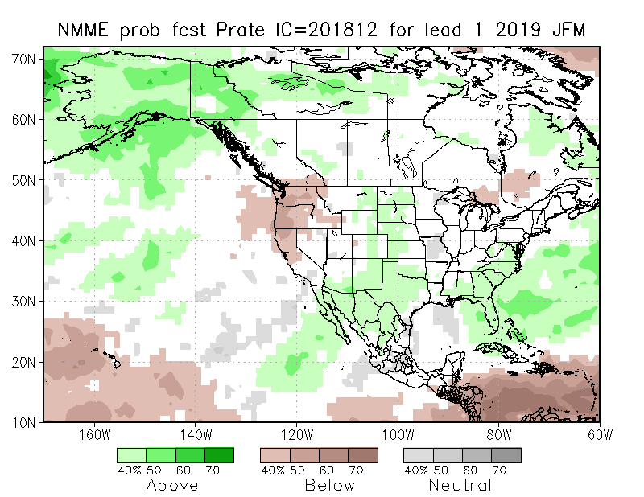
NMME T & P EnsMean forecasts
Jan
JFM
Forecast is based on developing El Nino conditions!!
Model forecast does not look like a canonical ElNino winter season precipitation forecast for California (Remember 2015/16 strongest El Nino!)

Slide 26
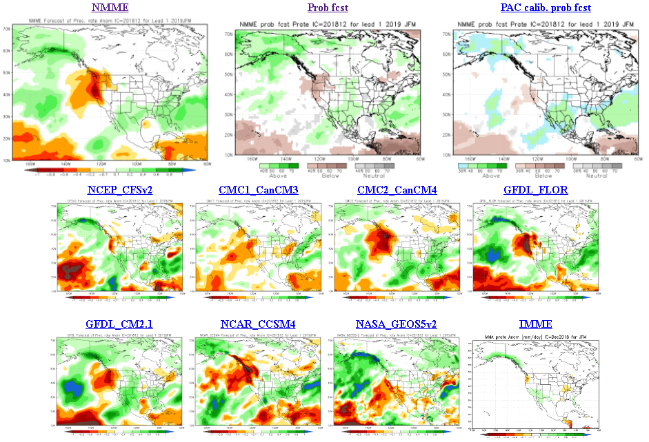
The agreement/uncertainty among the diff. NMME models’ forecasts (middle and bottom panels) for Jan-Feb-Mar Precipitation!!!
26

Slide 27
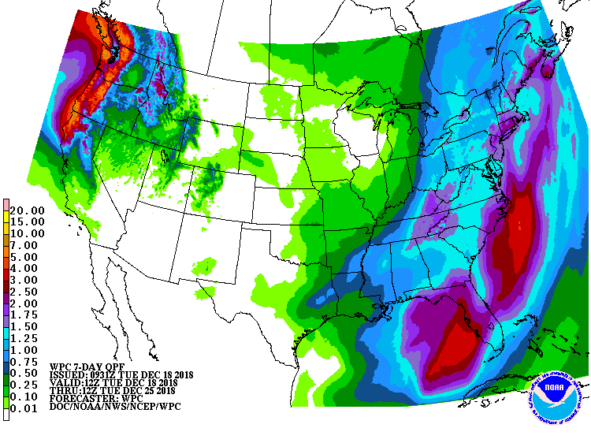
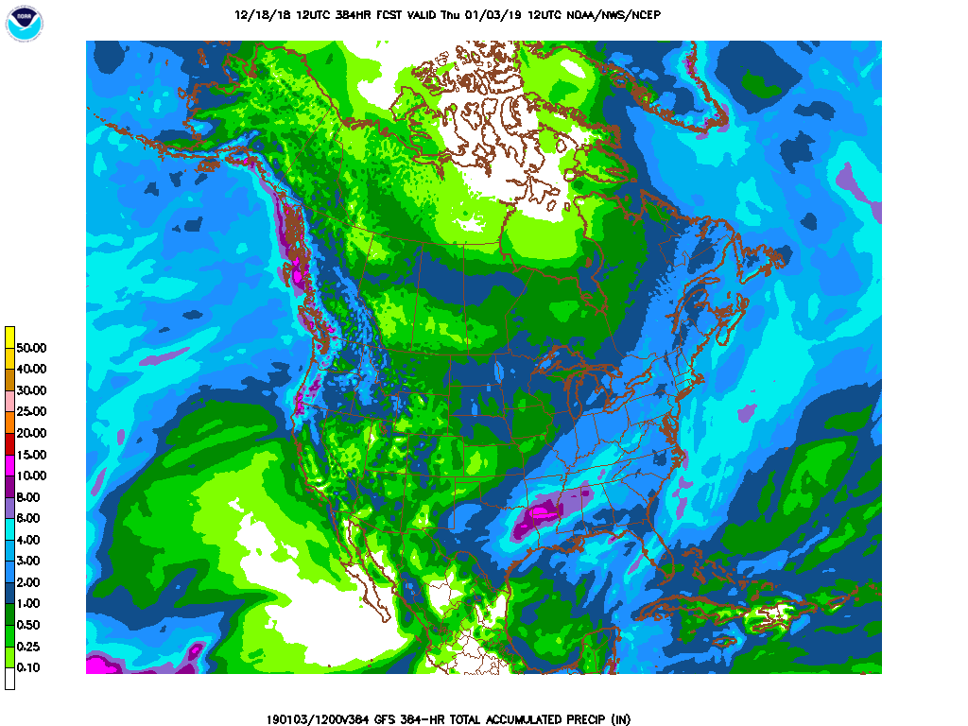
From 11/12/18 12Z run – showing slow appearance of precip in CA area – but probably not in time to help ongoing active fires!! .
Next 7 days QPF Forecast
GFS Model Guidance for next 16 days.
Southwest and Pacific Northwest are obviously the important areas to watch, both in terms of drought and the upcoming rainy season!!

Slide 28
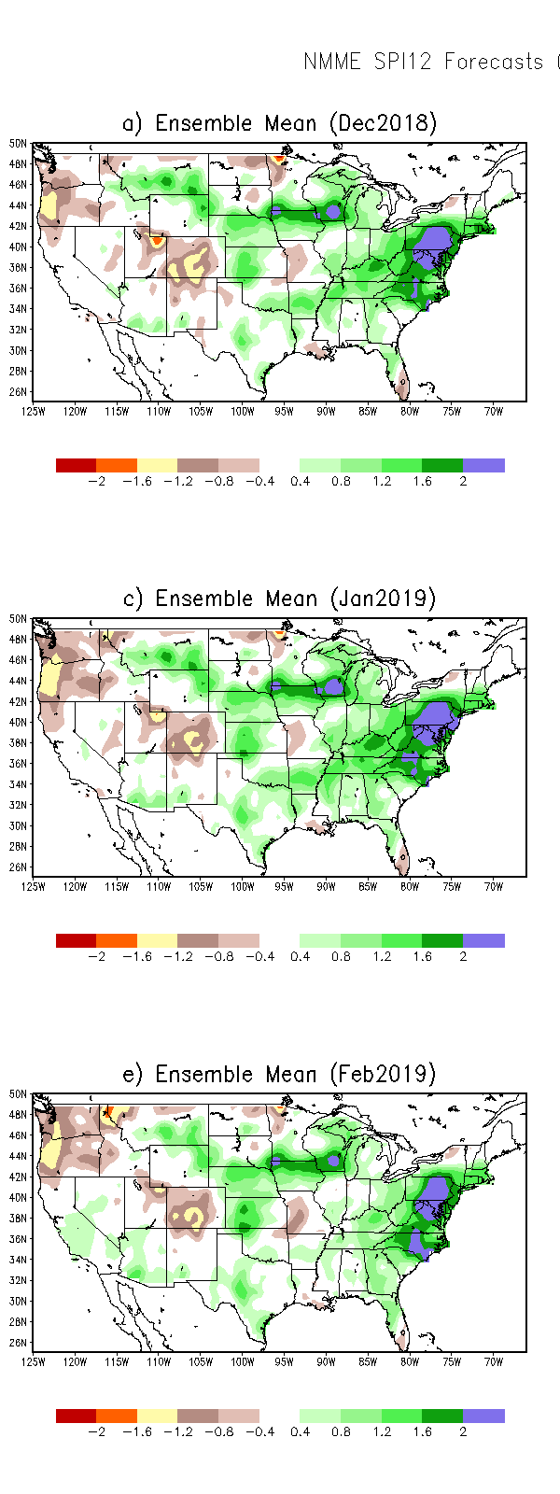
SPI3
SPI6
SPI12
SPI3, SPI6
& SPI12
Forecasts from 6NMME Models
(uses obs. P up to past month, and forecast months’ P from NMME models)
The goodness and skill of these SPI’s forecasts depend directly on the NMME models’ skill in predicting precipitation!!!
Short vs long term persistence/ improvement!!

Slide 29
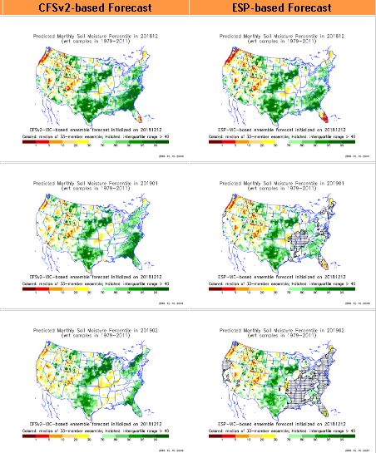
Hydrological Monitoring and Seasonal Forecasting @ MSU (Michigan State University ) NLDAS model
Monthly Soil Moisture Percentile Prediction issued on 201812 with this IC.
http://drought.geo.msu.edu/research/forecast/smi.monthly.php
The inter quartile range suggest greater uncertainty about the forecast in these shaded regions.
The forecast soil moisture situation looks good except in Pacific Northwest! CA!

Slide 30
Precip Forecast
NASA GEOS5 Forecasts
This model’s forecast of precip along west coast swings widely from month to month.
Dec 2018
Soil Moisture Forecast Percentile
Jan 2019
IC
Dec 18
Feb 2019
Jan 19
Feb 19

Slide 31
Monthly Drought Tendency in Probability
(This and next slide!) Exptl. Probability Drought Outlook from Kingtse Mo and Li Xu based on NMME ensemble members’ SPI6 (from precip) forecast – Since it is based on SPI6, longer/term lasting droughts will not be depicted!!

Slide 32
Seasonal Drought Tendency in Probability

Slide 33
Summary
Current ENSO status and forecast. ENSO-neutral conditions are present. Equatorial sea surface temperatures (SSTs) are above average across most of the Pacific Ocean. The patterns of convection and winds are mostly near average over the tropical Pacific. El Niño is expected to form and continue through the Northern Hemisphere winter 2018-19 (~90% chance) and through spring (~60% chance).
Current Drought conditions:
East of, and including, Texas, the country is (almost) drought free over all of the eastern two thirds of the country.
However, the longer term drought in the southwest, in the four corners states area over UT/AZ/CO/NM and California, continues to persist there, with no steady improvement!
The relative short term drought that developed in the Northwest over OR/WA over the last few months/couple of seasons, has gradually gotten worse, but the rainy season just begun here!
The short/long term drought (since early 2017) in parts of the Northern High Plains has all but vanished, but it appears in a muted form over very small areas in some northern parts of North Dakota.
In spite of these drought declarations, analysis of rainfall received over the last few months/years reveal the exact nature of the varying levels of quantitative rainfall deficit in the short/long term drought regions.
Prediction:
Rainfall season(D/JFM) is coming up for all coastal western states! At present, development of El Nino conditions in the next couple of months appears all but certain. But, how this developing El Nino will alter/impact this seasonal rainfall pattern in CA, OR, WA and the adjoining states, particularly in the southwest will decide the future of droughts in these regions. Many of the NMME models, in spite of the strong expected El Nino boundary conditions, forecast below normal rainfall along all of west coast states, which is not helpful for drought conditions here. This forecast not consistent with canonical ENSO precip patterns observed in the past (before 2015/16 El Nino)
Overall, short term improvement is expected in the drought conditions over much of the northwest, south and west in the drought regions, since rainy season here is underway. But how this rainfall season gets affected/modulated by the developing ElNino will considerably impact the drought conditions not just for the Pacific coastal states, but also in the southwest states. But the longer term drought from longer tem rainfall deficits in these regions is expected to remain, in a diminished status. **END***

Slide 34
Miscellaneous maps

