Slide 1
Drought Outlook Support Briefing December 2019
Climate Prediction Center/NCEP/NOAA
http://www.cpc.ncep.noaa.gov/products/Drought
Phone: 1-877-680-3341
Pwd: 858747#

Slide 2
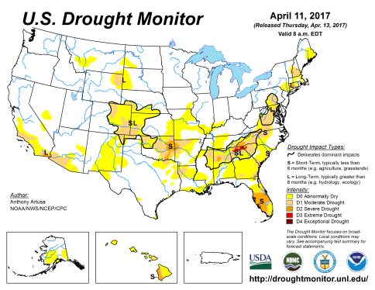
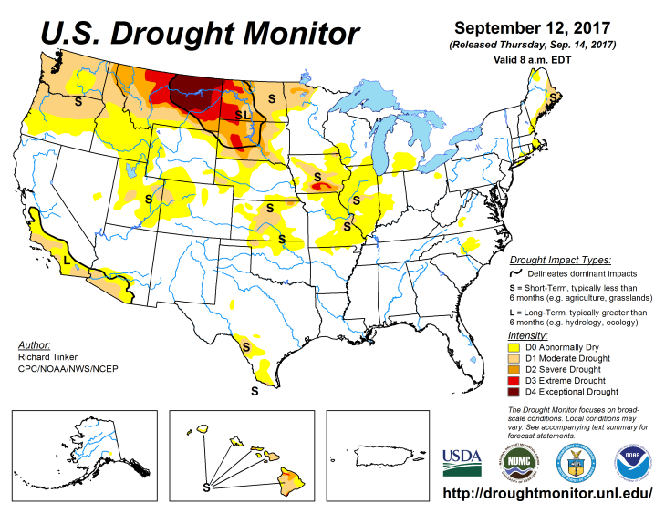
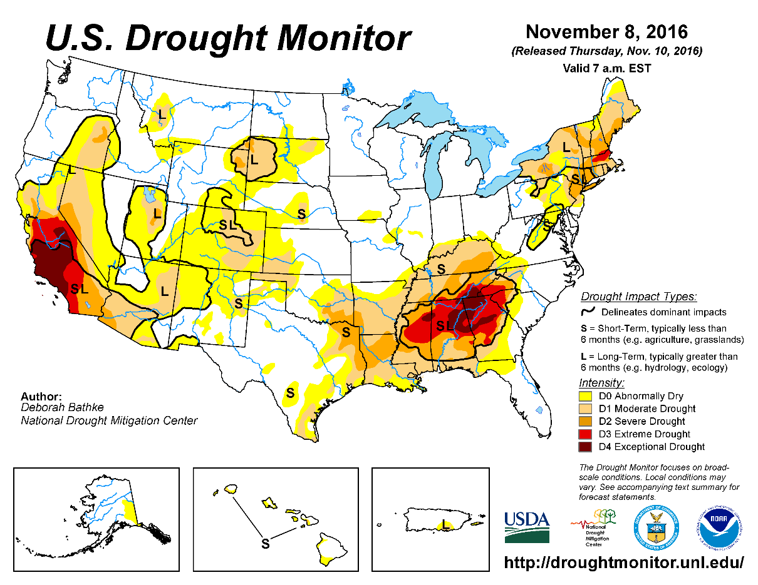
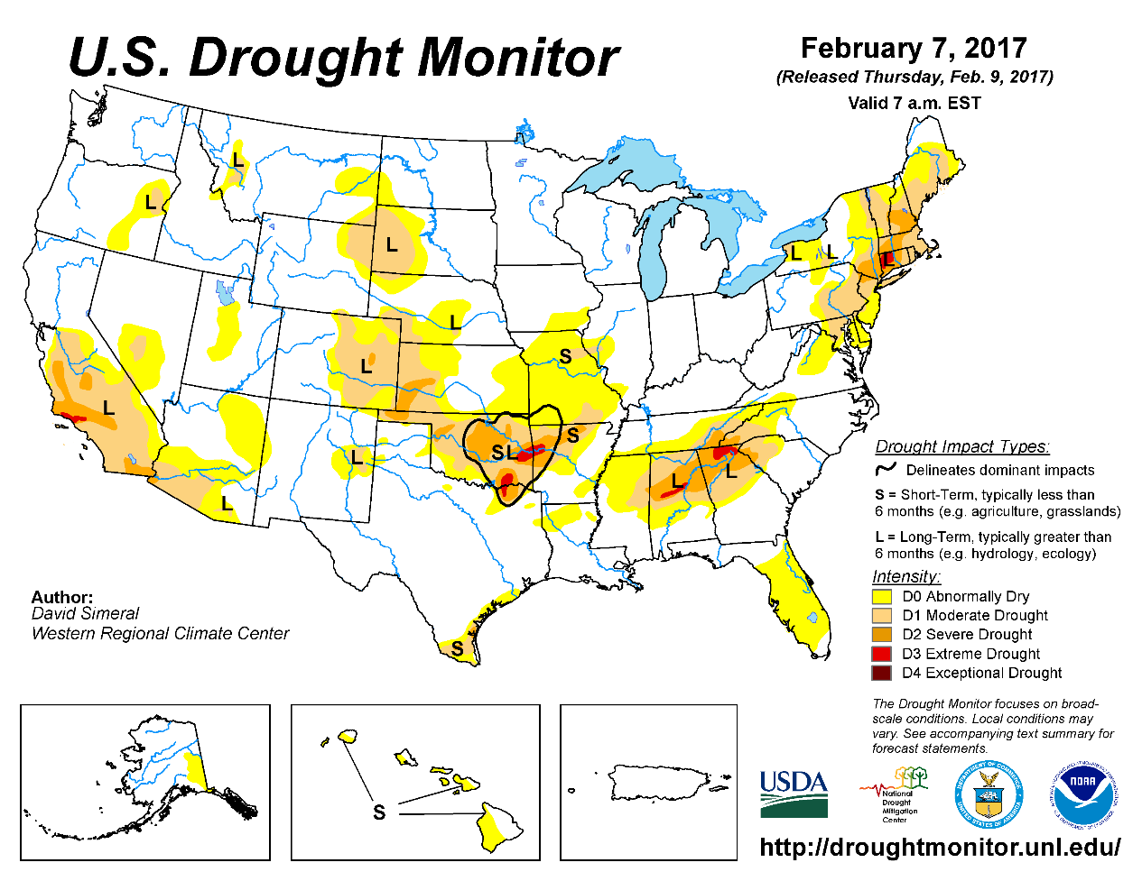
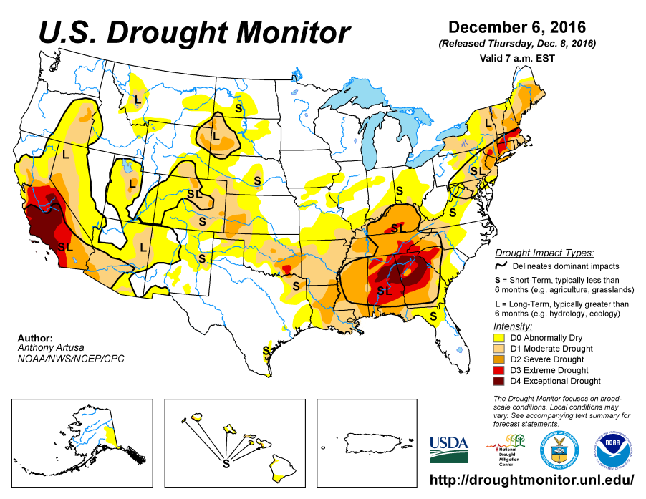
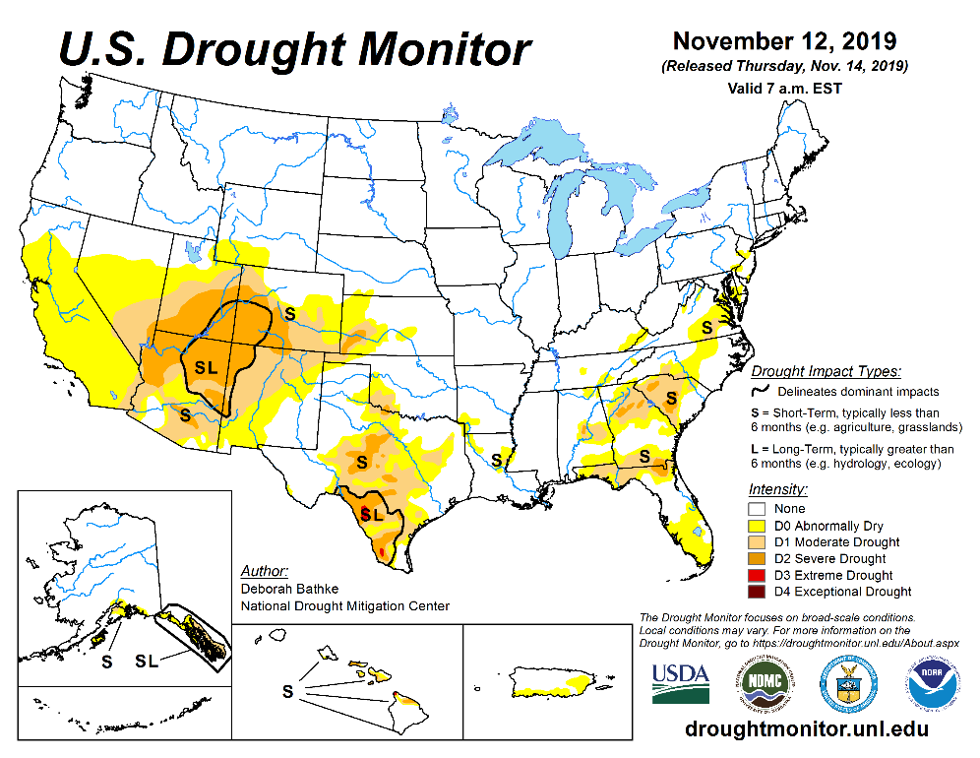
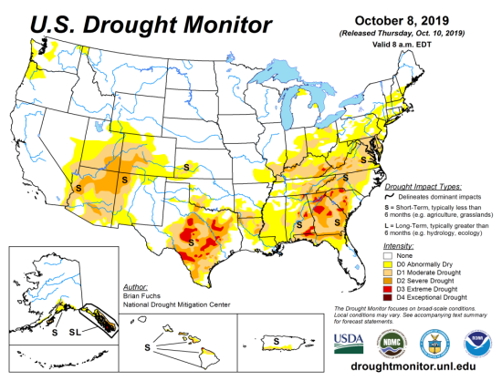
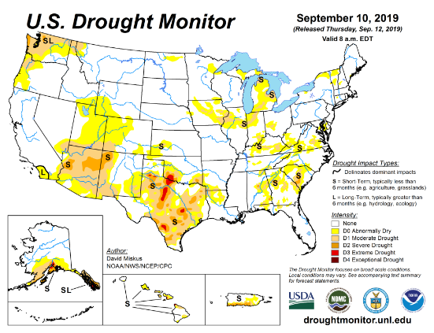
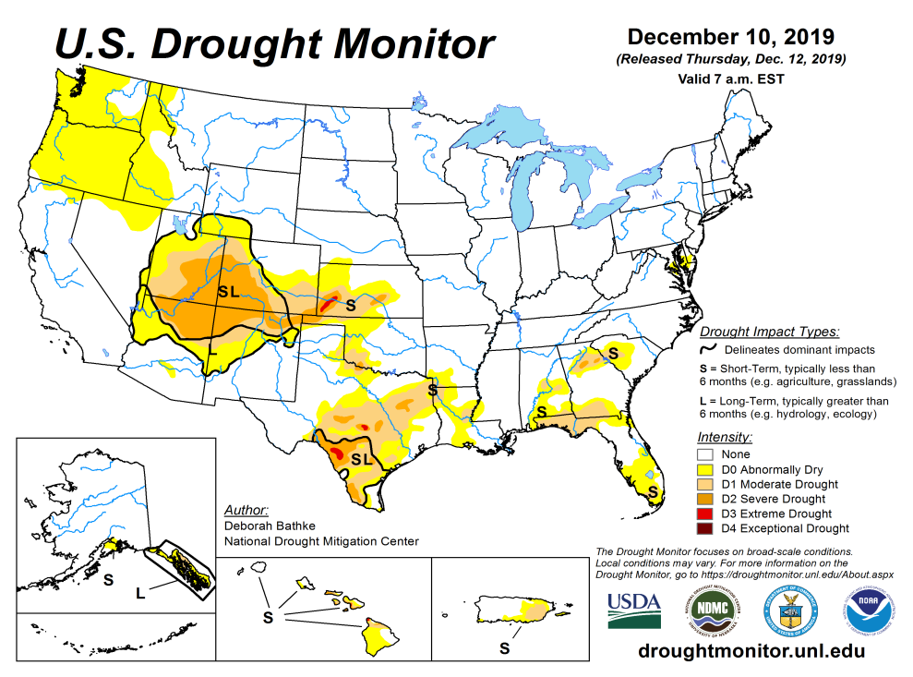
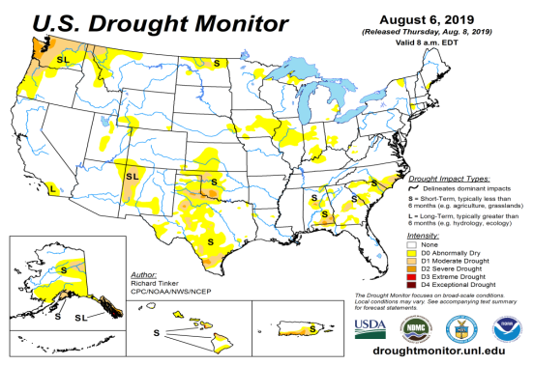
Drought Monitor
November
October
After reaching a relative minimum in the area of drought coverage across the US in April/May, the drought area started to increase, peaked in October, and since then has decreased at least in the southeast. Only small pockets of mild short term drought exist in the southeast.
Drought in the four corner states (AZ/MM/UT/CO) has been vacillating in both intensity and shape.
Weak dryness is emerging on and off in the Pacific western states of CA, OR and WA.
September
Recent/Latest
August
February

Slide 3
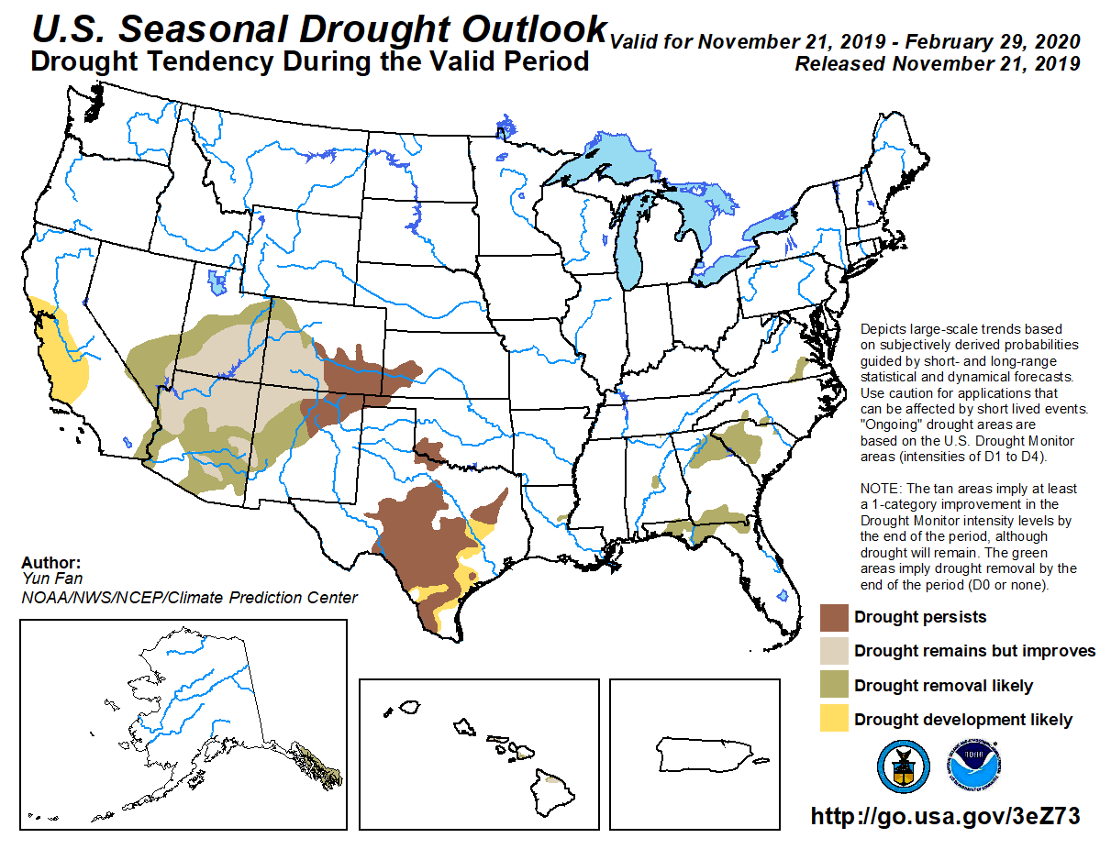
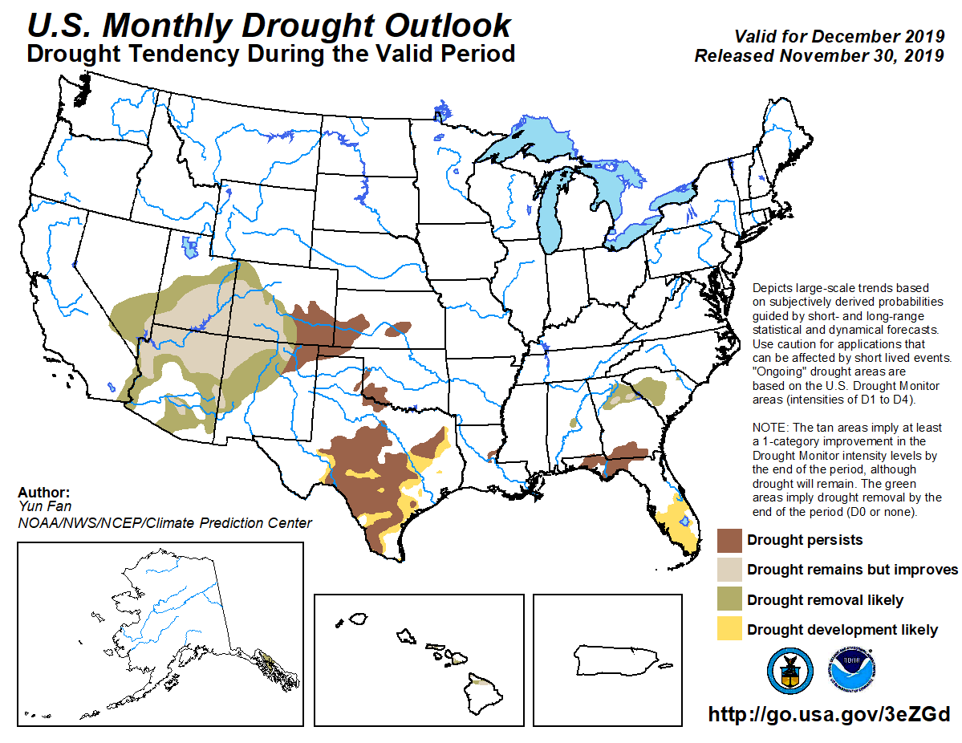
(Prev) Seasonal/Monthly Drought outlooks
(New Seasonal Drought Outlook to be released in 2 days!)
Seasonal Outlook
(Mid Nov 2019- Feb 2020)
issued 11/21/19
Monthly outlook
(for Dec 2019)
issued 11/30/19
Pretty good monthly forecast so far. →

Slide 4
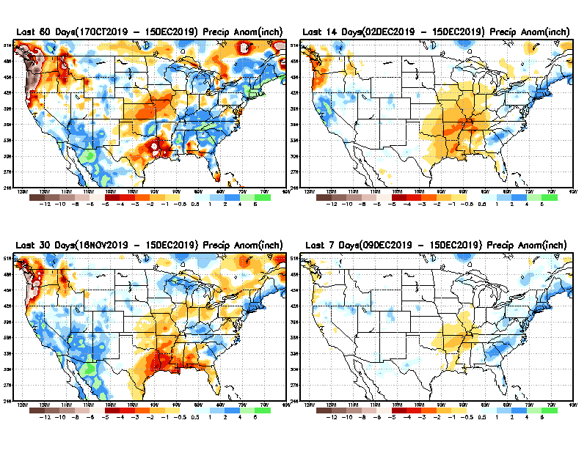
Precipitation ANOM during last 7, 14, 30, & 60 days.
60 Days
14 Days
These maps in this and following slides, including
a) Anom and b) Percent of precip. in these and other longer time ranges. Now daily updated at:
30 Days
7 Days
From: Recent Accumulated Precipitation https://www.cpc.ncep.noaa.gov/products/Drought/briefing_prcp.shtml

Slide 5
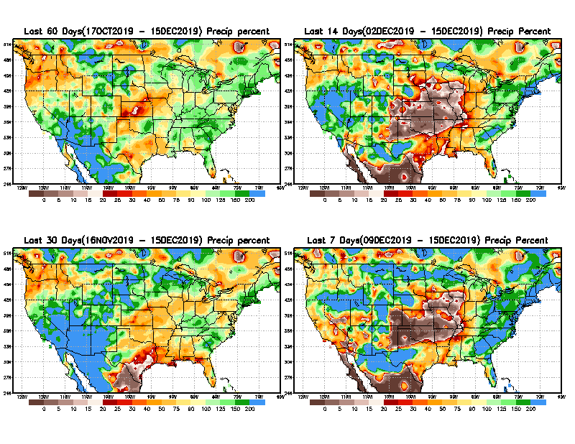
Precipitation Percent during last 7, 14, 30, & 60 days.
60 Days
14 Days
NOW !
In regions, where the rainfall season is strictly limited to a few months (say 3-4), even one month of acute rainfall deficit can be of concern !!
In other regions of relatively broad rainfall months, this need not be a big issue!!
30 days
7 Days
From: Recent Accumulated Precipitation https://www.cpc.ncep.noaa.gov/products/Drought/briefing_prcp.shtml

Slide 6
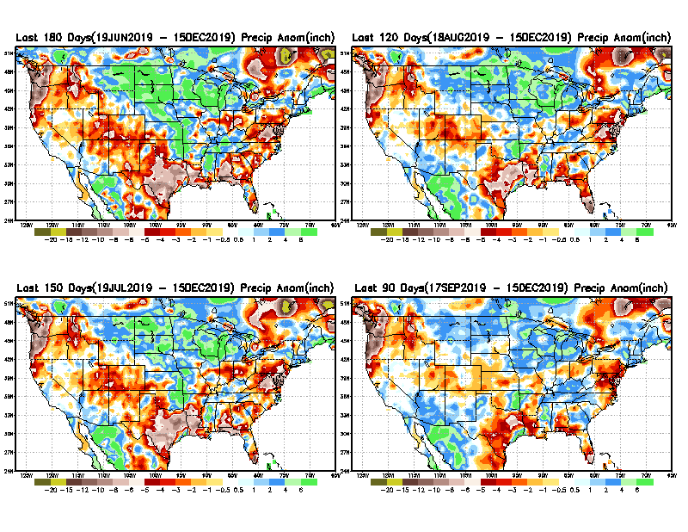
Total precipitation ANOM during last 3, 4, 5, and 6 months.
6 M
4 M
5 M
3 M
While the Precip anomalies deficit may seem large in some regions, it is the % of precip (next slide) that matters more!!
From: Recent Accumulated Precipitation https://www.cpc.ncep.noaa.gov/products/Drought/briefing_prcp.shtml

Slide 7
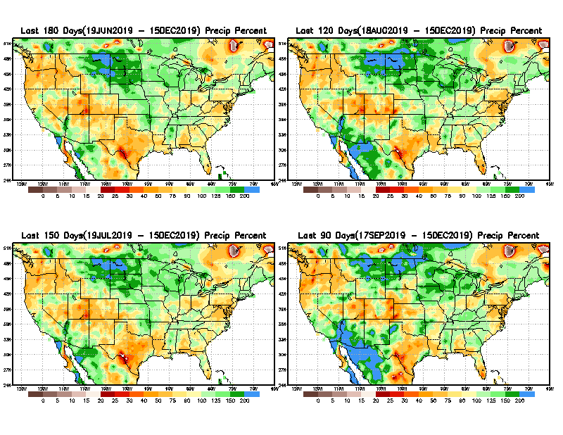
Total precipitation Percent during last 3, 4, 5, and 6 months.
6 M
4 M
In these interim time scale 3-6 months, we need to pay attention to regions, which are dark-red /red & brown (<50%)
5 M
3M
While accrued precipitation deficits are real,
droughts are declarations!!

Slide 8
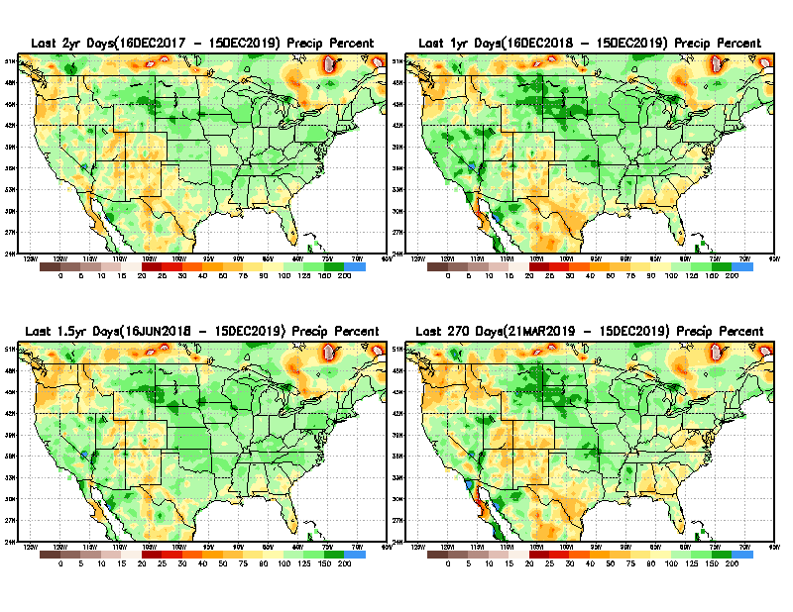
Total precipitation Percent during last 9 months, 1 yr, 1.5yrs, & 2 yrs.
2 Y
1 Y
1.5 Y
9 M
From: Recent Accumulated Precipitation https://www.cpc.ncep.noaa.gov/products/Drought/briefing_prcp.shtml

Slide 9
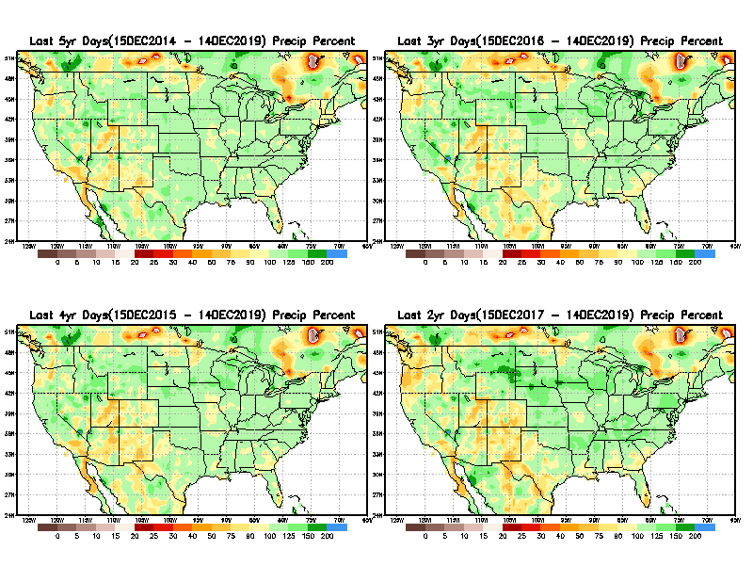
Total precipitation Percent during last 2 yrs, 3 yrs, 4 yrs, & 5 yrs.
5 Y
3 Y
Still longer term rainfall deficit variability in play? Especially in the southwest!
Will these deficits ever go away, OR is these part of the new norm??
Not so bad in the east!!
4 Y
2 Y
From: Recent Accumulated Precipitation https://www.cpc.ncep.noaa.gov/products/Drought/briefing_prcp.shtml

Slide 10
Rainy (3-month)Season across the US

Slide 11
Watch how Southeast contrasts w TX and SW as we move forward to January.
Adapted from Rich Tinker.

Slide 12
Adapted from
Rich Tinker

Slide 13
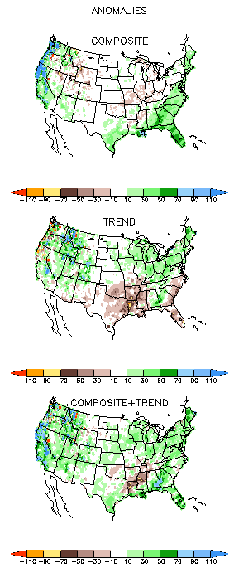
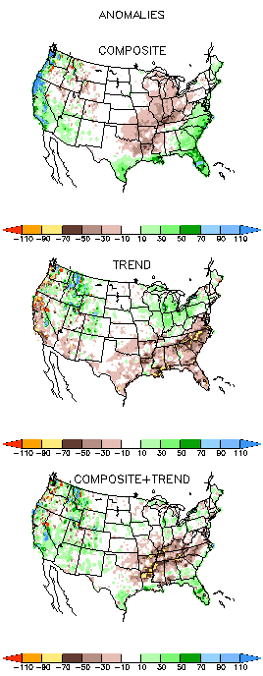
EL NINO Precip COMPOSITES & Trend maps
DJF
JFM
Only this is of relevance to us now due to neutral ENSO status.

Slide 14
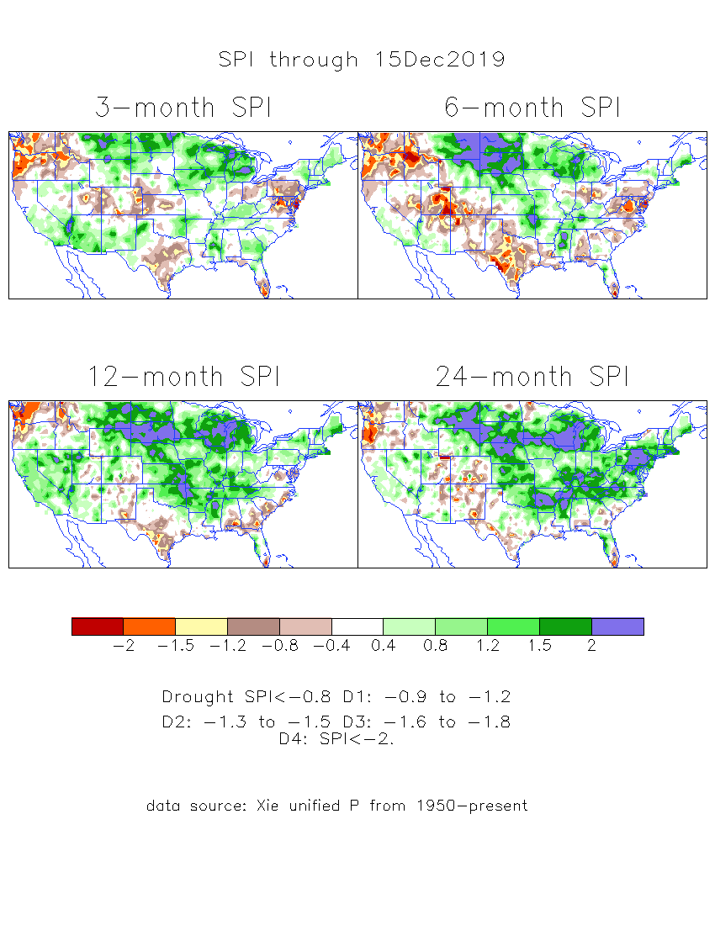
The Standardized Precipitation Index SPI (based on Observed P)
----- NOW
Very interesting graphic & details for the drought across the US based on the more generalized precip deficit/excess, the Standardized Precipitation Index (SPI).
The dark brown and red colors, indicating standardized precipitation deficits, in the various time periods, approximately correspond to the appropriate short/long term drought monitor regions and their intensities
Overall, there is a great deal of similarity between the short/medium and long term SPI patterns,
In the short term, the lack of precip and the cumulative dryness in the TX/southwest has gotten worse.
Likewise the Pacific NW has also become more dry.
Short term improvement in/near the 4-corner states area in the west, but longer term drought exists and perisists.

Slide 15
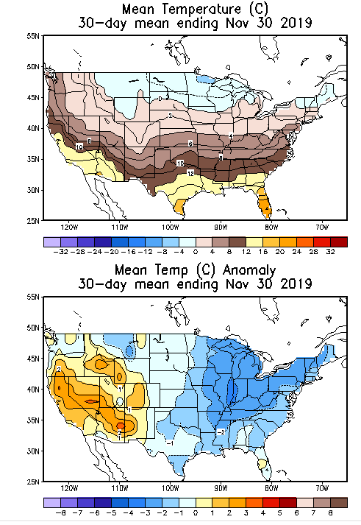
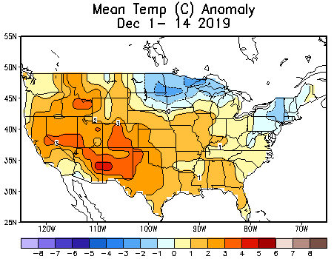
Recent US Temperatures
November US T pattern exhibited generally warm in the west and cool in the east.
December so far been more warmer over much of the country except in the northeast.

Slide 16
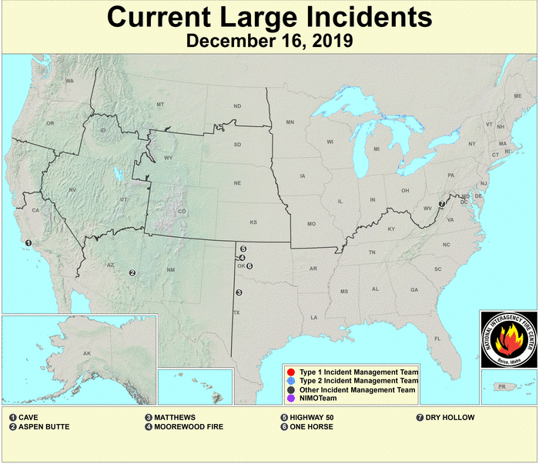
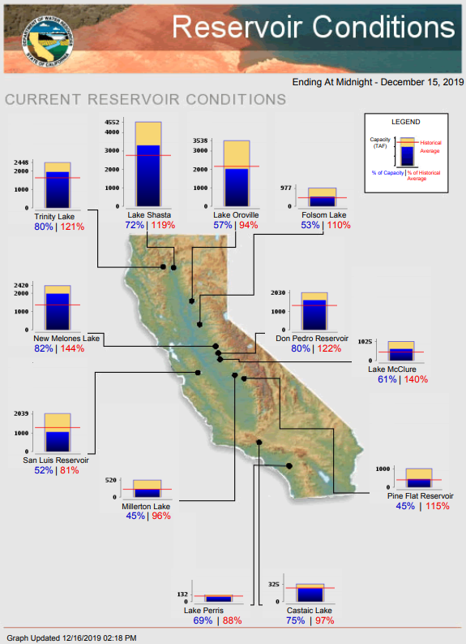
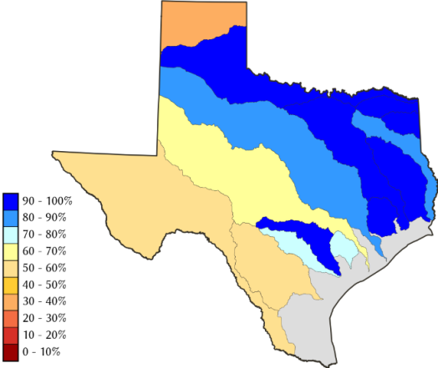
Water Reservoir Levels in some Western/Southern States! !
https://fsapps.nwcg.gov/afm/index.php
No reported major fire incidents now in the West/CA.
Except in few high elevations, all snow has melted.
Northern CA reservoirs beginning to show
Weakness, but rainy season coming up!
COLORADO
End of Nov’2019 water reservoir storages at 109 % of long term average –
(last year: 80% of Average)
TX
California reservoirs are at or above historic average levels.
https://fsapps.nwcg.gov/afm/index.php

Slide 17
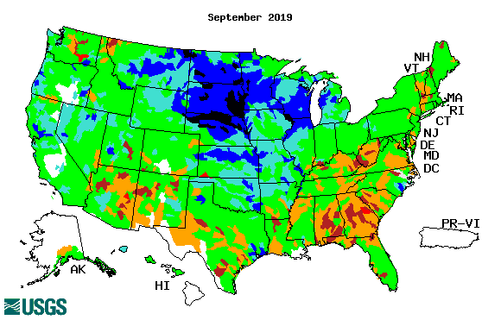
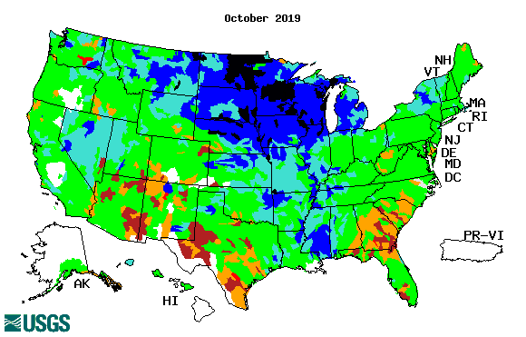
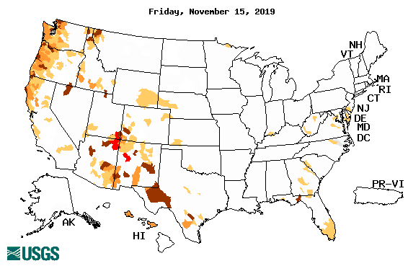
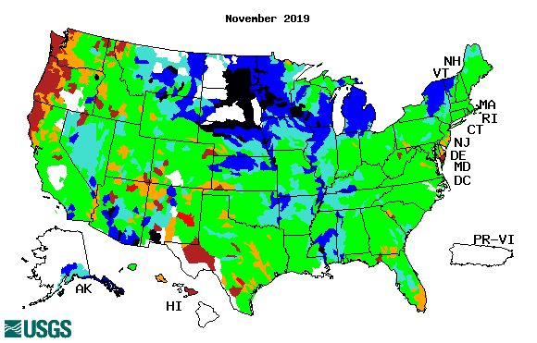
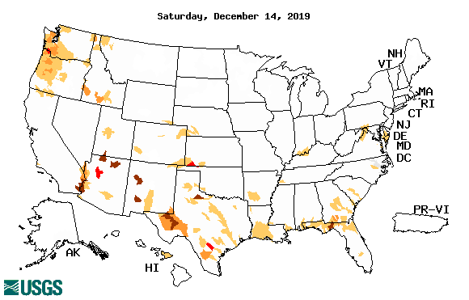
Streamflow (USGS)
Overall, worsened stream flow conditions in the southeast.
Slight improved conditions in the southwest.
Pacific NW much improved now.
Map shows only below normal 7-day average streamflow compared to historical streamflow for the day of year.
One month ago (left) &
Now (below)
17

Slide 18
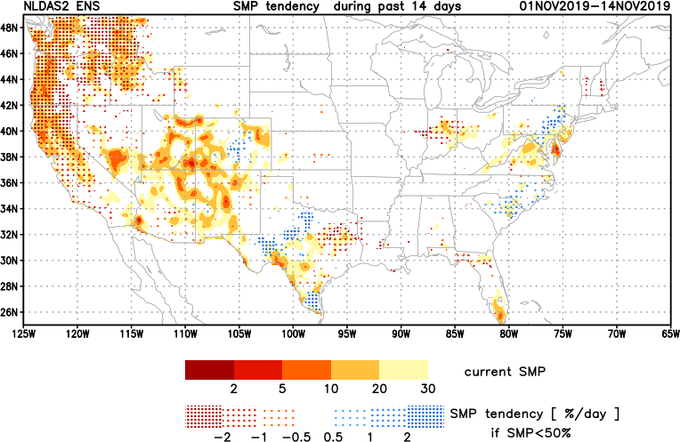
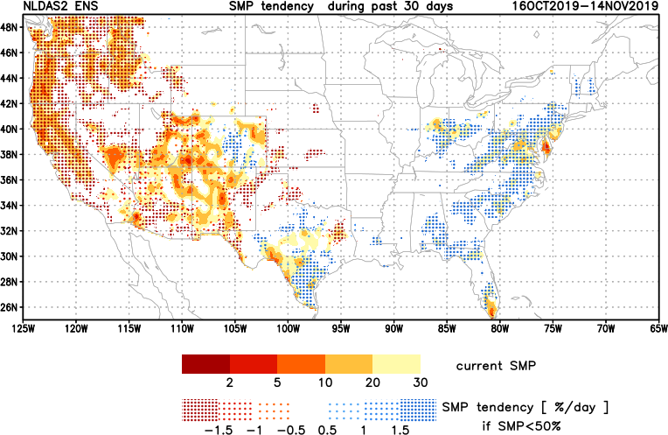
[Last Month]
NCEP Ensemble mean NLDAS2 models’ Soil Moisture tendency
7 days
14 days
Moistening soil moisture tendency over the last month in the drought affected regions, especially in the southeast – reacting to the rainfall received !
30 days

Slide 19
[Now]
NCEP Ensemble mean NLDAS2 models’ Soil Moisture tendency/trend
7 days
14 days
Drying soil moisture tendency over the last month in the drought affected regions, especially in the southeast.
30 days

Slide 20
EL NIÑO/SOUTHERN OSCILLATION (ENSO)
DIAGNOSTIC DISCUSSION
issued by CLIMATE PREDICTION CENTER/NCEP/NWS and the International Research Institute for Climate and Society
12 December 2019
ENSO Alert System Status: Not Active
Synopsis: ENSO-neutral is favored during the Northern Hemisphere winter 2019-20 (~70% chance), continuing through spring 2020 (65% chance).

Slide 21
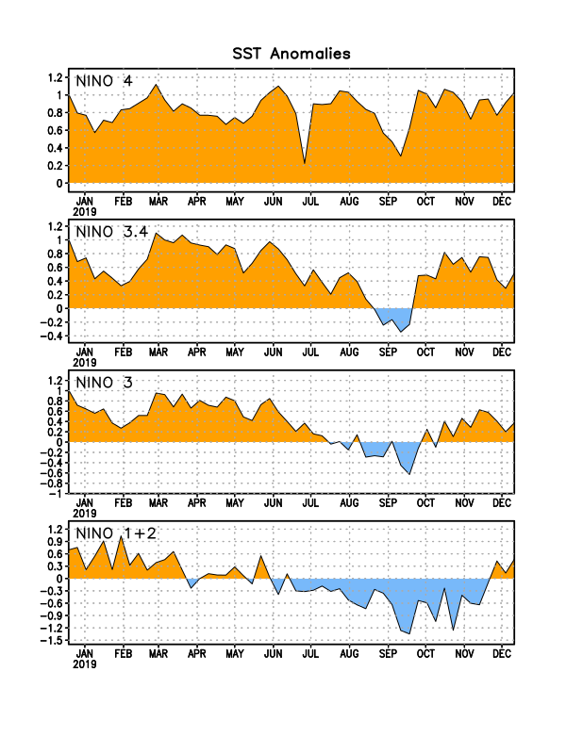
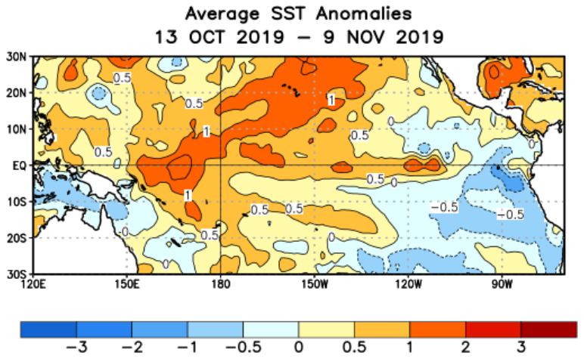
Latest values of SST indices in the various Nino Regions.
The sub surface heat anom has been vacillating for the past few months. Will we be in neutral territory for how long?
?

Slide 22
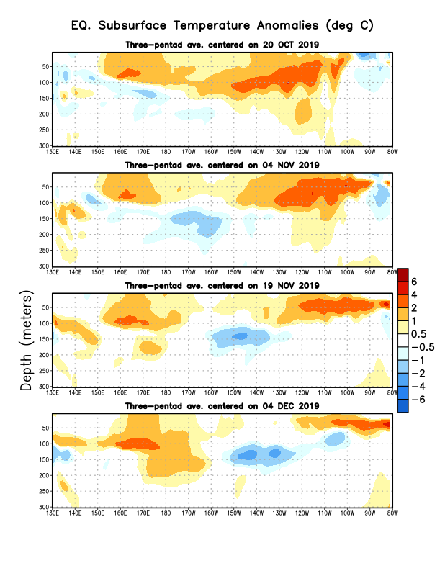
Sub-Surface Temperature Departures in the Equatorial Pacific
Most recent pentad analysis

Slide 23
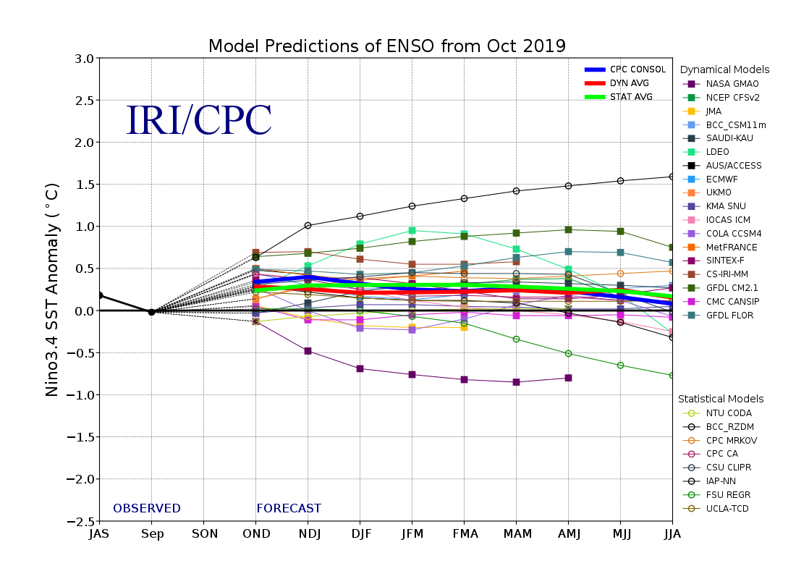
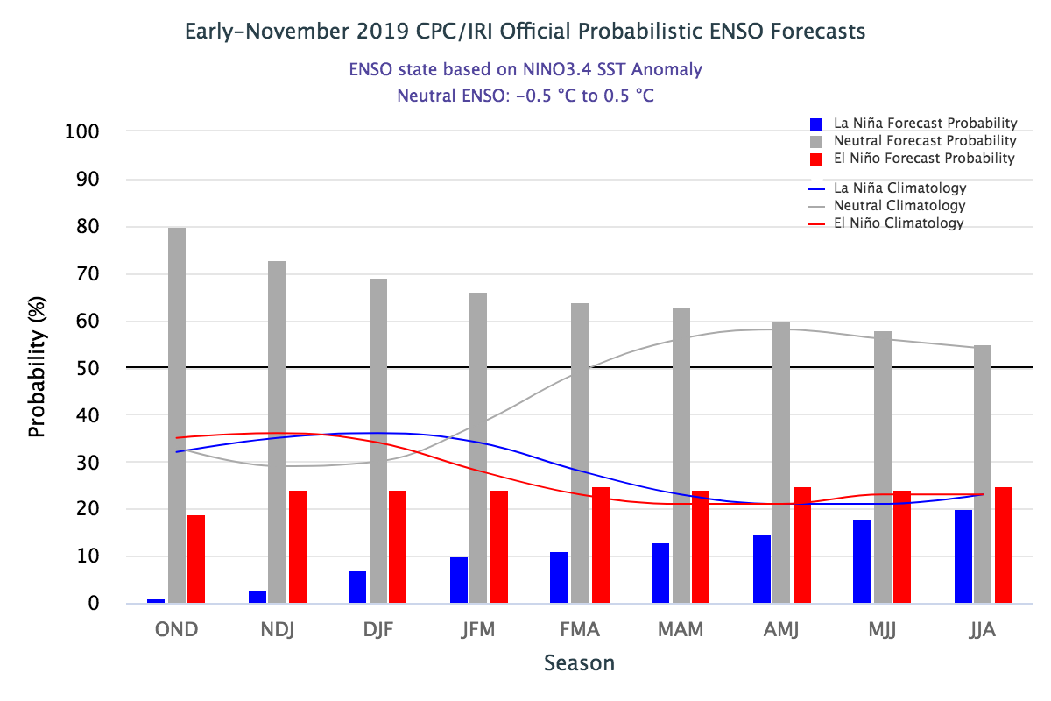
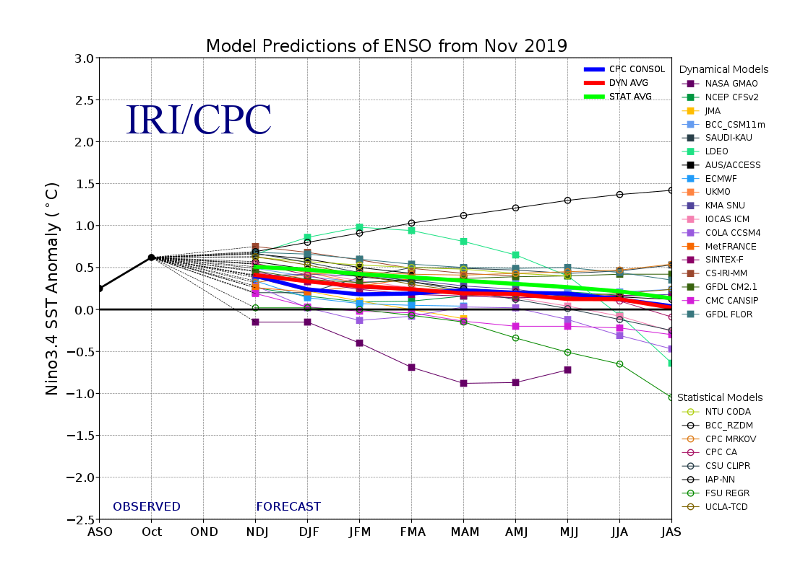
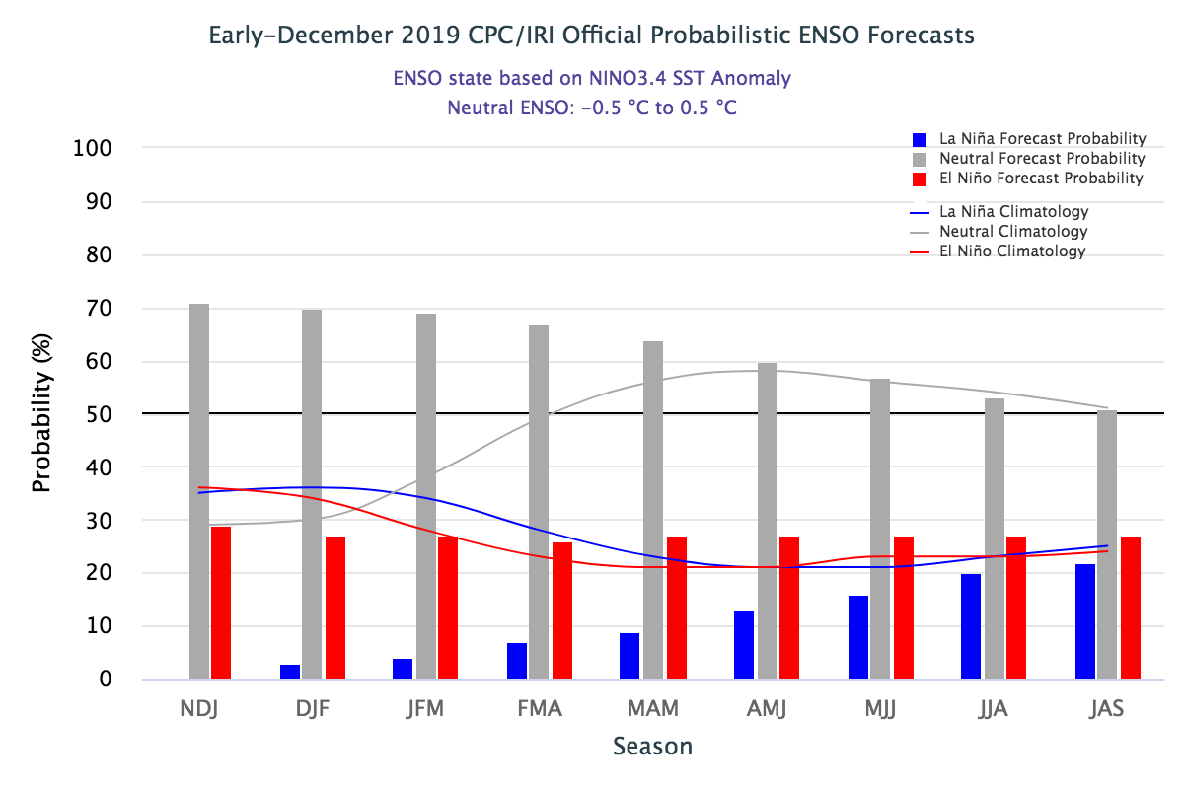
ENSO Forecasts
Early- November CPC/IRI forecast
Early- December CPC/IRI forecast
Same neutral ENSO forecast as last month. But Neutral for how long? Or a swing to ?

Slide 24
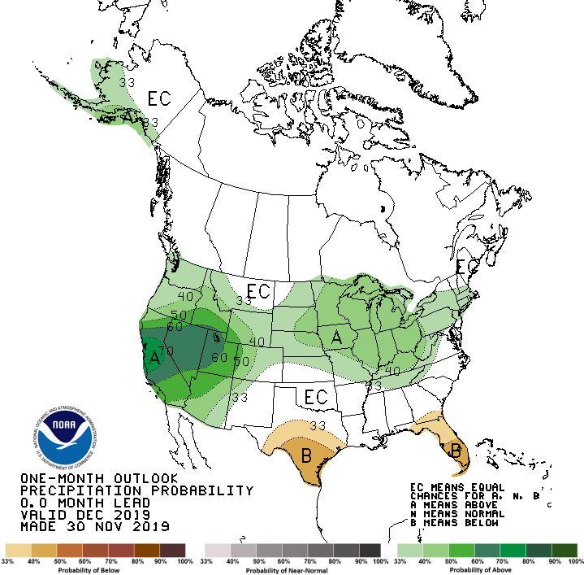
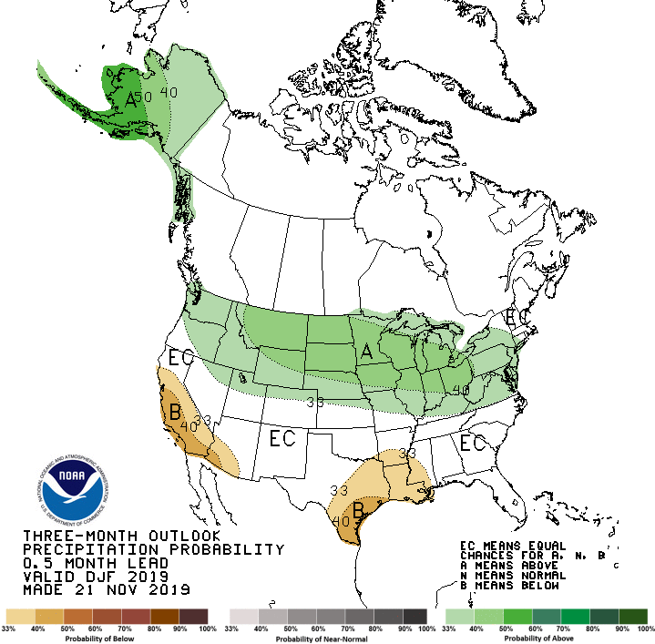
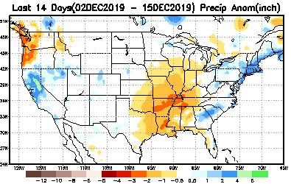
Released Nov 30th
Previous(Last month)
CPC’s official
Precipitation outlook for Monthly (Dec)/Seasonal (DJF)
Released Nov 21st
Observed so far this month!! ☹
First half of month!
Second half month ?
Next slide!

Slide 25
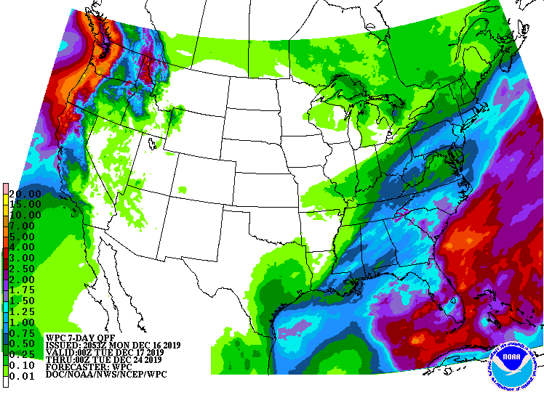
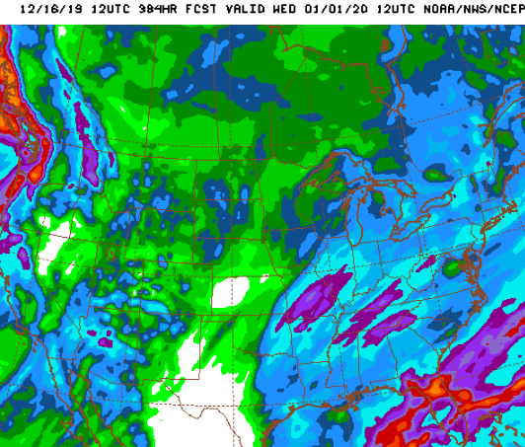
WPC Next 7 days QPF Forecast
GFS Model Guidance for next 16 days.
For much of the south east, the Gulf coast, the four corner states, and the Pacific northwest and California, light to heavy rainfall is expected in the short term, which will further ease the drought/dry conditions here.

Slide 26
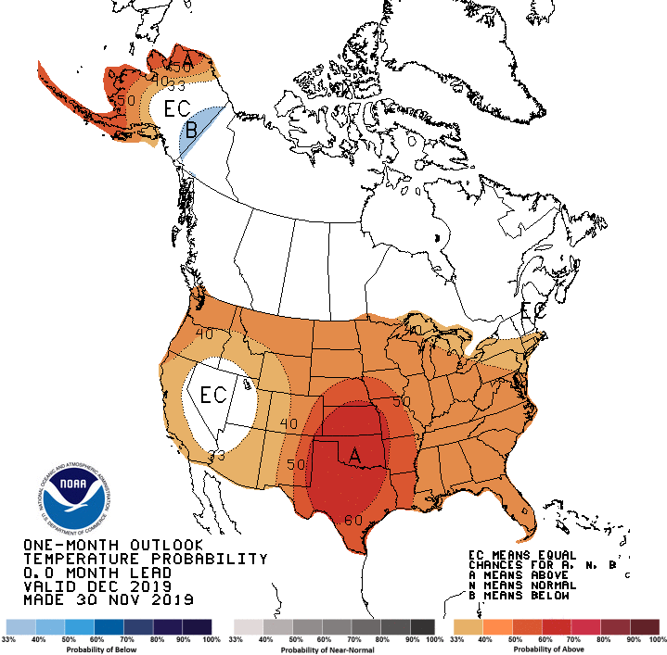
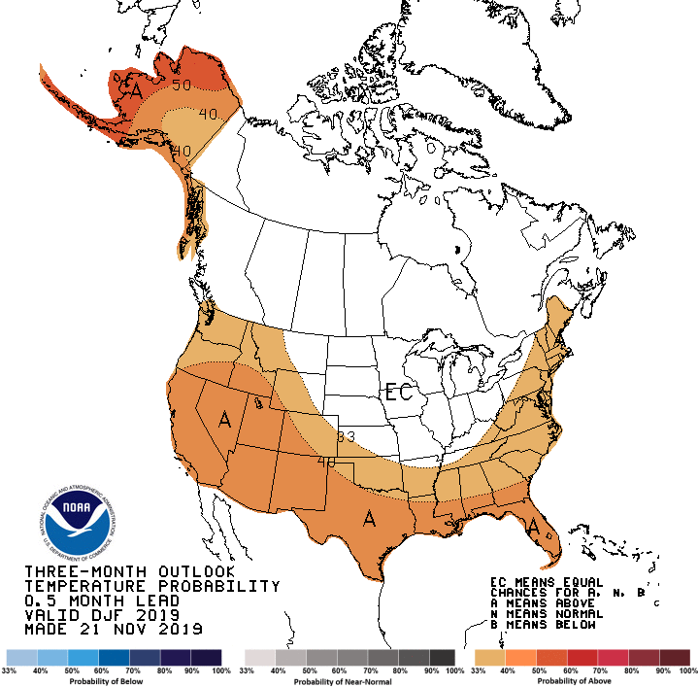
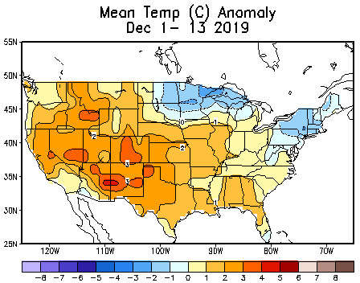
Previous (Last Month)
CPC’s official
Temperature outlook for Monthly (Dec)/Seasonal (DJF)
Made
Nov 30th
Made Nov 21st
Observed so far this month!!

Slide 27
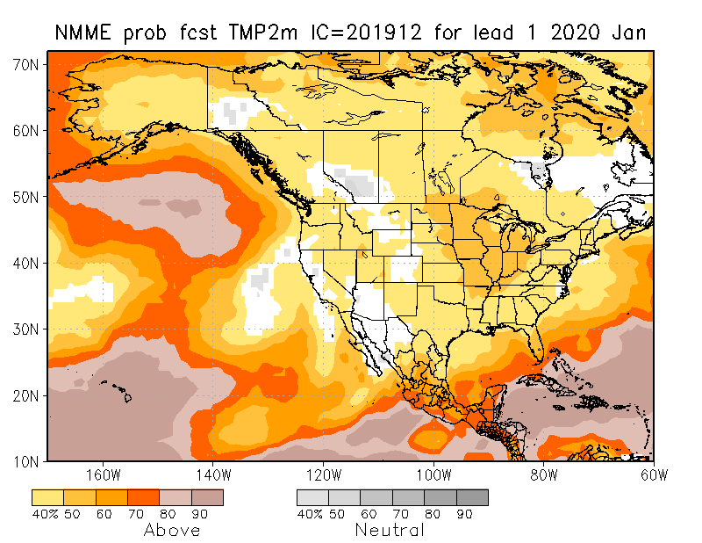
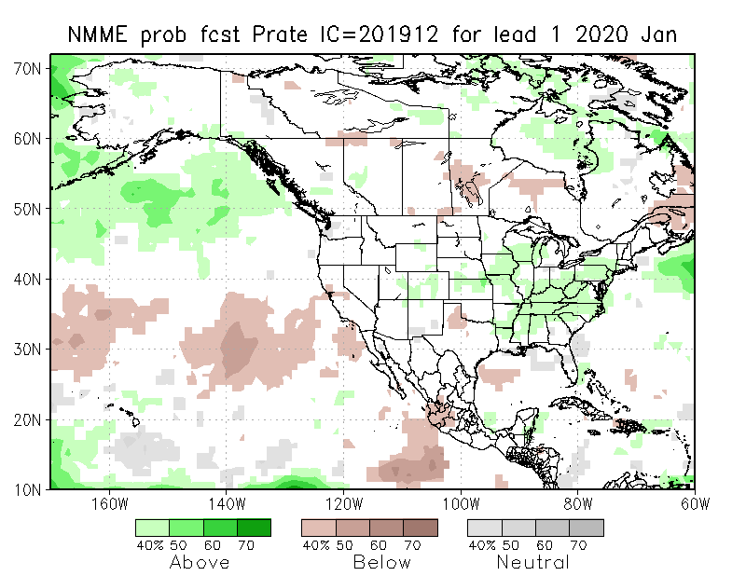
NMME T & P EnsMean forecasts
Jan
JFM
Red-Dot (warm everywhere!) forecast for Temperature generally holds good. Both monthly and seasonal forecasts call for above normal temperatures of various extents across the country.
But the forecast precipitation patterns are based on ENSO-neutral conditions and so its reliability?

Slide 30
Forecast uncertain in Hatched areas.

Slide 31
Forecast from
Initial Conditions:
12/03/2019
http://drought.geo.msu.edu/research/forecast/smi.monthly.php
Predicted Monthly Soil Moisture Percentile
Initial Conditions 2 months ago:
10/01/2019
The inter quartile range suggest greater uncertainty about the forecast in these shaded regions.

Slide 32
Precipitation
NASA GEOS 5 Model
Precipitation & Soil Moisture Forecast
(Not available this month)
Nov 2019
Soil Moisture
Dec 2019
Nov
2019
I.C.
Jan 2019
Jan
2019
Dec 2019

Slide 33
Summary
Current ENSO status and forecast. ENSO-neutral is favored during the Northern Hemisphere winter 2019-20 (~70% chance), continuing through spring 2020 (65% chance).
Current Drought conditions:
After reaching a relative minimum in the area of drought coverage across the US in April/May, the drought area started to increase in the south, which peaked in October, and since then has decreased at least in the southeast. Only small pockets of mild short term drought exist in the southeast.
Drought in the four corner states (AZ/MM/UT/CO) has been vacillating in both intensity and shape and even location. Drought continues to dominate southern Texas.
Weak dryness is emerging on and off in the Pacific western states of CA, OR and WA, and in Idaho, where the upcoming season is the rainy season.
Stream flow conditions have improved considerably since last month in the southeast, but worsened in the Pacific Northwest, along the coastal regions. In the southwest, around the four corner states area and in western Texas, the stream flow conditions continue to be below normal.
California reservoirs, continue to be at better than historically average levels. CA’s 2019 wildfire season was not worse than previous devastating years.
Prediction:
Expected presence of near normal ENSO conditions in the tropical equatorial Pacific through winter and spring, is not helping with any confidence in the NMME model’s forecasts for precipitation.
Careful examination of the current precipitation deficiencies on many time scales across the United States and the extent/march of the compact/expanded rainy season in the drought affected and the precipitation deficit regions, will help guide the drought forecasters.
Based on these considerations, and the expected rainfall in the short term, further relief of the existing pockets of drought in the southeast is expected. The drought in the four corners region will get better in the short term but might persist in the long term, due to continued long term rainfall deficits in the region.
The dryness in the Pacific Northwest and ID is likely to disappear and not materialize into drought by the end of the forecast/rainy season in these regions. However, drought in the western Texas is likely to persist and may even get worse by the end of JFM season. The drought in southern TX may even extend westward. Deep southern FL is an area of concern. ---****---

Slide 34
For ensemble hindcast
Addnl. two slides for Slide 31.
From ECMWF Antje Weisheimer

Slide 35
Estimate the Signal to Noise ratio (SNR) for real-time forecast
assumption:
Signal are independent of noise
Noise are mutually independent
Signal may be correlated
Approximation:
Noise: variance of ensemble member to ensemble mean (spread)
Signal: ensemble mean variance if long-term mean of ensemble close to zero
DelSole et al 2014, GRL; Desole and Tippett (2007)

Slide 36
Miscellaneous maps

Slide 37
Miscellaneous maps

