Slide 1
Drought Outlook Support Briefing December 2020
Climate Prediction Center/NCEP/NOAA
http://www.cpc.ncep.noaa.gov/products/Drought
Phone: 1-877-680-3341
Pwd: 858747#

Slide 2
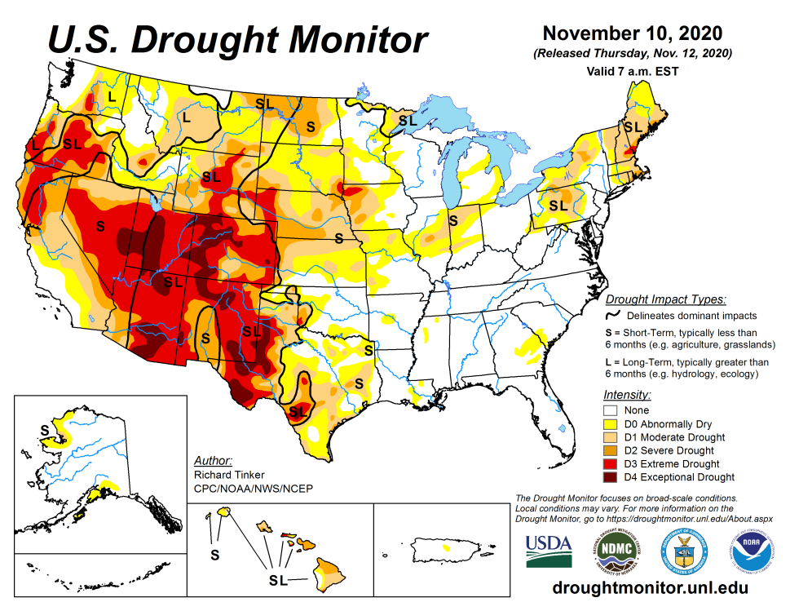
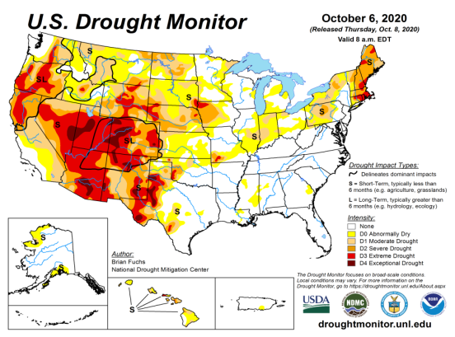
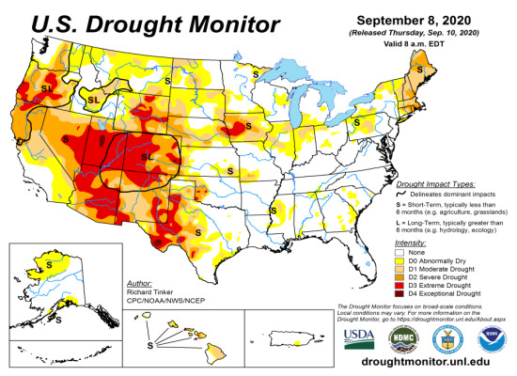
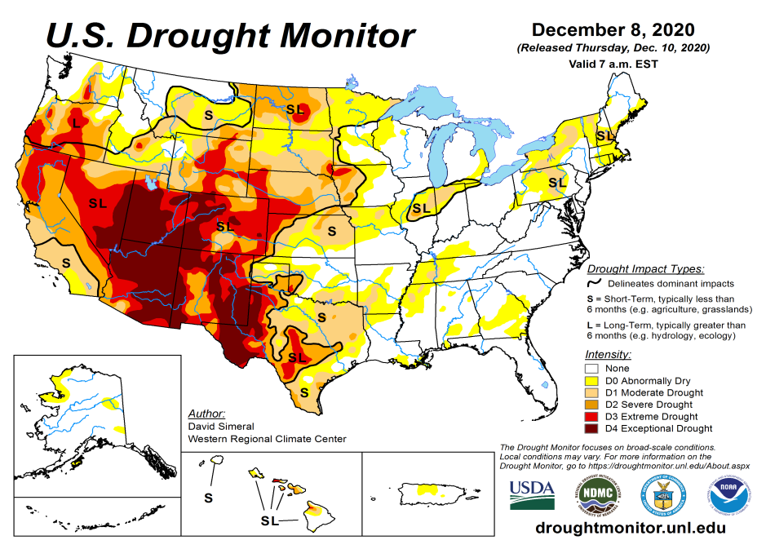
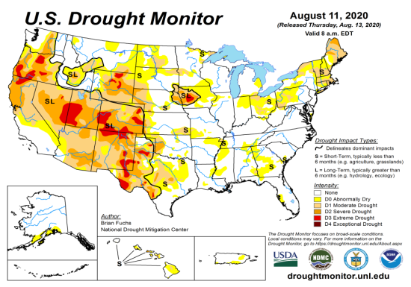
Drought Monitor
Monitoring is important because, unlike US T/P fcsts, for drought forecasts, we have to know where we are, before we can tell where we are going!!
Drought forecasts are tendency forecasts.
November
October
Over the last several months, drought area & severity has overall generally increased across the South, West & NW.
The drought in the Dakotas, Wyoming, Nebraska and vicinity which developed late summer continues to hang in there.
More than half of the country is in some form of low to severe drought or at least in dry condition.
As predicted last month, drought in the Northeastern (New England) states is finally beginning to get some relief.
But also as predicted, some dryness is beginning to emerge in the southeast.
September
December
(Recent/Latest)
August
February

Slide 3
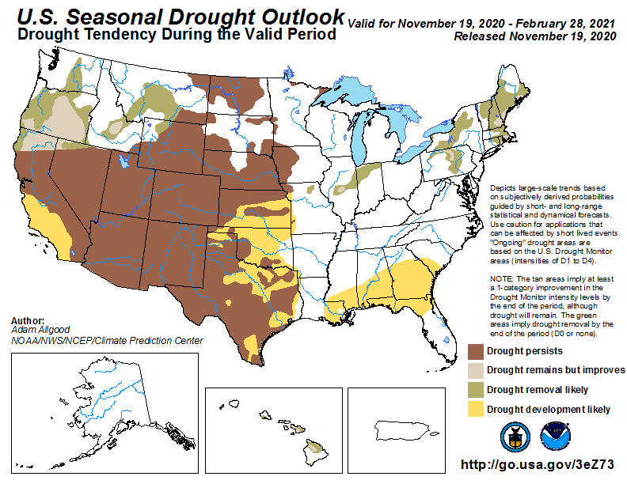
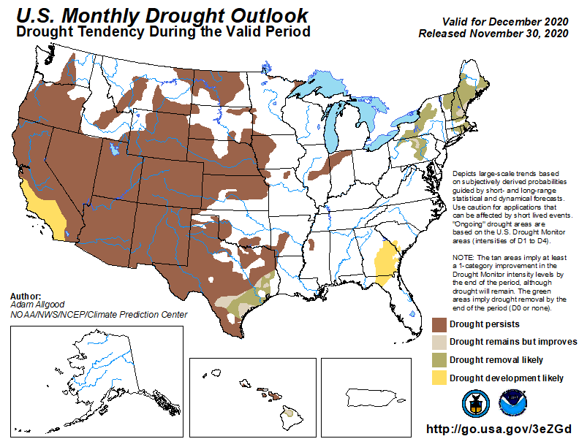
(Prev) Seasonal/Monthly Drought outlooks
(New Seasonal Drought Outlook to be released in 2 days!)
(New Monthly Drought Outlook to be released end of the month)
Seasonal Outlook
(Mid Nov 2020- Feb 2021)
issued 11/19/20
Monthly outlook
(for December 2020)
issued 11/30/20
Much of the western half is in drought. It was not too long ago (~May 2019), the US had almost the lowest coverage of area covered by drought! Approx. < 4% or so. Now it is ?? (See next slide!)
Similar looking Monthly and seasonal outlooks. New Drought is expected to emerge in the Southeast, and it is beginning to happen.
The ongoing La Nina and the associated below normal precip. across the South is increasing the drought affected areas.

Slide 4
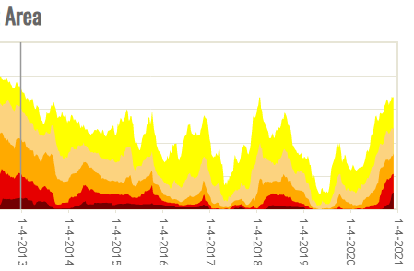
50%
The current % of area extents at D3 or worse drought are like those in 2013.

Slide 5
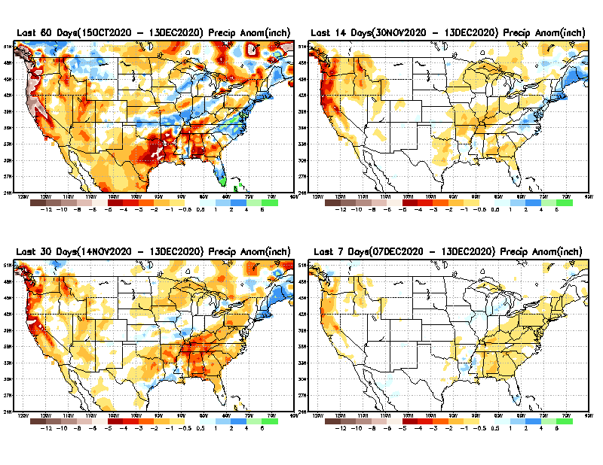
Precipitation ANOM during last 7, 14, 30, & 60 days.
60 Days
14 Days
These maps in this and following slides, including a) Total,
b) Anom and
c) Percent of Normal precip. in these and other longer time ranges are now (routinely) daily updated at:
30 Days
7 Days
Hur. DELTA
Alaska regn. was also added here as separate maps recently.
From: Recent Accumulated Precipitation https://www.cpc.ncep.noaa.gov/products/Drought/briefing_prcp.shtml

Slide 6
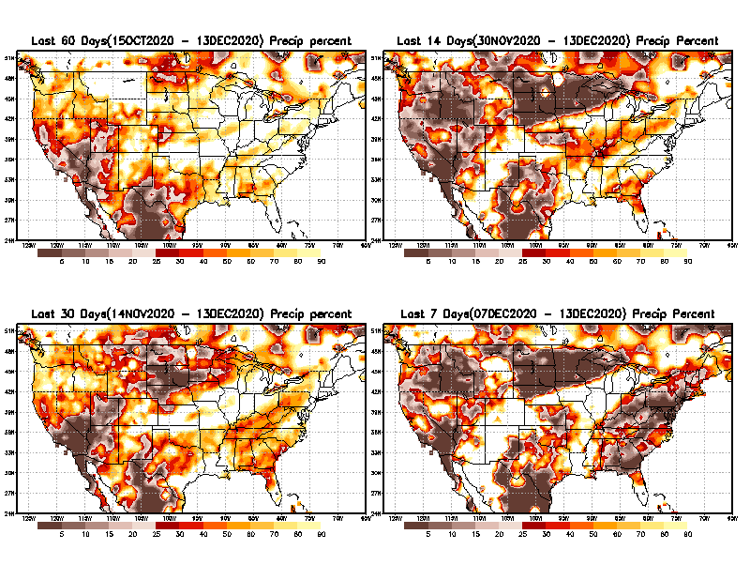
Precipitation Percent during last 7, 14, 30, & 60 days.
60 Days
14 Days
This plot shows only the rainfall deficient regions <= 90% of normal.
-- This shows more clearly possible/likely drought developing region in the future unless there is above normal rainfall in these regions in the future, to offset these shortfalls.
30 days
7 Days
From: Recent Accumulated Precipitation https://www.cpc.ncep.noaa.gov/products/Drought/briefing_prcp.shtml

Slide 7
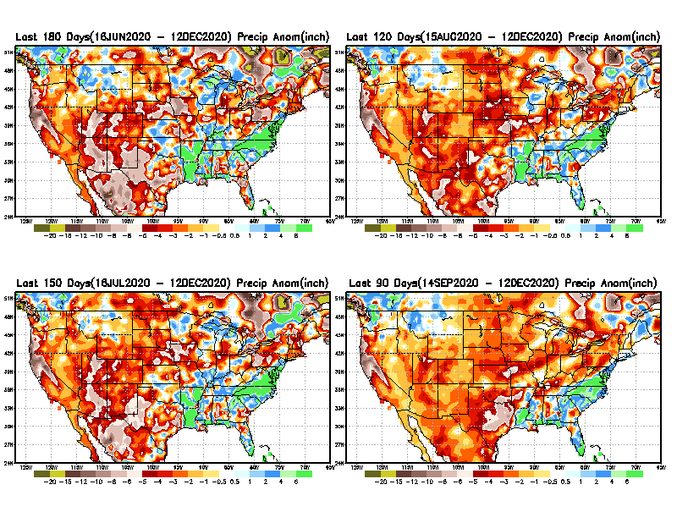
Total precipitation ANOM during last 3, 4, 5, and 6 months.
6 M
4 M
While the Precipitation anomalies deficit may seem large in some regions (compared to others), it is the % of normal precip (next slide) that matters more!!
5 M
3 M
From: Recent Accumulated Precipitation https://www.cpc.ncep.noaa.gov/products/Drought/briefing_prcp.shtml

Slide 8
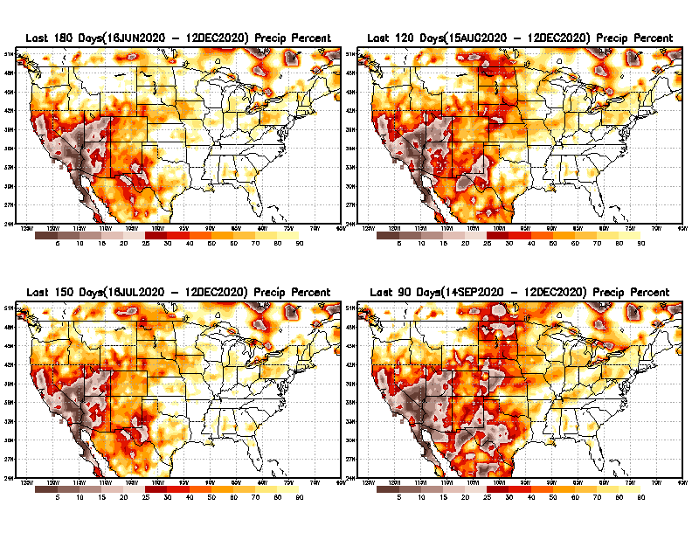
Total precipitation Percent during last 3, 4, 5, and 6 months.
6 M
4 M
In these interim time scale 3-6 months, we need to pay attention to regions, which are dark-brown, red & dark red (<50%).
While accrued precipitation deficits are real & objective,
droughts are subjective declarations!!
5 M
3M
East vs West!
Broad vs Narrow
rainfall season.
In general, West suffers more from frequent and lasting droughts.
With these various rainfall deficits in diff. time ranges, where and how exactly does one declare drought? Other factors (T/SM/E, etc..) do matter, but is cumulative precip. Deficits/percent_of_normal ultimately more important?

Slide 9
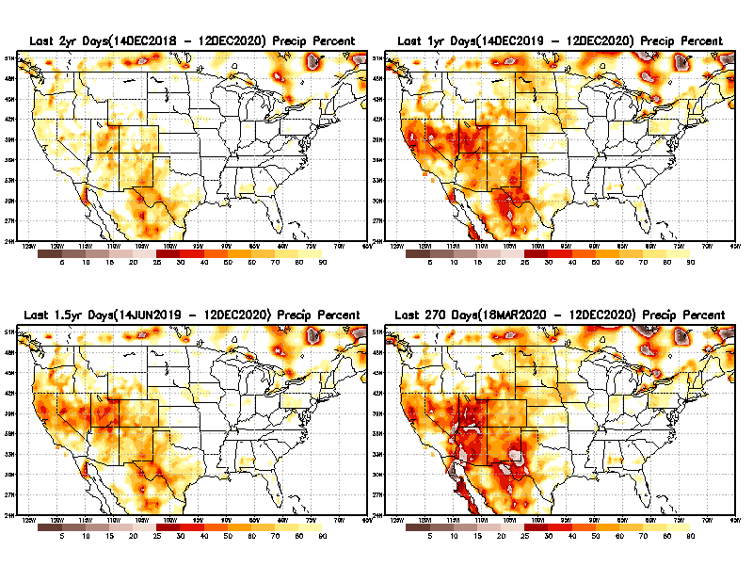
Total precipitation Percent during last 9 months, 1 yr, 1.5yrs, & 2 yrs.
2 Y
1 Y
Tinderbox areas, where some form of longer term rainfall
deficiencies already, exist !!
-Almost all are in the WEST!
-This & Next slide!!
1.5 Y
9 M
From: Recent Accumulated Precipitation https://www.cpc.ncep.noaa.gov/products/Drought/briefing_prcp.shtml

Slide 10
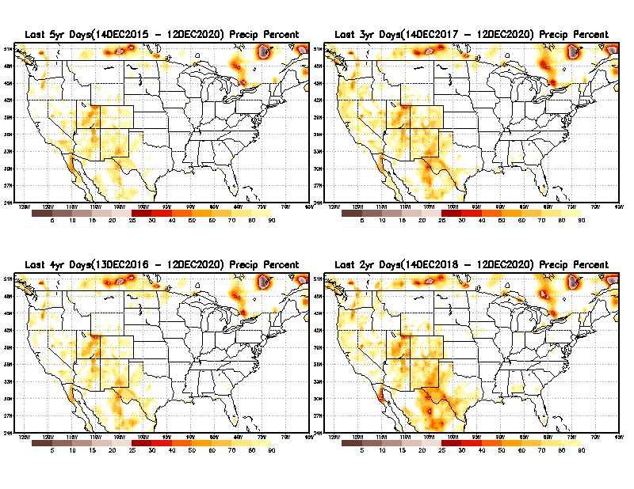
Total precipitation Percent during last 2 yrs, 3 yrs, 4 yrs, & 5 yrs.
5 Y
3 Y
In new format
4 Y
2 Y
In this time range, across the country, there is not any big area where the rainfall is less than 50%.
From: Recent Accumulated Precipitation https://www.cpc.ncep.noaa.gov/products/Drought/briefing_prcp.shtml

Slide 11
Rainy (3-month)Season across the US
East vs West!
More darker colors in regn. central/west => narrow rainy season (months)
Overall, more white space in the east -> distributed rainfall season (except ~FL).

Slide 12
October-least green map!
As if not enough so far, September/October are still climatologically bad months for west coast fire season ☹
*********
EAST vs
CTR/WEST
Behavior in Drought is loosely tied to rainfall climo!!
*********
Adapted from Rich Tinker.

Slide 13
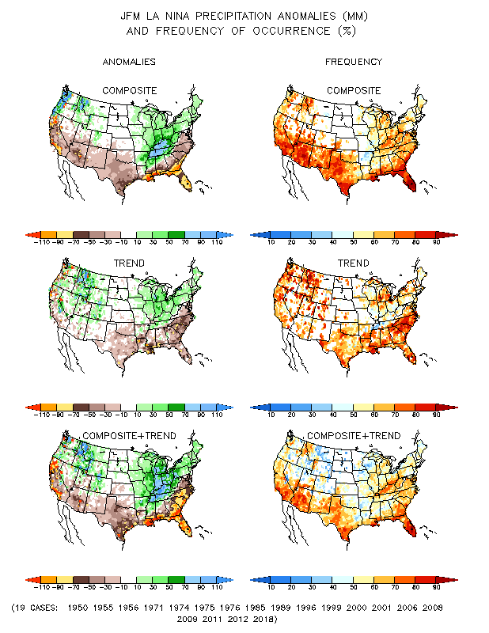
La Nina Precip COMPOSITES & Trend map
JFM
WET
DRY

Slide 14
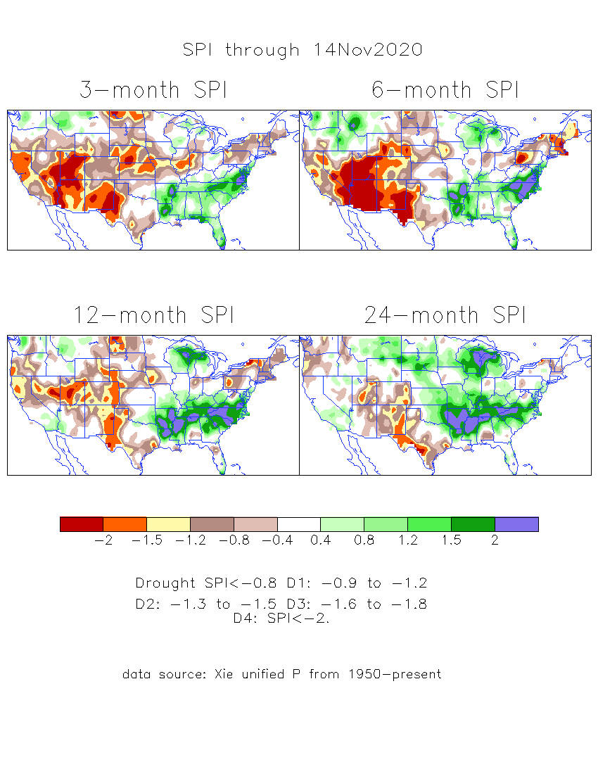
The Standardized Precipitation Index SPI (based on Observed P)
----- Last Month
Very interesting graphic & details for the drought across the US based on the more generalized precip deficit/excess, the Standardized Precipitation Index (SPI).
The dark brown and red colors, indicating standardized precipitation deficits, in the various time periods, approximately correspond to the appropriate short/long term drought monitor regions and their intensities

Slide 15
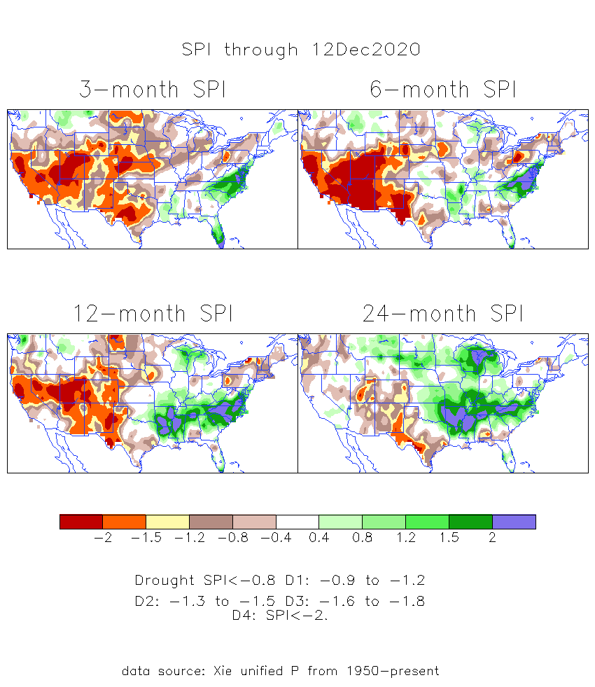
The Standardized Precipitation Index SPI (based on Observed P)
----- NOW
Very interesting graphic & details for the drought across the US based on the more generalized precip deficit/excess, the Standardized Precipitation Index (SPI).
The dark brown and red colors, indicating standardized precipitation deficits, in the various time periods, approximately correspond to the appropriate short/long term drought monitor regions and their intensities
----- NOW
How does one negotiate and reconcile declaring short term vs long term drought when precip. deficiencies patterns differ on many different time scales locally!!
What is the cutoff delineating time between short VS long term drought!!

Slide 16
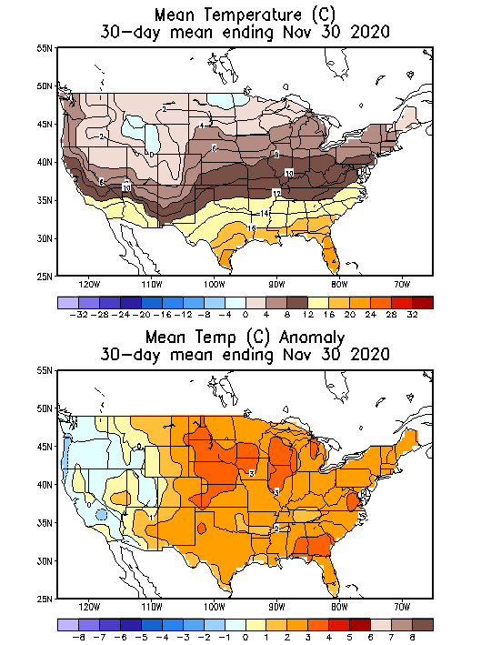
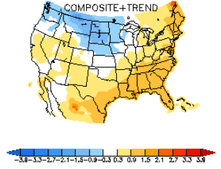
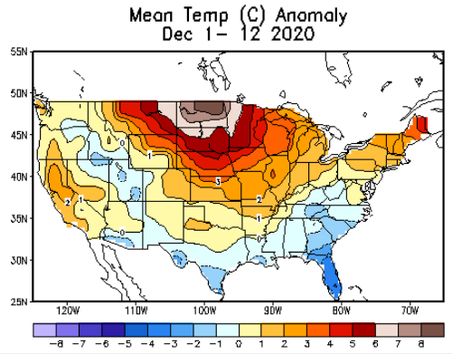
Recent US Temperatures
Canonical La Nina T - DJF

Slide 17
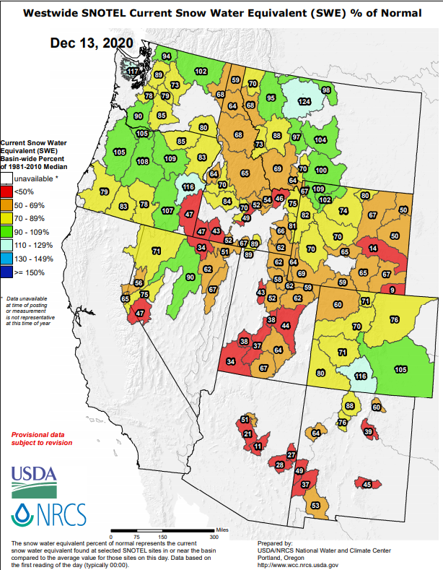
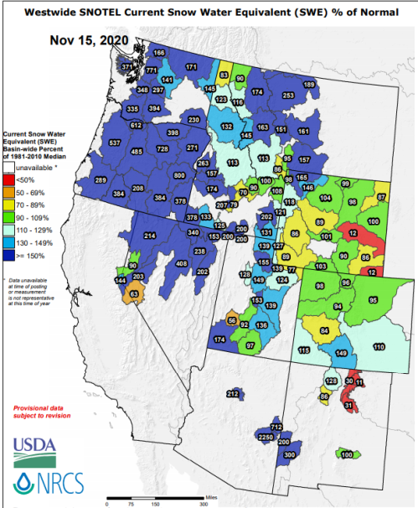
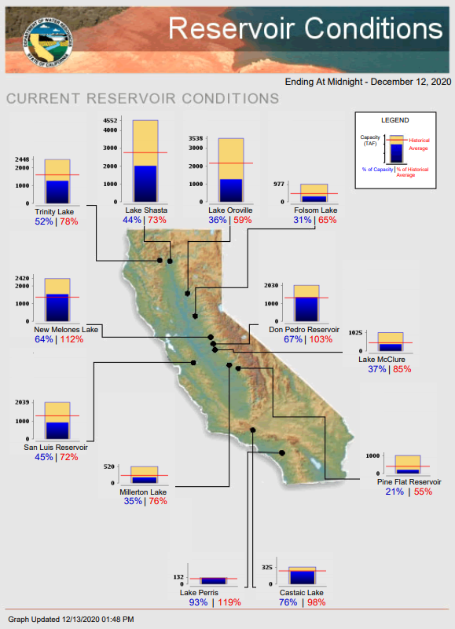
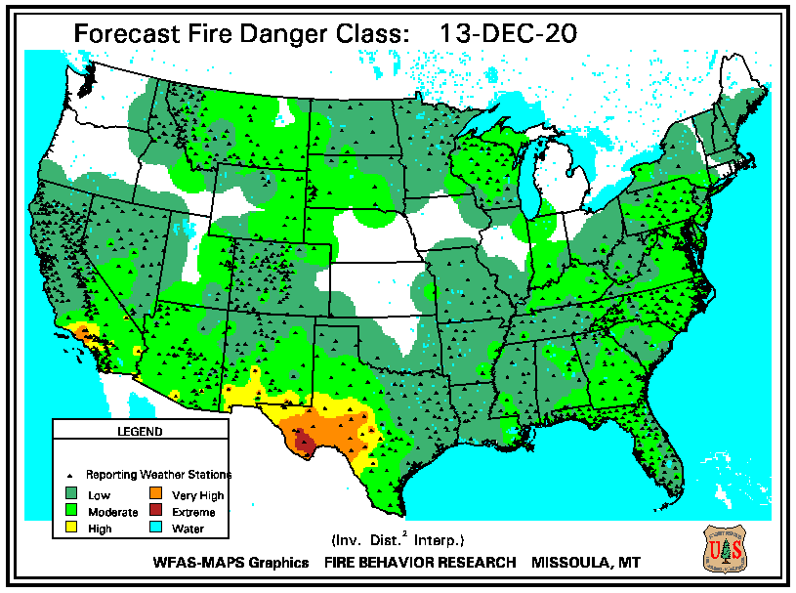
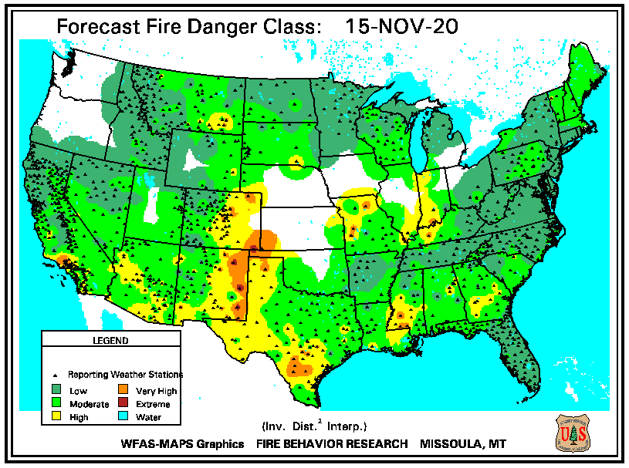
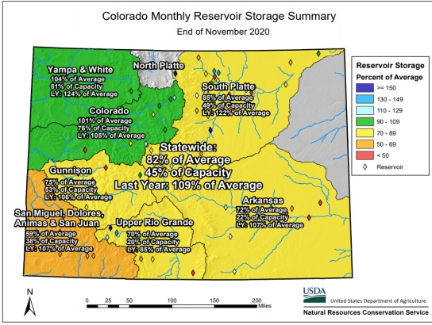
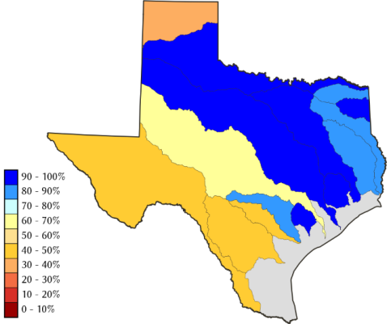
THIS MONTH
LAST MONTH
https://fsapps.nwcg.gov/
It is winter, and we still cant’ say fire season is over in the west!! Sanderson fire in CA still active!!
LAST MONTH
THIS MONTH
CO
All reservoirs are at “below historical average levels”!!
TX
82 %
of AVG!
La Nina is here in full force thru winter/!!
Impact on upcoming CA season ? water reservoir levels??

Slide 18
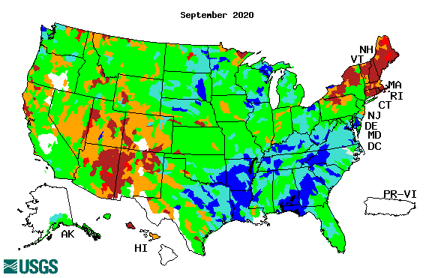
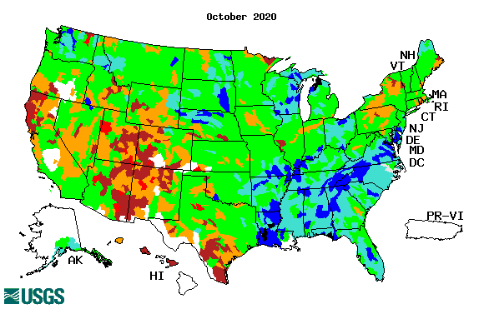
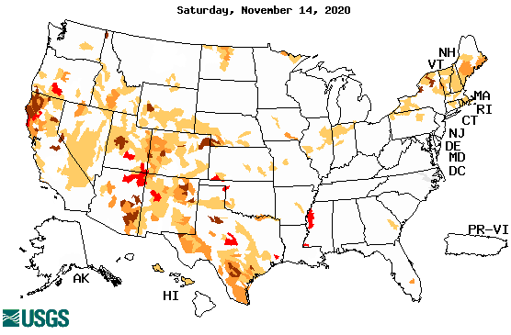
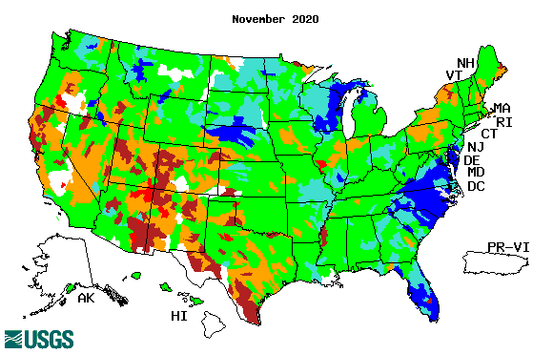
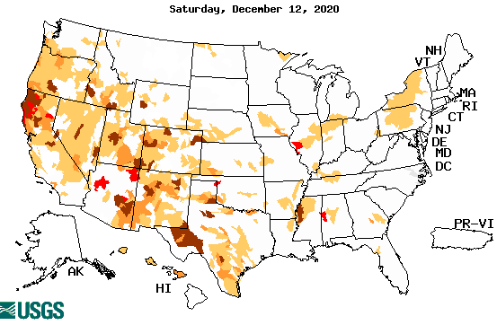
Streamflow (USGS)
Worse conditions in the southwest, in the monsoon region.
Northeast drought considerably improved.
Pacific NW much improved now.
Map shows only below normal 7-day average streamflow compared to historical streamflow for the day of year.
One month ago (left) &
Now (below)
Note:
CA,
TX,
Maine/
Northeast
Except for the NE, overall worsened drought/drier conditions across the south and west!!
18

Slide 19
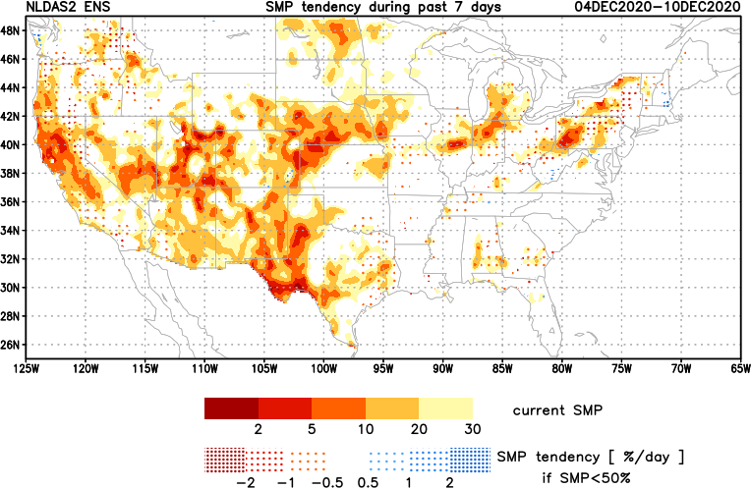
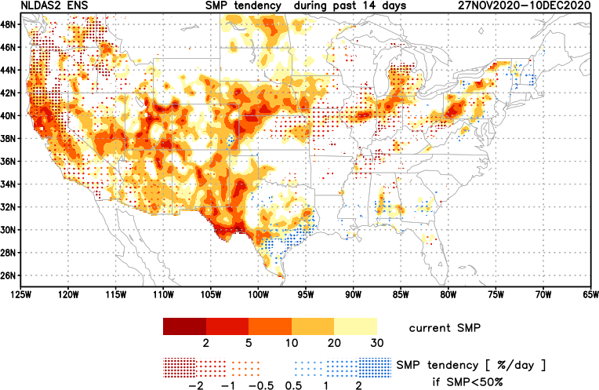
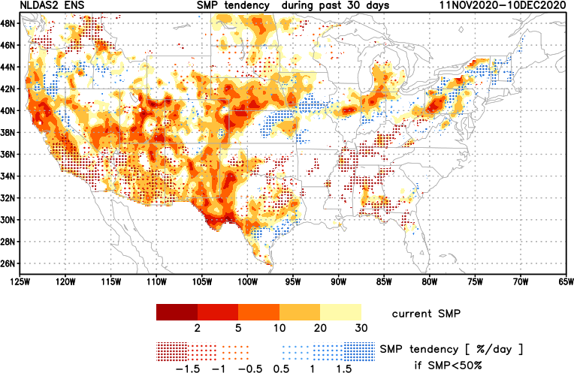
[Now]
NCEP Ensemble mean NLDAS2 models’ Soil Moisture tendency/trend
7 days
14 days
30 days
Western half, mostly straightforward!
Eastern half, east of TX, somewhat mixed picture.

Slide 20
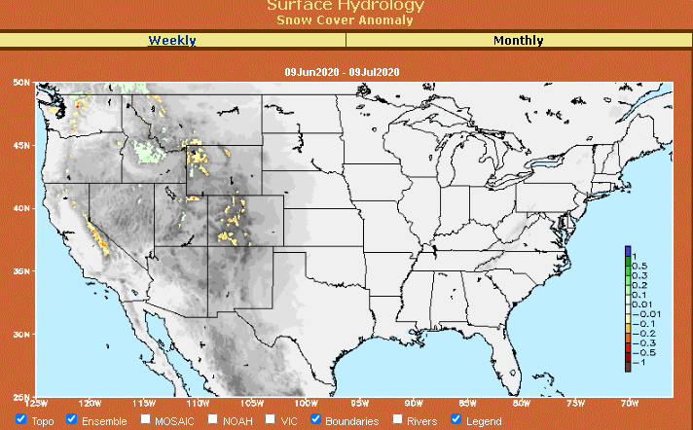
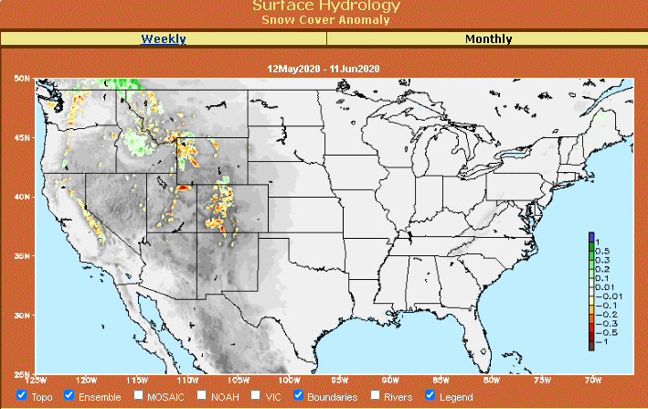
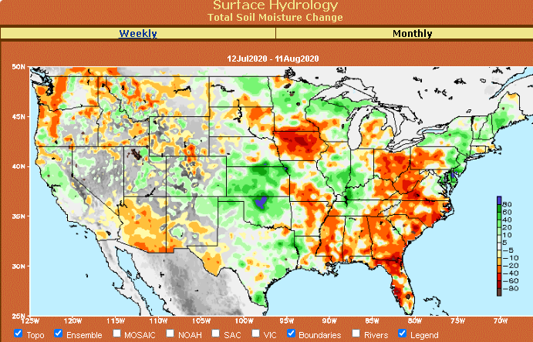
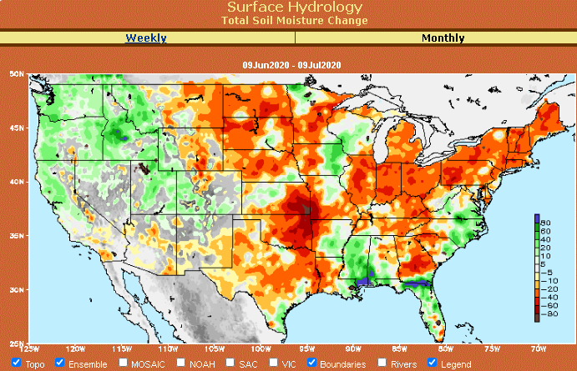
Snow cover & Soil Moisture Anomalies
Snow cover
SLIDE
NOT SHOWN!
Last month ~ this time
Now
Look further for areas of drought development

Slide 21
EL NIÑO/SOUTHERN OSCILLATION (ENSO)
DIAGNOSTIC DISCUSSION
issued by CLIMATE PREDICTION CENTER/NCEP/NWS and the International Research Institute for Climate and Society
10 December 2020
ENSO Alert System Status: La Nina Advisory
Synopsis: La Niña is likely to continue through the Northern Hemisphere winter 2020-21 (~95% chance during January-March), with a potential transition during the spring 2021 (~50% chance of Neutral during April-June).

Slide 22
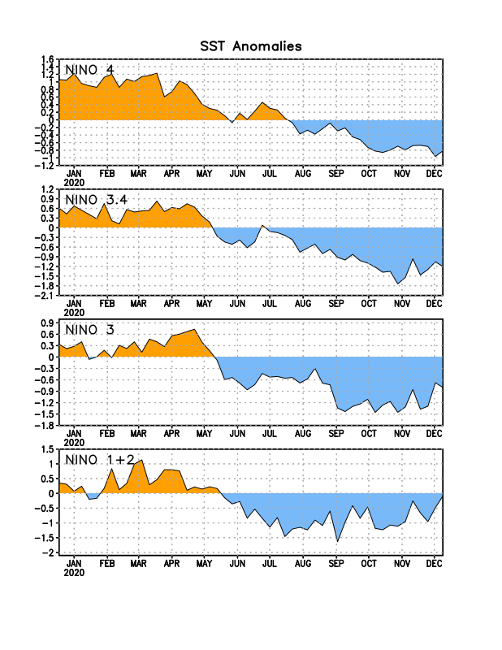
Latest values of SST indices in the various Nino Regions.
This is the most blue! (cold) in all 4 indices (see left) in a while. Subsurface ocean heat anomalies are also cold!!

Slide 23
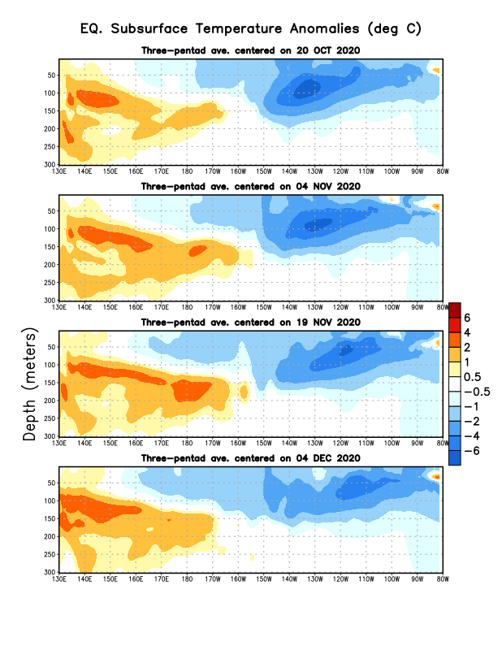
Sub-Surface Temperature Departures in the Equatorial Pacific
Central and eastern tropical SST and subsurface exhibit cold La Nina conditions!!
Warm sub-surface anomalies lurking in the western Pacific. La Nina transitioning/ending in late Spring? To what ? Neutral/El Nino??
Most recent pentad analysis

Slide 24
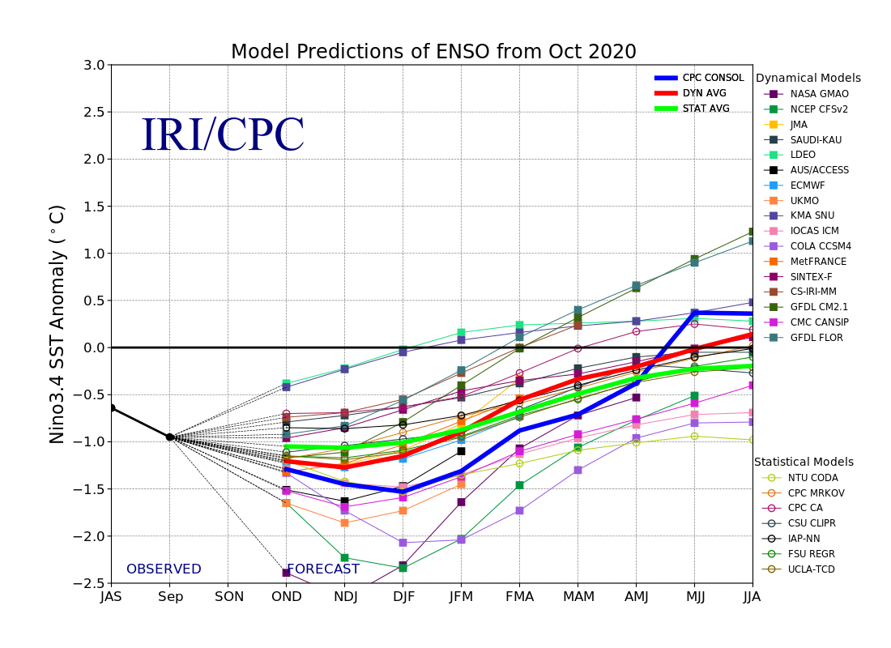
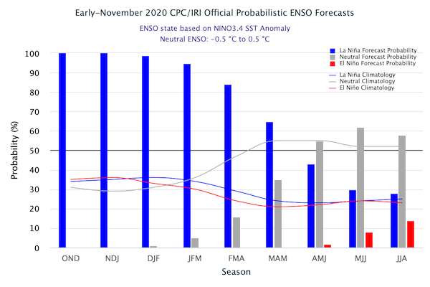
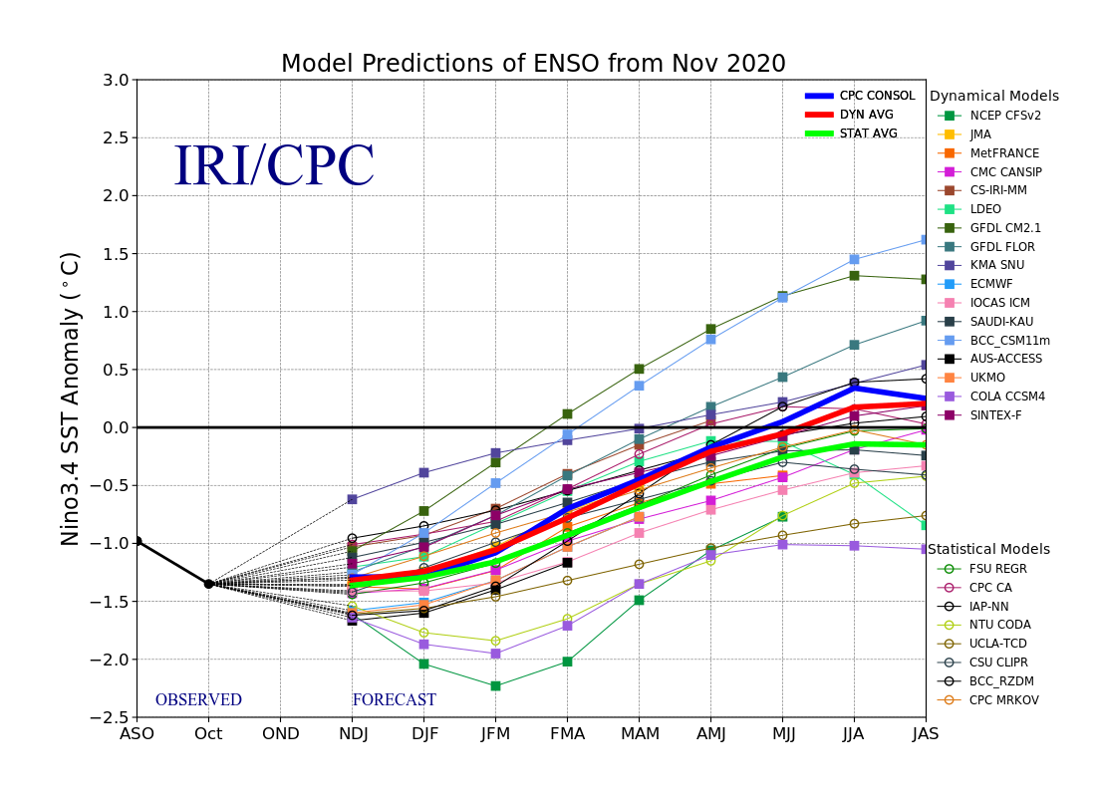
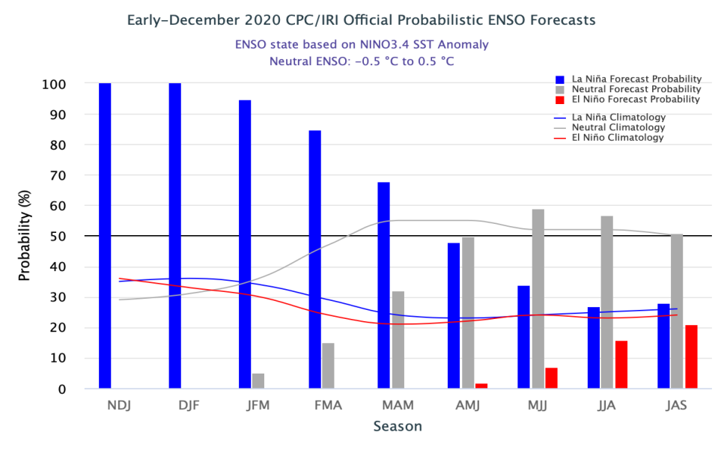
ENSO Forecasts
Early- November CPC/IRI forecast
Early- December CPC/IRI forecast
NDJ < -1 C
La Nina through Winter & early spring.
Expected Canonical impacts already happening and forecast!!

Slide 25
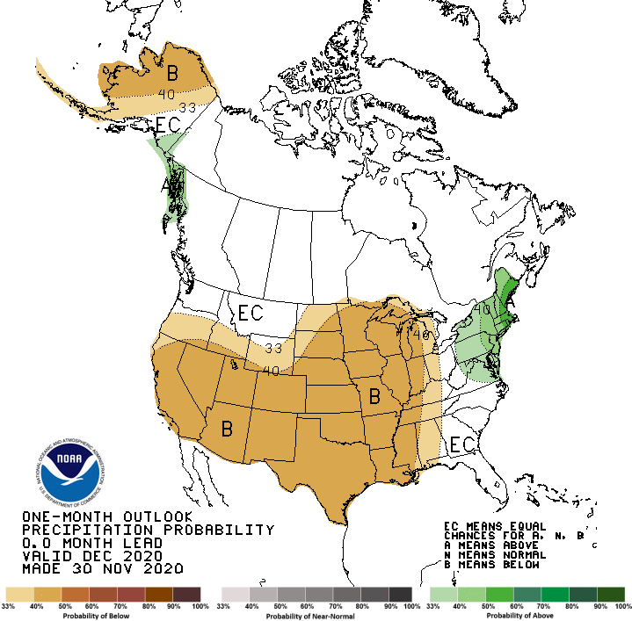
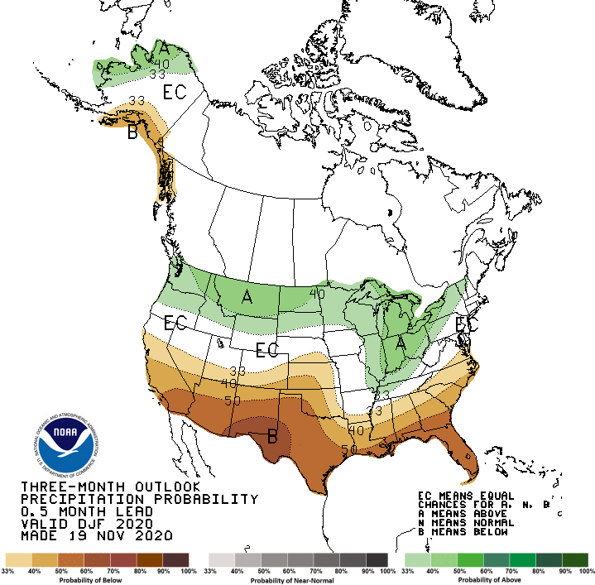
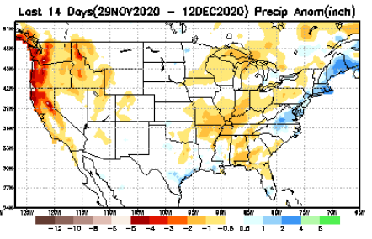
Released Nov 30th
Previous(Last month)
CPC’s official
Precipitation OUTLOOK for Monthly (Dec)/Seasonal (DJF)
Released Nov 19th
Observed so far this month!!
Monthly P/T forecasts verified at mid-month are generally good! Why? ☺ (becoz they r mostly based on GFS’ 2-wk fcsts). We still have many days to go in the month.

Slide 26
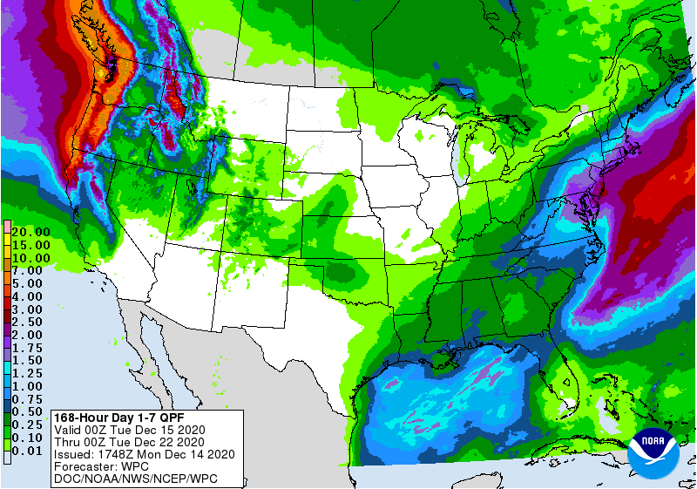
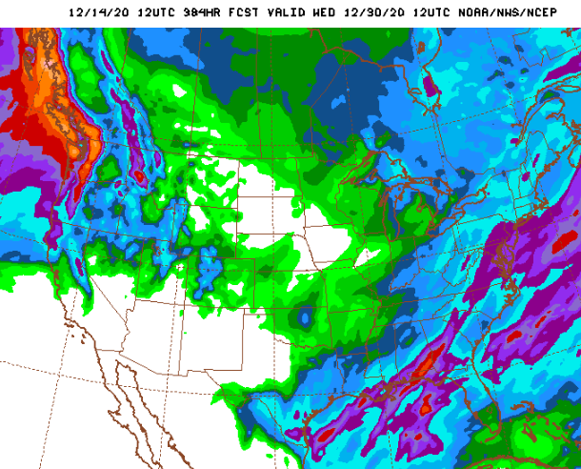
WPC Next 7 days QPF Forecast
GFS Model Guidance for next 16 days.
No rainfall in the short term in southern CA, AZ, NM– where the drought is severe. Much of the US drought is in the West.
Big Relief from remaining drought possible in the upper North West and far NE.

Slide 27
Made
Nov 30th
Previous (Last Month)
CPC’s official
Temperature outlook for Monthly (Dec)/Seasonal (DJF)
Made Nov 19th
Observed so far this month!! ☺

Slide 28
NMME T & P Ens.Mean forecasts
Jan
Much of the country is warm except in the Northwest. The south is WARM+
JFM
The forecast P pattern is the expected canonical La Nina composite, with dry relative conditions in the
South.

Slide 29
Agreement/Disagreement among the various NMME models’ JFM seasonal Precip. Forecast.
??

Slide 30
SPI6 Fcst made from last month(background) compared with this month(foreground, red border)
Forecast uncertain in Hatched areas.
The SPI6 fcsts made last month vs. this month based on NMME models’ precip fcst. suggests continuation of drought in the south and west, in the upper Midwest. Possible total drought removal in the Pacific NW and NE. Possibility of developing dry/drought conditions in the SE by end of fcst season.

Slide 31
Latest Initial Conditions:
12/08/2020
http://drought.geo.msu.edu/research/forecast/smi.monthly.php
Predicted Monthly Soil Moisture Percentile
MSU stopped updating 06/10/20 ☹
Initial Conditions 1 month ago:
11/03/2020
The inter quartile range suggest greater uncertainty about the forecast in these shaded regions.

Slide 32
Summary
Current Drought conditions:
Over the last several months, drought area & severity has overall generally increased across the South West & NW.
The drought in the Dakotas, Wyoming, Nebraska and vicinity which developed late summer continues to hang in there.
More than half of the country is some form of low to severe drought or at least in dry condition.
As predicted last month, drought in the Northeastern (New England) states has finally begun to get some relief.
But also as predicted, some dryness is beginning to emerge in the southeast, consistent with La Nina.
Some/many of California reservoirs levels are below their historical average levels. It is going to be tough with the La Nina expected to continue through upcoming winter!
Just last May US had almost the lowest coverage of area covered by drought! ~ < 4%. Now more than 50% of the country is under drought! The current % of US area at D3 or worse(20%) drought is like as high as it were in 2013.
Current ENSO status and forecast:
La Niña is likely to continue through the Northern Hemisphere winter 2020-21 (~95% chance during January-March), with a potential transition during the spring 2021 (~50% chance of Neutral during April-June).
Prediction:
La Nina is ongoing and strong with lower boundary condition in the form of extensive cold surface and subsurface temperature conditions in the tropical eq. Pacific, so, our confidence in model’s forecasts is increased. The models forecast less than normal rainfall across the southern tier states for the DJFM season.
These below normal rainfall conditions combined with higher than normal temperatures will make the drought persist at the same or even worse levels in the upcoming season. The drought in central and southern CA, NV, UT, AZ, NM and western TX will persist may even get worse. But the Pacific Northwest is likely to get better due to seasonal and enhanced precipitation associated with La Nina, and hence much relief from dryness and drought, and even complete removal of drought conditions here.
The drought conditions in New England states & vicinity is very likely to be gone by the end of forecast season.
Existing developing dry/drought conditions in NE/IA border, and IN, OH will not likely improve, as well as Dakotas will likely remain in drought, as there is no favorable ENSO signal, plus the climo is also not favorable.
The seasonal (lack of) rainfall, combined with even less than that normal rainfall conditions (due to La Nina) in SE state areas could develop some level of drought (how severe is tricky!!) by the end of the DJFM season.
*********************

Slide 33
Miscellaneous maps

Slide 34
Miscellaneous maps

