Slide 1
Drought Outlook Support Briefing December 2021
Climate Prediction Center/NCEP/NOAA
http://www.cpc.ncep.noaa.gov/products/Drought
Bonus topic: One possible explanation for the ongoing multiyear DROUGHT in the Southwest.

Slide 2
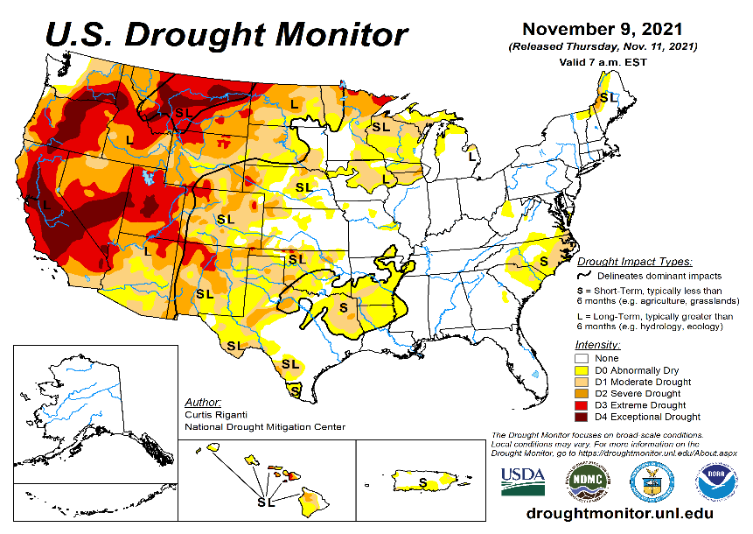
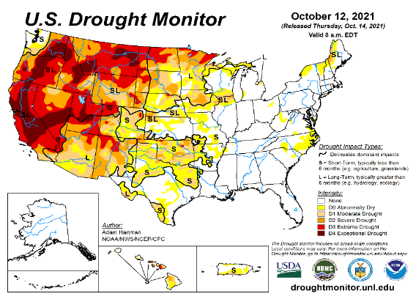
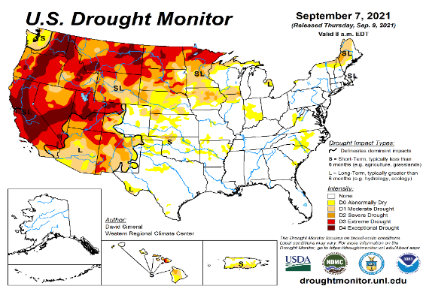
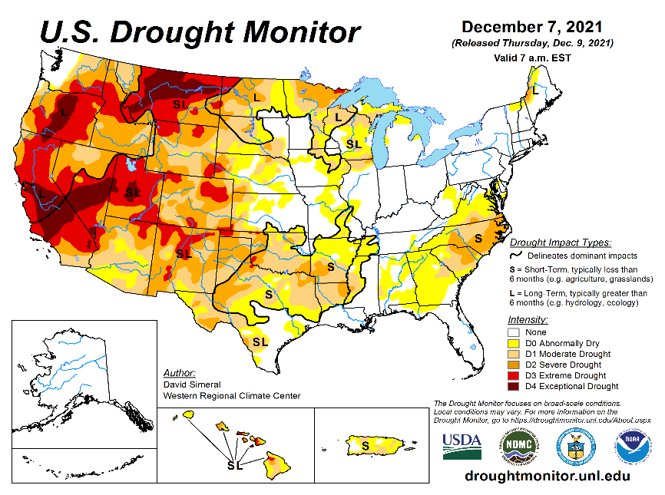
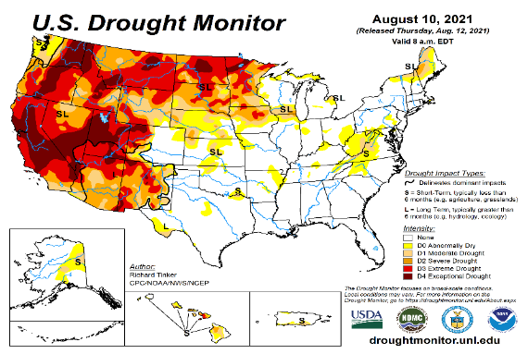
Drought Monitor
Monitoring is important because, unlike US T/P fcsts, for drought forecasts, we have to know where we are, before we can tell where we are going!! Drought forecasts are tendency forecasts.
November
Since mid/late summer in the last few months, there seems to be gradual eastward expansion of the drought in the southwest into southern states into eastern CO, Oklahoma, Texas, and beyond, as well as into northern Plains states into around the Great Lakes states.
The recent good summer monsoon in the US southwest is not enough to offset longer term drought here.
Also in the eastern US, which was relatively drought free (as compared to the west) some noticeable dryness and short term drought has emerged lately in the mid-Atlantic states especially in NC and in neighboring states.
The next important question is, with the ongoing La Nina taking full hold, will the drought in drought in the south expand even further eastward? What about Florida where some dryness has recently developed, but not into drought just yet! And the drought in the mid-Atlantic states?
October
September
December
(Recent/Latest)
August
?

Slide 3
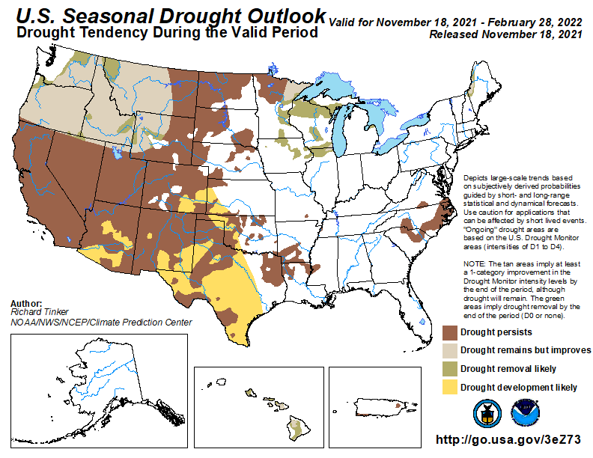
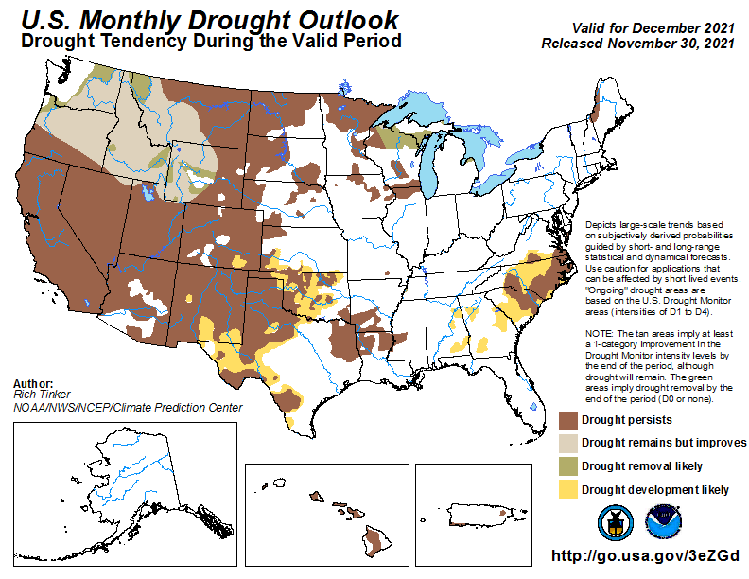
(Previous) Seasonal/Monthly Drought outlooks
New Seasonal+ Drought Outlook to be released in 2 days!
New Monthly Drought Outlook to be released end of this month)
Seasonal Outlook
(18 Nov. 2021- Feb. 2022)
issued 11/18/21
Monthly outlook
(for December 2021)
issued 11/30/21
Almost similar looking monthly and seasonal drought outlooks. Some improvement was expected along the Pacific Northwest due to oncoming rainy season combined with the upcoming La Nina, when dryness is expected in the southwest. Question to consider is will the drought in the south further intensify and expand eastward? Will Florida develop drought? (See La Nina Precip composites later!, slide #13)

Slide 4
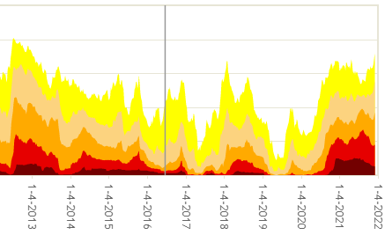
Time series since 2000 spilt into 2 panels.
The recent drought has somewhat stagnated ?
Every drought is different.!
Every situation is different!!
Current drought!
As the La Nina takes strong hold during the ongoing winter (DJF+) will the drought areas across the US increase?

Slide 5
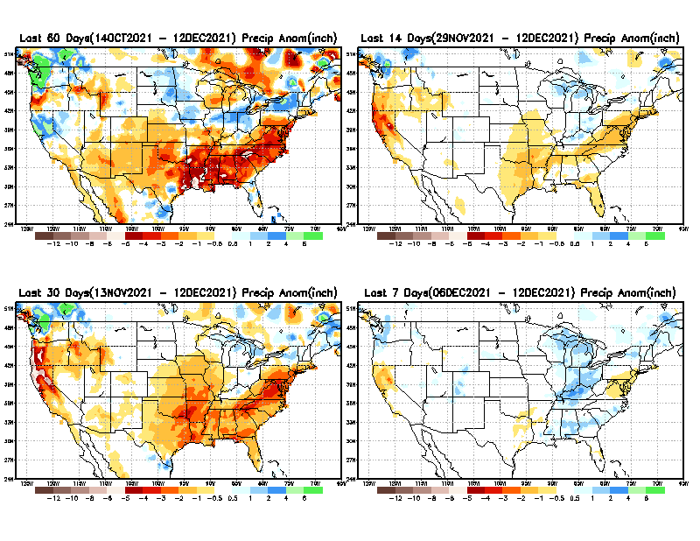
Precipitation ANOM during last 7, 14, 30, & 60 days.
This and next few slides show Precip deficit (excess).
Droughts, for the MOST part, begin and end with precip!! Lately, Temps are becoming (secondarily) important as well.
60 Days
14 Days
?
30 Day
7 Days
These maps in this and following slides, including a) Total,
b) Anom and
c) Percent of Normal precip. in these and other longer time ranges are now (routinely) daily updated at:
?
From: Recent Accumulated Precipitation https://www.cpc.ncep.noaa.gov/products/Drought/briefing_prcp.shtml

Slide 6
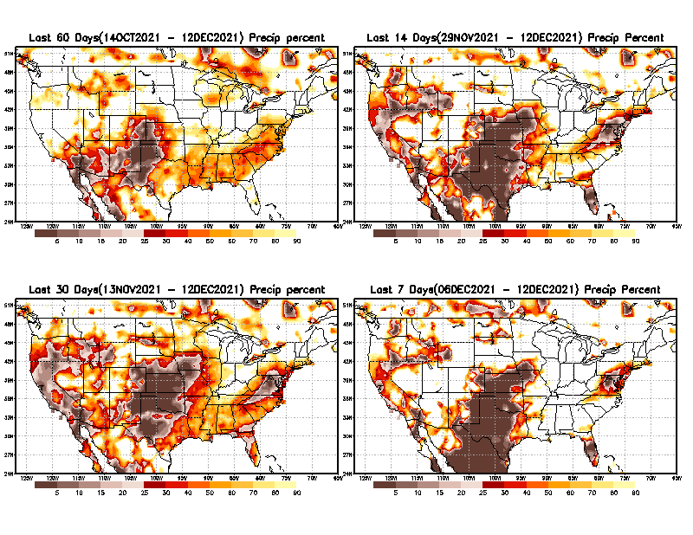
Precipitation Percent (of normal) during last 7, 14, 30, & 60 days - Only Deficit Areas <=90% shown !
60 Days
14 Days
This plot shows only the rainfall deficient regions <= 90% of normal.
-- This shows more clearly possible/likely drought developing region in the future unless there is above normal rainfall in these regions in the future, to offset these shortfalls.
30 days
7 Days
From: Recent Accumulated Precipitation https://www.cpc.ncep.noaa.gov/products/Drought/briefing_prcp.shtml

Slide 7
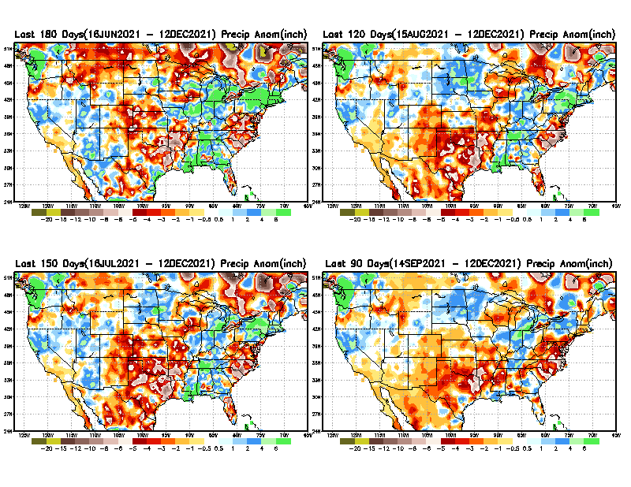
Total precipitation ANOM during last 3, 4, 5, and 6 months.
6 M
4 M
While the Precipitation anomalies deficit may seem large in some regions (compared to others), it is the % of normal precip (next slide) that matters more!!
5 M
3 M
From: Recent Accumulated Precipitation https://www.cpc.ncep.noaa.gov/products/Drought/briefing_prcp.shtml

Slide 8
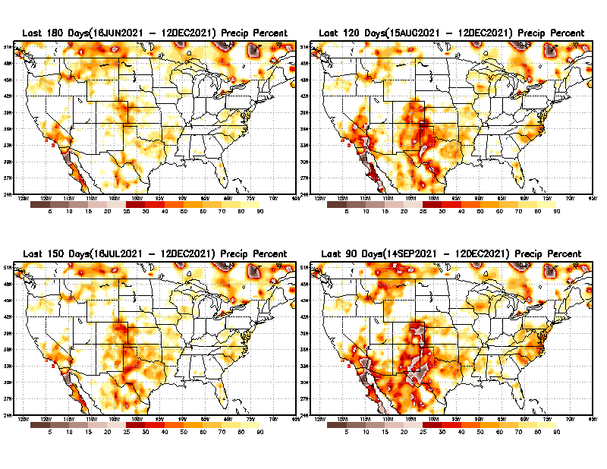
Total precipitation Percent (of normal) during last 3, 4, 5, and 6 months Only Deficit Areas <=90% shown!!
6 M
4 M
In these interim time scale 3-6 months, we need to pay attention to regions, which are dark-brown, red & dark red (<50%).
Not so bad along coast!
in %
While accrued precipitation deficits are real & objective,
droughts are subjective declarations!!
5 M
3M
East vs West!
Broad vs Narrow
rainfall season.
In general, West suffers more from frequent and lasting droughts.
Short term(S) Drought is generally declared when rainfall deficits exist in the 3-6 months time range. { Long term deficits beyond 1 or 2 years is Long term L drought! }

Slide 9
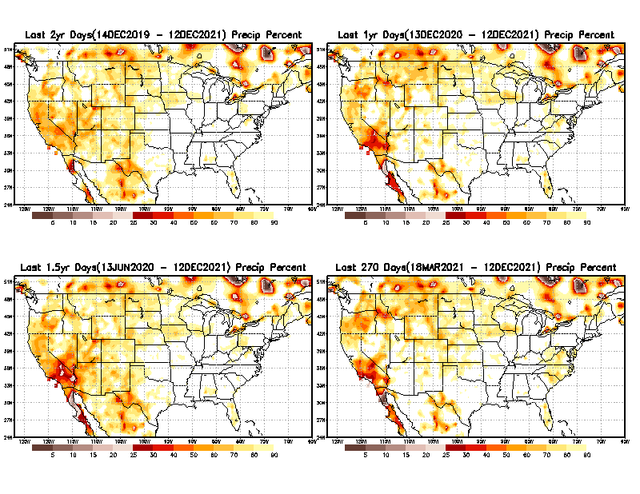
Total precipitation Percent during last 9 months, 1 yr, 1.5yrs, & 2 yrs. .–Only Deficit Areas shown!! <=90%
2 Y
1 Y
Tinderbox areas, where some form of longer term rainfall
deficiencies already, exist !!
-Almost all are in the west!, all part of the long term drought
-This & Next slide!!
1.5 Y
9 M
From: Recent Accumulated Precipitation https://www.cpc.ncep.noaa.gov/products/Drought/briefing_prcp.shtml

Slide 10
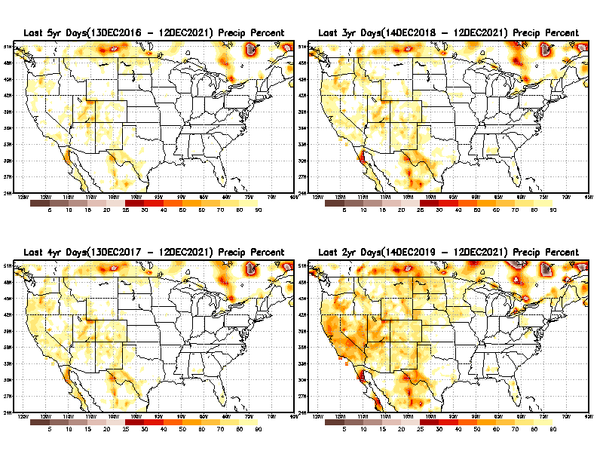
Total precipitation Percent (of normal) during last 2, 3, 4, & 5 yrs. .–Only Deficit Areas <=90% shown !!
5 Y
3 Y
In these long time ranges (2-5 yrs), there is a general dearth/lack of precipitation in the southwest US.
4 Y
2 Y
Ongoing multiyear drought in the SouthWest!! Ongoing La Nina will not help.
From: Recent Accumulated Precipitation https://www.cpc.ncep.noaa.gov/products/Drought/briefing_prcp.shtml

Slide 11
Rainy (3-month)Season across the US
NDJ –Large rainfall deficits in the middle of country and SE!
East vs West!
More darker colors in west/central => narrow rainy season (months)
Overall, more white space in the east => distributed rainfall season (except ~FL).

Slide 12
SON season, difficult season for drought forecast? Also transition-ing ENSO?
OCT - Month with the least WHITE & GREEN!
*********
EAST vs
CTR/WEST
Drought Behavior is loosely tied to rainfall climo!! And the limited rainy season in the west
*********
Adapted from Rich Tinker.

Slide 13
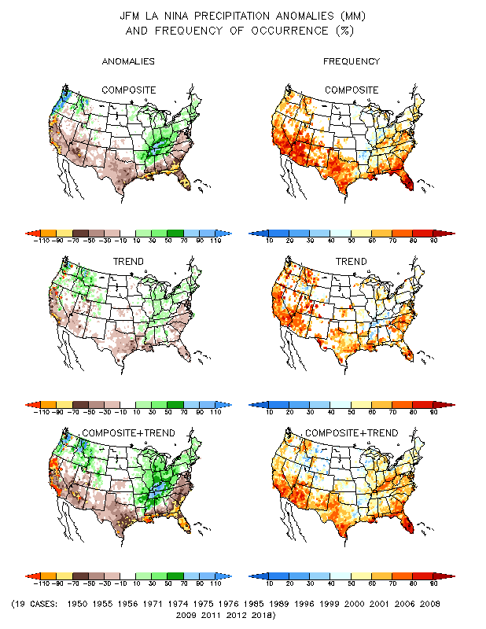
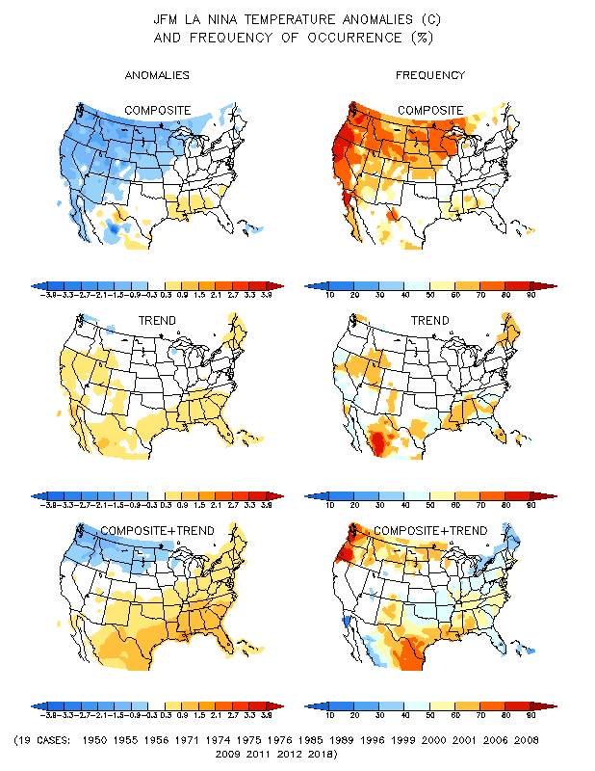
La Nina Precip/Temperature COMPOSITES & Trend map
JFM
P
T

Slide 14
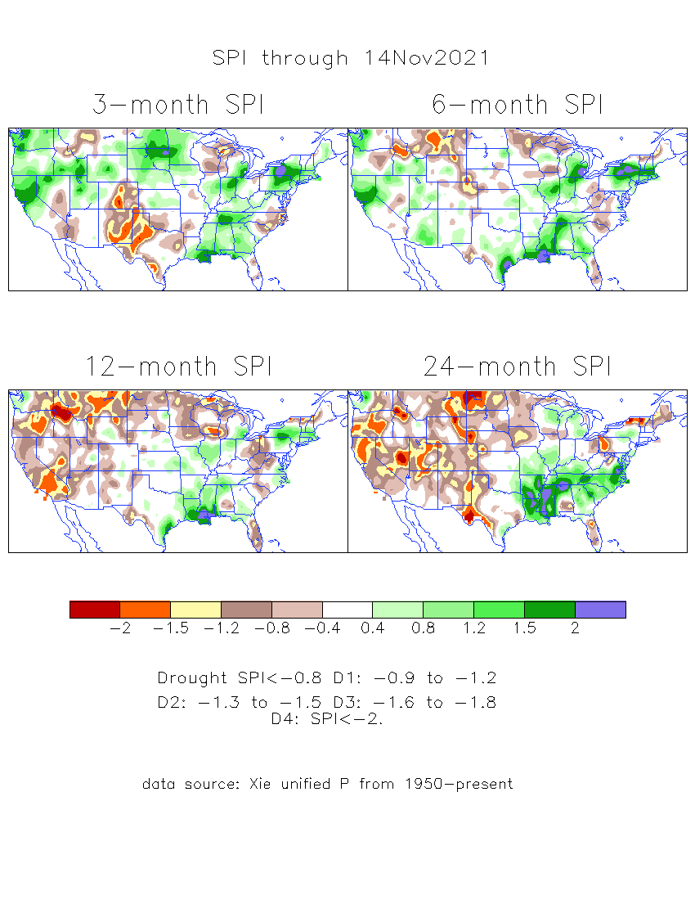
The Standardized Precipitation Index SPI (based on Observed P)
----- Last Month
Very interesting graphic & details for the drought across the US based on the more generalized precip deficit/excess, the Standardized Precipitation Index (SPI).
The dark brown and red colors, indicating standardized precipitation deficits, in the various time periods, approximately correspond to the appropriate short/long term drought monitor regions and their intensities
Don’t let the short term improvement in the southwest fool you!
There is an ongoing long term drought here.

Slide 15
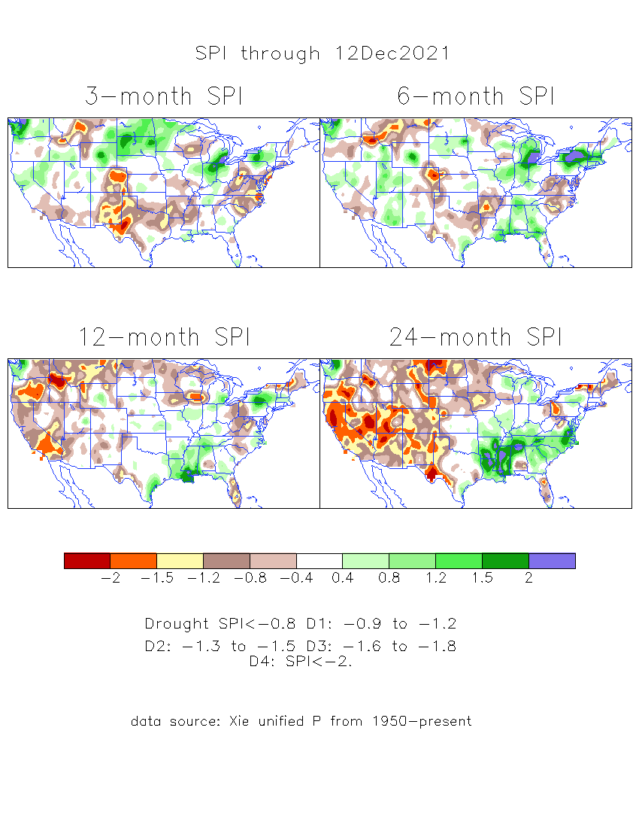
The Standardized Precipitation Index SPI (based on Observed P)
----- NOW
Very interesting graphic & details for the drought across the US based on the more generalized precip deficit/excess, the Standardized Precipitation Index (SPI).
The dark brown and red colors, indicating standardized precipitation deficits, in the various time periods, approximately correspond to the appropriate short/long term drought monitor regions and their intensities
Short
The short term drought has somewhat shifted/extended from southwest to northwest and the northern Plains. But the long term drought in the southwest remains.
----- NOW
Long
How does one negotiate and reconcile declaring short term vs long term drought when precip. deficiencies patterns differ on many different time scales locally!!
What is the cutoff delineating time between short VS long term drought!!
At exactly where does drought begin?

Slide 16
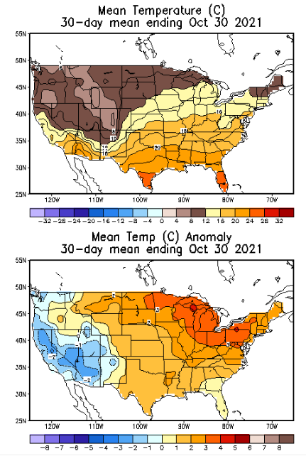
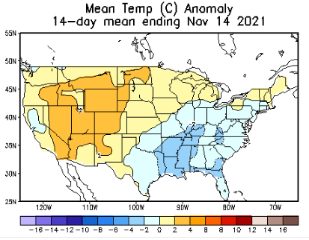
Slide from last month..
Recent US Temperatures
Almost a east-west flip in the south this month as compared to last month.
So far this month !!

Slide 17
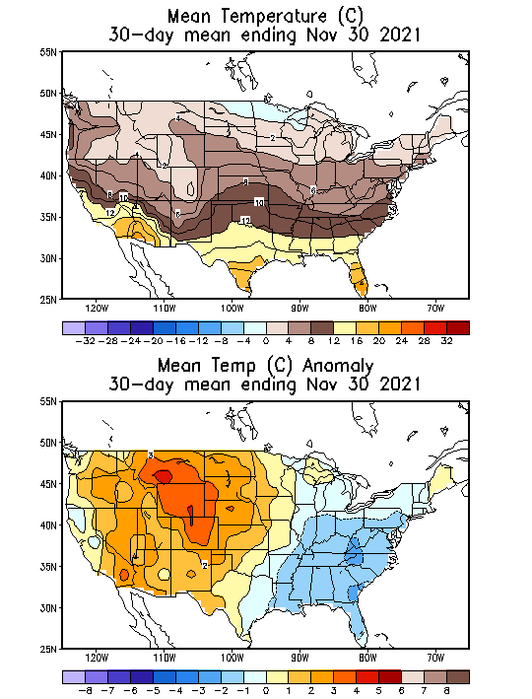
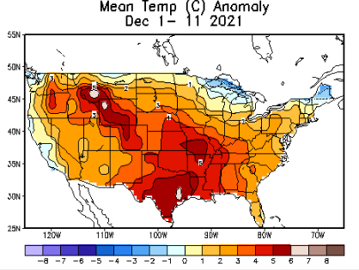
Now..
Recent US Temperatures
Almost a east-west flip in the south this month as compared to last month.
So far this month !!

Slide 18
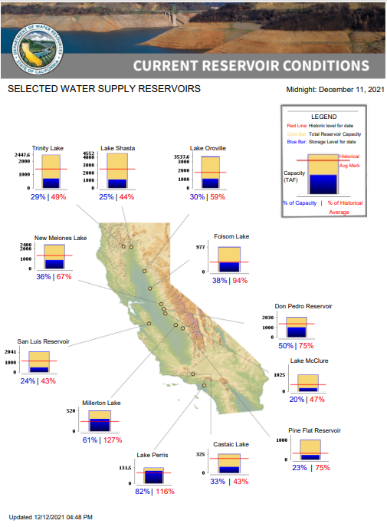
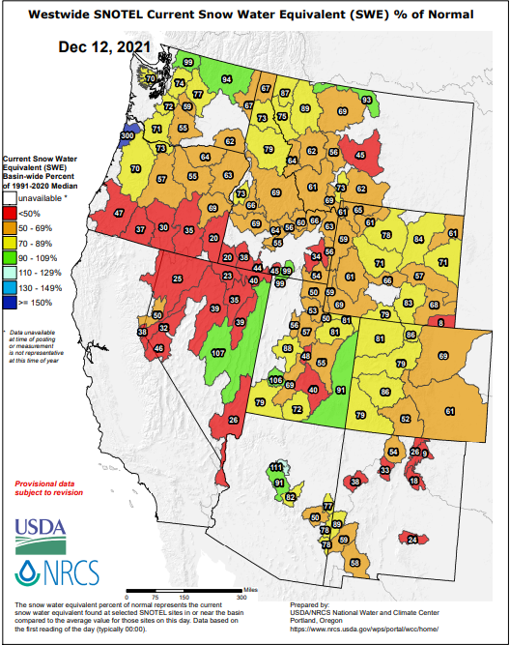
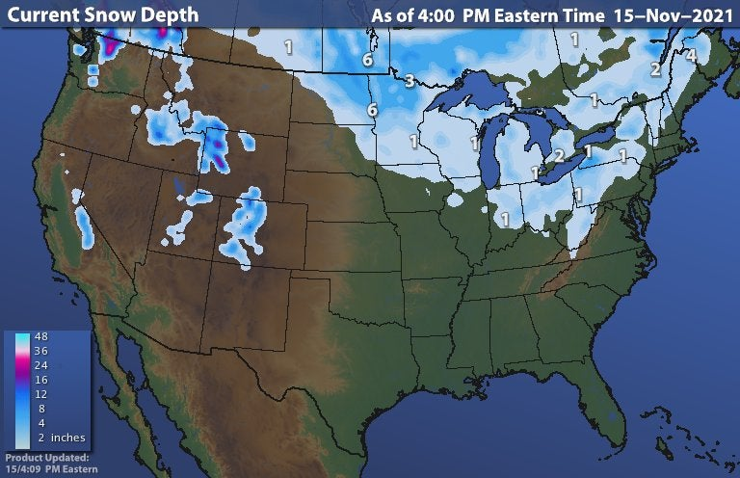
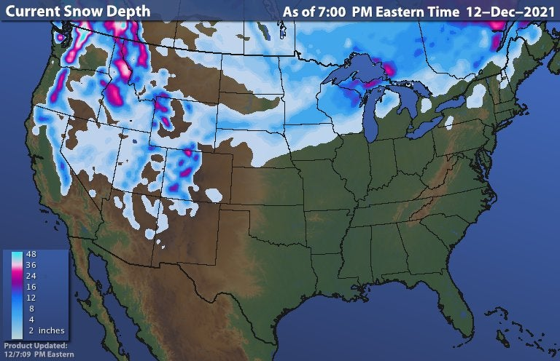
Last month
Many CA reservoirs are already very low!!
This month
La Nina conditions this upcoming winter will further worsen the water situation in CA and some western states.
https://www.wunderground.com/maps/snow/snow-cover

Slide 19
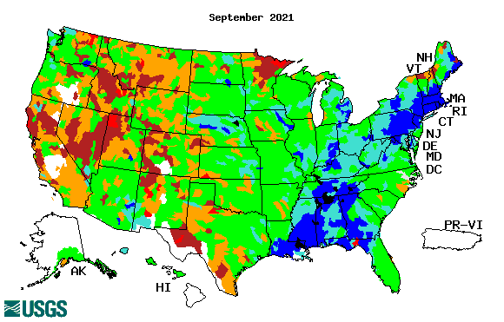
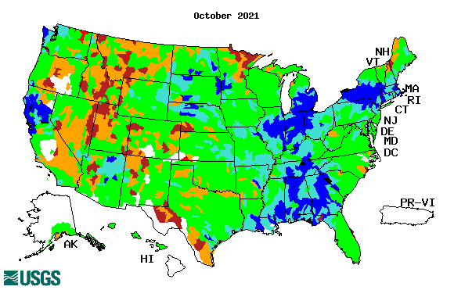
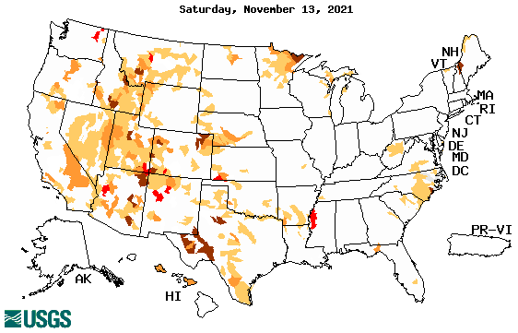
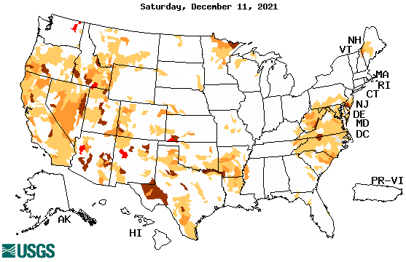
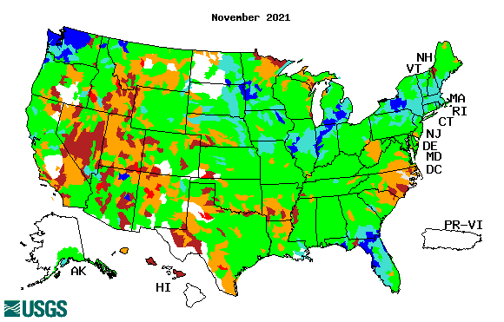
Streamflow (USGS)
Same data source USGS:
Look at the monthly maps for Northeast vs weekly maps in the bottom!!
Map shows only below normal 7-day average streamflow compared to historical streamflow for the day of year.
One month ago (left) &
Now (below)
Streamflow is only a partial indicator, as it is highly managed.
Look along the Pacific coastal states. If sometimes, the various indicators are confusing, go back to % of rainfall deficit maps – to reinforce!!
19

Slide 20
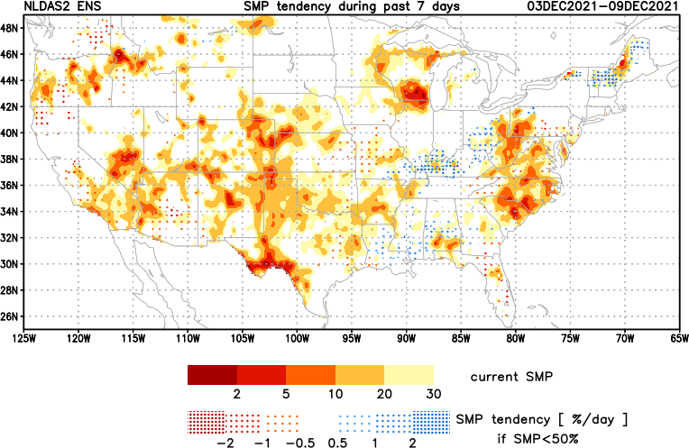
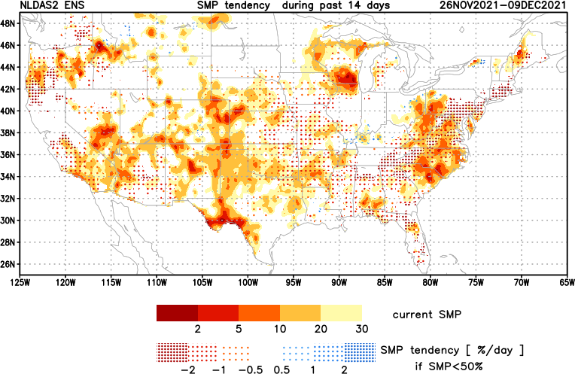
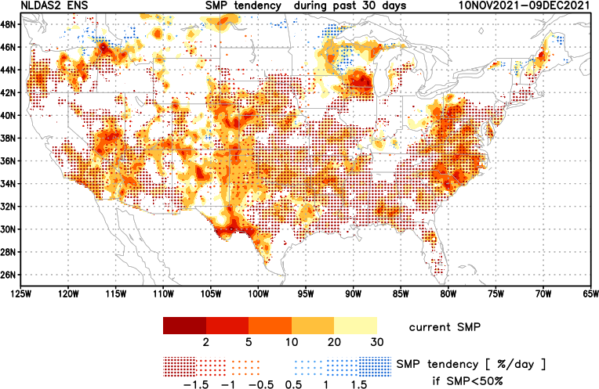
[Slide not shown]
NCEP Ensemble mean NLDAS2 models’ Soil Moisture tendency/trend
7 days
14 days
30 days

Slide 21
EL NIÑO/SOUTHERN OSCILLATION (ENSO)
DIAGNOSTIC DISCUSSION
issued by CLIMATE PREDICTION CENTER/NCEP/NWS and the International Research Institute for Climate and Society
9 December 2021
ENSO Alert System Status: La Nina Advisory
Synopsis: La Niña is favored to continue through the Northern Hemisphere winter 2021-22 (~95% chance) and transition to ENSO-neutral during the spring 2022 (~60% chance during April-June).
CPC’s Oceanic Niño Index (ONI) [3 month running mean of ERSST.v5 SST anomalies in the Niño 3.4 region (5ºN-5ºS, 120º-170ºW)], based on centered 30-year base periods updated every 5 years.

Slide 22
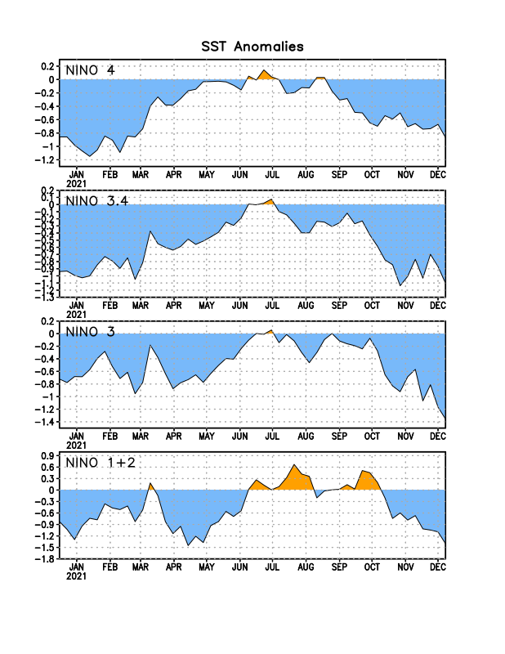
Latest values of SST indices in the various Nino Regions.

Slide 23
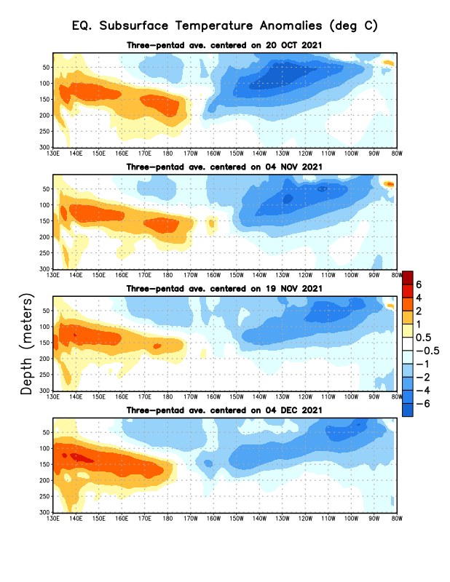
Sub-Surface Temperature Departures in the Equatorial Pacific
The subsurface cold anomalies are fully in place, but anoms are weakening?
Warm waters in the WP are lurking!
Most recent pentad analysis

Slide 24
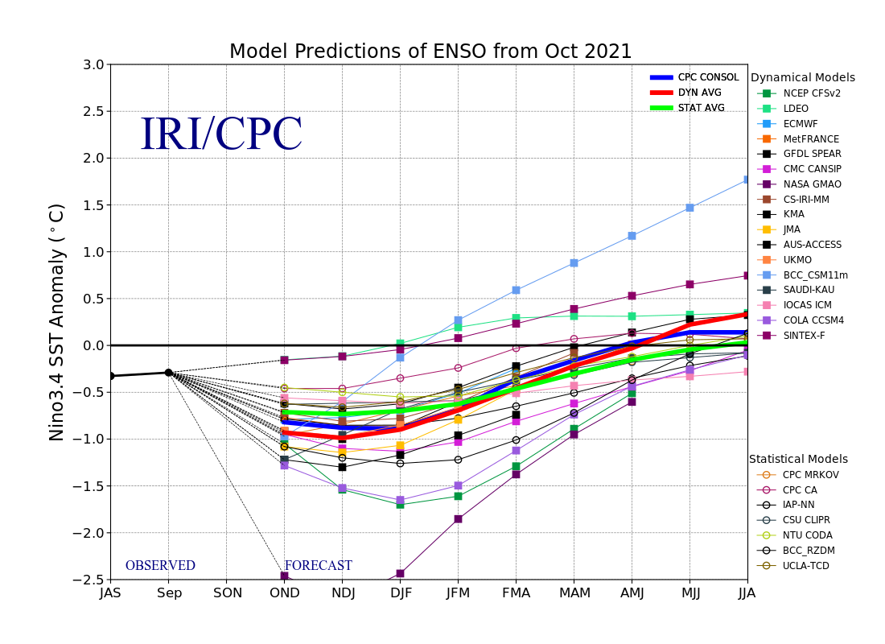
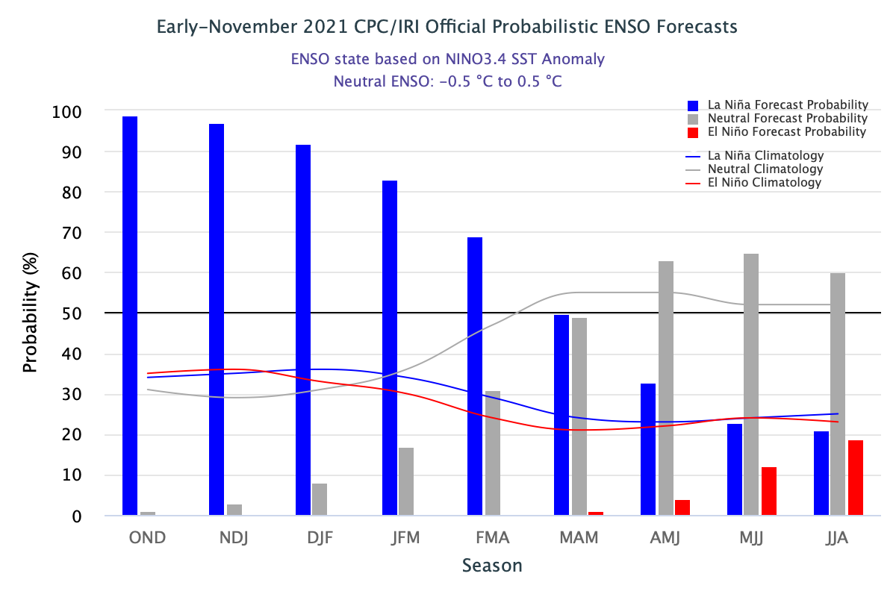
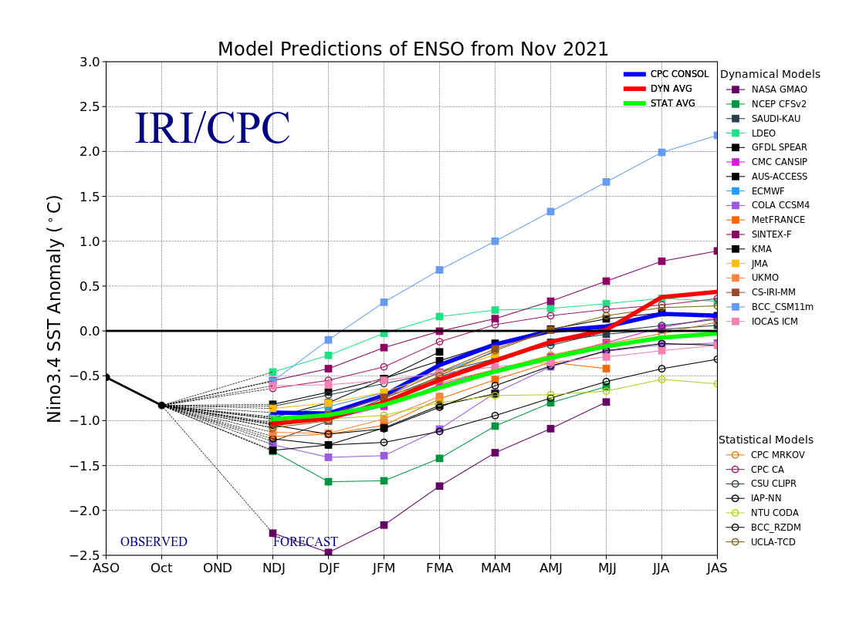
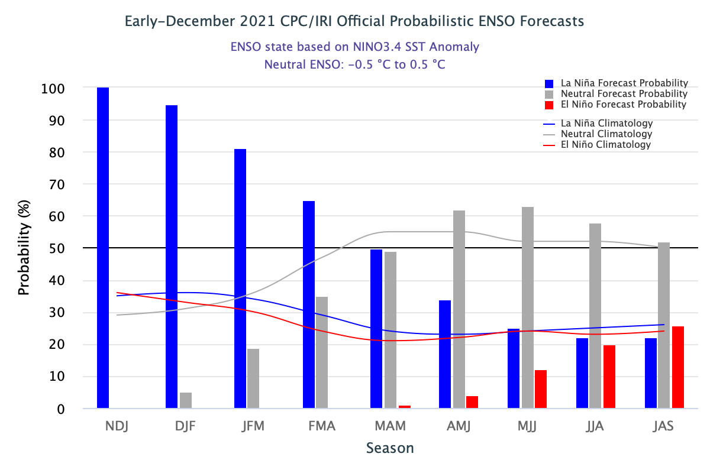
ENSO Forecasts
Early- November CPC/IRI forecast
Early- December CPC/IRI forecast
Dynamical, Statistical, CPC-Consolidated fcsts are coming together!! But still at ~ -0.5C !
Looks like a quick weak La Nina Event during this upcoming winter ONLY or slightly beyond too!

Slide 25
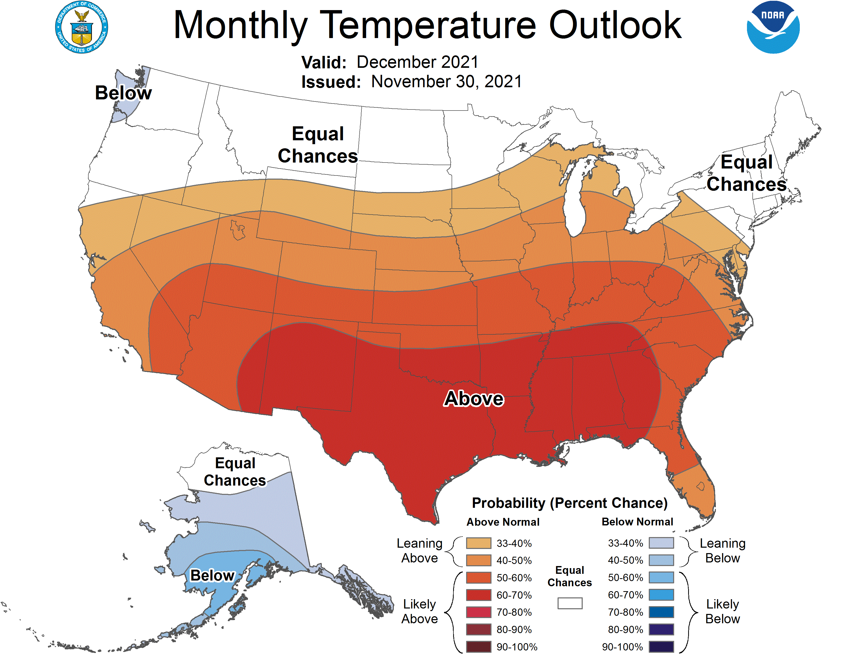
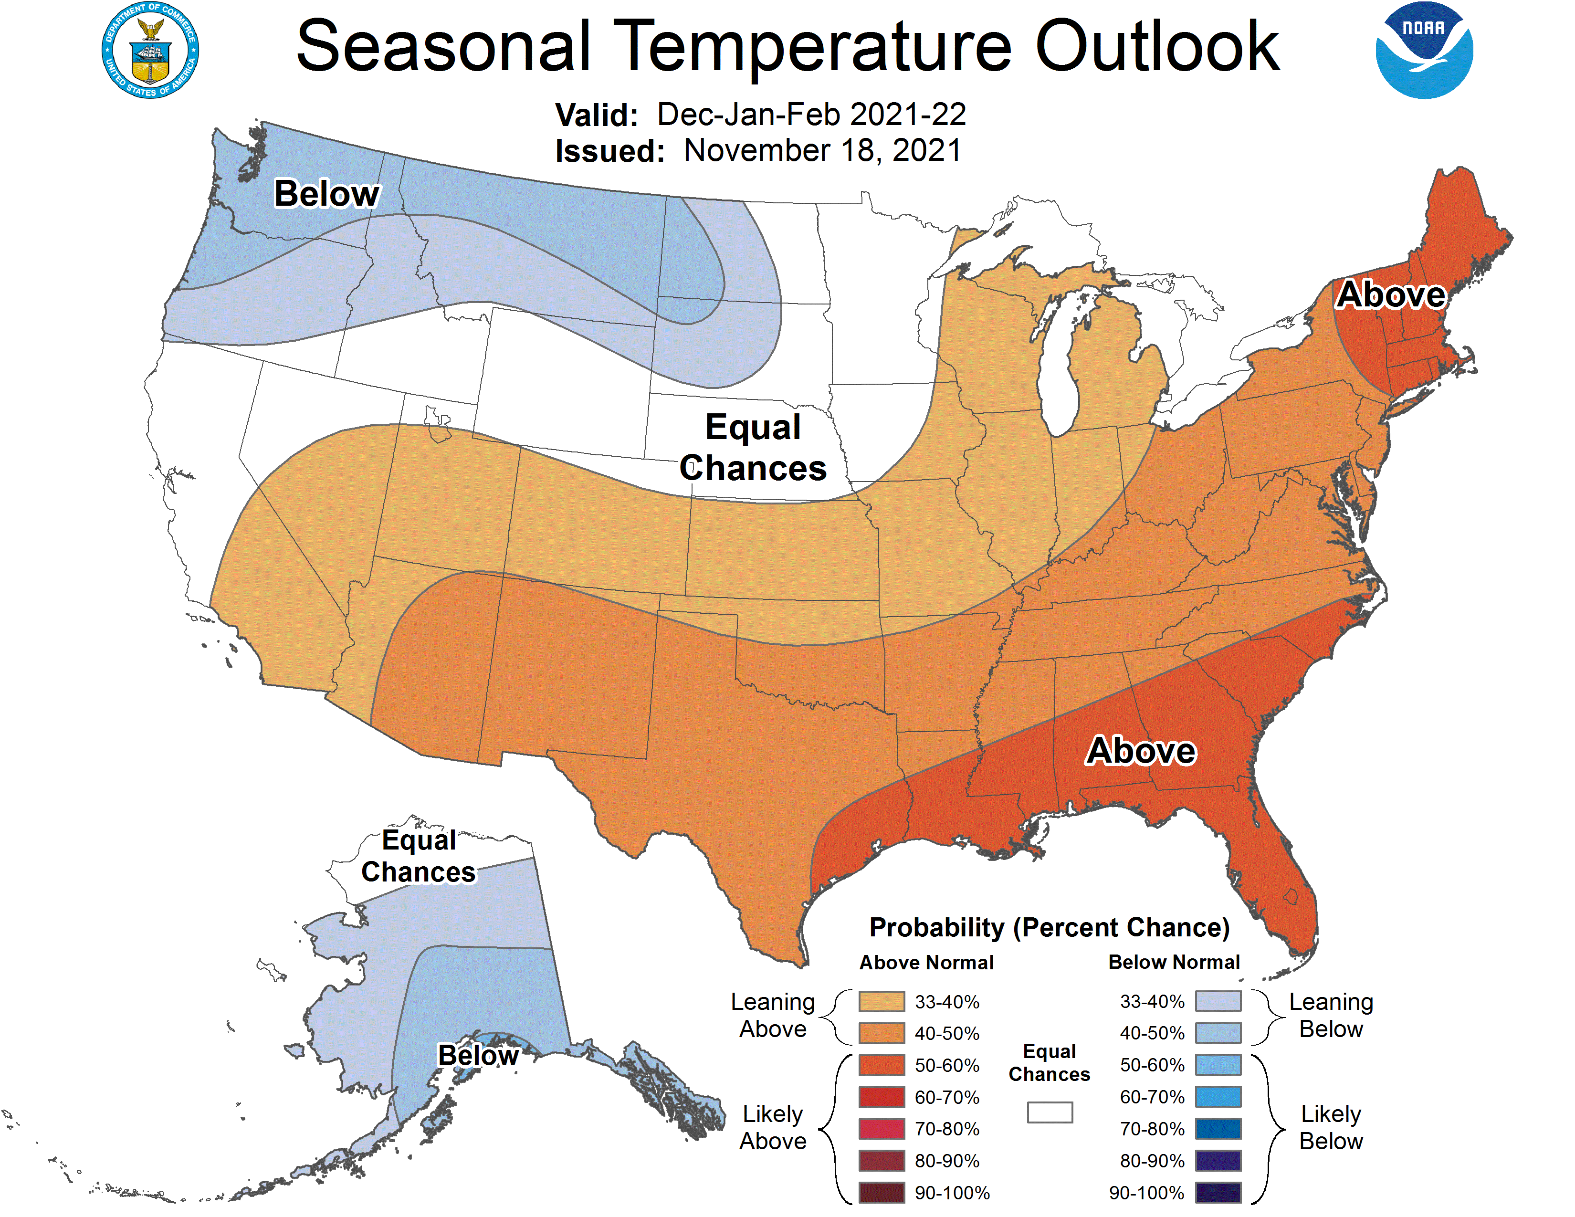
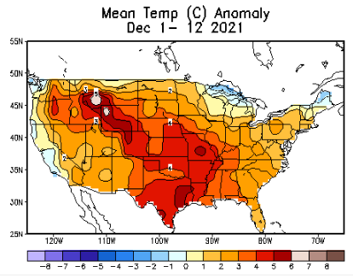
Previous (Last Month)
CPC’s official
Temperature OUTLOOK for Monthly (December)/Seasonal (DJF)
Released Nov 18th
Observed so far this month!! ☺

Slide 26
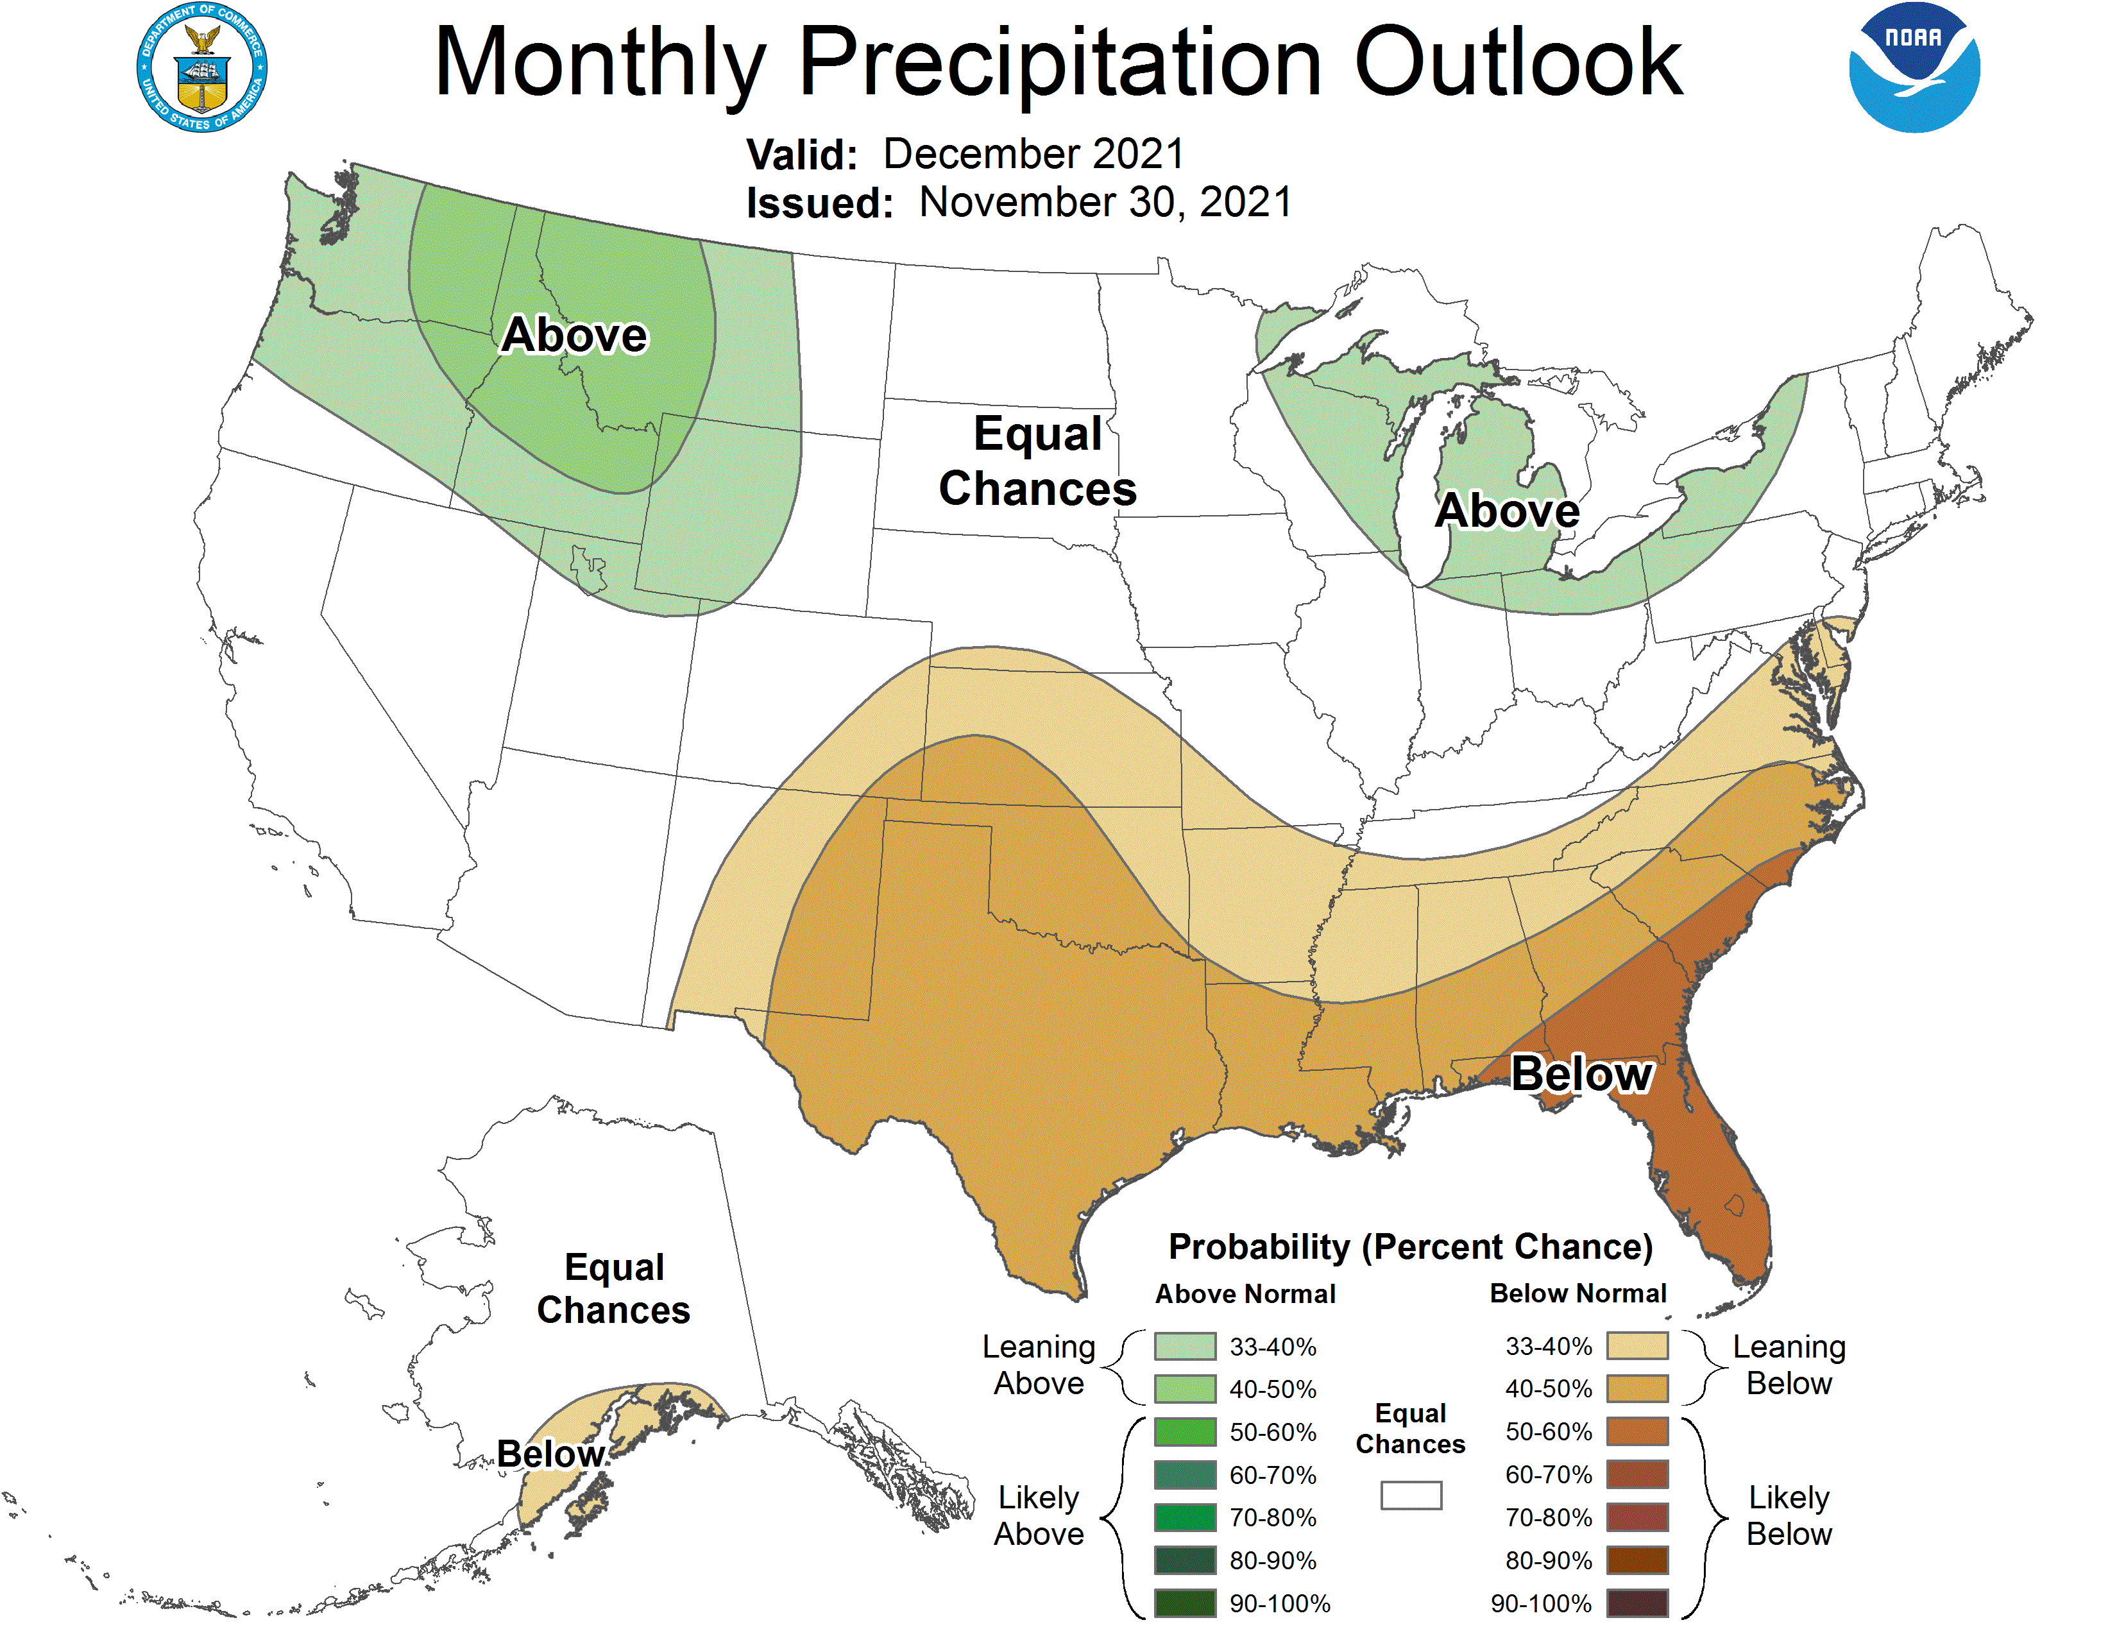
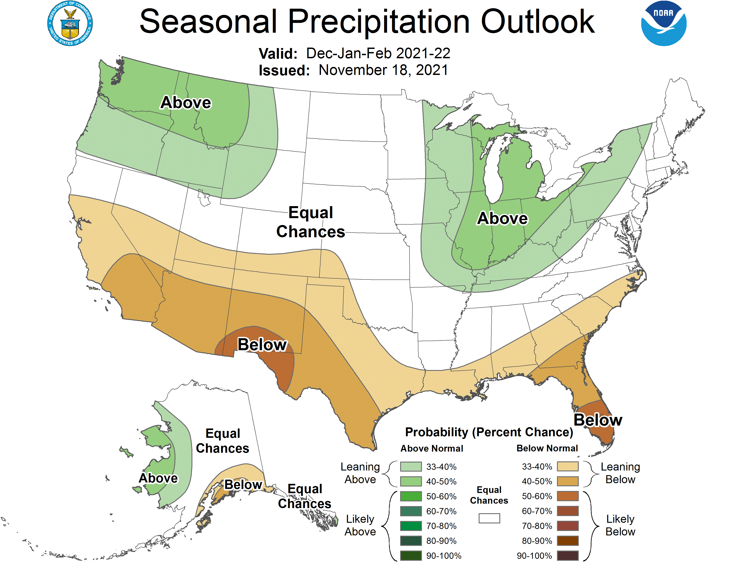
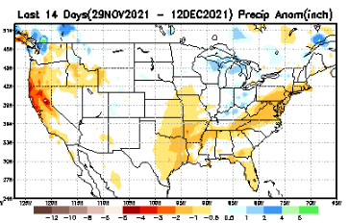
Previous(Last month)
CPC’s official
Precipitation OUTLOOK for Monthly (December)/Seasonal (DJF)
Released Nov 18th
Very similar looking!
Based on La Nina !!!!
Observed so far this month!! ☹
Monthly P/T forecasts verified at mid-month are generally good! Why?
But so far, fcst looks ☹

Slide 27
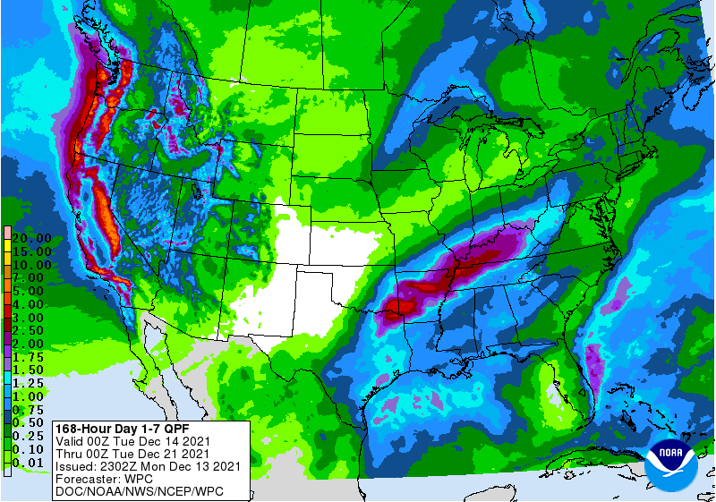
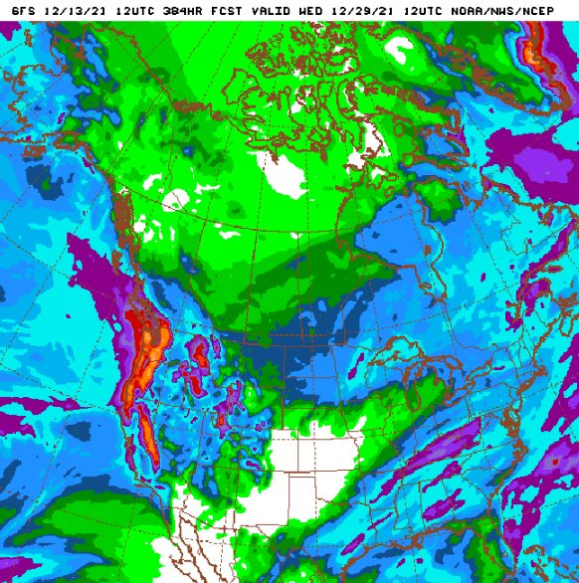
NCEP/WPC Next 7 days QPF (Quantitative Precipitation Forecast)
GFS Model Guidance for the
next 16 days.
Good rainfall is forecast along the Pacific northwest, as well as over northern/central CA. Season starting way too early! ☺
But La Nina is coming!!

Slide 28
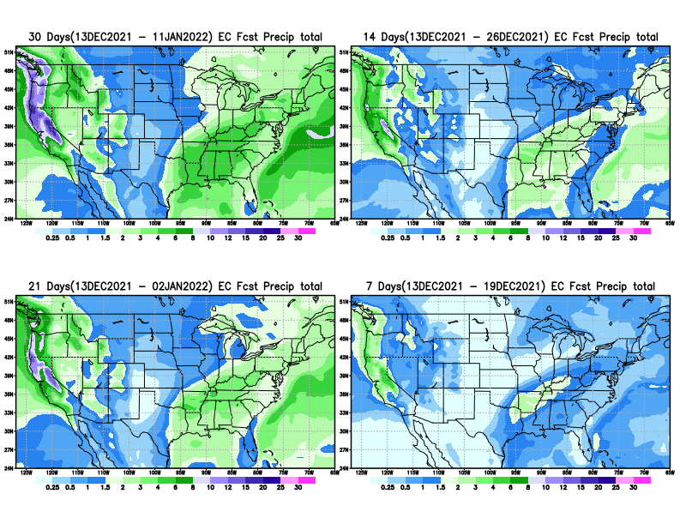
From European Center (EC) Precip forecast (made yesterday, 13 Dec) for next 30 days.

Slide 29
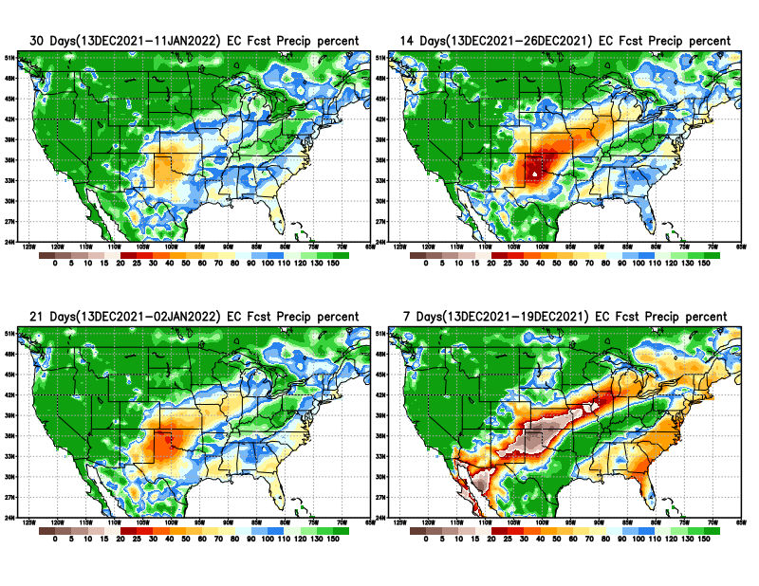
From European Center (EC) Precip forecast (made yesterday, 13 Dec) for next 30 days.
20
40

Slide 32
Week-4 Soil Moisture Percentile (SMP) Fcst based on VIC model forced with ECMWF-extended precipitation forecast!
??
(From Drs. Li Xu and Yun Fan) More detail at From: https://www.cpc.ncep.noaa.gov/products/people/lxu/flashd/flash_prediction.html

Slide 33
NMME T & P Ens.Mean forecasts for
Jan
JFM

Slide 34
Agreement/Disagreement among the various NMME models’ JFM seasonal Precip. Forecast.
??

Slide 35
(From NMME) compared with this month(foreground, red border)
Why is there so fewer hatched areas in SPI6 fcst from NMME models’ based fcst this month as compared to last month (left 2 columns) ? Fcsts more confident now?
Forecast uncertain in Hatched areas.
These maps are based on NMME models’ precip forecast uncertainty/certainty (among ensemble members) over the next 3 months
SPI6 Fcst made from last month
SPI6/SPI12 Fcst made from this month

Slide 36
http://drought.geo.msu.edu/research/forecast/smi.monthly.php
Latest Initial Conditions:
11/09/2021
Predicted Monthly Soil Moisture Percentile
MSU Soil Moisture Percentile forecast NOT available this month, NOT updated!
CPC’s soil moisture percentile – Leaky bucket Model
The inter quartile range suggest greater uncertainty about the forecast in these shaded regions. Lots of uncertainty regions!! ☹

Slide 37
BONUS Topic: One possible (obvious! ☺ ) explanation for the multiyear DROUGHT in the Southwest (CA/AZ/NM/NV/UT/CO & vicinity)!!
More La Ninas lately ?
More frequent La Ninas lately ?
Compared to other regions of the globe, the SST warming/trend in the central eq. Pacific (Nino 3.4) is relatively much small. (See Fig. above) – Why is this ?
Does nature try to compensate for the warming else/everywhere by producing more La Ninas in the central eq. Pacific? - Just my thought ! Let’s check !!!
Since the 1997 monster El Nino (stronger than the famous 1982/83 event), just a quick count of CPC’s Nino 3.4 index++ values for the three month overlapping seasons, (Data at CPC site only available only from 1950!)
(25 years) (47 years)
1997-2021 1950-1996
La Nina(DJF) 10 13
El Nino(DJF) 8 17
La Nina(all 3mos) 99 136
El Nino(all 3mos) 73 158
(Overlapping 3month seasons)
Look at Ratios of La Ninas (vs El Ninos) in the shorter
recent period vs the longer earlier period!!
***Analysis of CPC’s official Nino 3.4 index data over the last 70 years shows that the more frequent La Nina’s in recent decades contributed to less rainfall in the southwest (See La Nina precip composites!, slide#13) and hence the ongoing long term drought in the Southwest!! Hence the long term southwest drought is unlikely to go away any time soon***
++ Barnston, Chelliah and Goldenberg (1997):Documentation of a highly ENSO‐related sst region in the equatorial pacific, Atmosphere-Ocean Volume 35, 1997. https://doi.org/10.1080/07055900.1997.9649597
*** The strong/weak annual monsoon rains in the southwest is just a minor modulator riding on this bigger/long-term signal. ***

Slide 38
Summary
Current Drought conditions:
Since mid/late summer in the last few months, there seems to be gradual eastward expansion of the drought in the southwest into southern states into eastern CO, Oklahoma, Texas, and beyond, as well as into northern Plains states into around the Great Lakes states. The recent good summer monsoon in the US southwest is not enough to offset longer term drought here.
Also in the eastern US, which was relatively drought free (as compared to the west) some noticeable dryness and short term drought has emerged lately in the mid-Atlantic states especially in NC and in neighboring states.
The next important question is, with the ongoing La Nina taking full hold, will the drought in drought in the south expand even further eastward? What about Florida where some dryness has recently developed, but not into drought just yet! And the drought in the mid-Atlantic states?
All California reservoirs levels continue to worsen to below their historical average levels. If the forecast warmth/temps and the lack of (seasonal) rainfall continues, things will probably get even more worse.
Current ENSO status and forecast: La Niña is favored to continue through the Northern Hemisphere winter 2021-22 (~95% chance) and transition to ENSO-neutral during the spring 2022 (~60% chance during April-June).
Prediction:
La Nina conditions are here now in full force, with anomalously cold waters in almost all of the tropical equatorial Pacific. Even last month, the forecast rainfall patterns for the month and DJF season very much resembled canonical ENSO patterns, with dry conditions along the southern tier states. With Lina conditions expected to peak In the current forecast JFM season, the same canonical rainfall pattern is expected to be forecast this upcoming JFM season also, as also the NMME models’ forecasts suggest now.
If the expected above normal precipitation forecast for the upcoming JFM season in these upper northwestern and part of the northern Great Plains states associated with the emerging La Nina verifies, it will also make an impact on the drought in these regions, even thought drought removal is here is unlikely, except may be along the coastal regions of Washington and Oregon.
The models forecast and there is a strong likelihood that the southern tier states, beginning with southern CA in the west and extending eastward, will likely experience below normal rainfall for the forecast season, due of course to the La Nina. Hence this will likely worsen the already existing drought in the southwestern, southern states, extending eastward in to TX,KS, OK & LA. The big uncertainty continues to be if new drought will develop in parts of FL. The drought in mid-Atlantic states is likely to persist into next month but may go away by end of JFM season. Development /extension of drought into Ohio valley is also unlikely as that region is likely to get more rainfall. ******

