Slide 1
Drought Outlook Support Briefing December 2022
Climate Prediction Center/NCEP/NOAA
http://www.cpc.ncep.noaa.gov/products/Drought
Points to ponder:
Often, there is a disconnect between the Short term (S) and Long term (L) drought in regions, and even with the short term (S) drought, the 3-month and 6-month signals are not quite consistent! With Long term (L) drought, it is even more trickier, as it is open ended, from 1 year and beyond!!!
Places/regions experiencing Short term drought may (not) be ok in the Long term and vice versa!!
This duality is difficult to reconcile, to convey and even be understood well by the public at large.
Public/Forecaster generally tends to focus more on the Short term Drought (for good reasons!!)
More importantly the very definitions and timescales associated with S/L term droughts and the declarations in the USDM are by themselves subjective!!

Slide 2
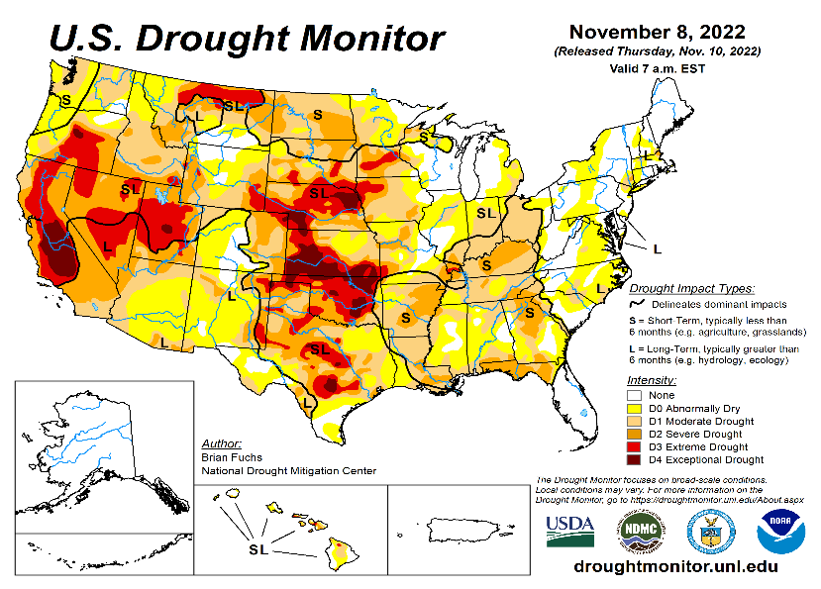
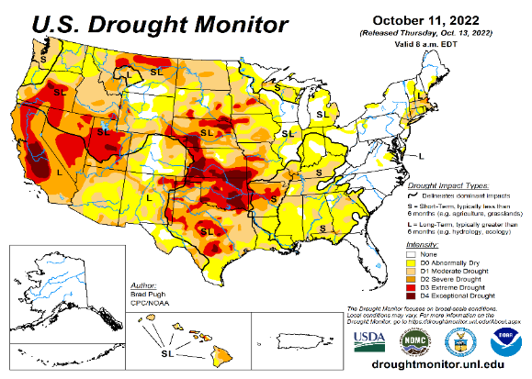
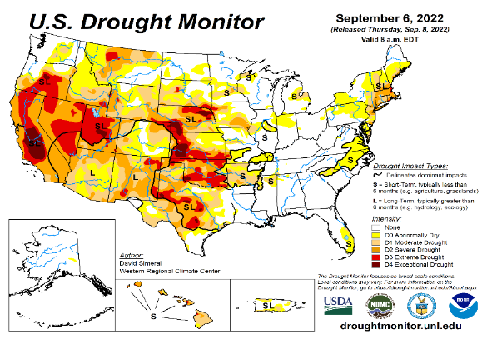
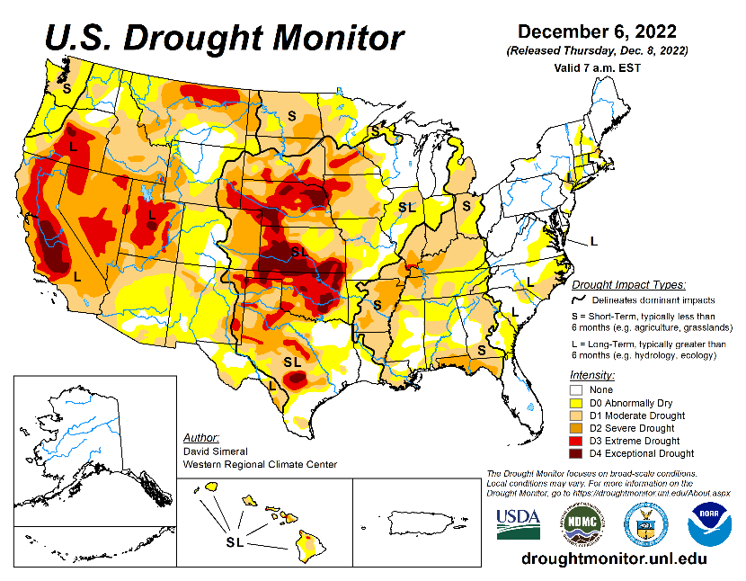
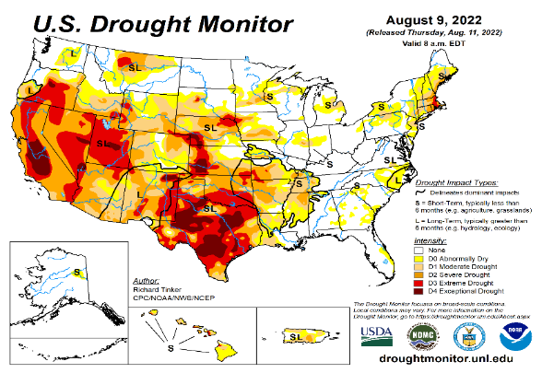
Drought Monitor
Monitoring is important because, unlike US T/P fcsts, for drought forecasts, we have to know where we are, before we can tell where we are going!! Drought forecasts are tendency forecasts.
November
October
It used to be that for many months (last year) the classic East-West dipole pattern with drought in the US west half, and (almost) no drought in the US east half, was in place.
But in the last few months, partly due to the second year of good SW monsoon, the S-term drought in the southwestern states has mostly gone, bur the L-term drought still exists in parts of CA/OR/NV/UT/and vicinity and unlikely to go away any time soon!. Interestingly, S-term drought is emerging in the eastern half of US, especially in the central Ohio valley and upper Midwest.
The drought in south central part of the US somewhat strengthened and expanded to the north, covering large parts of MT/Dakotas/ NE/KS/OK, but conditions in Texas has slightly improved. The drought in this central part of the US is both short and long term.
The current severe winter storm, which recently dumped more than 3 feet of snow in the Sierra Nevada and heading east towards the Dakotas is likely to temporarily ease the drought conditions in those regions. The ongoing DJFM rainy season along the west coast states will definitely help the drought situation here, esp. in many CA reservoir levels.
The ongoing 3-year La Nina has generally increased the overall drought areas coverage across the entire United States. Accordingly, Drought is also emerging along the Gulf coast states.
September
December
(Recent/Latest)
August
?

Slide 3
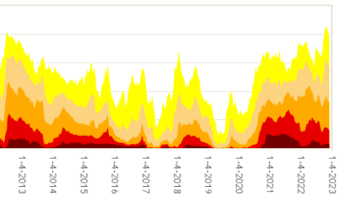
Time series since 2000 spilt into 2 (above & below) panels.
The spatial details of
Every drought is different.!
Every situation is different!!
Current drought!
For whatever it is worthy of news, the D0-D4 drought areal coverage across US is staying at ~ excess of 80% .
The winter rainy season along the Pacific west coast states is likely to bring down the severe drought coverage areas.

Slide 4
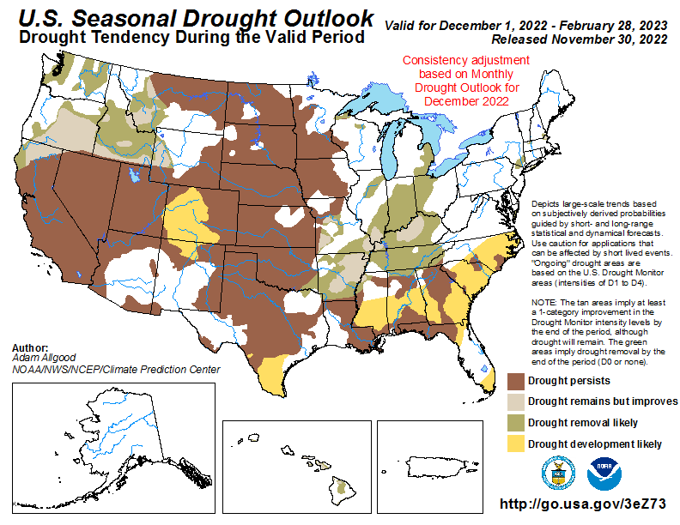
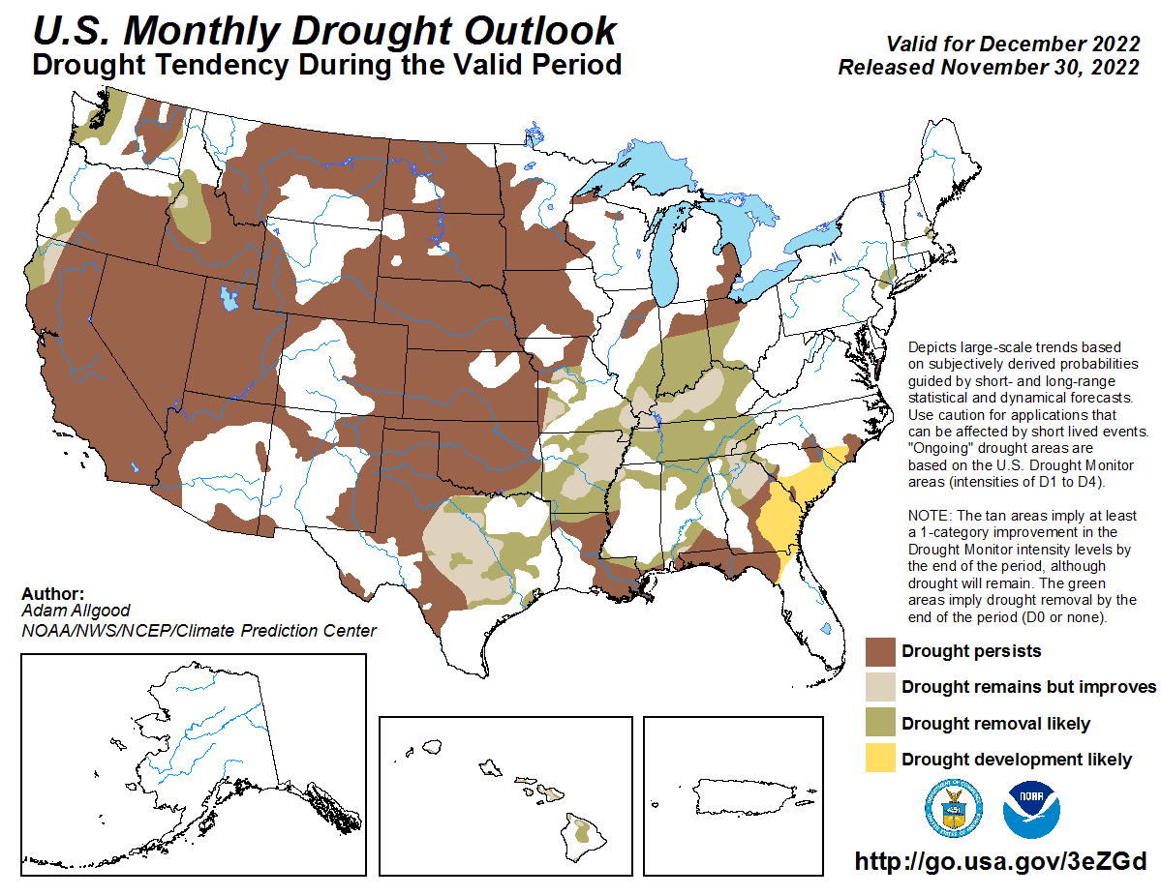
(Previous) Seasonal/Monthly Drought outlooks
New Seasonal+ Drought Outlook to be released in 2 days!
New Monthly Drought Outlook to be released end of this month)
Updated Seasonal Outlook
(1 Dec – 28 Feb 2023)
issued 10/31/22
Monthly outlook (for December 2022)
issued 11/30/22
The ongoing winter rainy season (DJF) along the west coast states, combined with the weakening/slowly exiting La Nina conditions is likely to improve the overall drought conditions and hence the drought areal coverage in the United States.

Slide 5
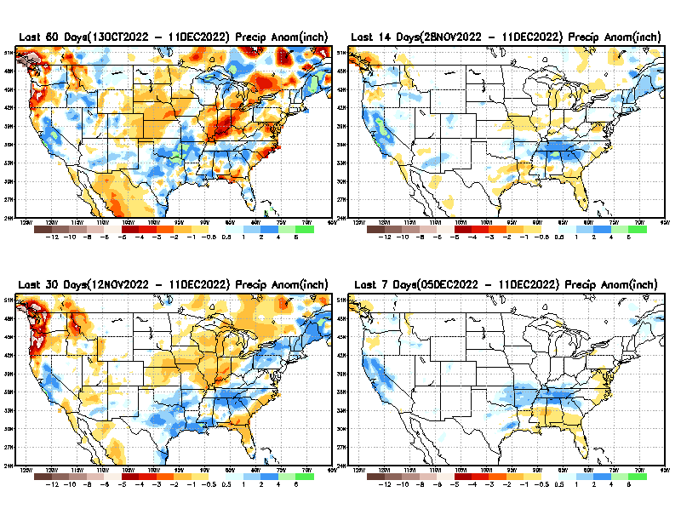
Precipitation ANOM during last 7, 14, 30, & 60 days.
This and next few slides show Precip deficit (excess).
Droughts, for the MOST part, begin and end with precip!! Lately, Temps are becoming (secondarily) important as well.
60 Days
14 Days
30 Days
7 Days
These maps in this and following slides, including a) Total,
b) Anom and
c) Percent of Normal precip. in these and other longer time ranges are now (routinely) daily updated at:
So far, a very good active SW monsoon, bringing relief/removal to/of the short term drought in the SW region! ☺. But long term drought? The two good monsoons in a row, is making a big dent in the short term drought! But is it also making an impact to the long term drought?
From: Recent Accumulated Precipitation https://www.cpc.ncep.noaa.gov/products/Drought/briefing_prcp.shtml

Slide 6
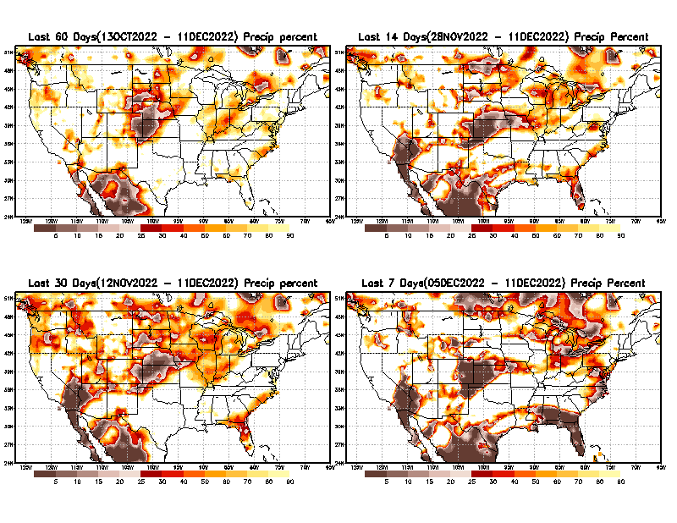
Precipitation Percent (of normal) during last 7, 14, 30, & 60 days - Only Deficit Areas <=90% shown !
60 Days
14 Days
This plot shows only the rainfall deficient regions <= 90% of normal.
-- This shows more clearly possible/likely drought developing region in the future unless there is above normal rainfall in these regions in the future, to offset these shortfalls.
30 days
7 Days
From: Recent Accumulated Precipitation https://www.cpc.ncep.noaa.gov/products/Drought/briefing_prcp.shtml

Slide 7
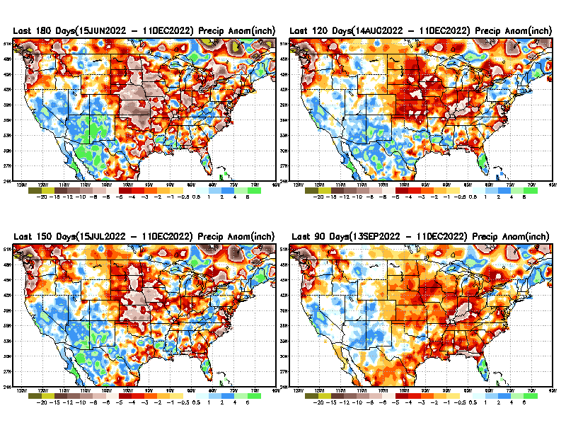
Total precipitation ANOM during last 3, 4, 5, and 6 months.
While the Precipitation anomalies deficit may seem large in some regions (compared to others), it is the % of normal precip (next slide) that matters more!!
6 M
4 M
5 M
3 M
From: Recent Accumulated Precipitation https://www.cpc.ncep.noaa.gov/products/Drought/briefing_prcp.shtml

Slide 8
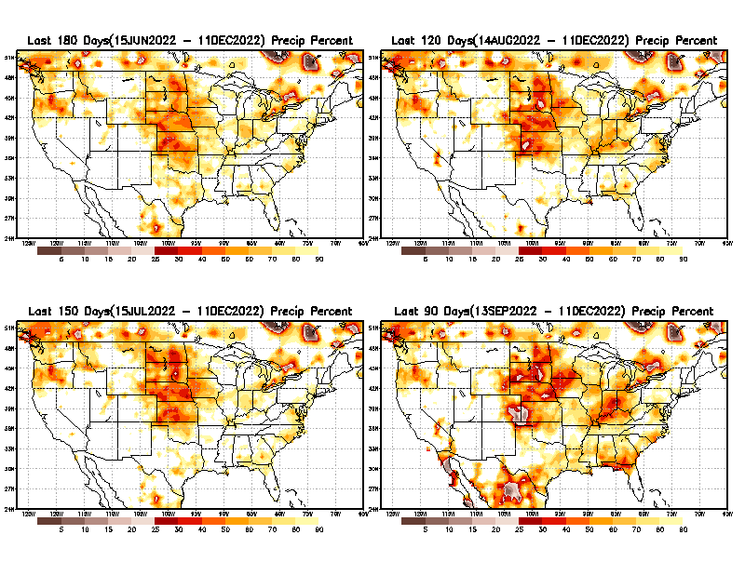
Total precipitation Percent (of normal) during last 3, 4, 5, and 6 months Only Deficit Areas <=90% shown!!
6 M
4 M
In these interim time scale 3-6 months, we need to pay attention to regions, which are dark-brown, red & dark red (<50%).
While accrued precipitation deficits are real & objective,
droughts are subjective declarations!!
5 M
3M
Hard to believe the witch lately betw. E/W compared to last year!
East vs West!
Broad vs Narrow
rainfall season.
In general, West suffers more from frequent and lasting droughts.
Short term(S) Drought is generally declared when rainfall deficits exist in the 3-6 months time range. {Long term deficits beyond 1 or 2 or more years is Long term L drought! }

Slide 9
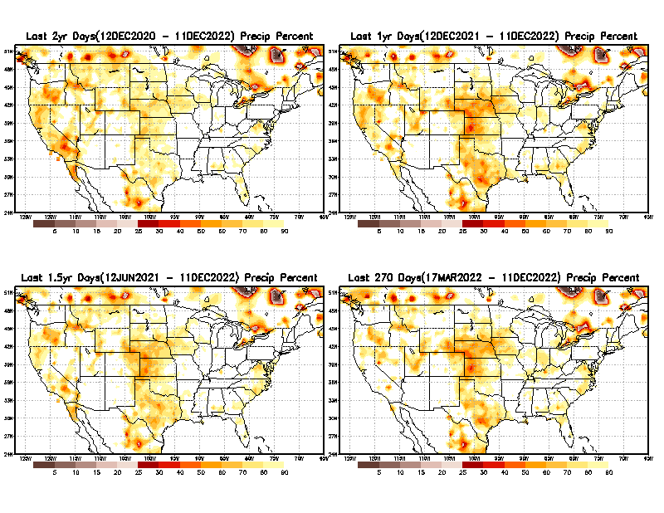
Total precipitation Percent during last 9 months, 1 yr, 1.5yrs, & 2 yrs. .–Only Deficit Areas shown!! <=90%
2 Y
1 Y
Tinderbox areas, where some form of longer term rainfall
deficiencies already, exist !!
-Almost all are in the west!, all part of the long term drought
-This & Next slide!!
1.5 Y
9 M
The character and even location/spatial extent of the short/S and long/L –term droughts are different!!!
From: Recent Accumulated Precipitation https://www.cpc.ncep.noaa.gov/products/Drought/briefing_prcp.shtml

Slide 10
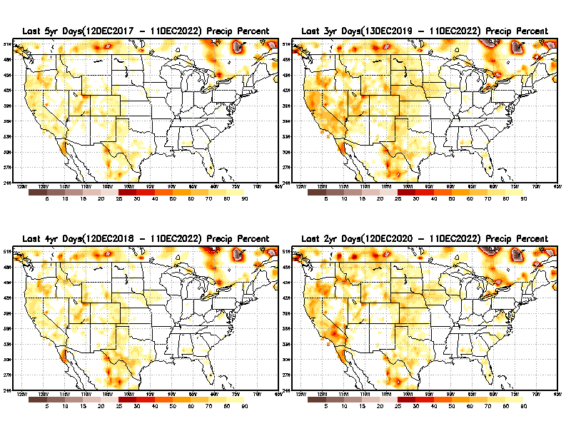
Total precipitation Percent (of normal) during last 2, 3, 4, & 5 yrs. .–Only Deficit Areas <=90% shown !!
5 Y
3 Y
In these long time ranges (2-5 yrs), there is a general dearth/lack of precipitation in the southwest US.
Recent Weather Blog News:
A recent study from the University of California, Los Angeles now claims the current drought that started in 2000 for the American Southwest is now the driest 22 years since 800 A.D. Researchers said climate change is to blame. Their proof? Tree rings!
4 Y
2 Y
Ongoing long term drought in the South West!! Current 3rd year La Nina does not help either!!
From: Recent Accumulated Precipitation https://www.cpc.ncep.noaa.gov/products/Drought/briefing_prcp.shtml

Slide 11
LEAST
MIXED
MOST
East vs West!
More darker colors in west/central => narrow rainy season (months)
Overall, more white space in the east => distributed rainfall season (except ~FL).
Rainy (3-month)Season across the US

Slide 12
With the monsoon ending, October is the driest of all months in the US. However, by November/ December, early winter rainfall may begin to show up along the Pacific west coast states.
*********
EAST vs
CTR/WEST
Drought Behavior is loosely tied to rainfall climo!! And the limited rainy season in the west
*********
Adapted from Rich Tinker.

Slide 13
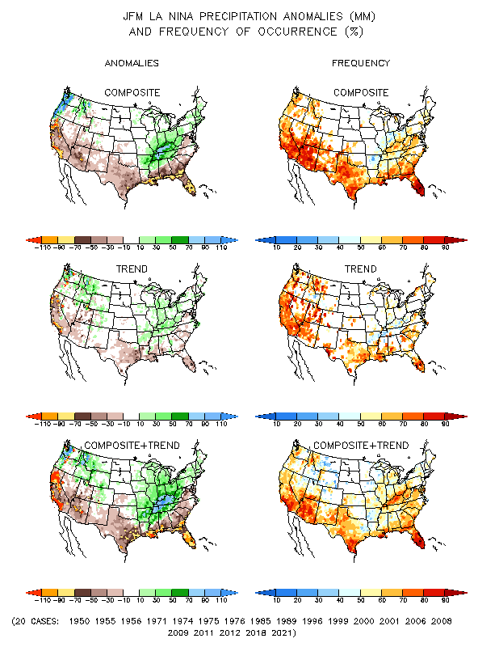
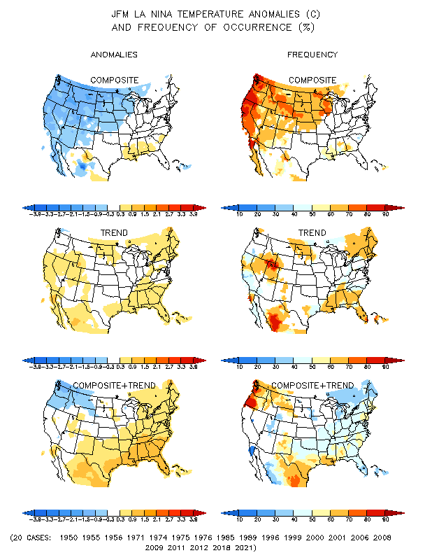
La Nina Precip/Temperature COMPOSITES & Trend map
JFM
P
T
50/50 Chance of
La Nina during JFM.
How likely will be the impacts?

Slide 14
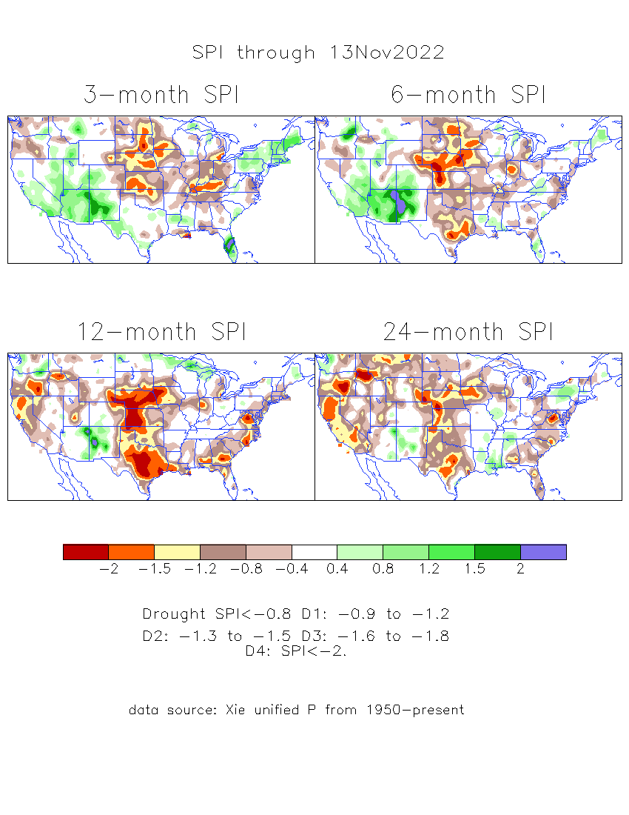
The Standardized Precipitation Index SPI (based on Observed P)
----- Last Month
Very interesting graphic & details for the drought across the US based on the more generalized precip deficit/excess, the Standardized Precipitation Index (SPI).
The dark brown and red colors, indicating standardized precipitation deficits, in the various time periods, approximately correspond to the appropriate short/long term drought monitor regions and their intensities

Slide 15
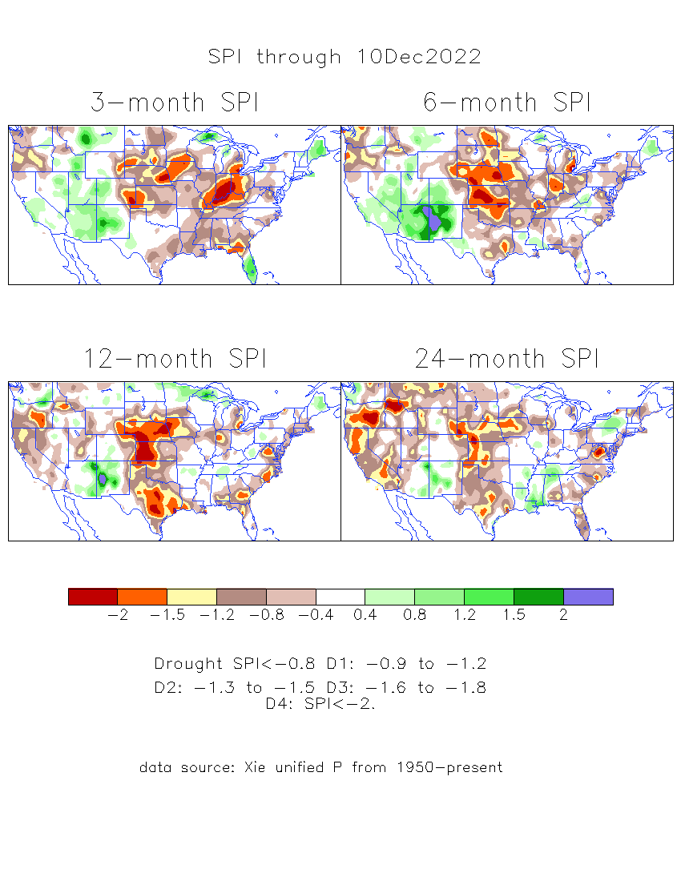
The Standardized Precipitation Index SPI (based on Observed P)
Compare with last month
----- NOW
Very interesting graphic & details for the drought across the US based on the more generalized precip deficit/excess, the Standardized Precipitation Index (SPI).
The dark brown and red colors, indicating standardized precipitation deficits, in the various time periods, approximately correspond to the appropriate short/long term drought monitor regions and their intensities
Short
No S-term drought here!! But L-term drought > 6 mon. continues.
Long
How does one negotiate and reconcile declaring short term vs long term drought when precip. deficiencies patterns differ on many different time scales locally!!
What is the cutoff delineating time between short VS long term drought!! Not so clear!!
At exactly where does drought begin?

Slide 16
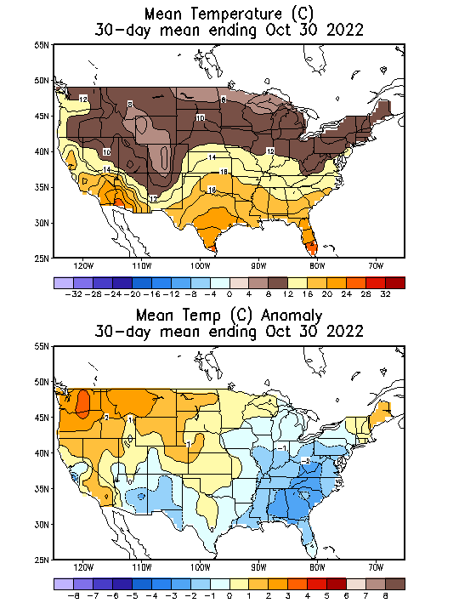
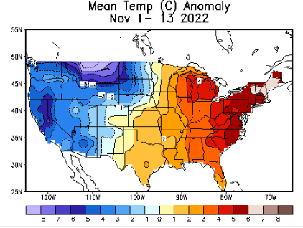
Last Month!
Recent US Temperatures
There is a lot more going on than just La Nina impacts!!
So far this month !!

Slide 17
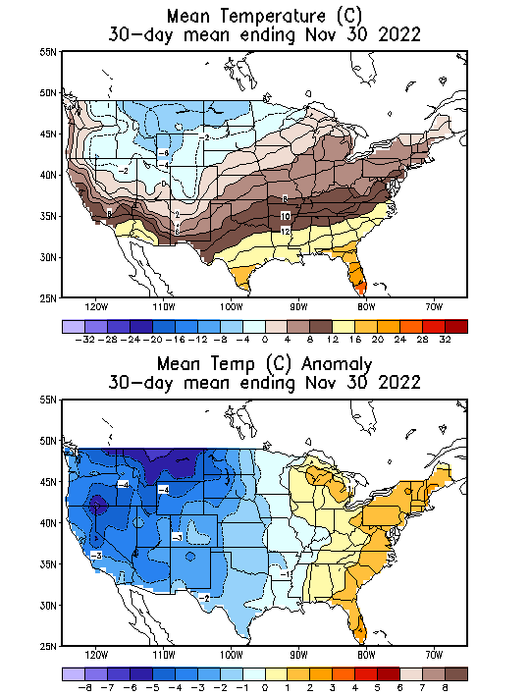
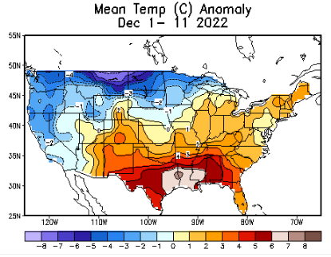
NOW
Recent US Temperatures
There is a lot more going on than just La Nina!!
Last month, it was more of a
West/cold –vs- East/warm/not-so-cold pattern.
This month so far it is :
Northwest/cold –vs-South/southeast/Wam pattern.
So far this month !!

Slide 18
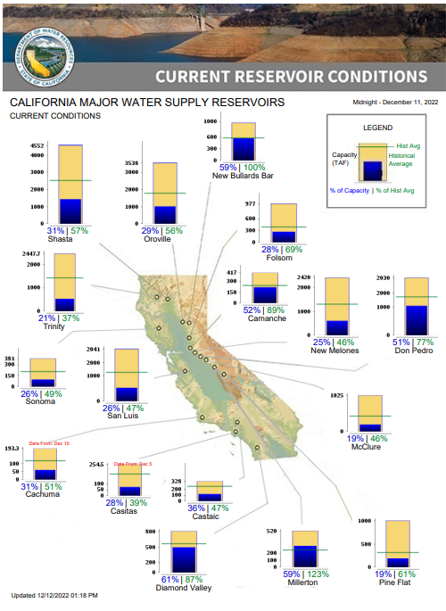
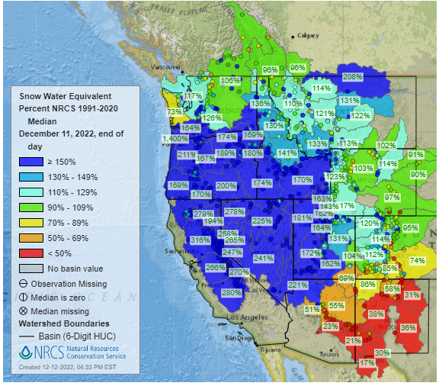
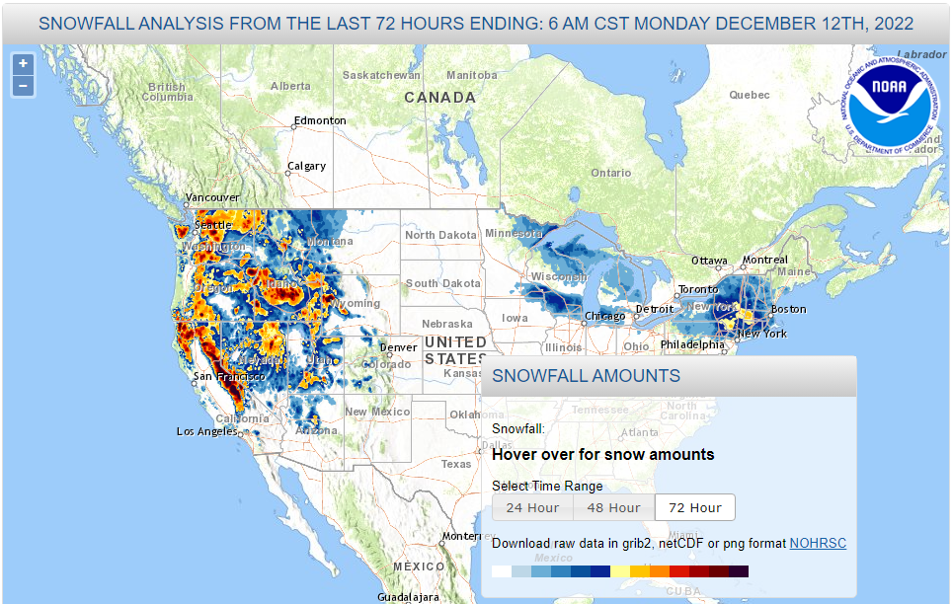
Snow Water Equivalent
% of Capacity
% of Hist. Avg.
of Reservoirs.
2022 Wild Fire Season
ACRES burned in Wild Fires
In CA:
So far in 2022: 362, 403 ☺
2021: 2, 400, 000
2020: 4, 304, 000
2019: 260, 000
Most CA water reservoirs are drastically low!
LA Times: ‘We got really lucky’: Why California escaped another destructive fire season in 2022.
(Even though this year 2022 is the third consecutive La Nina Year!)

Slide 19
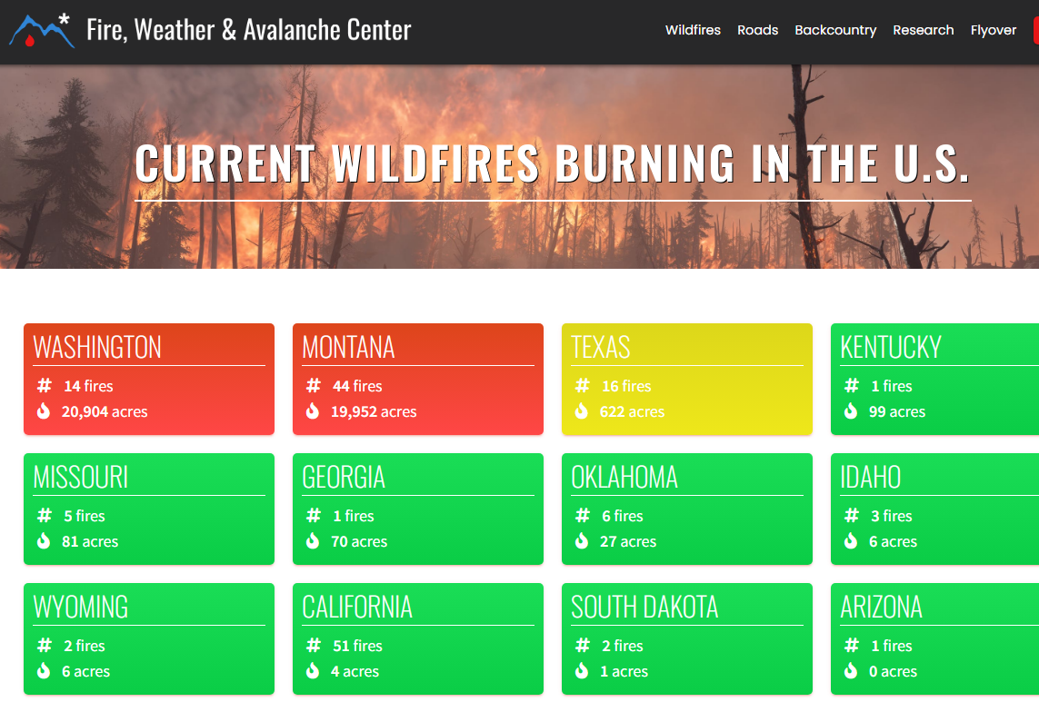
Note: In spite of the ongoing drought, All the fires are gone..
Of course it is getting cold.. ☺
THIS MONTH !!
https://www.fireweatheravalanche.org/fire/current-list-of-us-wildfires
(not govt. source! Not sure how good is this data?)

Slide 20
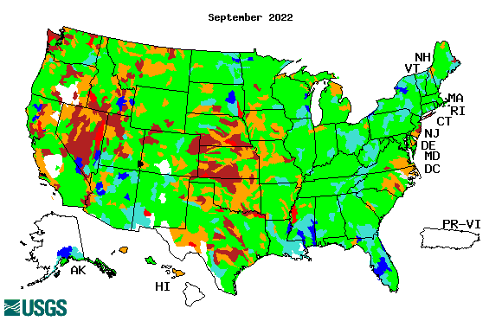
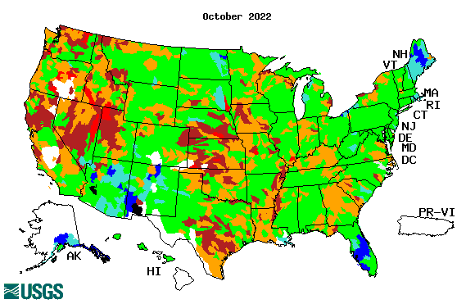
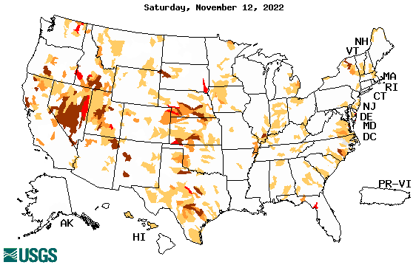
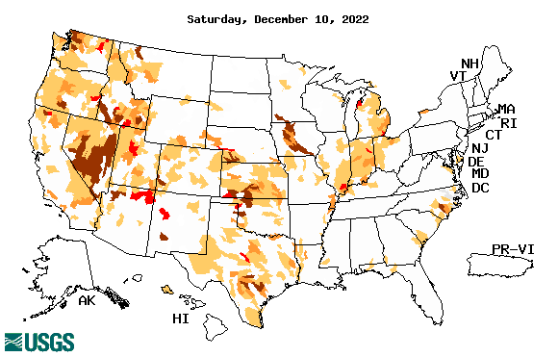
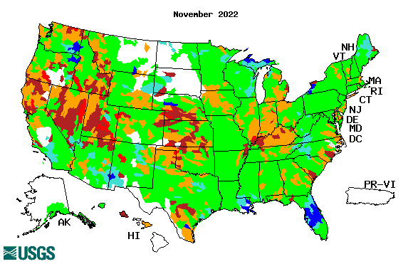
Streamflow (USGS)
Most US east droughts are relatively short lived (as compared to US west). However, if you recall, the drought over the New England states last year was a real surprise!!
Map shows only below normal 7-day average streamflow compared to historical streamflow for the day of year.
One month ago (left) &
Now (below)
Streamflow is only a partial indicator, as it is highly managed.
If sometimes, the various indicators are confusing, go back to % of rainfall deficit maps – to reinforce!!
20

Slide 21
EL NIÑO/SOUTHERN OSCILLATION (ENSO)
DIAGNOSTIC DISCUSSION
issued by CLIMATE PREDICTION CENTER/NCEP/NWS and the International Research Institute for Climate and Society
8 December 2022
ENSO Alert System Status:
La Nina Advisory
Synopsis: La Niña is expected to continue into the winter,
with equal chances (50/50) of La Niña and ENSO-neutral during January-March 2023.
In February-April 2023, there is a 71% chance of ENSO-neutral.
CPC’s Oceanic Niño Index (ONI) [3 month running mean of ERSST.v5 SST anomalies in the Niño 3.4 region (5ºN-5ºS, 120º-170ºW)], based on centered 30-year base periods updated every 5 years.
?

Slide 22
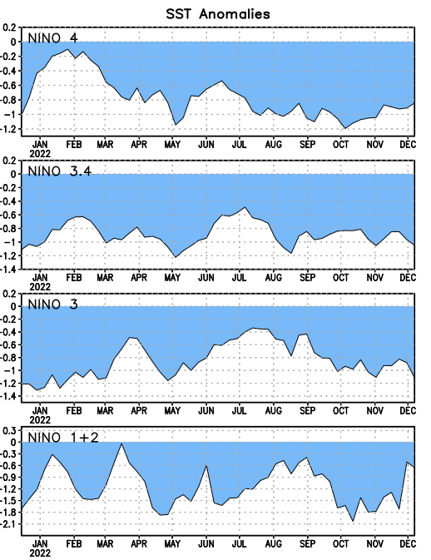
Latest values of SST indices in the various Nino Regions.
Rapidly decreasing Subsurface cold water reserve…

Slide 23
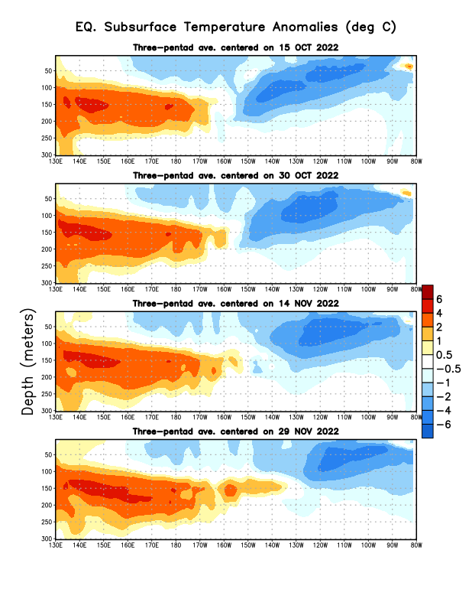
Sub-Surface Temperature Departures in the Equatorial Pacific
The cold water is still in the east tropical Pacific with la Nina conditions.
But, lately the subsurface warm water is slowly edging/expanding eastward.
Most recent pentad analysis

Slide 24
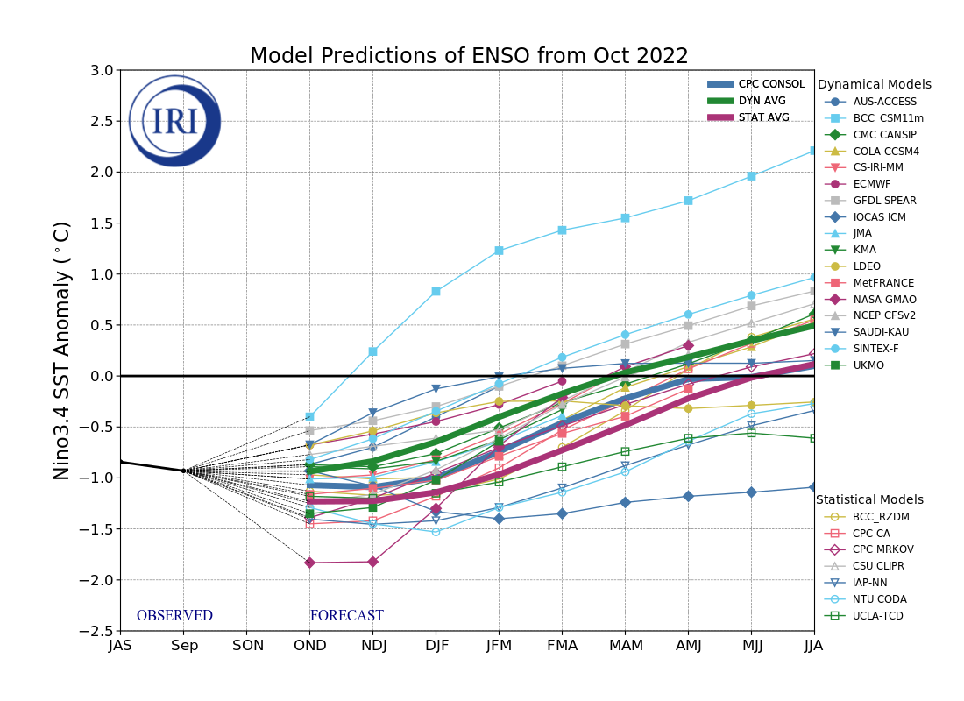
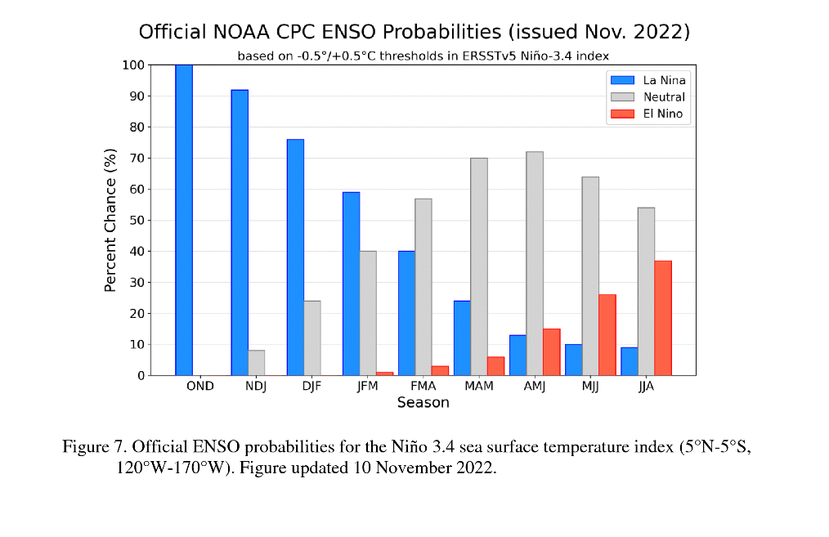
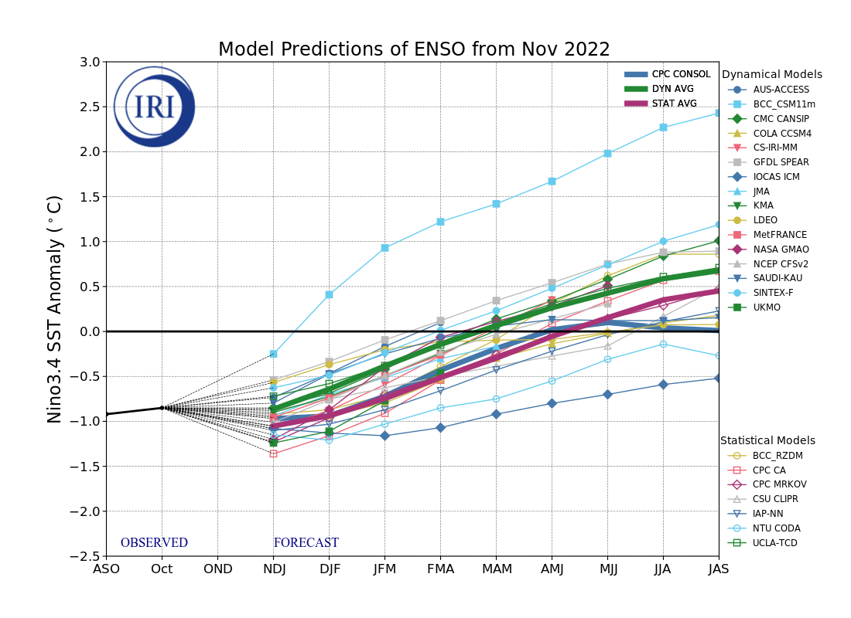
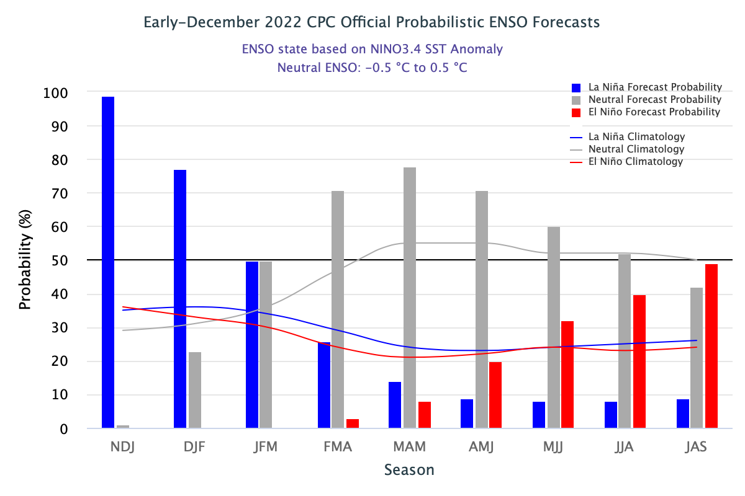
Official ENSO Forecasts
Early- November
This figure going through format changes!
Early-December CPC forecast
50/50 % chance of La Nina for the upcoming JFM forecast season.

Slide 25
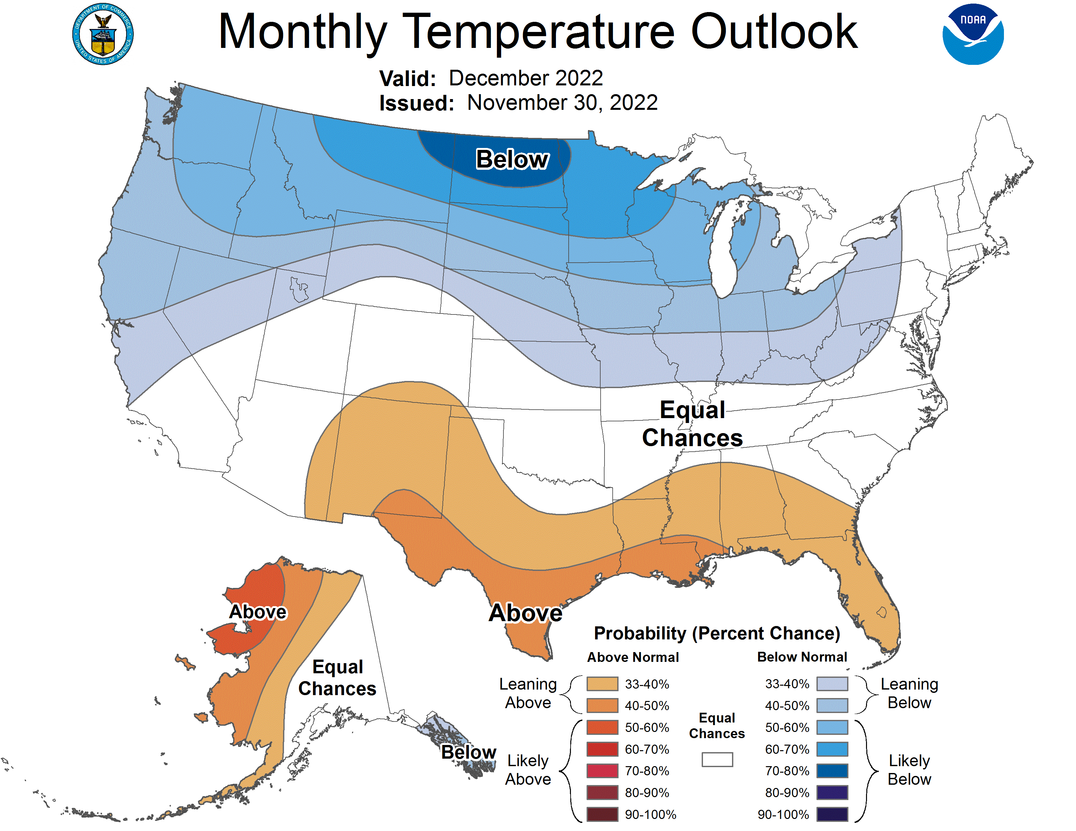
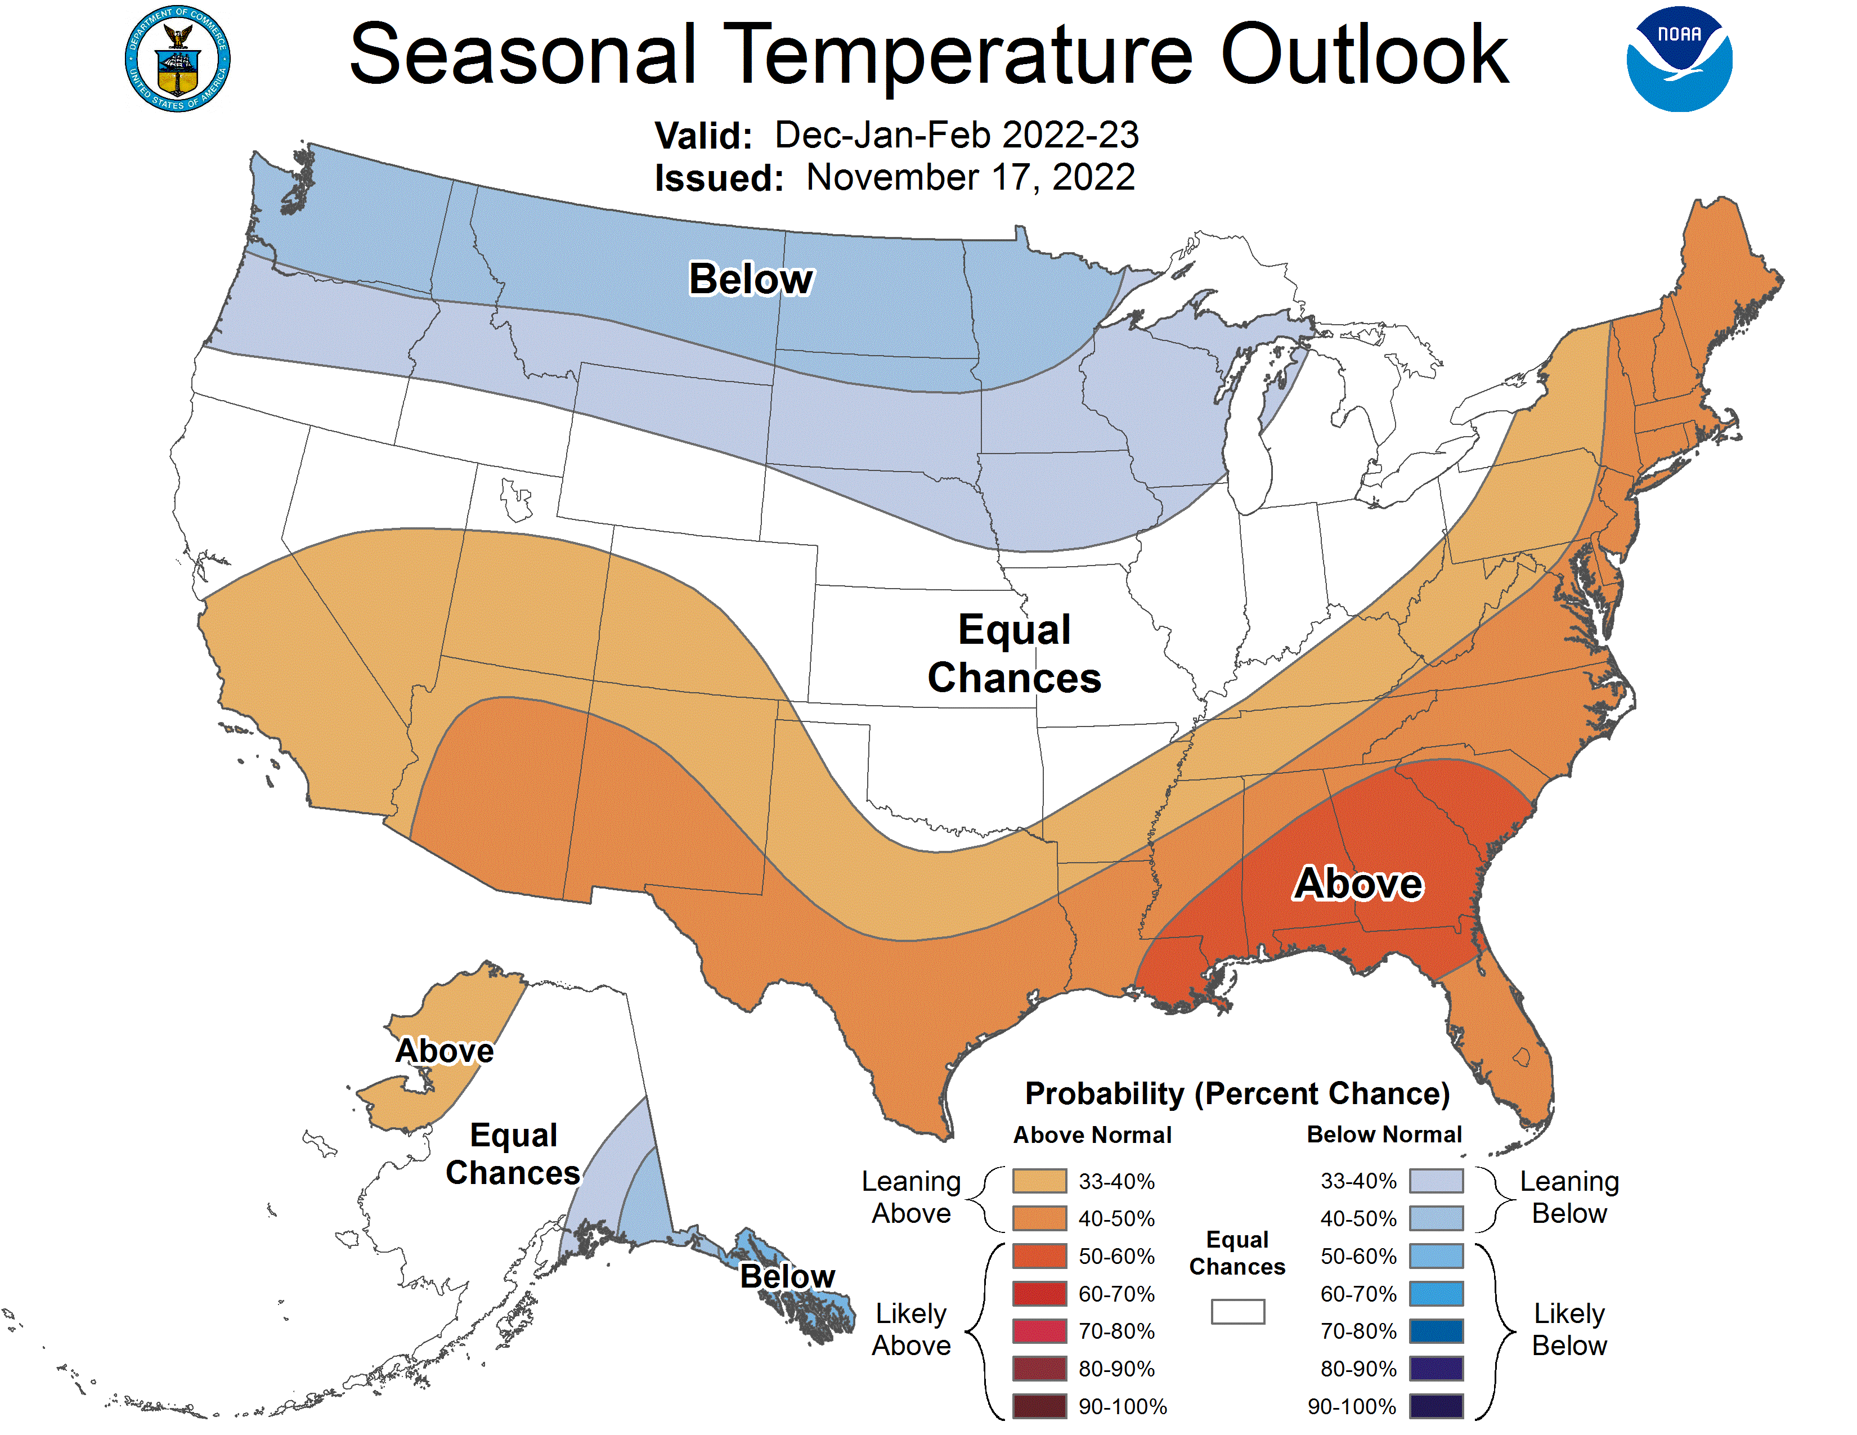
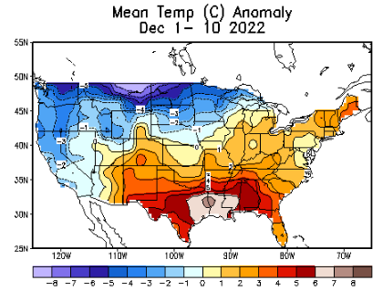
Previous (Last Month’s)
CPC’s official
Temperature OUTLOOK for Monthly (Dec)/Seasonal (DJF)
Monthly P/T forecasts verified at mid-month are generally good! Becoz of good skill upto 2 wks.
Released Nov 17th
Observed so far this month!! ☺
E/W

Slide 26
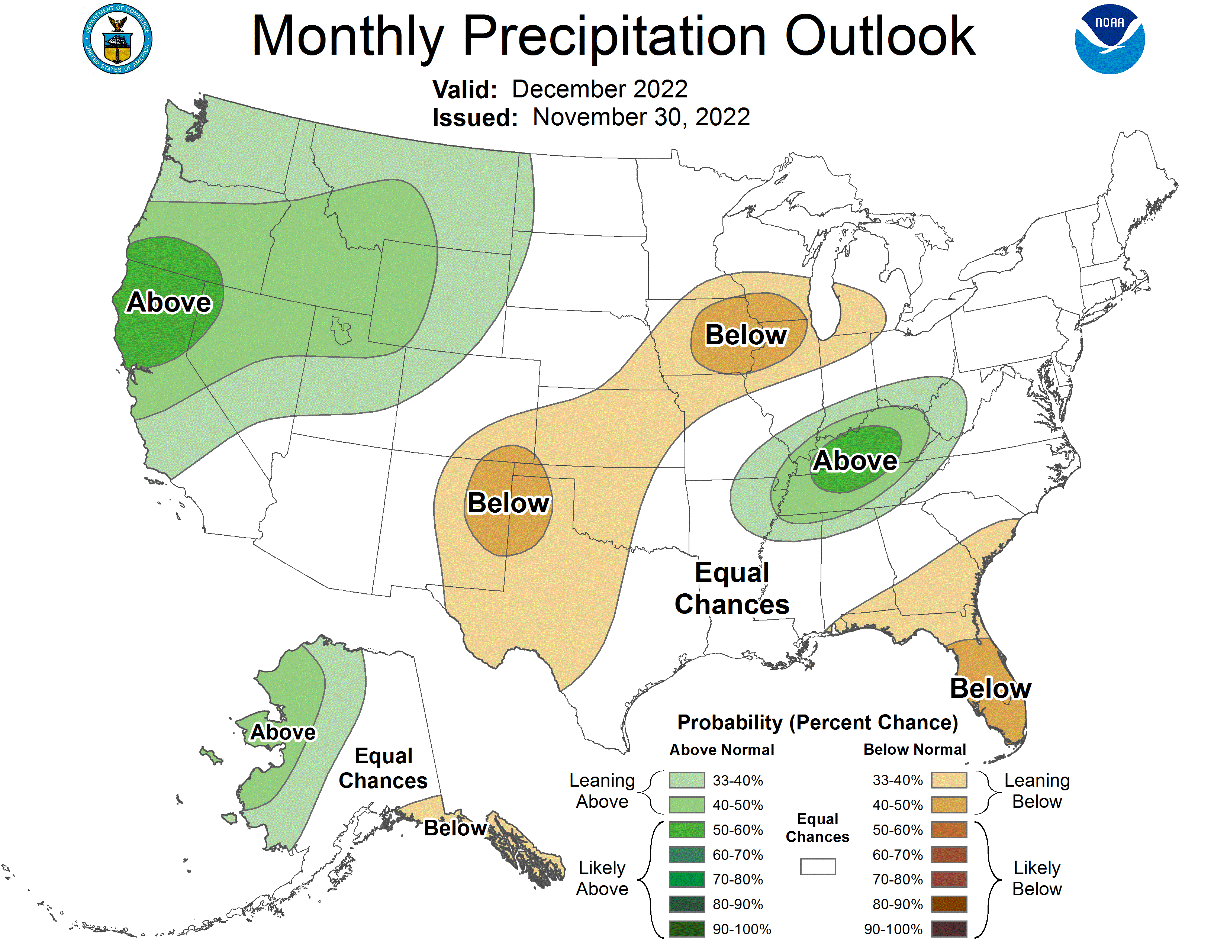
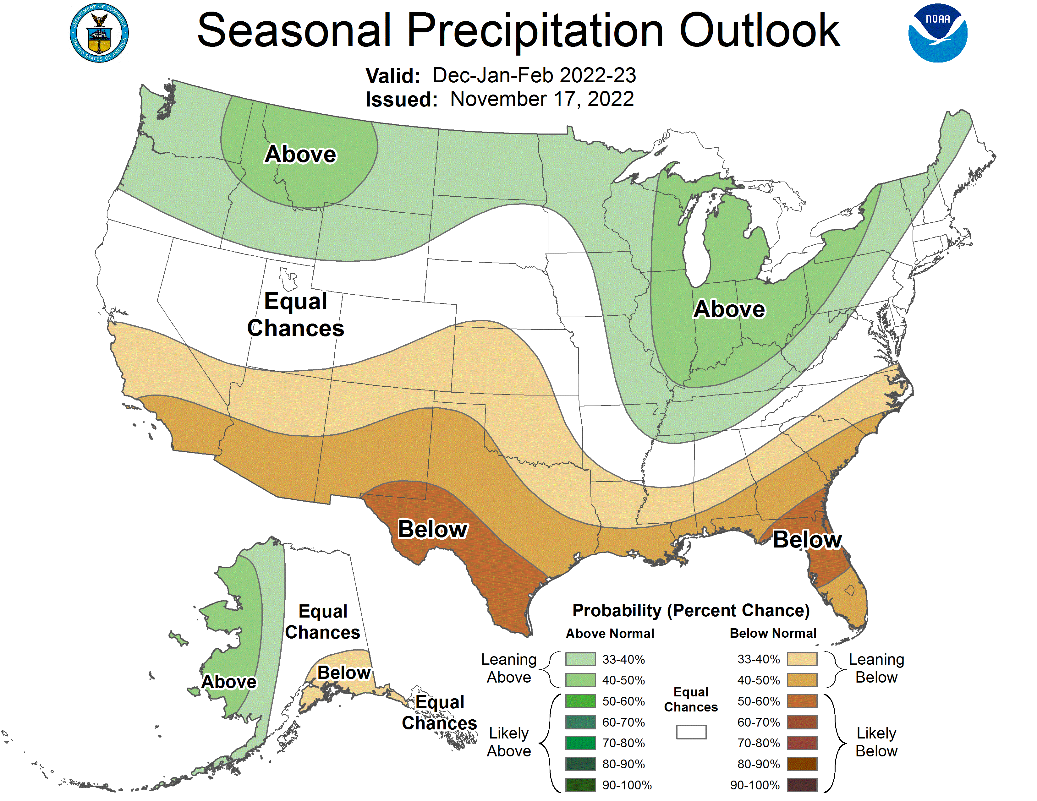
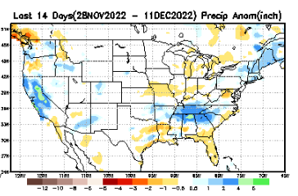
Previous(Last month)
CPC’s official
Precipitation OUTLOOK for Monthly (Dec)/Seasonal (DJF)
Released Nov 17th
Monthly P/T forecasts verified at mid-month are generally good! Becoz of good skill upto 2 wks.
Observed so far this month!! ☺

Slide 27
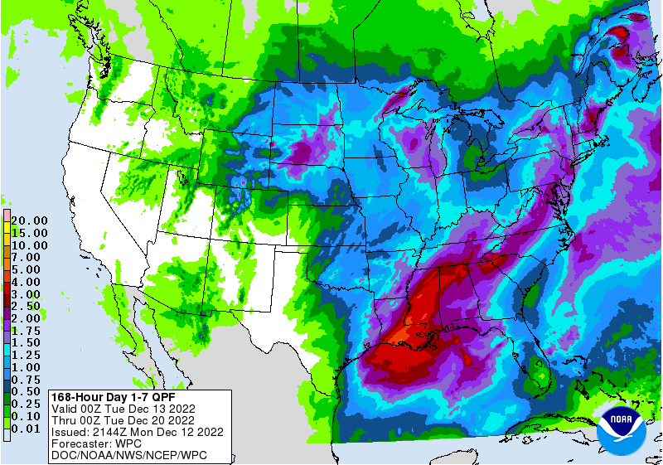
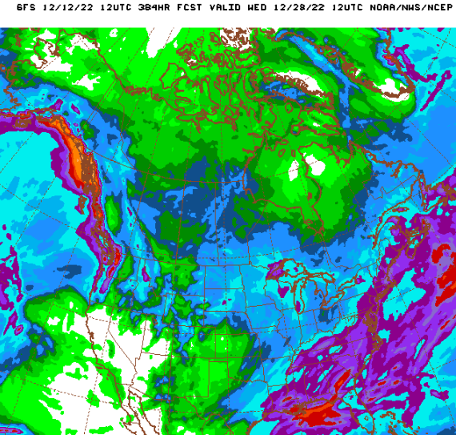
NCEP/WPC Next 7 days QPF (Quantitative Precipitation Forecast)
GFS Model Guidance for the
next 16 days.
Rain has arrived in Pacific NW. But, central/southern CA is not seeing any rain quite yet!

Slide 28
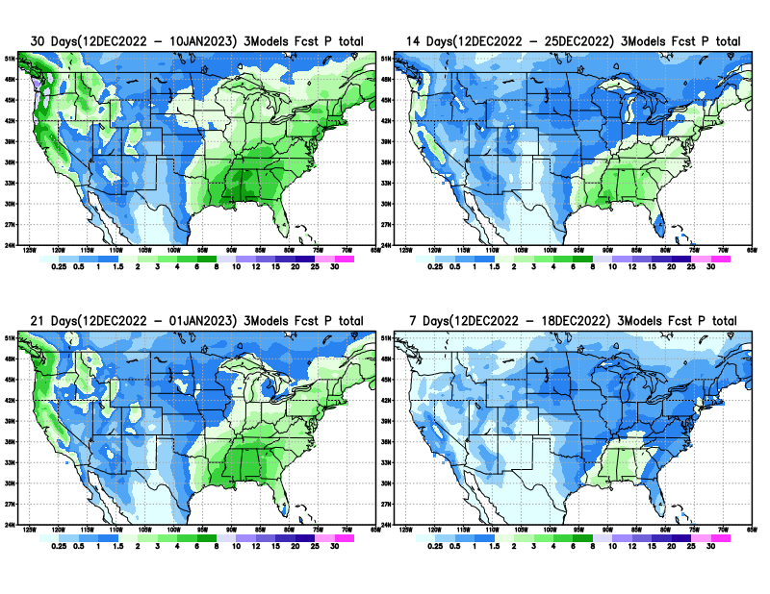
From 3 Models average Precip forecast (made yesterday, 12 Dec) for next 30 days.
The 3Models are: CFSV2, GEFS, & EC

Slide 29
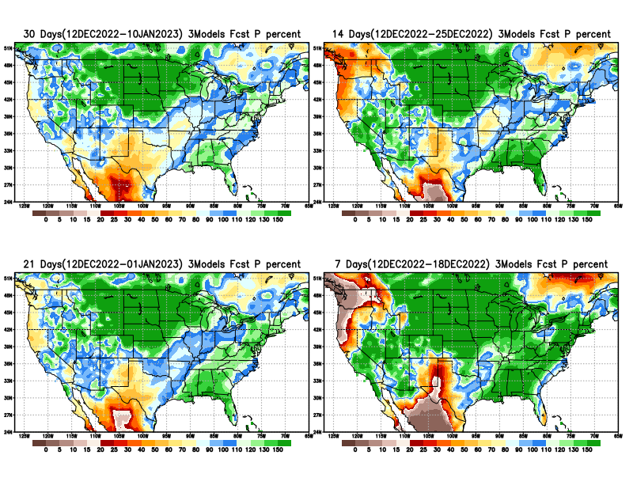
From 3 Models average Precip forecast (made yesterday, 12 Dec) for next 30 days.
20
40

Slide 30
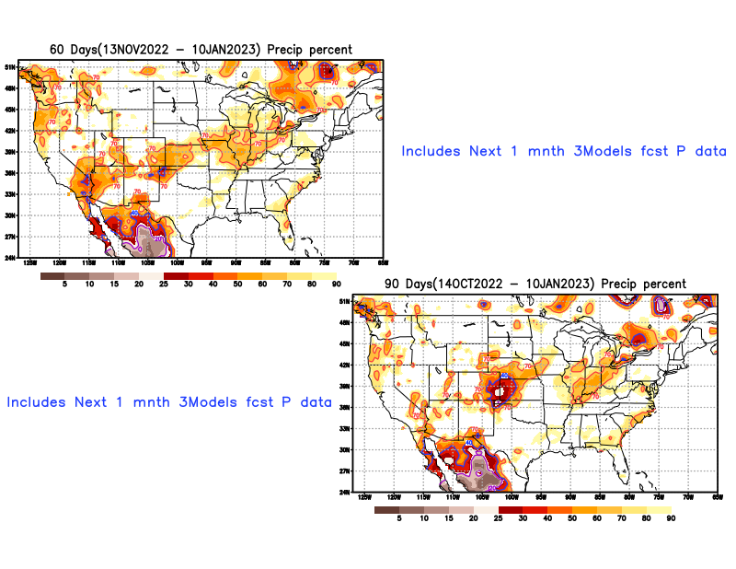
From 3 Models average Precip forecast (made yesterday, 12 Dec) for next 30 days.

Slide 31
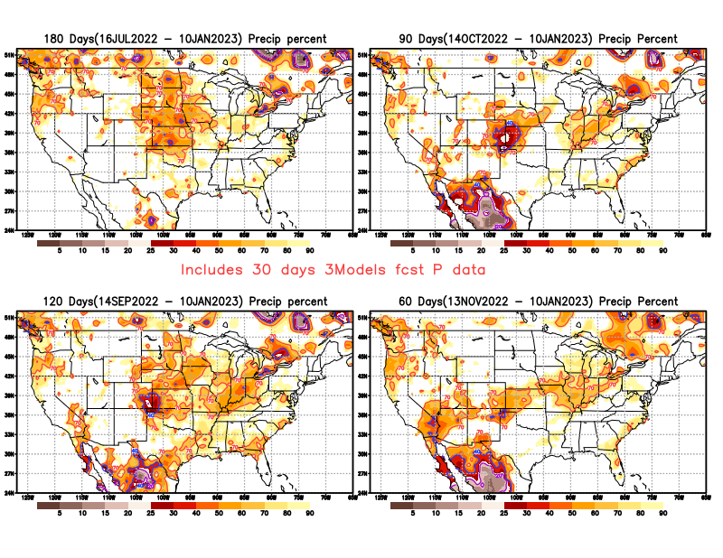
From 3 Models average Precip forecast (made yesterday, 12 Dec) for next 30 days.

Slide 32
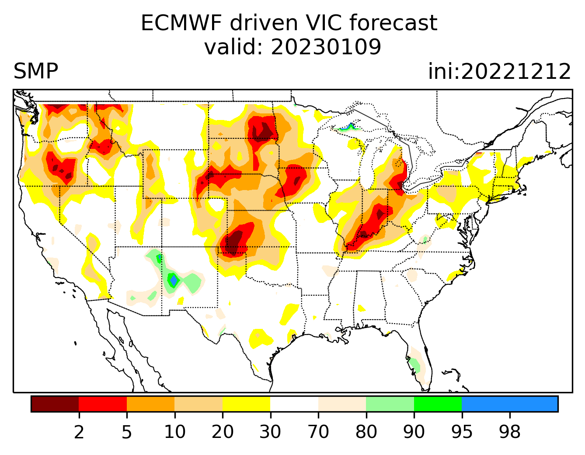
Week-4 Soil Moisture Percentile (SMP) Fcst based on VIC model forced with ECMWF-extended precipitation forecast!
Now: Based on Yesterday’s IC
While not exactly mapping 1-to-1 with the drought areas, this map is generally connected to the drought areas in some ways, as it is related to soil moisture!!
This dryness may exist next month, but will likely be not there by end of JFM.
(From Drs. Li Xu and Yun Fan) More detail at From: https://www.cpc.ncep.noaa.gov/products/people/lxu/flashd/flash_prediction.html#10

Slide 33
NMME T (left) & P (right) Ens.Mean forecasts for
Jan
JFM

Slide 34
Agreement/Disagreement among the various NMME models’ JFM seasonal Precip. Forecast.
??

Slide 35
(From NMME) compared with this month(foreground, red border)
Why is there so fewer hatched areas in SPI6 fcst from NMME models’ based fcst this month as compared to last month (left 2 columns) ? Fcsts more confident now?
Forecast uncertain in Hatched areas.
These maps are based on NMME models’ precip forecast uncertainty/certainty (among ensemble members) over the next 3 months
SPI6 Fcst made from last month
SPI6 & SPI12 Fcst made from this month

Slide 36
May skip this slide !!
No new/updated data!
http://drought.geo.msu.edu/research/forecast/smi.monthly.php
Predicted Monthly Soil Moisture Percentile
Latest Initial Conditions:
10/04/2022
CPC’s soil moisture percentile – Leaky bucket Model
The inter quartile range suggest greater uncertainty about the forecast in these shaded regions. LOTs of uncertainty regions!! ☹

Slide 37
BONUS Topic: Discussion continues!! Explanation for the multiyear DROUGHT in the Southwest (CA/AZ/NM/NV/UT/CO & vicinity)!!
More La Nina’s lately ?
More frequent La Ninas lately ?
YES!! The stats in the table below (bottom left) are from the Official CPC ENSO declarations page/table!
Compared to other regions of the globe, the SST warming/trend in the central eq. Pacific (Nino 3.4) is relatively much small. (See Fig. above) – Why is this ?
Does nature try to compensate for the warming else/everywhere by producing more La Ninas in the equatorial Pacific? - Just my observation from data! Let’s check !!!
Since the 1997 monster El Nino (stronger than the famous 1982/83 event), just a quick count of CPC’s Nino 3.4 index++ values for the three month overlapping seasons, (Data at CPC site only available only from 1950!)
(26 years) (47 years) (73 years)
1997-2022 1950-1996 1950-2022
La Nina(DJF) 11 16 27
El Nino(DJF) 8 17 25
La Nina(all 3mos) 116 150 266
El Nino(all 3mos) 77 166 243
(Overlapping 3month seasons)
Look at Ratios of La Ninas (vs El Ninos) in the shorter
recent (26 yr) period vs the longer (47 yr) earlier period!!
Compare the ratios of La Nina to El Nio in the squared boxes.
And imagine what if the rest of 2022 remain in La Nina column?
***Analysis of CPC’s official Nino 3.4 index data over the last 70 years shows that the more frequent La Nina’s in recent decades contributed to less rainfall in the southwest (See La Nina precip composites!, slide#13) and hence the ongoing long term drought in the Southwest!! Hence the long term southwest drought is unlikely to go away any time soon***
++ Barnston, Chelliah and Goldenberg (1997):Documentation of a highly ENSO‐related SST region in the equatorial pacific, Atmosphere-Ocean Volume 35, 1997. https://doi.org/10.1080/07055900.1997.9649597
*** The strong/weak annual monsoon rains in the southwest is a minor modulator riding on this bigger/longer-term signal. ***

Slide 38
Summary
Current Drought conditions:
It used to be that for many months (last year) the classic East-West dipole pattern with drought in the US west half, and (almost) no drought in the US east half, was in place.
But in the last few months, partly due to the second year of good SW monsoon, the S-term drought in the southwestern states has mostly gone, but the L-term drought still exists in parts of CA/OR/NV/UT/and vicinity and unlikely to go away any time soon!. Interestingly, S-term drought is emerging in the eastern half of US, mainly in the central Ohio valley & upper Midwest.
The drought in south central part of the US somewhat strengthened and expanded to the north, covering large parts of OK/KS/NE/Dakotas/MT, but conditions in TX slightly improved. The drought in this central part of the US is both S- & L- term.
The current severe winter storm, which recently dumped more than 3 feet of snow in the Sierra Nevada and heading east towards the Dakotas is likely to temporarily ease the drought conditions in those regions. The ongoing DJFM rainy season along the west coast states will definitely help the drought situation here, esp. in many CA reservoir levels.
The ongoing 3-year La Nina has generally increased the overall drought areas coverage across the entire United States. Accordingly, Drought is also emerging along the Gulf coast states.
Current ENSO status and forecast: La Niña is expected to continue into the winter, with equal chances of La Niña and ENSO-neutral during January-March 2023. In February-April 2023, there is a 71% chance of ENSO-neutral.
Prediction: The third year La Nina is in supposedly on its way out. The subsurface cold water in tropical equatorial pacific is slowly getting depleted, and the odds of either La Nina/Neutral ENSO conditions is 50/50 in the upcoming forecast season JFM. It may be a slow transition from La Nina to ENSO neutral conditions.
But the multi model NMME ensemble mean forecasts of T/P for the upcoming month(J) and forecast season (JFM) look very much like as if the La Nina conditions are going to be present at some level!
The long term trend and La Nina composite maps of Precipitation over the US for the JFM forecast season interestingly are similar to each other. Hence in spite of the expected weakened chances of La Nina, La Nina composites type impacts cannot be ruled out during JFM, and is consistent with the NMME model forecasts.
Along the central US states, from eastern NM, western TX onward in parts of northern OK, border areas of CO/KS, Nebraska and the Dakotas the three models forecast (EC/CFSV2/GEFS) suggest that the S/L drought during JFM is likely to persist or even intensify. The rainfall climatology for the JFM season also favors dry conditions. The existing drought in the FL pan-handle and in nearby Gulf coast areas may also persist or even intensify. The La Nina composites and NMME model forecasts also support this.
The drought in the Ohio valley, central Midwest region may go away from the likely above normal rain expected/forecast from La Nina conditions.
While there may be short term relief in the southwest and northwestern states, the L-term drought will stay. New short term may develop in the Pacific Northwest! ****

Slide 39
Summary
Current Drought conditions:
It used to be that for many months (last year) the classic East-West dipole pattern with drought in the US west half, and (almost) no drought in the US east half, was in place.
But beginning some time early this year, short term drought kept wavering (emerging and going away), across large parts of the Midwest, and along the Atlantic coastal areas esp. in VA/NC.
Drought in south central part of the US also strengthened. Drought in the Gulf coast of AL and FL panhandle also strengthened from last month.
The active southwest monsoon (for the second year in a row) impacted the 4-corner states (AZ/NM/UT/CO) area almost eliminated the short term drought in the region. But the long term drought still remain in some parts of the south western states. However, the upcoming DJF rainy season along the west coast states will definitely help the drought situation here, especially the very low reservoir levels across California.
The ongoing La Nina has generally increased the overall drought areas coverage across the entire United States. The D0-D4 areal coverage across the US exceeded 80% for the first time since 2000, when USDM started.
Current ENSO status and forecast: There is a 76% chance of La Niña during the Northern Hemisphere winter (December-February) 2022-23, with a transition to ENSO-neutral favored in February-April 2023 (57% chance).
Prediction: The third year La Nina is firmly in place through the forecast season (DJF). The rainy season will be starting very soon, in a matter of few weeks, and will likely mitigate or lessen the drought impacts in many areas of the northwestern states, ID/MT as well as northern CA.
The 2nd year active SW monsoon has all but erased the short term(S) drought in large parts of the 4-corners region. However, the LT drought will continue to stay in some parts of the SW region, particularly in southern CA, and the adjacent states such as NV/UT. Continued above normal temperatures forecast and the La Nina associated below normal rainfall across the southern states, from across TX/OK/LA, eastward to FL, is a major factor to either keep the drought here or enhance it, or even possibly develop in places where there is no drought now.
It is likely that parts of the Gulf states including coastal AL,GA/FL will develop some dryness, & possibly even drought by the end of the DJF forecast season, given La Nina impacts. Any drought in central and mid- Atlantic coastal states may stay at some dry/low drought category levels by DJF. The La Nina/canonical above normal rainfall in the Ohio valley will likely remove drought here.
The rainfall climatology, and the T/P forecasts in the central US states, will likely persist/worsen the current drought in parts of NE/KS/OK/TX as well as AR/LA. ****

