Slide 1
Drought Outlook Support Briefing
December 2023
Climate Prediction Center/NCEP/NOAA
http://www.cpc.ncep.noaa.gov/products/Drought
Points to ponder:
Often, there is a disconnect between the Short term (S) and Long term (L) drought in regions, and even with the short term (S) drought, the 3-month and 6-month signals are not quite consistent! With Long term (L) drought, it is even more trickier, as it is open ended from 1 year and beyond!!!
Places/regions experiencing Short term drought may (not) be ok in the Long term and vice versa!!
This duality is difficult to reconcile, to convey and even be clearly understood well by the public at large.
Public/Forecaster generally tends to focus more on the Short term Drought (for good reasons!!)
More importantly the very definitions and timescales associated with S/L term droughts and the declarations in the USDM are by themselves subjective!! Short term vs Long term drought need to be clearly distinguished and shown to the public!!
It may take a long time for drought to develop, but those conditions can end very quickly! as it happened in CA after DJF 2023 winter. Forecast models are yet to (seasonal) correctly forecast these changes in advance!
Subjective(delayed) USDM vs Objective(real time) map! A few days of recent heavy precip can change the USDM a lot!
New (last few months):
Towards objective drought monitoring goals, we introduced, a new objective AI/Deep-Learning based Experimental ODI (objective drought indicator, updated daily, Slide # 3) compared with Official USDM (US Drought Monitor, produced weekly by USDM authors).
Towards prediction, we introduce a new section with few slides at the end, consolidating the various exptl. drought outlooks by purely objective methods developed here at CPC! All these in preparation of a broad general push towards Probabilistic Drought outlooks.

Slide 2
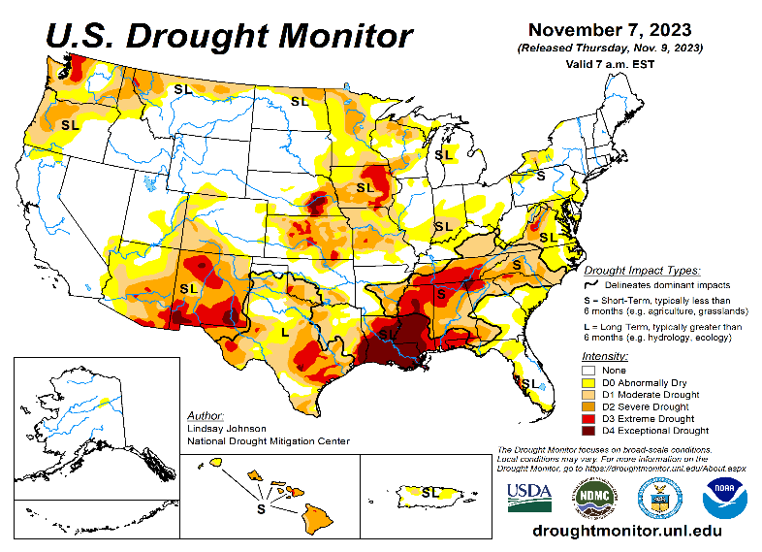
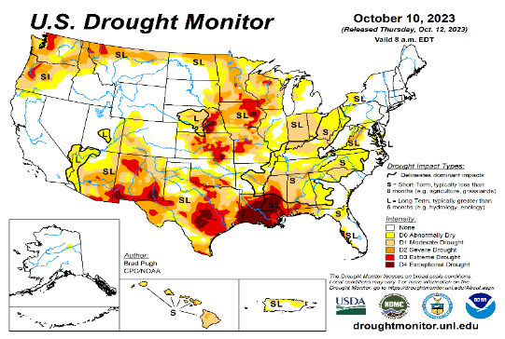
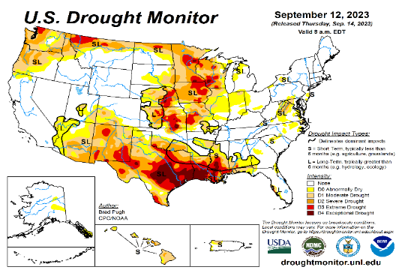
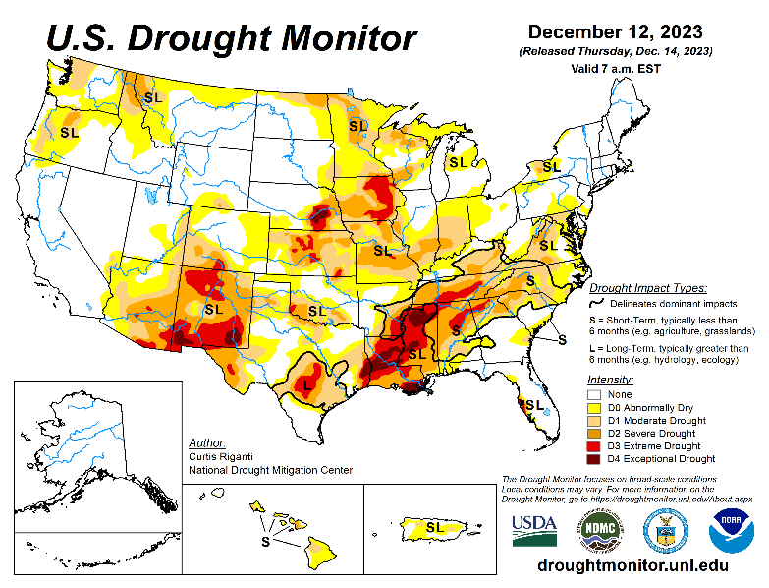
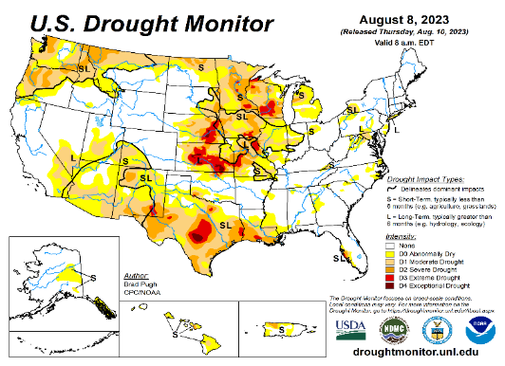
Drought Monitor
Monitoring is important because, unlike US T/P fcsts, for drought forecasts, we have to know where we are, before we can tell where we are going!! Drought forecasts are tendency forecasts.
November
It is good to see no drought, short term or long term almost anywhere in California for the past several months. Strange thing about it was that all the S/L term drought got removed in that just/last one winter season, that too in an La Nina winter when it is supposed to receive less rainfall (canonically speaking). How will this current El Nino winter be?
Water levels in almost all CA reservoirs are now at or above their normal levels. However, the water storage levels in the much bigger lakes, Lake Powell and Lake Mead in NV/AZ still continue to be historically low, and the two decade(s) long hydrological drought still exist here.
The current winter rains in Pacific NW is already improving drought conditions in the region.
July/August started off with drought mainly in the central part of the country approximately running north-south, with relatively drought free conditions elsewhere, except in the Pacific northwest.
But last couple of months severe drought got entrenched in the Gulf south states, particularly in Louisiana & vicinity, extending northeastward into lower Ohio valley.
The relatively poor monsoon this year in the southwestern states has created short term drought conditions in AZ/NM and in parts of UT/CO. Parts of Texas seems to get in and out of low to moderate drought.
Only about 44 % of the country is in drought free status! The flash/short term drought up and down the Ohio Valley, that developed quickly that we correctly predicted, seems not so short term anymore, but is staying especially strongly n the lower Ohio Valley.
For past couple of months, we introduce a feature new set of slides consolidating a few objective drought outlooks, produced experimentally at CPC.
October
September
December
(Recent/Latest)
August
?

Slide 3
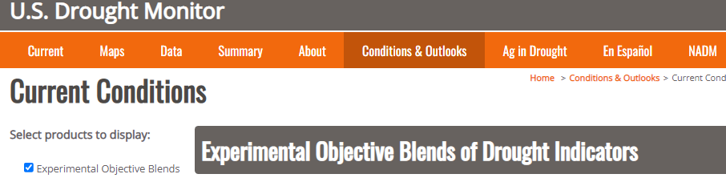
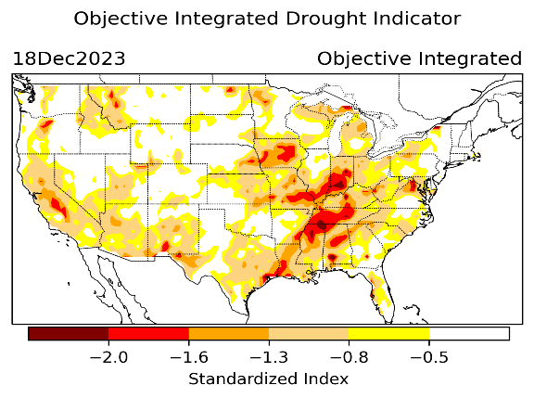
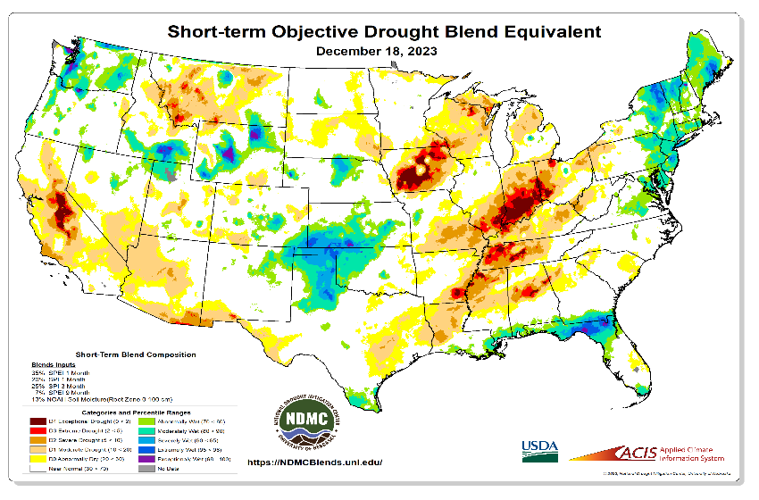
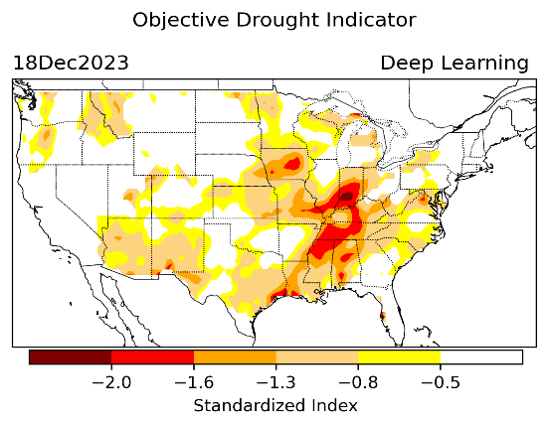
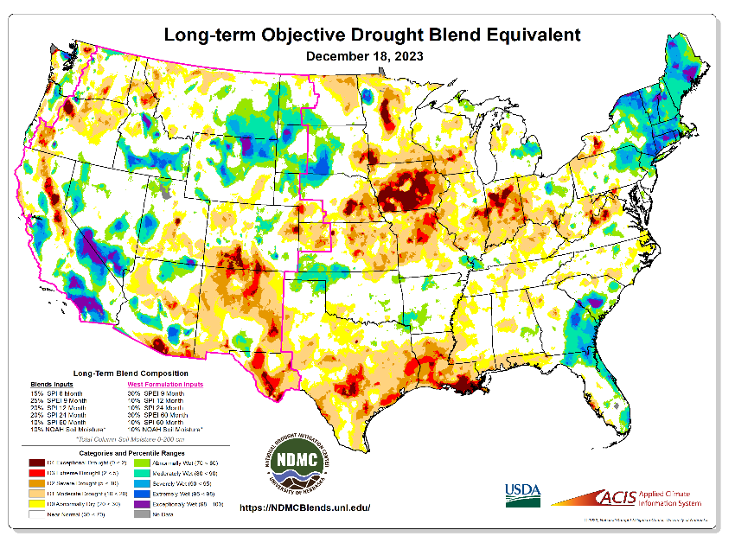
Exptl. Objective Drought Monitor
(showing S/term & L/Term separately) from
National Drought Mitigation Center (NDMC)
New slide now included recently in this briefing!
CPC’s own Experimental
Objective Drought Indicator (ODI)
using AI/Deep Learning ! – Updates daily !!
https://www.cpc.ncep.noaa.gov/products/people/lxu/odi/#deep-learning-increment-training
Based on the CPC P/analysis &
VIC (Princeton) NLDAS model assimilation:
Standardize Precipitation index (SPI)
Standardize Precipitation-Evapo –
transpiration index (SPEI)
Evapotranspiration Stress Index (ESI)
Soil Moisture Percentile (SMP)
Standardize Runoff Index (SRI)
-can be split into Short/Long Term Droughts!
https://droughtmonitor.unl.edu/ConditionsOutlooks/CurrentConditions.aspx
Objective
& Updates Daily!
12/18
Objectively Integrated
versus Deep Learning
Methods ~ gives |||r results. Both Objective!
Both update daily!
Objective &
Runs Weekly!
On Monday!
Objective
& Updates Daily!
* A manuscript (Xu & Chelliah) is under preparation.
Latest Official USDM (US Drought Monitor)
Subjective &
Produced Manually!
Weekly!
Objective &
Runs Weekly!
On Monday!
These two maps above, used to be produced at CPC(Rich Tinker!), but now recently officially done by NDMC operations!
*Released every Thursday, for conditions as of Tuesday!

Slide 4
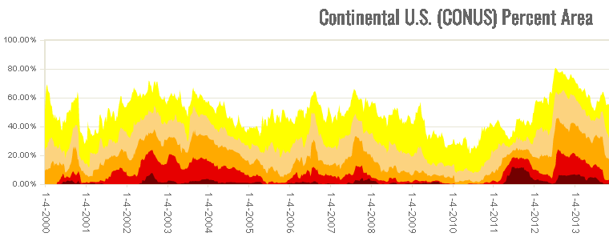
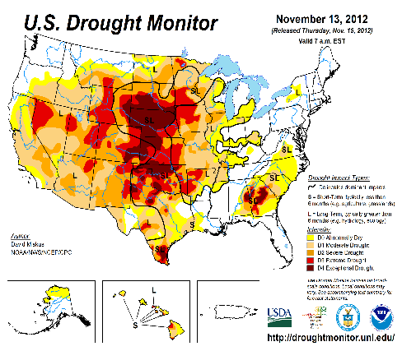

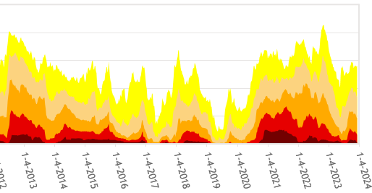

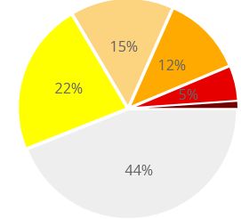

In general, The spatial details of every drought is different.! Every situation is different!!
Time series since 2000 spilt into 2 (above & below) panels.
CONUS % Land Area
Current drought!
Now, only about 44 % (last month 50%) of the country is drought free! About 56 % of the lower 48 states in some kind of dryness/drought!

Slide 5
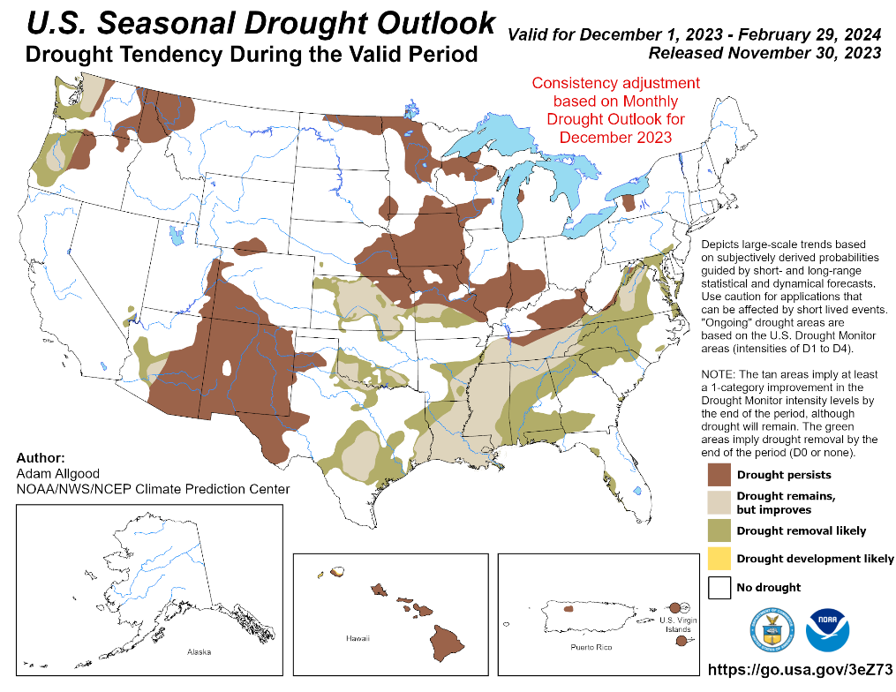
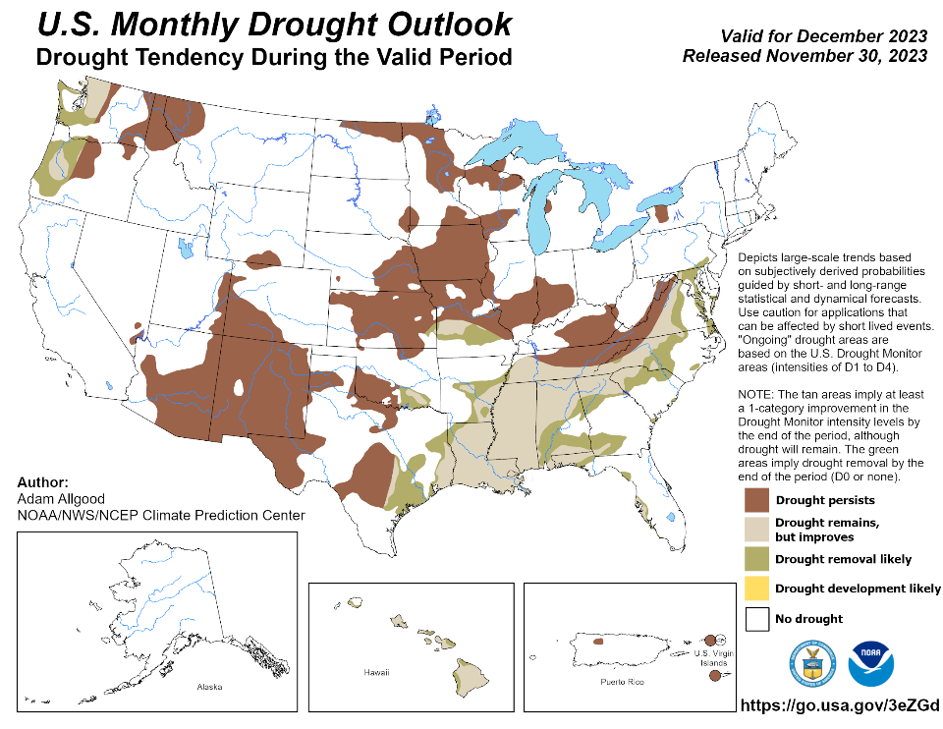
(Previous) Seasonal/Monthly Drought outlooks
New Seasonal+ Drought Outlook(SDO) to be released in 2 days!
(reissued again at end of month for consistency with MDO!)
New Monthly Drought Outlook (MDO) to be released at end of this month)
Updated Seasonal Outlook
( 1 Dec – 29 Feb 2024)
issued 11/30/23
Monthly outlook (for December 2023)
issued 11/30/23

Slide 6
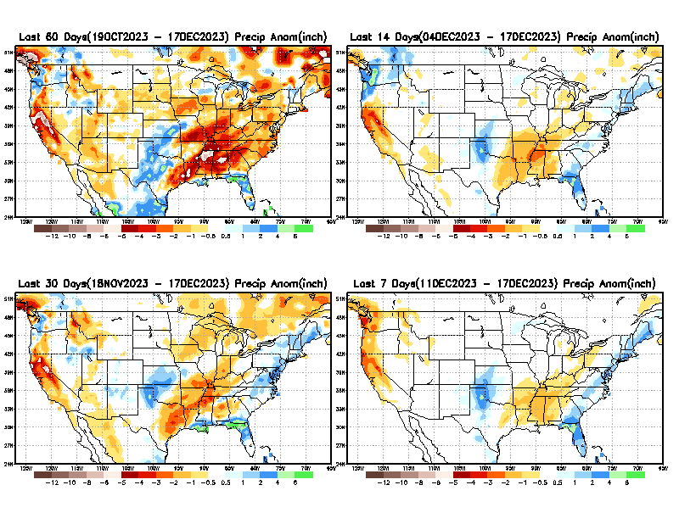
Precipitation ANOM during last 7, 14, 30, & 60 days.
This and next few slides show Precip deficit (excess).
Droughts, for the MOST part, begin and end with precip!! Lately, Temps are becoming (secondarily) important as well.
60 Days
14 Days
30 Days
7 Days
These maps in this and following slides, including a) Total,
b) Anom and
c) Percent of Normal precip. in these and other longer time ranges are now (routinely) daily updated at:
From: Recent Accum./Anom Precipitation https://www.cpc.ncep.noaa.gov/products/Drought/briefing_prcp.shtml

Slide 7
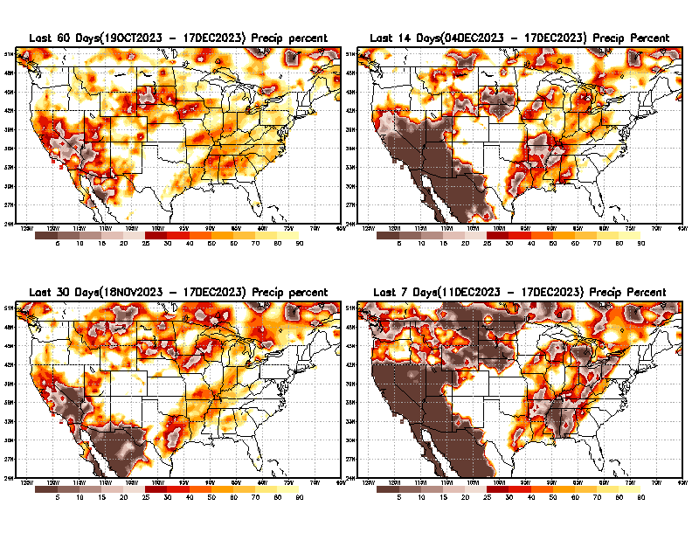
Precipitation Percent (of normal) during last 7, 14, 30, & 60 days - Only Deficit Areas <=90% shown !
60 Days
14 Days
This plot shows only the rainfall deficient regions <= 90% of normal.
-- This shows more clearly possible/likely drought developing region in the future unless there is above normal rainfall in these regions in the future, to offset these shortfalls.
30 days
7 days
From: Recent Anom/% of normal Precipitation https://www.cpc.ncep.noaa.gov/products/Drought/briefing_prcp.shtml

Slide 8
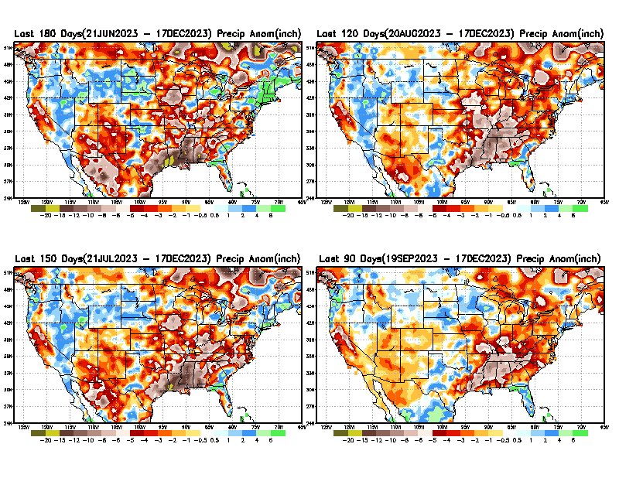
Total precipitation ANOM during last 3, 4, 5, and 6 months.
While the Precipitation anomalies deficit may seem large in some regions (compared to others),
it is the
% of normal precip (next slide) that matters more!!
6 M
4 M
5 M
3 M
From: Recent % of Normal Precipitation https://www.cpc.ncep.noaa.gov/products/Drought/briefing_prcp.shtml

Slide 9
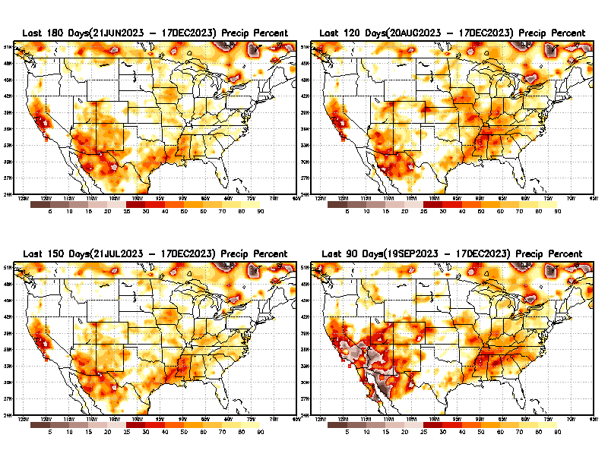
Total precipitation Percent (of normal) during last 3, 4, 5, and 6 months Only Deficit Areas <=90% shown!!
6 M
4 M
In these interim time scale 3-6 months, we need to pay attention to regions, which are dark-brown, red & dark red (<50%).
While accrued precipitation deficits are real & objective,
droughts are subjective declarations!!
5 M
3 M
East vs West!
Broad vs Narrow
rainfall season.
In general, West US suffers more from frequent and lasting droughts. Droughts in East US are less and less lasting!
What about Center ?
More like West than East?
Short term(S) Drought is generally declared when rainfall deficits exist in the 3-6 months time range. {Long term deficits beyond 1 or 2 or more years is Long term L drought! }

Slide 10
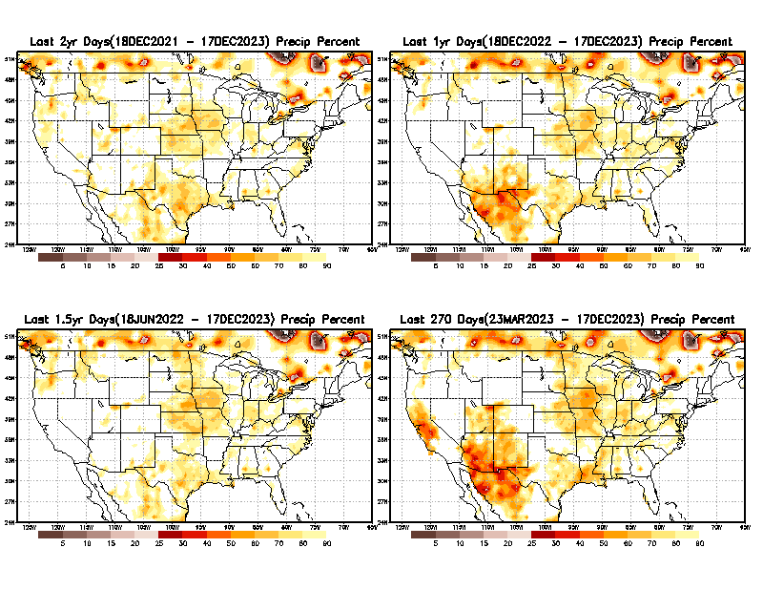
Total precipitation Percent during last 9 months, 1 yr, 1.5yrs, & 2 yrs. .–Only Deficit Areas shown!! <=90%
2 Y
1 Y
1.5 Y
9 M
The character and even location/spatial extent of the short/S and long/L –term droughts are different!!!
From: Recent Accumulated Precipitation https://www.cpc.ncep.noaa.gov/products/Drought/briefing_prcp.shtml

Slide 11
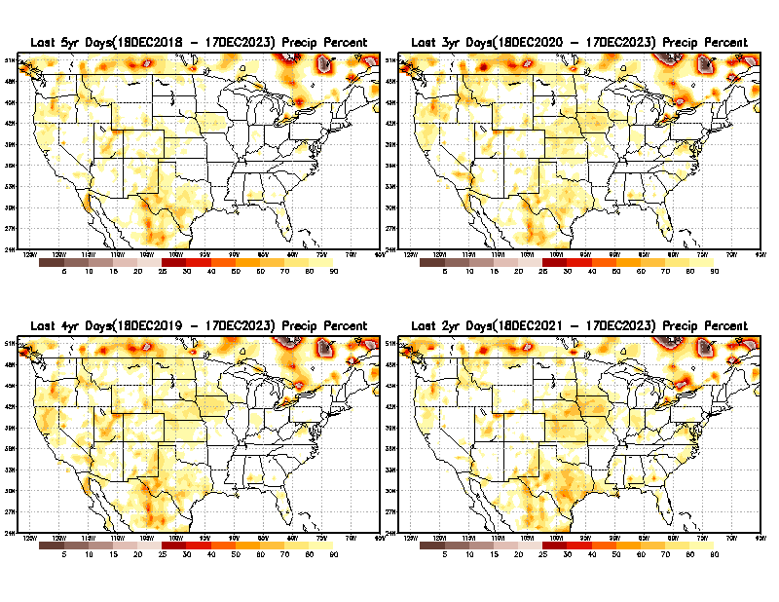
Total precipitation Percent (of normal) during last 2, 3, 4, & 5 yrs. .–Only Deficit Areas <=90% shown !!
5 Y
3 Y
4 Y
2 Y
From: Recent Accumulated Precipitation https://www.cpc.ncep.noaa.gov/products/Drought/briefing_prcp.shtml

Slide 12
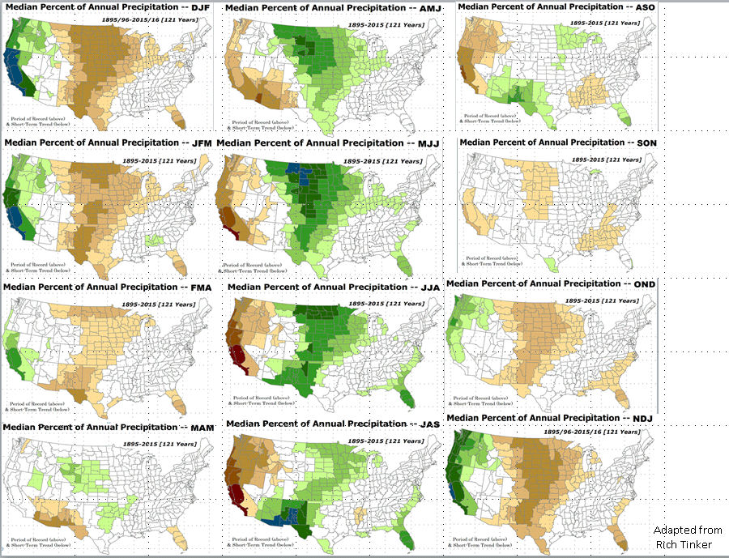

LEAST
MIXED
MOST
East vs West!
More darker colors in west/central => narrow rainy season (months)
Overall, more white space in the east => distributed rainfall season (except ~FL).

Slide 13
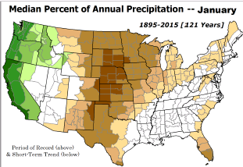
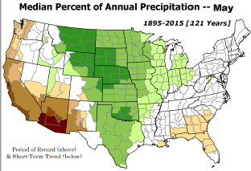
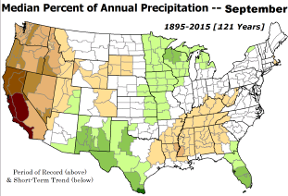
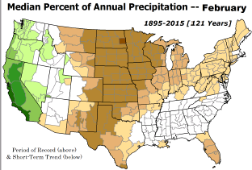
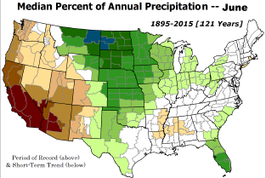
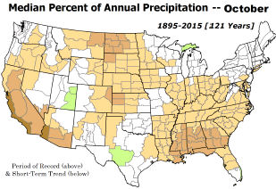

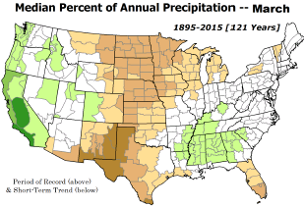
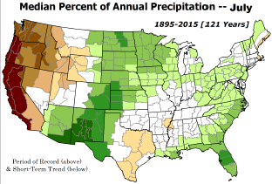
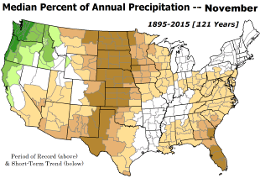
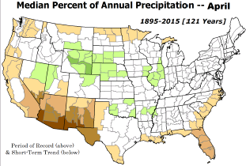
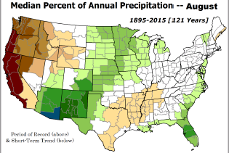
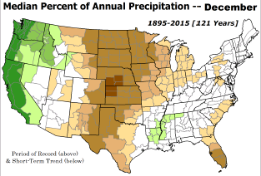
DJF is THE MAIN rainy along the west coast and dryness in the central US.
*********
EAST vs
CTR/WEST
Drought Behavior is loosely tied to rainfall climo!! And the limited rainy season in the west
*********
Adapted from Rich Tinker.

Slide 14
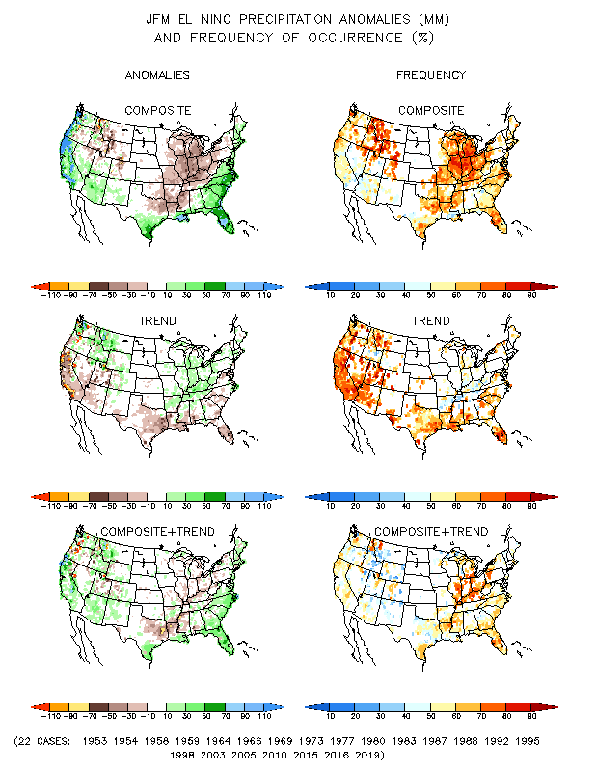
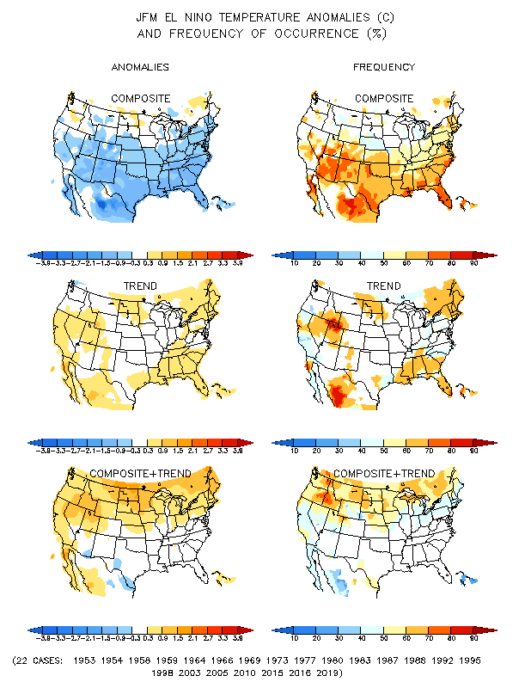
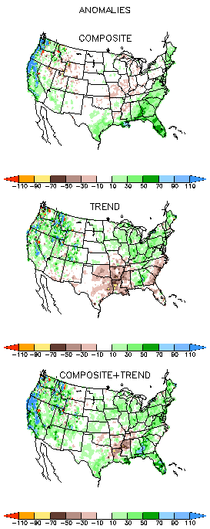
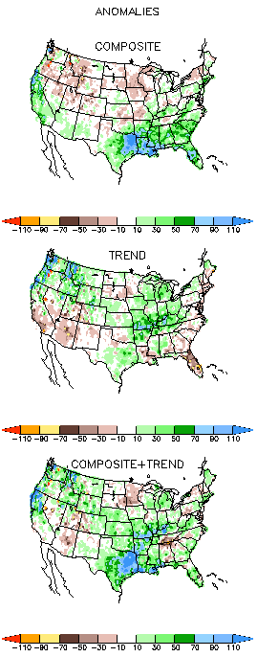
El Nino Precip/Temperature COMPOSITES & Trend map
JFM
P
T
Full
El NINO conditions !
Opposing signals!
The Occurrence frequency is WEAK!
Southeast US –Above Normal Prcp!
Generally, during El Nino winters, along both west/eastern coasts, precip is above normal. But lately exceptions do occur! Ex.: DJF 2015/16 !

Slide 15
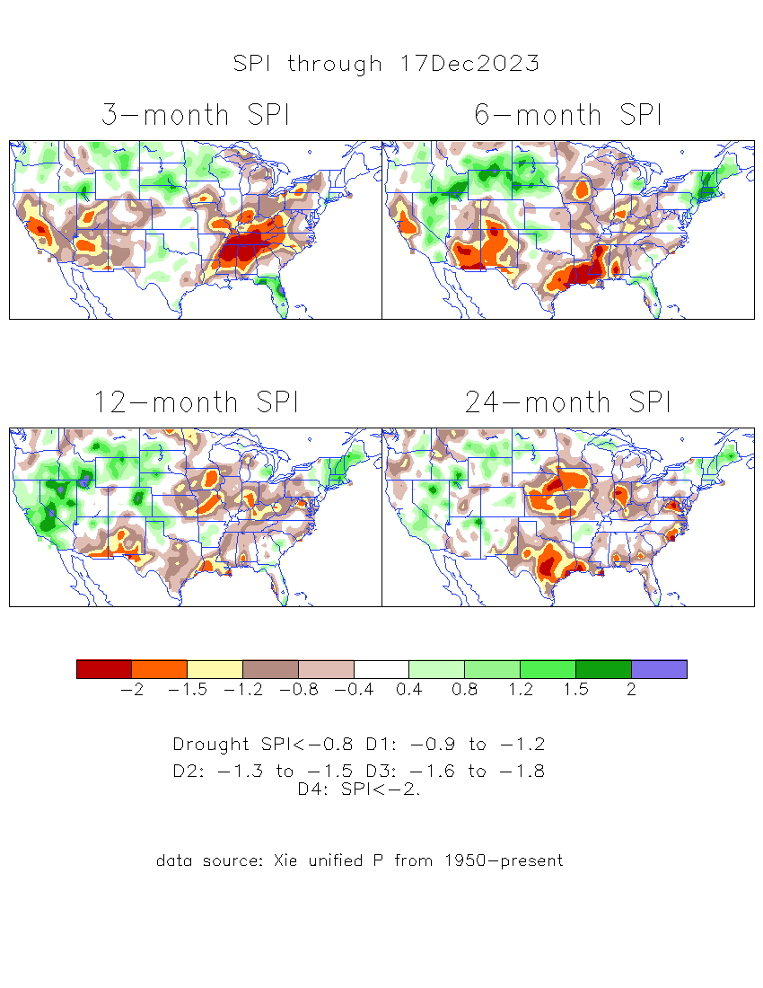
The Standardized Precipitation Index SPI
(based on Observed P)
Compare with last month
----- NOW
Very interesting graphic & details for the drought across the US based on the more generalized precip deficit/excess, the Standardized Precipitation Index (SPI).
The dark brown and red colors, indicating standardized precipitation deficits, in the various time periods, approximately correspond to the appropriate short/long term drought monitor regions and their intensities
Short
Long
How does one negotiate and reconcile declaring short term vs long term drought when precip. deficiencies patterns differ on many different time scales locally!!
What is the cutoff delineating time between short VS long term drought!! Not so clear!!
At exactly where, does drought begin?

Slide 16
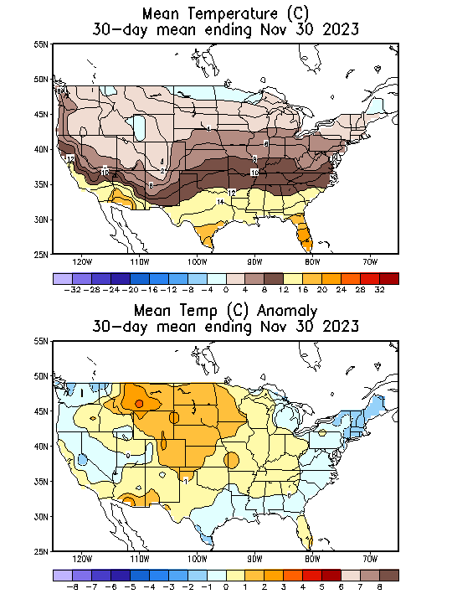
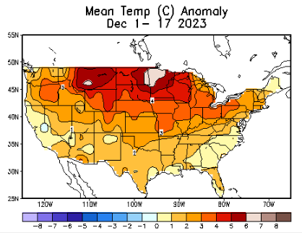
NOW
Recent US Temperatures
.
So far this month !!

Slide 17
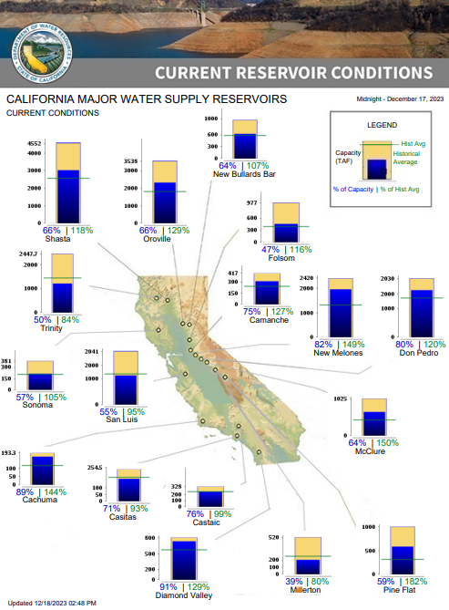
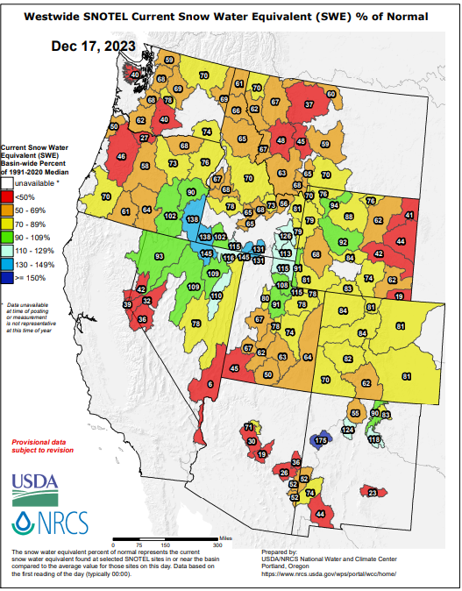
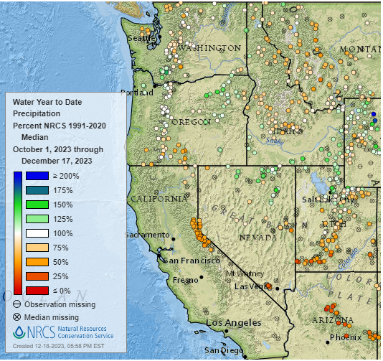

There isn’t much much/any snow anywhere!
% of Capacity
% of Hist. Avg.
of Reservoirs.
Water Year
(just started!),
Year-to-date Precipitation:
October 1, 2023 – Dec.17, 2023
https://www.nrcs.usda.gov/wps/portal/wcc/home/
Many CA water reservoirs are AT or ABOVE their historical average/ CAPACITY levels ! ☺
https:/www.nohrsc.noaa.gov/interactive/html/map.html?
WHOEVER thought that the California drought/reservoir-water-levels will turn around in just ONE La NINA winter!!
But a very different story for the big lakes Lake Mead & Lake Powell in NV, see next slide! ☹

Slide 18
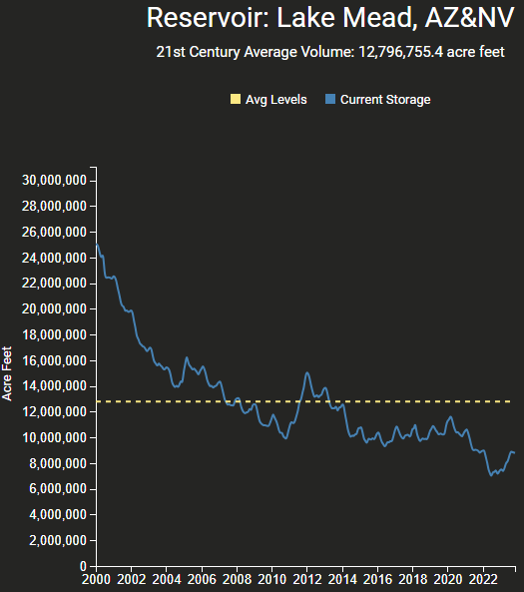
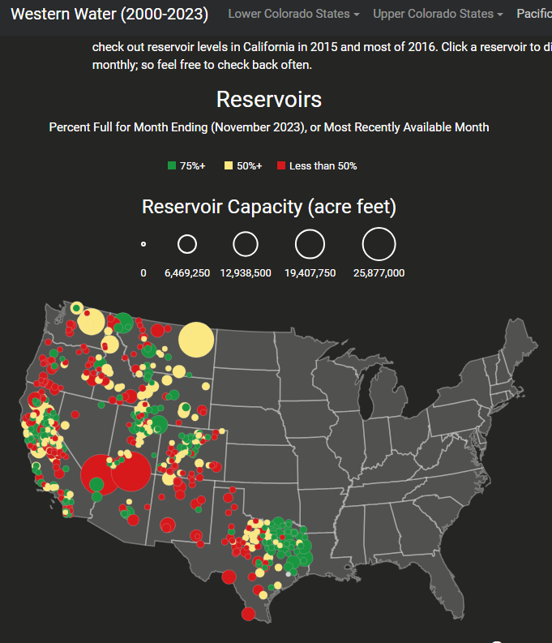
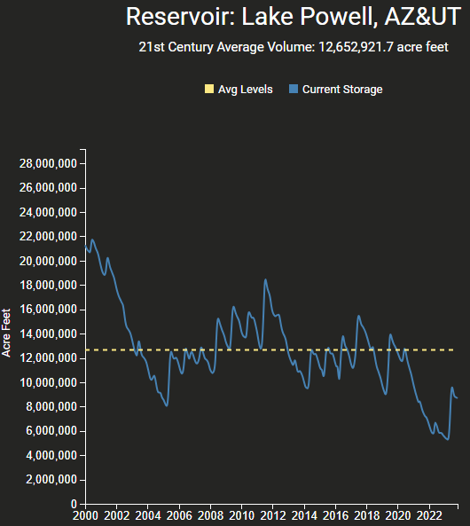
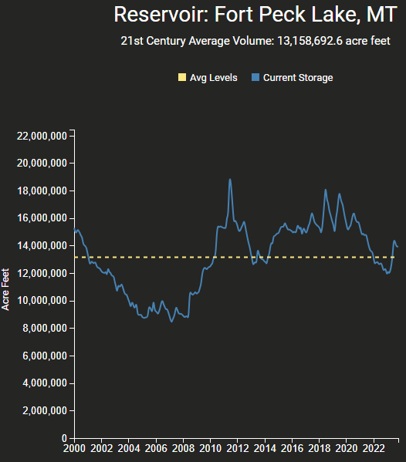
https://www.deanfarr.com/western_water/
Hydro Electric power generating turbines STOP operating at the critical 7 million acre feet level
Lakes Mead, Powell in NV/AZ are at historic /dire low levels! ☹ ☹ HUGE consequences for electric power for western states CA/NV/AZ/UT !!
Only very slight improvement in recent months!

Slide 19
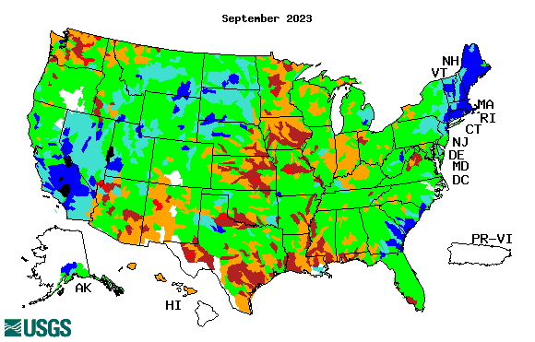






Streamflow (USGS)
Most US east droughts are relatively short lived (as compared to US west).
But in last 2 decades, recently in 2000, 2016, 2020, & 2022, New York and New England experienced historic drought conditions not seen since the 1960s.
Map shows only below normal 7-day average streamflow compared to historical streamflow for the day of year.
One month ago (left) &
Now (below)
Streamflow is only a partial indicator, as sometimes it is highly managed.
If sometimes, the various indicators are confusing, go back to % of rainfall deficit maps – to confirm/reinforce!!
https://waterwatch.usgs.gov/?m=nwc
19

Slide 20

EL NIÑO/SOUTHERN OSCILLATION (ENSO)
DIAGNOSTIC DISCUSSION
issued by
CLIMATE PREDICTION CENTER/NCEP/NWS
and the International Research Institute for Climate and Society
14 December 2023
ENSO Alert System Status: El Niño Advisory
Synopsis: El Niño is expected to continue through the Northern Hemisphere winter, with a transition to ENSO-neutral favored during April-June 2024 (60% chance).
 |  | >= +0.5 | <= -0.5
 |  | El Nino | La Nina | #of years
ALL | 1950-2023 | 249 | 269 | 74
3-month | 1950-1996 | 166 | 150 | 47
seasons | 1997-2023 | 83 | 119 | 27
 | 1970-1996 | 88 | 96 | 27
ONLY | 1950-2023 | 26 | 29 | 74
DJF | 1950-1996 | 17 | 16 | 47
seasons | 1997-2023 | 9 | 13 | 27
 | 1970-1996 | 10 | 10 | 27
CPC’s Oceanic Niño Index (ONI) [3 month running mean of ERSST.v5 SST anomalies in the Niño 3.4 region (5ºN-5ºS, 120º-170ºW)], based on centered 30-year base periods updated every 5 years.
For historical purposes, periods of below and above normal SSTs are colored in blue and red when the threshold (0.5) is met for a minimum of 5 consecutive 3-month overlapping seasons.

Slide 21





Latest values of SST indices in the various Nino Regions.
Sub-surface oceanic heat build-up is at near max. so far during this event.

Slide 22


Sub-Surface Temperature Departures in the Equatorial Pacific
While the Sub-surface oceanic heat build-up is at maximum (prev. slide) so far during this event,
the subsurface cold anomalies in the western Pacific are also developing fast, increasing in amplitude and pushing eastward, suggesting what ? A La Nina is immediately on the way also after the current El Nino this Winter?
??
Most recent pentad analysis

Slide 23




Official ENSO Forecasts
November CPC/NOAA forecast
https://www.cpc.ncep.noaa.gov/products/people/wwang/cfsv2fcst/images3/PacSSTSeaadj.gif
December CPC/NOAA forecast
~ 45% chance of La Nina by JAS 2024???
Latest ensemble membrs (blue!)show are less bullish

Slide 24


Previous (Last Month’s)
CPC’s official
Temperature OUTLOOK for Monthly (Dec)/Seasonal (DJF)
Monthly P/T forecasts verified at mid-month are generally good! Becoz of good skill upto 2 wks.
Released Nov 16th
Observed so far this month!! ☺

Slide 25



Previous(Last month)
CPC’s official
Precipitation OUTLOOK for
Monthly (Dec)/Seasonal (DJF)
Monthly P/T forecasts verified at mid-month are generally good! (??) Becoz of good skill upto 2 wks.
Released Nov 16th
Observed so far this month!! ☺ ☹

Slide 26




GEFS
WPC/NCEP’s Next 7 days QPF (Quantitative Precipitation Forecast)
GEFS*/GFS Model Guidance for the next 15 days.
(*new)
GFS

Slide 27

From 3 Models average Precip forecast (made 17/18 Dec) for next 30 days.
The 3Models are: CFSV2, GEFS, & EC

Slide 28

From 3 Models average Precip forecast (made 17/18 Dec) for next 30 days.
20
40

Slide 29

From 3 Models average Precip forecast (made yesterday 17/18 Dec) for next 30 days.

Slide 30

From 3 Models average Precip forecast (made yesterday 17/18 Dec) for next 30 days.

Slide 31

From 3 Models average Precip forecast (made yesterday 17/18 Dec) for next 30 days.

Slide 32




NMME*
T (left) &
P (right)
Ens.Mean forecasts for
Jan
T
P
JFM
Lots of confidence (??) in Above Normal Precip for southeast US during upcoming DJF !Why ?
NMME* : North American Multi Models Ensemble

Slide 33

Agreement/Disagreement among the various NMME models’ JFM seasonal Precip. Forecast.
??
Last month - ALL models are forecasting ABOVE Normal precip for the southeast US during NDJ !! – TREND+ENSO !!
This month – While the models still forecast above normal precip along CA, there is quite a bit of variability about it.

Slide 34




http://drought.geo.msu.edu/research/forecast/smi.monthly.php
Predicted Monthly Soil Moisture Percentile
Latest Initial Conditions: 12/12/23
DATA not available !
CPC’s soil moisture percentile – Leaky bucket Model
The inter quartile range suggest greater uncertainty about the forecast in these shaded regions in the ESP based forecast!

Slide 35


BONUS Topic: Discussion continues!! Explanation for the multiyear DROUGHT in the Southwest (CA/AZ/NM/NV/UT/CO & vicinity)!!
More La Nina’s lately ?
More frequent La Ninas lately ?
YES!! The stats in the table below (bottom left) are from the Official CPC ENSO declarations page/table!
(SKIP)
slide
Compared to other regions of the globe, the SST warming/trend in the central eq. Pacific (Nino 3.4) is relatively much small. (See Fig. above) – Why is this ?
Does nature try to compensate for the warming else/everywhere by producing more La Ninas in the equatorial Pacific? - Just my observation from data! Let’s check !!!
Since the 1997 monster El Nino (stronger than the famous 1982/83 event), just a quick count of CPC’s Nino 3.4 index++ values for the three month overlapping seasons, (Data at CPC site only available only from 1950!)
(27 years) (47 years) (74 years)
1997-2023 1950-1996 1950-2023
La Nina(DJF) 13 16 29
El Nino(DJF) 9 17 26
La Nina(all 3mos) 119 150 269
El Nino(all 3mos) 83 166 249
(Overlapping 3month seasons)
Look at Ratios of La Ninas (vs El Ninos) in the shorter
recent (27 yr) period vs the longer (47 yr) earlier period!!
Compare the ratios of La Nina to El Nino in the squared boxes.
***Analysis of CPC’s official Nino 3.4 index data over the last 70 years shows that the more frequent La Ninas in recent decades contributed to less rainfall in the southwest (See La Nina precip composites!, slide#13) and hence the ongoing long term drought in the Southwest!! Hence the long term southwest drought is unlikely to go away any time soon***
++ Barnston, Chelliah and Goldenberg (1997):Documentation of a highly ENSO‐related SST region in the equatorial pacific,
Atmosphere-Ocean Volume 35, 1997. https://doi.org/10.1080/07055900.1997.9649597
*** The strong/weak annual monsoon rains in the southwest is a minor modulator riding on this bigger/longer-term signal. ***

Slide 36
Exptl. objective drought forecast slides

Slide 37
Objective drought forecast
Support for Seasonal Drought Outlook (SDO)
  NMME Standardized Prcp. Index (SPI) forecast
    CONUS
    AK regions
  NMME Standardized Prcp. Evap. Index (SPEI) forecast (new development)
  NMME_VIC Soil Moisture Percentile (SMP) forecast (coming soon)
  NMME_VIC Standardized Runoff Index (SRI) forecast (coming soon)
Support for Monthly Drought forecast (MDO)/flash drought
  Meteorological drought (SPI)
  Agricultural drought (SMP)
  Hydrological drought (SRI)
Towards Probabilistic drought outlook (in development!)
This and following few slides are added new in recent months!

Slide 38

The North American Multi-Model Ensemble (NMME):
  CFSv2,
  NCAR_CCSM4
  GFDL_SPEAR
  CanCM4i
  GEM_NEMO
  NASA_GEOS5v2
Quantile-Mapping (BCSD) bias correction and downscaling
The Hatched area: Signal to Noise Ratio SNR < 1
Maximum likelihood to estimate the gamma distribution
Focus on the Meteorological drought
https://www.cpc.ncep.noaa.gov/products/Drought/Figures/SPI/Prediction/ENS_spi3-12_4x3_hatched.jpg

Slide 39


Focusses on Alaska
The same method as CONUS
Long-term drought
Observation in Alaska is poor!
Skill obviously is dependent on Model performance
https://www.cpc.ncep.noaa.gov/products/Drought/AK/nmme.shtml

Slide 40

NMME Multi-Model Ensemble Median (MMEM)
Standardized Prcp. Evap. Index (SPEI) Forecast
Focusses on the climatic water balance: P - PET
Replace for the Palmer drought indices
The PET is estimated by Hargreaves (1985), FAO recommendation method without solar radiation, humidity and wind observation
Historical 1991-2020 base period
Rank-based non-parametric standardized indices (SI)
Good for the long-term drought and short-term drought
https://ftp.cpc.ncep.noaa.gov/CPC/li.xu/SDO/spei.html

Slide 41

Based on CFSv2 Neural Network (NN) Forecast
3-Month Standardized Precipitation Index
(These next 4 weeks forecast can useful for flash droughts forecast!)
Sub-seasonal Drought Forecast, supports the monthly drought outlook (MDO)
The advanced Neural Network (NN) to bias correct and consolidate the forecast signal (developed by Dr. Yun Fan)
Focusses on the quickly developing Precipitation Deficiency
Weekly forecast, up to 35 days
Flash drought ( Rapid onset drought)
  Two drought categories degradation (NoDrought->D1 and D0->D2)
  Mostly happens in the warm season
https://ftp.cpc.ncep.noaa.gov/CPC/li.xu/Subseasonal_SPI/

Slide 42

Based on ECMWF-extended Precip forecast
VIC model driven Soil Moisture Percentile (SMP) forecast
ECMWF 48r1 version extended forecast, up to 32 days
Possibly the best sub-seasonal forecast currently available
Forecasted meteorological Forcing to drive the VIC model
With realistic land initial from the VIC land analysis
Predictability: land initial + sub-seasonal forecast
SMP for agricultural drought
https://www.cpc.ncep.noaa.gov/products/people/lxu/flashd/flash_prediction.html#10

Slide 43

Based on ECMWF-extended Precip forecast,
VIC model driven Std. Runoff Index(SRI3) forecast
The same EC_VIC model forecast
Focus on the runoff deficiency for hydrological drought
VIC is well prestige for the hydrological forecast
Important for the western US region
Future development
https://www.cpc.ncep.noaa.gov/products/people/lxu/flashd/flash_prediction.html#10

Slide 44
Summary
Current Drought conditions:
It is good to see no drought, short term or long term almost anywhere in California for the past several months. Strange thing about it was that all the S/L term drought got removed in that just/last one winter season, that too in an La Nina winter when it is supposed to receive less rainfall (canonically speaking). How will this current El Nino winter be?
Water levels in almost all CA reservoirs are now at or above their normal levels. However, the water storage levels in the much bigger lakes, Lake Powell and Lake Mead in NV/AZ still continue to be historically low, and the two decade(s) long hydrological drought still exist here. The current winter rains in Pacific NW is already improving drought conditions there.
July/August started off with drought mainly in the central part of the country approximately running north-south, with relatively drought free conditions elsewhere, but last couple of months severe drought got entrenched in the Gulf south states, particularly in Louisiana & vicinity, extending northeastward into lower Ohio valley.
The relatively poor monsoon this year in the southwestern states has created short term drought conditions in AZ/NM and in parts of UT/CO. Parts of Texas seems to get in and out of low to moderate drought.
Only about 44 % of the country is in drought free status! The flash/short term drought up and down the Ohio Valley, that developed quickly that we correctly predicted, seems not so short term anymore, but is staying especially strongly n the lower Ohio Valley. For past couple of months, we introduce a feature new set of slides consolidating a few objective drought outlooks, produced experimentally at CPC.
Current ENSO status and forecast: El Niño is expected to continue through the Northern Hemisphere winter, with a transition to ENSO-neutral favored during April-June 2024 (60% chance).
Prediction: The El Nino is fully established and is in the strongest state right now so far. However, it is still not absolutely clear if one can expect the same canonical El Nino impacts around the globe, especially over the United States. The more recent highly anomalous/unusual impacts of ENSO events (2015/16/17 and 2022/23 winters) do linger in mind.
The above, combined with the NMME models forecast precip for the upcoming month, rules out any drought presence/ development by the end of the JFM forecast season, anywhere along the Pacific coastal states, especially in CA and west of the mountains in WA/OR states, and also anywhere Atlantic coastal regions. The same can be told for the southeast and FL. But the rainfall many not be enough to offset or remove drought in deep drought entranced LA/MS and vicinity.
The flash/drought development that we correctly forecast two months ago up and down the Ohio Valley is probably not short lived, but may stay/persist longer, especially in parts of TX/LA/MS/AL/TN & vicinity, despite some possible improvement, by the end of only JFM forecast season. Elsewhere in upper central Midwest around IA/MO and vicinity the drought will still however persist in some form. Overall, the drought situation up and down the Ohio valley will very much depend on how canonical this ongoing El Nino impacts will be, which looks like it will be somewhat canonical with less than normal rainfall for the region.
The drought in the south and particularly southwest in AZ/NM, may get better, but not gone, given the rainfall forecast. ****

