Slide 1
Drought Outlook Support Briefing
December 2024
Climate Prediction Center/NCEP/NOAA
http://www.cpc.ncep.noaa.gov/products/Drought
Points to ponder:
Often, there is a disconnect between the Short term (S) and Long term (L) drought in regions, and even with the short term (S) drought, the 3-month and 6-month signals are not quite consistent! With Long term (L) drought, it is even more trickier, as it is open ended from 6 months-onwards and beyond!!!
Places/regions experiencing Short term drought may (not) be ok in the Long term and vice versa!!
This duality is difficult to reconcile, to convey and even be clearly understood well by the public at large.
Public/Forecaster generally tends to focus more on the Short term Drought (for good reasons!!)
More importantly the very definitions and timescales associated with S/L term droughts and the declarations in the USDM are by themselves subjective!! Short term vs Long term drought need to be clearly distinguished and shown to the public!!
It may take a long time for drought to develop, but those conditions can end very quickly! as it happened in CA after DJF 2023 winter. Forecast models are yet to (seasonal) correctly forecast these changes in advance!
Subjective(delayed) USDM vs Objective (real time) map! A few days of more recent heavy precip can change the USDM a lot!
New (last several months):
Towards objective drought monitoring goals, we introduced, a new objective AI/Deep-Learning based Experimental ODI (objective drought indicator, updated daily, Slide # 3) compared with Official USDM (US Drought Monitor, produced weekly by USDM authors).
Towards prediction, we introduce a new section with few slides at the end, consolidating the various exptl. drought outlooks by purely objective methods developed here at CPC! All these in preparation of a broad general push towards Probabilistic Drought outlooks.
New issues/questions to ponder:
How much rainfall/Precip. deficient have to be, and after how long, do we actually declare Drought?
Do these have to vary by region?
i.e., When, what exact dry/rainfall-deficient conditions, trigger a Drought call?
Should there be minimum duration of Drought (conditions/criteria!) ? (We know there is no such maximum!)
i.e., Can a region quickly get into a Drought (say for a month or less, for a couple of weeks!) and get out of it?

Slide 2
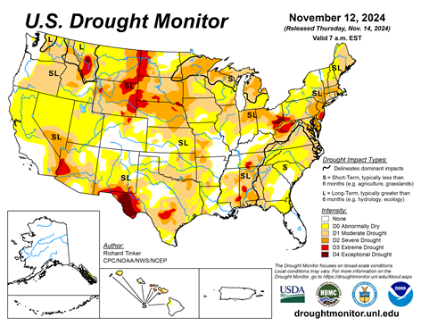
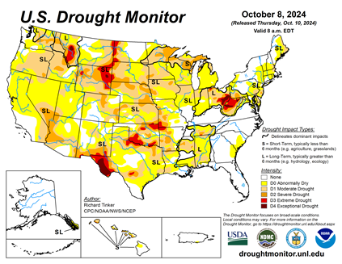

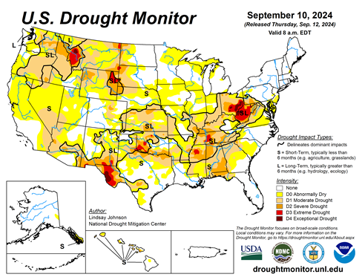
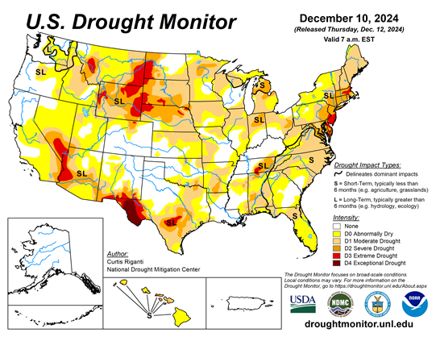


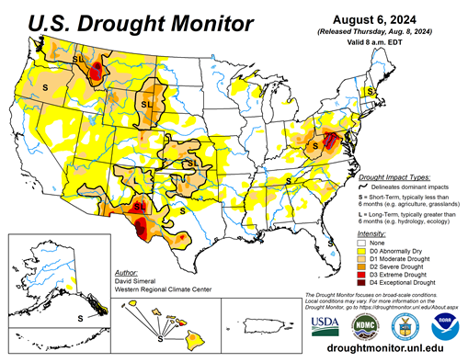
Drought Monitor
Monitoring is important because, unlike US T/P fcsts, for drought forecasts, we have to know where we are, before we can tell where we are going!! Drought forecasts are tendency forecasts as changes from the latest USDM.
California for the most part, until a few months ago, has remained drought free for about twenty months now luckily due to above normal rainfall during both recent 2022/23 (La Nina, strange!) and 2023/24 (El Nino, canonical!) winter rainfall seasons. But in the last couple of months some dryness has kept in. But we are in the middle of winter/DJF rainfall season with La Nina not yet fully established !
Water levels in almost all CA reservoirs are now at or above their normal levels. However, the water storage levels in the much bigger southern lakes, Lake Powell and Lake Mead in NV/AZ still continue to be very low, and have not recovered completely from the 2+ decades(since ~2000) long hydrological drought that existed in the region.
Comparing the most recent USDM with that back in summer, there is a considerable increase in the drought covered areas of the United States.
In our June/July Drought briefings, we suggested that, “Overall, % of US land areas under drought will slightly increase from existing very low levels, mainly due to drought concern in the western/central US states.” – which did happen, as we can see from the current USDM map.
Large parts of NV/UT/AZ/NM and TX are still dry or under drought due to long term/decadal drought in the SW, as well as the poor back to back SW monsoons in 2023 and 2024.
While the drought in WA & OR got relief from the early winter rains, drought in the border/interior areas of MT,WY the Dakotas and NE has not improved worsened and is likely to not get any relief soon.
Much of the coastal regions of northeastern states and the Delmarva region and vicinity that quickly developed drought conditions recently, may get some relief if in fact the evading La Nina finally materializes.
Since early summer, questions still remain about when the La Nina will actually develop and how strong it will be! A lot depends on if the La Nina will finally develop and how strong will it be? Generally La Nina phase of ENSO is associated with less rain across the US and vice versa during El Nino. If La Nina is established during DJF/JFM, less than normal rainfall is expected across the southern US states thus enhancing drought, raising concerns, across the southern states .
November
October
December
(Recent/Latest)
August

Slide 3
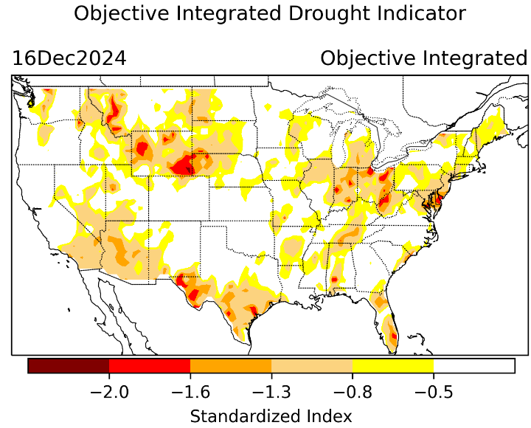
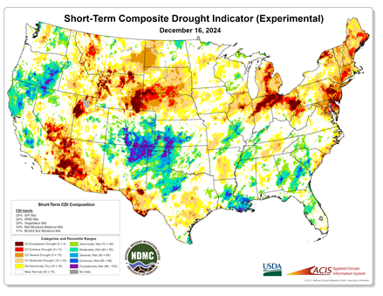
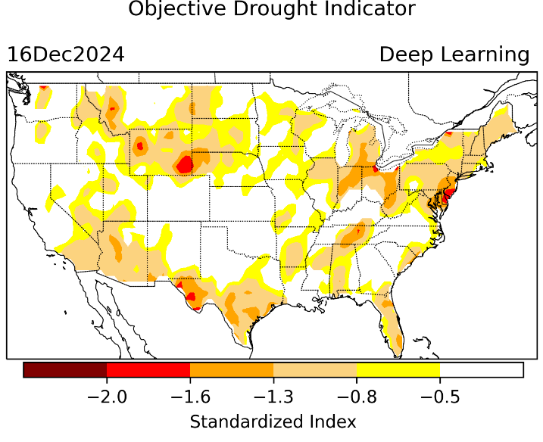
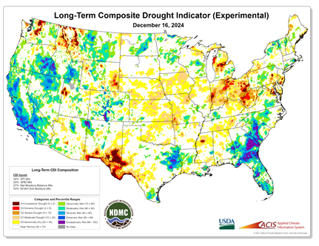
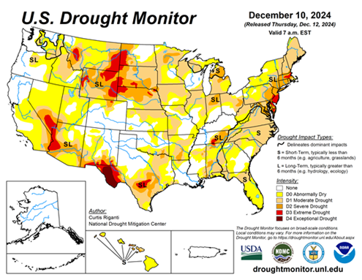
Exptl. Objective Drought Monitor
(showing S/term & L/Term separately) from
National Drought Mitigation Center (NDMC)
New slide now included recently in this briefing!
CPC’s own Experimental
Objective Drought Indicator (ODI)
using AI/Deep Learning ! – Updates daily !!
https://www.cpc.ncep.noaa.gov/products/people/lxu/odi/#deep-learning-increment-training
Based on the CPC P/analysis &
VIC (Princeton) NLDAS model assimilation:
Standardize Precipitation index (SPI)
Standardize Precipitation-Evapo –
transpiration index (SPEI)
Evapotranspiration Stress Index (ESI)
Soil Moisture Percentile (SMP)
Standardize Runoff Index (SRI)
-can be split into Short/Long Term Droughts!
https://droughtmonitor.unl.edu/ConditionsOutlooks/CurrentConditions.aspx
Objective
& Updates Daily!
Objectively Integrated
versus Deep Learning
Methods ~ gives |||r results. Both Objective!
Both “update daily” based on indicators day before!
Objective, but
runs Weekly!
On Mondays!
Objective
& Updates Daily!
* A manuscript (Xu & Chelliah) is under preparation.
Latest Official USDM (US Drought Monitor)
(about a week old!)
Subjective &
Produced Manually!
Weekly!
Objective, but
runs Weekly!
On Mondays!
These two maps above, used to be produced at CPC (Rich Tinker!), every Monday but now recently officially moved to NDMC operations!
*Released every Thursday, for conditions as of Tuesday!

Slide 4
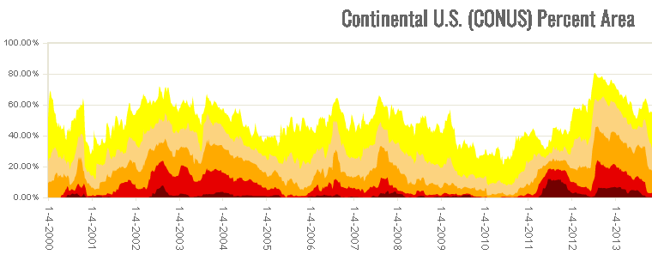
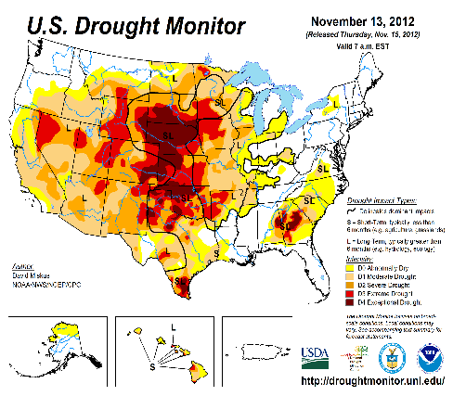

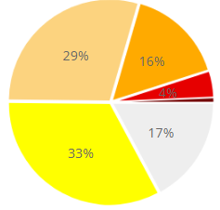
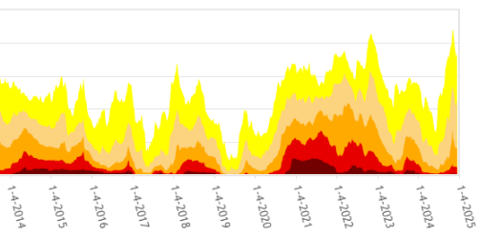

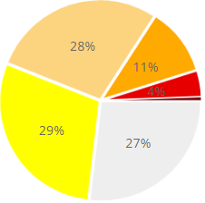

In general, The spatial details of every drought is different.! Every situation is different!!
Time series since 2000 spilt into 2 (above & below) panels.
After 2024 El Nino!
After 2019 El Nino !
3 back to back La Ninas !
last
month !
CONUS % Land Area
This month !
We said in this briefing a 3,4 months ago, that the relative minimum in the %(percent) of US land coverage by Drought has reached its lower limit, and will likely increase from that low point onwards and it has been happening, as we suggested. We said it based on 2 factors: weak 2024 SW monsoon, ending of El Nino, possible trending La Nina development.

Slide 5
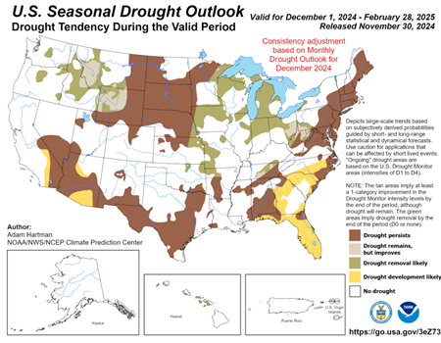
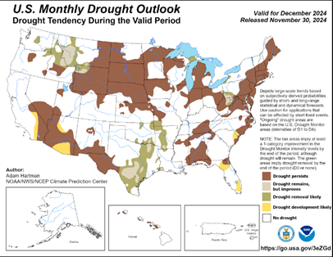
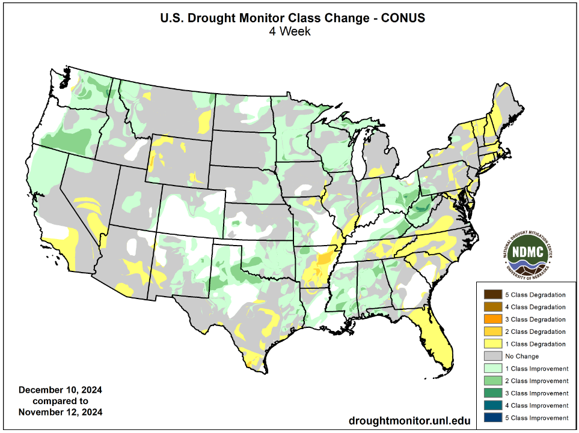
(Previous) Seasonal/Monthly Drought outlooks
New Seasonal+ Drought Outlook(SDO) to be released in 2 days!
(reissued again at end of month for consistency with MDO!)
New Monthly Drought Outlook (MDO) to be released at end of this month)
Updated Seasonal Outlook
( 1 Dec 2024 – 28 Feb 2025)
issued 11/30/24
Both outlook maps from cpc website!
Monthly outlook (for December 2024)
issued 11/30/24
Both outlook maps from cpc website!
https://droughtmonitor.unl.edu/Maps/ChangeMaps.aspx

Slide 6
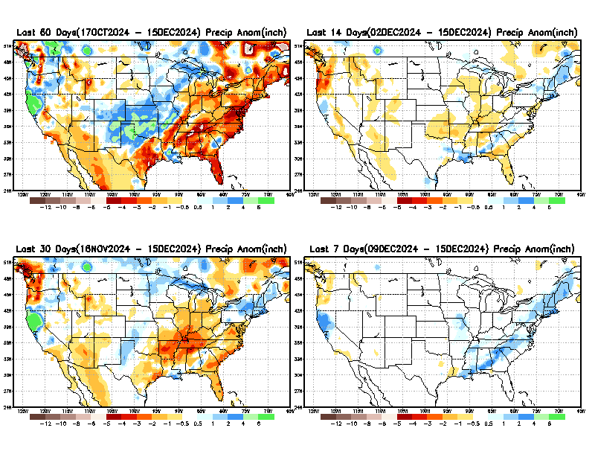
Precipitation ANOM during last 7, 14, 30, & 60 days.
This and next few slides show Precip deficit (excess).
Droughts, for the MOST part, begin and end with precip!! Lately, Temps are becoming (secondarily) important as well.
60 Days
14 Days
30 Days
7 Days
These maps in this and following slides, including a) Total,
b) Anom and
c) Percent of Normal precip. in these and other longer time ranges are now (routinely) daily updated at:
From: Recent Accum./Anom Precipitation https://www.cpc.ncep.noaa.gov/products/Drought/briefing_prcp.shtml

Slide 7
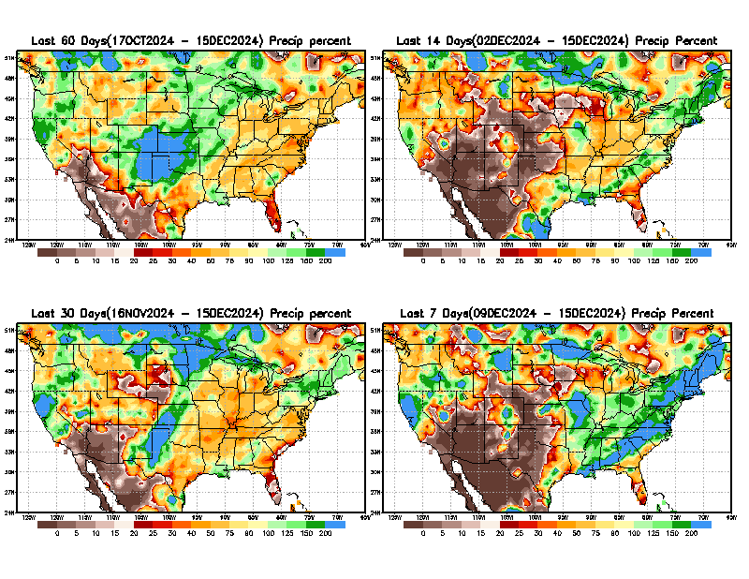
Precipitation Percent (of normal) during last 7, 14, 30, & 60 days - Only Deficit Areas <=90% shown !
60 Days
14 Days
This plot shows only the rainfall deficient regions <= 90% of normal.
-- This shows more clearly possible/likely drought developing region in the future unless there is above normal rainfall in these regions in the future, to offset these shortfalls.
30 days
7 days
From: Recent Anom/% of normal Precipitation https://www.cpc.ncep.noaa.gov/products/Drought/briefing_prcp.shtml

Slide 8
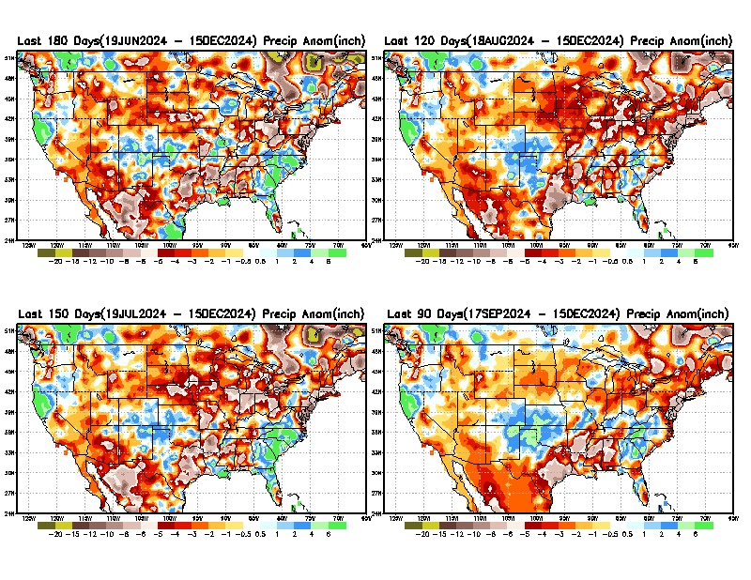
Total precipitation ANOM during last 3, 4, 5, and 6 months.
While the Precipitation anomalies deficit may seem large in some regions (compared to others),
it is the
% of normal precip (next slide) that matters more!!
6 M
4 M
5 M
3 M
From: Recent % of Normal Precipitation https://www.cpc.ncep.noaa.gov/products/Drought/briefing_prcp.shtml

Slide 9
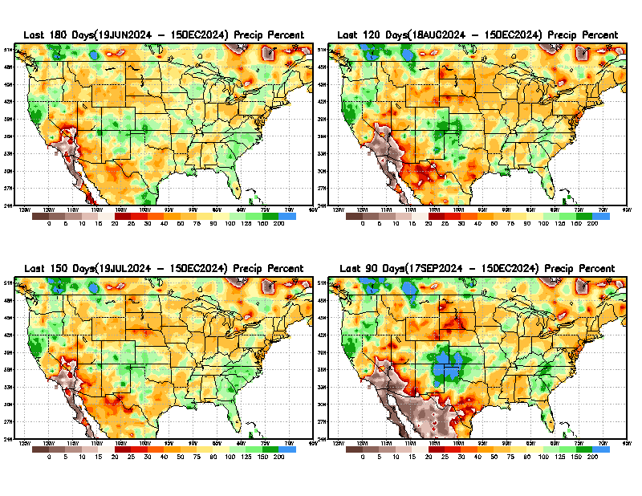
Total precipitation Percent (of normal) during last 3, 4, 5, and 6 months Only Deficit Areas <=90% shown!!
6 M
4 M
In these interim time scale 3-6 months, we need to pay attention to regions, which are dark brown, brown, dark red, & red (<40%).
While accrued precipitation deficits are real & objective,
droughts are subjective declarations!!
5 M
3 M
East vs West!
Broad vs Narrow
rainfall season.
In general, West US suffers more from frequent and lasting droughts. Droughts in East US are generally less and less lasting!
What about Center ?
More like West than East?
Short term(S) Drought is generally declared when large/severe rainfall deficits exist in the 3-6 months time range. {Long term deficits beyond 1 or 2 or more years is Long term L drought! }

Slide 10
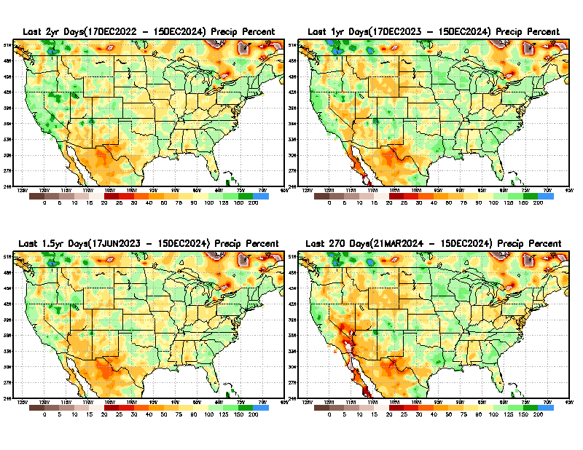
Total precipitation Percent during last 9 months, 1 yr, 1.5yrs, & 2 yrs. .–Only Deficit Areas shown!! <=90%
2 Y
1 Y
1.5 Y
9 M
The character and even location/spatial extent of the short/S and long/L –term droughts are different!!!
From: Recent Accumulated Precipitation https://www.cpc.ncep.noaa.gov/products/Drought/briefing_prcp.shtml

Slide 11
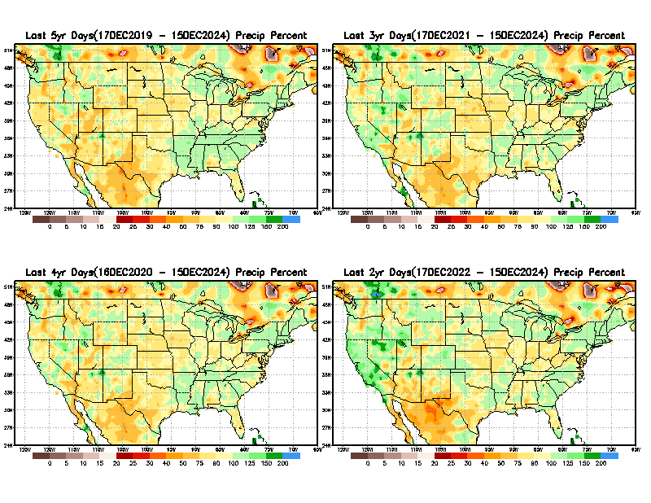

Total precipitation Percent (of normal) during last 2, 3, 4, & 5 yrs. .–Only Deficit Areas <=90% shown !!
5 Y
3 Y
Deficits are not much!
In terms of long-term-drought, overall, the country is in good shape! Including the southwest, especially California & vicinity. ☺ ☺
4 Y
2 Y
From: Recent Accumulated Precipitation https://www.cpc.ncep.noaa.gov/products/Drought/briefing_prcp.shtml

Slide 12
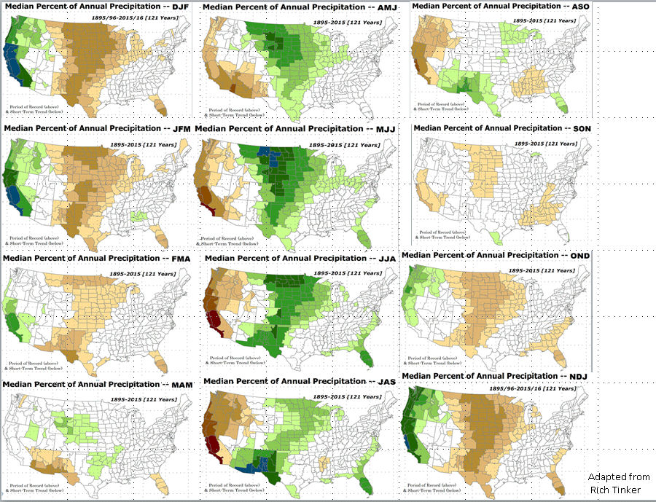

LEAST
In-BETWEEN
MOST
East vs West!
More darker colors in west/central => narrow rainy season (months)
Overall, more white space in the east => distributed rainfall season (except ~FL).

Slide 13
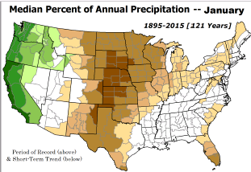
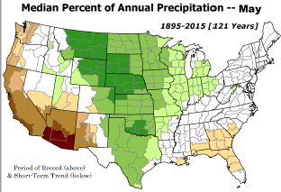
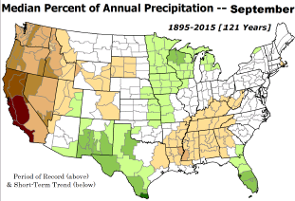
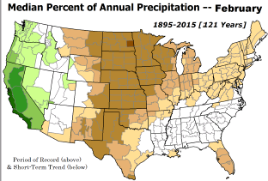
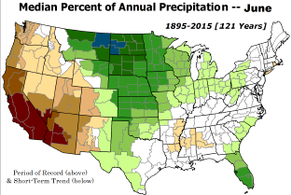
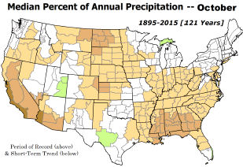

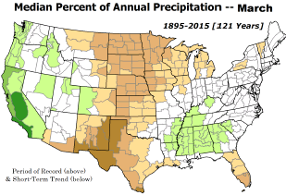
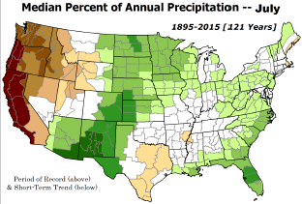
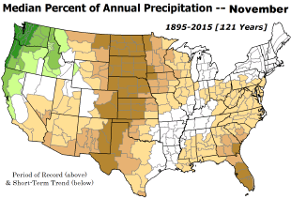
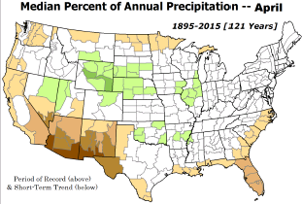
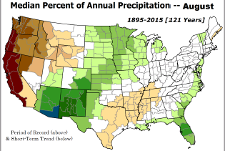
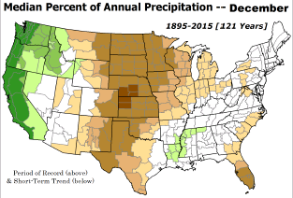
JFM is in the middle of the dry half of the year over the central one third of the US and among the wet rainy months of rainy season for western costal US.
*********
EAST vs
CTR/WEST
Drought Behavior is loosely tied to rainfall climo!! And the limited rainy season in the west
*********
Adapted from Rich Tinker.

Slide 14
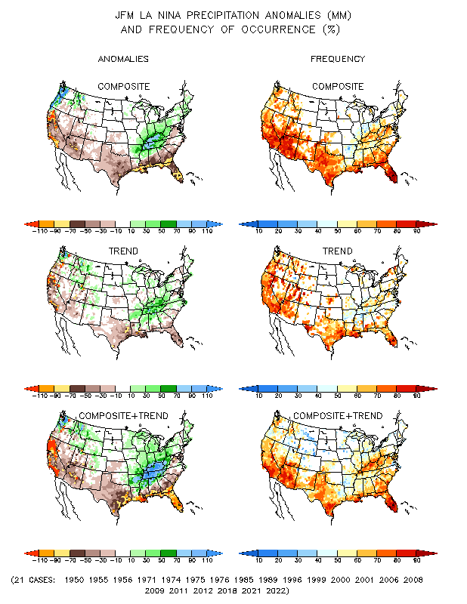
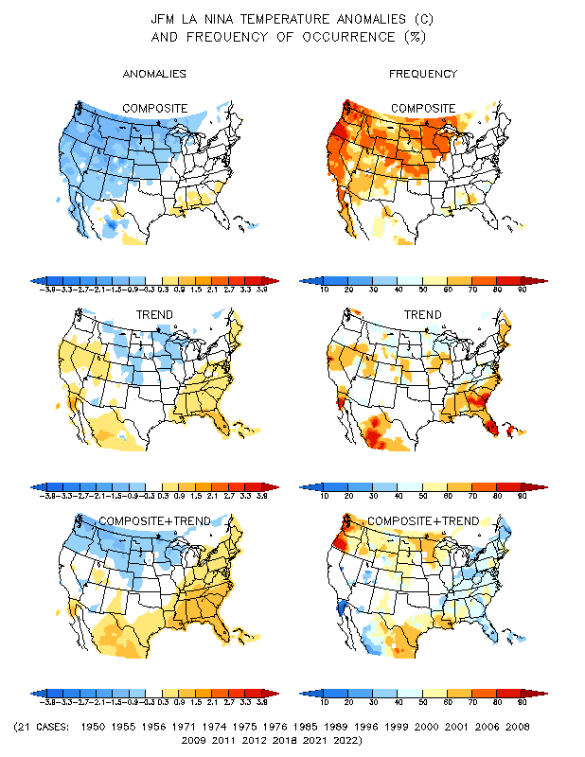
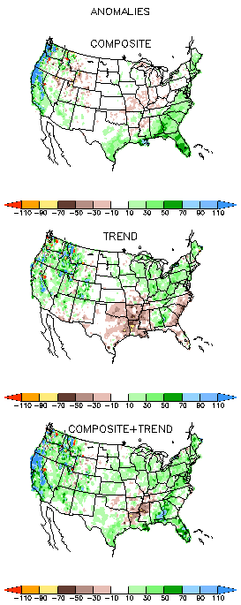
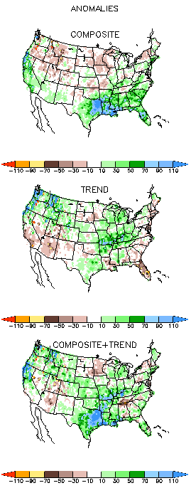
La Nina Precip/Temperature COMPOSITES & Trend map
JFM
P
T
Opposing signals!
https://www.cpc.ncep.noaa.gov/products/precip/CWlink/ENSO/composites/
During Winter and during La Nina: Generally warm and dry along southern states.
Not warm & not Dry along northern tier states. Compare NMME forecasts in later slides!

Slide 15
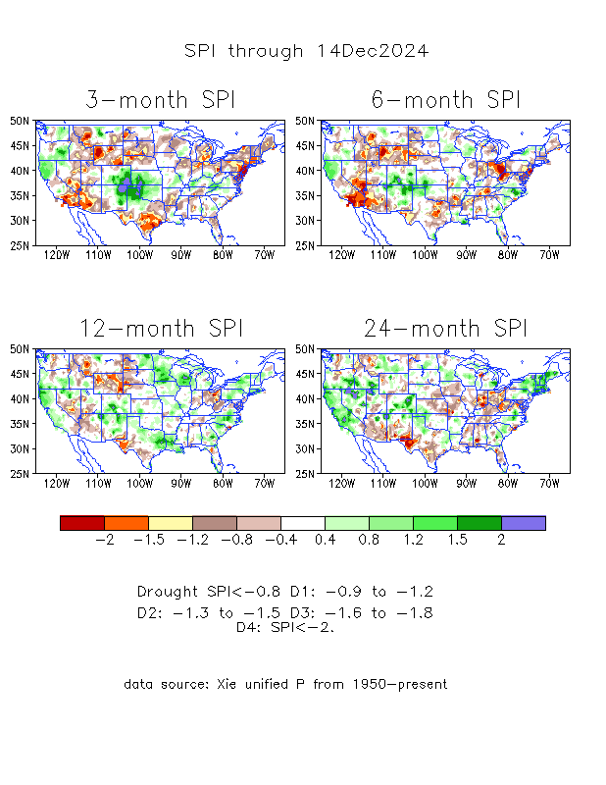
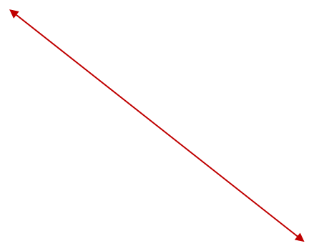
The Standardized Precipitation Index SPI
(based on Observed P)
Compare with last month
----- NOW
https://www.cpc.ncep.noaa.gov/products/Drought/Figures/index/spi_plot.gif
Very interesting graphic & details for the drought across the US based on the more generalized precip deficit/excess, the Standardized Precipitation Index (SPI).
The dark brown and red colors, indicating standardized precipitation deficits, in the various time periods, approximately correspond to the appropriate short/long term drought monitor regions and their intensities
Short
Long
How does one negotiate and reconcile declaring short term vs long term drought when precip. deficiencies patterns differ on many different time scales locally!!
What is the cutoff delineating time between short VS long term drought!! Not so clear!!
At exactly where, does drought begin?
Based on this SPI indicator/measure,
The brown areas are various levels of DRY regions!
The yellow/red are more probably drought regions!

Slide 16
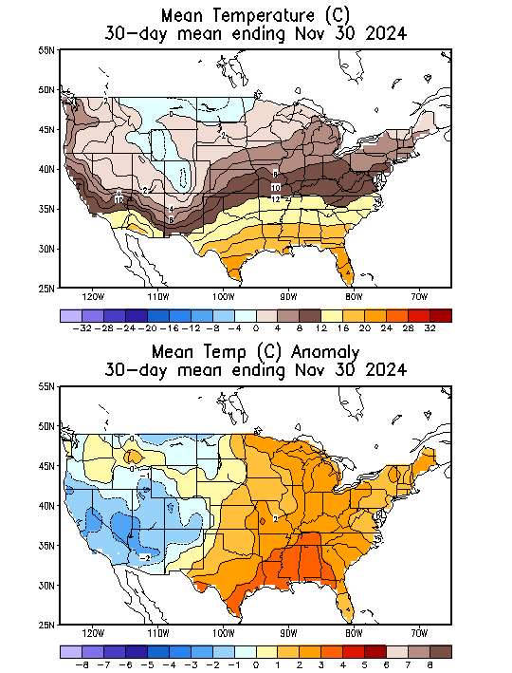
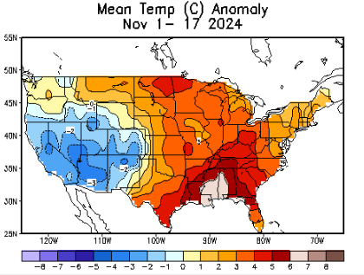
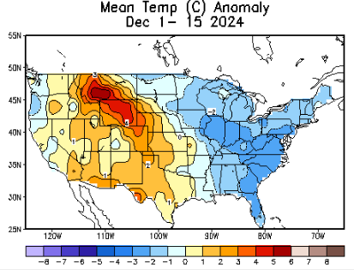
Recent US Temperatures
.
Last
month !!
Last month at this time!
https://www.cpc.ncep.noaa.gov/products/tanal/temp_analyses.php
So far this month !!
NOW!

Slide 17
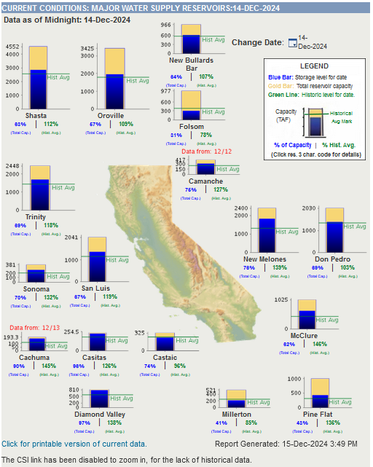
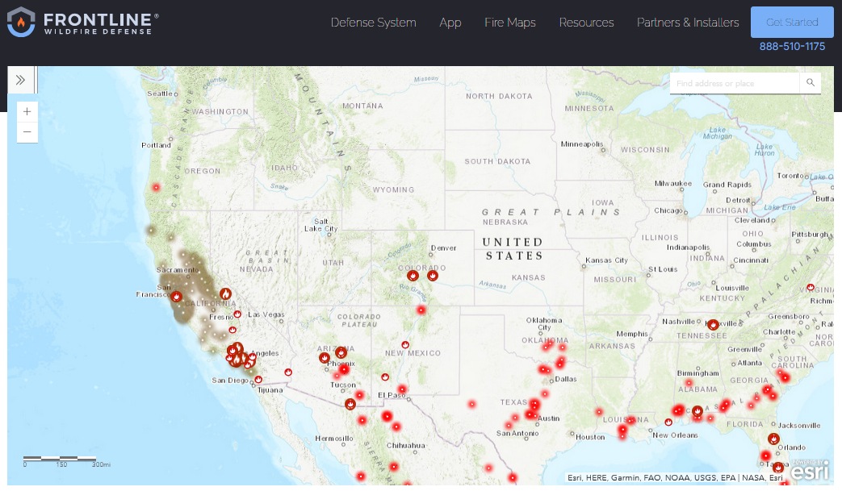
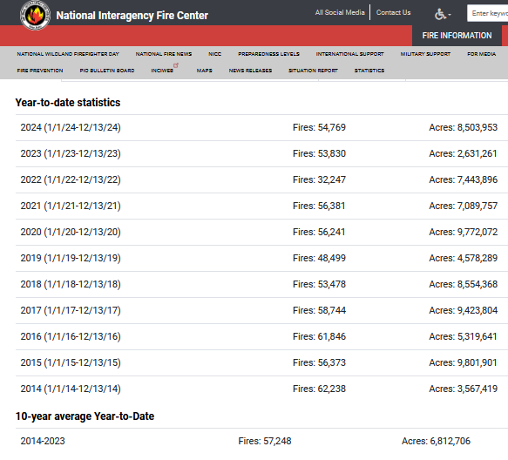
https://www.frontlinewildfire.com/california-wildfire-map/
https://cdec.water.ca.gov/resapp/RescondMain
Actual Fire locations and hotspots
% of Capacity
% of Hist. Avg.
of Reservoirs.
#s are high this year (cf. last year) due to fires in the Northeast
Many CA water reservoirs are AT their historical average/ CAPACITY levels ! ☺ . After this past winter, most reservoirs were ABOVE their historical averages. BUT Not anymore!
https://www.nifc.gov/fire-information/nfn

Slide 18
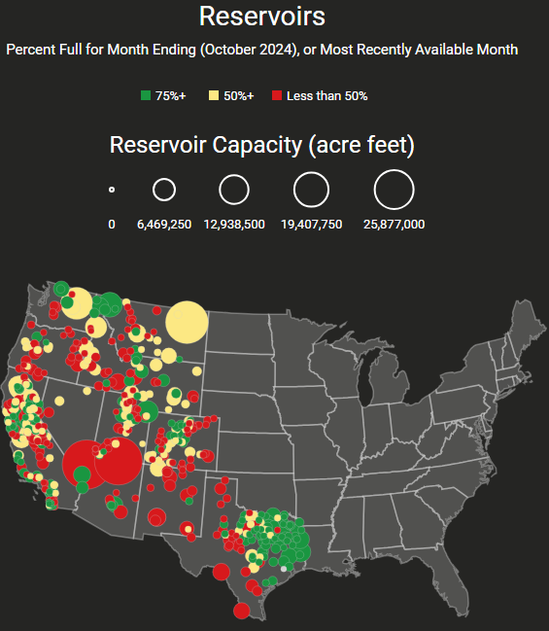



Western Water (2000-2024), from Dean Farr
Percent Full for Month Ending (October 2024)
Percent full for Month ending November 2024
https://www.deanfarr.com/western_water/
Lakes Mead, Powell in NV/AZ are at low levels! ☹ ☹ HUGE consequences for electric power for western states CA/NV/AZ/UT !!
Overall similar conditions in October and November for the US west!!

Slide 19







Streamflow (USGS)
Most US east droughts are relatively short lived (as compared to US west).
But in last 2 decades, recently in 2000, 2016, 2020, & 2022, New York and New England experienced historic drought conditions not seen since the 1960s.
https://waterwatch.usgs.gov/?m=nwc
Map shows only below normal 7-day average streamflow compared to historical streamflow for the day of year.
One month ago (left) &
Now (below)
Streamflow is only a partial indicator, as sometimes it is highly managed.
If sometimes, the various indicators are confusing, go back to % of rainfall deficit maps – to confirm/reinforce!!
https://waterwatch.usgs.gov/index.php?id=ww_drought
19

Slide 20

EL NIÑO/SOUTHERN OSCILLATION (ENSO)
DIAGNOSTIC DISCUSSION
issued by
CLIMATE PREDICTION CENTER/NCEP/NWS
and the International Research Institute for Climate and Society
12 December 2024
ENSO Alert System Status: La Niña Watch
ENSO-neutral conditions are present. Equatorial sea surface temperatures (SSTs) are near-to-below average in the central and eastern Pacific Ocean. La Niña conditions are most likely to emerge in November 2024 - January 2025 (59% chance), with a transition to ENSO-neutral most likely by March-May 2025 (61% chance).
(If you recall, back in June the forecast was for 65% chance of La Nina development during July-September!)
CPC’s Oceanic Niño Index (ONI) [3 month running mean of ERSST.v5 SST anomalies in the Niño 3.4 region (5ºN-5ºS, 120º-170ºW)], based on centered 30-year base periods updated every 5 years. For historical purposes, periods of below and above normal SSTs are colored in blue and red when the threshold (0.5) is met for a minimum of 5 consecutive 3-month overlapping seasons.
https://origin.cpc.ncep.noaa.gov/products/analysis_monitoring/ensostuff/ONI_v5.php

Slide 21





Latest values of SST indices in the various Nino Regions.
The recent El Nino came in a hurry after 3 back-to-back La Ninas has all but gone away in a great hurry to make room or ANOTHER La Nina which is on the way!!? ?
Slides 21-23 here are from Michelle’s latest ENSO weekly ppt!

Slide 22


Sub-Surface Temperature Departures in the Equatorial Pacific
Most recent pentad analysis
Is the subsurface cold water content/volume gradually increasing or just vacillating?
Is prediction of ENSO event even in the next few months, becoming difficult?

Slide 23




Official ENSO Forecasts
November CPC/NOAA forecast
The majority of models indicate ENSO-neutral will persist through July-September 2024. Thereafter, most models indicate a transition to La Niña around August-October 2024.
https://iri.columbia.edu/our-expertise/climate/forecasts/enso/current/
A slight pull back or slow down in the developing La Nina ??
December CPC/NOAA forecast
https://www.cpc.ncep.noaa.gov/products/people/wwang/cfsv2fcst/images3/PacSSTSeaadj.gif
https://iri.columbia.edu/our-expertise/climate/forecasts/enso/current/
Latest ensemble membrs (blue!)show are less bullish

Slide 24



Previous (Last Month’s)
CPC’s official
Temperature OUTLOOK for Monthly (Dec)/Seasonal (DJF)
Monthly P/T forecasts verified at mid-month are generally good! Becoz of good skill upto 2 wks.
Released November 21st
Observed so far this month!! ☺

Slide 25



Previous(Last month)
CPC’s official
Precipitation OUTLOOK for
Monthly (Dec)/Seasonal (DJF)
Released November 21st
Monthly P/T forecasts verified at mid-month are generally good! (??) Becoz of good skill upto 2 wks.
Observed so far this month!! ☹
☹

Slide 26




GEFS
https://www.wpc.ncep.noaa.gov/qpf/day1-7.shtml
WPC/NCEP’s Next 7 days QPF (Quantitative Precipitation Forecast)
GEFS*/GFS Model Guidance for the next 15 days.
(*new)
GFS

Slide 27

From 3 Models average Precip forecast (made 15 & 16 Dec) for next 30 days.
The 3 Models are: CFSV2, GEFS, ERA5

Slide 28

From 3 Models average Precip forecast (made 15 & 16 Dec) for next 30 days.
20
40

Slide 29


From 3 Models average Precip forecasts (made 15 & 16 Dec) for next 30 days.

Slide 30

From 3 Models average Precip forecasts (made 15 & 16 Dec ) for next 30 days.

Slide 31

From 3 Models average Precip forecasts (made 15 & 16 Dec) for next 30 days.

Slide 32


Even thru’ up to 5 years period, the country as a whole looks good, in terms of good rainfall!!! And lower drought coverage!!
From 3 Models average Precip forecasts (made 15 & 16 Dec ) for next 30 days.

Slide 33




NMME*
T (left) &
P (right)
Ens.Mean forecasts for
Jan
T
P
JFM
Overall, across the US, less than normal rainfall (& above normal T) is forecast by NMME for both the month and season!
Warm & Dry across the Southern states !
Models overplaying the La Nina impact ?
NMME* : North American Multi Models Ensemble

Slide 34


Agreement/Disagreement among the various NMME models’ JFM seasonal Precip. Forecast.
??

Slide 35


BONUS Topic: Discussion continues!! Explanation for the multiyear DROUGHT in the Southwest (CA/AZ/NM/NV/UT/CO & vicinity)!!
More La Nina’s lately ?
More frequent La Ninas lately ?
YES!! The stats in the table below (bottom left) are from the Official CPC ENSO declarations page/table!
(SKIP)
slide
Compared to other regions of the globe, the SST warming/trend in the central eq. Pacific (Nino 3.4) is relatively much small. (See Fig. above) – Why is this ?
Does nature try to compensate for the warming else/everywhere by producing more La Ninas in the equatorial Pacific? - Just my observation from data! Let’s check !!!
Since the 1997 monster El Nino (stronger than the famous 1982/83 event), just a quick count of CPC’s Nino 3.4 index++ values for the three month overlapping seasons, (Data at CPC site only available only from 1950!)
(27 years) (47 years) (74 years)
1997-2023 1950-1996 1950-2023
La Nina(DJF) 13 16 29
El Nino(DJF) 9 17 26
La Nina(all 3mos) 119 150 269
El Nino(all 3mos) 85 166 250
(Overlapping 3month seasons)
Look at Ratios of La Ninas (vs El Ninos) in the shorter
recent (27 yr) period vs the longer (47 yr) earlier period!!
Compare the ratios of La Nina to El Nino in the squared boxes.
***Analysis of CPC’s official Nino 3.4 index data over the last 70 years shows that the more frequent La Ninas in recent decades contributed to less rainfall in the southwest (See La Nina precip composites!, slide#13) and hence the ongoing long term drought in the Southwest!! Hence the long term southwest drought is unlikely to go away any time soon***
++ Barnston, Chelliah and Goldenberg (1997):Documentation of a highly ENSO‐related SST region in the equatorial pacific,
Atmosphere-Ocean Volume 35, 1997. https://doi.org/10.1080/07055900.1997.9649597
*** The strong/weak annual monsoon rains in the southwest is a minor modulator riding on this bigger/longer-term signal. ***

Slide 36
Summary
Current Drought conditions:
California for the most part, until a few months ago, has remained drought free for about twenty months now luckily due to above normal rainfall during both recent 2022/23 (La Nina, strange!) and 2023/24 (El Nino, canonical!) winter rainfall seasons. But in the last couple of months some dryness has kept in. But we are in the middle of winter/DJFM rainfall season with La Nina not yet fully established.
Water levels in almost all CA reservoirs are now at or above their normal levels. However, the water storage levels in the much bigger southern lakes, Lake Powell and Lake Mead in NV/AZ still continue to be very low, and have not recovered completely from the 2+ decades(since ~2000) long hydrological drought that existed in the region.
Comparing the most recent USDM with that back in summer, there is a considerable increase in the drought covered areas of the United States. In our June/July Drought briefings, we suggested that, “Overall, % of US land areas under drought will slightly increase from existing very low levels, mainly due to drought concern in the western/central US states.” – which did happen, as we can see from the current USDM map.
Large parts of NV/UT/AZ/NM and TX are still dry or under drought due to long term/decadal drought in the SW, as well as the poor back to back SW monsoons in 2023 and 2024. While the drought in WA & OR got relief from the early winter rains, drought in the border/interior areas of MT,WY the Dakotas and NE has not improved worsened and is likely to not get any relief soon.
Much of the coastal regions of northeastern states and the Delmarva region and vicinity that quickly developed drought conditions recently, may get some/complete relief if in fact the evading La Nina finally materializes.
Generally La Nina phase of ENSO is associated with less rain across the US and vice versa during El Nino. If La Nina is established during DJF/JFM, less than normal rainfall is expected across the southern US states thus enhancing drought, raising concerns, across the southern states .
Current ENSO status and forecast: ENSO-neutral conditions are present. Equatorial sea surface temperatures (SSTs) are near-to-below average in the central and eastern Pacific Ocean. La Niña conditions are most likely to emerge in November 2024 - January 2025 (59% chance), with a transition to ENSO-neutral most likely by March-May 2025 (61% chance).
Prediction: It is still not certain that L Nina will emerge in the next three months. Given this, the model forecasts have to be taken with a grain of salt. During the upcoming 2025 JFM forecast season, La Nina is forecast to develop (59% chance!), in terms of possibly expecting any canonical La Nina impacts. Nevertheless, the models, as if anticipating an assured La Nina, are somewhat consistent in forecasting generally below normal precip across much of the southern United States and above normal precip in the northern tier states, including Ohio valley.
Recall the last two (2023 & 2024) DJF rainfall seasons (one La Nina winter & another El Nino winter), both brought excessive rainfall to California that ended the 2 decades long drought. This JFM winter also, the models expectedly forecast only canonical (less than normal) rainfall here. What will happen this (2025) La Nina(?) winter is the major question and uncertainty for west coast areas, especially the southern CA, NV, AZ border region. It is likely that severe drought in NM/western TX border region will worsen and possibly expand.
Drought in the central US will likely persist. Existing drought conditions will likely worsen and new drought may emerge along parts of. southern states TX, LA, MS, and AL. It is likely that by the end of the forecast season JFM season, the sudden emergence of dry/drought conditions in the coastal regions of northeast and mid Atlantic states will not stay, but new dryness/drought conditions will possibly emerge in southeast Including Florida. *****

