Slide 1
Drought Outlook Support Briefing
(formerly Drought Outlook Discussion)
February 2019
Climate Prediction Center/NCEP/NOAA
http://www.cpc.ncep.noaa.gov/products/Drought
Phone: 1-877-590-4933
Pwd: 3994107#
Thanks to Dave Miskus and Li Xu for covering for me last month!! ☺

Slide 2
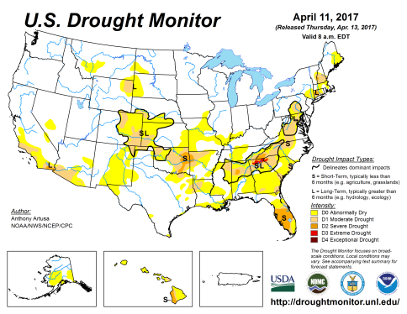
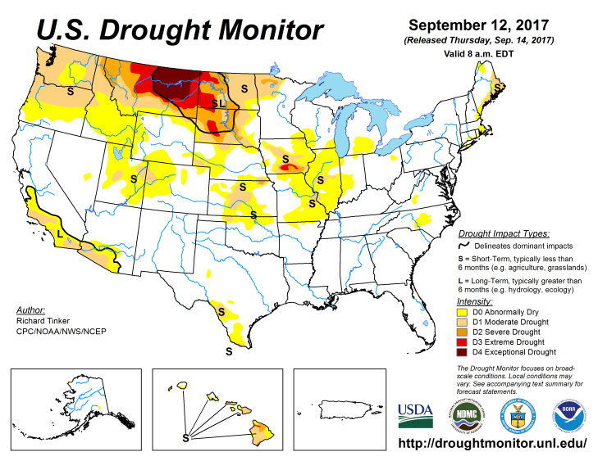
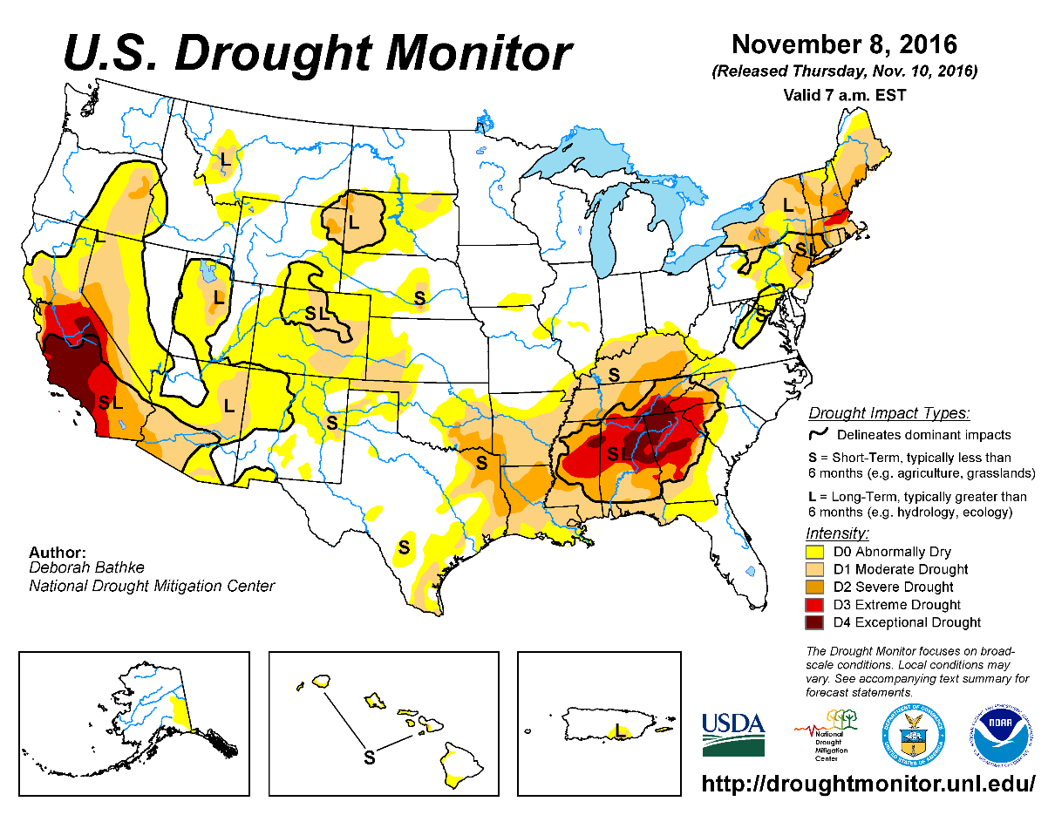
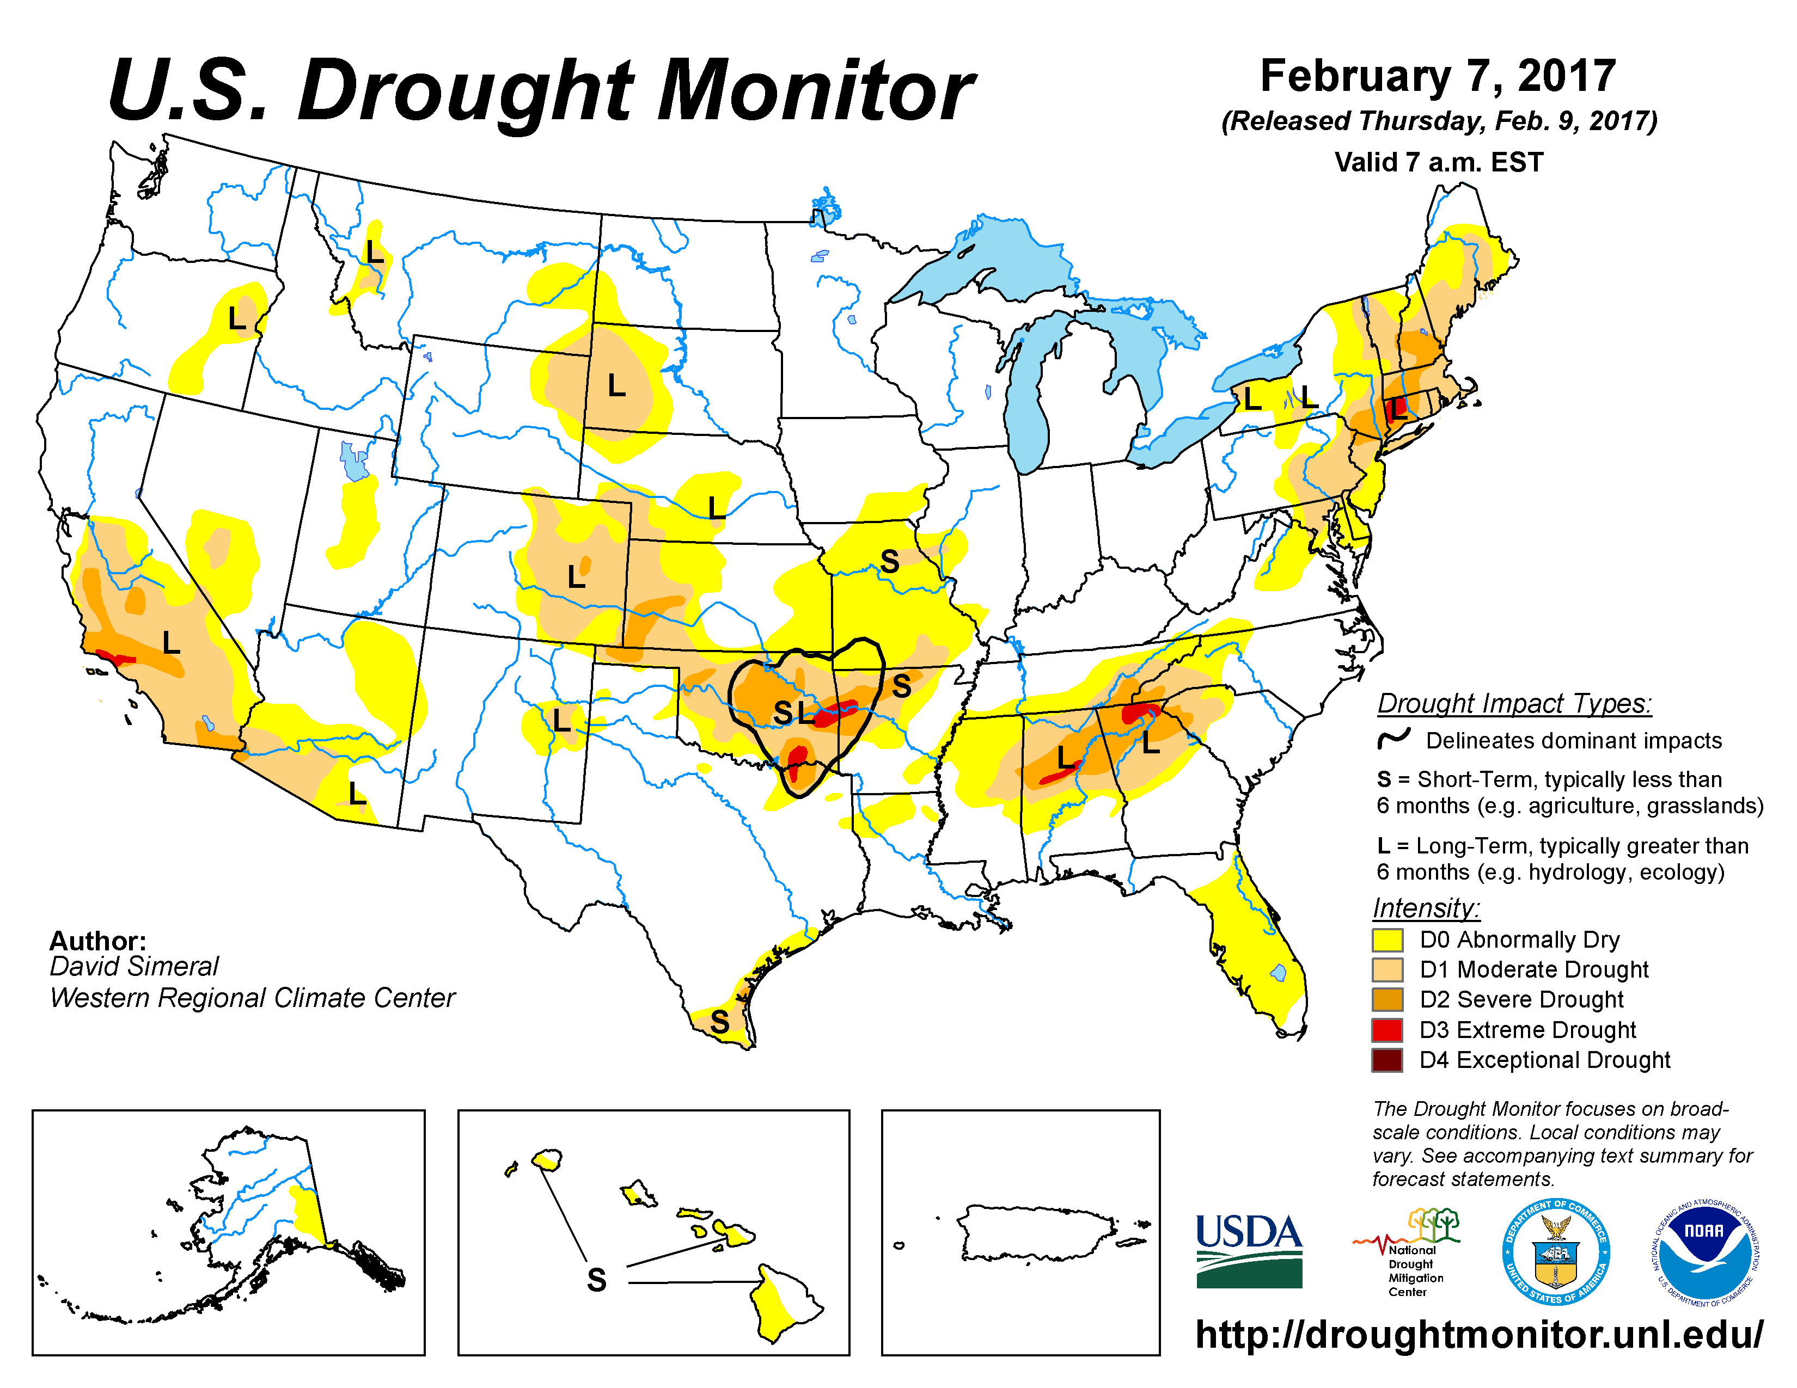
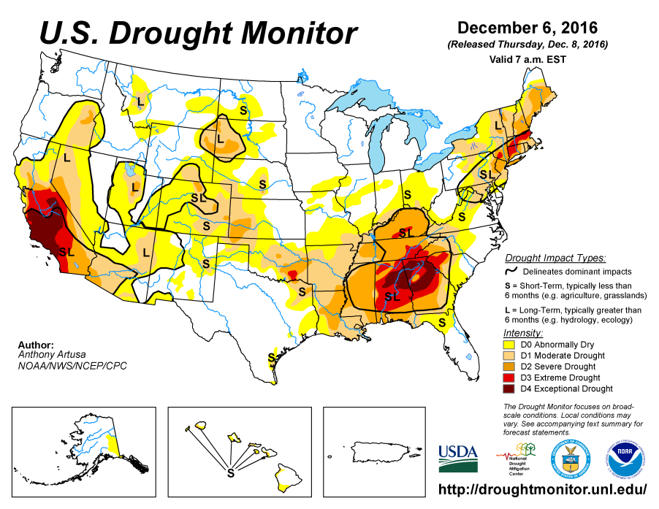
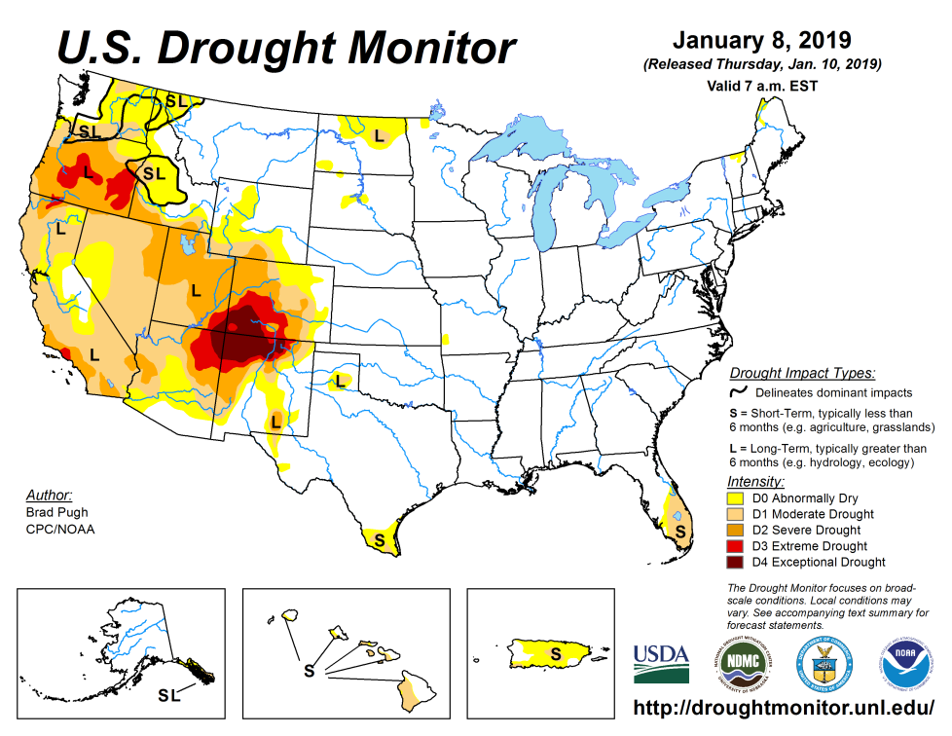
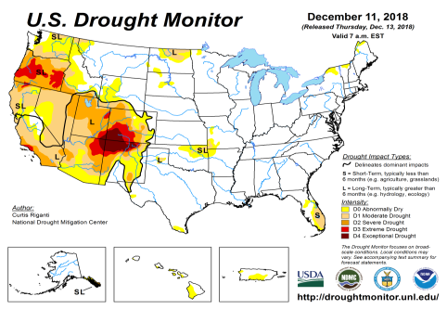
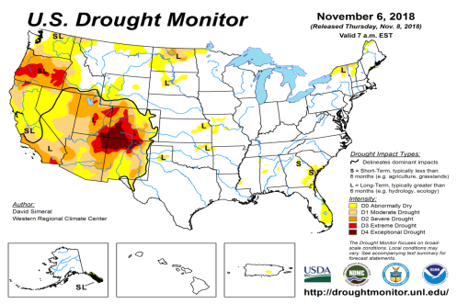
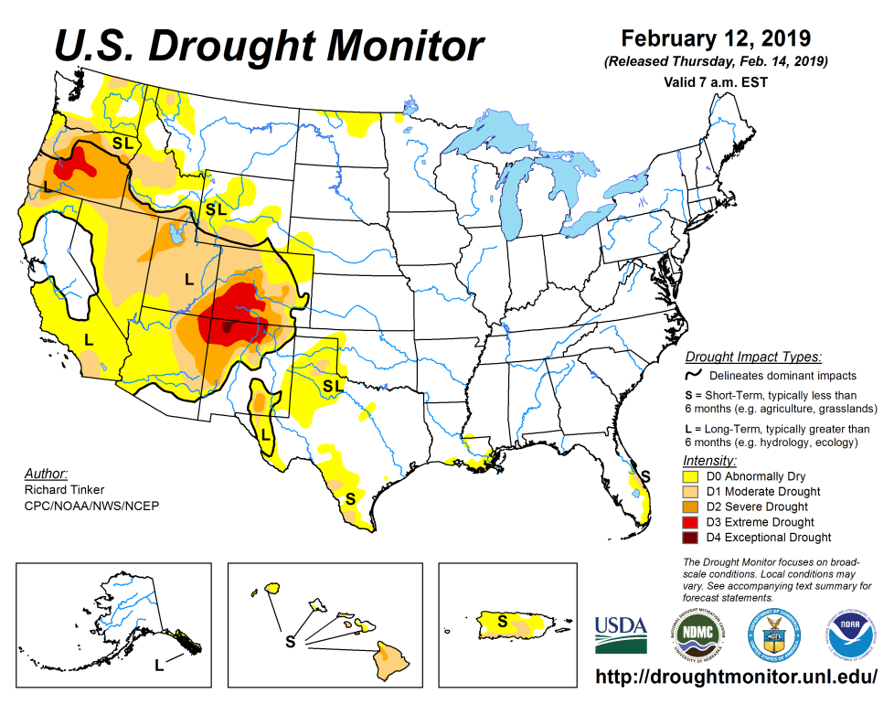
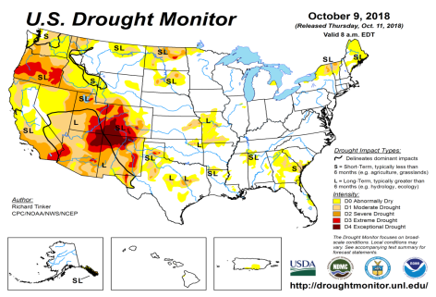
Drought Monitor
December
Slowly, but steadily the ongoing recent winter rains is making a dent in the drought over the South and the West.
The recent above normal rains in California in particular is surely making its impact felt there, including the longstanding desert southwest in that state.
January
November
Latest/Recent
October

Slide 3
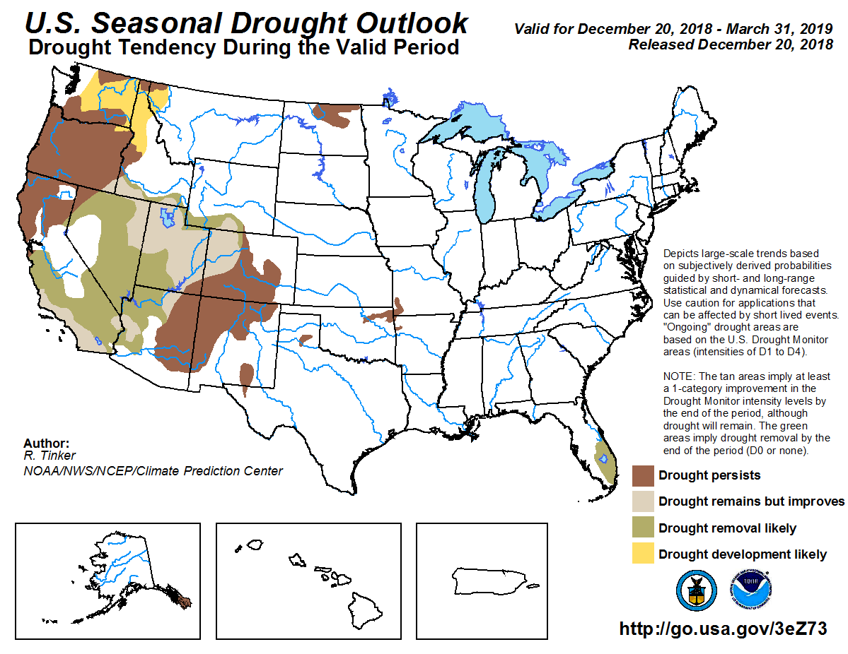
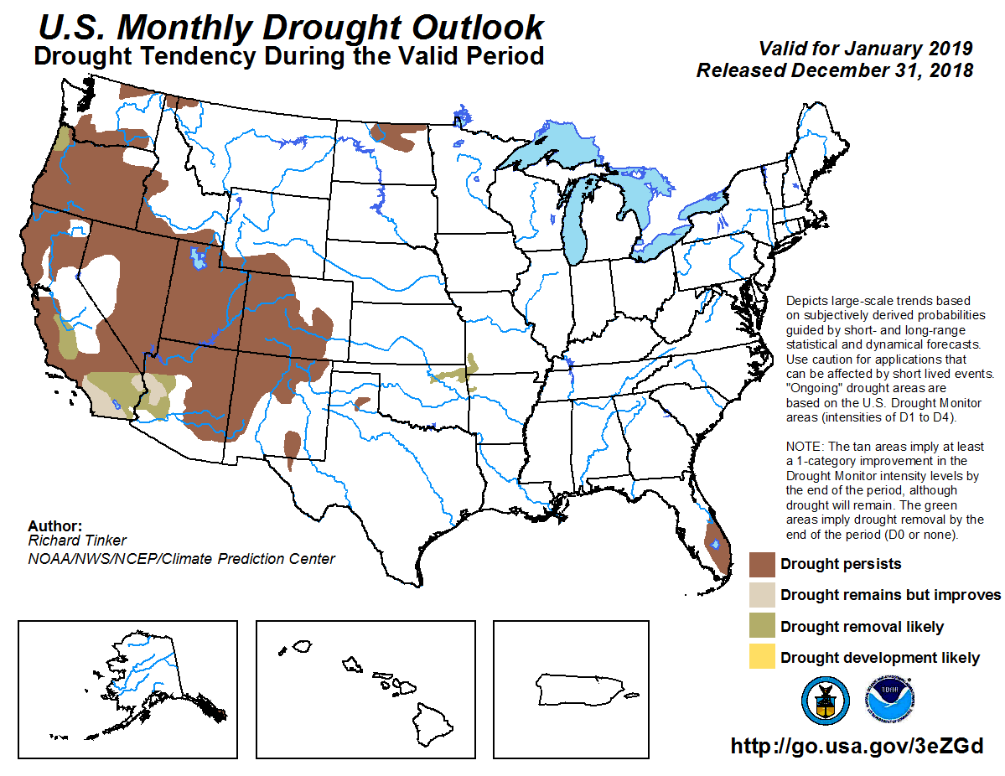
(Prev) Seasonal/Monthly Drought outlooks
Seasonal Outlook (Mid December 2018 - March 2019)
issued 12/20/18
Monthly outlook
(for January 2019)
issued 12/31/19
Slide as shown here
last month for outlooks made a month earlier in December.
Note: Drought removal likely in seasonal outlook for much of CA/NV and vicinity.

Slide 4
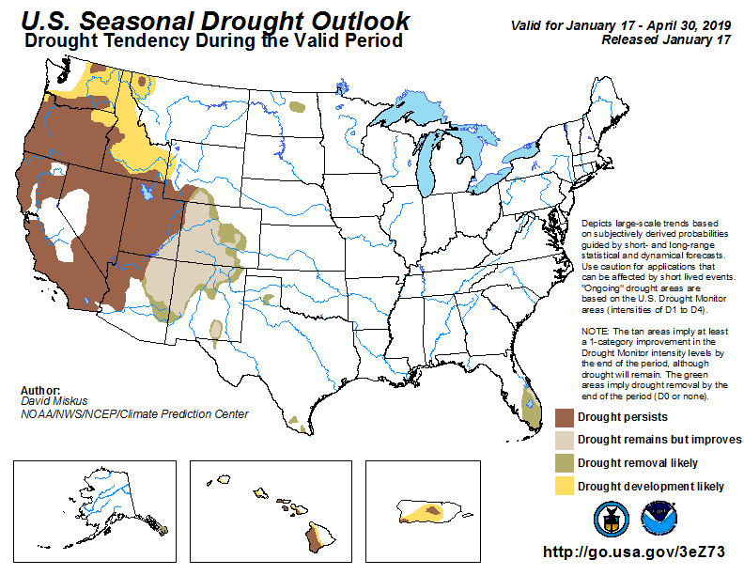
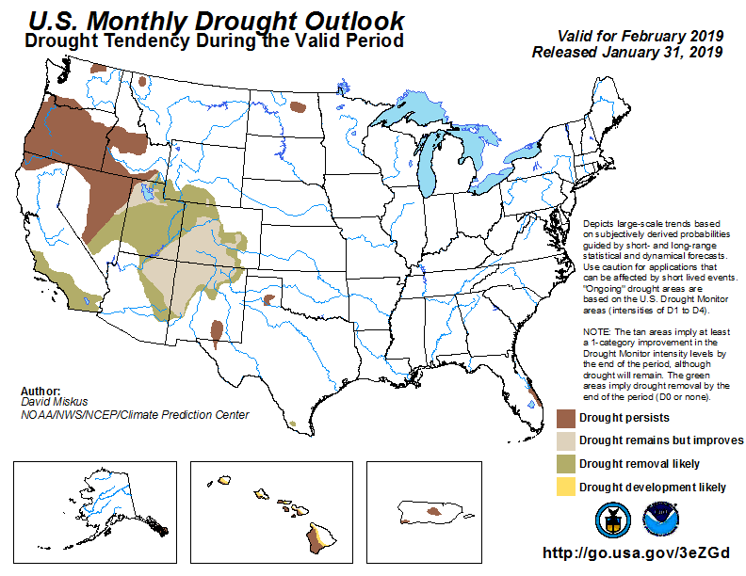
(Prev) Seasonal/Monthly Drought outlooks
(New Seasonal Drought Outlook to be released in 2 days!)
Seasonal Outlook (Mid January 2019 - April 2019)
issued 1/17/19
Monthly outlook
(for February 2019)
issued 1/31/19
Some back and forth in recent couple of SDO!
Difficulty in (Seasonal) climate prediction? (See later for ongoing changes (particularly this month) in El Nino/strength/continuance probabilities!!)

Slide 5
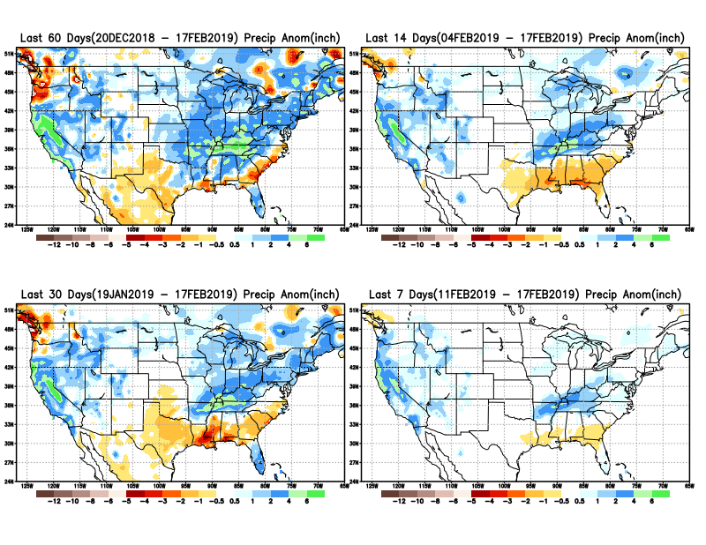
Precipitation ANOM during last 7, 14, 30, & 60 days.

Slide 6
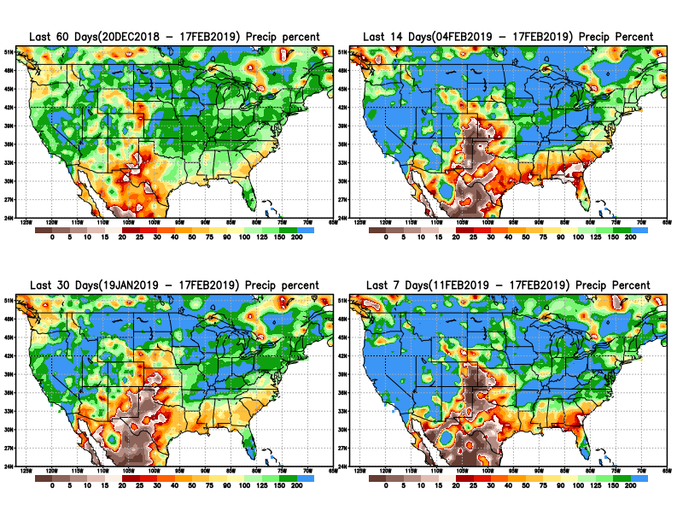
Precipitation Percent during last 7, 14, 30, & 60 days.
NOW !

Slide 7
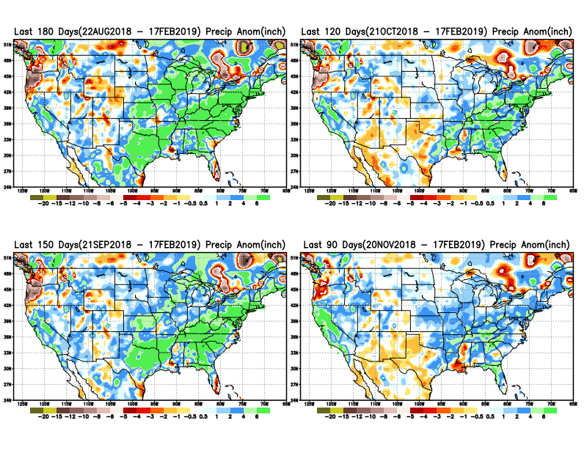
Total precipitation ANOM during last 3, 4, 5, and 6 months.
6 M
4 M
5 M
3 M

Slide 8
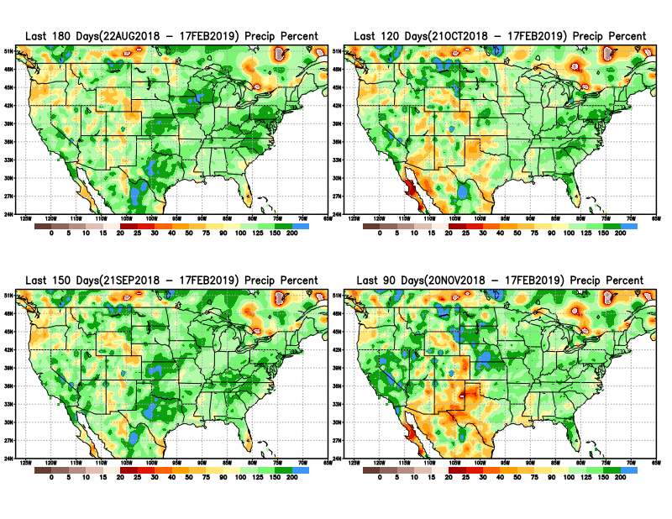
Total precipitation Percent during last 3, 4, 5, and 6 months.
6 M
4 M
5 M
3 M

Slide 9
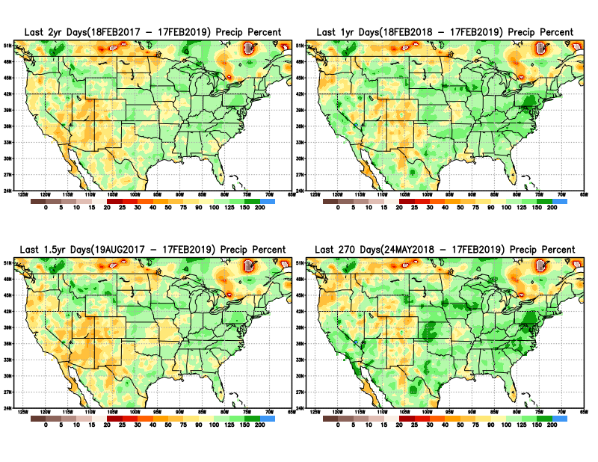
Total precipitation Percent during last 9 months, 1 yr, 1.5yrs, & 2 yrs.
2 Y
1 Y
Rainfall Data issues? Few observations, rugged terrain, interpolation problems!!
The deficits in UT/AZ, southern CA, and parts of NM/CO are long term – possibly a consequence of the two back to back La Nina’s! and even earlier La Ninas!!
1.5 Y
9 M

Slide 10
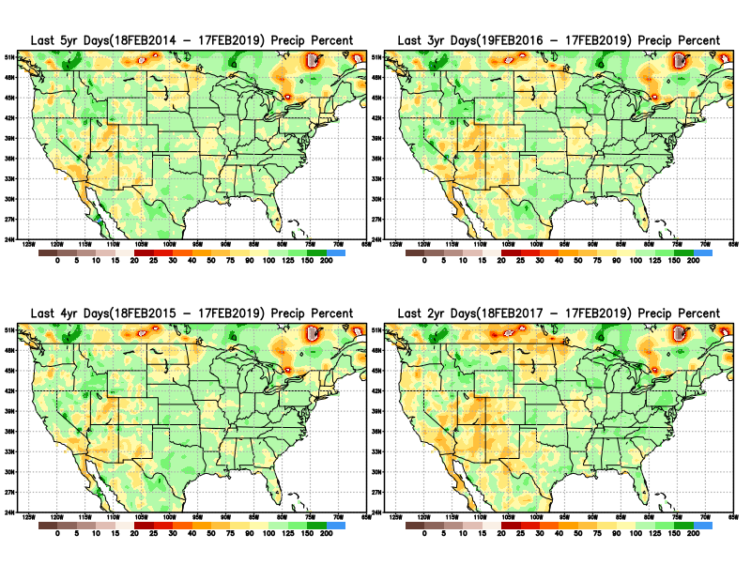
Total precipitation Percent during last 2 yrs, 3 yrs, 4 yrs, & 5 yrs.
5 Y
3 Y
Still longer term rainfall deficit variability in play? Especially in the southwest!
4 Y
2 Y
Quality of data/problem in the Northern High Plains area, especially in interpolation of sparse data in the rugged topography region!

Slide 11
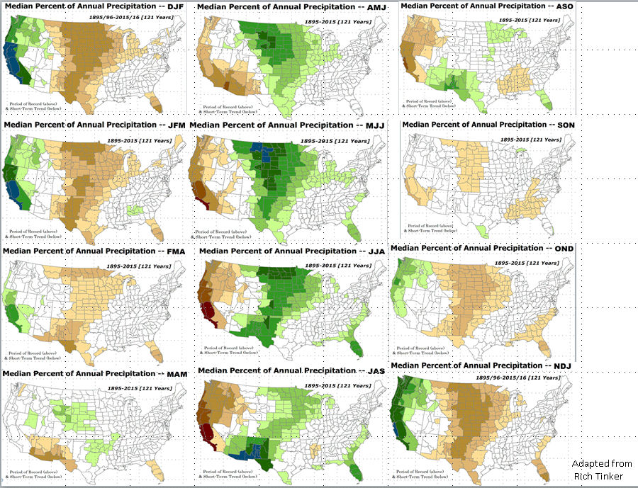

Rainy (3-month)Season across the US

Slide 12
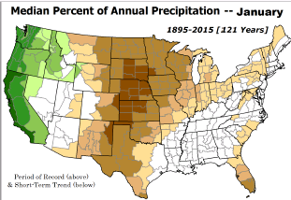
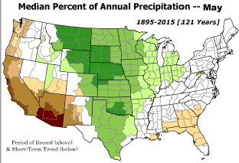
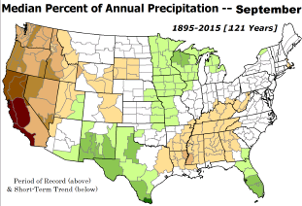
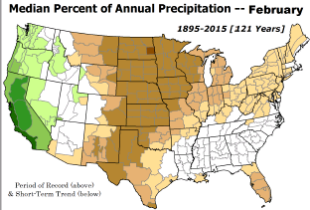
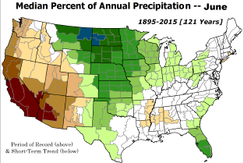
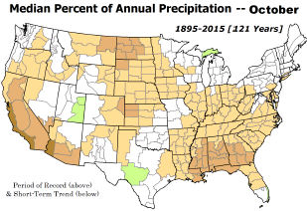

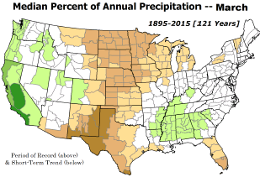
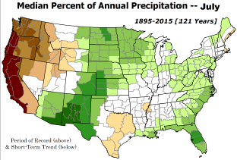
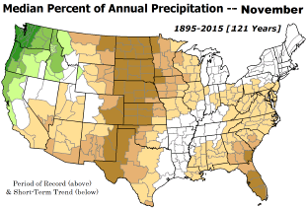
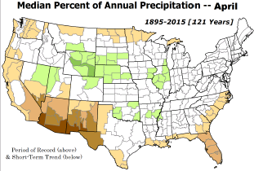
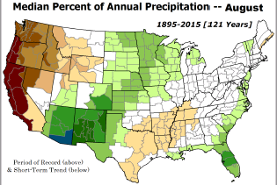
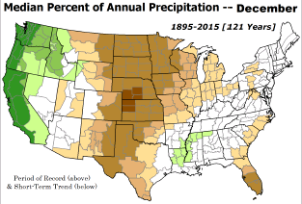
Adapted from Rich Tinker.

Slide 13
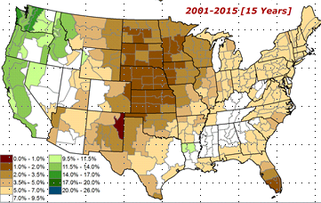
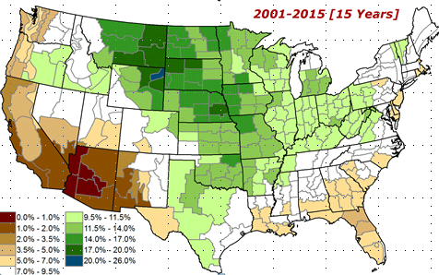
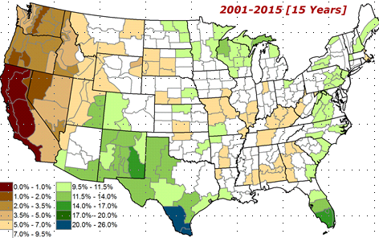
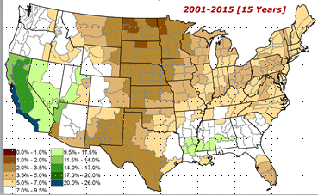
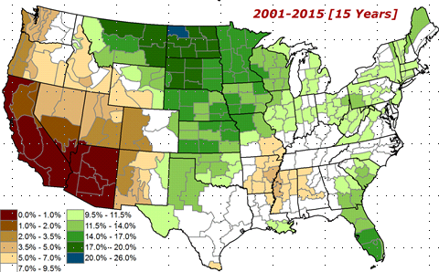
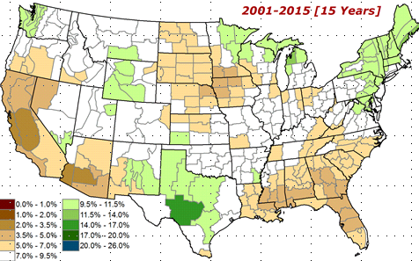

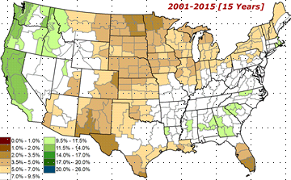
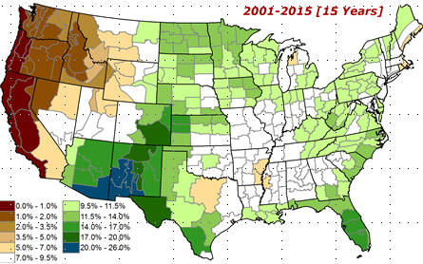
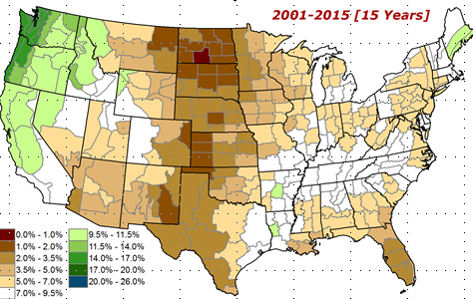
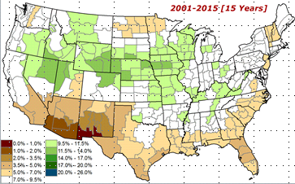
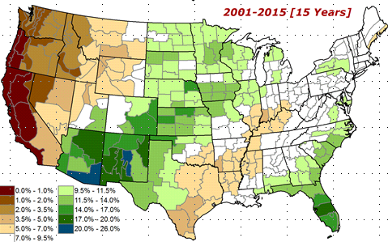
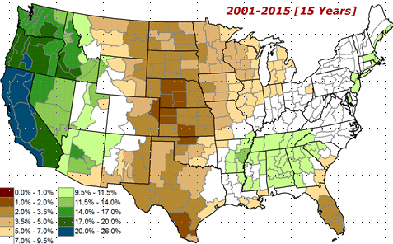
Adapted from
Rich Tinker

Slide 14
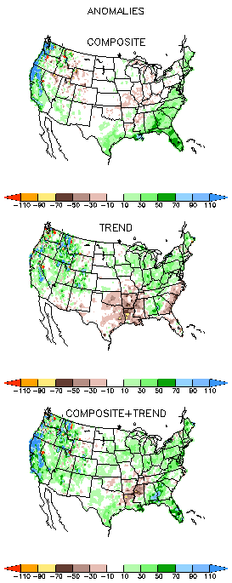
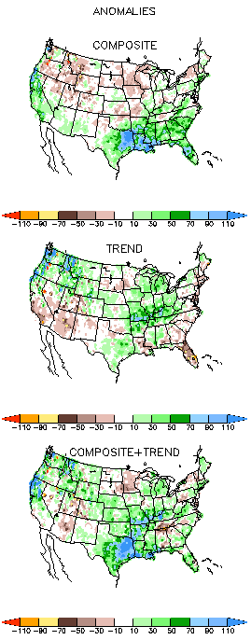
EL NINO Precip COMPOSITES
DJF
MAM

Slide 15
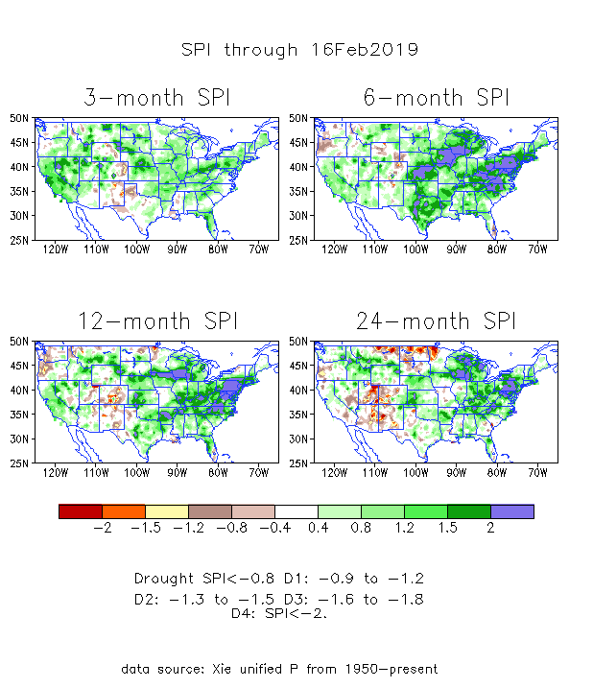
The Standardized Precipitation Index SPI
(based on Observed P)
----- NOW
Very interesting graphic & details for the drought across the US based on the more generalized precip deficit/excess, the Standardized Precipitation Index (SPI).
The dark brown and red colors, indicating standardized precipitation deficits, in the various time periods, approximately correspond to the appropriate short/long term drought monitor regions and their intensities
In the short term (~3 mo-6mo), the drought in the south and west has almost gone. Some medium term concerns remain in OR and vicinity.
In the longer term ~12m-24m and longer, rainfall deficits remain in the AZ/NM/UT/CO states area.

Slide 16
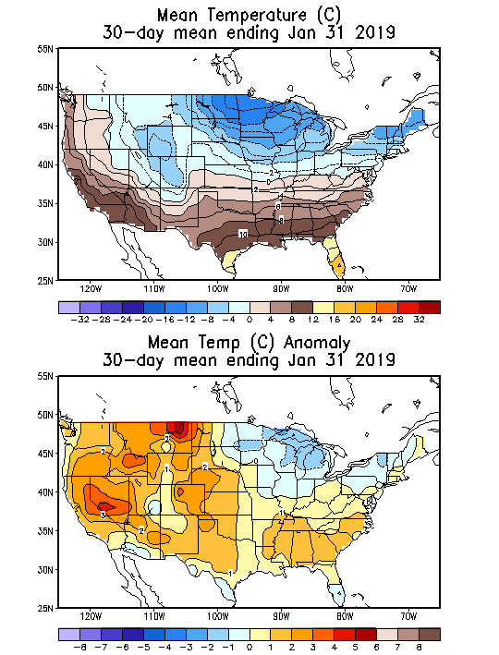
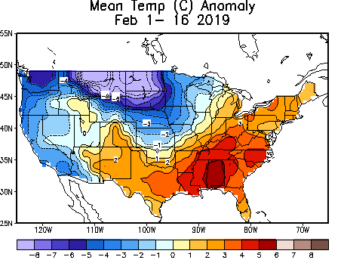
Recent US Temperatures
In December, much of the country has been relatively warmer than normal, particularly the upper Midwest.

Slide 17



Water Reservoir Levels in some Western/Southern States! And Snow Depth!!
Northern CA reservoirs beginning to show
Weakness, but rainy season coming up!
Reservoir Storage Summary for River Basins
TX
https://fsapps.nwcg.gov/afm/index.php

Slide 18







Streamflow (USGS)
Streamflow very good in Texas & eastward.!
In the west, it is generally below normal, but much improvement from previous months !
Oregon and California stream flows considerably better now than in previous months!
Map shows only below normal 7-day average streamflow compared to historical streamflow for the day of year.
One month ago (left) &
Now (below)
18

Slide 19
EL NIÑO/SOUTHERN OSCILLATION (ENSO)
DIAGNOSTIC DISCUSSION
issued by CLIMATE PREDICTION CENTER/NCEP/NWS and the International Research Institute for Climate and Society
14 February 2019
ENSO Alert System Status: El Nino Advisory
Synopsis: Weak El Nino conditions are present and are expected to continue through the Northern Hemisphere spring 2019 ~55% chance.

Slide 20




Latest values of SST indices in the various Nino Regions.
The sub surface heat anom continues to stay in the +ve territory! .
?
Relatively short lived!

Slide 21



Sub-Surface Temperature Departures in the Equatorial Pacific
The equatorial sub-surface and near-surface temperatures in the tropical east Pacific is considerably cooler than since November!!
Most recent pentad analysis

Slide 22



ENSO Forecasts
Early- January CPC/IRI forecast
Early- February CPC/IRI forecast
NOAA Official ENSO Forecast: Weak El Nino conditions present now expected to continue ( ~55% chance) through Spring.

Slide 23



Previous(Last month)
CPC’s official
Monthly (Jan)/Seasonal (JFM)
Precipitation outlook
Released Jan 31th
Released Jan 17th
Observed so far this month!!
☺

Slide 24


Previous CPC’s official
Monthly (Jan)/Seasonal (JFM)
Temperature outlook
Made
Jan 31th
Observed so far this month!!
Made Jan 17th

Slide 25




NMME T & P
EnsMean forecasts
Mar
MAM
If verifies will very much help conditions here.
Forecast is based on El Nino conditions!! Will El Nino get strong or fade away?

Slide 26

The agreement/uncertainty among the diff. NMME models’ forecasts (middle and bottom panels) for Mar-Apr-May Precipitation!!!
26

Slide 27



SPI3
SPI6
SPI12
SPI3, SPI6
& SPI12
Forecasts from 6NMME Models
(uses obs. P up to past month, and forecast months’ P from NMME models)
The goodness and skill of these SPI’s forecasts depend directly on the NMME models’ skill in predicting precipitation!!!

Slide 28



SPI3
SPI6
SPI12
SPI3, SPI6
& SPI12
Forecasts from 6NMME Models
(uses obs. P up to past month, and forecast months’ P from NMME models)
The goodness and skill of these SPI’s forecasts depend directly on the NMME models’ skill in predicting precipitation!!!

Slide 29



http://drought.geo.msu.edu/research/forecast/smi.monthly.php
Predicted Monthly Soil Moisture Percentile
With Soil Moisture Percentile
Initial Conditions: 2/12/2019
The inter quartile range suggest greater uncertainty about the forecast in these shaded regions.

Slide 30


Precipitation
NASA GEOS 5 Model
Precipitation & Soil Moisture Forecast
Feb 2019
Soil Moisture
Mar 2019
IC
2/19
Apr 2019
3/19
2018
4/19

Slide 31

Monthly Drought Tendency in Probability

Slide 32

Seasonal Drought Tendency in Probability

Slide 33
Summary
Current ENSO status and forecast. Weak El Nino conditions are present and are expected to continue through the Northern Hemisphere spring 2019 (~55% chance).
Current Drought conditions:
  East of, and including most of Texas, the country is drought free over all of the eastern two thirds of the country.
  Slowly, but steadily the ongoing recent winter rains is making a dent in the drought over the Southwest and the West. The recent above normal rains in California in particular is surely making its impact felt there, including the longstanding desert southwest in that state and vicinity.
  The stream flow conditions in the western states and in Oregon in the Pacific Northwest are now in considerably improved conditions compared to the previous months’ conditions.
  Overall, in the short term (~3 mo-6mo), the drought in the south and west has almost gone. Some medium term concerns remain in OR and vicinity. In the longer term ~12m-24m and longer, rainfall deficits remain in the AZ/NM/UT/CO states area.
  Prediction:
  Rainfall season(M/MAM) is soon coming to an end in the western states. But the big player with great uncertainty in terms of its strength and its impacts is the El Nino, which has just finally presented itself with actual weak El Nino conditions in the tropical Pacific. It is not clear how this current weak El Nino conditions will develop further or weaken and dissipate prematurely, with a forecast of only a 55% probability of its continuance into and through the end of the upcoming Spring season. Many of the NMME models, in spite of the weak expected El Nino conditions, forecasts above normal rainfall across southern states.
  Overall, short to medium term improvement is expected in the drought conditions over much of the western states especially OR and CA. But the much longer term (>18 months) rainfall deficits in the four corner states of AZ/NM/UT/CO region, the drought is expected to persist but improve, especially if the above normal rainfall forecasted here actually happen. It is not clear if any new development of drought conditions is expected anywhere, and it appears that any such development is probably unlikely. **END***

Slide 34


WPC Next 7 days QPF Forecast
GFS Model Guidance for next 16 days.

Slide 35

Miscellaneous maps

