Slide 1
Drought Outlook Support Briefing
February 2020
Climate Prediction Center/NCEP/NOAA
http://www.cpc.ncep.noaa.gov/products/Drought
Phone: 1-877-680-3341
Pwd: 858747#

Slide 2
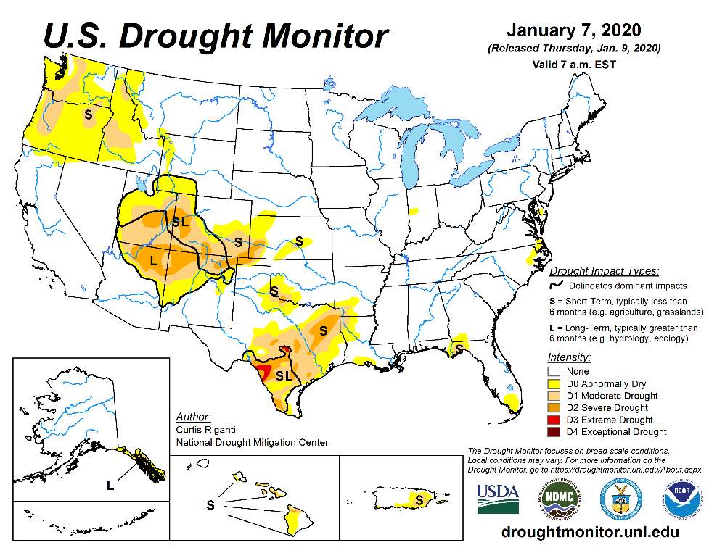
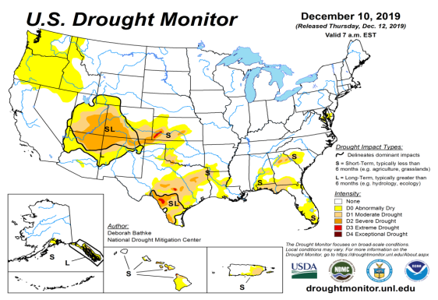
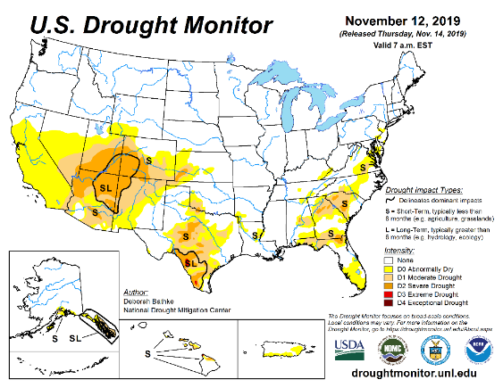
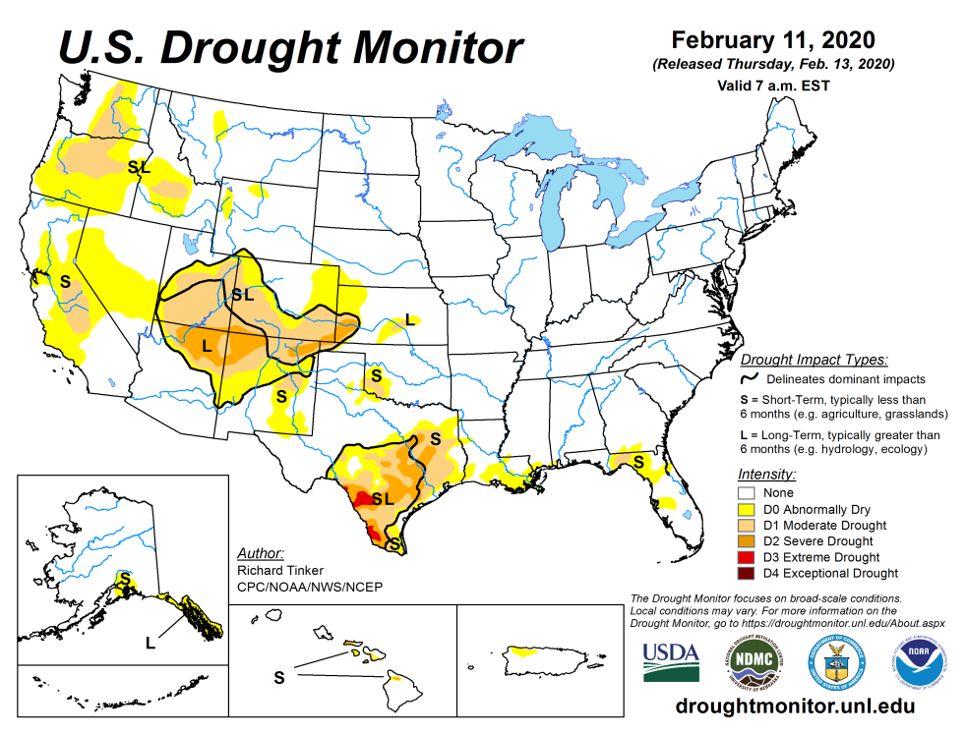
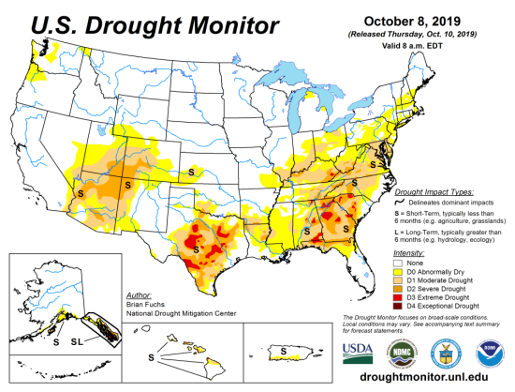
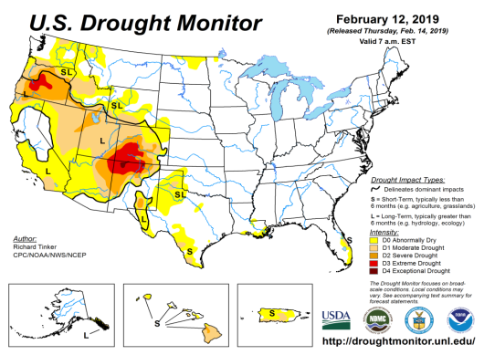
Drought Monitor
January
December
Monitoring is important because, unlike US T/P fcsts, for drought forecasts, we have to know where we are, before we can tell where we are going!!
Drought forecasts are tendency forecasts.
Drought in the southeast, that was present late last year is all but gone.
The drought in the four corner states area (AZ/NM/UT/CO) weakens or strengthens off and on, where there has been a long term rainfall deficit present for a few years now (see later!)
Winter is the main rainfall season along the Pacific coastal states, and any precip. deficit in these west coast states during this season is of concern.
November
Recent/Latest
October
February

Slide 3
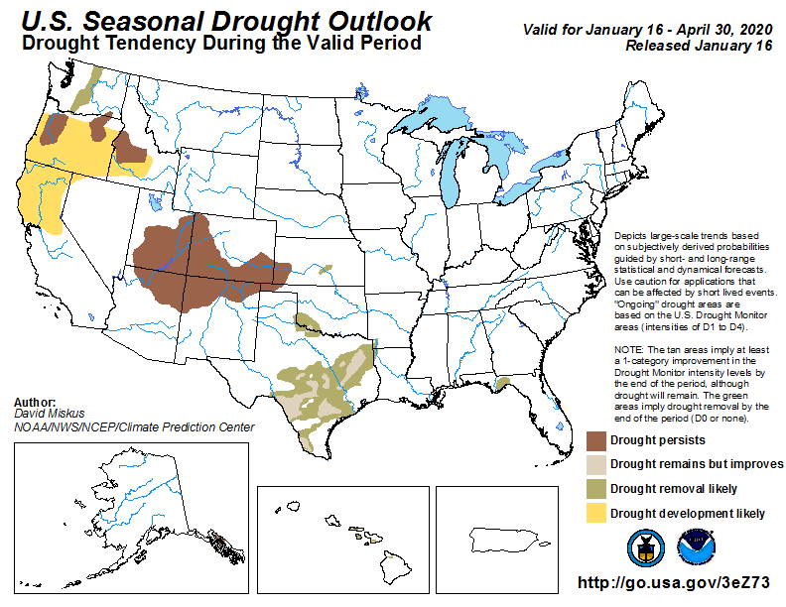
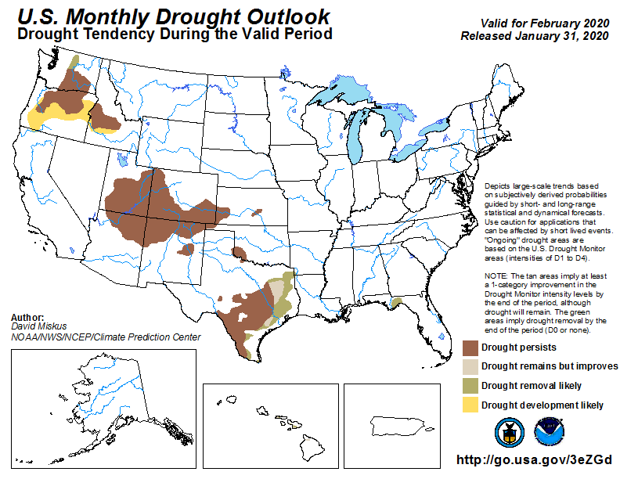
(Prev) Seasonal/Monthly Drought outlooks
(New Seasonal Drought Outlook to be released in 2 days!)
Seasonal Outlook
(Mid Jan 2020- Apr 2020)
issued 01/16/20
Monthly outlook
(for Feb 202)
issued 01/31/20

Slide 4
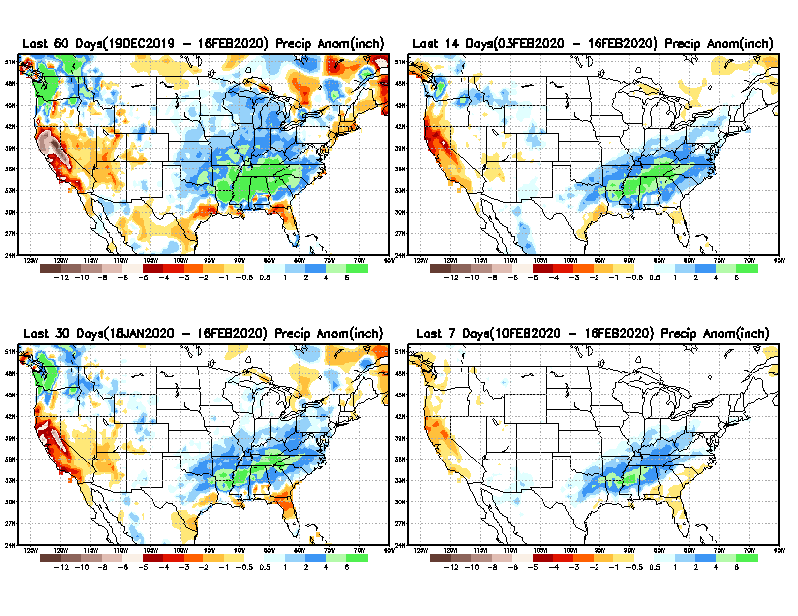
Precipitation ANOM during last 7, 14, 30, & 60 days.
60 Days
14 Days
These maps in this and following slides, including
a) Anom and b) Percent of precip. in these and other longer time ranges. Now daily updated at:
30 Days
7 Days
Alaska will be added here soon!
From: Recent Accumulated Precipitation https://www.cpc.ncep.noaa.gov/products/Drought/briefing_prcp.shtml

Slide 5
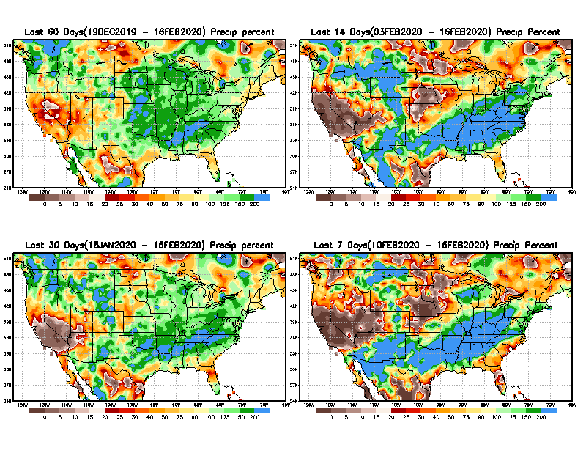
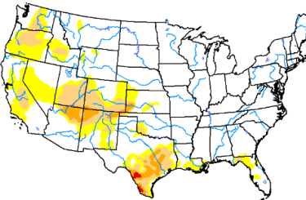
Precipitation Percent during last 7, 14, 30, & 60 days.
60 Days
14 Days
NOW !
In regions, where the main rainfall season is limited to a few (3-4) months of the year, even one month of large rainfall deficit can be of concern !!
In other regions of relatively broad rainfall months, this need not be a big issue!!
30 days
7 Days
From: Recent Accumulated Precipitation https://www.cpc.ncep.noaa.gov/products/Drought/briefing_prcp.shtml

Slide 6
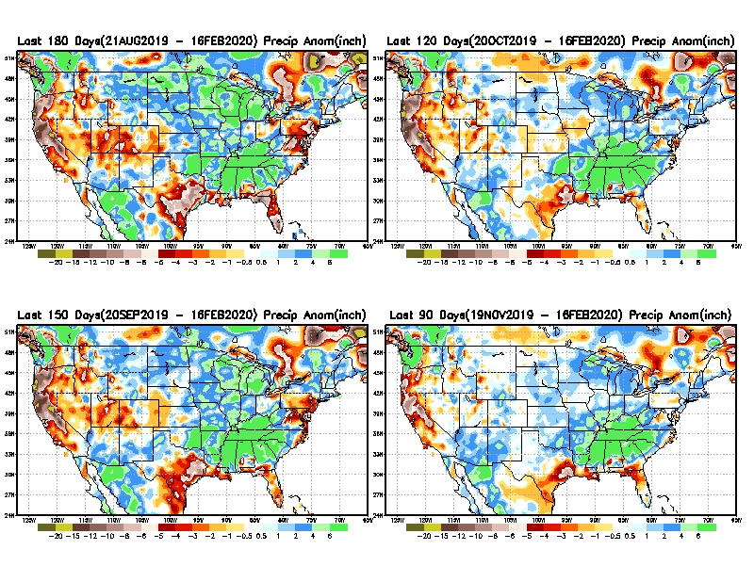
Total precipitation ANOM during last 3, 4, 5, and 6 months.
6 M
4 M
While the Precipitation anomalies deficit may seem large in some regions (compared to others), it is the % of normal precip (next slide) that matters more!!
5 M
3 M
From: Recent Accumulated Precipitation https://www.cpc.ncep.noaa.gov/products/Drought/briefing_prcp.shtml

Slide 7
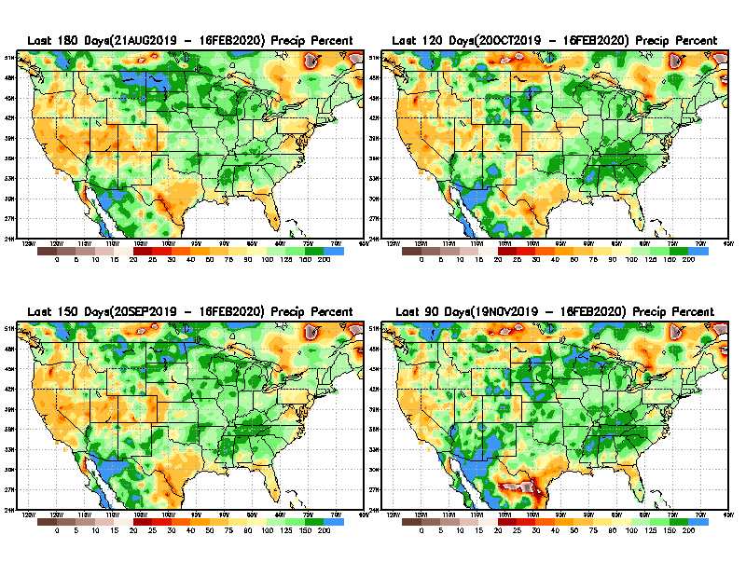
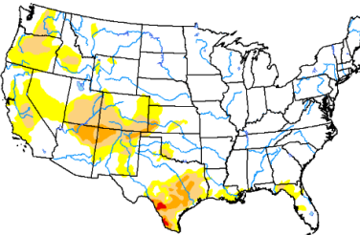
Total precipitation Percent during last 3, 4, 5, and 6 months.
6 M
4 M
In these interim time scale 3-6 months, we need to pay attention to regions, which are dark-red /red & brown (<50%)
5 M
3M
While accrued precipitation deficits are real & objective,
droughts are subjective declarations!!
With these various rainfall deficits in diff. time ranges, where and how exactly does one declare drought? Other factors (T/SM/E, etc..) do matter, but is cumulative precip. deficits ultimately more important?

Slide 8
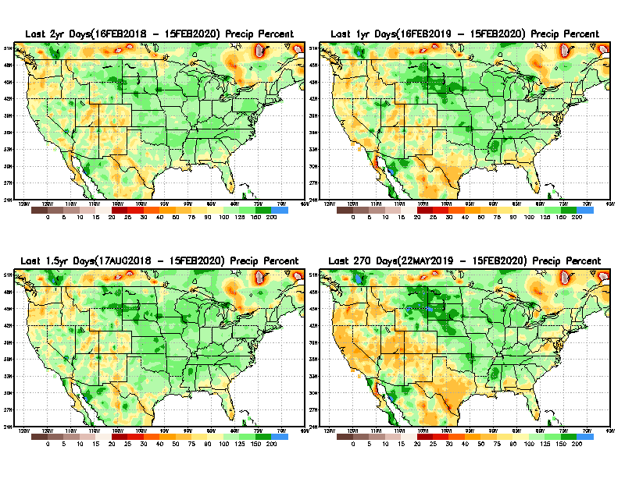
Total precipitation Percent during last 9 months, 1 yr, 1.5yrs, & 2 yrs.
2 Y
1 Y
1.5 Y
9 M
What exactly are the time scales for short(S) and long(L) term drought?
From: Recent Accumulated Precipitation https://www.cpc.ncep.noaa.gov/products/Drought/briefing_prcp.shtml

Slide 9
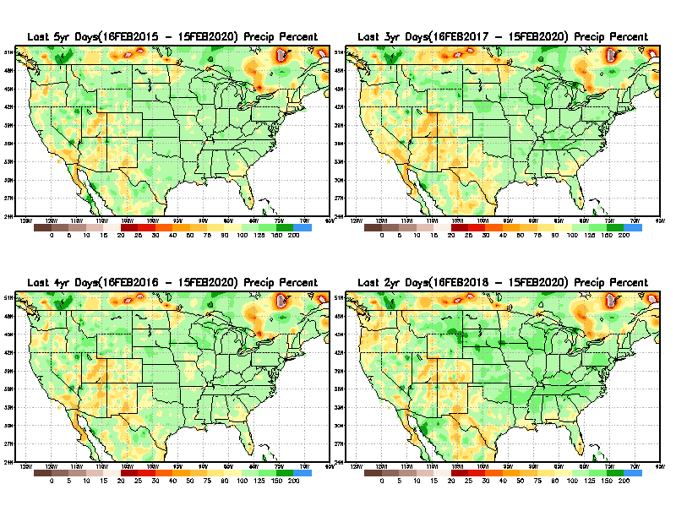
Total precipitation Percent during last 2 yrs, 3 yrs, 4 yrs, & 5 yrs.
5 Y
3 Y
Still longer term rainfall deficit variability in play? Especially in the southwest!
Will these deficits ever go away, OR is these part of the new norm??
Not so bad in the east!!
4 Y
2 Y
From: Recent Accumulated Precipitation https://www.cpc.ncep.noaa.gov/products/Drought/briefing_prcp.shtml

Slide 10
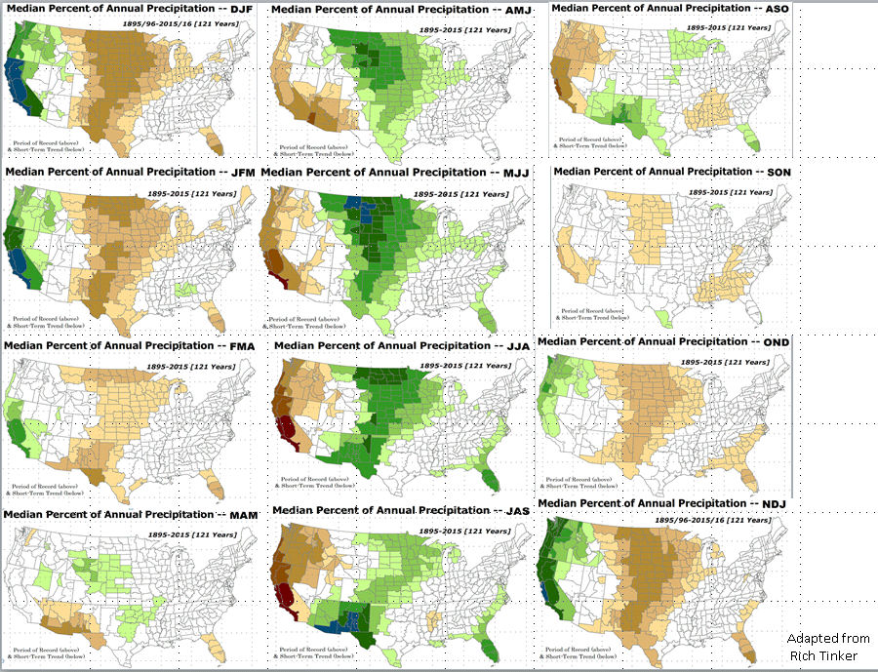

Rainy (3-month)Season across the US

Slide 11
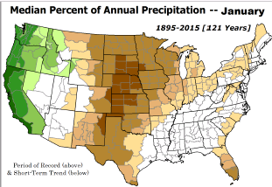
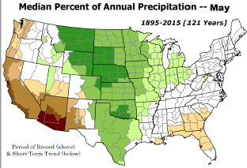
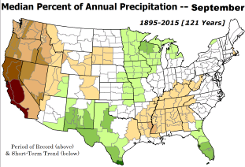
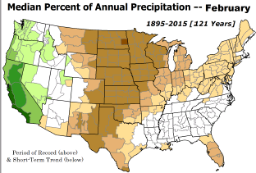
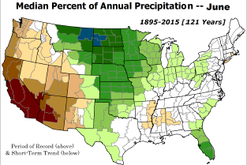
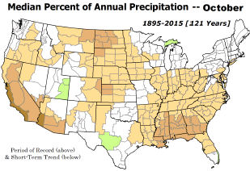

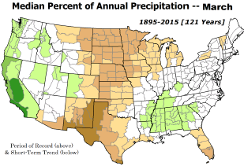
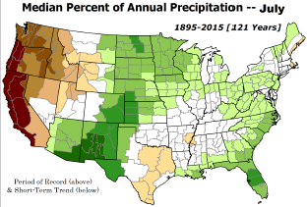
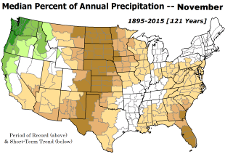
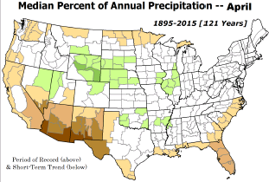
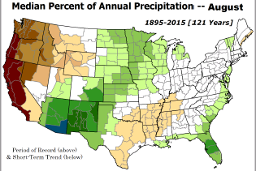
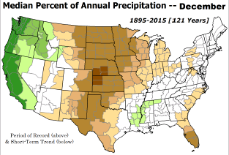
Adapted from Rich Tinker.

Slide 12
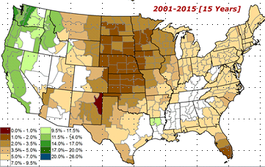
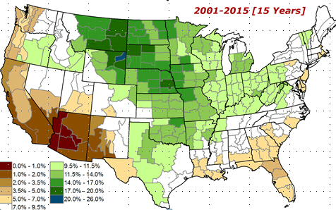
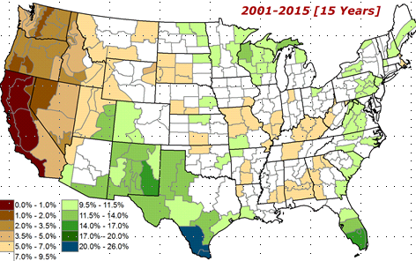
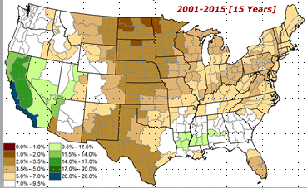
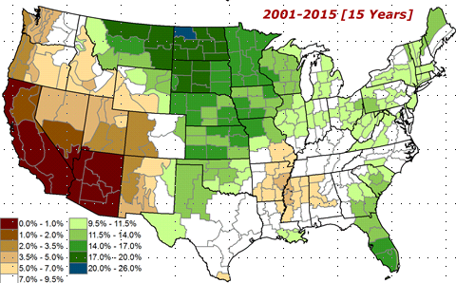
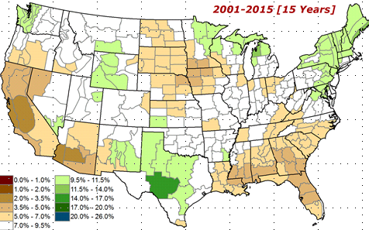

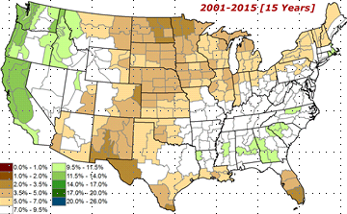
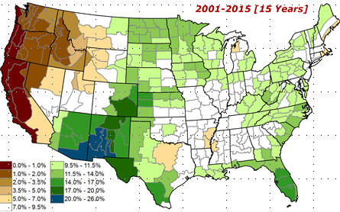
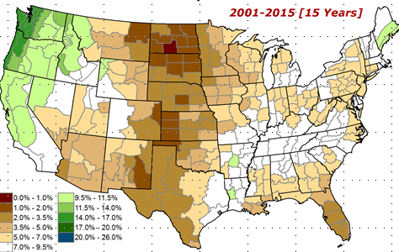
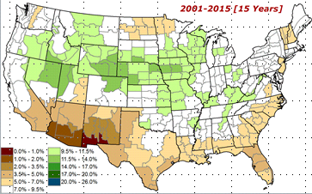
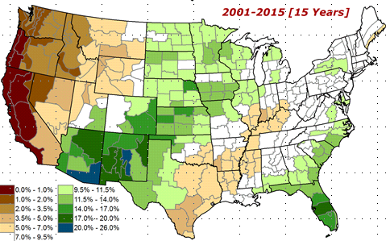
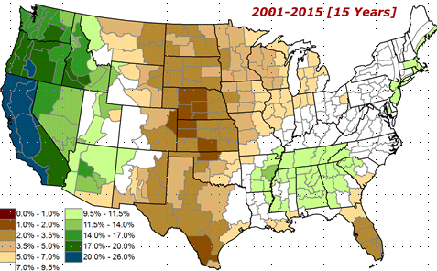
Adapted from
Rich Tinker

Slide 13
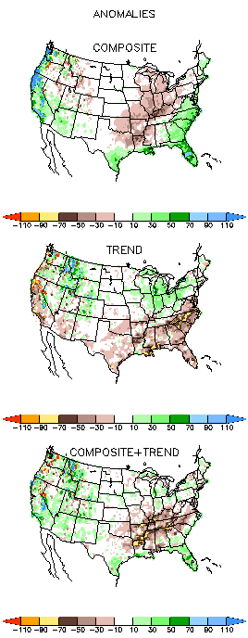
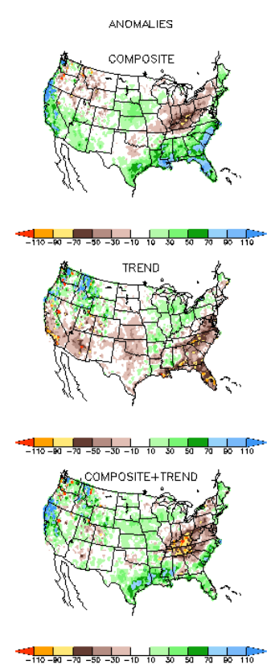
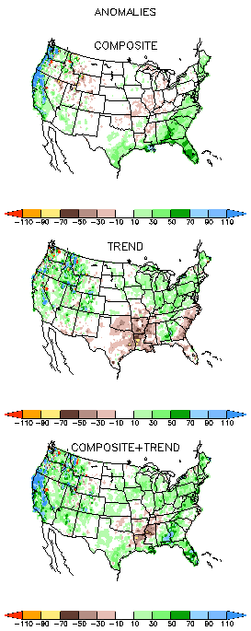
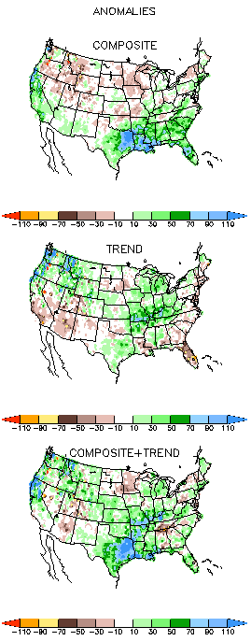
EL NINO Precip COMPOSITES & Trend maps
JFM
FMA
Only this is of relevance to us now due to neutral ENSO status.

Slide 14
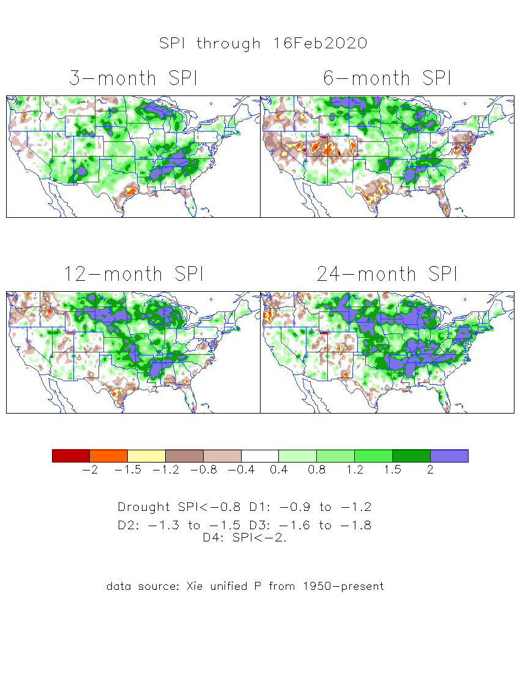
The Standardized Precipitation Index SPI
(based on Observed P)
----- NOW
Very interesting graphic & details for the drought across the US based on the more generalized precip deficit/excess, the Standardized Precipitation Index (SPI).
The dark brown and red colors, indicating standardized precipitation deficits, in the various time periods, approximately correspond to the appropriate short/long term drought monitor regions and their intensities

Slide 15
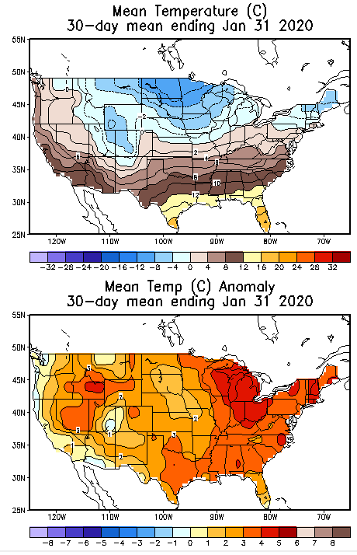
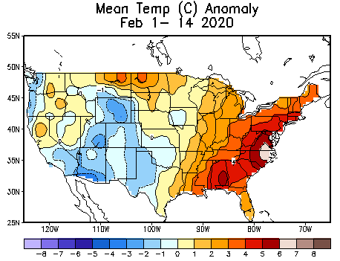
Recent US Temperatures

Slide 16
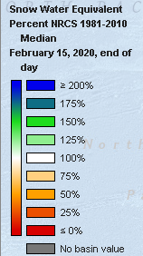
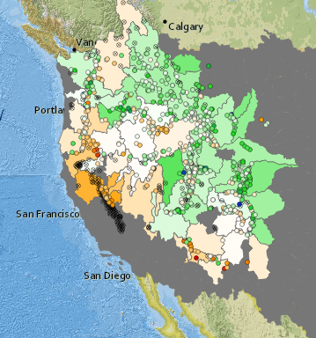



https://www.nrcs.usda.gov/wps/portal/wcc/
California reservoirs are at or near average levels.
TX
Northern CA reservoirs beginning to show
Weakness, but rainy season coming up!

Slide 17







Streamflow (USGS)
Improving conditions in the southwest, getting bad.
Pacific NW much improved now.
Map shows only below normal 7-day average streamflow compared to historical streamflow for the day of year.
One month ago (left) &
Now (below)
17

Slide 18



[Now]
NCEP Ensemble mean NLDAS2 models’ Soil Moisture tendency/trend
7 days
14 days
Drying soil moisture tendency over the last month in the drought affected regions, especially in the southeast.
30 days

Slide 19




Snow cover
Last Month
This Month
Slightly more snow now on ground than last month.
Is there a snow anomaly map available ?

Slide 20
EL NIÑO/SOUTHERN OSCILLATION (ENSO)
DIAGNOSTIC DISCUSSION
issued by CLIMATE PREDICTION CENTER/NCEP/NWS and the International Research Institute for Climate and Society
13 February 2020
ENSO Alert System Status: Not Active
Synopsis: ENSO-neutral is favored through Northern Hemisphere spring 2020 (~60% chance), continuing through summer 2020 (~50% chance).

Slide 21




Latest values of SST indices in the various Nino Regions.
The sub surface heat anom has been vacillating for the past few months. Will we be in neutral territory for how long?

Slide 22


Sub-Surface Temperature Departures in the Equatorial Pacific
Most recent pentad analysis

Slide 23




ENSO Forecasts
Early- January CPC/IRI forecast
Early- February CPC/IRI forecast
Same neutral ENSO forecast as last month. But Neutral for how long? Or a swing to ?

Slide 24



Released Jan 31th
Previous(Last month)
CPC’s official
Precipitation outlook for
Monthly (Feb)/Seasonal (FMA)
Released Jan 16th
Observed so far this month!!
Monthly P/T forecasts verified at mid-month are generally good! Why? ☺ (becoz they r mostly based on GFS’ 2-wk fcsts)
Second half month ?
Next slide!

Slide 25



WPC Next 7 days QPF Forecast
GFS Model Guidance for next 16 days.

Slide 26


Made
Jan 31th
Previous (Last Month)
CPC’s official
Temperature outlook for
Monthly (Feb)/Seasonal (FMA)
Made
Jan 16th
Observed so far this month!!

Slide 27




NMME T & P
EnsMean forecasts
Mar
MAM
The seasonal mean precip forecast signal is not in the drought areas of interest !!

Slide 28


Slide 29

Forecast uncertain in Hatched areas.

Slide 30


Slide 31


Slide 32




Initial Conditions:
02/11/2020
http://drought.geo.msu.edu/research/forecast/smi.monthly.php
Predicted Monthly Soil Moisture Percentile
Initial Conditions 1 months ago:
12/03/2019
The inter quartile range suggest greater uncertainty about the forecast in these shaded regions.

Slide 33
Summary
Current ENSO status and forecast. ENSO-neutral conditions are present and is favored through Northern Hemisphere spring 2020 (~60% chance), continuing through summer 2020 (~50% chance).
Current Drought conditions:
  After reaching a relative minimum in the area of drought coverage across the US in April/May 2019, the drought area started to increase in the south, which peaked in October, and since then has decreased at least in the southeast. Only scatter drought exist in the southeast.
  Drought in the four corner states (AZ/MM/UT/CO) has been vacillating back and forth in both intensity and shape and even location. Drought continues to dominate southern Texas.
  Precipitation has been deficient along the Pacific coastal states through much of the winter precip season there so far, with only the rest of February and March. This has led to moderate dryness and emerging drought in the Pacific western states of CA, OR and WA, and in Idaho and NV.
  California reservoirs, continue to be at better than historically average levels, due to excellent water management system.
  Prediction:
  Expected presence of near normal/neutral ENSO conditions in the tropical equatorial Pacific through spring and even summer, is taking away the even little edge and confidence via boundary conditions in the model’s seasonal forecasts of precipitation and temperature over the continental US.
  Careful examination of the current precipitation deficiencies on many time scales across the United States and the extent/march of the compact/expanded rainy season in the drought affected and the precipitation deficit regions, will help guide the drought forecasters. These considerations lead us to suggest that the drought in southwestern Texas will persist, while the short term rainfall will remove the drought in eastern TX. The emerging drought in CA will broaden and get probably get worse. Drought in NV, eastern CO/KS border will likely persist or strengthen.
  The drought in the four corners region will get continue to persist, due to continued short and long term rainfall deficits in the region. Parts of NV will likely see emergence of new dry/drought regions.
  No new development of drought is expected in the eastern US and the Midwest.
  *********************

Slide 34


Improve
SDO [FMA’20]
(1/7/20 USDM)
Persist
Develop
Persist
Improve
Improve
Considered Development,
but short-term & ERF wetness,
FMA climo dry
Improve
Persist
ERFs wetness; LLFs = EC;
FMA climo ~ dry (west)
Improve
Persist

Slide 35

Miscellaneous maps

Slide 36

Miscellaneous maps

