Slide 1
Drought Outlook Support Briefing February 2021
Climate Prediction Center/NCEP/NOAA
http://www.cpc.ncep.noaa.gov/products/Drought
Phone: 1-877-680-3341
Pwd: 858747#

Slide 2
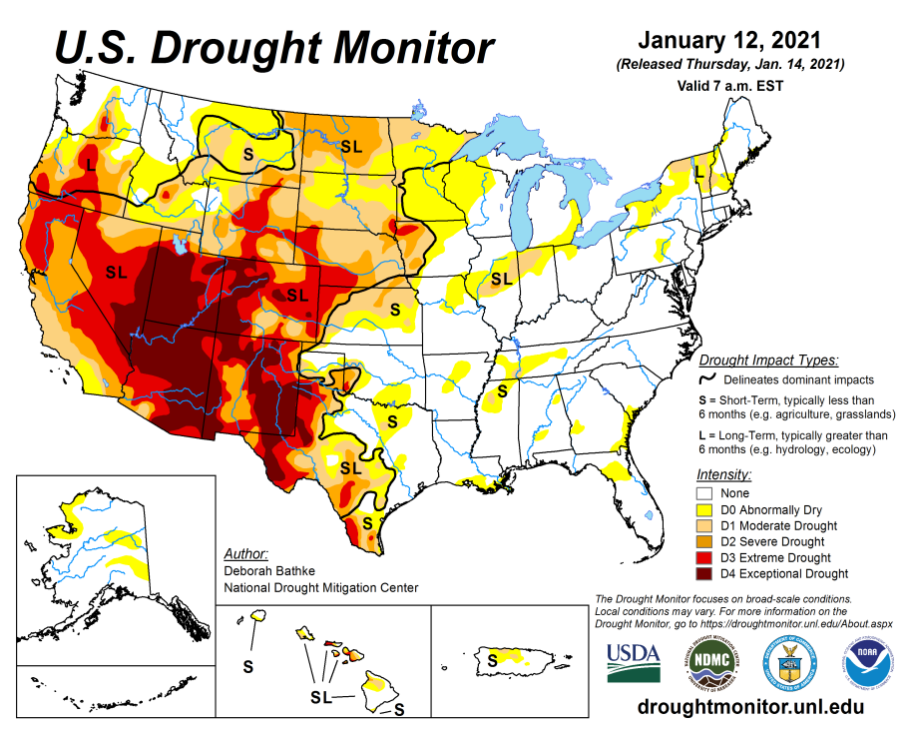
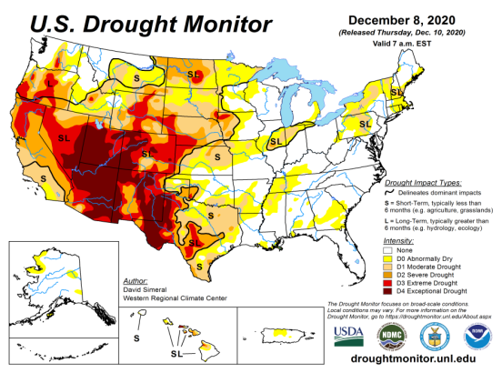
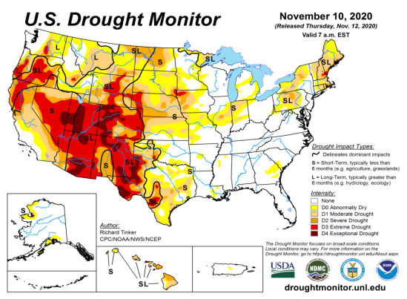
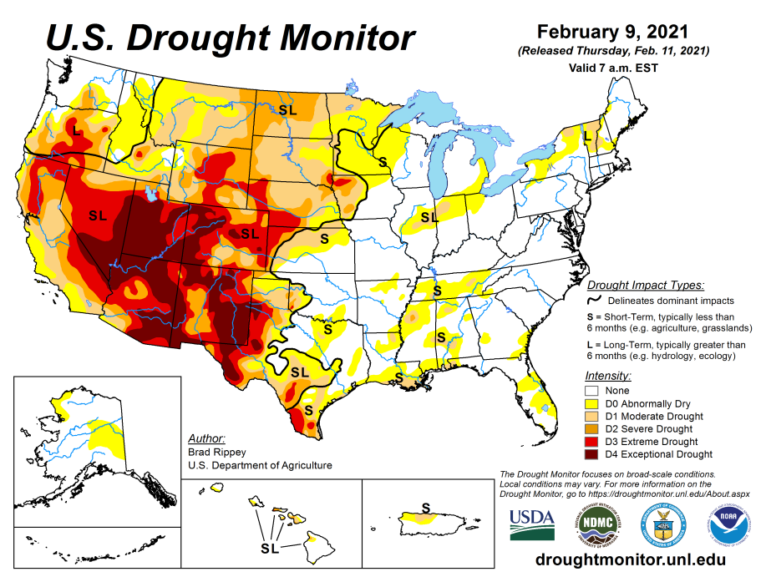
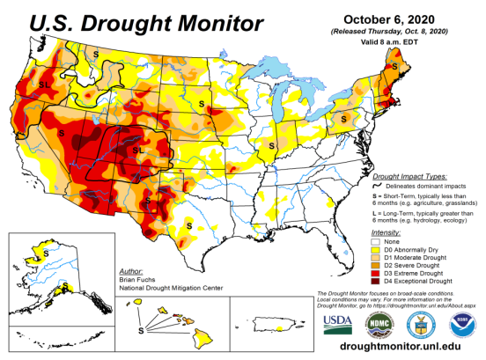
Drought Monitor
Monitoring is important because, unlike US T/P fcsts, for drought forecasts, we have to know where we are, before we can tell where we are going!! Drought forecasts are tendency forecasts.
January
December
Over the last several months, drought area & severity has overall generally just about the same. The worse drought conditions are in the border areas of states AZ, NV, UT, CO, and OR, CA and western TX. These are regions are part of the long term drought.
The drought in the Dakotas, MT, Wyoming, Nebraska, Kansas and vicinity which developed in the last year continues to hang in there.
About 50 % of the country is experiencing category D1 or worse drought condition.
Drought in the Northeastern (New England) states is finally and slowly beginning to get some relief and fade away. Or Is it?
Developing dryness in parts of Gulf coast states.
November
February
(Recent/Latest)
October
February

Slide 3
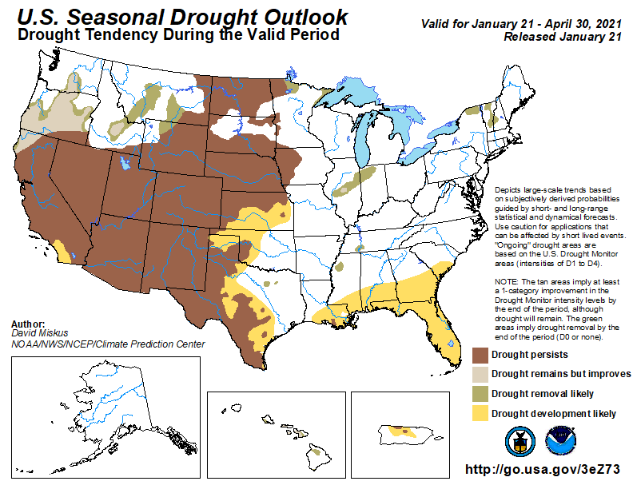
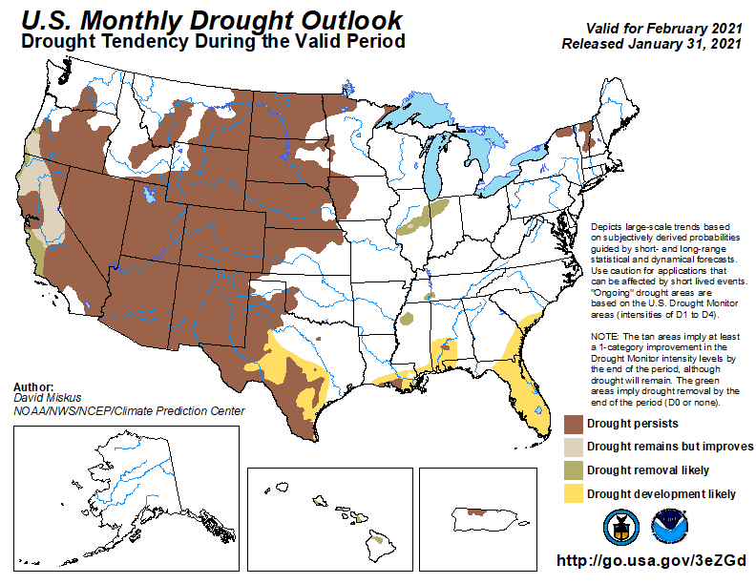
(Prev) Seasonal/Monthly Drought outlooks
(New Seasonal Drought Outlook to be released in 2 days!)
(New Monthly Drought Outlook to be released end of the month)
Seasonal Outlook
(Mid Jan 2021- Apr 2021)
issued 01/21/21
Monthly outlook
(for February 2020)
issued 01/31/21
Similar looking Monthly and seasonal outlooks, except in the southeast. New Drought is expected to emerge in the Southeast, and it is beginning to happen. Will that happen?
The ongoing La Nina and the associated below normal precip. across the southwest is increasing the drought affected areas.
Question: During this moderate La Nina winter, how well are the observed T/P monthly/seasonal patterns conforming to the canonical (expected) composite patterns?

Slide 4
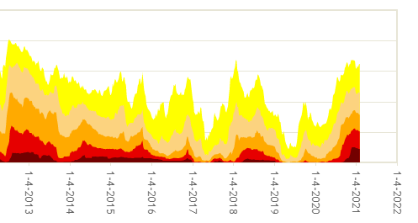
50%
The current % of area extents at D2/D3/D4 drought are approaching the drought during 2013 (the worst since 2000)?

Slide 5
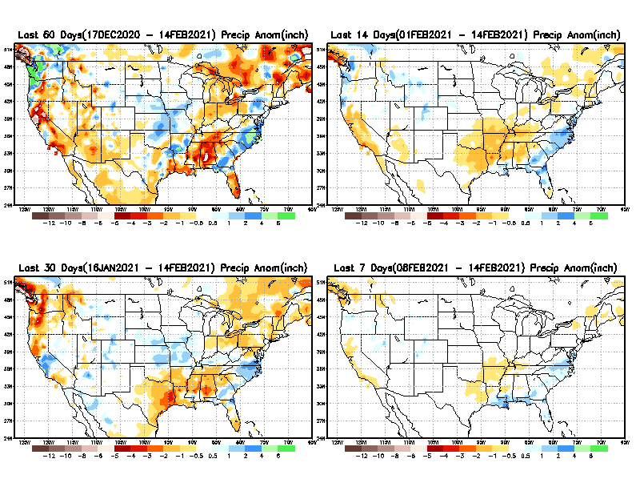
Precipitation ANOM during last 7, 14, 30, & 60 days.
Not much evidence (so far) of Ohio valley excess precip noted during La Nina – It has been a crazy winter of extreme weather so far!! (Also this past year with Hurricanes, West Coast Fires, and now COLD!!!)
60 Days
14 Days
30 Days
7 Days
These maps in this and following slides, including a) Total,
b) Anom and
c) Percent of Normal precip. in these and other longer time ranges are now (routinely) daily updated at:
From: Recent Accumulated Precipitation https://www.cpc.ncep.noaa.gov/products/Drought/briefing_prcp.shtml

Slide 6
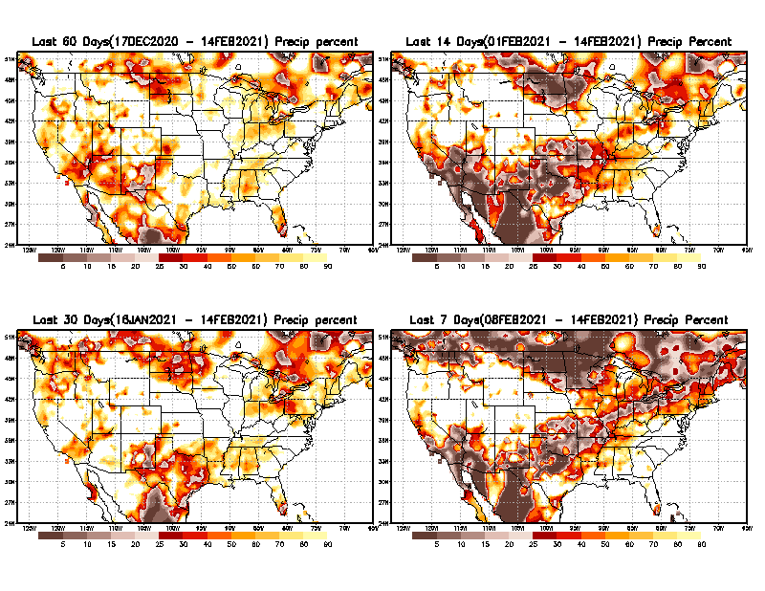
Precipitation Percent during last 7, 14, 30, & 60 days.
Seasonal fcst even during ENSO is becoming difficult!! Even winter!!
60 Days
14 Days
This plot shows only the rainfall deficient regions <= 90% of normal.
-- This shows more clearly possible/likely drought developing region in the future unless there is above normal rainfall in these regions in the future, to offset these shortfalls.
30 days
7 Days
From: Recent Accumulated Precipitation https://www.cpc.ncep.noaa.gov/products/Drought/briefing_prcp.shtml

Slide 7
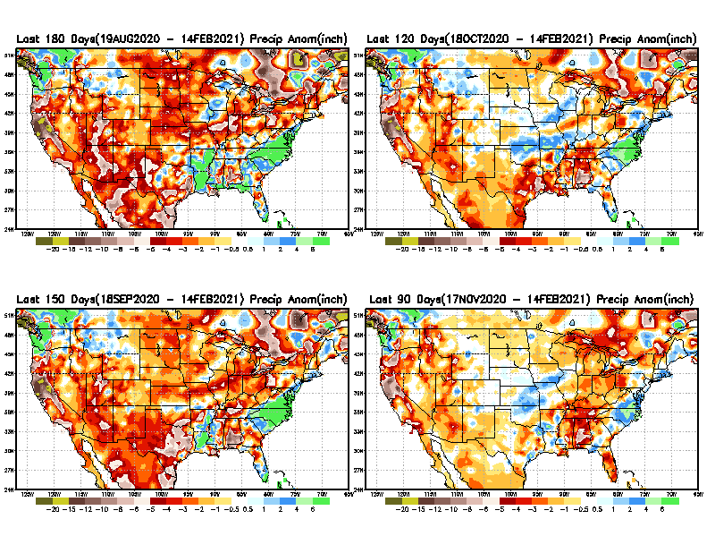
Total precipitation ANOM during last 3, 4, 5, and 6 months.
6 M
4 M
While the Precipitation anomalies deficit may seem large in some regions (compared to others), it is the % of normal precip (next slide) that matters more!!
5 M
3 M
From: Recent Accumulated Precipitation https://www.cpc.ncep.noaa.gov/products/Drought/briefing_prcp.shtml

Slide 8
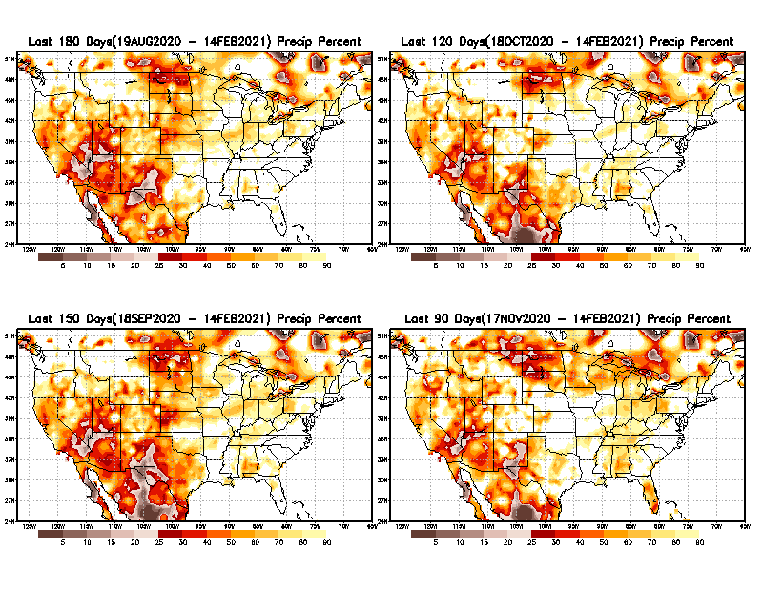
Total precipitation Percent during last 3, 4, 5, and 6 months.
6 M
4 M
In these interim time scale 3-6 months, we need to pay attention to regions, which are dark-brown, red & dark red (<50%).
While accrued precipitation deficits are real & objective,
droughts are subjective declarations!!
5 M
3M
East vs West!
Broad vs Narrow
rainfall season.
In general, West suffers more from frequent and lasting droughts.
With these various rainfall deficits in diff. time ranges, where and how exactly does one declare drought? Other factors (T/SM/E, etc..) do matter, but is cumulative precip. Are deficits/percent_of_normal ultimately more important?

Slide 9
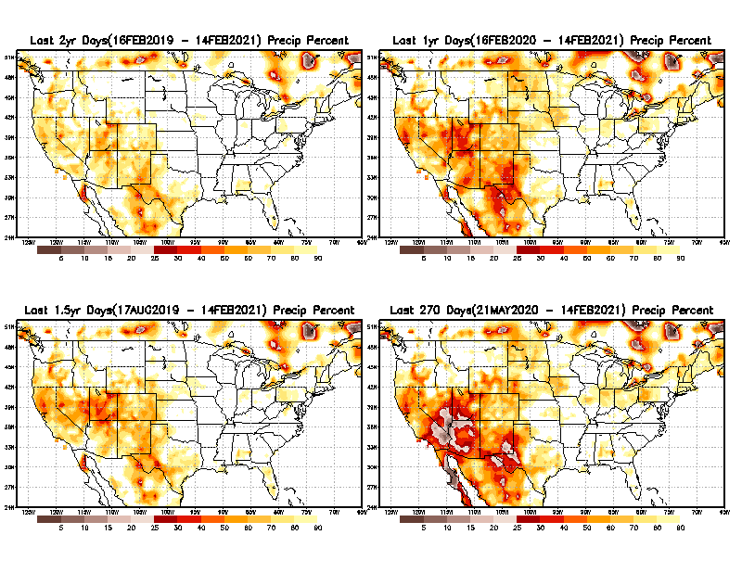
Total precipitation Percent during last 9 months, 1 yr, 1.5yrs, & 2 yrs.
2 Y
1 Y
Tinderbox areas, where some form of longer term rainfall
deficiencies already, exist !!
-Almost all are in the southwest!
-This & Next slide!!
1.5 Y
9 M
From: Recent Accumulated Precipitation https://www.cpc.ncep.noaa.gov/products/Drought/briefing_prcp.shtml

Slide 10
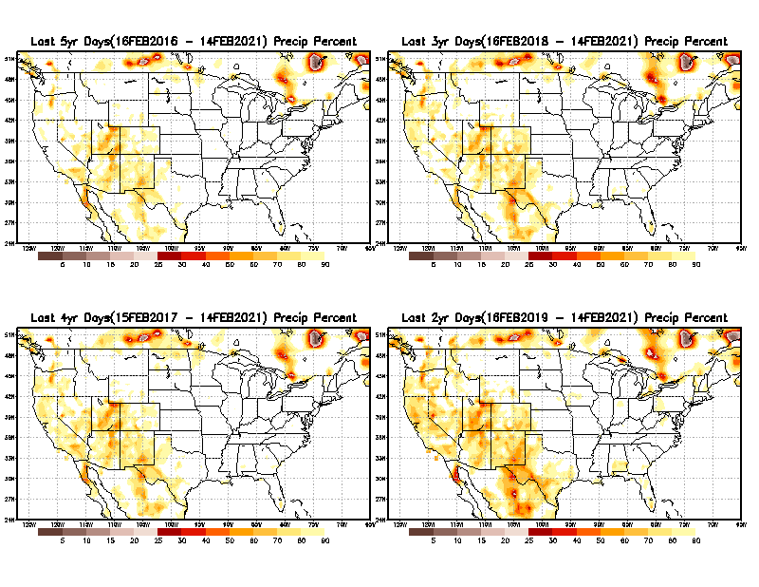
Total precipitation Percent during last 2 yrs, 3 yrs, 4 yrs, & 5 yrs.
5 Y
3 Y
In these long time ranges (2-5 yrs), there is a general dearth/lack of precipitation in the southwest US. – where the current severe drought ravages!!. At the end of this current ongoing La Nina the long term situation will get even worse!!
4 Y
2 Y
From: Recent Accumulated Precipitation https://www.cpc.ncep.noaa.gov/products/Drought/briefing_prcp.shtml

Slide 11
Rainy (3-month)Season across the US
East vs West!
More darker colors in west/central => narrow rainy season (months)
Overall, more white space in the east => distributed rainfall season (except ~FL).

Slide 12
*********
EAST vs
CTR/WEST
Drought Behavior is loosely tied to rainfall climo!!
*********
Adapted from Rich Tinker.

Slide 13
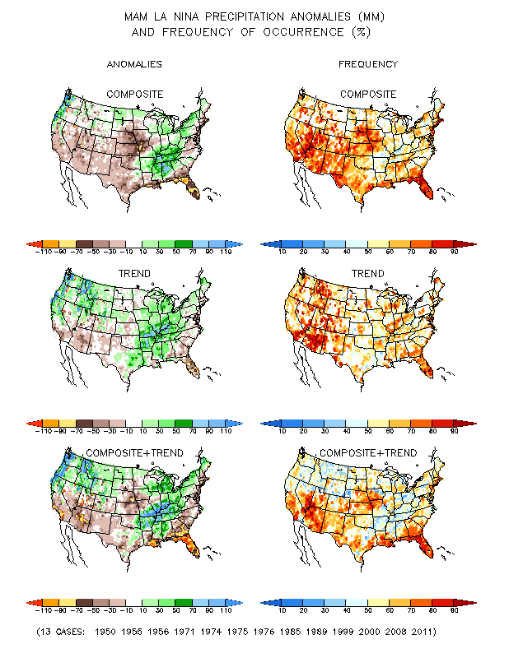
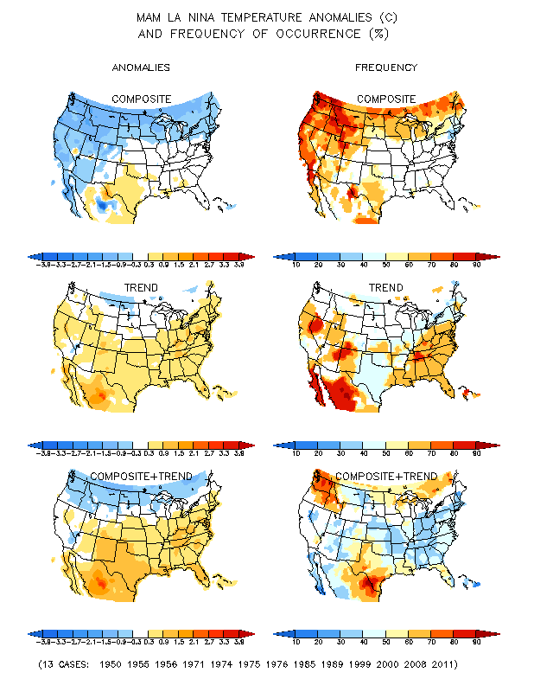
La Nina Precip/Temperature COMPOSITES & Trend map
MAM
P
T
WET
DRY

Slide 14
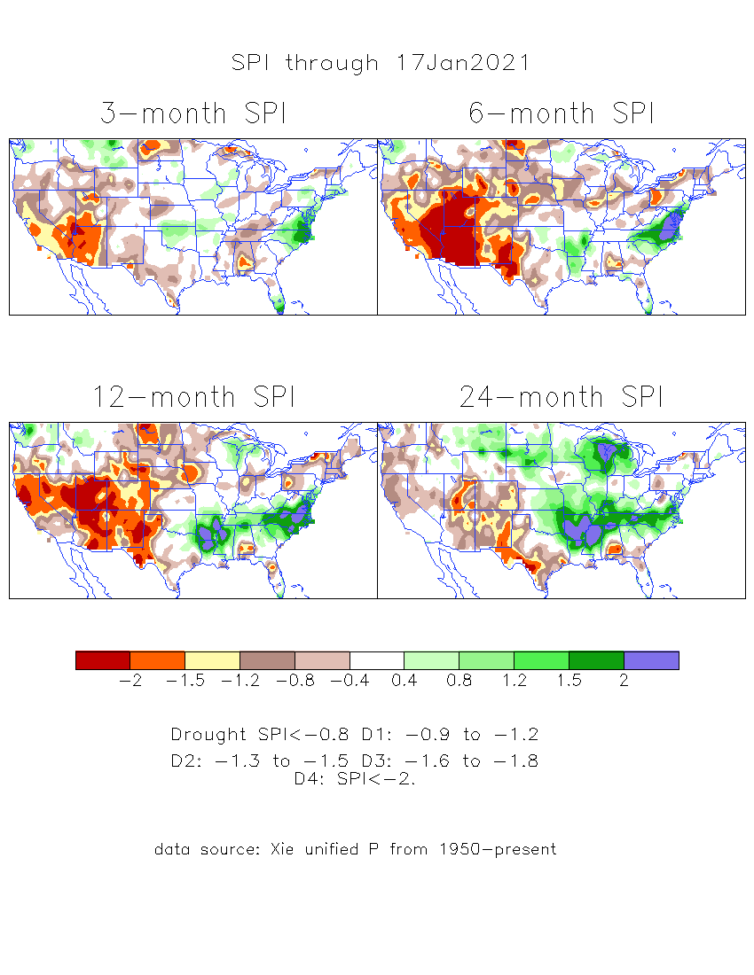
The Standardized Precipitation Index SPI (based on Observed P)
----- Last Month
Very interesting graphic & details for the drought across the US based on the more generalized precip deficit/excess, the Standardized Precipitation Index (SPI).
The dark brown and red colors, indicating standardized precipitation deficits, in the various time periods, approximately correspond to the appropriate short/long term drought monitor regions and their intensities

Slide 15
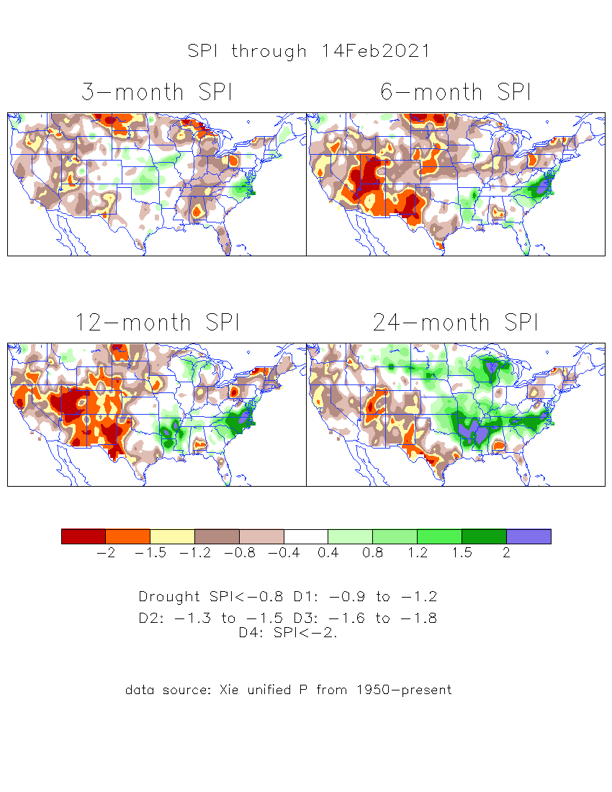
The Standardized Precipitation Index SPI (based on Observed P)
----- NOW
Very interesting graphic & details for the drought across the US based on the more generalized precip deficit/excess, the Standardized Precipitation Index (SPI).
The dark brown and red colors, indicating standardized precipitation deficits, in the various time periods, approximately correspond to the appropriate short/long term drought monitor regions and their intensities
Short-term situation has gotten slightly better in the west, but long term situation is, and will stay worse -- as we said last month!!
----- NOW
How does one negotiate and reconcile declaring short term vs long term drought when precip. deficiencies patterns differ on many different time scales locally!!
What is the cutoff delineating time between short VS long term drought!!

Slide 16
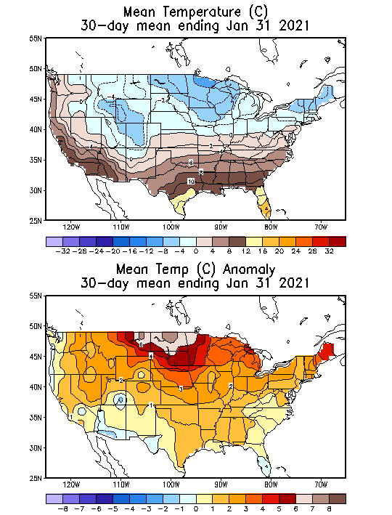
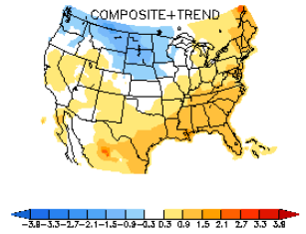
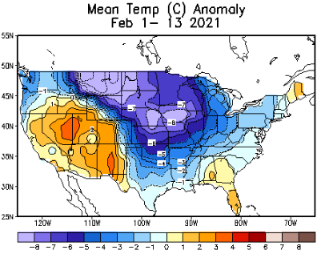
Recent US Temperatures
Canonical La Nina T - DJF
Last month, observed T anom are opposite of the La Nina Composites!! This month? Not quite La Nina –ish!!

Slide 17
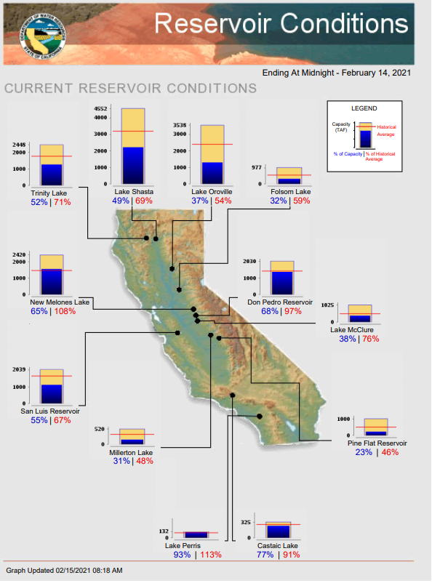
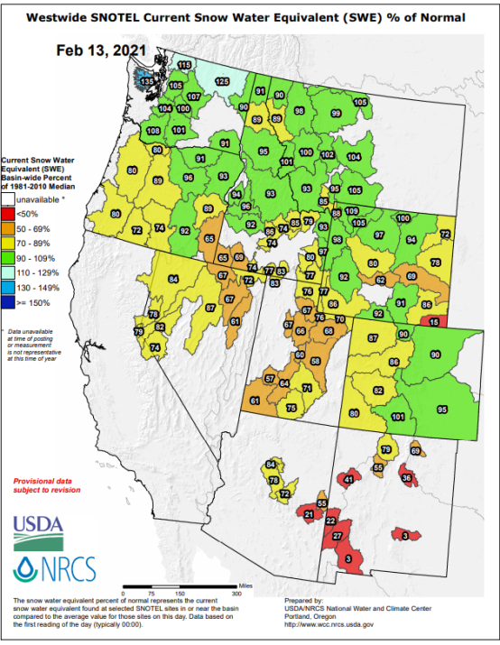
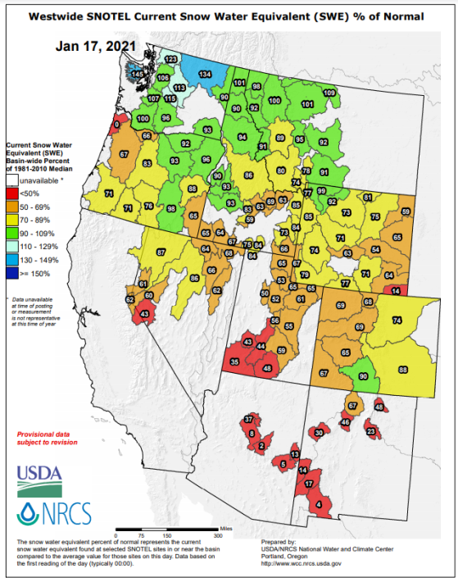
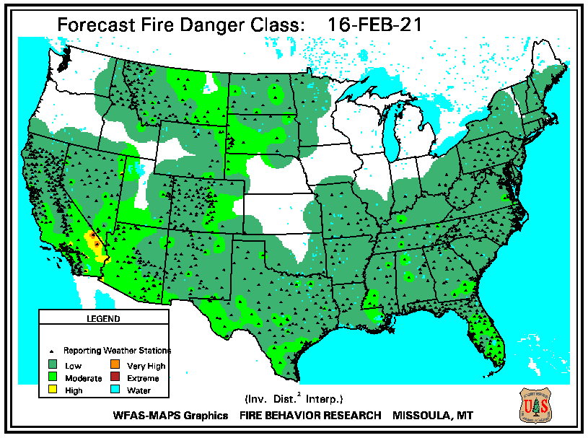
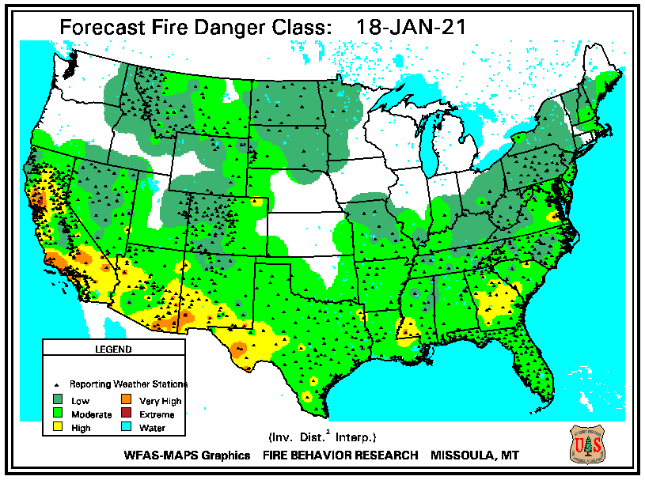
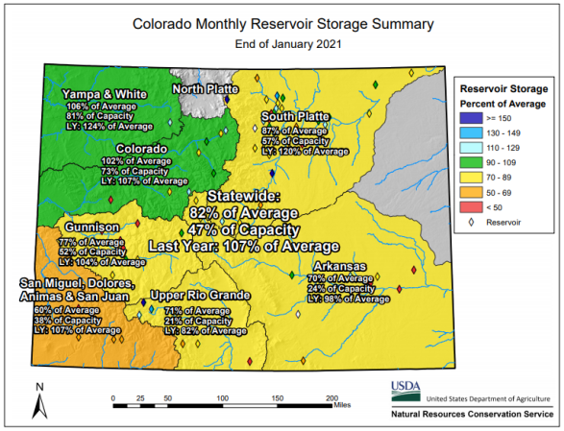
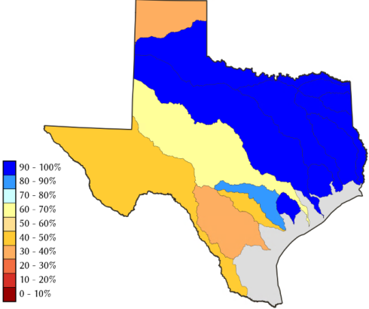
THIS MONTH
LAST MONTH
https://fsapps.nwcg.gov/
CO
Many CA reservoirs are at low levels”!!
TX
82 %
of AVG!
Because of La Nina and from conditions even before La Nina, water reservoir levels are low!! If La Nina continues onto second year, this year, it will be a major problem!!

Slide 18
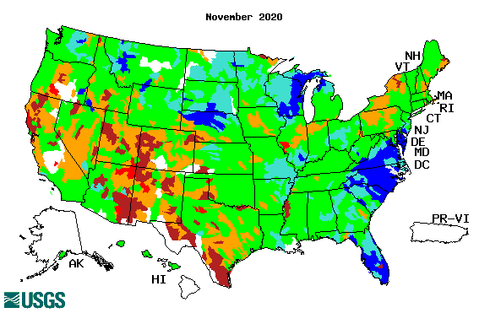
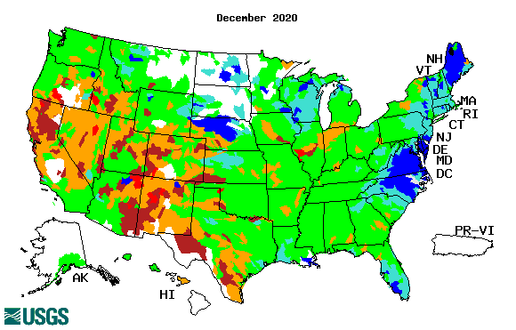
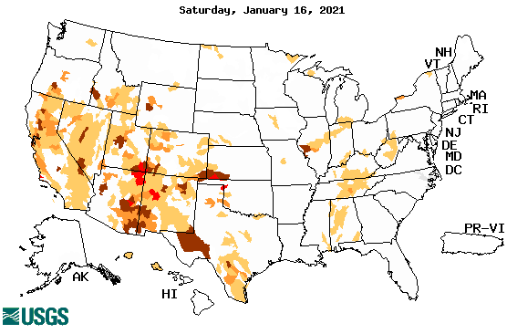
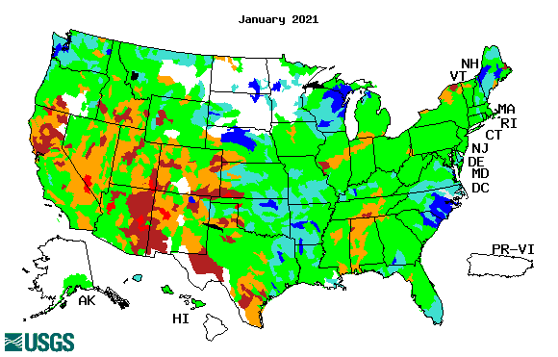
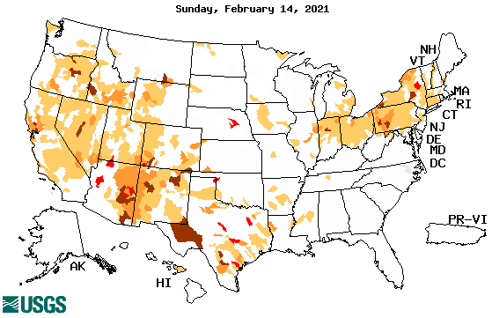
Streamflow (USGS)
Worse conditions in the southwest, in the monsoon region.
Northeast drought considerably improved.
Pacific NW much improved now.
Map shows only below normal 7-day average streamflow compared to historical streamflow for the day of year.
One month ago (left) &
Now (below)
Note:
CA,
TX,
Maine/
Northeast
Overall, similar streamflow conditions in the south and west . The white areas in maps (left) indicate no data or frozen land.
18

Slide 19
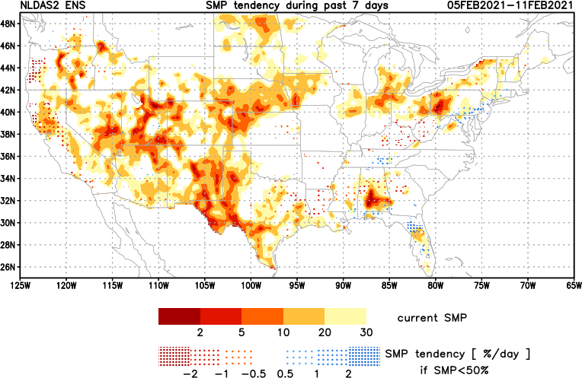
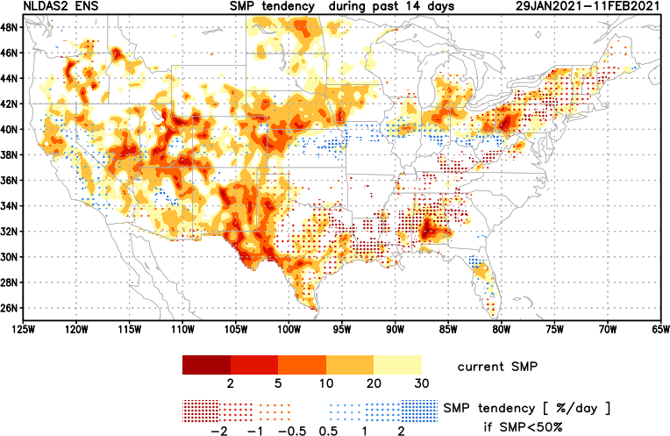
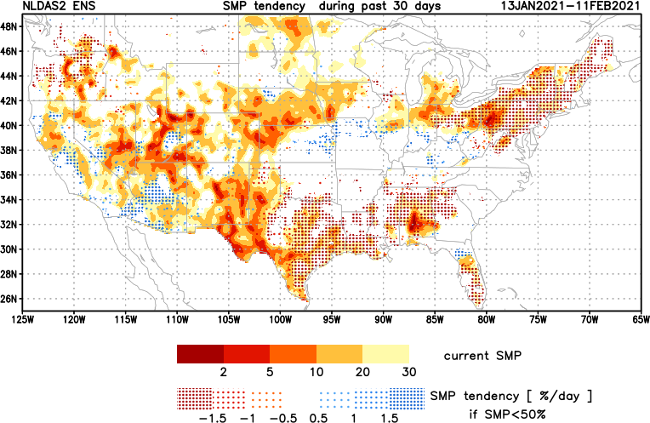
[Now]
NCEP Ensemble mean NLDAS2 models’ Soil Moisture tendency/trend
7 days
14 days
30 days
Western half, mostly straightforward!
Ohio/PA border region and eastern TX/Gulf states – watcvh out!!

Slide 20
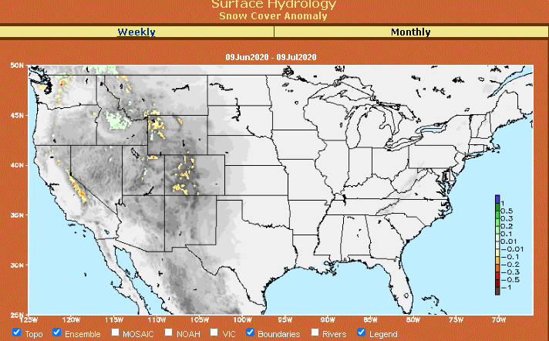
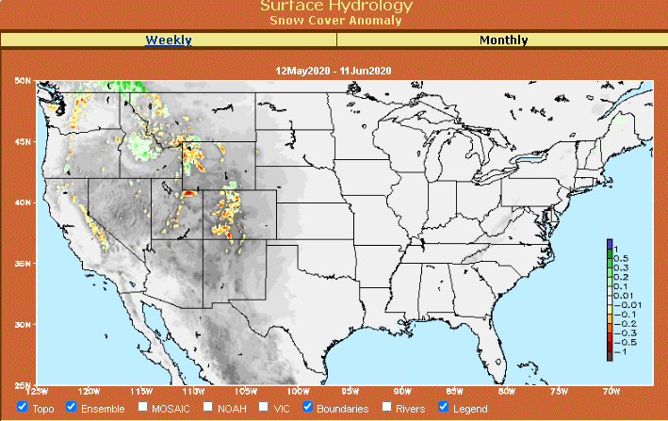
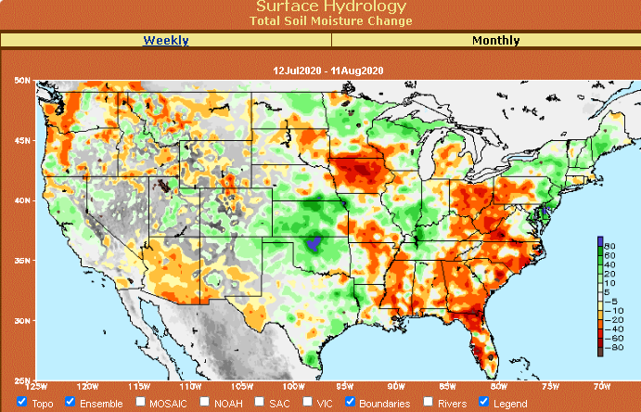
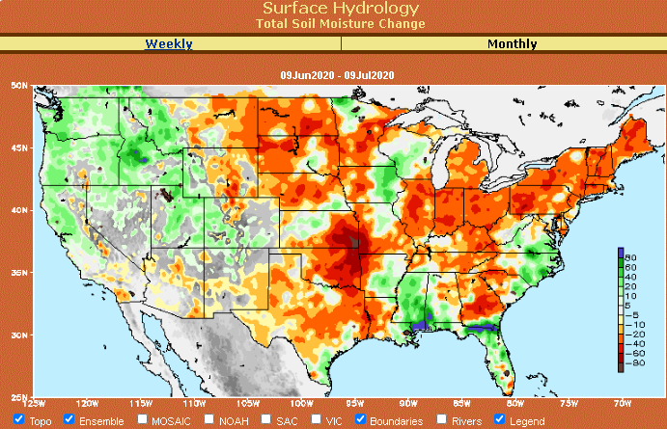
Snow cover & Soil Moisture Anomalies
Snow cover
SLIDE
NOT SHOWN!
Last month ~ this time
Now
Look further for areas of drought development

Slide 21
EL NIÑO/SOUTHERN OSCILLATION (ENSO)
DIAGNOSTIC DISCUSSION
issued by CLIMATE PREDICTION CENTER/NCEP/NWS and the International Research Institute for Climate and Society
11 February 2021
ENSO Alert System Status: La Nina Advisory
Synopsis: There is a ~60% chance of a transition from La Niña to ENSO-Neutral during the Northern Hemisphere spring 2021 (April-June). -------- ENSO status during - Upcoming forecast season March-April-May –is tricky!

Slide 22
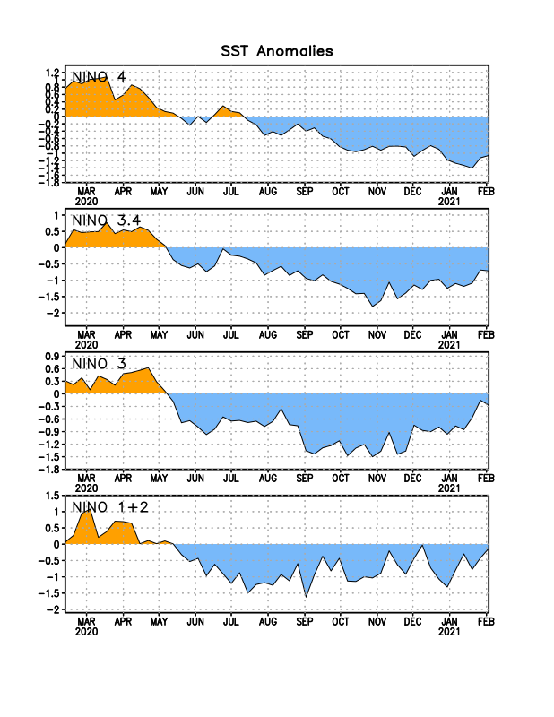
Latest values of SST indices in the various Nino Regions.
This is the most blue! (cold) in all 4 indices (see left) in a while. Subsurface ocean heat anomalies are also cold!!

Slide 23
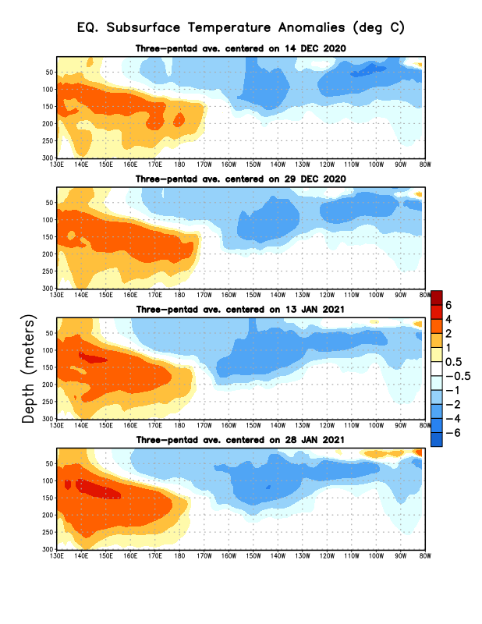
Sub-Surface Temperature Departures in the Equatorial Pacific
Central and eastern tropical SST and subsurface exhibit cold La Nina conditions!!
Warm sub-surface anomalies lurking in the western Pacific and popping up in far eastern tropical Pacific. La Nina transitioning/ending in late Spring? To what ? Neutral/El Nino??
Most recent pentad analysis

Slide 24
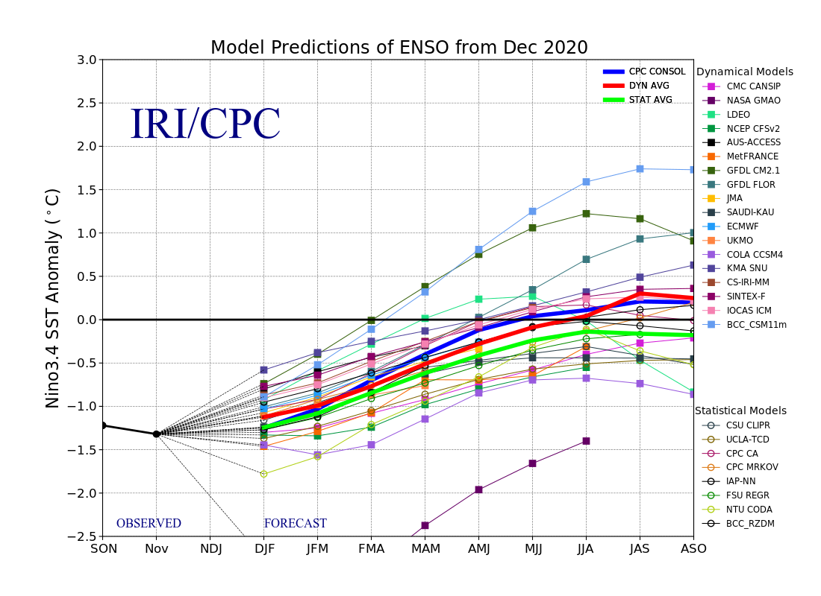
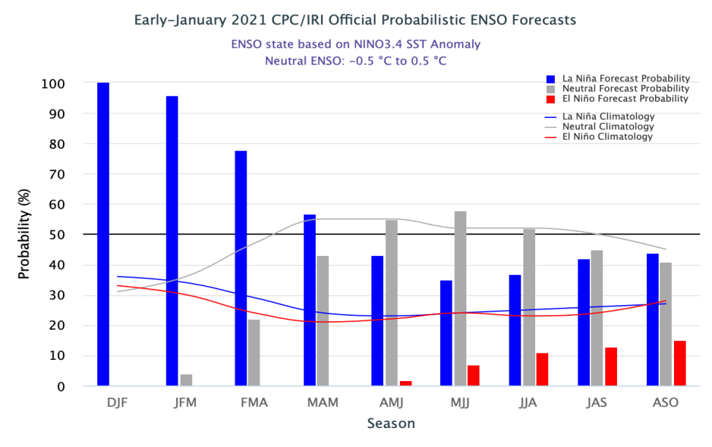
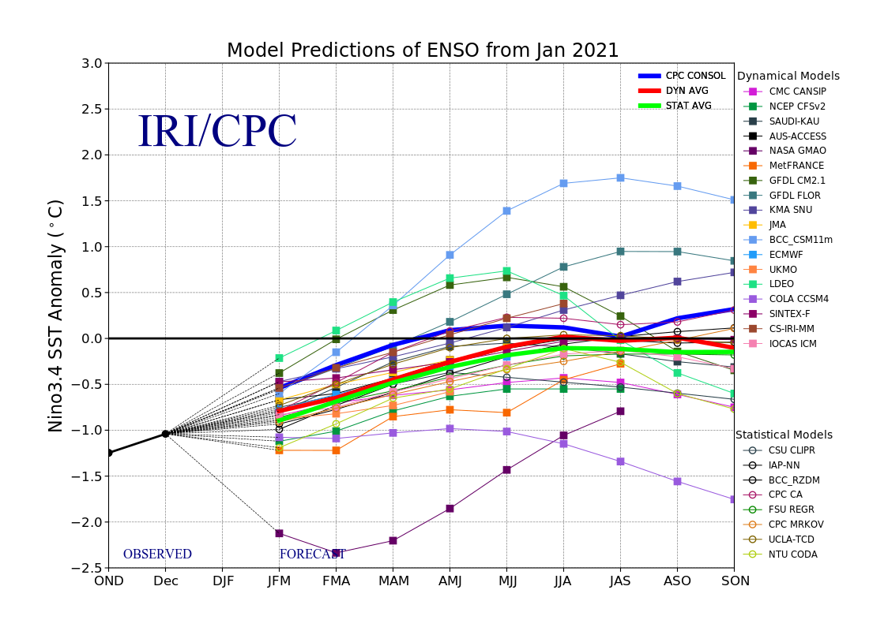
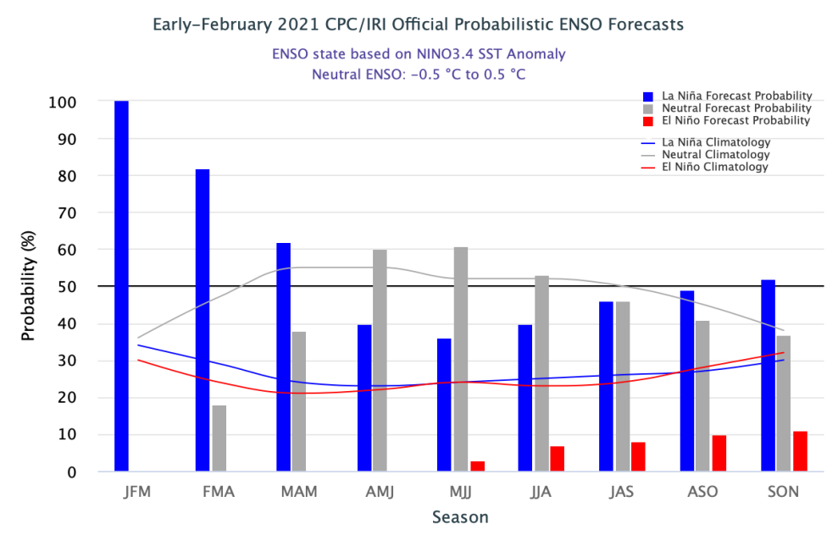
ENSO Forecasts
Early- January CPC/IRI forecast
Early- February CPC/IRI forecast
Will La Nina last through next 3 months (MAM)? Will the La Nina remerge later this year?

Slide 25
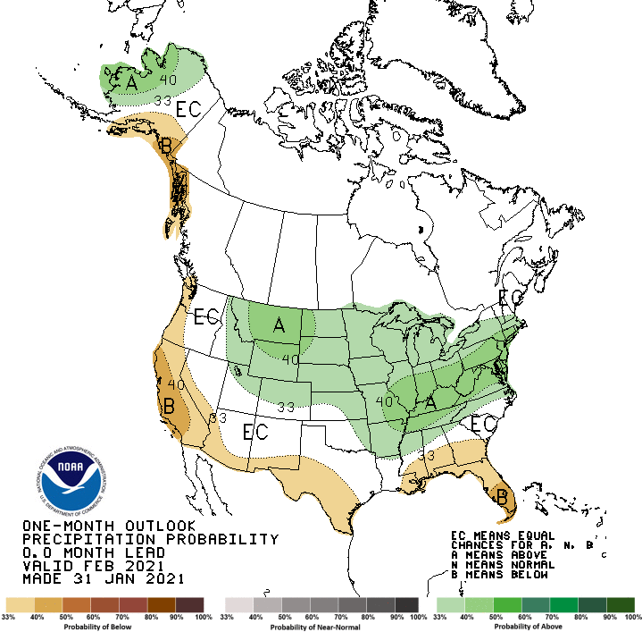
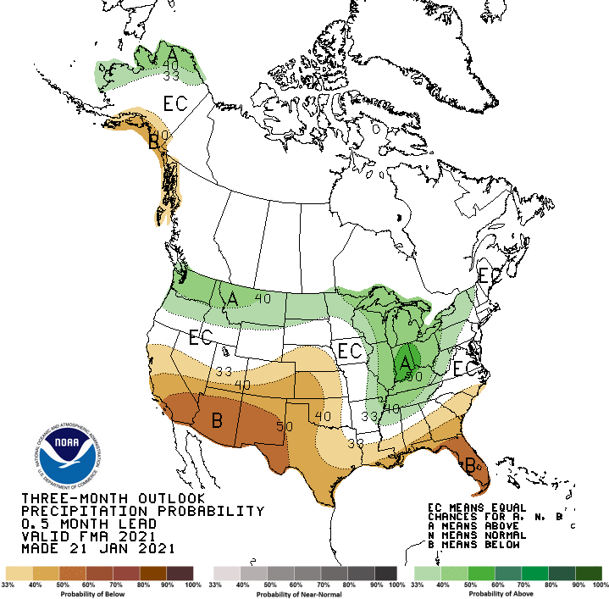
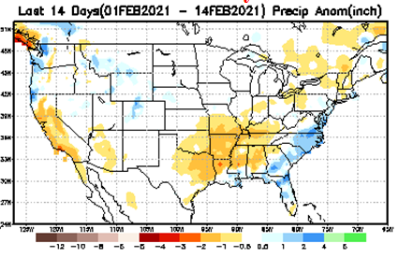
Previous(Last month)
CPC’s official
Precipitation OUTLOOK for Monthly (Feb)/Seasonal (FMA)
Released Jan 31st
Released Jan 21st
What happened?
Observed so far this month!! ☹ ☹
Monthly P/T forecasts verified at mid-month are generally good! Why? ☺ (becoz they r mostly based on GFS’ 2-wk fcsts). We still have many days to go in the month. – BUT now, it looks bad!!

Slide 26
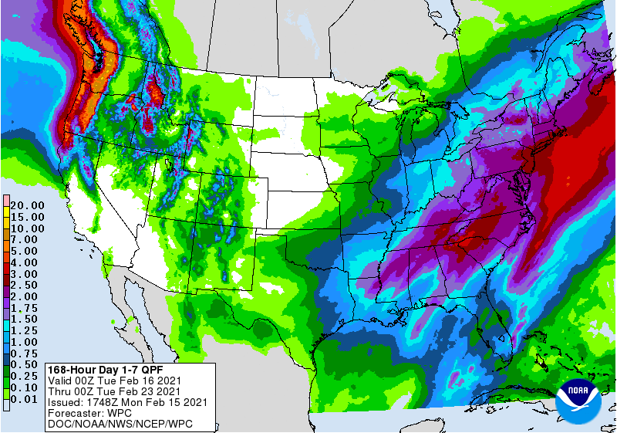
NCEP/WPC Next 7 days QPF Forecast
Precip amounts in this region varies highly from one model run to next!!
GFS Model Guidance for next 16 days.

Slide 27
From European Center (EC) Precip forecast (made yesterday, 15 Feb.) for next 4 weeks.

Slide 29
Looking back from future (16 Mar) how 60 days and 90 days precip percentile will look, including the 1- month European Center(EC) forecast (made yesterday, 15 Feb) precip amounts.
Possible developing drought in parts of LA/MS/AL/FL and coastal GA in the next month/season? (See also 3-4-5 months precip deficits in this region, earlier slides 7/8 !)

Slide 30
Made
Jan 31th
Previous (Last Month)
CPC’s official
Temperature outlook for Monthly (Feb)/Seasonal (FMA)
Made Jan 21st
Observed so far this month!! ☺ ☹

Slide 31
NMME T & P Ens.Mean forecasts
Mar
Much of the country is warm except in the Northwest. The south is WARM+
MAM
The forecast P pattern is the expected canonical La Nina composite, with dry relative conditions in the
South.

Slide 32
Agreement/Disagreement among the various NMME models’ JFM seasonal Precip. Forecast.
??

Slide 33
SPI6 Fcst made from last month(background) compared with this month(foreground, red border)
Forecast uncertain in Hatched areas.
The SPI6 fcsts made last month vs. this month based on NMME models’ precip fcst. suggests continuation of drought in the south and west, in the upper Midwest. Possible total drought removal in the Pacific NW and NE. Possibility of developing dry/drought conditions in the SE by end of fcst season.
SPI6 Fcst made from last month
SPI6 Fcst made from this month

Slide 34
http://drought.geo.msu.edu/research/forecast/smi.monthly.php
Latest Initial Conditions:
02/02/2021
Predicted Monthly Soil Moisture Percentile
MSU stopped updating 06/10/20 ☹
Initial Conditions 1 month ago:
01/12/2021
The inter quartile range suggest greater uncertainty about the forecast in these shaded regions.

Slide 35
Summary
Current Drought conditions:
Over the last several months, drought area & severity has stayed overall just about the same. The worse drought conditions are in the border areas of states AZ, NV, UT, CO, and OR, CA and western TX. These are regions are part of the long term drought. So even short term improvement may not help much.
The drought in the Dakotas, MT, Wyoming, Nebraska, Kansas and vicinity which developed in the last year continues to hang in there.
About 50 % of the country is experiencing category D1 or worse drought condition.
Drought in the Northeastern (New England) states is finally and slowly beginning to get some relief and fade away. Developing dryness in OH/PA border?
Possible developing dryness in the southeast especially along parts of Gulf coast states.
Some/many of California reservoirs levels are below their historical average levels. It is going to be tough with the La Nina expected to continue through rest of winter and early spring. If a second year La Nina remerge later this year (hope not!) it will worsen the water situation further!
Current ENSO status and forecast:
There is a ~60% chance of a transition from La Niña to ENSO-Neutral during the Northern Hemisphere spring 2021 (April-June).
Prediction:
ENSO status during - upcoming forecast season March-April-May –is tricky! both in terms of La Nina status and confidence in model forecasts of the associated impacts!
The observed temperature and precipitation patterns so far are not quite canonical, except in the southwest with lower rainfall amounts, which has worsened the drought conditions there. Not much evidence of enhanced precip in the Ohio valley yet! Possible emergence of dry/mild drought conditions in the Ohio valley is likely, esp. along Ohio/PA border.
Drought in the Dakotas (particularly ND), MT, Wyoming, Nebraska, Kansas and vicinity which developed during last year will persist through the forecast season.
Both Short and long term drought conditions in the south and west is expected to persist and not improve!
Mild drought conditions might develop in parts of southeastern states, particularly in parts of eastern TX, LA, MS, AL, and FL.
*********************

Slide 36
Miscellaneous maps

Slide 37
Miscellaneous maps

