Slide 1
Drought Outlook Support Briefing
February 2022
Climate Prediction Center/NCEP/NOAA
http://www.cpc.ncep.noaa.gov/products/Drought
Points to ponder:
Often, there is a disconnect between the Short term (S) and Long term (L) drought in regions.
Places/regions experiencing Short term drought may (not) be ok in the Long term and vice versa!!
This duality is difficult to reconcile, to convey and even be understood by the public at large.
Public/Forecaster focus tends to be more on the Short term Drought (for good reasons!!)
More importantly the very definitions and timescales associated with S/L term droughts and the declarations in the USDM are by themselves subjective!!

Slide 2
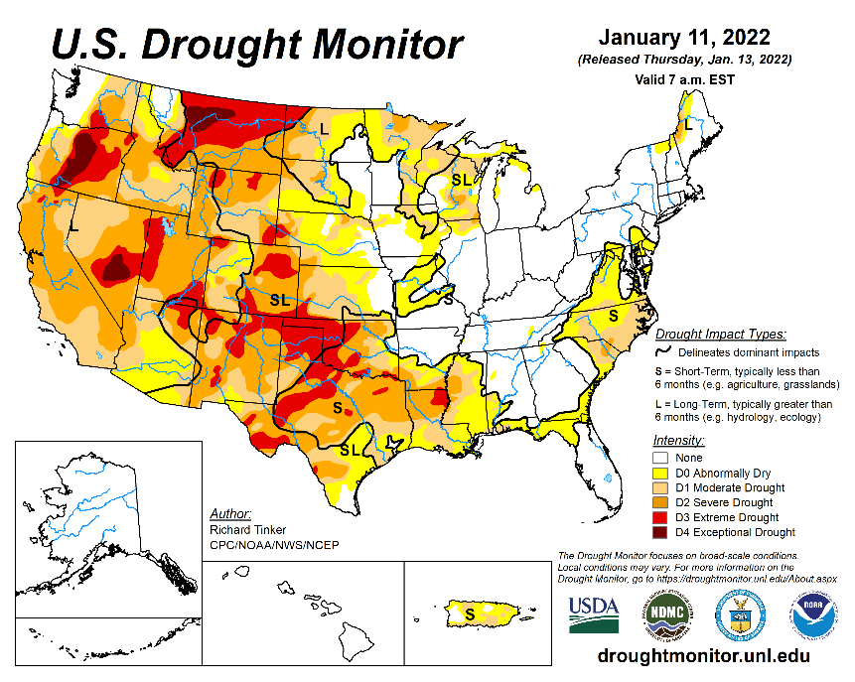
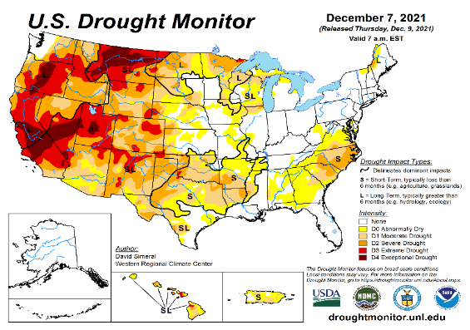
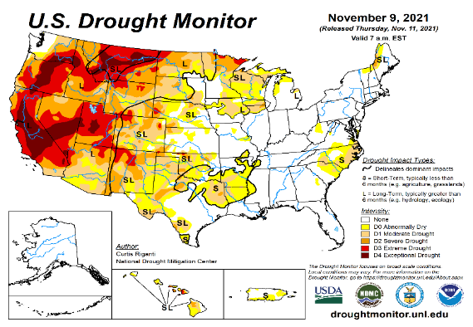
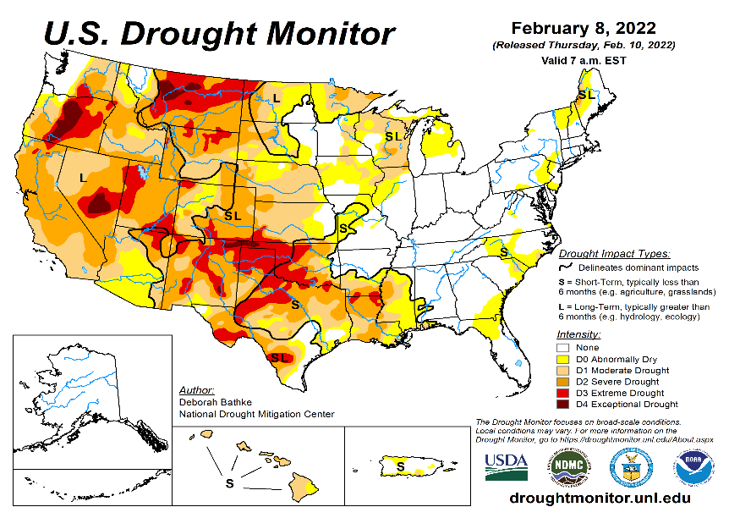
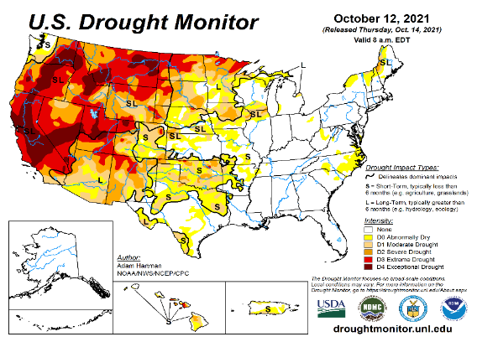
Drought Monitor
Monitoring is important because, unlike US T/P fcsts, for drought forecasts, we have to know where we are, before we can tell where we are going!! Drought forecasts are tendency forecasts.
January
December
Overall, the area covered by the severe D3/D4 drought categories has been coming down from the peak values that existed during much of 2021. In fact, upon further analysis, 2021 may turn out to be one of the top drought years for the US.
The slightly improved drought conditions in the far SW, (CA & vicinity) during January, from the unusual December rains (during La Nina) continued into February so far. In fact, over much of the western two thirds of the US states, there is little change in drought conditions from the previous month.
With the almost disappearing temporary very short term drought conditions in the mid Atlantic states that quickly developed during December/January the eastern one third US is almost drought free for NOW.
November
February
(Recent/Latest)
October
?

Slide 3
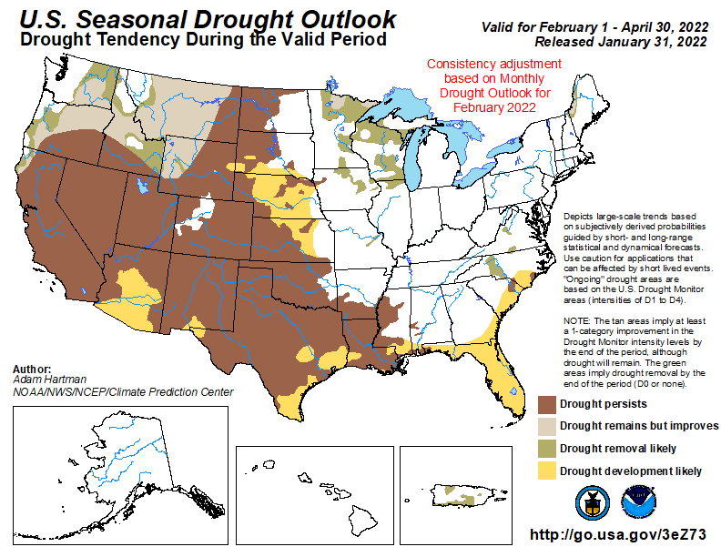
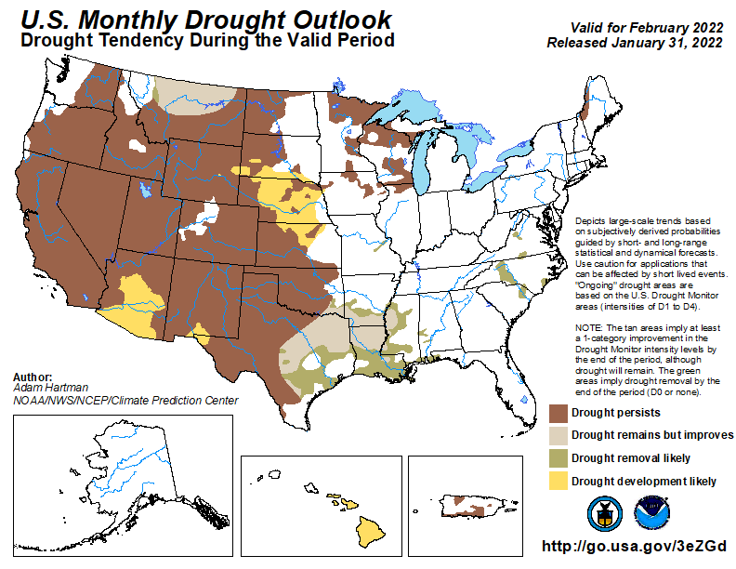
(Previous) Seasonal/Monthly Drought outlooks
New Seasonal+ Drought Outlook to be released in 2 days!
New Monthly Drought Outlook to be released end of this month)
Updated Seasonal Outlook
(1 Feb. 1 - Apr. 30, 2022)
issued 1/31/22
Monthly outlook
(for February 2022)
issued 1/31/22
It is the classic great West versus East drought paradigm !!
US East droughts are different than West droughts!!
This is mainly related to the rainfall climatology! – Of course ENSO impact matters!

Slide 4
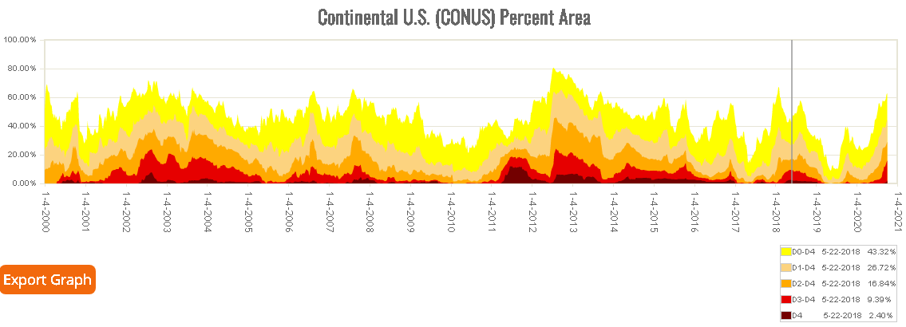
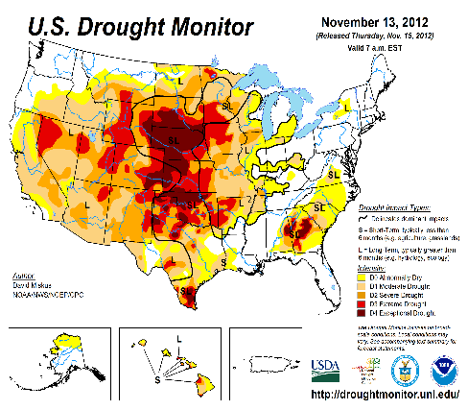
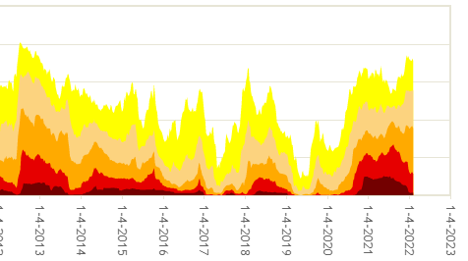



Time series since 2000 spilt into 2 panels.
The recent drought has somewhat stagnated ?
Every drought is different.!
Every situation is different!!
MOST D4/D3 US coverage in 2021 since USDM began.
Current drought!
As the La Nina is slowly weakening and is on its way out,
have we seen the worst of the current drought status over the US for now?

Slide 5
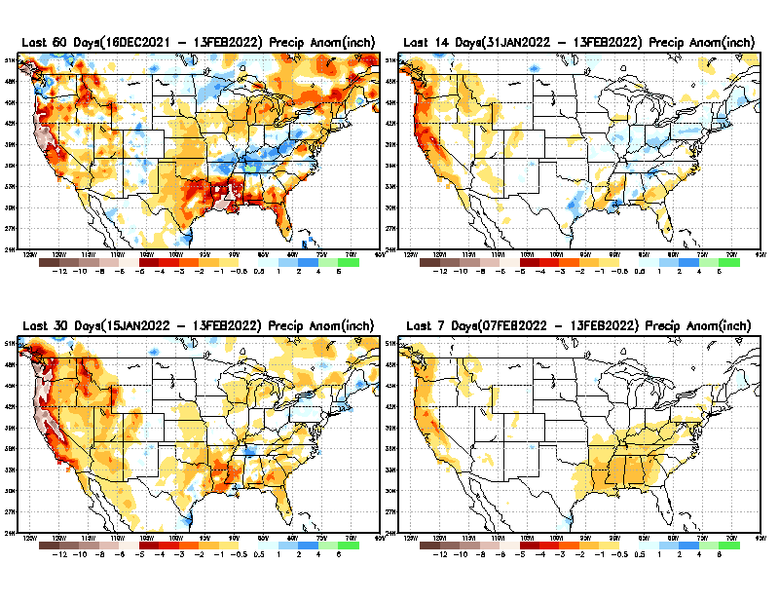
Precipitation ANOM during last 7, 14, 30, & 60 days.
This and next few slides show Precip deficit (excess).
Droughts, for the MOST part, begin and end with precip!! Lately, Temps are becoming (secondarily) important as well.
60 Days
14 Days
30 Day
7 Days
These maps in this and following slides, including a) Total,
b) Anom and
c) Percent of Normal precip. in these and other longer time ranges are now (routinely) daily updated at:
?
From: Recent Accumulated Precipitation https://www.cpc.ncep.noaa.gov/products/Drought/briefing_prcp.shtml

Slide 6
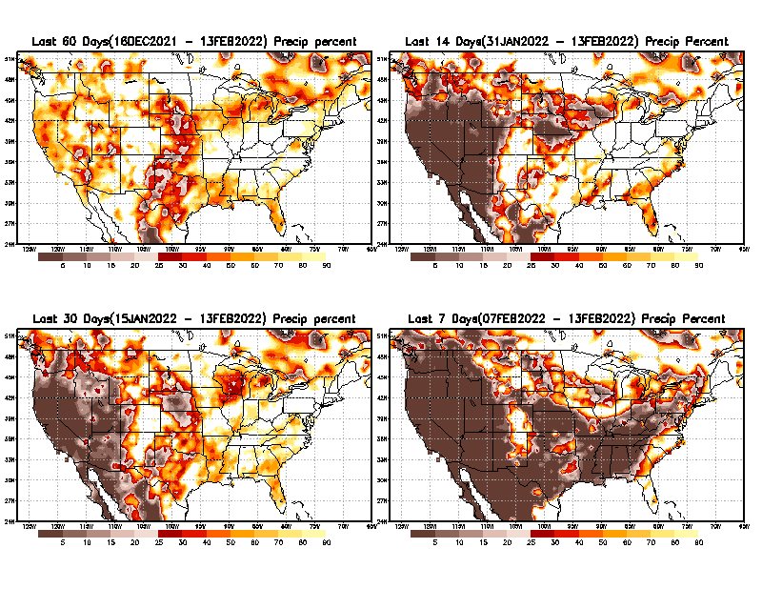
Precipitation Percent (of normal) during last 7, 14, 30, & 60 days - Only Deficit Areas <=90% shown !
60 Days
14 Days
This plot shows only the rainfall deficient regions <= 90% of normal.
-- This shows more clearly possible/likely drought developing region in the future unless there is above normal rainfall in these regions in the future, to offset these shortfalls.
30 days
7 Days
From: Recent Accumulated Precipitation https://www.cpc.ncep.noaa.gov/products/Drought/briefing_prcp.shtml

Slide 7
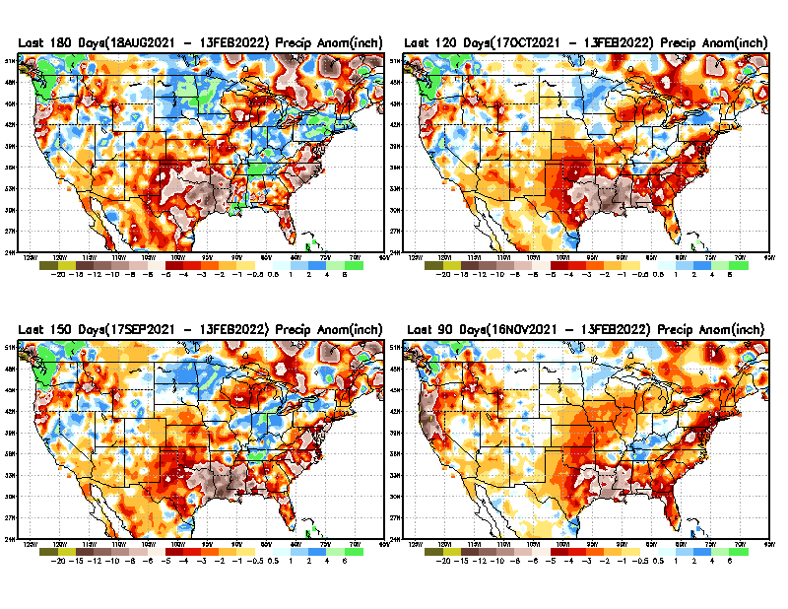
Total precipitation ANOM during last 3, 4, 5, and 6 months.
6 M
4 M
While the Precipitation anomalies deficit may seem large in some regions (compared to others), it is the % of normal precip (next slide) that matters more!!
5 M
3 M
From: Recent Accumulated Precipitation https://www.cpc.ncep.noaa.gov/products/Drought/briefing_prcp.shtml

Slide 8
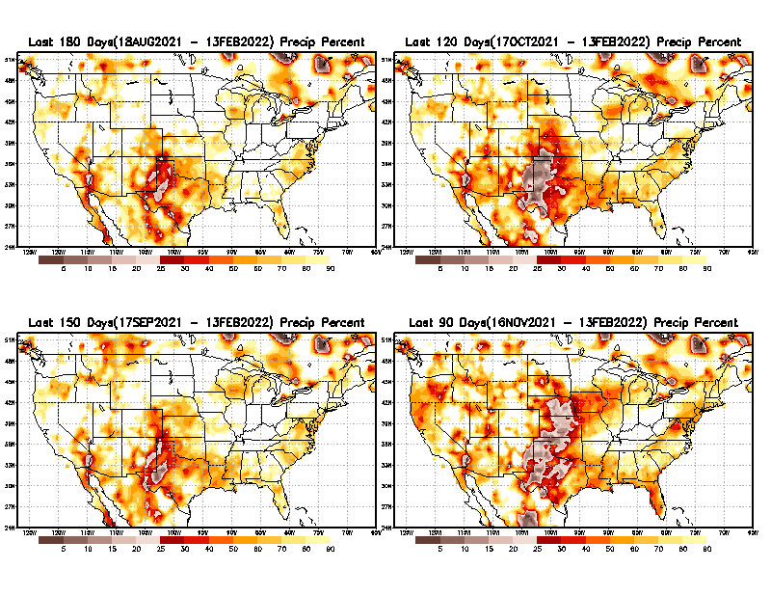
Total precipitation Percent (of normal) during last 3, 4, 5, and 6 months Only Deficit Areas <=90% shown!!
6 M
4 M
In these interim time scale 3-6 months, we need to pay attention to regions, which are dark-brown, red & dark red (<50%).
Not so bad along coast!
in %
While accrued precipitation deficits are real & objective,
droughts are subjective declarations!!
5 M
3M
East vs West!
Broad vs Narrow
rainfall season.
In general, West suffers more from frequent and lasting droughts.
Short term(S) Drought is generally declared when rainfall deficits exist in the 3-6 months time range. { Long term deficits beyond 1 or 2 years is Long term L drought! }

Slide 9
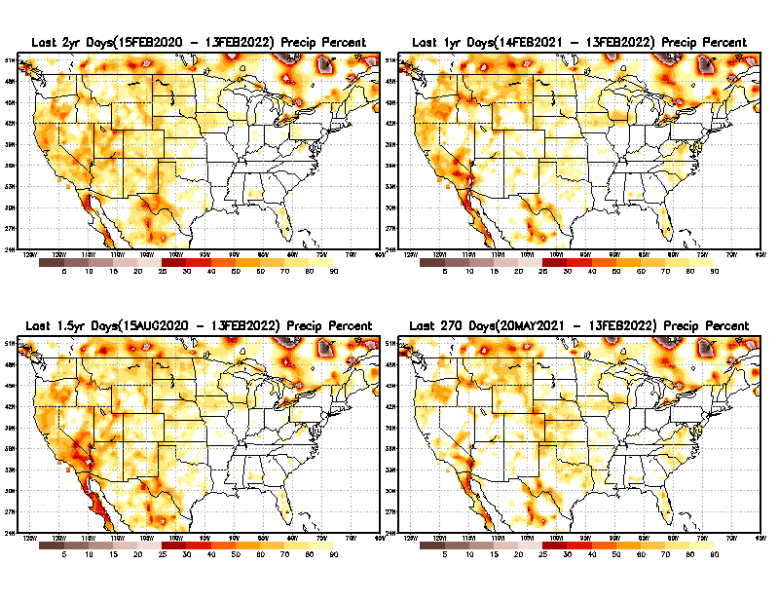
Total precipitation Percent during last 9 months, 1 yr, 1.5yrs, & 2 yrs. .–Only Deficit Areas shown!! <=90%
2 Y
1 Y
Tinderbox areas, where some form of longer term rainfall
deficiencies already, exist !!
-Almost all are in the west!, all part of the long term drought
-This & Next slide!!
1.5 Y
9 M
From: Recent Accumulated Precipitation https://www.cpc.ncep.noaa.gov/products/Drought/briefing_prcp.shtml

Slide 10
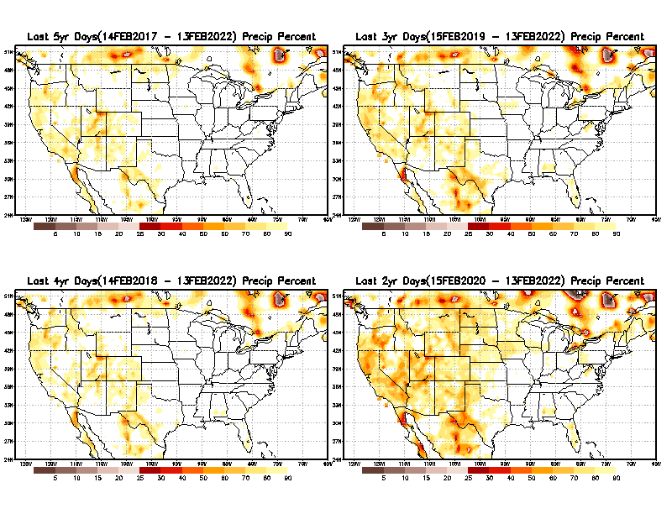
Total precipitation Percent (of normal) during last 2, 3, 4, & 5 yrs. .–Only Deficit Areas <=90% shown !!
5 Y
3 Y
In these long time ranges (2-5 yrs), there is a general dearth/lack of precipitation in the southwest US.
Weather Blog News Today:
A recent study from the University of California, Los Angeles now claims the current drought that started in 2000 for the American Southwest is now the driest 22 years since 800 A.D. Researchers said climate change is to blame. Their proof? Tree rings.
4 Y
2 Y
Ongoing long term drought in the SouthWest!! Exiting La Nina may soon help.
From: Recent Accumulated Precipitation https://www.cpc.ncep.noaa.gov/products/Drought/briefing_prcp.shtml

Slide 11
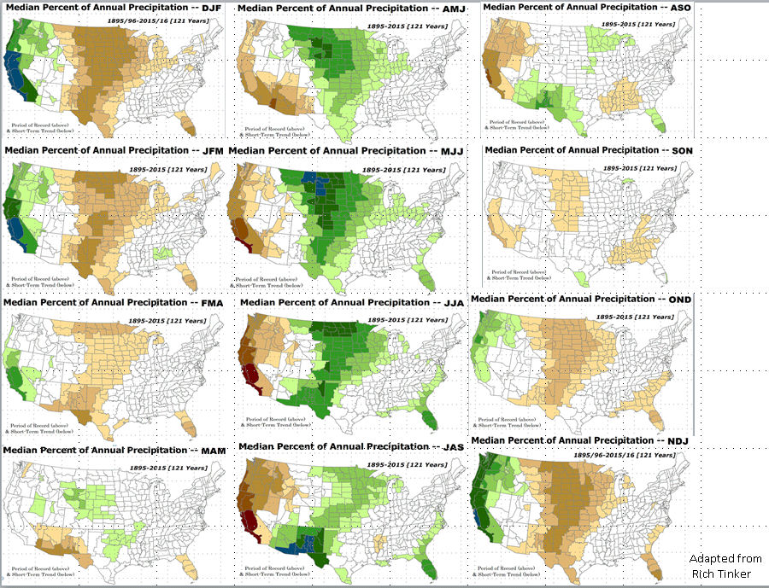

Rainy (3-month)Season across the US
East vs West!
More darker colors in west/central => narrow rainy season (months)
Overall, more white space in the east => distributed rainfall season (except ~FL).

Slide 12
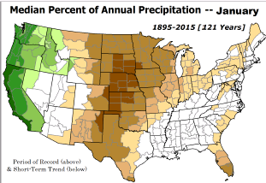
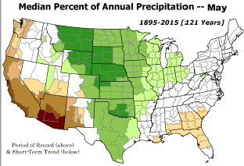
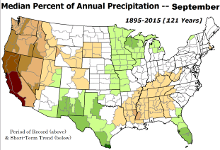
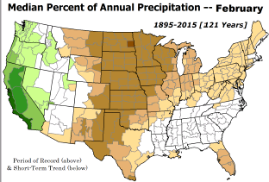
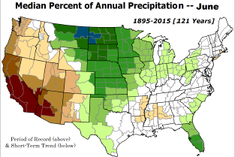
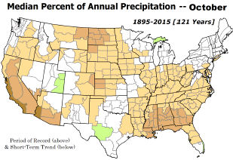

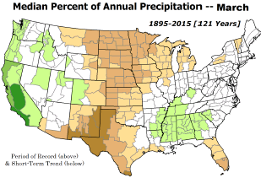
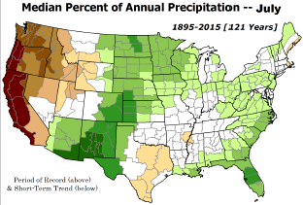
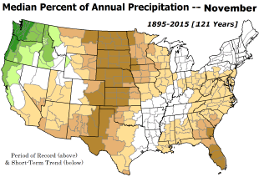
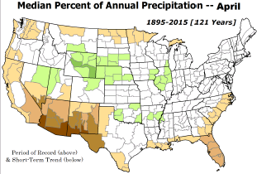
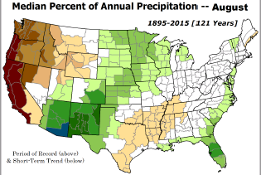
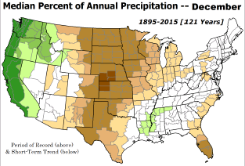
For the forecast season MAM, we are rapidly moving away from the rainy winter season in the west!
*********
EAST vs
CTR/WEST
Drought Behavior is loosely tied to rainfall climo!! And the limited rainy season in the west
*********
Adapted from Rich Tinker.

Slide 13
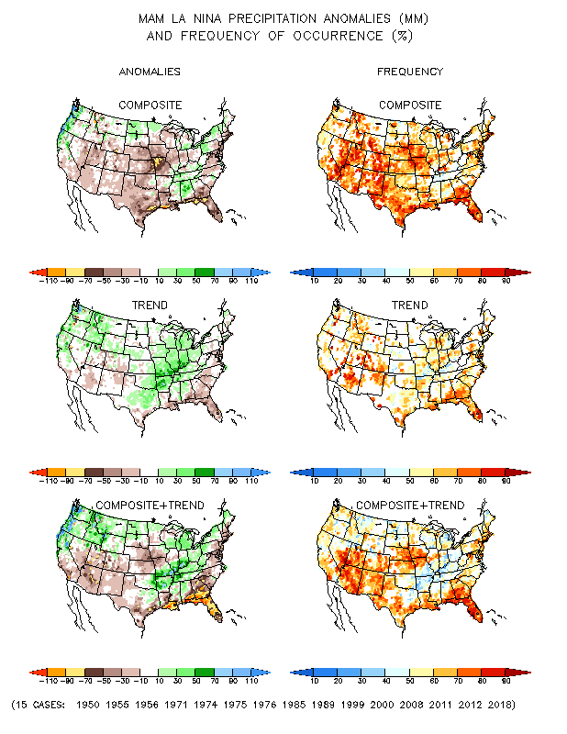
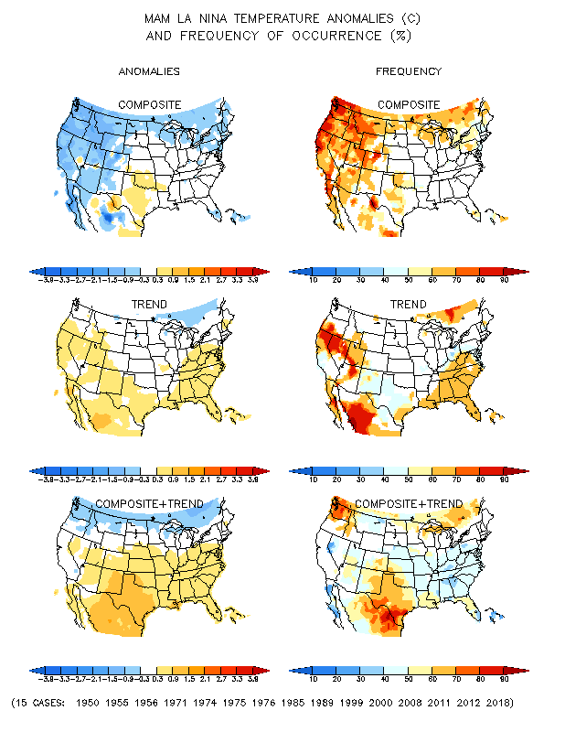
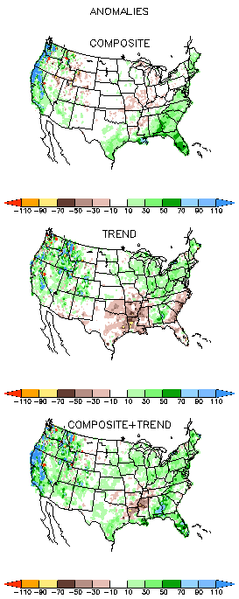
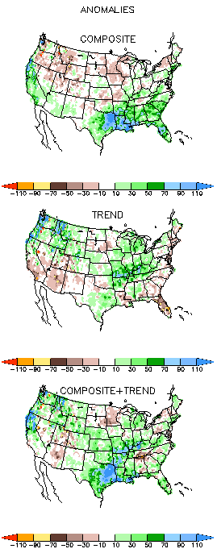
La Nina Precip/Temperature COMPOSITES & Trend map
MAM
P
T
1
+
1
=
2
Look at frequency along southeast!
Over 70%

Slide 14
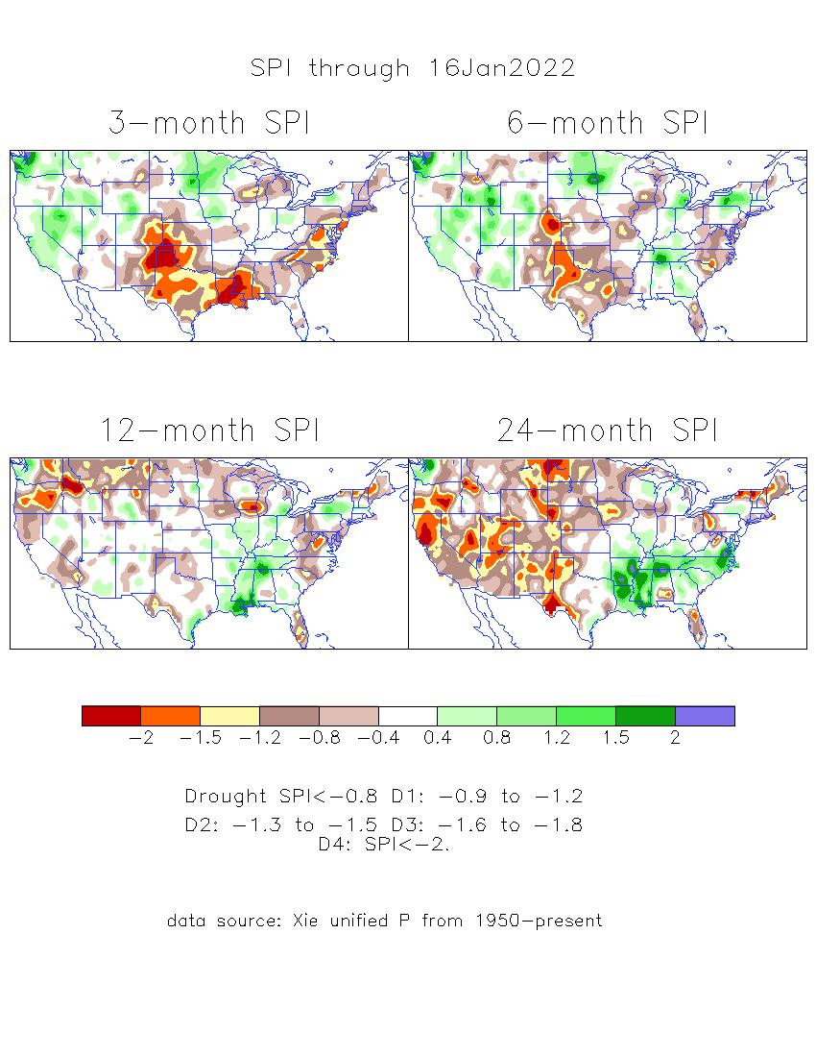
The Standardized Precipitation Index SPI
(based on Observed P)
----- Last Month
Very interesting graphic & details for the drought across the US based on the more generalized precip deficit/excess, the Standardized Precipitation Index (SPI).
The dark brown and red colors, indicating standardized precipitation deficits, in the various time periods, approximately correspond to the appropriate short/long term drought monitor regions and their intensities
Don’t let the short term improvement in the southwest fool you!
There is an ongoing long term drought here.

Slide 15
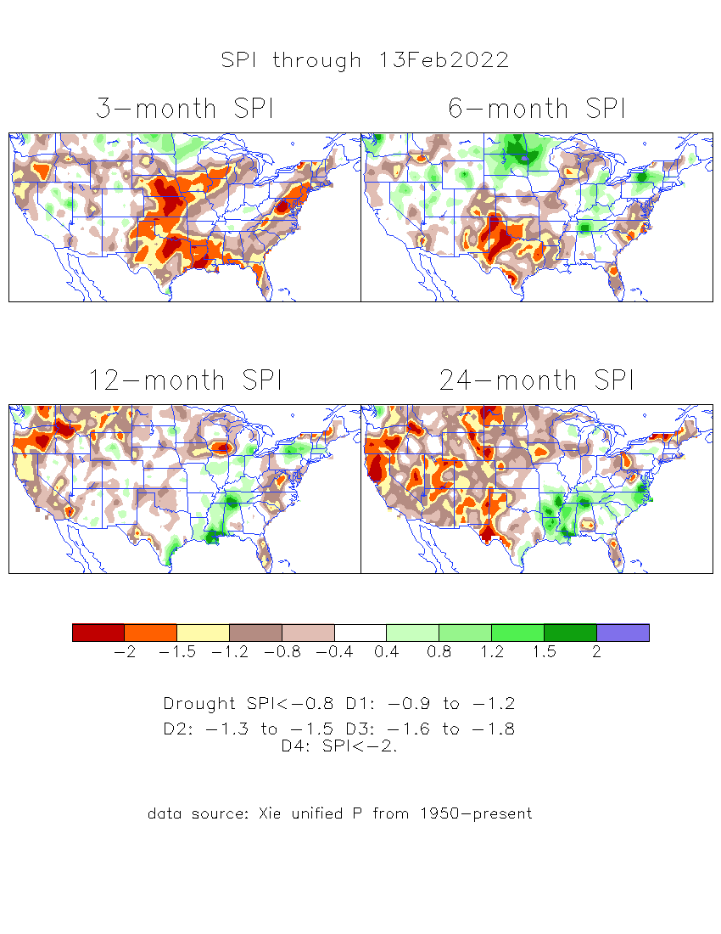
The Standardized Precipitation Index SPI
(based on Observed P)
----- NOW
Very interesting graphic & details for the drought across the US based on the more generalized precip deficit/excess, the Standardized Precipitation Index (SPI).
The dark brown and red colors, indicating standardized precipitation deficits, in the various time periods, approximately correspond to the appropriate short/long term drought monitor regions and their intensities
Short
The short term drought has somewhat shifted/extended from southwest to northwest and the northern Plains. But the long term drought in the southwest remains.
----- NOW
Long
How does one negotiate and reconcile declaring short term vs long term drought when precip. deficiencies patterns differ on many different time scales locally!!
What is the cutoff delineating time between short VS long term drought!! Not so clear!!
At exactly where does drought begin?
Based on this data, there is a slight enhancement in S/term drought from last month to this month

Slide 16
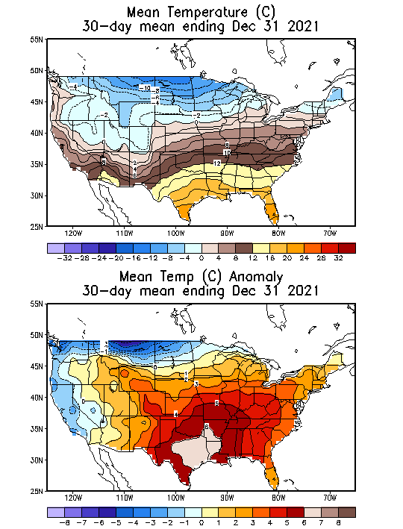
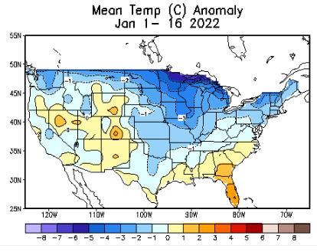
Slide from last month..
Recent US Temperatures
In spite of the of the La Nina, quite a variability in monthly US Temps. (Focus on maps on bottom left! vs next slide!)
So far this month !!

Slide 17
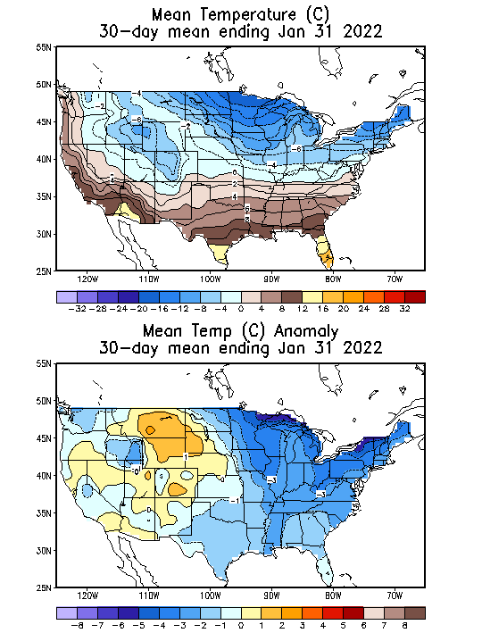
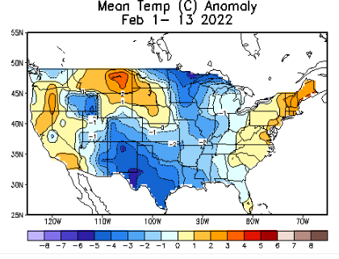
Now..
Recent US Temperatures
What a contrast in US South/East temps. Between December and Jan/Feb!! Esp. over Texas!!!
There is a lot more going on than just La Nina!!
So far this month !!

Slide 18
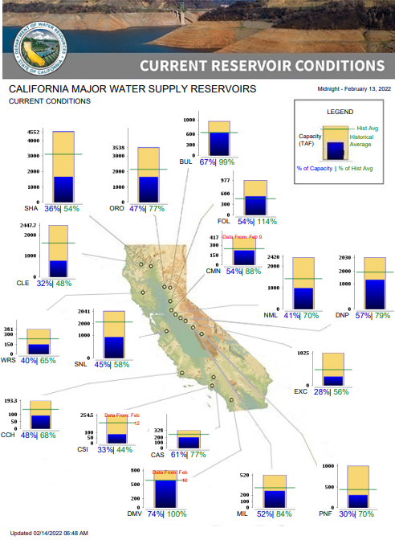
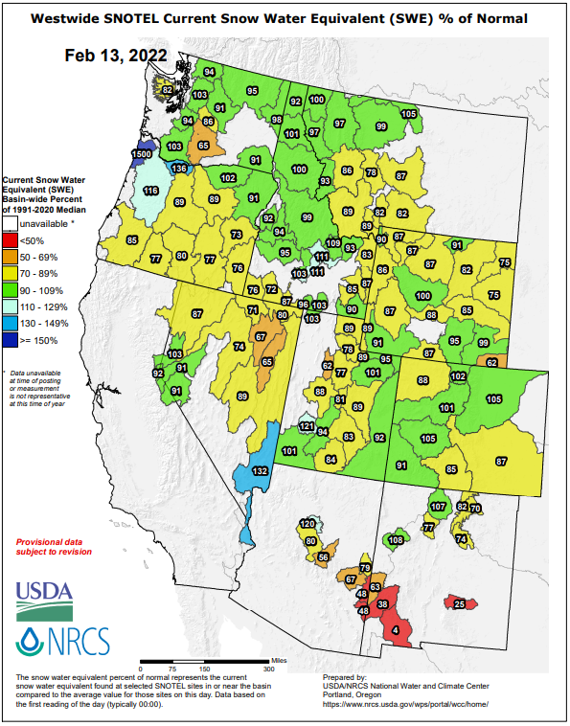
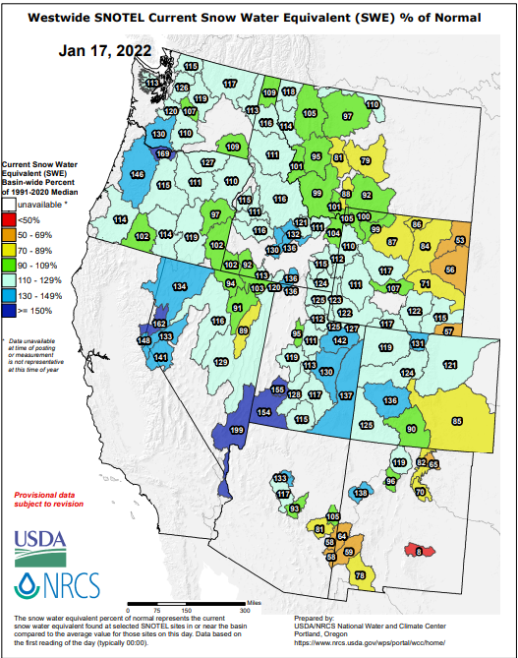
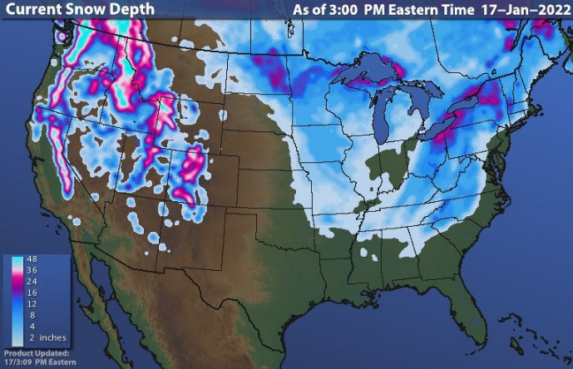
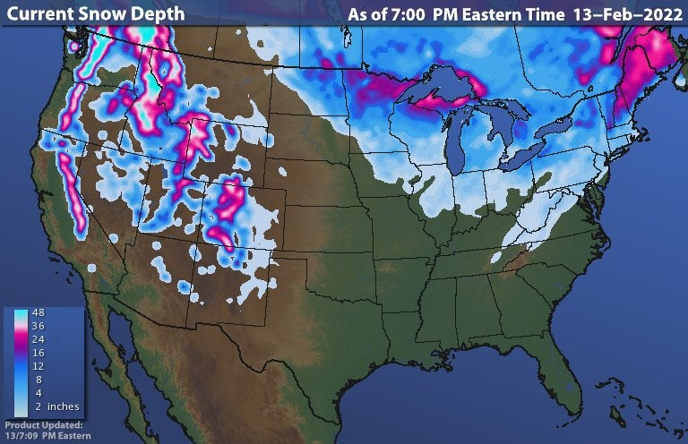

Much of US west snow cover is below median!! See above! cf: prev. month.
Last month
Northern CA reservoirs are low, but southern CA reservoirs have recently improved however!
This month
La Nina conditions continue to “not help/improve” the reservoir levels/conditions in northern CA.
https://www.wunderground.com/maps/snow/snow-cover

Slide 19
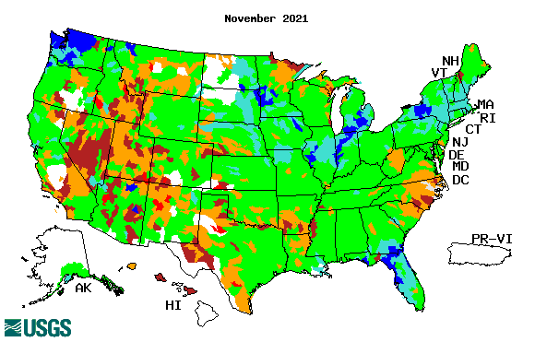
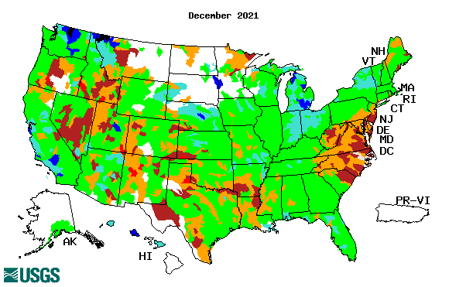
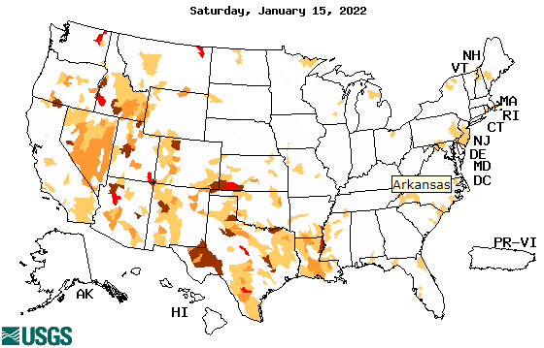
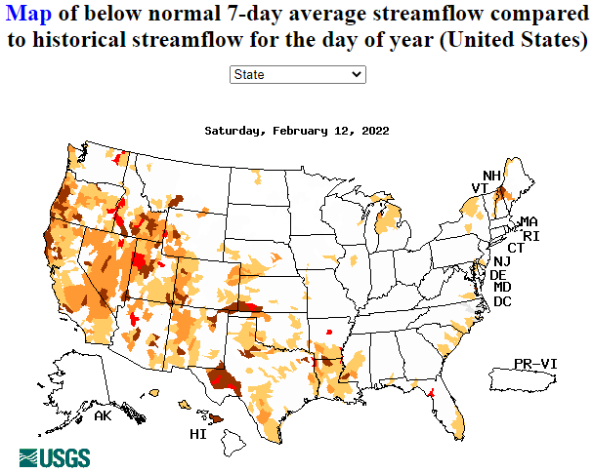
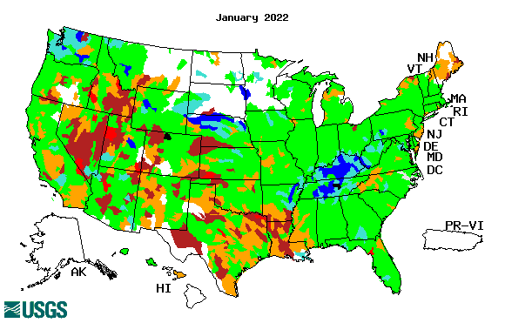
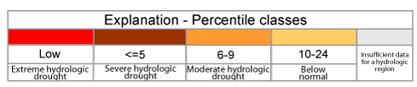

Streamflow (USGS)
Most US east droughts are relatively short lived (as compared to US west). However, if you recall, the drought over the New England states last year was a real surprise!!
Map shows only below normal 7-day average streamflow compared to historical streamflow for the day of year.
One month ago (left) &
Now (below)
Streamflow is only a partial indicator, as it is highly managed.
Look along the Pacific coastal states. If sometimes, the various indicators are confusing, go back to % of rainfall deficit maps – to reinforce!!
19

Slide 20



[Slide not shown]
NCEP Ensemble mean NLDAS2 models’ Soil Moisture tendency/trend
7 days
14 days
30 days

Slide 21

EL NIÑO/SOUTHERN OSCILLATION (ENSO)
DIAGNOSTIC DISCUSSION
issued by
CLIMATE PREDICTION CENTER/NCEP/NWS
and the International Research Institute for Climate and Society
10 February 2022
ENSO Alert System Status:
La Nina Advisory
Synopsis: La Niña is likely to continue into the Northern Hemisphere spring (77% chance during March-May 2022) and then transition to ENSO-neutral (56% chance during May-July 2022).
CPC’s Oceanic Niño Index (ONI) [3 month running mean of ERSST.v5 SST anomalies in the Niño 3.4 region (5ºN-5ºS, 120º-170ºW)], based on centered 30-year base periods updated every 5 years.

Slide 22




Latest values of SST indices in the various Nino Regions.

Slide 23


Sub-Surface Temperature Departures in the Equatorial Pacific
The subsurface cold anomalies in east Pacific are slowly weakening and reducing in extent/volume!
Warm waters in the WP are strengthening and rapidly expanding eastward.
Most recent pentad analysis

Slide 24




ENSO Forecasts
Early- December CPC/IRI forecast
Early- February CPC/IRI forecast
Dynamical, Statistical, CPC-Consolidated fcsts are coming together!! But still at ~ -0.5C !
Looks like a quick weak La Nina Event during this upcoming winter ONLY or slightly beyond too!

Slide 25


Previous (Last Month)
CPC’s official
Temperature OUTLOOK for
Monthly (February)/Seasonal (FMA)
Probably poor verifying Heidke skill even during La Nina!!
Released Jan 20th
Observed so far this month!! ☹ ☹

Slide 26



Previous(Last month)
CPC’s official
Precipitation OUTLOOK for
Monthly (February)/Seasonal (FMA)
Released Jan 20th
Very similar looking!
Based on La Nina !!!!
Observed so far this month!!
Monthly P/T forecasts verified at mid-month are generally good! Why?
But so far, fcst looks somewhat mixed.

Slide 27



NCEP/WPC Next 7 days QPF (Quantitative Precipitation Forecast)
GFS Model Guidance for the
next 16 days.

Slide 28

From European Center (EC) Precip forecast (made yesterday, 14 Feb) for next 30 days.

Slide 29

From European Center (EC) Precip forecast (made yesterday, 14 Feb) for next 30 days.
20
40

Slide 30


Slide 31


Slide 32

Week-4 Soil Moisture Percentile (SMP) Fcst based on VIC model forced with ECMWF-extended precipitation forecast!
Shown in December!
Watch here! Situation changes quickly in these eastern US regions, as compared to west!
??
(From Drs. Li Xu and Yun Fan) More detail at From: https://www.cpc.ncep.noaa.gov/products/people/lxu/flashd/flash_prediction.html

Slide 33

Week-4 Soil Moisture Percentile (SMP) Fcst based on VIC model forced with ECMWF-extended precipitation forecast!
Now: Yesterday’s IC
Mid Atlantic Drought Gone..
??
All indicators point to developing drought conditions in FL and near its northern state border areas.
(From Drs. Li Xu and Yun Fan) More detail at From: https://www.cpc.ncep.noaa.gov/products/people/lxu/flashd/flash_prediction.html

Slide 34




NMME T & P
Ens.Mean forecasts for
Mar
MAM

Slide 35

Agreement/Disagreement among the various NMME models’ MAM seasonal Precip. Forecast.
??

Slide 36


(From NMME) compared with this month(foreground, red border)
Why is there so fewer hatched areas in SPI6 fcst from NMME models’ based fcst this month as compared to last month (left 2 columns) ? Fcsts more confident now?
Forecast uncertain in Hatched areas.
These maps are based on NMME models’ precip forecast uncertainty/certainty (among ensemble members) over the next 3 months
SPI6 Fcst made from last month
SPI6 & SPI12 Fcst made from this month

Slide 37




Slide not shown!!
http://drought.geo.msu.edu/research/forecast/smi.monthly.php
Latest Initial Conditions:
12/21/2021
Predicted Monthly Soil Moisture Percentile
MSU Soil Moisture Percentile forecast NOT available this month, NOT updated!
CPC’s soil moisture percentile – Leaky bucket Model
The inter quartile range suggest greater uncertainty about the forecast in these shaded regions. Lots of uncertainty regions!! ☹

Slide 38


BONUS Topic: Discussion continues!! Explanation for the multiyear DROUGHT in the Southwest (CA/AZ/NM/NV/UT/CO & vicinity)!!
More La Ninas lately ?
More frequent La Ninas lately ?
YES!! The stats in the table below (bottom left) are from the Official CPC ENSO declarations page/table!
Compared to other regions of the globe, the SST warming/trend in the central eq. Pacific (Nino 3.4) is relatively much small. (See Fig. above) – Why is this ?
Does nature try to compensate for the warming else/everywhere by producing more La Ninas in the central eq. Pacific? - Just my thought ! Let’s check !!!
Since the 1997 monster El Nino (stronger than the famous 1982/83 event), just a quick count of CPC’s Nino 3.4 index++ values for the three month overlapping seasons, (Data at CPC site only available only from 1950!)
(25 years) (47 years)
1997-2021 1950-1996
La Nina(DJF) 10 13
El Nino(DJF) 8 17
La Nina(all 3mos) 101 136
El Nino(all 3mos) 73 158
(Overlapping 3month seasons)
Look at Ratios of La Ninas (vs El Ninos) in the shorter
recent (25 yr) period vs the longer (47 yr) earlier period!!
***Analysis of CPC’s official Nino 3.4 index data over the last 70 years shows that the more frequent La Nina’s in recent decades contributed to less rainfall in the southwest (See La Nina precip composites!, slide#13) and hence the ongoing long term drought in the Southwest!! Hence the long term southwest drought is unlikely to go away any time soon***
++ Barnston, Chelliah and Goldenberg (1997):Documentation of a highly ENSO‐related sst region in the equatorial pacific,
Atmosphere-Ocean Volume 35, 1997. https://doi.org/10.1080/07055900.1997.9649597
*** The strong/weak annual monsoon rains in the southwest is just a minor modulator riding on this bigger/long-term signal. ***

Slide 39
Summary
Current Drought conditions:
Overall, the area covered by the severe D3/D4 drought categories has been coming/trending down from the peak values that existed during much of 2021. In fact, upon further analysis, 2021 may turn out to be one of the worst/top drought years for the US.
The slightly improved drought conditions in the far SW (CA & vicinity) during January, from the unusual December rains during La Nina (but not in January) continued into February so far. In fact, over much of the western two thirds of the US states, there is little change in drought conditions from the previous month.
With the almost disappearing temporary very short term drought conditions in the mid Atlantic states that quickly developed during December/January the eastern one third US is almost drought free for NOW.
Northern CA reservoirs are still low, but many southern CA reservoirs have recently improved !
Current ENSO status and forecast: La Niña is likely to continue into the Northern Hemisphere spring (77% chance during March-May 2022) and then transition to ENSO-neutral (56% chance during May-July 2022).
Prediction:
  Large parts of California & near vicinity received some uncharacteristic (for La Nina) above/normal rainfall during December, but not in January. Because of this, some mild improvement that has occurred in short term drought conditions here during December/January continued February so far.. This prevented the drought from getting further worse in this region. The long term drought in this region and southwestern states will continue to persist.
  Models and official seasonal forecasts continue to predict the same old canonical composite precip patterns across southern tier states with dry conditions along the southern tier states. With Lina conditions expected to still hang in during the current forecast MAM season (before returning to ENSO neutral conditions!), the same canonical rainfall pattern is forecast this upcoming MAM season also, as the NMME models’ forecasts suggest now. There is considerable inter-monthly observed temperature variability but the model forecasts unfortunately cannot catch that even during the La Nina conditions.
  If the expected above normal precipitation forecast for the upcoming MAM season in these upper northwestern and part of the northern Great Plains states associated with the La Nina occurs, it will also make an impact on the drought in these regions, and further improvement in the drought conditions is expected in the Northern Great Plains, as the rainy season also begins here in May.
  The big question is how fast the La Nina will weaken/disappear or continue to still hang in during the MAM forecast season, and if it will produce the expected impacts. But it is still a good bet to leave the developing dry/drought conditions in the narrow Gulf coast and in Florida and along/near its border on GA extending eastward along the coast based on La Nina + climo. ******

