Slide 1
Drought Outlook Support Briefing
February 2025
Climate Prediction Center/NCEP/NOAA
http://www.cpc.ncep.noaa.gov/products/Drought
Points to ponder:
Often, there is a disconnect between the Short term (S) and Long term (L) drought in regions, and even with the short term (S) drought, the 3-month and 6-month signals are not quite consistent! With Long term (L) drought, it is even more trickier, as it is open ended from 6 months-onwards and beyond!!!
Places/regions experiencing Short term drought may (not) be ok in the Long term and vice versa!!
This duality is difficult to reconcile, to convey and even be clearly understood well by the public at large.
Public/Forecaster generally tends to focus more on the Short term Drought (for good reasons!!)
More importantly the very definitions and timescales associated with S/L term droughts and the declarations in the USDM are by themselves subjective!! Short term vs Long term drought need to be clearly distinguished and shown to the public!!
It may take a long time for drought to develop, but those conditions can end very quickly! as it happened in CA after DJF 2023 winter. Forecast models are yet to (seasonal) correctly forecast these changes in advance!
Subjective(delayed) USDM vs Objective (real time) map! A few days of more recent heavy precip can change the USDM a lot!
New (last several months):
Towards objective drought monitoring goals, we introduced, a new objective AI/Deep-Learning based Experimental ODI (objective drought indicator, updated daily, Slide # 3) compared with Official USDM (US Drought Monitor, produced weekly by USDM authors).
Towards prediction, we introduce a new section with few slides at the end, consolidating the various exptl. drought outlooks by purely objective methods developed here at CPC! All these in preparation of a broad general push towards Probabilistic Drought outlooks.
New issues/questions to ponder:
How much rainfall/Precip. deficient have to be, and after how long, do we actually declare Drought?
Do these have to vary by region?
i.e., When, what exact dry/rainfall-deficient conditions, trigger a Drought call?
Should there be minimum duration of Drought (conditions/criteria!) ? (We know there is no such maximum!)
i.e., Can a region quickly get into a Drought (say for a month or less, for a couple of weeks!) and get out of it?

Slide 2
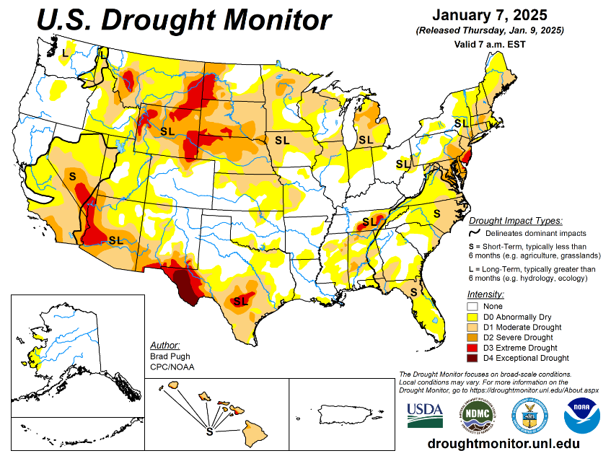
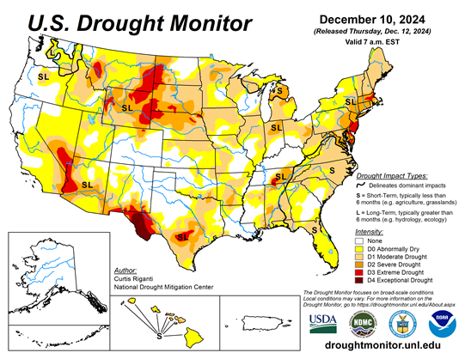
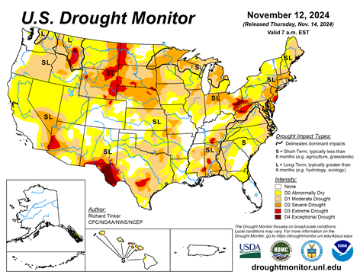
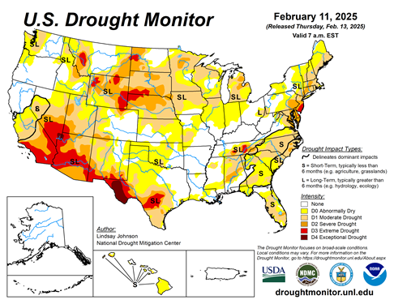

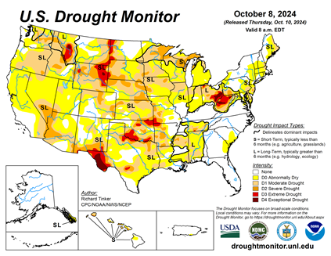
Drought Monitor
Monitoring is important because, unlike US T/P fcsts, for drought forecasts, we have to know where we are, before we can tell where we are going!! Drought forecasts are tendency forecasts as changes from the latest USDM.
California for the most part, until four or so months ago, has remained drought free for about twenty months now luckily due to above normal rainfall during both recent 2022/23 (La Nina, strange!) and 2023/24 (El Nino, canonical!) winter rainfall seasons. But in the last few months dryness/drought has kept in, esp. in southern CA, where the seasonal winter rainfall has been below normal.
Water levels in almost all CA reservoirs are now at or above their normal levels. However, the water storage levels in the much bigger southern lakes, Lake Powell and Lake Mead in NV/AZ still continue to be very low, and have not recovered completely from the 2+ decades(since ~2000) long hydrological drought that existed in the region.
Comparing the most recent USDM with that back in summer, there is a considerable increase in the drought covered areas of the United States.
In our 2024 June/July Drought briefings, we suggested that, “Overall, % of US land areas under drought will begin to increase from the then existing very low levels, mainly due to the fact that the 2023/24 El Nino had ended and La Nina may emerge soon.
Large parts of NV/UT/AZ/NM and TX are still dry or under drought due to long term/decadal drought in the SW, as well as the poor back to back SW monsoons in 2023 and 2024.
While the drought in WA & OR got relief from the early winter rains, drought in the border/interior areas of MT,WY the Dakotas and NE has not improved worsened and is likely to not get any relief soon.
Much of the coastal regions of northeastern states and the Atlantic coastal regions that developed drought conditions recently.
Since early summer last year, questions continuously lingered about when the La Nina will actually develop and how strong it will be! Finally it appears that, La Nina may be here (based on 1st 3-mon avg Nino 3.4 value) for now, but expected to transition to neutral ENSO conditions very soon.
A lot depends on the expected canonical impacts from the weak La Nina like conditions, however, the rainfall along the southern tier states of the US is below normal for past few months, and the forecast models are continuing the same.
January
December
November
February
(Recent/Latest)
October

Slide 3
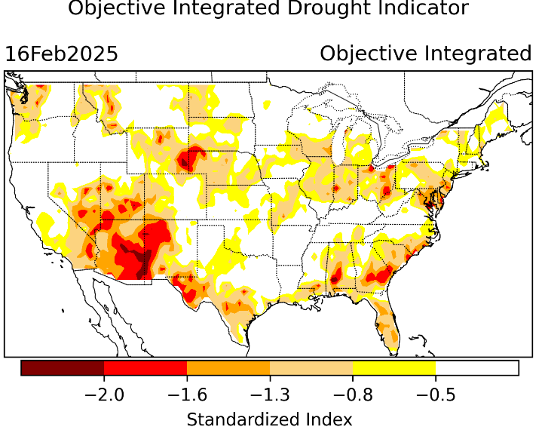
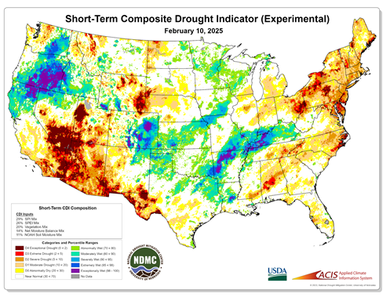
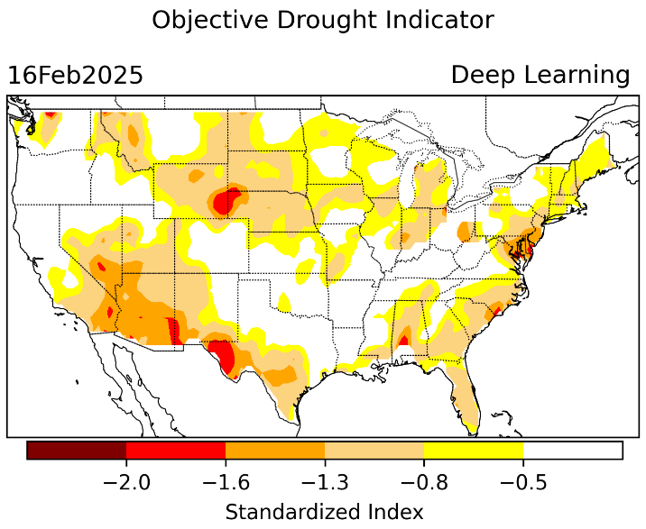
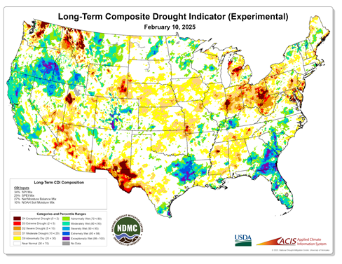
Exptl. Objective Drought Monitor
(showing S/term & L/Term separately) from
National Drought Mitigation Center (NDMC)
New slide now included recently in this briefing!
CPC’s own Experimental
Objective Drought Indicator (ODI)
using AI/Deep Learning ! – Updates daily !!
https://www.cpc.ncep.noaa.gov/products/people/lxu/odi/#deep-learning-increment-training
Based on the CPC P/analysis &
VIC (Princeton) NLDAS model assimilation:
Standardize Precipitation index (SPI)
Standardize Precipitation-Evapo –
transpiration index (SPEI)
Evapotranspiration Stress Index (ESI)
Soil Moisture Percentile (SMP)
Standardize Runoff Index (SRI)
-can be split into Short/Long Term Droughts!
https://droughtmonitor.unl.edu/ConditionsOutlooks/CurrentConditions.aspx
Objective
& Updates Daily!
Objectively Integrated
versus Deep Learning
Methods ~ gives |||r results. Both Objective!
Both “update daily” based on indicators day before!
Objective, but
runs Weekly!
On Mondays!
Objective
& Updates Daily!
* A manuscript (Xu & Chelliah) is under preparation.
Latest Official USDM (US Drought Monitor)
(about a week old!)
Subjective &
Produced Manually!
Weekly!
Objective, but
runs Weekly!
On Mondays!
These two maps above, used to be produced at CPC (Rich Tinker!), every Monday but now recently officially moved to NDMC operations!
*Released every Thursday, for conditions as of Tuesday!

Slide 4
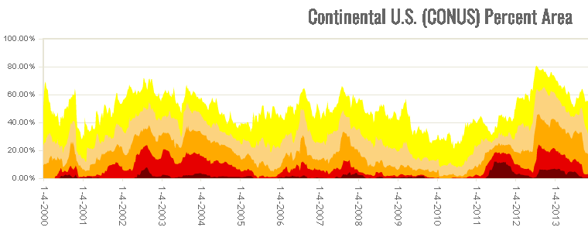
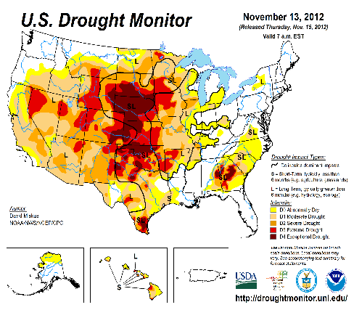

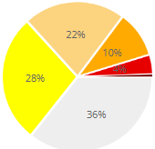
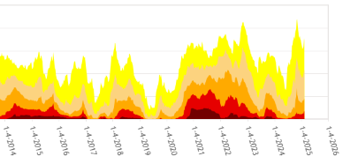

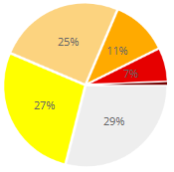

In general, The spatial details of every drought is different.! Every situation is different!!
Time series since 2000 spilt into 2 (above & below) panels.
After 2024 El Nino!
After 2019 El Nino !
3 back to back La Ninas !
last
month !
CONUS % Land Area
This month !
We see a general overall increase in drought coverage areas across the US since the end of most recent El Nino as we ramp up towards La Nina, which is expected, and as we have been suggesting here.

Slide 5
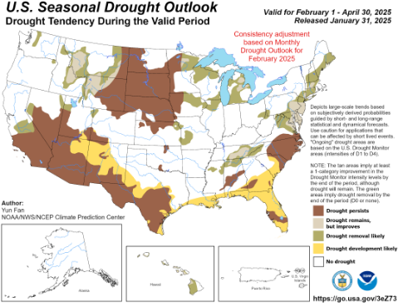
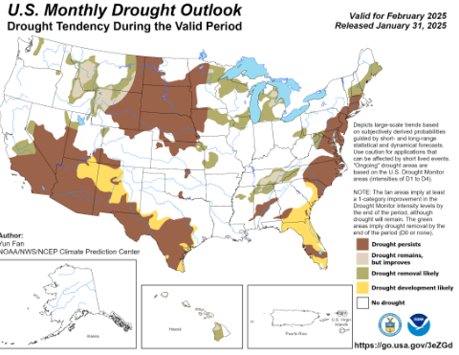
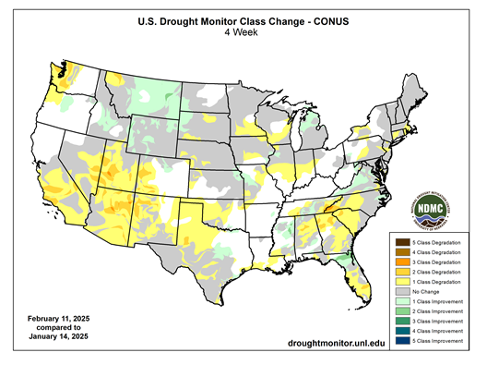
(Previous) Seasonal/Monthly Drought outlooks
New Seasonal+ Drought Outlook(SDO) to be released in 2 days!
(reissued again at end of month for consistency with MDO!)
New Monthly Drought Outlook (MDO) to be released at end of this month)
Updated Seasonal Outlook
( 1 Feb 2025 – 30 Apr 2025)
issued 1/31/25
Both outlook maps from cpc website!
Monthly outlook (for February 2025)
issued 1/31/25
Both outlook maps from cpc website!
https://droughtmonitor.unl.edu/Maps/ChangeMaps.aspx

Slide 6
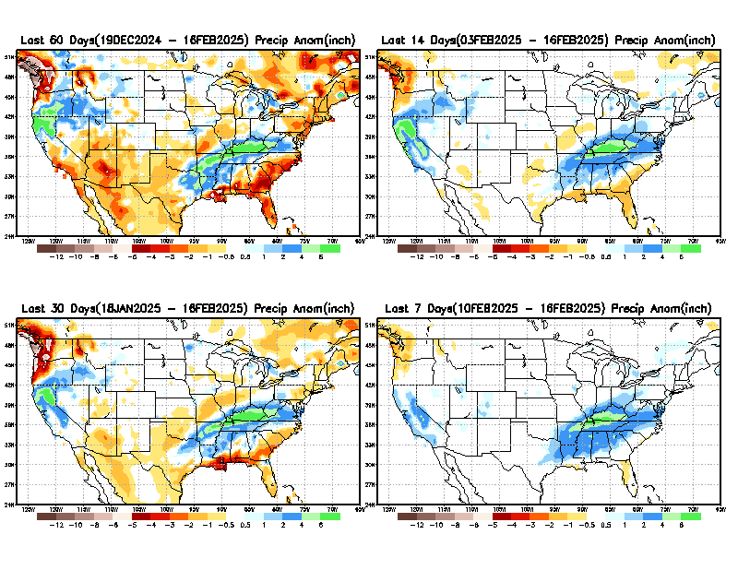
Precipitation ANOM during last 7, 14, 30, & 60 days.
This and next few slides show Precip deficit (excess).
Droughts, for the MOST part, begin and end with precip!! Lately, Temps are becoming (secondarily) important as well.
60 Days
14 Days
30 Days
7 Days
These maps in this and following slides, including a) Total,
b) Anom and
c) Percent of Normal precip. in these and other longer time ranges are now (routinely) daily updated at:
From: Recent Accum./Anom Precipitation https://www.cpc.ncep.noaa.gov/products/Drought/briefing_prcp.shtml

Slide 7
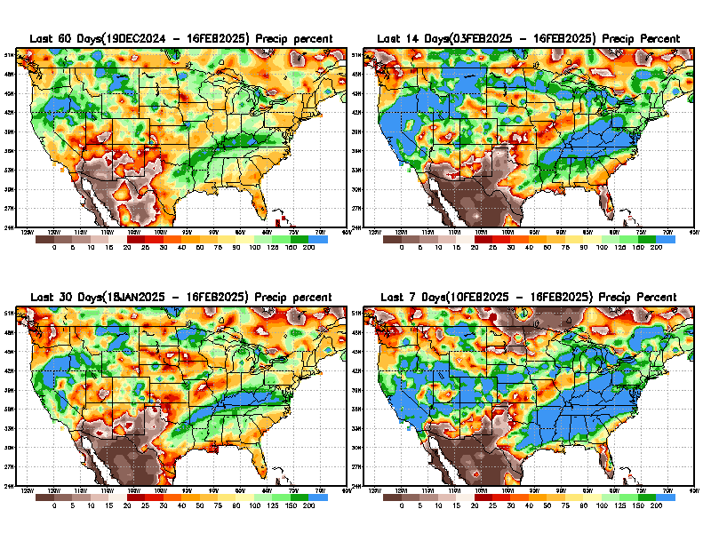
Precipitation Percent (of normal) during last 7, 14, 30, & 60 days - Only Deficit Areas <=90% shown !
60 Days
14 Days
This plot shows only the rainfall deficient regions <= 90% of normal.
-- This shows more clearly possible/likely drought developing region in the future unless there is above normal rainfall in these regions in the future, to offset these shortfalls.
30 days
7 days
From: Recent Anom/% of normal Precipitation https://www.cpc.ncep.noaa.gov/products/Drought/briefing_prcp.shtml

Slide 8
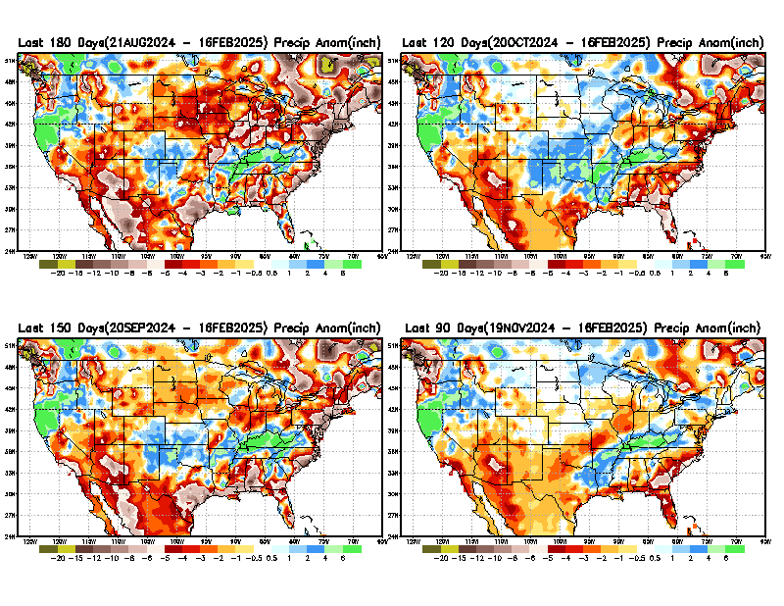
Total precipitation ANOM during last 3, 4, 5, and 6 months.
While the Precipitation anomalies deficit may seem large in some regions (compared to others),
it is the
% of normal precip (next slide) that matters more!!
6 M
4 M
5 M
3 M
The entire southwest including southern CA, the emerging dearth of precip in the short term is emerging!
Of course the south & southeast and along Atl. coastal regions is worrisome!
–----- La Nina !!
From: Recent % of Normal Precipitation https://www.cpc.ncep.noaa.gov/products/Drought/briefing_prcp.shtml

Slide 9
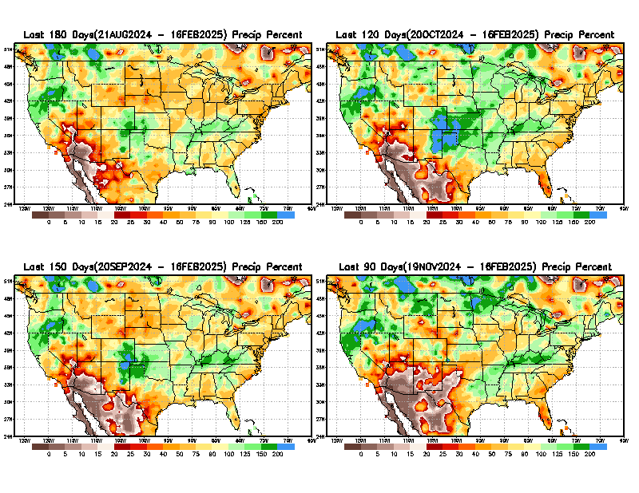
Total precipitation Percent (of normal) during last 3, 4, 5, and 6 months Only Deficit Areas <=90% shown!!
6 M
4 M
In these interim time scale 3-6 months, we need to pay attention to regions, which are dark brown, brown, dark red, & red (<40%).
While accrued precipitation deficits are real & objective,
droughts are subjective declarations!!
5 M
3 M
East vs West!
Broad vs Narrow
rainfall season.
In general, West US suffers more from frequent and lasting droughts. Droughts in East US are generally less and less lasting!
What about Center ?
More like West than East?
Short term(S) Drought is generally declared when large/severe rainfall deficits exist in the 3-6 months time range. {Long term deficits beyond 1 or 2 or more years is Long term L drought! }

Slide 10
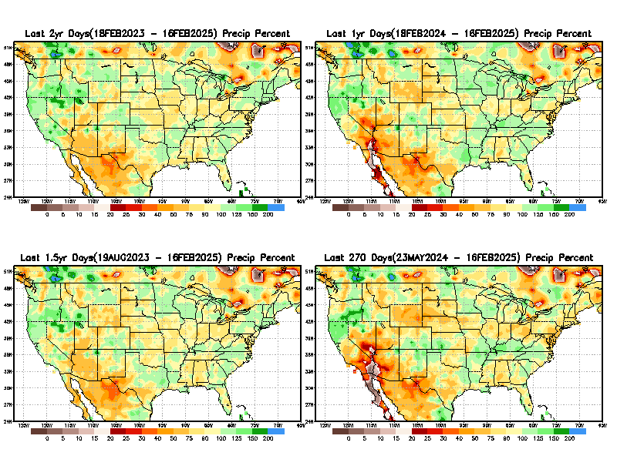
Total precipitation Percent during last 9 months, 1 yr, 1.5yrs, & 2 yrs. .–Only Deficit Areas shown!! <=90%
2 Y
1 Y
1.5 Y
9 M
The character and even location/spatial extent of the short/S and long/L –term droughts are different!!!
From: Recent Accumulated Precipitation https://www.cpc.ncep.noaa.gov/products/Drought/briefing_prcp.shtml

Slide 11
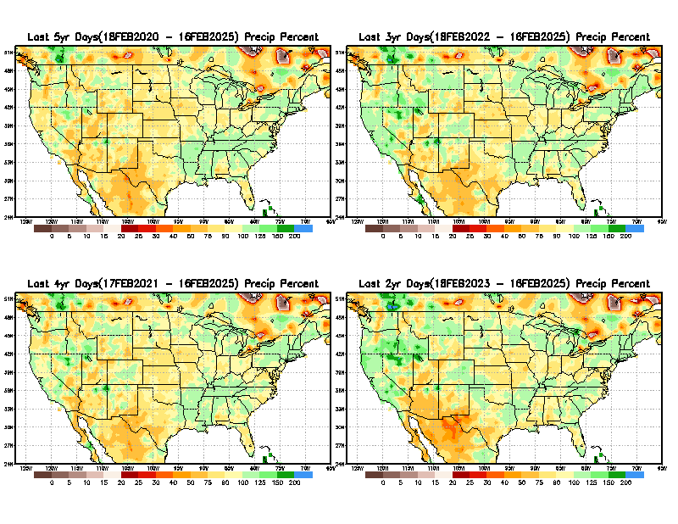

Total precipitation Percent (of normal) during last 2, 3, 4, & 5 yrs. .–Only Deficit Areas <=90% shown !!
5 Y
3 Y
Deficits are not much!
In terms of long-term-drought, overall, the country is in good shape! Including the southwest, especially California & vicinity. - ??????
4 Y
2 Y
From: Recent Accumulated Precipitation https://www.cpc.ncep.noaa.gov/products/Drought/briefing_prcp.shtml

Slide 12
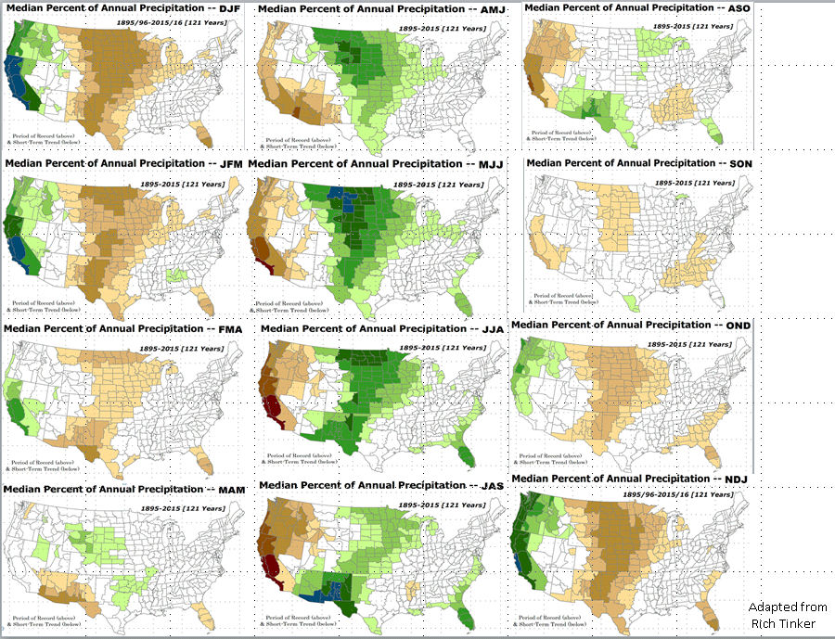

Rainfall wise, the MAM, is not bad for the country as a whole, EXCEPT for LA NINA!! ☹
(see later!)
LEAST
In-BETWEEN
MOST
East vs West!
More darker colors in west/central => narrow rainy season (months)
Overall, more white space in the east => distributed rainfall season (except ~FL).

Slide 13
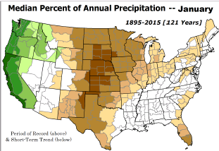
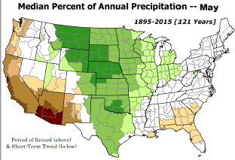
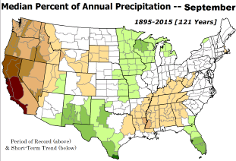
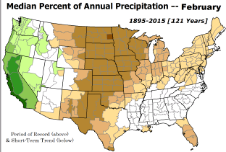
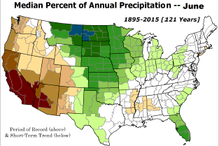
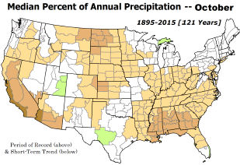

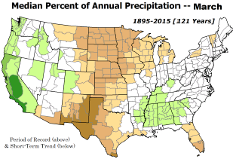
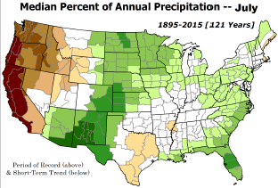
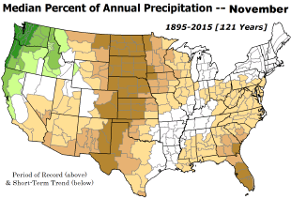
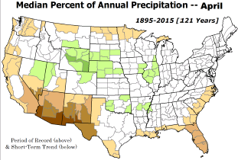
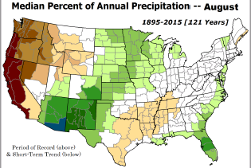
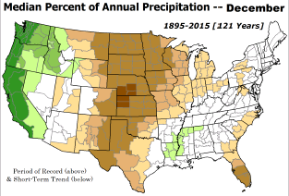
*********
EAST vs
CTR/WEST
Drought Behavior is loosely tied to rainfall climo!! And the limited rainy season in the west
*********
Adapted from Rich Tinker.

Slide 14
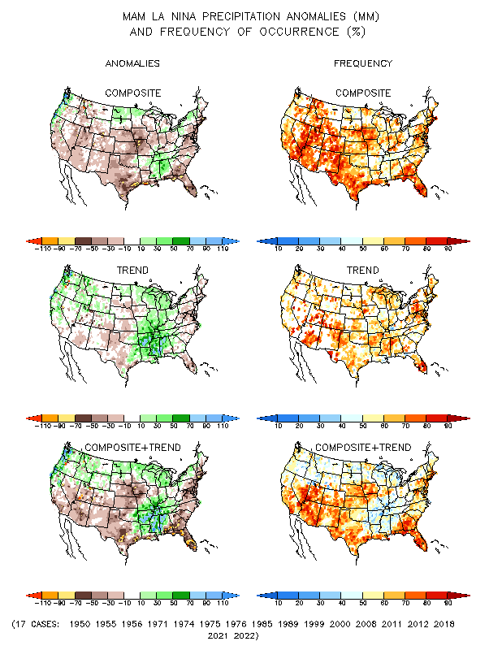
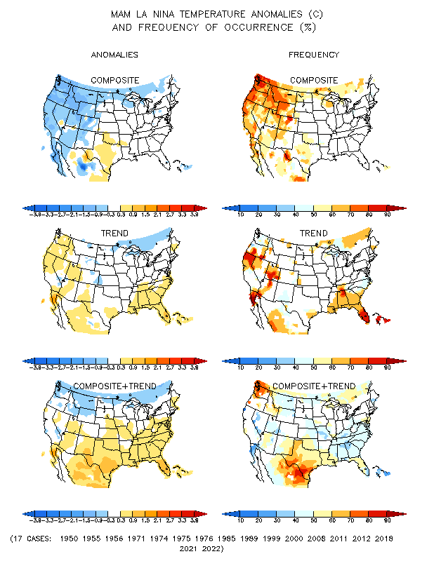
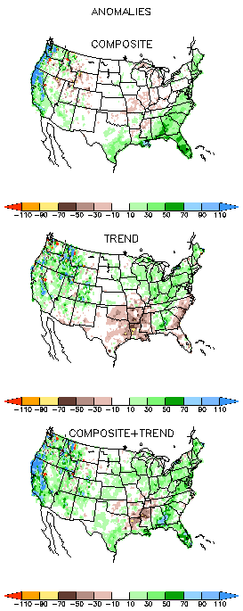
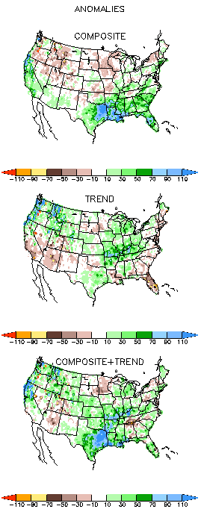
La Nina Precip/Temperature COMPOSITES & Trend map
MAM
P
T
Opposing signals!
https://www.cpc.ncep.noaa.gov/products/precip/CWlink/ENSO/composites/
During Winter and during La Nina: Generally warm and dry along southern states.
Not warm & not Dry along northern tier states. Compare NMME forecasts in later slides!

Slide 15
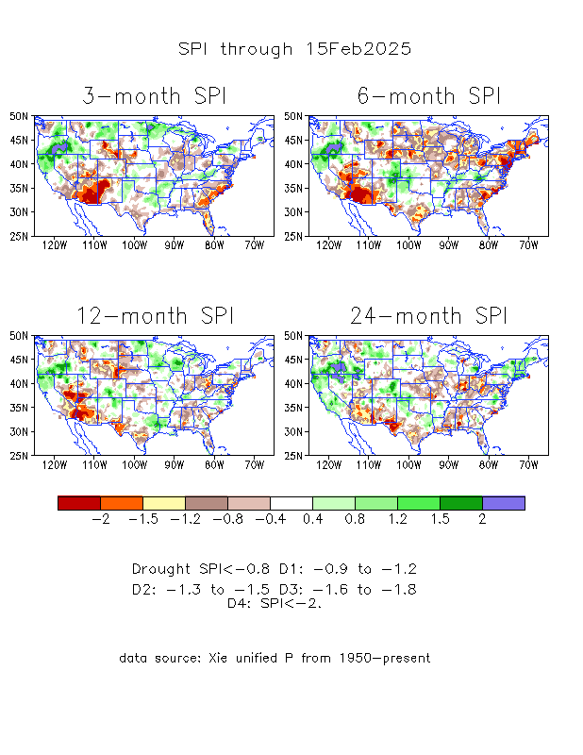
The Standardized Precipitation Index SPI
(based on Observed P)
Compare with last month
----- NOW
https://www.cpc.ncep.noaa.gov/products/Drought/Figures/index/spi_plot.gif
Very interesting graphic & details for the drought across the US based on the more generalized precip deficit/excess, the Standardized Precipitation Index (SPI).
The dark brown and red colors, indicating standardized precipitation deficits, in the various time periods, approximately correspond to the appropriate short/long term drought monitor regions and their intensities
Short
The S/T drought looks a bit more ominous than the L/T drought!
Long
How does one negotiate and reconcile declaring short term vs long term drought when precip. deficiencies patterns differ on many different time scales locally!!
What is the cutoff delineating time between short VS long term drought!! Not so clear!!
At exactly where, does drought begin?
Based on this SPI indicator/measure,
The brown areas are various levels of DRY regions!
The yellow/red are more probably the worrisome drought regions!

Slide 16
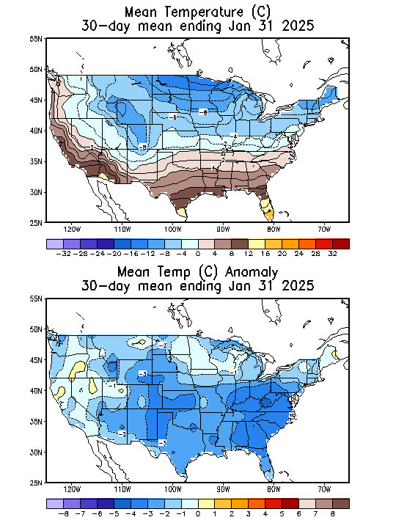
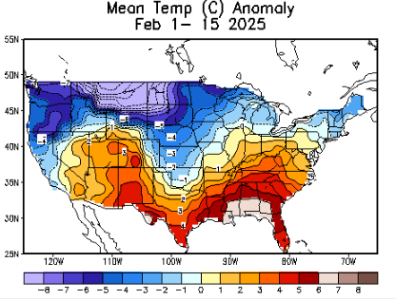
Recent US Temperatures
.
Last
month !!
Last month at this time!
https://www.cpc.ncep.noaa.gov/products/tanal/temp_analyses.php
So far this month !!
NOW!

Slide 17
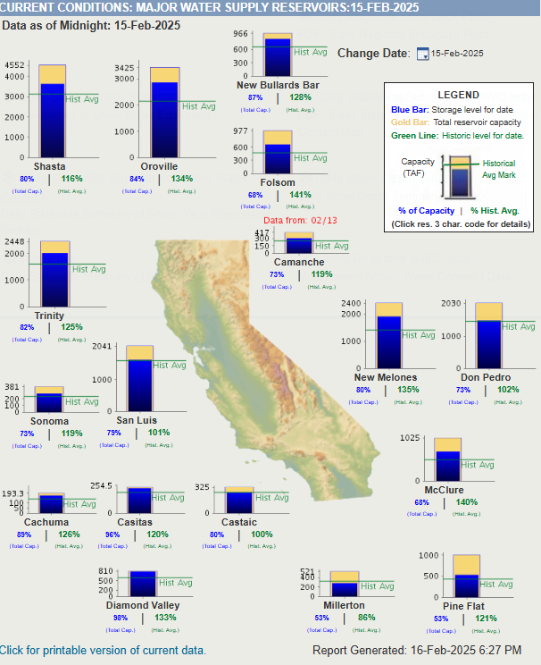
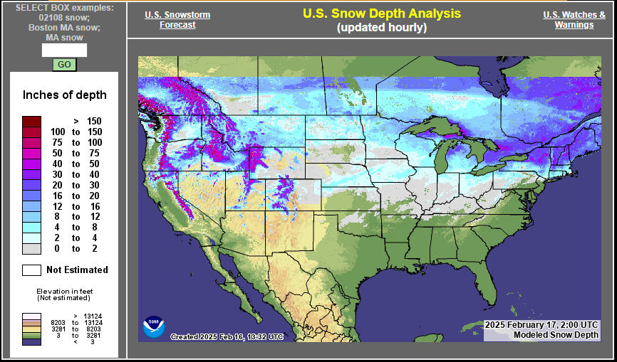

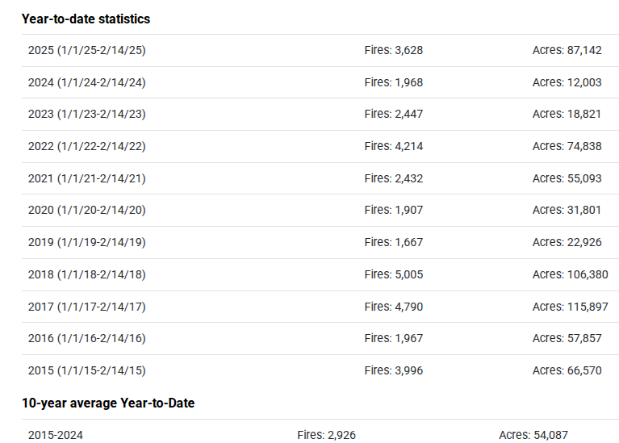
https://www.frontlinewildfire.com/california-wildfire-map/
https://www.nohrsc.noaa.gov/nsa/
https://cdec.water.ca.gov/resapp/RescondMain
Actual Fire locations and hotspots
% of Capacity
% of Hist. Avg.
of Reservoirs.
https://www.weatherstreet.com/weather-forecast/Snow-Depth-US.htm
#s are high this year (cf. last year) due to fires in the Northeast
Many CA water reservoirs are AT their historical average/ CAPACITY levels ! ☺ . After this past winter, most reservoirs were ABOVE their historical averages. BUT Not anymore!
https://www.nifc.gov/fire-information/nfn

Slide 18
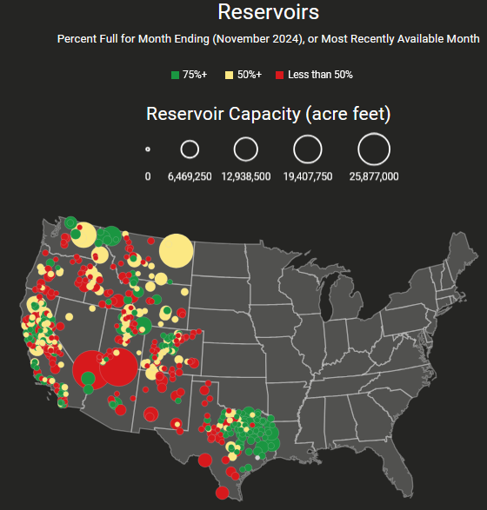
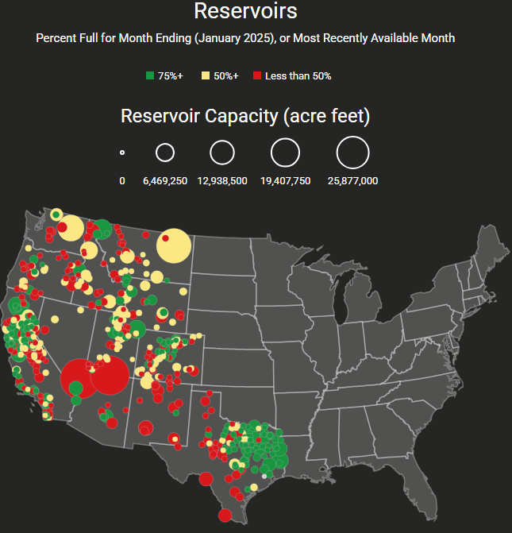


Western Water (2000-2024), from Dean Farr
Percent Full for Month Ending (November 2024)
Percent full for Month ending January 2025
https://www.deanfarr.com/western_water/
Lakes Mead, Powell in NV/AZ are at low levels! ☹ ☹ HUGE consequences for electric power for western states CA/NV/AZ/UT !!
Comparing Reservoir levels for the US West in November 2024 (before winter !) and end of January 2025.

Slide 19
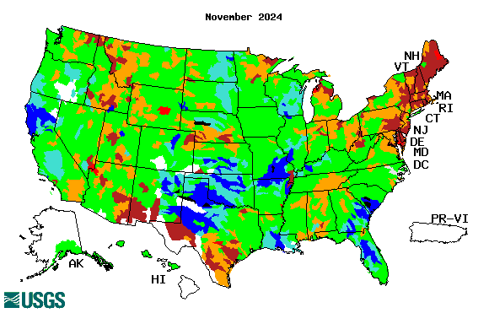
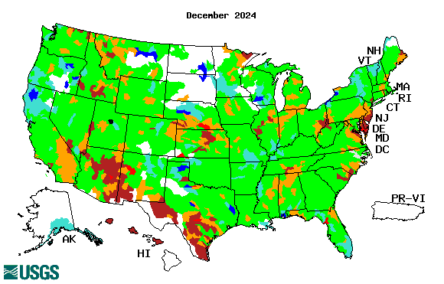





Streamflow (USGS)
Most US east droughts are relatively short lived (as compared to US west).
But in last 2 decades, recently in 2000, 2016, 2020, & 2022, New York and New England experienced historic drought conditions not seen since the 1960s.
https://waterwatch.usgs.gov/?m=nwc
Map shows only below normal 7-day average streamflow compared to historical streamflow for the day of year.
One month ago (left) &
(not available!)
Now (below)
Streamflow is only a partial indicator, as sometimes it is highly managed.
If sometimes, the various indicators are confusing, go back to % of rainfall deficit maps – to confirm/reinforce!!
https://waterwatch.usgs.gov/index.php?id=ww_drought
19

Slide 20

EL NIÑO/SOUTHERN OSCILLATION (ENSO)
DIAGNOSTIC DISCUSSION
issued by
CLIMATE PREDICTION CENTER/NCEP/NWS
and the International Research Institute for Climate and Society
13 February 2025
ENSO Alert System Status: La Niña Advisory
La Niña conditions are present. Equatorial sea surface temperatures (SSTs) are below average in the central and east-central Pacific Ocean. La Niña conditions are expected to persist through February-April 2025 (59%chance), with a transition to ENSO-neutral likely during March-May 2025 (60% chance).
CPC’s Oceanic Niño Index (ONI) [3 month running mean of ERSST.v5 SST anomalies in the Niño 3.4 region (5ºN-5ºS, 120º-170ºW)], based on centered 30-year base periods updated every 5 years. For historical purposes, periods of below and above normal SSTs are colored in blue and red when the threshold (0.5) is met for a minimum of 5 consecutive 3-month overlapping seasons.
https://origin.cpc.ncep.noaa.gov/products/analysis_monitoring/ensostuff/ONI_v5.php

Slide 21





Latest values of SST indices in the various Nino Regions.
The recent El Nino came in a hurry after 3 back-to-back La Ninas has all but gone away in a great hurry to make room or ANOTHER La Nina which is on the way!!? ?
Slides 21-23 here are from Michelle’s latest ENSO weekly ppt!

Slide 22


Sub-Surface Temperature Departures in the Equatorial Pacific
Most recent pentad analysis
The La Nina that just would not come, is finally here.. How long will it stay? The sub-surface warm water in the western eq. Pacific is stalled there for now…

Slide 23




Official ENSO Forecasts
Look at how statistical & dynamical fcts differ! But +ve phase (El Nino) is unlikely !?
December CPC/NOAA forecast
The majority of models indicate ENSO-neutral will persist through July-September 2024. Thereafter, most models indicate a transition to La Niña around August-October 2024.
https://iri.columbia.edu/our-expertise/climate/forecasts/enso/current/
A slight pull back or slow down in the developing La Nina ??
February CPC/NOAA forecast
https://www.cpc.ncep.noaa.gov/products/people/wwang/cfsv2fcst/images3/PacSSTSeaadj.gif
https://iri.columbia.edu/our-expertise/climate/forecasts/enso/current/
Latest ensemble membrs (blue!)show are less bullish

Slide 24



Previous (Last Month’s)
CPC’s official
Temperature OUTLOOK for Monthly (Feb)/Seasonal (FMA)
Monthly P/T forecasts verified at mid-month are generally good! Becoz of good skill upto 2 wks.
Released January 16th
Observed so far this month!! ☺

Slide 25



Previous(Last month)
CPC’s official
Precipitation OUTLOOK for
Monthly (Feb)/Seasonal (FMA)
Released January 16th
Monthly P/T forecasts verified at mid-month are generally good! (??) Becoz of good skill upto 2 wks.
Observed so far this month!! ☹
☹

Slide 26




GEFS
https://www.wpc.ncep.noaa.gov/qpf/day1-7.shtml
WPC/NCEP’s Next 7 days QPF (Quantitative Precipitation Forecast)
GEFS*/GFS Model Guidance for the next 15 days.
(*new)
GFS

Slide 27

From 3 Models average Precip forecast for next 30 days.
The 3 Models are: CFSV2, GEFS, ERA5

Slide 28

From 3 Models average Precip forecast for next 30 days.
20
40

Slide 29


From 3 Models average Precip forecasts for next 30 days.

Slide 30

From 3 Models average Precip forecasts for next 30 days.

Slide 31

From 3 Models average Precip forecasts for next 30 days.

Slide 32


Even thru’ up to 5 years period, the country as a whole looks good, in terms of good rainfall!!! And lower drought coverage!!
From 3 Models average Precip forecasts for next 30 days.

Slide 33




NMME*
T (left) &
P (right)
Ens.Mean forecasts for
Mar
T
P
JFM
Overall, across the US, less than normal rainfall (& above normal T) is forecast by NMME for both the month and season!
Warm & Dry across the Southern states !
Models overplaying the La Nina impact ?
NMME* : North American Multi Models Ensemble

Slide 34



Agreement/Disagreement among the various NMME models’ MAM seasonal Precip. Forecast.
??

Slide 35


BONUS Topic: Discussion continues!! Explanation for the multiyear DROUGHT in the Southwest (CA/AZ/NM/NV/UT/CO & vicinity)!!
More La Nina’s lately ?
More frequent La Ninas lately ?
YES!! The stats in the table below (bottom left) are from the Official CPC ENSO declarations page/table!
(SKIP)
slide
Compared to other regions of the globe, the SST warming/trend in the central eq. Pacific (Nino 3.4) is relatively much small. (See Fig. above) – Why is this ?
Does nature try to compensate for the warming else/everywhere by producing more La Ninas in the equatorial Pacific? - Just my observation from data! Let’s check !!!
Since the 1997 monster El Nino (stronger than the famous 1982/83 event), just a quick count of CPC’s Nino 3.4 index++ values for the three month overlapping seasons, (Data at CPC site only available only from 1950!)
(27 years) (47 years) (74 years)
1997-2023 1950-1996 1950-2023
La Nina(DJF) 13 16 29
El Nino(DJF) 9 17 26
La Nina(all 3mos) 119 150 269
El Nino(all 3mos) 85 166 250
(Overlapping 3month seasons)
Look at Ratios of La Ninas (vs El Ninos) in the shorter
recent (27 yr) period vs the longer (47 yr) earlier period!!
Compare the ratios of La Nina to El Nino in the squared boxes.
***Analysis of CPC’s official Nino 3.4 index data over the last 70 years shows that the more frequent La Ninas in recent decades contributed to less rainfall in the southwest (See La Nina precip composites!, slide#13) and hence the ongoing long term drought in the Southwest!! Hence the long term southwest drought is unlikely to go away any time soon***
++ Barnston, Chelliah and Goldenberg (1997):Documentation of a highly ENSO‐related SST region in the equatorial pacific,
Atmosphere-Ocean Volume 35, 1997. https://doi.org/10.1080/07055900.1997.9649597
*** The strong/weak annual monsoon rains in the southwest is a minor modulator riding on this bigger/longer-term signal. ***

Slide 36
Summary
Current Drought conditions:
California for the most part, until four or so months ago, has remained drought free for about twenty months now luckily due to above normal rainfall during both recent 2022/23 (La Nina, strange!) and 2023/24 (El Nino, canonical!) winter rainfall seasons. But in the last few months dryness/drought has kept in, esp. in southern CA, where the seasonal winter rainfall has been below normal.
Water levels in almost all CA reservoirs are now at or above their normal levels. However, the water storage levels in the much bigger southern lakes, Lake Powell and Lake Mead in NV/AZ still continue to be very low, and have not recovered completely from the 2+ decades(since ~2000) long hydrological drought that existed in the region.
In our 2024 June/July Drought briefings, we suggested that, “Overall, % of US land areas under drought will begin to increase from the then existing very low levels, mainly due to the fact that the 2023/24 El Nino had ended and La Nina may emerge soon. As we expected, comparing the most recent USDM with that back in summer, there is a considerable increase in the drought covered areas of the United States.
Large parts of NV/UT/AZ/NM and TX are still dry or under drought due to long term/decadal drought in the SW, as well as the poor back to back SW monsoons in 2023 and 2024.
While the drought in WA & OR got relief from the early winter rains, drought in the border/interior areas of MT,WY the Dakotas and NE has not improved worsened and is likely to not get any relief soon.
Much of the coastal regions of northeastern states and the Atlantic coastal regions that developed drought conditions recently.
Since early summer last year, questions continuously lingered about when the La Nina will actually develop and how strong it will be! Finally it appears that, La Nina may be here (based on 1st 3-mon avg Nino 3.4 value) for now, but expected to transition to neutral ENSO conditions very soon. A lot depends on the expected canonical impacts from the weak La Nina like conditions, however, the rainfall along the southern tier states of the US is below normal for past few months, and the forecast models are continuing the same.
Current ENSO status and forecast: La Niña conditions are present. Equatorial sea surface temperatures (SSTs) are below average in the central and east-central Pacific Ocean. La Niña conditions are expected to persist through February-April 2025 (59% chance), with a transition to ENSO-neutral likely during March-May 2025 (60% chance).
Prediction: Finally, the La Nina conditions have appeared for now, and expected/forecast to transition to ENSO neutral conditions within the next couple/months. Nevertheless, the models have been somewhat and are consistent in forecasting generally below normal precip across much of the southern United States and near normal and/or above normal precip in the northern tier states, including esp. the Ohio valley.
Recall the last two (2023 & 2024) DJFM rainfall seasons (one La Nina winter & another El Nino winter), both brought excessive rainfall to California that ended the 2 decades long drought. This M winter also, the models expectedly forecast only canonical (less than normal) rainfall here. What will happen during the remainder of this (2025) rainfall season (through March!) is the major question and uncertainty for west coast areas, especially the southern CA, NV, AZ border region. It is likely that severe drought in these regions in southern CA and extending eastward in to the southwestern US, will worsen and possibly expand.
Drought in the central US will likely persist, and may not see improvement Existing drought conditions will likely worsen and new drought may even emerge along parts of southwestern states and parts of TX. Based on the possible weakening of La Nina, and the three models precip forecast over the next month, it is our contention however that the drought along the southeast, east of TX and along much of the coastal Atlantic states, (except in parts of FL and along coastal AL/GA/SC region), the existing drought conditions will likely improve and may not exist by the end of the forecast season MAM. The confidence associated with this particular region & forecast is low. *****

