Slide 1
Drought Outlook Support Briefing
(formerly Drought Outlook Discussion)
January 2019
Presented by: David Miskus for Muthu Chelliah
PPT Updated by: Li Xu
Climate Prediction Center/NCEP/NOAA
http://www.cpc.ncep.noaa.gov/products/Drought
Phone: 1-877-590-4933
Pwd: 3994107#

Slide 2
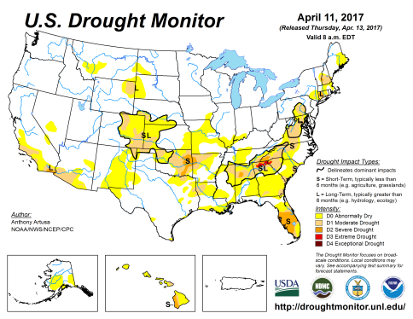
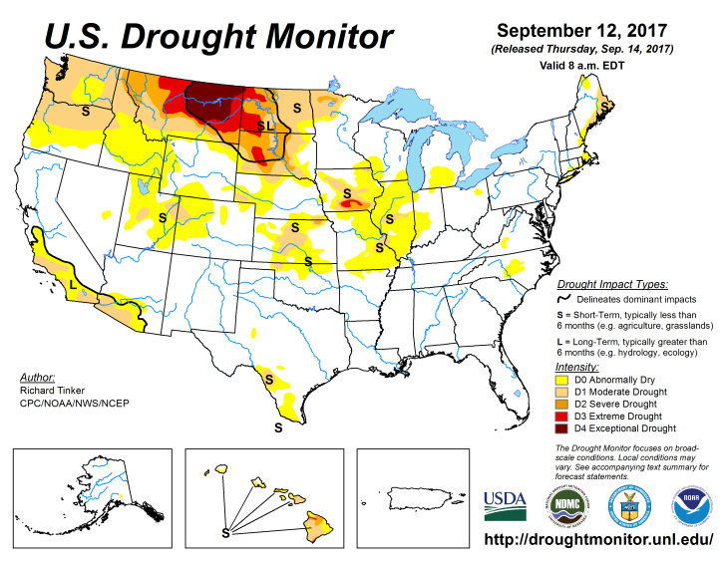
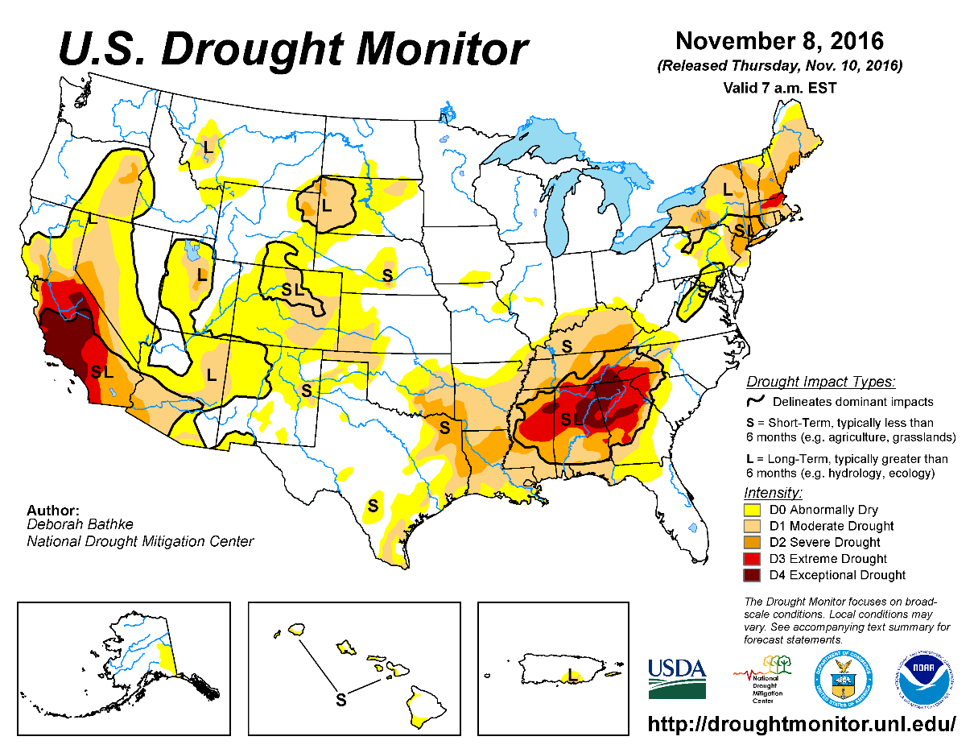
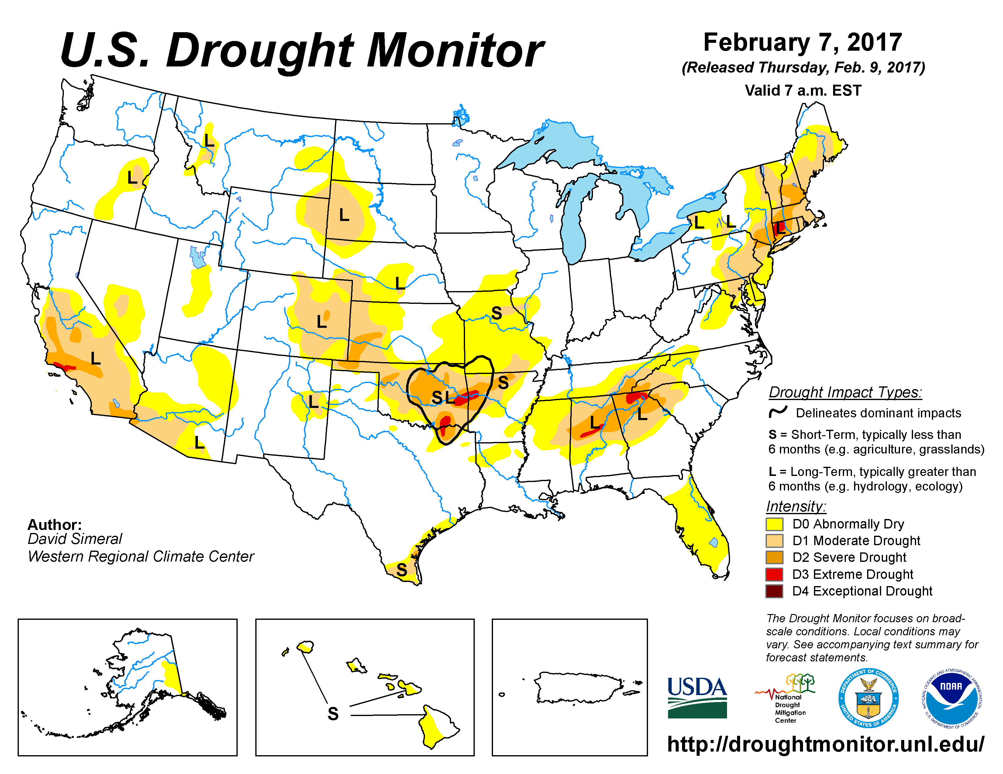
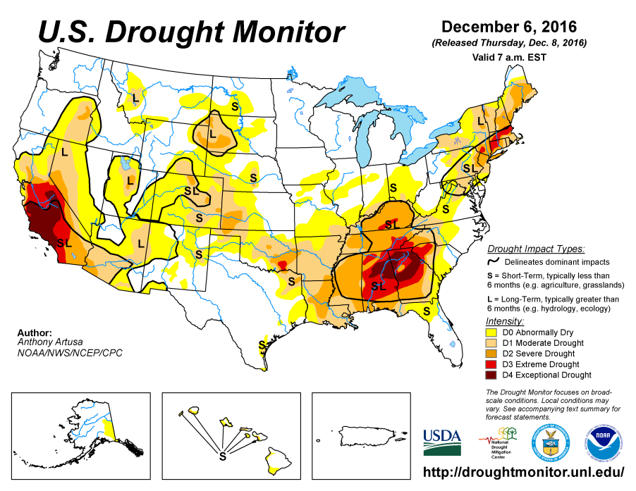
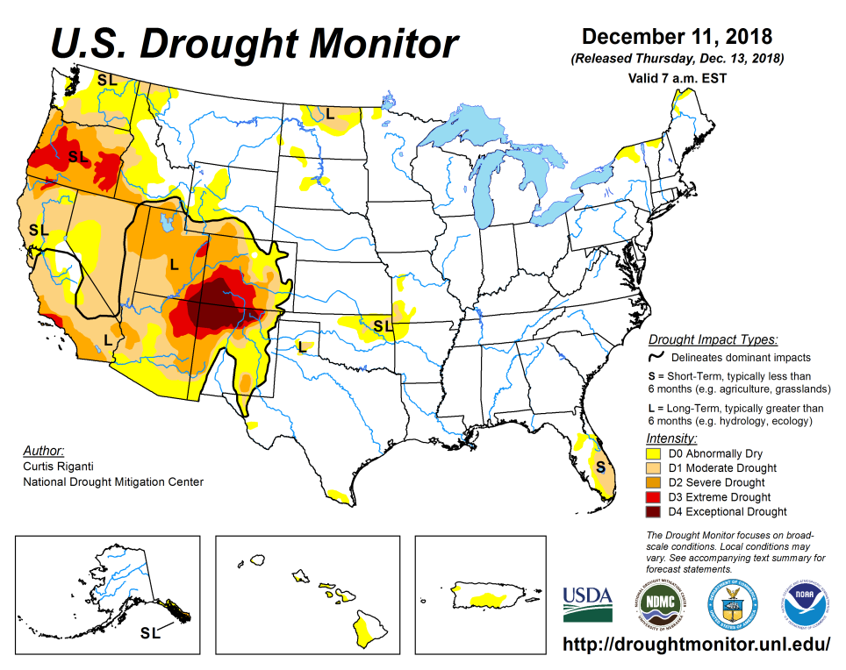
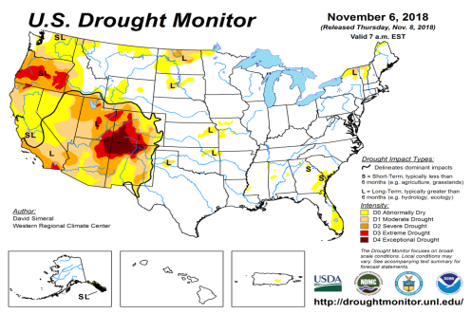
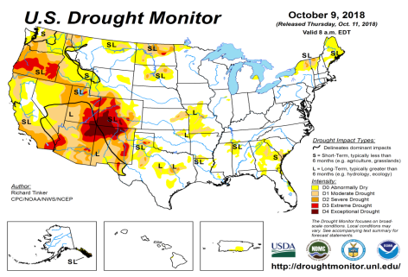
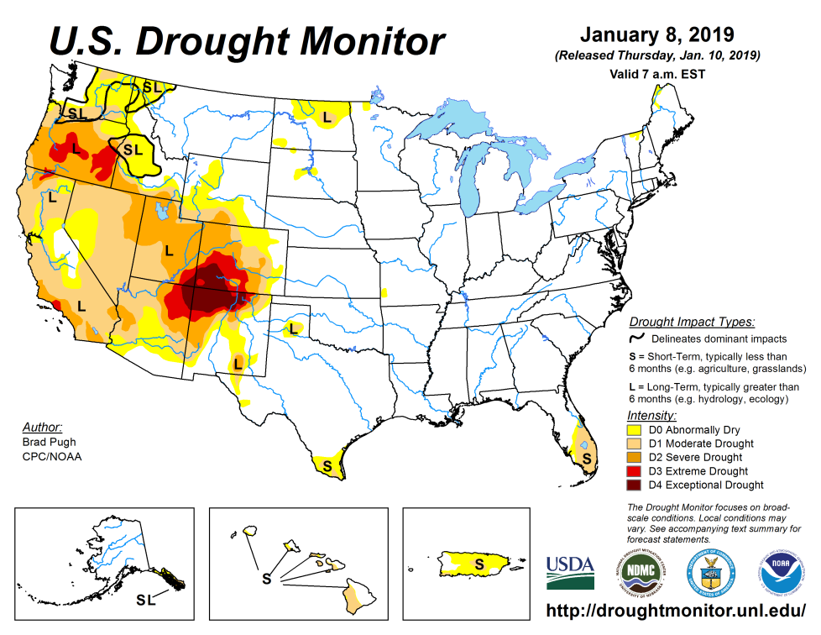
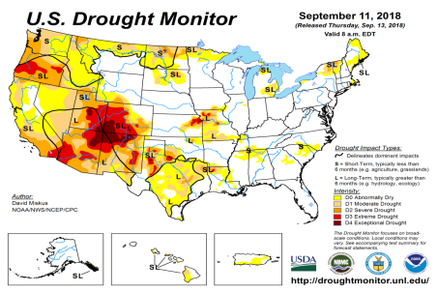
Drought Monitor
December
November
October
Latest/Recent
September

Slide 3
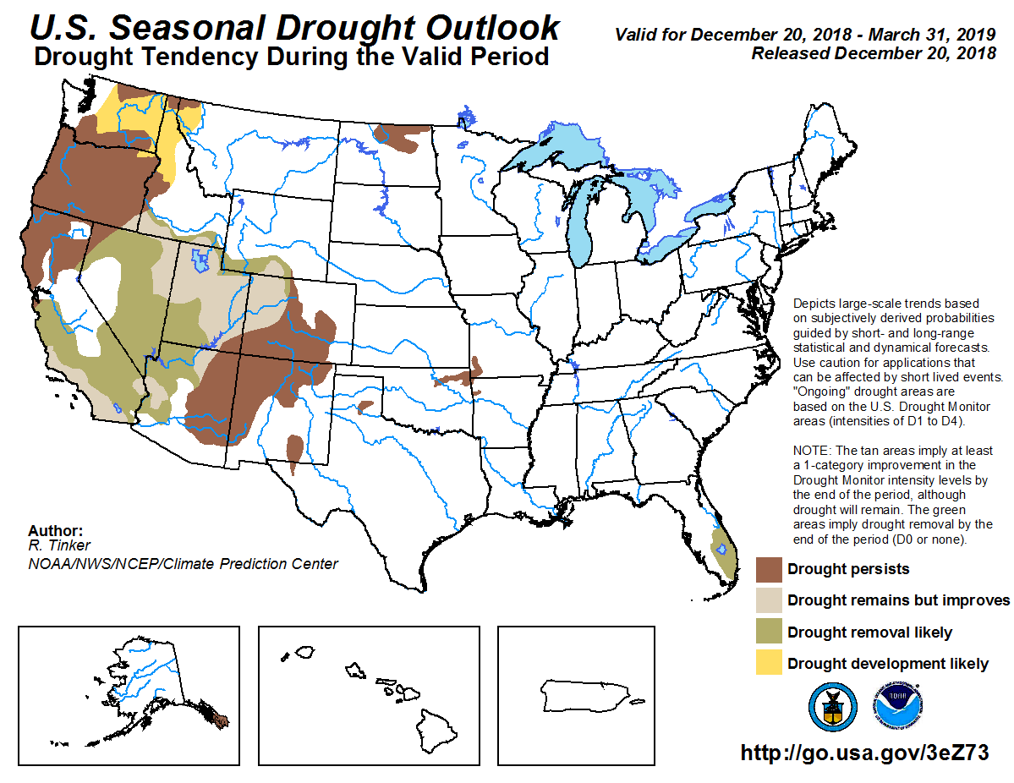
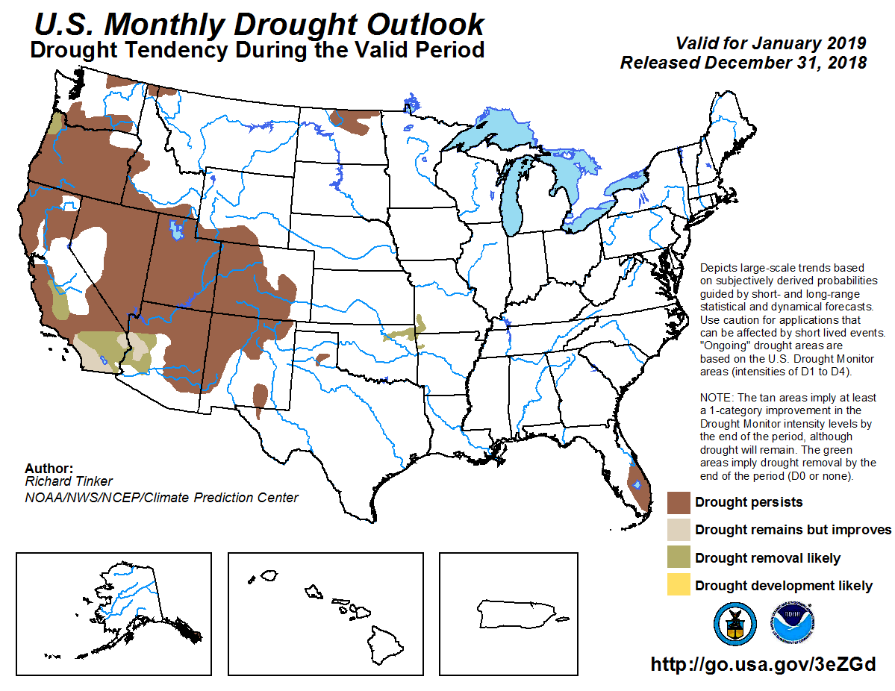
(Prev) Seasonal/Monthly Drought outlooks
(New Seasonal Drought Outlook to be released tomorrow!)
Seasonal Outlook (Mid December 2018 - March 2019)
issued 12/20/18
Monthly outlook
(for January 2019)
issued 12/31/19

Slide 4
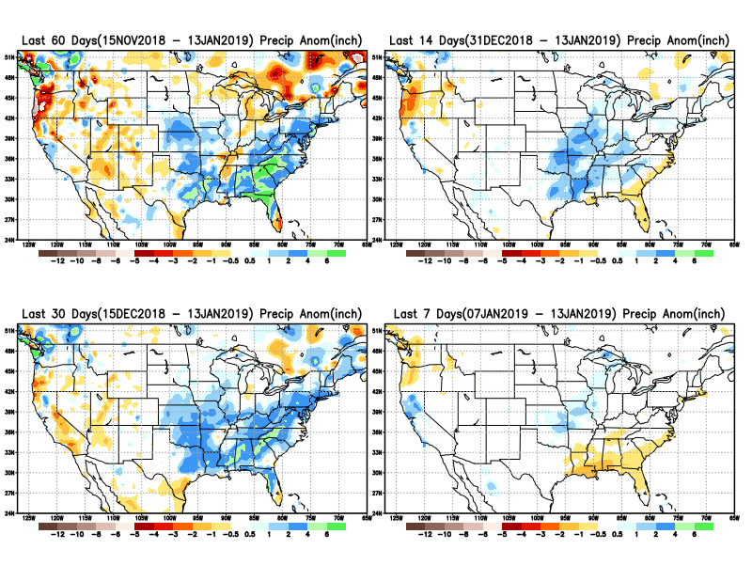
Precipitation ANOM during last 7, 14, 30, & 60 days.

Slide 5
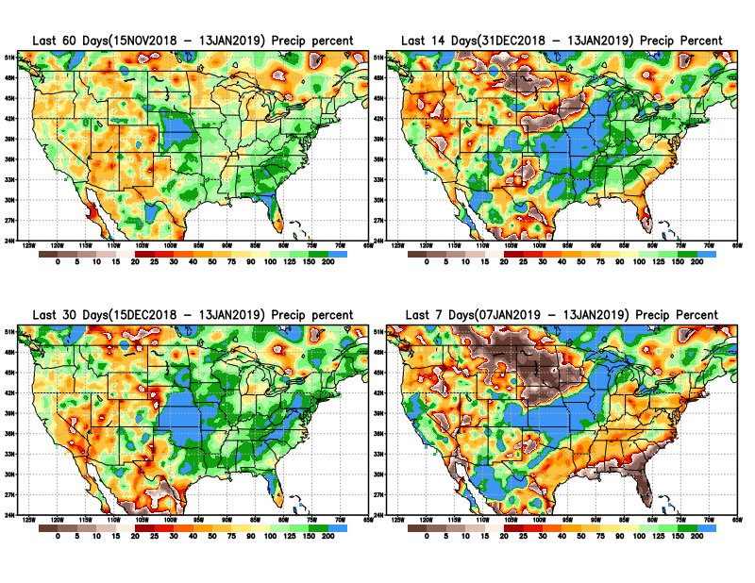
Precipitation Percent during last 7, 14, 30, & 60 days.
NOW !

Slide 6
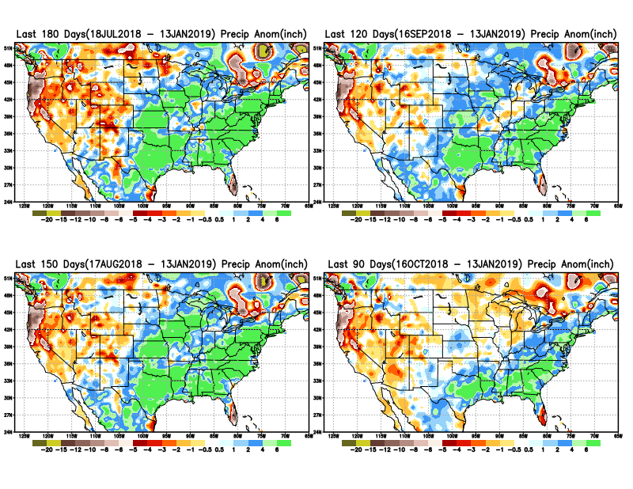
Total precipitation ANOM during last 3, 4, 5, and 6 months.
6 M
4 M
5 M
3 M

Slide 7
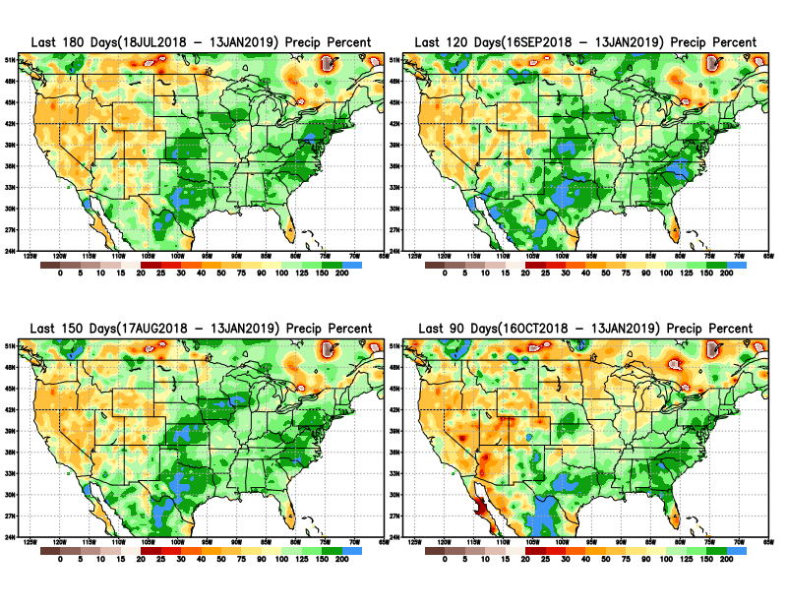
Total precipitation Percent during last 3, 4, 5, and 6 months.
6 M
4 M
5 M
3 M

Slide 8
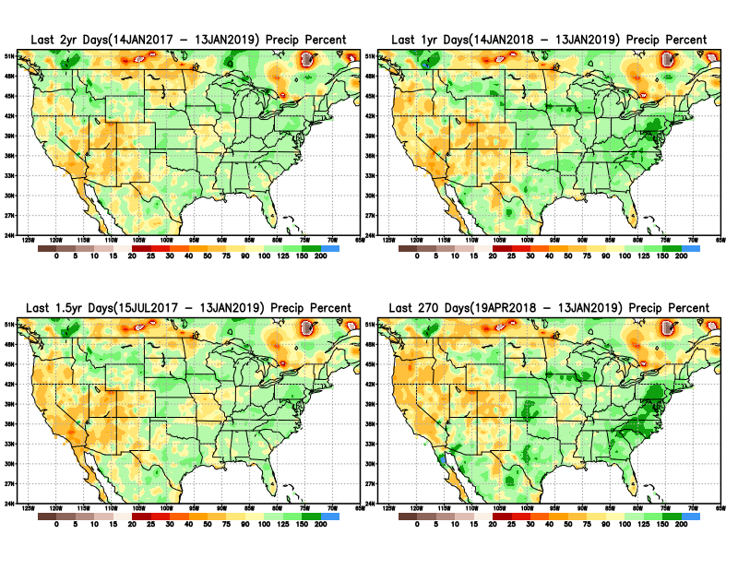
Total precipitation Percent during last 9 months, 1 yr, 1.5yrs, & 2 yrs.
2 Y
1 Y
Rainfall Data issues? Few observations, rugged terrain, interpolation problems!!
The deficits in UT/AZ, southern CA, and parts of NM/CO are long term – possibly a consequence of the two back to back La Nina’s! and even earlier La Ninas!!
1.5 Y
9 M

Slide 9
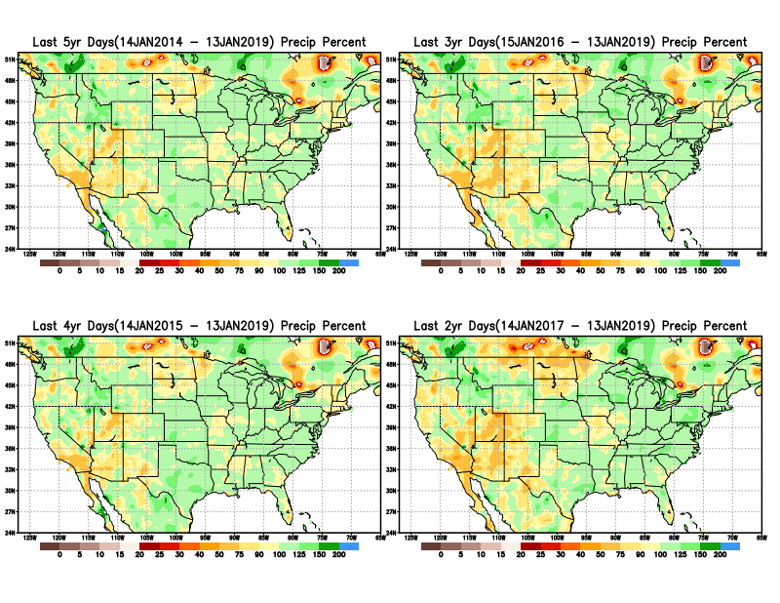
Total precipitation Percent during last 2 yrs, 3 yrs, 4 yrs, & 5 yrs.
5 Y
3 Y
Still longer term rainfall deficit variability in play? Especially in the southwest!
4 Y
2 Y
Quality of data/problem in the Northern High Plains area, especially in interpolation of sparse data in the rugged topography region!

Slide 10
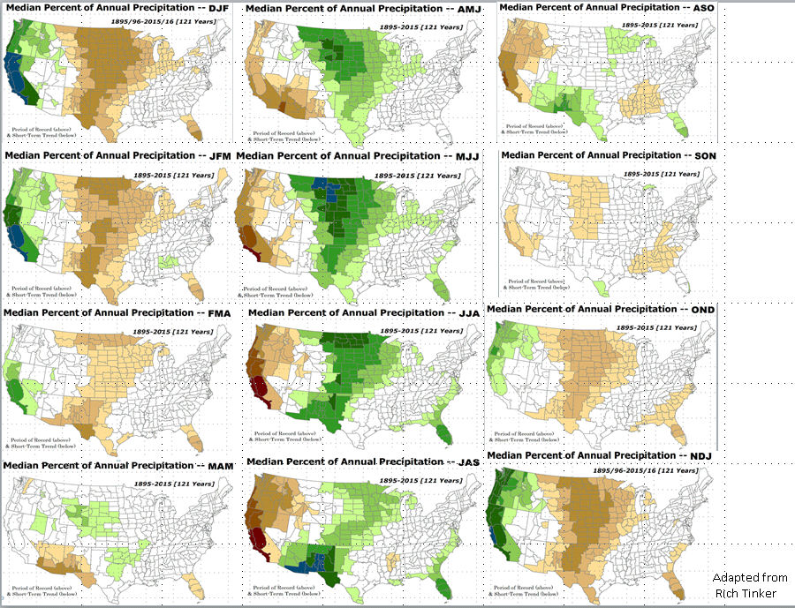

Rainy (3-month)Season across the US

Slide 11
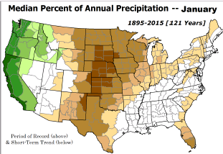
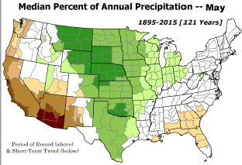
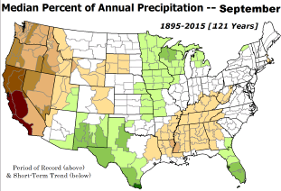
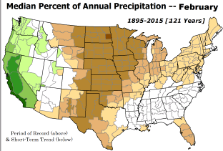
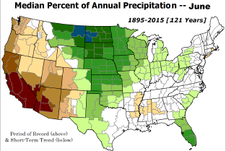
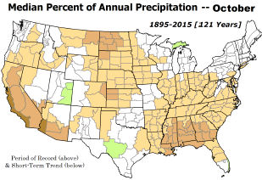

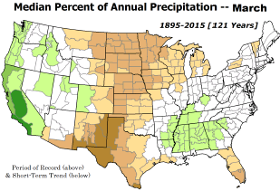
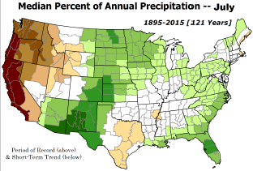
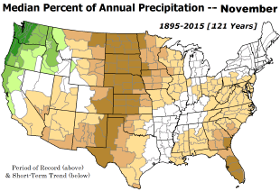
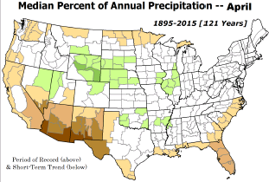
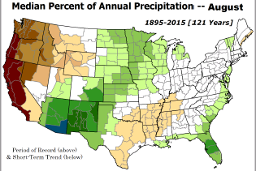
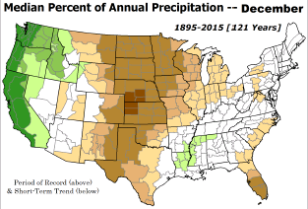
Adapted from Rich Tinker.

Slide 12
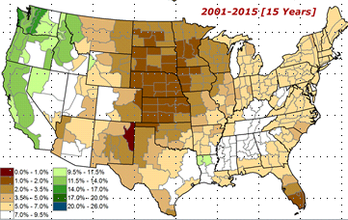
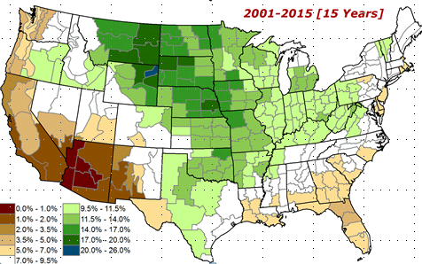
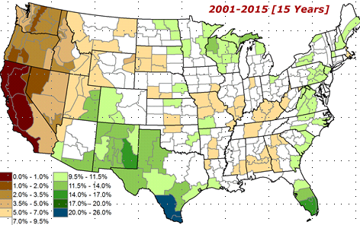
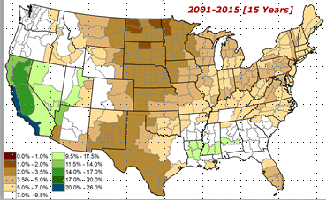
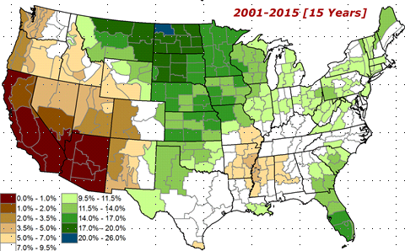
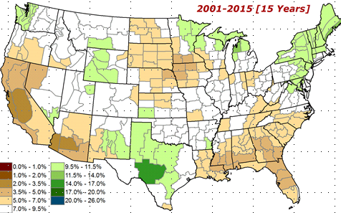

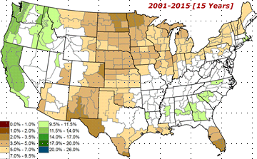
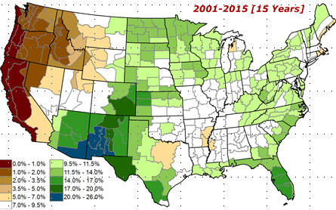
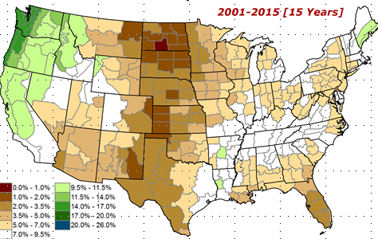
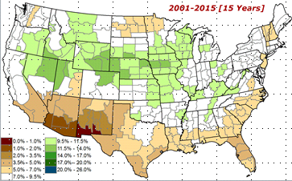
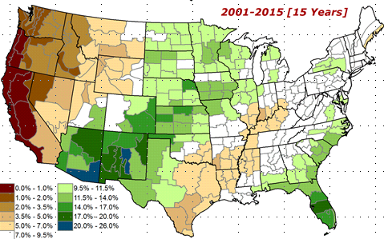
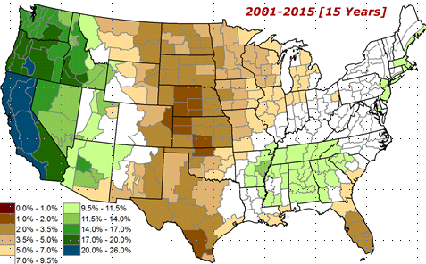
Adapted from
Rich Tinker

Slide 13
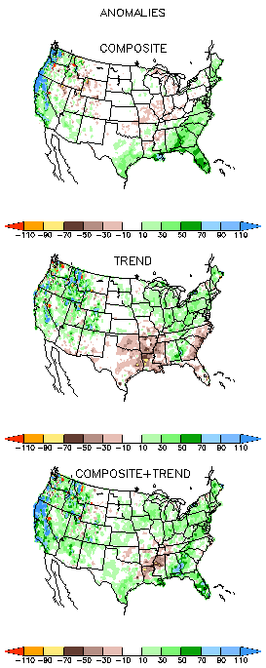
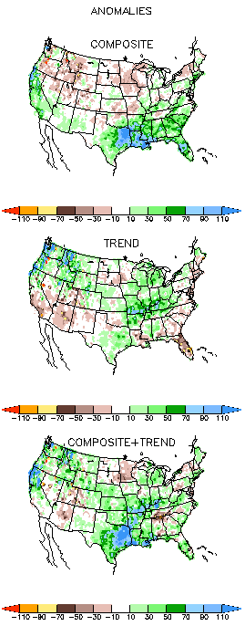
EL NINO Precip COMPOSITES
DJF
MAM

Slide 14
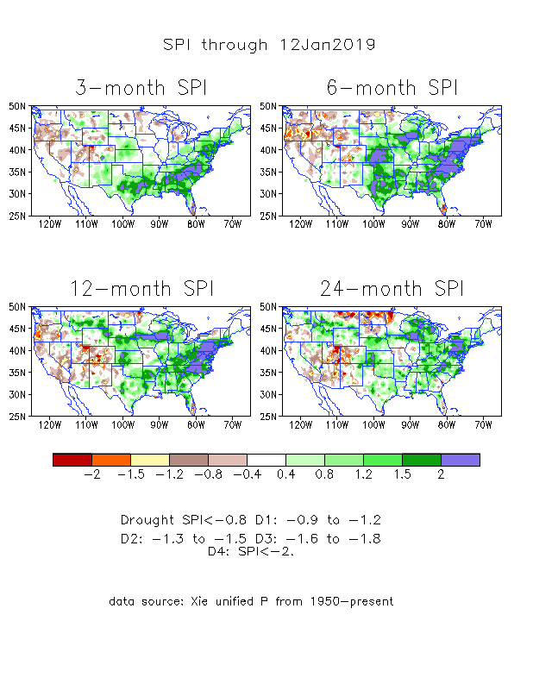
The Standardized Precipitation Index SPI
(based on Observed P)
----- NOW
Very interesting graphic & details for the drought across the US based on the more generalized precip deficit/excess, the Standardized Precipitation Index (SPI).
The dark brown and red colors, indicating standardized precipitation deficits, in the various time periods, approximately correspond to the appropriate short/long term drought monitor regions and their intensities
In the short term (~3 mo-6mo), the drought in Pacific Northwest over Oregon.
In the longer term ~12m and longer, rainfall deficits remain in the Southwest

Slide 15
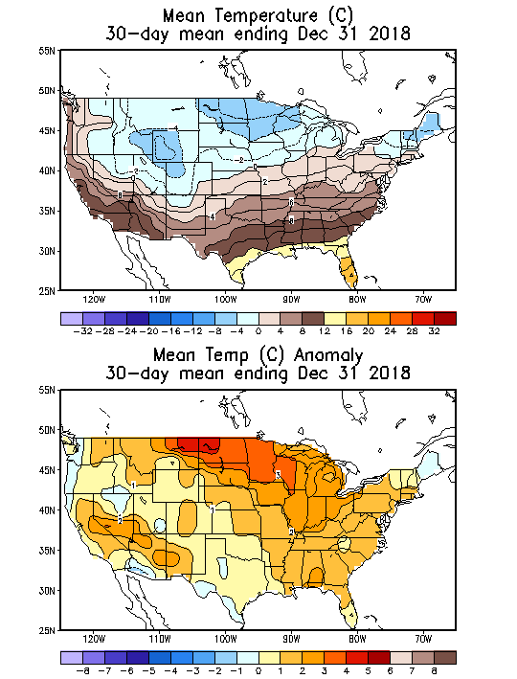
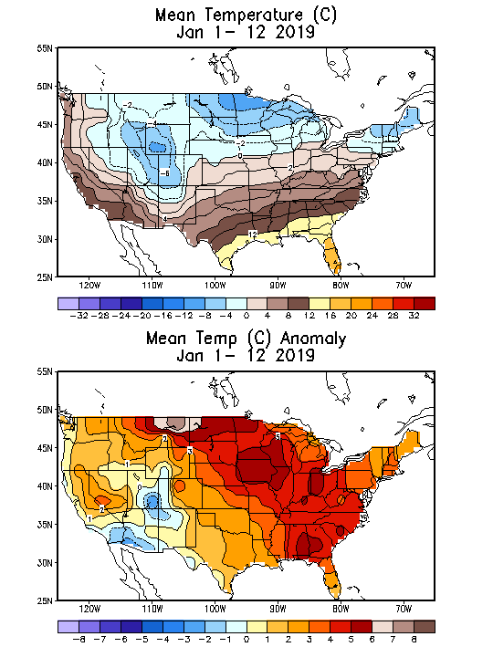
Recent US Temperatures
In December, much of the country has been relatively warmer than normal, particularly the upper Midwest.

Slide 16
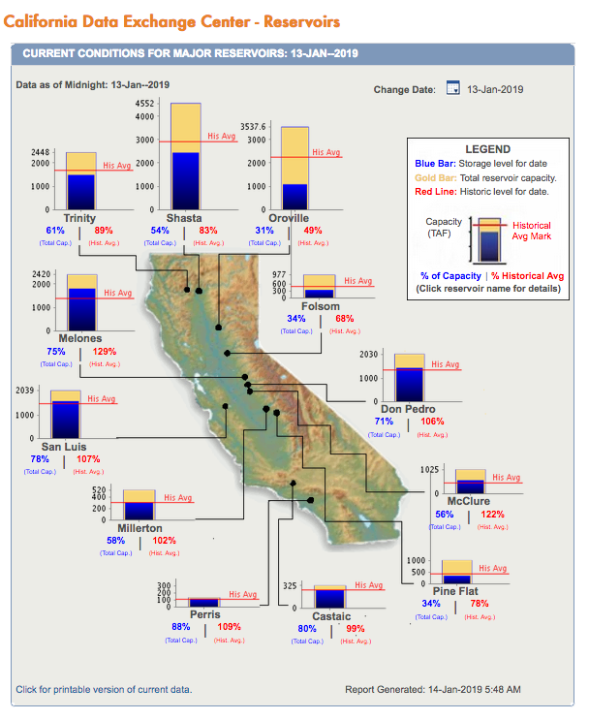
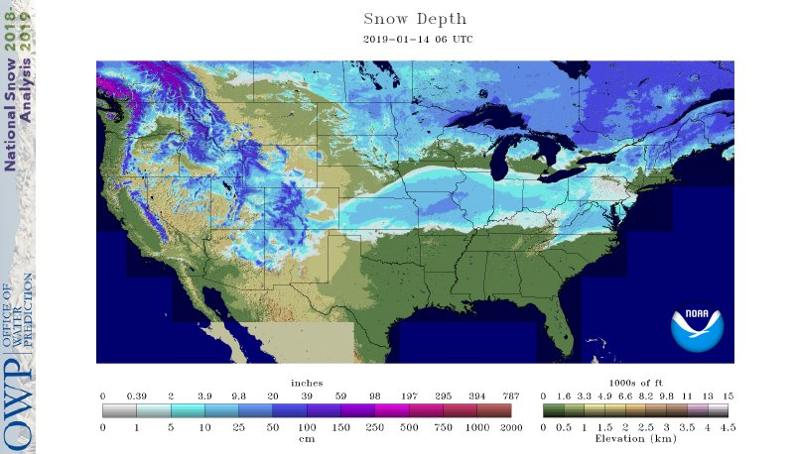

Water Reservoir Levels in some Western/Southern States! And Snow Depth!!
Northern CA reservoirs beginning to show
Weakness, but rainy season coming up!
Reservoir Storage Summary for River Basins
2019-1-14
TX
https://fsapps.nwcg.gov/afm/index.php

Slide 17







Streamflow (USGS)
Streamflow very good in Texas & eastward.!
In the west, it is generally below and much below normal, but back and forth!
Oregon, worse now in recent months!
Map shows only below normal 7-day average streamflow compared to historical streamflow for the day of year.
One month ago (left) &
Now (below)
17

Slide 18
EL NIÑO/SOUTHERN OSCILLATION (ENSO)
DIAGNOSTIC DISCUSSION
issued by CLIMATE PREDICTION CENTER/NCEP/NWS and the International Research Institute for Climate and Society
14 January 2019
ENSO Alert System Status: El Nino Watch !!
Synopsis: ENSO-neutral conditions are present.* Equatorial sea surface temperatures (SSTs) are above average across most of the Pacific Ocean. The patterns of convection and winds are mostly near average over the tropical Pacific. El Niño is expected to form and continue through the Northern Hemisphere spring 2019 (~65% chance).

Slide 19




Latest values of SST indices in the various Nino Regions.
The sub surface heat anom continues to stay in the +ve territory! .
Relatively short lived!
Equatorial sea surface temperatures (SSTs) are above average across most of the Pacific Ocean.

Slide 20


Sub-Surface Temperature Departures in the Equatorial Pacific
The equatorial sub surface temperatures in the tropical Pacific have gradually increased and expanded into the east Pacific.

Slide 21



ENSO Forecasts
Early- January CPC/IRI forecast
Mid- December CPC/IRI forecast
NOAA Official ENSO Forecast: El Niño is expected to form and continue through the Northern Hemisphere spring 2019 (~65% chance).

Slide 22


Previous(Last month)
CPC’s official
Monthly (Dec)/Seasonal (DJF)
Precipitation outlook
Released Dec 31th
Released Dec 20th
☺
Observed so far this month!!

Slide 23


Previous CPC’s official
Monthly (Dec)/Seasonal (DJF)
Temperature outlook
Made
Dec 31th
Observed so far this month!!
Made Dec 20th

Slide 24




NMME T & P
EnsMean forecasts
Feb
FMA
Forecast is based on developing El Nino conditions!!

Slide 25

The agreement/uncertainty among the diff. NMME models’ forecasts (middle and bottom panels) for Feb-Mar-Apr Precipitation!!!
25

Slide 26



SPI3
SPI6
SPI12
SPI3, SPI6
& SPI12
Forecasts from 6NMME Models
(uses obs. P up to past month, and forecast months’ P from NMME models)
The goodness and skill of these SPI’s forecasts depend directly on the NMME models’ skill in predicting precipitation!!!

Slide 27

2018
2018
NASA Soil
Moisture
Forecast
2018
2018

Slide 28

Monthly Drought Tendency in Probability
(This and next slide!) Exptl. Probability Drought Outlook from Kingtse Mo and Li Xu based on NMME ensemble members’ SPI6 (from precip) forecast

Slide 29

Seasonal Drought Tendency in Probability

Slide 30
Summary
Current ENSO status and forecast. Equatorial sea surface temperatures (SSTs) are above average across most of the Pacific Ocean. The patterns of convection and winds are mostly near average over the tropical Pacific. El Niño is expected to form and continue through the Northern Hemisphere spring (~65% chance).
Current Drought conditions:
  East of, and including, Texas, the country is (almost) drought free over all of the eastern two thirds of the country.
  However, the longer term drought in the southwest, in the four corners states area over UT/AZ/CO/NM and California, continues to persist there, with no steady improvement!
  The relative short term drought that developed in the Northwest over OR/WA over the last few months/couple of seasons.
  The short/long term drought (since early 2017) in parts of the Northern High Plains has all but vanished, but it appears in a muted form over very small areas in some northern parts of North Dakota.
  In spite of these drought declarations, analysis of rainfall received over the last few months/years reveal the exact nature of the varying levels of quantitative rainfall deficit in the short/long term drought regions.
  Prediction:
  Rainfall season(F/FMA) is coming up for coastal western states! At present, development of El Nino conditions in the next couple of months appears all but certain. But, how this developing El Nino will alter/impact this seasonal rainfall pattern in CA, OR, WA and the adjoining states, particularly in the southwest will decide the future of droughts in these regions. Many of the NMME models, in spite of the strong expected El Nino boundary conditions, forecast below normal rainfall along all of west coast states, which is not helpful for drought conditions here. This forecast not consistent with canonical ENSO precip patterns observed in the past (before 2015/16 El Nino)
  Overall, short term improvement is expected in the drought conditions over much of the northwest, south and west in the drought regions, since rainy season here is underway. But how this rainfall season gets affected/modulated by the developing ElNino will considerably impact the drought conditions not just for the Pacific coastal states, but also in the southwest states. But the longer term drought from longer tem rainfall deficits in these regions is expected to remain, in a diminished status. **END***

Slide 31


Seasonal Drought
Outlook [FMA’19]
Next 7 days QPF Forecast
GFS Model Guidance for next 16 days.

Slide 32


6-10 Day ERFs

Slide 33


8-14 Day ERFs

Slide 34


Weeks 3-4 Outlooks

Slide 35


Slide 36


Slide 37


Slide 38


Slide 39


Slide 40

Miscellaneous maps

