Slide 1
Drought Outlook Support Briefing January 2020
David Miskus (for Muthu Chelliah) & Li Xu
Climate Prediction Center/NCEP/NOAA
http://www.cpc.ncep.noaa.gov/products/Drought
Phone: 1-877-680-3341
Pwd: 858747#

Slide 2
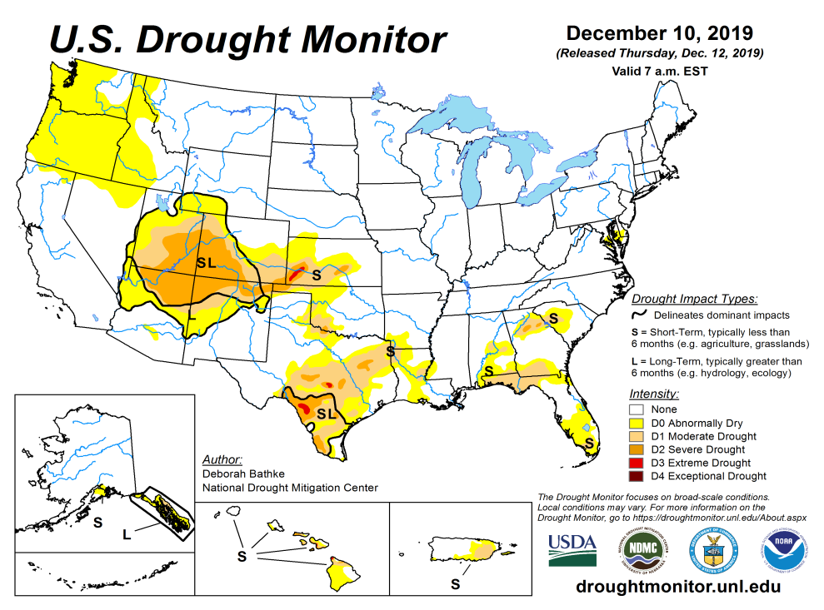
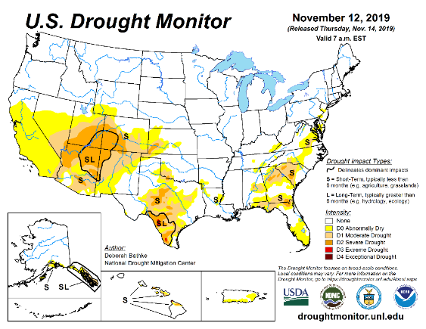
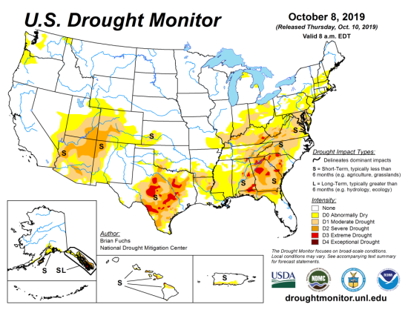
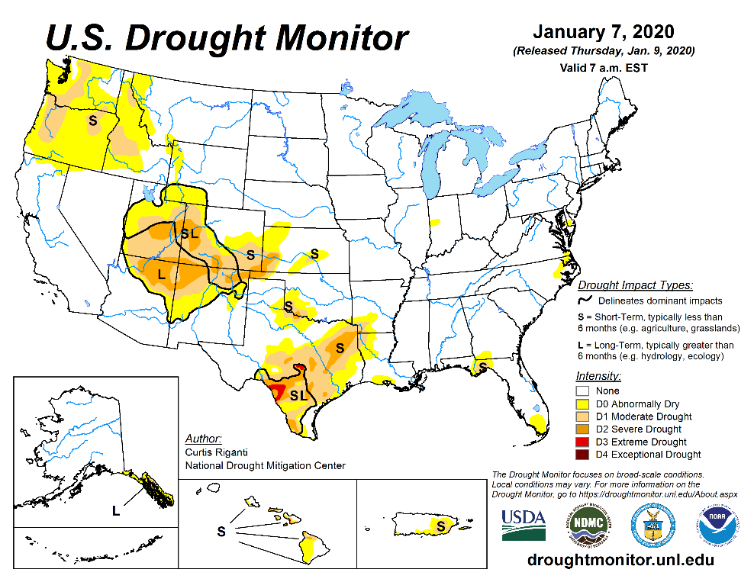
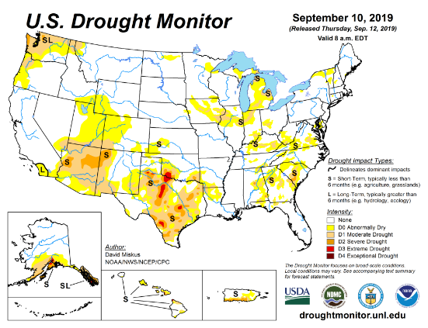
Drought Monitor
December
November
After reaching a relative minimum in the area of drought coverage across the US in April/May 2019, the drought area started to increase, peaked in October, and since then has decreased at least in the southeast. Only small pockets of mild short term drought exist in the southeast.
Drought in the four corner states (AZ/MM/UT/CO) has been vacillating in both intensity and shape.
Weak dryness is emerging on and off in the Pacific western states of CA, OR and WA.
October
Recent/Latest
September
February

Slide 3
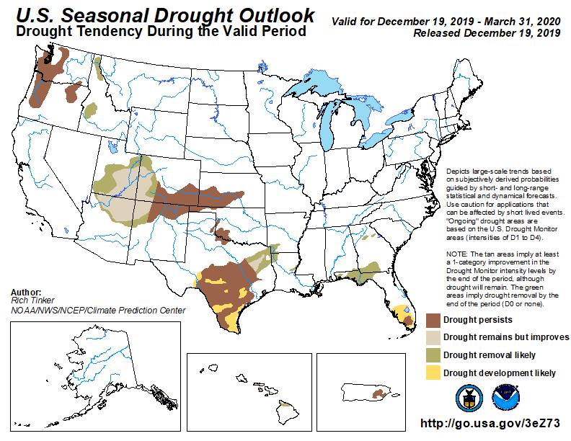
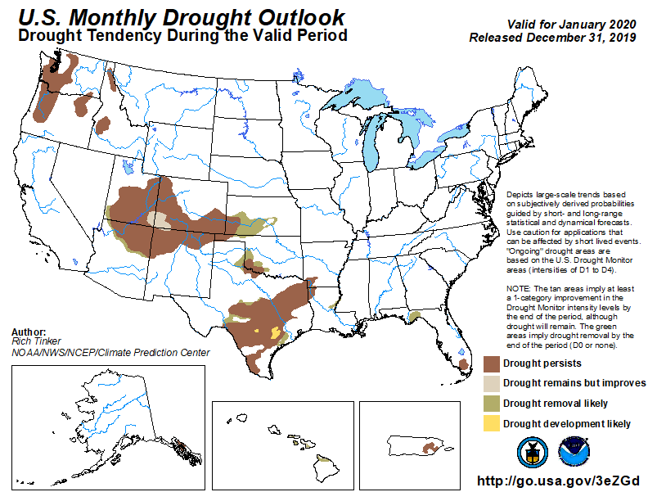
(Prev) Seasonal/Monthly Drought outlooks
(New Seasonal Drought Outlook to be released in 2 days!)
Seasonal Outlook
(Mid Dec 2019- Mar 2020)
issued 12/19/19
Monthly outlook
(for Jan 202)
issued 12/31/19

Slide 4
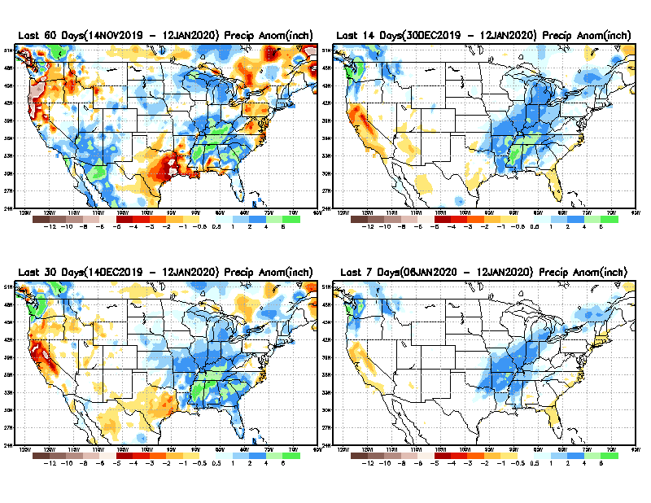
Precipitation ANOM during last 7, 14, 30, & 60 days.
60 Days
14 Days
These maps in this and following slides, including
a) Anom and b) Percent of precip. in these and other longer time ranges. Now daily updated at:
30 Days
7 Days
From: Recent Accumulated Precipitation https://www.cpc.ncep.noaa.gov/products/Drought/briefing_prcp.shtml

Slide 5
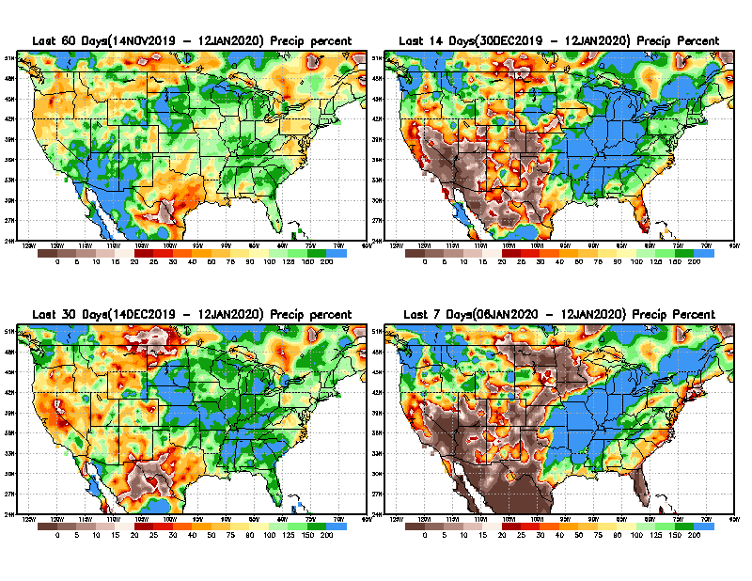
Precipitation Percent during last 7, 14, 30, & 60 days.
60 Days
14 Days
NOW !
In regions, where the rainfall season is strictly limited to a few months (say 3-4), even one month of acute rainfall deficit can be of concern !!
In other regions of relatively broad rainfall months, this need not be a big issue!!
30 days
7 Days
From: Recent Accumulated Precipitation https://www.cpc.ncep.noaa.gov/products/Drought/briefing_prcp.shtml

Slide 6
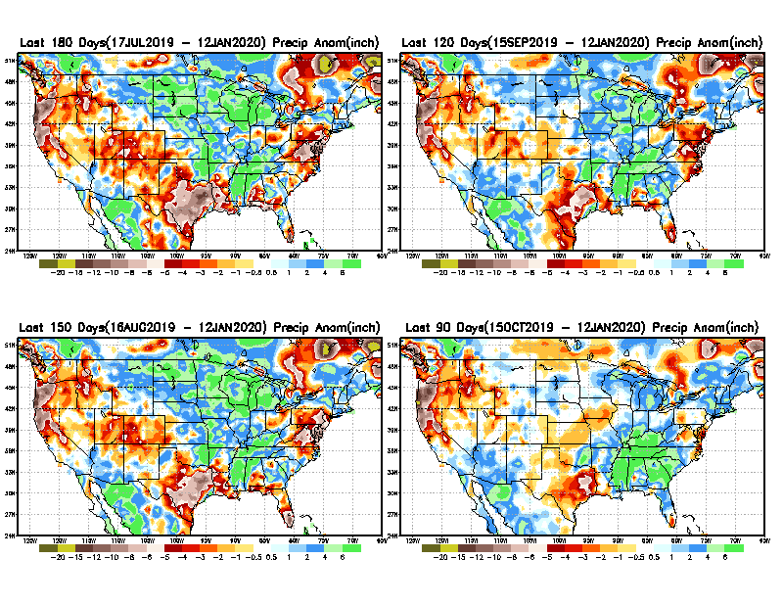
Total precipitation ANOM during last 3, 4, 5, and 6 months.
6 M
4 M
5 M
3 M
While the Precip anomalies deficit may seem large in some regions, it is the % of precip (next slide) that matters more!!
From: Recent Accumulated Precipitation https://www.cpc.ncep.noaa.gov/products/Drought/briefing_prcp.shtml

Slide 7
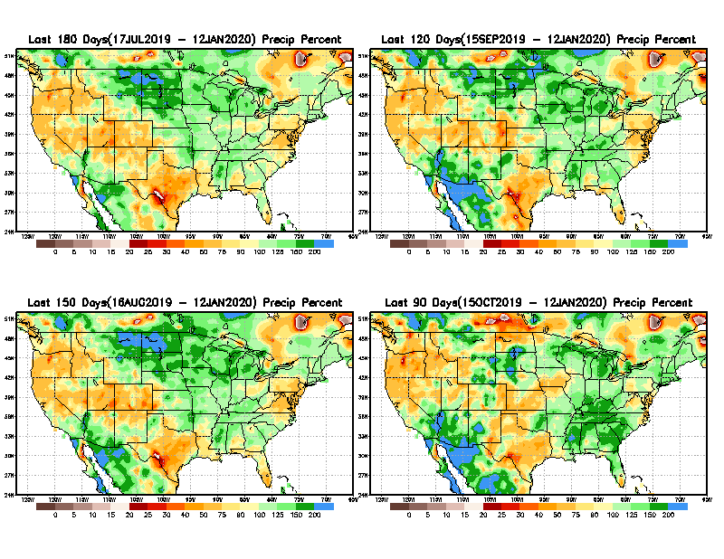
Total precipitation Percent during last 3, 4, 5, and 6 months.
6 M
4 M
In these interim time scale 3-6 months, we need to pay attention to regions, which are dark-red /red & brown (<50%)
5 M
3M
While accrued precipitation deficits are real,
droughts are declarations!!

Slide 8
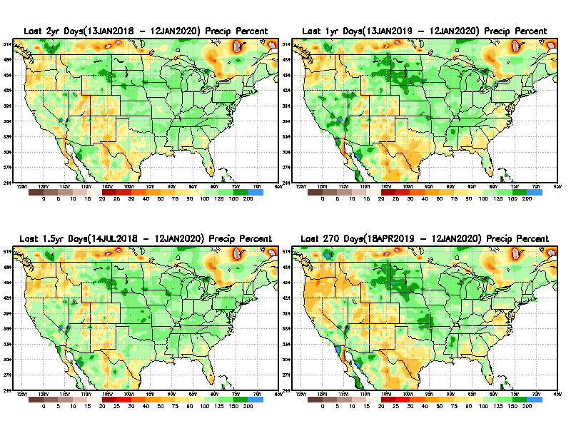
Total precipitation Percent during last 9 months, 1 yr, 1.5yrs, & 2 yrs.
2 Y
1 Y
1.5 Y
9 M
From: Recent Accumulated Precipitation https://www.cpc.ncep.noaa.gov/products/Drought/briefing_prcp.shtml

Slide 9
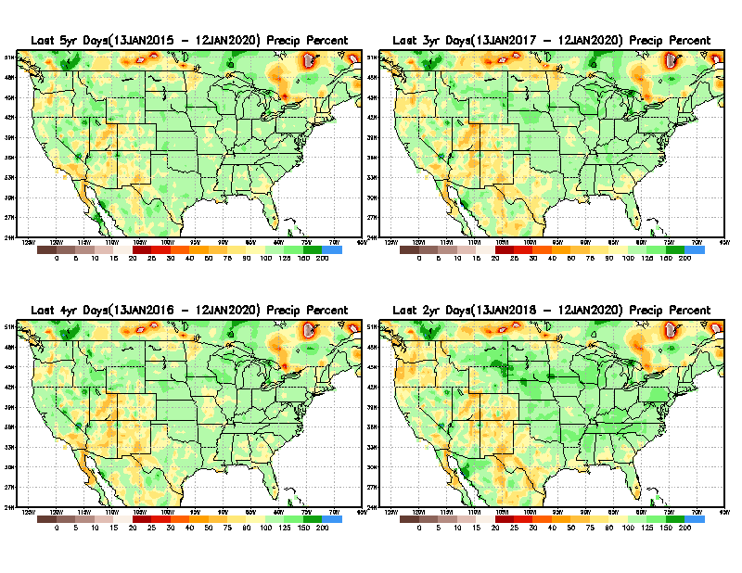
Total precipitation Percent during last 2 yrs, 3 yrs, 4 yrs, & 5 yrs.
5 Y
3 Y
Still longer term rainfall deficit variability in play? Especially in the southwest!
Will these deficits ever go away, OR is these part of the new norm??
Not so bad in the east!!
4 Y
2 Y
From: Recent Accumulated Precipitation https://www.cpc.ncep.noaa.gov/products/Drought/briefing_prcp.shtml

Slide 10
Rainy (3-month)Season across the US

Slide 11
Adapted from Rich Tinker.

Slide 12
Adapted from
Rich Tinker

Slide 13
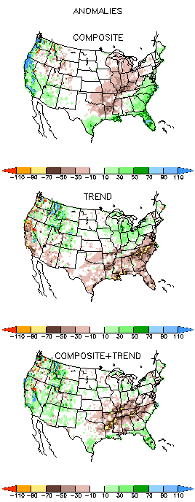
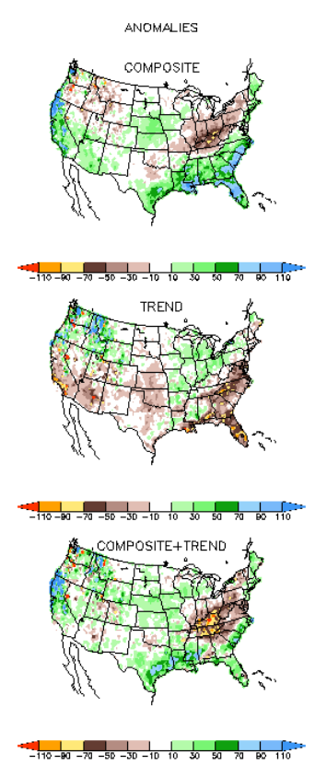
EL NINO Precip COMPOSITES & Trend maps
JFM
FMA
Only this is of relevance to us now due to neutral ENSO status.

Slide 14
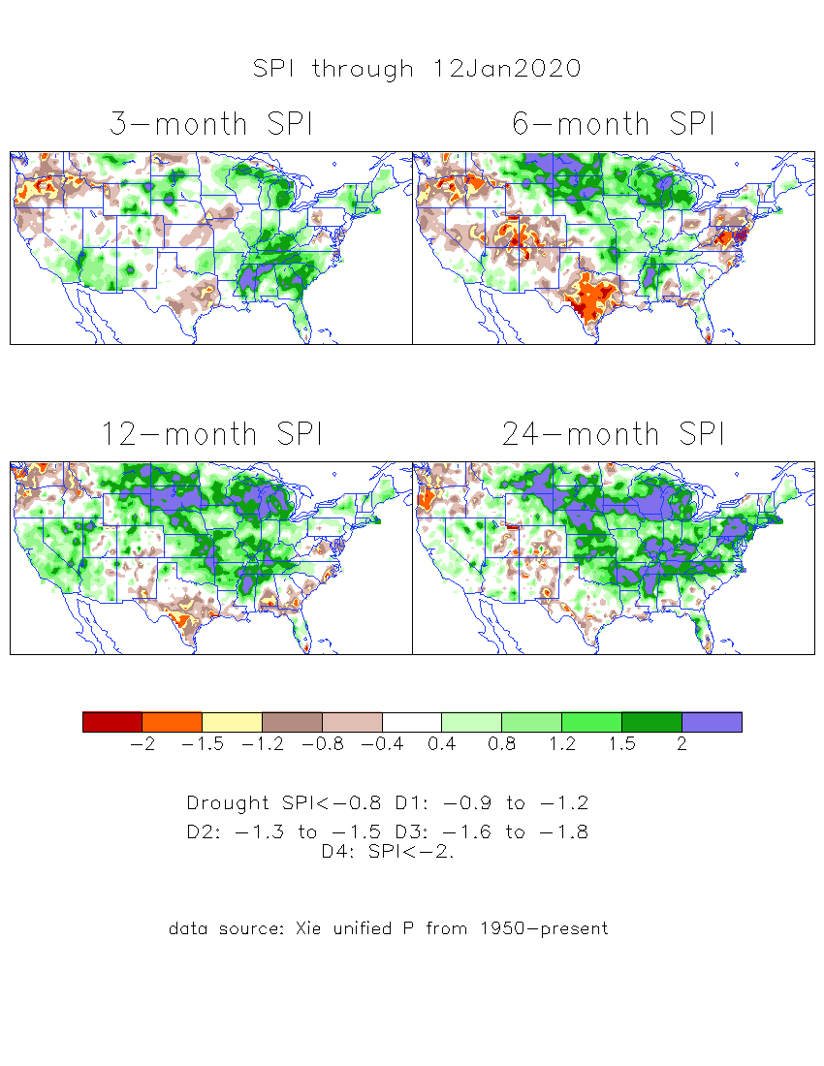
The Standardized Precipitation Index SPI (based on Observed P)
----- NOW
Very interesting graphic & details for the drought across the US based on the more generalized precip deficit/excess, the Standardized Precipitation Index (SPI).
The dark brown and red colors, indicating standardized precipitation deficits, in the various time periods, approximately correspond to the appropriate short/long term drought monitor regions and their intensities

Slide 15
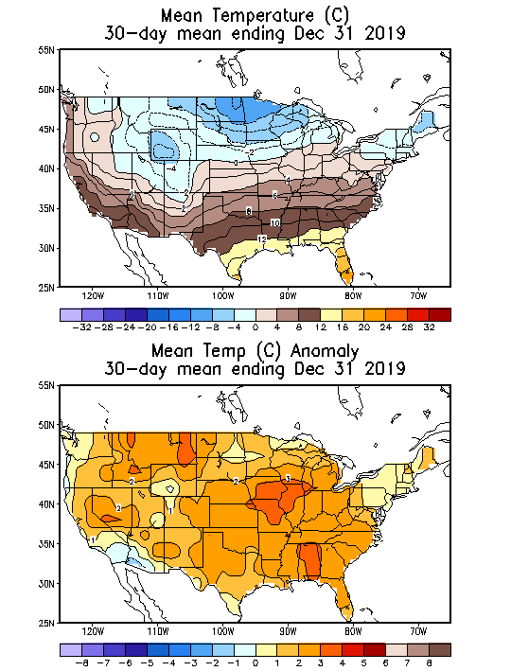
Recent US Temperatures

Slide 16
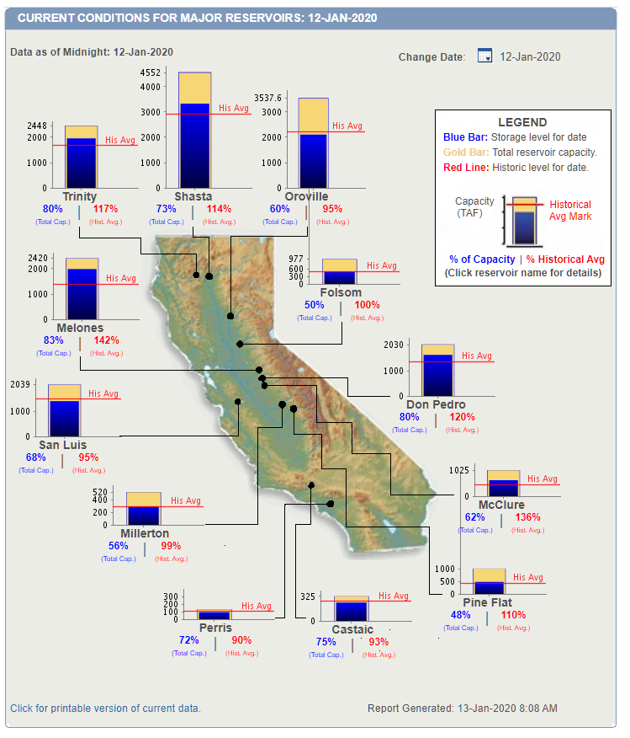
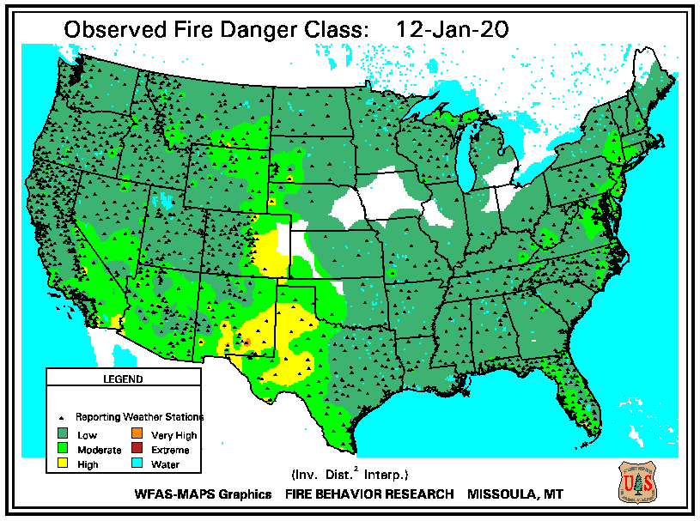
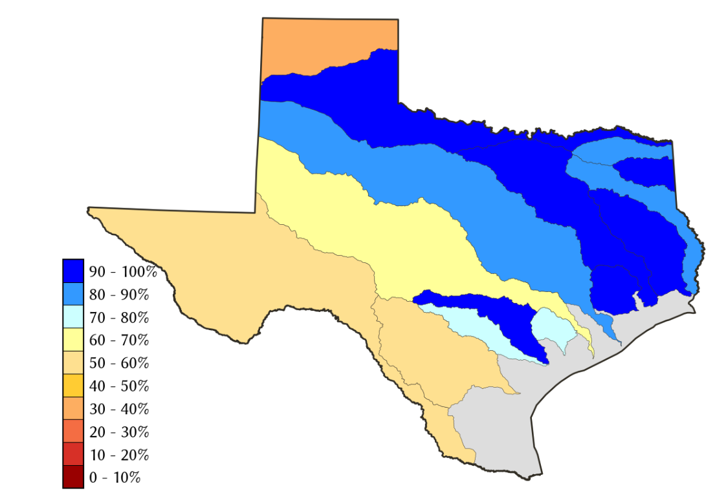
Water Reservoir Levels in some Western/Southern States! !
https://fsapps.nwcg.gov/afm/index.php
Except in few high elevations, all snow has melted.
Northern CA reservoirs beginning to show
Weakness, but rainy season coming up!
No reported major fire incidents now in the West/CA.
California reservoirs are at or above historic average levels.
TX
https://fsapps.nwcg.gov/afm/index.php

Slide 17
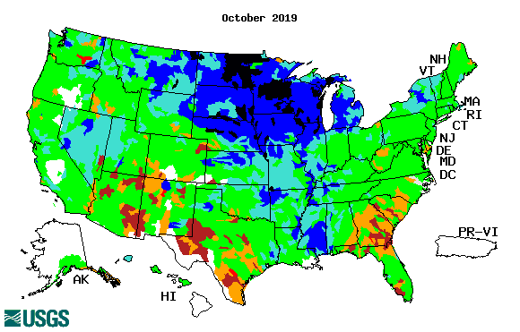
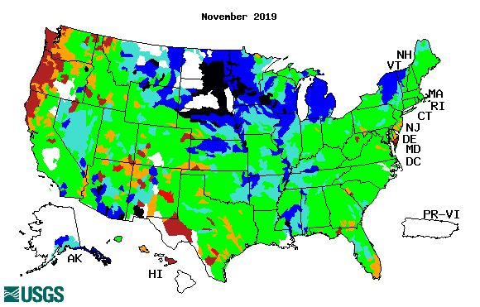
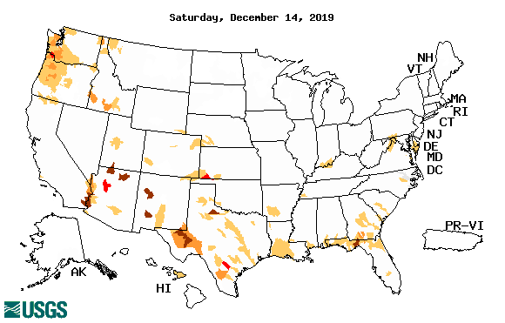
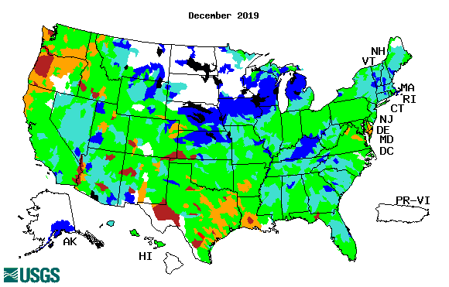
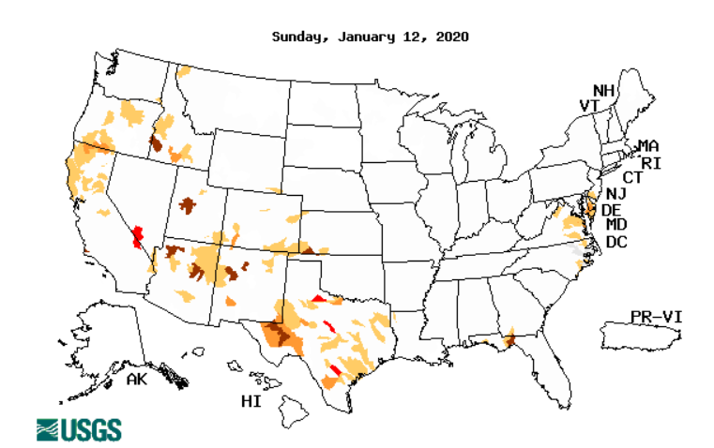
Streamflow (USGS)
Overall, worsened stream flow conditions in the southeast.
Slight improved conditions in the southwest.
Pacific NW much improved now.
Map shows only below normal 7-day average streamflow compared to historical streamflow for the day of year.
One month ago (left) &
Now (below)
17

Slide 18
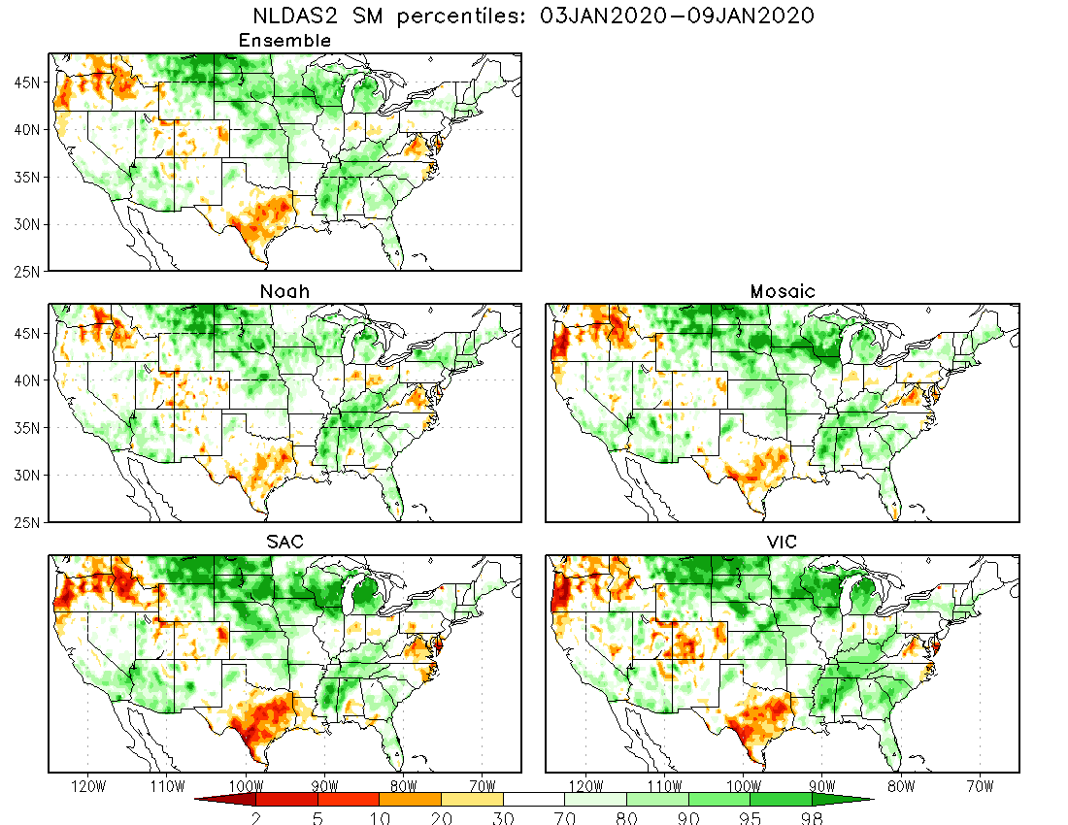

Slide 19
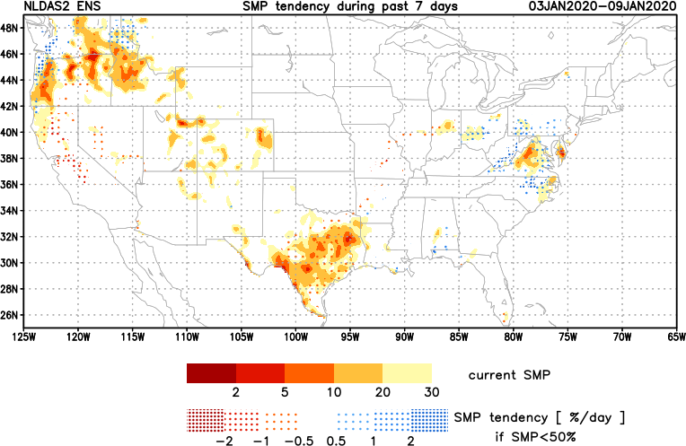
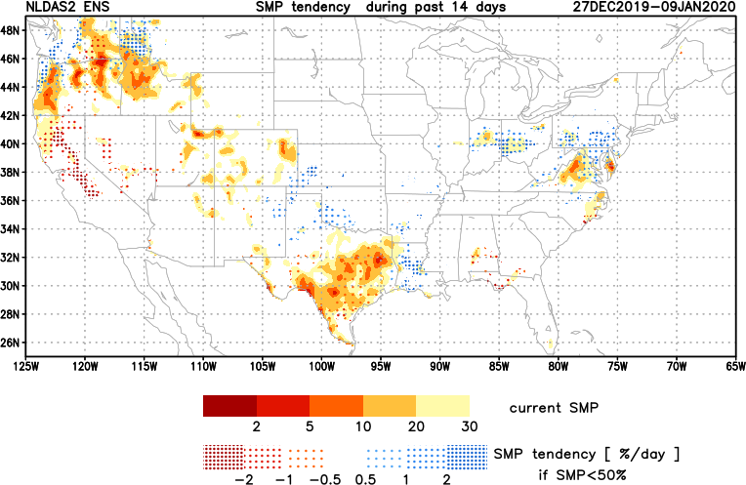
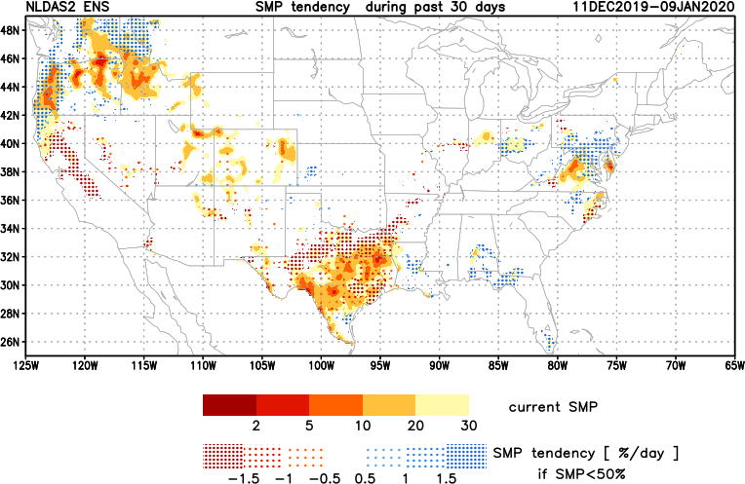
[Now]
NCEP Ensemble mean NLDAS2 models’ Soil Moisture tendency/trend
7 days
14 days
Drying soil moisture tendency over the last month in the drought affected regions, especially in the southeast.
30 days

Slide 20
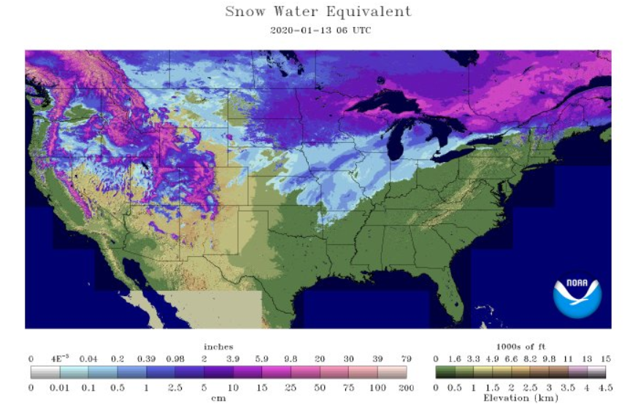
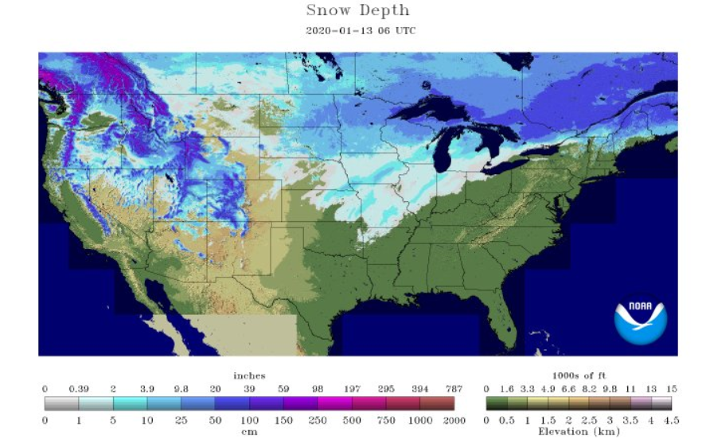
Snow cover

Slide 21
EL NIÑO/SOUTHERN OSCILLATION (ENSO)
DIAGNOSTIC DISCUSSION
issued by CLIMATE PREDICTION CENTER/NCEP/NWS and the International Research Institute for Climate and Society
13 January 2020
ENSO Alert System Status: Not Active
Synopsis: ENSO-neutral is favored through Northern Hemisphere spring 2020 (~60% chance), continuing through summer 2020 (~50% chance)

Slide 22
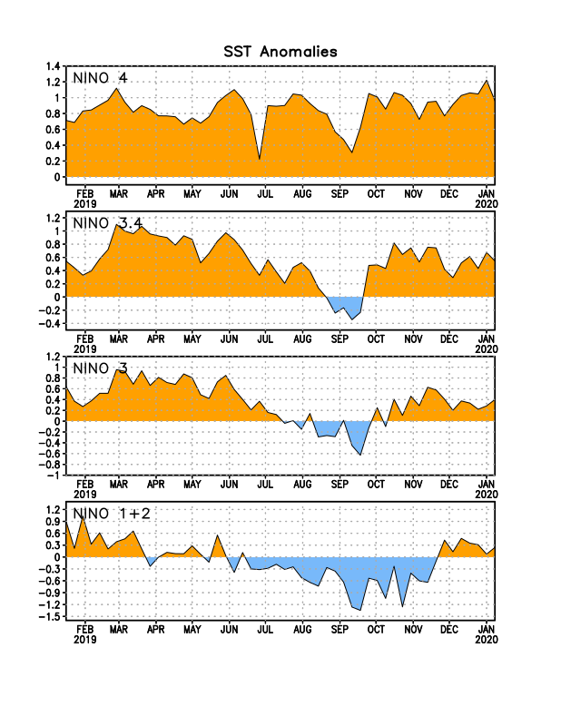
Latest values of SST indices in the various Nino Regions.
The sub surface heat anom has been vacillating for the past few months. Will we be in neutral territory for how long?

Slide 23
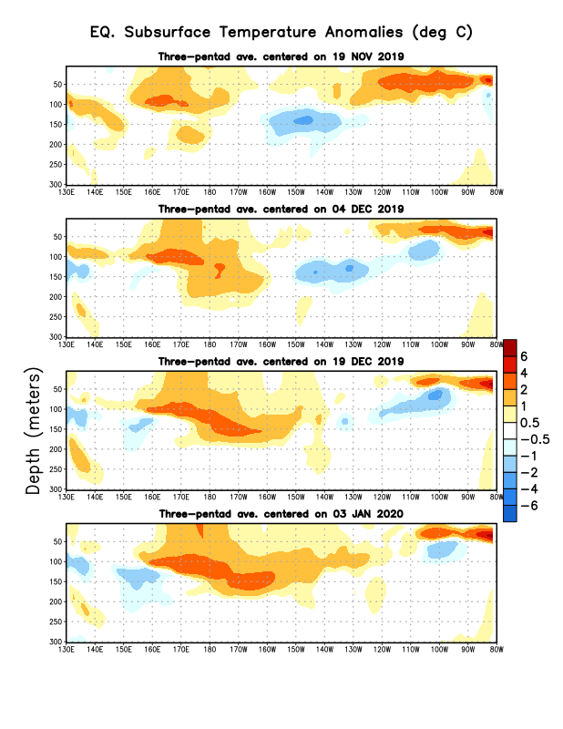
Sub-Surface Temperature Departures in the Equatorial Pacific
Most recent pentad analysis

Slide 24
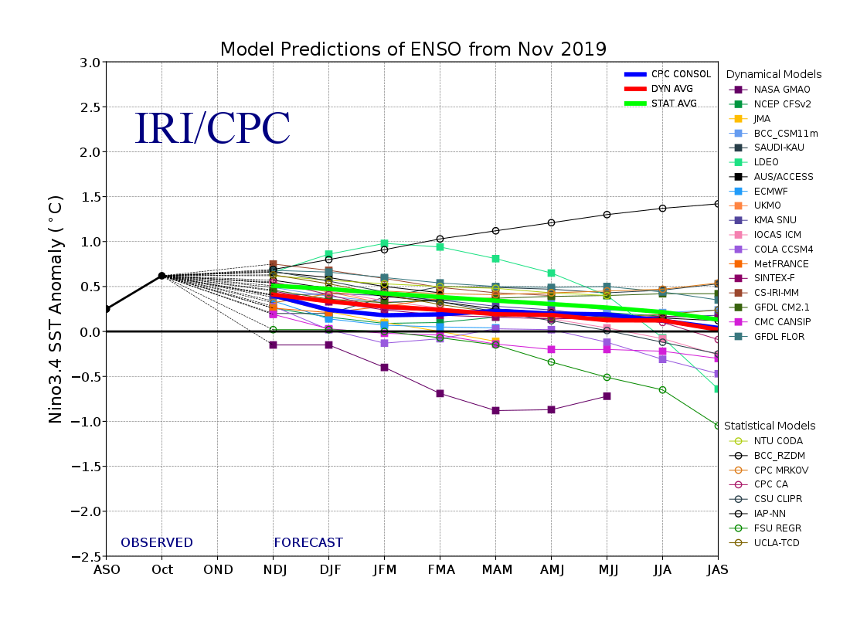
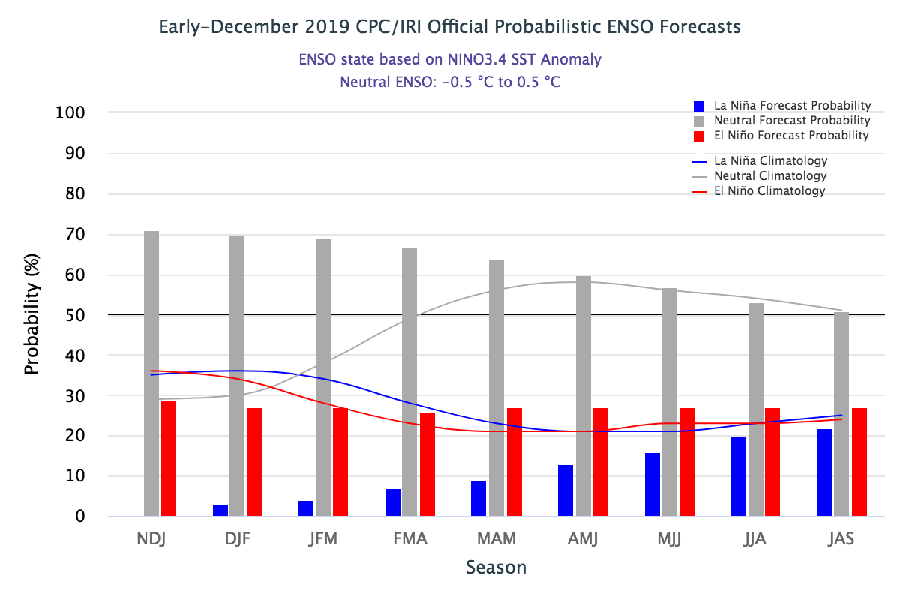
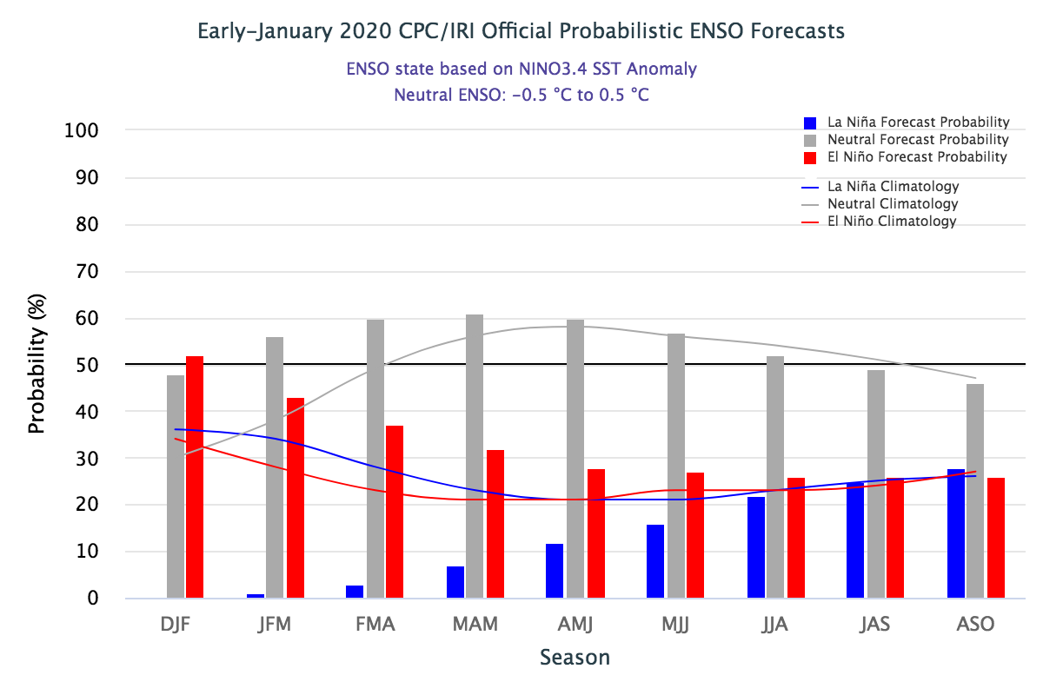
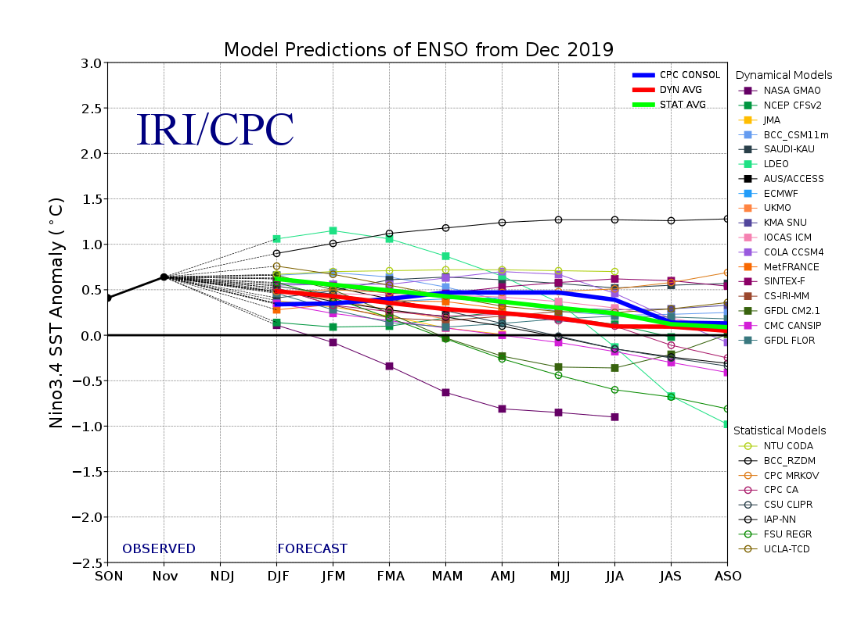
ENSO Forecasts
Early- December CPC/IRI forecast
Same neutral ENSO forecast as last month. But Neutral for how long? Or a swing to ?

Slide 25
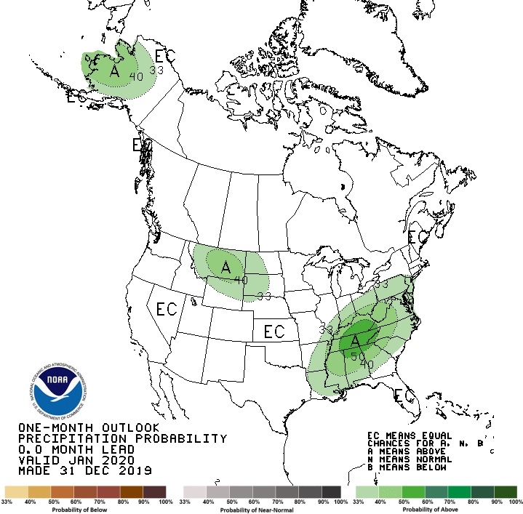
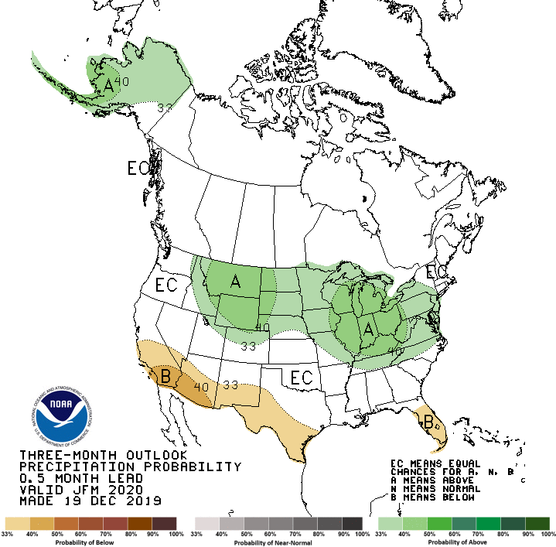
Released Dec 31th
Previous(Last month)
CPC’s official
Precipitation outlook for Monthly (Dec)/Seasonal (DJF)
Released Dec 19st
Observed so far this month!!
First half of month!
Second half month ?
Next slide!

Slide 26
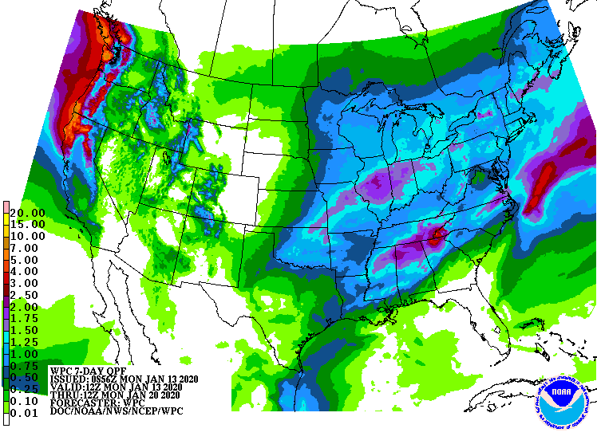
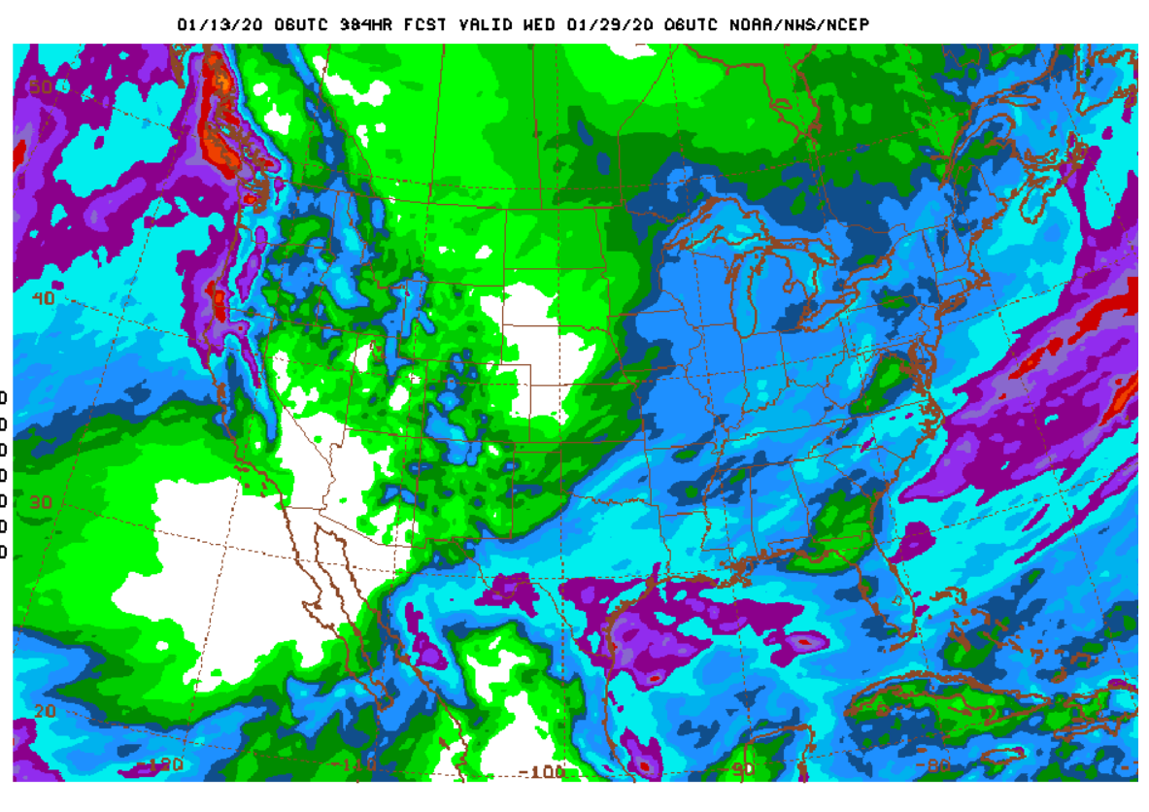
WPC Next 7 days QPF Forecast
GFS Model Guidance for next 16 days.

Slide 27
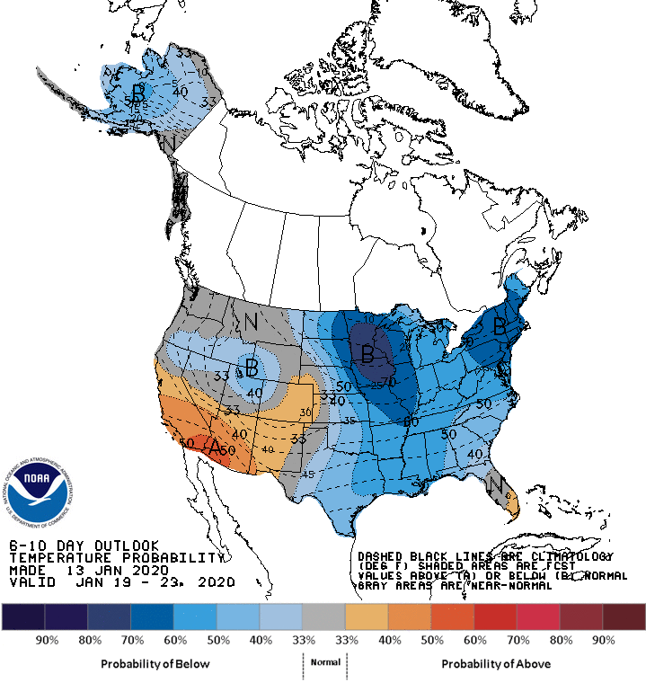
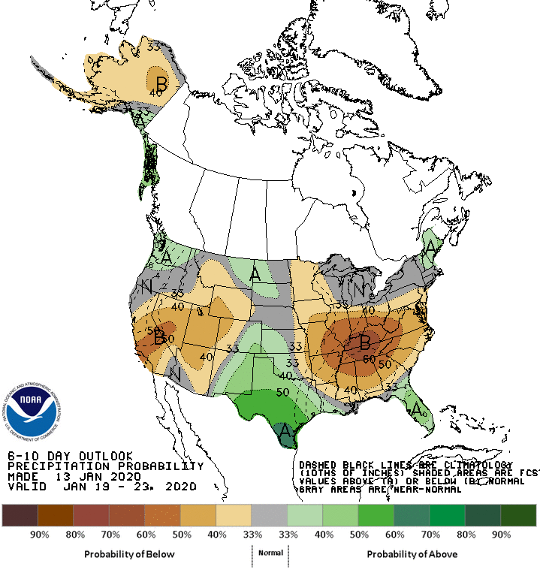
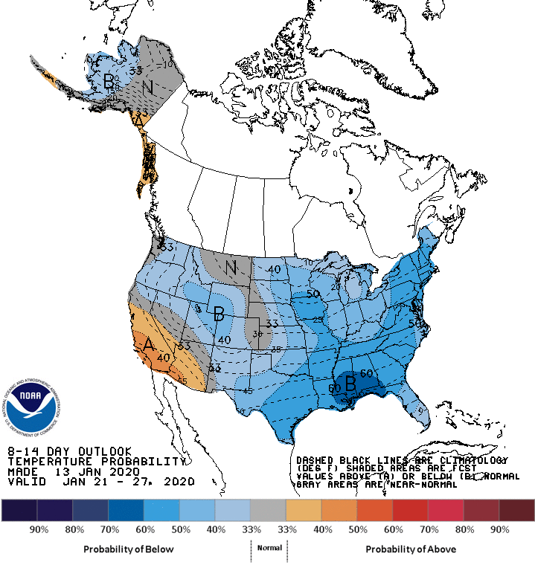
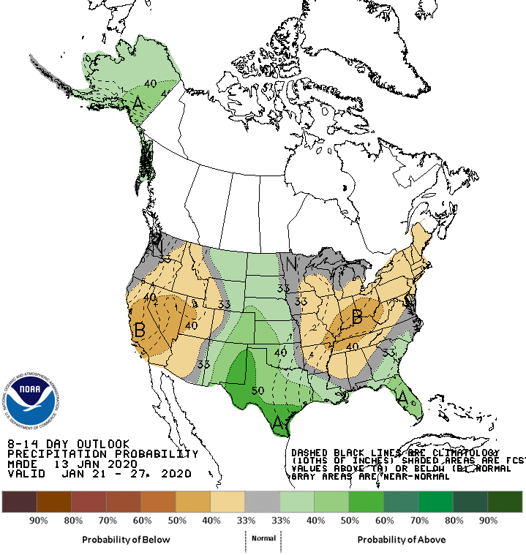
6-10 Day ERFs
8-14 Day ERFs

Slide 28
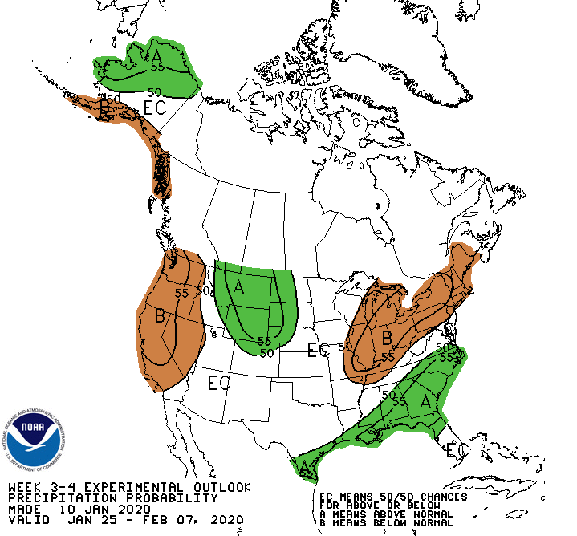
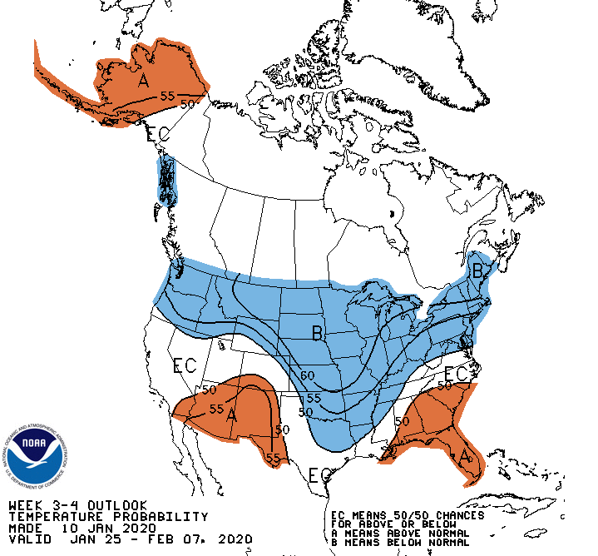
Week 3-4 Outlooks
(made 1/10/20)

Slide 29
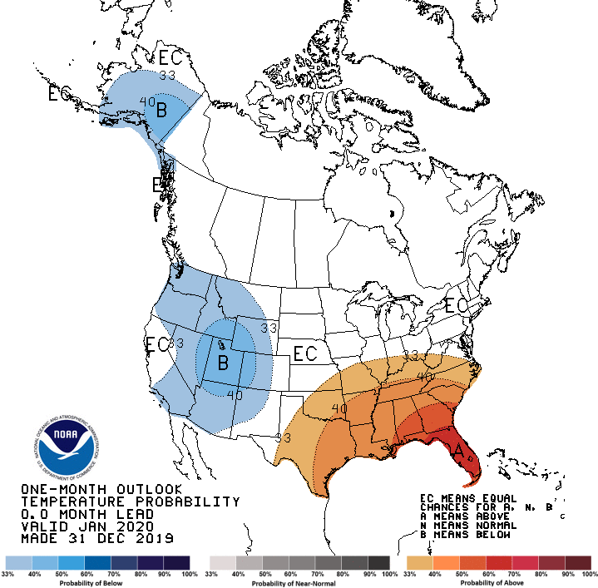
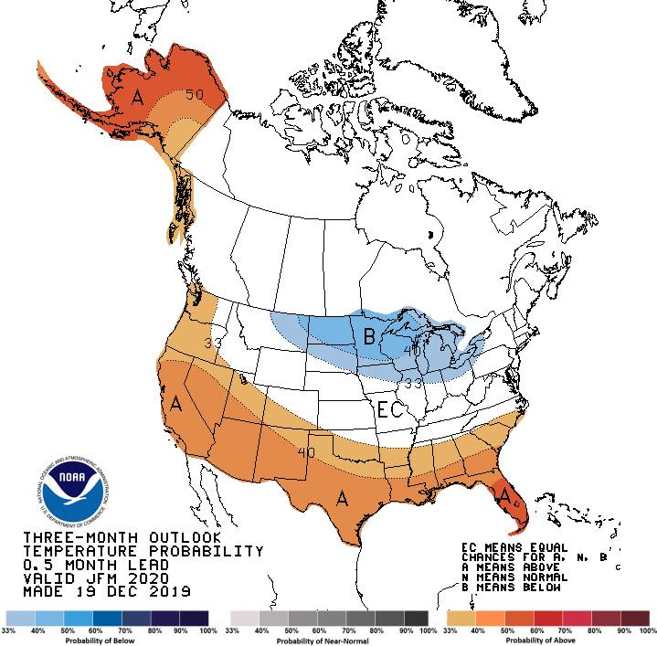
Made
Dec 31th
Previous (Last Month)
CPC’s official
Temperature outlook for Monthly (Dec)/Seasonal (DJF)
Made
Dec 19st
Observed so far this month!!

Slide 30
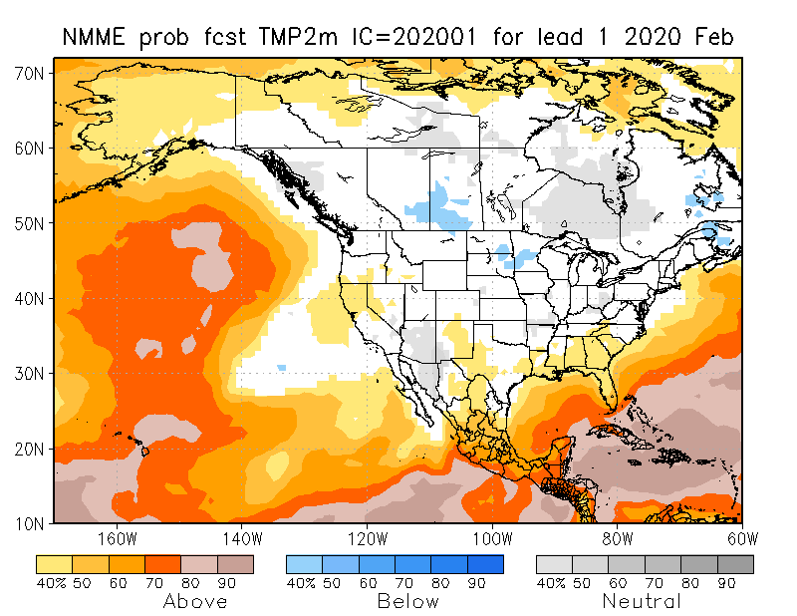
NMME T & P EnsMean forecasts
Feb
FMA

Slide 31
Forecast uncertain in Hatched areas.

Slide 34
http://drought.geo.msu.edu/research/forecast/smi.monthly.php
Initial Conditions:
01/07/2020
Predicted Monthly Soil Moisture Percentile
Initial Conditions 1 months ago:
12/03/2019
The inter quartile range suggest greater uncertainty about the forecast in these shaded regions.

Slide 35
Summary
Current ENSO status and forecast. ENSO-neutral conditions are present. ENSO-neutral is favored through Northern Hemisphere spring 2020 (~60% chance), continuing through summer 2020 (~50% chance).
Current Drought conditions:
After reaching a relative minimum in the area of drought coverage across the US in April/May 2019, the drought area started to increase in the south, which peaked in October, and since then has decreased at least in the southeast. Only scatter drought exist in the southeast.
Drought in the four corner states (AZ/MM/UT/CO) has been vacillating in both intensity and shape and even location. Drought continues to dominate southern Texas.
Weak dryness is emerging on and off in the Pacific western states of CA, OR and WA, and in Idaho, where the upcoming season is the rainy season.
California reservoirs, continue to be at better than historically average levels. CA’s 2019 wildfire season was not worse than previous devastating years.
Prediction:
Expected presence of near normal ENSO conditions in the tropical equatorial Pacific through winter and spring, is not helping with any confidence in the NMME model’s forecasts for precipitation.
Careful examination of the current precipitation deficiencies on many time scales across the United States and the extent/march of the compact/expanded rainy season in the drought affected and the precipitation deficit regions, will help guide the drought forecasters.
Based on these considerations, and the expected rainfall in the short term, further relief of the existing drought in the southeast is expected. The drought in the four corners region will get better in the short term but might persist in the long term, due to continued long term rainfall deficits in the region.
Next, the preliminary SDO:

Slide 36
Last 30-Days
10/1/19-1/13/20
1/13/20
>
>

Slide 37
Latest Preliminary 1-Month (Feb’20) LLFs

Slide 38
Latest Preliminary 3-Month (FMA’20) LLFs

Slide 39
Hawaii: All 4 locations favor above
normal precipitation at 1- & 3-Months.
Caribbean/Puerto Rico
JFM 2020 T & P Outlooks

Slide 40
Improve
SDO [FMA’20]
(1/7/20 USDM)
Persist
Develop
Persist
Improve
Improve
Considered Development,
but short-term & ERF wetness,
FMA climo dry
Improve
Persist
ERFs wetness; LLFs = EC;
FMA climo ~ dry (west)
Improve
Persist

Slide 41
Miscellaneous maps

Slide 42
Miscellaneous maps

