Slide 1
Drought Outlook Support Briefing January 2021
Climate Prediction Center/NCEP/NOAA
http://www.cpc.ncep.noaa.gov/products/Drought
Phone: 1-877-680-3341
Pwd: 858747#

Slide 2
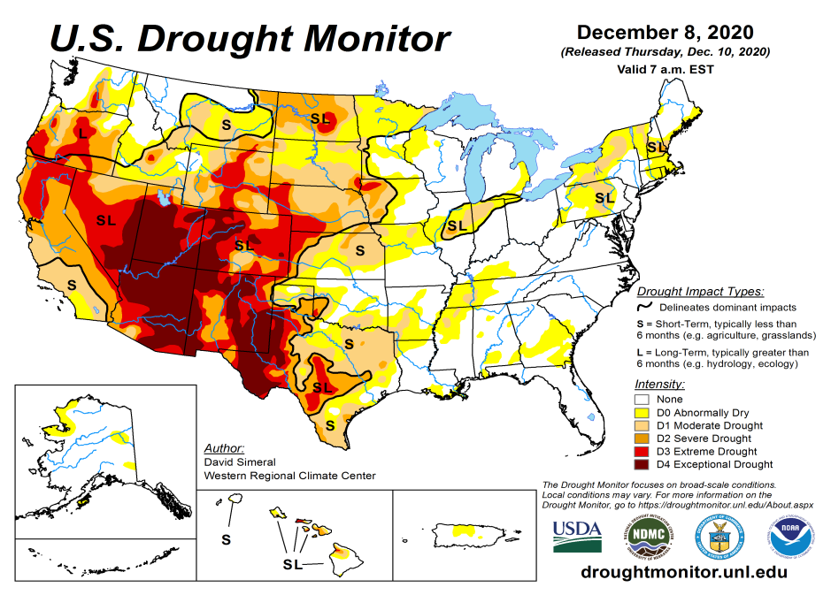
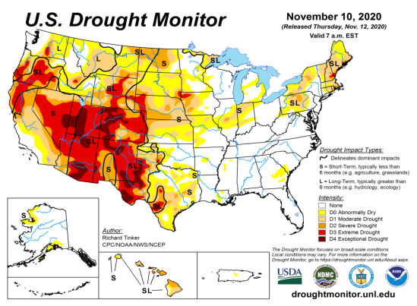
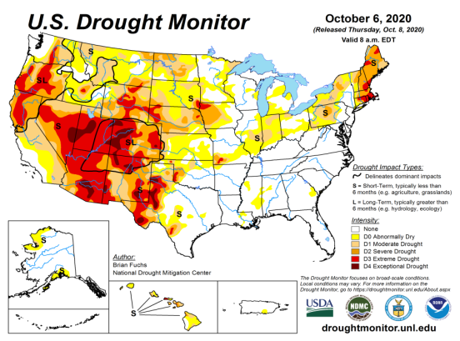
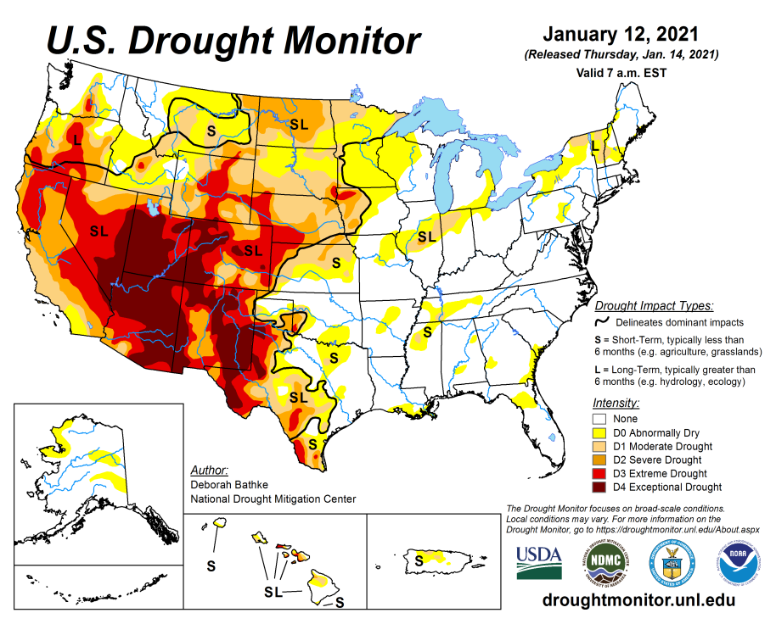
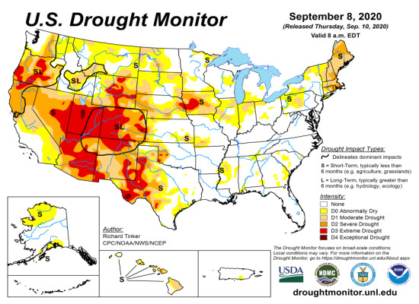
Drought Monitor
Monitoring is important because, unlike US T/P fcsts, for drought forecasts, we have to know where we are, before we can tell where we are going!! Drought forecasts are tendency forecasts.
December
November
Over the last several months, drought area & severity has overall generally increased across the South & West. The worse contiguous drought conditions are in the border areas of states CA, AZ, NV, & UT.
The drought in the Dakotas, Wyoming, Nebraska, Kansas and vicinity which developed late summer continues to hang in there.
About 50 % of the country is experiencing category D1 or worse drought condition.
Drought in the Northeastern (New England) states is finally and slowly beginning to get some relief and fade away.
Developing dryness in southeast.
October
January
(Recent/Latest)
September
February

Slide 3
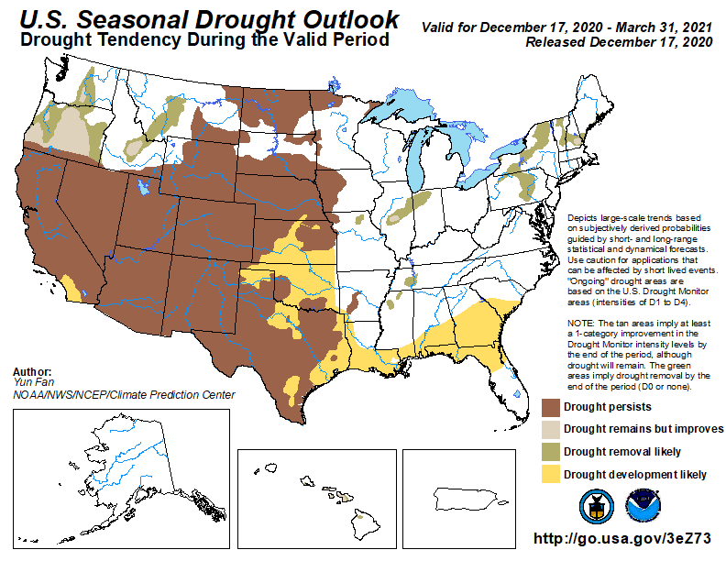
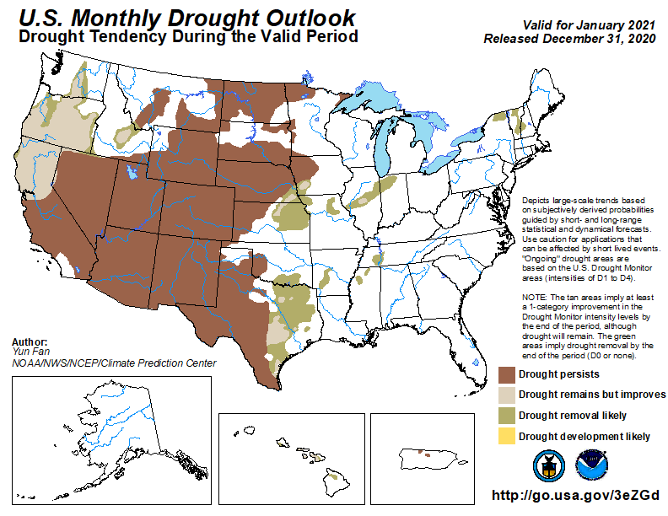
(Prev) Seasonal/Monthly Drought outlooks
(New Seasonal Drought Outlook to be released in 2 days!)
(New Monthly Drought Outlook to be released end of the month)
Seasonal Outlook
(Mid Dec 2020- Mar 2021)
issued 12/17/20
Monthly outlook
(for January 2020)
issued 12/31/20
Similar looking Monthly and seasonal outlooks, except in the southeast. New Drought is expected to emerge in the Southeast, and it is beginning to happen. Will that happen?
The ongoing La Nina and the associated below normal precip. across the southwest is increasing the drought affected areas.
Question: During this moderate La Nina winter, how well are the observed T/P monthly/seasonal patterns conforming to the canonical (expected) composite patterns?

Slide 4
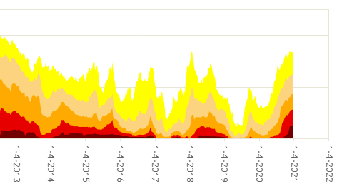
50%
The current % of area extents at D2/D3 or worse drought are approaching the drought during 2013 (the worst since 2000)?

Slide 5
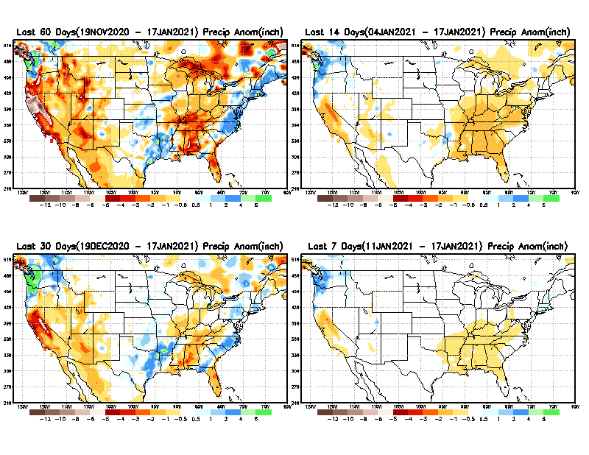
Precipitation ANOM during last 7, 14, 30, & 60 days.
60 Days
14 Days
These maps in this and following slides, including a) Total,
b) Anom and
c) Percent of Normal precip. in these and other longer time ranges are now (routinely) daily updated at:
30 Days
7 Days
From: Recent Accumulated Precipitation https://www.cpc.ncep.noaa.gov/products/Drought/briefing_prcp.shtml

Slide 6
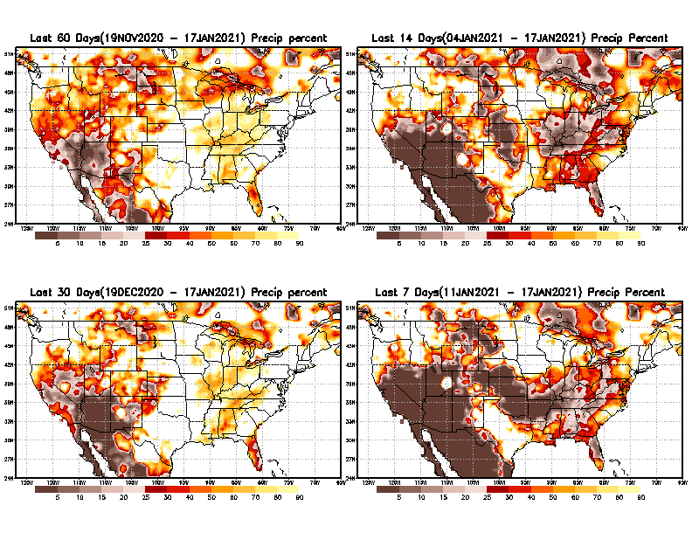
Precipitation Percent during last 7, 14, 30, & 60 days.
60 Days
14 Days
This plot shows only the rainfall deficient regions <= 90% of normal.
-- This shows more clearly possible/likely drought developing region in the future unless there is above normal rainfall in these regions in the future, to offset these shortfalls.
30 days
7 Days
From: Recent Accumulated Precipitation https://www.cpc.ncep.noaa.gov/products/Drought/briefing_prcp.shtml

Slide 7
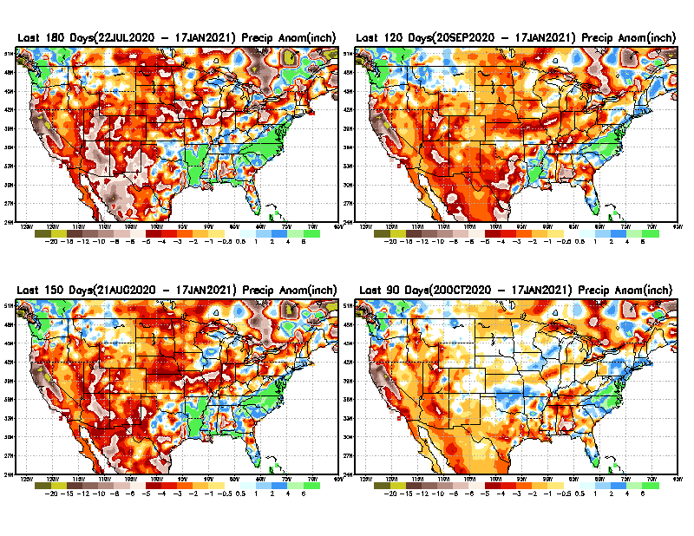
Total precipitation ANOM during last 3, 4, 5, and 6 months.
6 M
4 M
While the Precipitation anomalies deficit may seem large in some regions (compared to others), it is the % of normal precip (next slide) that matters more!!
5 M
3 M
From: Recent Accumulated Precipitation https://www.cpc.ncep.noaa.gov/products/Drought/briefing_prcp.shtml

Slide 8
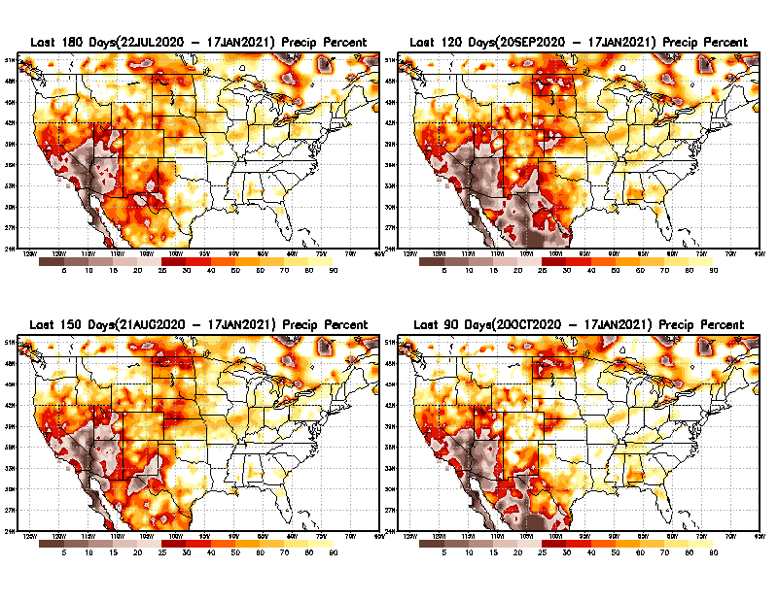
Total precipitation Percent during last 3, 4, 5, and 6 months.
6 M
4 M
In these interim time scale 3-6 months, we need to pay attention to regions, which are dark-brown, red & dark red (<50%).
While accrued precipitation deficits are real & objective,
droughts are subjective declarations!!
5 M
3M
East vs West!
Broad vs Narrow
rainfall season.
In general, West suffers more from frequent and lasting droughts.
With these various rainfall deficits in diff. time ranges, where and how exactly does one declare drought? Other factors (T/SM/E, etc..) do matter, but is cumulative precip. Are deficits/percent_of_normal ultimately more important?

Slide 9
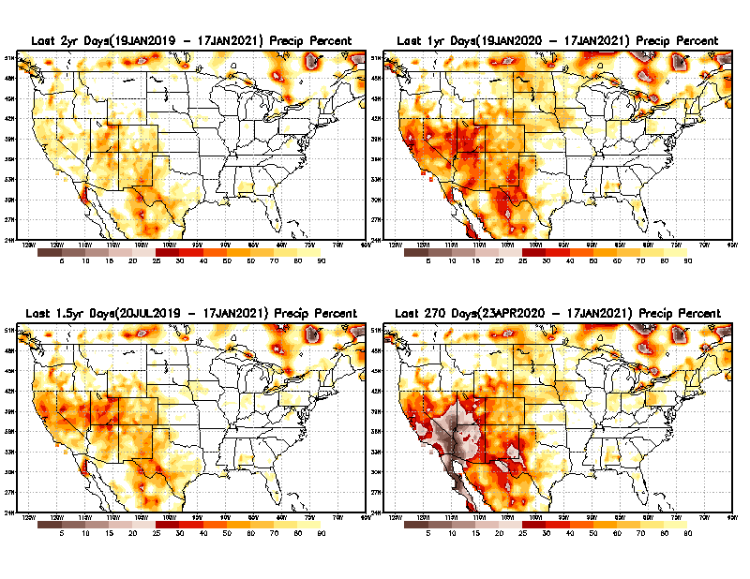
Total precipitation Percent during last 9 months, 1 yr, 1.5yrs, & 2 yrs.
2 Y
1 Y
Tinderbox areas, where some form of longer term rainfall
deficiencies already, exist !!
-Almost all are in the southwest!
-This & Next slide!!
1.5 Y
9 M
From: Recent Accumulated Precipitation https://www.cpc.ncep.noaa.gov/products/Drought/briefing_prcp.shtml

Slide 10
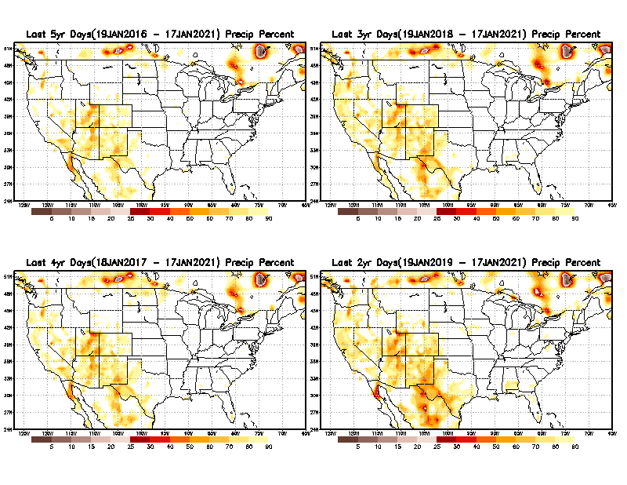
Total precipitation Percent during last 2 yrs, 3 yrs, 4 yrs, & 5 yrs.
5 Y
3 Y
In these long time ranges (2-5 yrs), there is a general dearth/lack of precipitation in the southwest US. – where the current severe drought ravages!!. At the end of this current ongoing La Nina the long term situation will get even worse!!
4 Y
2 Y
From: Recent Accumulated Precipitation https://www.cpc.ncep.noaa.gov/products/Drought/briefing_prcp.shtml

Slide 11
Rainy (3-month)Season across the US
East vs West!
More darker colors in regn. central/west => narrow rainy season (months)
Overall, more white space in the east -> distributed rainfall season (except ~FL).

Slide 12
*********
EAST vs
CTR/WEST
Behavior in Drought is loosely tied to rainfall climo!!
*********
Adapted from Rich Tinker.

Slide 13
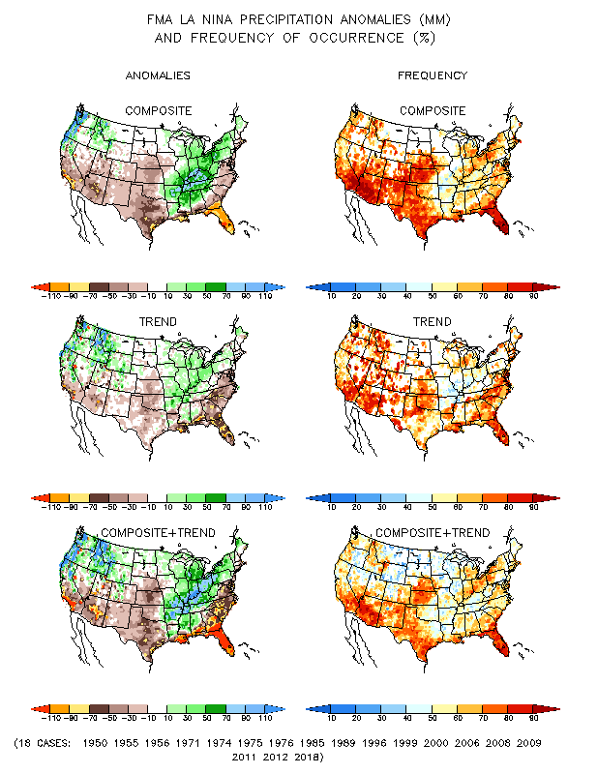
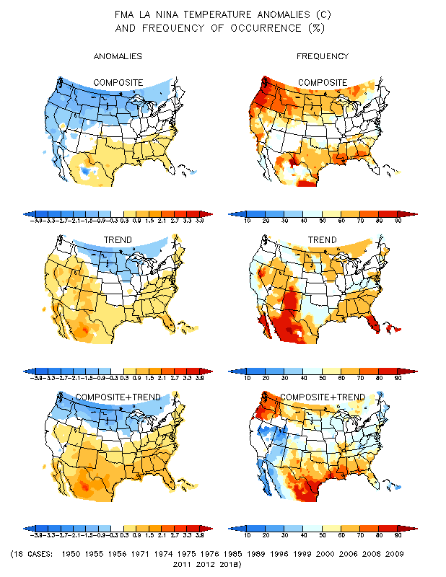
La Nina Precip/Temperature COMPOSITES & Trend map
FMA
P
T
WET
DRY

Slide 14
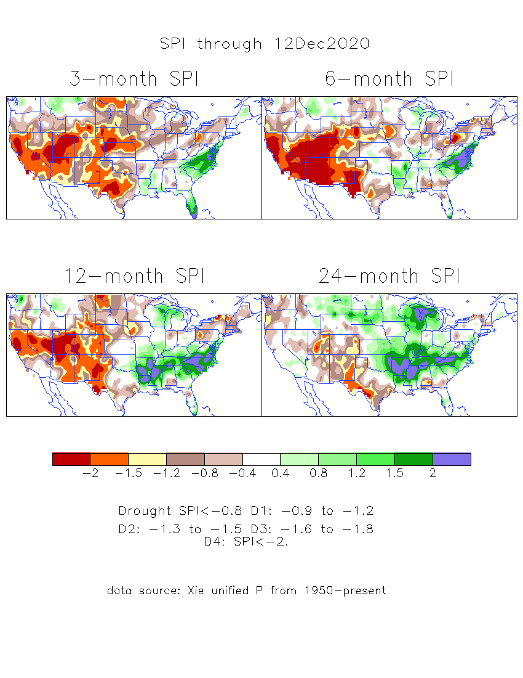
The Standardized Precipitation Index SPI (based on Observed P)
----- Last Month
Very interesting graphic & details for the drought across the US based on the more generalized precip deficit/excess, the Standardized Precipitation Index (SPI).
The dark brown and red colors, indicating standardized precipitation deficits, in the various time periods, approximately correspond to the appropriate short/long term drought monitor regions and their intensities

Slide 15
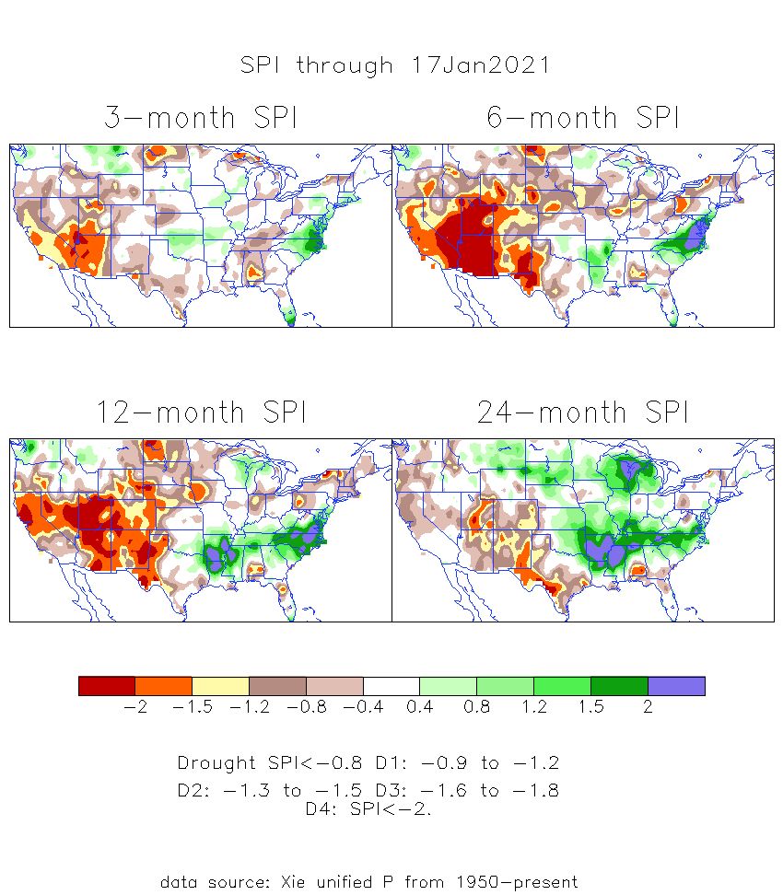
The Standardized Precipitation Index SPI (based on Observed P)
----- NOW
Very interesting graphic & details for the drought across the US based on the more generalized precip deficit/excess, the Standardized Precipitation Index (SPI).
The dark brown and red colors, indicating standardized precipitation deficits, in the various time periods, approximately correspond to the appropriate short/long term drought monitor regions and their intensities
The 3-month has actually better now than last month in the west!
----- NOW
How does one negotiate and reconcile declaring short term vs long term drought when precip. deficiencies patterns differ on many different time scales locally!!
What is the cutoff delineating time between short VS long term drought!!

Slide 16
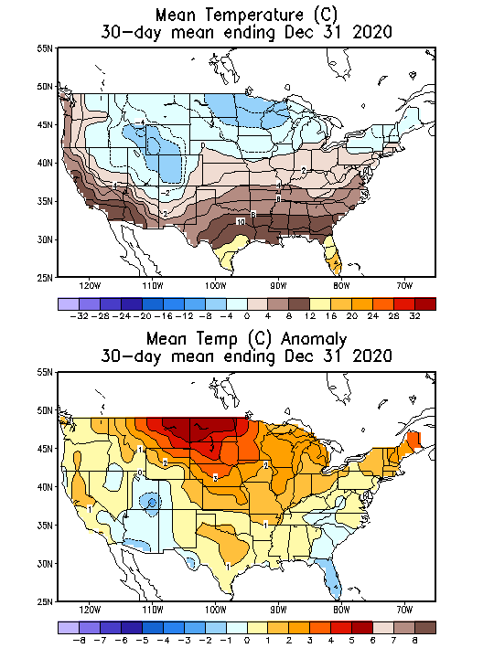
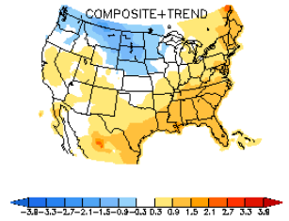
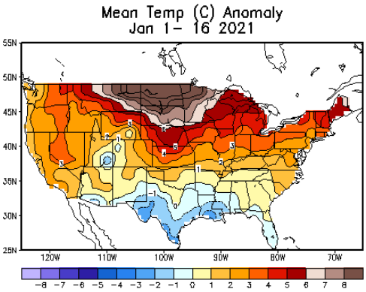
Recent US Temperatures
Canonical La Nina T - DJF
So far this winter, observed T anom are almost opposite of the La Nina Composites!!

Slide 17
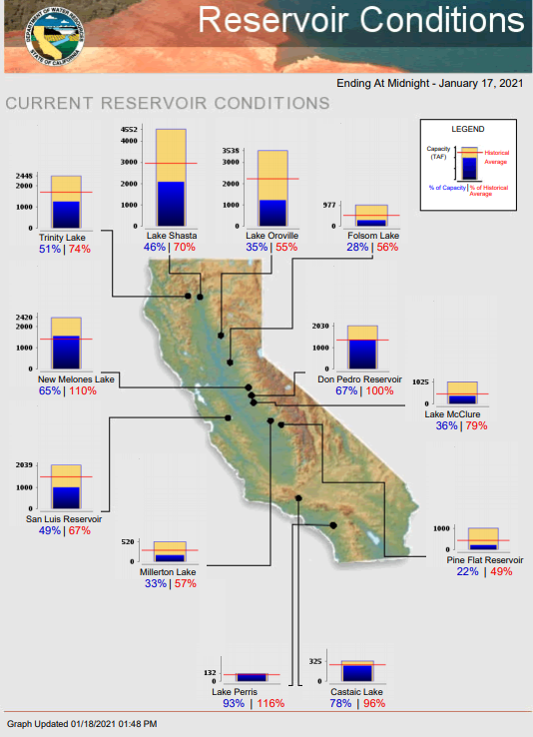
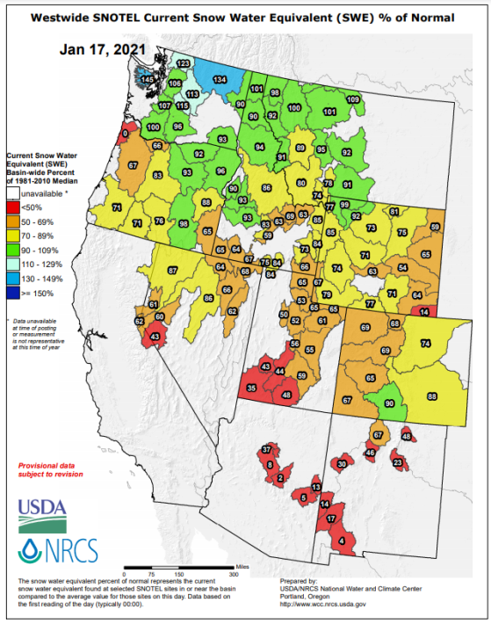
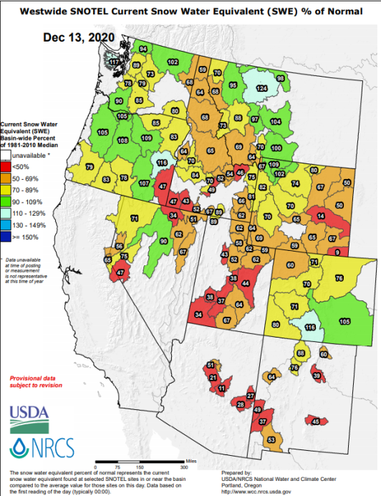
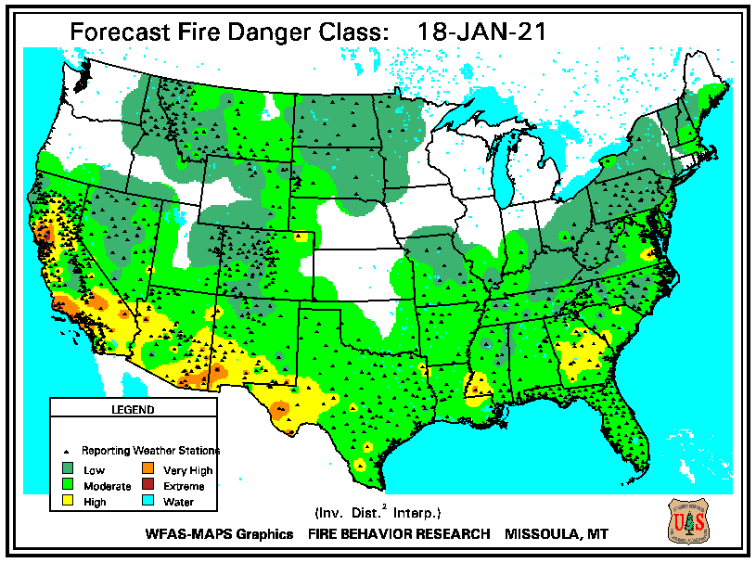
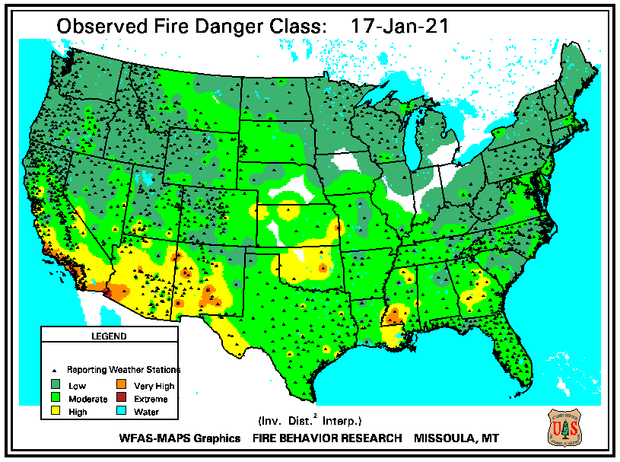
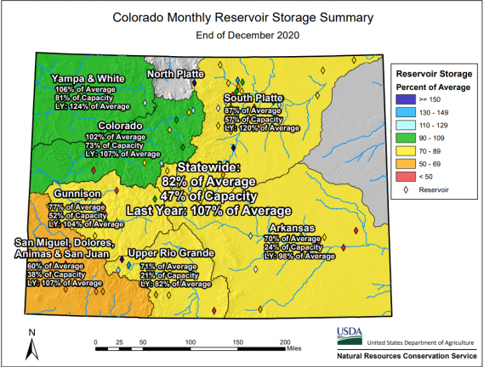
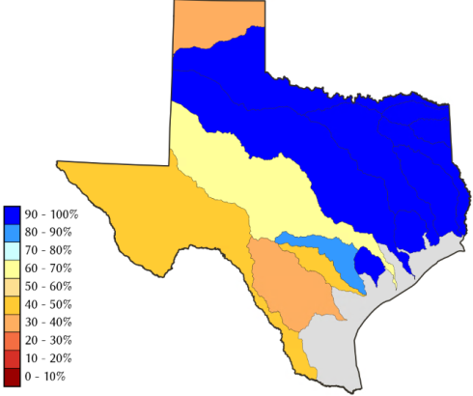
THIS MONTH
LAST MONTH
https://fsapps.nwcg.gov/
CO
Many CA reservoirs are at “below historical average levels”!!
TX
82 %
of AVG!
La Nina is here in full force thru winter!!
Impact at end of rainy season ? water reservoir levels??

Slide 18
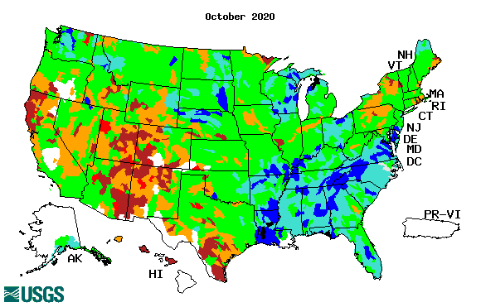
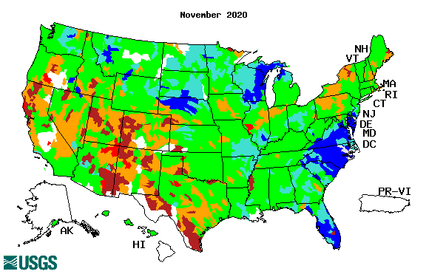
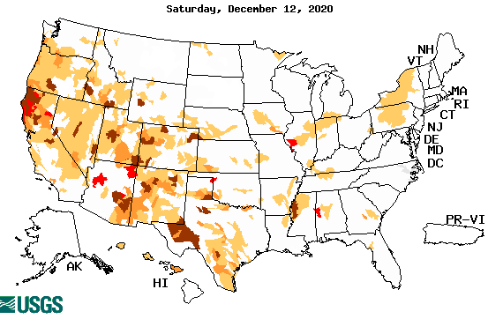
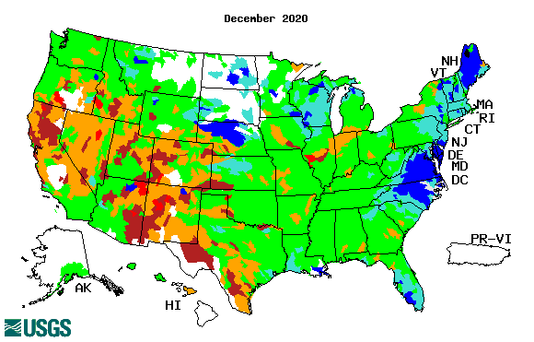
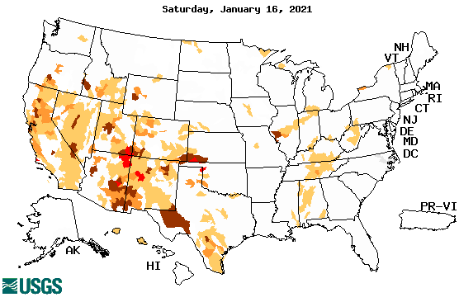
Streamflow (USGS)
Worse conditions in the southwest, in the monsoon region.
Northeast drought considerably improved.
Pacific NW much improved now.
Map shows only below normal 7-day average streamflow compared to historical streamflow for the day of year.
One month ago (left) &
Now (below)
Note:
CA,
TX,
Maine/
Northeast
Except for the NE, overall worsened drought/drier conditions across the south and west!!
18

Slide 19
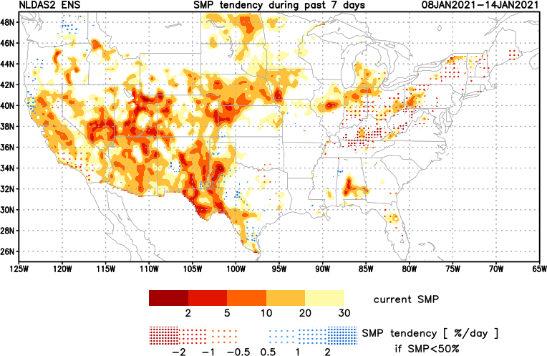
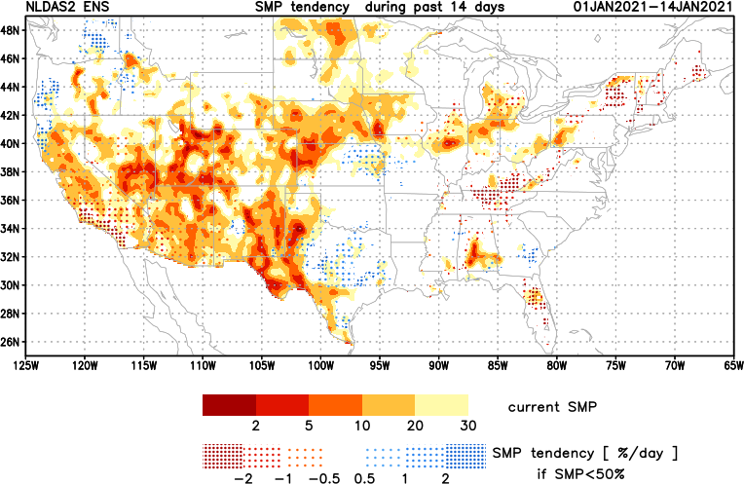
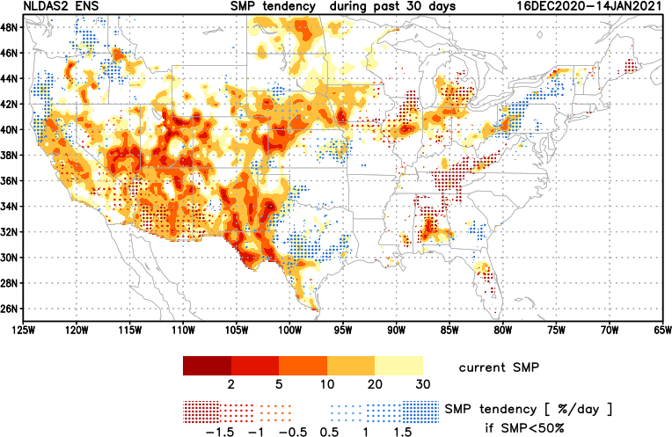
[Now]
NCEP Ensemble mean NLDAS2 models’ Soil Moisture tendency/trend
7 days
14 days
30 days
Western half, mostly straightforward!
Eastern half, east of TX, somewhat mixed picture.

Slide 20
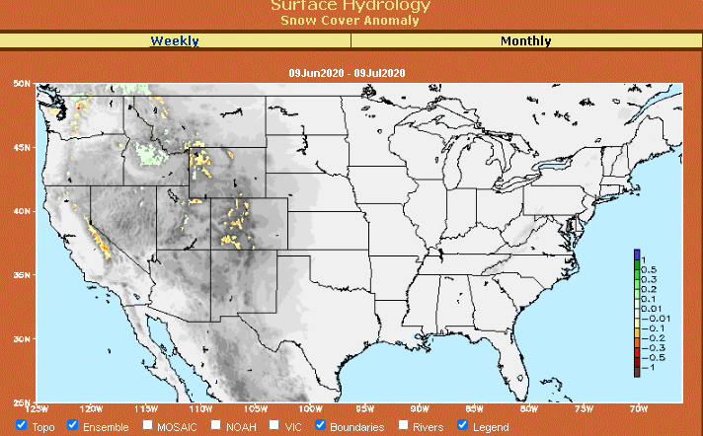
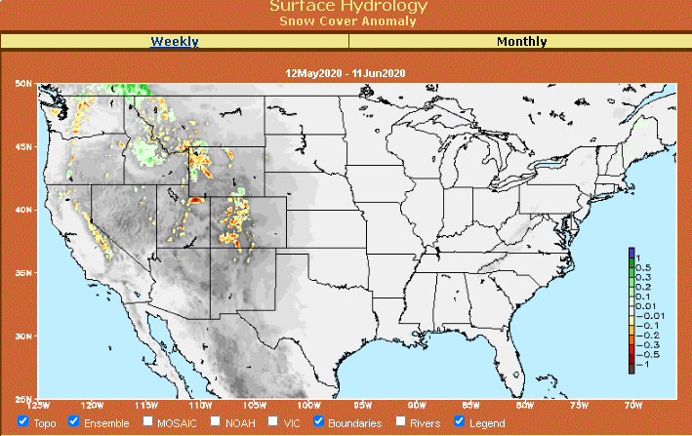
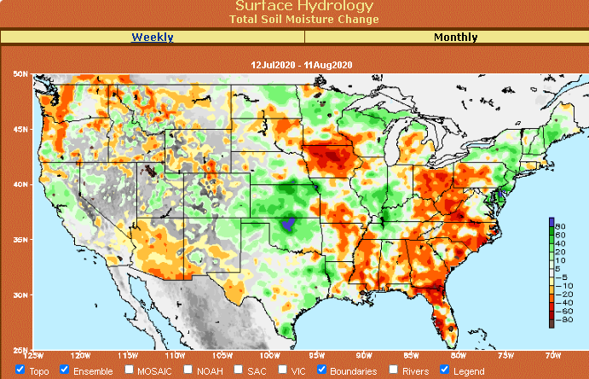
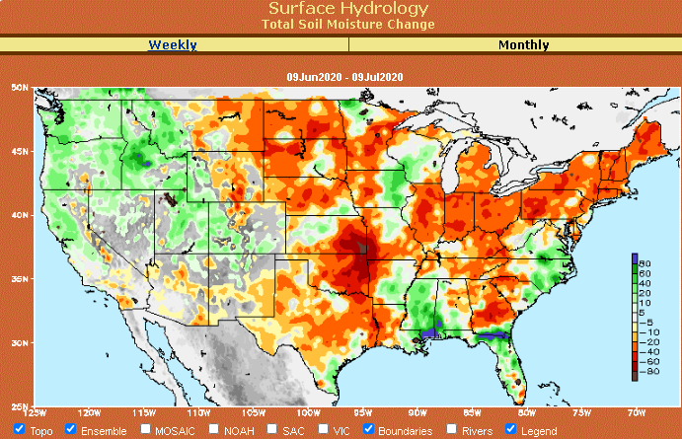
Snow cover & Soil Moisture Anomalies
Snow cover
SLIDE
NOT SHOWN!
Last month ~ this time
Now
Look further for areas of drought development

Slide 21
EL NIÑO/SOUTHERN OSCILLATION (ENSO)
DIAGNOSTIC DISCUSSION
issued by CLIMATE PREDICTION CENTER/NCEP/NWS and the International Research Institute for Climate and Society
14 January 2021
ENSO Alert System Status: La Nina Advisory
Synopsis: La Niña is expected to continue through the Northern Hemisphere winter 2020-21 (~95% chance during January-March), with a potential transition to ENSO-neutral during the spring 2021 (55% chance during April-June).

Slide 22
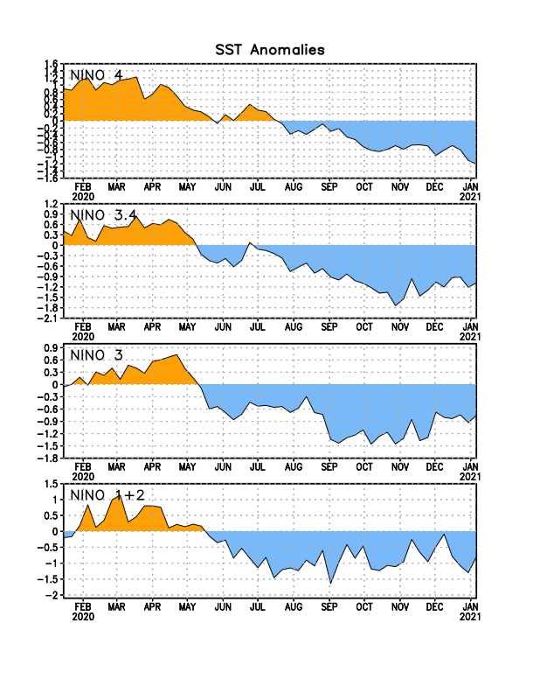
Latest values of SST indices in the various Nino Regions.
This is the most blue! (cold) in all 4 indices (see left) in a while. Subsurface ocean heat anomalies are also cold!!

Slide 23
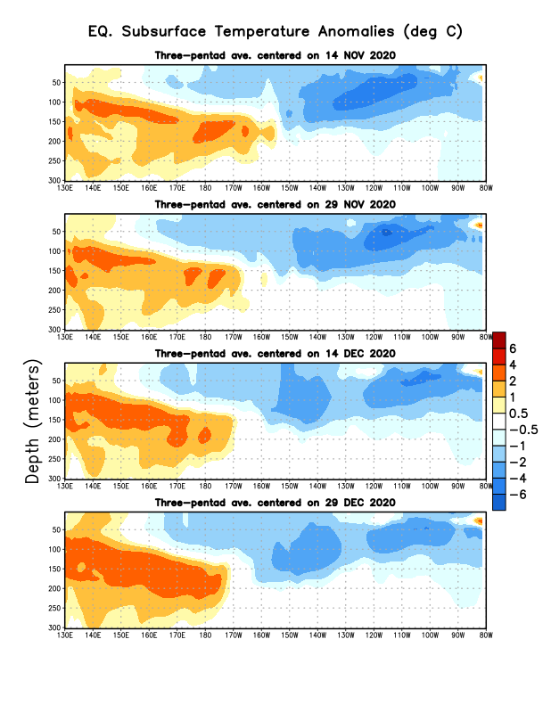
Sub-Surface Temperature Departures in the Equatorial Pacific
Central and eastern tropical SST and subsurface exhibit cold La Nina conditions!!
Warm sub-surface anomalies lurking in the western Pacific. La Nina transitioning/ending in late Spring? To what ? Neutral/El Nino??
Most recent pentad analysis

Slide 24
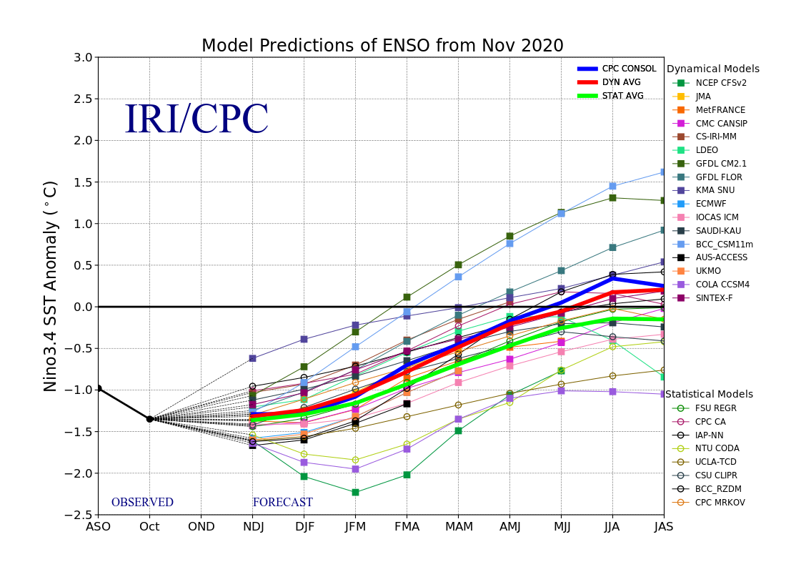
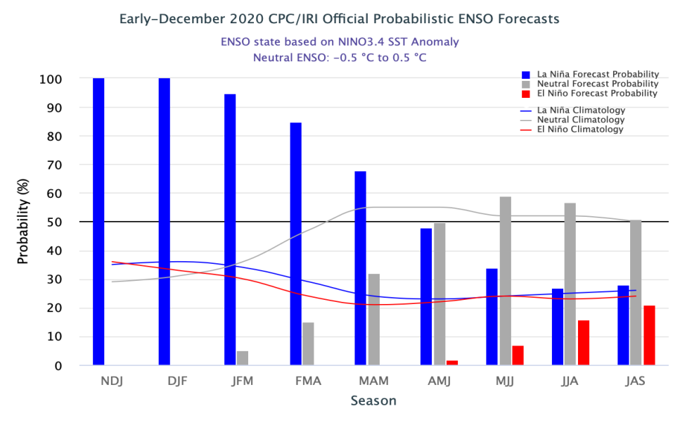
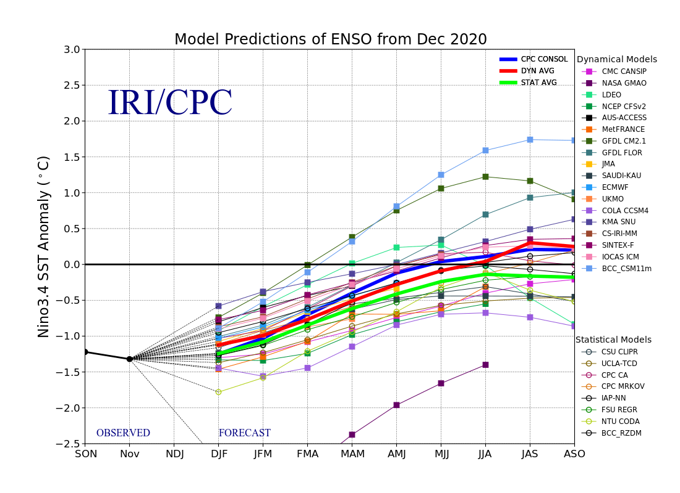
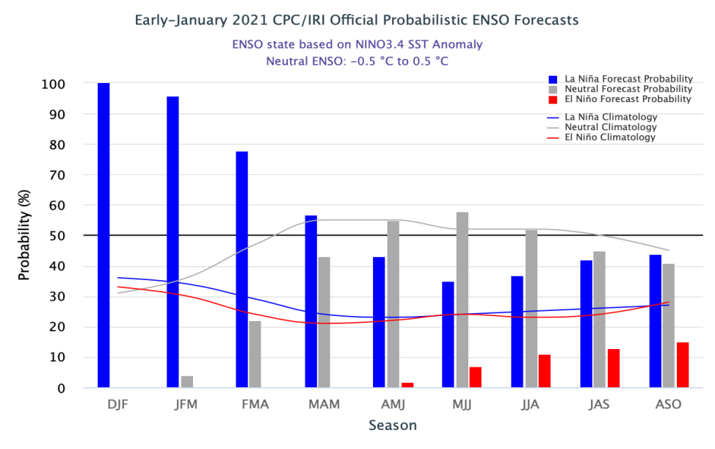
ENSO Forecasts
Early- December CPC/IRI forecast
Early- January CPC/IRI forecast
NDJ < -1 C
La Nina through Winter & early spring.
Expected Canonical impacts already happening in Precip, but not in Temperature!!

Slide 25
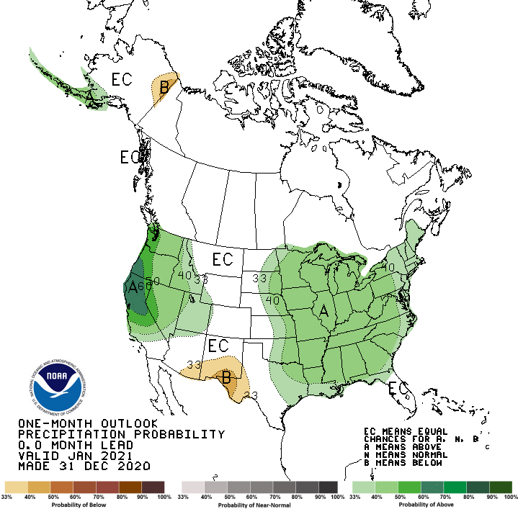
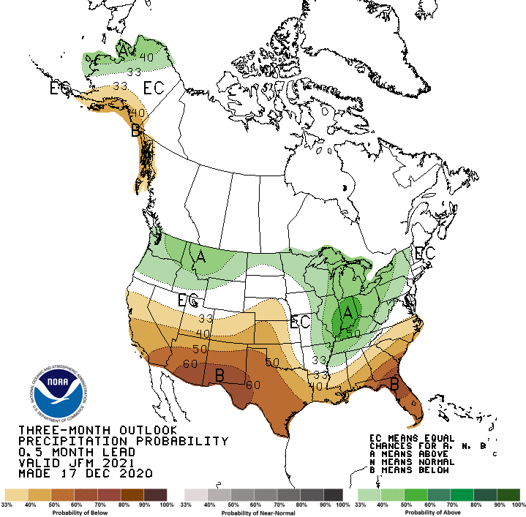
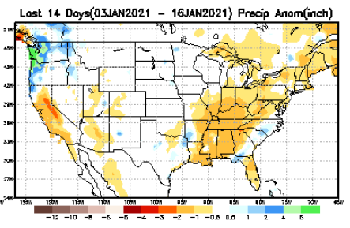
Previous(Last month)
CPC’s official
Precipitation OUTLOOK for Monthly (Jan)/Seasonal (JFM)
Released Dec 31st
What happened?
Released Jan 17th
Observed so far this month!!
Monthly P/T forecasts verified at mid-month are generally good! Why? ☺ (becoz they r mostly based on GFS’ 2-wk fcsts). We still have many days to go in the month.

Slide 26
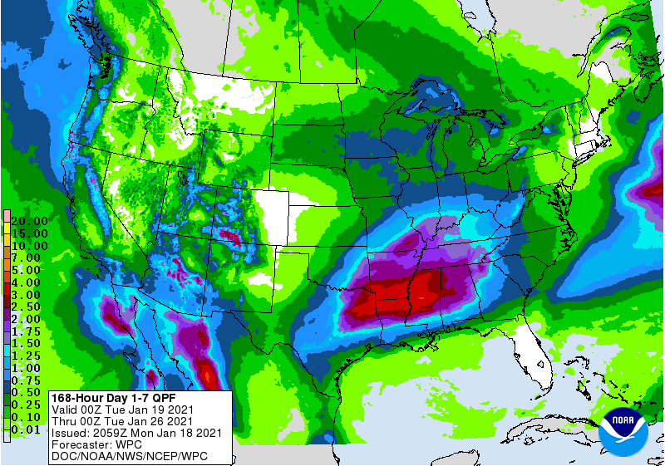
WPC Next 7 days QPF Forecast
GFS Model Guidance for next 16 days.

Slide 28
A new exptl. figure added in this month’s briefing, which shows on 16 Feb(future), looking back how 60 days and 90 days precip percentile will look, including the 1- month European Center(EC) forecast (made yesterday, 18 Jan) precip amounts.
Possible developing drought in parts of LA/MS/AL/FL and coastal GA in the next month/season?

Slide 29
Made
Nov 30th
Previous (Last Month)
CPC’s official
Temperature outlook for Monthly (Jan)/Seasonal (JFM)
Made Nov 19th
Observed so far this month!! ☺ ☹

Slide 30
NMME T & P Ens.Mean forecasts
Feb
Much of the country is warm except in the Northwest. The south is WARM+
FMA
The forecast P pattern is the expected canonical La Nina composite, with dry relative conditions in the
South.

Slide 31
Agreement/Disagreement among the various NMME models’ JFM seasonal Precip. Forecast.
??

Slide 32
SPI6 Fcst made from last month(background) compared with this month(foreground, red border)
Forecast uncertain in Hatched areas.
The SPI6 fcsts made last month vs. this month based on NMME models’ precip fcst. suggests continuation of drought in the south and west, in the upper Midwest. Possible total drought removal in the Pacific NW and NE. Possibility of developing dry/drought conditions in the SE by end of fcst season.

Slide 33
http://drought.geo.msu.edu/research/forecast/smi.monthly.php
Latest Initial Conditions:
12/08/2020
Predicted Monthly Soil Moisture Percentile
MSU stopped updating 06/10/20 ☹
Initial Conditions 1 month ago:
12/08/2020
The inter quartile range suggest greater uncertainty about the forecast in these shaded regions.

Slide 34
Summary
Current Drought conditions:
Over the last several months, drought area & severity has overall generally increased across the South & West. The worse contiguous drought conditions are in the border areas of states CA, AZ, NV, & UT. Parts of central and eastern TX saw some improvement.
The drought in the Dakotas, Wyoming, Nebraska, Kansas and vicinity continues to hang in there.
About 50 % of the country is experiencing category D1 or worse drought condition.
Drought in the Northeastern (New England) states is finally and slowly beginning to get some relief and fade away.
Possible developing dryness in the southeast.
Some/many of California reservoirs levels are below their historical average levels. It is going to be tough with the La Nina expected to continue through upcoming winter!
Just last May US had almost the lowest coverage of area covered by drought! ~ < 4%. Now more than 50% of the country is under drought!
Current ENSO status and forecast:
La Niña is expected to continue through the Northern Hemisphere winter 2020-21 (~95% chance during January-March), with a potential transition to ENSO-neutral during the spring 2021 (55% chance during April-June).
Prediction:
La Nina is expected to persist through NH winter and the models are forecasting mostly typical canonical precipitation and temperature impacts. But the observed temperature and precipitation patterns so far are not quite canonical, except in the southwest with lower rainfall amounts, which has worsened the drought conditions there. Not much of enhanced precip in the Ohio valley yet! Temperature patterns expected in the northern and southern tier states during La Nina is not
There will be temporary short term (month !) improvement in the drought conditions in the southwest, but the long term drought in the southwest, as well as in the Dakotas and NE/KS will stay for the season!
The remaining vestiges of drought conditions in the northeastern states & vicinity is most likely to be gone by the end of forecast season.
The Ohio valley is really tricky, as the expected enhanced La Nina rainfall has not occurred yet, and the models continue to forecast rain here.
Mild drought conditions might develop in parts of southeastern states, particularly in parts of LA, MS, AL, and FL, as well as coastal Georgia. *********************

Slide 35
Miscellaneous maps

Slide 36
Miscellaneous maps

