Slide 1
Drought Outlook Support Briefing January 2023
Climate Prediction Center/NCEP/NOAA
http://www.cpc.ncep.noaa.gov/products/Drought
Points to ponder:
Often, there is a disconnect between the Short term (S) and Long term (L) drought in regions, and even with the short term (S) drought, the 3-month and 6-month signals are not quite consistent! With Long term (L) drought, it is even more trickier, as it is open ended, from 1 year and beyond!!!
Places/regions experiencing Short term drought may (not) be ok in the Long term and vice versa!!
This duality is difficult to reconcile, to convey and even be understood well by the public at large.
Public/Forecaster generally tends to focus more on the Short term Drought (for good reasons!!)
More importantly the very definitions and timescales associated with S/L term droughts and the declarations in the USDM are by themselves subjective!!
No amount of excess rainfall/deluge can compensate/make-up for large rainfall deficits accrued over many/long years – case in point/CA.

Slide 2
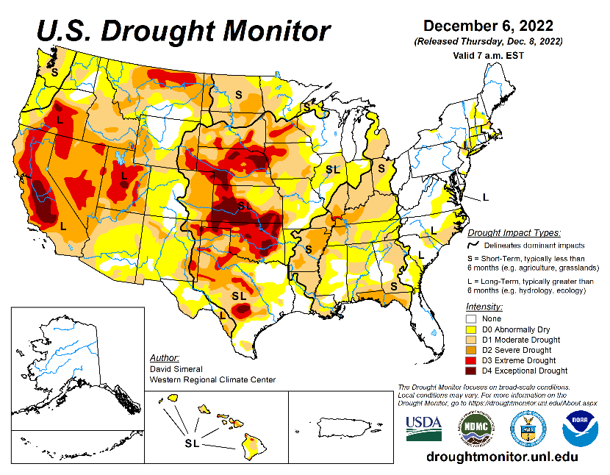
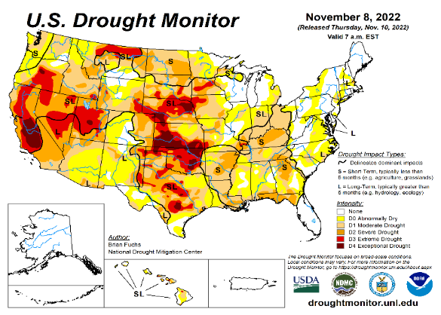
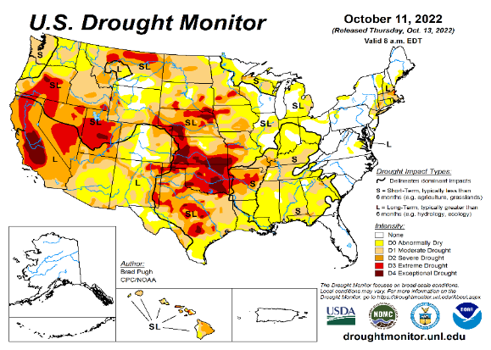
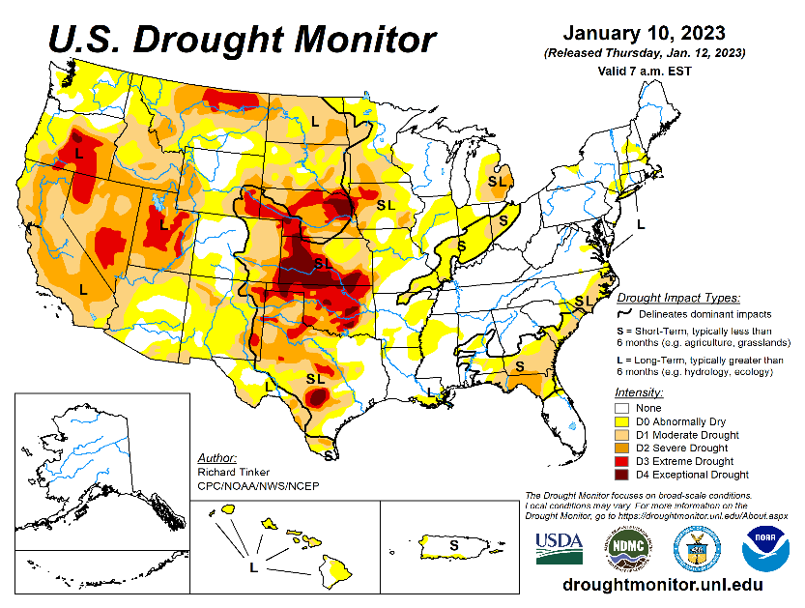
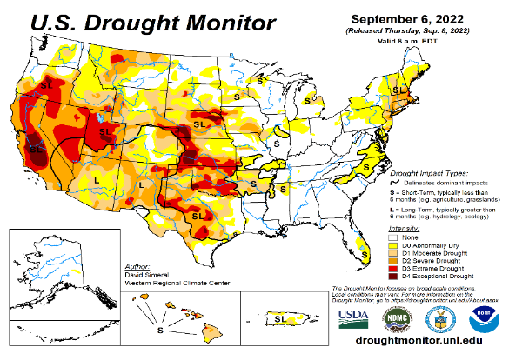
Drought Monitor
Monitoring is important because, unlike US T/P fcsts, for drought forecasts, we have to know where we are, before we can tell where we are going!! Drought forecasts are tendency forecasts.
December
It used to be that for many months (last year) the classic East-West dipole pattern with drought in the US west half, and (almost) no drought in the US east half, was in place.
But in the last few months, partly due to the second year of good recent (2022) SW monsoon, the S-term drought in the southwestern states has mostly gone, but the L-term drought still exists in parts of CA/OR/NV/UT/AZ/NM and vicinity.
The recent deluge/excess rain over CA is the main story this month. The short term drought across CA may be gone, but cannot make-up for long term accrued rainfall deficit in the region.
It is not clear if the Long-term drought in the southwest, esp. in CA/NV/UT & vicinity will be gone any time soon, considering the (still!) low water levels in many reservoirs in the region. The L/T term here in the region is ~20 years or so. But, compared to a month ago, the recent CA rains did help somewhat mitigate/increase many reservoir levels across CA.
The drought in south central part of the US, covering large parts of MT/Dakotas/ NE/KS/OK western has only very slightly improved. The drought in this central part of the US is both short and long term.
The ongoing 3-year La Nina has generally increased the overall drought areas coverage across the entire United States. Accordingly, Drought that emerged along the Gulf coast states is till present.
November
October
January
(Recent/Latest)
September
?

Slide 3
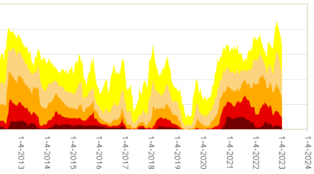
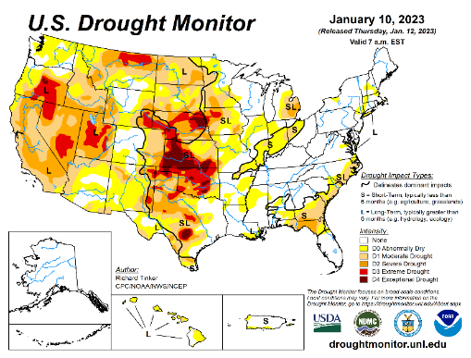
In general, The spatial details of Every drought is different.! Every situation is different!!
But, do these two drought spatial maps (above and below) look similar? Somewhat yes! In both cases, the pattern developed 2, 3 La Nina Events! ☺
Time series since 2000 spilt into 2 (above & below) panels.
Current drought!

Slide 4
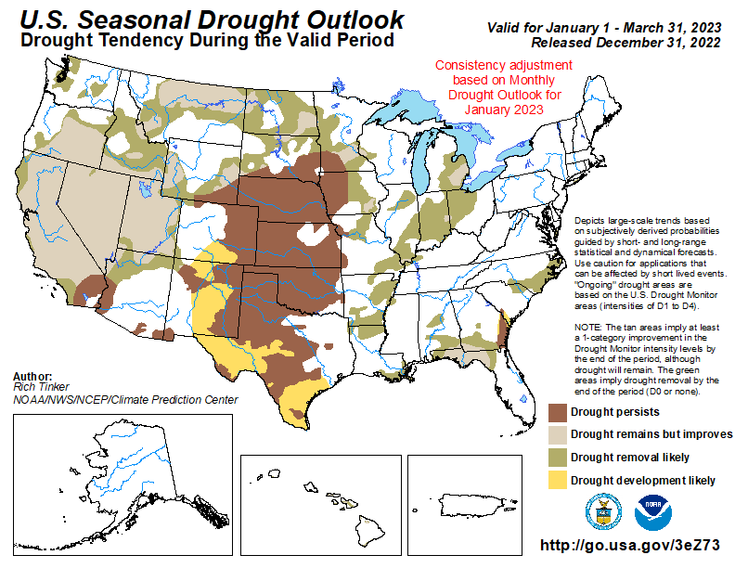
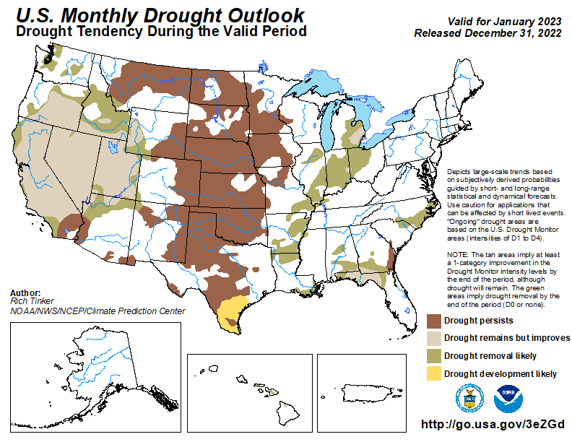
(Previous) Seasonal/Monthly Drought outlooks
New Seasonal+ Drought Outlook to be released in 2 days!
New Monthly Drought Outlook to be released end of this month)
Updated Seasonal Outlook
( 1 Jan – 31 Mar 2023)
issued 12/31/22
Monthly outlook (for January 2023)
issued 12/31/22
The ongoing winter rainy season (DJF) along the west coast states, combined with the weakening/slowly exiting La Nina conditions is likely to improve the overall drought conditions and hence the drought areal coverage in the United States.

Slide 5
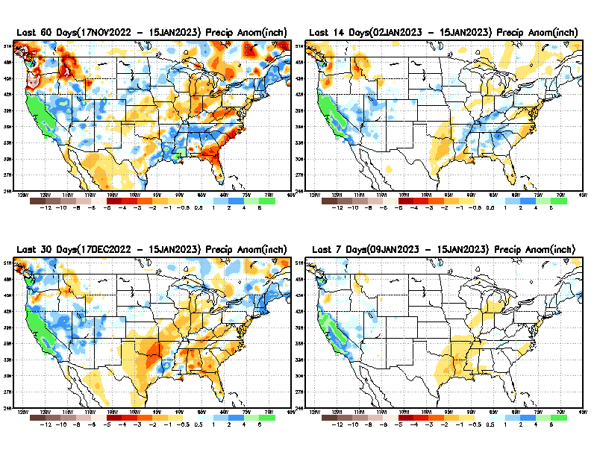
Precipitation ANOM during last 7, 14, 30, & 60 days.
This and next few slides show Precip deficit (excess).
Droughts, for the MOST part, begin and end with precip!! Lately, Temps are becoming (secondarily) important as well.
60 Days
14 Days
30 Days
7 Days
These maps in this and following slides, including a) Total,
b) Anom and
c) Percent of Normal precip. in these and other longer time ranges are now (routinely) daily updated at:
From: Recent Accum./Anom Precipitation https://www.cpc.ncep.noaa.gov/products/Drought/briefing_prcp.shtml

Slide 6
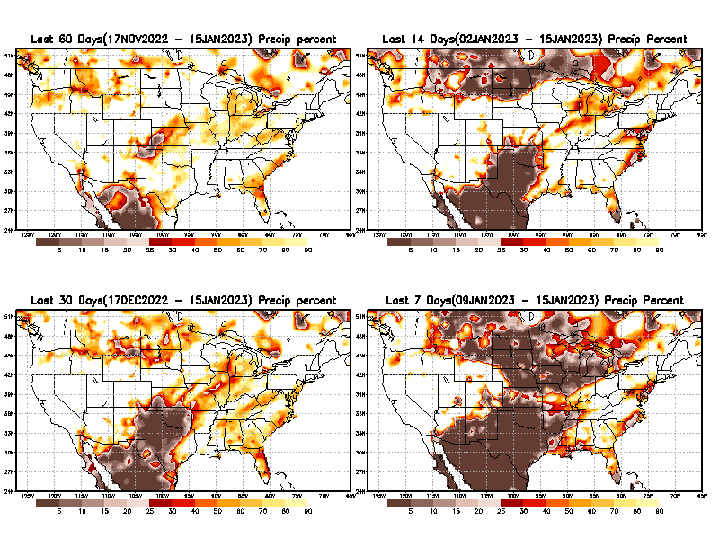
Precipitation Percent (of normal) during last 7, 14, 30, & 60 days - Only Deficit Areas <=90% shown !
60 Days
14 Days
This plot shows only the rainfall deficient regions <= 90% of normal.
-- This shows more clearly possible/likely drought developing region in the future unless there is above normal rainfall in these regions in the future, to offset these shortfalls.
30 days
7 Days
From: Recent Anom/% of normal Precipitation https://www.cpc.ncep.noaa.gov/products/Drought/briefing_prcp.shtml

Slide 7
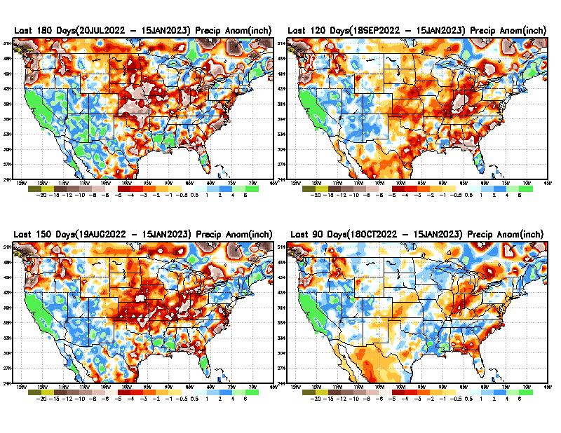
Total precipitation ANOM during last 3, 4, 5, and 6 months.
While the Precipitation anomalies deficit may seem large in some regions (compared to others), it is the % of normal precip (next slide) that matters more!!
6 M
4 M
5 M
3 M
From: Recent % of Normal Precipitation https://www.cpc.ncep.noaa.gov/products/Drought/briefing_prcp.shtml

Slide 8
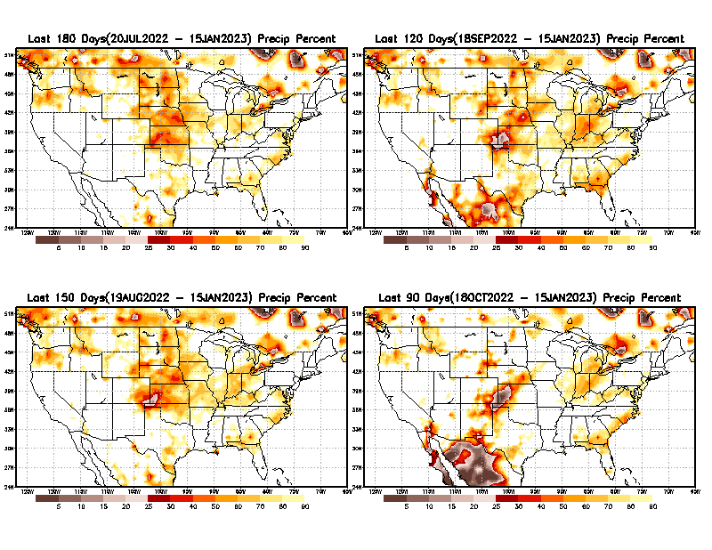
Total precipitation Percent (of normal) during last 3, 4, 5, and 6 months Only Deficit Areas <=90% shown!!
6 M
4 M
In these interim time scale 3-6 months, we need to pay attention to regions, which are dark-brown, red & dark red (<50%).
While accrued precipitation deficits are real & objective,
droughts are subjective declarations!!
M
3M
Hard to believe the witch lately betw. E/W compared to last year!
East vs West!
Broad vs Narrow
rainfall season.
In general, West suffers more from frequent and lasting droughts.
Short term(S) Drought is generally declared when rainfall deficits exist in the 3-6 months time range. {Long term deficits beyond 1 or 2 or more years is Long term L drought! }

Slide 9
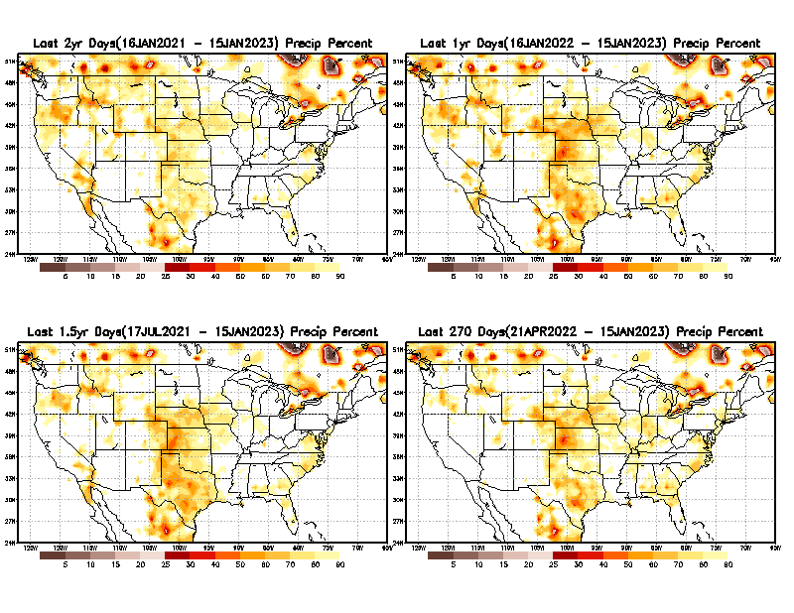
Total precipitation Percent during last 9 months, 1 yr, 1.5yrs, & 2 yrs. .–Only Deficit Areas shown!! <=90%
2 Y
1 Y
Tinderbox areas, where some form of longer term rainfall
deficiencies already, exist !!
-This & Next slide!!
1.5 Y
9 M
The character and even location/spatial extent of the short/S and long/L –term droughts are different!!!
From: Recent Accumulated Precipitation https://www.cpc.ncep.noaa.gov/products/Drought/briefing_prcp.shtml

Slide 10
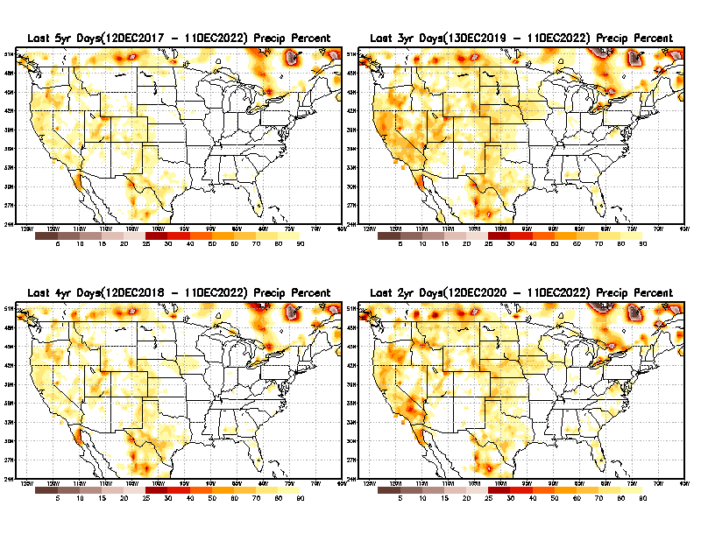
Total precipitation Percent (of normal) during last 2, 3, 4, & 5 yrs. .–Only Deficit Areas <=90% shown !!
5 Y
3 Y
In these long time ranges (2-5 yrs), there is a general dearth/lack of precipitation in the southwest US.
Recent Weather Blog News:
A recent study from the University of California, Los Angeles now claims the current drought that started in 2000 for the American Southwest is now the driest 22 years since 800 A.D. Researchers said climate change is to blame. Their proof? Tree rings!
4 Y
This is MAP as shown last month!
2 Y
From: Recent Accumulated Precipitation https://www.cpc.ncep.noaa.gov/products/Drought/briefing_prcp.shtml

Slide 11
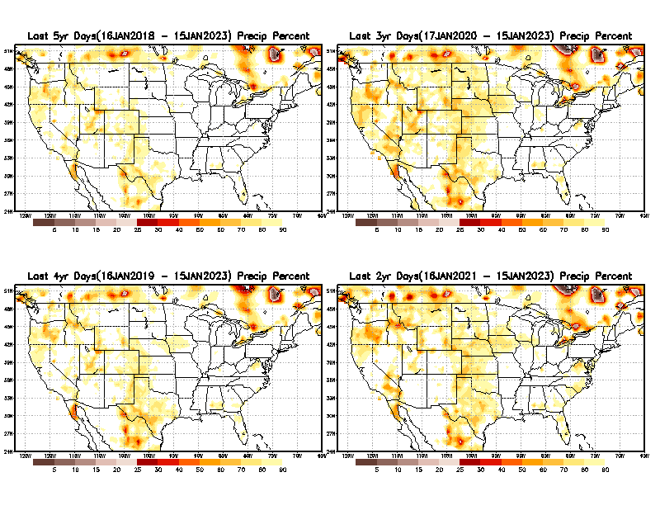
Total precipitation Percent (of normal) during last 2, 3, 4, & 5 yrs. .–Only Deficit Areas <=90% shown !!
5 Y
3 Y
In these long time ranges (2-5 yrs), there is a general dearth/lack of precipitation in the southwest US.
Recent Weather Blog News:
A recent study from the University of California, Los Angeles now claims the current drought that started in 2000 for the American Southwest is now the driest 22 years since 800 A.D. Researchers said climate change is to blame. Their proof? Tree rings!
4 Y
This is MAP as updated now!
2 Y
Ongoing long term drought (longer than 5 times!) in the South West!!
From: Recent Accumulated Precipitation https://www.cpc.ncep.noaa.gov/products/Drought/briefing_prcp.shtml

Slide 12
LEAST
Rainy/dry
(3-month) Seasons across the US
MIXED
MOST
East vs West!
More darker colors in west/central => narrow rainy season (months)
Overall, more white space in the east => distributed rainfall season (except ~FL).

Slide 13
*********
EAST vs
CTR/WEST
Drought Behavior is loosely tied to rainfall climo!! And the limited rainy season in the west
*********
Adapted from Rich Tinker.

Slide 14
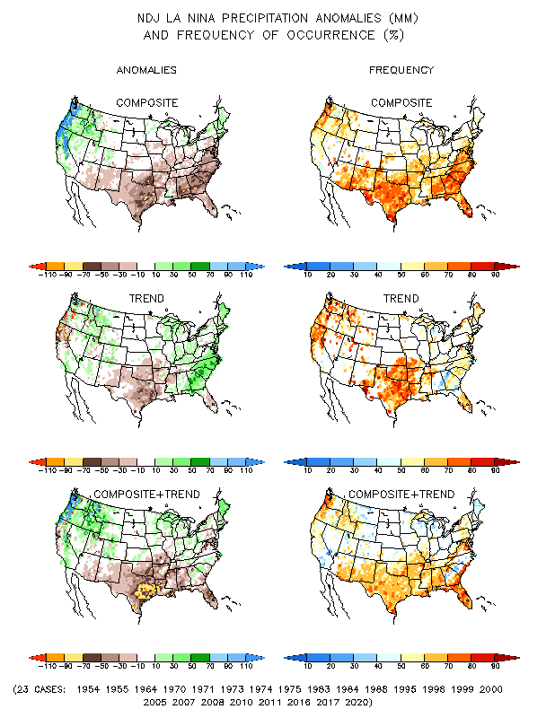
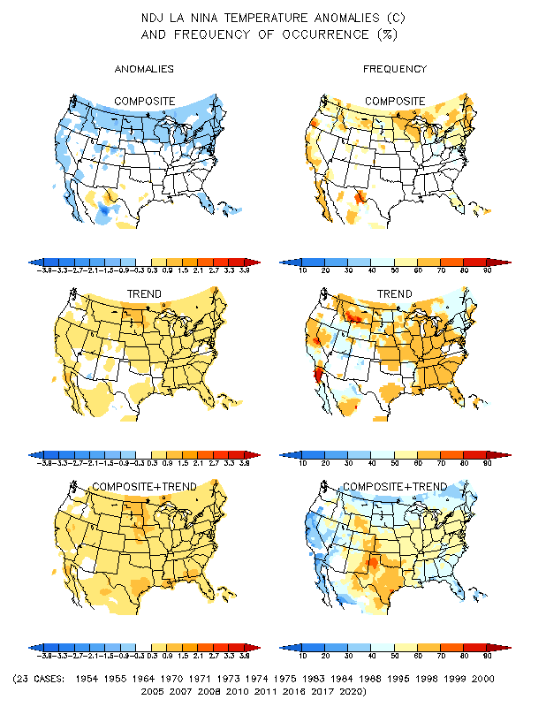
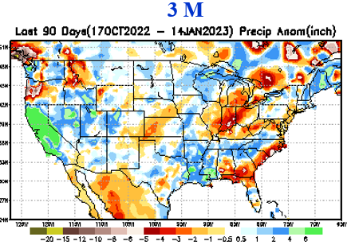
La Nina Precip/Temperature COMPOSITES & Trend map
NDJ
P
T
50/50 Chance of
La Nina during JFM.
How likely will be the impacts?
Expected from past La Nina composites!! But, this is what actually happened!!

Slide 15
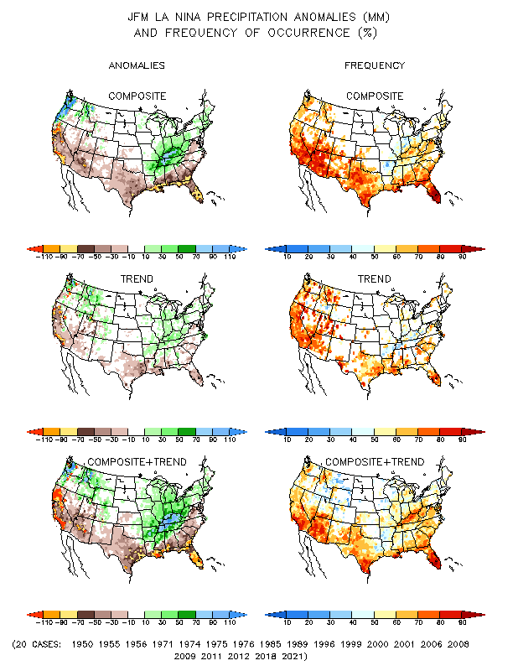
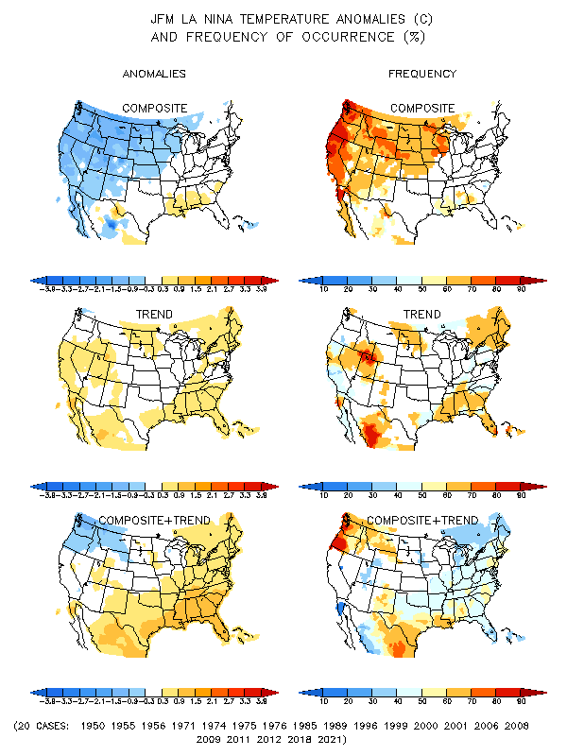
La Nina Precip/Temperature COMPOSITES & Trend map
FMA
P
T
50/50 Chance of
La Nina during JFM.
How likely will be the impacts?

Slide 16
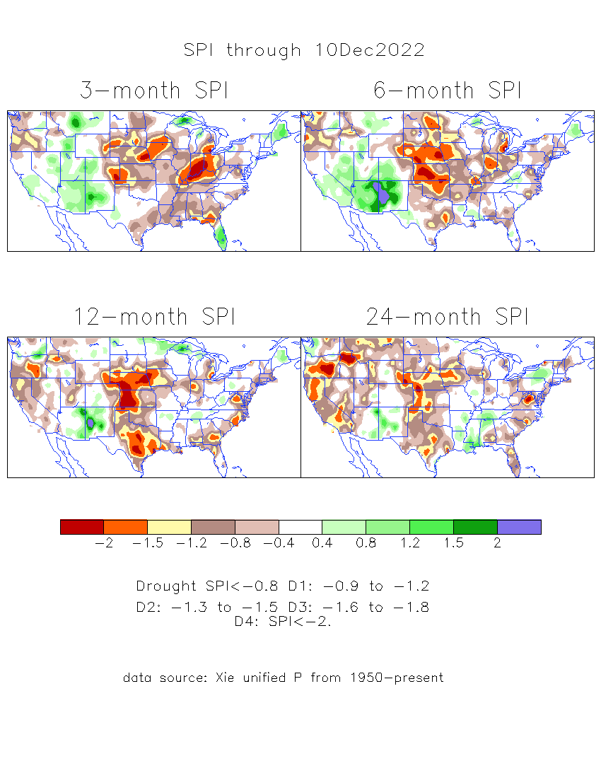
The Standardized Precipitation Index SPI (based on Observed P)
----- Last Month
Very interesting graphic & details for the drought across the US based on the more generalized precip deficit/excess, the Standardized Precipitation Index (SPI).
The dark brown and red colors, indicating standardized precipitation deficits, in the various time periods, approximately correspond to the appropriate short/long term drought monitor regions and their intensities

Slide 17
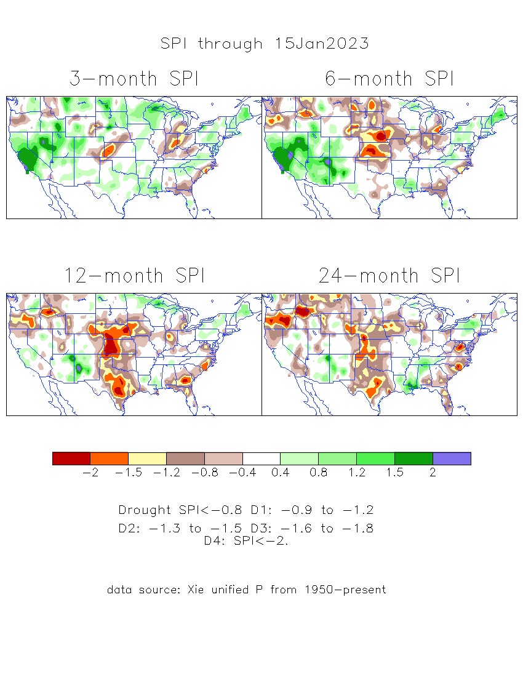
The Standardized Precipitation Index SPI (based on Observed P)
Compare with last month
----- NOW
Very interesting graphic & details for the drought across the US based on the more generalized precip deficit/excess, the Standardized Precipitation Index (SPI).
The dark brown and red colors, indicating standardized precipitation deficits, in the various time periods, approximately correspond to the appropriate short/long term drought monitor regions and their intensities
Short
No S-term drought here!! But L-term drought > 6 mon. continues.
Long
How does one negotiate and reconcile declaring short term vs long term drought when precip. deficiencies patterns differ on many different time scales locally!!
What is the cutoff delineating time between short VS long term drought!! Not so clear!!
At exactly where does drought begin?

Slide 18
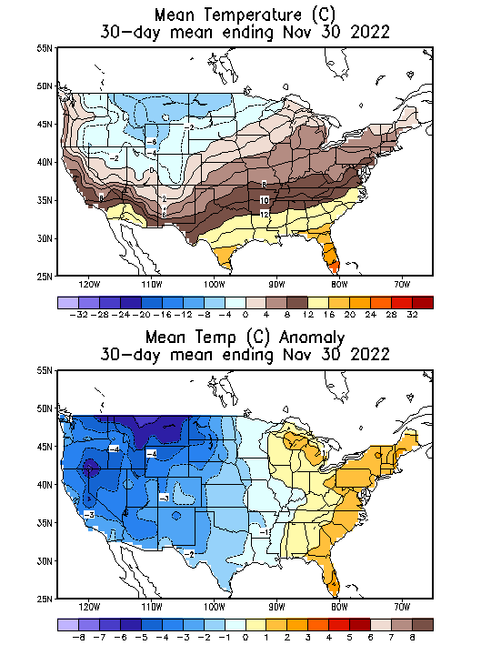
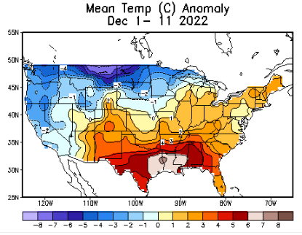
Slide From briefing
Last Month!
Recent US Temperatures
There is a lot more going on than just La Nina impacts!!
So far this month !!

Slide 19
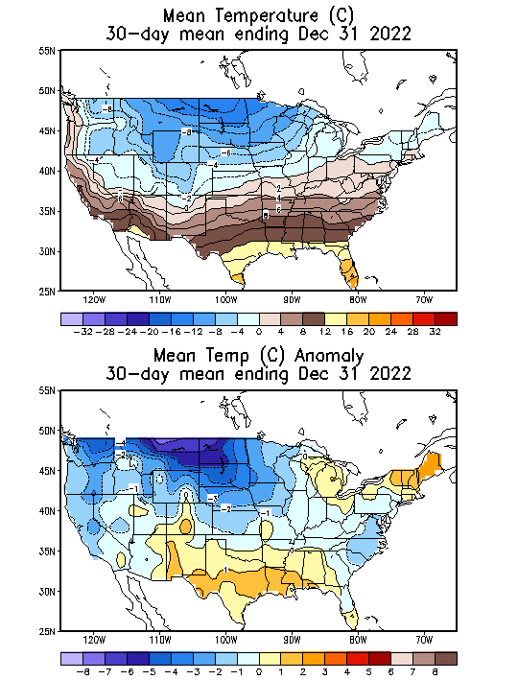
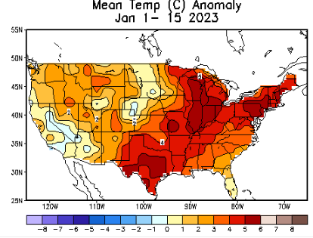
NOW
Recent US Temperatures
.
Large intraseasonal variability from one month to next across US even within the La Nina DJF Winter!
So far this month !!

Slide 20
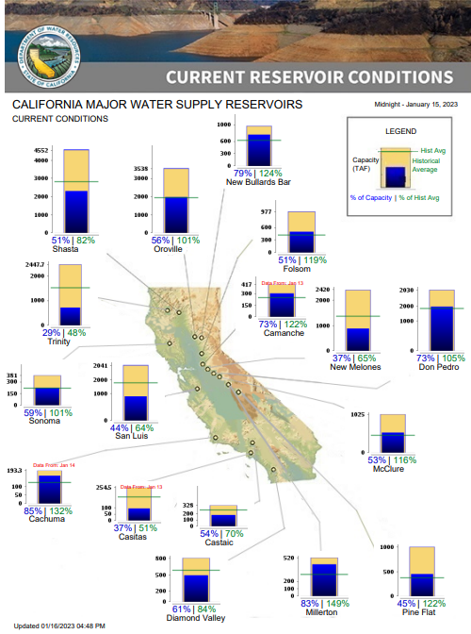
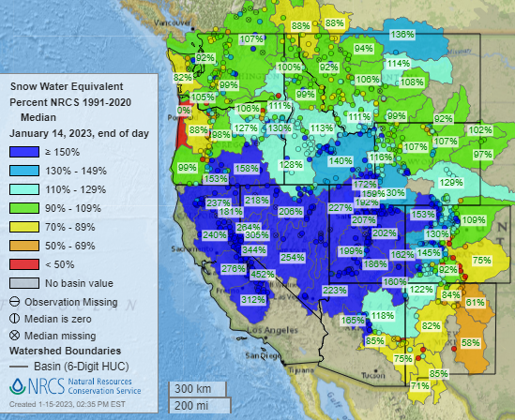
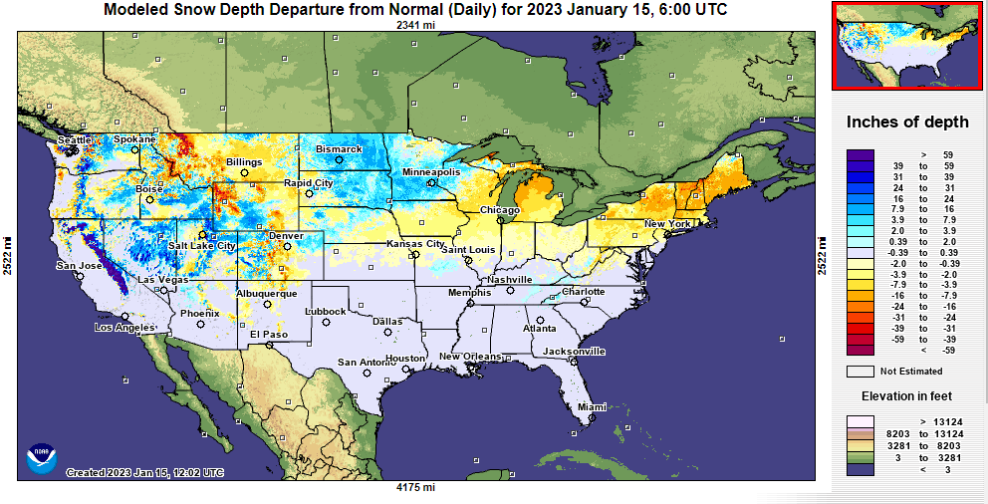
Snow Water Equivalent
% of Capacity
% of Hist. Avg.
of Reservoirs.
Many CA water reservoirs are getting better, but still very low!
NOHRSC

Slide 21
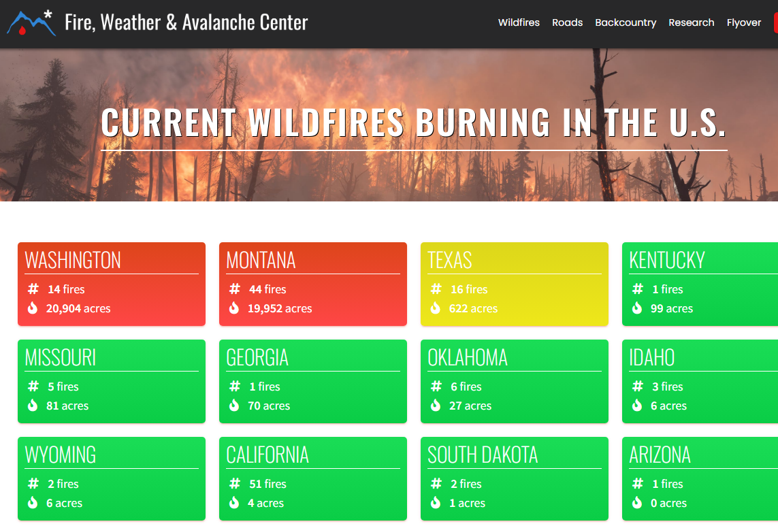
Note: In spite of the ongoing drought, All the fires are gone..
Of course it is getting cold.. ☺
THIS MONTH !!
https://www.fireweatheravalanche.org/fire/current-list-of-us-wildfires
(not govt. source! Not sure how good is this data?)

Slide 22
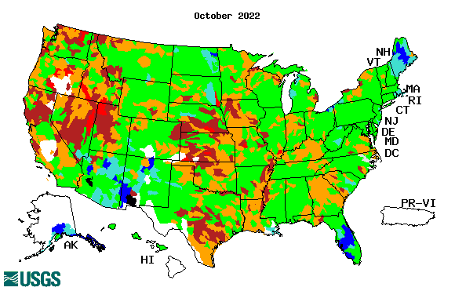
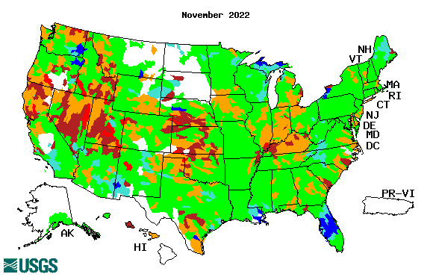
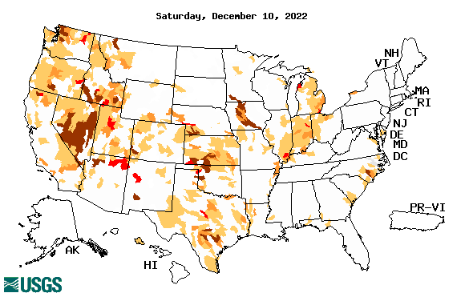
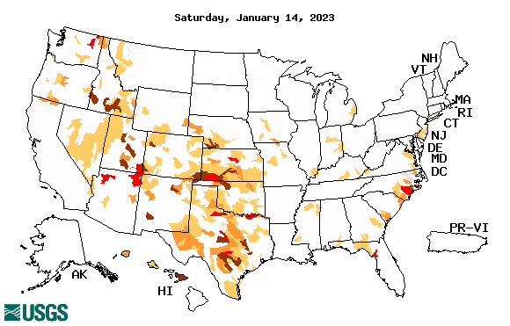
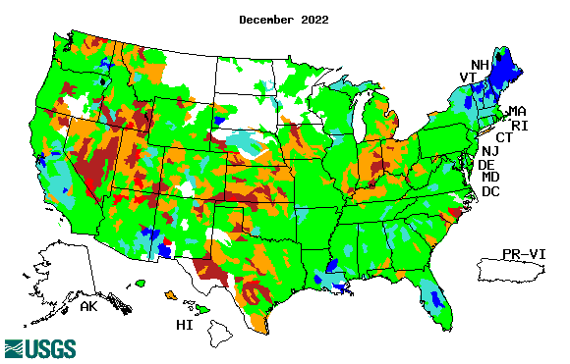
Streamflow (USGS)
Most US east droughts are relatively short lived (as compared to US west). However, if you recall, the drought over the New England states last year was a real surprise!!
Map shows only below normal 7-day average streamflow compared to historical streamflow for the day of year.
One month ago (left) &
Now (below)
Streamflow is only a partial indicator, as it is highly managed.
If sometimes, the various indicators are confusing, go back to % of rainfall deficit maps – to reinforce!!
22

Slide 23
EL NIÑO/SOUTHERN OSCILLATION (ENSO)
DIAGNOSTIC DISCUSSION
issued by CLIMATE PREDICTION CENTER/NCEP/NWS and the International Research Institute for Climate and Society
12 January 2023
ENSO Alert System Status:
La Nina Advisory
Synopsis: A transition from La Niña to ENSO-neutral is anticipated during the February-April 2023 season. By Northern Hemisphere spring (March-May 2023), the chance for ENSO-neutral is 82%.
CPC’s Oceanic Niño Index (ONI) [3 month running mean of ERSST.v5 SST anomalies in the Niño 3.4 region (5ºN-5ºS, 120º-170ºW)], based on centered 30-year base periods updated every 5 years.
?

Slide 24
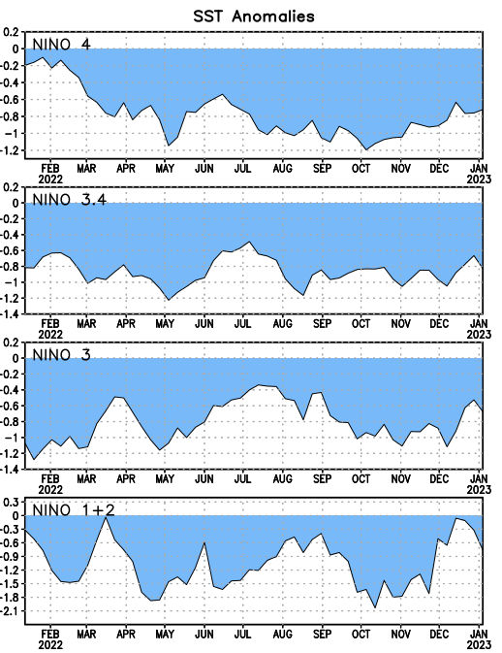
Latest values of SST indices in the various Nino Regions.
Rapidly decreasing Subsurface cold water reserve…

Slide 25
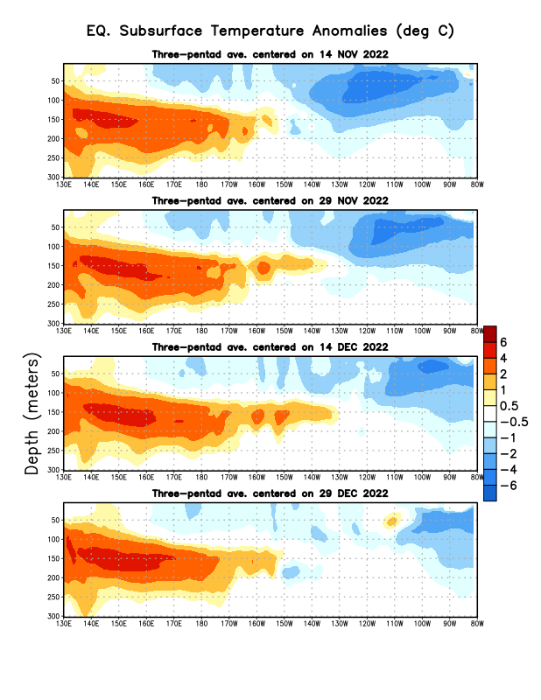
Sub-Surface Temperature Departures in the Equatorial Pacific
The cold water is still in the east tropical Pacific with la Nina conditions.
But, lately the subsurface warm water is slowly edging/expanding eastward.
Most recent pentad analysis

Slide 26
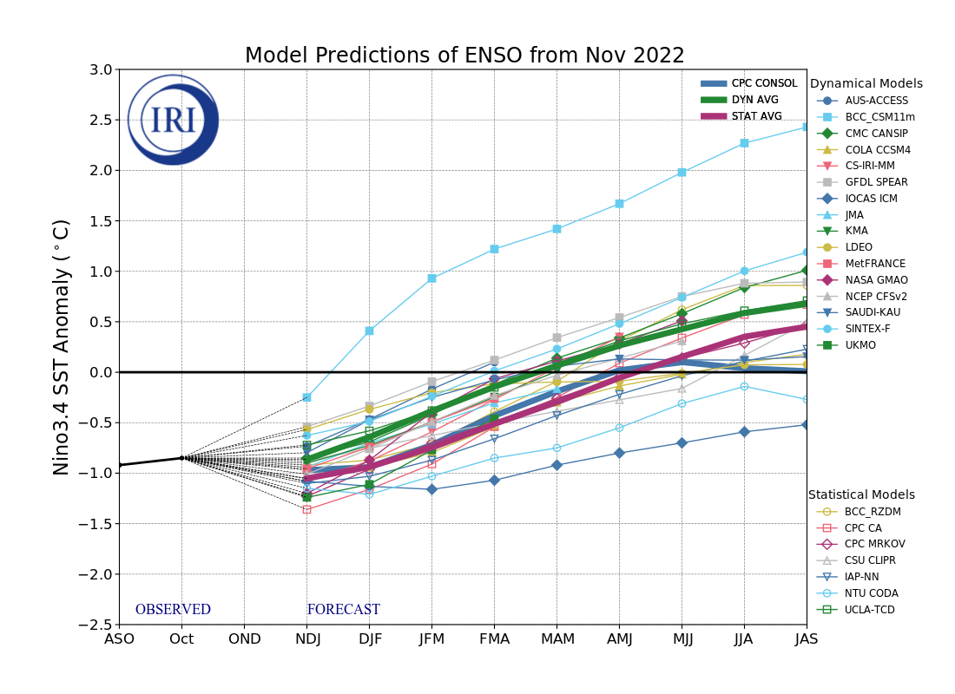
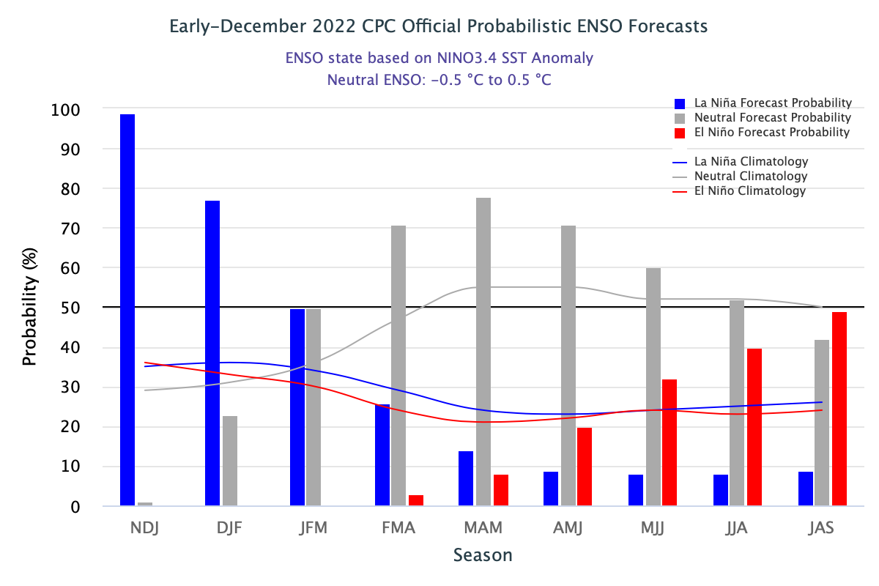
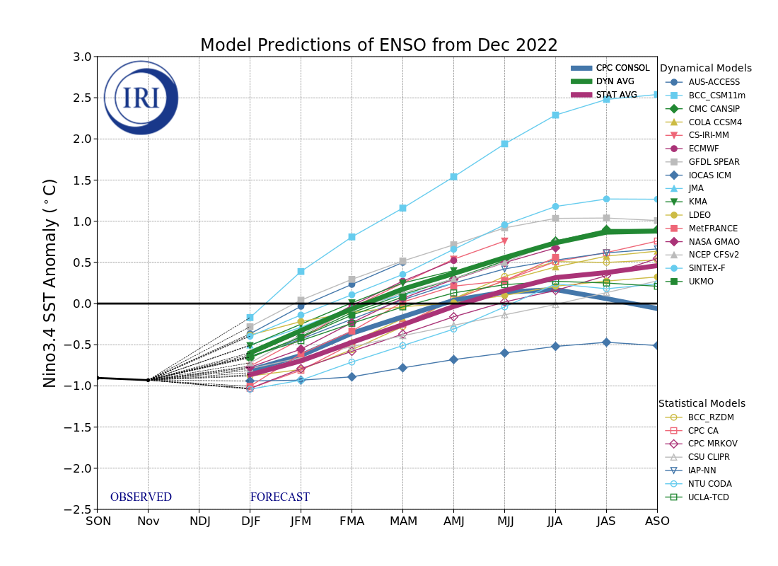
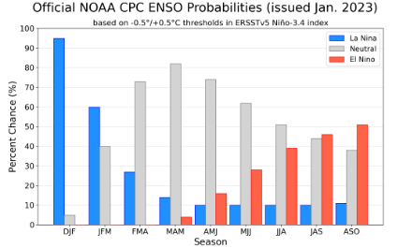
Official ENSO Forecasts
Early- December
This figure going through format changes!
Early-January CPC forecast
50/50 % chance of La Nina for the upcoming JFM forecast season.

Slide 27
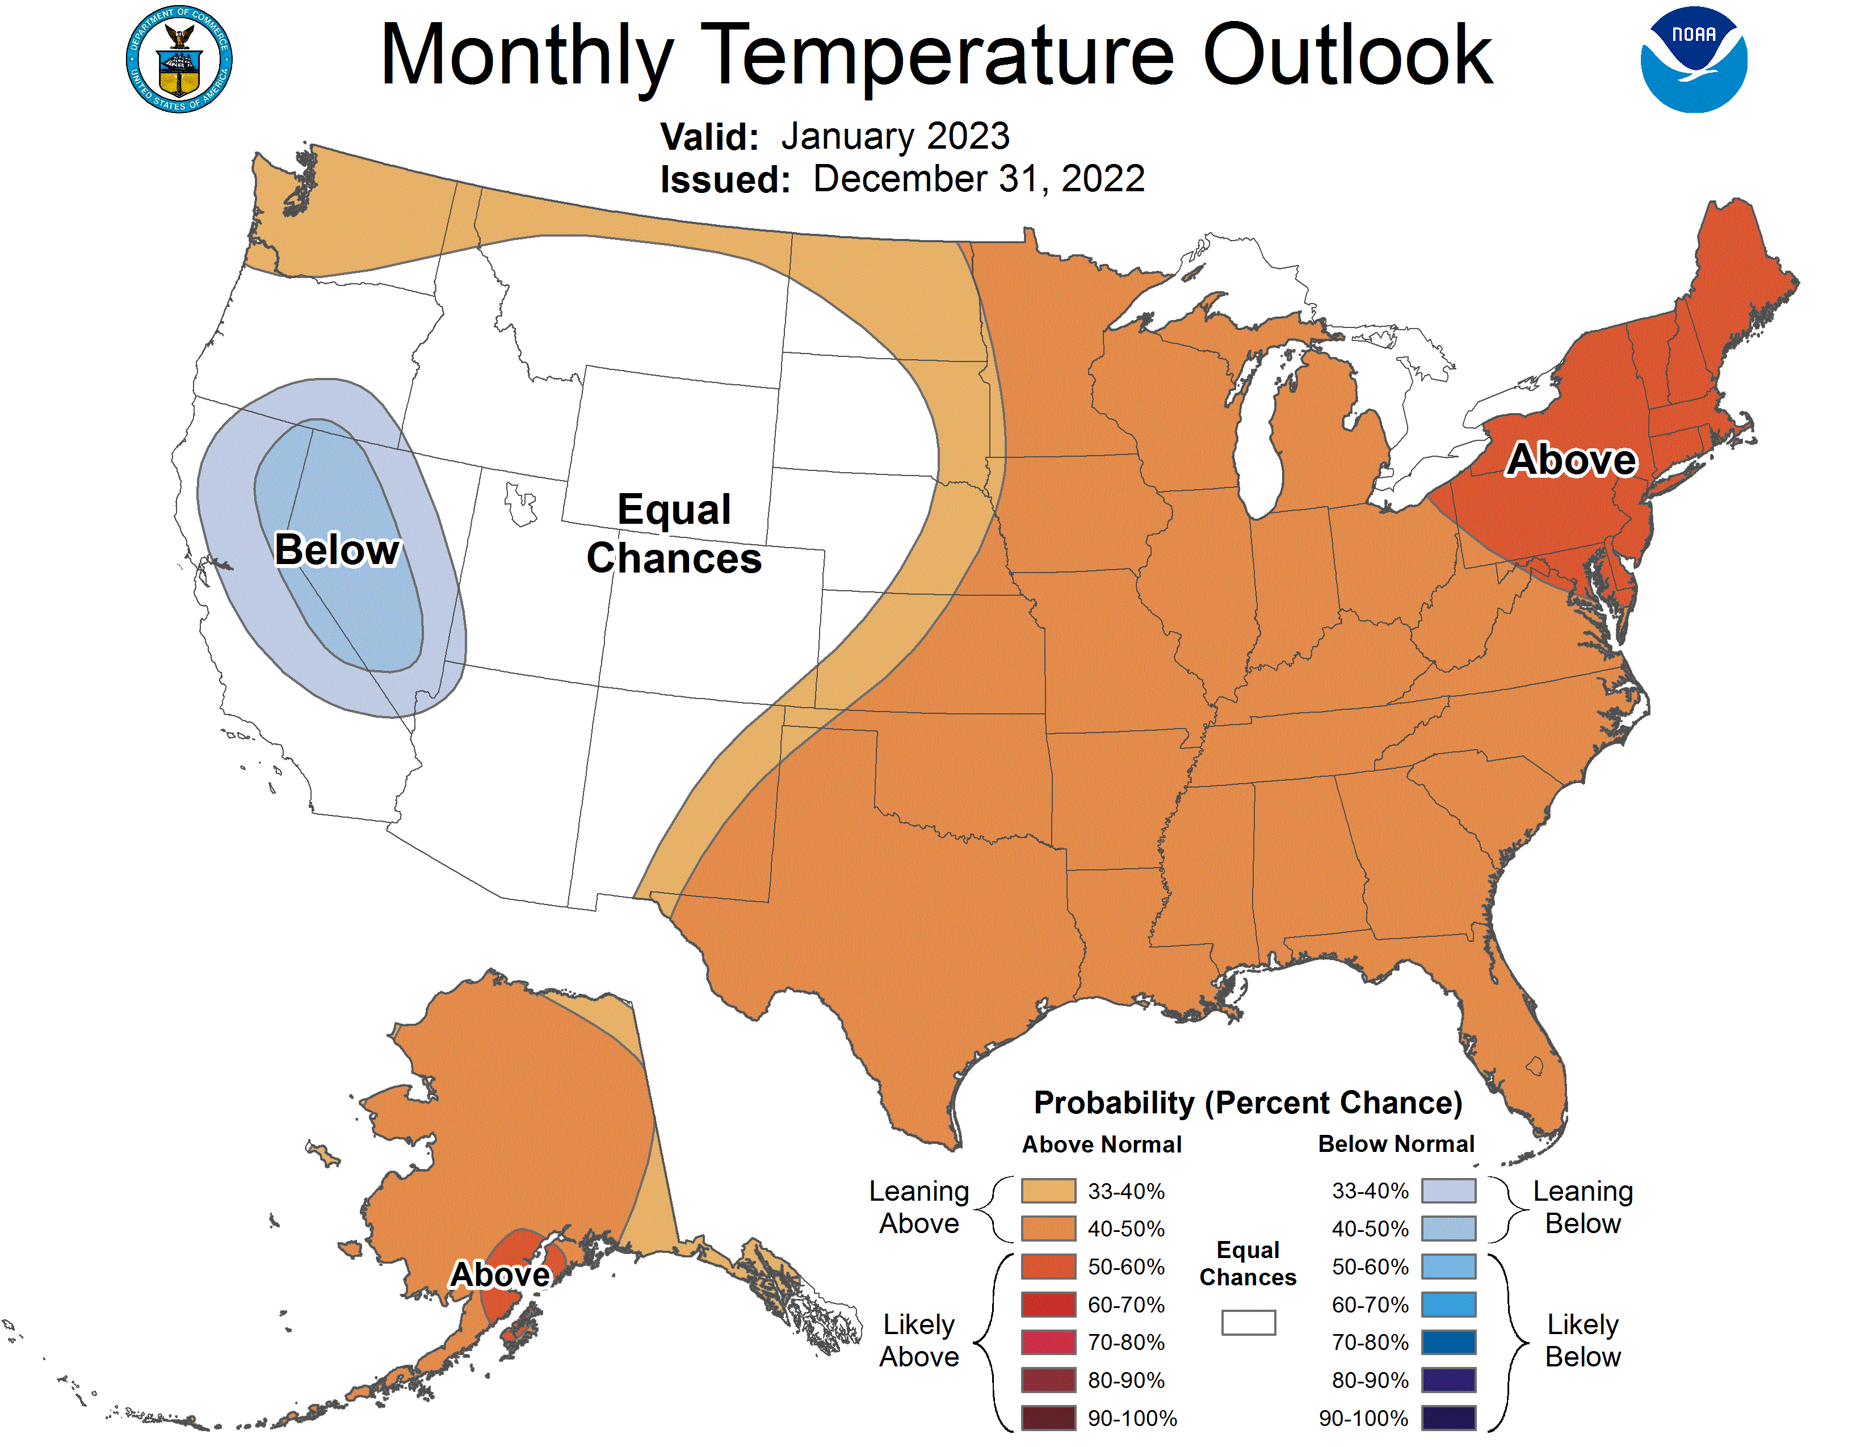
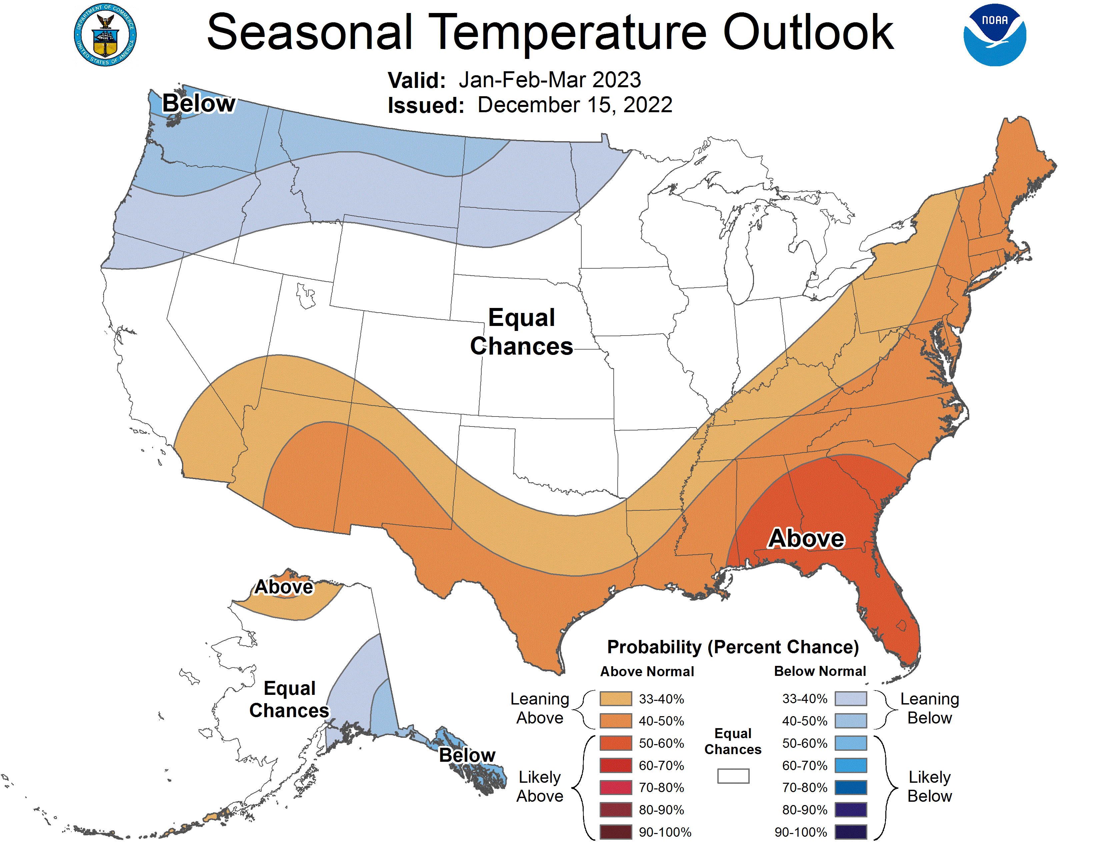
Previous (Last Month’s)
CPC’s official
Temperature OUTLOOK for Monthly (Jan)/Seasonal (JFM)
Monthly P/T forecasts verified at mid-month are generally good! Becoz of good skill upto 2 wks.
Released Dec 15th
Observed so far this month!! ☺
E/W

Slide 28
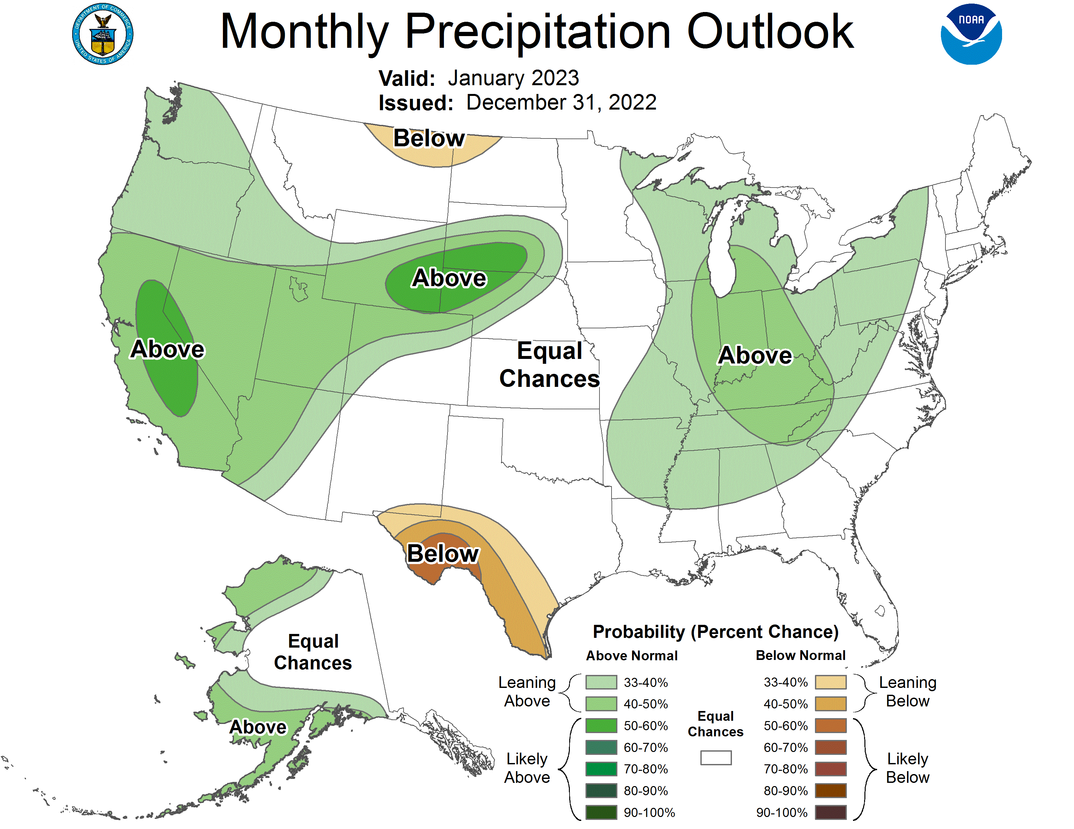
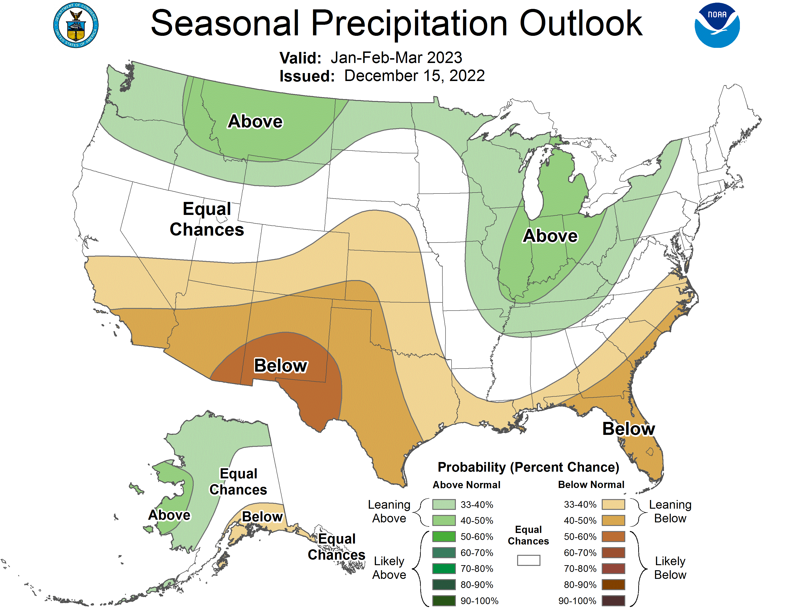
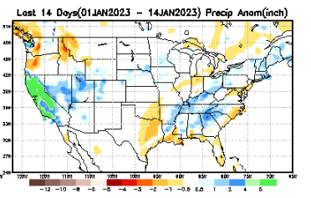
Previous(Last month)
CPC’s official
Precipitation OUTLOOK for Monthly (Jan)/Seasonal (JFM)
Released Dec 15th
Monthly P/T forecasts verified at mid-month are generally good! Becoz of good skill upto 2 wks.
Observed so far this month!! ☺

Slide 29
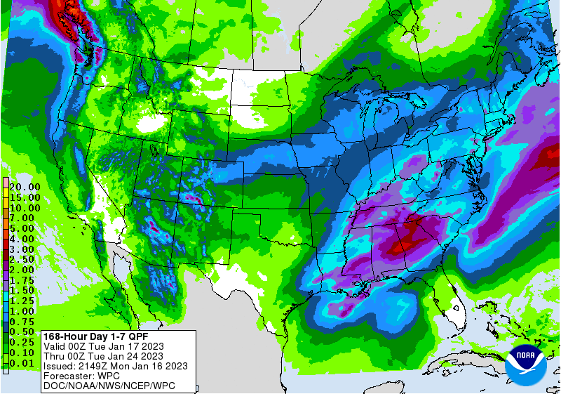
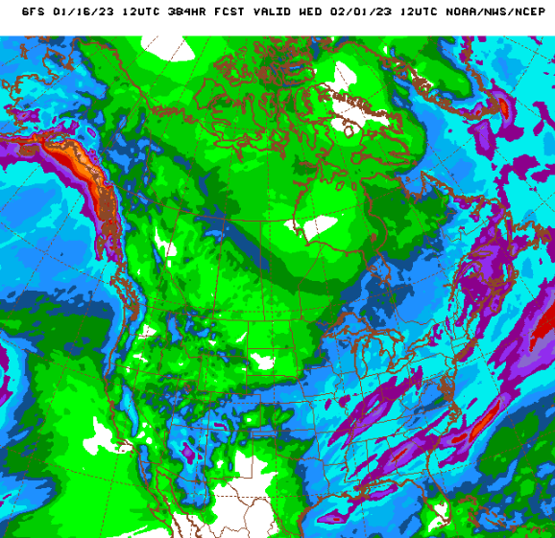
NCEP/WPC Next 7 days QPF (Quantitative Precipitation Forecast)
GFS Model Guidance for the
next 16 days.
Rain has arrived in Pacific NW. But, central/southern CA is not seeing any rain quite yet!

Slide 30
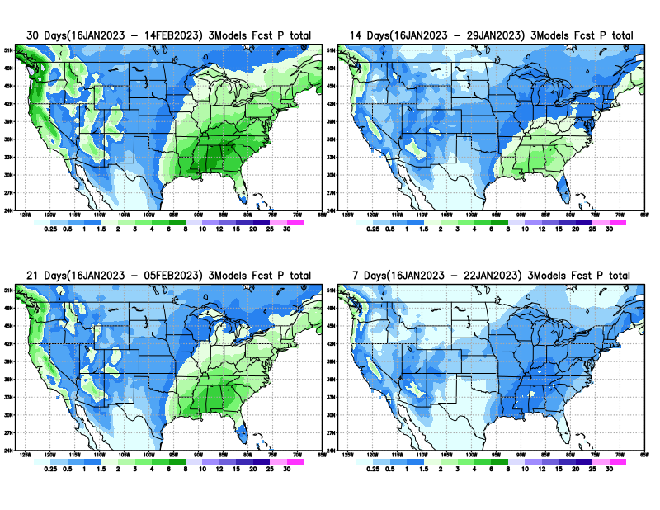
From 3 Models average Precip forecast (made yesterday, 15/16 Jan) for next 30 days.
The 3Models are: CFSV2, GEFS, & EC

Slide 31
From 3 Models average Precip forecast (made yesterday, 15/16 Jan) for next 30 days.
20
40

Slide 32
From 3 Models average Precip forecast (made yesterday, 15/16 Jan) for next 30 days.

Slide 33
From 3 Models average Precip forecast (made yesterday, 15/16 Jan) for next 30 days.

Slide 34
Week-4 Soil Moisture Percentile (SMP) Fcst based on VIC model forced with ECMWF-extended precipitation forecast!
Now: Based on Yesterday’s IC
While not exactly mapping 1-to-1 with the drought areas, this map is generally connected to the drought areas in some ways, as it is related to soil moisture!!
This dryness may exist next month, but will likely be not there by end of JFM. – I said this last month
(From Drs. Li Xu and Yun Fan) More detail at From: https://www.cpc.ncep.noaa.gov/products/people/lxu/flashd/flash_prediction.html#10

Slide 35
NMME T (left) & P (right) Ens.Mean forecasts for
Feb
FMA

Slide 36
Agreement/Disagreement among the various NMME models’ FMA seasonal Precip. Forecast.
??

Slide 37
(From NMME) compared with this month(foreground, red border)
Why is there so fewer hatched areas in SPI6 fcst from NMME models’ based fcst this month as compared to last month (left 2 columns) ? Fcsts more confident now?
Forecast uncertain in Hatched areas.
These maps are based on NMME models’ precip forecast uncertainty/certainty (among ensemble members) over the next 3 months
SPI6 Fcst made from last month I.C.
SPI6 & SPI12 Fcst made from this month

Slide 38
May skip this slide !!
No new/updated data!
http://drought.geo.msu.edu/research/forecast/smi.monthly.php
Predicted Monthly Soil Moisture Percentile
Latest Initial Conditions:
DATA not available !
CPC’s soil moisture percentile – Leaky bucket Model
The inter quartile range suggest greater uncertainty about the forecast in these shaded regions. LOTs of uncertainty regions!! ☹

Slide 39
BONUS Topic: Discussion continues!! Explanation for the multiyear DROUGHT in the Southwest (CA/AZ/NM/NV/UT/CO & vicinity)!!
More La Nina’s lately ?
More frequent La Ninas lately ?
YES!! The stats in the table below (bottom left) are from the Official CPC ENSO declarations page/table!
Compared to other regions of the globe, the SST warming/trend in the central eq. Pacific (Nino 3.4) is relatively much small. (See Fig. above) – Why is this ?
Does nature try to compensate for the warming else/everywhere by producing more La Ninas in the equatorial Pacific? - Just my observation from data! Let’s check !!!
Since the 1997 monster El Nino (stronger than the famous 1982/83 event), just a quick count of CPC’s Nino 3.4 index++ values for the three month overlapping seasons, (Data at CPC site only available only from 1950!)
(26 years) (47 years) (73 years)
1997-2022 1950-1996 1950-2022
La Nina(DJF) 11 16 27
El Nino(DJF) 8 17 25
La Nina(all 3mos) 117 150 267
El Nino(all 3mos) 77 166 243
(Overlapping 3month seasons)
Look at Ratios of La Ninas (vs El Ninos) in the shorter
recent (26 yr) period vs the longer (47 yr) earlier period!!
Compare the ratios of La Nina to El Nio in the squared boxes.
And imagine what if the rest of 2022 remain in La Nina column?
***Analysis of CPC’s official Nino 3.4 index data over the last 70 years shows that the more frequent La Nina’s in recent decades contributed to less rainfall in the southwest (See La Nina precip composites!, slide#13) and hence the ongoing long term drought in the Southwest!! Hence the long term southwest drought is unlikely to go away any time soon***
++ Barnston, Chelliah and Goldenberg (1997):Documentation of a highly ENSO‐related SST region in the equatorial pacific, Atmosphere-Ocean Volume 35, 1997. https://doi.org/10.1080/07055900.1997.9649597
*** The strong/weak annual monsoon rains in the southwest is a minor modulator riding on this bigger/longer-term signal. ***

Slide 40
Summary
Current Drought conditions:
It used to be that for many months (last year) the classic East-West dipole pattern with drought in the US west half, and (almost) no drought in the US east half, was in place. But in the last few months, partly due to the second year of good recent (2022) SW monsoon, the S-term drought in the southwestern states has mostly gone, but the L-term drought still exists in parts of CA/OR/NV/UT/AZ/NM and vicinity.
The recent deluge/excess rain over CA is the main story this month. The short term drought across CA may be gone, but cannot make-up for long term accrued rainfall deficit in the region.
It is not clear if the Long-term drought in the southwest, esp. in CA/NV/UT & vicinity will be gone any time soon, considering the (still!) low water levels in many reservoirs in the region. The L/T term here in the region is ~20 years or so. But, compared to a month ago, the recent CA rains did help somewhat mitigate/increase many reservoir levels across CA.
The drought in south central part of the US, covering large parts of MT/Dakotas/ NE/KS/OK western has only very slightly improved. The drought in this central part of the US is both short and long term.
The ongoing 3-year La Nina has generally increased the overall drought areas coverage across the entire United States. Accordingly, Drought that emerged along the Gulf coast states is till present.
Current ENSO status and forecast: A transition from La Niña to ENSO-neutral is anticipated during the February-April 2023 season. By Northern Hemisphere spring (March-May 2023), the chance for ENSO-neutral is 82%.
Prediction: The third year La Nina almost on its way out. The subsurface cold water in tropical equatorial pacific is depleted, and the odds of either La Nina/Neutral ENSO conditions is most likely in the upcoming forecast season FMA.
But the multi model NMME ensemble mean forecasts of T/P for the upcoming month(J) and forecast season (JFM) look very much like as if the La Nina conditions are going to be present at some level! BUT so far, in this rainfall season, the rainfall over CA, are NOT anything like what can be expected from past La Nina composites. Same thing also happened in 2015/16.
While the models are lately having difficulty in predicting even during ENSO conditions (still predicting past composites!), it will be difficult to expect the model to forecast, during the expected ENSO-neutral conditions during FMA, with any skill.
Along the central US states and esp. along central and western TX, the three models forecast (EC/CFSV2/GEFS) suggest that the S/L drought during FMA is likely to persist. The rainfall climatology for the FMA season also favors dry conditions along central US states. The existing drought in parts of FL pan-handle and in nearby Gulf coast areas may continue next month, and may persist at least in FL by end of FMA season.
The minor drought in the Ohio valley, central Midwest region may likely go away by end of the upcoming forecast season.
Since the short term drought along the southwest is almost gone, and only L-term drought remains, not much L-term improvement is expected or possible before the end of the FMA forecast season and the L-term drought in these regions will stay. New short term may even develop in the Pacific Northwest, as the rainfall ends before the end of the FMA season.
****

