Slide 1
Drought Outlook Support Briefing
January 2025
Climate Prediction Center/NCEP/NOAA
http://www.cpc.ncep.noaa.gov/products/Drought
Points to ponder:
Often, there is a disconnect between the Short term (S) and Long term (L) drought in regions, and even with the short term (S) drought, the 3-month and 6-month signals are not quite consistent! With Long term (L) drought, it is even more trickier, as it is open ended from 6 months-to multiple years!!!
Places/regions experiencing Short term drought may (not) be ok in the Long term and vice versa!!
This duality is difficult to reconcile, to convey and even be clearly understood well by the public at large.
Public/Forecaster generally tends to focus more on the Short term Drought (for good reasons!!)
More importantly the very definitions and timescales associated with S/L term droughts and the declarations in the USDM are by themselves subjective!! Short term vs Long term drought need to be clearly distinguished and shown to the public!!
It may take a long time for drought to develop, but those conditions can end very quickly with a dynamic increase in precipitation! Forecast models are yet to correctly forecast these changes in advance!
Subjective (delayed) USDM vs Objective (real time) map! A few days of more recent heavy precip can change the USDM a lot!
New (last several months):
Towards objective drought monitoring goals, we introduced, a new objective AI/Deep-Learning based Experimental ODI (objective drought indicator, updated daily, Slide # 3) compared with Official USDM (US Drought Monitor, produced weekly by USDM authors).
Towards prediction, we introduce a new section with few slides at the end, consolidating the various exptl. drought outlooks by purely objective methods developed here at CPC! All these in preparation of a broad general push towards Probabilistic Drought outlooks.
New issues/questions to ponder:
How much rainfall/Precip. deficient have to be, and after how long, do we actually declare Drought?
Do these have to vary by region (spoiler alert: yes)?
i.e., When, what exact dry/rainfall-deficient conditions, trigger a Drought call? Objective & consensus subjective combination.
Should there be minimum duration criteria)? Even less than a month? Depends on location, season, and impacts

Slide 2
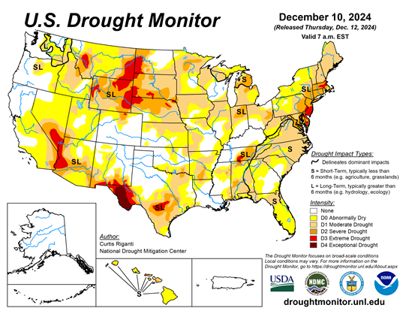
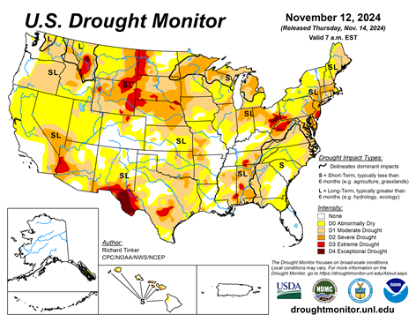
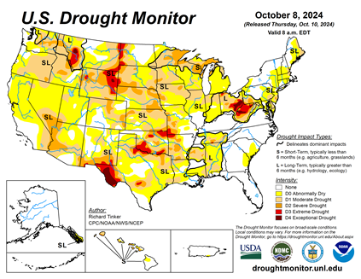
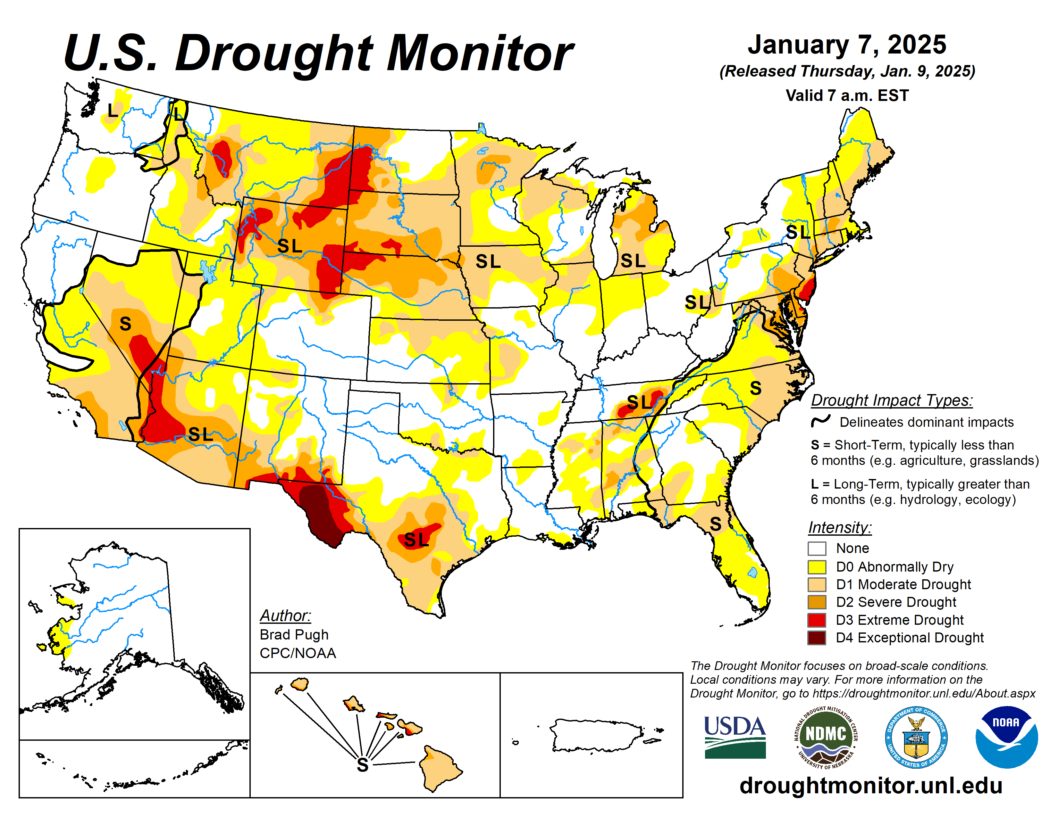
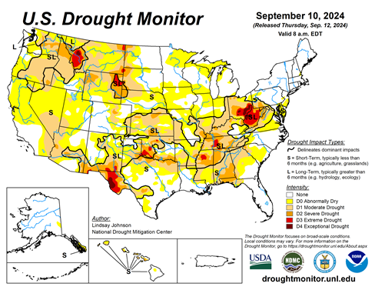
Drought Monitor
Monitoring is important because, unlike US T/P fcsts, for drought forecasts, we have to know where we are, before we can tell where we are going!! Drought forecasts are tendency forecasts as changes from the latest USDM.
California for the most part, until a few months ago, has remained drought free for about twenty months now luckily due to above normal rainfall during both recent 2022/23 (La Nina, strange!) and 2023/24 (El Nino, canonical!) winter rainfall seasons. But in the last couple of months some dryness has kept in. Water levels in CA reservoirs are good but surface moisture loss has triggered large, rapidly-spreading fires in southern CA. Water storage levels in the much bigger Lake Powell and Lake Mead continue to be very low, and are nowhere near the long-term average contents.
This is decades in the making. Comparing the most recent USDM with that back in summer, there is a considerable increase in the drought covered areas of the United States, but down somewhat from record coverage in November.
In our June/July Drought briefings, we suggested that, “Overall, % of US land areas under drought will slightly increase from existing very low levels, mainly due to drought concern in the western/central US states.” – which did happen, as we can see from the current USDM map.
Large parts of NV/UT/AZ/NM and TX are still dry or under drought due to long term/decadal drought in the SW, as well as the poor back to back SW monsoons in 2023 and 2024.
While the drought in WA & OR got relief from the early winter rains, drought in the border/interior areas of MT,WY the Dakotas and NE has not significantly improved and is likely to not get any relief soon.
Much of the coastal regions of northeastern states and the Delmarva region and vicinity that quickly developed drought conditions earlier have seen some relief and may get more, consistent with canonical La Nina correlations.
A lot depends on the strength and duration of La Nina? Generally La Nina phase of ENSO is associated with less rain across the US and vice versa during El Nino, enhancing any dryness and raising concerns across the southern states .
December
November
October
January
(Recent/Latest)
September

Slide 3
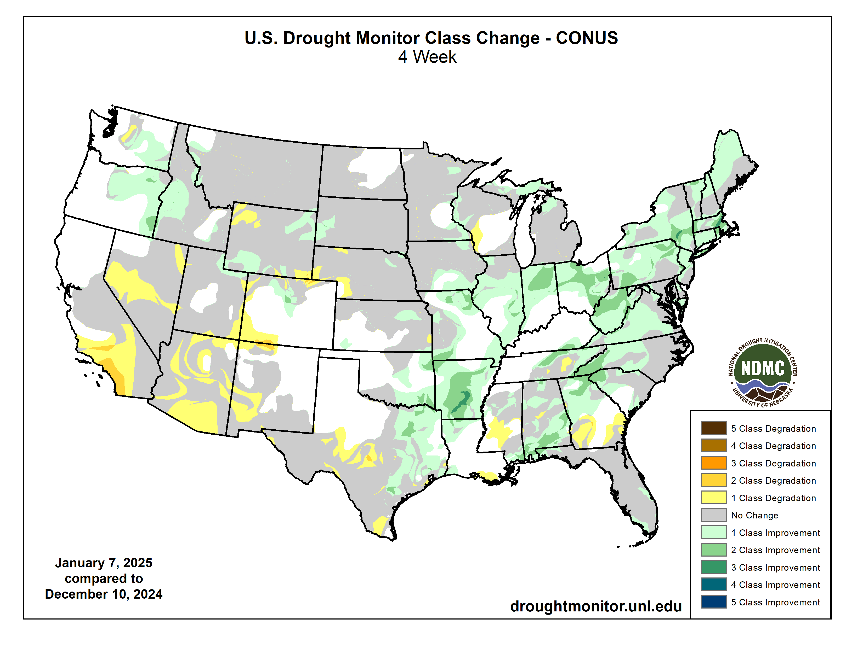
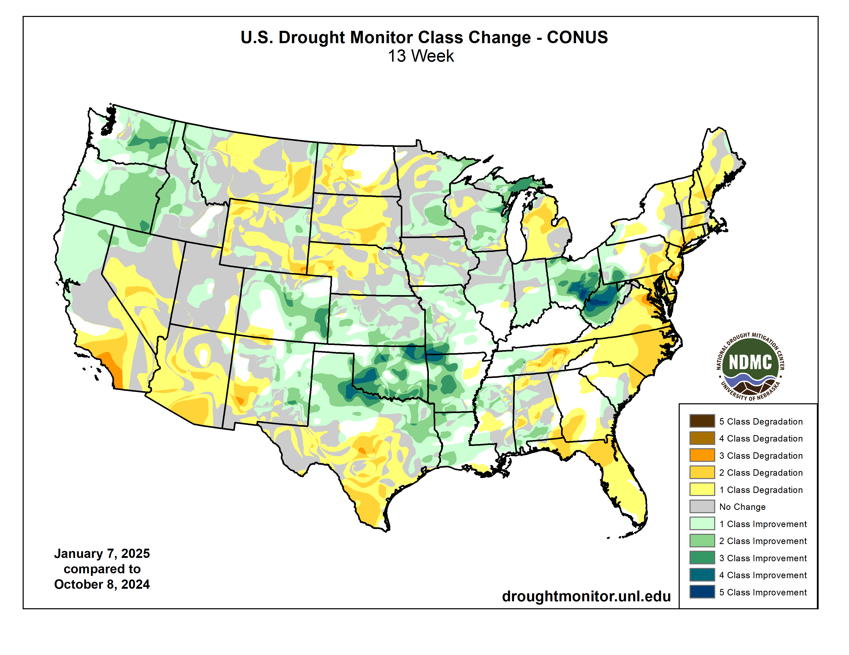
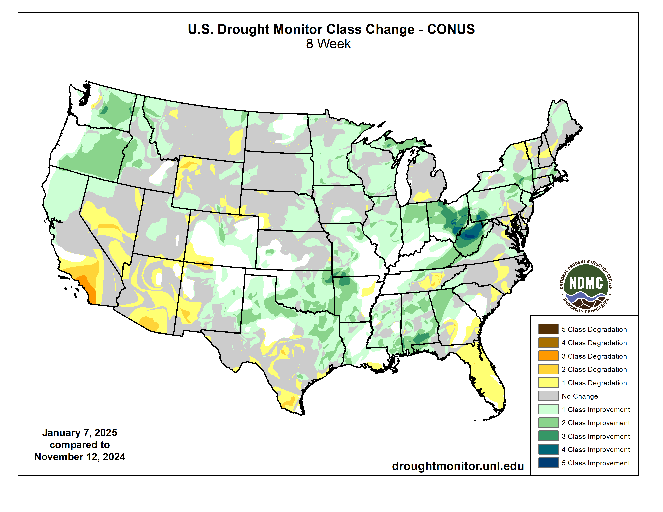
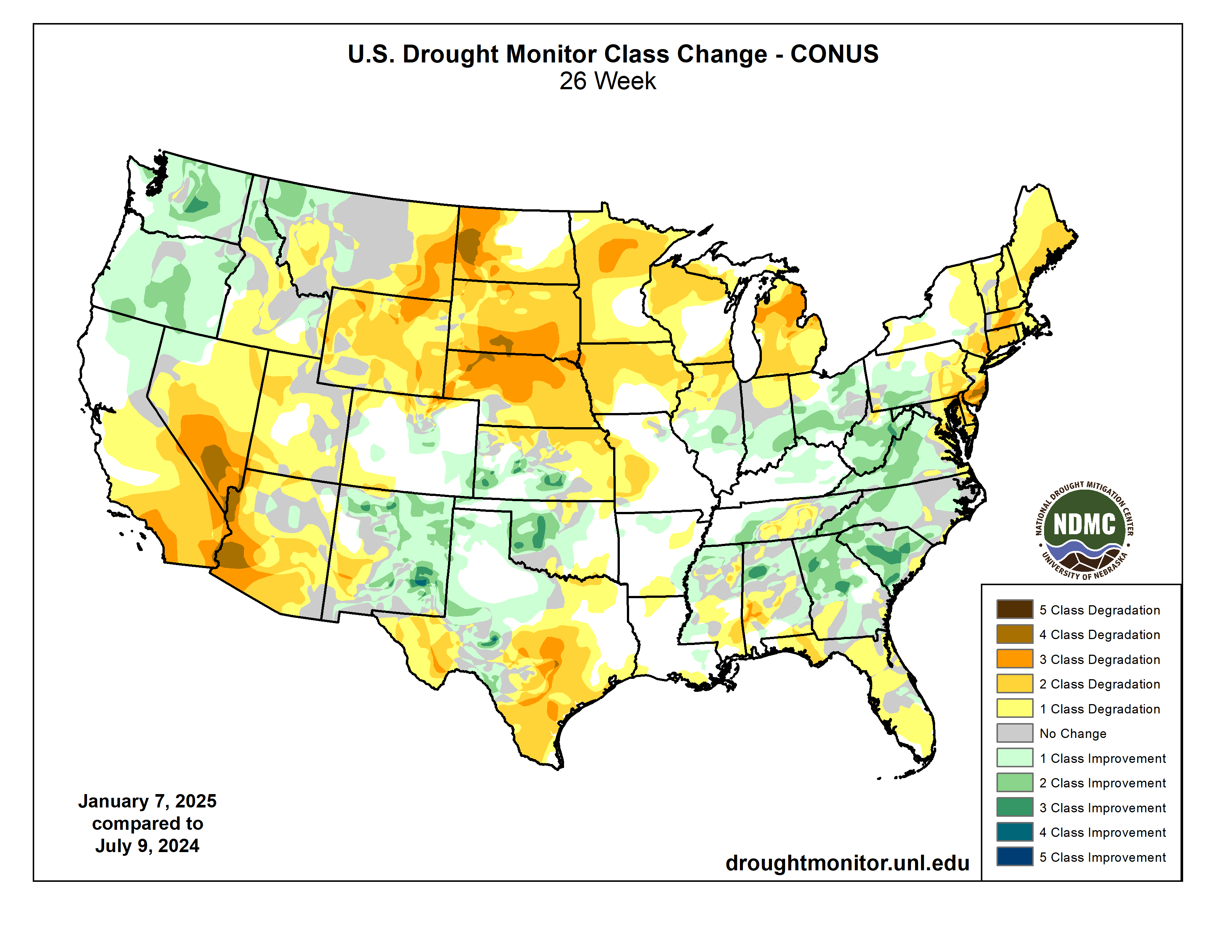
Drought Monitor Change

Slide 4
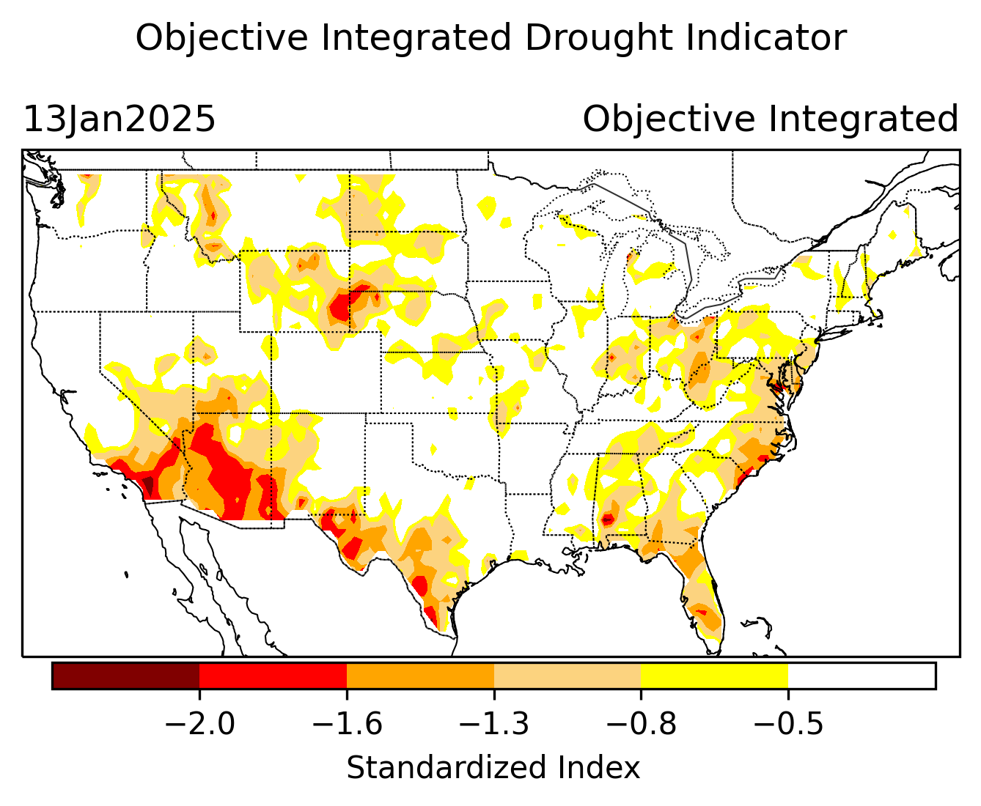
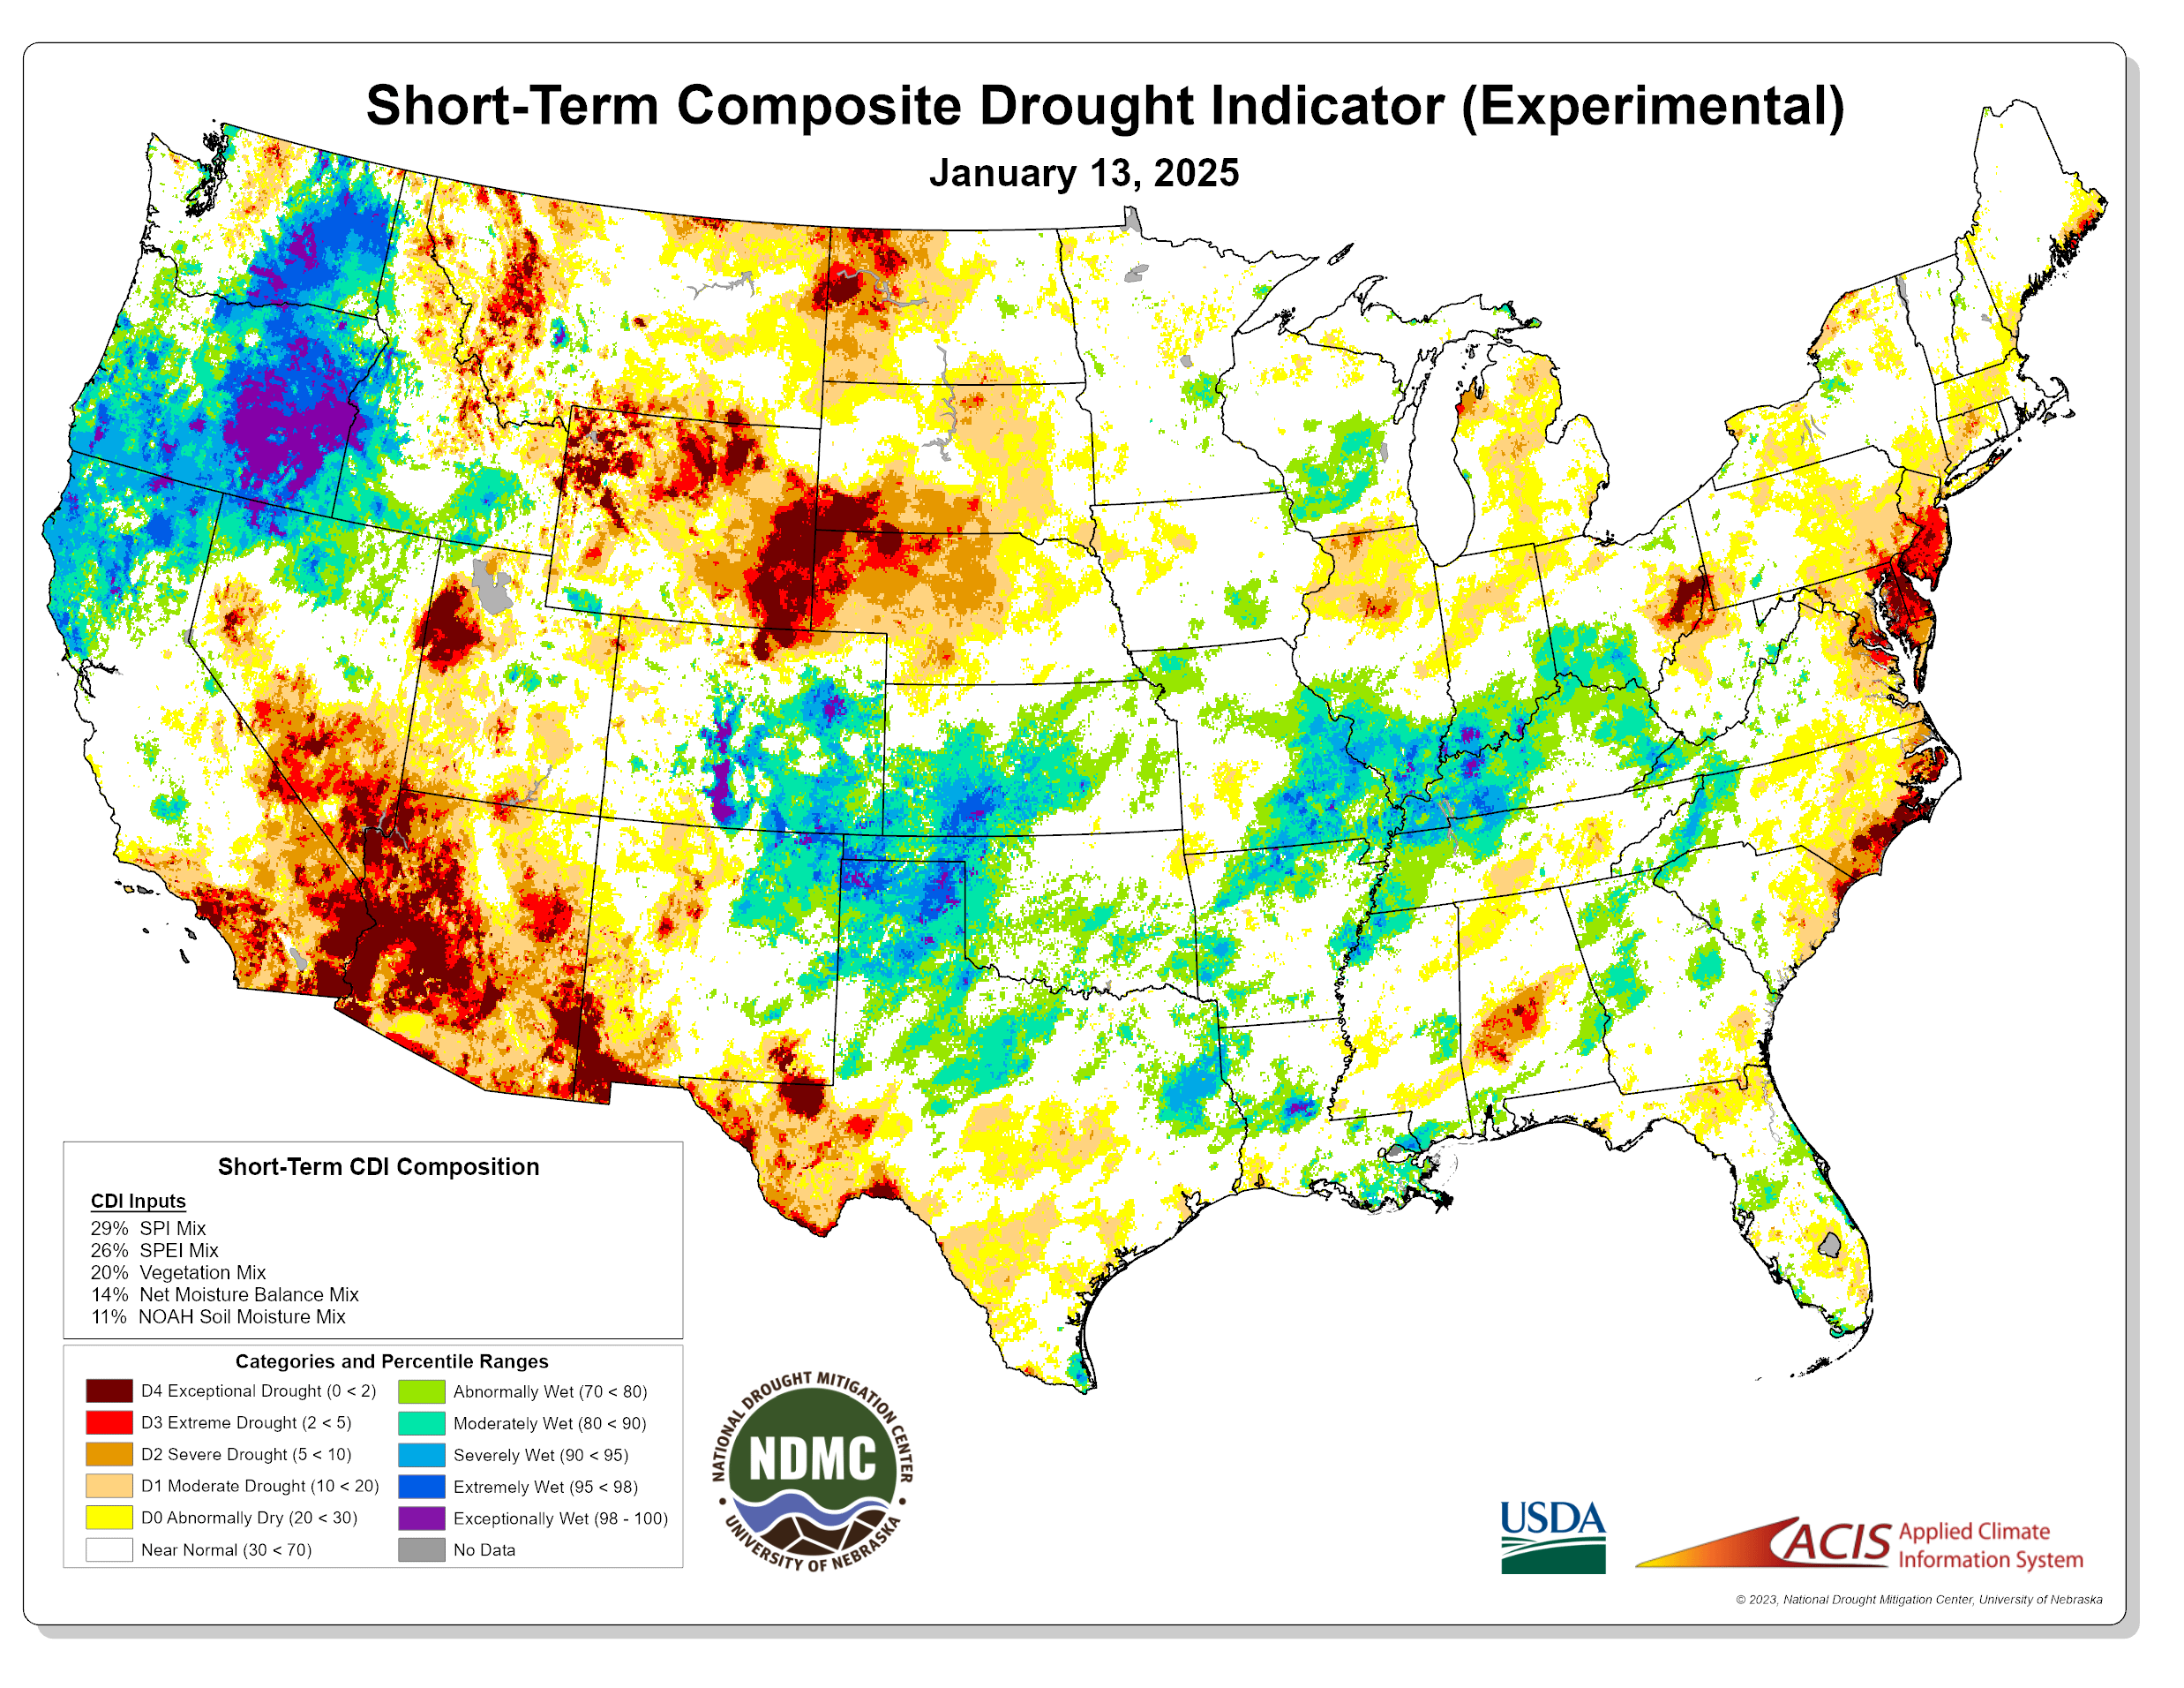
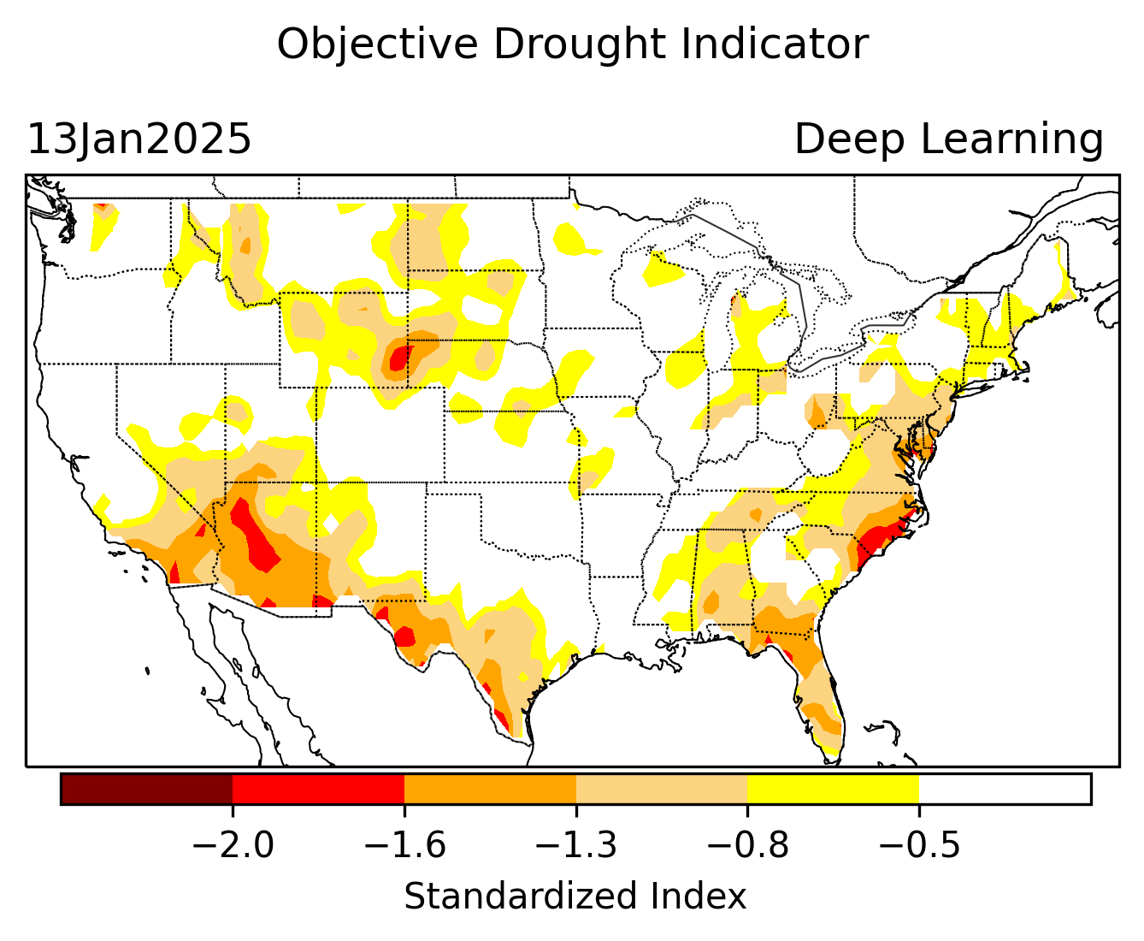
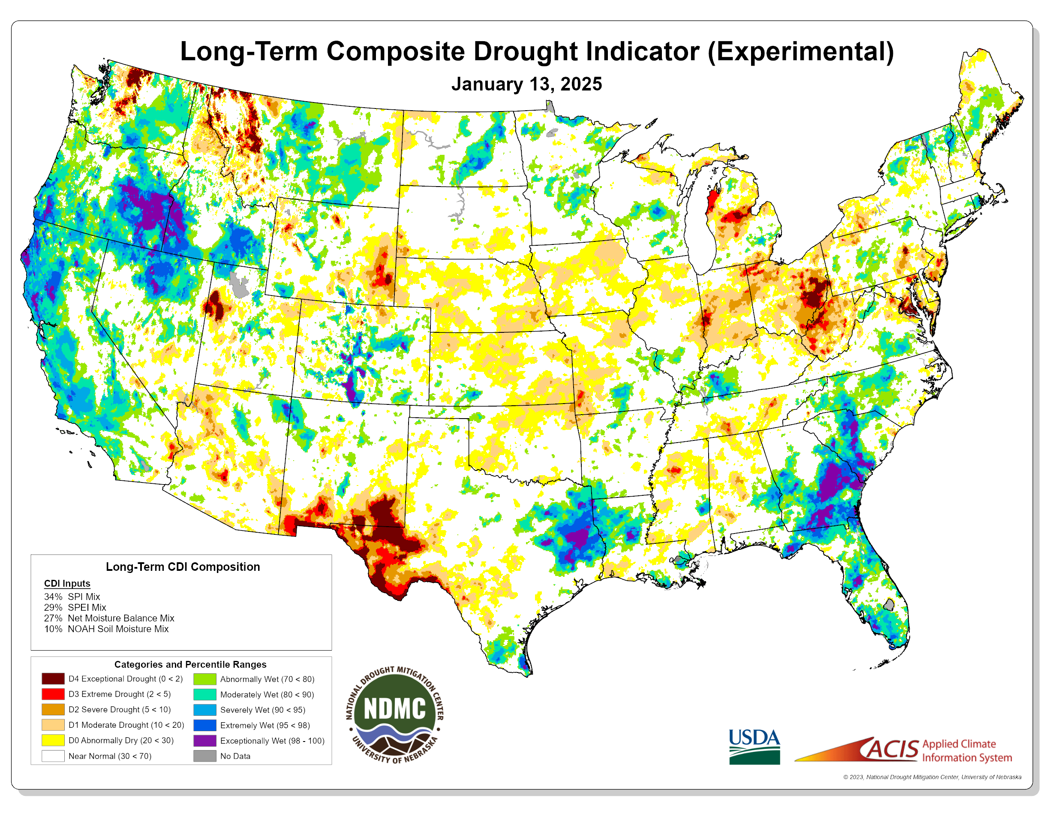
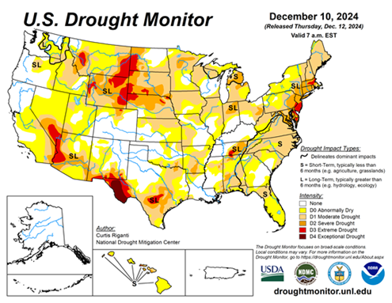

Exptl. Objective Drought Monitor
(showing S/term & L/Term separately) from
National Drought Mitigation Center (NDMC)
New slide now included recently in this briefing!
CPC’s own Experimental
Objective Drought Indicator (ODI)
using AI/Deep Learning ! – Updates daily !!
https://www.cpc.ncep.noaa.gov/products/people/lxu/odi/#deep-learning-increment-training
Based on the CPC P/analysis &
VIC (Princeton) NLDAS model assimilation:
Standardize Precipitation index (SPI)
Standardize Precipitation-Evapo –
transpiration index (SPEI)
Evapotranspiration Stress Index (ESI)
Soil Moisture Percentile (SMP)
Standardize Runoff Index (SRI)
-can be split into Short/Long Term Droughts!
https://droughtmonitor.unl.edu/ConditionsOutlooks/CurrentConditions.aspx
Objective
& Updates Daily!
Objectively Integrated
versus Deep Learning
Methods ~ gives |||r results. Both Objective!
Both “update daily” based on indicators day before!
Objective
& Updates Daily!
Objective
runs Weekly
On Mondays!
* A manuscript (Xu & Chelliah) is under preparation.
Latest Official USDM (US Drought Monitor)
(about a week old!)
Subjective &
Produced Manually!
Weekly!
Objective
runs Weekly
On Mondays!
These two maps above, used to be produced at CPC every Monday but now officially moved to NDMC operations!
*Released every Thursday, for conditions as of Tuesday!

Slide 5
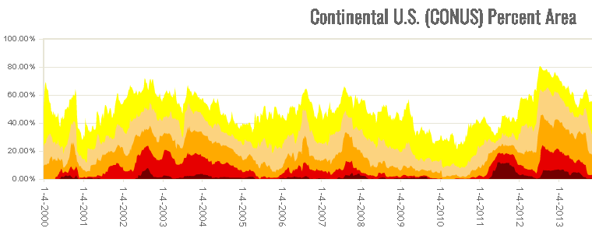
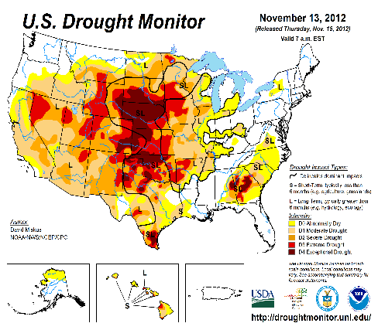

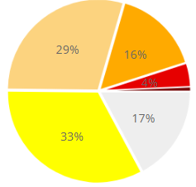
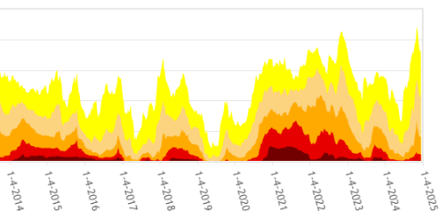

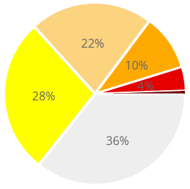

In general, The spatial details of every drought is different.! Every situation is different!!
Time series since 2000 spilt into 2 (above & below) panels.
After 2024 El Nino!
After 2019 El Nino !
3 back to back La Ninas !
last
month !
CONUS % Land Area
This month !
We said in this briefing a 3,4 months ago, that the relative minimum in the %(percent) of US land coverage by Drought has reached its lower limit, and will likely increase from that low point onwards and it has been happening, as we suggested. We said it based on 2 factors: weak 2024 SW monsoon, ending of El Nino, and (FINALLY) La Nina development.

Slide 6
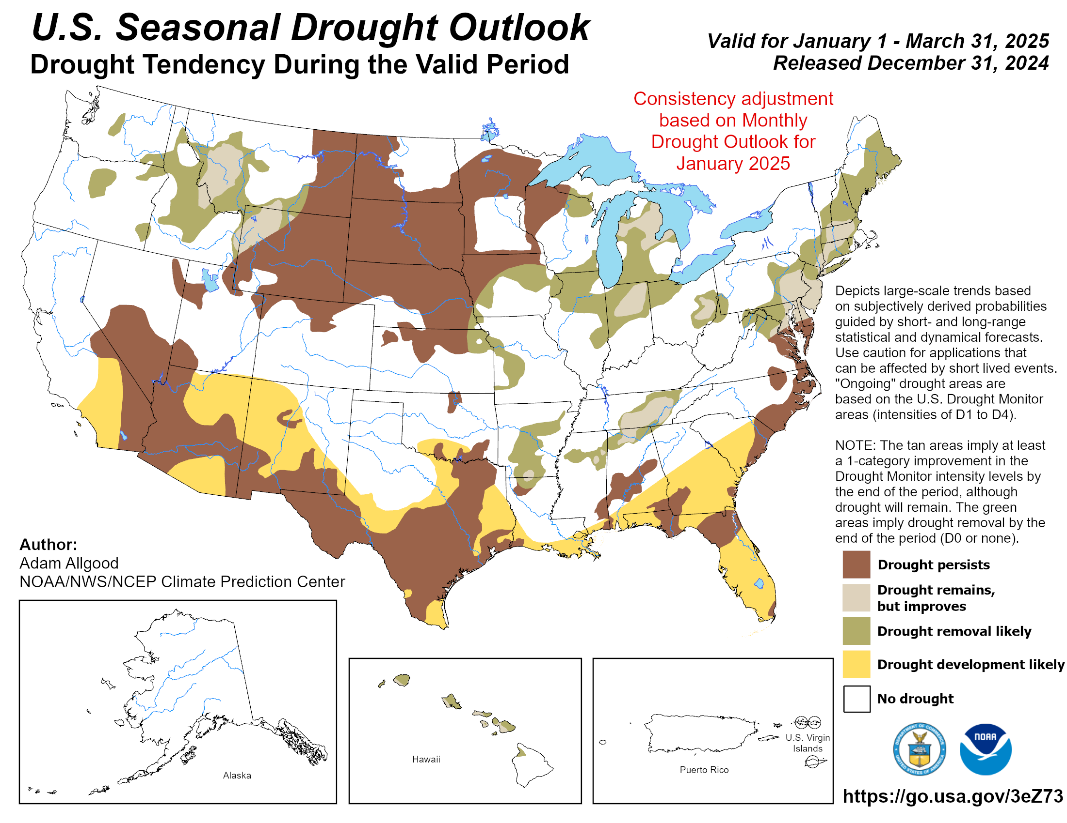
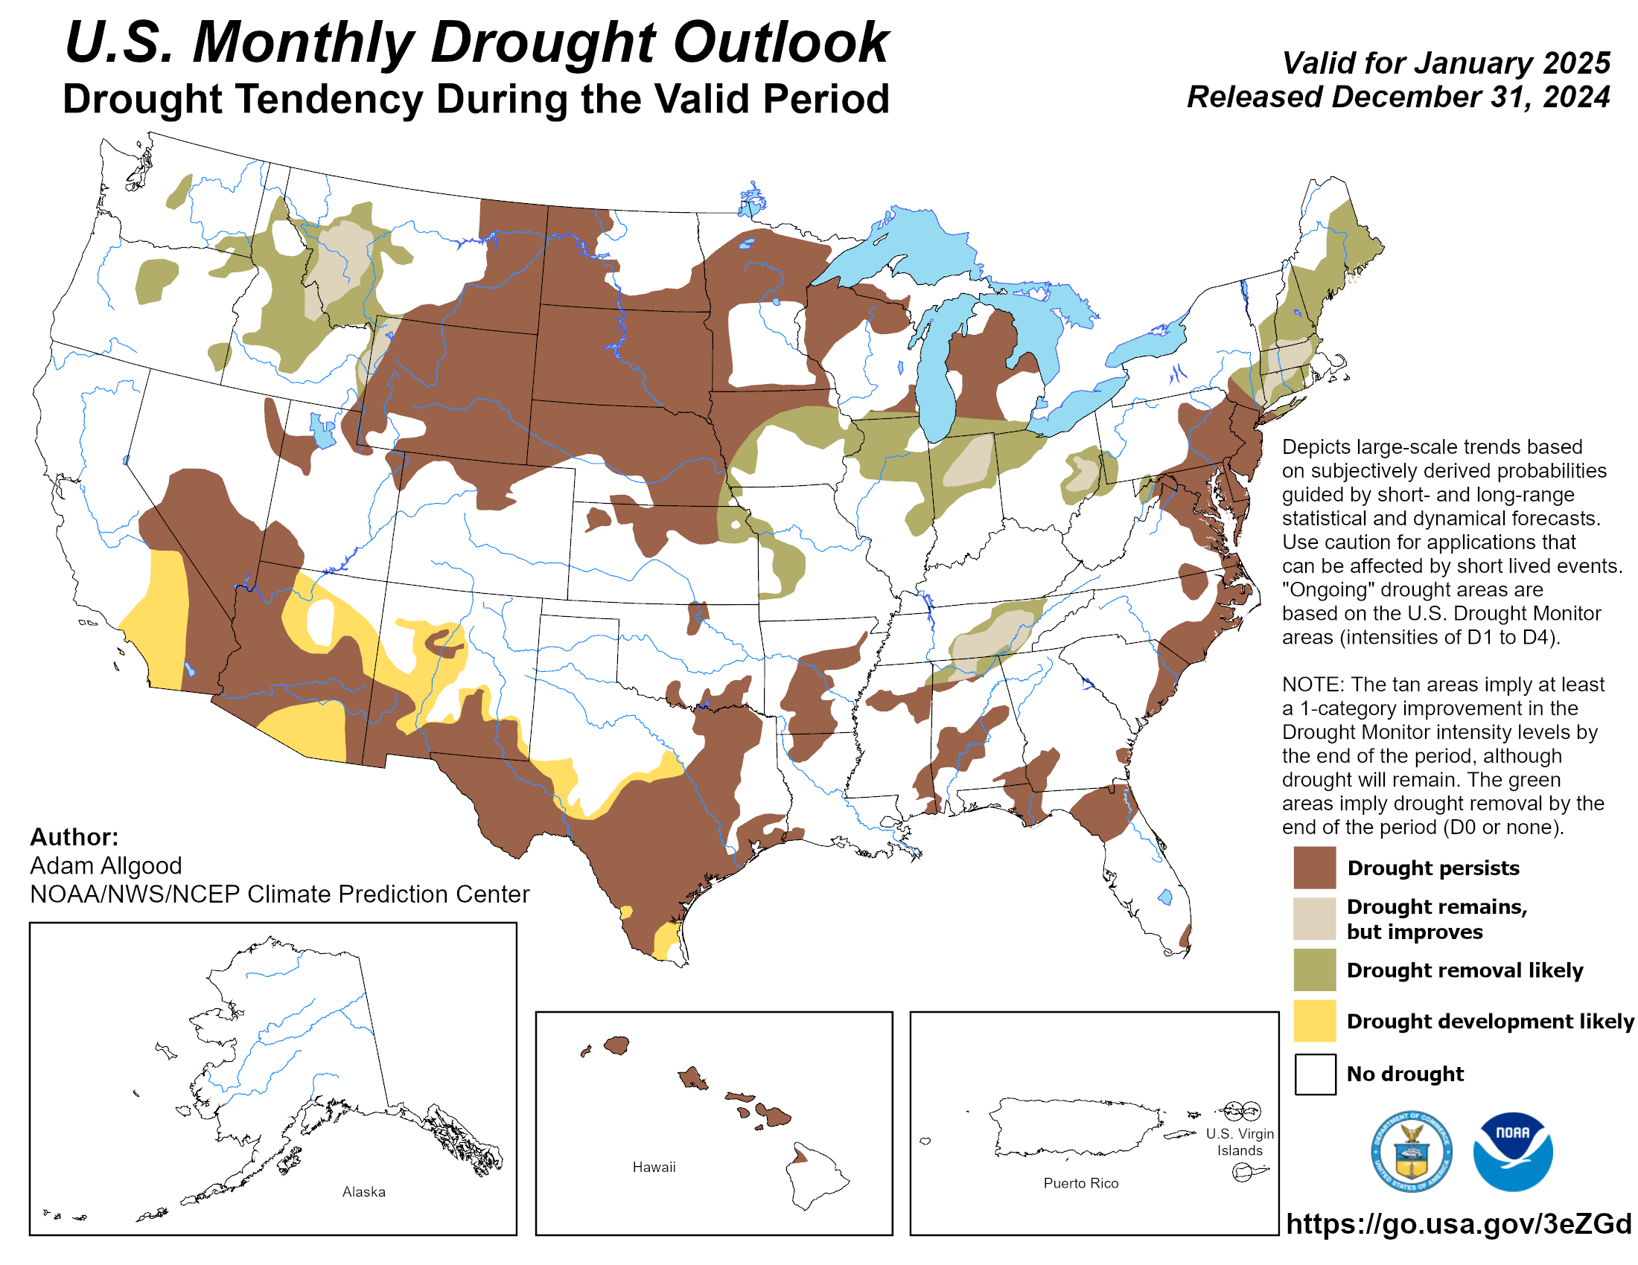

(Previous) Seasonal/Monthly Drought outlooks
New Seasonal+ Drought Outlook(SDO) to be released in 2 days!
(reissued again at end of month for consistency with MDO!)
New Monthly Drought Outlook (MDO) to be released at end of this month)
Updated Seasonal Outlook
( 1 Jan 2025 – 31 Mar 2025)
issued 12/31/24
Both outlook maps from cpc website!
Monthly outlook (for January 2025)
issued 12/31/24
https://droughtmonitor.unl.edu/Maps/ChangeMaps.aspx
Both outlook maps from cpc website!

Slide 7
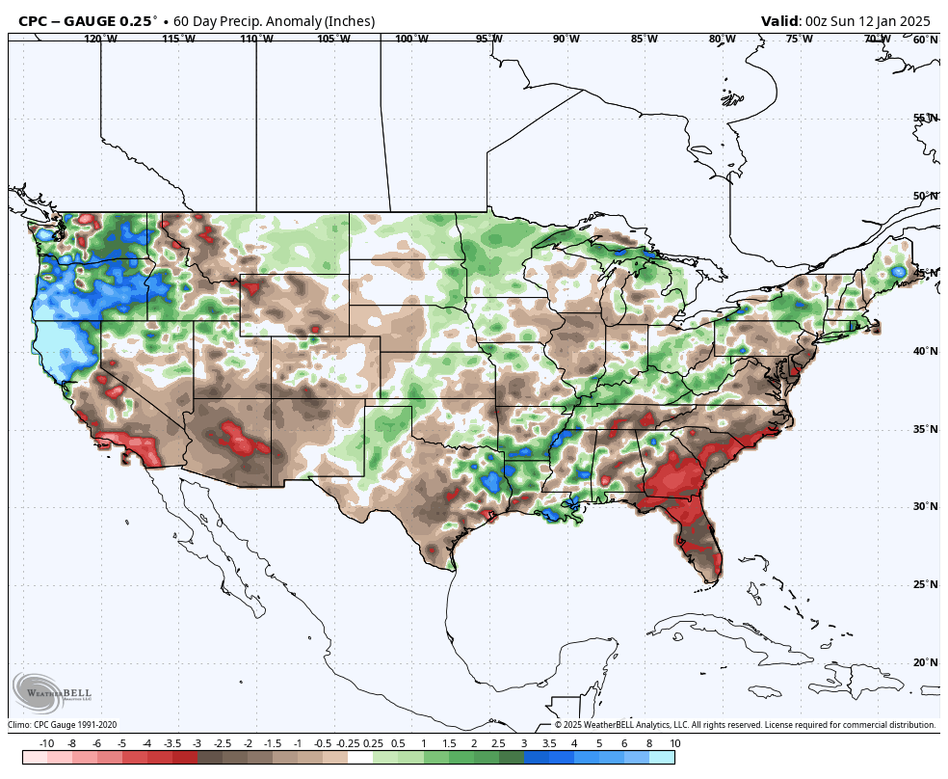
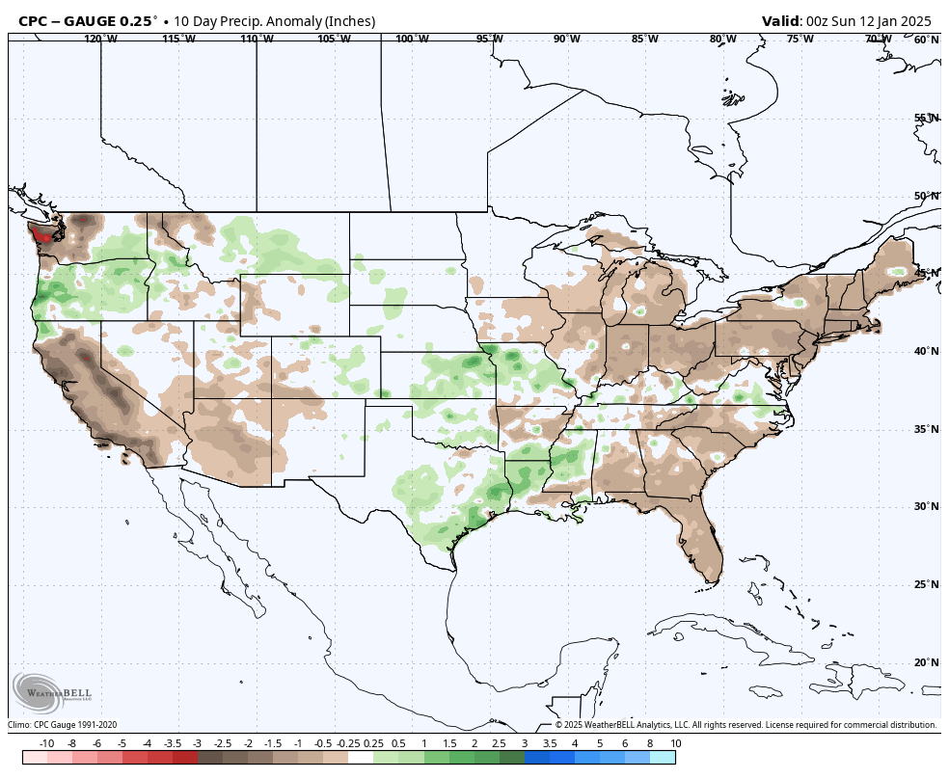
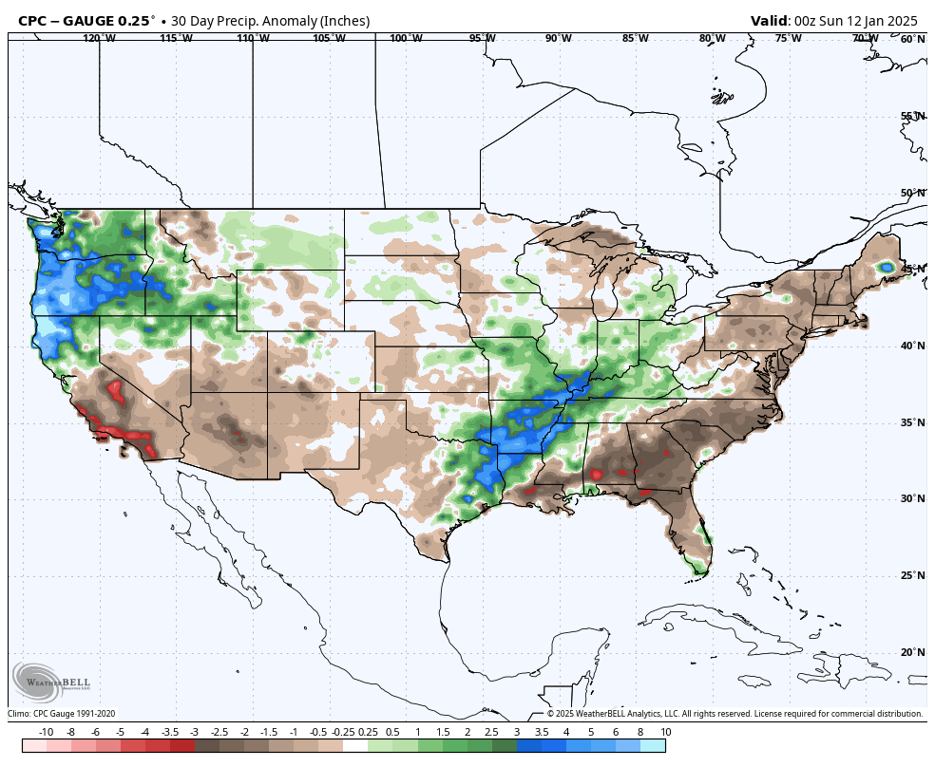
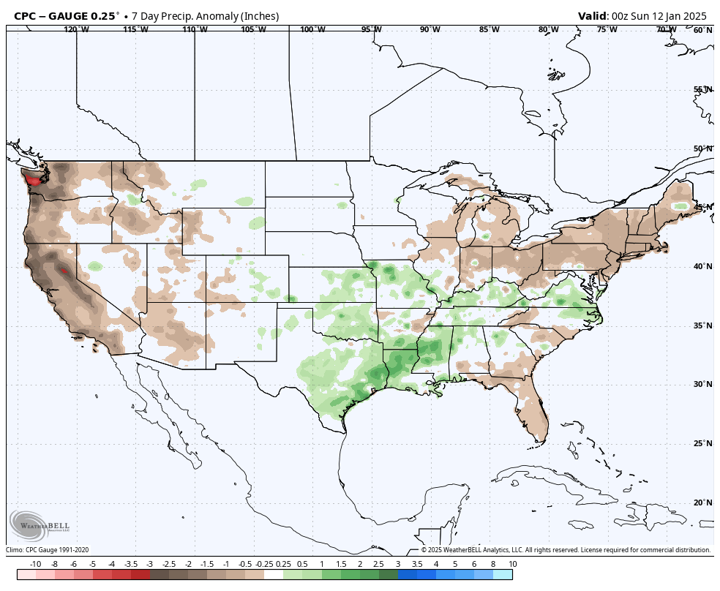
Precipitation ANOM during last 7, 14, 30, & 60 days.
This and next few slides show Precip deficit (excess).
Droughts, for the MOST part, begin and end with precip!! Lately, Temps are becoming (secondarily) important as well.
60 Days
10 Days
These maps in this and following slides, including a) Total,
b) Anom and
c) Percent of Normal precip. in these and other longer time ranges are now (routinely) daily updated at:
30 Days
7 Days
CPC ¼ deg. Grid
Graphic from Weatherbell
From: Recent Accum./Anom Precipitation https://www.cpc.ncep.noaa.gov/products/Drought/briefing_prcp.shtml

Slide 8
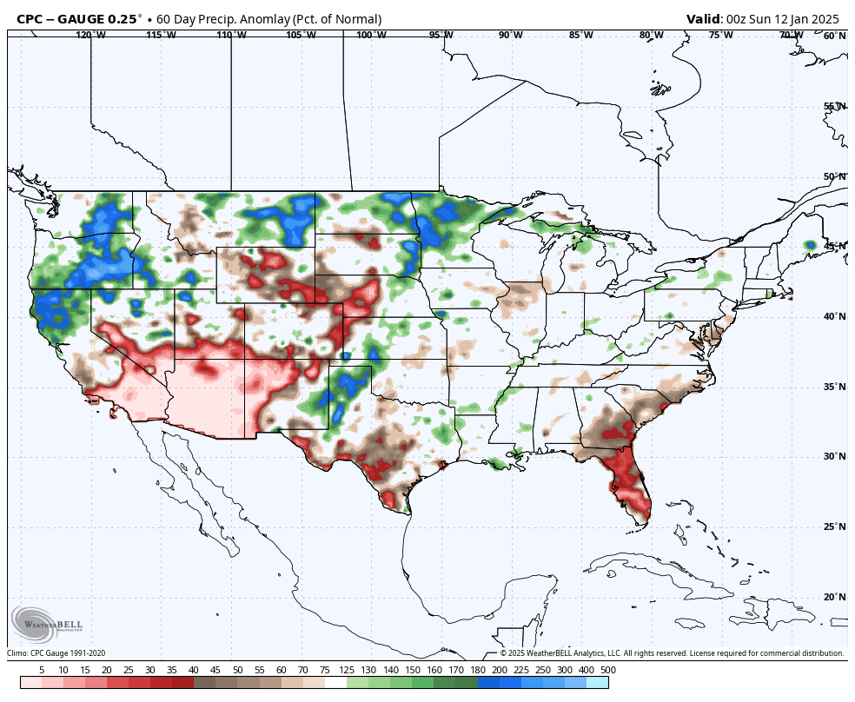
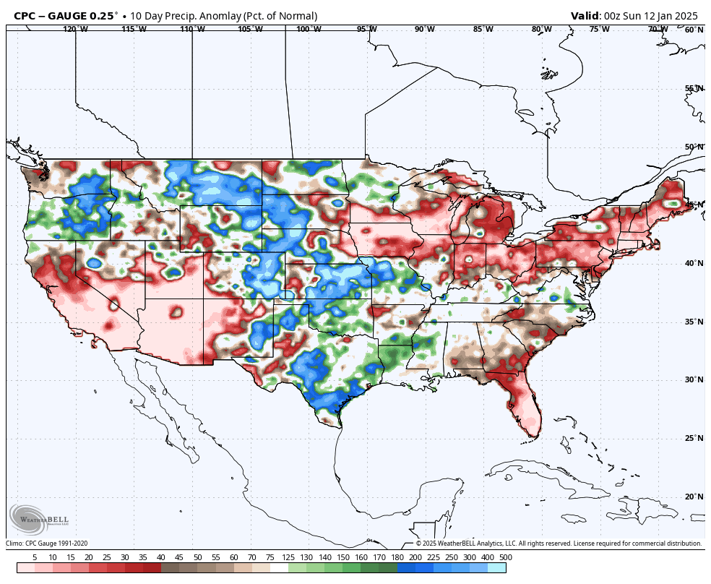
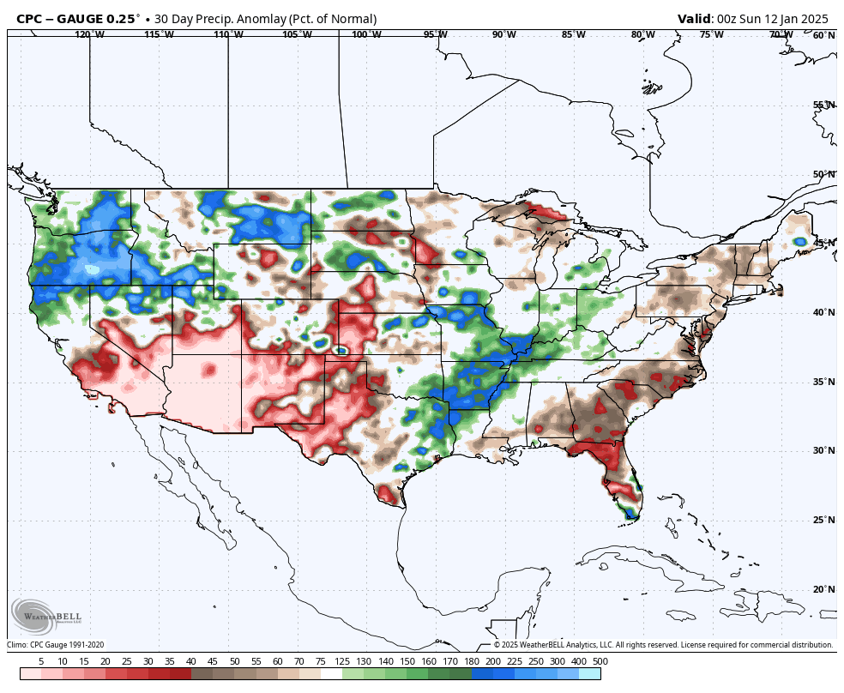
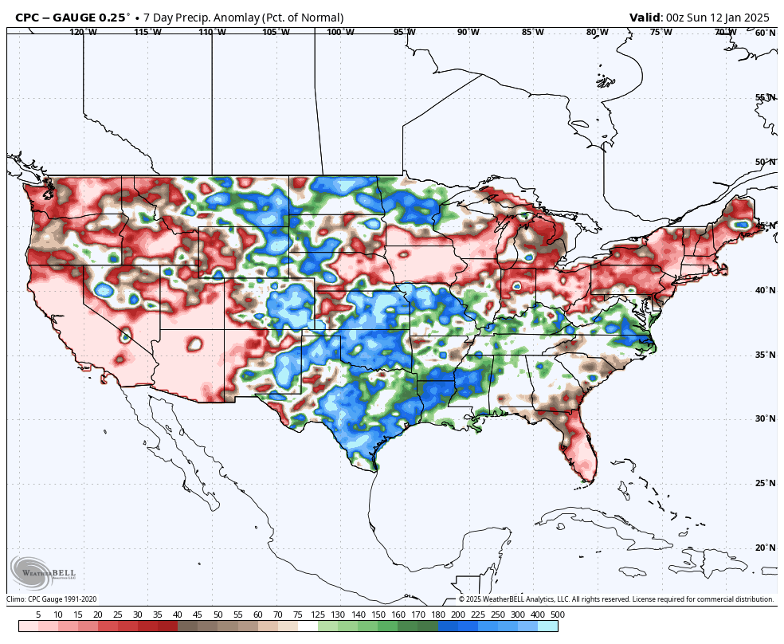
Precipitation Percent (of normal) during last 7, 14, 30, & 60 days -
60 Days
10 Days
This plot shows only the rainfall deficient regions <= 90% of normal.
-- This shows more clearly possible/likely drought developing region in the future unless there is above normal rainfall in these regions in the future, to offset these shortfalls.
30 Days
7 Days
CPC ¼ deg. Grid
Graphic from Weatherbell
From: Recent Anom/% of normal Precipitation https://www.cpc.ncep.noaa.gov/products/Drought/briefing_prcp.shtml

Slide 9
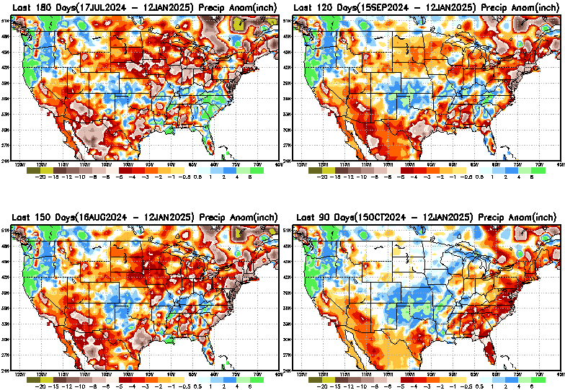
Total precipitation ANOM during last 3, 4, 5, and 6 months.
While the Precipitation anomalies deficit may seem large in some regions (compared to others),
it is the
% of normal precip (next slide) that matters more!!
6 M
4 M
5 M
3 M
From: Recent % of Normal Precipitation https://www.cpc.ncep.noaa.gov/products/Drought/briefing_prcp.shtml

Slide 10
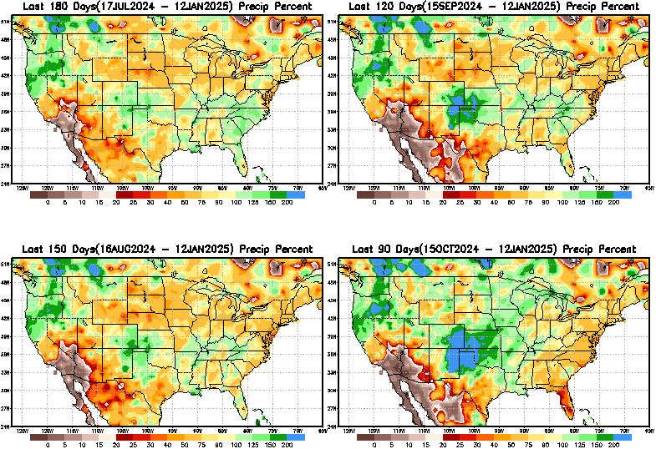
Total precipitation Percent (of normal) during last 3, 4, 5, and 6 months Only Deficit Areas <=90% shown!!
6 M
4 M
In these interim time scale 3-6 months, we need to pay attention to regions, which are dark brown, brown, dark red, & red (<40%).
While accrued precipitation deficits are real & objective,
droughts are subjective declarations!!
5 M
3 M
East vs West!
Broad vs Narrow
rainfall season.
In general, West US suffers more from frequent and lasting droughts. Droughts in East US are generally less and less lasting!
What about Center ?
More like West than East?
Short term(S) Drought is generally declared when large/severe rainfall deficits exist in the 3-6 months time range. {Long term deficits beyond 1 or 2 or more years is Long term L drought! }

Slide 11
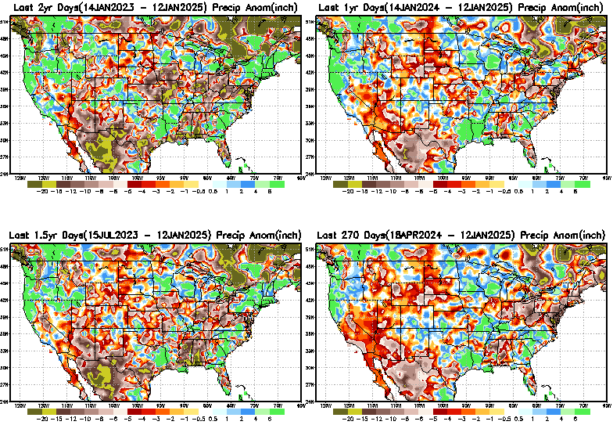
Total precipitation Percent during last 9 months, 1 yr, 1.5yrs, & 2 yrs. .–Only Deficit Areas shown!! <=90%
2 Y
1 Y
1.5 Y
9 M
The character and even location/spatial extent of the short/S and long/L –term droughts are different!!!
From: Recent Accumulated Precipitation https://www.cpc.ncep.noaa.gov/products/Drought/briefing_prcp.shtml

Slide 12
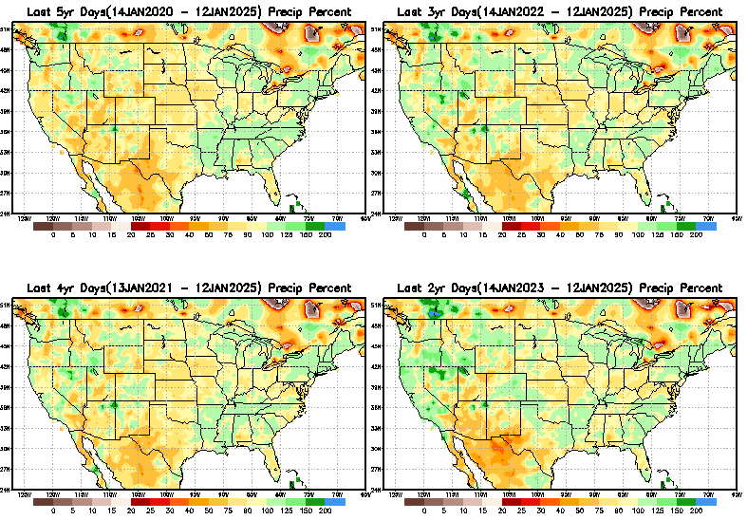
Total precipitation Percent (of normal) during last 2, 3, 4, & 5 yrs. .–Only Deficit Areas <=90% shown !!
5 Y
3 Y
Deficits are not much!
In terms of long-term-drought, overall, the country is in good shape! Including the southwest, especially California & vicinity. ☺ ☺
4 Y
2 Y
From: Recent Accumulated Precipitation https://www.cpc.ncep.noaa.gov/products/Drought/briefing_prcp.shtml

Slide 13
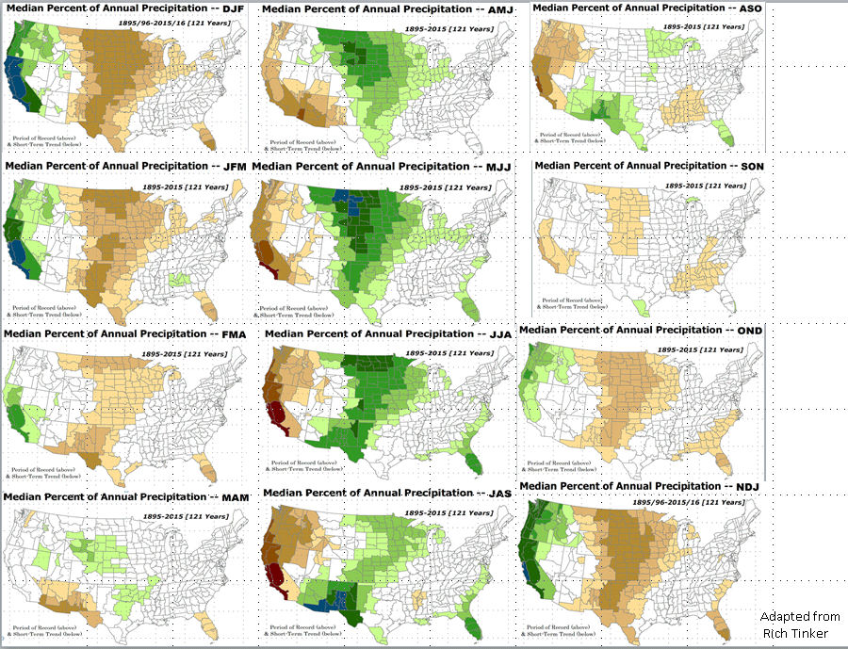

East vs West!
More darker colors in west/central => narrow rainy season (months)
Overall, more white space in the east => distributed rainfall season (except ~FL).
LEAST
In-BETWEEN
MOST

Slide 14
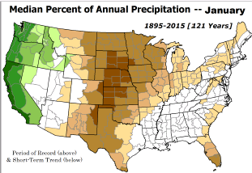
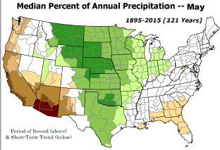
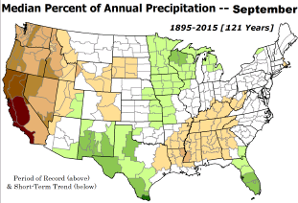
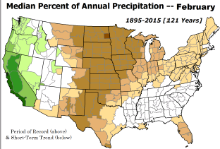
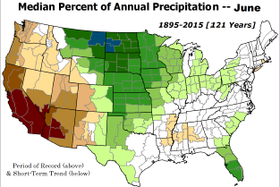
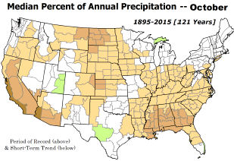

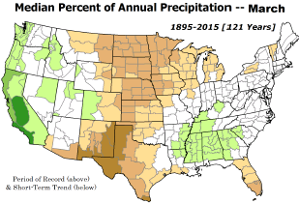
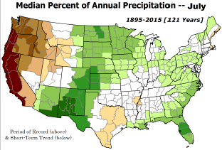
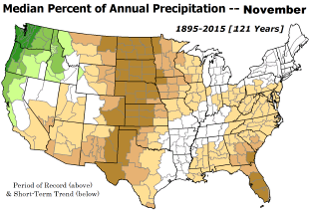
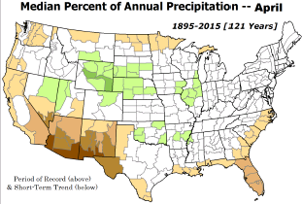
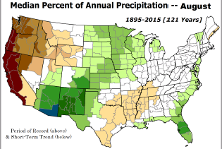
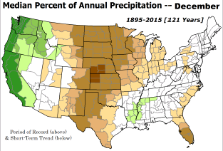
JFM is in the middle of the dry half of the year over the central one third of the US and among the wet rainy months of rainy season for western costal US.
*********
EAST vs
CTR/WEST
Drought Behavior is loosely tied to rainfall climo!! And the limited rainy season in the west
*********
Adapted from Rich Tinker.

Slide 15
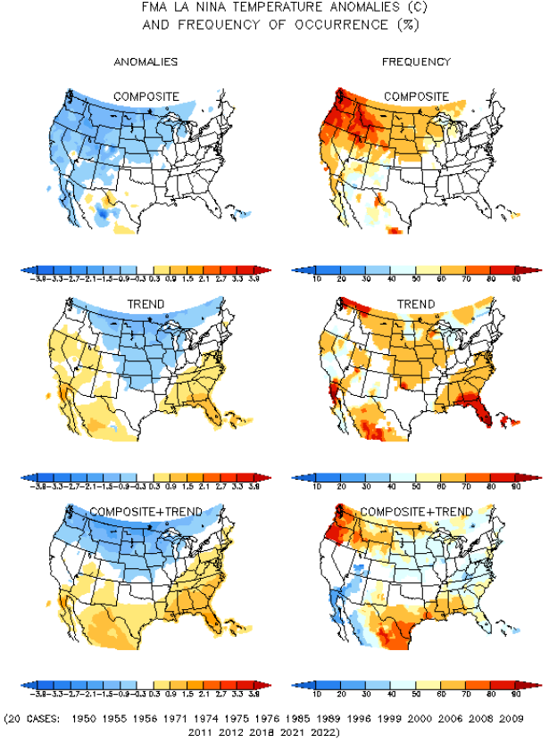
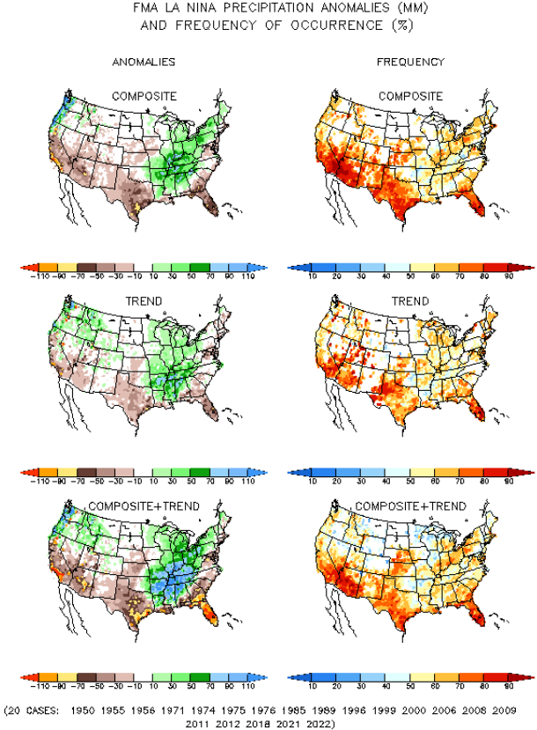
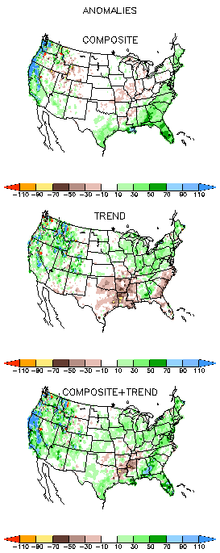
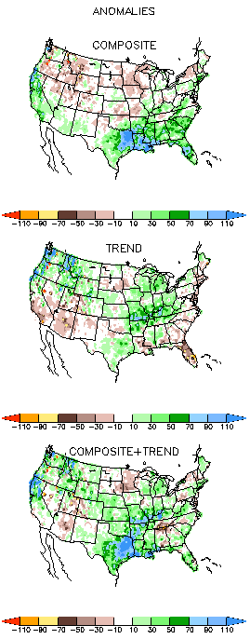
La Nina Precip/Temperature COMPOSITES & Trend map
FMA
T
P
Opposing signals!
https://www.cpc.ncep.noaa.gov/products/precip/CWlink/ENSO/composites/
During Winter and during La Nina: Generally warm and dry along southern states.
Not warm & not Dry along northern tier states. Compare NMME forecasts in later slides!

Slide 16


Slide 17

The Standardized Precipitation Index SPI
(based on Observed P)
Compare with last month
----- NOW
Very interesting graphic & details for the drought across the US based on the more generalized precip deficit/excess, the Standardized Precipitation Index (SPI).
The dark brown and red colors, indicating standardized precipitation deficits, in the various time periods, approximately correspond to the appropriate short/long term drought monitor regions and their intensities
Short
Long
How does one negotiate and reconcile declaring short term vs long term drought when precip. deficiencies patterns differ on many different time scales locally!!
What is the cutoff delineating time between short VS long term drought!! Not so clear!!
At exactly where, does drought begin?
https://www.cpc.ncep.noaa.gov/products/Drought/Figures/index/spi_plot.gif
Based on this SPI indicator/measure,
The brown areas are various levels of DRY regions!
The yellow/red are more probably drought regions!

Slide 18



Recent US Temperatures
.
Last
month !!
Prior
Month!
https://www.cpc.ncep.noaa.gov/products/tanal/temp_analyses.php
So far this month !!
NOW!

Slide 19



https://www.frontlinewildfire.com/california-wildfire-map/
URL
https://cdec.water.ca.gov/resapp/RescondMain
Actual Fire locations and hotspots
% of Capacity
% of Hist. Avg.
of Reservoirs.
Jan 1-12 acres consumed in So CA 6.5 times the 10-year avg for 49 states
URL
Many CA water reservoirs are AT their historical average/ CAPACITY levels ! ☺ . After this past winter, most reservoirs were ABOVE their historical averages. BUT Not anymore!

Slide 20


Western Water (2000-2024), from Dean Farr
Percent Full for End of November 2024)
Percent full for End of December 2024
https://www.deanfarr.com/western_water/
URL
Lakes Mead, Powell in NV/AZ are at low levels! ☹ ☹ HUGE implications for electric power and water supplies for CA/NV/AZ/UT !!
Some reductions in Pacific Northwest!!
Overall very similar

Slide 21










Streamflow (USGS)
Most US east droughts are relatively short lived (as compared to US west).
But in last 2 decades, recently in 2000, 2016, 2020, & 2022, New York and New England experienced historic drought conditions not seen since the 1960s.
https://waterwatch.usgs.gov/?m=nwc
Map shows only below normal 7-day average streamflow compared to historical streamflow for the day of year.
One month ago (left) &
Now (below)
Streamflow is only a partial indicator, as sometimes it is highly managed.
If sometimes, the various indicators are confusing, go back to % of rainfall deficit maps – to confirm/reinforce!!
https://waterwatch.usgs.gov/index.php?id=ww_drought
21

Slide 22

EL NIÑO/SOUTHERN OSCILLATION (ENSO)
DIAGNOSTIC DISCUSSION
issued by
CLIMATE PREDICTION CENTER/NCEP/NWS
and the International Research Institute for Climate and Society
9 January 2025
ENSO Alert System Status: La Niña FINALLY
The much-anticipated La Niña is officially here. Equatorial sea surface temperatures (SSTs) are below-average in the central and east-central Pacific Ocean. Conditions are likely to continue through February - April 2025 (59% chance), with a transition to ENSO-neutral most likely for March-May 2025 (60% chance).
(If you recall, back in June the forecast was for 65% chance of La Nina development during July-September!)
Atmospheric features have resembled La Niña correlations for 1-2 months, esp. in central Pacific (subjective)
CPC’s Oceanic Niño Index (ONI) [3 month running mean of ERSST.v5 SST anomalies in the Niño 3.4 region (5ºN-5ºS, 120º-170ºW)], based on centered 30-year base periods updated every 5 years. For historical purposes, periods of below and above normal SSTs are colored in blue and red when the threshold (0.5) is met for a minimum of 5 consecutive 3-month overlapping seasons.
https://origin.cpc.ncep.noaa.gov/products/analysis_monitoring/ensostuff/ONI_v5.php

Slide 23





Latest values of SST indices in the various Nino Regions.
The recent El Nino came in a hurry after 3 back-to-back La Ninas has all but gone away in a great hurry to make room or ANOTHER La Nina which is on the way!!? ?

Slide 24


Sub-Surface Temperature Departures in the Equatorial Pacific
Most recent pentad analysis
Subsurface cold water content/volume significantly increased this past month.

Slide 25





Official ENSO Forecasts
December 2024 CPC/NOAA forecast
A slight pull back or slow down in the developing La Nina ??
January 2025 CPC/NOAA forecast
https://www.cpc.ncep.noaa.gov/products/people/wwang/cfsv2fcst/images3/PacSSTSeaadj.gif
Latest ensemble membrs (blue!)show are less bullish
https://iri.columbia.edu/our-expertise/climate/forecasts/enso/current/

Slide 26



Previous (Last Month’s)
CPC’s official
Temperature OUTLOOK for Monthly (Jan)/Seasonal (JFM)
Released December 19th
Monthly P/T forecasts verified at mid-month are generally good! Becoz of good skill up to 2 wks.
Observed so far this month!! ☺

Slide 27



Previous(Last month)
CPC’s official
Precipitation OUTLOOK for
Monthly (Jan)/Seasonal (JFM)
Released December 19th
Monthly P/T forecasts verified at mid-month are generally good! (??) Becoz of good skill upto 2 wks.
Observed so far this month!! 😌
☹

Slide 28






GEFS
WPC/NCEP’s Next 7 days QPF (Quantitative Precipitation Forecast)
GEFS*/GFS Model Guidance for the next 15 days.
(*new)
GFS
https://www.wpc.ncep.noaa.gov/qpf/day1-7.shtml

Slide 29

From 3 Models average Precip forecast (made 12 & 13 Jan) for next 30 days.
The 3 Models are: CFSV2, GEFS, ERA5

Slide 30

From 3 Models average Precip forecast (made 12 & 13 Jan) for next 30 days.
20
40

Slide 31


From 3 Models average Precip forecasts (made 12 & 13 Jan) for next 30 days.

Slide 32

From 3 Models average Precip forecasts (made 12 & 13 Jan ) for next 30 days.

Slide 33

From 3 Models average Precip forecasts (made 12 & 13 Jan) for next 30 days.

Slide 34


From 3 Models average Precip forecasts (made 12 & 13 Jan) for next 30 days.

Slide 35





NMME*
T (left) &
P (right)
Ens.Mean forecasts for
Feb
T
P
FMA
Overall, across the US, less than normal rainfall (& above normal T) is forecast by NMME for both the month and season!
Warm & Dry across the Southern states !
Models overplaying the La Nina impact ?
NMME* : North American Multi Models Ensemble

Slide 36


Agreement/Disagreement among the various NMME models’ JFM seasonal Precip. Forecast.
??

Slide 37


BONUS Topic: Discussion continues!! Explanation for the multiyear DROUGHT in the Southwest (CA/AZ/NM/NV/UT/CO & vicinity)!!
More La Nina’s lately ?
More frequent La Ninas lately ?
YES!! The stats in the table below (bottom left) are from the Official CPC ENSO declarations page/table!
Compared to other regions of the globe, the SST warming/trend in the central eq. Pacific (Nino 3.4) is relatively much small. (See Fig. above) – Why is this ?
Does nature try to compensate for the warming else/everywhere by producing more La Ninas in the equatorial Pacific? - Just my observation from data! Let’s check !!!
Since the 1997 monster El Nino (stronger than the famous 1982/83 event), just a quick count of CPC’s Nino 3.4 index++ values for the three month overlapping seasons, (Data at CPC site only available only from 1950!)
(27 years) (47 years) (74 years)
1997-2023 1950-1996 1950-2023
La Nina(DJF) 13 16 29
El Nino(DJF) 9 17 26
La Nina(all 3mos) 119 150 269
El Nino(all 3mos) 85 166 250
(Overlapping 3month seasons)
Look at Ratios of La Ninas (vs El Ninos) in the shorter
recent (27 yr) period vs the longer (47 yr) earlier period!!
Compare the ratios of La Nina to El Nino in the squared boxes.
(SKIP) slide
***Analysis of CPC’s official Nino 3.4 index data over the last 70 years shows that the more frequent La Ninas in recent decades contributed to less rainfall in the southwest (See La Nina precip composites!, slide#13) and hence the ongoing long term drought in the Southwest!! Hence the long term southwest drought is unlikely to go away any time soon***
++ Barnston, Chelliah and Goldenberg (1997):Documentation of a highly ENSO‐related SST region in the equatorial pacific,
Atmosphere-Ocean Volume 35, 1997. https://doi.org/10.1080/07055900.1997.9649597
*** The strong/weak annual monsoon rains in the southwest is a minor modulator riding on this bigger/longer-term signal. ***

Slide 38
Summary
Current Drought conditions:
California had remained drought free for 1-2 years due to above normal rainfall during both recent 2022/23 (La Nina, strange!) and 2023/24 (El Nino, canonical!) winter rainfall seasons. But in the last couple of months some dryness has developed, especially in southern parts of the state.
Water levels in CA reservoirs are near or above normal, Lakes Mead and Powell are major reservoirs of the Colorado River, formed by the Hoover Dam and Glen Canyon Dam, respectively. Lake Mead's full pool level is 1,229 feet, and it has a dead pool level of 895 feet. Powell has a full pool of 3,700 feet and a dead pool of 3,370 feet.
  On January 1, 2025, Lake Mead water level is 1,062.32 feet above sea level, while Lake Powell is 3,574.08 feet above sea level.
  Dead pool level is when the water is low enough to stop flowing through the dam, severely impacting hydroelectric power.
  These projected levels are enough to keep the Colorado River in a Tier 1 water shortage for the coming year, which is the least severe shortage condition.
  Powell is up 3.2 feet from the prior year on 1/9/25 but down 7.8 feet from early July 2024 peak of 3587 ft (now 3570 ft, long-term mean 3631 ft).
  Mead is down 5.1 feet from prior year on 1/9/25, but up 4 feet from late November low of 1061 ft (now 1065 ft, long-term mean 1153 ft).
Comparing the most recent USDM with that back in summer, there are considerably more dryness and drought (D0-D4) covered areas of the United States (64%, up from 26% Jun 14), although it is down from the record set in early November (88%). In our June/July Drought briefings, we suggested that, “Overall, % of US land areas under drought will slightly increase from existing very low levels, mainly due to drought concern in the western/central US states.” – which did happen, as we can see from the current USDM map.
Large parts of NV/UT/AZ/NM and TX are still dry or under drought due to long term/decadal drought in the SW, as well as the poor back to back SW monsoons in 2023 and 2024. While the drought in WA & OR got relief from the early winter rains, drought in the border/interior areas of MT,WY, the Dakotas and NE generally has not improved and is likely to not get any relief soon (seasonable dryness east of Rockies).
Much of the Northeast and Delmarva regions that quickly developed drought conditions in late summer have seen some relief.
Generally La Nina phase of ENSO is associated with less rain across the US and vice versa during El Nino. If La Nina is established during DJF/JFM, less than normal rainfall is expected across the southern US states, thus causing or enhancing drought there.
Southern California dryness/fires continue, no significant wind or dryness relief in sight for at least 2 weeks.
Current ENSO status and forecast: Equatorial sea surface temperatures (SSTs) are below average in the central Pacific Ocean. La Niña conditions present and should to continue through FMA 2025 (59% chance); transition to ENSO-neutral likely for MAM 2025 (61%).
Prediction: La Nina is finally here, and many tools indicate canonical conditions for 1-3 months (dry south tier, wetter north tier and OH Valley). Nevertheless, the models overestimated the development and strength of La Nina.
Recall the last 2023 & 2024 DJF seasons (one La Nina & another El Nino winter) both brought excessive rainfall to California that ended 2 decades long drought. This FMA, the models expectedly forecast only canonical (less than normal) rainfall here, which along with dry easterly winds brought severe wildfire conditions to southern CA despite adequate reservoir levels.
Drought in the central US will likely persist during this seasonably dry time of year, but precipitation typically ticks upward by the end of April. Existing drought conditions will likely persiste or worsen and new drought may emerge along the southern tier of states. It is likely that existing dryness/drought in the coastal regions of northeast and mid Atlantic states will continue to improve, but new dryness/drought conditions could emerge in southeast Including Florida. *****

