Slide 1
Drought Outlook Support Briefing (formerly Drought Outlook Discussion) July 2018
Climate Prediction Center/NCEP/NOAA
http://www.cpc.ncep.noaa.gov/products/Drought
Phone: 1-877-680-3341
Pwd: 858747#

Slide 2
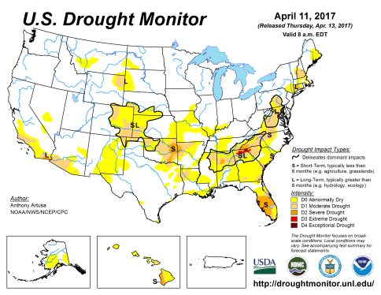
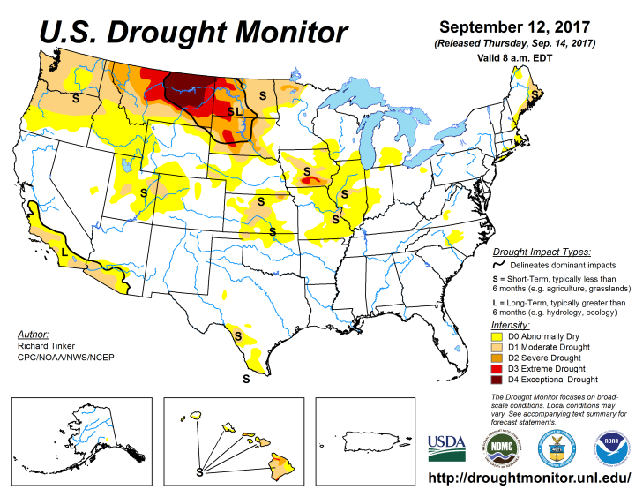
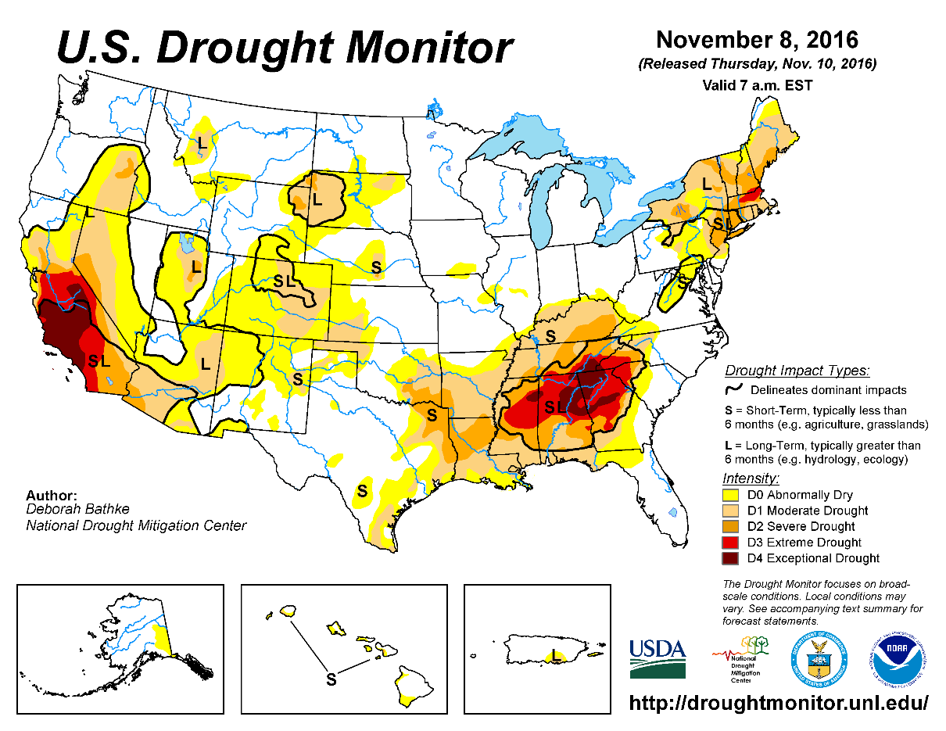
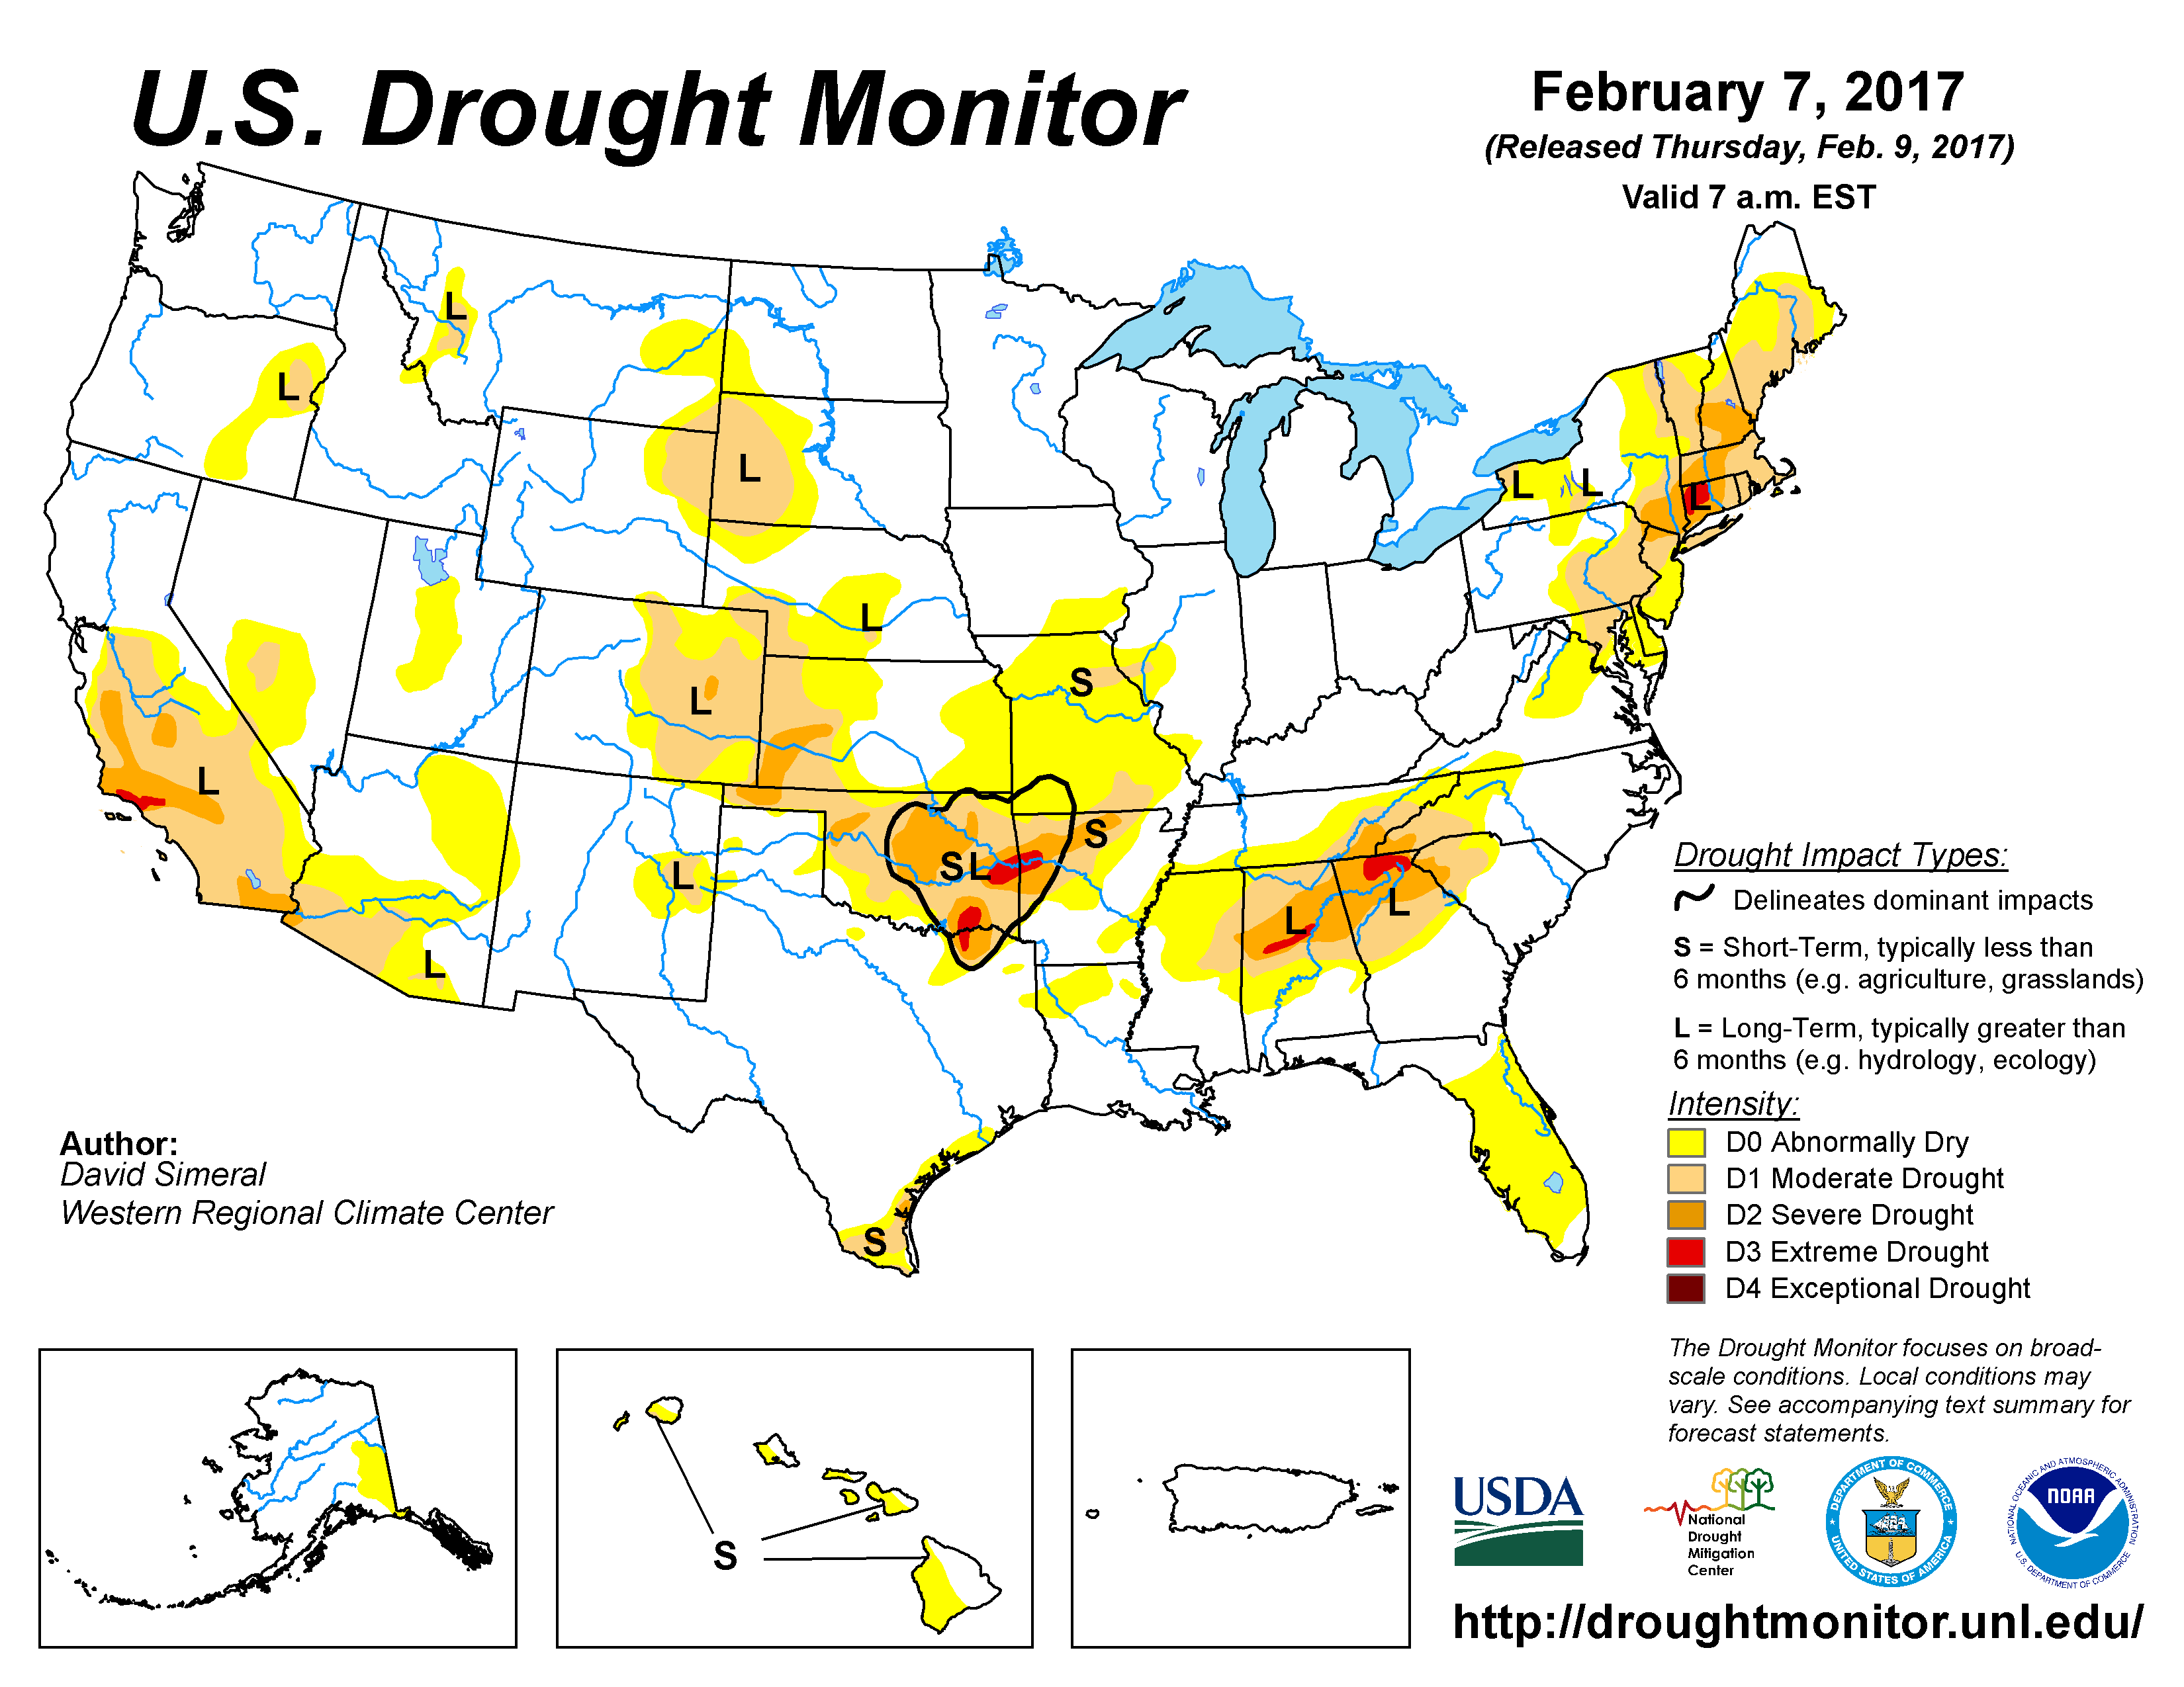
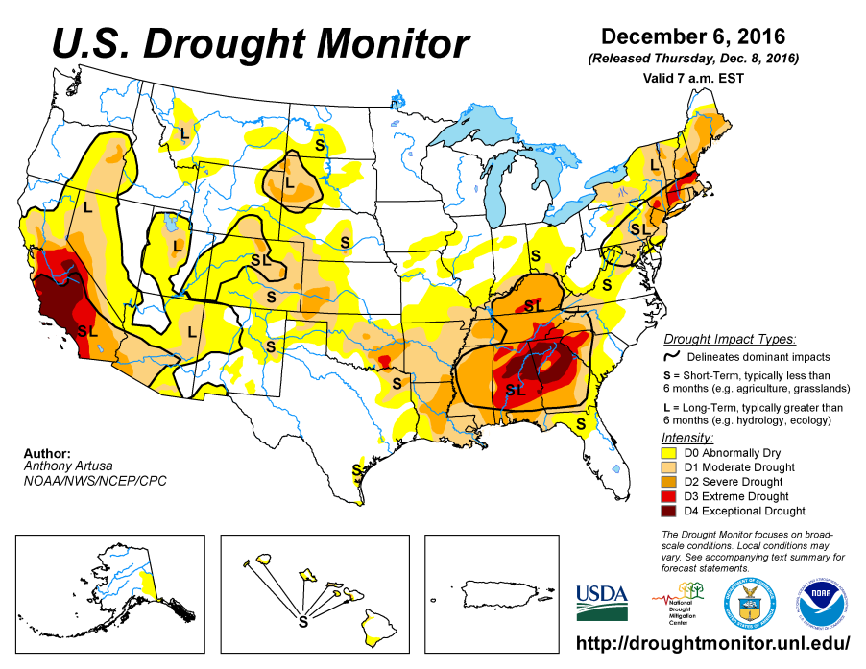
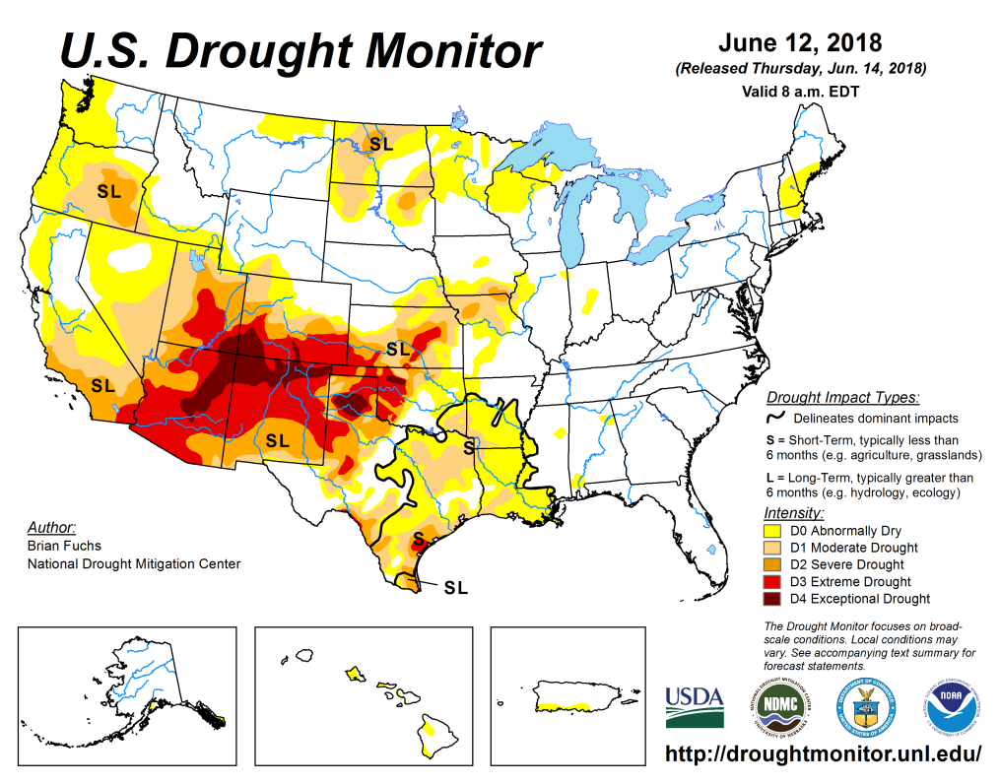
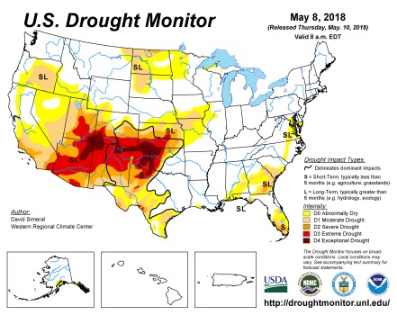
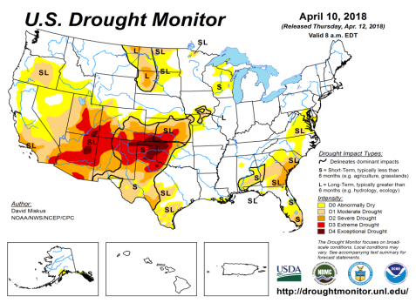
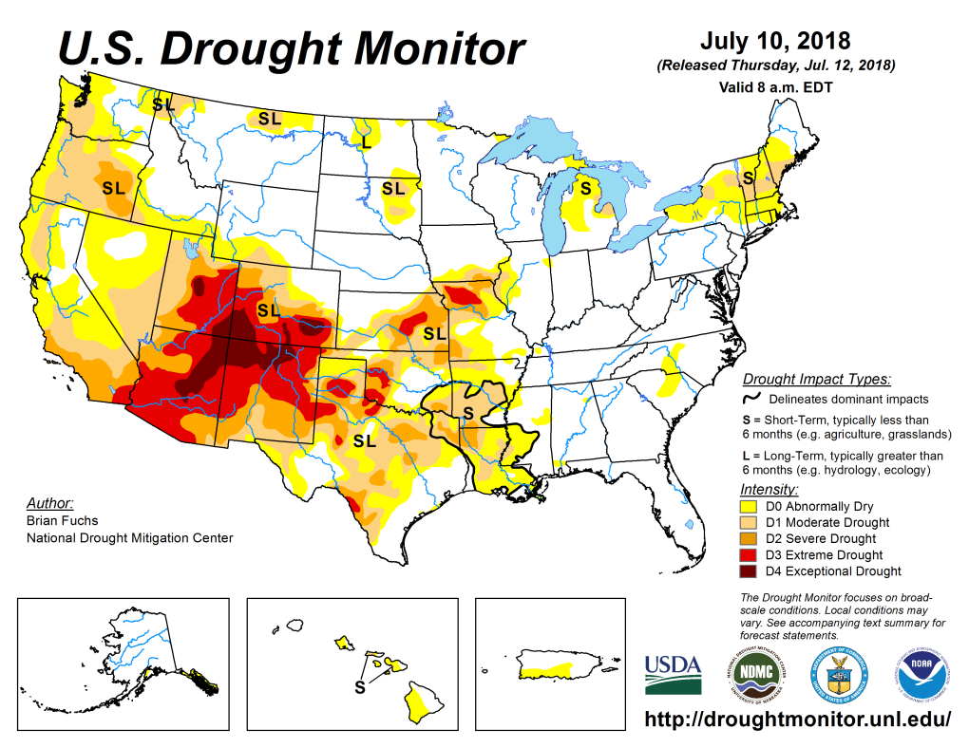
Drought Monitor
June
May
Previous
Apr
The USDM is more or less about the same over the last few months, in the southwestern states, particularly CA, UT, AZ,CO, NM, TX, OK, KS – except in the Northern Plains (Dakotas), where there is considerable improvement, and the subtle changes in the Pacific Northwest, and new minor drought development in the Northeast.
Even though ENSO has already transitioned from La Nina to neutral conditions, the drought impacts in the southwest continue to linger.
Latest/Recent

Slide 3
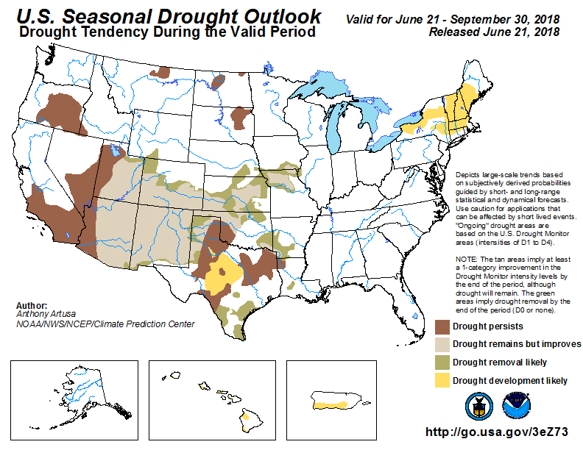
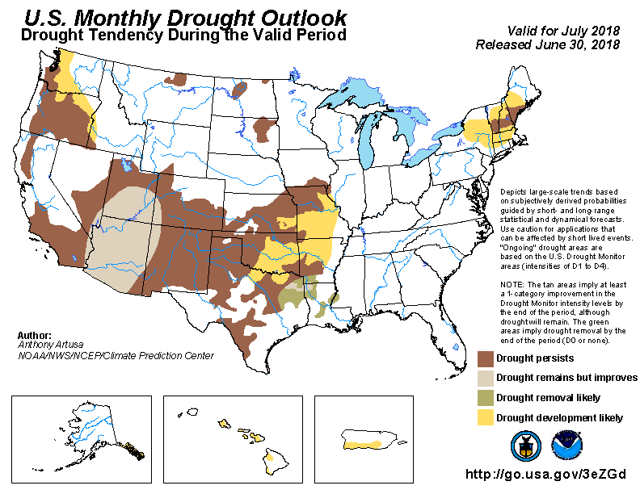
(Prev) Seasonal/Monthly Drought outlooks
Seasonal Outlook (Mid June 2018 - September 2018)
issued 06/21/18
Monthly outlook
(for July 2018)
issued 06/30/18
As noted while the area/extent covered by drought across the south/west has relatively stayed about the same, both the monthly and seasonal forecasts is suggesting various levels of improvement in the short term in parts of the monsoon southwest and adjacent regions..

Slide 4
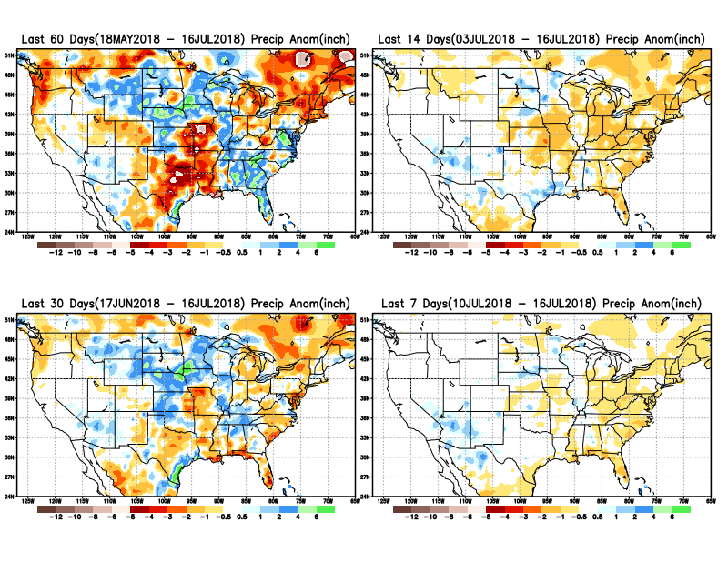
Precipitation ANOM during last 7, 14, 30, & 60 days.
For a change, instead of the east, there has also been some rainfall in the southwest to varying extents in the last four weeks.
** Increasing dryness in far northeast and far northwest!! ** -this is noted since last month!!

Slide 5
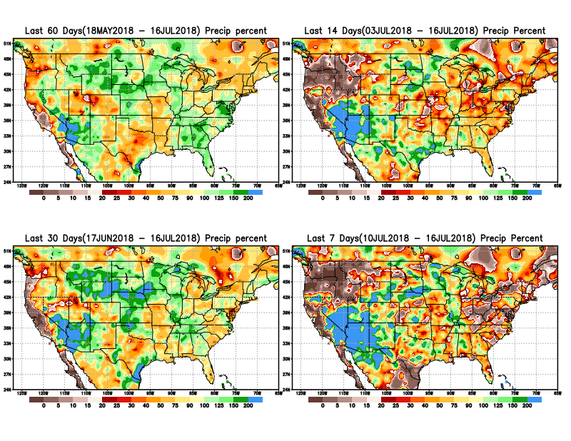
Precipitation Percent during last 7, 14, 30, & 60 days.
In the short term 1-2 months there has been some relief/ alleviation of drought in the far southern CA, AZ/NM/UT, Aug/Sep – more rain is yet to come. But longer term rainfall/ deficits, drought, remain here.

Slide 6
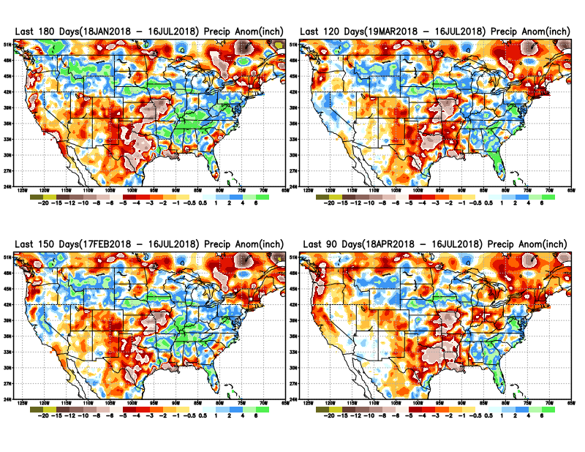
Total precipitation ANOM during last 3, 4, 5, and 6 months.
6 M
4 M
5 M
3 M

Slide 7
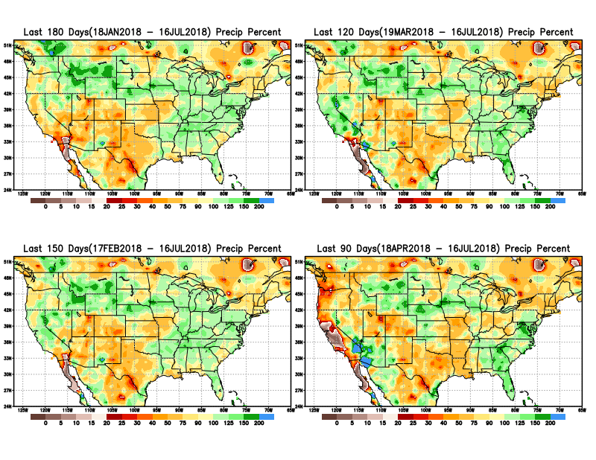
Total precipitation Percent during last 3, 4, 5, and 6 months.
6 M
4 M
5 M
Note Precipitation deficits
3 M

Slide 8
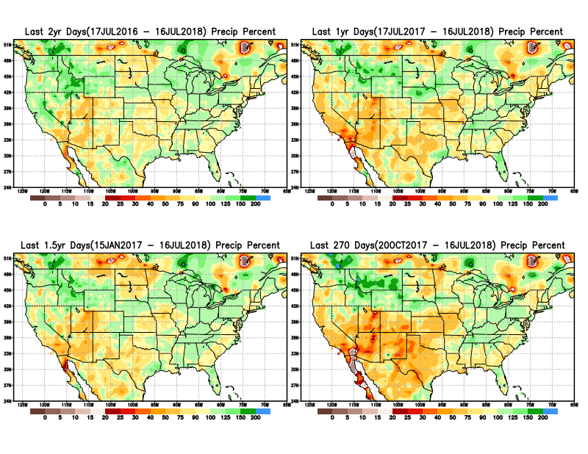
Total precipitation Percent during last 9 months, 1 yr, 1.5yrs, & 2 yrs.
2 Y
1 Y
There are many long term rainfall deficit regions in the country, particularly deficits in UT/AZ, southern CA, and parts of NM/CO are long term – possibly a consequence of the two back to back La Nina’s!
OR
Still longer term variability in play? Especially in the southwest!
1.5 Y
9 M

Slide 9
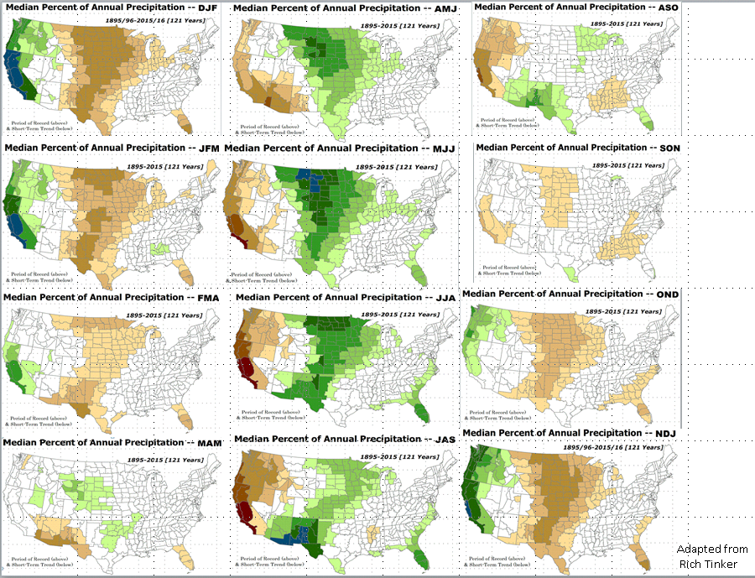
Rainy Season across the US

Slide 10
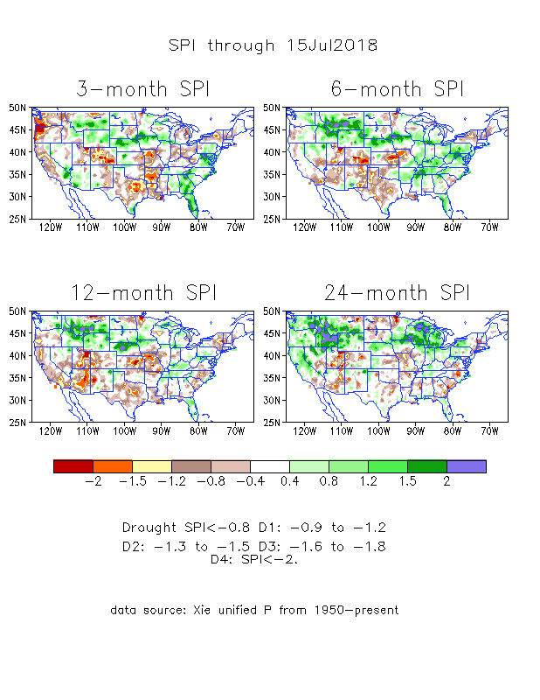
The Standardized Precipitation Index SPI (based on Observed P)
----- NOW
Very interesting graphic & details for the drought across the US based on the more generalized precip deficit/excess, the Standardized Precipitation Index (SPI).
The dark brown and red colors, indicating standardized precipitation deficits, in the various time periods, approximately correspond to the appropriate short/long term drought monitor regions and their intensities

Slide 11
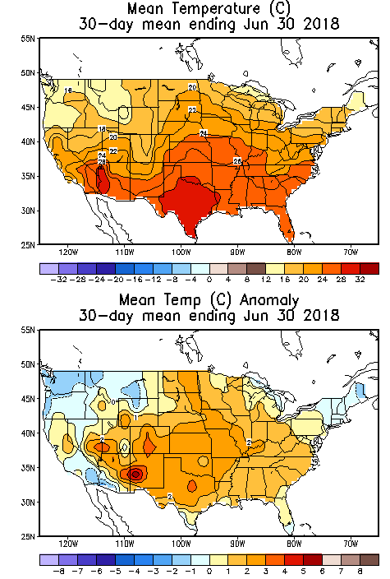
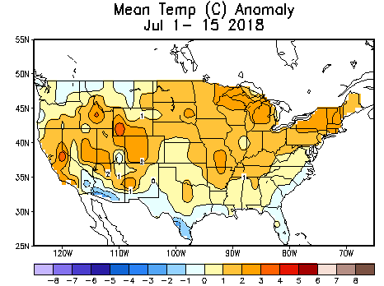
Recent US Temperatures
In June, much of the country is warmer than normal, except in the northwest and southwest.
In July, warmth across most of the country as in June, except along the deep coastal/border south, where it is relatively cooler.

Slide 12
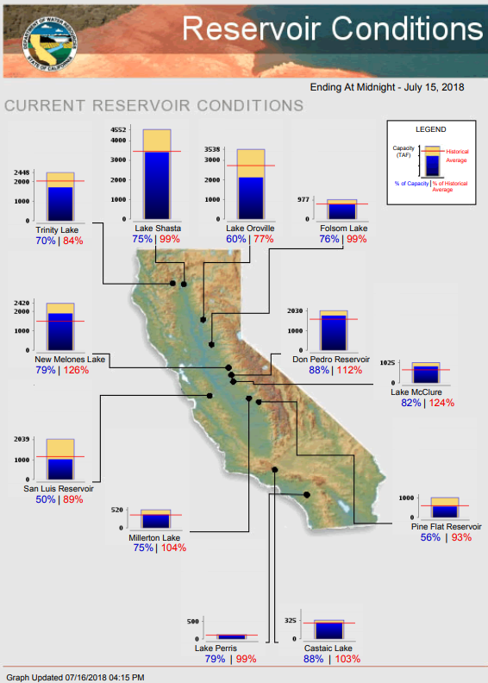
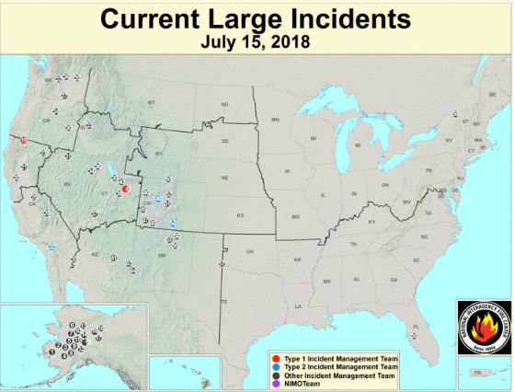
Most of the CA reservoirs continue to be at better than satisfactory levels, except for the Lake Oroville near northern Sierra Nevada, nearing completion!
FIRE
http://cdec.water.ca.gov/cgi-progs/products/rescond.pdf
https://fsapps.nwcg.gov/afm/index.php

Slide 13
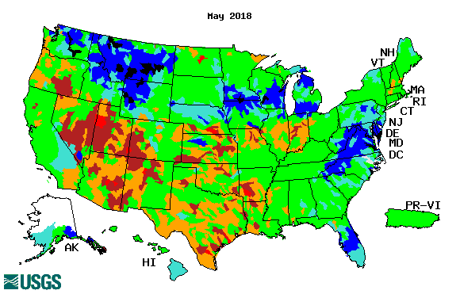
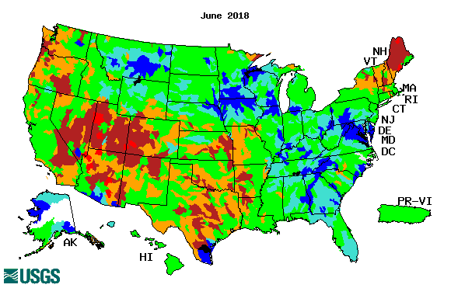
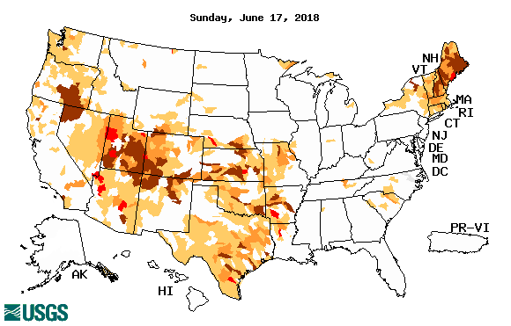
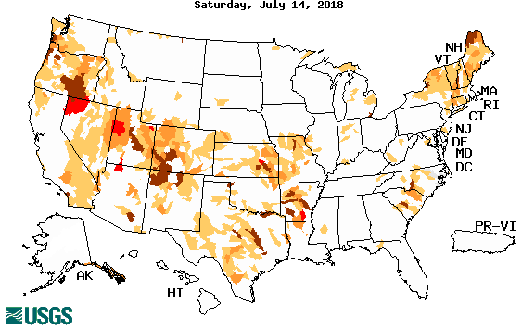
Streamflow (USGS)
Streamflow worsened in June/July in Pacific NW and NE.
A mixed picture overall in the southwest. Definitely better in AZ.
Map shows only below normal 7-day average streamflow compared to historical streamflow for the day of year.
One month ago (left) &
Now (below)

Slide 14
EL NIÑO/SOUTHERN OSCILLATION (ENSO)
DIAGNOSTIC DISCUSSION
issued by CLIMATE PREDICTION CENTER/NCEP/NWS and the International Research Institute for Climate and Society
12 July 2018
ENSO Alert System Status: El Nino Watch !!
Synopsis: ENSO-neutral is favored through Northern Hemisphere summer 2018, with the chance for El Niño increasing to about 65% during fall, and to about 70% during winter 2018-19.

Slide 15
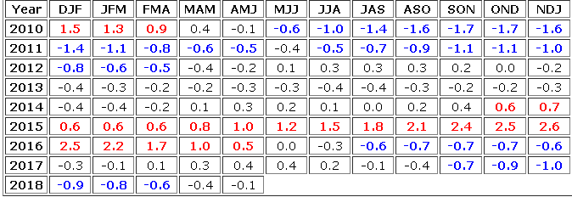
Out of La Nina for sure! And in Neutral Conditions!
But for how long? Trending towards El Nino soon!
http://www.cpc.ncep.noaa.gov/products/analysis_monitoring/ensostuff/ensoyears.shtml

Slide 16
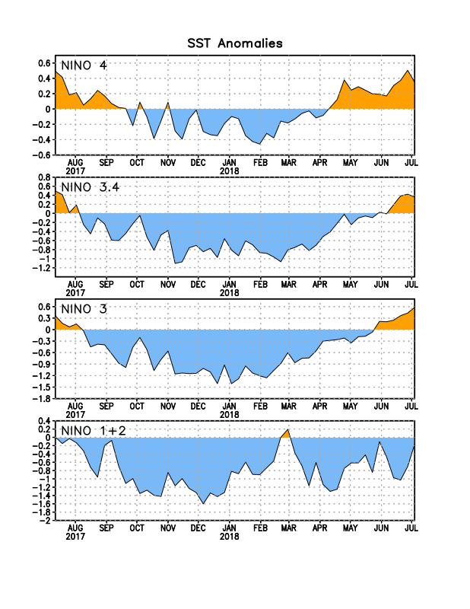
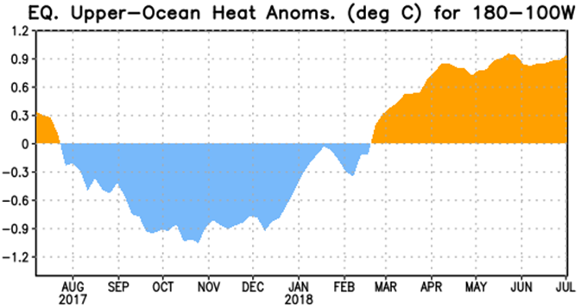
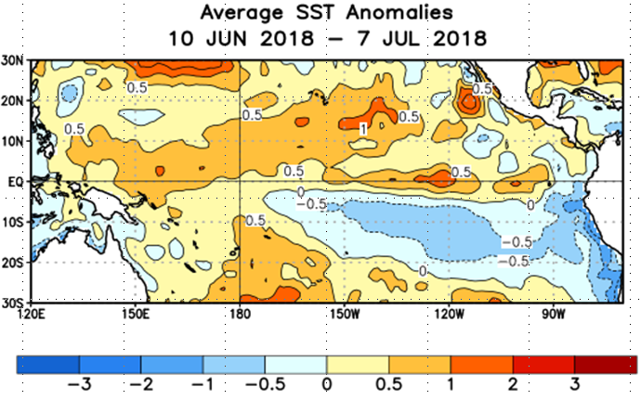
Latest values of SST indices in the various Nino Regions.
The sub surface heat anom is well in the +ve territory! .
Relatively short lived!
Equatorial SST’s are at near to slightly below normal levels in all three ocean basins.

Slide 17
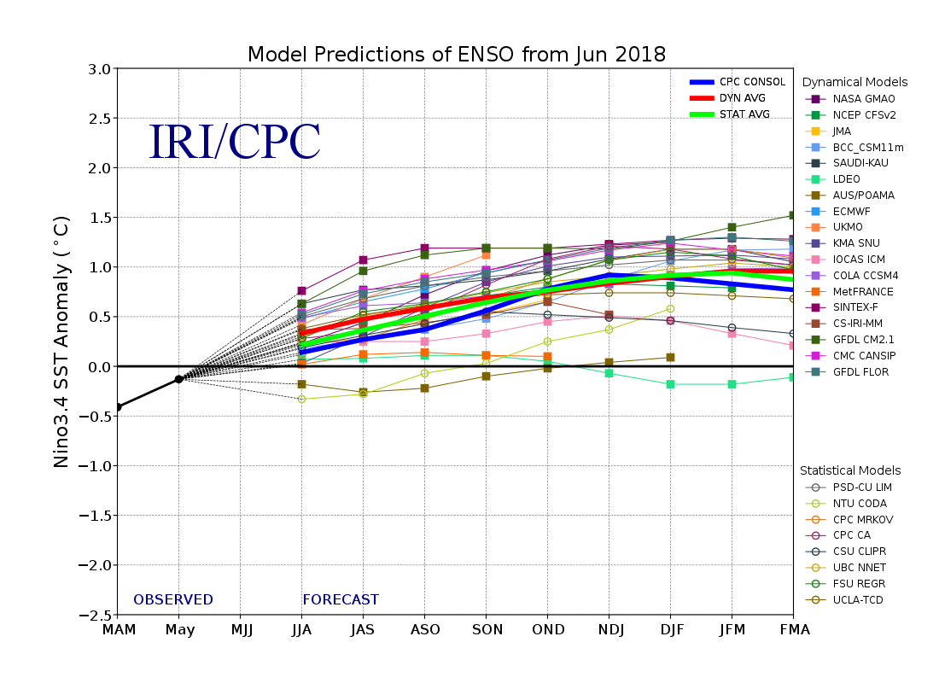
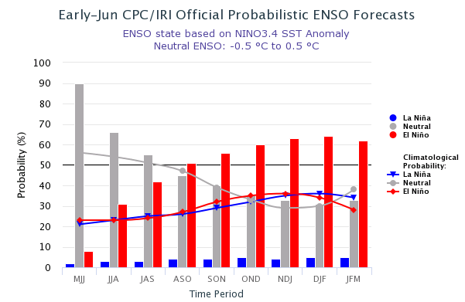
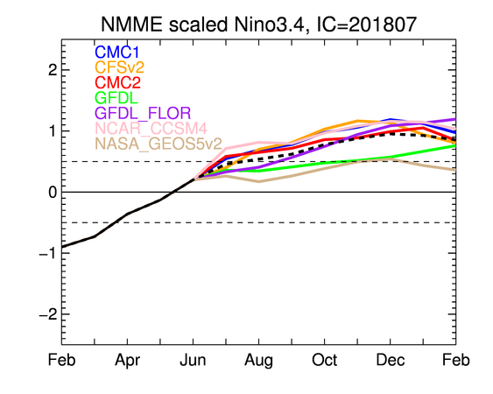
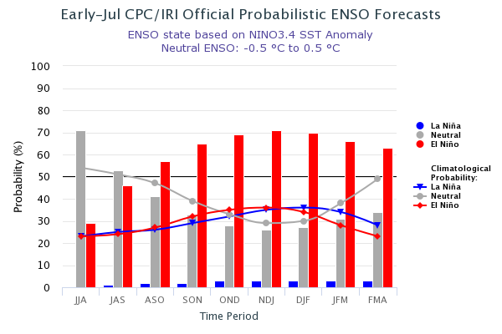
ENSO Forecasts
Early- June CPC/IRI forecast
NMME Models’ – Nino 3.4 forecasts
Early- July CPC/IRI forecast
Current summer: Netral conditions. Afterwards, slowly trending towards El Nino in upcoming Fall and Winter!

Slide 18
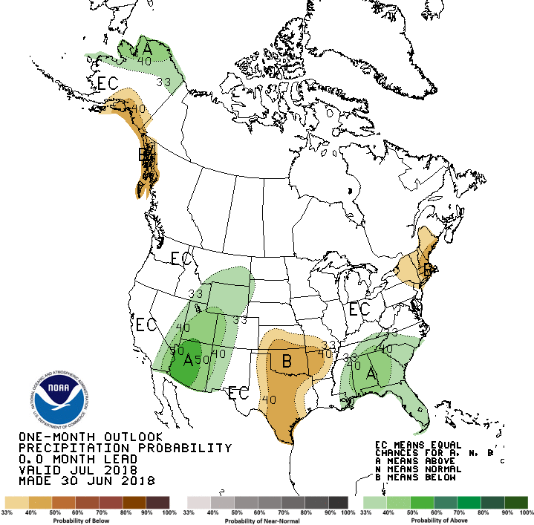
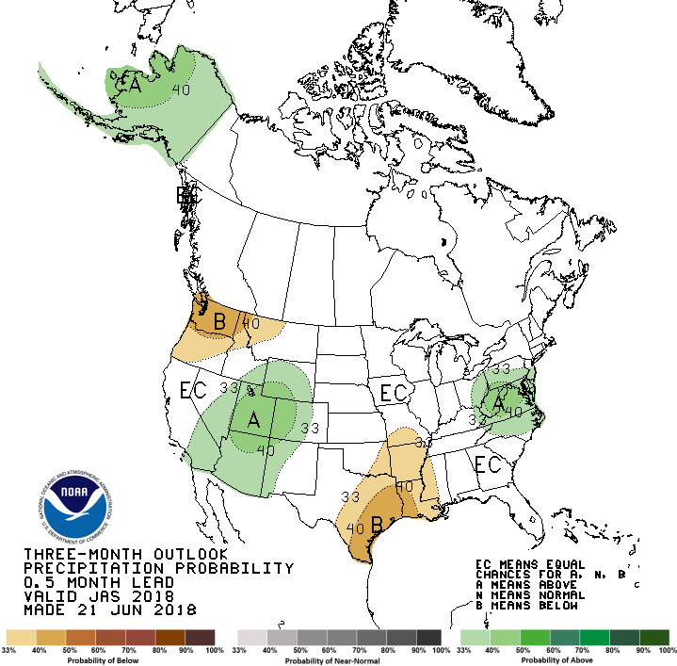
Previous CPC’s official Monthly (July) /Seasonal (JAS)
Precipitation outlook
Released June 30th
Released June 21st

Slide 19
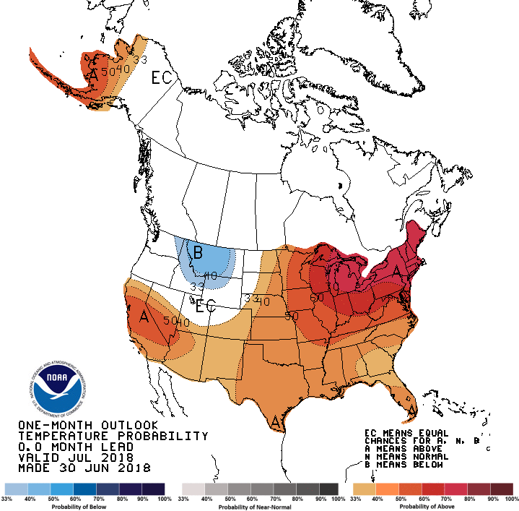
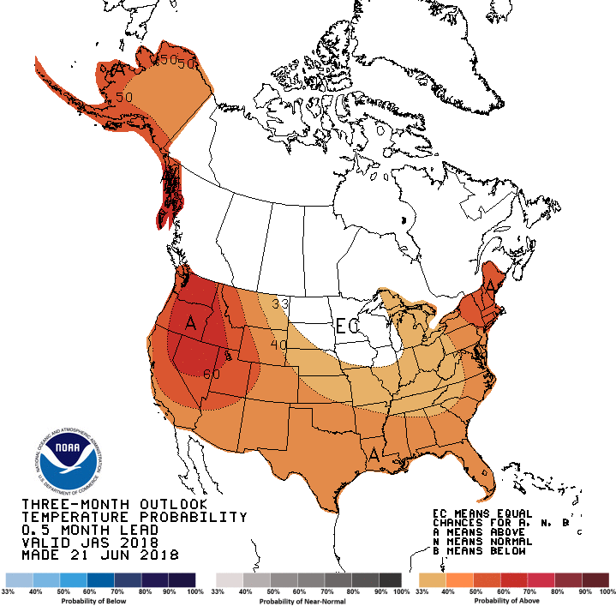
Previous CPC’s official Monthly (Jul) /Seasonal (JAS)
Temperature outlook
Made
June 30th
Made June 21st

Slide 20
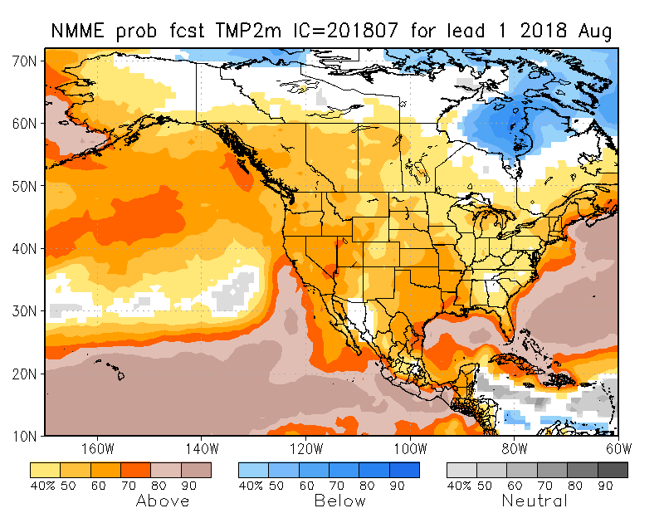
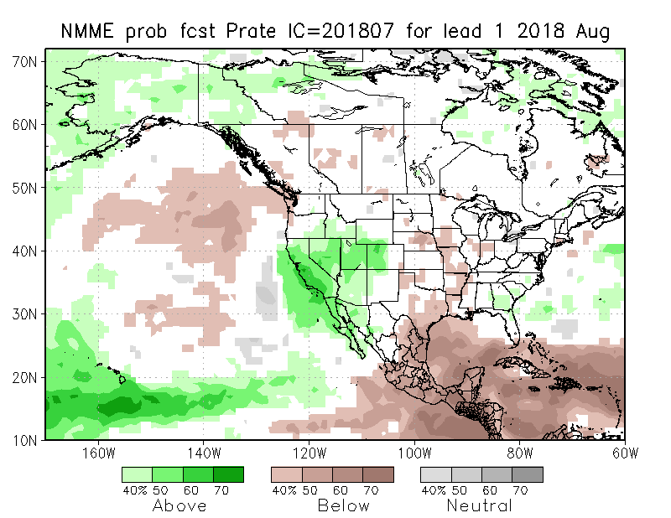
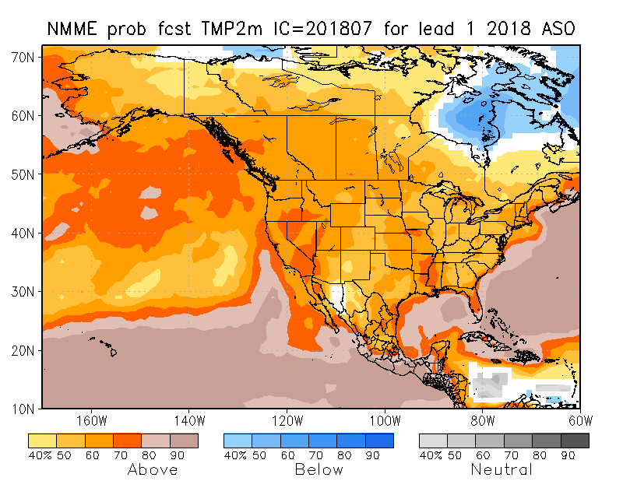
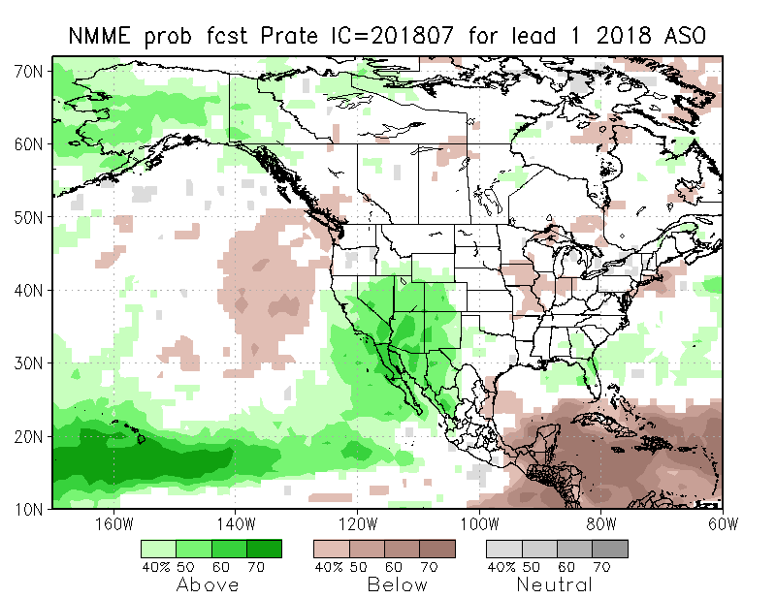
NMME T & P EnsMean forecasts
Aug
ASO
Current ENSO state is neutral. Last month’s and this month’s forecast of above normal rainfall in the southwest, will help the drought there. But the forecast above normal T and less precip in the Pacific NW, will exasperate the dryness and drought situation.

Slide 21
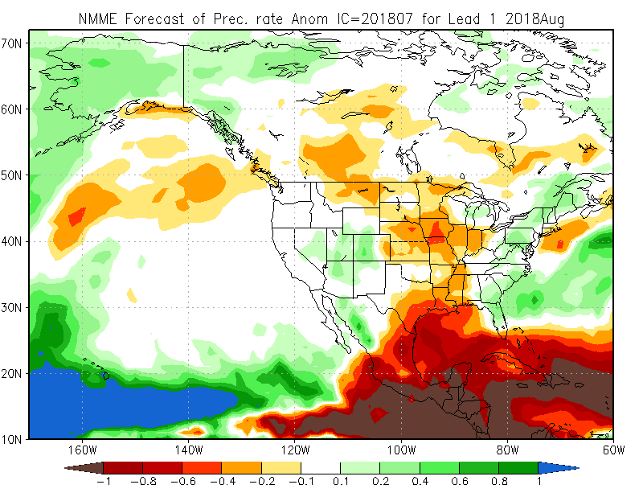
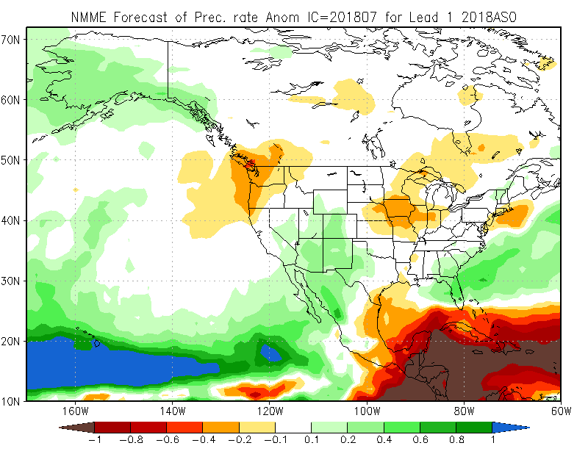
Prate ANOM forecast - NMME

Slide 22
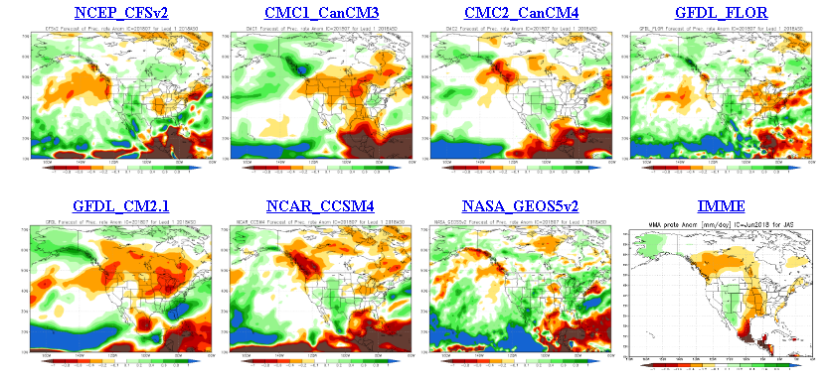
The agreement/uncertainty among the diff. NMME models’ forecasts for Aug-Sep-Oct Precipitation!!!
?? There is a little bit more agreement for the precip in the southwest, amongst the various models, which the ensemble mean is picking up!!

Slide 23
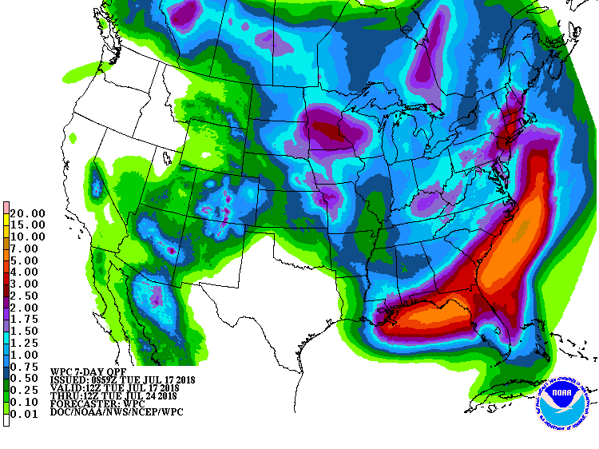
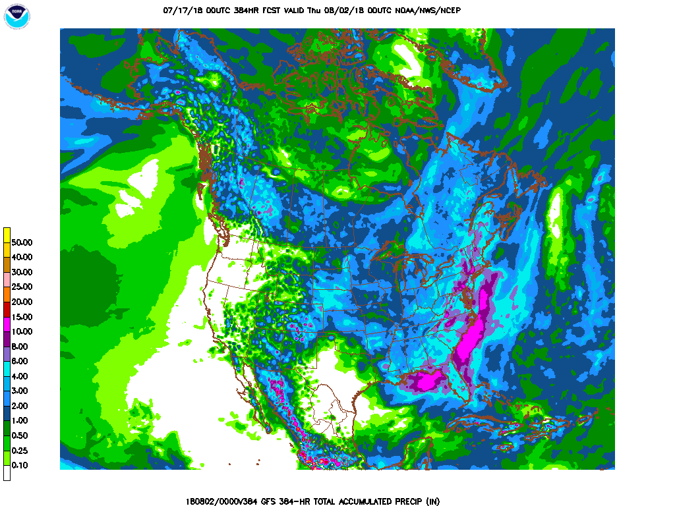
This will take care of developing dryness in NE.
Next 7 days QPF Forecast
GFS Model Guidance for next 16 days.

Slide 24
SPI3
SPI6
SPI3 & SPI6
Forecasts from 6NMME Models
(uses obs. P up to past month, and forecast months’ P from NMME models)
The goodness and skill of these SPI’s forecasts depend directly on these models’ skill in predicting precip!!!
The NMME models indicate that by September, the short term SPI(3)/drought will be improved, over the monsoon southwest, and even across the south, but longer term dryness/drought will continue to stay.

Slide 25
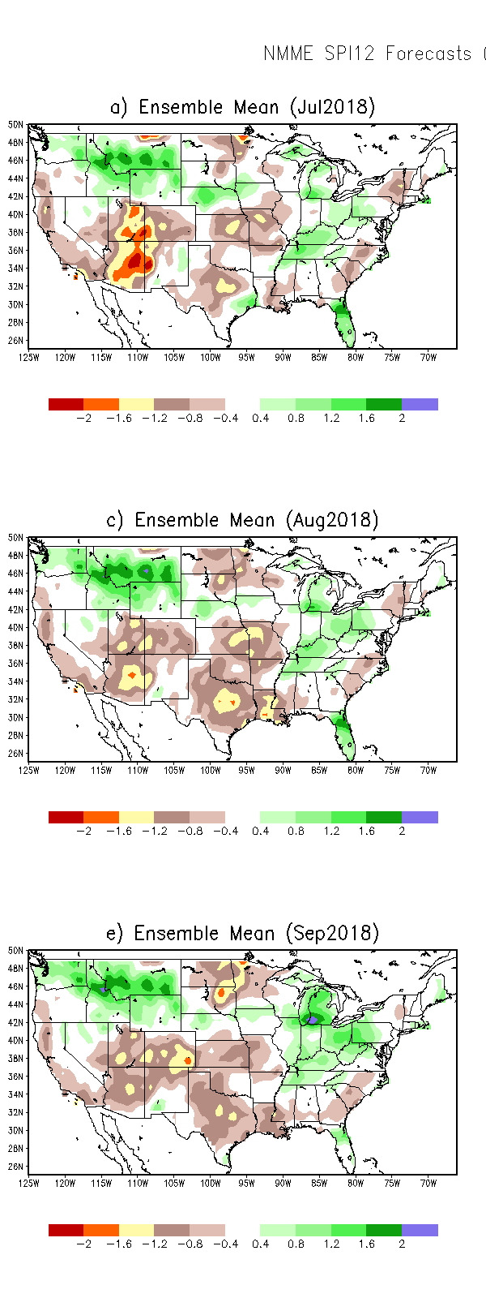
SPI3
SPI6
SPI12
SPI3 & SPI6 & SPI12

Slide 26
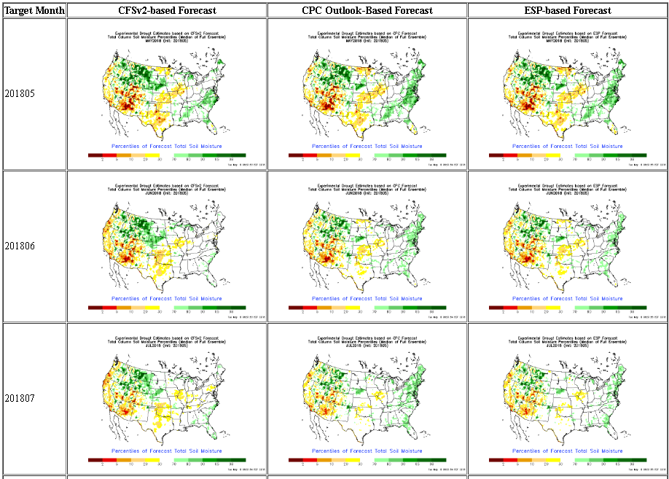
NLDAS Drought Forecast Analysis
The system developed by Princeton University and University of Washington was transitioned to NCEP/EMC as the experimental forecast system.
Forecast using 201805 Initial Condition- Soil Moisture Percentile forecast
Almost always these forecasts generally smoothen and weaken the drought from the levels at IC.
They did the same last year to the 2017 Northern Plains drought.
NLDAS FORECASTS NOT AVAILABLE THIS MONTH

Slide 27
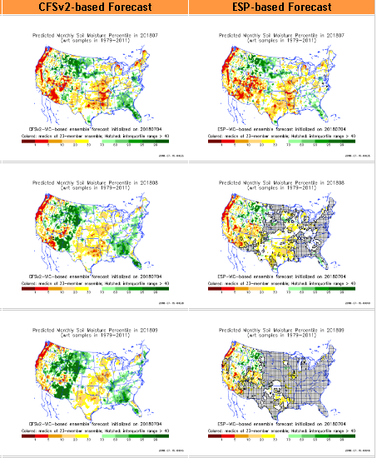
Hydrological Monitoring and Seasonal Forecasting @ MSU (Michigan State University ) NLDAS model
Monthly Soil Moisture Percentile Prediction issued on 201807 with this IC.
http://drought.geo.msu.edu/research/forecast/smi.monthly.php
The inter quartile range suggest greater uncertainty about the forecast in these shaded regions.

Slide 28
Precip Forecast
NASA GEOS5 Forecasts
Jul
Soil Moisture Forecast Percentile
Aug
IC
Jul
Sep
Aug
Sep

Slide 29
Exptl. Probability Drought Outlook from Kingtse Mo and Li Xu based on NMME ensemble members’ Precip forecast .

Slide 30
Aug 2018
In the official
Drought Outlook Tendency Format!!
ASO 2018

Slide 31
Summary
Current ENSO status and forecast. ENSO-neutral is favored through Northern Hemisphere summer 2018, with the chance for El Niño increasing to 65% during fall, and ~70% during winter 2018-19.
Current Drought conditions:
The Northern Plains drought, affecting eastern Montana, and the North/South Dakotas, which arose from the highly deficit 2017 rainfall season is now considerably improved, and is almost gone, due to this years ongoing rainfall season.
The much larger and more important South/Southwest drought, covering parts of far southern CA, NV, UT, AZ, CO, NM, KS, OK, parts of TX and MO, which is predominantly, but not exclusively, a consequence of the rainfall deficit associated with the back to back two La Ninas that just ended, is undergoing changes in intensity and size, especially along the edges. But the recent early, and above normal southwest, summer monsoon rains so far, has eased the short term rainfall deficit and drought conditions in AZ, NM and vicinity. And, the good news is, the monsoon season is not over yet (see rainfall forecast below)
It was pointed out last month, that dryness was developing in the Pacific Northwest and in the Northeast. Since then, the dryness continued to get worse in the Northwest, and drought conditions are emerging there.
Prediction:
The recent La Nina has already transitioned to ENSO neutral conditions, and is expected to stay in neutral state throughout summer.
In the absence of a strong lower boundary forcing, the model forecasts for the season generally tend to be all over the place. However, this month, most models of the NMME are in agreement in producing above normal rainfall amounts over the monsoon southwest region, thus probably easing the drought conditions for the upcoming season. But since the rainfall deficits there are large, the long term drought conditions will continue to be there. Attention must be paid to IA/MO and vicinity, for possible drought development/ enhancement, where dryness exist and models forecast below normal rainfall for the upcoming season.
In the Pacific Northwest, the accruing rainfall deficits, below normal rainfall forecast for the season, above normal temperatures are likely to enhance drought conditions there.
The emerging dryness in the Northeast is unlikely to deepen in the short term, since the models forecast some decent rains in this time period. ***END***

Slide 32
Miscellaneous maps

