Slide 1
Drought Outlook Support Briefing July 2019
Climate Prediction Center/NCEP/NOAA
http://www.cpc.ncep.noaa.gov/products/Drought
Phone: 1-877-680-3341
Pwd: 858747#

Slide 2
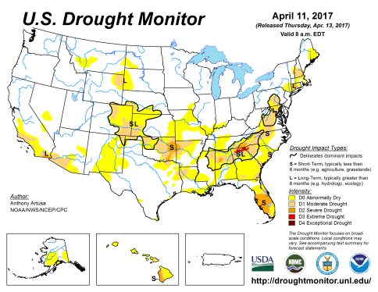
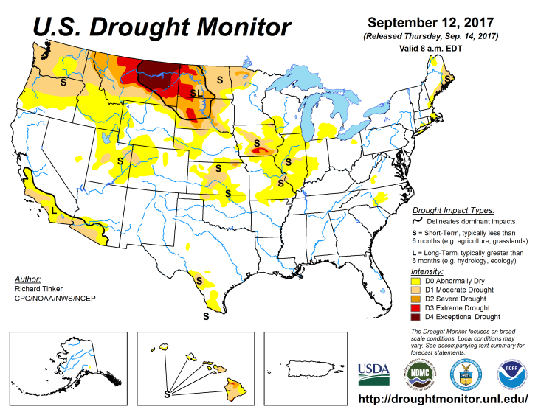
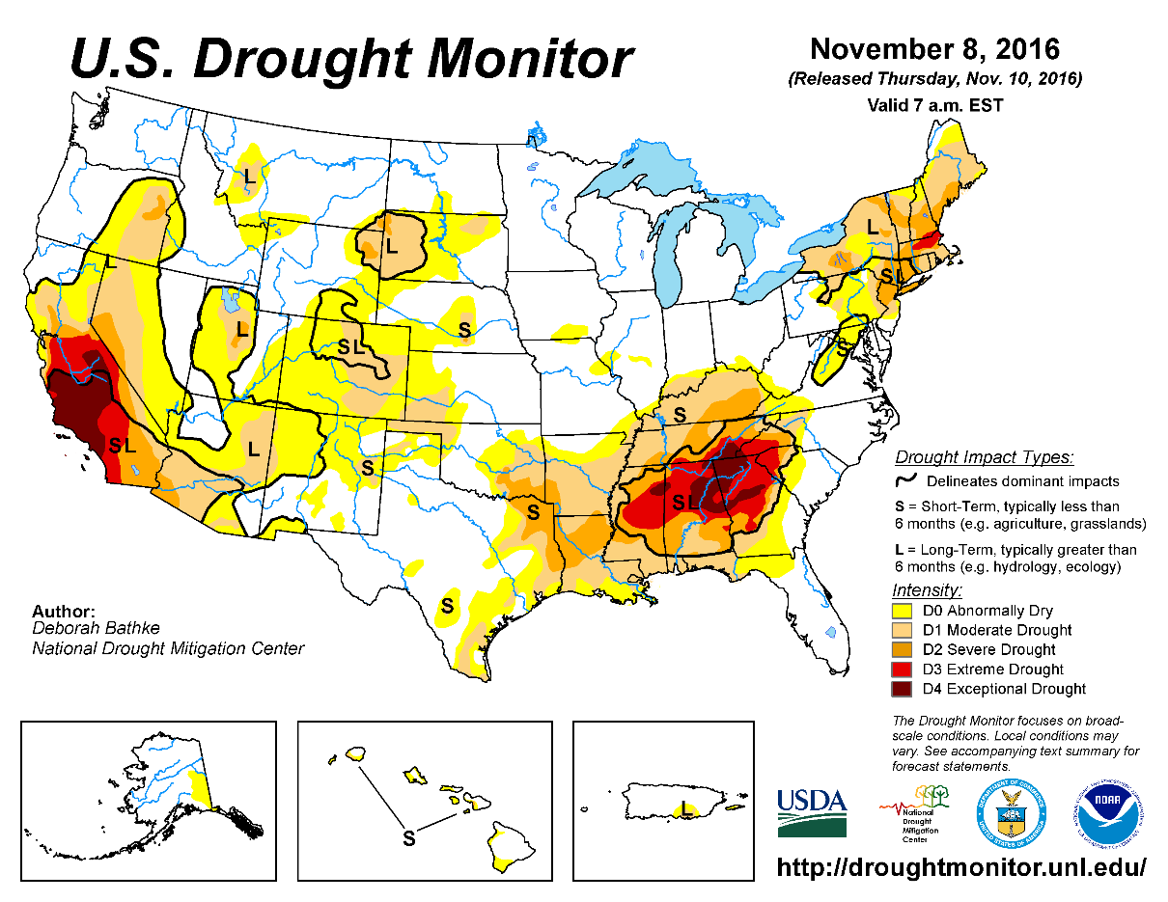
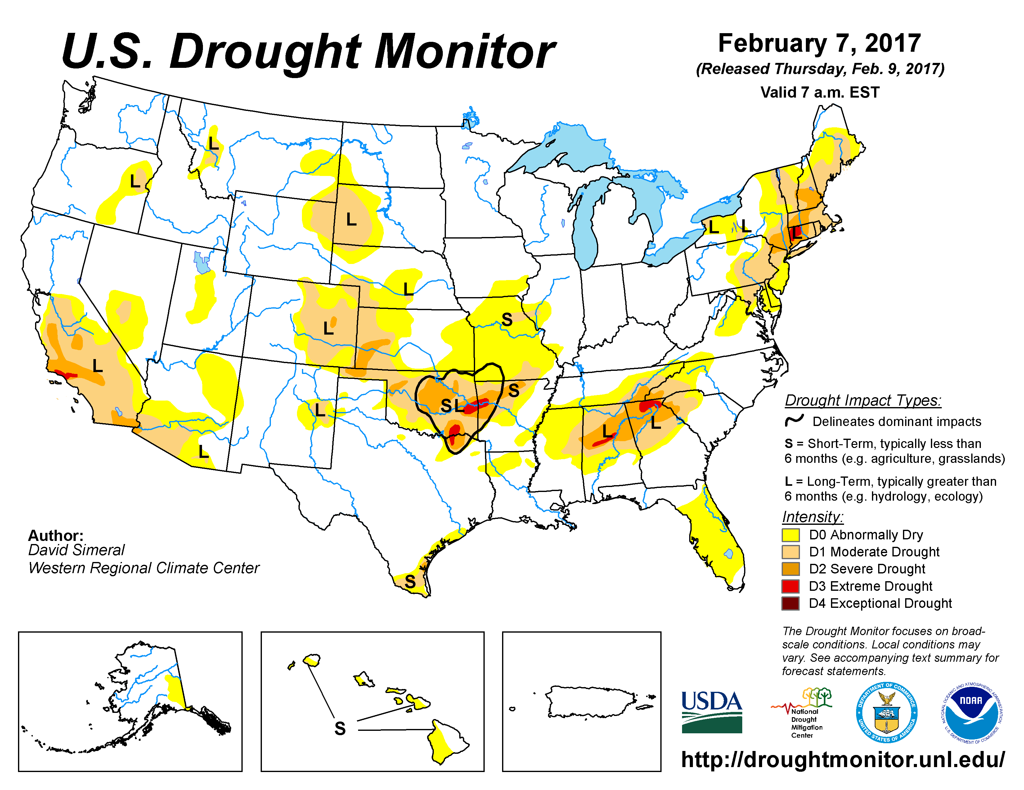
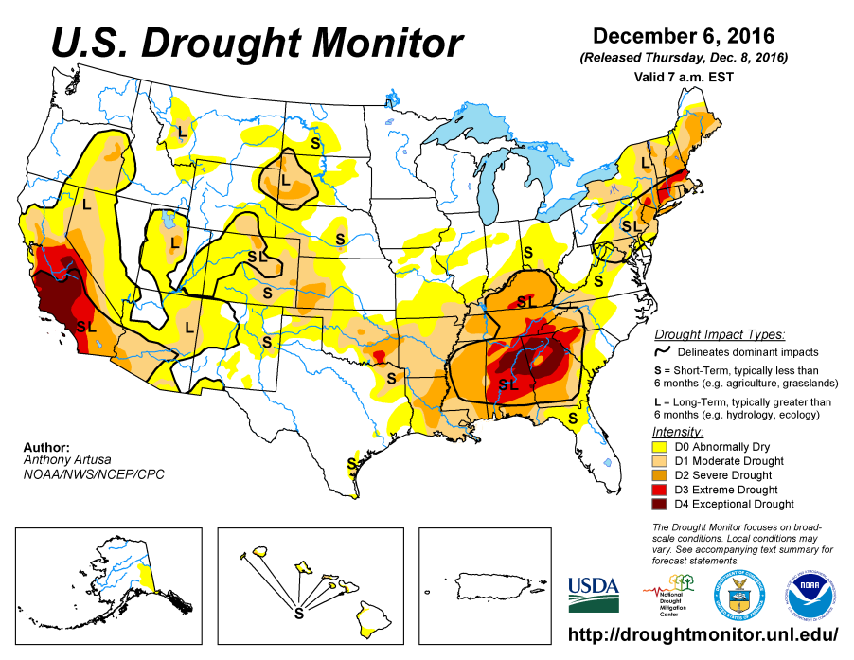
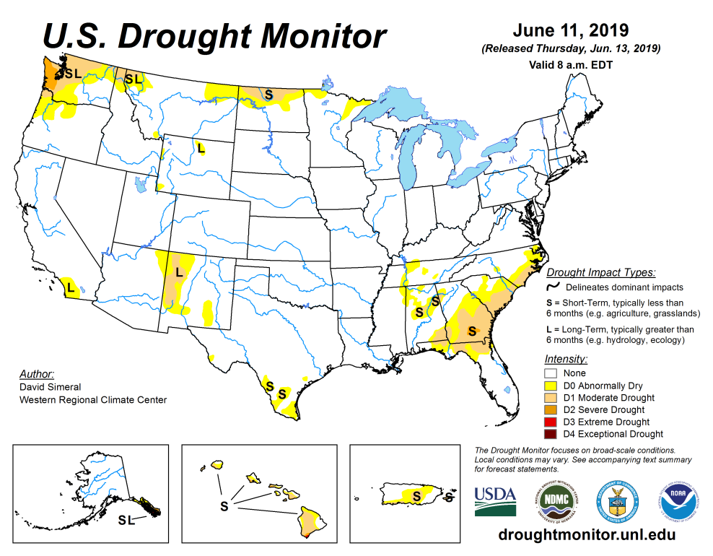
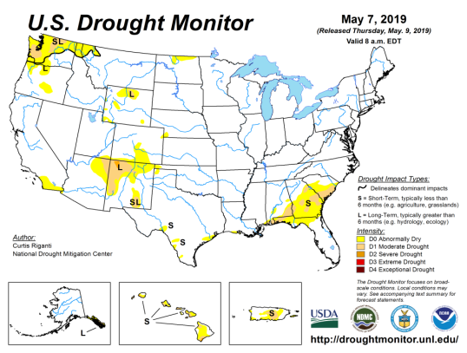
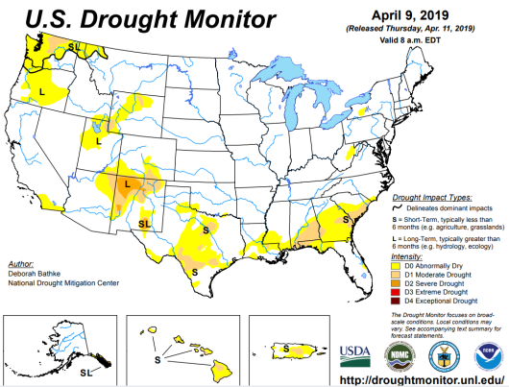
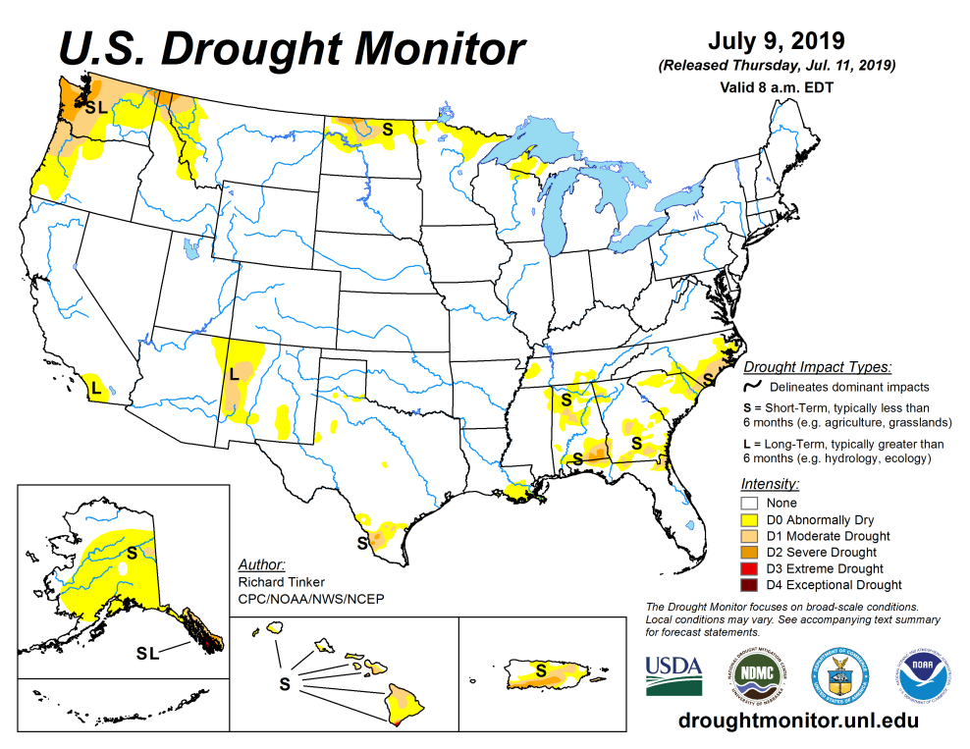
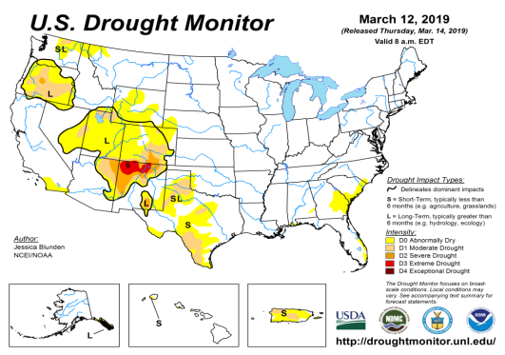
Drought Monitor
June
May
The sequence of drought monitor maps, over the last 5 months, shows the gradual and steady improvement in the drought conditions
According to the DM, four regions have droughts:
Pacific NW,
around four corner states area esp. NM.
The Southeast, centered over GA
The Northern Great Plains esp. ND.
April
Recent/Latest
March
February

Slide 3
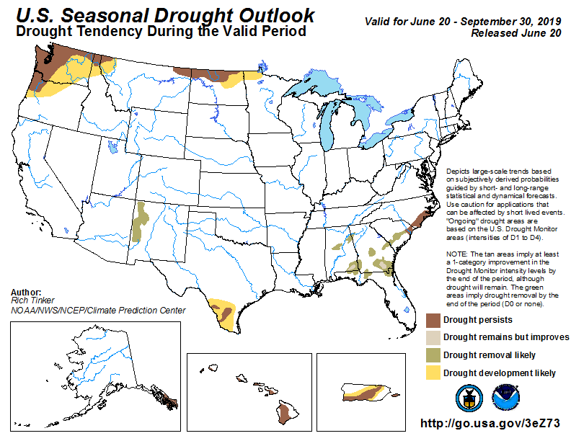
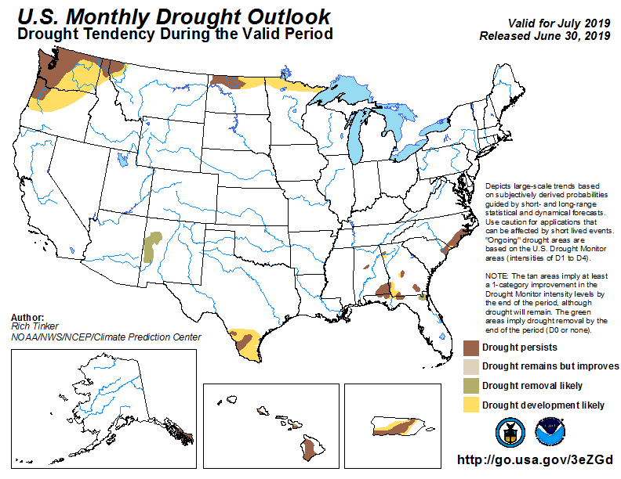
(Prev) Seasonal/Monthly Drought outlooks
(New Seasonal Drought Outlook to be released in 2 days!)
Seasonal Outlook
(Mid june 2019- Sep 2019)
issued 6/20/19
Monthly outlook
(for July 2019)
issued 6/30/19

Slide 4
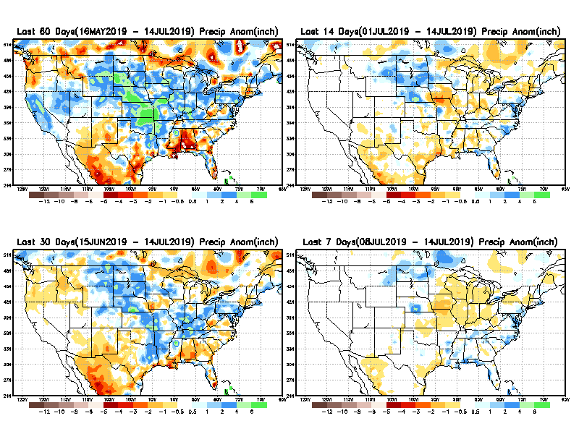
Precipitation ANOM during last 7, 14, 30, & 60 days.
60 Days
14 Days
These maps in this and following slides, including Total, Anom and Percent of precip in these and other longer time ranges are now daily updated at:
30 Days
7 Days
From: Recent Accumulated Precipitation https://www.cpc.ncep.noaa.gov/products/Drought/briefing_prcp.shtml

Slide 5
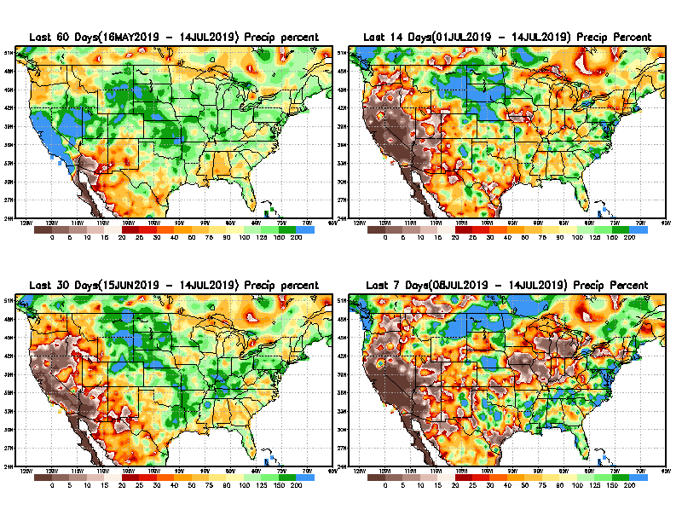
Precipitation Percent during last 7, 14, 30, & 60 days.
60 Days
14 Days
NOW !
30 days
7 Days
From: Recent Accumulated Precipitation https://www.cpc.ncep.noaa.gov/products/Drought/briefing_prcp.shtml

Slide 6
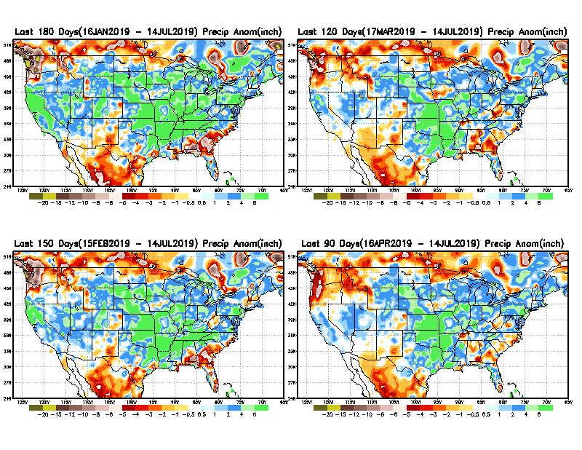
Total precipitation ANOM during last 3, 4, 5, and 6 months.
6 M
4 M
5 M
3 M
From: Recent Accumulated Precipitation https://www.cpc.ncep.noaa.gov/products/Drought/briefing_prcp.shtml

Slide 7
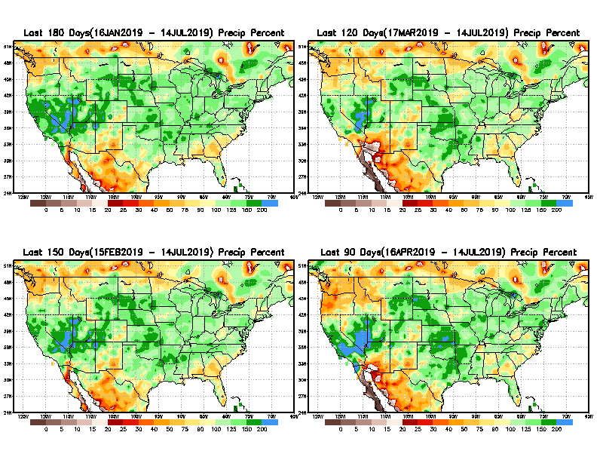
Total precipitation Percent during last 3, 4, 5, and 6 months.
6 M
4 M
5 M
3 M

Slide 8
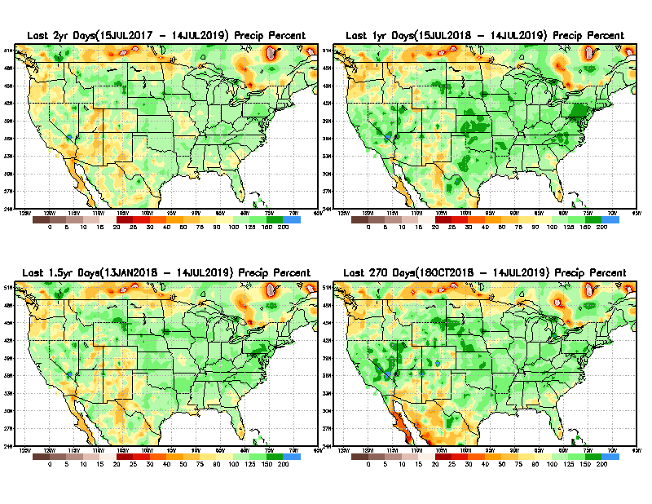
Total precipitation Percent during last 9 months, 1 yr, 1.5yrs, & 2 yrs.
2 Y
1 Y
1.5 Y
9 M
From: Recent Accumulated Precipitation https://www.cpc.ncep.noaa.gov/products/Drought/briefing_prcp.shtml

Slide 9
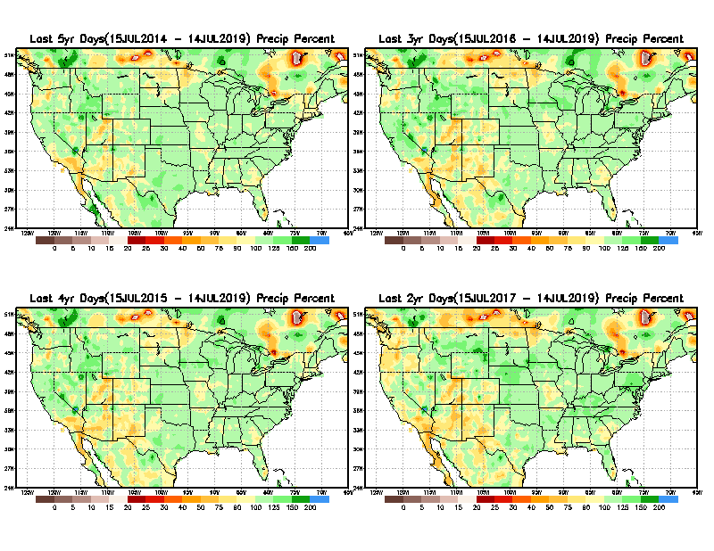
Total precipitation Percent during last 2 yrs, 3 yrs, 4 yrs, & 5 yrs.
5 Y
3 Y
Still longer term rainfall deficit variability in play? Especially in the southwest!
Will these deficits ever go away, OR is these part of the new norm??
4 Y
2 Y
From: Recent Accumulated Precipitation https://www.cpc.ncep.noaa.gov/products/Drought/briefing_prcp.shtml

Slide 10
Rainy (3-month)Season across the US

Slide 11
Adapted from Rich Tinker.

Slide 12
Adapted from
Rich Tinker

Slide 13
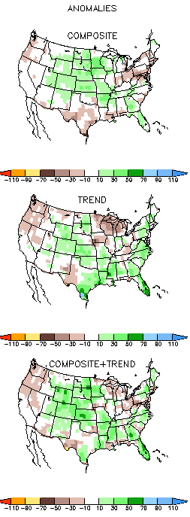
EL NINO Precip COMPOSITES
JAS
ASO

Slide 14
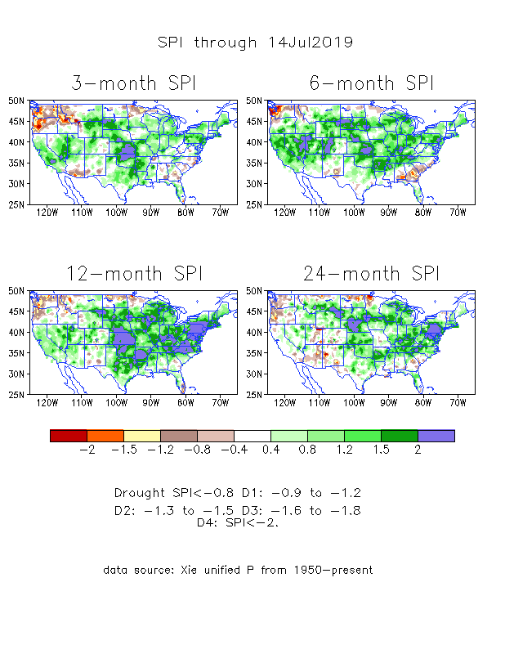
The Standardized Precipitation Index SPI (based on Observed P)
----- NOW
Very interesting graphic & details for the drought across the US based on the more generalized precip deficit/excess, the Standardized Precipitation Index (SPI).
The dark brown and red colors, indicating standardized precipitation deficits, in the various time periods, approximately correspond to the appropriate short/long term drought monitor regions and their intensities
In the short term (~3-6 mo) dryness still exists in the far southeast, and in he Pacific NW, and in ND.
In the longer term ~12m-24m and longer, rainfall deficits remain in the AZ/NM/UT/CO states area and in Northwest and in the Northern Plains.

Slide 15
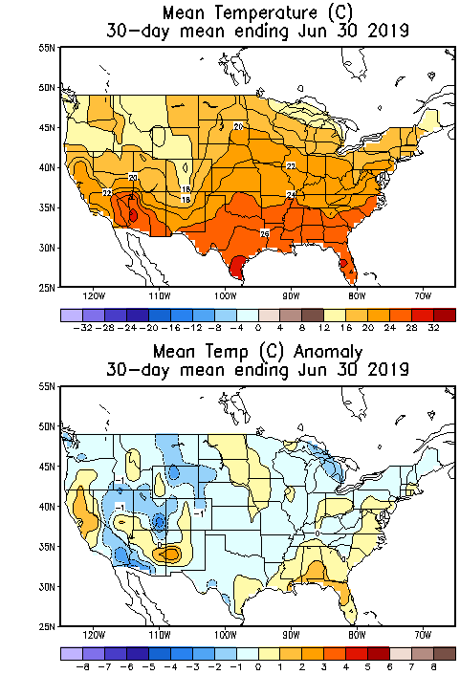
Recent US Temperatures
June was cold over the large part of US, but warm over the southeast and west coast.
July so far is warmer than normal over the eastern US, cold in western US.

Slide 16
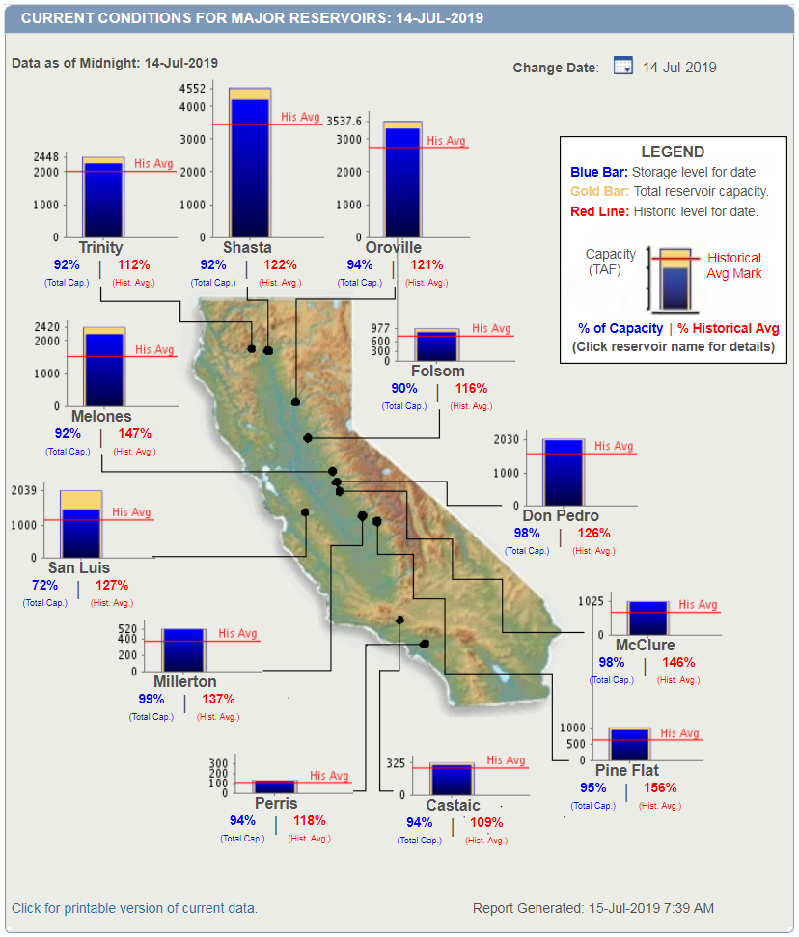
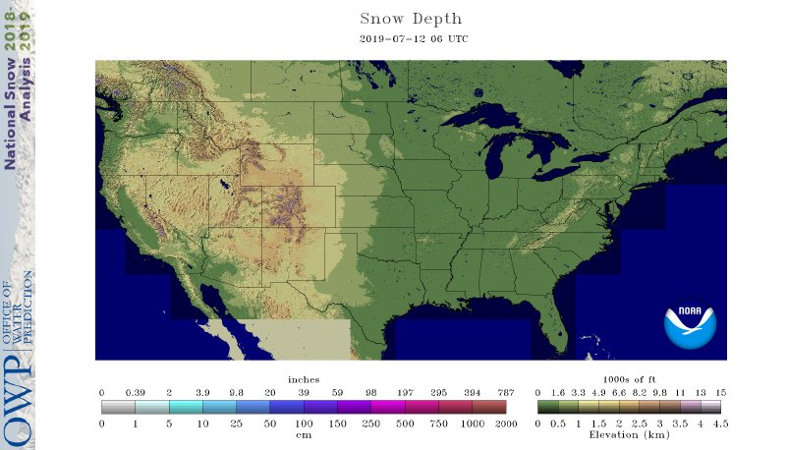
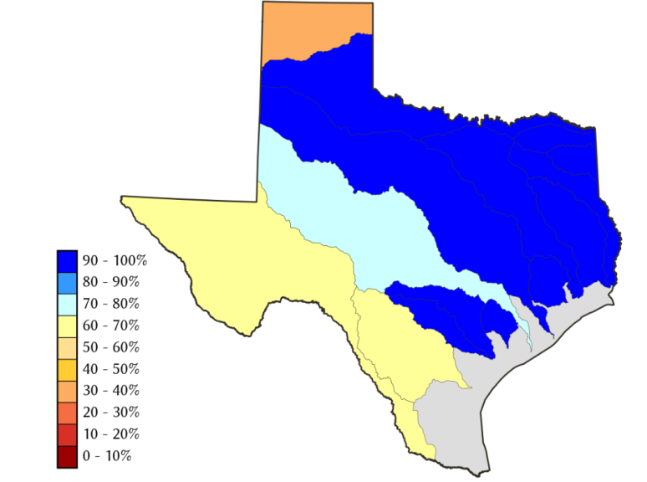
Water Reservoir Levels in some Western/Southern States! And Snow Depth!!
Except in few high elevations, all snow has melted.
Northern CA reservoirs beginning to show
Weakness, but rainy season coming up!
California reservoirs are in good shape.
TX
https://fsapps.nwcg.gov/afm/index.php

Slide 17
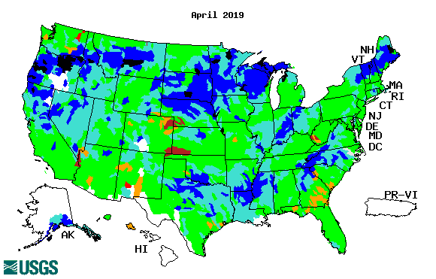
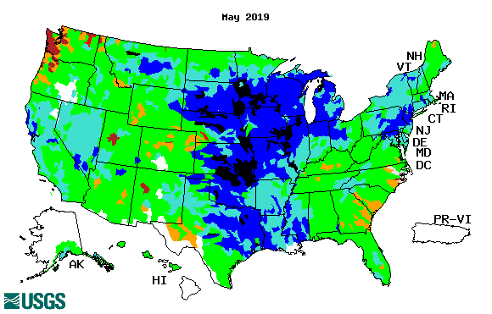
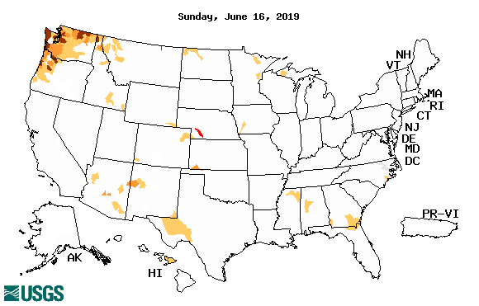
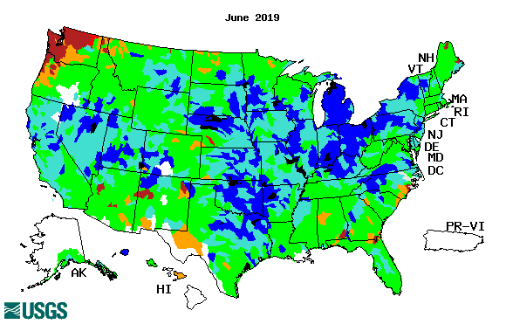
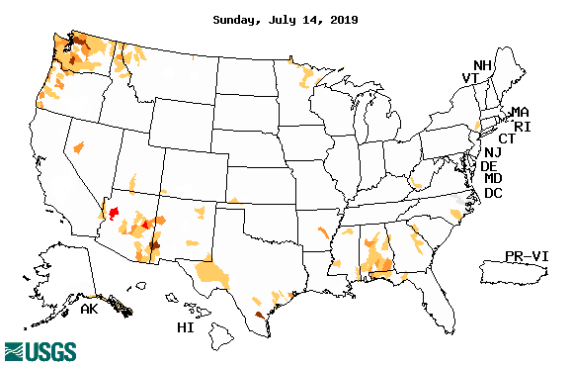
Streamflow (USGS)
Overall, gradual and steady improvement in streamflow conditions across the country, over the last few months.
Map shows only below normal 7-day average streamflow compared to historical streamflow for the day of year.
One month ago (left) &
Now (below)
17

Slide 18
EL NIÑO/SOUTHERN OSCILLATION (ENSO)
DIAGNOSTIC DISCUSSION
issued by CLIMATE PREDICTION CENTER/NCEP/NWS and the International Research Institute for Climate and Society
11 July 2019
ENSO Alert System Status: El Nino Advisory
Synopsis: El Niño is present.* Equatorial sea surface temperatures (SSTs) are above average across most of the Pacific Ocean. The pattern of anomalous convection and winds are consistent with El Niño. A transition from El Niño to ENSO-neutral is expected in the next month or two, with ENSO-neutral most likely to continue through Northern Hemisphere fall and winter.*

Slide 19
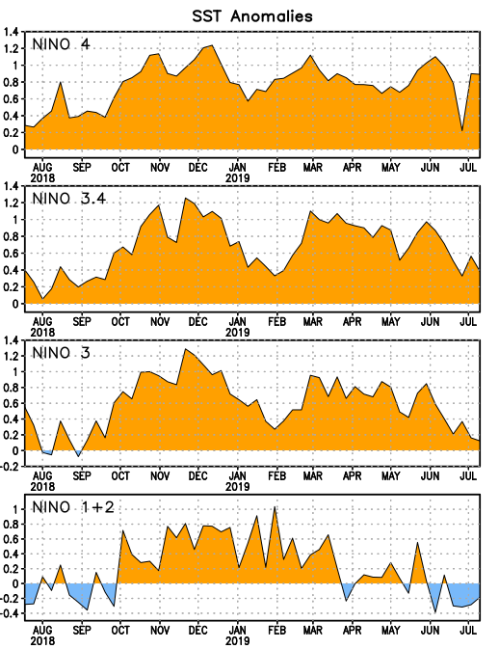
Latest values of SST indices in the various Nino Regions.
The sub surface heat anom has fallen in the last month.
Decreasing!
?
Relatively short lived!

Slide 20
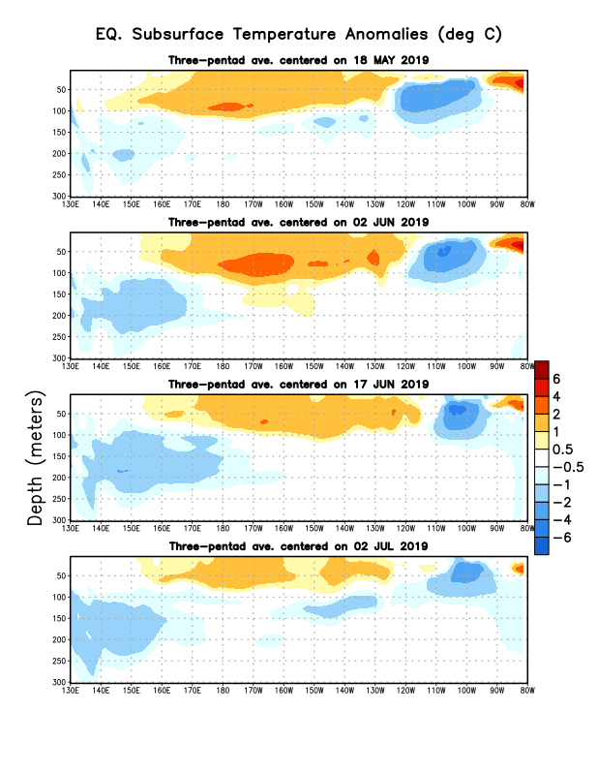
Sub-Surface Temperature Departures in the Equatorial Pacific
Most recent pentad analysis

Slide 21
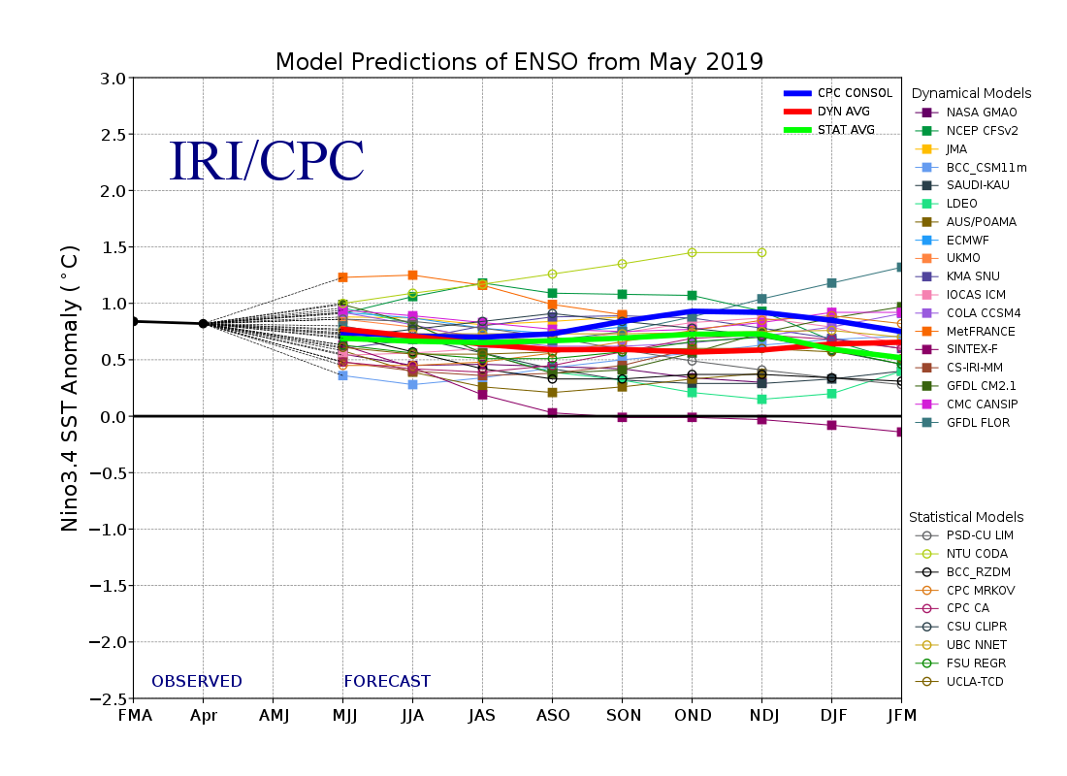
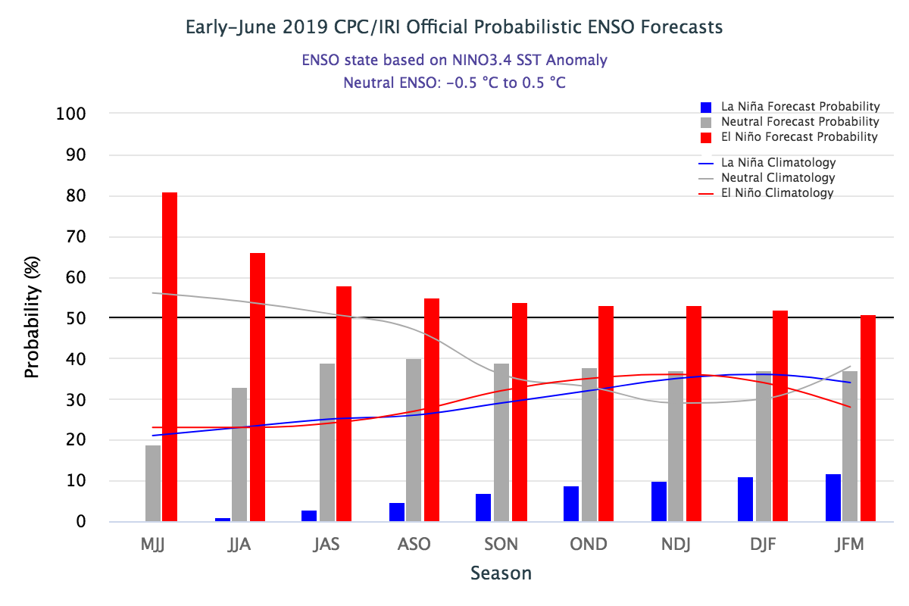
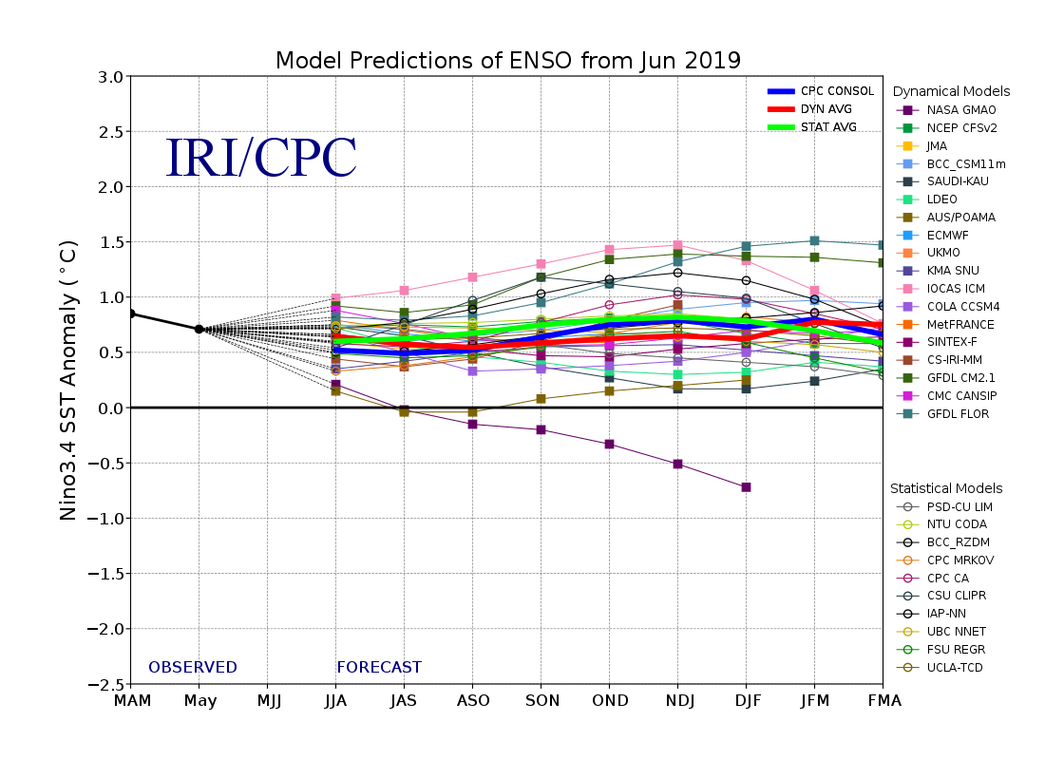
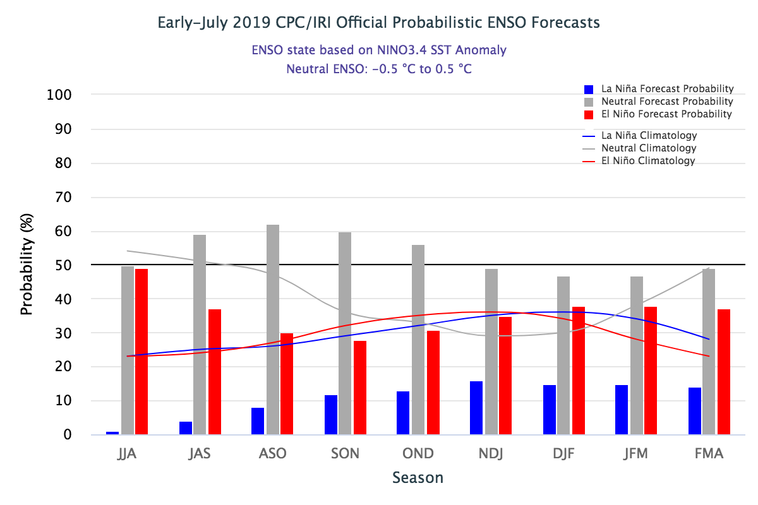
ENSO Forecasts
Early- June CPC/IRI forecast
Early- July CPC/IRI forecast

Slide 22
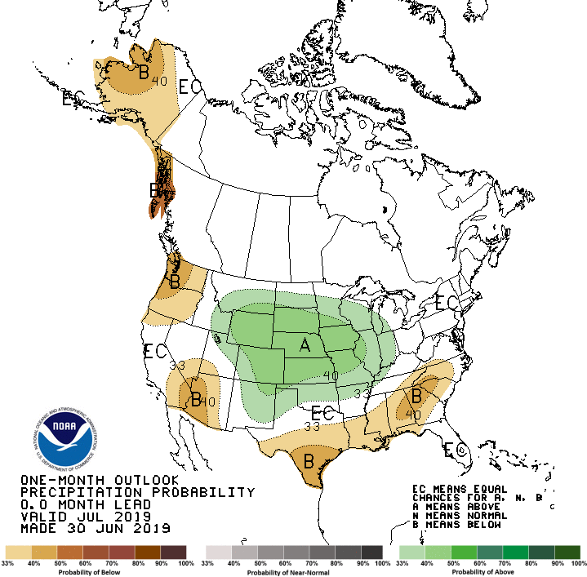
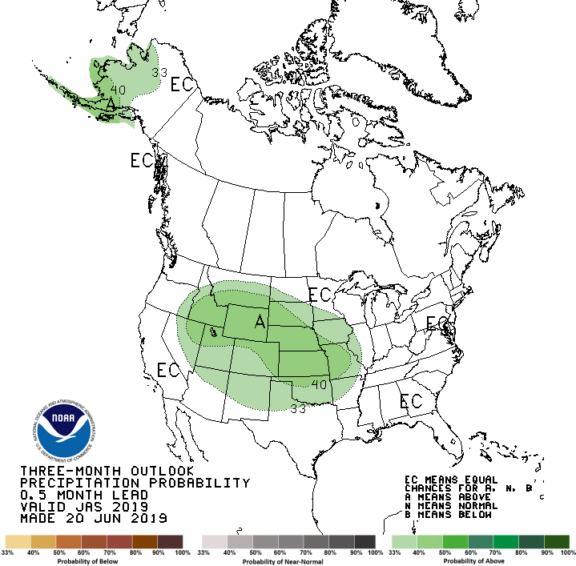
Released June 30st
Previous(Last month)
CPC’s official
Precipitation outlook for Monthly (July)/Seasonal (JAS)
Released June 20th
Observed so far this month!!

Slide 23
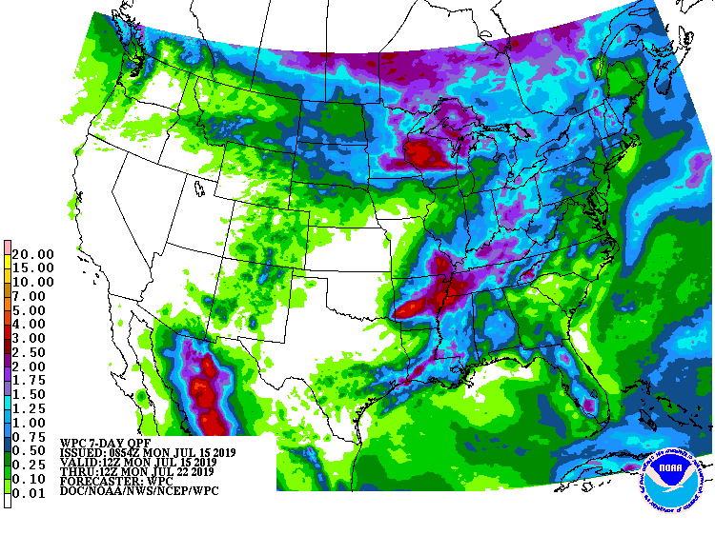
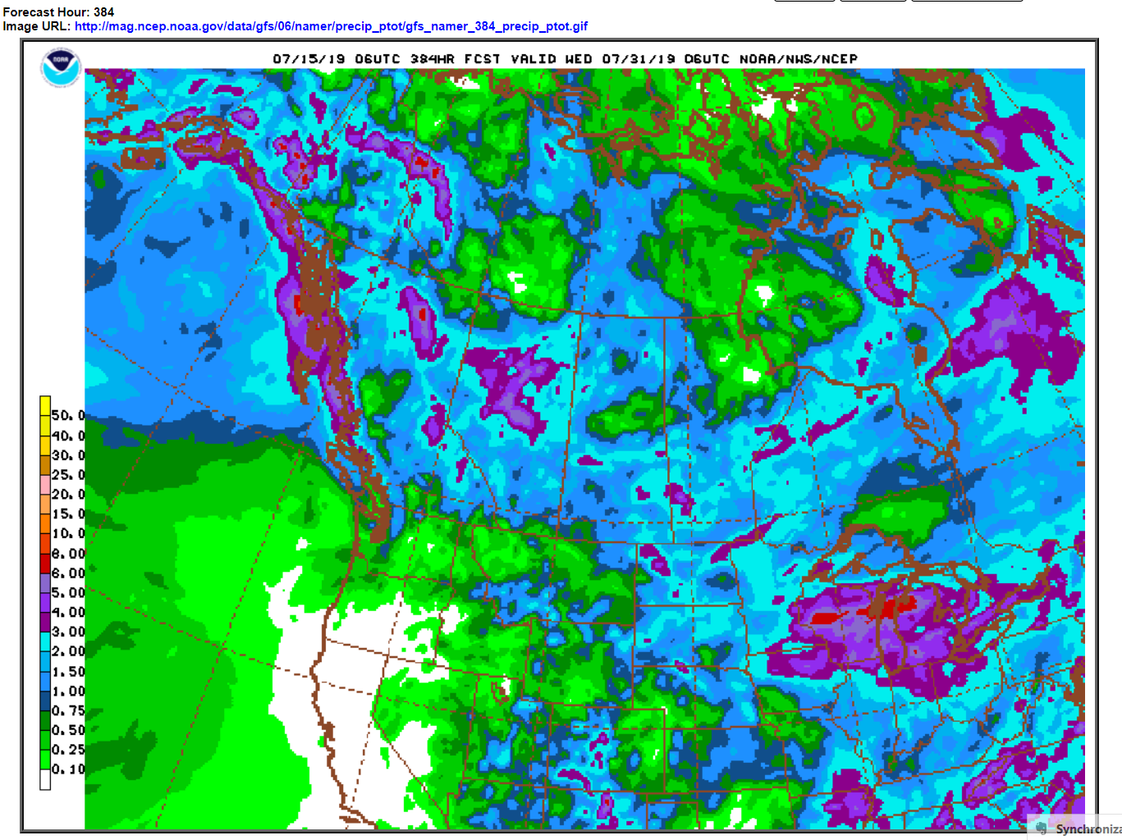
WPC Next 7 days QPF Forecast
GFS Model Guidance for next 16 days.

Slide 24
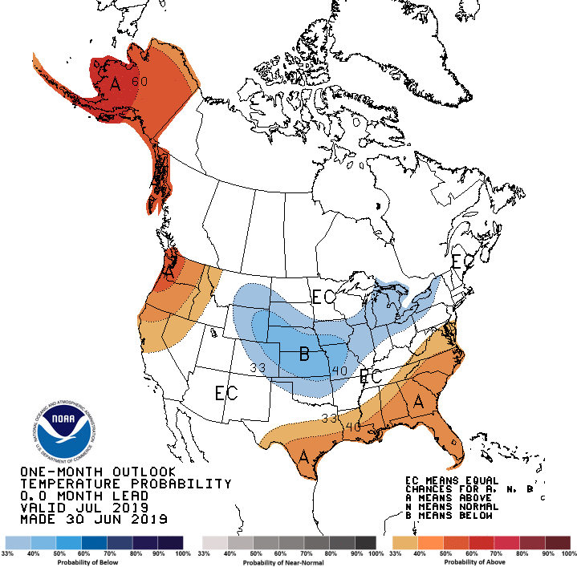
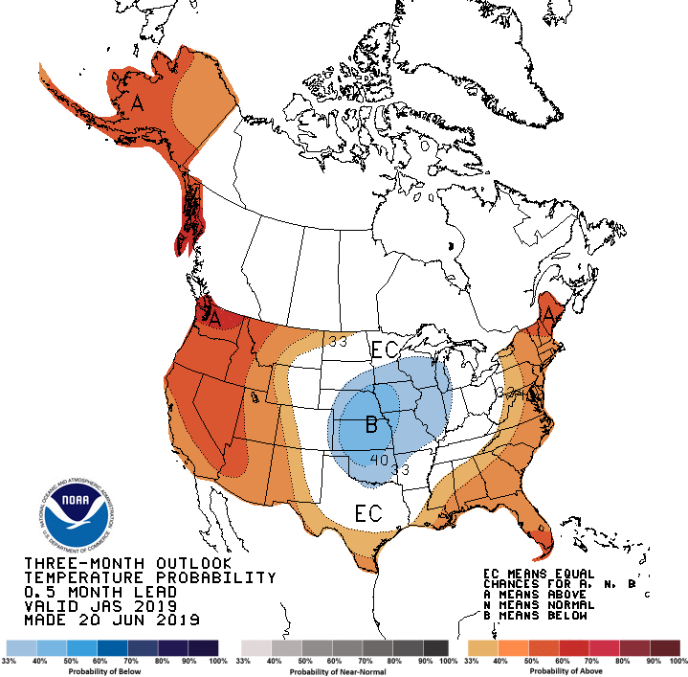
Previous CPC’s official
Temperature outlook for Monthly (July)/Seasonal (JAS)
Made
June 30st
Observed so far this month!! ☺
Made June 20th

Slide 25
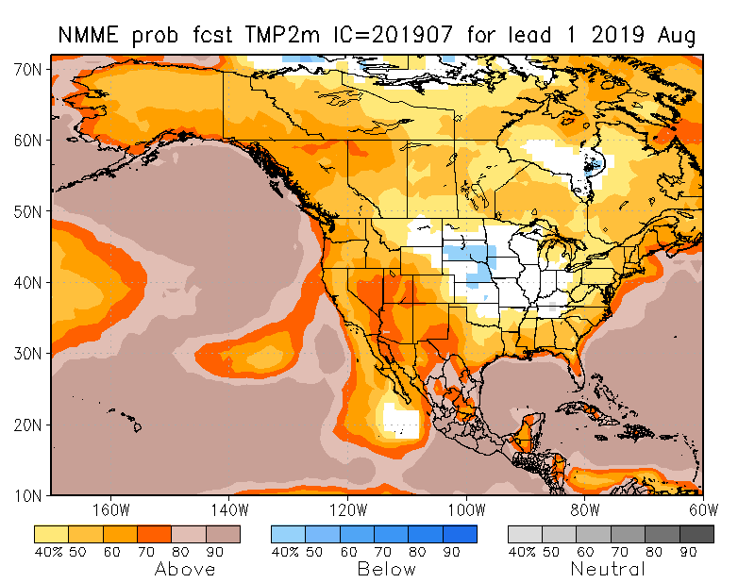
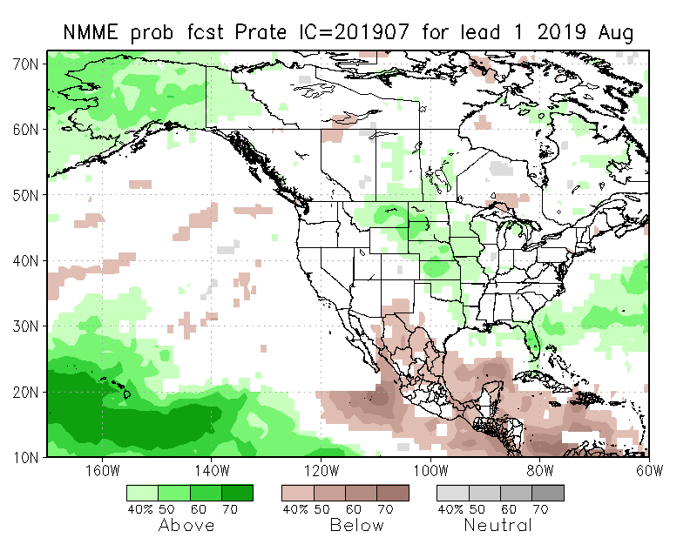
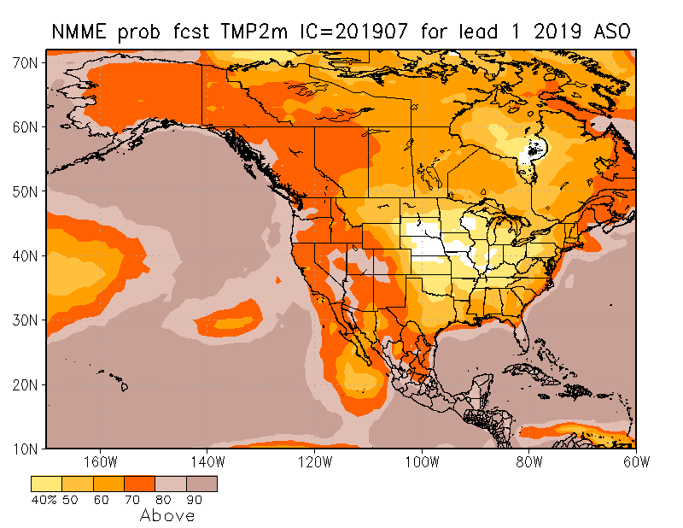
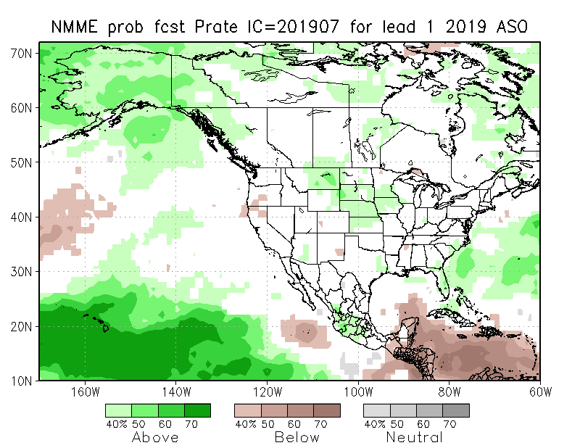
NMME T & P EnsMean forecasts
Aug
ASO
Both monthly and seasonal forecasts call for above normal temperatures except in the middle of the centered near KS.
Forecast seasonal precip map is very similar to the ENSO impact+trend map seen earlier.

Slide 26
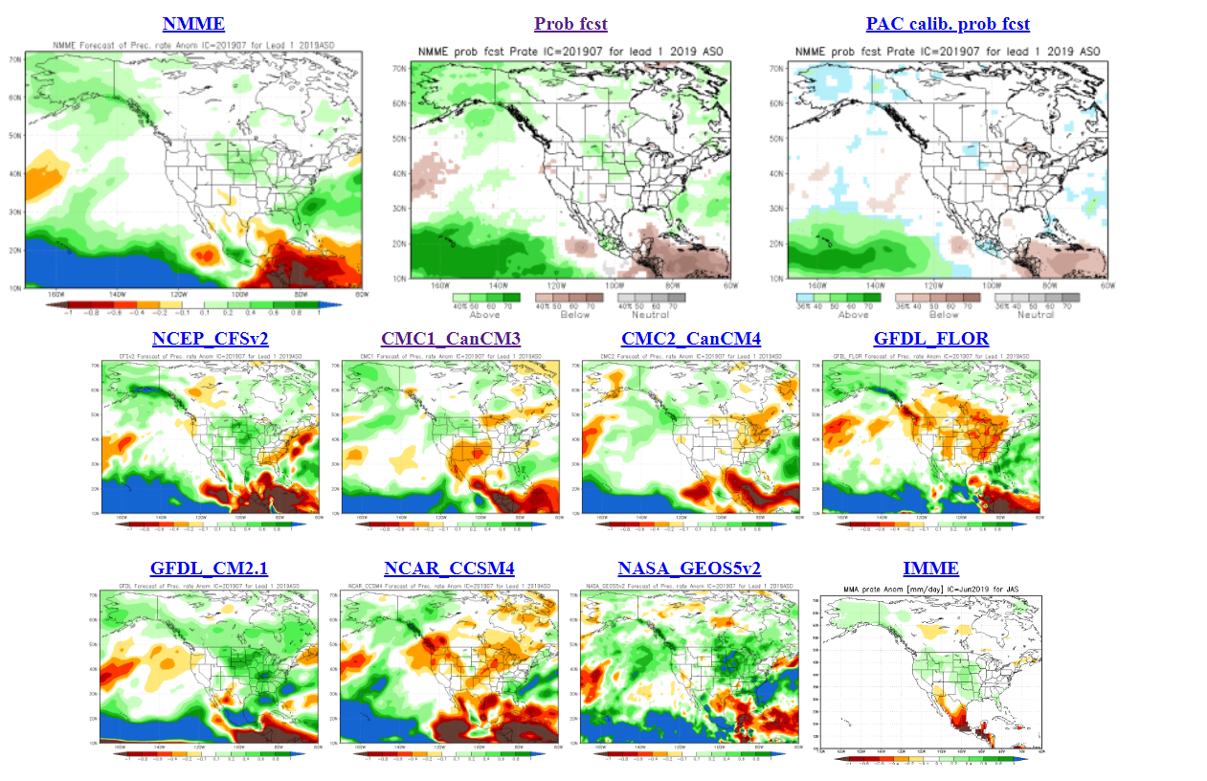
The agreement/uncertainty among the diff. NMME models’ forecasts (middle and bottom panels) for Aug-Sep-Oct Precipitation!!!
26

Slide 27
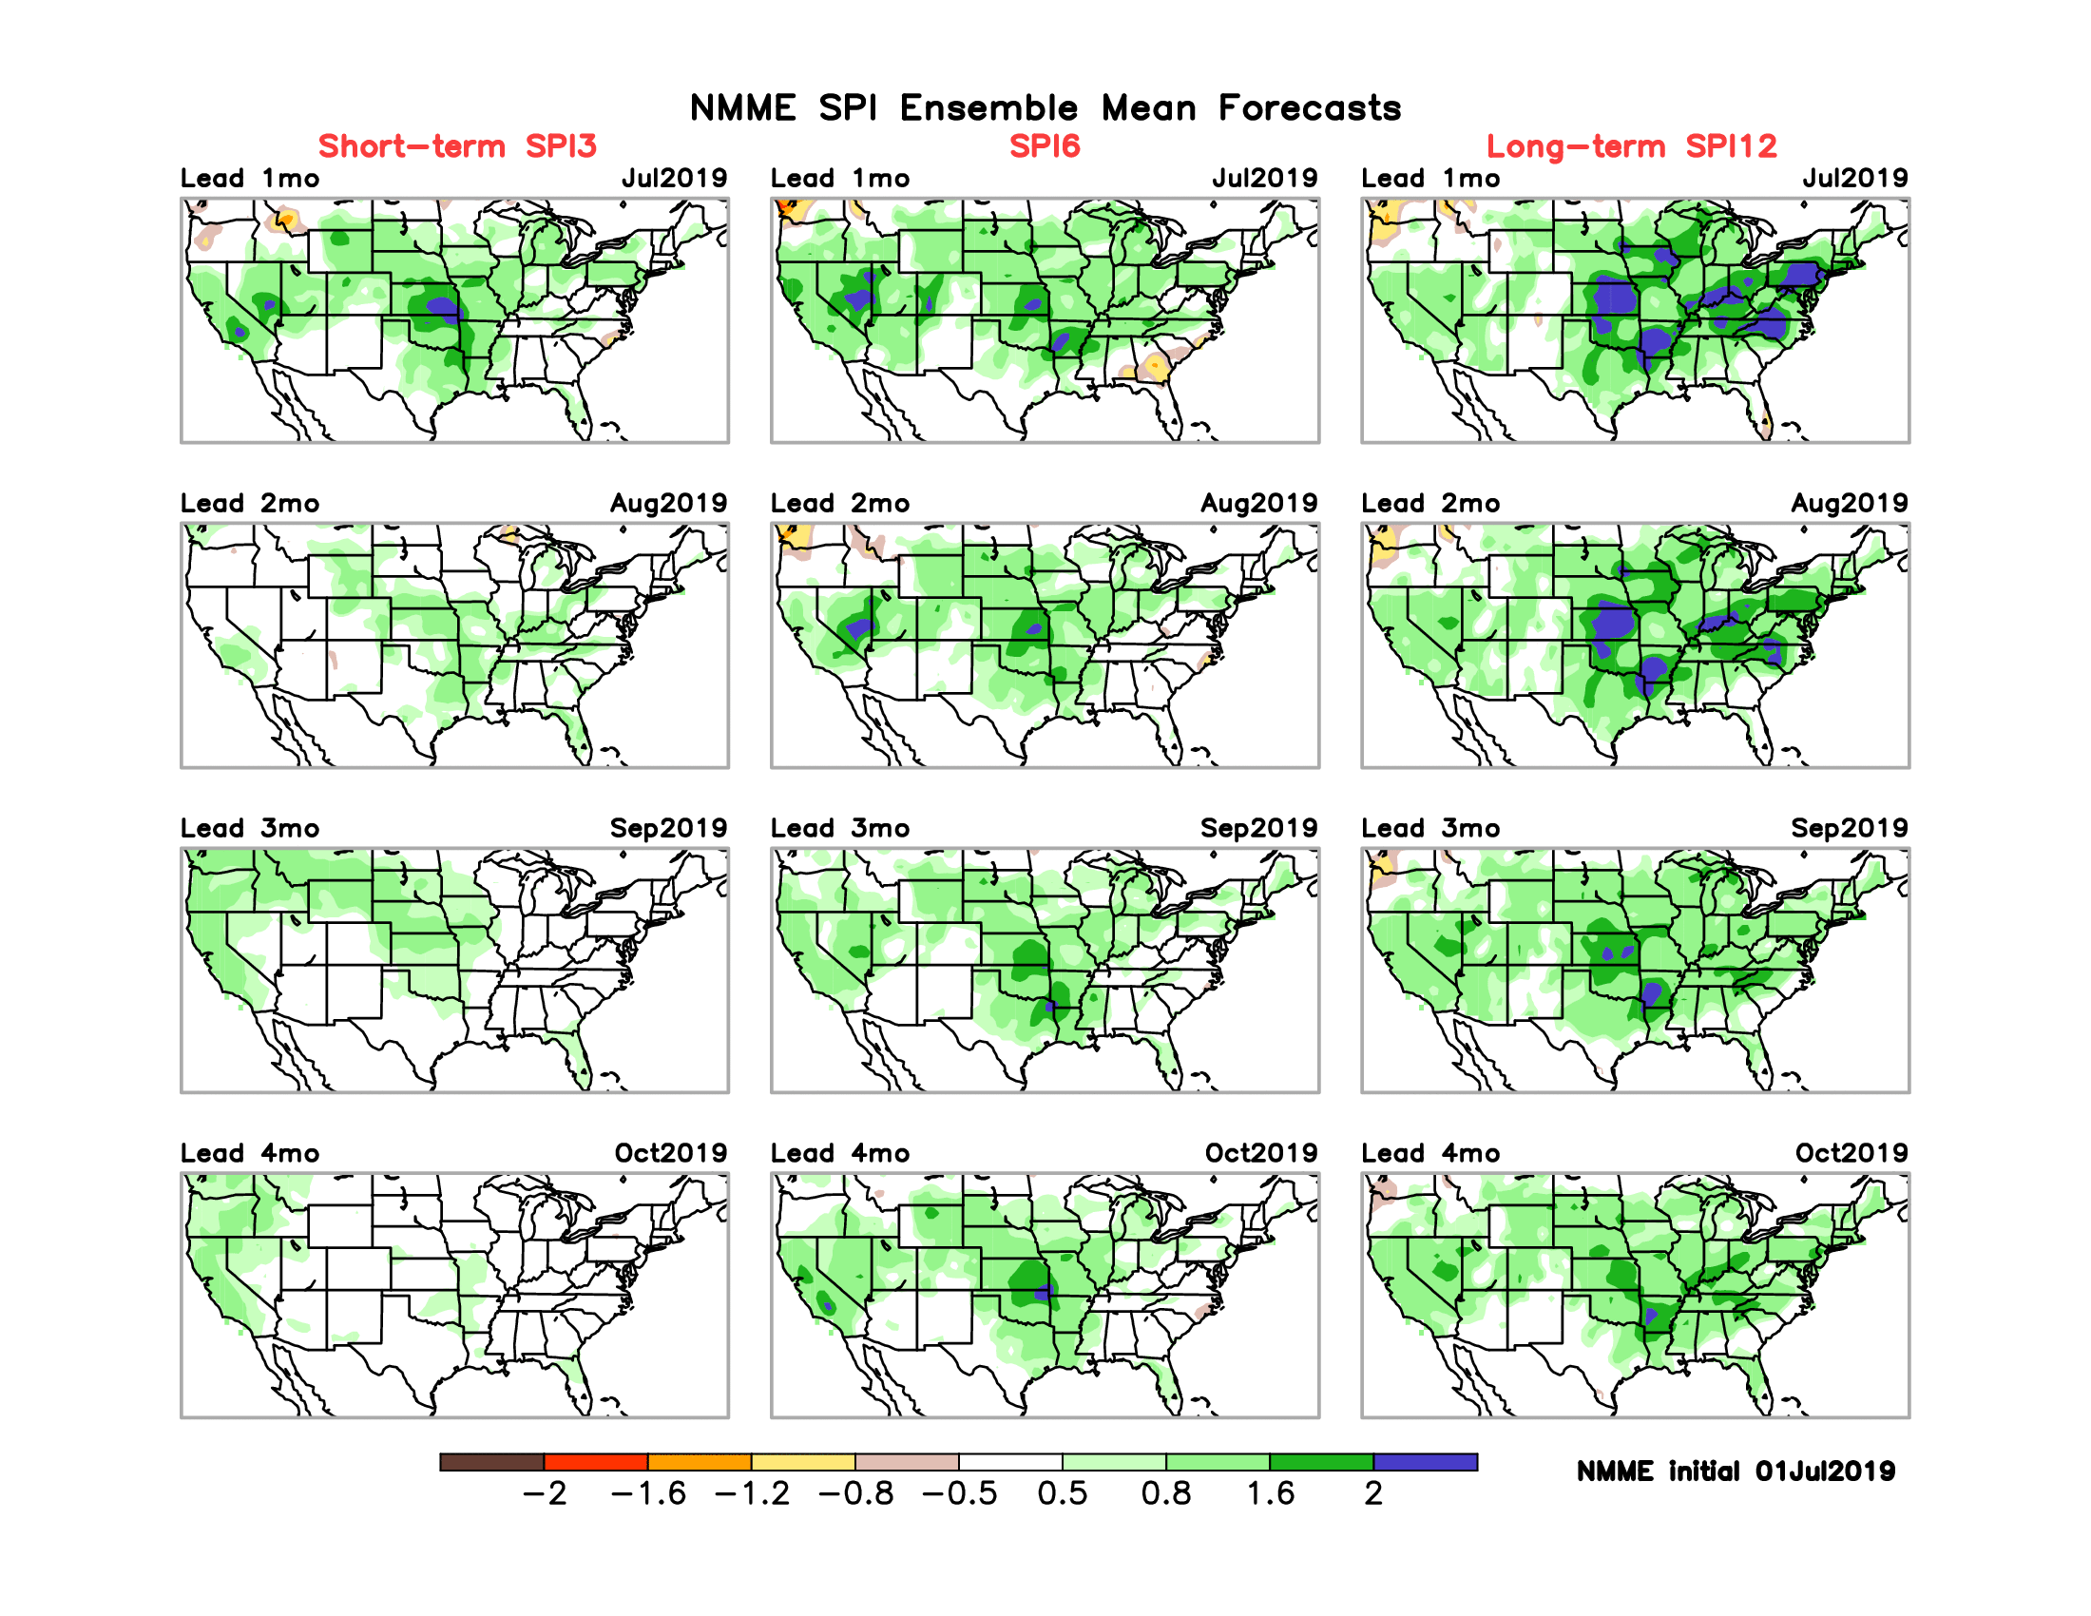
SPI3, SPI6
& SPI12
Forecasts from 6 NMME Models
(uses obs. P up to past month, and forecast months’ P from NMME models)
The goodness and skill of these SPI’s forecasts depend directly on the NMME models’ skill in predicting precipitation!!!

Slide 28
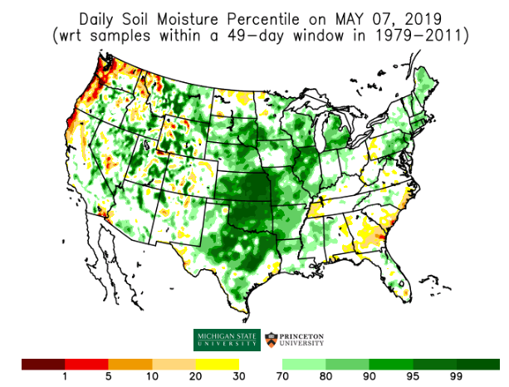
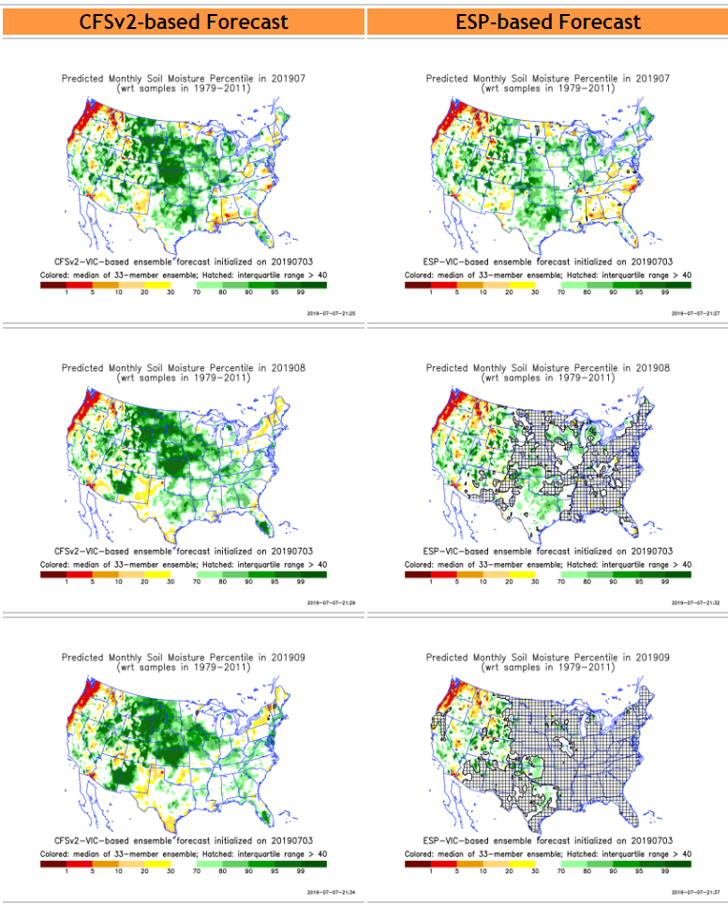
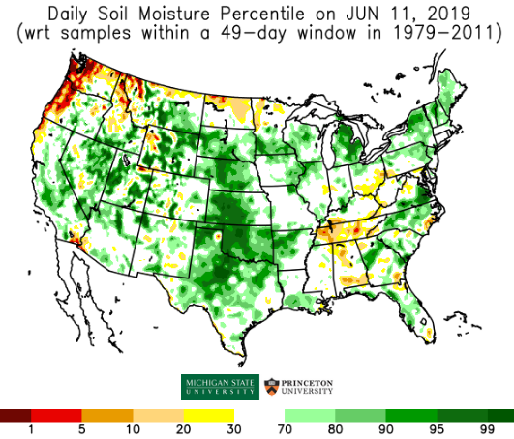
Initial Conditions: 5/7/2019
http://drought.geo.msu.edu/research/forecast/smi.monthly.php
Predicted Monthly Soil Moisture Percentile
Initial Conditions: 6/11/2019
Latest
Initial Conditions:
7/09/2019
The inter quartile range suggest greater uncertainty about the forecast in these shaded regions.

Slide 29
Recent 7 days mean SM percentile.

Slide 30
Precipitation
NASA GEOS 5 Model
Precipitation & Soil Moisture Forecast
Jul 2019
Soil Moisture
Aug 2019
IC 6/30
8/1
Sep 2019
9/1
2018
10/1

Slide 31
Monthly Drought Probabilistic Forecast
made this month for next month (July)
and season(JAS).

Slide 32
Seasonal Drought Probabilistic Forecast

Slide 33
Summary
Current ENSO status and forecast. Weak El Niño is present. Equatorial sea surface temperatures (SSTs) are above average across most of the Pacific Ocean. The pattern of anomalous convection and winds are consistent with El Niño. A transition from El Niño to ENSO-neutral is expected in the next month or two, with ENSO-neutral most likely to continue through Northern Hemisphere fall and winter.*
Current Drought conditions:
Drought (D1-D4) area across the contiguous US has slightly decreased this month (3.63% on 7/9) from the near-record low area coverage of 4% drought coverage last month (6/18).
According to the DM, 5 small areas of drought remain: Pacific Northwest (WA, w OR, n ID, w MT); northern Plains (n ND); Four Corners region (w NM); southern Plains (s TX); and Southeast (s AL, s GA, coastal Carolinas).
Recent rains in the Southeast (Hurricane Barry) and ND has reduced drought conditions there. Some short-term (60-days) spotty dryness is being watched for D0 development in parts of New England & Midwest.
California reservoirs continue to be are at more than satisfactory levels, and the streamflow conditions across the country has considerably improved for the better over the last three months except in Pacific Northwest.
Long-term (>1 year) deficits still remain over large areas in the Southwest and West - which is not completely reflected in the drought monitor.
Prediction:
The drought along the Pacific Northwest is likely to persist and may deteriorate; however, the wet season typically begins in the Fall, so we’ll need to see if it’s onset is delayed.
Continued monitoring of rainfall deficits and forecast in the northern part of Northern Great Plains is essential, as July rainfall amounts received here may tip the existing mild drought conditions one way or other. This region is very tricky, and must be carefully monitored!
In spite of the fact the ongoing El Nino is not very strong, NMME models’ ensemble mean forecast indicate a somewhat typical canonical + trend impact pattern for ASO season. This combined with seasonal rainfall may completely eliminate the drought conditions in the Southeast. In the Southwest, there will be short term improvement (Southwest monsoon?), but the very long term rainfall deficits will persist.
Overall, the upcoming season will continue to be likely a season with very low percent area coverage for drought across the contiguous US; however, drought in Alaska, Hawaii, and Puerto Rico has grown recently and needs to be monitored.

Slide 34
Miscellaneous maps

Slide 35
Miscellaneous maps

