Slide 1
Drought Outlook Support Briefing July 2020
Climate Prediction Center/NCEP/NOAA
http://www.cpc.ncep.noaa.gov/products/Drought
Phone: 1-877-680-3341
Pwd: 858747#

Slide 2
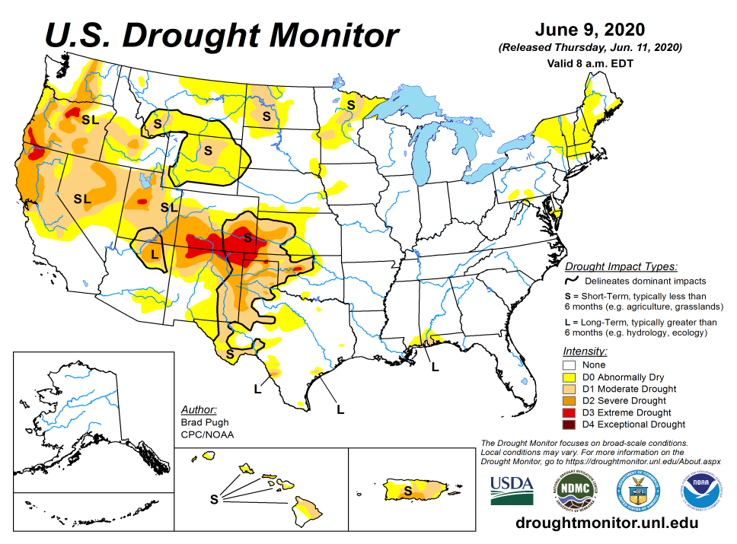
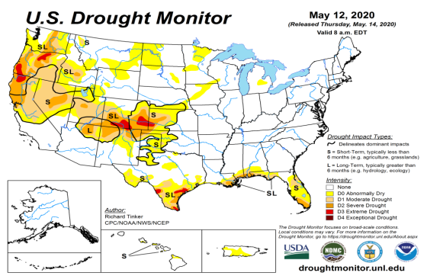
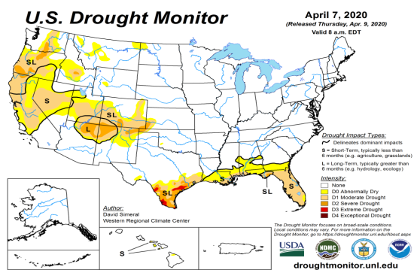
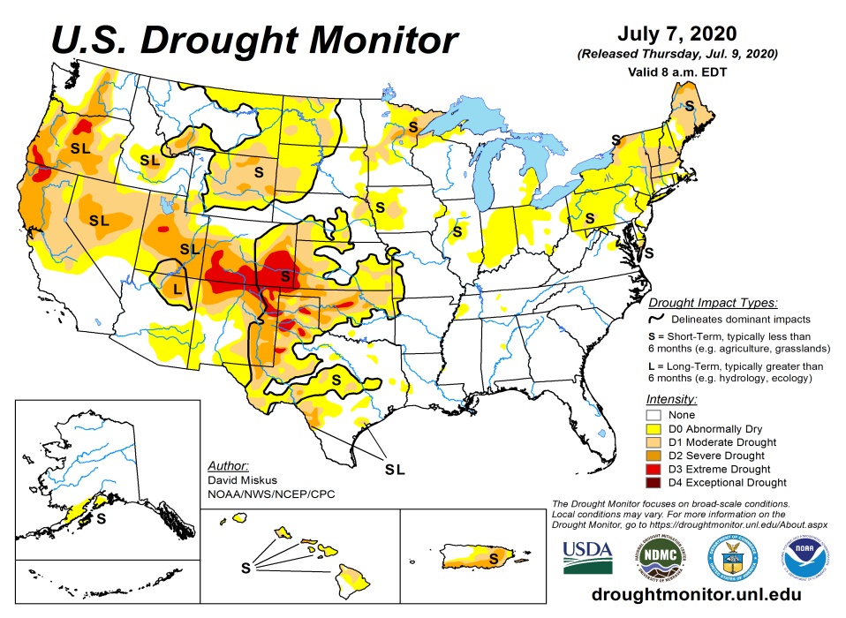
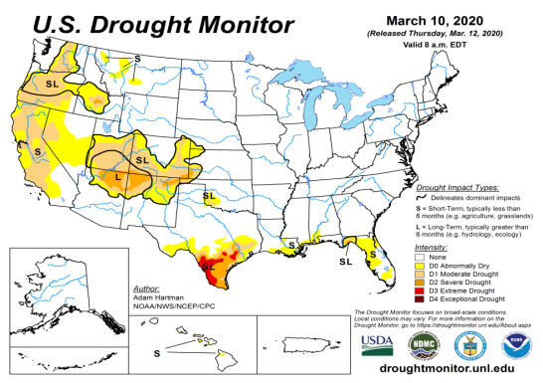
Drought Monitor
June
Monitoring is important because, unlike US T/P fcsts, for drought forecasts, we have to know where we are, before we can tell where we are going!!
Drought forecasts are tendency forecasts.
May
Over the last few months, drought area & severity has overall generally increased across the South, West & Northern Plains.
The short/long term drought in the four corner states area (AZ/NM/ UT/CO) has expanded and intensified eastward to the neighboring states of KS/OK/TX/NE/IA.
Existing drought in OR, Northern CA, NV, ID, WA, UT continues.
Drought in western/ northwestern TX has intensified.
Dryness/Drought in Northern Great Plain states has expanded.
April
July
(Recent/Latest)
March
February

Slide 3
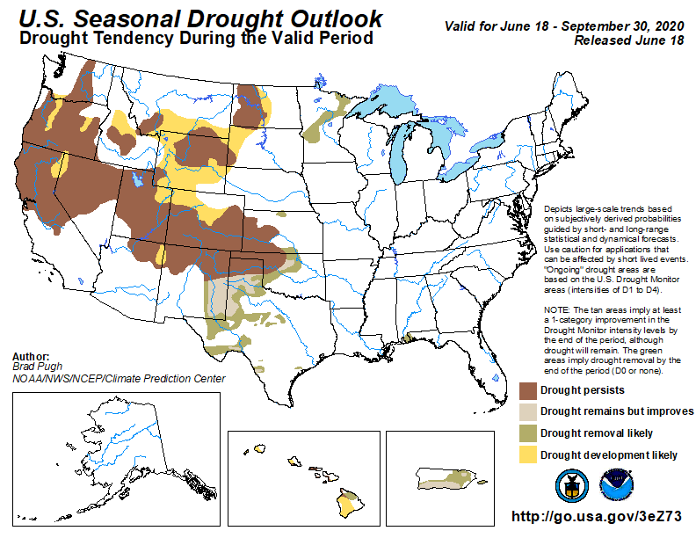
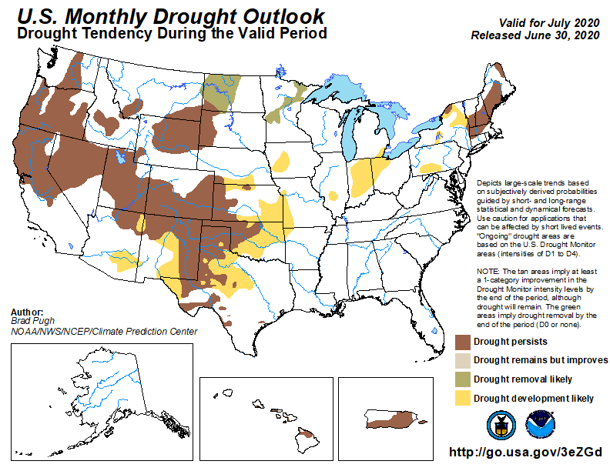
(Prev) Seasonal/Monthly Drought outlooks
(New Seasonal Drought Outlook to be released in 2 days!)
(New Monthly Drought Outlook to be released end of the month)
Seasonal Outlook
(Mid June 2020- Sep 2020)
issued 06/18/20
Monthly outlook
(for July 2020)
issued 06/30/20
As we suggested here, and as outlooks correctly indicated, drought in southeast have disappeared.
Historically skill wise, our Drought outlooks, do better once drought is already identified in the drought monitor (USDM) in some form. We do not always identify new/developing droughts correctly, and our skill here is relatively poor. I notice some general reluctance to declare new drought development areas.
Last few months in these briefings, and in form of recommendations, even before drought development areas were identified in the USDM in the Northern Great Plains area of the Dakotas and vicinity, we had been cautioning for possible drought development in the region, and accordingly the dry/drought areas have increased, as indicated in DM.

Slide 4
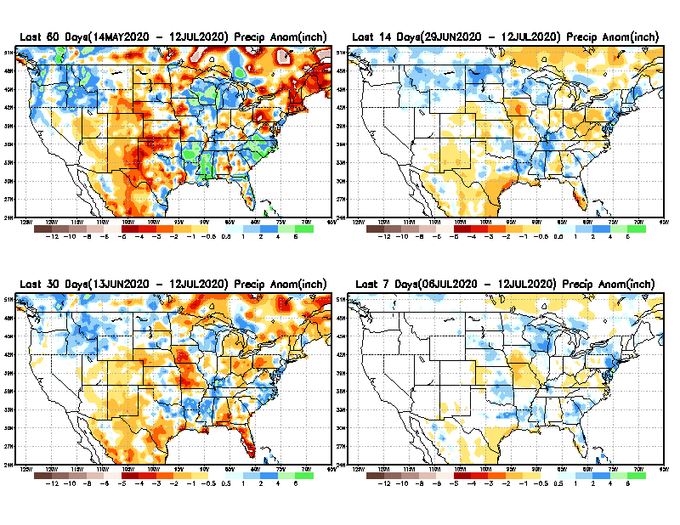
Precipitation ANOM during last 7, 14, 30, & 60 days.
60 Days
14 Days
These maps in this and following slides, including a) Total,
b) Anom and
c) Percent of Normal precip. in these and other longer time ranges are now (routinely) daily updated at:
30 Days
7 Days
Alaska regn. was also added here as separate maps recently.
From: Recent Accumulated Precipitation https://www.cpc.ncep.noaa.gov/products/Drought/briefing_prcp.shtml

Slide 5
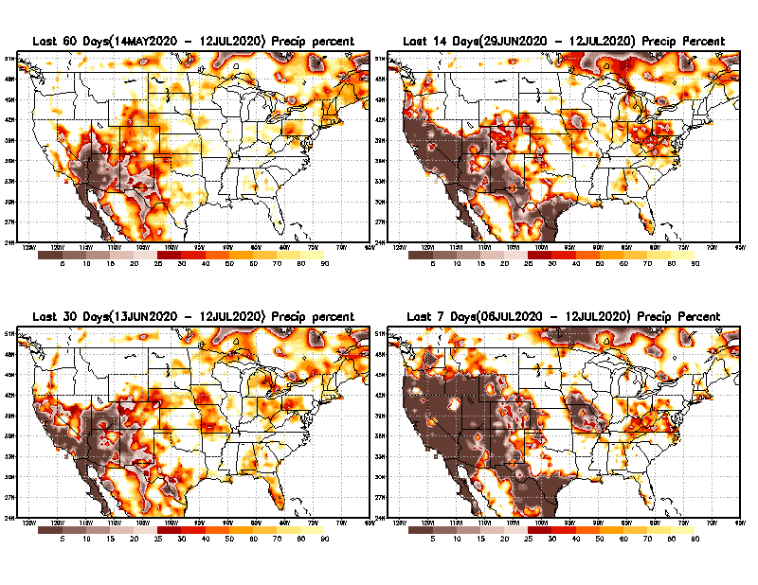
Precipitation Percent during last 7, 14, 30, & 60 days.
60 Days
14 Days
I am thinking of showing this plot instead of previous one.
This plot shows only the rainfall deficient regions <= 70% of normal.
-- This shows more clearly possible/likely drought developing region in the future unless there is above normal rainfall in these regions to offset these shortfalls.
30 days
Late monsoon !!
7 Days
This may look bad, may be not!!
From: Recent Accumulated Precipitation https://www.cpc.ncep.noaa.gov/products/Drought/briefing_prcp.shtml

Slide 6
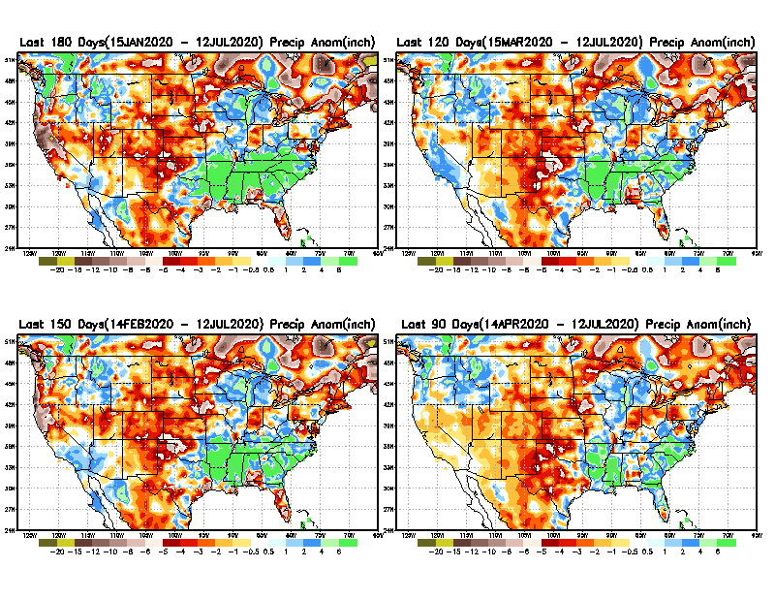
Total precipitation ANOM during last 3, 4, 5, and 6 months.
6 M
4 M
While the Precipitation anomalies deficit may seem large in some regions (compared to others), it is the % of normal precip (next slide) that matters more!!
5 M
3 M
From: Recent Accumulated Precipitation https://www.cpc.ncep.noaa.gov/products/Drought/briefing_prcp.shtml

Slide 7
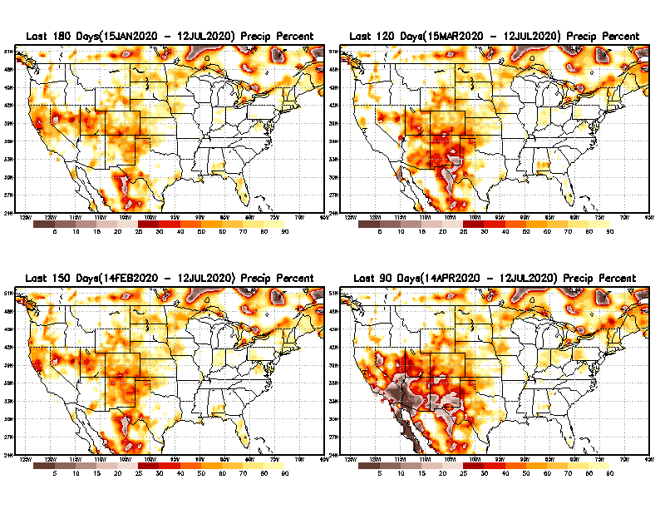
Total precipitation Percent during last 3, 4, 5, and 6 months.
6 M
4 M
In these interim time scale 3-6 months, we need to pay attention to regions, which are dark-brown, red & dark red (<50%).
5 M
3M
While accrued precipitation deficits are real & objective,
droughts are subjective declarations!!
East vs West!
Broad vs Narrow
rainfall season.
With these various rainfall deficits in diff. time ranges, where and how exactly does one declare drought? Other factors (T/SM/E, etc..) do matter, but is cumulative precip. Deficits/percent_of_normal ultimately more important?

Slide 8
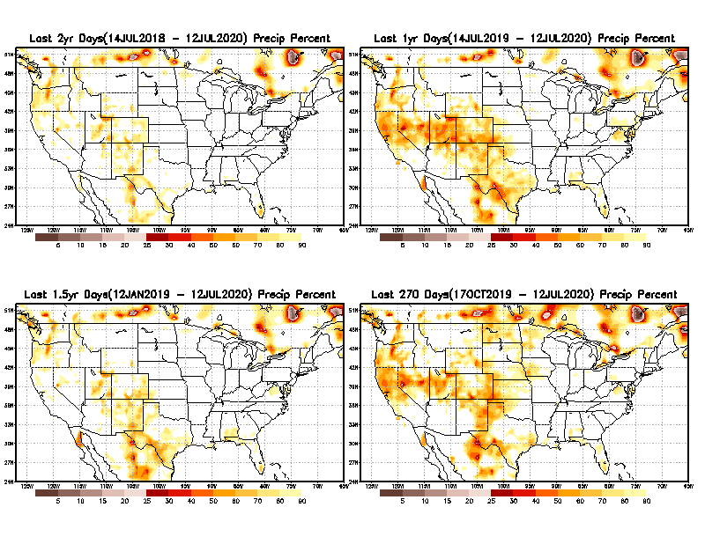
Total precipitation Percent during last 9 months, 1 yr, 1.5yrs, & 2 yrs.
2 Y
1 Y
In new format
1.5 Y
9 M
What exactly are the time scales for short(S) and long(L) term drought?
From: Recent Accumulated Precipitation https://www.cpc.ncep.noaa.gov/products/Drought/briefing_prcp.shtml

Slide 9
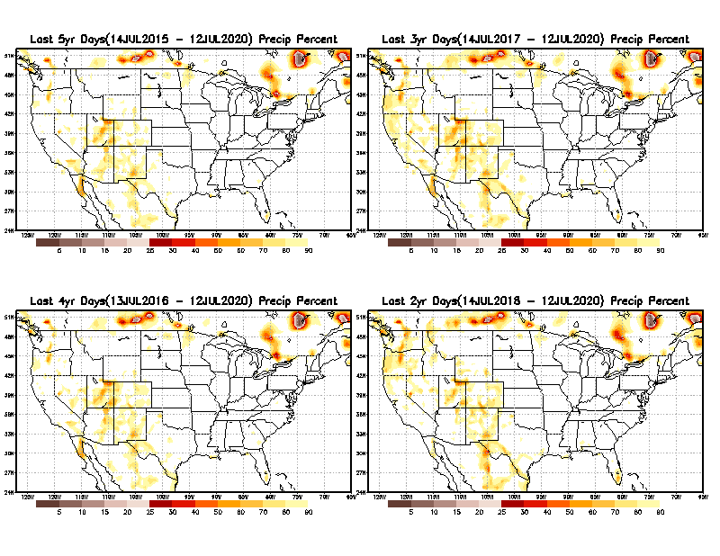
Total precipitation Percent during last 2 yrs, 3 yrs, 4 yrs, & 5 yrs.
5 Y
3 Y
Still longer term rainfall deficit variability in play? Especially in the southwest!
In new format
4 Y
2 Y
For the country as a whole ,there is not any big are where the rainfall is less than 70% on time scales longer than 1-1.5 yrs.
From: Recent Accumulated Precipitation https://www.cpc.ncep.noaa.gov/products/Drought/briefing_prcp.shtml

Slide 10
Rainy (3-month)Season across the US
East vs West!
More darker colors in regn. central/west => narrow rainy season (months)
Overall, more white space in the east -> distributed rainfall season (except ~FL).

Slide 11
*********
EAST vs
CTR/WEST
Behavior in Drought is loosely tied to rainfall climo!!
*********
Adapted from Rich Tinker.

Slide 12
Adapted from
Rich Tinker

Slide 13
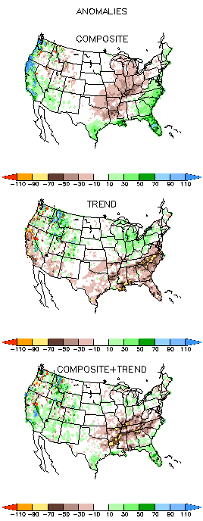
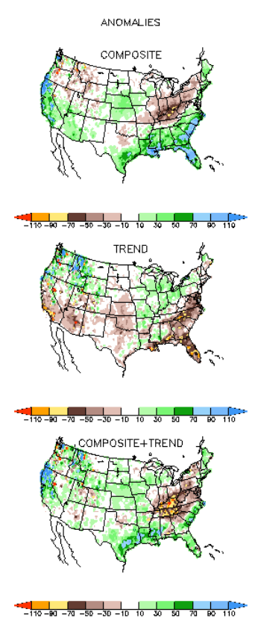
EL NINO Precip COMPOSITES & Trend maps
JFM
FMA
Only this is of relevance to us now due to neutral ENSO status.

Slide 14
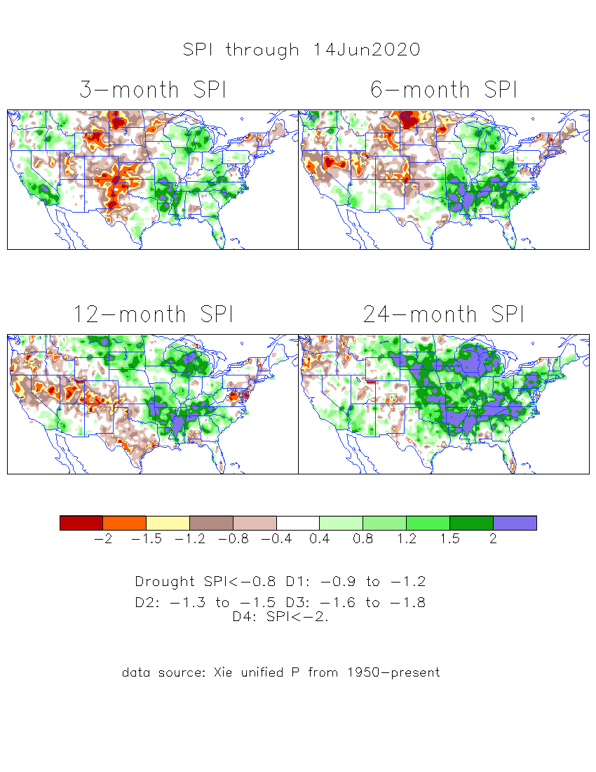
The Standardized Precipitation Index SPI (based on Observed P)
----- Last Month
Very interesting graphic & details for the drought across the US based on the more generalized precip deficit/excess, the Standardized Precipitation Index (SPI).
The dark brown and red colors, indicating standardized precipitation deficits, in the various time periods, approximately correspond to the appropriate short/long term drought monitor regions and their intensities
Have to keep an eye on this region!!
(have been saying this since mid-March briefing)

Slide 15
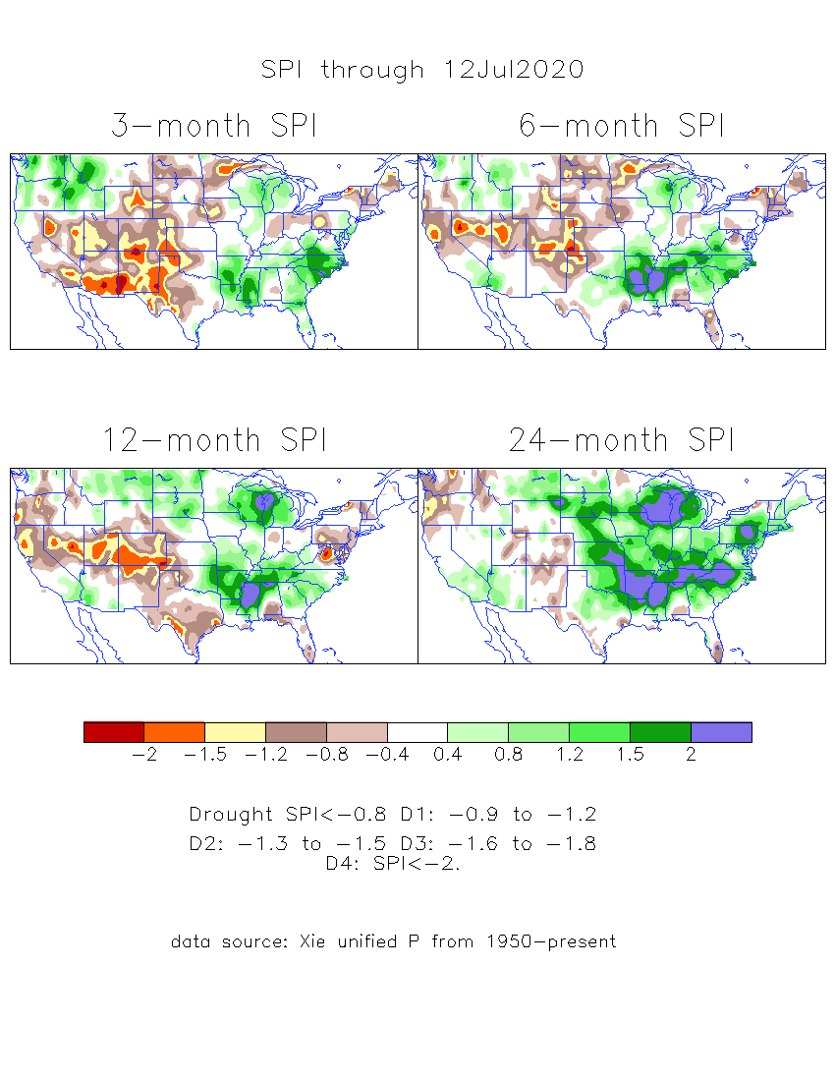
The Standardized Precipitation Index SPI (based on Observed P)
----- NOW
Very interesting graphic & details for the drought across the US based on the more generalized precip deficit/excess, the Standardized Precipitation Index (SPI).
The dark brown and red colors, indicating standardized precipitation deficits, in the various time periods, approximately correspond to the appropriate short/long term drought monitor regions and their intensities
Have to keep an eye on this region!!
How does one negotiate and reconcile declaring short term vs long term drought when precip. deficiencies patterns differ on many different time scales locally!!
What is the cutoff delineating time between short VS long term drought!!

Slide 16
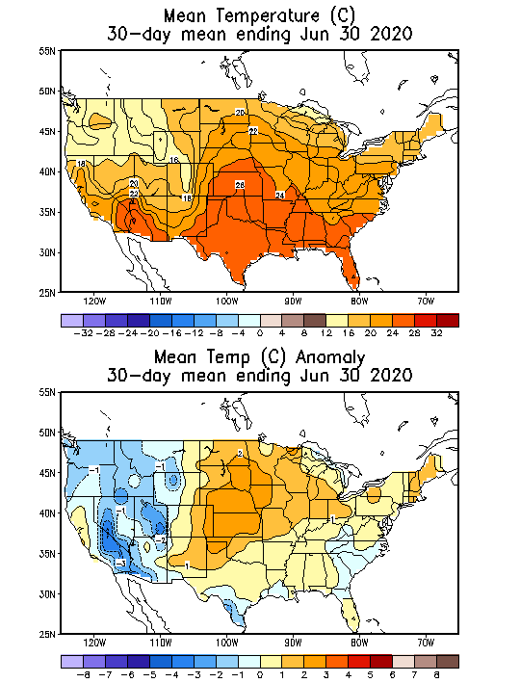
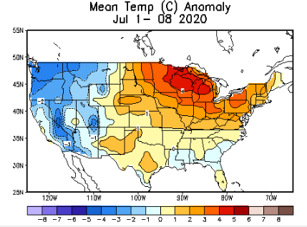
Recent US Temperatures
So far relatively similar rainfall pattern this month as compared to last month.

Slide 17
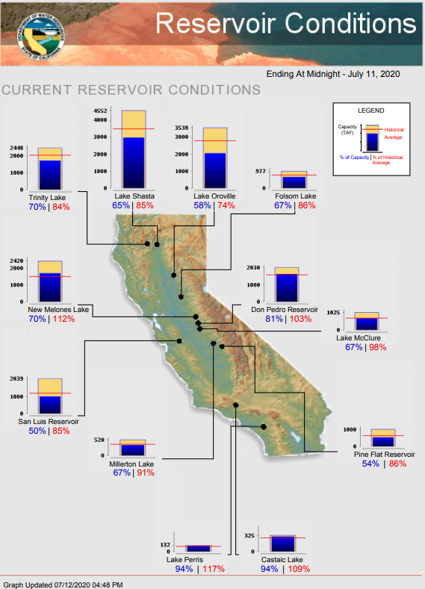
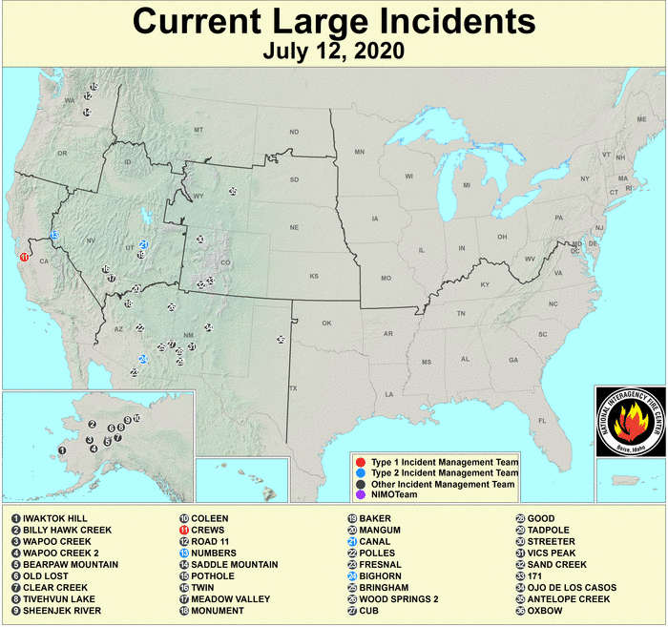
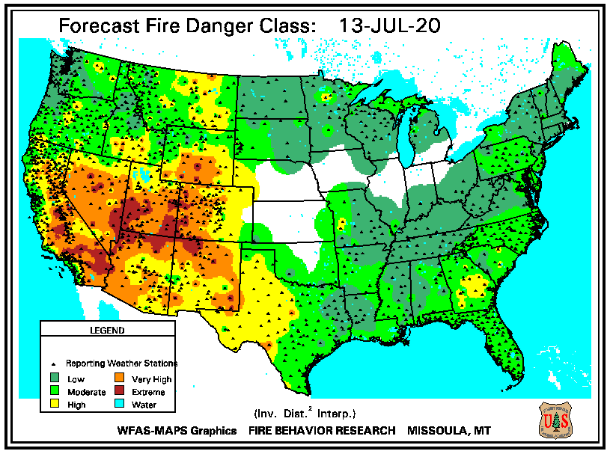
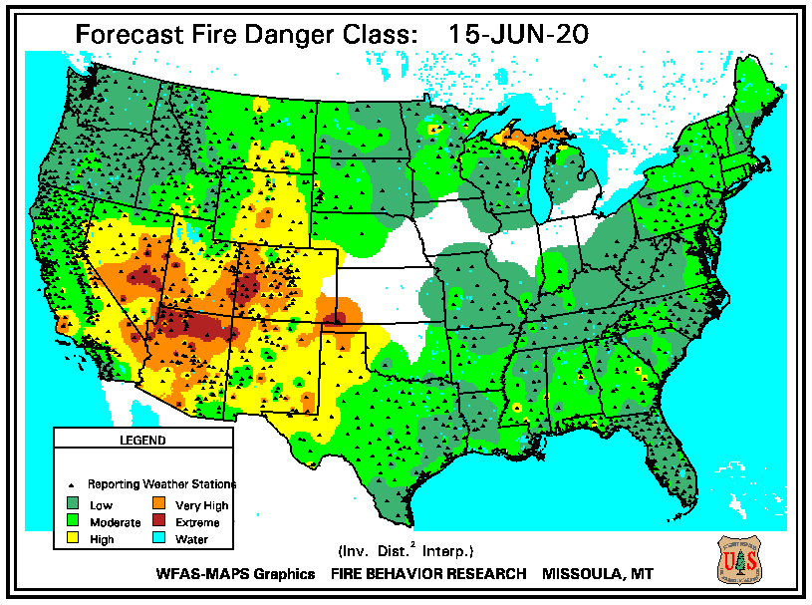
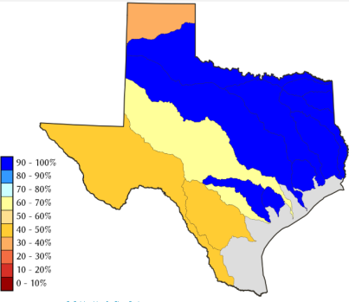
https://fsapps.nwcg.gov/
https://www.nrcs.usda.gov/wps/portal/wcc/
https://www.wfas.net/index.php/fire-danger-rating-fire-potential--danger-32
TX
Some/many of California reservoirs levels are below their historical average levels. Next rainy season is 6-months away.

Slide 18
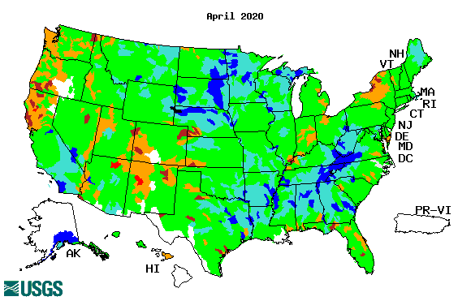
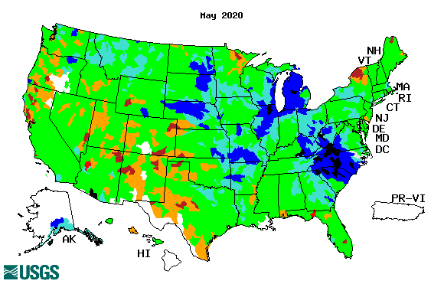
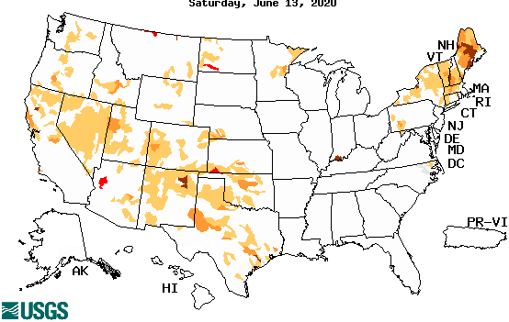
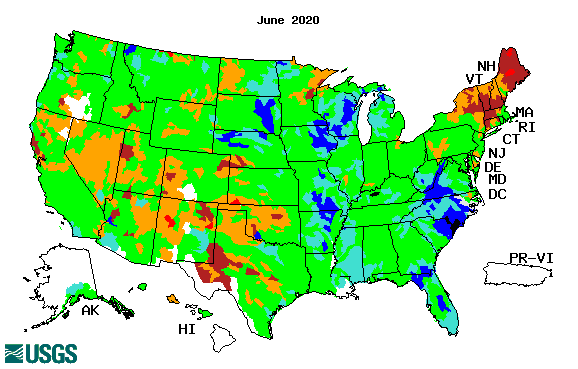
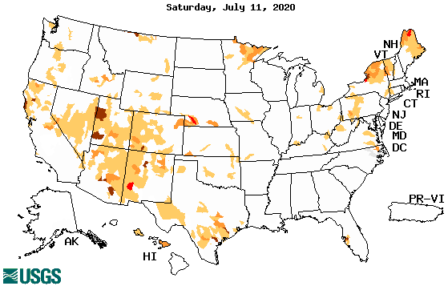
Streamflow (USGS)
Improving conditions in the southwest, getting bad.
Pacific NW much improved now.
Map shows only below normal 7-day average streamflow compared to historical streamflow for the day of year.
The far NE drought/dryness could be short term – month? not season!!?
One month ago (left) &
Now (below)
18

Slide 19
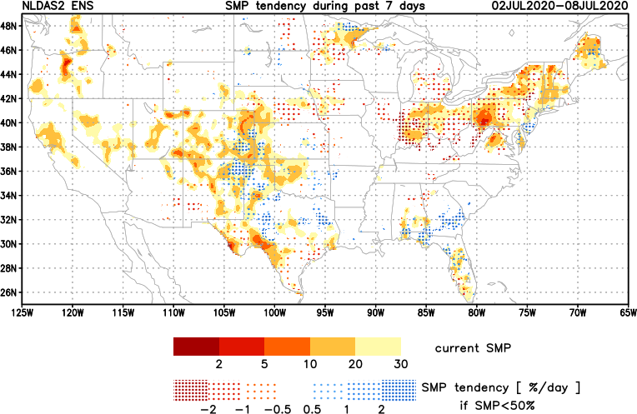
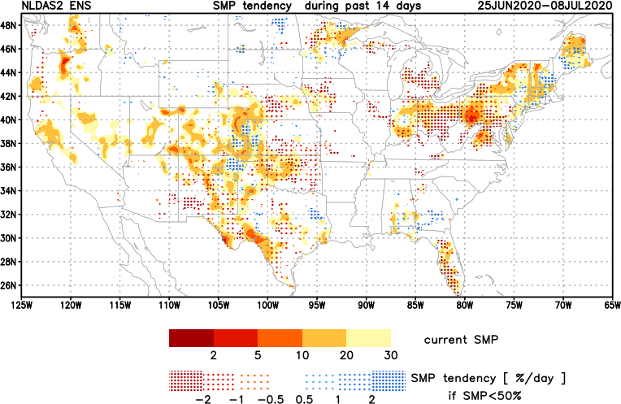
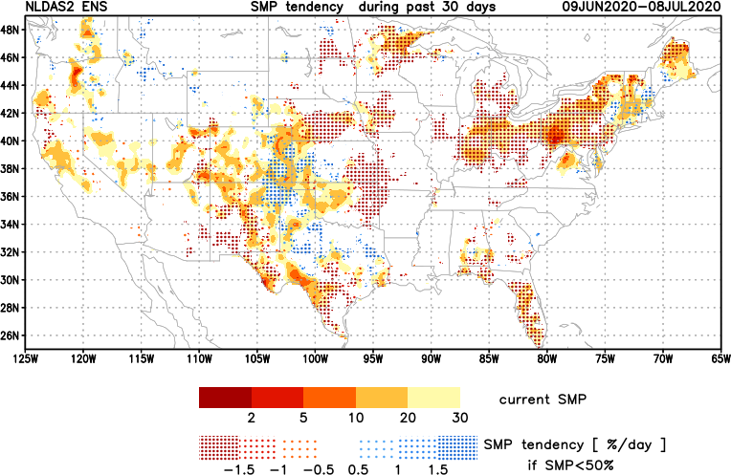
[Now]
NCEP Ensemble mean NLDAS2 models’ Soil Moisture tendency/trend
7 days
14 days
30 days
Last month we said:
Overall Moistening tendency in the southeast and far northwest, but generally drying tendency in the southwest and west.
Now: about same + drying in NorthEast, but will that turn in to monthly/seasonal drought?

Slide 20
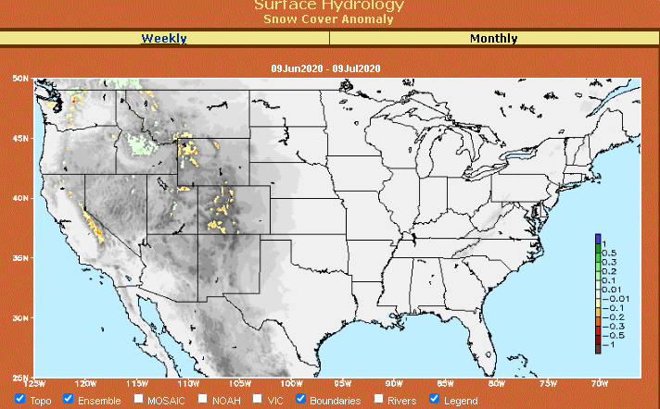
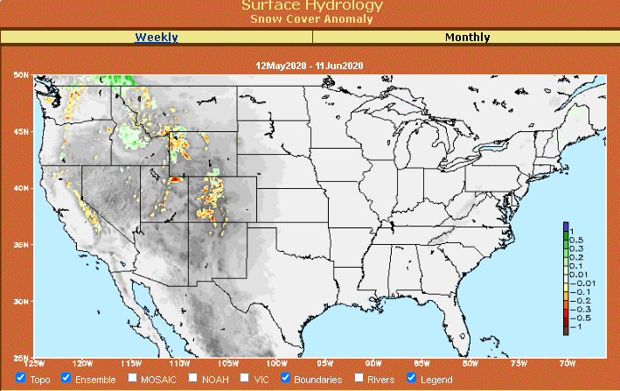
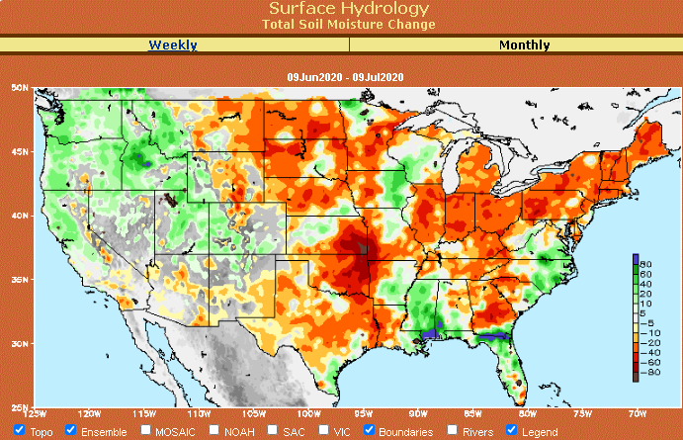
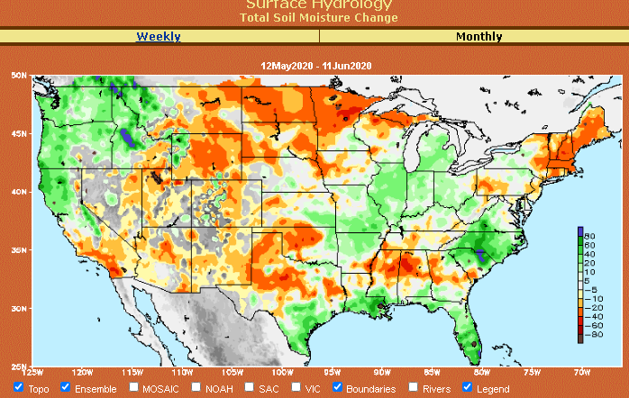
Snow cover & Soil Moisture Anomalies
Snow cover
Last month ~ this time
Now
Look further for areas of drought development

Slide 21
EL NIÑO/SOUTHERN OSCILLATION (ENSO)
DIAGNOSTIC DISCUSSION
issued by CLIMATE PREDICTION CENTER/NCEP/NWS and the International Research Institute for Climate and Society
9 July 2020
ENSO Alert System Status: La Nina Watch
Synopsis: ENSO-neutral is favored to continue through the summer, with a 50-55% chance of La Niña development during Northern Hemisphere fall 2020 and continuing through winter 2020-21 (~50% chance).

Slide 22
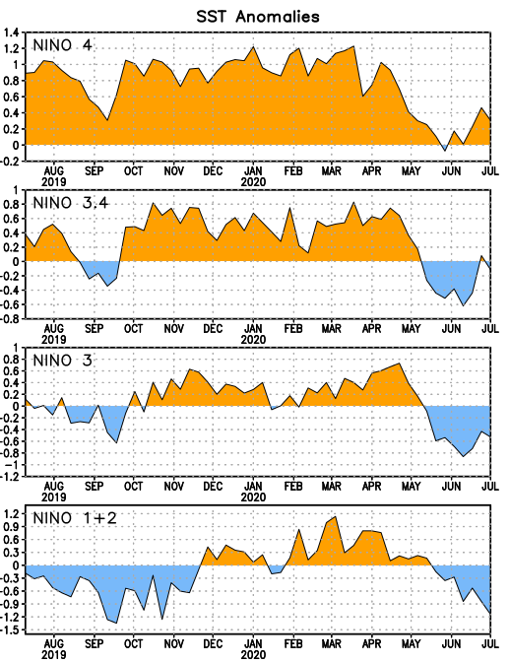
Latest values of SST indices in the various Nino Regions.
Officially in ENSO neutral territory now and for next 3-months. But (how soon) will we in La Nina? ☺ or ….

Slide 23
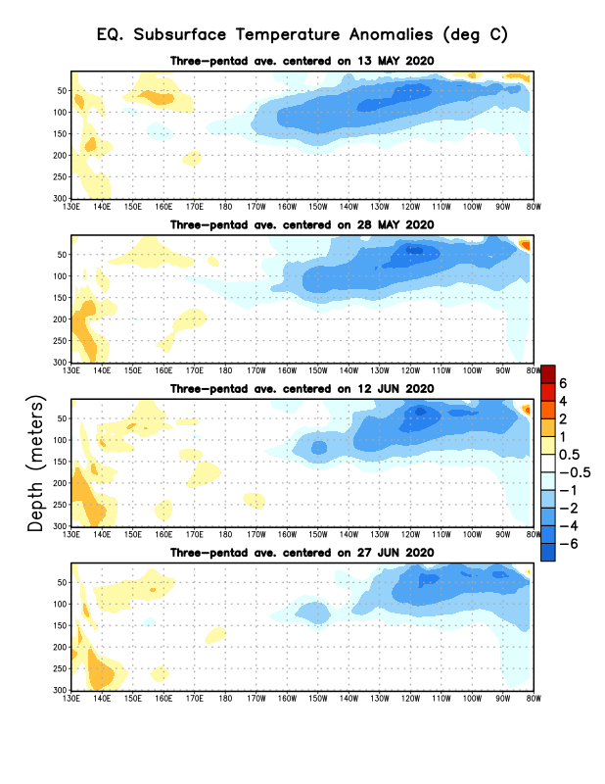
Sub-Surface Temperature Departures in the Equatorial Pacific
Tropical Pacific (Nino 3.4) surface SST in ENSO neutral status vs cool Subsurface
Most recent pentad analysis

Slide 24
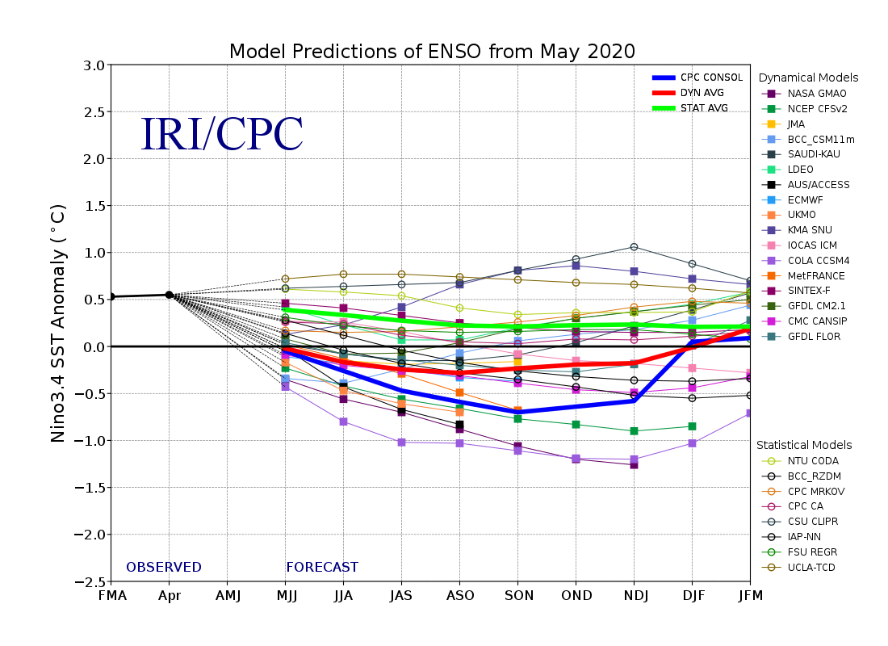
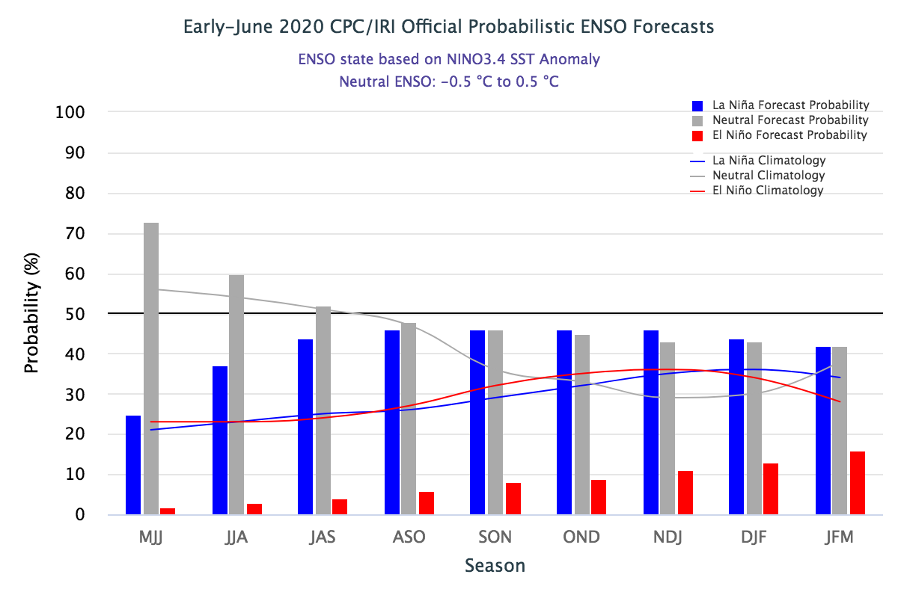
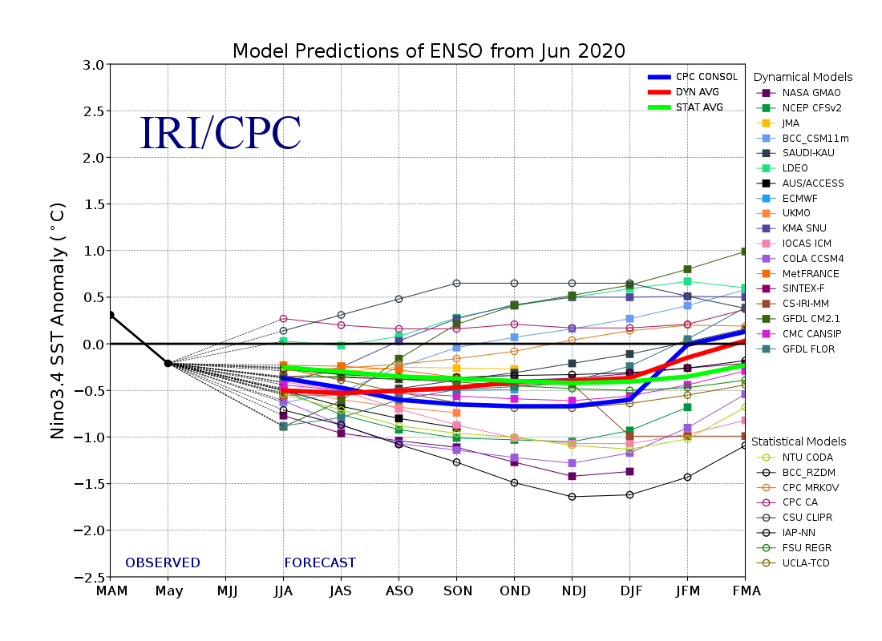
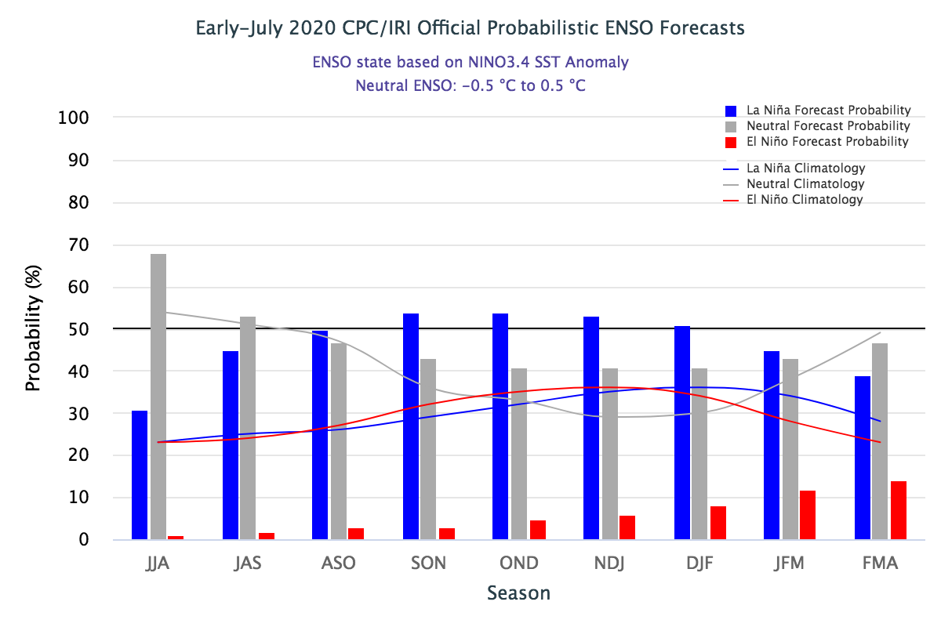
ENSO Forecasts
Early- June CPC/IRI forecast
Onwards to quick increasing (??) probability for La Nina later in the year.
Barely >50 percent.
50-50 Chance
Early- July CPC/IRI forecast
Mostly ENSO Neutral t0 developing La Nina during next 3 months.

Slide 25
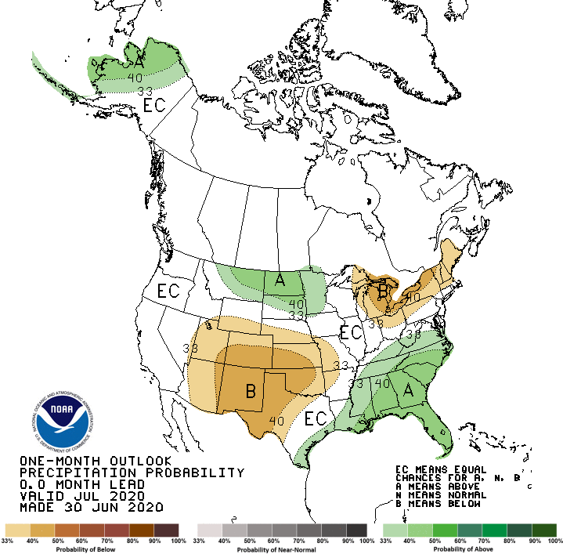
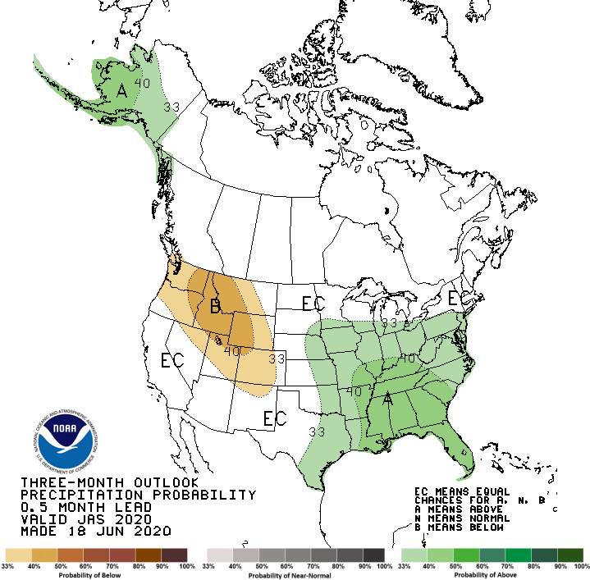
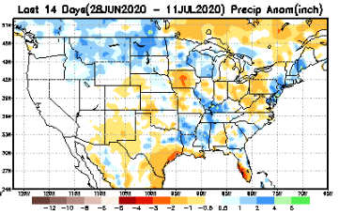
Released June 30th
Previous(Last month)
CPC’s official
Precipitation OUTLOOK for Monthly (July)/Seasonal (JAS)
Released June 18th
Observed so far this month!!
Monthly P/T forecasts verified at mid-month are generally good! Why? ☺ (becoz they r mostly based on GFS’ 2-wk fcsts)
But this month, so far ????

Slide 26
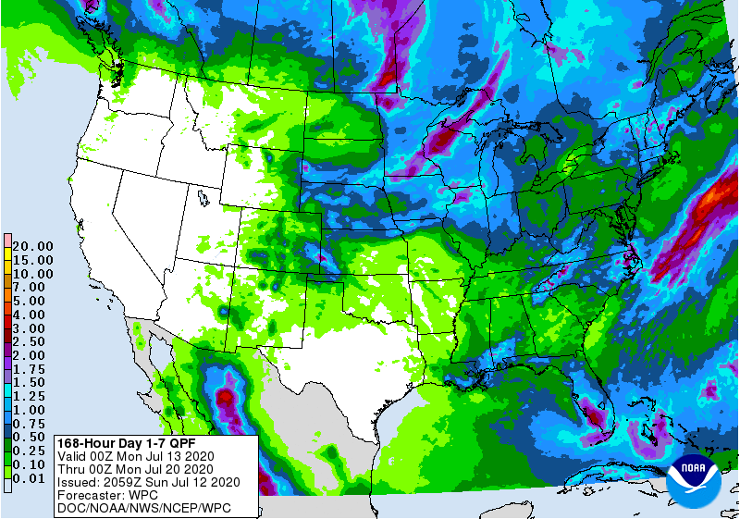
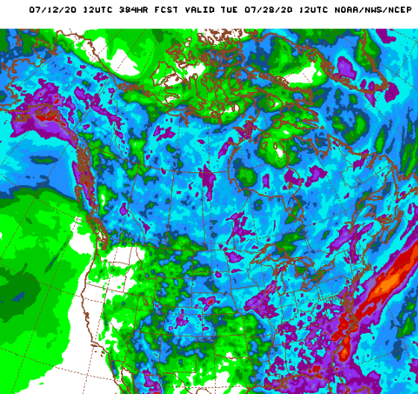
WPC Next 7 days QPF Forecast
Probably flooding in some parts of the SE this week!!
But relative dryness parts of Dakotas Minnesota
GFS Model Guidance for next 16 days.

Slide 27
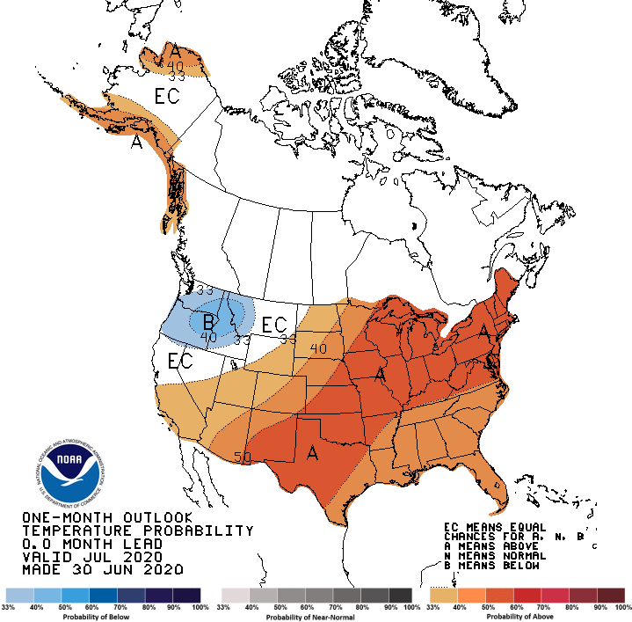
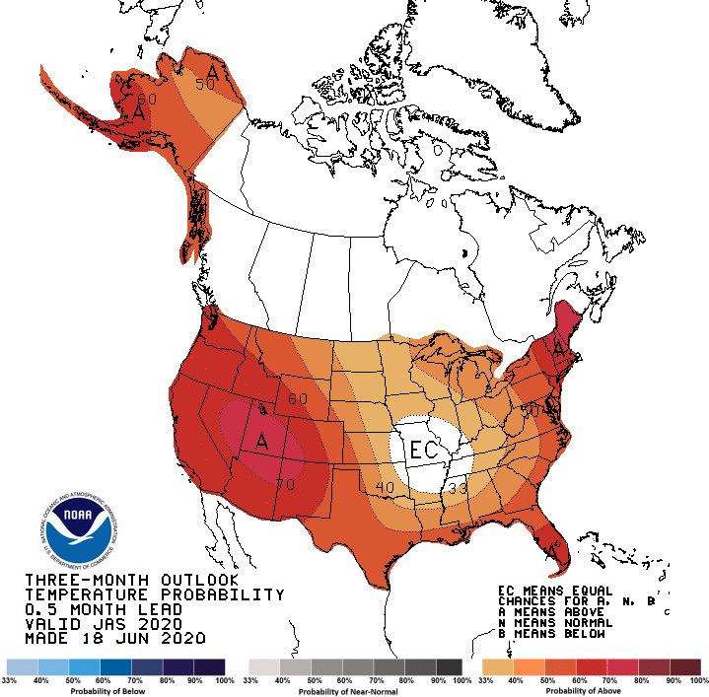
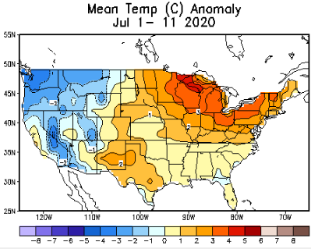
Made
June 30th
Previous (Last Month)
CPC’s official
Temperature outlook for Monthly (July)/Seasonal (JAS)
Made
Jun 18th
Observed so far this month!! ☺

Slide 28
NMME T & P Ens.Mean forecasts
Aug
These NMME models always make these red (warmer T) forecasts.
ASO
There is some precip signal in drought areas in the northern Plains area, which may help end the drought here.

Slide 29
Agreement/Disagreement in the various NMME models’ MJJ seasonal Precip. Forecst.
??

Slide 30
Fcst made from last month(background) compared with this month(foreground, red border)
Forecast uncertain in Hatched areas.
Fcsts generally no good!(see 4 corners area)–disconnect with the USDM. Based mainly on NMME precip fcst deficiency.

Slide 32
Latest Initial Conditions:
07/12/2020
http://drought.geo.msu.edu/research/forecast/smi.monthly.php
Predicted Monthly Soil Moisture Percentile
MSU stopped updating 06/10/20 ☹
MSU stopped updating 06/10/20 ☹
Initial Conditions 1 months ago:
06/09/2020
The inter quartile range suggest greater uncertainty about the forecast in these shaded regions.

Slide 33
Summary
Current Drought conditions:
Over the last few months, drought area & severity has overall generally increased across the South, West & Northern Plains.
The short/long term drought in the four corner states area (AZ/NM/ UT/CO) has expanded and intensified eastward to the neighboring states of KS/OK/TX/NE/IA.
Existing Drought in OR, northern CA, NV, ID, WA, UT continues while in western TX it has intensified.
Dryness/Drought in Northern Great Plain states has expanded, even though recent rains lessened drought intensity in this general region.
Some/many of California reservoirs levels are below their historical average levels. Next rainy season is 6-months away. It is going to be tough with the above normal Temperature forecast.
Current ENSO status and forecast:
- ENSO-neutral is favored to continue through the summer, with a 50-55% chance of La Niña development during Northern Hemisphere fall 2020 and continuing through winter 2020-21 (~50% chance). La Nina Watch is in effect.
Prediction:
Generally useful skill in seasonal forecasting of rainfall is low, and that is only slightly enhanced when there is an enhanced tropical boundary forcing/ENSO. The possible transitioning from normal to La Nina conditions expected during the next 3-mon season implies non-existent to very weak ENSO related boundary forcing.
Drought in western and northwestern TX is likely to get better, with the rest of the rainfall season coming up.
Pacific Northwest’s short term drought is nearly gone, but smaller regions of long term drought will persist in some form.
The drought in the west and the four corners states region in its eastward expanded state will continue to persist, but with some/moderate improvement with the upcoming rainy season in the region. The long tem drought in northern CA, NV, and UT will likely remain.
Also the continued forecast of above normal monthly/seasonal temperatures across much of the south and western US, does not help the drought conditions in the west combined with an already weak North American monsoon so far.
The drought in the Northern Great Plains states may improve slightly, but the longer than two months rainfall shortfalls are difficult to be made up in the remainder of the rainfall season.
Dryness, and precipitation deficits in the NE states is likely to continuously improve and will be most likely gone by the end of the forecast season. *********************

Slide 34
Miscellaneous maps

Slide 35
Miscellaneous maps

