Slide 1
Drought Outlook Support Briefing
July 2021
Climate Prediction Center/NCEP/NOAA
http://www.cpc.ncep.noaa.gov/products/Drought

Slide 2
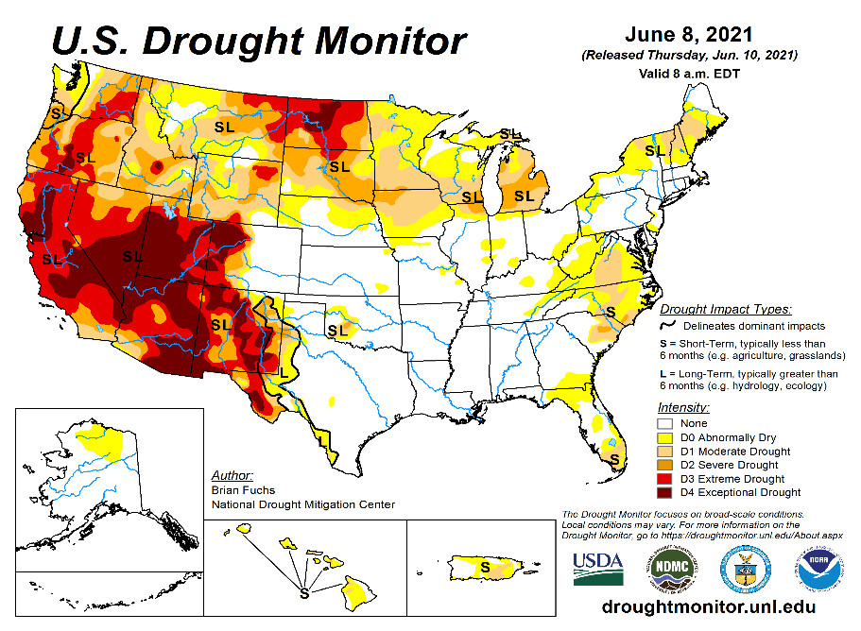
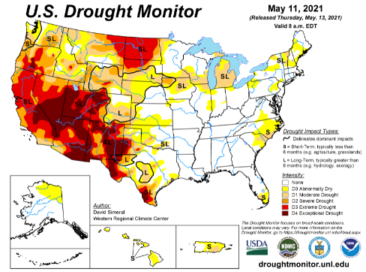
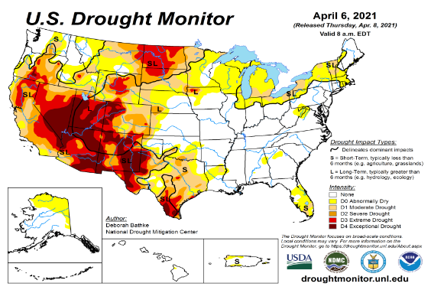
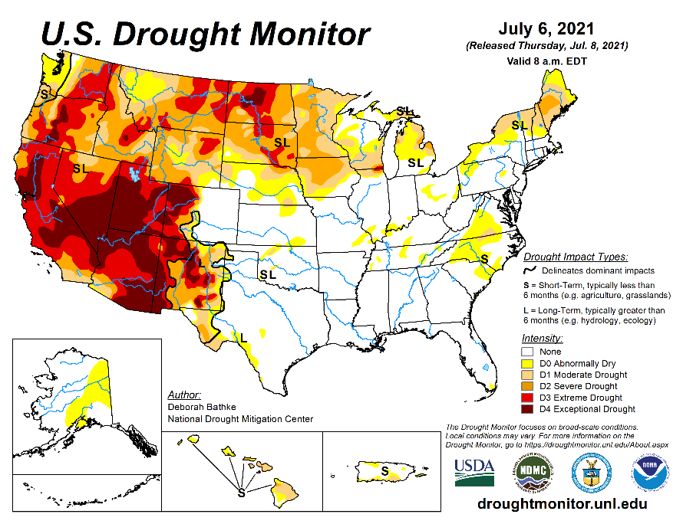
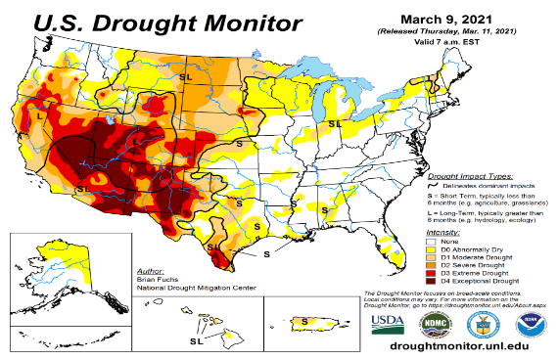
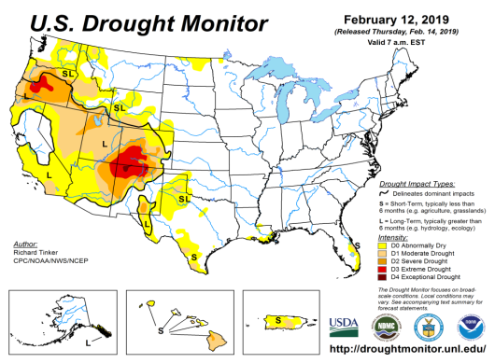
Drought Monitor
Monitoring is important because, unlike US T/P fcsts, for drought forecasts, we have to know where we are, before we can tell where we are going!! Drought forecasts are tendency forecasts.
June
May
Over the last 4-5 months, drought area & severity has overall generally remained about the same. The worse drought conditions are in the border areas of southwest states CA, AZ, NV, UT, CO, and NM. These west regions are part of the long term drought.
Improvement has been noted over parts of TX, eastern CO, and parts of NM.
Rainfall continues to be deficient in the ongoing summer rainy season in Northern Great Plains, leading to continued drought here, expanding into Minnesota.
About 50 % of the country is continuing to experience category D1 or worse drought condition (next side!). Dry/Drought conditions over the eastern US slightly improved and western US worsened.
April
July
(Recent/Latest)
March
February

Slide 3
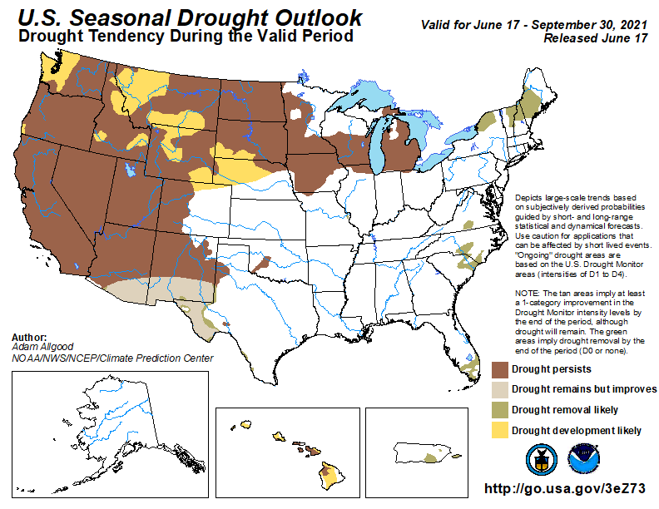
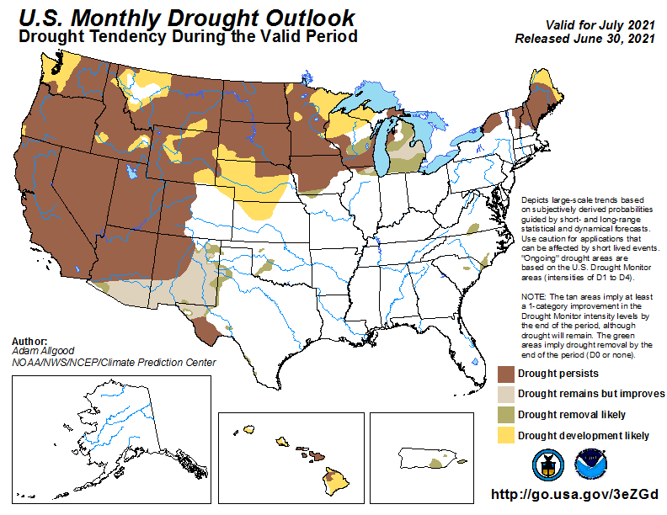
(Prev) Seasonal/Monthly Drought outlooks
New Seasonal+ Drought Outlook to be released in 2 days!
New Monthly Drought Outlook to be released end of this month)
Seasonal Outlook
(Mid June 2021- Sep 2021)
issued 06/17/21
Monthly outlook
(for July 2021)
issued 06/30/21
  Similar looking Monthly and seasonal outlooks, except in the northeast!
  Also compare West vs East.

Slide 4
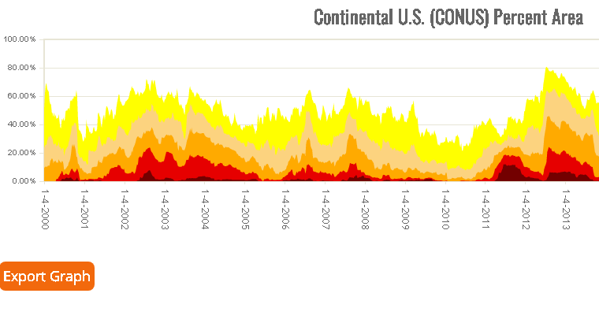
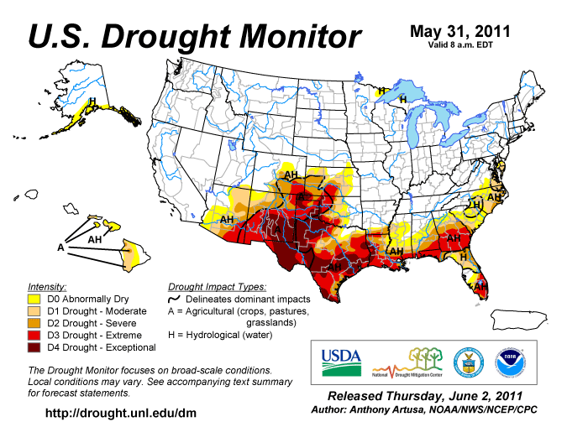
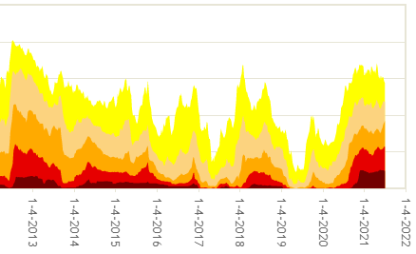



Famous 2011 TX drought
Each drought is different!!
The recent drought has somewhat stagnated ?
50%
Now!
Most area continuously under severe D4 drought for a long time since 2000?

Slide 5
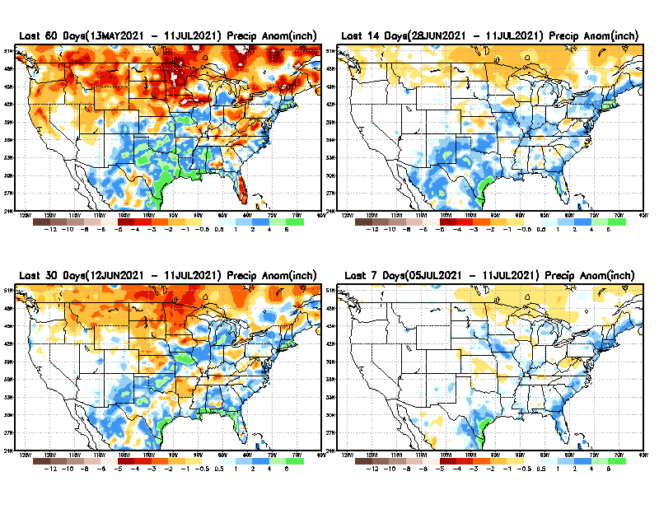
Precipitation ANOM during last 7, 14, 30, & 60 days.
This and next few slides show Precip deficit (excess).
Droughts, for the MOST part, begin and end with precip!! Lately, Temps are becoming (secondarily) important as well.
60 Days
14 Days
30 Days
7 Days
These maps in this and following slides, including a) Total,
b) Anom and
c) Percent of Normal precip. in these and other longer time ranges are now (routinely) daily updated at:
From: Recent Accumulated Precipitation https://www.cpc.ncep.noaa.gov/products/Drought/briefing_prcp.shtml

Slide 6
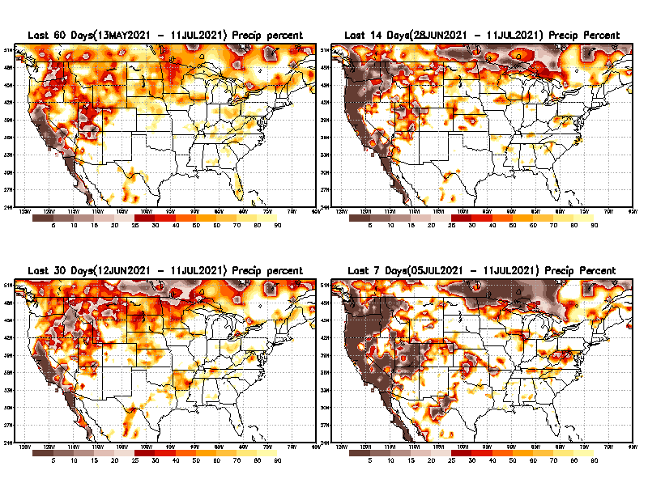
Precipitation Percent (of normal) during last 7, 14, 30, & 60 days - Only Deficit Areas <=90% shown !
60 Days
14 Days
This plot shows only the rainfall deficient regions <= 90% of normal.
-- This shows more clearly possible/likely drought developing region in the future unless there is above normal rainfall in these regions in the future, to offset these shortfalls.
30 days
7 Days
From: Recent Accumulated Precipitation https://www.cpc.ncep.noaa.gov/products/Drought/briefing_prcp.shtml

Slide 7
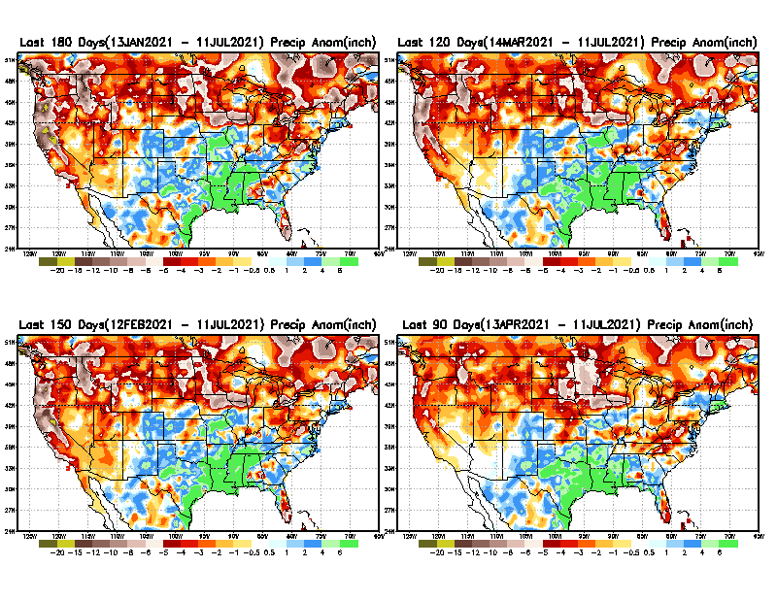
Total precipitation ANOM during last 3, 4, 5, and 6 months.
6 M
4 M
While the Precipitation anomalies deficit may seem large in some regions (compared to others), it is the % of normal precip (next slide) that matters more!!
5 M
3 M
May look bad here, but in % map (next!)
From: Recent Accumulated Precipitation https://www.cpc.ncep.noaa.gov/products/Drought/briefing_prcp.shtml

Slide 8
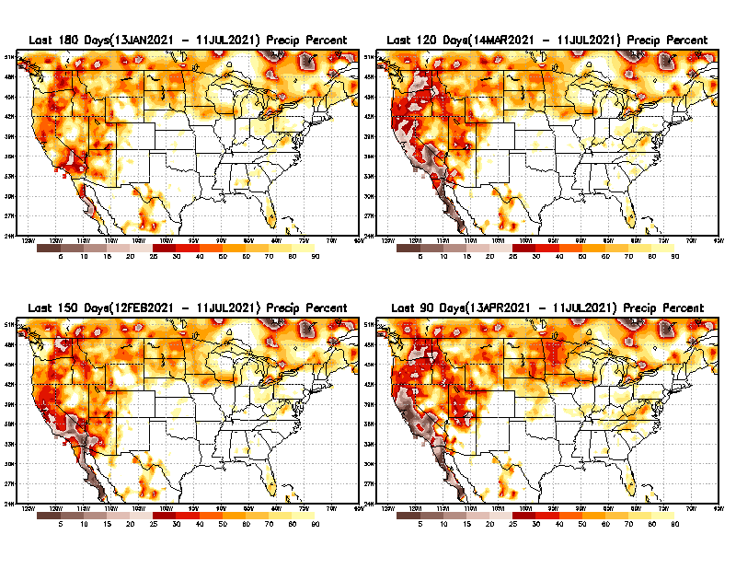
Total precipitation Percent (of normal) during last 3, 4, 5, and 6 months Only Deficit Areas <=90% shown!!
6 M
4 M
In these interim time scale 3-6 months, we need to pay attention to regions, which are dark-brown, red & dark red (<50%).
While accrued precipitation deficits are real & objective,
droughts are subjective declarations!!
5 M
3M
East vs West!
Broad vs Narrow
rainfall season.
In general, West suffers more from frequent and lasting droughts.
With these various rainfall deficits in diff. time ranges, where and how exactly does one declare drought? Other factors (T/SM/E, etc..) do matter, but is cumulative precip. Are deficits/percent_of_normal ultimately more important?

Slide 9
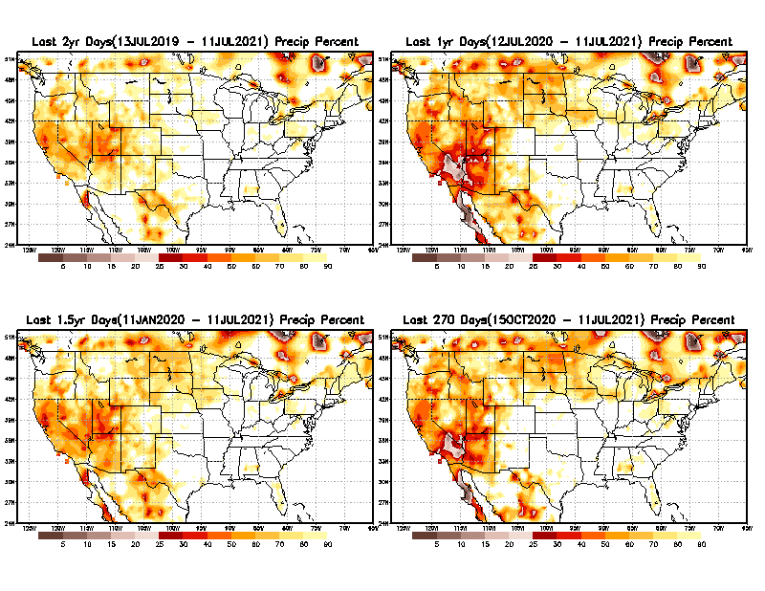
Total precipitation Percent during last 9 months, 1 yr, 1.5yrs, & 2 yrs. .–Only Deficit Areas shown!! <=90%
2 Y
1 Y
Tinderbox areas, where some form of longer term rainfall
deficiencies already, exist !!
-Almost all are in the southwest!, all part of the long term drought
-This & Next slide!!
1.5 Y
9 M
From: Recent Accumulated Precipitation https://www.cpc.ncep.noaa.gov/products/Drought/briefing_prcp.shtml

Slide 10
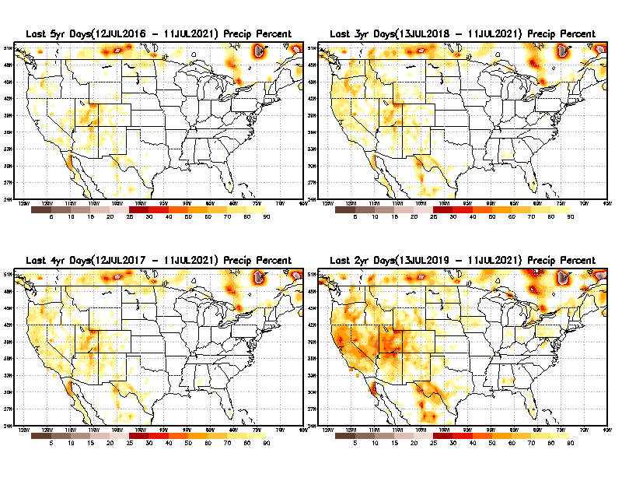
Total precipitation Percent (of normal) during last 2, 3, 4, & 5 yrs. .–Only Deficit Areas <=90% shown !!
5 Y
3 Y
In these long time ranges (2-5 yrs), there is a general dearth/lack of precipitation in the southwest US. – where the current severe drought ravages!!.
If the La Nina returns later in the year, things will get even worse!!
4 Y
2 Y
Ongoing multiyear drought in the SouthWest!! Getting Worse.
Last few years, each year is a new record for the Fire Season!!
From: Recent Accumulated Precipitation https://www.cpc.ncep.noaa.gov/products/Drought/briefing_prcp.shtml

Slide 11
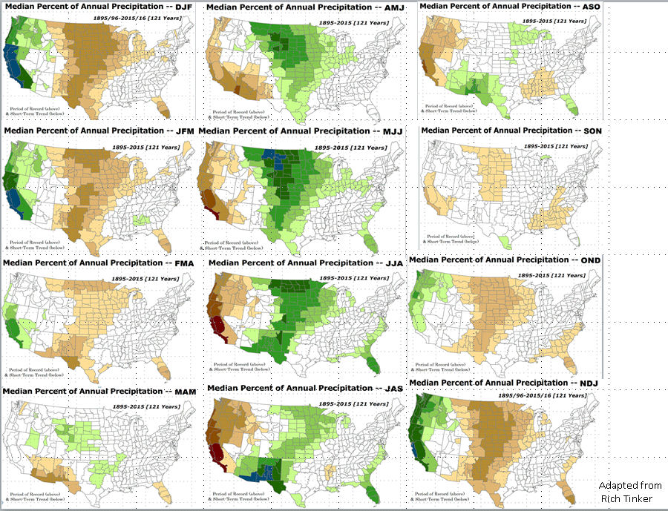

Rainy (3-month)Season across the US
East vs West!
More darker colors in west/central => narrow rainy season (months)
Overall, more white space in the east => distributed rainfall season (except ~FL).

Slide 12
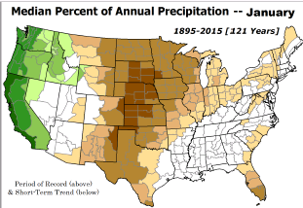
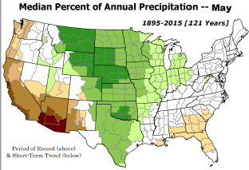
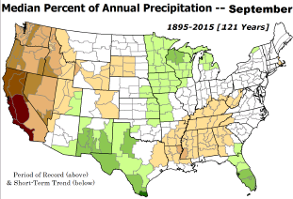
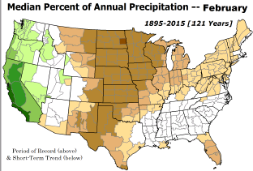
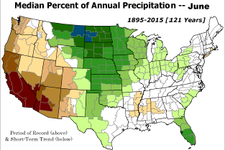
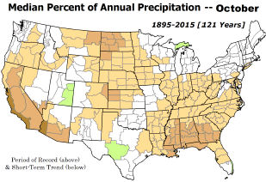

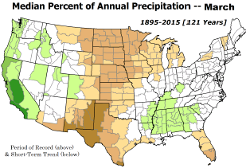
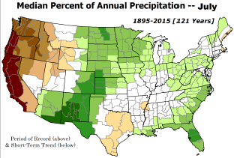
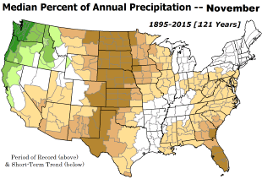
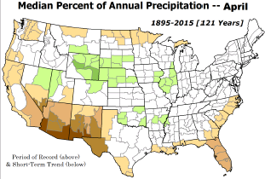
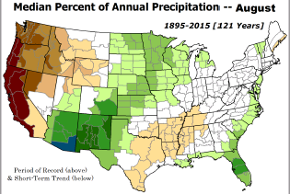
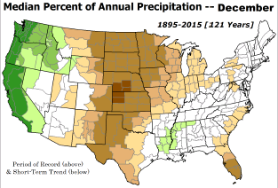
*********
EAST vs
CTR/WEST
Drought Behavior is loosely tied to rainfall climo!! And the limited rainy season in the west
*********
Adapted from Rich Tinker.

Slide 13
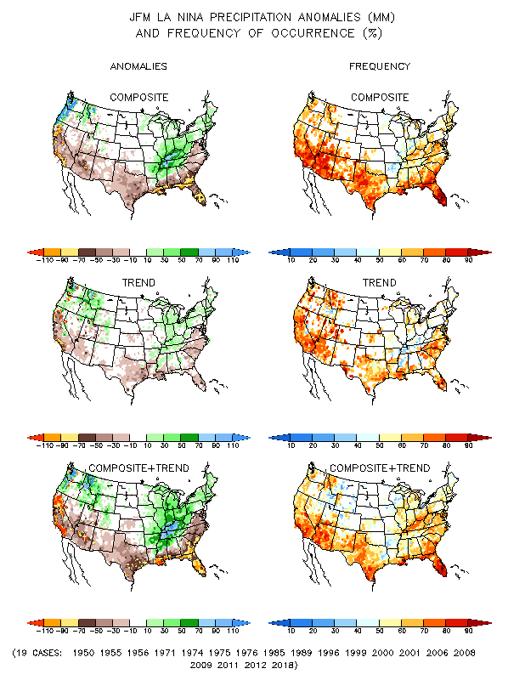
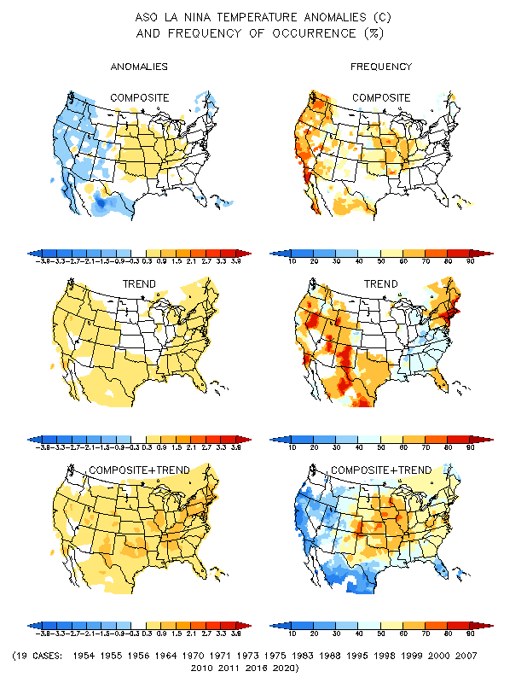
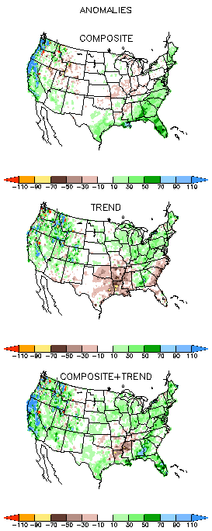
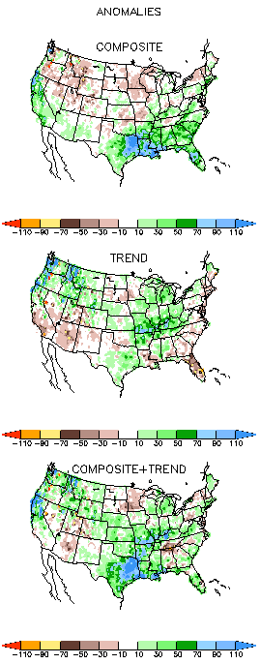
La Nina Precip/Temperature COMPOSITES & Trend map
ASO
P
T
With expected ENSO-neutral conditions, this row is relevant!!

Slide 14
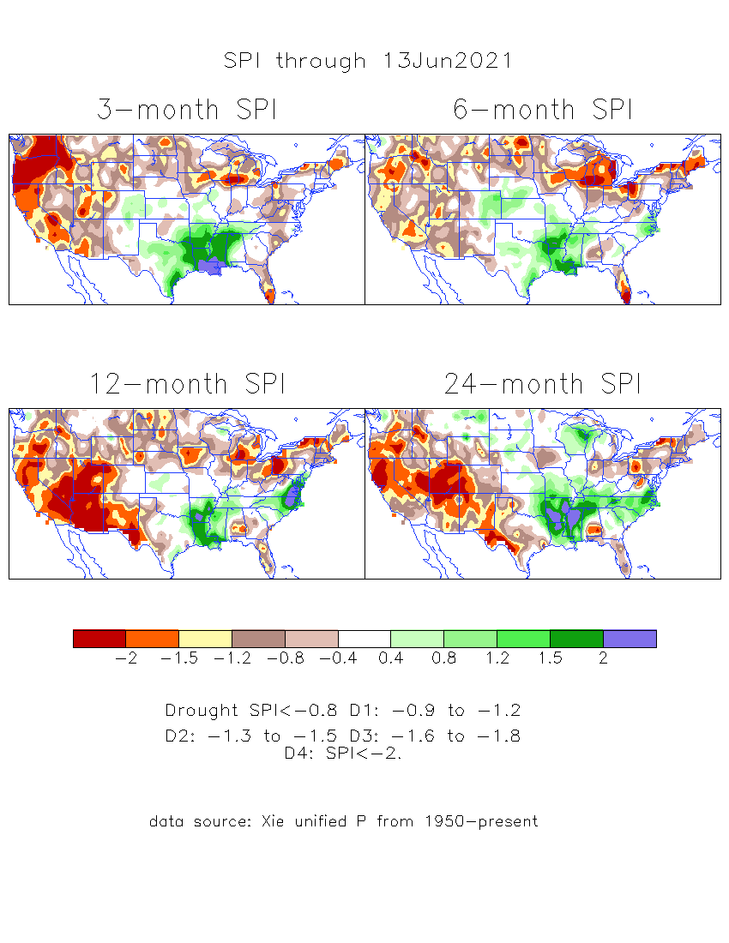
The Standardized Precipitation Index SPI
(based on Observed P)
----- Last Month
Very interesting graphic & details for the drought across the US based on the more generalized precip deficit/excess, the Standardized Precipitation Index (SPI).
The dark brown and red colors, indicating standardized precipitation deficits, in the various time periods, approximately correspond to the appropriate short/long term drought monitor regions and their intensities

Slide 15
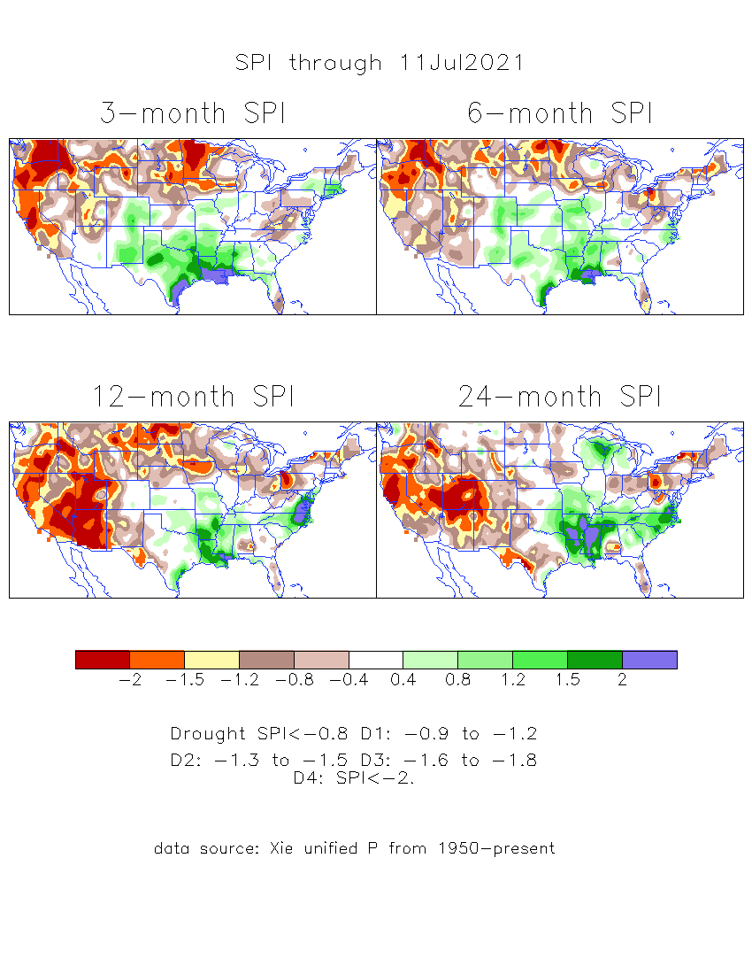
The Standardized Precipitation Index SPI
(based on Observed P)
----- NOW
Very interesting graphic & details for the drought across the US based on the more generalized precip deficit/excess, the Standardized Precipitation Index (SPI).
The dark brown and red colors, indicating standardized precipitation deficits, in the various time periods, approximately correspond to the appropriate short/long term drought monitor regions and their intensities
Short
The short term drought has shifted/extended from southwest to northwest. But the long term drought in the southwest remains.
----- NOW
Long
How does one negotiate and reconcile declaring short term vs long term drought when precip. deficiencies patterns differ on many different time scales locally!!
What is the cutoff delineating time between short VS long term drought!!

Slide 16
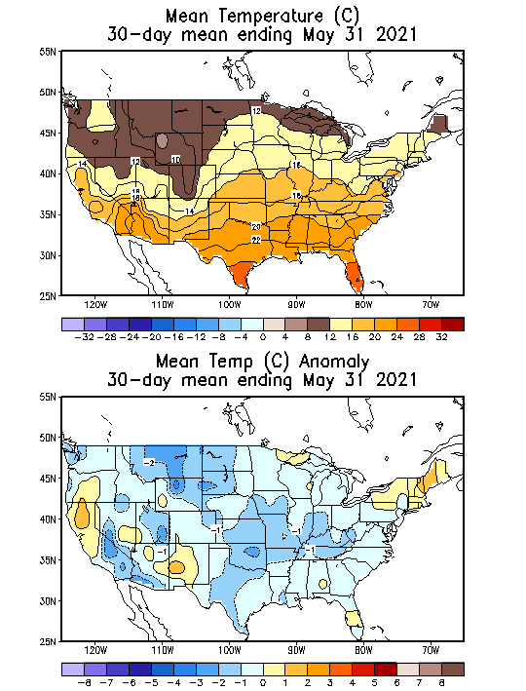
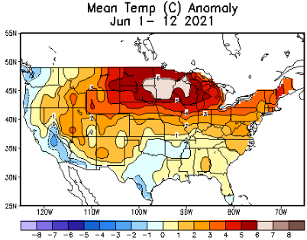
Recent US Temperatures
Slide shown last month)
Such swings in winter Temperatures
Even in the midst of La Nina!!
From Jan –> Feb -> Mar
Now back to cold across much of US! So far!!
So far this month !!
Remember, the TX freeze!!

Slide 17
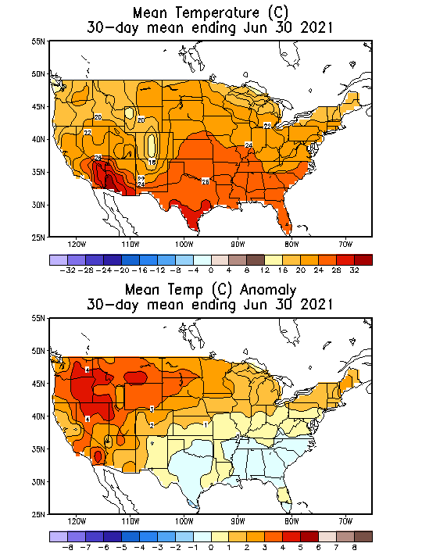
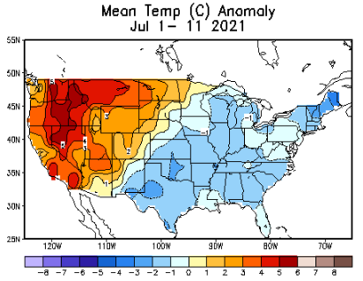
Recent US Temperatures
Such swings in winter Temperatures
Even in the midst of La Nina!!
From Mar->Apr –> May -> Jun
So far this month !!
Remember, the TX freeze!!

Slide 18
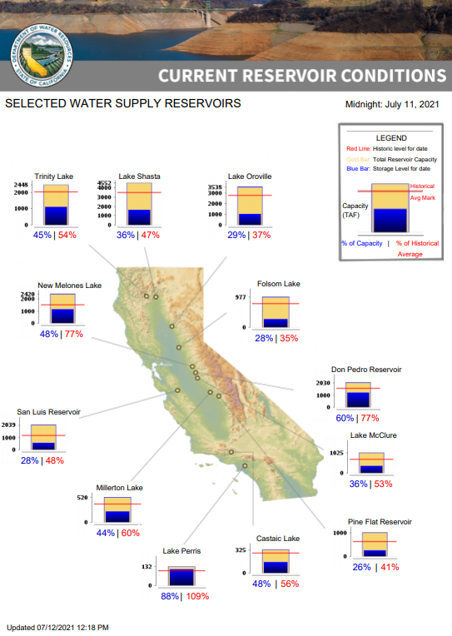
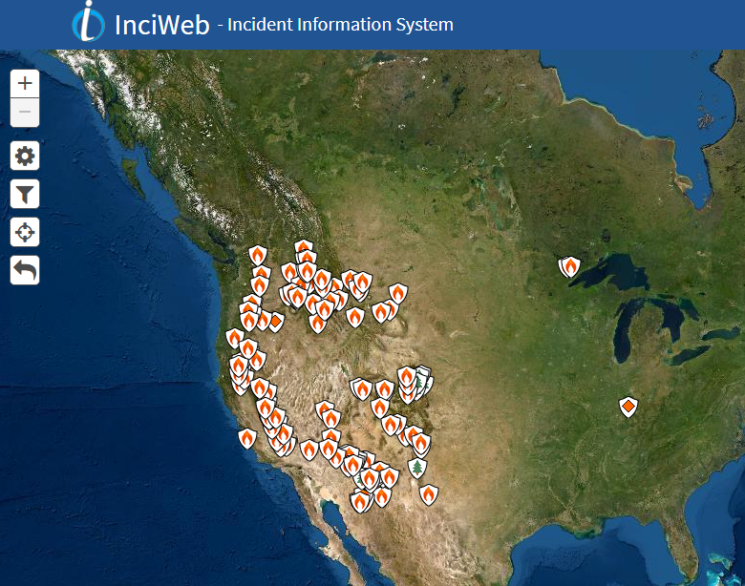
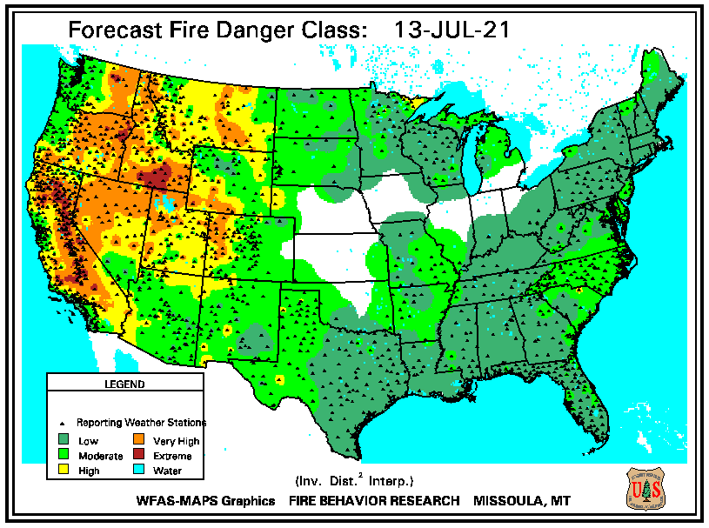
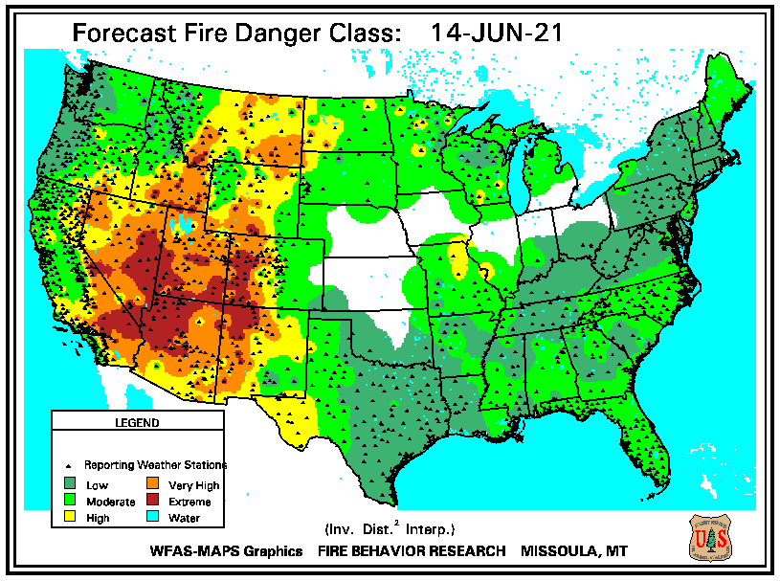
THIS MONTH
https://fsapps.nwcg.gov/
# of Fires NOW in western states, twice as that during last year, at this time!!
???
Many CA reservoirs are already low!!
3-months ago in APRIL Briefing we said here !!
“If La Nina continues reappears later this year, it will be a major problem for water in the western states!!!!
ALARM/WARNING!! for this year’s Fire Season for the US West/Southwest states even before that La Nina”
If La Nina continues reappears later this year, it will be a major problem for water in the western states!!!!
ALARM/WARNING!! for this year’s Fire Season for the US West/Southwest states!! (see US Drought Monitor!)

Slide 19
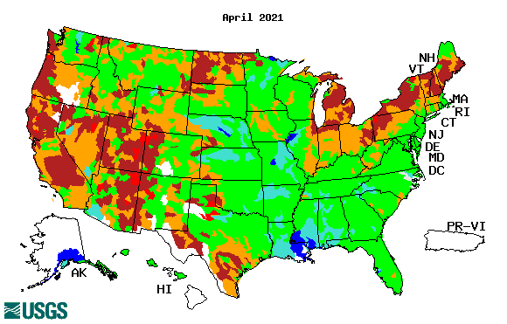
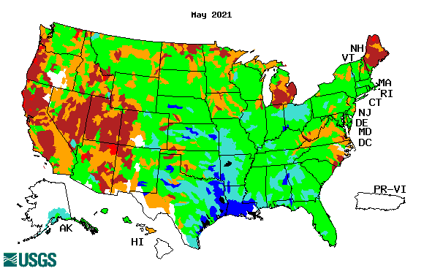
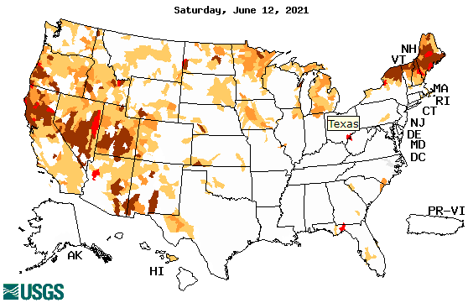
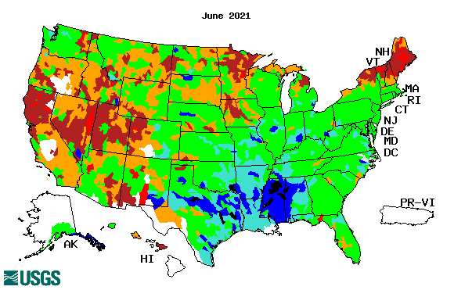
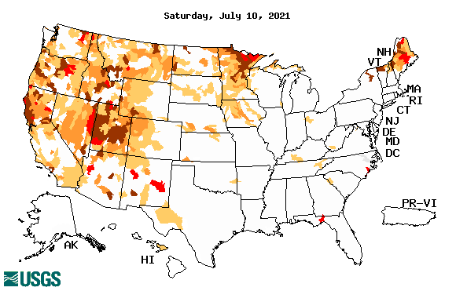
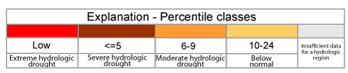

Streamflow (USGS)
Same data source USGS:
Look at the monthly maps for Northeast vs weekly maps in the bottom!!
Map shows only below normal 7-day average streamflow compared to historical streamflow for the day of year.
One month ago (left) &
Now (below)
Streamflow is only a partial indicator, as it is highly managed.
Look along the Pacific coastal states. If sometimes, the various indicators are confusing, go back to % of rainfall deficit maps – to reinforce!!
19

Slide 20



[Now]
NCEP Ensemble mean NLDAS2 models’ Soil Moisture tendency/trend
7 days
14 days
30 days
These NLDAS2 based SM tendency mas are a few days old!! But note the change in the middle part of the country!! Upper Midwest consistently dry!!

Slide 21
EL NIÑO/SOUTHERN OSCILLATION (ENSO)
DIAGNOSTIC DISCUSSION
issued by CLIMATE PREDICTION CENTER/NCEP/NWS and the International Research Institute for Climate and Society
8 July 2021
ENSO Alert System Status: La Nina Watch
Synopsis: ENSO-neutral is favored through the Northern Hemisphere summer and into the fall (51% chance for the August-October season), with La Niña potentially emerging during the September-November season and lasting through the 2021-22 winter (66% chance during November-January).

Slide 22




Latest values of SST indices in the various Nino Regions.

Slide 23


Sub-Surface Temperature Departures in the Equatorial Pacific
Do the current subsurface conditions suggest La Nina development later in the year?
Most recent pentad analysis

Slide 24




ENSO Forecasts
Early- June CPC/IRI forecast
Early- July CPC/IRI forecast
La Nina is on its way out temporariy? Only to come back later in the year?

Slide 25


Made
Jun 30th
Previous (Last Month)
CPC’s official
Temperature OUTLOOK for
Monthly (July)/Seasonal (JAS)
Made June 17th
Observed so far this month!! ☺

Slide 26



Previous(Last month)
CPC’s official
Precipitation OUTLOOK for
Monthly (July)/Seasonal (JAS)
Released Jun 30th
Released June 17th
Observed so far this month!! ☹
Monthly P/T forecasts verified at mid-month are generally good! Why? ☺
(becoz they are mostly based on GFS’ 2-wk fcsts).
But so far, fcst looks ??

Slide 27



NCEP/WPC Next 7 days QPF Forecast
Actual Precip amounts and region generally varies highly from one model run to next!!
GFS Model Guidance for the
next 16 days.
Looks like the southwest American monsoon is slowly making its entry in the southwest, particularly in many parts of rhe four corner states. The Ohio valley and up and down the Midwest is also forecast to get some rain.

Slide 28

From European Center (EC) Precip forecast (made yesterday, 12 July) for next 30 days.

Slide 29

From European Center (EC) Precip forecast (made yesterday, 12 July) for next 30 days.

Slide 30


Slide 31


Slide 32






(Recent)US T & P Forecasts
6-10 d 8-14 d WK 3+4 Month Season
Skill Separation
Look at the High Temps. In the far west, Pacific NW, and in the Great Plains states.
SW Monsoon is probably above normal in the short term, but ? on the seasonal scale!

Slide 33

Week-4 Soil Moisture Percentile (SMP) Fcst based on VIC model forced with ECMWF-extended precipitation forecast!
??
(From Drs. Li Xu and Yun Fan) More detail at From: https://www.cpc.ncep.noaa.gov/products/people/lxu/flashd/flash_prediction.html

Slide 34




NMME T & P
Ens.Mean forecasts for
Aug
Much of the country is fcst to be warm, except in eastern TX & vicinity. The west is WARM+
ASO
Will the SW monsoon be good this year thru ASO.
The drought expand/redevel-op further in the NW? and in the Northern Great Plains area. How bad can it get anyway?

Slide 35

Agreement/Disagreement among the various NMME models’ ASO seasonal Precip. Forecast.
??

Slide 36


(From NMME) compared with this month(foreground, red border)
Why is there so fewer hatched areas in SPI6 fcst from NMME models’ based fcst this month as compared to last month (left 2 columns) ? Fcsts more confident now?
Forecast uncertain in Hatched areas.
Many pieces of hatched areas in the central and mostly in the eastern half of the US – indicating the model’s inability to know the status of drought here.
SPI6 Fcst made from last month
SPI6/SPI12 Fcst made from this month

Slide 37




http://drought.geo.msu.edu/research/forecast/smi.monthly.php
Latest Initial Conditions:
06/01/2021
Predicted Monthly Soil Moisture Percentile
MSU Soil Moisture Percentile forecast NOT available, NOT updated!
CPC’s soil moisture percentile – Leaky bucket Model
The inter quartile range suggest greater uncertainty about the forecast in these shaded regions.

Slide 38
Summary
Current Drought conditions:
Over the last 4-5 months, drought area & severity has overall generally remained about the same. The worse drought conditions are in the border areas of southwest states CA, AZ, NV, UT, CO, and NM. These west regions are part of the long term drought. Improvement has been noted (S/Term drought has ended) over most parts of TX, eastern CO, and parts of NM.
Rainfall continues to be deficient in the ongoing summer rainy season in Northern Great Plains, leading to continued drought here, expanding into Minnesota.
About 50 % of the country is continuing to experience category D1 or worse drought condition (next side!). Dry/Drought conditions over the eastern US slightly improved and western US worsened.
All California reservoirs levels are well below their historical average levels. If the forecast heat/temps and the lack of (seasonal) rainfall continues, things will probably get dire.
The fire season in the US western states is already well underway, and is much worse this year, as compared to the same time last year (a record year!), with about twice the area of acres burnt.
Current ENSO status and forecast: ENSO-neutral is favored through the Northern Hemisphere summer and into the fall (51% chance for the August-October season), with La Niña potentially emerging during the September-November season and lasting through the 2021-22 winter (66% chance during November-January).
Prediction:
  With only the very slight chances (51 %) of ENSO neutral conditions during the forecast season, how good will be the model forecasts? Nevertheless, with the forecast above normal temperatures in the west and the continued dry season along the west coast states, the short term drought in the Pacific coastal and adjoining states especially in OR/WA is expected to broaden and get worse.
  The long term drought in the south and west is very entrenched. The present drought and forecast T/P conditions here are likely to contribute to unfortunately a yet another severe fire season for the western states. Water shortages could certainly develop in many of the southwest/western states. But, with the southwest monsoon rainfall expected to bring above normal rainfall during the next few weeks, there can be some short term relief and even short term improvement in the drought in parts of AZ/NM,UT, and CO, but not so much for the long term drought!
  By the end of the forecast season, east of Minnesota, there will most likely be no areas under drought including Florida, the New England states and the Mid Atlantic states.
  With the continued below normal rainfall conditions during the critical June/July months in the Northern Great Plains, drought conditions there will either stay the same or even get worse by the end of the forecast season.
  In the event that La Nina begins to develops later in the forecast season (ASO) or later in winter, as the official forecast calls for, conditions will further deteriorate more than now with even more reduced rainfall in the south and west later in fall and winter! ***********

Slide 39

Miscellaneous maps

Slide 40

Miscellaneous maps

