Slide 1
Drought Outlook Support Briefing July 2023
Climate Prediction Center/NCEP/NOAA
http://www.cpc.ncep.noaa.gov/products/Drought
Points to ponder:
Often, there is a disconnect between the Short term (S) and Long term (L) drought in regions, and even with the short term (S) drought, the 3-month and 6-month signals are not quite consistent! With Long term (L) drought, it is even more trickier, as it is open ended from 1 year and beyond!!!
Places/regions experiencing Short term drought may (not) be ok in the Long term and vice versa!!
This duality is difficult to reconcile, to convey and even be clearly understood well by the public at large.
Public/Forecaster generally tends to focus more on the Short term Drought (for good reasons!!)
More importantly the very definitions and timescales associated with S/L term droughts and the declarations in the USDM are by themselves subjective!!
The S/L term drought conditions in large parts of California, a year ago, even just 6 months ago, has now mostly gone. Many/most reservoirs in CA are at or above their historical averages and even near capacity. However, the two large major reservoirs, Lake Mead and Lake Powell in the CA/AZ/UT border area are still at dangerously low levels, thus impacting hydro electric power supply and distribution to nearby states. Even the big snow melt from the record large snow amounts made only a very minor impact to the water flow to these two reservoirs.
It may take a long time for drought to develop, but those conditions can end very quickly! Forecast models are yet to (seasonal) correctly forecast these changes in advance!
Short term vs Long term drought need to be clearly distinguished and shown to the public!!
Subjective(delayed) USDM vs Objective(real time) map! A few days or recent heavy precip can change the USDM a lot!
New objective AI/Deep-Learning based Experimental ODI (objective drought indicator, runs daily) compared with Official USDM (US Drought Monitor, produced weekly by USDM authors).

Slide 2
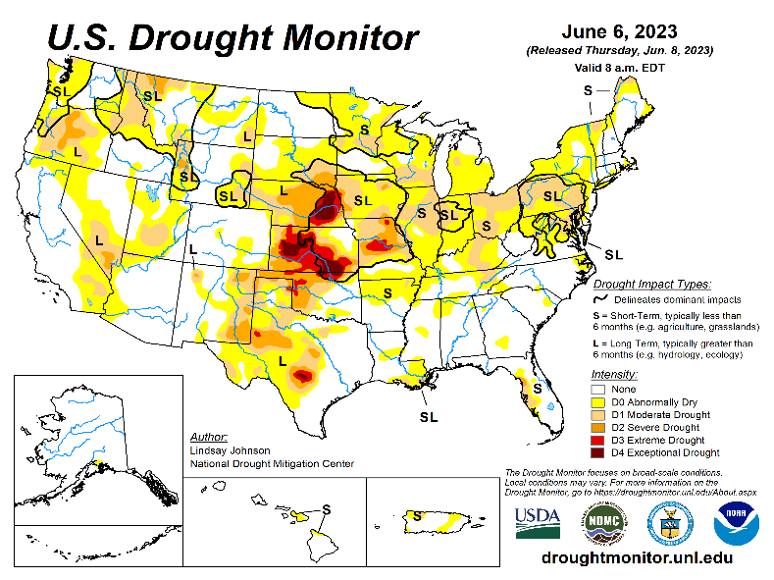
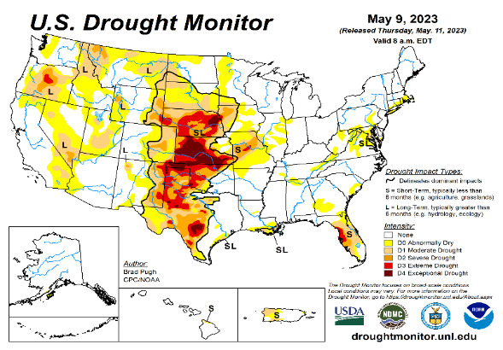
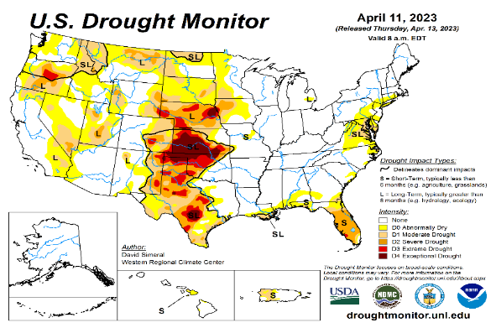
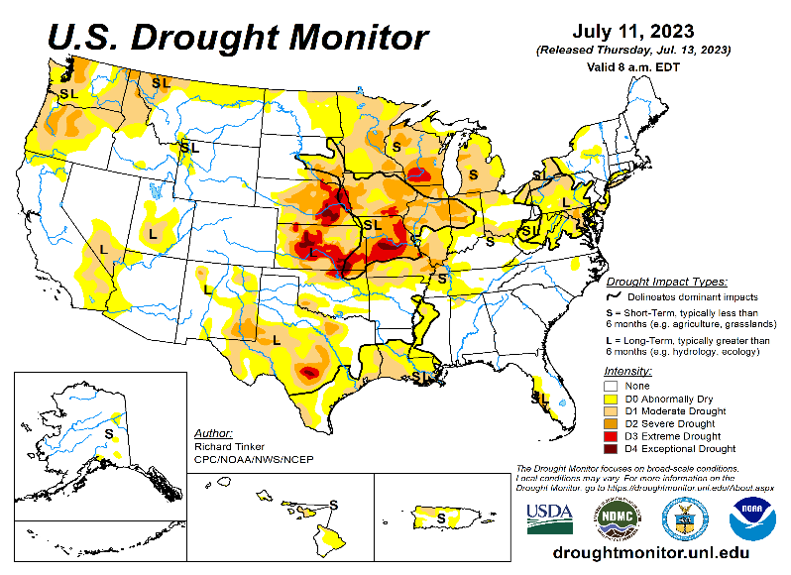
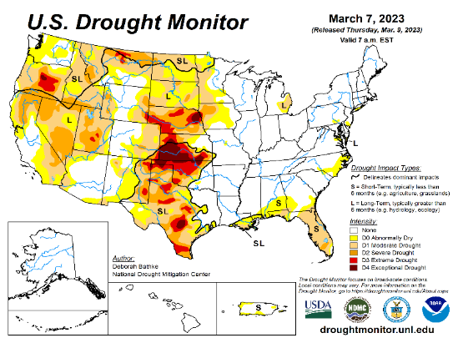
Drought Monitor
Monitoring is important because, unlike US T/P fcsts, for drought forecasts, we have to know where we are, before we can tell where we are going!! Drought forecasts are tendency forecasts.
June
May
Towards the end of last year 2022, until December or so, severe drought conditions (both short and long term) remained in the west, mild drought conditions expanded in to portions of the eastern half of the US also, covering most of the country with very high % areas of the entire US affected by drought. The situation now is now suddenly and drastically different.
The recent winter rainy season in CA and the west coast states, wiped out not only the S-term drought but also the L-term drought in most areas. Water levels in most CA reservoirs are now ABOVE their normal levels. However, the water storage levels in the huge Lakes Powell and Lake Mead in NV continue to be historically low, & decade(s) long hydrological drought still lingers. Recharge into these 2 reservoirs from subsurface stream flows has been severely impacted.
S/L term droughts still remain in parts of northwestern states of WA/OR/ID/MT.
Across the US, there is a considerable decrease and sudden drop in the areal coverage of all drought categories. Area covered by >D1 category drought is now ~ 25%. Drought along central US states has slightly shifted/expanded eastward, esp. drought in southern TX has now expanded into LA.
The subjectively made, weekly once issued official USDM map is not able to keep up with the daily heavy deluge of rains as happened during recent winter, which can change severe rain deficits to severe excesses, from severe drought to severe floods in just a few days.
The sudden expansion of dry, S-term drought conditions in parts of upper mid-west and northeast had taken on a new dimension. However, the recent heavy rains in the northeast saturated the region. Though S term near MD/PA is gone, pockets of L term drought remain in the region.
April
July
(Recent/Latest)
March
?

Slide 3
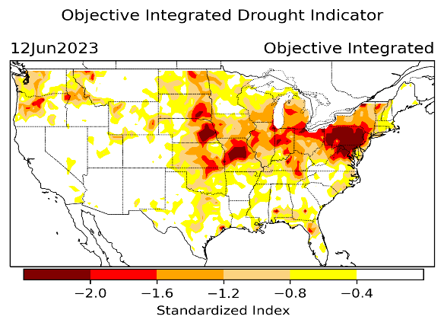
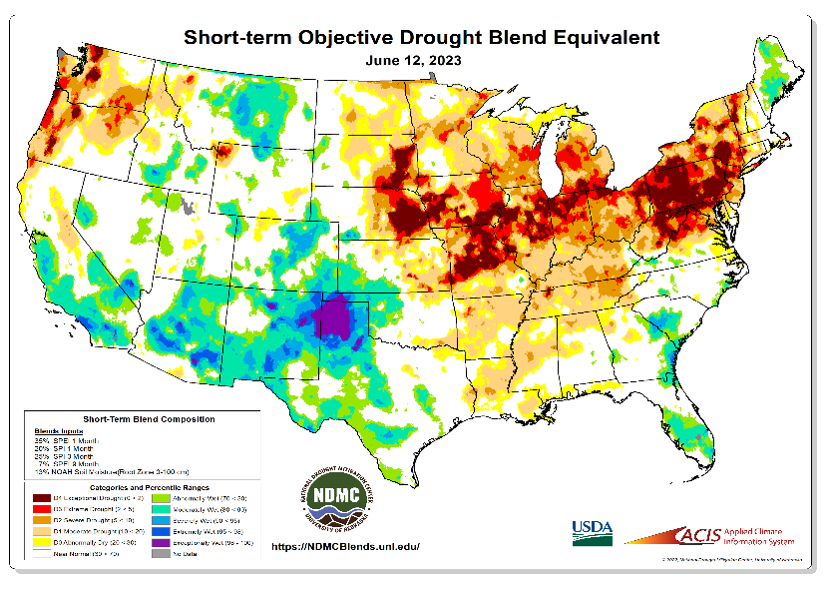
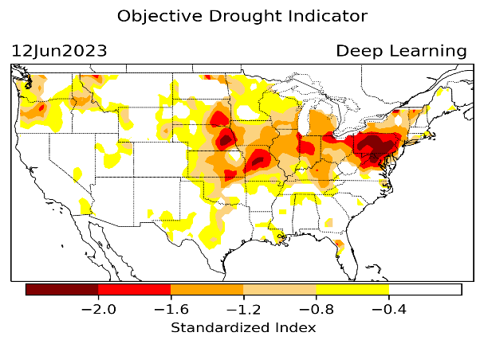
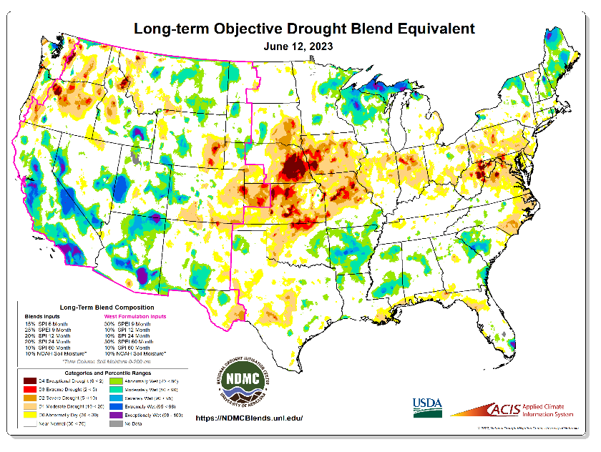
Exptl. Objective Drought Monitor (showing S/term & L/Term separately) from National Drought Mitigation Center (NDMC)
New slide now included in this briefing!
CPC’s own Experimental
Objective Drought Indicator (ODI)
using AI/Deep Learning ! – Updates daily !!
https://www.cpc.ncep.noaa.gov/products/people/lxu/odi/#deep-learning-increment-training
Based on the CPC P/analysis &
VIC (Princeton) NLDAS model assimilation:
Standardize Precipitation index (SPI)
Standardize Precipitation-Evapo –
transpiration index (SPEI)
Evapotranspiration Stress Index (ESI)
Soil Moisture Percentile (SMP)
Standardize Runoff Index (SRI)
-can be split into Short/Long Term Droughts!
https://droughtmonitor.unl.edu/ConditionsOutlooks/CurrentConditions.aspx
Objective &
Runs Daily!
Objectively Integrated
versus Deep Learning
methods.
Both Objective!
Both update daily!
Objective &
Runs Weekly!
On Monday!
Objective &
Runs Daily!
* A manuscript (Xu & Chelliah) is under preparation.
{ Slide shown last month }
See/compare our fcst recommmendation! last month ☺ ☺
Latest Official USDM (US Drought Monitor)
Subjective &
Runs Weekly!
Objective &
Runs Weekly!
On Monday!
These two maps above, used to be produced at CPC(Rich Tinker!), but recently officially done by NDMC operations!
*Released every Thursday, for conditions as of Tuesday!

Slide 4
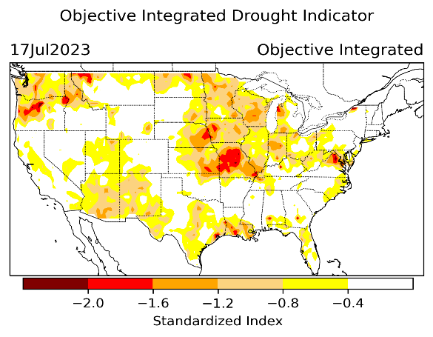
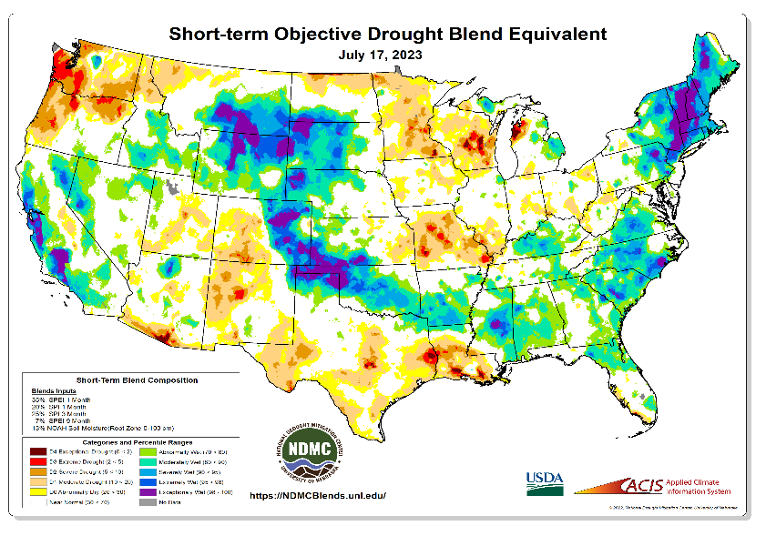
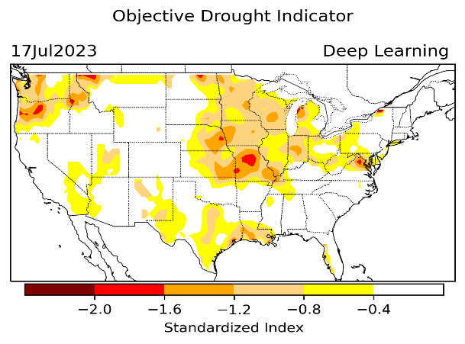
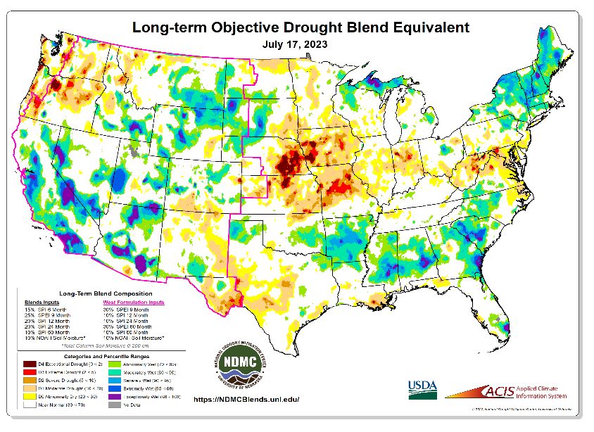
Exptl. Objective Drought Monitor (showing S/term & L/Term separately) from National Drought Mitigation Center (NDMC)
New slide now included in this briefing!
CPC’s own Experimental
Objective Drought Indicator (ODI)
using AI/Deep Learning ! – Updates daily !!
https://www.cpc.ncep.noaa.gov/products/people/lxu/odi/#deep-learning-increment-training
Based on the CPC P/analysis &
VIC (Princeton) NLDAS model assimilation:
Standardize Precipitation index (SPI)
Standardize Precipitation-Evapo –
transpiration index (SPEI)
Evapotranspiration Stress Index (ESI)
Soil Moisture Percentile (SMP)
Standardize Runoff Index (SRI)
-can be split into Short/Long Term Droughts!
https://droughtmonitor.unl.edu/ConditionsOutlooks/CurrentConditions.aspx
Objective &
Runs Daily!
Objectively Integrated
versus Deep Learning
methods.
Both Objective!
Both update daily!
Objective &
Runs Weekly!
On Monday!
Objective &
Runs Daily!
* A manuscript (Xu & Chelliah) is under preparation.
Latest Official USDM (US Drought Monitor)
Slide for This Month !
Subjective &
Runs Weekly!
Objective &
Runs Weekly!
On Monday!
These two maps above, used to be produced at CPC(Rich Tinker!), but recently officially done by NDMC operations!
*Released every Thursday, for conditions as of Tuesday!

Slide 5
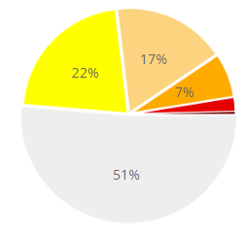
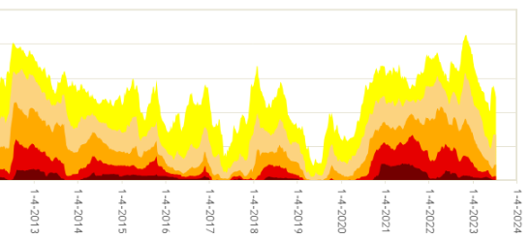
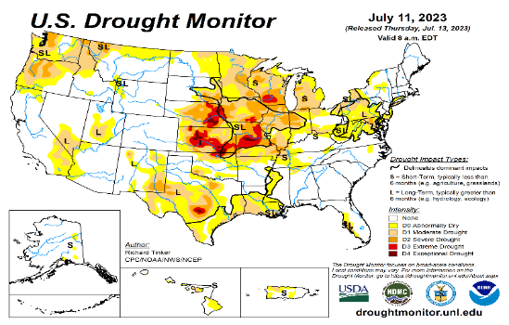
In general, The spatial details of Every drought is different.! Every situation is different!!
Time series since 2000 spilt into 2 (above & below) panels.
Current drought!
In early 2023 (interestingly coincidentally as ten years ago in 2013!) there is such a drastic decrease in the coverage of US drought areas in all categories!!

Slide 6
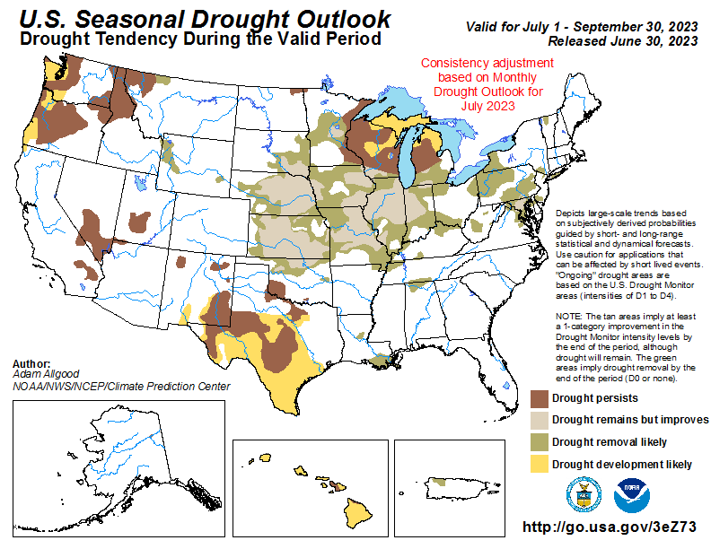
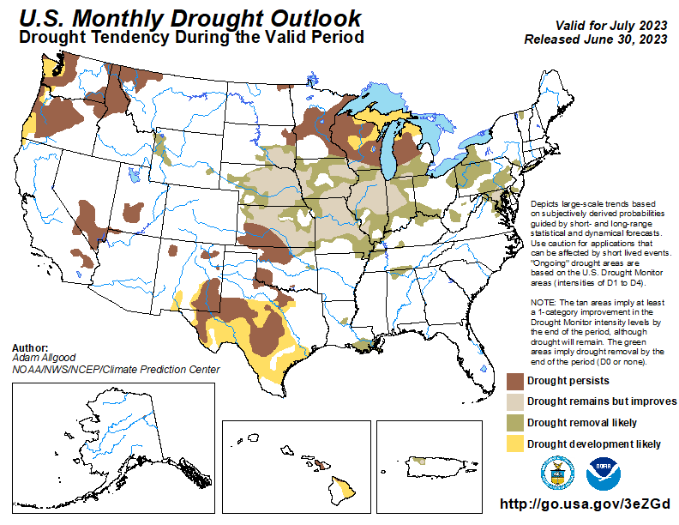
(Previous) Seasonal/Monthly Drought outlooks
New Seasonal+ Drought Outlook(SDO) to be released in 2 days!
(reissued again at end of month for consistency with MDO!)
New Monthly Drought Outlook (MDO) to be released at end of this month)
Updated Seasonal Outlook
( 1 July – 30 Sep 2023)
issued 6/30/23
Monthly outlook (for July 2023)
issued 6/30/23

Slide 7
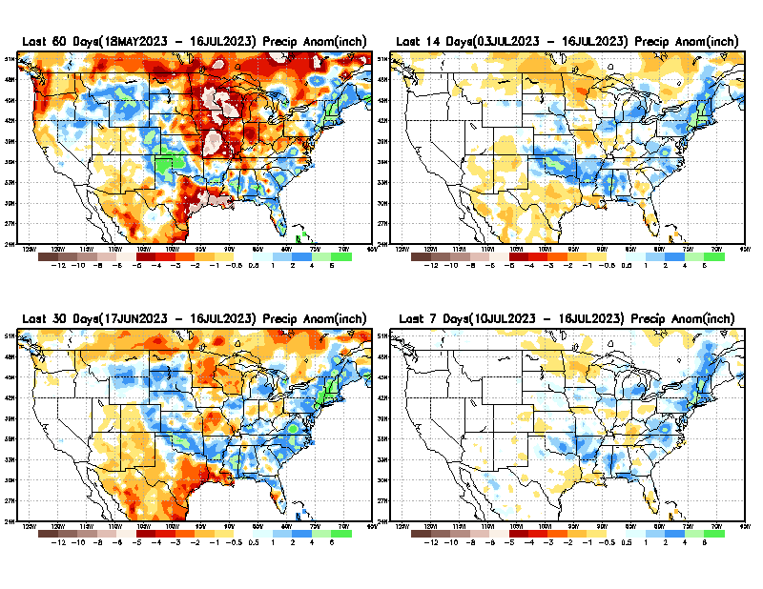
Precipitation ANOM during last 7, 14, 30, & 60 days.
This and next few slides show Precip deficit (excess).
Droughts, for the MOST part, begin and end with precip!! Lately, Temps are becoming (secondarily) important as well.
60 Days
14 Days
30 Days
7 Days
These maps in this and following slides, including a) Total,
b) Anom and
c) Percent of Normal precip. in these and other longer time ranges are now (routinely) daily updated at:
From: Recent Accum./Anom Precipitation https://www.cpc.ncep.noaa.gov/products/Drought/briefing_prcp.shtml

Slide 8
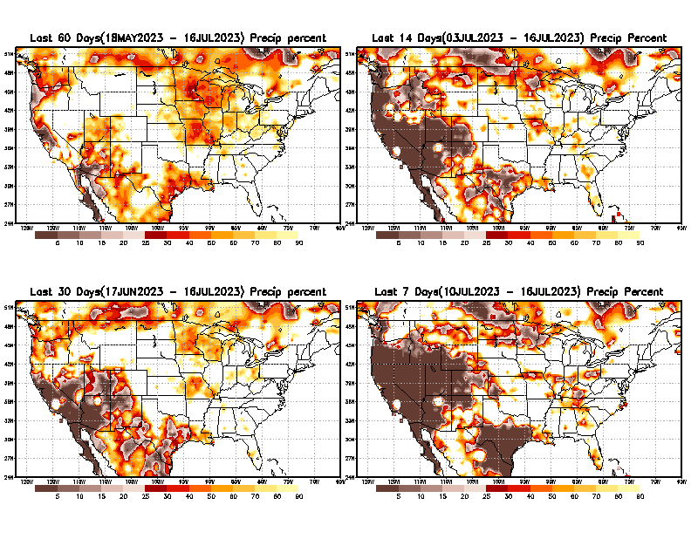
Precipitation Percent (of normal) during last 7, 14, 30, & 60 days - Only Deficit Areas <=90% shown !
60 Days
14 Days
This plot shows only the rainfall deficient regions <= 90% of normal.
-- This shows more clearly possible/likely drought developing region in the future unless there is above normal rainfall in these regions in the future, to offset these shortfalls.
30 days
7 Days
From: Recent Anom/% of normal Precipitation https://www.cpc.ncep.noaa.gov/products/Drought/briefing_prcp.shtml

Slide 9
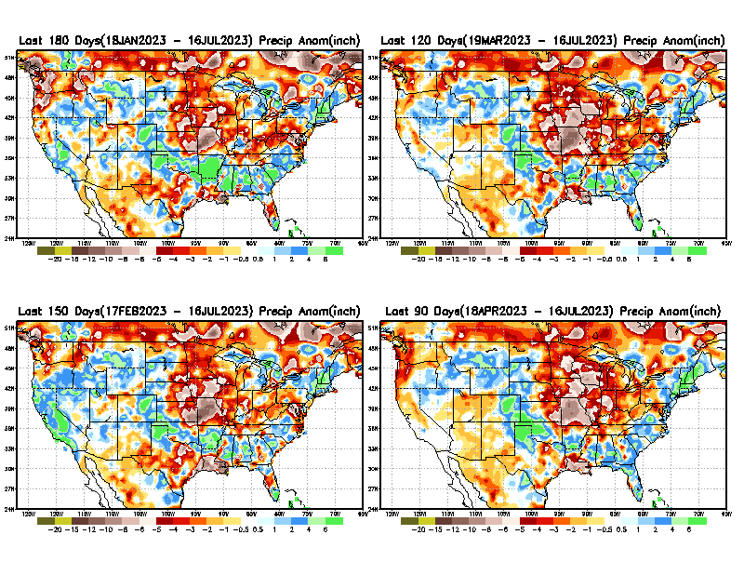
Total precipitation ANOM during last 3, 4, 5, and 6 months.
While the Precipitation anomalies deficit may seem large in some regions (compared to others),
it is the
% of normal precip (next slide) that matters more!!
6 M
4 M
5 M
3 M
From: Recent % of Normal Precipitation https://www.cpc.ncep.noaa.gov/products/Drought/briefing_prcp.shtml

Slide 10
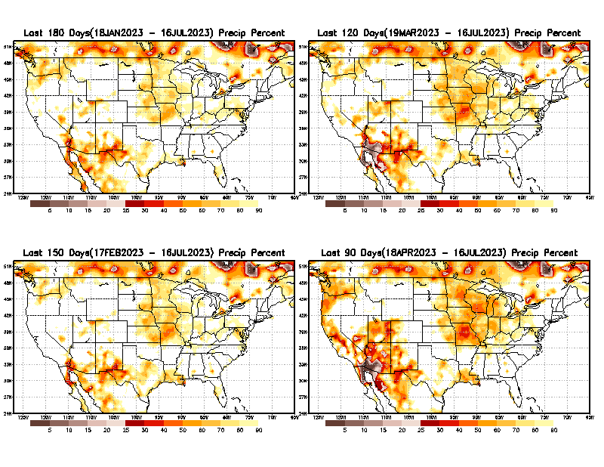
Total precipitation Percent (of normal) during last 3, 4, 5, and 6 months Only Deficit Areas <=90% shown!!
6 M
4 M
In these interim time scale 3-6 months, we need to pay attention to regions, which are dark-brown, red & dark red (<50%).
While accrued precipitation deficits are real & objective,
droughts are subjective declarations!!
5 M
3 M
East vs West!
Broad vs Narrow
rainfall season.
In general, West US suffers more from frequent and lasting droughts. Droughts in East US are less and less lasting!
What about Center ?
More like West than East?
Short term(S) Drought is generally declared when rainfall deficits exist in the 3-6 months time range. {Long term deficits beyond 1 or 2 or more years is Long term L drought! }

Slide 11
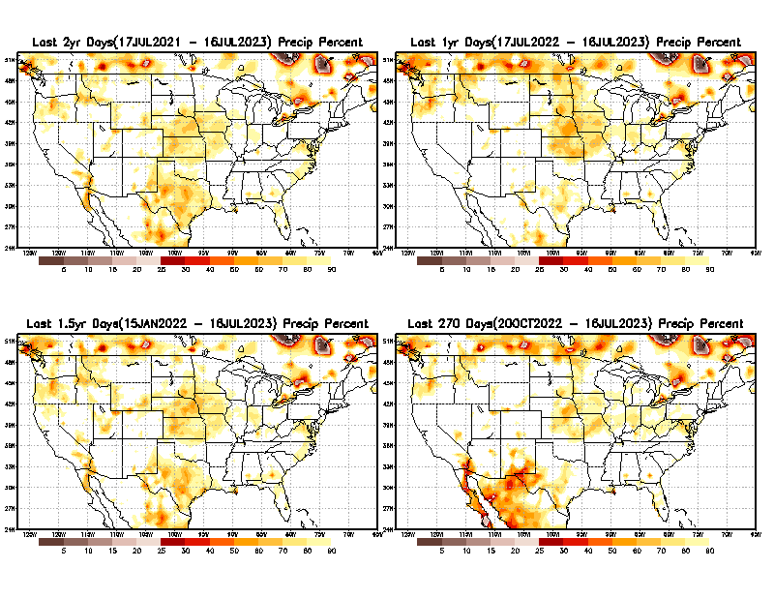
Total precipitation Percent during last 9 months, 1 yr, 1.5yrs, & 2 yrs. .–Only Deficit Areas shown!! <=90%
2 Y
1 Y
1.5 Y
9 M
The character and even location/spatial extent of the short/S and long/L –term droughts are different!!!
From: Recent Accumulated Precipitation https://www.cpc.ncep.noaa.gov/products/Drought/briefing_prcp.shtml

Slide 12
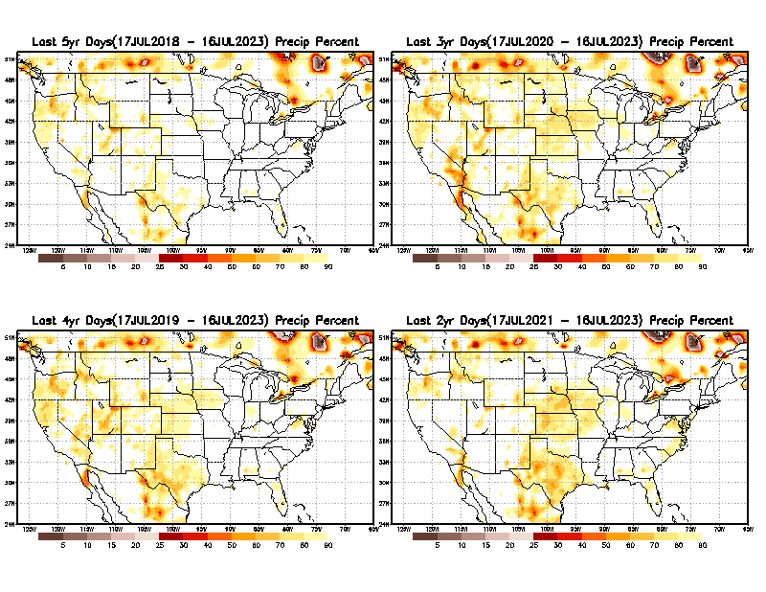
Total precipitation Percent (of normal) during last 2, 3, 4, & 5 yrs. .–Only Deficit Areas <=90% shown !!
5 Y
3 Y
In spite of the recent deluges/floods in California, there still exists a small longer term rainfall deficit in CA and parts of the southwest/ western US.
However, currently, most CA reservoirs are nearing or in excess of their historical averages.
BTW, Not sure if the longer term (20+years) since 2000’s has officially ended! ☺
4 Y
2 Y
From: Recent Accumulated Precipitation https://www.cpc.ncep.noaa.gov/products/Drought/briefing_prcp.shtml

Slide 13
LEAST
Rainy/dry
(3-month) Seasons across the US
MIXED
MOST
East vs West!
More darker colors in west/central => narrow rainy season (months)
Overall, more white space in the east => distributed rainfall season (except ~FL).

Slide 14
June/July/Aug/Sep are imp. rainy months for the southwest.
Florida too!!
This year’s Monsoon ?
*********
EAST vs
CTR/WEST
Drought Behavior is loosely tied to rainfall climo!! And the limited rainy season in the west
*********
Adapted from Rich Tinker.

Slide 15
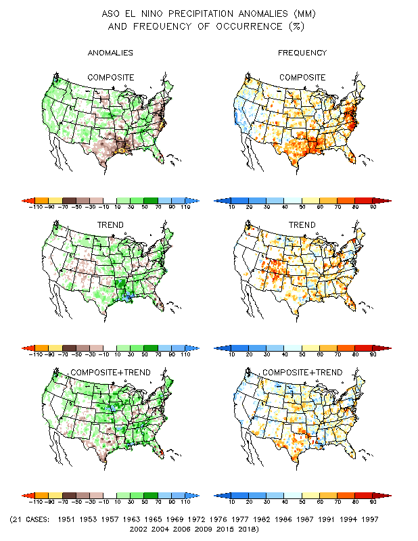
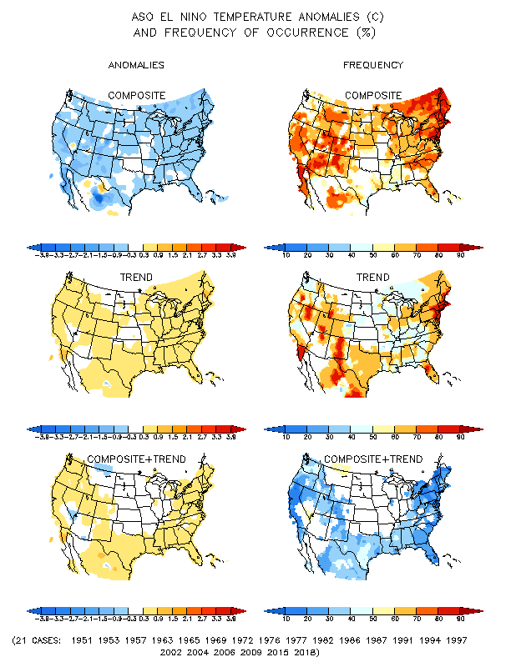
El Nino Precip/Temperature COMPOSITES & Trend map
ASO
P
T
Transitio-ning to
ENSO neutral and then to El NINO conditions

Slide 16
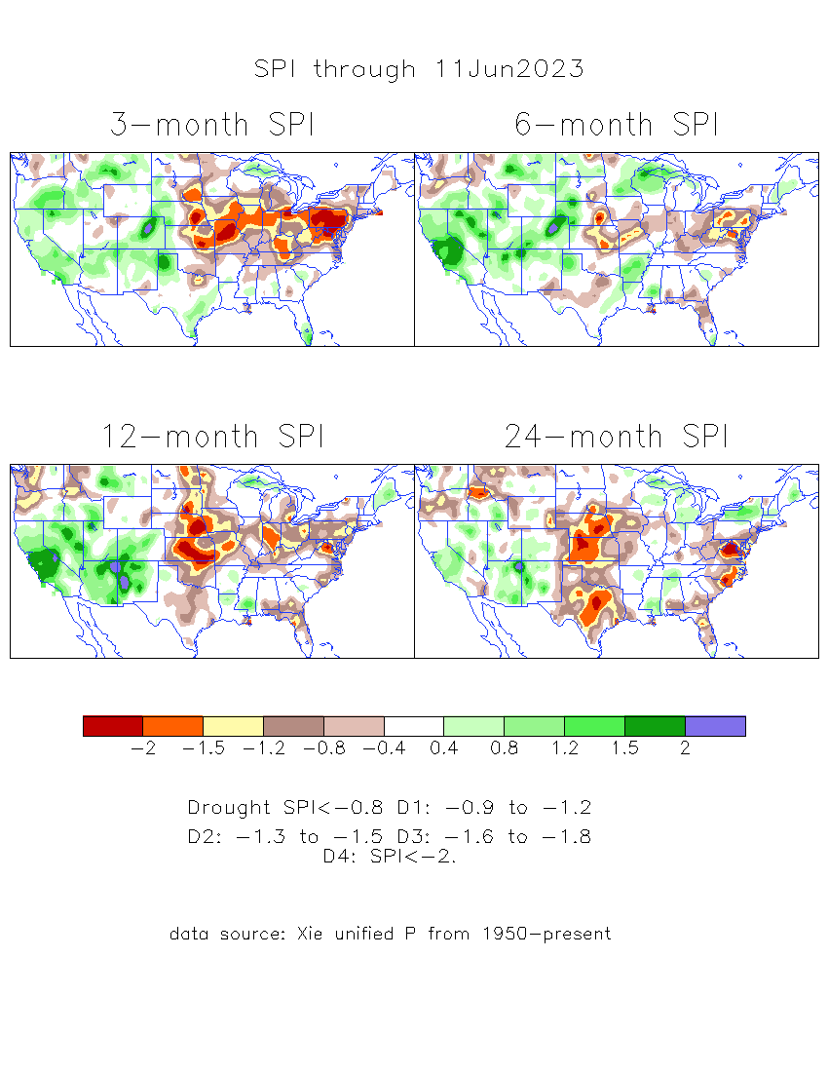
The Standardized Precipitation Index SPI (based on Observed P)
----- Last Month
Very interesting graphic & details for the drought across the US based on the more generalized precip deficit/excess, the Standardized Precipitation Index (SPI).
The dark brown and red colors, indicating standardized precipitation deficits, in the various time periods, approximately correspond to the appropriate short/long term drought monitor regions and their intensities

Slide 17
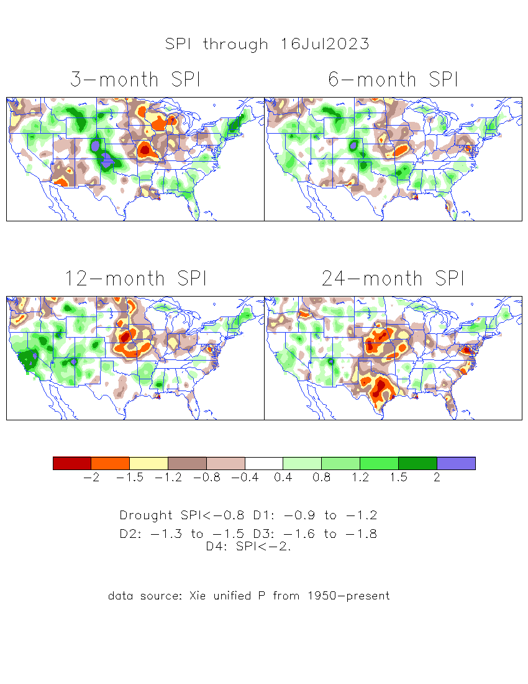
The Standardized Precipitation Index SPI (based on Observed P)
Compare with last month
----- NOW
Very interesting graphic & details for the drought across the US based on the more generalized precip deficit/excess, the Standardized Precipitation Index (SPI).
The dark brown and red colors, indicating standardized precipitation deficits, in the various time periods, approximately correspond to the appropriate short/long term drought monitor regions and their intensities
Short
No S-term drought here! Also big impact on L-term drought in west!
Long
How does one negotiate and reconcile declaring short term vs long term drought when precip. deficiencies patterns differ on many different time scales locally!!
What is the cutoff delineating time between short VS long term drought!! Not so clear!!
At exactly where does drought begin?

Slide 18
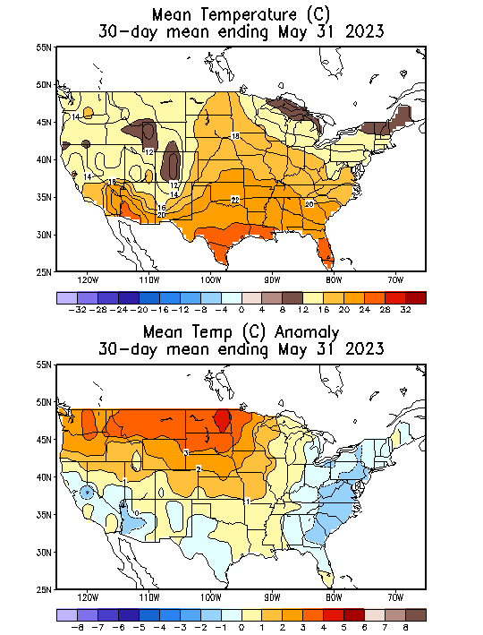
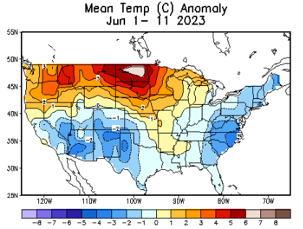
Slide From briefing
Last Month at this time of month!
Recent US Temperatures
.
So far this month !!

Slide 19
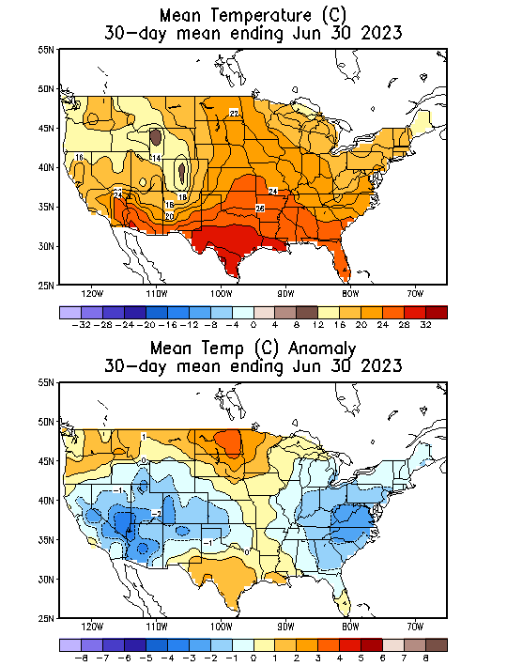
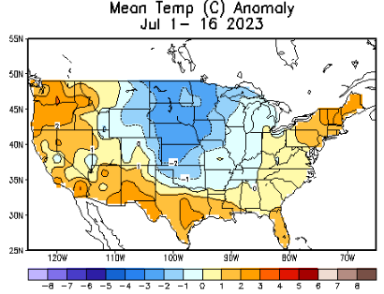
NOW
Recent US Temperatures
.
So far, contrast from last month!
So far this month !!

Slide 20
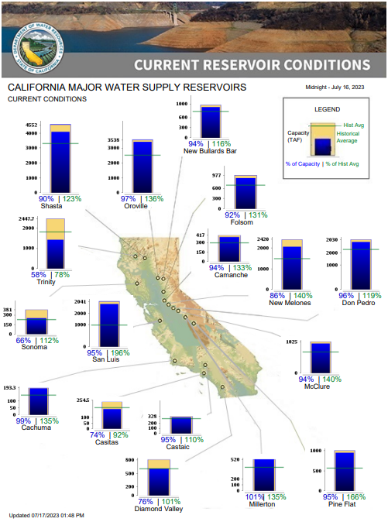
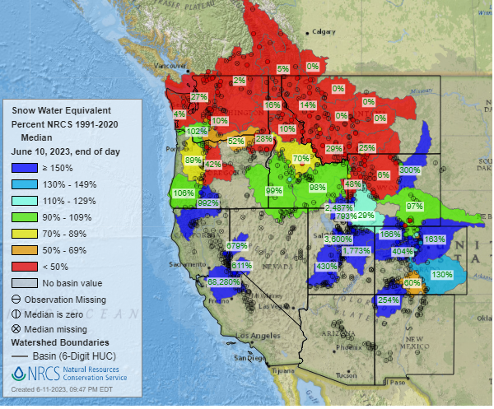
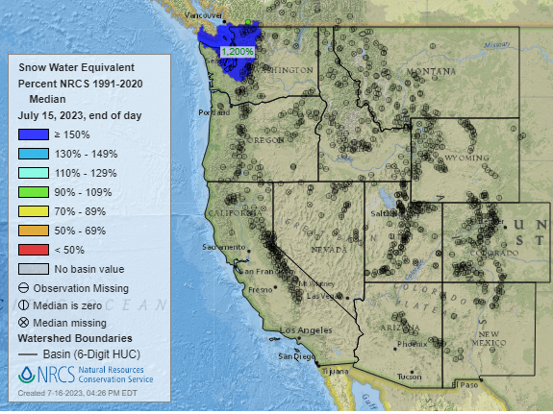
Snow Water Equivalent
% of Capacity
% of Hist. Avg.
of Reservoirs.
Last Month
https://www.nrcs.usda.gov/wps/portal/wcc/home/
Many CA water reservoirs are AT or ABOVE their historical average/ CAPACITY levels ! ☺
This Month
https://www.nohrsc.noaa.gov/interactive/html/map.html?
But a very different story for the big lakes Lake Mead & Lake Powell in NV, see next slide! ☹

Slide 21
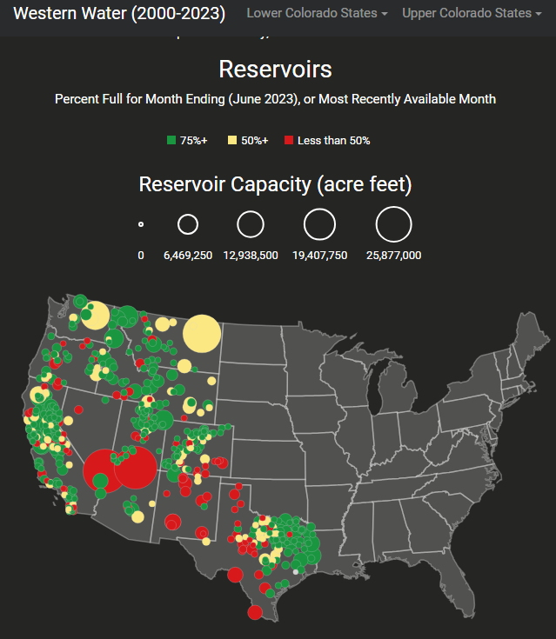
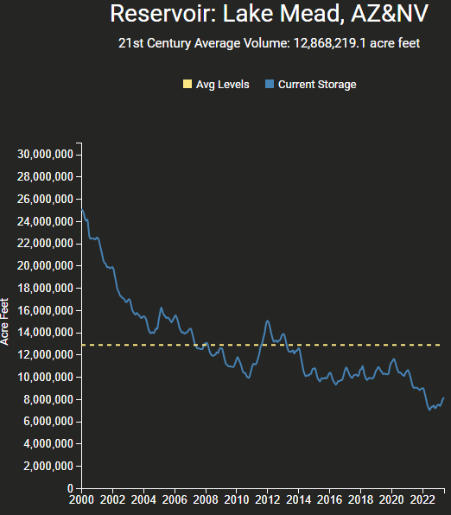
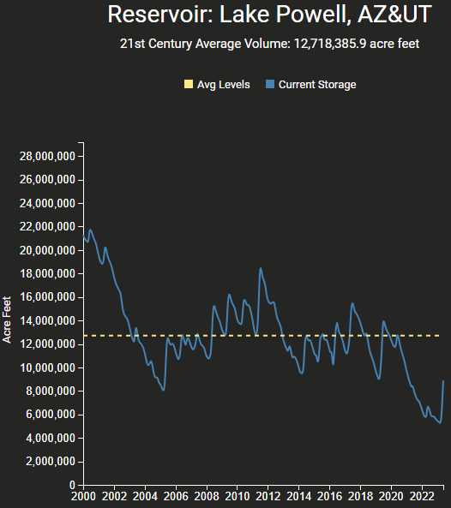
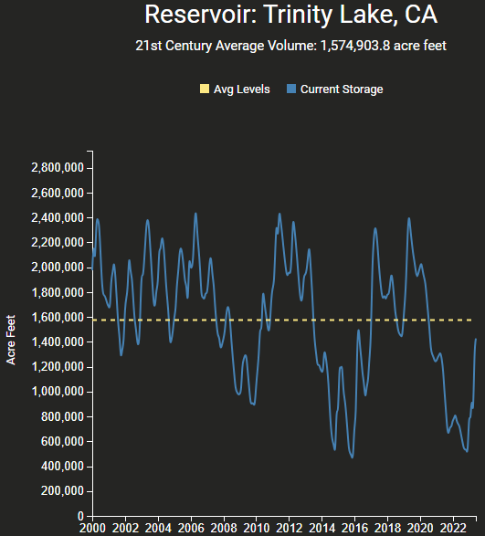
https://www.deanfarr.com/western_water/
https://www.deanfarr.com/western_water/
Hydro Electric power generating turbines STOP operating at the critical 7 million acre feet level
Lakes Mead, Powell in NV/AZ are at historic /dire low levels! ☹ ☹ HUGE consequences for electric power for western states CA/NV/AZ/UT !!
Only very slight improvement in recent months!

Slide 22
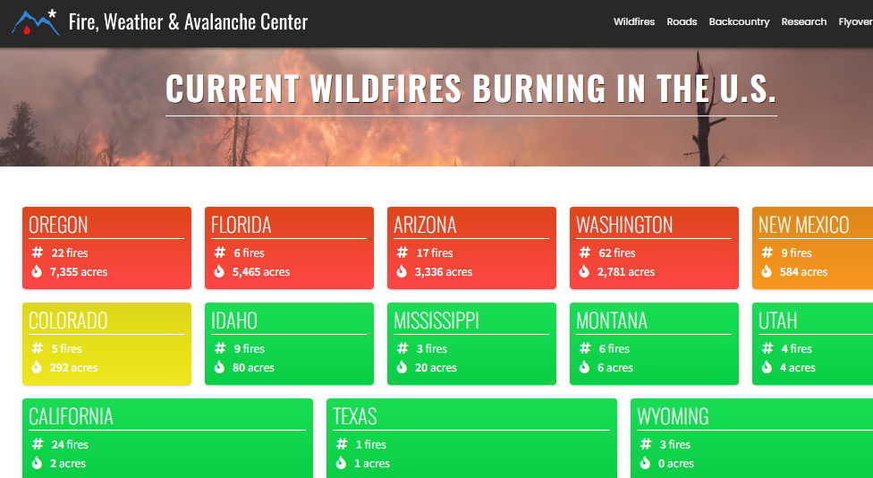
Slide Not shown
THIS MONTH !!
No major fire weather issue
THIS MONTH !!
https://www.fireweatheravalanche.org/fire/current-list-of-us-wildfires
(not govt. source! Not sure how good is this data?)

Slide 23
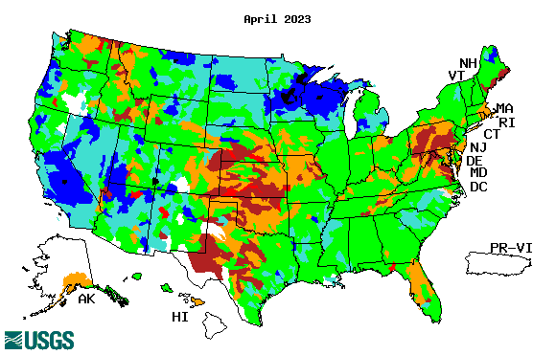
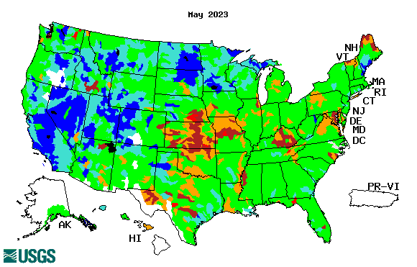
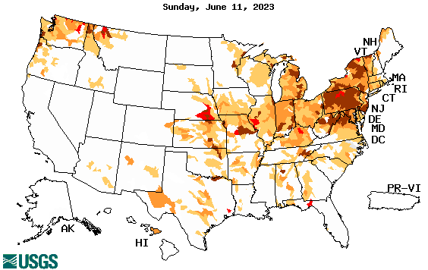
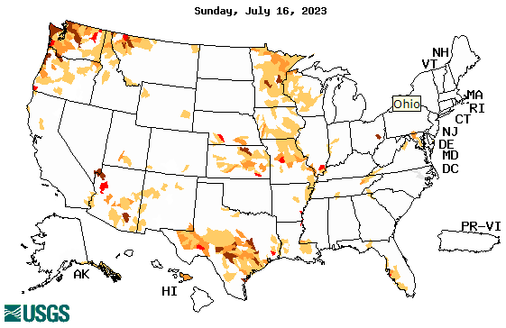
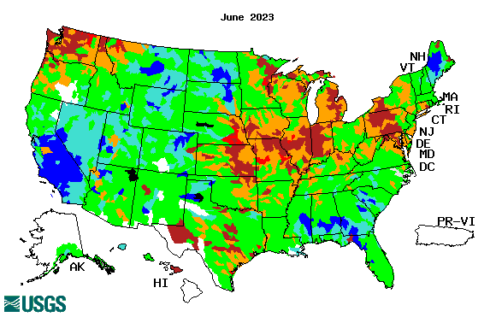
Streamflow (USGS)
Most US east droughts are relatively short lived (as compared to US west). However, if you recall, the drought over the New England states last year was a real surprise!!
Map shows only below normal 7-day average streamflow compared to historical streamflow for the day of year.
One month ago (left) &
Now (below)
Streamflow is only a partial indicator, as sometimes it is highly managed.
If sometimes, the various indicators are confusing, go back to % of rainfall deficit maps – to confirm/reinforce!!
23

Slide 24
EL NIÑO/SOUTHERN OSCILLATION (ENSO)
DIAGNOSTIC DISCUSSION
issued by CLIMATE PREDICTION CENTER/NCEP/NWS and the International Research Institute for Climate and Society
13 July 2023
ENSO Alert System Status: El Niño Advisory
Synopsis: There is a greater than 90% chance that El Niño will continue through the Northern Hemisphere winter.
CPC’s Oceanic Niño Index (ONI) [3 month running mean of ERSST.v5 SST anomalies in the Niño 3.4 region (5ºN-5ºS, 120º-170ºW)], based on centered 30-year base periods updated every 5 years.

Slide 25
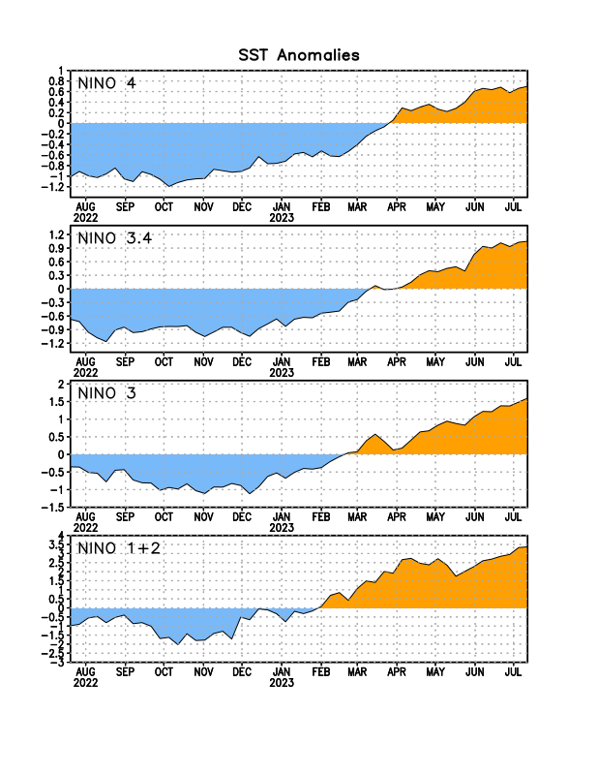
Latest values of SST indices in the various Nino Regions.
Rapidly decreasing Subsurface cold water reserve…

Slide 26
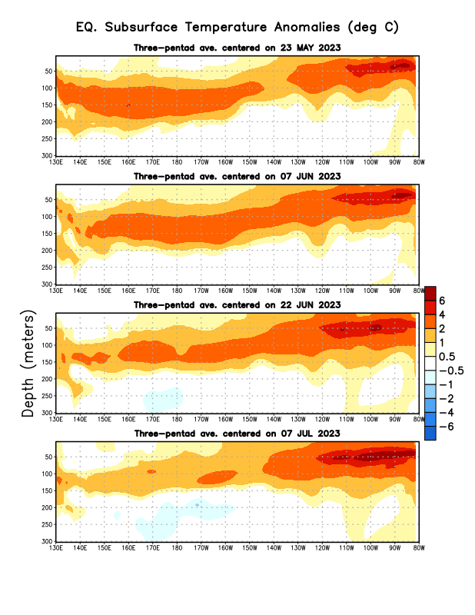
Sub-Surface Temperature Departures in the Equatorial Pacific
Will the El Nino come/happen as we think it is going to happen?
Most recent pentad analysis

Slide 27
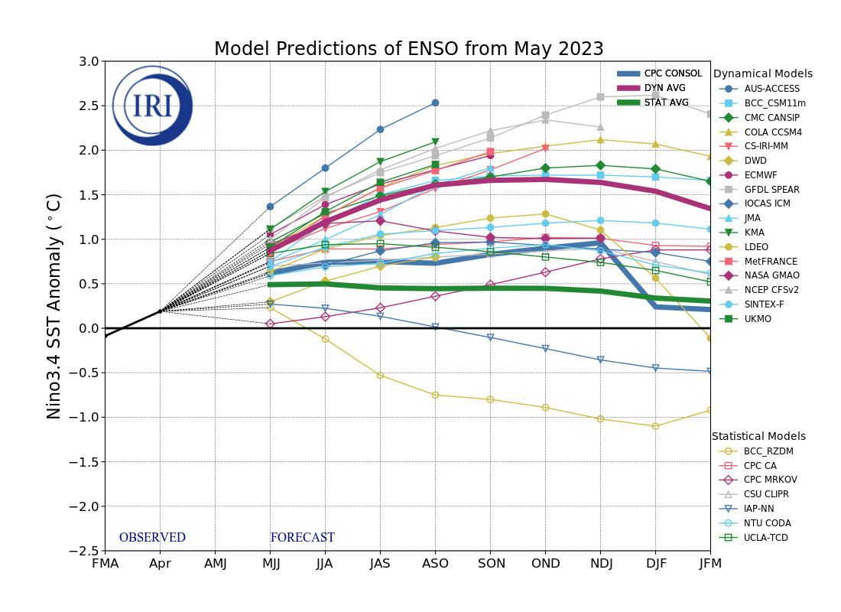
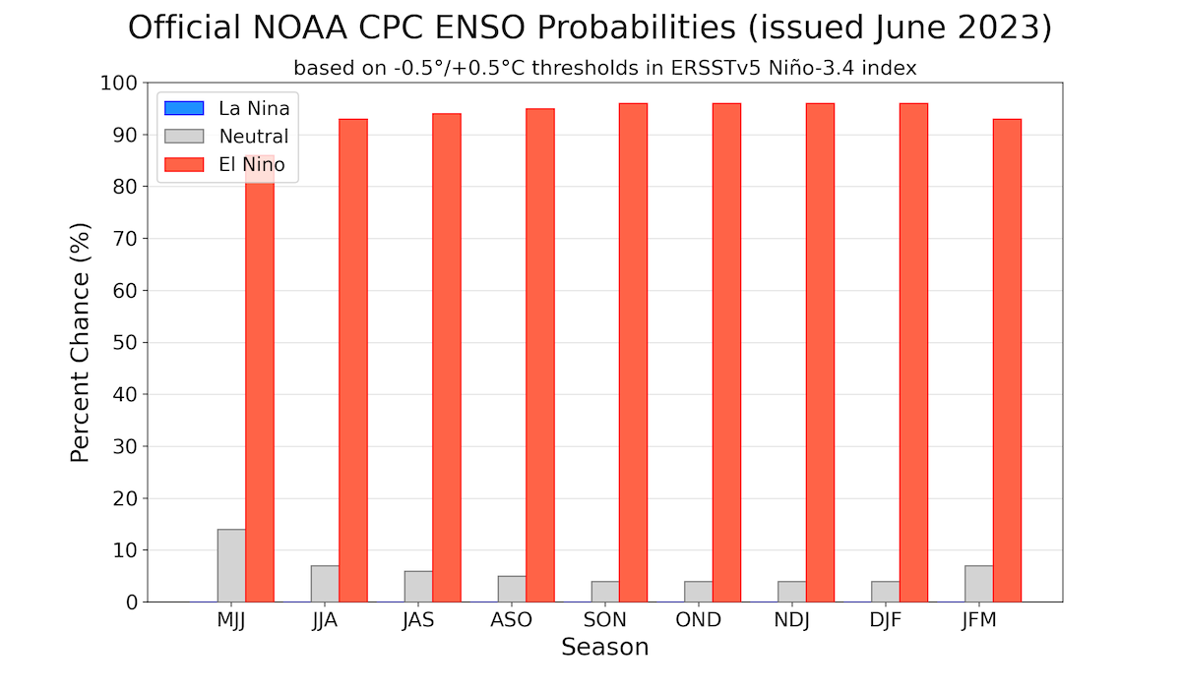
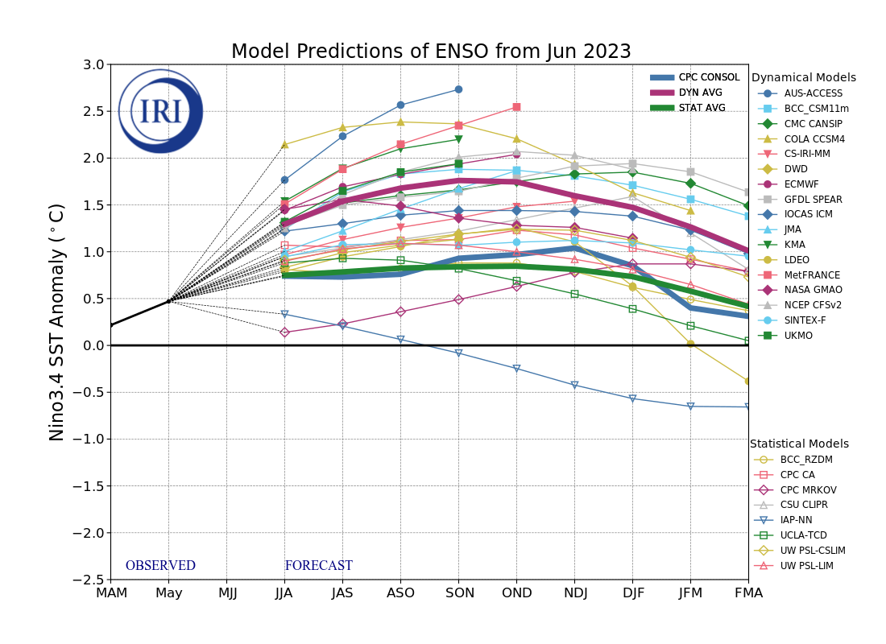
Official ENSO Forecasts
June
July CPC forecast
Both Stat.Avg & CPC-consolidated
are keeping it under 0.5 deg. C ??

Slide 28
Previous (Last Month’s)
CPC’s official
Temperature OUTLOOK for Monthly (July)/Seasonal (JAS)
Monthly P/T forecasts verified at mid-month are generally good! Becoz of good skill upto 2 wks.
Released June 15th
Observed so far this month!! ☺ ☹
E/W

Slide 29
Previous(Last month)
CPC’s official
Precipitation OUTLOOK for Monthly (July)/Seasonal (JAS)
Monthly P/T forecasts verified at mid-month are generally good! (??) Becoz of good skill upto 2 wks.
Released June 15th
Observed so far this month!! ☺ ☹

Slide 30
NCEP/WPC Next 7 days QPF (Quantitative Precipitation Forecast)
GFS Model Guidance for the
next 16 days.
Reg. California, the severe drought conditions, a year ago, a few months ago, has literally turned into a flood situation!

Slide 31
From 2 Models average Precip forecast (made 16/17 July) for next 30 days.
The 3Models are: CFSV2, GEFS, & EC

Slide 32
From 2 Models average Precip forecast (made 16/17 July) for next 30 days.
20
40

Slide 33
From 2 Models average Precip forecast (made yesterday 16/17 July) for next 30 days.

Slide 34
From 3 Models average Precip forecast (made yesterday 16/17 July) for next 30 days.

Slide 35
From 2 Models average Precip forecast (made yesterday 16/17 July) for next 30 days.

Slide 36
Week-4 Soil Moisture Percentile (SMP) Fcst based on VIC model forced with ECMWF-extended precipitation forecast!
This month
Now: Based on Yesterday’s IC
While not exactly mapping 1-to-1 with the drought areas, this map is generally connected to the drought areas in some ways, as it is related to soil moisture!!
Above Slide from last month
(From Drs. Li Xu and Yun Fan) More detail at From: https://www.cpc.ncep.noaa.gov/products/people/lxu/flashd/flash_prediction.html#10

Slide 37
NMME* T (left) & P (right) Ens.Mean forecasts for
Aug
ASO
NMME* : North American Multi Models Ensemble

Slide 38
Agreement/Disagreement among the various NMME models’ ASO seasonal Precip. Forecast.
??

Slide 39
(From NMME) compared with this month(foreground, red border)
Why is there so fewer hatched areas in SPI6 fcst from NMME models’ based fcst this month as compared to last month (left 2 columns) ? Fcsts more confident now?
Forecast uncertain in Hatched areas.
These maps are based on NMME models’ precip forecast uncertainty/certainty (among ensemble members) over the next 3 months
SPI6 Fcst made from last month I.C.
SPI6 & SPI12 Fcst made from this month

Slide 40
http://drought.geo.msu.edu/research/forecast/smi.monthly.php
Predicted Monthly Soil Moisture Percentile
Latest Initial Conditions:
DATA not available !
CPC’s soil moisture percentile – Leaky bucket Model
The inter quartile range suggest greater uncertainty about the forecast in these shaded regions in the ESP based forecast!

Slide 41
BONUS Topic: Discussion continues!! Explanation for the multiyear DROUGHT in the Southwest (CA/AZ/NM/NV/UT/CO & vicinity)!!
More La Nina’s lately ?
More frequent La Ninas lately ?
YES!! The stats in the table below (bottom left) are from the Official CPC ENSO declarations page/table!
Compared to other regions of the globe, the SST warming/trend in the central eq. Pacific (Nino 3.4) is relatively much small. (See Fig. above) – Why is this ?
Does nature try to compensate for the warming else/everywhere by producing more La Ninas in the equatorial Pacific? - Just my observation from data! Let’s check !!!
Since the 1997 monster El Nino (stronger than the famous 1982/83 event), just a quick count of CPC’s Nino 3.4 index++ values for the three month overlapping seasons, (Data at CPC site only available only from 1950!)
(27 years) (47 years) (74 years)
1997-2023 1950-1996 1950-2023
La Nina(DJF) 12 16 28
El Nino(DJF) 8 17 25
La Nina(all 3mos) 119 150 269
El Nino(all 3mos) 77 166 243
(Overlapping 3month seasons)
Look at Ratios of La Ninas (vs El Ninos) in the shorter
recent (27 yr) period vs the longer (47 yr) earlier period!!
Compare the ratios of La Nina to El Nino in the squared boxes.
***Analysis of CPC’s official Nino 3.4 index data over the last 70 years shows that the more frequent La Ninas in recent decades contributed to less rainfall in the southwest (See La Nina precip composites!, slide#13) and hence the ongoing long term drought in the Southwest!! Hence the long term southwest drought is unlikely to go away any time soon***
++ Barnston, Chelliah and Goldenberg (1997):Documentation of a highly ENSO‐related SST region in the equatorial pacific, Atmosphere-Ocean Volume 35, 1997. https://doi.org/10.1080/07055900.1997.9649597
*** The strong/weak annual monsoon rains in the southwest is a minor modulator riding on this bigger/longer-term signal. ***

Slide 42
Summary
Current Drought conditions:
Towards the end of last year 2022, until December or so, severe drought conditions (both short and long term) remained in the west, mild drought conditions expanded in to portions of the eastern half of the US also, covering most of the country with very high % areas of the entire US affected by drought. The situation now is now drastically different.
The recent winter rainy season in CA and the west coast states, wiped out not only the S-term drought but also the L-term drought in most areas. Water levels in most CA reservoirs are now ABOVE their normal levels. However, the water storage levels in the huge Lakes Powell and Lake Mead in NV continue to be historically low, & decade(s) long hydrological drought still lingers. Recharge into the 2 reservoirs from subsurface stream flows has been highly impacted.
S/L term droughts still remain in parts of northwestern states of WA/OR/ID/MT.
Across the US, there is a considerable decrease and sudden drop in the areal coverage of all drought categories. Area covered by >D1 category drought is now ~ 25%. Drought along central US states has slightly shifted/expanded eastward, esp. drought in southern TX has now expanded into LA.
The sudden expansion of dry, S-term drought conditions in parts of upper mid-west and northeast had taken on a new dimension. However, the recent heavy rains in the northeast saturated the region. Though S term near MD/PA is gone, pockets of L term drought remain in the region.
Current ENSO status and forecast: There is a greater than 90% chance that El Niño will continue through the Northern Hemisphere winter.
Prediction: The transition from the third-year La Nina to an El Nino is now complete, and El Nino conditions in terms of SST are observed. Lately, while the warm SST anomalies have expanded all across tropical equatorial Pacific, the subsurface upper ocean heat content (integrated temperature at various depths) has slightly weakened. It is not clear if during the upcoming forecast ASO season, one can expect the same canonical ENSO impacts around the globe, such as those impacts observed twenty/thirty years ago, as the global SST conditions elsewhere (outside of Nino 3.4 and tropical eq. Pacific) in the world oceans have definitely warmed in recent decades. While the models are clearly having difficulty lately in predicting (seasonal time scale) even during this past winter season under established La Nina conditions (look at California deluge!) it will be difficult if the models can forecast with certainty, what will happen during the ongoing mild El Nino conditions in the forecast season ASO.
The NMME model’s precip guidance for the forecast season ASO is neither encouraging nor useful. Considering likely weak El Nino conditions and near summer conditions, and a lackluster forecast for the southwest monsoon this year in much of the four corner states, we expect development of short term drought conditions in the region, and in parts of adjacent NV.
Also drought in central/southern TX and adjoining LA will likely persist and/or possibly worsen slightly. Drought conditions in the central/upper Midwest will likely improve slightly.
Given the rainfall climatology the lack of rain along the west coast states, we expect no change in the existing conditions in the Pacific Northwest. The remaining L/drought in/near PA/WV/MD will likely go way by the end of ASO season. No development of drought is expected all along the Atlantic coastal states/regions from north to south. ******

