Slide 1
Drought Outlook Support Briefing
July 2024
Climate Prediction Center/NCEP/NOAA
http://www.cpc.ncep.noaa.gov/products/Drought
Points to ponder:
Often, there is a disconnect between the Short term (S) and Long term (L) drought in regions, and even with the short term (S) drought, the 3-month and 6-month signals are not quite consistent! With Long term (L) drought, it is even more trickier, as it is open ended from 6 months-onwards and beyond!!!
Places/regions experiencing Short term drought may (not) be ok in the Long term and vice versa!!
This duality is difficult to reconcile, to convey and even be clearly understood well by the public at large.
Public/Forecaster generally tends to focus more on the Short term Drought (for good reasons!!)
More importantly the very definitions and timescales associated with S/L term droughts and the declarations in the USDM are by themselves subjective!! Short term vs Long term drought need to be clearly distinguished and shown to the public!!
It may take a long time for drought to develop, but those conditions can end very quickly! as it happened in CA after DJF 2023 winter. Forecast models are yet to (seasonal) correctly forecast these changes in advance!
Subjective(delayed) USDM vs Objective(real time) map! A few days of recent heavy precip can change the USDM a lot!
New (last few months):
Towards objective drought monitoring goals, we introduced, a new objective AI/Deep-Learning based Experimental ODI (objective drought indicator, updated daily, Slide # 3) compared with Official USDM (US Drought Monitor, produced weekly by USDM authors).
Towards prediction, we introduce a new section with few slides at the end, consolidating the various exptl. drought outlooks by purely objective methods developed here at CPC! All these in preparation of a broad general push towards Probabilistic Drought outlooks.

Slide 2
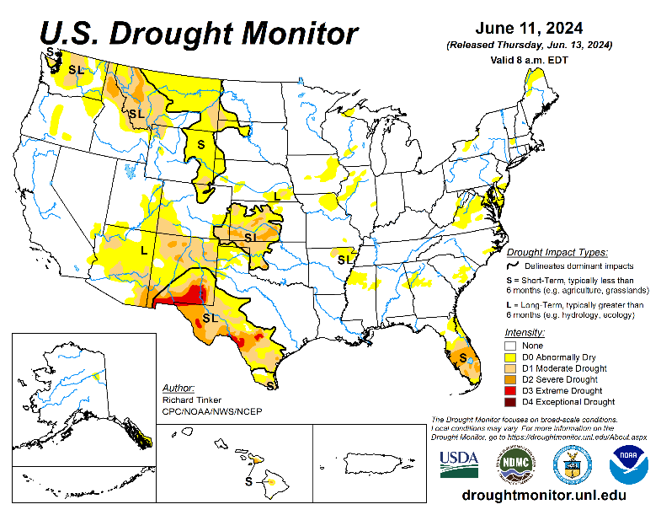
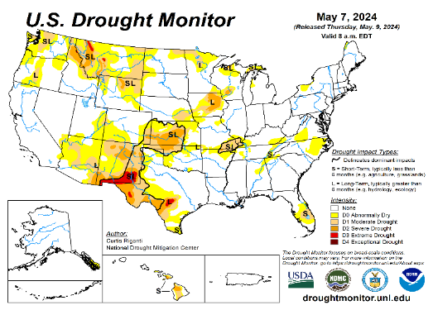
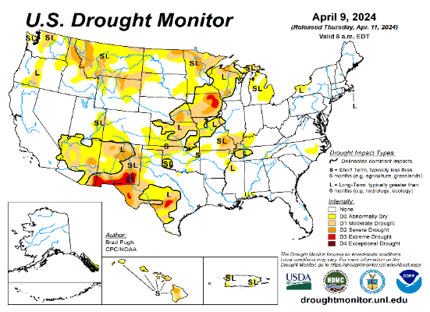
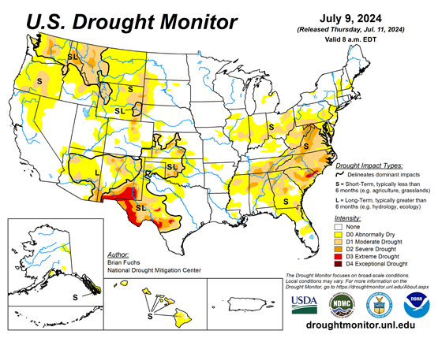
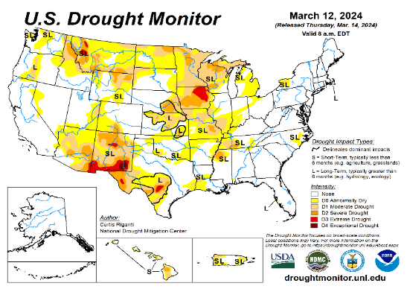
Drought Monitor
Monitoring is important because, unlike US T/P fcsts, for drought forecasts, we have to know where we are, before we can tell where we are going!! Drought forecasts are tendency forecasts as changes from the latest USDM.
June
California has remained drought free for about 18 months now. Above normal rainfall (strangely) during last year’s La Nina winter (2022/23) and (canonically, as expected) during this year’s El Nino winter (2023/24) in California, thus two back to back above normal winter rainfall seasons, have more than compensated for, and totally eliminated the both the Long & Short term drought in the region.
Water levels in almost all CA reservoirs are now at or well above their normal levels. However, the water storage levels in the much bigger lakes, Lake Powell and Lake Mead in NV/AZ still continue to be very low, and have not recovered from the 2+ decade(s) long hydrological drought that existed in the region.
The S/L term drought in the interior Pacific Northwest and in parts of WA, ID & MT is still stubbornly persisting. But drought in MN/IA/WI/ MO/KS is nearly gone, as we had suggested.
We have been suggesting/projecting for the past few months that the overall drought situation across the entire US will be improving slowly and steadily, and it actually happened as suggested. As we suggested earlier, last month, a large 71% (3 months ago it was only 54 %) of the lower 48 states was totally drought free. Having reached the “near bottom” for the % of US areas covered under drought during last month, we again suggested a possible increase in drought area coverage over the next few months and it happened this month!! Questions remain about when & the strength of the upcoming La Nina!
The upcoming La Nina, which is generally a poor rainfall period for the US, combined with the hot summer temperatures may begin to slowly increase the US areas under drought.
While CA is totally drought free (ST & LT) large parts of AZ/NM and even western of TX are still under drought due to long term/decadal drought in the SW, as well as the poor SW monsoon this past year (2023). Another possible 2024 poor SW monsoon in AZ/NM and in vicinity might persist or even make the current drought in the region worse. The drought in the SW is really more ominous than the temporary flash dryness in the east.
May
April
July
(Recent/Latest)
March

Slide 3
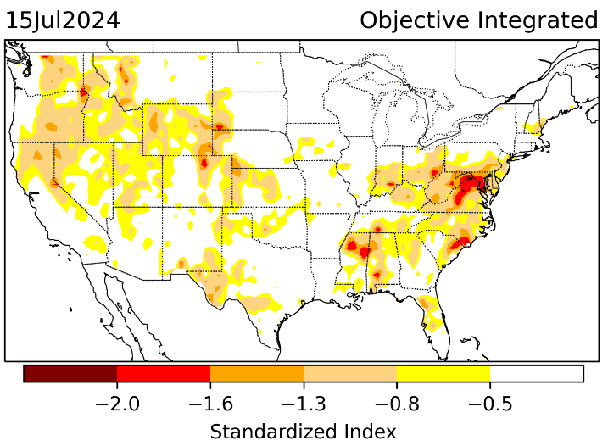
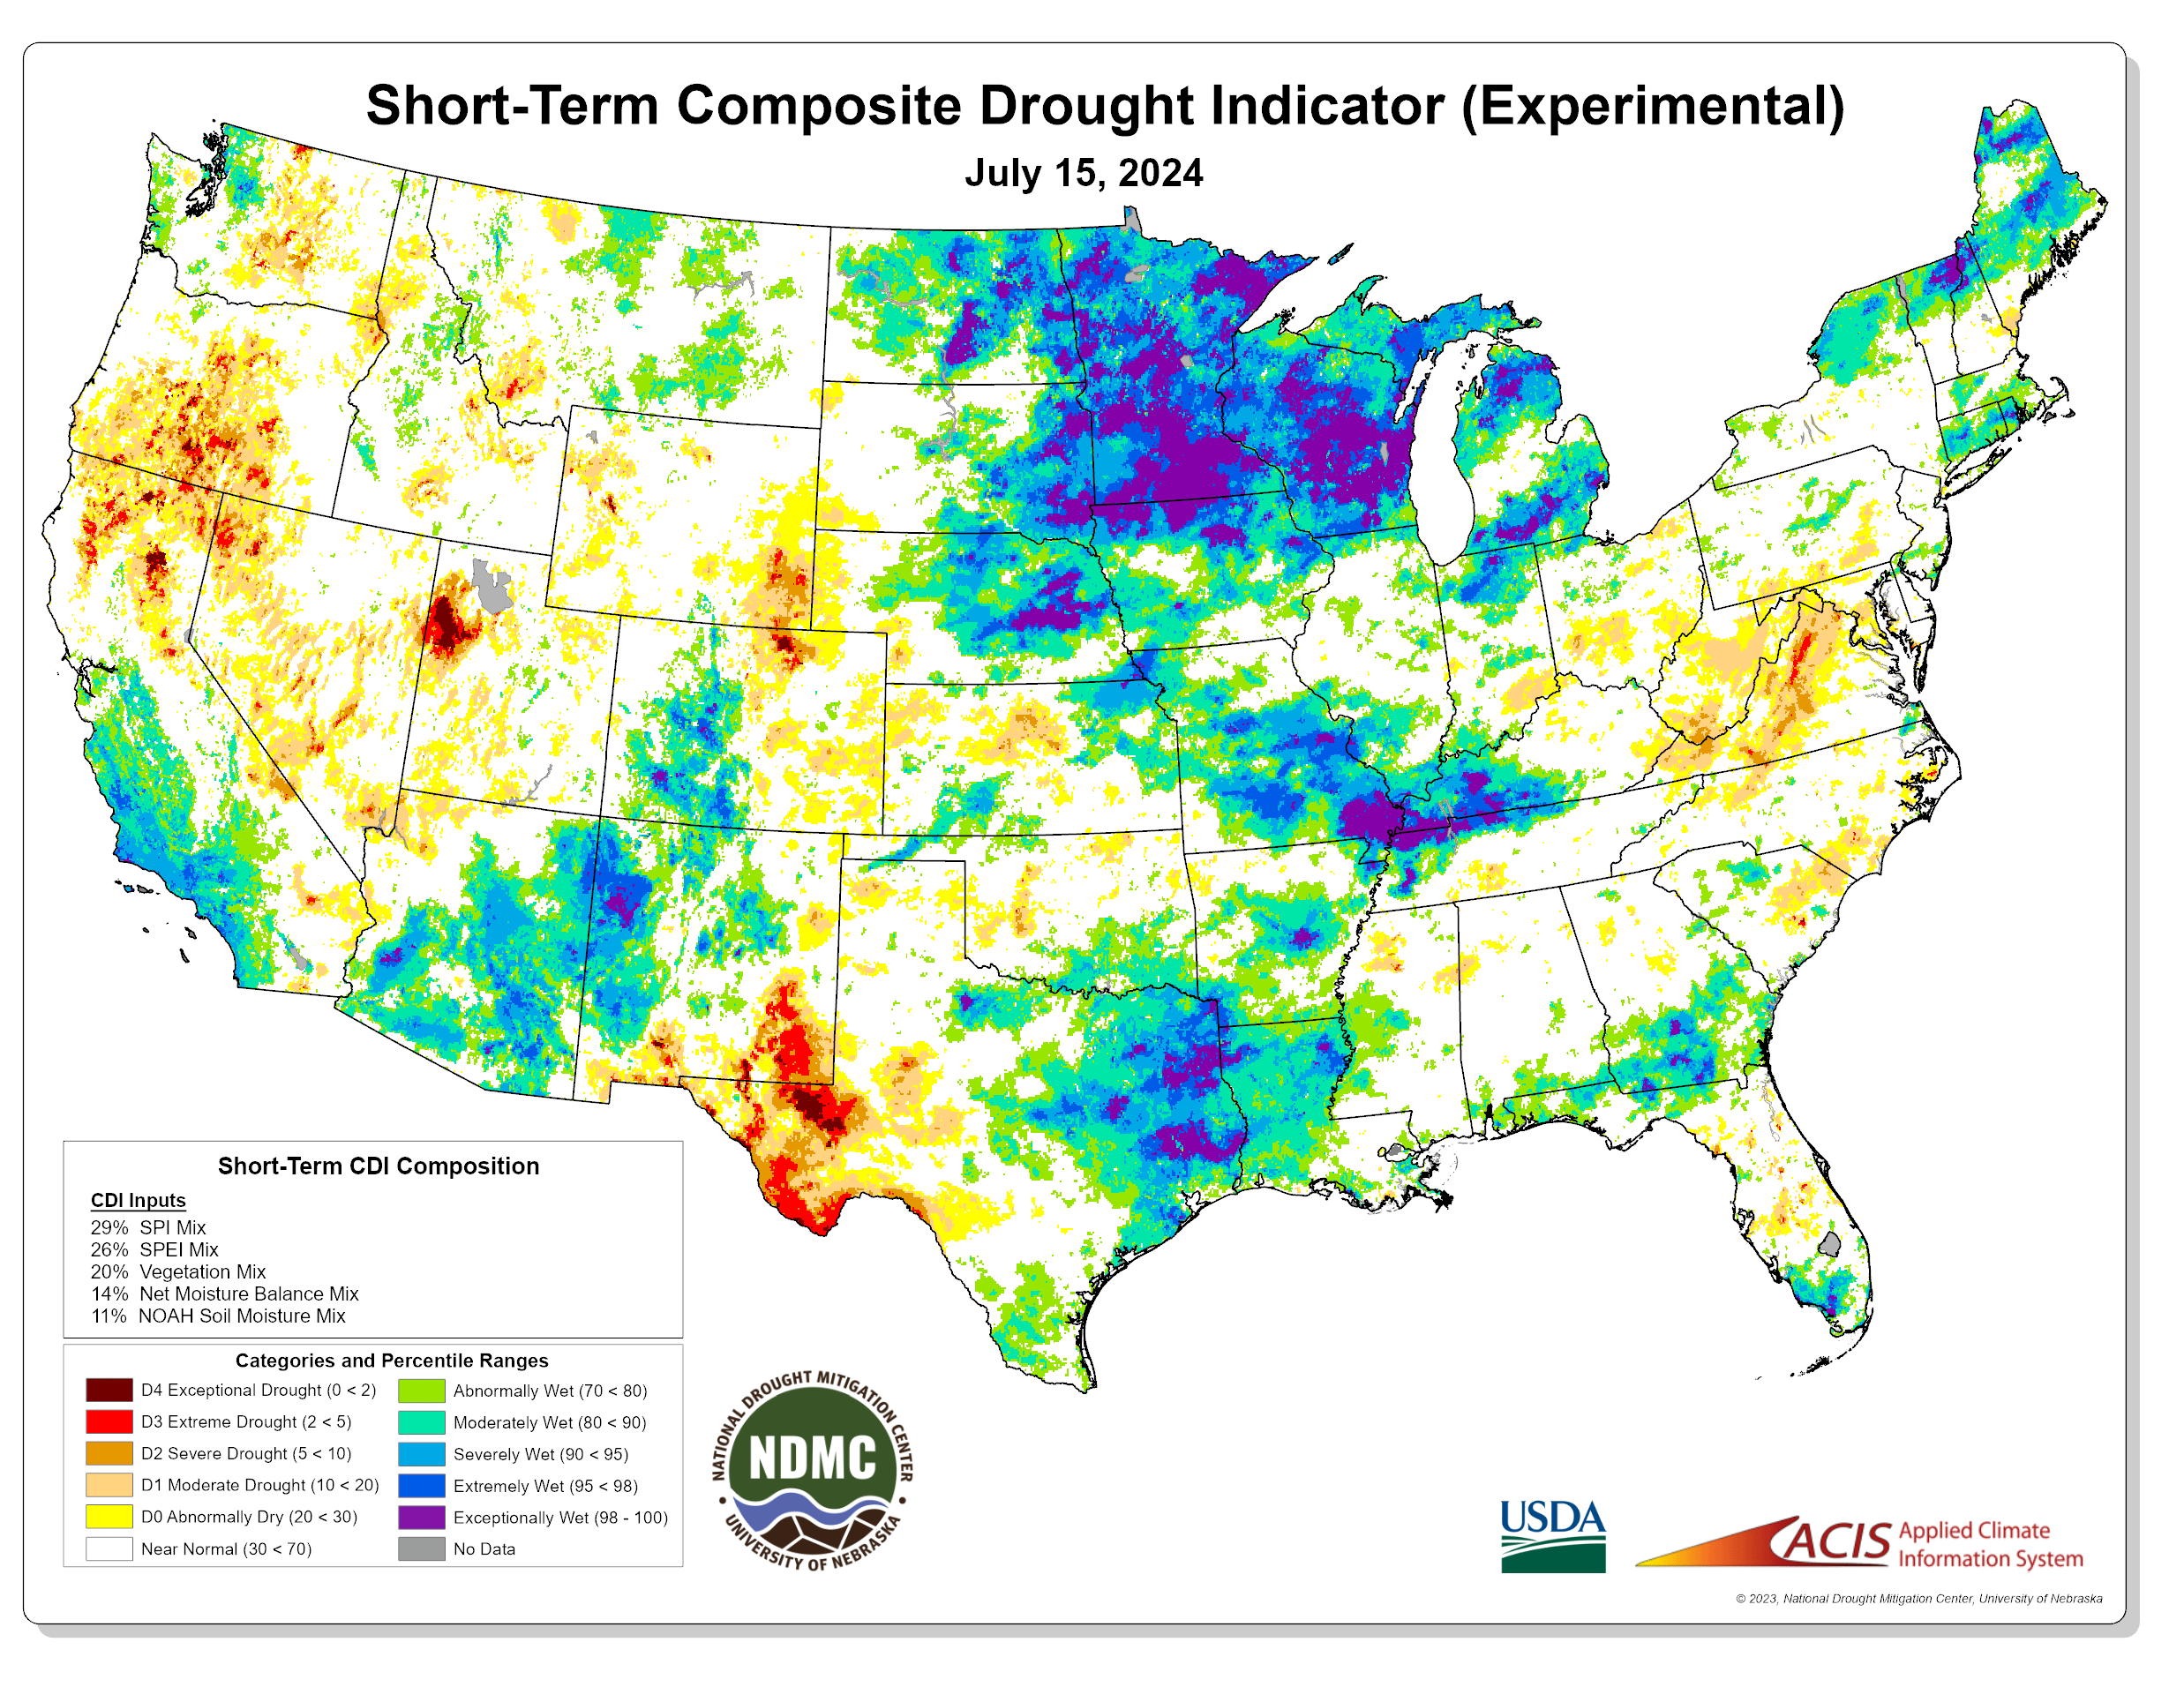
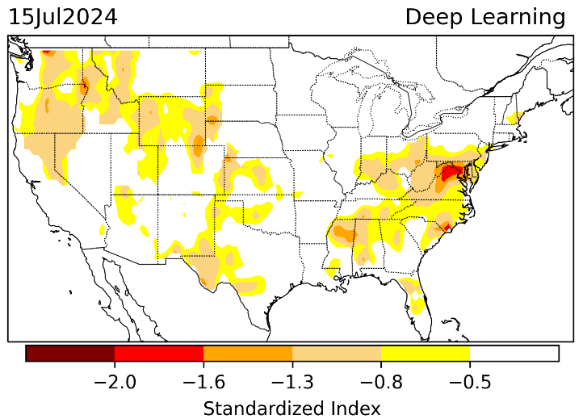
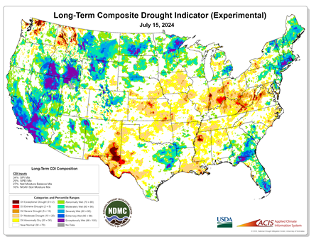

Exptl. Objective Drought Monitor
(showing S/term & L/Term separately) from
National Drought Mitigation Center (NDMC)
New slide now included recently in this briefing!
CPC’s own Experimental
Objective Drought Indicator (ODI)
using AI/Deep Learning ! – Updates daily !!
https://www.cpc.ncep.noaa.gov/products/people/lxu/odi/#deep-learning-increment-training
Based on the CPC P/analysis &
VIC (Princeton) NLDAS model assimilation:
Standardize Precipitation index (SPI)
Standardize Precipitation-Evapo –
transpiration index (SPEI)
Evapotranspiration Stress Index (ESI)
Soil Moisture Percentile (SMP)
Standardize Runoff Index (SRI)
-can be split into Short/Long Term Droughts!
https://droughtmonitor.unl.edu/ConditionsOutlooks/CurrentConditions.aspx
Objective
& Updates Daily!
Objectively Integrated
versus Deep Learning
Methods ~ gives |||r results. Both Objective!
Both update daily!
Objective, but
Runs Weekly!
On Monday!
Objective
& Updates Daily!
* A manuscript (Xu & Chelliah) is under preparation.
Subjective &
Produced Manually!
Weekly!
Latest Official USDM (US Drought Monitor)
(about a week old!)
Objective, but
Runs Weekly!
On Monday!
These two maps above, used to be produced at CPC(Rich Tinker!), but now recently officially moved to NDMC operations!
*Released every Thursday, for conditions as of Tuesday!

Slide 4
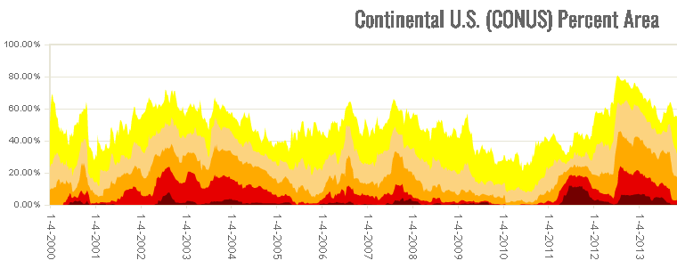
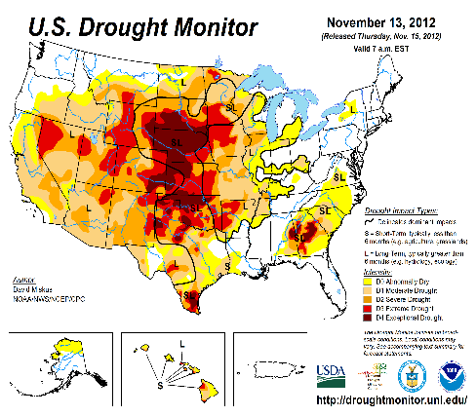

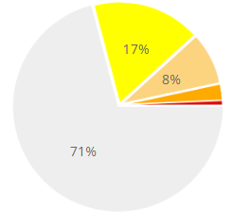
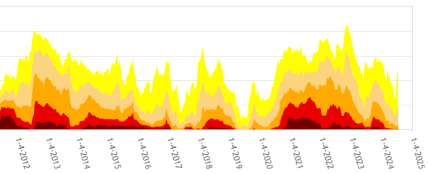

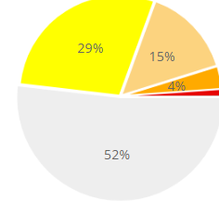

In general, The spatial details of every drought is different.! Every situation is different!!
Time series since 2000 spilt into 2 (above & below) panels.
last
month !
CONUS % Land Area
This month !
Last month drought free US areas was 71, Now, this month, it is 52%.
We have been indicating, here in this briefing, for the last 4, 5 months that the overall drought covered area will be decreasing for the past few months (that happened!), and in last month’s briefing we said, that streak will end, and the drought areas will begin to increase and that just happened between last month and now.

Slide 5
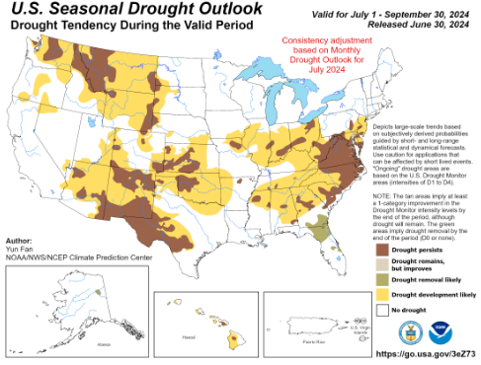
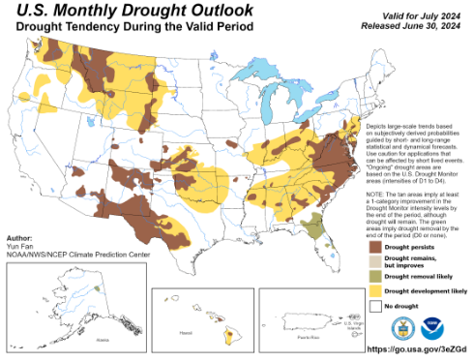
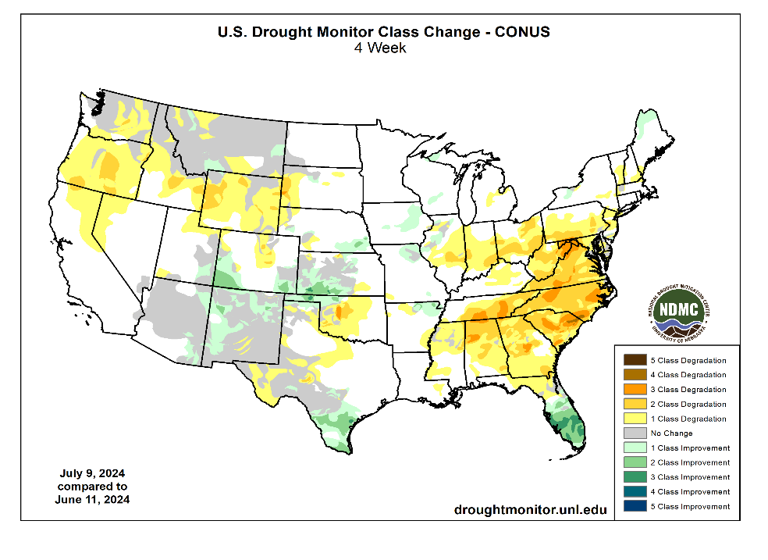
(Previous) Seasonal/Monthly Drought outlooks
New Seasonal+ Drought Outlook(SDO) to be released in 2 days!
(reissued again at end of month for consistency with MDO!)
New Monthly Drought Outlook (MDO) to be released at end of this month)
Updated Seasonal Outlook
( 1 July – 30 Sep 2024)
issued 6/30/24
Monthly outlook (for June 2024)
issued 6/30/24

Slide 6
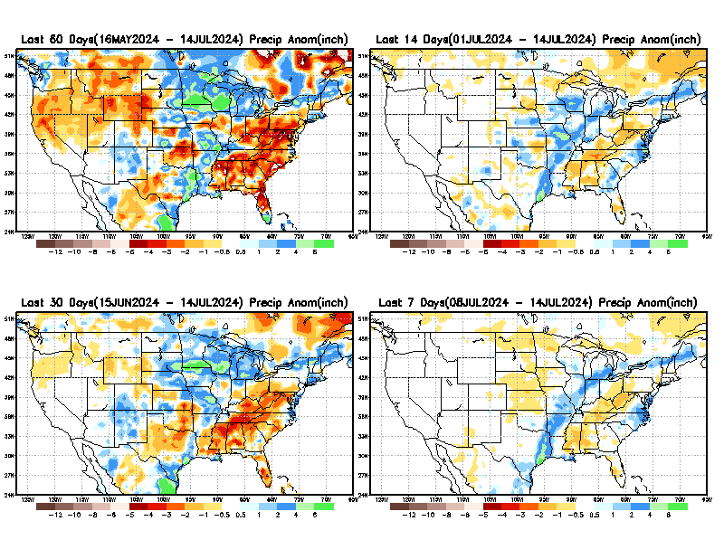
Precipitation ANOM during last 7, 14, 30, & 60 days.
This and next few slides show Precip deficit (excess).
Droughts, for the MOST part, begin and end with precip!! Lately, Temps are becoming (secondarily) important as well.
60 Days
14 Days
30 Days
7 Days
These maps in this and following slides, including a) Total,
b) Anom and
c) Percent of Normal precip. in these and other longer time ranges are now (routinely) daily updated at:
From: Recent Accum./Anom Precipitation https://www.cpc.ncep.noaa.gov/products/Drought/briefing_prcp.shtml

Slide 7
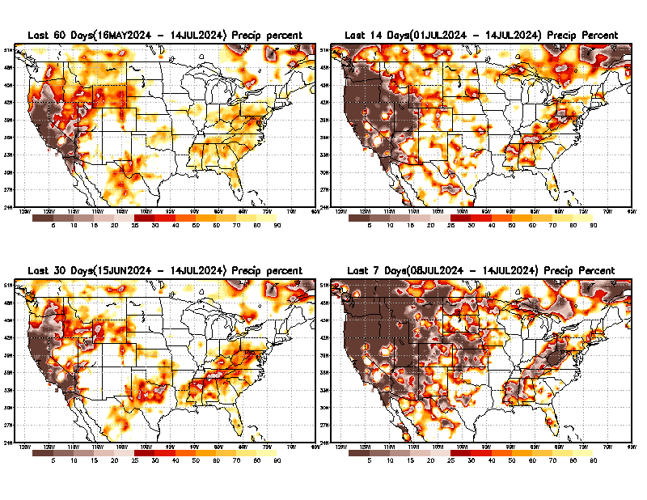
Precipitation Percent (of normal) during last 7, 14, 30, & 60 days - Only Deficit Areas <=90% shown !
60 Days
14 Days
This plot shows only the rainfall deficient regions <= 90% of normal.
-- This shows more clearly possible/likely drought developing region in the future unless there is above normal rainfall in these regions in the future, to offset these shortfalls.
30 days
7 days
From: Recent Anom/% of normal Precipitation https://www.cpc.ncep.noaa.gov/products/Drought/briefing_prcp.shtml

Slide 8
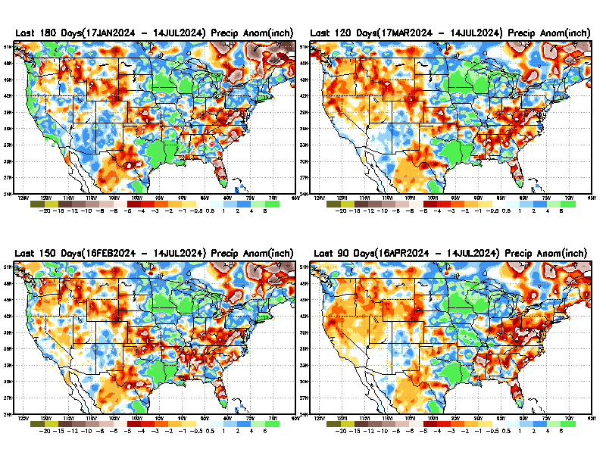
Total precipitation ANOM during last 3, 4, 5, and 6 months.
While the Precipitation anomalies deficit may seem large in some regions (compared to others),
it is the
% of normal precip (next slide) that matters more!!
6 M
4 M
5 M
3 M
From: Recent % of Normal Precipitation https://www.cpc.ncep.noaa.gov/products/Drought/briefing_prcp.shtml

Slide 9
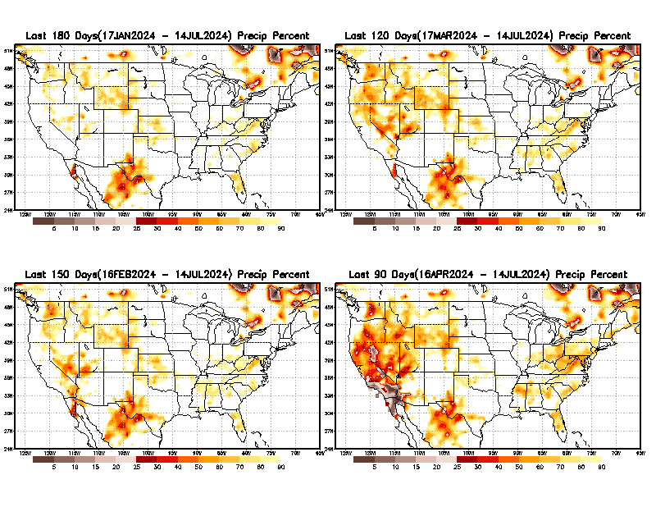
Total precipitation Percent (of normal) during last 3, 4, 5, and 6 months Only Deficit Areas <=90% shown!!
6 M
4 M
In these interim time scale 3-6 months, we need to pay attention to regions, which are dark-brown, red & dark red (<50%).
NOT BAD AT ALL for S/Term Drought
While accrued precipitation deficits are real & objective,
droughts are subjective declarations!!
5 M
3 M
East vs West!
Broad vs Narrow
rainfall season.
In general, West US suffers more from frequent and lasting droughts. Droughts in East US are generally less and less lasting!
What about Center ?
More like West than East?
Short term(S) Drought is generally declared when rainfall deficits exist in the 3-6 months time range. {Long term deficits beyond 1 or 2 or more years is Long term L drought! }

Slide 10
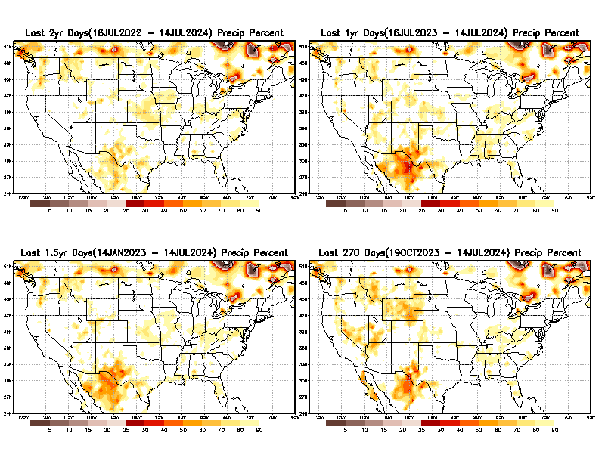
Total precipitation Percent during last 9 months, 1 yr, 1.5yrs, & 2 yrs. .–Only Deficit Areas shown!! <=90%
2 Y
1 Y
1.5 Y
9 M
The character and even location/spatial extent of the short/S and long/L –term droughts are different!!!
From: Recent Accumulated Precipitation https://www.cpc.ncep.noaa.gov/products/Drought/briefing_prcp.shtml

Slide 11
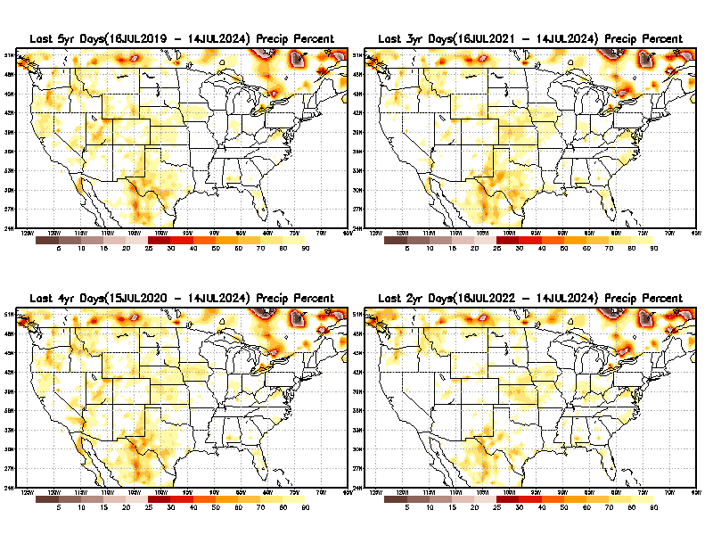
Total precipitation Percent (of normal) during last 2, 3, 4, & 5 yrs. .–Only Deficit Areas <=90% shown !!
5 Y
3 Y
Deficits are not much!
4 Y
2 Y
From: Recent Accumulated Precipitation https://www.cpc.ncep.noaa.gov/products/Drought/briefing_prcp.shtml

Slide 12
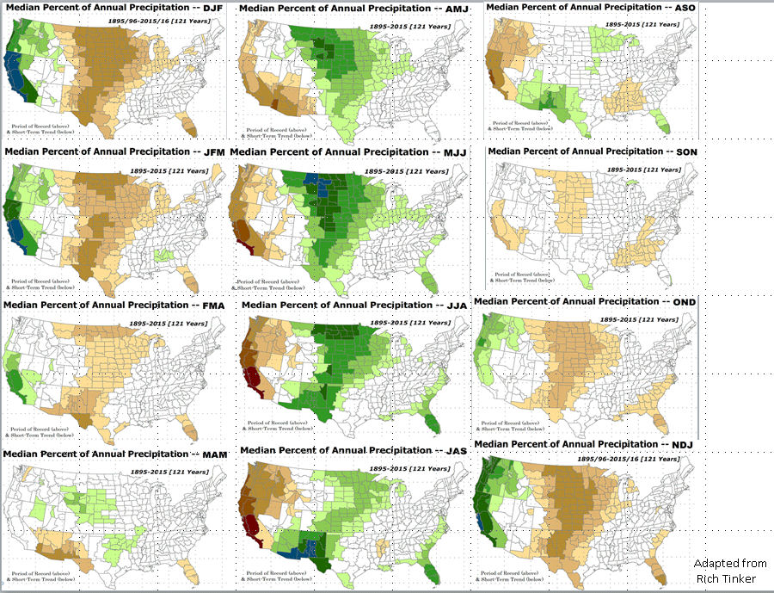

LEAST
MIXED
MOST
East vs West!
More darker colors in west/central => narrow rainy season (months)
Overall, more white space in the east => distributed rainfall season (except ~FL).

Slide 13
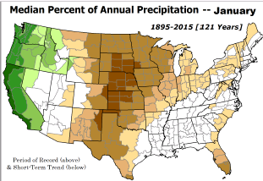
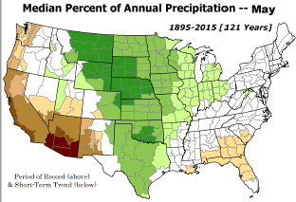
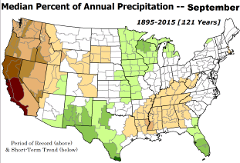
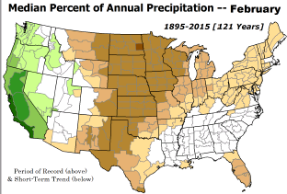
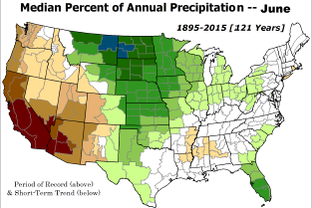
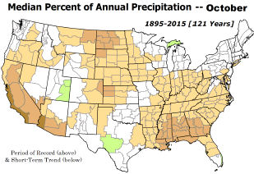

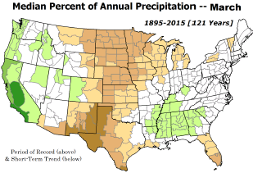
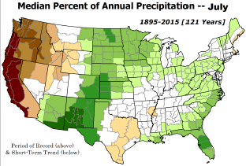
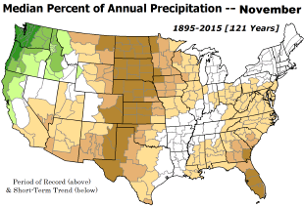
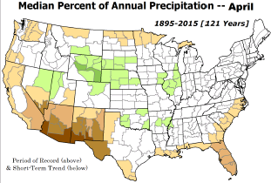
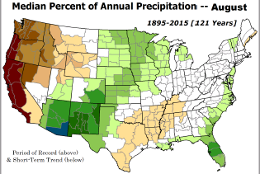
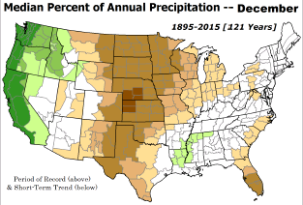
*********
EAST vs
CTR/WEST
Drought Behavior is loosely tied to rainfall climo!! And the limited rainy season in the west
*********
Adapted from Rich Tinker.

Slide 14
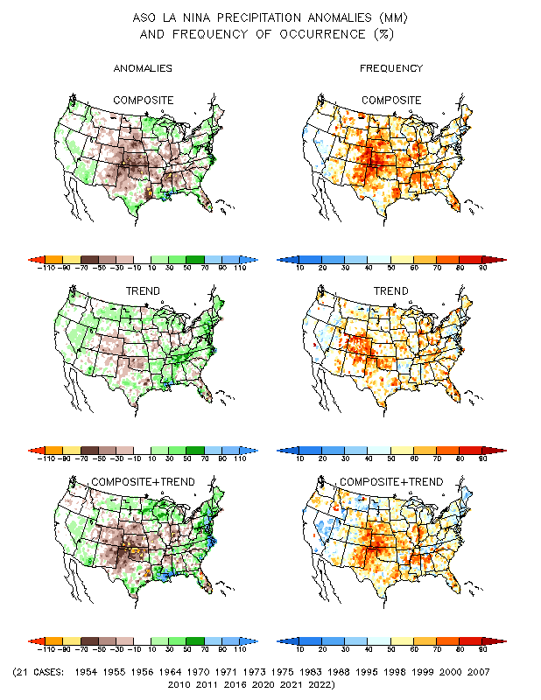
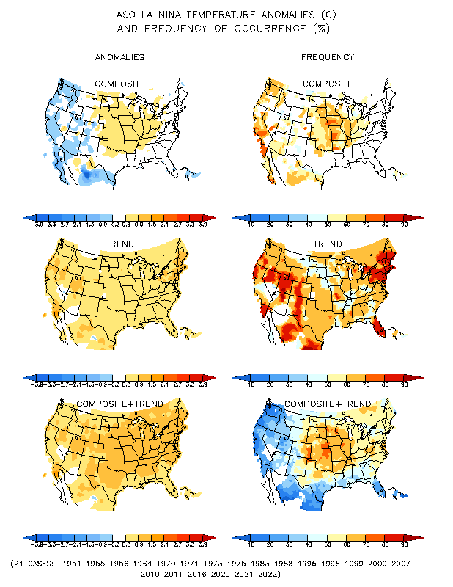
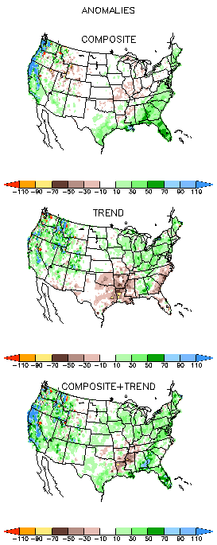
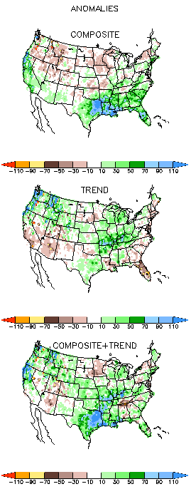
La Nina Precip/Temperature COMPOSITES & Trend map
ASO
P
T
Opposing signals!

Slide 15
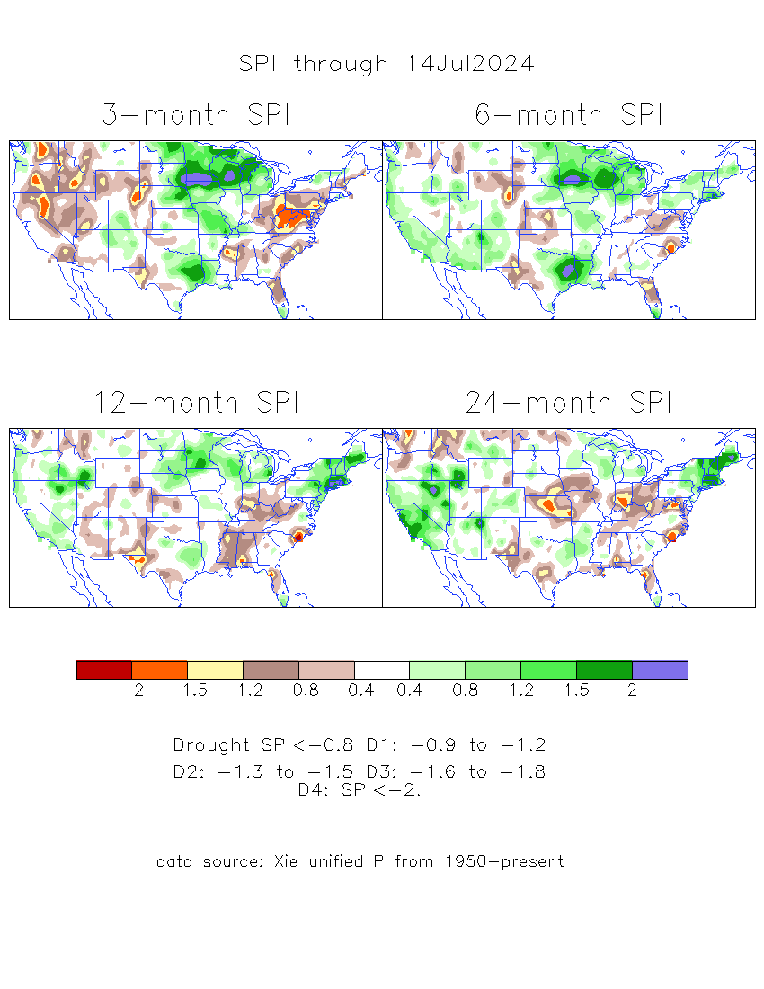
The Standardized Precipitation Index SPI
(based on Observed P)
Compare with last month
----- NOW
Very interesting graphic & details for the drought across the US based on the more generalized precip deficit/excess, the Standardized Precipitation Index (SPI).
The dark brown and red colors, indicating standardized precipitation deficits, in the various time periods, approximately correspond to the appropriate short/long term drought monitor regions and their intensities
Short
Long
How does one negotiate and reconcile declaring short term vs long term drought when precip. deficiencies patterns differ on many different time scales locally!!
What is the cutoff delineating time between short VS long term drought!! Not so clear!!
At exactly where, does drought begin?
The US land area under drought has gone up from last month!
Based on this SPI indicator/measure,
The brown areas are various levels of DRY regions!
The yellow/red are more probably drought regions!

Slide 16
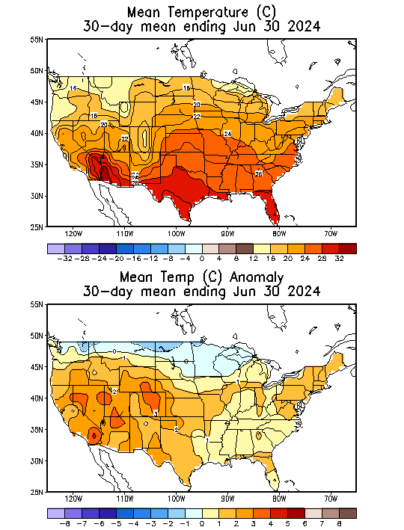
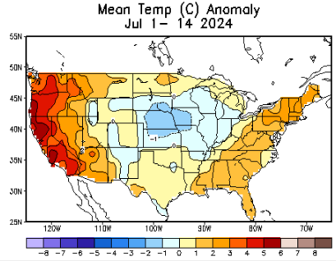
NOW
Recent US Temperatures
.
Last
month !!
So far this month !!

Slide 17
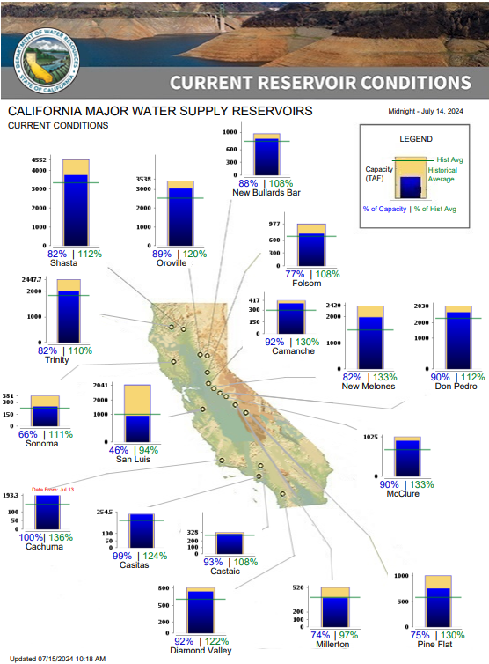

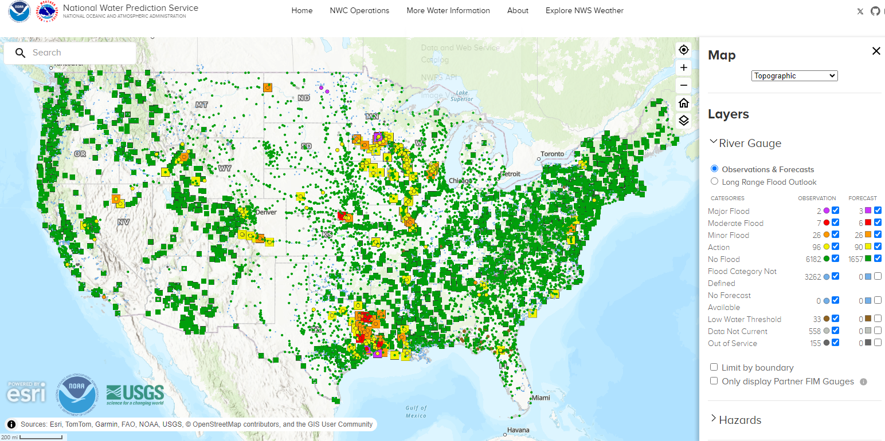

% of Capacity
% of Hist. Avg.
of Reservoirs.
Water Year
(just started!),
Year-to-date Precipitation:
October 1, 2023 – Dec.17, 2023
https://www.nrcs.usda.gov/wps/portal/wcc/home/
Many CA water reservoirs are AT or ABOVE their historical average/ CAPACITY levels ! ☺
https:/www.nohrsc.noaa.gov/interactive/html/map.html?
Overall, across US, less snow on ground than normal!
WHOEVER thought that the California drought/reservoir-water-levels will turn around in just ONE La NINA winter!!
But a very different story for the big lakes Lake Mead & Lake Powell in NV, see next slide! ☹

Slide 18
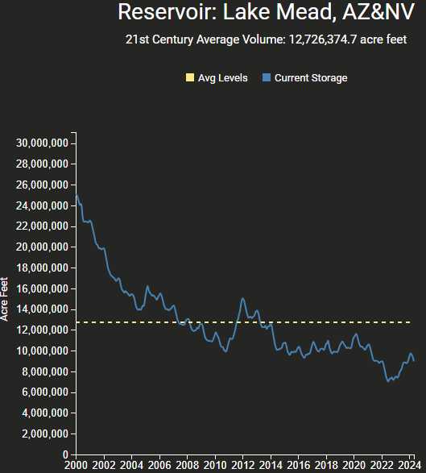
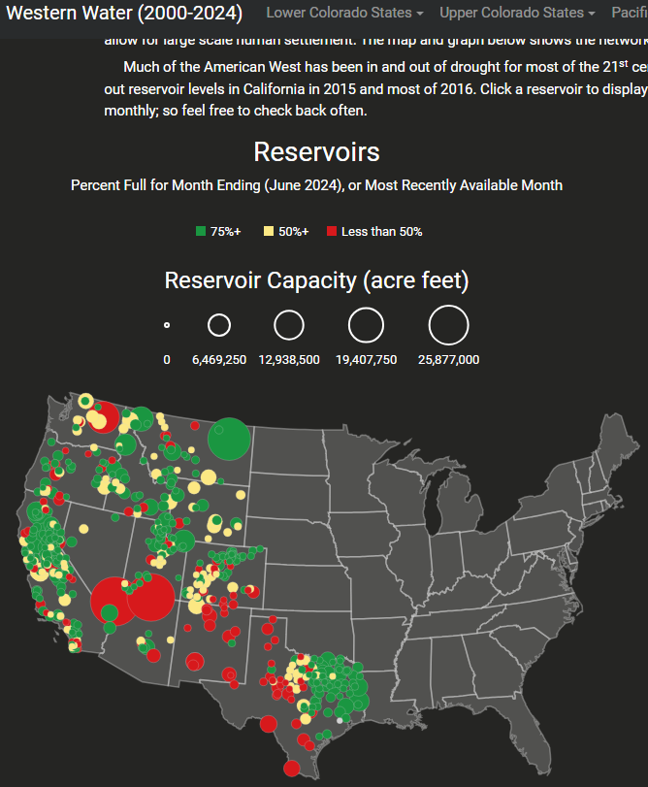
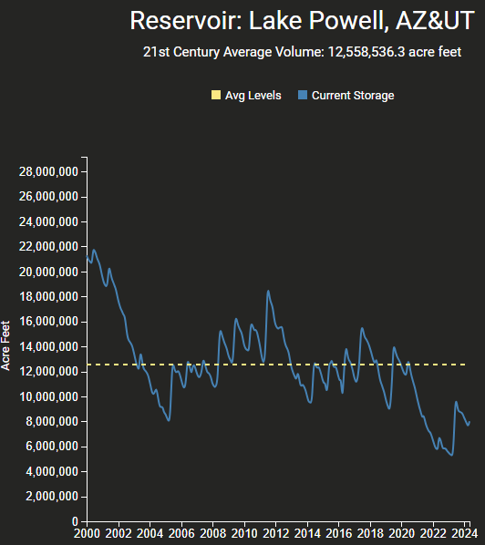
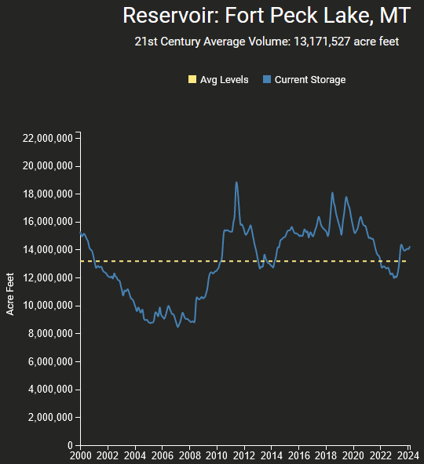
Reservoirs
Percent Full for Month Ending (June 2024), or Most Recently Available Month
Hydro Electric power generating turbines STOP operating at the critical 7 million acre feet level
https://www.deanfarr.com/western_water/
Lakes Mead, Powell in NV/AZ are at low levels! ☹ ☹ HUGE consequences for electric power for western states CA/NV/AZ/UT !! Slowly improving in recent months!

Slide 19
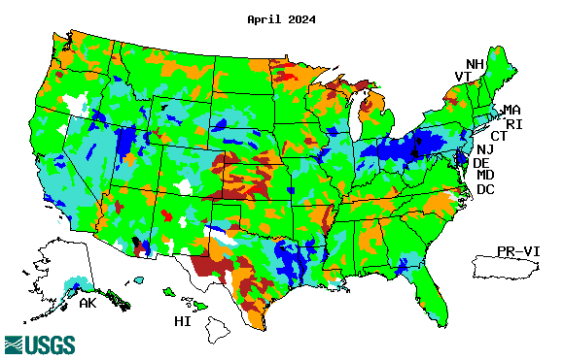






Streamflow (USGS)
Most US east droughts are relatively short lived (as compared to US west).
But in last 2 decades, recently in 2000, 2016, 2020, & 2022, New York and New England experienced historic drought conditions not seen since the 1960s.
Map shows only below normal 7-day average streamflow compared to historical streamflow for the day of year.
One month ago (left) &
Now (below)
Streamflow is only a partial indicator, as sometimes it is highly managed.
If sometimes, the various indicators are confusing, go back to % of rainfall deficit maps – to confirm/reinforce!!
https://waterwatch.usgs.gov/?m=nwc
19

Slide 20

EL NIÑO/SOUTHERN OSCILLATION (ENSO)
DIAGNOSTIC DISCUSSION
issued by
CLIMATE PREDICTION CENTER/NCEP/NWS
and the International Research Institute for Climate and Society
15 July 2024
ENSO Alert System Status: La Niña Watch
Synopsis: ENSO Alert System Status: La Niña Watch
ENSO-neutral conditions are present.*
Equatorial sea surface temperatures (SSTs) are above average in the western and west-central Pacific, near average in the east-central Pacific, and below average in the eastern Pacific Ocean.
ENSO-neutral is expected to continue for the next several months, with La Niña favored to develop during August-October (70% chance) and persist into the Northern Hemisphere winter 2024-25 (79% chance during November-January).*
CPC’s Oceanic Niño Index (ONI) [3 month running mean of ERSST.v5 SST anomalies in the Niño 3.4 region (5ºN-5ºS, 120º-170ºW)], based on centered 30-year base periods updated every 5 years. For historical purposes, periods of below and above normal SSTs are colored in blue and red when the threshold (0.5) is met for a minimum of 5 consecutive 3-month overlapping seasons.

Slide 21





Latest values of SST indices in the various Nino Regions.
The recent El Nino came in a hurry after 3 back-to-back La Ninas has all but gone away in a great hurry to make room or ANOTHER La Nina which is on the way!!? ?

Slide 22


Sub-Surface Temperature Departures in the Equatorial Pacific
Most recent pentad analysis
Is the subsurface cold water content/volume increasing (toward a la Nina event) ?
Or decreasing slightly, lately ???
Will the expected La Nina definitely come?
Is prediction of ENSO even in the next few months, becoming difficult, in this new changing climate we are in now?

Slide 23




Official ENSO Forecasts
June CPC/NOAA forecast
The majority of models indicate ENSO-neutral will persist through July-September 2024. Thereafter, most models indicate a transition to La Niña around August-October 2024.
A slight pull back or slow down in the developing La Nina ??
July CPC/NOAA forecast
https://www.cpc.ncep.noaa.gov/products/people/wwang/cfsv2fcst/images3/PacSSTSeaadj.gif
Latest ensemble membrs (blue!)show are less bullish

Slide 24



Previous (Last Month’s)
CPC’s official
Temperature OUTLOOK for Monthly (July)/Seasonal (JAS)
Monthly P/T forecasts verified at mid-month are generally good! Becoz of good skill upto 2 wks.
Released June 20th
Observed so far this month!! ☺

Slide 25



Previous(Last month)
CPC’s official
Precipitation OUTLOOK for
Monthly (July)/Seasonal (JAS)
Released June 20th
Monthly P/T forecasts verified at mid-month are generally good! (??) Becoz of good skill upto 2 wks.
Observed so far this month!! ☹ ☹
☹

Slide 26




GEFS
WPC/NCEP’s Next 7 days QPF (Quantitative Precipitation Forecast)
GEFS*/GFS Model Guidance for the next 15 days.
(*new)
GFS

Slide 27

From 3 Models average Precip forecast (made 14 & 15 July) for next 30 days.
The 3 Models are: CFSV2, GEFS, ERA5

Slide 28

From 3 Models average Precip forecast (made 14 & 15 July) for next 30 days.
20
40

Slide 29

Except here, the rest of the country looks good, in terms of rainfall, not just in this short time scale/period, but even up to 5 years, see next maps!
From 3 Models average Precip forecasts (made 14 & 15 July) for next 30 days.

Slide 30

From 3 Models average Precip forecasts (made 16 & 17 June) for next 30 days.

Slide 31

Drought threat does not look bad even in long term! Only in the near short term! All depends on the monsoon this year in the SW.
From 3 Models average Precip forecasts (made yesterday 16 &17 June) for next 30 days.

Slide 32

Even thru’ up to 5 years period, the country as a whole looks good, in terms of good rainfall!!! And lower drought coverage!!
From 3 Models average Precip forecasts (made 16 & 17 June) for next 30 days.

Slide 33




NMME*
T (left) &
P (right)
Ens.Mean forecasts for
Aug
T
P
ASO
Note this general area of deficient precip forecast during the next 3 months, implying a weakened upcoming SW monsoon! (as was last year!)
More HOT!
NMME* : North American Multi Models Ensemble

Slide 34

Agreement/Disagreement among the various NMME models’ ASO seasonal Precip. Forecast.
??

Slide 35




http://drought.geo.msu.edu/research/forecast/smi.monthly.php
Predicted Monthly Soil Moisture Percentile
Latest Initial Conditions: 6/11/24
DATA not available !
CPC’s soil moisture percentile – Leaky bucket Model
The inter quartile range suggest greater uncertainty about the forecast in these shaded regions in the ESP based forecast!

Slide 36


BONUS Topic: Discussion continues!! Explanation for the multiyear DROUGHT in the Southwest (CA/AZ/NM/NV/UT/CO & vicinity)!!
More La Nina’s lately ?
More frequent La Ninas lately ?
YES!! The stats in the table below (bottom left) are from the Official CPC ENSO declarations page/table!
(SKIP)
slide
Compared to other regions of the globe, the SST warming/trend in the central eq. Pacific (Nino 3.4) is relatively much small. (See Fig. above) – Why is this ?
Does nature try to compensate for the warming else/everywhere by producing more La Ninas in the equatorial Pacific? - Just my observation from data! Let’s check !!!
Since the 1997 monster El Nino (stronger than the famous 1982/83 event), just a quick count of CPC’s Nino 3.4 index++ values for the three month overlapping seasons, (Data at CPC site only available only from 1950!)
(27 years) (47 years) (74 years)
1997-2023 1950-1996 1950-2023
La Nina(DJF) 13 16 29
El Nino(DJF) 9 17 26
La Nina(all 3mos) 119 150 269
El Nino(all 3mos) 85 166 250
(Overlapping 3month seasons)
Look at Ratios of La Ninas (vs El Ninos) in the shorter
recent (27 yr) period vs the longer (47 yr) earlier period!!
Compare the ratios of La Nina to El Nino in the squared boxes.
***Analysis of CPC’s official Nino 3.4 index data over the last 70 years shows that the more frequent La Ninas in recent decades contributed to less rainfall in the southwest (See La Nina precip composites!, slide#13) and hence the ongoing long term drought in the Southwest!! Hence the long term southwest drought is unlikely to go away any time soon***
++ Barnston, Chelliah and Goldenberg (1997):Documentation of a highly ENSO‐related SST region in the equatorial pacific,
Atmosphere-Ocean Volume 35, 1997. https://doi.org/10.1080/07055900.1997.9649597
*** The strong/weak annual monsoon rains in the southwest is a minor modulator riding on this bigger/longer-term signal. ***

Slide 37
Summary
Current Drought conditions:
California has remained drought free for about 18 months now. Above normal rainfall (strangely) during last year’s La Nina winter (2022/23) and (canonically, as expected) during this year’s El Nino winter (2023/24) in California, thus two back to back above normal winter rainfall seasons, have more than compensated for, and totally eliminated the both the Long & Short term drought in the region.
Water levels in almost all CA reservoirs are now at or well above their normal levels. However, the water storage levels in the much bigger lakes, Lake Powell and Lake Mead in NV/AZ still continue to be very low, and have not recovered from the 2+ decade(s) long hydrological drought that existed in the region.
The S/L term drought in the interior Pacific Northwest and in parts of WA, ID & MT is still stubbornly persisting. But drought in MN/IA/WI/ MO/KS is nearly gone, as we had suggested.
We have been suggesting/projecting for the past few months that the overall drought situation across the entire US will be improving slowly and steadily, and it actually happened as suggested. As we suggested earlier, last month, a large 71% (3 months ago it was only 54 %) of the lower 48 states was totally drought free. Having reached the “near bottom” for the % of US areas covered under drought during last month, we again suggested a possible increase in drought area coverage over the next few months and it happened this month!! Questions remain about when & the strength of the upcoming La Nina!
The upcoming La Nina, which is generally a poor rainfall period for the US, combined with the hot summer temperatures may begin to slowly increase the US areas under drought.
While CA is totally drought free (ST & LT) large parts of AZ/NM and even western of TX are still under drought due to long term/decadal drought in the SW, as well as the poor SW monsoon this past year (2023). Another possible 2024 poor SW monsoon in AZ/NM and in vicinity might persist or even make the current drought in the region worse. The emerging S/T dryness/drought in the SW is really a bit more ominous than the temporary flash dryness in the east.
Current ENSO status and forecast: ENSO-neutral conditions are present. ENSO-neutral is expected to continue for the next several (??) months, with La Niña favored to develop during August-October (70% chance) and persist into the Northern Hemisphere winter 2024-25 (79% chance during November-January).*
Prediction: Even this close, during the upcoming ASO forecast season there are still in in ENSO-neutral territory, again very tricky, in terms of possibly expecting any La Nina impacts for the upcoming forecast season!. Again, the expected strength of the La Nina during ASO is likely to be weak. Nevertheless, the models are somewhat consistent in predicting certain key precipitation futures across the United States, not to mention the overall above normal warmth across the US.
The models are somewhat unanimous in predicting a huge dry patch and a relatively weak monsoon, again this year, in the southwest, around the AZ/NM/UT/CO four corner states and western TX, and less precip than normal in to areas extending further north along the mountainous Rockies into WY, ID and MT. The existing drought in parts of SD,NE, KS are also particularly vulnerable, and may continue that way without much improvement. Overall, % of US land areas under drought will slightly increase from existing very low levels, mainly due to drought concern in the western/central US states.
The wetness forecast during ASO along the southeast, associated with or combined with the above normal hurricane season, and the rainfall climatology will likely remove any traces of dryness/drought in the region (as per USDM), and by the end of the season, will likely prevent any drought of any potential concern. This same argument applies to the mid-Atlantic states as well. The recent drought declaration in much of the eastern US states was for only a short very transient and is considered far less ominous than the drought development/concern in the US southwest states, especially due to possible poor monsoon in the region and further north. *****

