Slide 1
Drought Outlook Support Briefing (formerly Drought Outlook Discussion) June 2018
Climate Prediction Center/NCEP/NOAA
http://www.cpc.ncep.noaa.gov/products/Drought
Phone: 1-877-680-3341
Pwd: 858747#

Slide 2
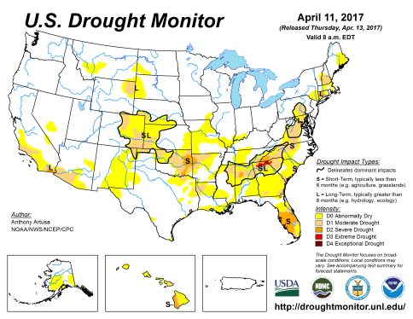
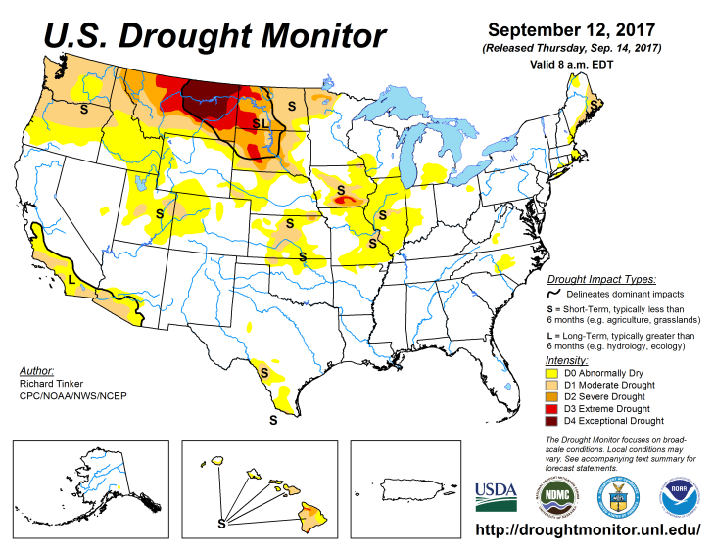
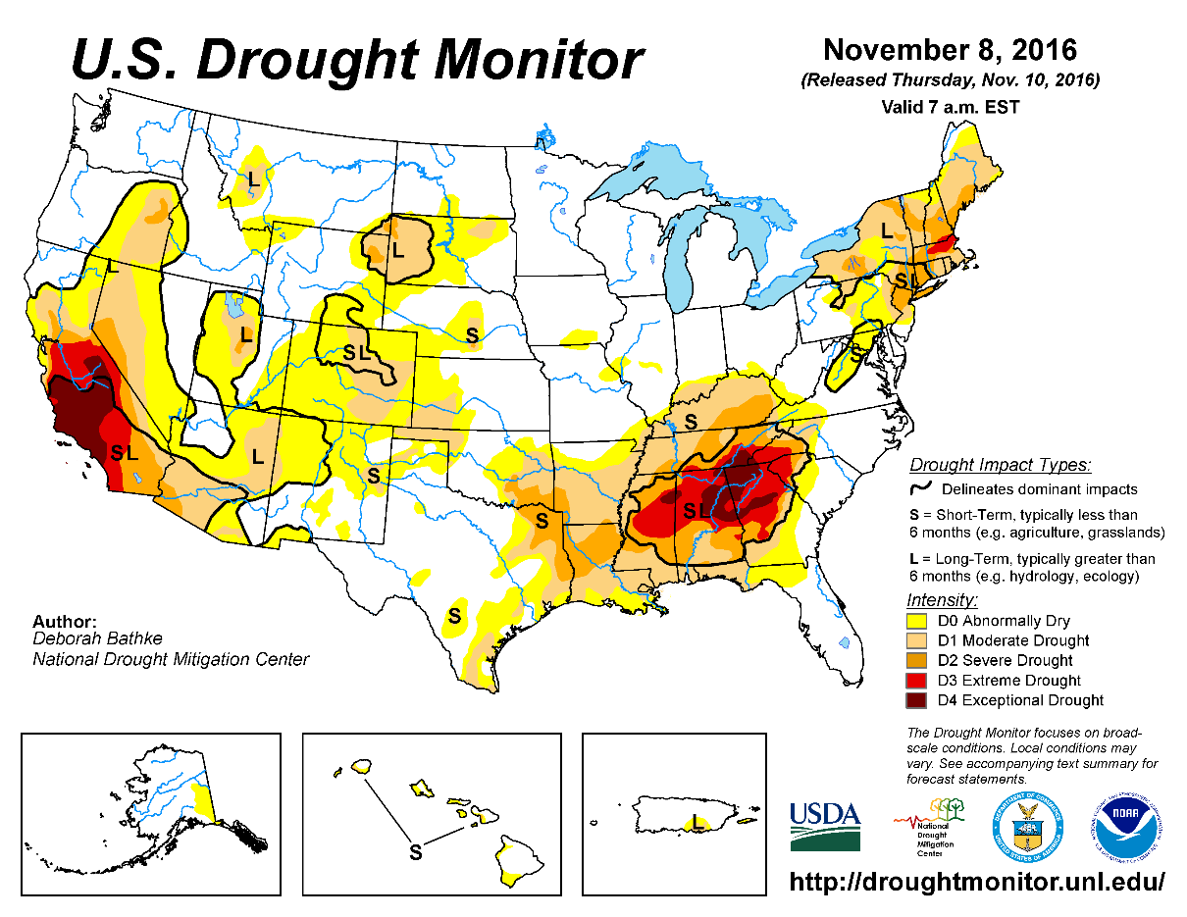
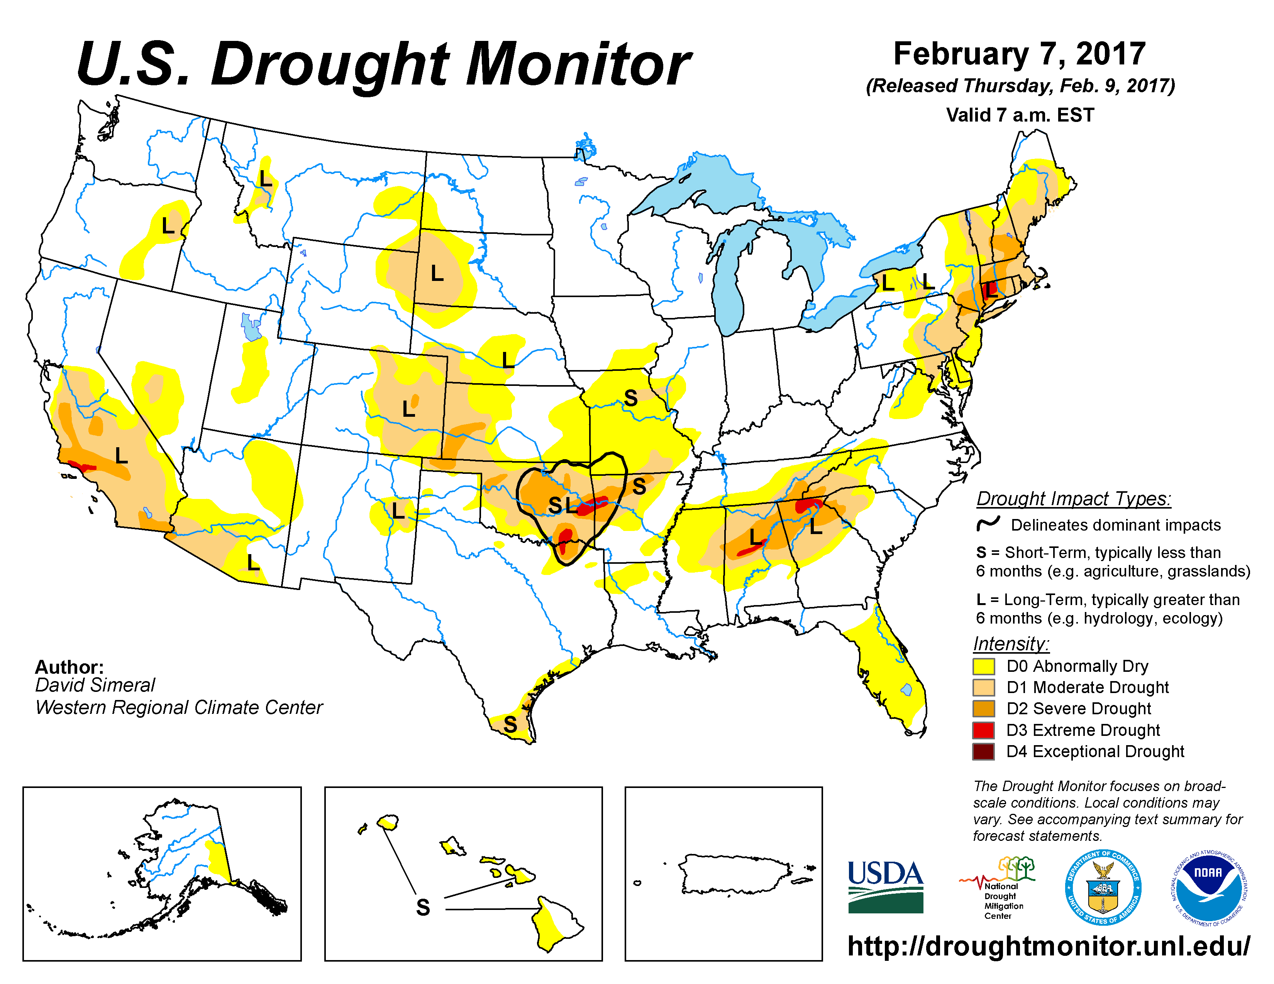
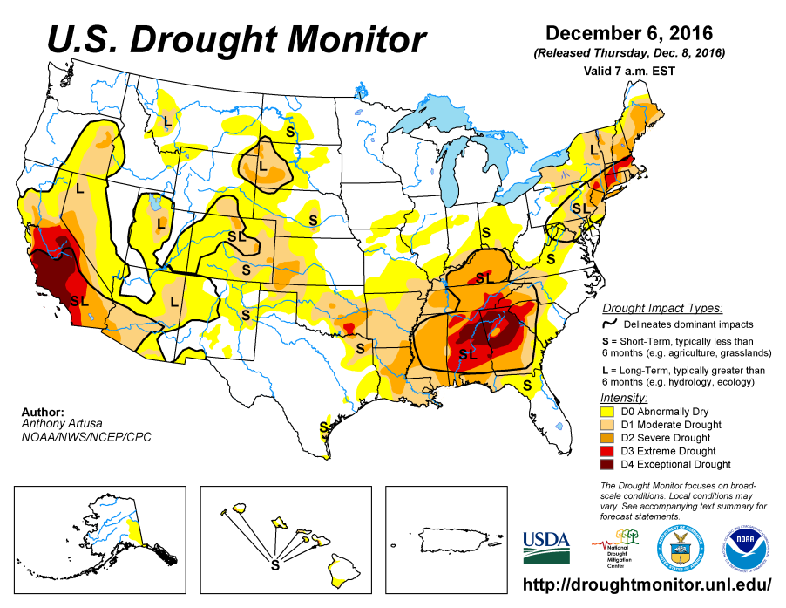
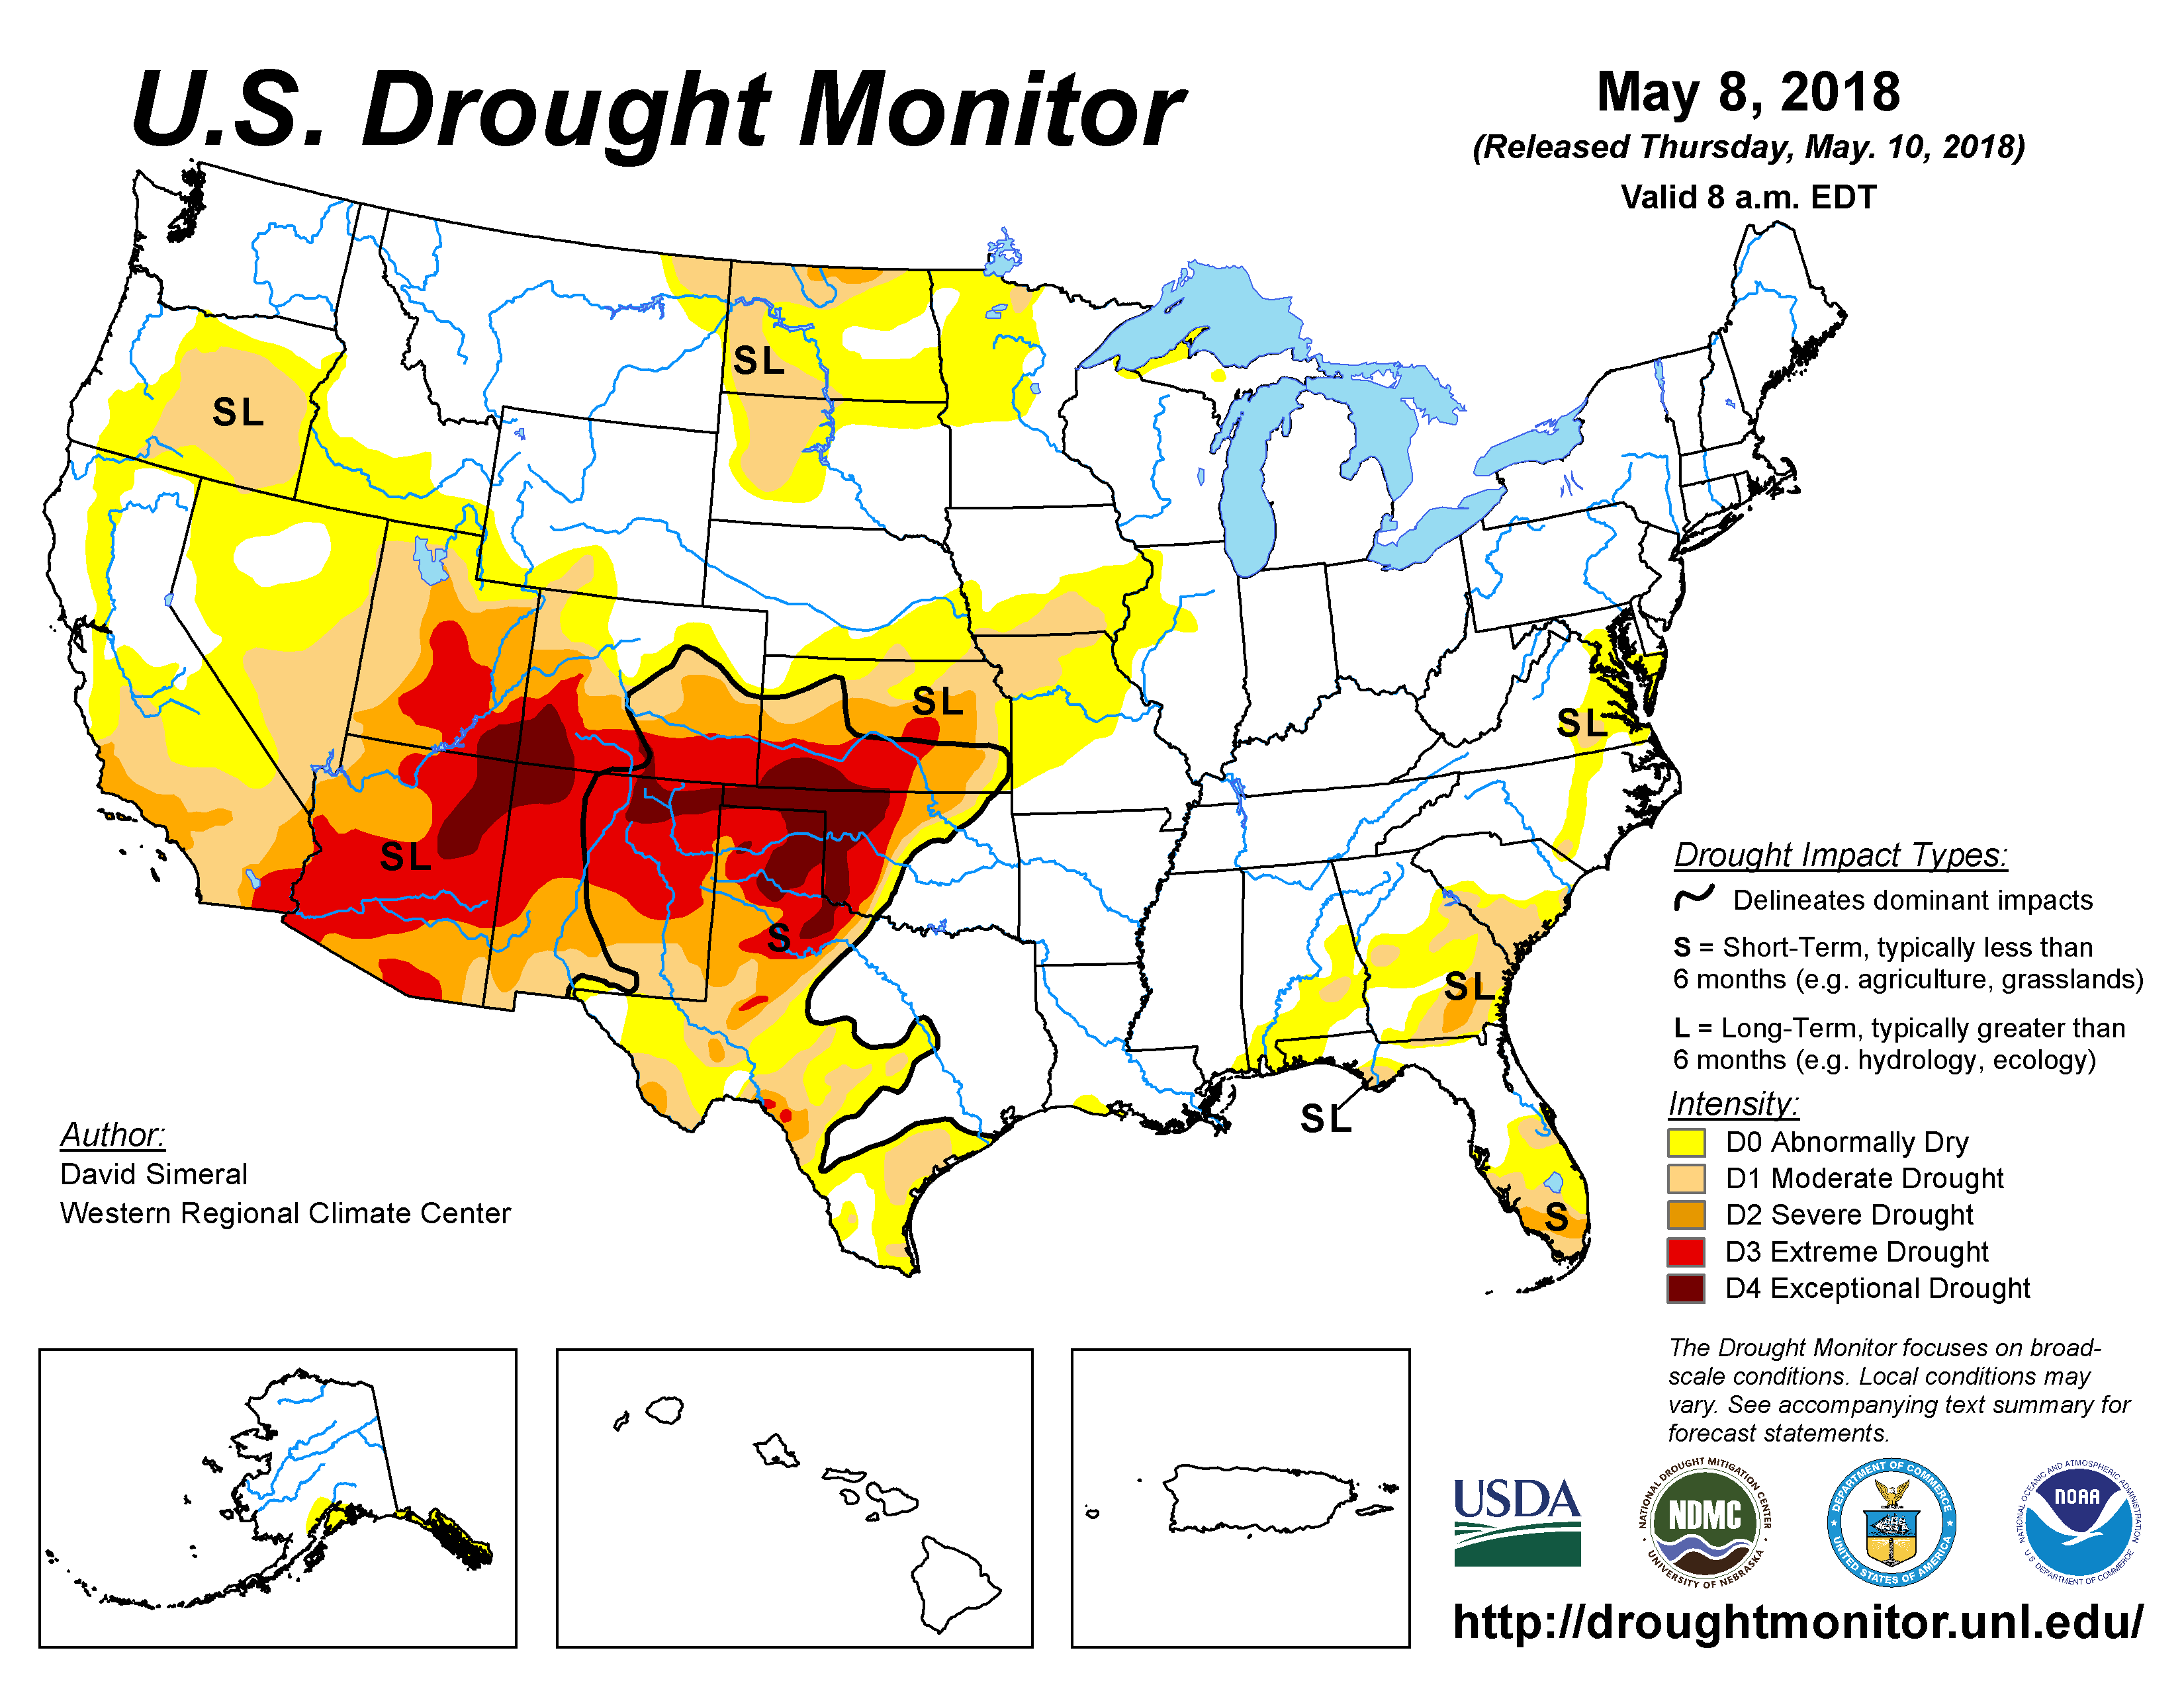
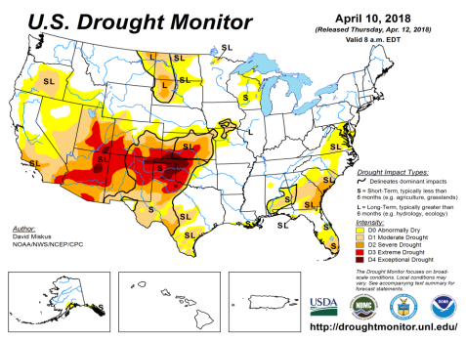
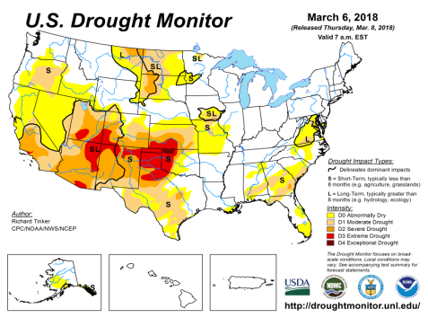
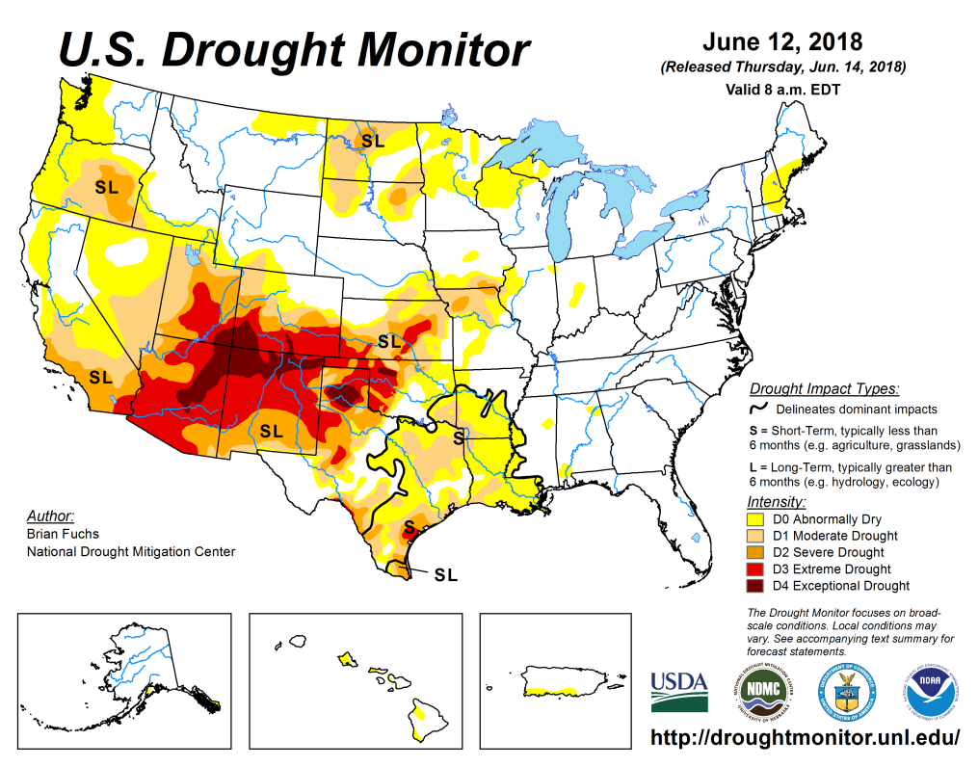
Drought Monitor
May
Apr
Previous
Mar
The USDM is relatively overall the same over the last few months, in the southwester states, particularly UT, AZ,CO, NM, TX, OK, KS.
Even though ENSO has already transitioned from La Nina to neutral conditions, the drought impacts in the southwest continue to linger, or has even gotten worse.
Latest/Recent

Slide 3
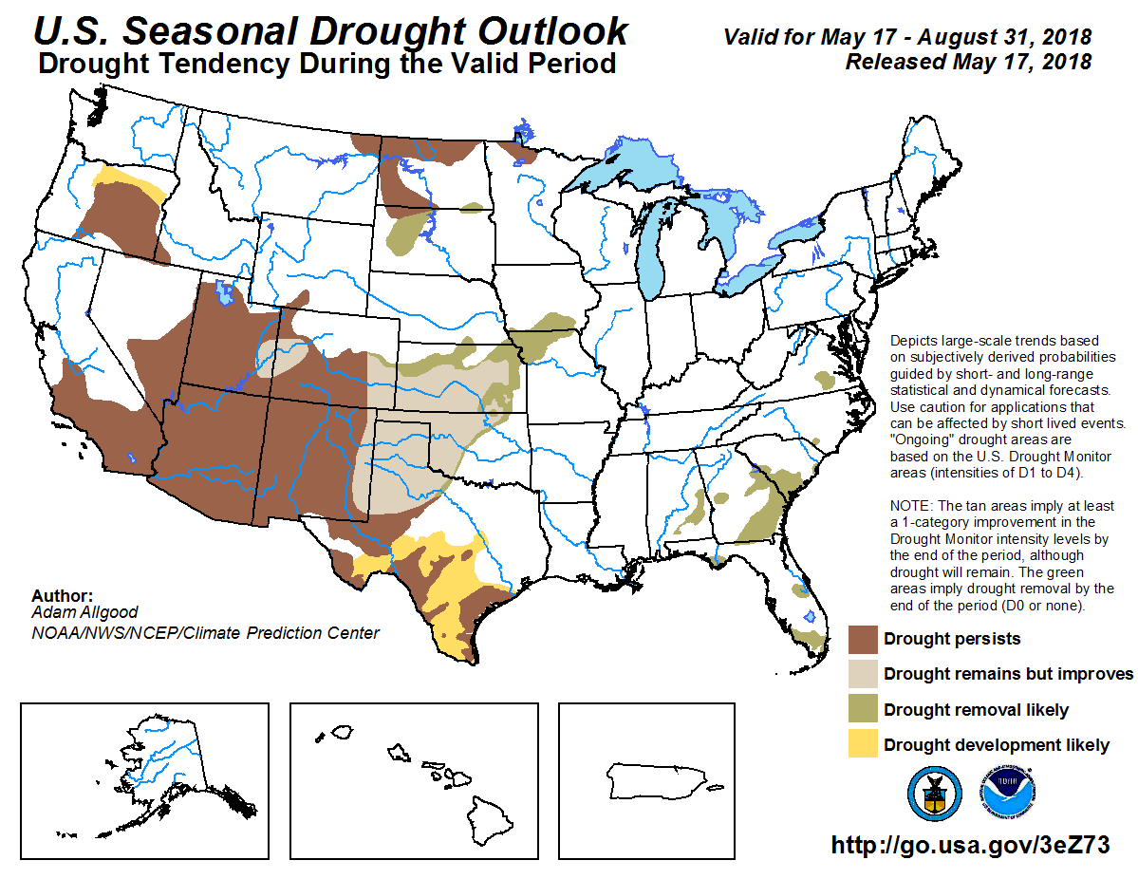
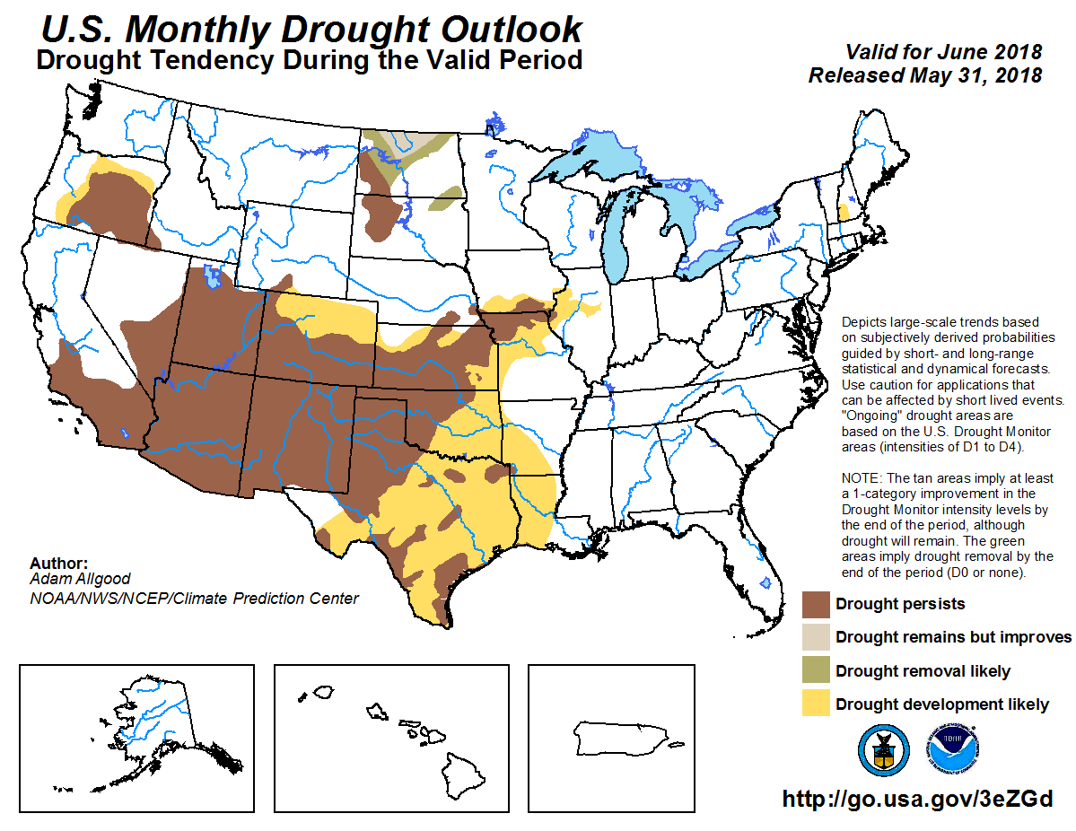
(Prev) Seasonal/Monthly Drought outlooks
Seasonal Outlook (Mid May 2018 - Aug 2018)
issued 05/17/18
Monthly outlook
(for June 2018)
issued 05/31/18
As noted while the area/extent covered by drought across the south/west has relatively stayed about the same, as noted in the previous slide, the monthly forecast of the same has also danced along the edges. But the seasonal forecast issued last month is suggesting some improvement in some parts of the southwest and the south.

Slide 4
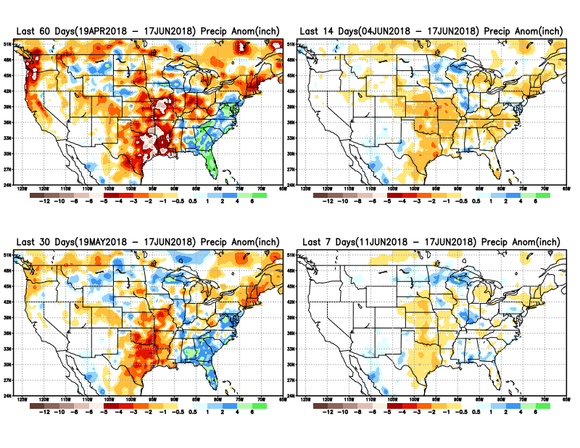
Total precipitation ANOM during last 7, 14, 30, & 60 days.
Some improvement in the Upper Midwest and eastern part eastern Northern Plains, possibly easing drought conditions there.
But the region of concern is the South, parts of Midwest.
Increasing dryness in far northeast and far northwest!!

Slide 5
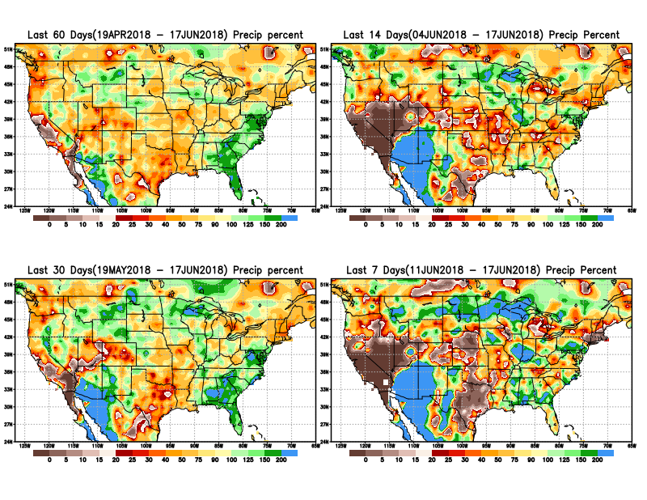
Total precipitation Percent during last 7, 14, 30, & 60 days.

Slide 6
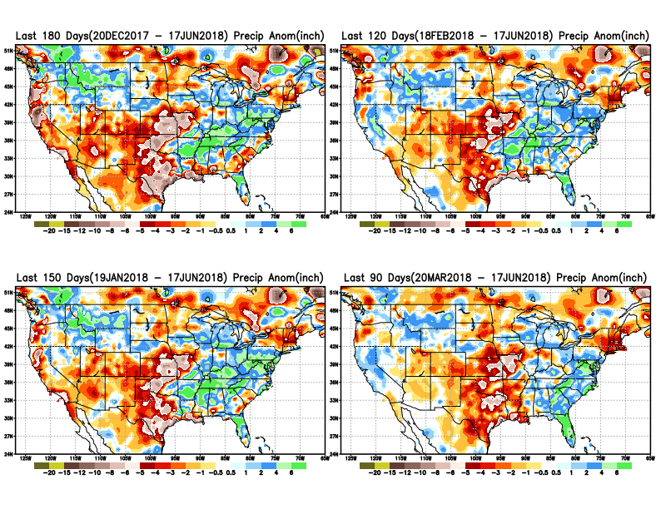
Total precipitation ANOM during last 3, 4, 5, and 6 months.

Slide 7
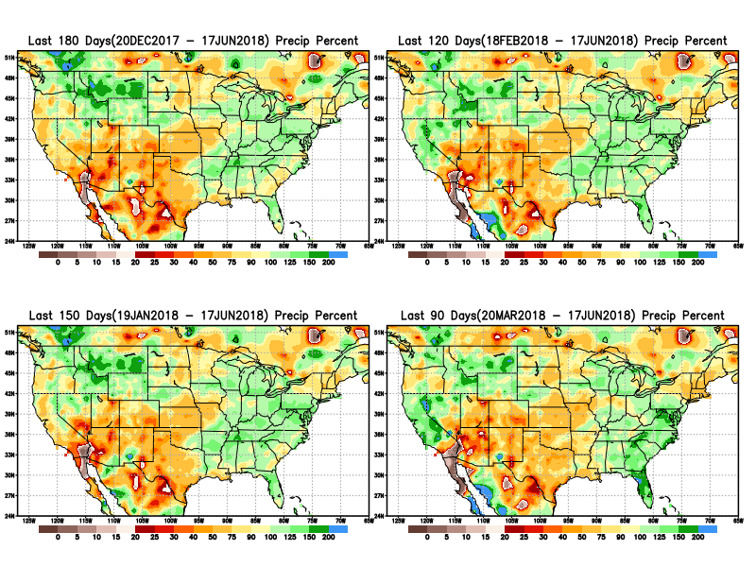
Total precipitation Percent during last 3, 4, 5, and 6 months.
Note Precipitation deficits

Slide 8
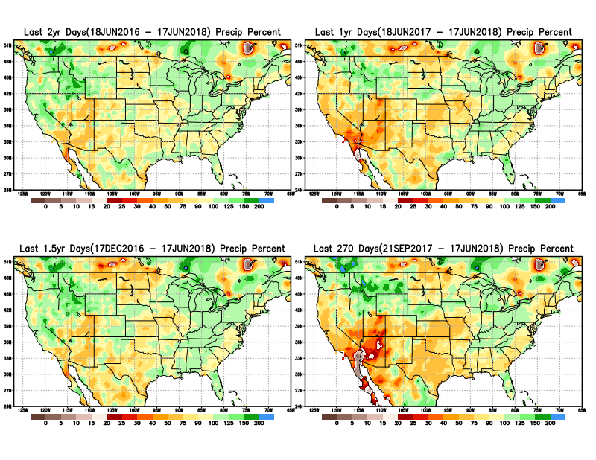
Total precipitation Percent during last 9 months, 1 yr, 1.5yrs, & 2 yrs.
There are many long term rainfall deficit regions in the country, particularly deficits in UT/AZ, southern CA, and parts of NM/CO are long term – possibly a consequence of the two back to back La Nina’s!
Still longer term variability in play? Especially in the southwest!

Slide 9
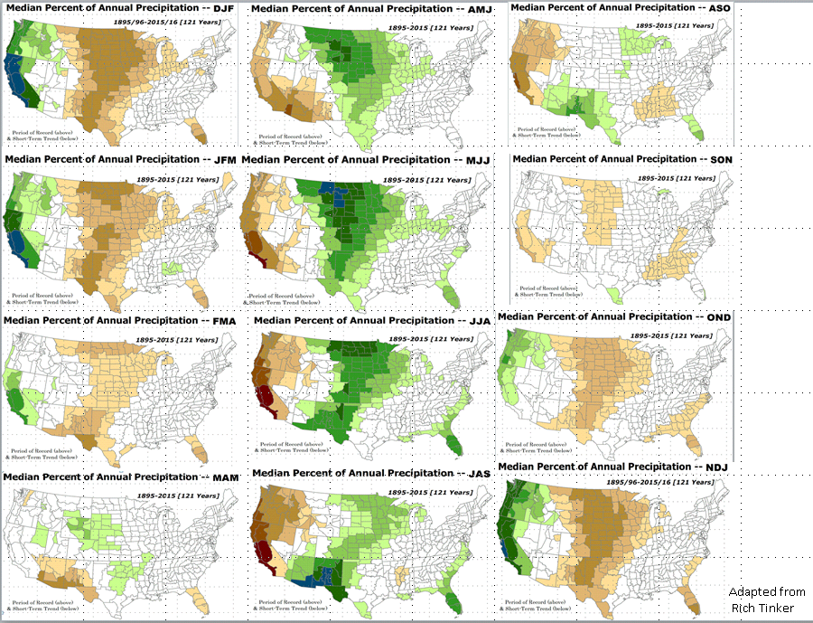
Rainy Season across the US

Slide 10
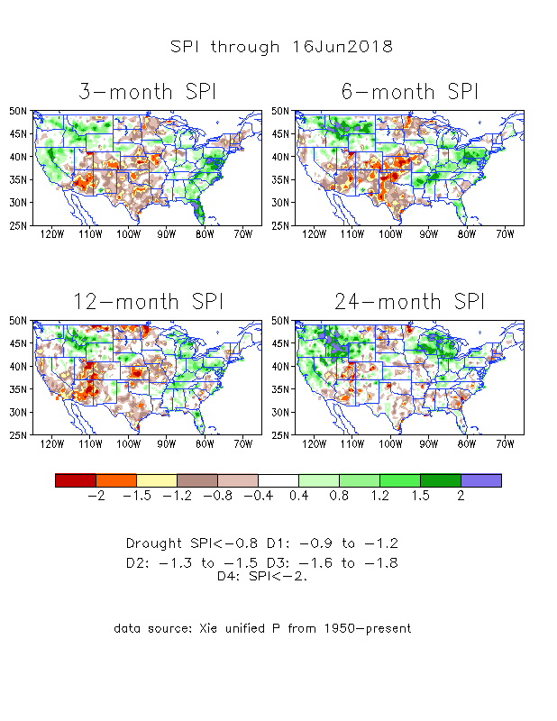
The Standardized Precipitation Index SPI (based on Observed P)
----- NOW
Very interesting graphic & details for the drought across the US based on the more generalized precip deficit/excess, the Standardized Precipitation Index (SPI).
The dark brown and red colors, indicating standardized precipitation deficits, in the various time periods, approximately correspond to the appropriate short/long term drought monitor regions and their intensities

Slide 11
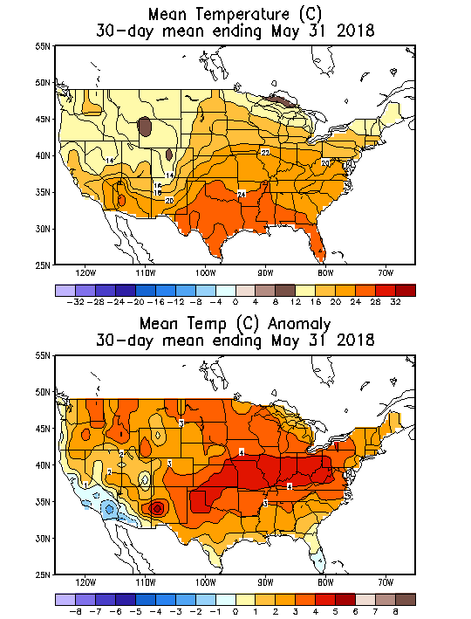
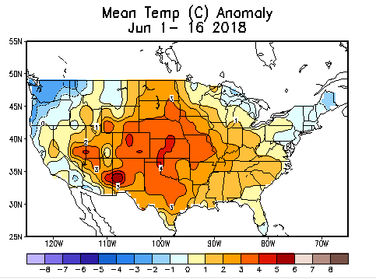
Recent US Temperatures
A total switch from cold April to a warm May!
The warmth continues in June, except in the Pacific northwest. Will it continue to stay this way?

Slide 12
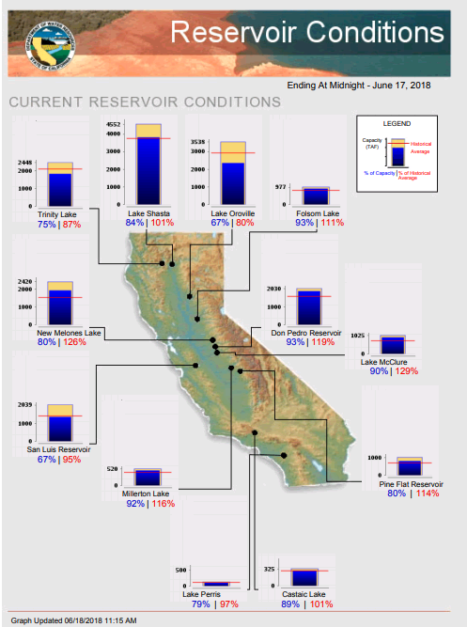
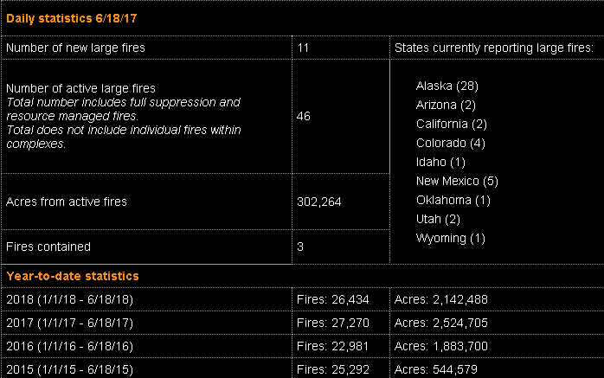
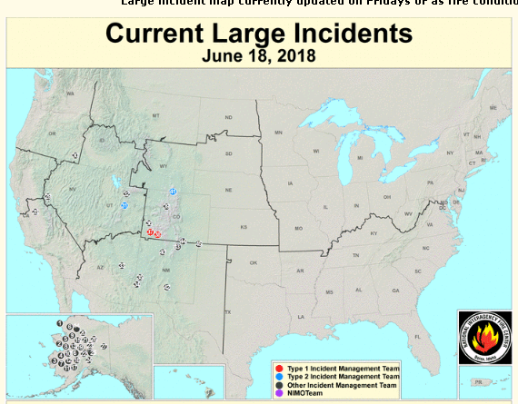
Most of the CA reservoirs continue to be at better than satisfactory levels, except for the Lake Oroville near northern Sierra Nevada. Lake Oroville construction update? Nearing completion?
FIRE
http://cdec.water.ca.gov/cgi-progs/products/rescond.pdf
https://fsapps.nwcg.gov/afm/index.php

Slide 13
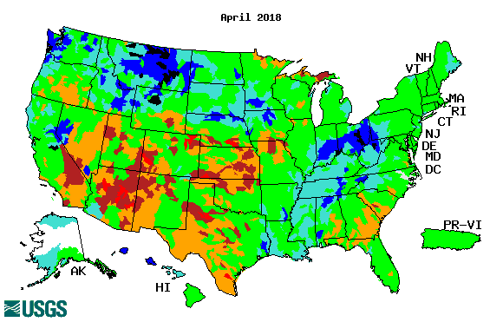
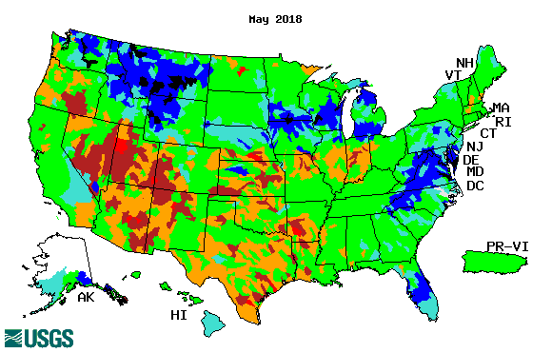
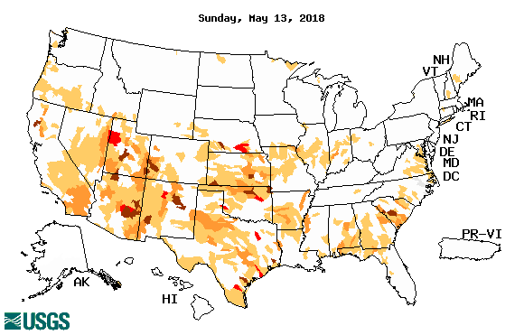
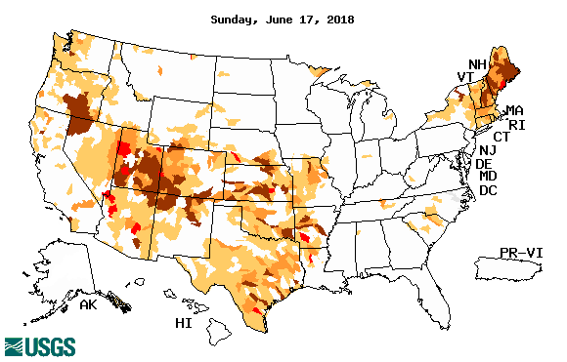
Streamflow (USGS)
The warming temps are melting the frozen ice and snow, which has resulted in increased streamflow in the northern high plains states.
Worsened in south central and south western states, but better in the southeast and along the Atlantic coastal states.
Map shows only below normal 7-day average streamflow compared to historical streamflow for the day of year.
One month ago (left) & Now (below)

Slide 14
EL NIÑO/SOUTHERN OSCILLATION (ENSO)
DIAGNOSTIC DISCUSSION
issued by CLIMATE PREDICTION CENTER/NCEP/NWS and the International Research Institute for Climate and Society
14 June 2018
ENSO Alert System Status: El Nino Watch !!
Synopsis: ENSO-neutral is favored through Northern Hemisphere summer 2018, with the chance for El Niño increasing to 50% during fall, and ~65% during winter 2018-19.

Slide 15
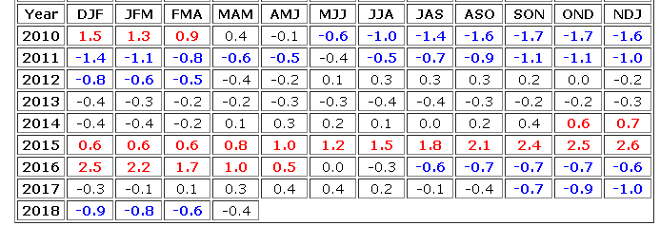
La Nina out, but effects linger? Or Neutral conditions ?
http://www.cpc.ncep.noaa.gov/products/analysis_monitoring/ensostuff/ensoyears.shtml

Slide 16
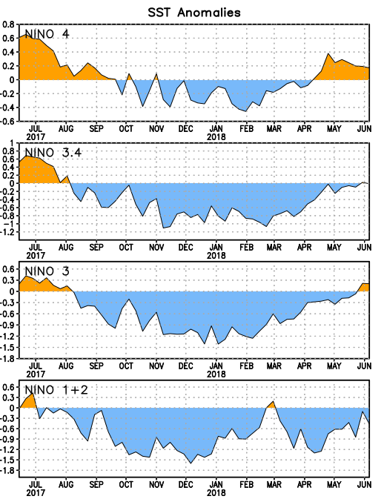
Latest values of SST indices in the various Nino Regions.
The sub surface heat anom is well in the +ve territory! .
Relatively short lived!
Equatorial SST’s are at near to slightly below normal levels in all three ocean basins.

Slide 17
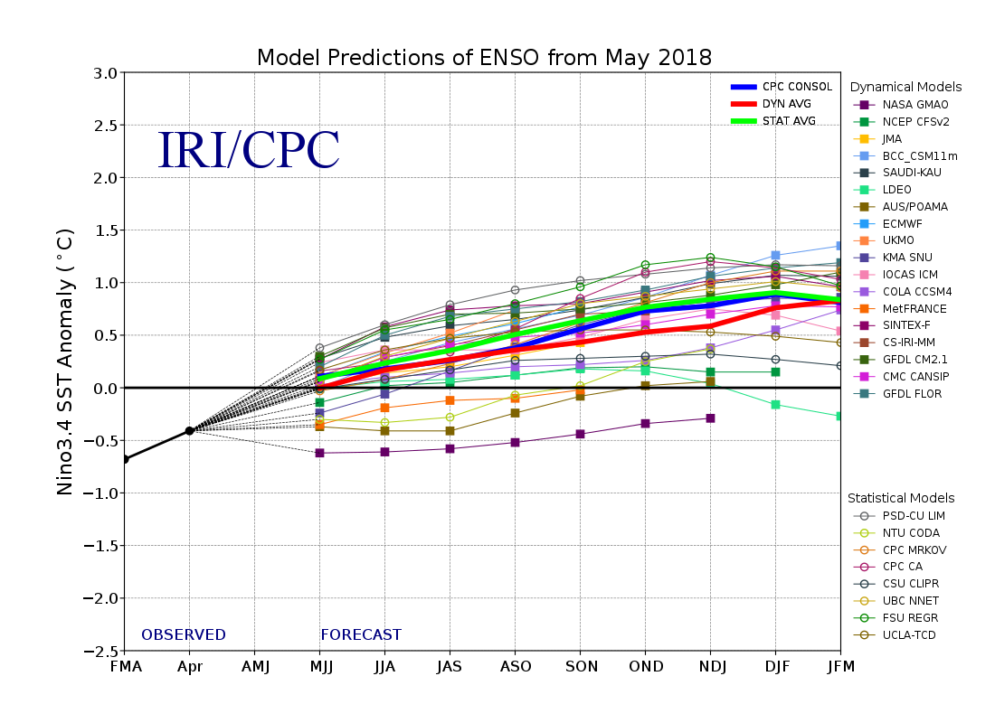
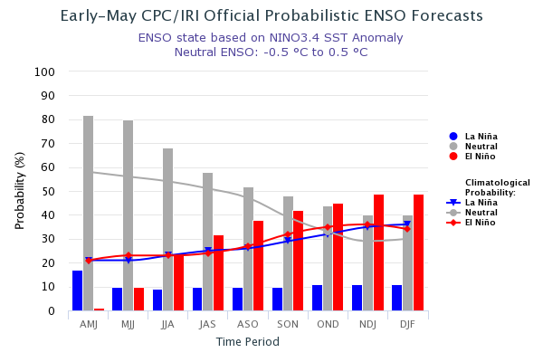
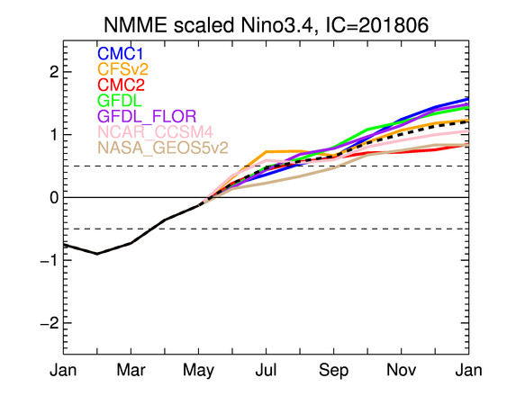
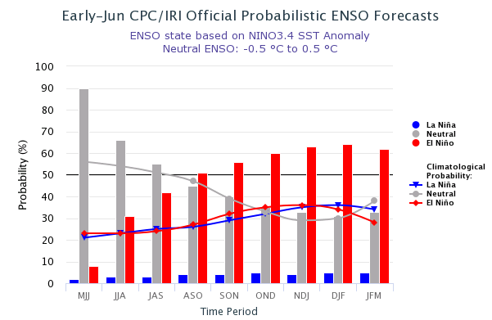
ENSO Forecasts
Early- May CPC/IRI forecast
NMME Models’ – Nino 3.4 forecasts
Early- June CPC/IRI forecast
For Next/upcoming summer: Chance of ElNino(/Neutral) is Fifty/Fifty!! Afterwards, trending towards El Nino in upcoming winter?

Slide 18
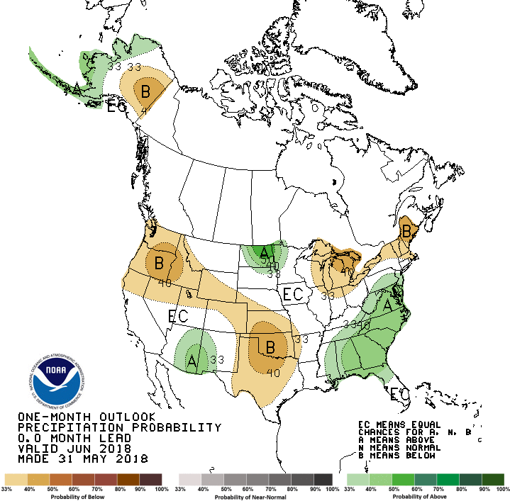
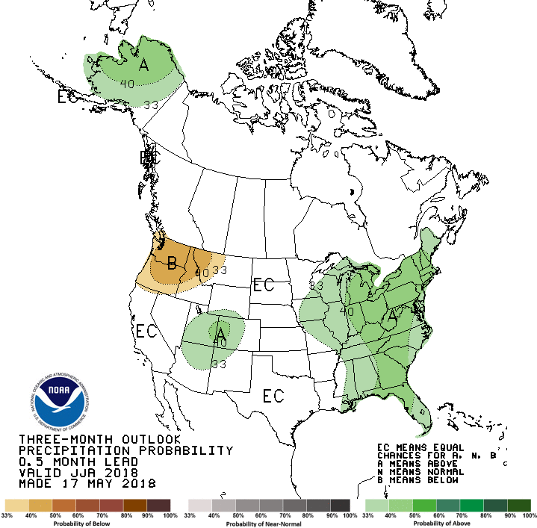
Previous CPC’s official Monthly (June) /Seasonal (JJA)
Precipitation outlook
Released May 31st
Released May 17th

Slide 19
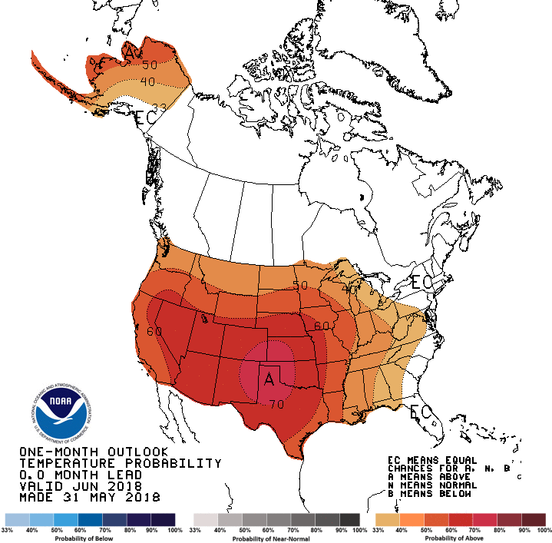
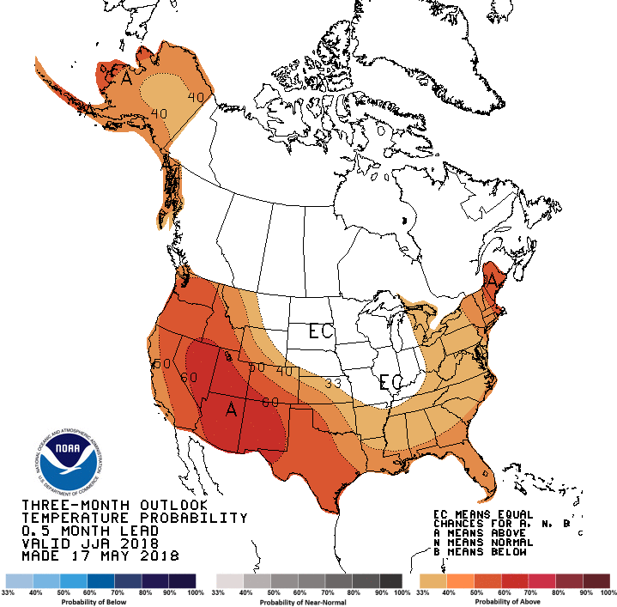
Previous CPC’s official Monthly (Jun) /Seasonal (JJA)
Temperature outlook
Made
May 31st
Made May 17th

Slide 20
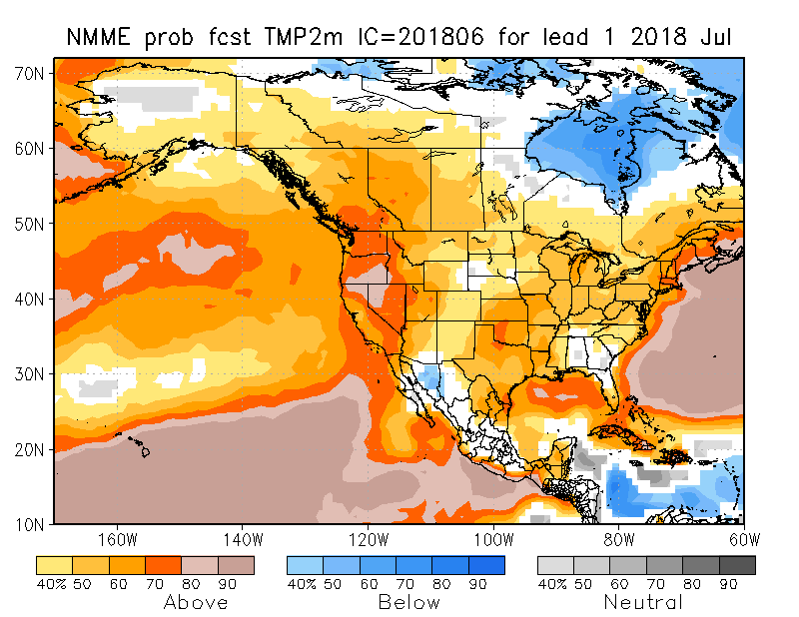
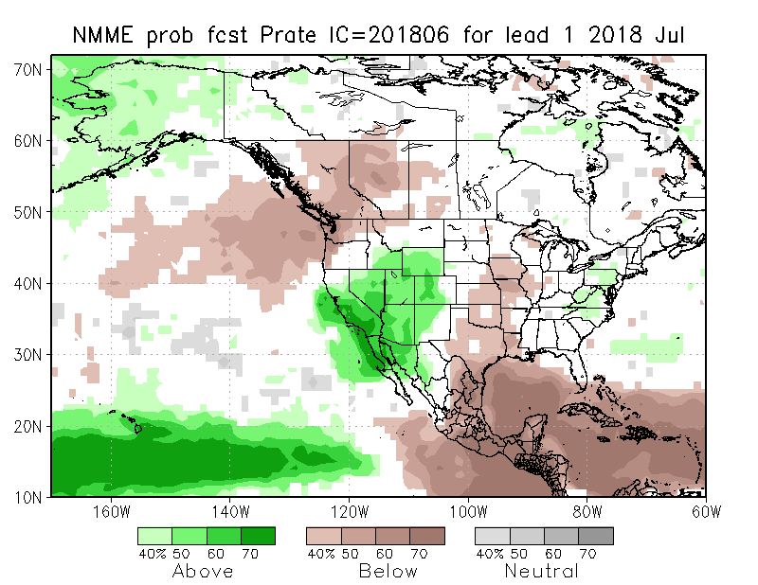
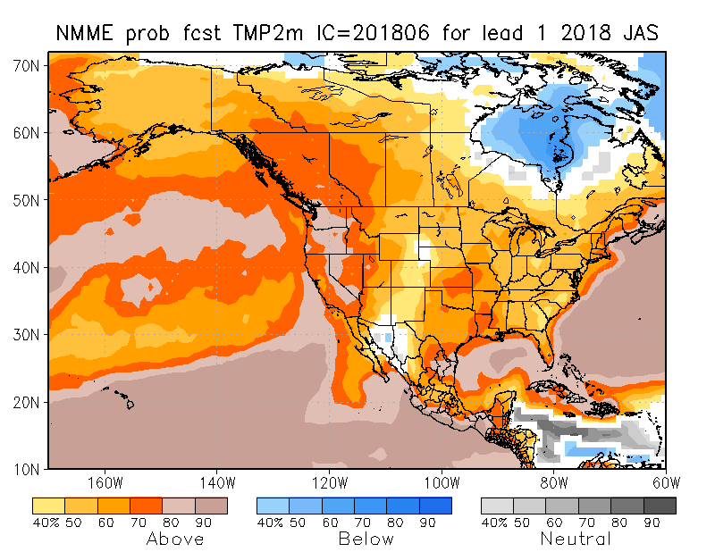
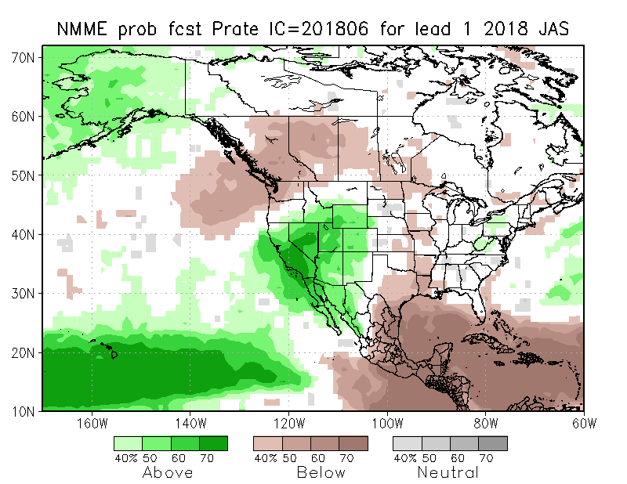
NMME T & P EnsMean forecasts
July
JAS
The La Nina has officially ended and tropical equatorial Pacific is in neutral conditions. T forecasts over US is characterized by general warmth/trend across the country (>80% in the west!). Above normal precip over southern CA/NV and vicinity in summer is very interesting. But ?(see next slide)!

Slide 21
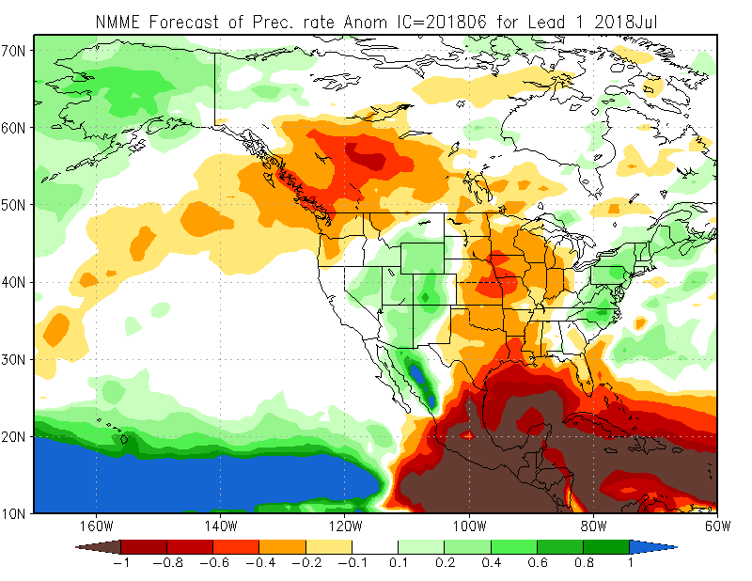
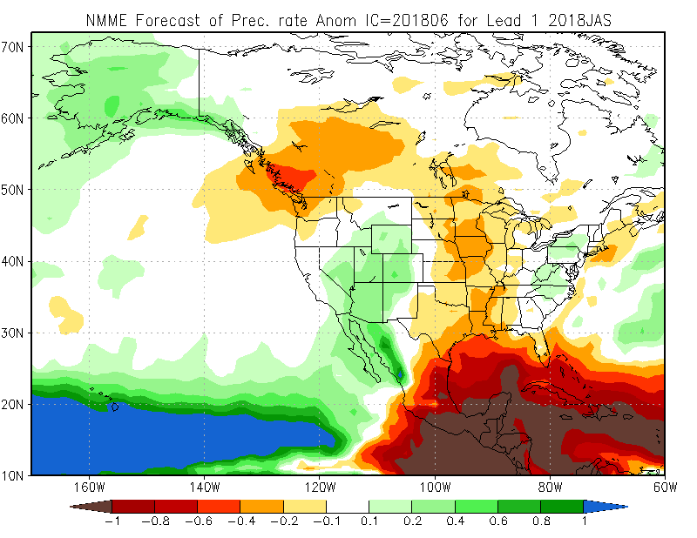
Prate ANOM forecast - NMME

Slide 22
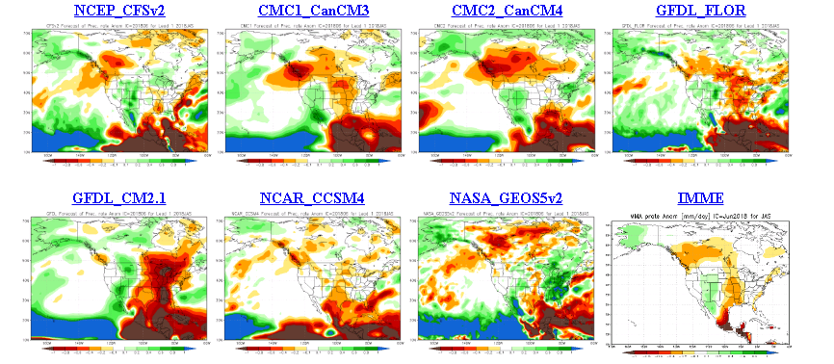
The agreement/uncertainty among the diff. NMME models’ forecasts for July-Aug-Sep Precipitation!!!
?? There is a little bit more agreement for the precip in the southwest, amongst the various models, which the ensemble mean is picking up!!

Slide 23
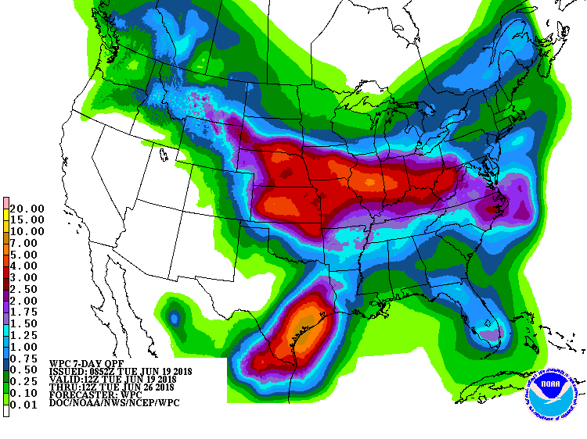
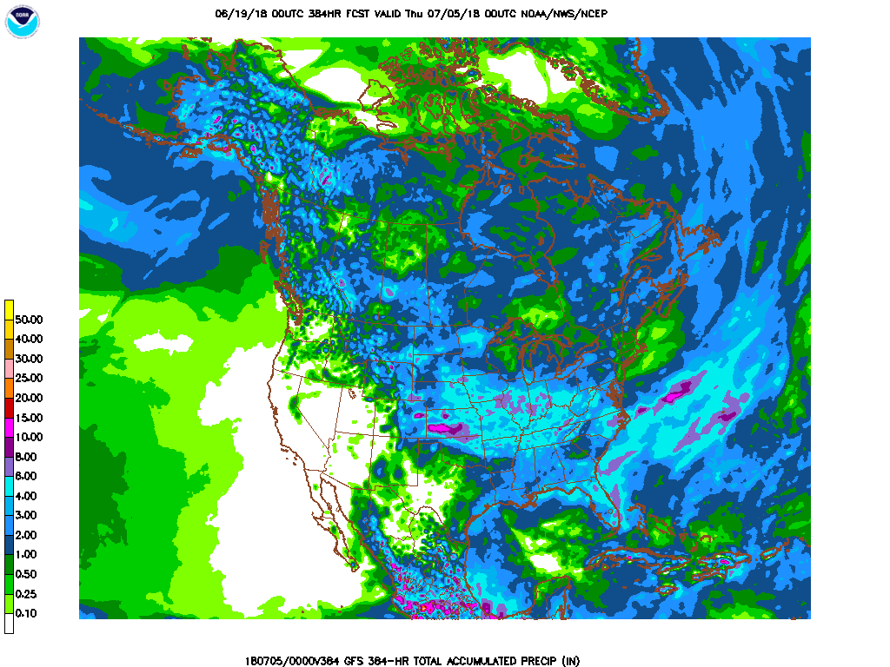
Next 7 days QPF Forecast
In the next 7 days, NE/KS/IS/MO and further due east is expected to get good rainfall as well as southeastern TX.
GFS Model Guidance for next 16 days.
Further reinforcement of precip forecast over the next seven days, impacting he drought on the northeastern fringes of the drought in the south and the western Ohio valley.

Slide 24
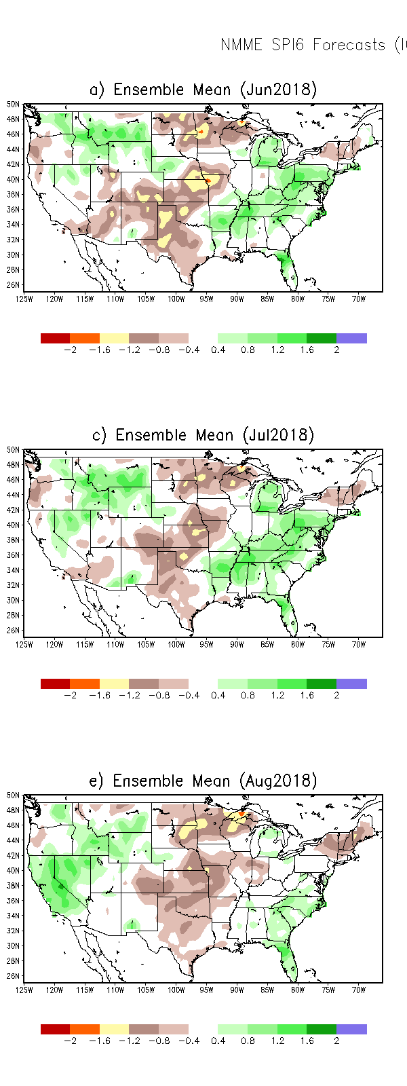
SPI3
SPI6
SPI3 & SPI6
Forecasts from 6NMME Models
(uses obs. P up to past month, and forecast months’ P from NMME models)
The goodness and skill of these SPI’s forecasts depend directly on these models’ skill in predicting precip!!!
In the past these NMME models and their forecasts always did not extend/intensify the Northern plains drought, and ended it repeatedly prematurely!!
The NMME models indicate that by August much of the short term deficit (SPI3), across the US south, may have eased and gone, while the longer term rainfall deficits/drought(SPI6) may continue to improve, but will not go away!
But from experience, we know such a situation (at least for SP3) is probably unlikely!

Slide 25
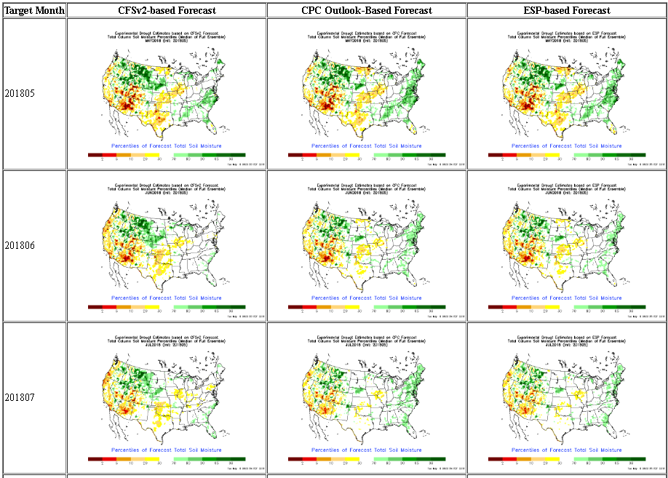
NLDAS Drought Forecast Analysis
The system developed by Princeton University and University of Washington was transitioned to NCEP/EMC as the experimental forecast system.
Forecast using 201805 Initial Condition- Soil Moisture Percentile forecast
Almost always these forecasts generally smoothen and weaken the drought from the levels at IC.
They did the same last year to the 2017 Northern Plains drought.
NLDAS FORECASTS NOT AVAILABLE THIS MONTH

Slide 26
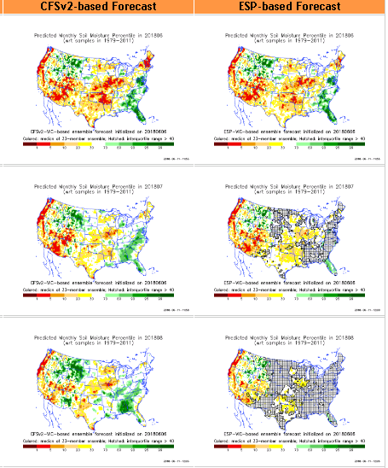
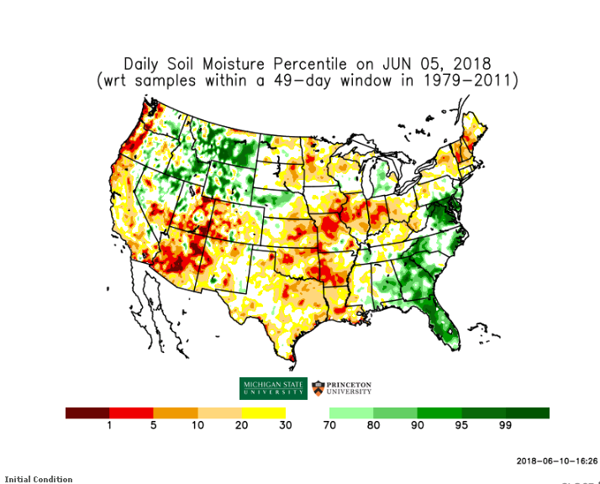
Hydrological Monitoring and Seasonal Forecasting @ MSU (Michigan State University ) NLDAS model
Monthly Soil Moisture Percentile Prediction issued on 201806 with this IC.
http://drought.geo.msu.edu/research/forecast/smi.monthly.php
The inter quartile range suggest greater uncertainty about the forecast in these shaded regions.

Slide 27
Precip Forecast
NASA GEOS5 Forecasts
Jun
Soil Moisture Forecast Percentile
Jul
April
Aug
May
Jun

Slide 28
Exptl. Probability Drought Outlook from Kingtse Mo and Li Xu based on NMME ensemble members’ Precip forecast .

Slide 29
July 2018
In the official
Drought Outlook Tendency Format!!
JAS 2018

Slide 30
Summary
Current ENSO status and forecast. ENSO-neutral is favored through Northern Hemisphere summer 2018, with the chance for El Niño increasing to 50% during fall, and ~65% during winter 2018-19.
Current Drought conditions:
Of the three drought areas noted last month, 1) the large major drought area in the Southwest and Southern states of southern CA, parts of NV, UT, AZ, CO, NM, KS, O, parts of TX, MO has more or less stayed put in place, 2) the Northern Plains drought impacting MT and Dakotas has slightly improved, and 3) the Southeast Atlantic coastal drought is all but gone (as predicted last month).
Rainfall deficits mainly from the recent two back to back La Ninas (and possibly some longer term variability) have contributed to the major large drought in the Southwest and South. Since the (ongoing) summer season is the main rainy season in large parts of this major drought region, even a normal summer rainy season this year is not expected to fully eliminate the drought in this region. However, it may help improve the drought situation.
Since the Northern plains drought is mainly a consequence of the rainfall deficit from 2017 rainy season (MJJA), a decent rainy 2018 season here will make a big difference to the drought in this region, and possibly even its elimination.
Possible new areas of developing dryness in the short term, to be kept under watch, are the far Northeast, western Ohio Valley(particularly MO), and Pacific Northwest (see rainfall deficit maps!)
Prediction:
As the recent La Nina has already transitioned to ENSO neutral conditions, and the chances of El Nino development is only about fifty-fifty, the overall ENSO type boundary/SST forcing is expected to be weak in the next few months. This in general implies greater uncertainty in seasonal forecast. But NMME models ensemble mean is suggesting/predicting an above normal monsoon/rainfall season in parts of the southwestern states, where drought situation is expected to improve, but nevertheless the drought is likely to remain, and not go away!
In the very short term, the GFS forecasts a tropical disturbance associated rain in southeastern TX will make a big difference to the developing/existing drought conditions there, even possibly totally eliminating the drought conditions there. More rain is also forecast along the northeastern border regions of the southern drought in parts of NE/KS/IA/MO, considerably improving the drought conditions in those regions. ***END***

Slide 31
Miscellaneous maps

