Slide 1
Drought Outlook Support Briefing June 2019
Climate Prediction Center/NCEP/NOAA
http://www.cpc.ncep.noaa.gov/products/Drought
Phone: 1-877-680-3341
Pwd: 858747#

Slide 2
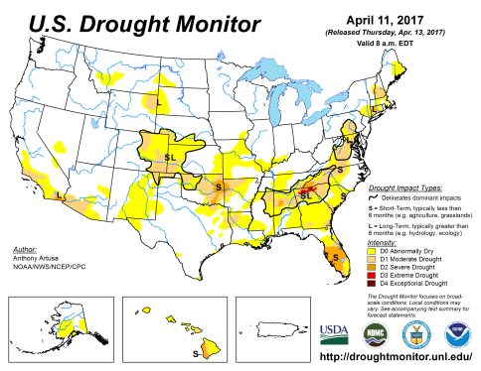
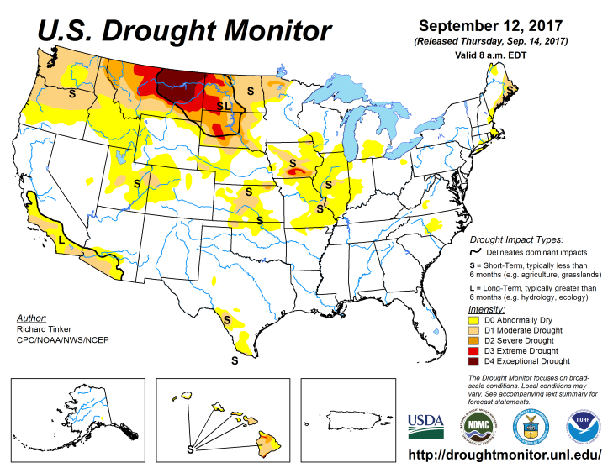
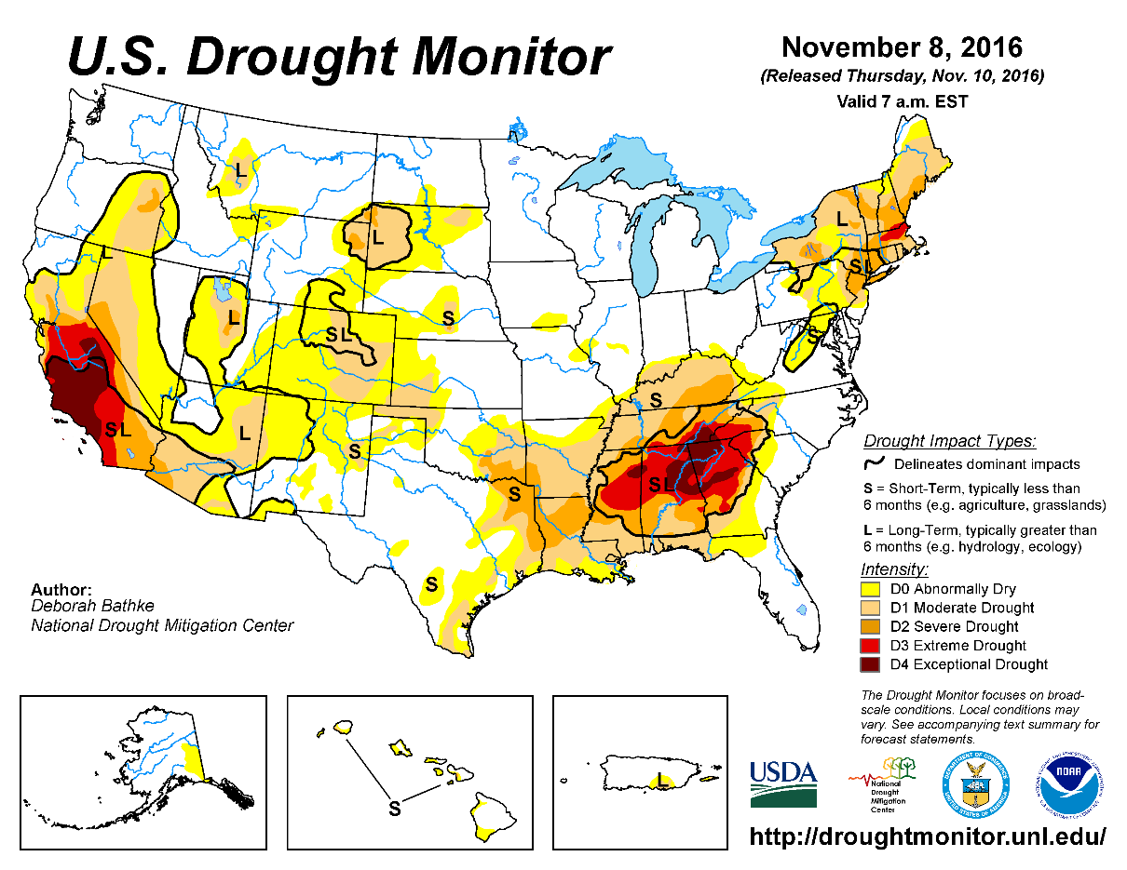
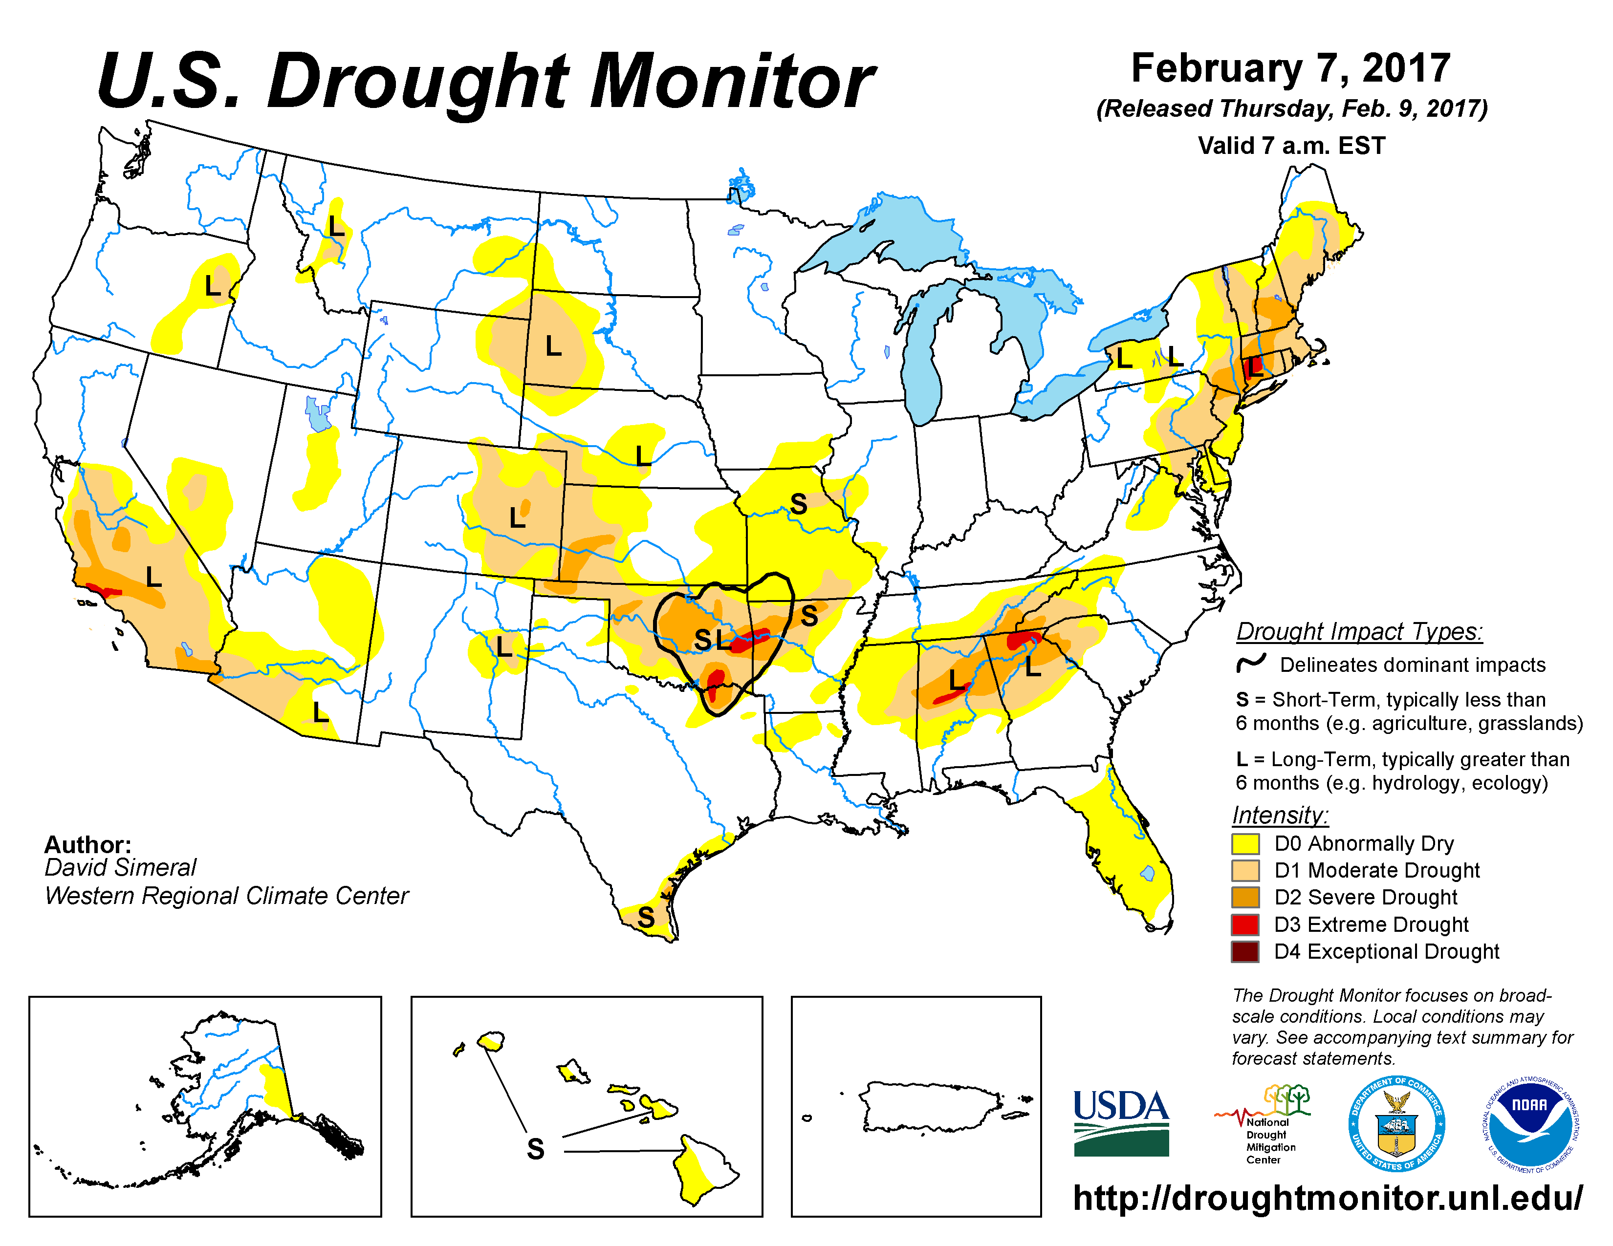
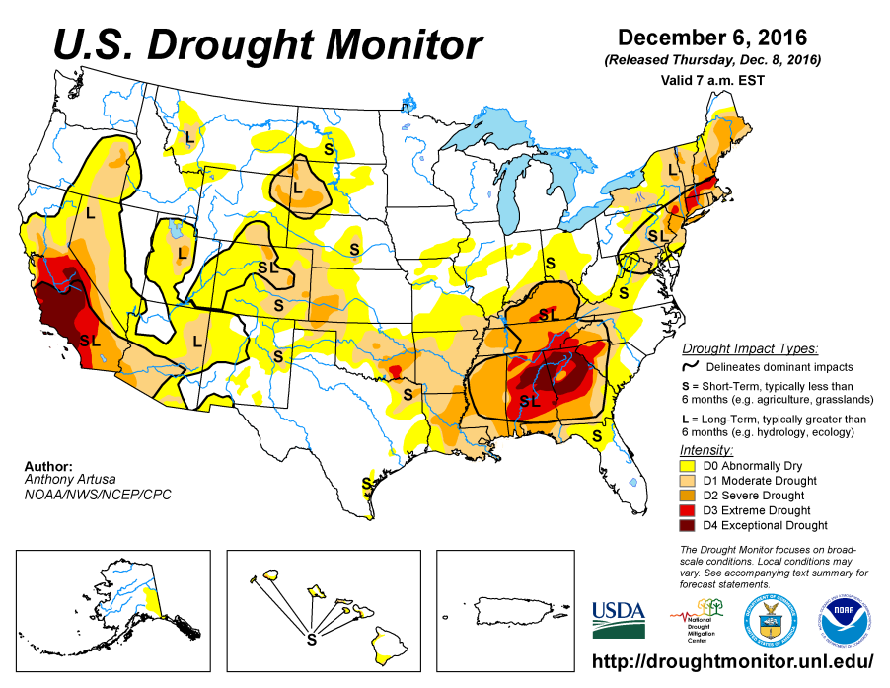
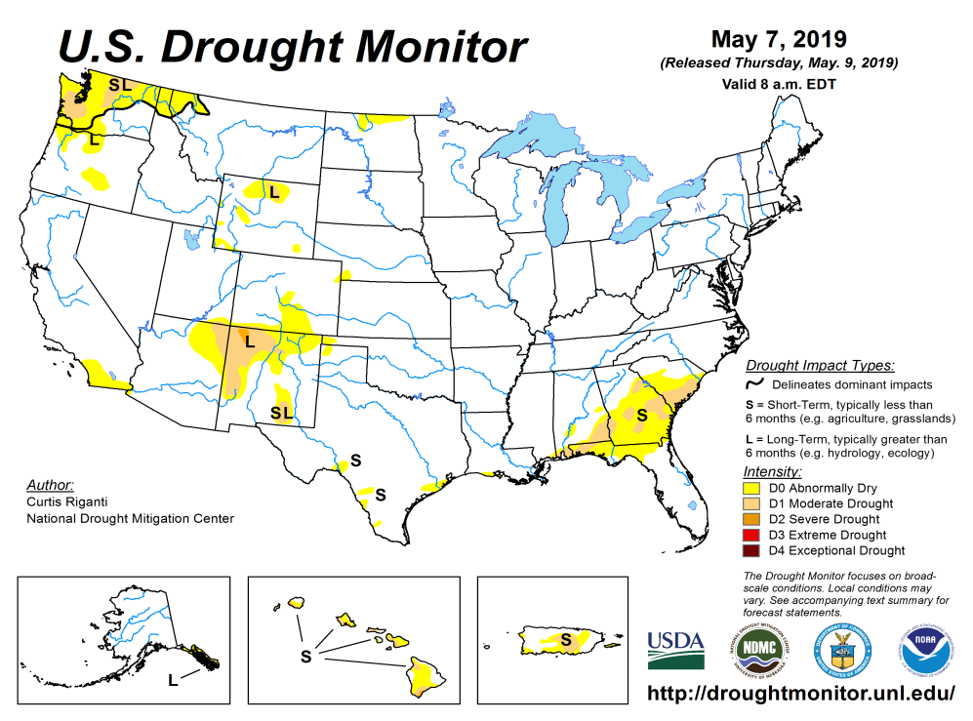
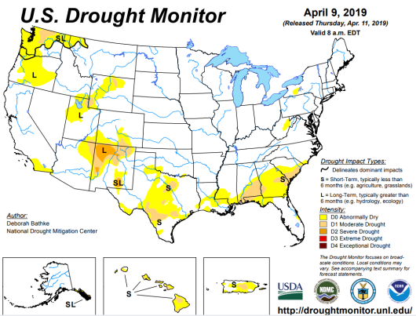
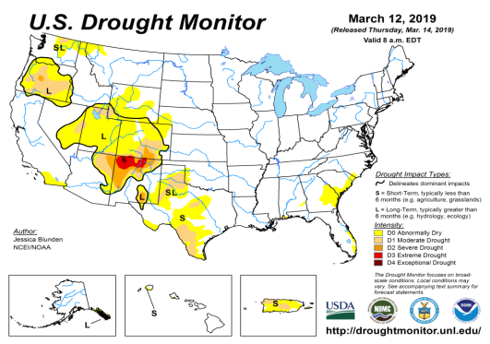
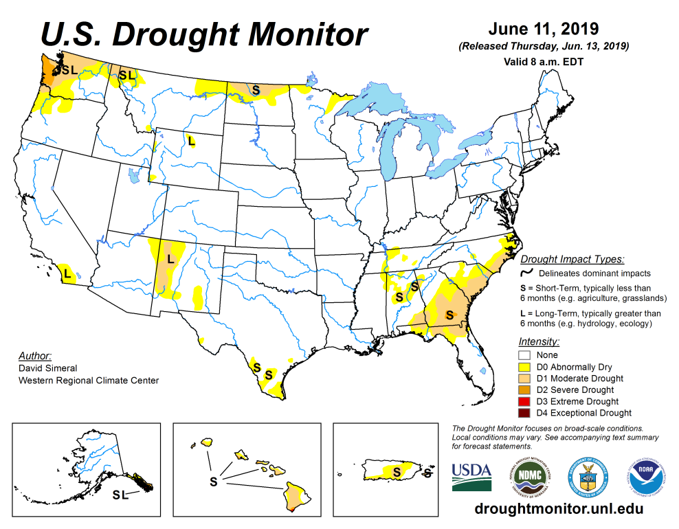
Drought Monitor
April
The sequence of drought monitor maps, month apart, over the last 5 months, shows the gradual and steady improvement in the drought conditions - that is, until last month
According to the DM, four regions have droughts:
Pacific NW,
around four corner states area esp. NM.
The Southeast, centered over GA – recently enhanced!
The Northern Great Plains esp. ND.
May
March
Recent/Latest
February

Slide 3
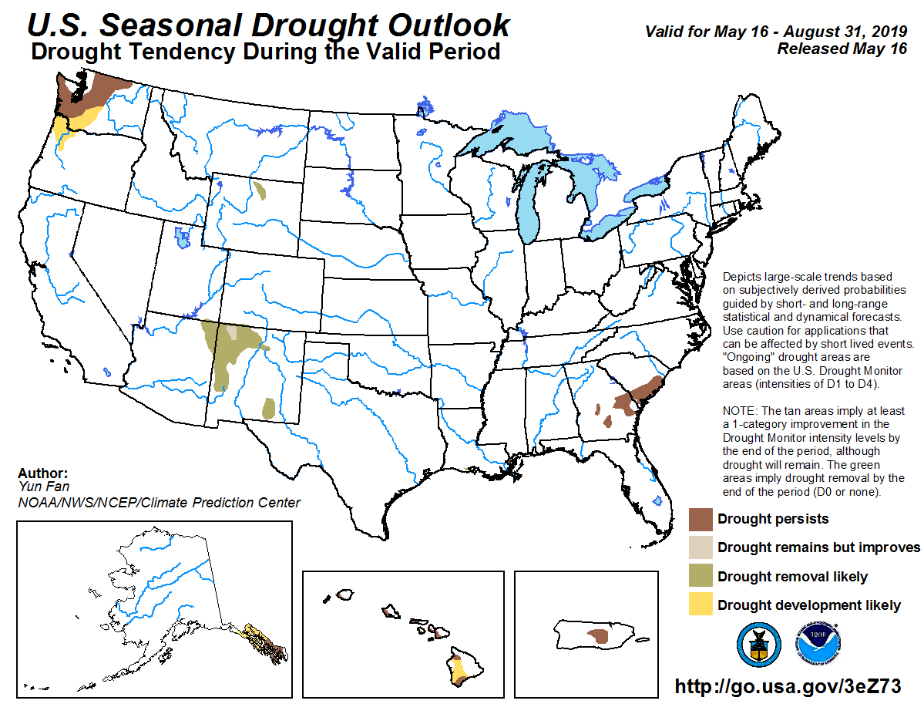
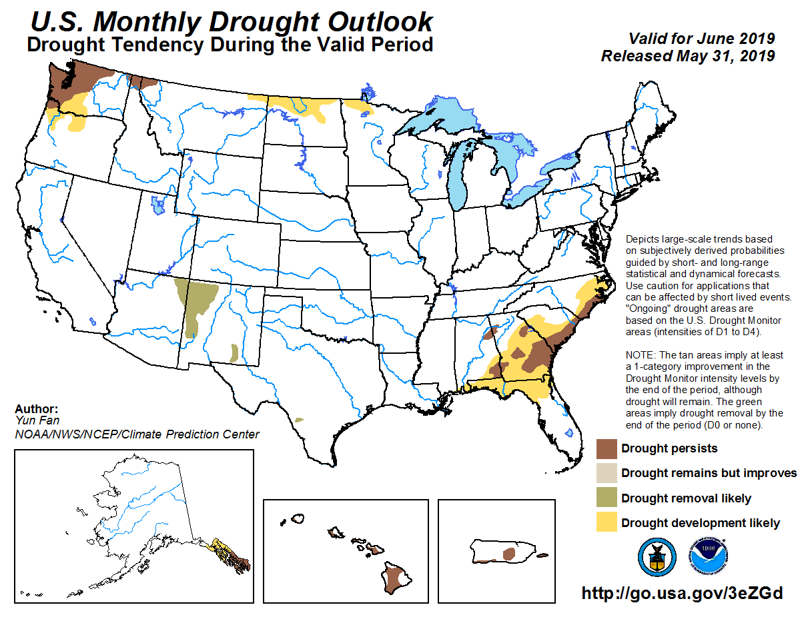
(Prev) Seasonal/Monthly Drought outlooks
(New Seasonal Drought Outlook to be released in 2 days!)
Seasonal Outlook
(Mid May 2019-Aug 2019)
issued 5/16/19
Monthly outlook
(for June 2019)
issued 5/31/19
Drought development in monthly outlook over the southeast as well as near ND. This part of Outlook looks good so far! But the drought removal in the four corners area has not worked out yet!
Overall a more optimistic picture was suggested by the SDO except in the Pacific NW.

Slide 4
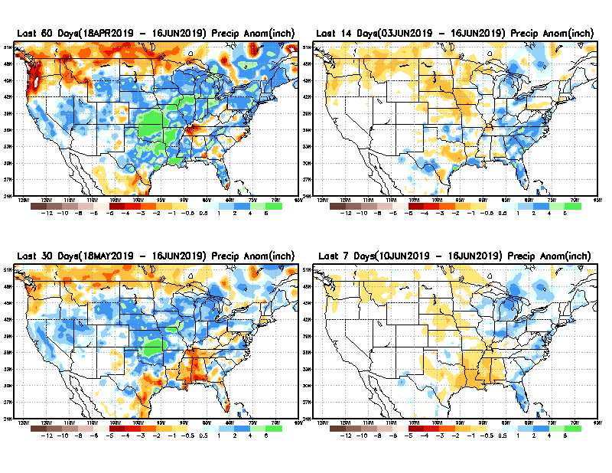
Precipitation ANOM during last 7, 14, 30, & 60 days.
60 Days
14 Days
These maps in this and following slides, including Total, Anom and Percent of precip in these and other longer time ranges are now daily updated at:
30 Days
7 Days
From: Recent Accumulated Precipitation https://www.cpc.ncep.noaa.gov/products/Drought/briefing_prcp.shtml

Slide 5
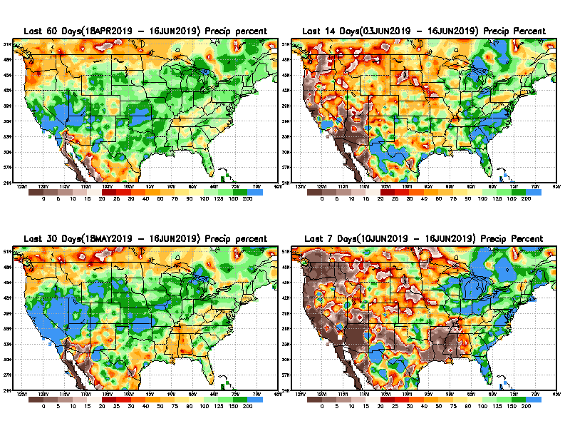
Precipitation Percent during last 7, 14, 30, & 60 days.
60 Days
14 Days
NOW !
Recent rains in the southeast has help the emerging drought situation here in the southeast.
The Precip forecast/outlook for next month/season is critical for any drought outlook in the Northern Plains.
30 days
7 Days
From: Recent Accumulated Precipitation https://www.cpc.ncep.noaa.gov/products/Drought/briefing_prcp.shtml

Slide 6
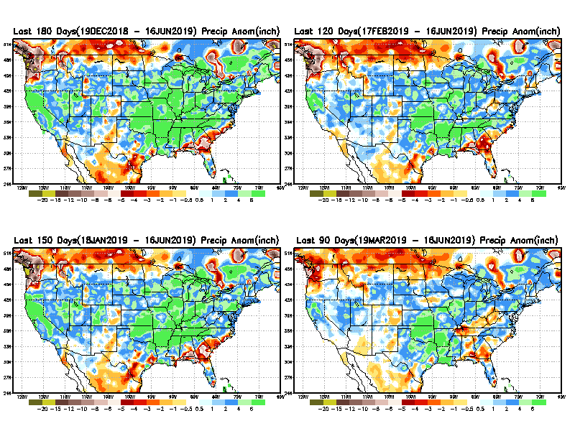
Total precipitation ANOM during last 3, 4, 5, and 6 months.
6 M
4 M
5 M
3 M
From: Recent Accumulated Precipitation https://www.cpc.ncep.noaa.gov/products/Drought/briefing_prcp.shtml

Slide 7
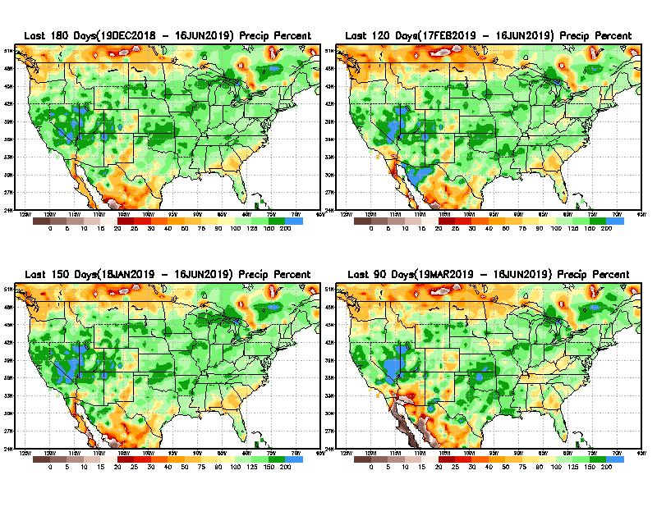
Total precipitation Percent during last 3, 4, 5, and 6 months.
6 M
4 M
Precip. deficits here complicated by data issues!
Recall:
In 2017, the Northern Great Plains Drought here started with similar deficits at about this time.
5 M
3 M
For the last two months we correctly picked up on the development of drought in both the ND area and the Southeast

Slide 8
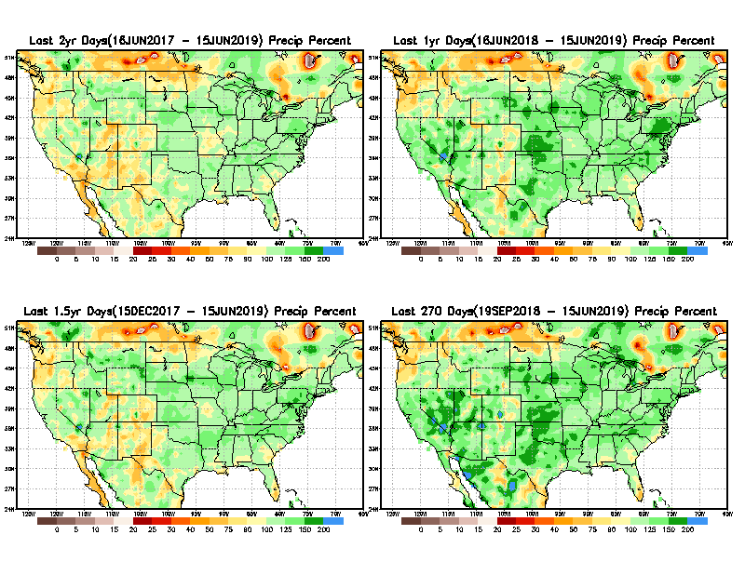
Total precipitation Percent during last 9 months, 1 yr, 1.5yrs, & 2 yrs.
2 Y
1 Y
1.5 Y
9 M
Long term rainfall deficits >1 year still exist in the southwest.
Does this really matter or not? Since it does not matter much to Drought Monitor!!
From: Recent Accumulated Precipitation https://www.cpc.ncep.noaa.gov/products/Drought/briefing_prcp.shtml

Slide 9
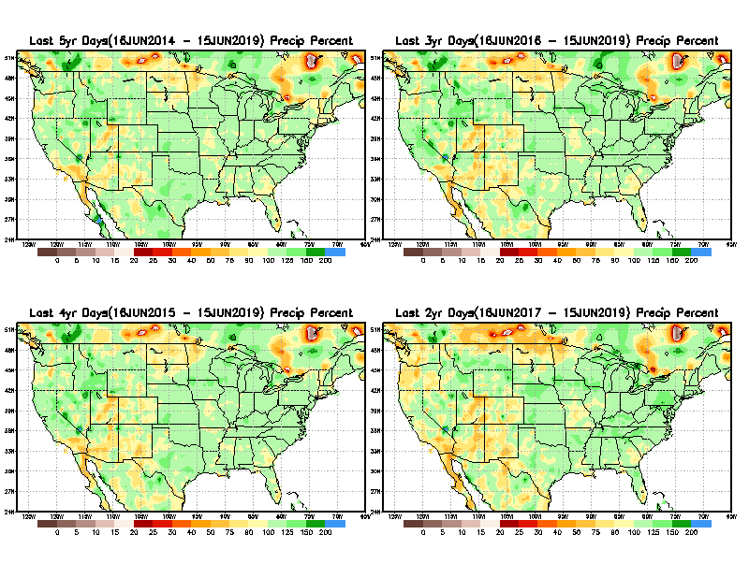
Total precipitation Percent during last 2 yrs, 3 yrs, 4 yrs, & 5 yrs.
5 Y
3 Y
Still longer term rainfall deficit variability in play? Especially in the southwest!
Will these deficits ever go away, OR is these part of the new norm??
4 Y
2 Y
From: Recent Accumulated Precipitation https://www.cpc.ncep.noaa.gov/products/Drought/briefing_prcp.shtml

Slide 10
Rainy (3-month)Season across the US

Slide 11
Ongoing rainfall season in the Northern Plains? Every month matters! Rainfall during the rest of
This month may make or break the drought conditions there.
Remember 2017!!
Adapted from Rich Tinker.

Slide 12
Adapted from
Rich Tinker

Slide 13
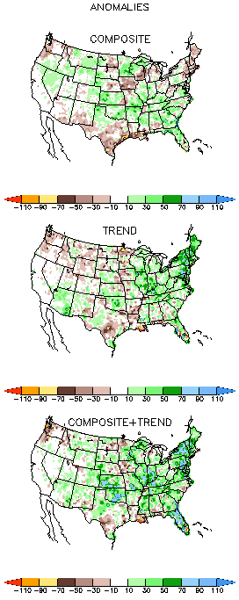
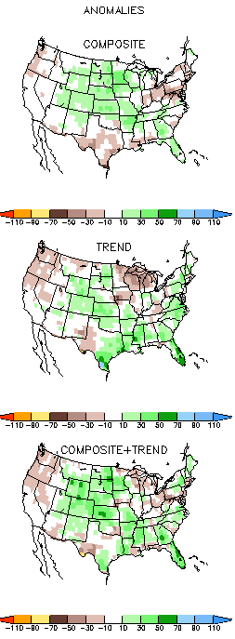
EL NINO Precip COMPOSITES
JJA
JAS
This and next month is critical for drought in the Northern Plains and the southeast Gulf coast – especially with the ongoing El Nino impacts!! But El Nino is not very strong and will it stay that way?

Slide 14
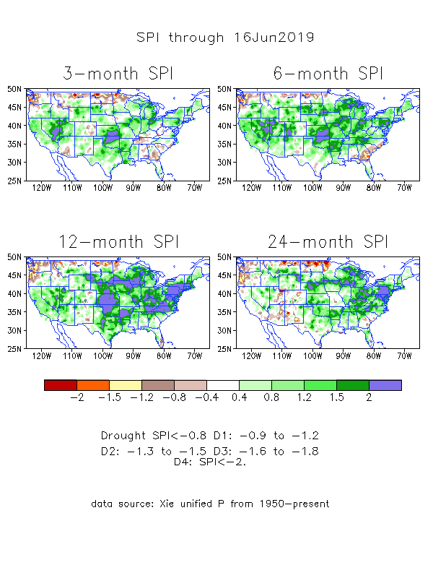
The Standardized Precipitation Index SPI (based on Observed P)
----- NOW
Very interesting graphic & details for the drought across the US based on the more generalized precip deficit/excess, the Standardized Precipitation Index (SPI).
The dark brown and red colors, indicating standardized precipitation deficits, in the various time periods, approximately correspond to the appropriate short/long term drought monitor regions and their intensities
In the short term (~3 mo) dryness still exists in the far southeast, and in he Pacific NW, and in ND.
In the 6m time scale, drought in OR/WA continues.
In the longer term ~12m-24m and longer, rainfall deficits remain in the AZ/NM/UT/CO states area and in Northwest and in the Northern Plains.

Slide 15
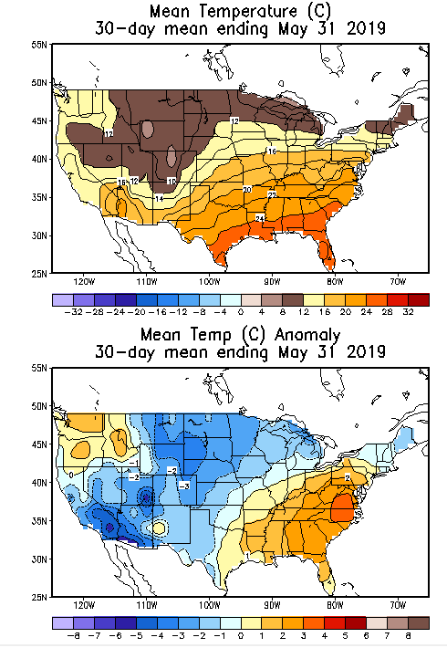
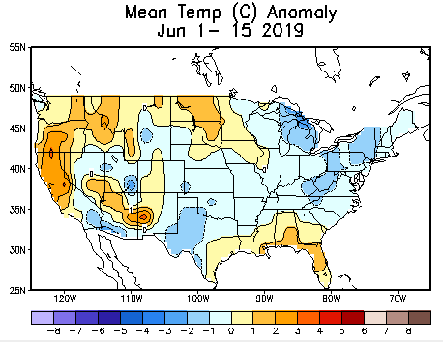
Recent US Temperatures
May was cold over the large part of central US, but warm over the east and northwest.
June so far has been has been a different story, with warmer than normal particularly over the drought regions.

Slide 16
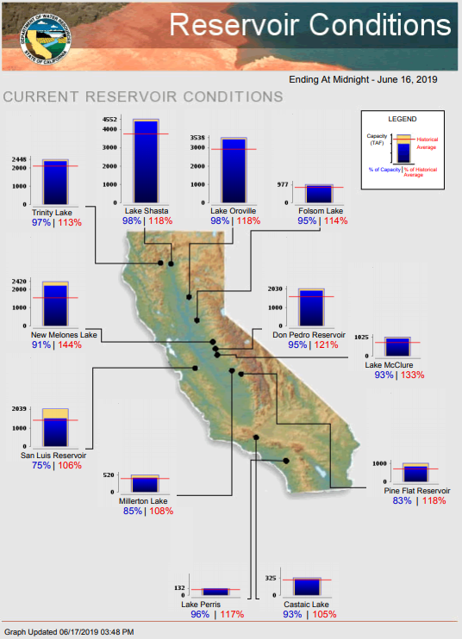
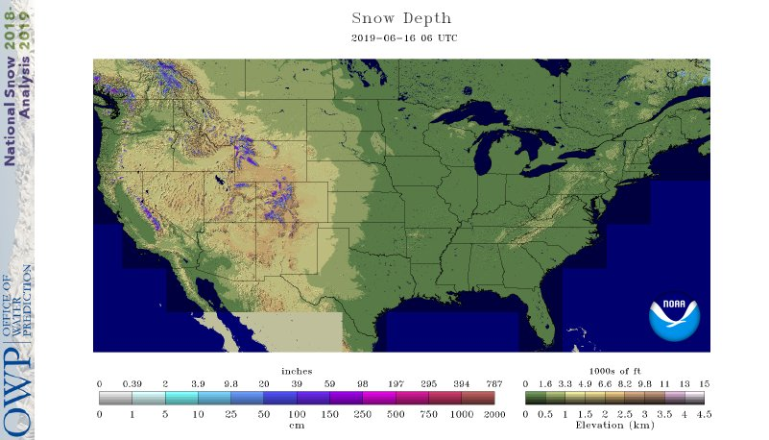
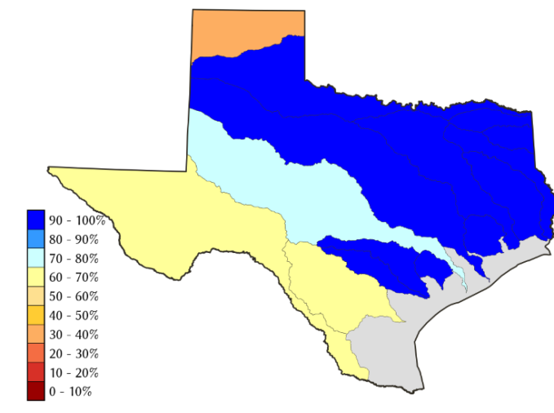
Water Reservoir Levels in some Western/Southern States! And Snow Depth!!
Northern CA reservoirs beginning to show
Weakness, but rainy season coming up!
Except in few high elevations, all snow has melted.
California reservoirs are in good shape.
TX
https://fsapps.nwcg.gov/afm/index.php

Slide 17
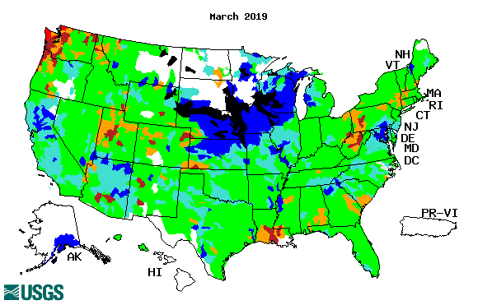
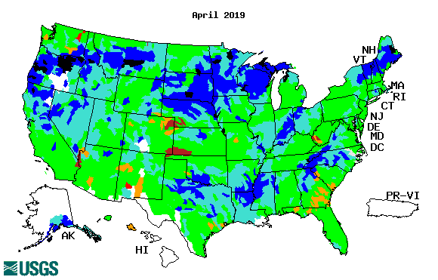
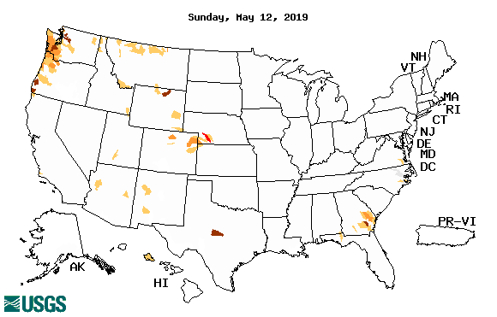
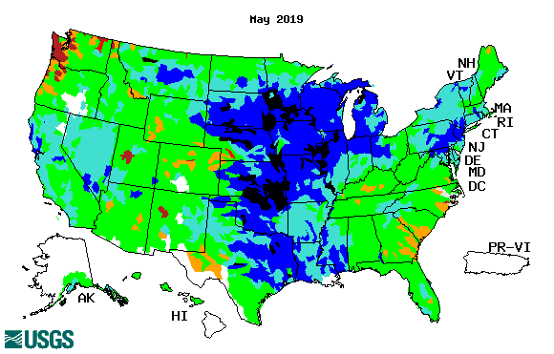
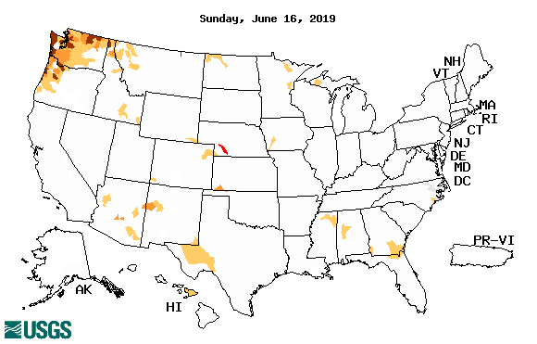
Streamflow (USGS)
Overall, gradual and steady improvement in streamflow conditions across the country, over the last few months.
Pacific Northwest ?
Map shows only below normal 7-day average streamflow compared to historical streamflow for the day of year.
One month ago (left) &
Now (below)
17

Slide 18
EL NIÑO/SOUTHERN OSCILLATION (ENSO)
DIAGNOSTIC DISCUSSION
issued by CLIMATE PREDICTION CENTER/NCEP/NWS and the International Research Institute for Climate and Society
13 June 2019
ENSO Alert System Status: El Nino Advisory
Synopsis: El Niño is predicted to persist through the Northern Hemisphere summer 2019 (66% chance), with lower odds of continuing through the fall and winter (50-55% chance). El Niño is present.* Equatorial sea surface temperatures (SSTs) are above average across most of the Pacific Ocean. The pattern of anomalous convection and winds are consistent with El Niño.

Slide 19
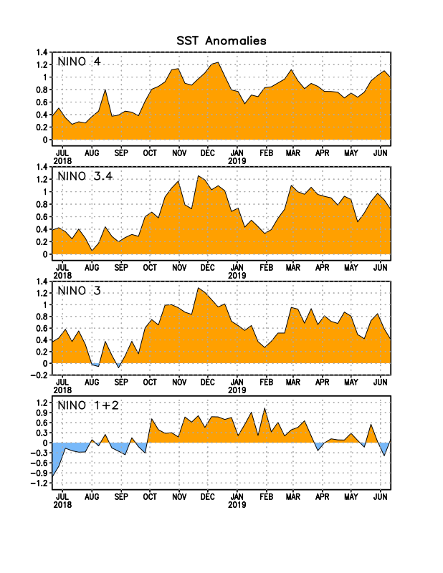
Latest values of SST indices in the various Nino Regions.
The sub surface heat anom has fallen in the last month.
Decreasing!
?
Relatively short lived!

Slide 20
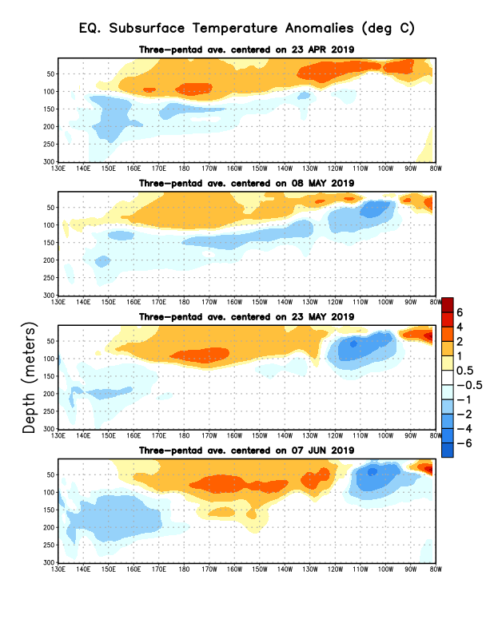
Sub-Surface Temperature Departures in the Equatorial Pacific
Where are we in the EL Nino cycle? Near peak?
The negative anomalies’ extent has increased!!
Will the El Nino strengthen further? Or weaken?
Most recent pentad analysis

Slide 21
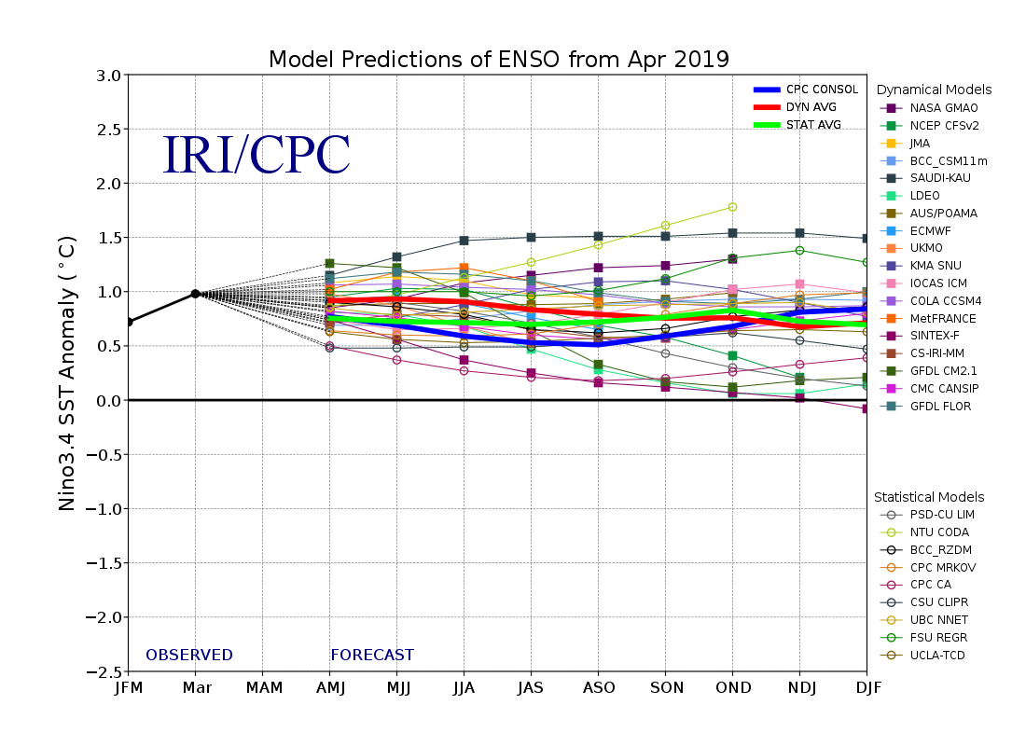
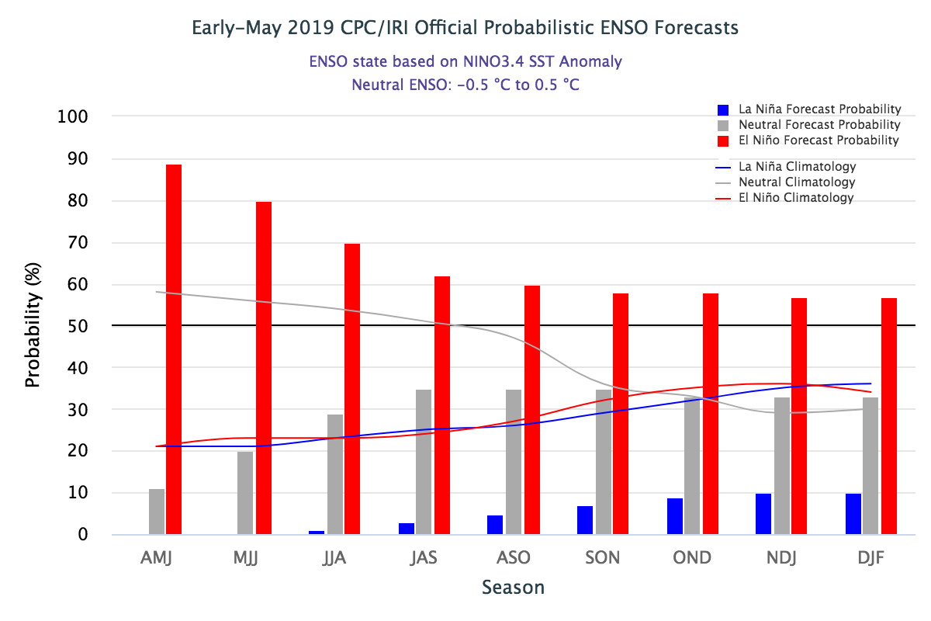
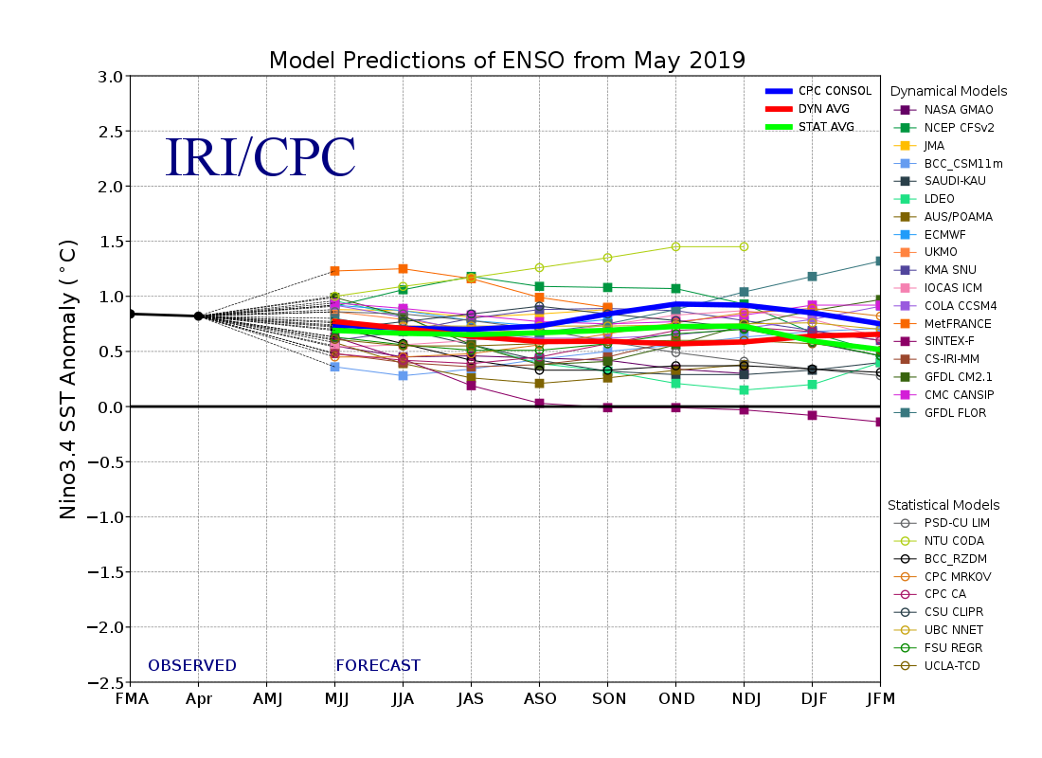
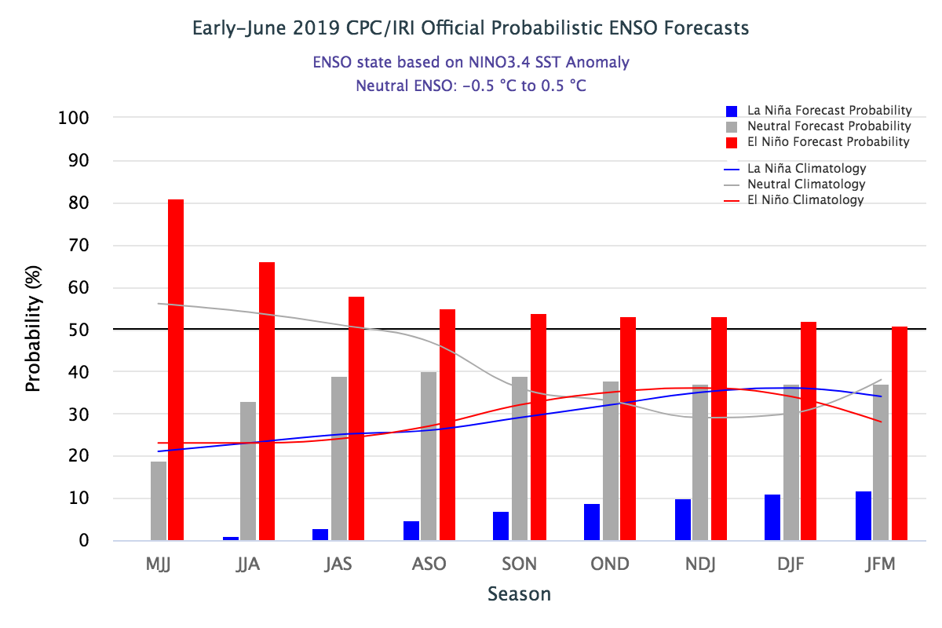
ENSO Forecasts
Early- May CPC/IRI forecast
Early- June CPC/IRI forecast
The models suggest that El Nino in some modest form is expected to remain and continue at least through upcoming winter.

Slide 22
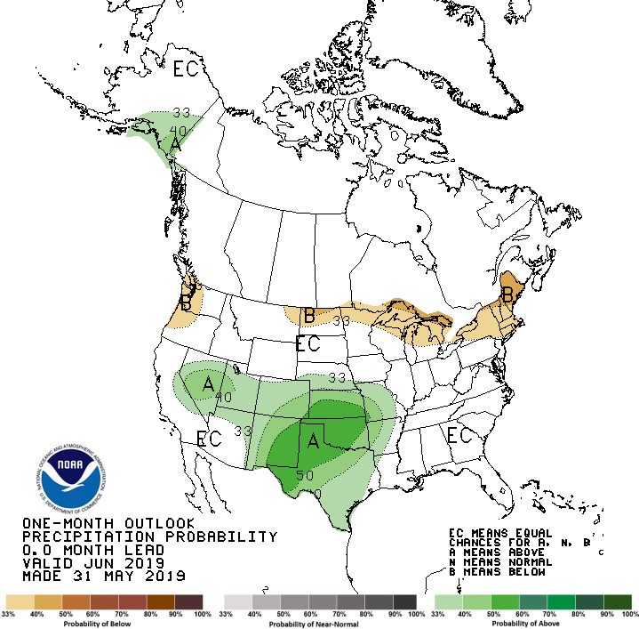
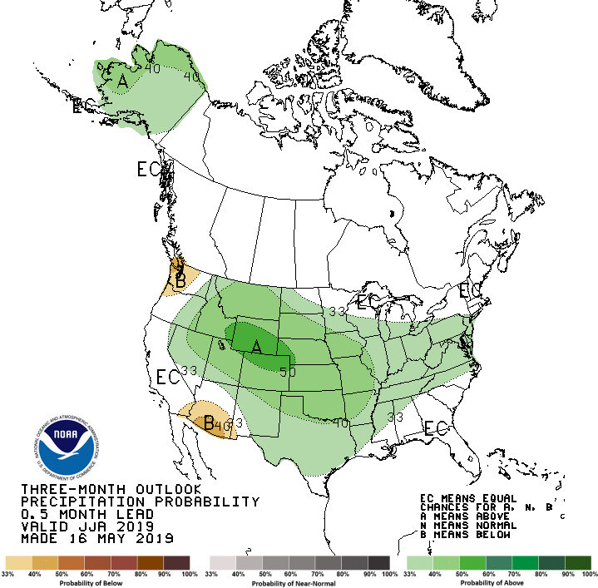
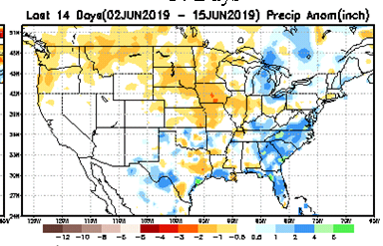
Previous(Last month)
CPC’s official
Precipitation outlook for Monthly (June)/Seasonal (JJA)
Released May 31st
Released May 16th
Observed so far this month!!

Slide 23
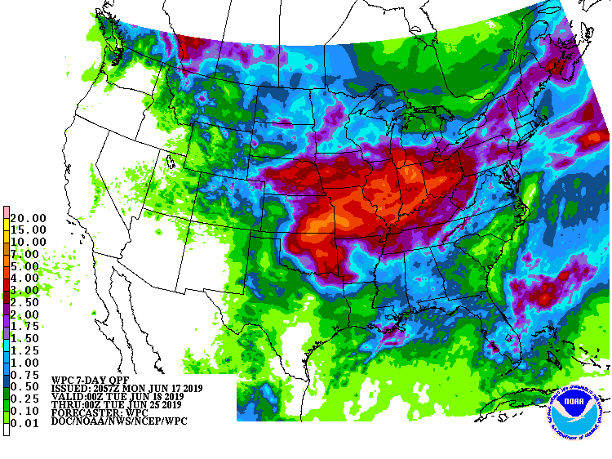
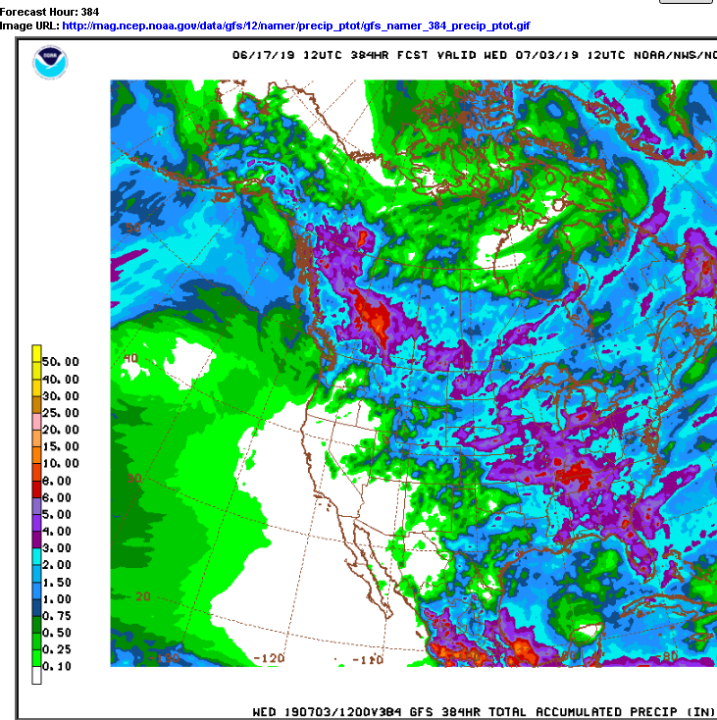
WPC Next 7 days QPF Forecast
GFS Model Guidance for next 16 days.

Slide 24
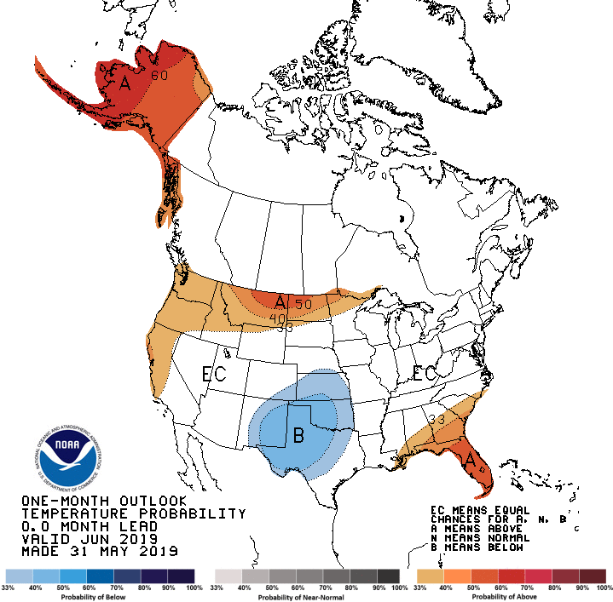
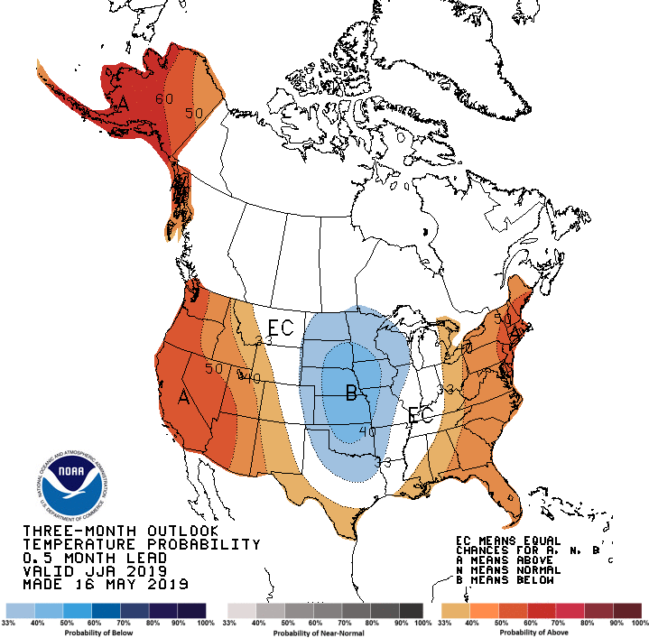
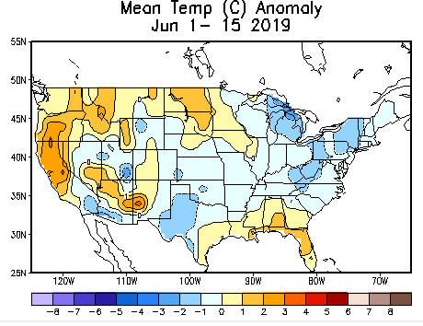
Previous CPC’s official
Temperature outlook for Monthly (June)/Seasonal (JJA)
Made
May 31st
Observed so far this month!! ☺
Made May 16th

Slide 25
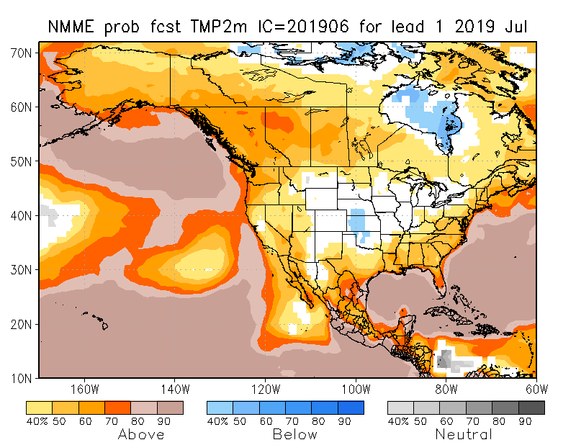
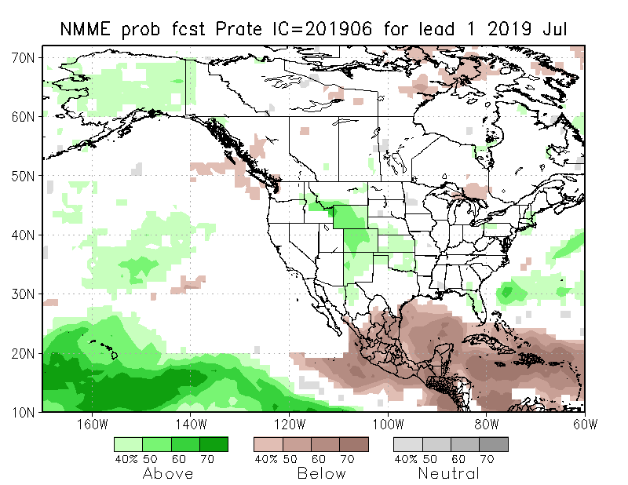
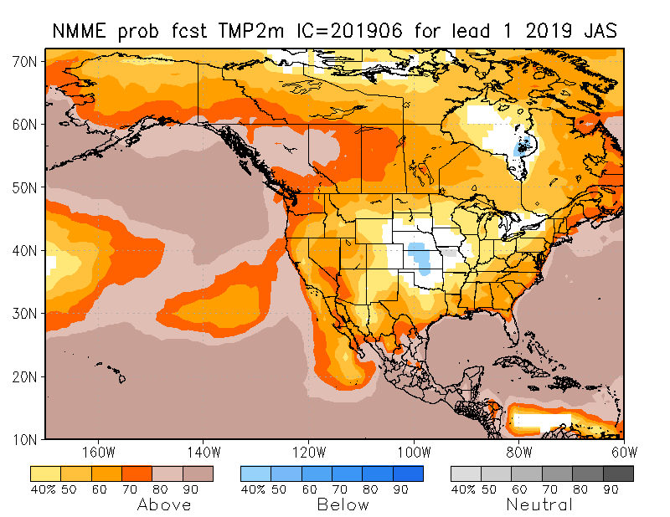
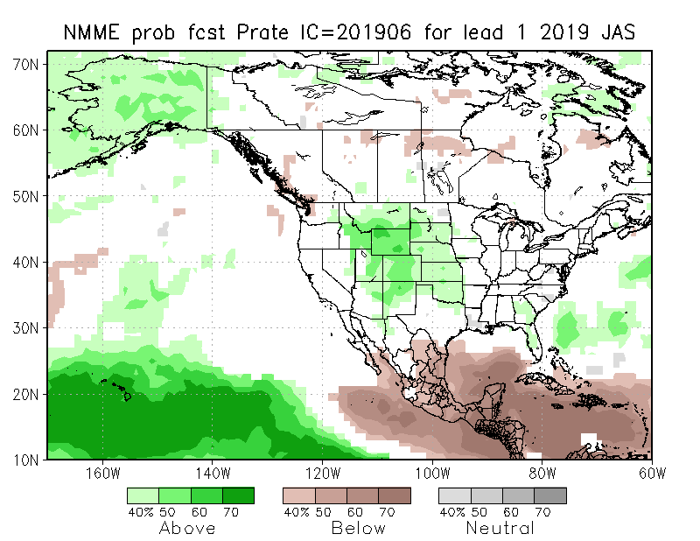
NMME T & P EnsMean forecasts
Jul
JAS
Both monthly and seasonal forecasts call for above normal temperatures except in the middle of the centered near KS.
Forecast seasonal precip map is very similar to the ENSO impact+trend map seen earlier.

Slide 26
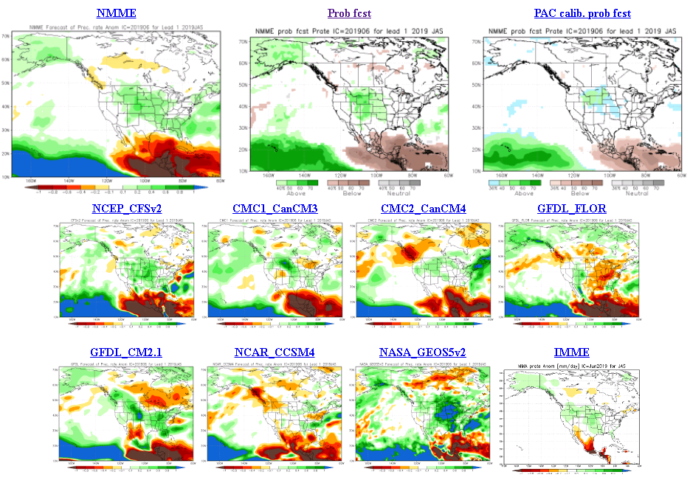
The agreement/uncertainty among the diff. NMME models’ forecasts (middle and bottom panels) for Jul-Aug-Sep Precipitation!!!
26

Slide 27
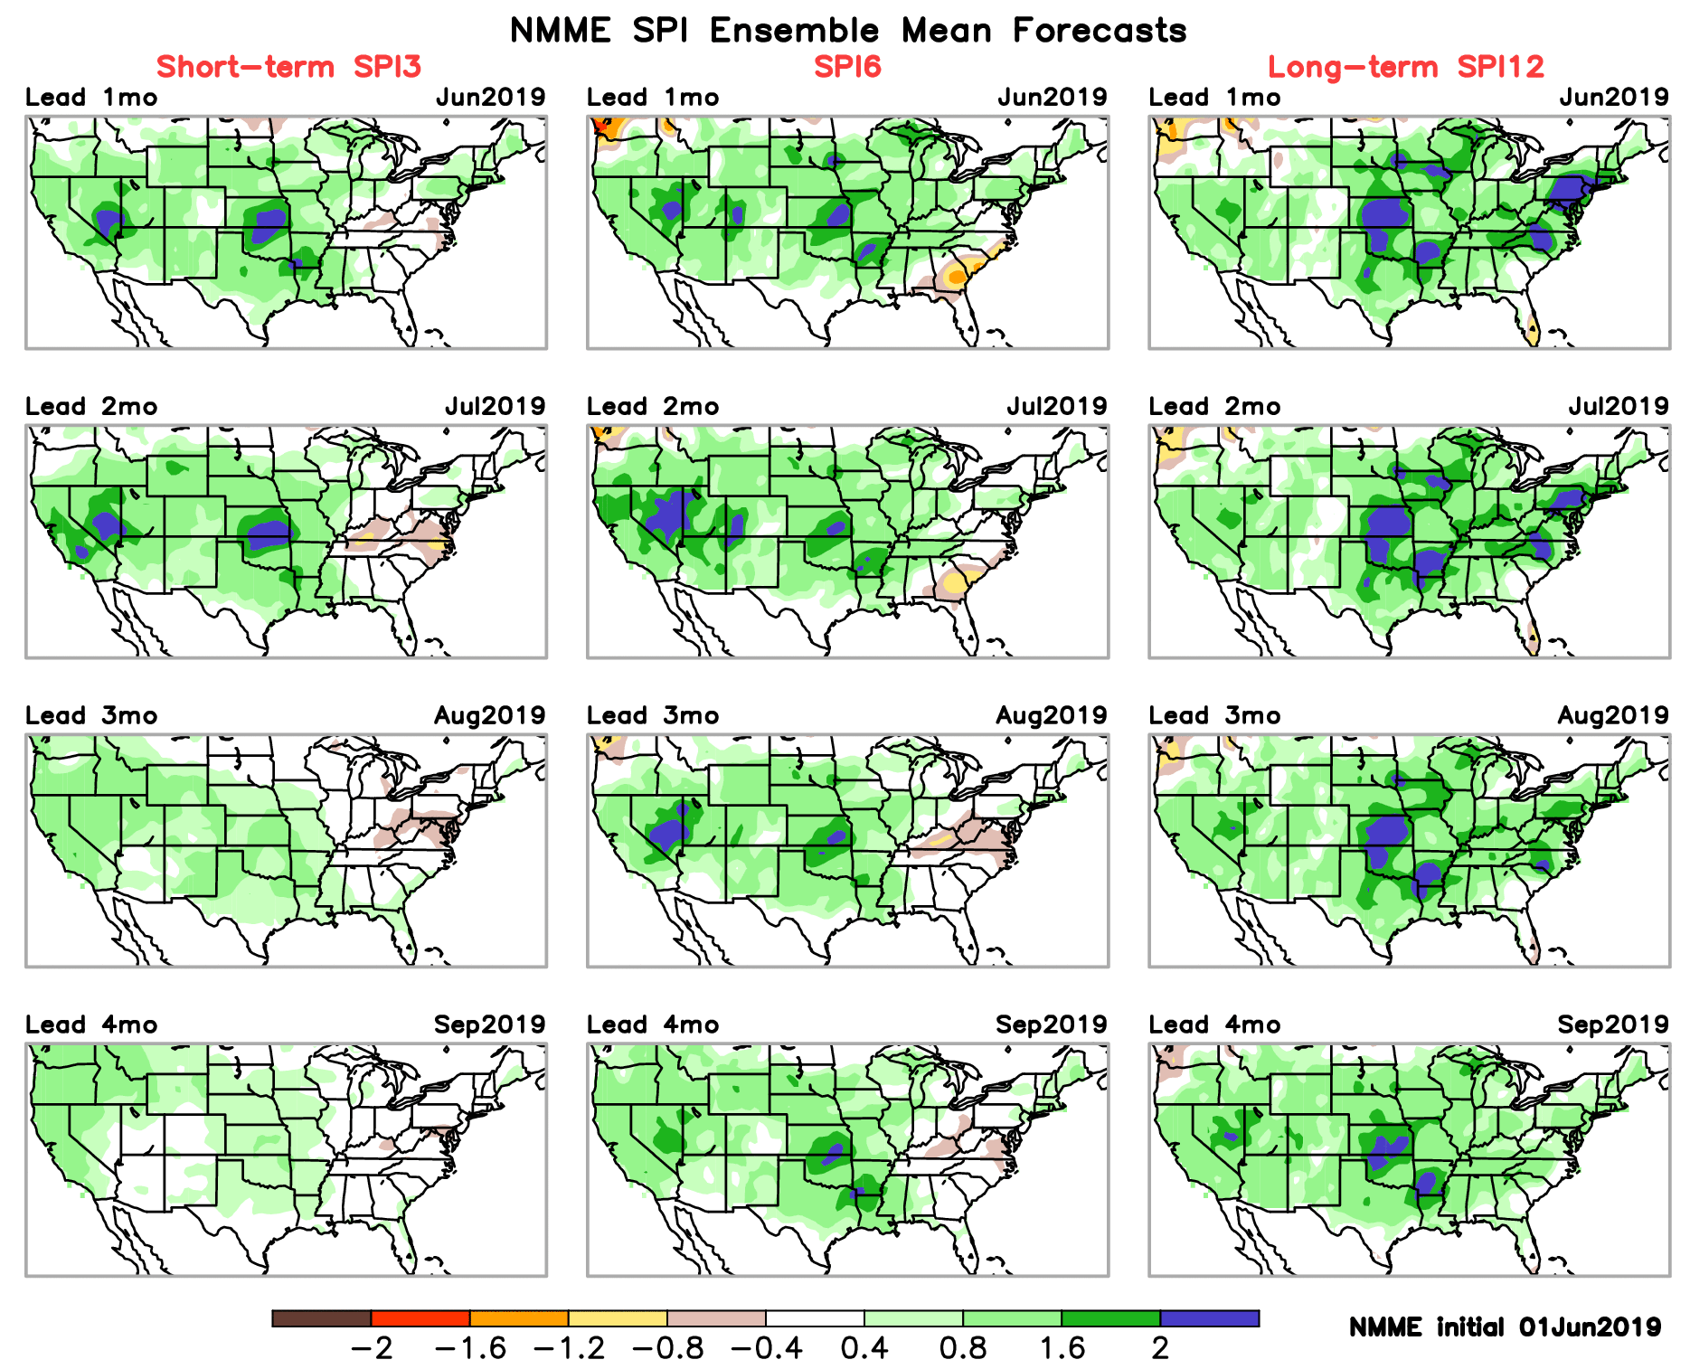
SPI3, SPI6
& SPI12
Forecasts from 6NMME Models
(uses obs. P up to past month, and forecast months’ P from NMME models)
The goodness and skill of these SPI’s forecasts depend directly on the NMME models’ skill in predicting precipitation!!!
Indications of short term drought appearing here, but vanishing before end of upcoming season.

Slide 28
Initial Conditions: 4/2/2019
http://drought.geo.msu.edu/research/forecast/smi.monthly.php
Predicted Monthly Soil Moisture Percentile
Initial Conditions: 5/7/2019
Latest
Initial Conditions:
6/11/2019
Things change fast in the east (see above).
But not so in the west! remains in NW.
Northern Plains ? Mild dry/drought?
The inter quartile range suggest greater uncertainty about the forecast in these shaded regions.

Slide 29
Recent 7 days mean SM percentile.
Ensemble mean, SM percentiles looks good even in the Northwest? ? Only VIC model seems realistic !

Slide 30
SKIP
Recent SM percentile.
Ensemble mean, SM percentiles looks good even in the Northwest? ? Only VIC model seems realistic !

Slide 31
Precipitation
NASA GEOS 5 Model
Precipitation & Soil Moisture Forecast
Jun 2019
Soil Moisture
Jul 2019
IC 5/31
7/1
Aug 2019
8/1
2018
9/1

Slide 32
Monthly/Seasonal Drought Forecast
made this month for next month (July)
and season(JAS).
Based on NMME models’ (dis)agreement in their precipitation forecasts’ computed SPI!!
Pretty much drought free across the country.
But Pacific Northwest ?

Slide 33
Soil Moisture (Shaded) and
Soil Moisture Trend (dots)
during the last
Week (left), two weeks (bottom)

Slide 34
Summary
Current ENSO status and forecast. Weak El Niño is predicted to persist through the Northern Hemisphere summer 2019 (66% chance), with lower odds of continuing through the fall and winter (50-55% chance).
Current Drought conditions:
Drought area across the US has slightly increased this month from the near-record low area coverage of only 2% Drought coverage last month.
According to the DM, only four small areas of drought remain: In the Pacific Northwest in Washington and western MT, in the Northern Plains states of North Dakota and vicinity, in the vicinity of the four corner states in the southwest, and in the far southeast along southern AL, GA and SC.
Recent rains in the Southeast has helped the emerging drought conditions there. But the rainfall shortfall in the May/June months of the rainy season in the North Dakota and vicinity has contributed to the emergence of drought conditions here. Both these conditions were well monitored and well forecast. Rainfall deficits in ND might accrue if the ongoing month/rainy season continues to be deficient, and may end up in more severe drought conditions here(recall 2017!). This area needs to be watched carefully.
California reservoirs continue to be are at more than satisfactory levels, and the streamflow conditions across the country has considerably improved for the better over the last three months except in Pacific Northwest.
However, in the 12m-24m and even longer time scales, rainfall deficits still remain over large areas in the southwest and west, which is not completely reflected in the drought monitor!
Prediction:
The drought along the Pacific Northwest is likely to persist and stay that way, if not possibly get worse.
Continued monitoring of rainfall deficits and forecast in the northern part of Northern Great Plains is essential, as June/July rainfall amounts received here may tip the existing mild drought conditions one way or other. This region is very tricky, and must be carefully monitored! Possible worsening of drought is likely here in this region.
In spite of the fact the ongoing El Nino is not very strong, NMME models’ ensemble mean forecast indicate a somewhat typical canonical + trend impact pattern for JAS season. This combined with seasonal rainfall may completely eliminate the drought conditions in the southeast. However, in the southwest there will be short term improvement, but the very long term rainfall deficits will stay. Overall, the upcoming season will continue to be likely a season with very low percent area coverage for drought across the US,. **END***

Slide 36
Miscellaneous maps

Slide 37
Miscellaneous maps

