Slide 1
Drought Outlook Support Briefing June 2020
Climate Prediction Center/NCEP/NOAA
http://www.cpc.ncep.noaa.gov/products/Drought
Phone: 1-877-680-3341
Pwd: 858747#

Slide 2
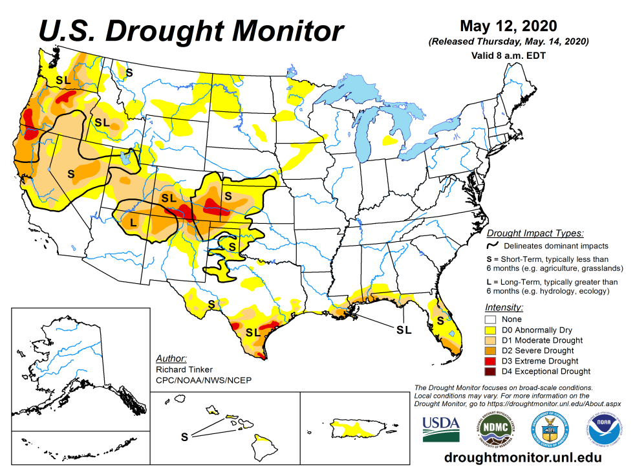
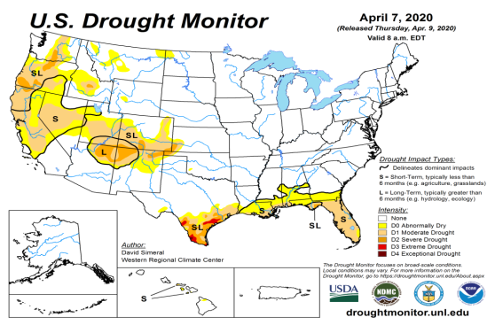
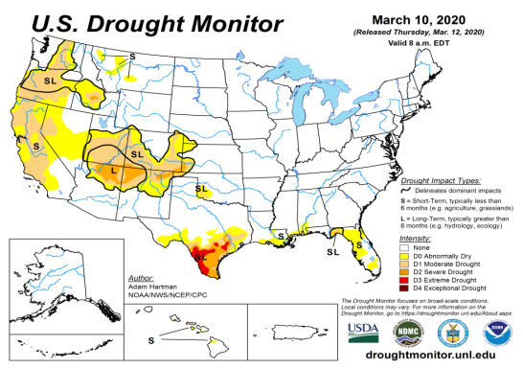
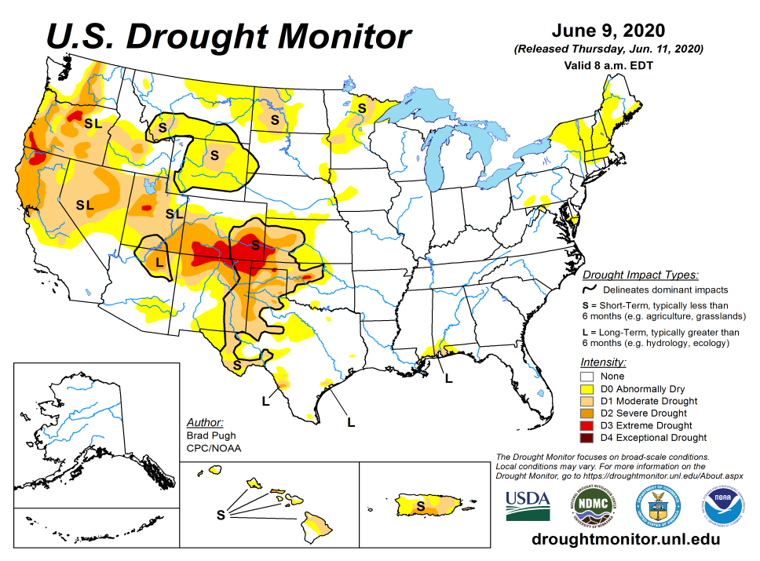
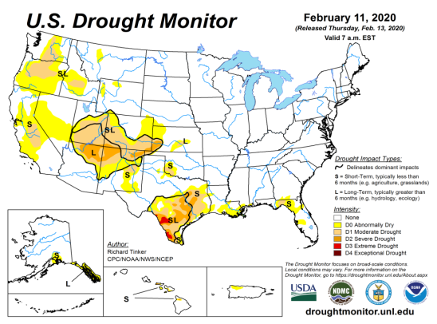
Drought Monitor
May
April
Monitoring is important because, unlike US T/P fcsts, for drought forecasts, we have to know where we are, before we can tell where we are going!!
Drought forecasts are tendency forecasts.
Over the last several months, drought, overall has generally increased in area across the South and the West.
The short/long term drought in the four corner states area (AZ/NM/ UT/CO) has expanded and intensified eastward to the neighboring states of KS/OK/TX.
Existing drought in OR, Northern CA, NV, ID, WA, UT continues.
Drought in southern TX and along the Gulf coast states of LA/FL has either shrunk or totally disappeared.
Drought in Northern Great Plain states has expanded.
March
June
(Recent/Latest)
February
February

Slide 3
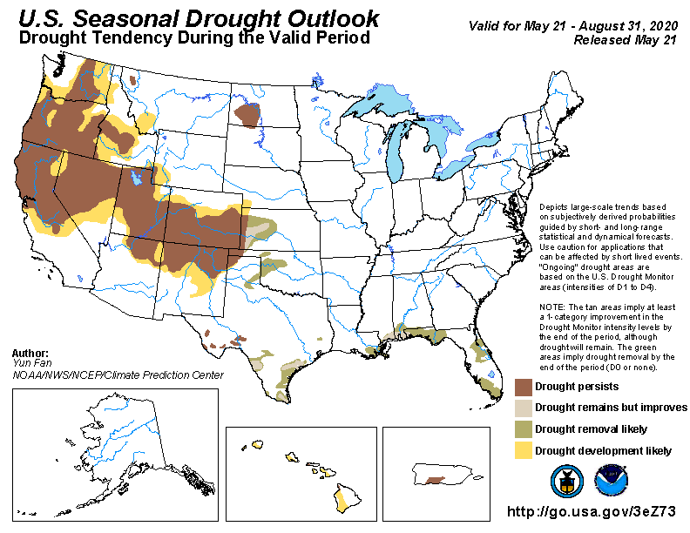
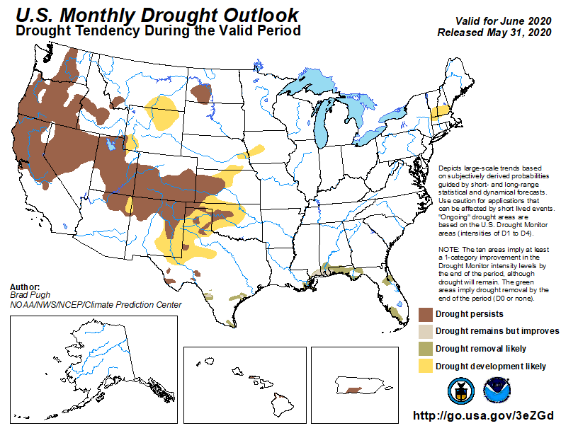
(Prev) Seasonal/Monthly Drought outlooks
(New Seasonal Drought Outlook to be released in 2 days!)
Seasonal Outlook
(Mid May 2020- Aug 2020)
issued 05/21/20
Monthly outlook
(for June 2020)
issued 05/31/20
As we suggested here, and as outlooks correctly indicated, drought in southeast have disappeared.
Historically skill wise, our Drought outlooks, do better once drought is already identified in the drought monitor (USDM) in some form. We do not always identify new/developing droughts correctly, and our skill here is relatively poor. I notice some general reluctance to declare new drought development areas.
Last few months in these briefings, and in form of recommendations, even before drought development areas were identified in the USDM in the Northern Great Plains area of the Dakotas and vicinity, we had been cautioning for possible drought development in the region, and accordingly the dry/drought areas have increased, as indicated in DM.

Slide 4
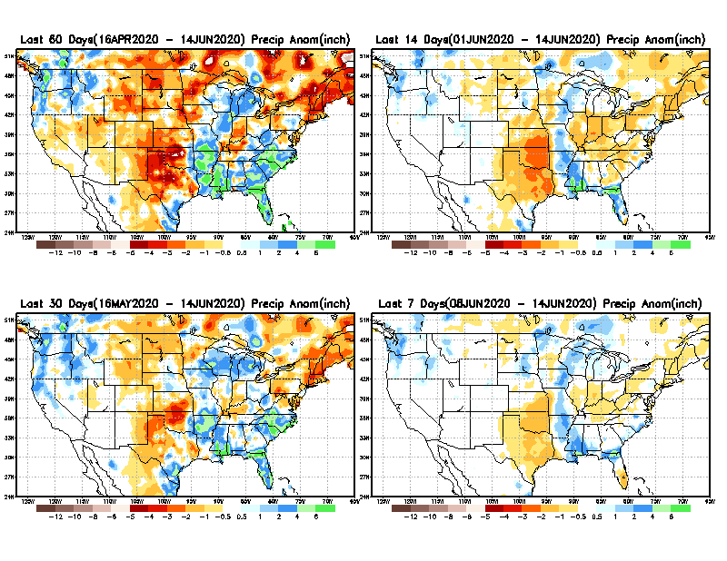
Precipitation ANOM during last 7, 14, 30, & 60 days.
60 Days
14 Days
These maps in this and following slides, including a) Total,
b) Anom and
c) Percent of Normal precip. in these and other longer time ranges are now (routinely) daily updated at:
30 Days
7 Days
Alaska regn. was also added here as separate maps recently.
From: Recent Accumulated Precipitation https://www.cpc.ncep.noaa.gov/products/Drought/briefing_prcp.shtml

Slide 5
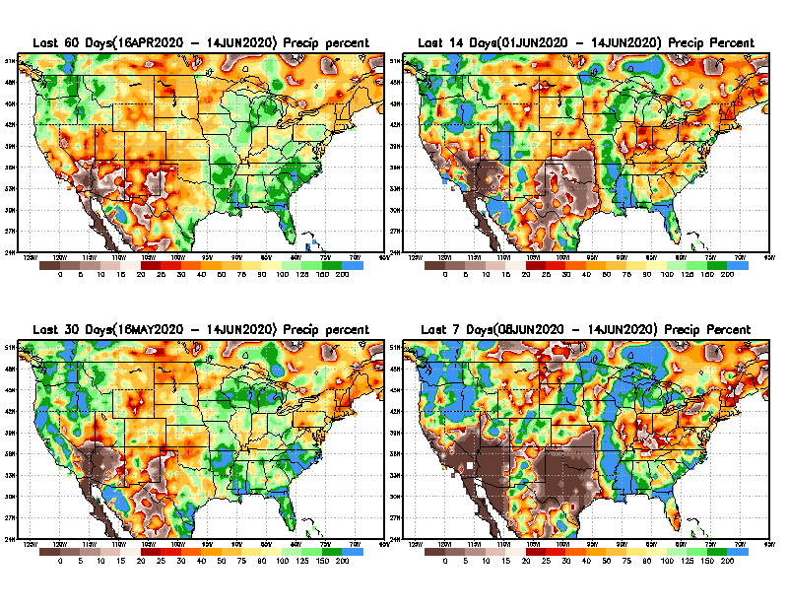
Precipitation Percent during last 7, 14, 30, & 60 days.
60 Days
14 Days
In regions, where the main rainfall season is limited to a few (3-4) months of the year, even one month of large rainfall deficit can be of concern !!
In other regions of relatively broad rainfall months, this need not be a big issue!!
30 days
7 Days
This may look bad, may be not!!
From: Recent Accumulated Precipitation https://www.cpc.ncep.noaa.gov/products/Drought/briefing_prcp.shtml

Slide 6
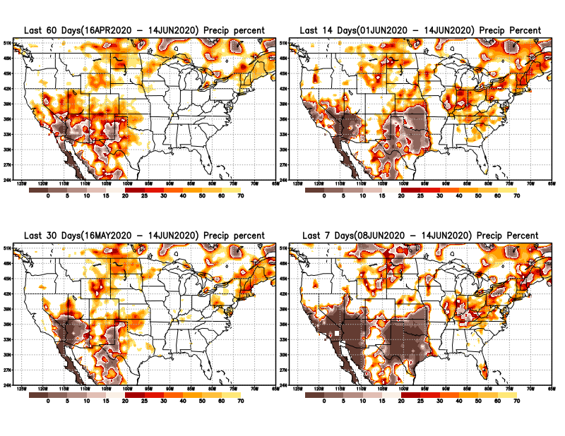
Precipitation Percent during last 7, 14, 30, & 60 days.
60 Days
14 Days
I am thinking of showing this plot instead of previous one.
This plot shows only the rainfall deficient regions <= 70% of normal.
-- This shows more clearly the drought possible/likely region in the future unless there is above normal rainfall falls in these regions to offset these shortfalls.
already
7 Days
These deficits here in SW + Possible Delayed N. American monsoon ? (also see forecasts in later slides)
30 days
This may look bad, may be not!!
From: Recent Accumulated Precipitation https://www.cpc.ncep.noaa.gov/products/Drought/briefing_prcp.shtml

Slide 7
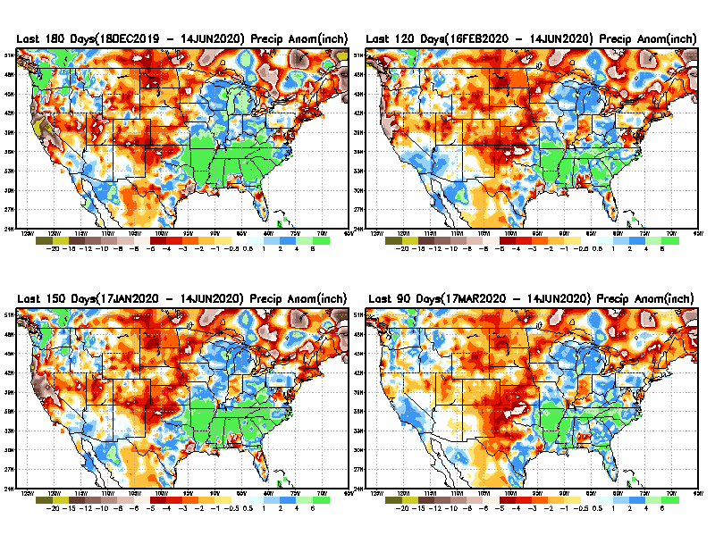
Total precipitation ANOM during last 3, 4, 5, and 6 months.
6 M
4 M
While the Precipitation anomalies deficit may seem large in some regions (compared to others), it is the % of normal precip (next slide) that matters more!!
5 M
3 M
From: Recent Accumulated Precipitation https://www.cpc.ncep.noaa.gov/products/Drought/briefing_prcp.shtml

Slide 8
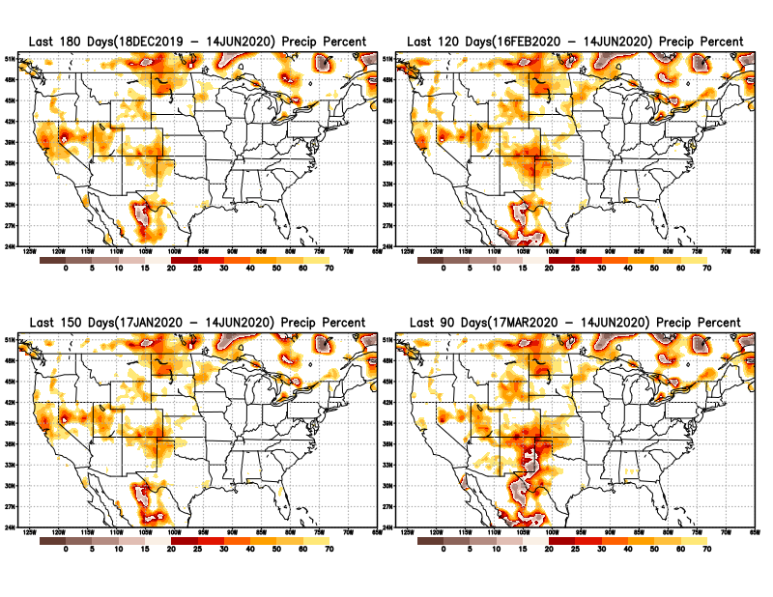
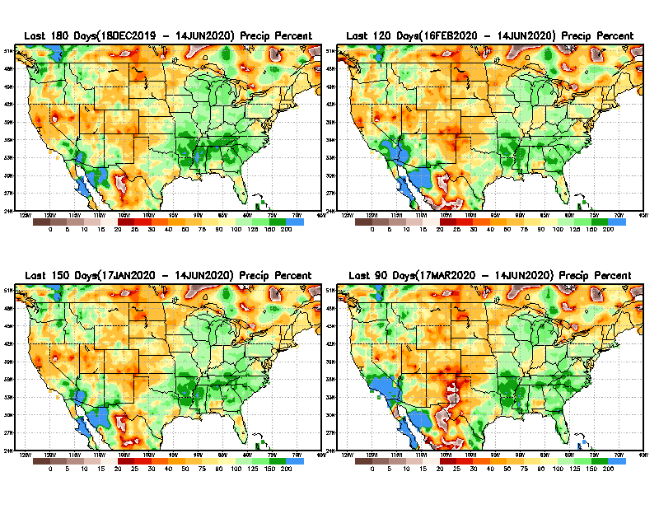
Total precipitation Percent during last 3, 4, 5, and 6 months.
6 M
4 M
In these interim time scale 3-6 months, we need to pay attention to regions, which are dark-brown, red & dark red (<50%).
5 M
3M
While accrued precipitation deficits are real & objective,
droughts are subjective declarations!!
East vs West!
Broad vs Narrow
rainfall season.
With these various rainfall deficits in diff. time ranges, where and how exactly does one declare drought? Other factors (T/SM/E, etc..) do matter, but is cumulative precip. Deficits/percent_of_normal ultimately more important?

Slide 9
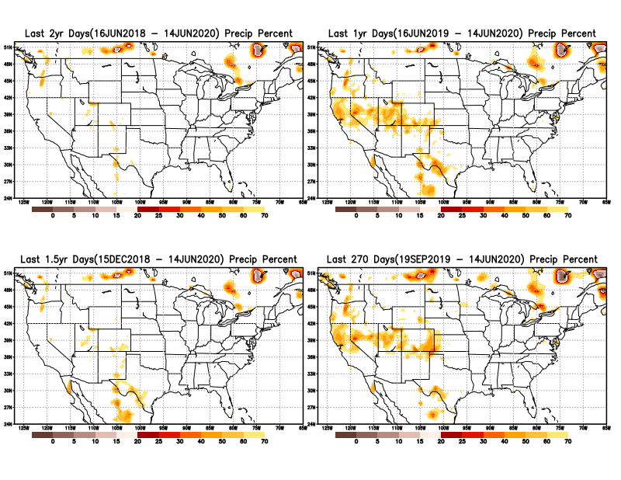
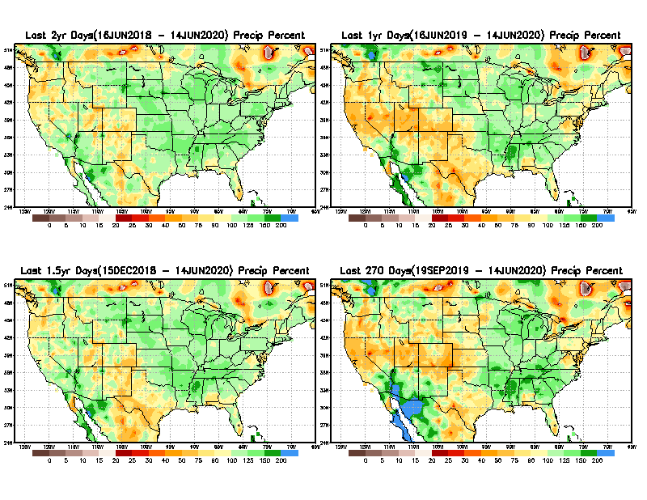
Total precipitation Percent during last 9 months, 1 yr, 1.5yrs, & 2 yrs.
2 Y
1 Y
In new format
1.5 Y
9 M
What exactly are the time scales for short(S) and long(L) term drought?
From: Recent Accumulated Precipitation https://www.cpc.ncep.noaa.gov/products/Drought/briefing_prcp.shtml

Slide 10
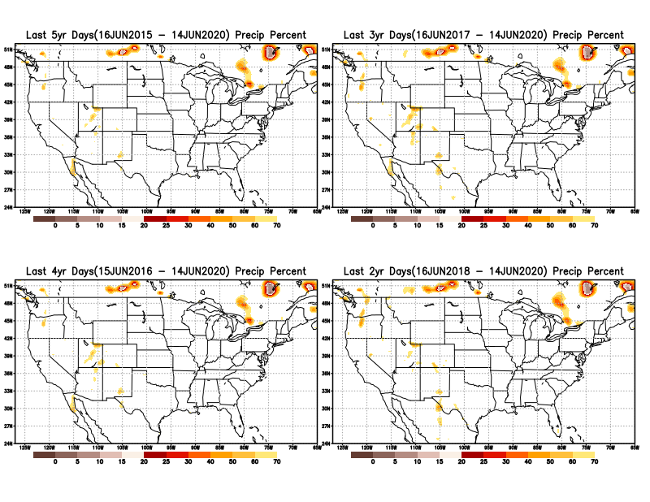
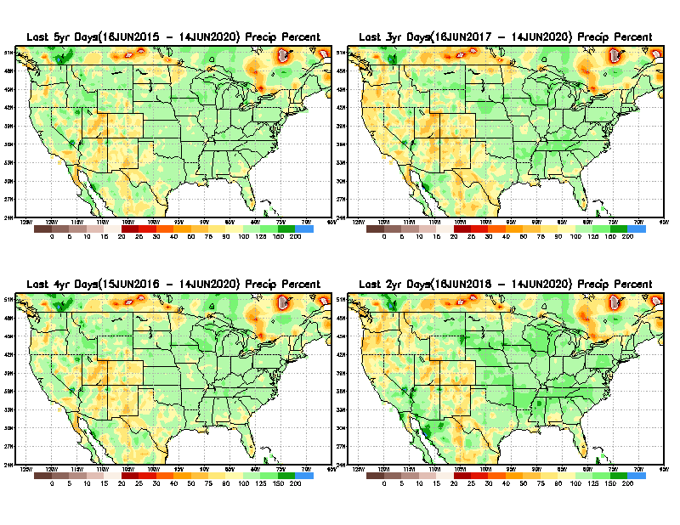
Total precipitation Percent during last 2 yrs, 3 yrs, 4 yrs, & 5 yrs.
5 Y
3 Y
Still longer term rainfall deficit variability in play? Especially in the southwest!
In new format
4 Y
2 Y
For the country as a whole ,there is not any big are where the rainfall is less than 70% on time scales longer than 1-1.5 yrs.
From: Recent Accumulated Precipitation https://www.cpc.ncep.noaa.gov/products/Drought/briefing_prcp.shtml

Slide 11
Rainy (3-month)Season across the US
East vs West!
Overall, more white space in the east -> distributed rainfall season (except ~FL).

Slide 12
*********
EAST vs
CTR/WEST
Behavior in Drought is loosely tied to rainfall climo!!
*********
Adapted from Rich Tinker.

Slide 13
Adapted from
Rich Tinker

Slide 14
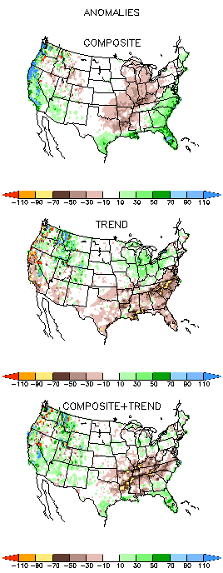
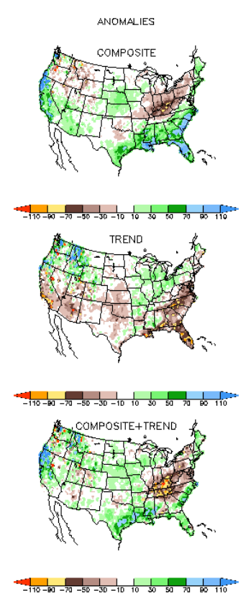
EL NINO Precip COMPOSITES & Trend maps
JFM
FMA
Only this is of relevance to us now due to neutral ENSO status.

Slide 15
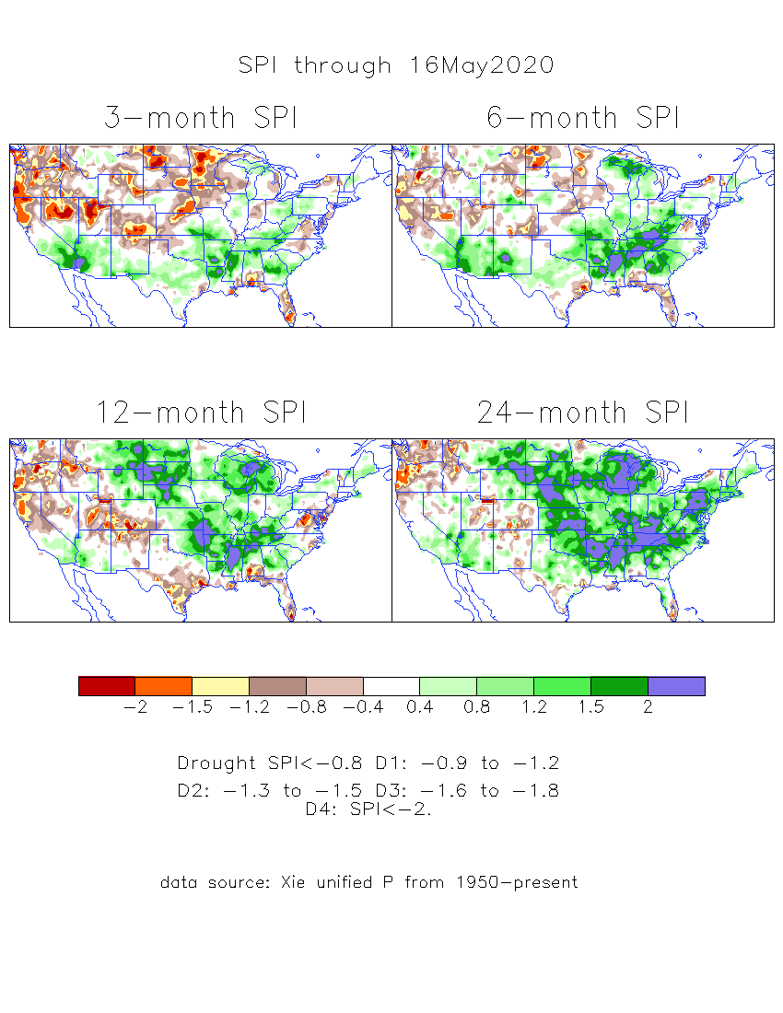
The Standardized Precipitation Index SPI (based on Observed P)
----- Last Month
Very interesting graphic & details for the drought across the US based on the more generalized precip deficit/excess, the Standardized Precipitation Index (SPI).
The dark brown and red colors, indicating standardized precipitation deficits, in the various time periods, approximately correspond to the appropriate short/long term drought monitor regions and their intensities
Have to keep an eye on this region!!
(have been saying this since mid-March briefing)

Slide 16
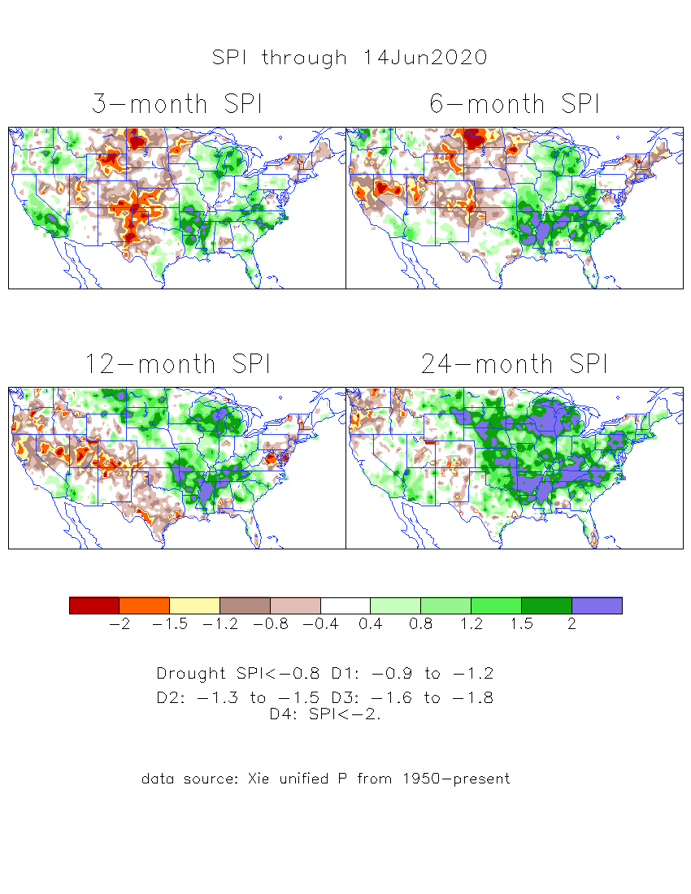
The Standardized Precipitation Index SPI (based on Observed P)
----- NOW
Very interesting graphic & details for the drought across the US based on the more generalized precip deficit/excess, the Standardized Precipitation Index (SPI).
The dark brown and red colors, indicating standardized precipitation deficits, in the various time periods, approximately correspond to the appropriate short/long term drought monitor regions and their intensities
Have to keep an eye on this region!!
How does one negotiate and reconcile declaring short term vs long term drought when precip. deficiencies exist on many different time scales.

Slide 17
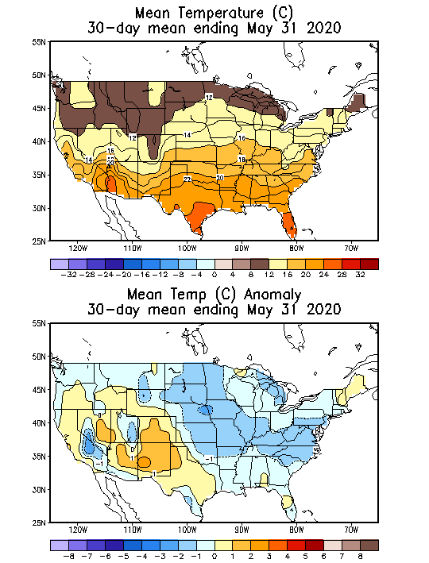
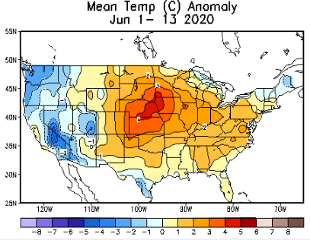
Recent US Temperatures
Such a flip in Temps. Across the US from last month to this month (at least so far!)

Slide 18
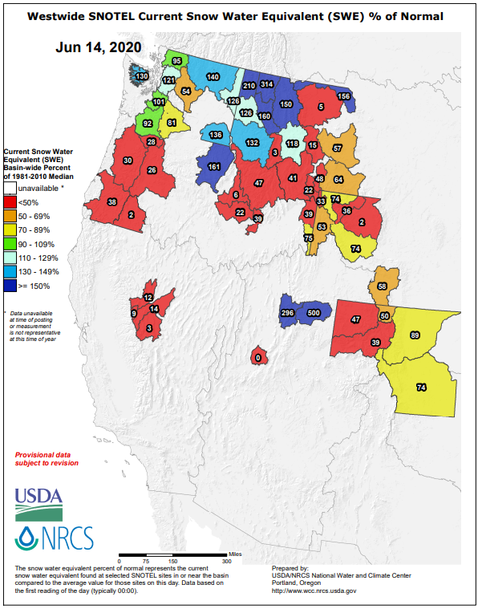
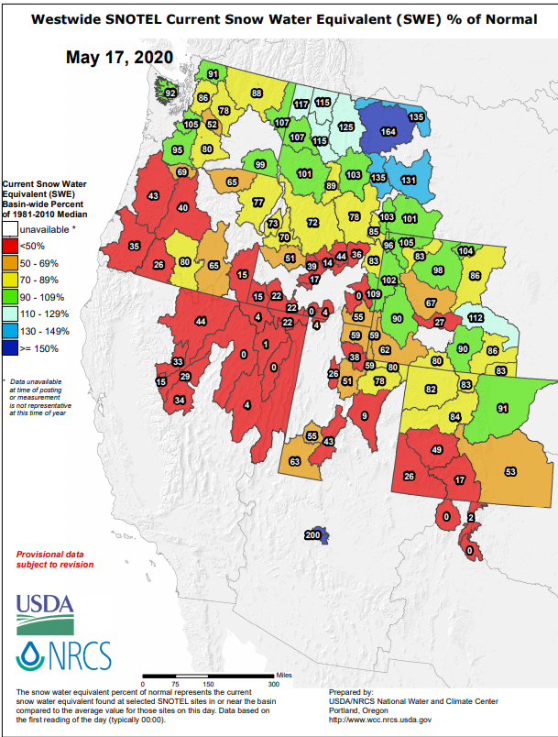
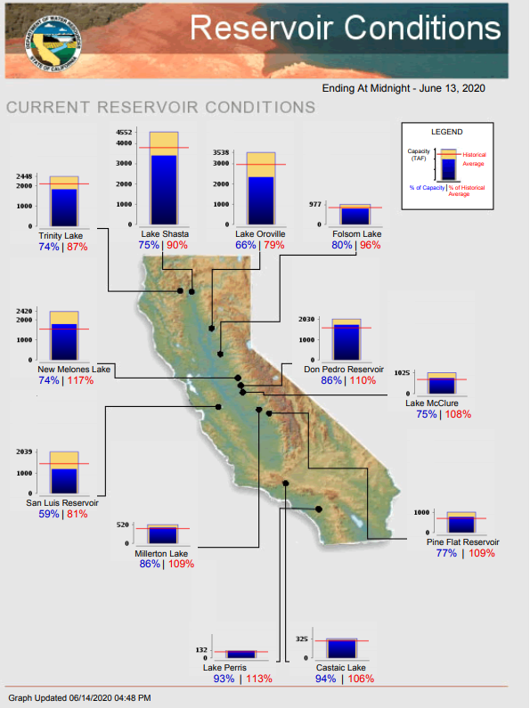
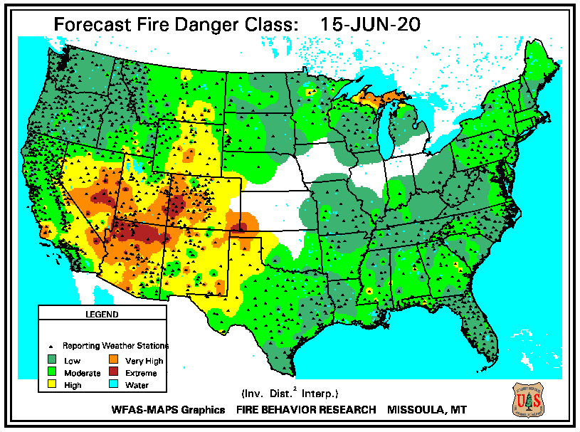
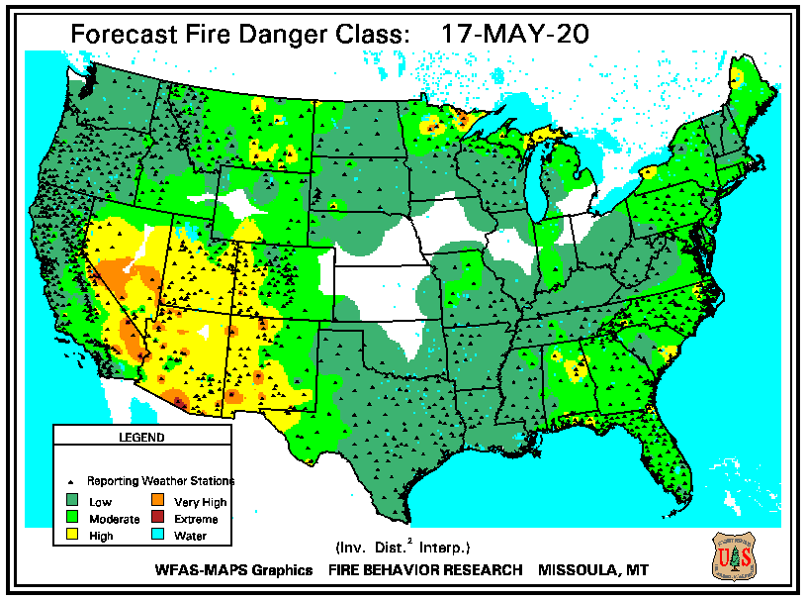
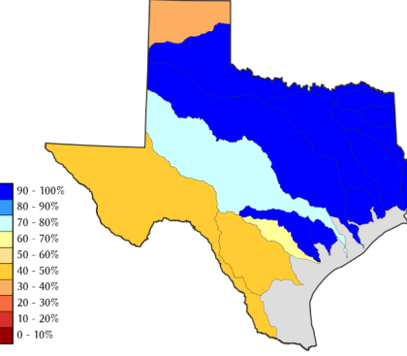
This month
Last month
https://www.nrcs.usda.gov/wps/portal/wcc/
TX
Some of California reservoirs levels are below their historical average levels. Next rainy season is 6-months away.

Slide 19
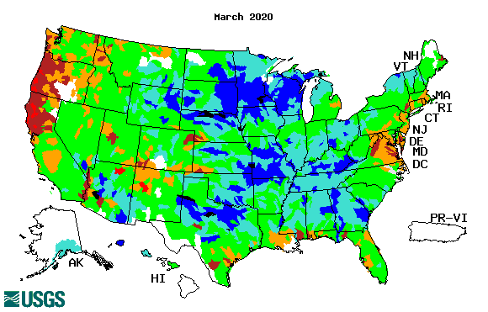
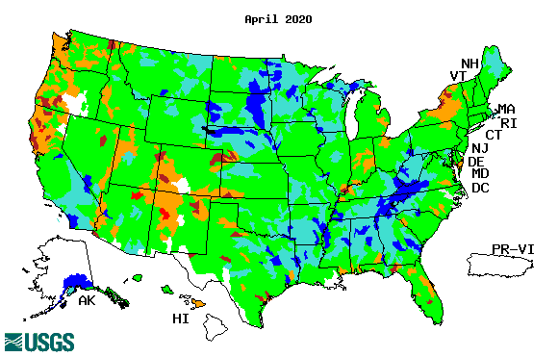
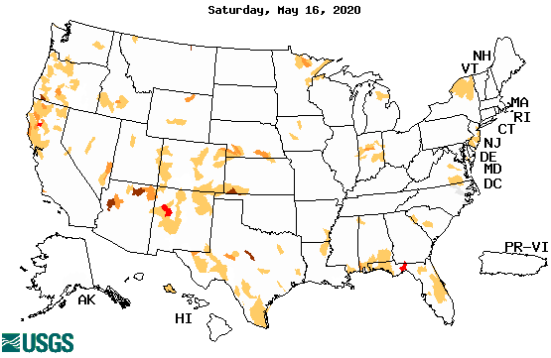
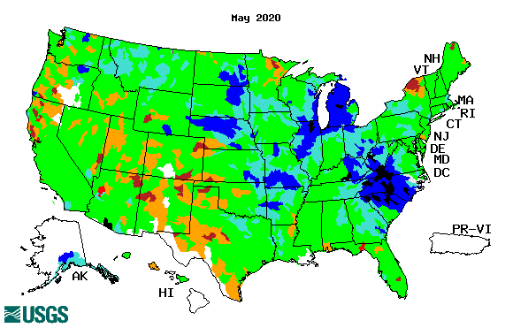
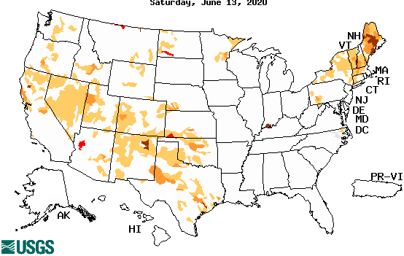
Streamflow (USGS)
Improving conditions in the southwest, getting bad.
Pacific NW much improved now.
Map shows only below normal 7-day average streamflow compared to historical streamflow for the day of year.
One month ago (left) &
Now (below)
The far NE drought/dryness could be short term – month? not season!!?
19

Slide 20
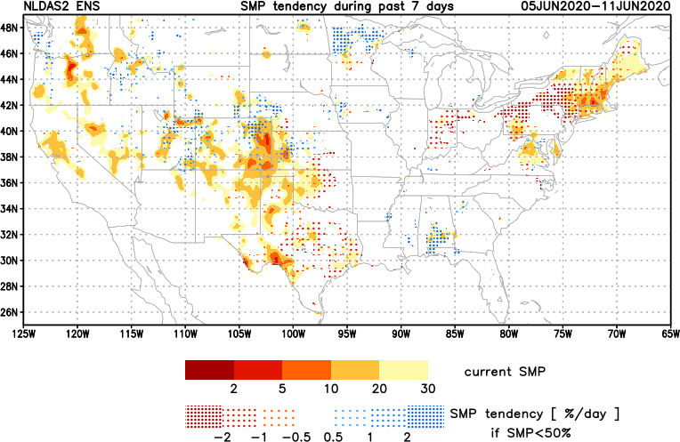
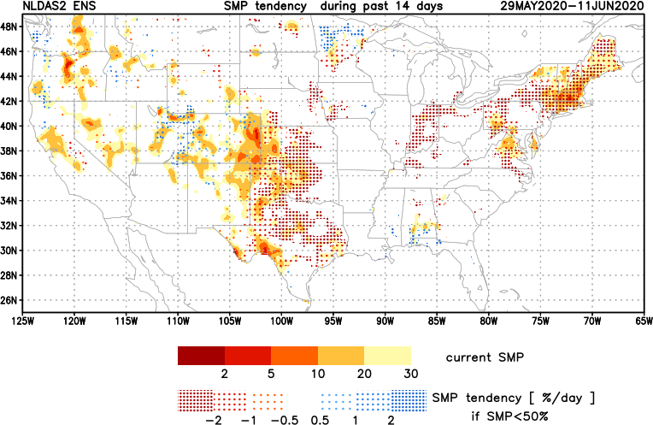
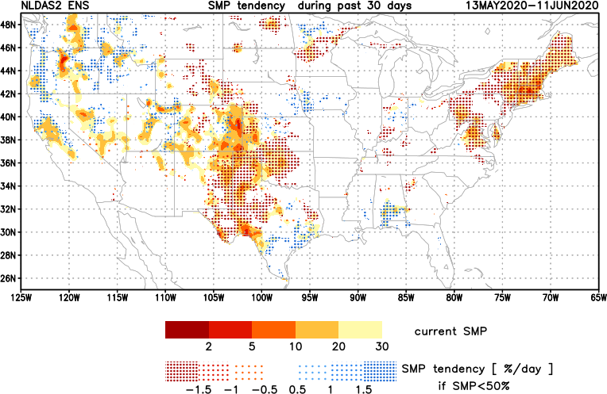
[Now]
NCEP Ensemble mean NLDAS2 models’ Soil Moisture tendency/trend
7 days
14 days
30 days
Last month we said:
Overall Moistening tendency in the southeast and far northwest, but generally drying tendency in the southwest and west.
Now: about same + drying in NorthEast, but will that turn in to monthly/seasonal drought?

Slide 21
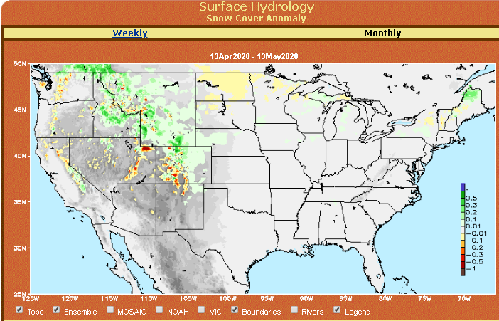
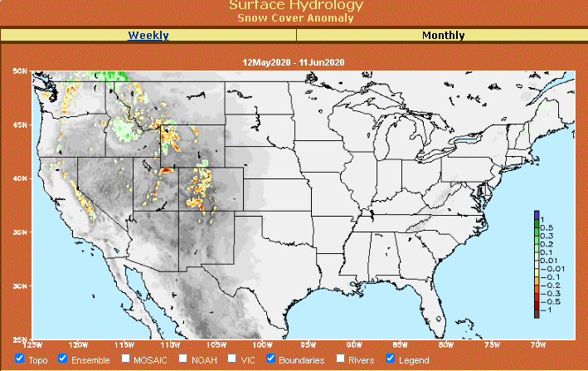
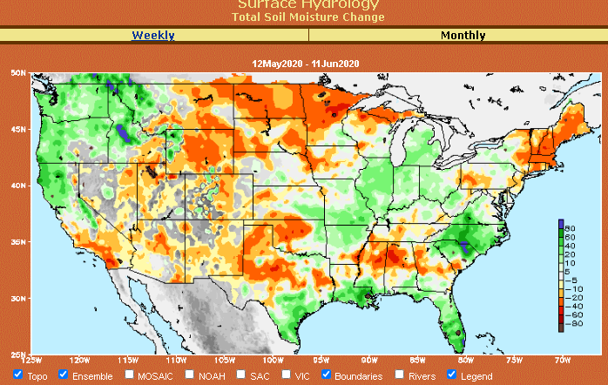
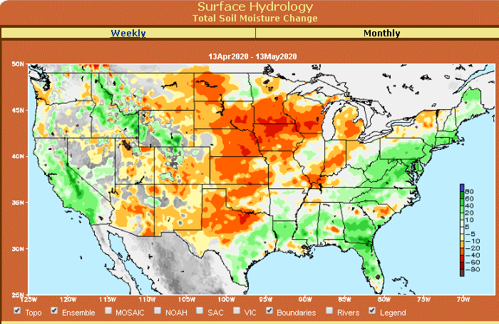
Snow cover & Soil Moisture Anomalies
Snow cover
Last month ~ this time
Now
Look further for areas of drought development

Slide 22
EL NIÑO/SOUTHERN OSCILLATION (ENSO)
DIAGNOSTIC DISCUSSION
issued by CLIMATE PREDICTION CENTER/NCEP/NWS and the International Research Institute for Climate and Society
11 June 2020
ENSO Alert System Status: Not Active
Synopsis: There is a ~60% chance of ENSO-neutral during Northern Hemisphere summer 2020, with roughly equal chances (~40-50%) of La Niña or ENSO-neutral during the autumn and winter 2020-21.

Slide 23
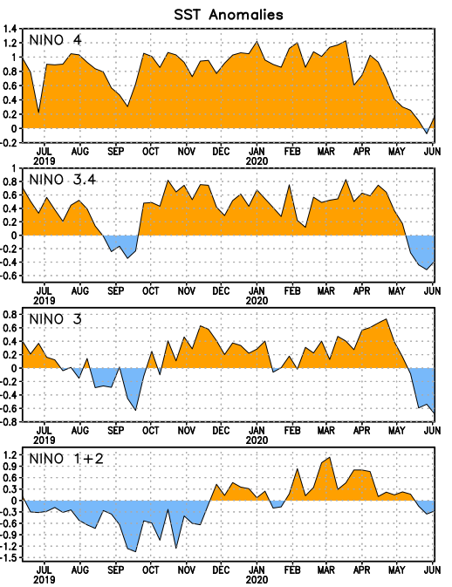
Latest values of SST indices in the various Nino Regions.
Officially in ENSO neutral territory now and for next 3-months. But (how soon) will we in La Nina? ☺ or ….

Slide 24
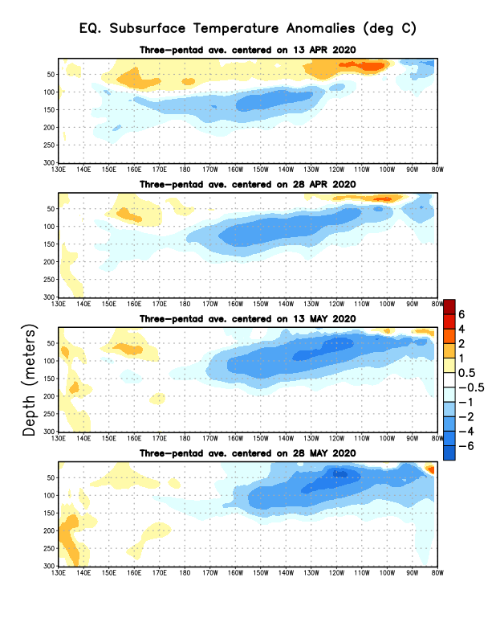
Sub-Surface Temperature Departures in the Equatorial Pacific
Tropical Pacific (Nino 3.4) surface SST in ENSO neutral status vs Subsurface
Most recent pentad analysis

Slide 25
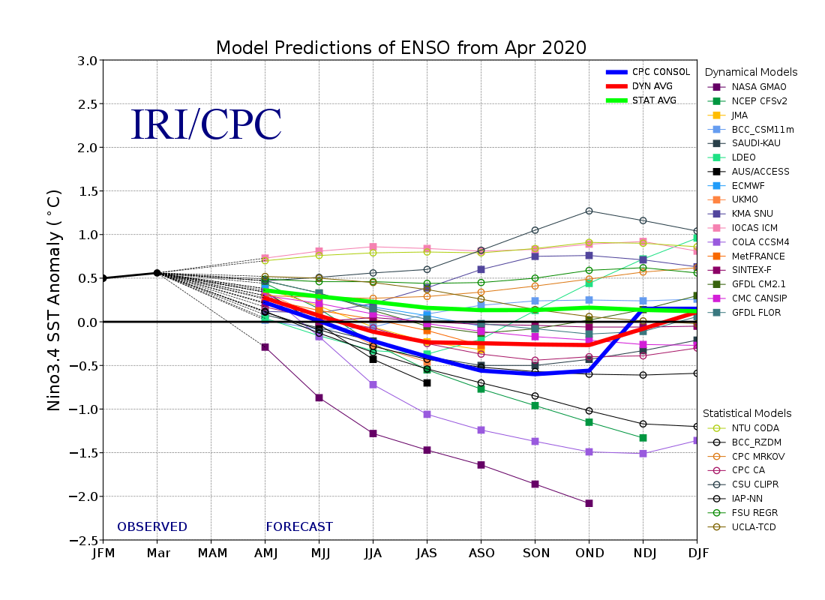
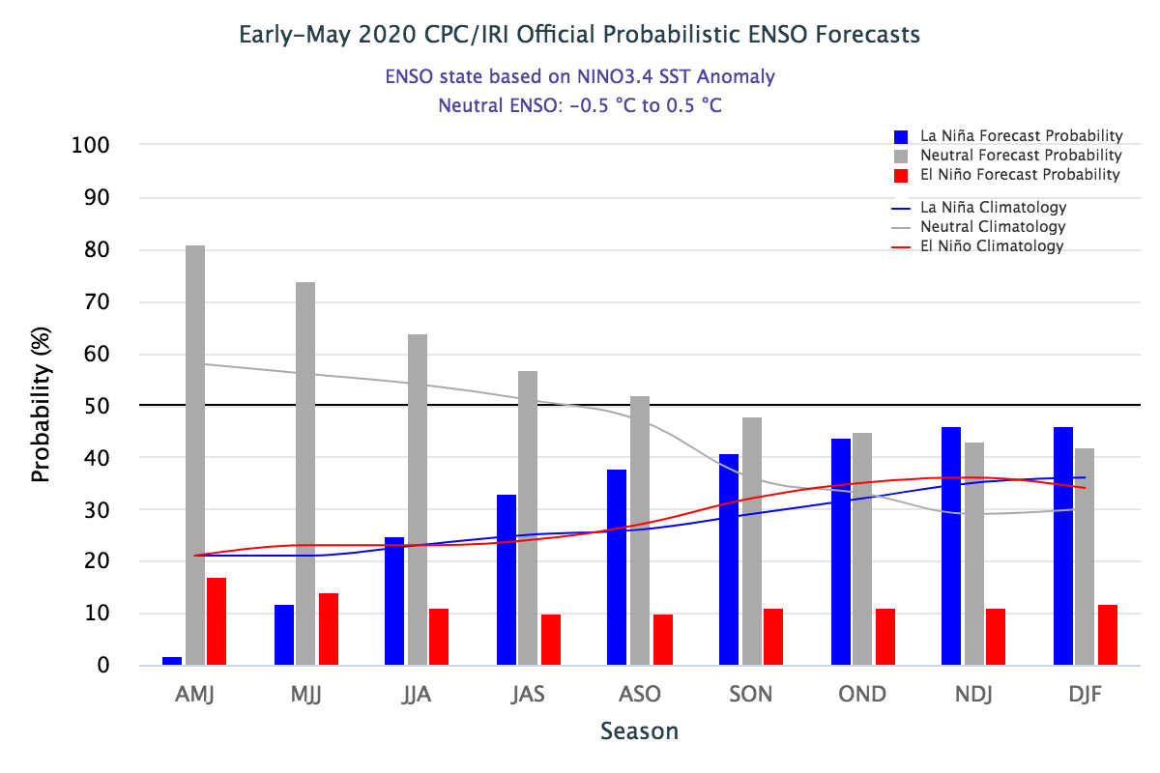
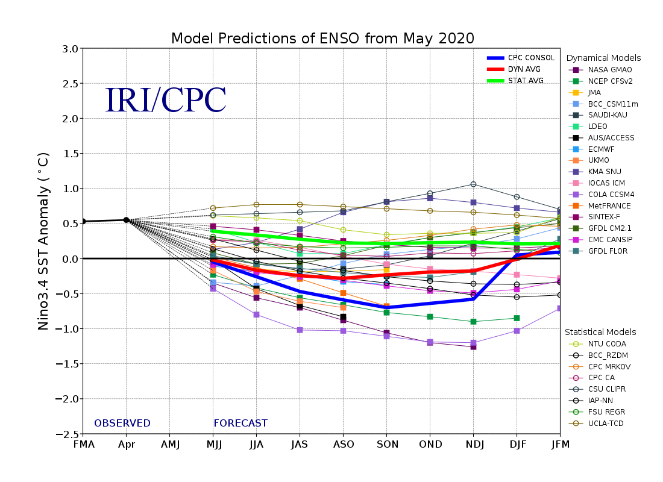
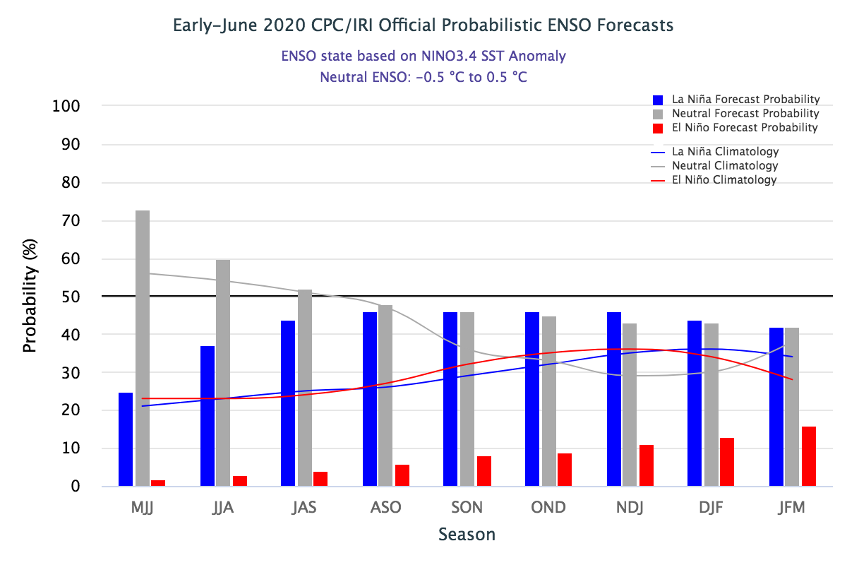
ENSO Forecasts
Early- May CPC/IRI forecast
Onwards to quick increasing probability for La Nina later in the year.
Early- June CPC/IRI forecast
CPC consolidation fcst should stop here..
ENSO Neutral for this forecast season. Not much help here to models for seasonal forecast signal!!

Slide 26
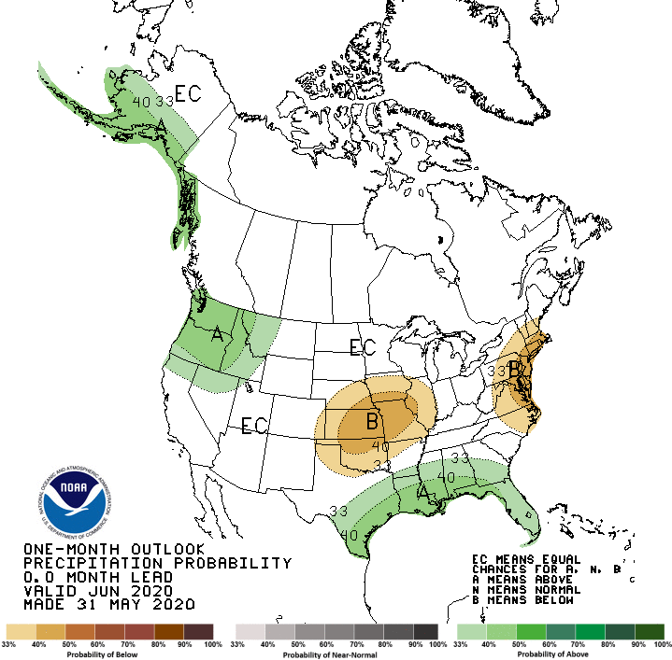
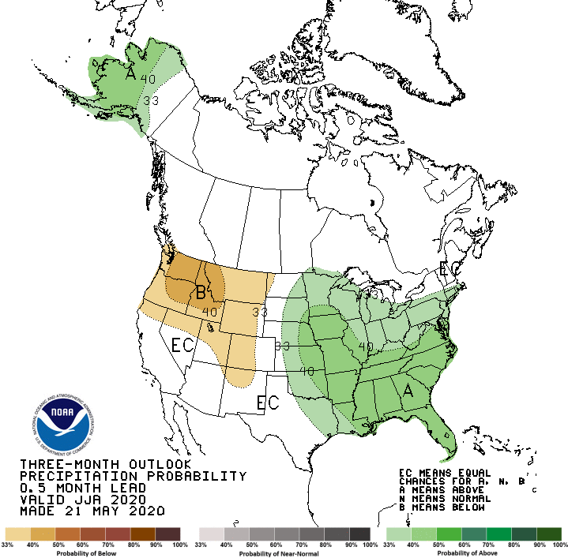
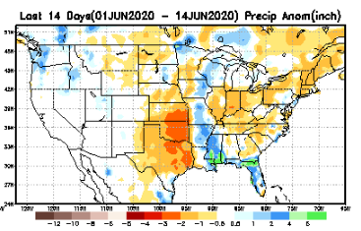
Released May 31st
Previous(Last month)
CPC’s official
Precipitation OUTLOOK for Monthly (June)/Seasonal (JJA)
Released May 21st
Observed so far this month!!
Monthly P/T forecasts verified at mid-month are generally good! Why? ☺ (becoz they r mostly based on GFS’ 2-wk fcsts)
But this month, so far ????

Slide 27
WPC Next 7 days QPF Forecast
Probably flooding in some parts of the SE this week!!
But relative dryness parts of Dakotas Minnesota
GFS Model Guidance for next 16 days.

Slide 28
Made
May 31st
Previous (Last Month)
CPC’s official
Temperature outlook for Monthly (June)/Seasonal (JJA)
Made
May 21st
Observed so far this month!! ☺

Slide 29
NMME T & P Ens.Mean forecasts
July
These NMME models always make these red-dot forecasts.
JAS
There is not much precip signal in drought areas? except for a weak signal ner MT/IDWY

Slide 30
Agreement/Disagreement in the various NMME models’ MJJ seasonal Precip. Forecst.
??

Slide 31
Made from last month compared with this month
Forecast uncertain in Hatched areas.

Slide 33
Initial Conditions:
06/09/2020
http://drought.geo.msu.edu/research/forecast/smi.monthly.php
Predicted Monthly Soil Moisture Percentile
Initial Conditions 1 months ago:
05/12/2020
The inter quartile range suggest greater uncertainty about the forecast in these shaded regions.

Slide 34
Summary
Current Drought conditions:
Over the last several months, drought, overall has increased in area across the South and the West.
The short/long term drought in the four corner states area (AZ/NM/ UT/CO) has expanded and intensified eastward to the neighboring states of KS/OK/TX.
Existing Drought in OR, Northern CA, NV, ID, WA, UT continues.
The drought in the southern TX and along the Gulf coast has mostly disappeared .
Drought in Northern Great Plains States of the Dakotas, WY have intensified or expanded
Some of California reservoirs levels are below their historical average levels. Next rainy season is 6-months away.
Current ENSO status and forecast:
- There is a ~60% chance of ENSO-neutral during Northern Hemisphere summer 2020, with roughly equal chances (~40-50%) of La Niña or ENSO-neutral during the autumn and winter 2020-21.
Prediction:
Generally useful skill in seasonal forecasting of rainfall is low, and that is only slightly enhanced when there is an enhanced tropical boundary forcing/ENSO. Unfortunately, the continued presence and forecast of ENSO conditions in the tropical equatorial Pacific through the rest of summer, is taking away the little edge and confidence in the model’s seasonal forecasts of precipitation. Also the continued forecast of above normal monthly/seasonal temperatures across the entire US, does not help the drought conditions in the west.
No new drought development is likely in the southeast, east of TX and along Atlantic coastal states.
The drought in the west and the four corners region in its eastward expanded state will continue to persist, but with some/moderate improvement with the upcoming rainy season in the region. The long tem drought in northern CA, NV, and UT will likely remain.
The recent expanding drought in the Northern Great Plains states will continue to persist or even possibly worsen (see rainfall deficit maps in slide 6, esp. left panels) in parts of WY, ND, eastern MT and parts of MN.
Dryness, and precipitation deficits in the NE states at 50-70% of normal rainfall levels in the last 2 months, is likely to develop dry/mild drought conditions, definitely in the monthly scale and unlikely in seasonal scale.
With the upcoming rainfall season, and the expected rainfall in the short and medium term, the drought conditions along the Gulf coast and in Florida will be considerably improved will be pretty much gone in the upcoming month of June and JJA season.
*********************

Slide 35
Miscellaneous maps

Slide 36
Miscellaneous maps

